Slide 1
Egos, Friendships, Rivalries, and Fights in Mid-Century Modern Architecture in America
Dirk Mol / Presenter
Session One: Introductions and Biographies of
Frank Lloyd Wright, Mies van der Rohe, Edith Farnsworth, an Philip Johnson

Slide 2
Dirk Mol / A caveat
I am not an architect
I am not an architectural historian or critic
I’m an architecture buff
Buff: someone who knows a lot about a particular subject
I’m also a dance aficionado
And a psychotherapist
And an erstwhile Episcopal priest

Slide 3
Goals of the facilitator:
What I hope will happen here
Participants will:
Enhance their appreciation for the field of architecture
Become more knowledgeable about architectural styles, particular architects, and their creations
Understand the human dimension of the profession
Pursue some of the resources that I have collected
Be inspired to learn more, to go down the rabbit hole to pursue what interests them, and visit buildings with an educated eye

Slide 4
How I design and approach study groups
I see my job as:
Providing you with resources to learn about the subject
Giving the context in which to understand the issues
Asking questions to stimulate discussion
Prodding you to do research on your own and report back to the group

Slide 5
Course Outline
Session One: Introductions
Participants will be given the opportunity to share their interest in the subject. The material presented will focus on biographical sketches of the four characters who form the heart of this inquiry and the events that made them famous.
Session Two: Frank and Phillip – A Lively Tango / Frenemies / Focus on ARCHITECTURE’S ODD COUPLE by Hugh Howard
A study of the shifting dynamics of these two characters (and they were characters) over several decades, sometimes as critics of each other’s work and personalities, sometimes as amicable acquaintances who visited each other’s homes, but mostly as implacable defenders of their architectural styles and their own places in the architectural pantheon.

Slide 6
More Outline
Session Three: Mies and Edith – A Bipolar Relationship—Mutual admirers, then enemies
- focus on BROKEN GLASS by Alex Beam
A look at the relationship between an architect who defined a new style and his “perfect” client, over the decade starting from when they met, through when they worked together to design and build the Edith Farnsworth House, to the time when they engaged in suit and countersuit and became bitter and disenchanted enemies.
Session Four: Mies and Phillip – Prickly Colleagues: Cooperation and Criticism
Material from both books
From the time Phillip first encountered Mies in the late 20s (while on an architectural tour of Europe) to the 50s to when they worked together (although not as equals) on the building of the Seagram’s building (a modern masterpiece) in NYC, Johnson remained mostly an ardent admirer and disciple of Mies until later in life when he became disillusioned and highly critical of the International Style of which Mies was the epitome.

Slide 7
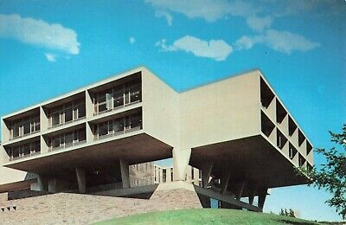
Milwaukee War Memorial / Eero Saarinen
1955-57

Slide 8
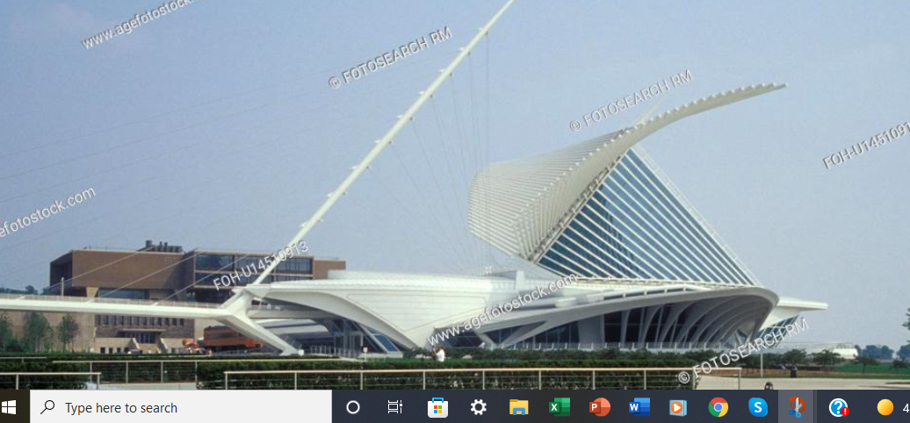
Calatrava Addition

Slide 9
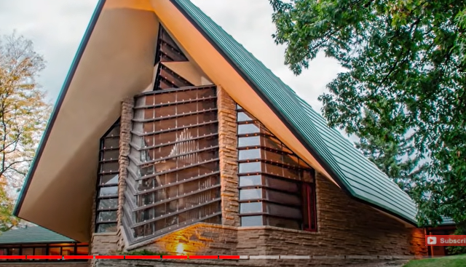
First Unitarian of Madison, Wis / 1949-51
Frank Lloyd Wright

Slide 10
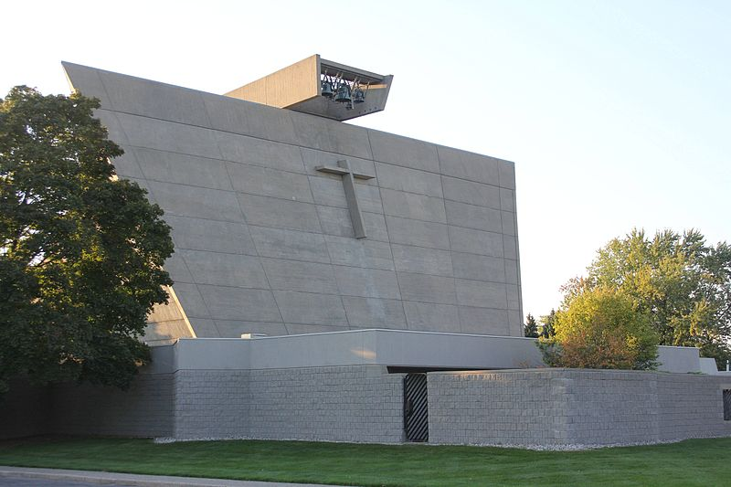
St. Francis de Sales Church / Marcel Breuer
Norton Shores (Muskegon) Michigan

Slide 11
INTRODUCTIONS:
Suggested items to share with the group if you wish
Why and for how long have you been interested in architecture?
What drew you to this particular exploration of the field?
What’s your favorite modern building? Favorite building in C-U?
Have you ever traveled hundreds of miles to see a particular building?
What do you hope to get from this study group?

Slide 12
The Players
Frank Lloyd Wright / 1867-1959 / age 91
Mies van der Rohe / 1886-1969 / age 83
Edith Farnsworth / 1904-1977 / age 73
Phillip Johnson /1906-2005 / age 98
Over 118 years of American architectural history from 1887 when Wright started working in architecture in Chicago to Johnson’s death.

Slide 13
STYLES in history of American Architecture
NeoClassical / whatever is an imitation of older classical styes
Greek Revival / a subset of neoclassical common in 19th C. residences
Gothic Revival / a favorite for churches and some houses / Grant Wood’s American Gothic
Beaux-Arts / neoclassical / think Greek and Roman temples / big in France / US Capital and many state capitals / White City
Richardsonian Romanesque / Classicism with a twist / Henry Hobson Richarson
Arts and Craft Movement / Robert Morris / centered in England
Prairie Style / mostly houses / Wrights early work / Oak Park

Slide 14
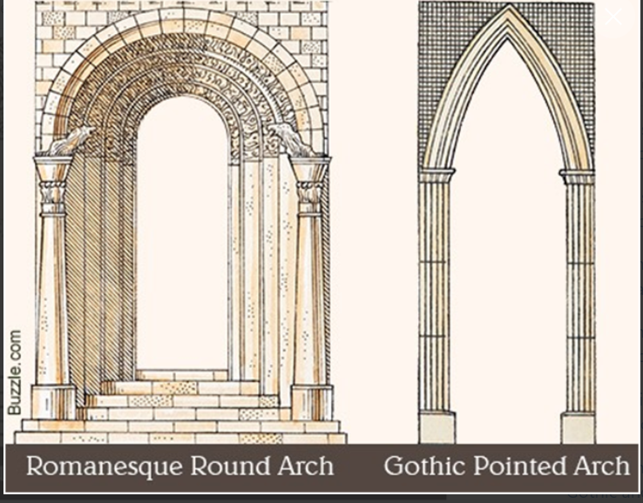
Romanesque vs. Gothic

Slide 15
More on Styles
Organic Architecture / Frank Lloyd Wright
Art Nouveau / French and Belgium / withered with WWI
Art Deco / 20s and 30s / withered with WW2 but still around
Modernism / ascendant from the 30s onward / roots in Europe / Gropius, Le Corbusier, Breuer, and Mies / Bauhaus in Germany / Chicago and Harvard became centers / late Yale was on the forfront
International Style / The epitome of Modernism / Miesian
Brutalism / A subset of Modernism / Le Corbusier
Post-Modernism / late 20th Century / very eclectic
Deconstructivism / a subset of Post-Modern / absence of obvious harmony, continuity, or symmetry / Gehry, Rem Koolhaus

Slide 16
Definitions
Brutalism
Wikipedia: a style of architecture or art characterized by a deliberate plainness, crudity (rudimentary or primitive), or violence of imagery. The term was first applied to functionalist buildings of the 1950s and 1960s that made much use of steel and concrete in starkly massive blocks.
Decontructivism
Wikipedia: Since the act of deconstructivism is not an empirical process, it can result in whatever an architect wishes, and it thus suffers from a lack of consistency.
Cattywampus, as we said in my family

Slide 17
My Favorite Brutalist Building
Marcel Breuer’s St. Francis de Sales Church
Norton Shores (Muskegon) Michigan (mid 60s)

Slide 18
The Players and their Styles
Frank Lloyd Wright / Influenced by Arts and Crafts, then created Prairie Style houses, then Organic Architecture and then . . . . . . .did whatever he wanted
Mies van der Rohe / One of the founders of Modernism / he created the International Style
Edith Farnsworth / The perfect client, until it all went bad
Phillip Johnson: Apostle of modernism, embraced International Style and then postmodern styles and then became very eclectic

Slide 19
Frank Lloyd Wright (FLW) / 1867-1959
America’s greatest architect? Absolutely
Genius and creator of a unique oeuvre of work
Egotist of the highest order
Arrogant / always sure he was right (no pun intended) and no one else knew anything
Acerbic tongue
Flagrant spendthrift / always in debt and needing more money
Loved fancy clothes and fine fast cars
Terrible business man but a genius at charming clients
Visionary / Dreamed a mile high building before it was possible

Slide 20
A FLW Chronology
Born June 7, 1867 in Richland Center, Wisconsin
Early years in places where his father was a Baptist minister
Family returned to Spring Green, Wisconsin where his mother’s family (the Lloyd Jones) owned farmland.
Worked on his uncle’s farms as a boy
Family moved to Madison where FLW attended high school but may not have graduated.
1881 / When FLW was 14 his parents separated, three years later his father left town and Frank never saw him again.
1886-87 / Studies civil engineering at the University of Wisconsin but never graduated / he once claimed he was one course short of a degree but there is no evidence.

Slide 21
FLW Chronology 2 / Early Career
Went to Chicago in 1887 and got work in architecture
1888-1893 / worked for Adler and Sullivan as a draftsman
Louis Sullivan, of “form follows function” and ‘father of the skyscraper” fame, mentored him
In 1889 Wright designed and built a house for himself and his family in Oak Park with a loan of $5000 from Sullivan
Started moonlighting and designed houses; when Sullivan found out he fired Wright and they didn’t speak for 12 years
1893-1900 / Wright set up his own office and started designing houses in many styles like Queen Anne and Colonial Revival / most were in Oak Park
Became attracted to the Arts and Crafts Movement and experimented with its ideas

Slide 22
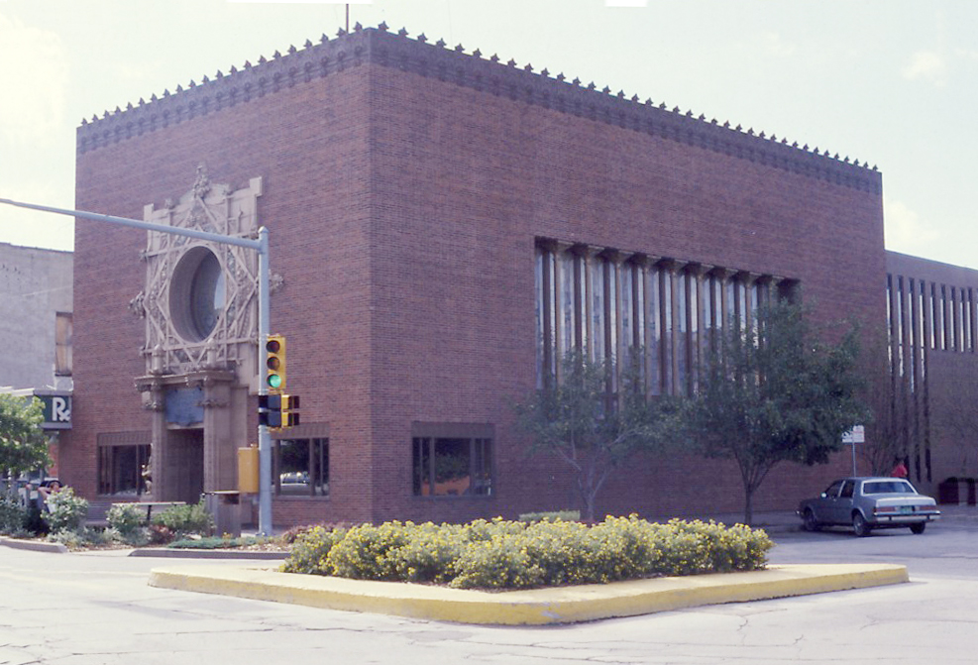
Sullivan ‘Jewel Box” Bank in Grinnell Iowa

Slide 23
FLW Chronology 3 / Developing his own style
Starting around 1901, he developed his Prairie Style houses / This led to a national reputation and larger clientele
1909 / Scandal / left his wife and six children and went to Europe with Mamah Cheney, the wife of an Oak Park client
1911 / Returned to the US and to hide out from the scandal, got land in Spring Green and started building Taliesin for himself and Mamah.
1914 / Tragedy at Taliesin / fire and murder of Mamah and 6 others.
1917-1922 / Did work in Tokyo, including the Imperial Hotel
Started designing houses in LA / Mayan temple influences
Marriages to Miriam Noel (1922-27) and Olga (Olgivanna Hinzenberg) (1928 – Wright’s death)

Slide 24
FLW Chronology 4 / Later Career
With the Depression and changes in architectural style in the 30s, Wrights career went into decline
1932 / Established the Taliesin Fellowship (at the suggestion of Olga)
Gave Wright income and established him as a teacher
Proposed Usonian houses that could be built cheaply and in vast numbers / few were ever actualized
1937 / established Taliesin West in Phoenix / Fellowship wintered there and came back to Spring Green in warmer weather

Slide 25
FLW Chronology 5 / Later work - Masterpieces
1937 Fallingwater / built for Edgar Kaufman and family / south of Pittsburgh over a stream / reestablished his design career and established in international reputation / Outdoing the modernists
1943-1959 Guggenheim Museum in NYC / Organic architecture meets the concrete city / completed after his death
Price Tower, Bartlesville, Oklahoma
Johnson Wax Buildings, Racine Wisconsin
Marin County Civic Center / California
House in Phoenix in a round style
April 4, 1959 / Died in Phoenix
2019 / 8 FLW building named UNESCO World Heritage Sites
2022 / Closing of the Taliesin School (Fellowship)

Slide 26
FLW / Resources for further investigation
YouTube
15 Most Iconic Designs by FLW https://www.youtube.com/results?search_query=15+iconic+building+by+frank+lloyd+wright
The Man who Built America / Very slow and meditative /59 minutes
https://www.youtube.com/watch?v=rn6yMKhzx6I
Johnson Wax Building - Frank Lloyd Wright https://www.youtube.com/watch?v=Mj8qH3GGSYk
Illinois Adventure #1505 Dana Thomas House / Springfield’s FLW treasure https://www.youtube.com/watch?v=xd7cx8nDYc4
Book: Hometown Architect / pictures and description of his Oak Park houses
Closing of Taleisan School https://www.architecturalrecord.com/articles/14481-taliesin-closure-sparks-controversy

Slide 27
Phillip Johnson / July 7, 1906-Jan 25, 2005
Child of privilege
Independently wealthy
Aesthete, urbane, erudite, charming
Traveler / architectural tours of Europe in late 20s and later
Art Collector / mostly 20th Century
Apostle of Modernism
Curator / Museum of Modern Art
Architect / Modernism and Post-modernism
Teacher / Yale
Always eclectic and multi-faceted / borrowed freely

Slide 28
Johnson / 1906-2005 /Chronology 1
Born in Cleveland; grew up in New London, Ohio
Attended Hackley School in Tarrytown, NY
Went to Harvard and studied Philosophy; graduated in 1927
Started traveling in Europe; met modernist architects like Le Corbusier, Breuer, and Walter Gropius (all of Bauhaus fame)
1928 / met Mies van der Rohe—start of a lifelong relationship (the subject of Session 4 of this class). Traveled to Brno, Czechoslovacia to see the Villa Tugendhat, a Mies structure under construction.
Met Alfred Barr, who was teaching at Wellesley, when his sister graduated. Barr became the first director of Museum of Modern Art (MOMA).

Slide 29
Johnson / Chronology 2
Barr becomes first director of MOMA / appoints Johnson first head of Architecture Dept at MOMA; Johnson had provided money to start the department
1932 / Johnson and Barr mount first exhibit of Modernism at MOMA; the book catalogue for the show is instrumental in raising awareness of Modernism.
1936 / leaves MOMA and pursues a career in journalism and politics; has a brief flirtation with Nazism and admires Hitler; later regrets that.
BUT helps Walter Gropius and Marcel Breuer immigrate to the US to escape Nazism
Early 40s / Returned to architecture; enrolled in Harvard School of Design where he studied with Gropius and Breuer and did a thesis by building his own house (9 Ash St in Cambridge) modeled after buildings by van der Rohe that he had seen.

Slide 30
Johnson / Chronology 3
After a brief stint in the Army during WW2, he returns to MOMA and starts to build his own architectural career in NYC.
Most significant buildings:
1949 / Glass House in New Canaan, Ct / for himself
1957 / Seagram’s Building on Park Avenue in NYC / assisting Mies, Johnson did mostly interiors and the Four Seasons Restaurant.
1978-84 / 550 Madison Ave—ATT building / his first Postmodernist design
Many more significant building . . .see Wikipedia

Slide 31
Johnson / Chronology 4
Gay / came out publicly in 1993
Had a brief relationship with a cabaret singer in 1934
45 year relationship with David Whitney, who died at age 66 a few months after Johnson / Johnson died at his Glass House on Jan 25, 2005 / age 98
In his will Johnson left his New Canaan compound (Glass House) to the National Trust for Historic Preservation. It is now open to the public.
In 1978, Johnson was awarded an American Institute of Architects Gold Medal.
In 1979 he became the first recipient of the Pritzker Architecture Prize the most prestigious international architectural award.^{[1]}
In 1991, Johnson received the Golden Plate Award of the American Academy of Achievement.^{[24]}

Slide 32
Johnson / Resources for Further Investigation
The Wikipedia article on Johnson seems to be well documented and is very informative / Check out all the photos of buildings, information about his political mistakes, and famous quotes.
https://en.wikipedia.org/wiki/Philip_Johnson
The Book
Architecture’s Odd Couple by Hugh Howard
The Glass House
https://savingplaces.org/places/glass-house#.YkXvwSjMJff
https://savingplaces.org/places/glass-house#.YjfkLnrMJff

Slide 33
Mies van der Rohe / 1886-1969
Pioneer of Modernism
Brilliant architect
Designer of furniture
German born—30 years or work; American-made famous—30 more years
Sometime curmudgeon / often a man of few words / taciturn
Cantankerous / often a prickly colleague
But still quotable: “Less is more” &“God is in the details”
Relationships with a number of women / Married once in Germany with three daughters / in 1947 had a son out of wedlock who became an architect

Slide 34
Mies van der Rohe / Chronology 1 Germany
Born Maria Ludwig Michael Mies in Aachen, Germany, near the Belgium and Dutch borders.
Moved to Berlin and started working for design firms and eventually set himself up as an architect.
Met Le Corbusier and Walter Groupius in Berlin and later at the Bauhus (Weimar, Dessau, Berlin) / Mies was the last director of the Bauhaus before it closed when the Nazis took over Germany
Renamed himself Ludwig Mies van der Rohe (his mother’s maiden name) to establish an professional identity.
1929 / Designed the German Pavilion for the Barcelona Exposition
Began designing Modernist houses, especially the Turgendhat house in Brno, which he visited with Johnson before it was complete in 1930
1937 / visits the US / gets offered job at Armour Institute

Slide 35
Mies /Chronology 2 / Early years in US
Immigrated to the US when he saw no future in Nazi Germany and became head of architecture at the Armour School of Technology (now IIT) in Chicago / Designed Crown Hall there in 1956
1945 / Met Edith Farnsworth at a dinner party and started working with her on the design of the Farnsworth House / construction started in 1950 and completed in 1951.
1949-1951 / 860-880 Lakeshore Drive / an early Modernist highrise
Many glass curtain wall building in Chicago / established the International Style

Slide 36
Mies / Later work in US
1958 / Seagram’s Building / Park Avenue in NYC / the epitome of the International Style, particularly with the plaza in front that took up half of the buildable lot / designed in cooperation of Philip Johnson, who mostly did interiors and the Four Seasons Restaurant (more on this is session 4 of the class.)
1964-1974 / Federal Plaza in Chicago / 219 South Dearborn
Early 70s / IBM building in Chicago / plaza north of river / built after Mies’s death
Died Aug 17, 1969 of esophageal cancer / buried in Graceland Cemetery in Chicago
2021 / Indiana University School of Design resurrects a building design first done for a progressive fraternity at IU but never built / now houses the architecture program

Slide 37
Mies van der Rohe / Resources for Further Investigation
https://www.archpaper.com/2022/02/mies-van-der-rohe-designed-eskenazi-school-opens-at-indiana-university
Wikipedia on Mies isn’t very good / lacks dates and things are out of chronological order but it has some good pictures
YouTube video tour of major works / 11 minutes
https://www.youtube.com/watch?v=xIb4Jr18pZ0

Slide 38
Resources for Further Study on Edith Farnsworth
Wikipedia page
https://en.wikipedia.org/wiki/Farnsworth_House
Tour of Edith Farnsworth House
https://www.youtube.com/watch?v=9lb4cUpQyRk
Forthcoming movie (?) about Edith and Mies / 2017 news
Maggie Gyllenhall and Jeff Bridges
https://www.architecturaldigest.com/story/jeff-bridges-will-portray-architect-mies-van-der-rohe

Slide 39
For Fun / Famous Architects and Styles
Ten Buildings that Changed America / 55 minutes
https://interactive.wttw.com/tenbuildings/video
YouTube/
Top 10 Famous Architects in the World and Their Work
Most the following are by Curious Muse / very good productions
Top 5 Modern Architects Explained: Who is Shaping Today’s Cities
Art Nouveau in 8 minutes: Why it has never gone away?
Art Deco in 9 minutes: Why is it the most popular architectural style?
Brutalist Architecture in 6 minutes: Ugly or beautiful?
Bauhaus in 7 minutes: Revolutionary design movement explained

Slide 40
Quiz / Print this page and compare it to the pages on architectural styles earlier in this Power Point and see what you have learned
These are the ten architects in the YouTube video: 10 TEN MOST FAMOUS: What do you think is their most characteristic style?
Antoni Gaudi
Frank Lloyd Wright
Mies van der Rohe
Phillip Johnson
Eero Saarinen
Richard Rogers
Frank Gehry
Norman Foster
Renzo Piano
Santiago Calatrava

Slide 41
More Advanced Research
Le Corbusier (1887-1965) Through His Works
https://www.youtube.com/watch?v=ykDMQDmbasA
ALSO Very extensive Wikipedia article
Walter Gropius (1883-1969) Through His Works
https://www.youtube.com/watch?v=oqK5K6qFJuI
Marcel Breuer (1902-1981) / Wikipedia article is pretty good
Video on his building for the Whitney / now the Met Modern
https://www.youtube.com/watch?v=5wY0yecj8Qk

Slide 42
For Next week
Session Two: Frank and Phillip – A Lively Tango / Frienemies /
Focus on ARCHITECTURE’S ODD COUPLE by Hugh Howard
A study of the shifting dynamics of these two characters (and they were characters) over several decades, sometimes as critics of each other’s work and personalities, sometimes as amicable acquaintances who visited each other’s homes, but mostly as implacable defenders of their architectural styles and their own places in the architectural pantheon.
Review chronologies on Wright and Johnson
Notice all the points of interaction
READ THE BOOK if you have it

Slide 43
Session 2 / Frank and Philip
Reports on your learnings during the last week.
from Sandy Comargo: An article on historic preservation issues in the UK
https://www.theguardian.com/artanddesign/2022/apr/04/eyesores-or-treasures-our-modernist-buildings-still-divide-communities
And this: https://www.architecturaldigest.com/gallery/most-beautiful-brutalist-buildings-world
Emmie Fisher pointed out the Urbana High School is a beautiful building. I see it as Gothic revival but WIKI identifies it at Tudor. Interesting architect.
https://en.wikipedia.org/wiki/Joseph_Royer_(architect)

Slide 44
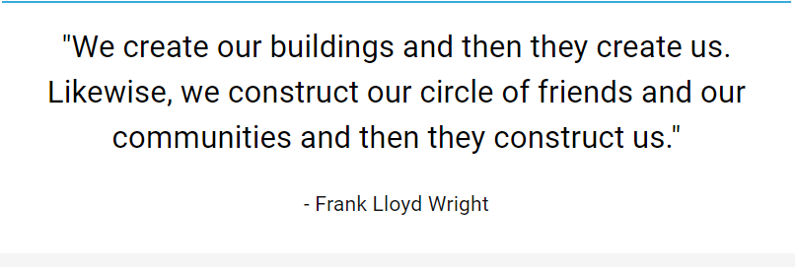
Wisdom from Frank

Slide 45
Today’s Agenda / 2
Review of chronology timelines
An overview of Architecture’s Odd Couple
A closer look at particular passages
Reactions, comments, opinions?

Slide 46
Part 1 / Before meeting
Chapter 1: Two Conversations
- 1927 / Wright and Lewis Mumford
- 1929 / Johnson and Barr / at Commencement at Wellsley
Chapter 2: Plotting a Comeback
- Wright’s acquaintance with Alexander Woolcott /
In July 1930, in a New Yorker article, Woolcott called Wright the
“father of Modern architecture
Chapter 3: European Travels
1926 / On his first solo trip, Johnson goes to Berlin and in the milieu
of Weimar Germany, starts to come to terms with his sexuality.
1929 / Extended trip when at the suggestions of Barr he meets
J.J.P. Oud and visits the Bauhaus, setting the stage for his
championship of Modernism.

Slide 47
Part 2 / The Competition Begins
Chapter 4: New Museum / MOMA is founded and has first show 1930 / Johnson again in Europe, traveling with Henry-Russell Hitchcock. Johnson meets Mies and travels with him to Brno to see the almost completed Turgendhat House
Chapter 5: Invitation Issued / Early 1931--Johnson, Barr, and Hitchcock plan the first MOMA show on Modernism / Johnson invites Wright to participate but Wright is coy, then consents to send drawings and a model. Johnson fails to accept Wright’s invite to visit Taliesin.
Chapter 6: Wright vs. Johnson / Summer 1931 -- J, H, and B travel to Europe to line up architects for the show / Wright balks because he is not the center of the show and withdraws.
Chapter 7: The Show Must Go On / 1932 Lewis Mumford intervenes and urges Wright to stay in / He relents and sends a model of HOUSE ON A MESA but it arrives way past the deadline for submissions / The show has a 6 week run with modest attendance / Wright sees the show when it is in Chicago.

Slide 48
Part 3 / The Competition Heats Up
Chapter 8: The Banks of Bear Run / 1935 - Wright meets the Kaufmanns / 1936-37 - The Building of Fallingwater / pp. 123-128—Frank’s Genius at work / John McAndrew (Philip’s successor at MOMA mounts a solo exhibit of Fallingwater.
Chapter 9: Politics and Art / late 30s--The impulsive indiscretions of an ambitious young man / Johnson’s flirtations with Fascism / 1937—The emigration of Mies and Gropius to the US / 1940-43 Johnson enrolls in architecture school at Harvard and designs and builds a house for himself—9 Ash Street.
Chapter 10: Wright’s Manhattan Project / 1943—Wright meets Solomon Guggenheim / Baroness Hilla Rebay / 1944 Wright works on design and site is acquired / 1945—Model is unveiled in NY / 1948 Guggeneheim dies and project stalls

Slide 49
Part 3 / The Final Skirmishes
Chapter 11: Philip Comes out Classical/ 1940s—Johnson makes many visits to Taliesin East and West and starts thinking more highly of Wright / Plans a show on Mies for MOMA; on visiting Mies in Chicago he sees the plans and model for the Edith Farnsworth house and after 27 other plans for his house in New Canaan, he envisions the Glass House./ 1945—Buys property in CT / 45-47—Designs the house / 48-49 --Construction
Chapter 12: The Whiskey Bottle and the Teapot

Slide 50
Prep for Session 3 / Mies and Edith
Read the book Broken Glass, if you have it
Review the timelines and resources on Mies and Farnsworth
Link to exhibition at Edith Farnsworth House on Peter Polumbo https://edithfarnsworthhouse.org/palumbo-interpretation-wall/

Slide 51
Session 3 / Mies and Edith
Session Three: Mies and Edith – A Bipolar Relationship—Mutual admirers, then enemies
- focus on BROKEN GLASS by Alex Beam
A look at the relationship between an architect who defined a new style and his “perfect” client, over the decade starting from when they met, through when they worked together to design and build the Edith Farnsworth House, to the time when they engaged in suit and countersuit and became bitter and disenchanted enemies.

Slide 52
Resources from group member
FLW house in Bradley/ Donna Offenbecker
https://franklloydwright.org/site/b-harley-bradley-house/
From Emmie Fisher:
1. House at 1411 W. University /now on sale
2. Prairie Glass House / N. Lincoln / Now an event space
https://prairieglasshouse.com/
3. Cedar Rock House, Independence Iowa
http://friendsofcedarrock.org/
4. Dancing House / Prague
https://www.re-thinkingthefuture.com/rtf-fresh-perspectives/a901-10-things-you-did-not-know-about-dancing-house-prague/
5. Two books: The Plaza Years 1954 – 1959 and Loving Frank, by Nancy Horan

Slide 53
Name Change / How authors get it wrong
It was during this period of career advancement and personal change that Mies indulged in a reinvention. He abandoned the name Maria Ludwig Michael Mies and rechristened himself Ludwig Mies van der Rohe, tacking his mother’s surname ROHE onto the Dutch particles suggesting nobility. (to assume the name ‘von der Rohe’ would have been unthinkable in title-conscious Germany). (Beam. page 13)
Check out the Wikipedia page on VAN (Dutch)
Van, van der (ver), vande, or vanden means “of’ or “from the”

Slide 54
Once again, Wright asserts himself
For the formal dinner introducing Mies to Armour supporters, Mies invited Wright to introduce him and according to Wright’s biography this is what he said,
I put my arm across Mies’s shoulders … and simply said, “Ladies and gentlemen, I give you Mies van der Rohe. But for me there would have been no Mies---certainly none here tonight. I admire him as an architect and respect and love him as a man. Armour Institute, I give you MY (Emphasis added) Mies van der Rohe. You treat him well and love him as I do. - Beam p. 11

Slide 55
What did shape Mies?
YouTube: Bauhaus in Seven Minutes
https://www.youtube.com/watch?v=Y69wOKg6yp4
YouTube: Mies in his own works / 11 minutes
https://www.youtube.com/watch?v=xIb4Jr18pZ0

Slide 56
Edith Farnsworth Chronology / Childhood and Youth
Native of Chicago
Father had lumber and paper business in Wisconsin and upper Mich / she spent some summer up there observing the workers
Educated in private schools / U of Chicago and Conservatory
Went to Italy to further her violin studies with Mario Corti / rumors are that they were lovers
Realized she wasn’t going to make it as a concert artist and came home / on the ship she met a doctor from Germany who sparked her interest in medicine
Decided on a career in medicine and went to Northwestern Med

Slide 57
Edith Farnsworth / Chronology 2
Associate Professor at Passavant Hospital specializing in Nephrology
Did important research, presented at national conferences, pioneered the use of medication to treat nephritis
1945 / Met Mies at a dinner party / they struck it off immediately
Late 40s / years of work on the design for her house / lots of trip out to Plano to scope out the property / lots of hours in Mies’s office and evenings socializing at his home
1949-1951 / Construction of the house / In1951 / Edith moved in / furnishing it with things of which Mies disapproved.

Slide 58
Farnsworth Chronology / The aftermath
The house had problems / leaking roof / flooding despite Mies’s claim that it was above the 100 year flood level / Oil smoke from the heating system made soot inside / The fireplace didn’t work well.
1952-56 / She refused to pay for cost overruns / he sued to recover monies he had spent on design and construction / she countersued for malpractice
She used the house for the next 15 years as a retreat
1971 / Sold it to Lord Peter Polumbo and moved to Tuscany, living in a villa Bagno a Ripoli with few modern conveniences / Translated Italian poetry and wrote poetry of her own

Slide 59
Mies and Edith / first meeting
Edith: “I wonder if there might be some young man in your office who would be willing to design a small studio-weekend house worthy of that lovely shore?”
Mies: “I would love to build any kind of house for you.”
Coming from this taciturn “massive stranger” as she describe him later, “the effect was tremendous, like a storm, a flood or other act of God.” (Beam, p. 4-5 / not footnote on conversation)

Slide 60
Early Years
The years of 1968 and 1957 were the Wunderjahre of the Mies-Edith relationship. They spent many weekends in Plano making plans for the house and plenty of time in the office, reviewing drawings or just joshing around with the younger architects. Farnsworth, an avidly interested client, reveled in the company of Mies’s junior confederates and often whiled away Saturday afternoons visiting the South Wabash Avenue office, or on giddy picnics by the Fox River. “She treated us, the office staff, like a bunch of kings until the end,” said Edward Duckett, one of Meis’s young architects. (Beam, p. 15-16)

Slide 61
How close were they?
Lots of days and weekends together while designing the house.
1947 / They travel together to NY to see the MOMA show, The Architecture of Mies van der Rohe, curated by Philip Johnson and including a model of the Edith Farnsworth house. (Wright saw the show and remarked “much ado about next to nothing.” which led to a falling out that was never patched up despite efforts by Edith To help Mies achieve a reconciliation.)
But neither Edith nor Mies ever confirmed, in speech or in writing, that they had an intimate relationship.
Is this issue a manifestation of our modern fascination with sex or evidence of personal reticence on the part of the two?

Slide 62
“God is in the details”
1947-49 / The work went slowly / Beam writes, Edith was eager to goad the architect forward. Alfred Caldwell, a student and collaborator of Mies’s at ITT, recalled a telephone call from Edith: “Caldwell, how can I get Mies to do my house? Every year it’s postponed, he says he’s too busy. That man, I can’t get him to do anything. I love the house, I want it. He keeps putting it off. Will you talk to him about it?”
Floor plan show meticulous attention to detail / Line up of joints (grout lines) of flooring / Height off ground—5’ 6”/ wanted site graded to within a tenth of an inch / Kitchen counter top was one solid piece of extruded stainless steel, including backsplash and stamped-in-place sink basins
https://www.google.com/search?q=plan+of+farnsworth+house&rlz=1C1GCEA_enUS855US855&oq=plan+of+farnsw&aqs=chrome.1.69i57j0i22i30j0i390j69i61l2.6631j0j7&sourceid=chrome&ie=UTF-8#imgrc=FDRv75W4y6YkxM

Slide 63
More details / and they disagreed about many of them
No rivet heads or welding marks
Mies insisted on travertine, from Italy / added $12,000 to $13,000 to the cost. Mies rejected many slabs.
Mies wanted shantung silk curtains; she wanted more color
Guide at house stated, “Mies’s firm did 3000 hours of work on 860-880 Lakeshore Drive; they did over 7000 hour of work on this house.”
Costs went up from an estimate of $40,000 to a final cost of over $70,000.
Mies later said, “Never talk to your client about architecture,” and “I think we should treat our clients as children.”
Mies once said, “This is the most important house in the world.” This was his legacy creation.
As cost overruns escalated, in March, 1951 Edith cancelled any more work and hired a lawyer.
Do you think Mies suffered from obsessive compulsive disorder?

Slide 64
The service module
Edith: As for the chimneys and dampers for the oil furnace, they could only be reached by the plumber’s oldest child, a thin wiry child who could be poked back among the pipes and was old enough to carry out orders. After one such session, the plumber dusted off the child and stood him on his feet. “You haven’t chosen a name for the house yet, have you? My suggestion would be ‘My Miesconception.’” (Beam, p. 129)
The STACK, which brought all the utilities into the house from underground, oil, water, and electricity also contained the pipe to drain rainwater from the roof which was slanted towards the center rather than towards the edges, thereby eliminating the need for gutters.

Slide 65
Whose house was it?
Architect Maritz Vandenberg wrote in a critique of the house:
It is undeniable that the Farnsworth House suffers from serious and elementary design faults. It was perfectly predictable that a badly-ventilated glass box, without sun-shading except for some nearby trees, would become oven-like in the hot Illinois summers, and that single-thickness glass in steel frames, devoid of cautionary measures such as convection heaters to sweep the glass with a warm air current, would stream with condensation in an Illinois winter. Mies’s disregard of such elementary truths illustrates his greatest weakness as an architect---namely, an obsession with perfect form so single-minded that awkward problems with loftily disregarded. (Beam, p. 158-59)
Perhaps Mies never intended to build a house for Edith Farnsworth. Instead he was indulging in an architectural exercise of consuming interest to himself. (Beam, p. 150)

Slide 66
More design flaws
Mies’s concessions to summerhouseness in this commission seem quite modest. There is virtually no storage space for, say, horseshoe sets, croquet mallets, or badminton equipment. Mies insisted on furnishing the house sparely, and exclusively with luxury furnishings: the aforementioned Barcelona chairs, an expensive (and beautiful) Brno chrome steel coffee table of his own design, and an elegant complementary dining table se of MR tubular chairs, another of his famous designs. There are no walls to hang art on, and attaching works to the primavera paneling of the kitchen-bathroom core, or to the teak finished wardrobe, seems sacrilegious. When Farnsworth later installed wicker furniture, Chinese statuary, and family photos in the home, Mies—or at lease the Miesians—scoffed.
(Beam, pp. 152-53)

Slide 67
Years of wrangling / 3 chapters and 60 pages of the book
Trial was not before a jury or judge but a master who was supposed to better understand the issues and then recommend a decision to a judge. Hearings lasted 6 weeks in May-July 1952 in a courtroom with no air-conditioning in the middle of a heat wave. Mies was there almost every day along with assistants; Edith only showed up about 6 times / Transcripts run to over 2500 pages.
Edith had more powerful evidence, especially when a rainstorm early in the trial produced terrible leaking around the windows / but Mies had better lawyers. Edith made the mistake of saying she wasn’t informed about the costs that were rising and didn’t see architectural plans. Unfortunately there is a photo of her looking over papers with Goldsmith, one of Mies’s ‘boys’.
After the hearing ended, it took the master 6 months to issue an opinion and then another six month for a judge to approve it. In the end there was an out-of-court settlement in which Edith had to pay $2500 instead of the $7000 or more that Mies claimed she owed him. He got no architect’s fees and did not fully reclaim what he had paid contractors.
The publicity was hard on both of them, the popular press was full of articles on this fight. Mies was vilified in some quarters and championed in others. But his reputation survived and he went on the greater and more profitable things, like the Seagrams building, which we will look at next week. The emotional toll on Edith was immense.

Slide 68
Farnworth Chronology / Later life of the house
Edith used the house for fifteen years and then gave up on making it liveable and sold it to Lord Peter Palumbo, a British architectural preservationist / wealth came from the rebuilding of London after the war.
She bought a villa in Tuscany with few modern conveniences and spent her last days translating Italian poetry and writing her own
Edith died in Dec 1977 and is buried in Graceland Cemetery in Chicago / ironically not far from where Mies is buried
2003 / Palumbo used it as one of his many residences for years but after a disastrous flood in 1996 (4-5 feet of water inside the house) he put it up for sale. Eventually it was auctioned / sold to National Trust for over $7 million in 2000. Palumbo moved his sculpture collection of outdoor works to his FLW property KENTUCK KNOB in Pennsylvania, about 4 miles from Falling water.
After extensive renovations and repairs the house was opened to the public / tours available at https://edithfarnsworthhouse.org/
National Historic Landmark and Historic Site
2021 / officially renamed the EDITH FARNSWORTH HOUSE
Proposals being considered to flood-proof the house

Slide 69
Next week / April 26: Mies and Philip and the Seagram’s Building--
Architecture’s Whiskey Bottle
Review the chronologies of Mies and Philip
Using the index in the ODD COUPLE book, check out all the references to Mies / Focus on Chapter 12--The Whisky Bottle and the Teapot.
Using the index in the BROKEN GLASS book, check out all the references to Philip / Focus on Chapter 12—Architects should kiss the feet of Mies van der Rohe
Do online research into the history and design of the Seagram’s building, paying special attention to why it was so groundbreaking. Learn about Phyllis Lambert.

Slide 70
Session 4 / Mies and Johnson and the Seagram Building
Prickly Colleagues: Cooperation and Criticism
Material from both books
From the time Phillip first encountered Mies in the late 20s (while on an architectural tour of Europe) to the 50s to when they worked together (although not as equals) on the building of the Seagram’s building (a modern masterpiece) in NYC, Johnson remained mostly an ardent admirer and disciple of Mies until later in life when he became disillusioned and highly critical of the International Style of which Mies was the epitome.

Slide 71
First, reactions to the idea for
Optional Additional Sessions (since I’ll be in town in May)
Possible topic and field trips
  Max Abramovich / Krannert Center and the Assembly Hall
  Field trips to buildings in town:
  - Krannert Center
    - Traditional church architecture / Holy Cross, Emmanuel, St. John the Divine
    - Contemporary church architecture / 3 of those FLW lookalikes
  The architecture and architects of Lincoln Center
  The World Trade Center Site / origins, disaster, and rebuilding
    Topics you suggest . . . . .

Slide 72
This week’s finds
Two from Architectural Digest on Zaha Hadid
https://www.architecturaldigest.com/story/zaha-hadid-architects-new-net-zero-project-nine-years-complete#intcid=_architectural-digest-bottom-recirc_3501e317-4b47-477e-be87-ac1e668a517b_text2vec1
https://www.architecturaldigest.com/story/zaha-hadid-architects-building-virtual-city-metaverse#intcid=_architectural-digest-bottom-recirc_b57489ce-6305-460c-9533-7a5efa1f47d3_text2vec1
https://www.google.com/search?gs_ssp=eJzj4tTP1TcwyrYoTjZg9OKqSsxIVMhITMlMAQBOYwb9&q=zaha+hadid&rlz=1C1GCEA_enUS855US855&oq=zAHA+h&aqs=chrome.1.0i131i355i433i512j46i131i433i512j69i57j0i433i512l2j0i512j69i60l2.7757j0j7&sourceid=chrome&ie=UTF-8
Diamond inspired architecture
https://www.architecturaldigest.com/gallery/best-diamond-inspired-architecture-around-the-world?utm_source=nl&utm_brand=ad&utm_mailing=ARD_Daily_AM_041222&utm_campaign=aud-dev&utm_medium=email&bxid=6253726fc9e292b4000faf6f&cndid=69288139&hasha=856174baa36b17de470a7bd8d7300eb8&hashb=641f58739ee4fbe379afea4f0adbec019b4b6b9e&hashc=32851bb99189890349836127abd081ca6973064f8ceb4de6ffd915fb29cbecab&esrc=AUTO_PRINT&utm_term=ARD_Daily

Slide 73
Fun Fact
https://www.countryliving.com/life/travel/g19418962/unusual-buildings-in-america/
Here’s the link to the PBS segment on the New Hampshire houses
https://www.pbs.org/video/frank-lloyd-wright-1650404605/
Thanks to Libbie Morley for sending this
Check this out: The invention of Lincoln Logs by FLW’s son
https://www.history.com/news/the-birth-of-lincoln-logs
Thanks to PBS Newshour for alerting me to this
The most unusual building in each US state
https://www.countryliving.com/life/travel/g19418962/unusual-buildings-in-america/
Thanks to Sandy Camargo for sending this

Slide 75
Mies and Johnson / The Arc of the Relationship
(First we will review the chronologies of Mies and Johnson / slides 27-37 above)
1928 / Met in Berlin / traveled together to Brno to see the Turgendhat house
1932 / Johnson and Barr mount the show on Modernism at MOMA / Mies is featured in the show
1941/ Johnson does his thesis project at Harvard by building a very Miesian house at 9 Ash St in Cambridge / furnishes it with furniture designed by Mies
1947 / Johnson mounts a show on Mies at MOMA / visits Chicago to collect material and views the model for the Edith Farnsworth House / Immediately adopts much of the design to the building of his own Glass House in New Canaan, which was complete in 1949
1955-58 / Cooperation on the Seagram Building in NYC
After 1959 Johnson begins to turn away from Modernism and is often critical of Mies. Mies was a Modernist to the end.

Slide 76
Johnson copies Mies
A funny thing happened on the way to building Mies’s glass house. Philip Johnson built it first. Johnson had played a huge role in promoting Mies’s distinctive style and his European accomplishments to the American audience. An eager acolyte with a sharp tongue and generally impeccable (if snobbish) taste, Johnson boosted Mies and his favorite European architects such as Oud and Le Corbusier in the groundbreaking 1932 MoMa International Style show, and again in the 1947 Exhibition devoted solely to Mies’s work.
Philip Johnson was a complicated fellow. In the first half of his long career as an architect—he died at age 99 in 2005—he was derided as “Mies van der Johnson,” so often did he swipe from the master’s canon. “I have always been delighted to be Mies van der Johnson,” he replied much later in life. “It has always seemed proper in the history of architecture for a young man to understand, even to imitate, the great genius of an older generation.”
For his part, Mies didn’t mind being borrowed from, “Sometimes people say, ‘How do you feel if somebody copies you?’ he commented in a 1960 interview. “I say that is not a problem for me. I think that is the reason we are working, that we find something everybody can use. We hope only that he uses it right.” - Howard, pp. 103-104

Slide 77
Exploring Mies’s influence on Johnson
Article on Johnson’s thesis house at 1 Ash St in Cambridge
https://www.knoll.com/knollnewsdetail/Philip-Johnson-Thesis-House
Nice video tour of the Glass House and surrounding landscape
https://theglasshouse.org/media/texture-transparency-the-glass-house/

Slide 78
History and Development of Seagram building
Beyond copying to cooperation
Wiki page on Seagram Building
https://en.wikipedia.org/wiki/Seagram_Building#Planning
Wright actually pitched himself to Bronfman but was never seriously considered. Someone in the Seagram’s organization wrote an inter-office memo: The roof (of a potential Wright building) will probably leak; the heating system and the lights probably won’t work; he will make it extremely difficult to house your employees because he will place them where he wants them, not where they are practically located. When you get through (if you ever finish it) it will cost twice as much as any other building. - Howard, p 226
Video: https://www.youtube.com/watch?v=UhRyWc5hDz8
Contrary to what the video tells you, it was not just a choice between three architects. LeCorbusier, Wright, and van der Rohe. Lambert and Johnson went through an extensive process in which at least 10 architects were considered. Lambert eventually settled on Mies. ( see Howard, pp.230-232)

Slide 79
Deterioration of the relationship after Seagram
The shotgun collaboration on Seagram and latent tensions between Mies and Johnson frayed their relationship beyond repair. Mies was more uncommunicative than usual during the Seagram project, and Johnson was chafing in the shadow of the Great Man, who owed his American renown, in part, to Johnson’s assiduous pamphleteering. Johnson the creative chameleon would soon cast off his Miesian skin and reinvent himself as an occasionally original, occasionally derivative, postmodernist architect in a career that spanned more than three decades after Mies’s death. “I am violently anti-Miesian,” he once declared in front of an audience at the Yale School of Architecture. “I think that this is the most natural thing in the world, just as I am not really very fond of my father.” Howard, p.248
The blow-up at the Glass House during their collaboration on Seagram: An inebriated Mies criticized Johnson’s use of steel piers on the corners in contrast to the post-less corners in the Farnsworth House. Mies said Johnson had tried to copy him and failed.
Johnson counterattacked, criticizing Stock Exchange building in Amsterdam by Hendrick Berlage, a building that Mies admired. Johnson said, “I’ve been meaning to ask you about Berlage and the Stock Exchange. All that decoration mixed up with masonry and steel . . . In view of your love of pure structure, I am at a loss to comprehend what you see in it or him.” Howard, p. 249

Slide 80
Mies and Phillip after Seagram’s
As an octogenarian in the late 60s, Mies had outlived the heyday of the modernist movement. In 1967, future Pritzker Architecture Prize winner Robert Venturi published the influential postmodernist manifesto Complexity and Contradiction in Architecture. Venturi head-butted Mies’s magnificent paradox Less is more. Venturi declared “Less is a bore.”
Years later Venturi allowed that “of all things I’ve said, I’ve never wanted to take anything back, except maybe ‘Less is a bore.’” – Howard, pp 255-257
Johnson on the other hand went on to thirty more years of creative work in various styles, thereby becoming one of the best known architect’s of the 20th Century / Again, see the Wikipedia page on Philip Johnson for dozens of good pictures of Johnson’s work. https://en.wikipedia.org/wiki/Philip_Johnson

Slide 81
A final appraisal
Charlie Rose’s interview with curators of two shows on Mies in 2001
- Paul Goldberg, Architecture critic at the New Yorker
- Barry Bergdoll, organizer of Mies in Berlin at MOMA
- Phyllis Lambert, organizer of Mies in America at the Whitney
https://www.youtube.com/watch?v=S9DsUHAuva8

Slide 82
Post-session fun / conversation over lunch?
Again I invite anyone who is interested to go to a nearby restaurant for a lunch and continued conversation, free of the constraints of technology. We learn best by explaining to others what we have learned for ourselves.

Slide 83
Contact
dirkvm1996@gmail.com
Please feel free to contact me with questions or comments . . .
GO FORTH AND LEARN !!!!!
Cumulative PowerPoint (minus book photos) will be on the OLLI web page by tomorrow.

