Slide 1
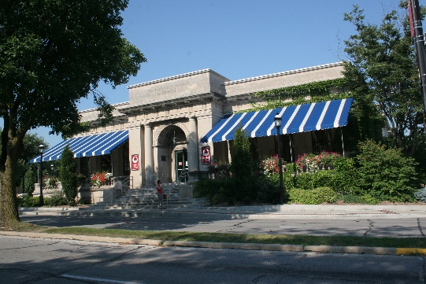
Champaign County Historical Archives at The Urbana Free Library
Sara Bennett | Archives Librarian
sbennett@urbanafree.org
April 19, 2021
Notes:
Who I am
Qualifications
Why we’re here

Slide 2
What is CCHA?
Department of The Urbana Free Library
Research-level collection on Champaign County history and genealogy
Established in 1956
Official repository for non-current Champaign County records since 1987
Urbana Municipal Documents Center (1970s-1990s)
Collections are open to the public
Reference staff available during all open hours

Slide 3
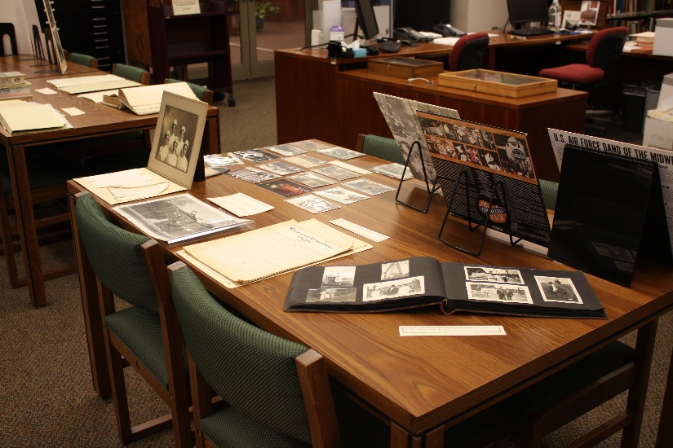
What can you find?
Primary focus is Champaign County
Collections that document life from the 1830s through the present day
Holdings are indexed in the Local History Online catalog available at: http://archivescatalog.urbanafreelibrary.org/polaris
Extensive holdings for the rest of Illinois
States that supplied significant migration routes of communities that comprise Champaign County

Slide 4
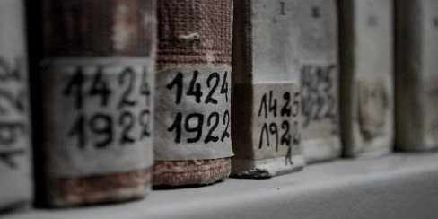
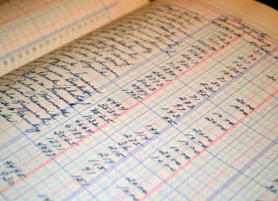
Collections
Books and journals
Champaign County records
City of Urbana records
Newspapers
Directories
Yearbooks
Records and manuscripts
Photographs
Maps and atlases
Oral histories
Local organization newsletters
Special collections
Chanute Air Museum collection
Digital databases and resources

Slide 5
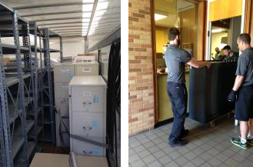
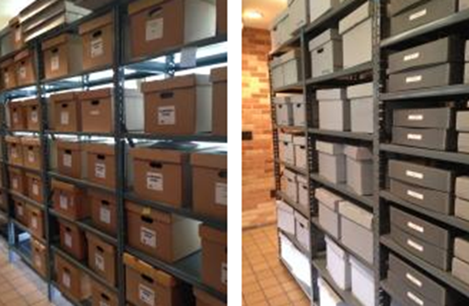
Chanute Collection
Acquired in 2015
Octave Chanute Aerospace Museum
Maps, blueprints, photographs, subject files, base publications, videos, scrapbooks, oral histories, personnel collections

Slide 6
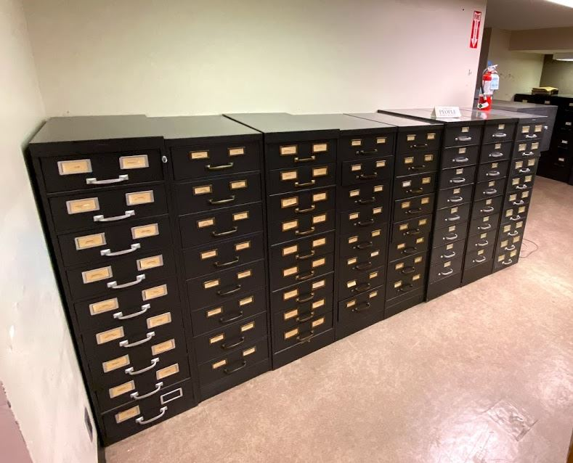
The News-Gazette Archives Collection
Collection housed at Lincoln Square Mall
Over 40 file cabinets of subject and name files including clippings, photos, and records
350 boxes of subject clippings
35 bound volumes of smaller newspapers
Notes:
Department of The Urbana Free Library
Research-level collection on Champaign County history and genealogy
Established in 1956
Urbana Municipal Documents Center
Official repository for non-current Champaign County records since 1987
Collections are open to the public
Reference staff available during all open hours

Slide 7
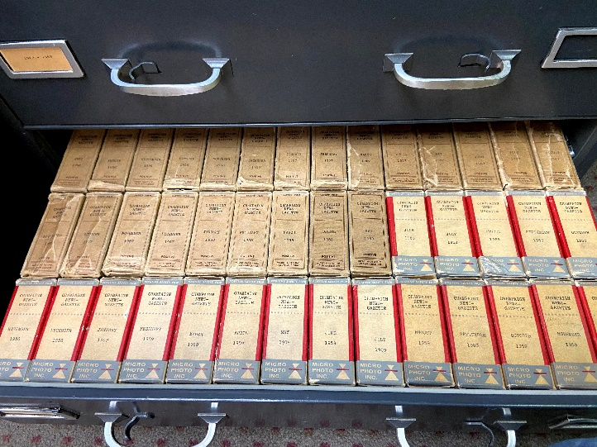
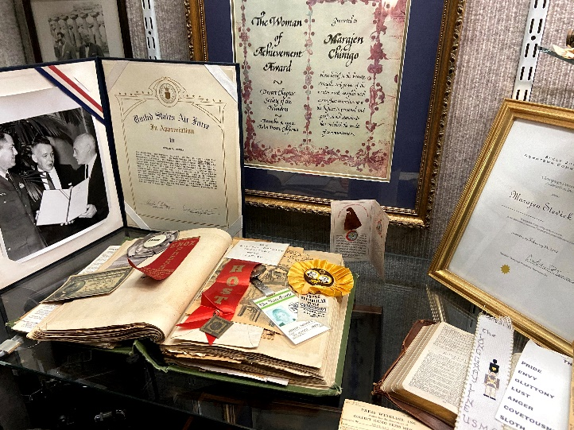
News-Gazette Collection

Slide 8
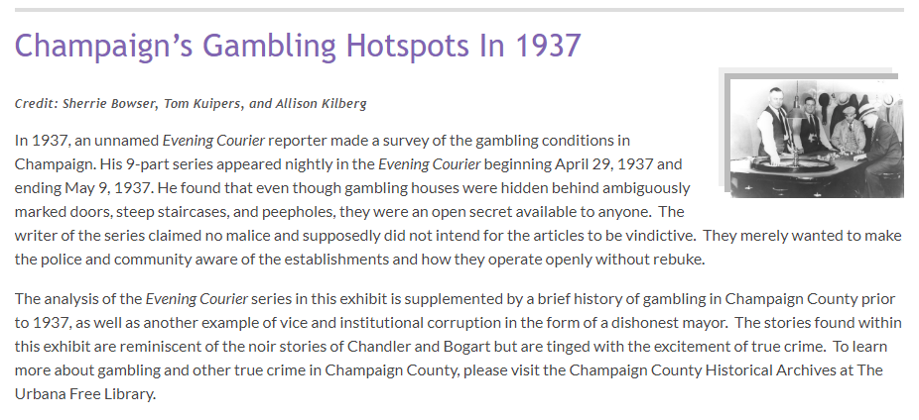
Digital Exhibits
https://urbanafree.omeka.net/

Slide 9
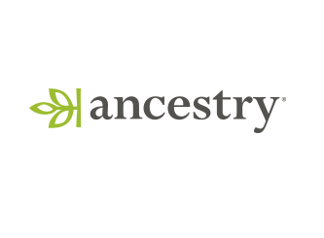
Databases
We subscribe to a number of databases including:
Ancestry Library Edition
Find My Past
Fold 3
Heritage Quest
MyHeritage Library Edition
The News-Gazette
Newspapers.com

Slide 10
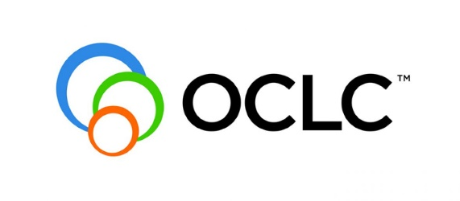
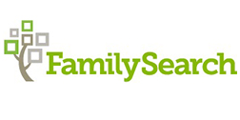
Databases (continued)
We partner with FamilySearch as an affiliate library, making materials from the Family History Library in Salt Lake City, Utah, available to our patrons.
If you are unable to find what you need here, our staff can help you make an interlibrary loan request to have materials sent to our library.

Slide 11
Digital Resources
Local History Online catalog
Illinois Digital Newspaper Collections
Illinois State Archives
Archives Grid
Periodical Source Index (PERSI) through FindMyPast

Slide 12
Our Genealogy Resources
Vital Records
Cemetery Records
Court Records
City Directories
Newspapers
Social Organizations
Yearbooks
Family Files, Photographs, Genealogy Books
Plat Maps, Grantor/Grantee land deed index

Slide 13
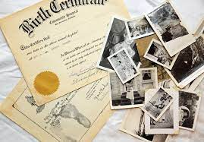
Vital Records
Records of life events, issues by the government.
Birth (1878-1914)
Death (1878-2001)
Marriage (1833-1975)
Naturalization (1859-1906)
Restrictions
Birth – 75 years
Death – 20 years
Marriage – 50 years

Slide 14
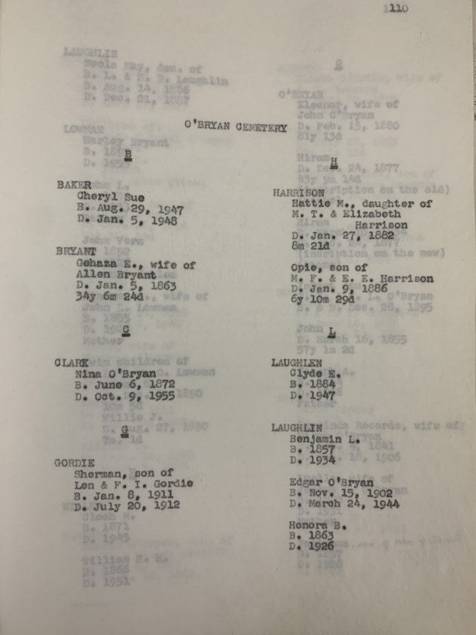
Cemetery, and Funeral Home Records
Microfilmed cemetery records
Cemetery record books
Funeral home collections
Heath funeral home

Slide 15
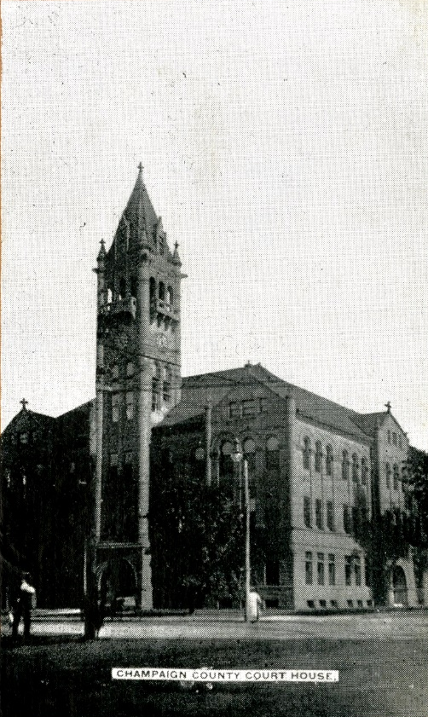
Court Records
County Court and 6th Circuit Court
Chancery court cases:
Divorces, foreclosures, titles, bills to quiet
Probate court cases:
Wills
Testate – Will
Intestate – No will
Establish where someone was living, land they owned, inheritance questions, related names.
Organized by case number and year.

Slide 16
City Directories
Index of names and addresses of people and businesses.
City directories can be used to verify where someone lived or their occupation.
Confirm details.
Lead you to employment or business records.

Slide 17
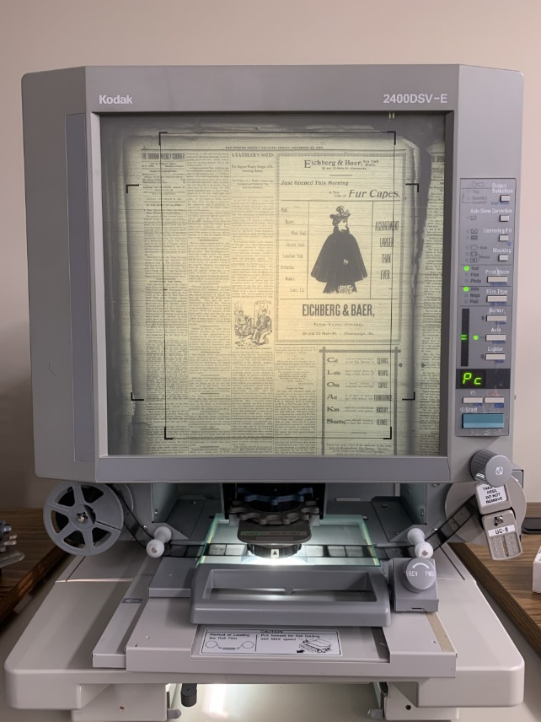
Newspapers
Wide microfilm selection, 1852-present
Obituaries, birth, marriage announcements
Social events
Other sources for newspapers:
Newspapers.com – largest online newspaper database
PERSI – Through Find My Past, Periodical Source Index
Illinois Digital Newspaper Collections

Slide 18
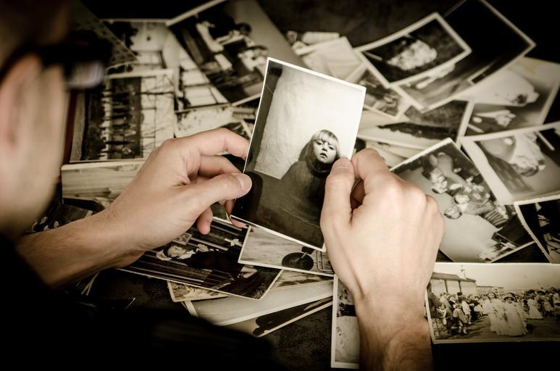
Social Organizations
League of Women Voters, Kiwanis, Champaign County Design and Conservation Foundation
Directories, membership lists, meeting minutes, promotional materials for events or parties
Flesh out the details of an ancestor.

Slide 19
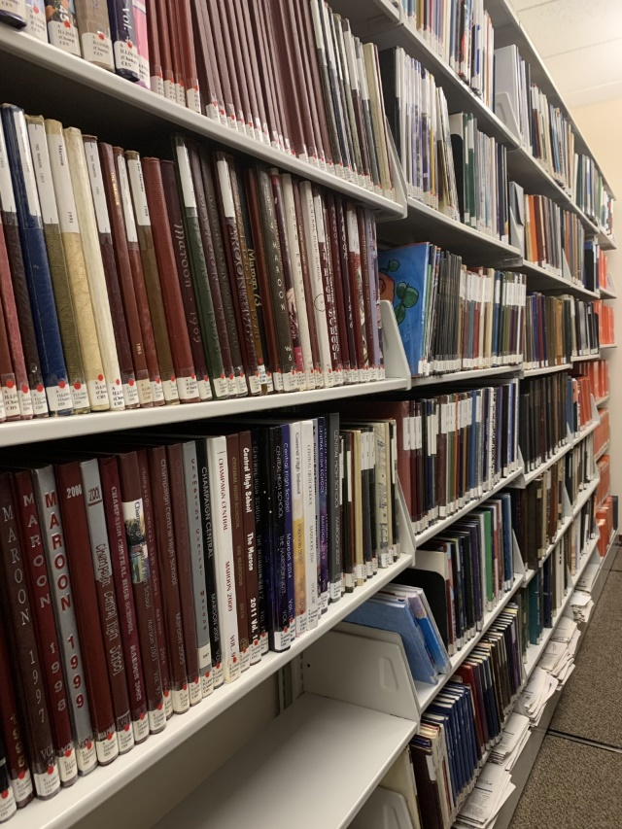
Yearbooks
Almost complete Champaign County high schools, incomplete elementary and middle sets
Search for photos
Activities and organizations

Slide 20
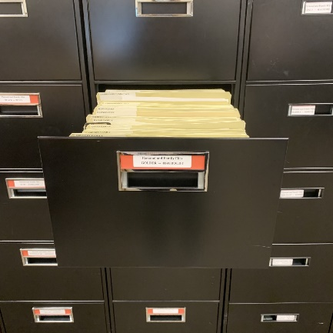
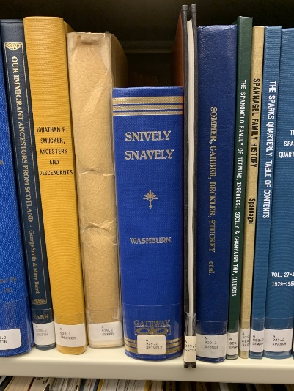
Family Files, Photographs, Family Genealogy Books
Files of local family histories
Family businesses
Genealogy
Interviews/Oral Histories
Corresponding family photo collections
Family genealogy books

Slide 21
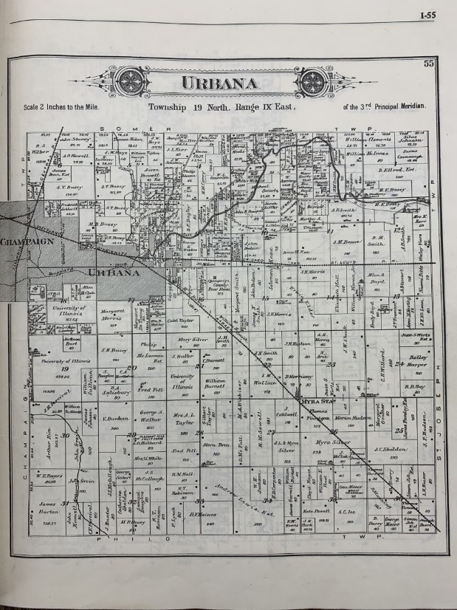
Plat Maps, Grantor/Grantee Land Deed Indexes
Plat maps show who owned land
Included land owners names
Microfilmed Grantor/Grantee land deed indexes
shows who bought and sold land.

Slide 22
Local History Online Catalog Tutorial

Slide 23
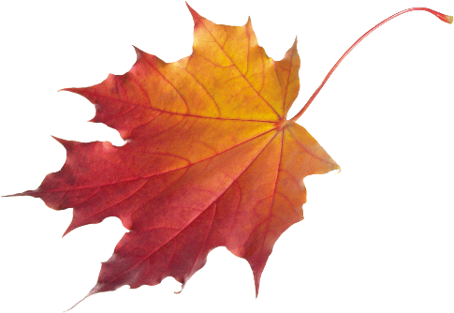
Workshops and Events
We offer workshops on genealogy and local history topics throughout the year.
Intermediate genealogy workshop
(5/29, 10 am-12 pm)
Journeying Through the American Indian Way of Life
(6/3, 6 pm – 7:30 pm)
Finding Family with DNA Testing
(7/8, 6 pm – 7:30 pm)

Slide 24
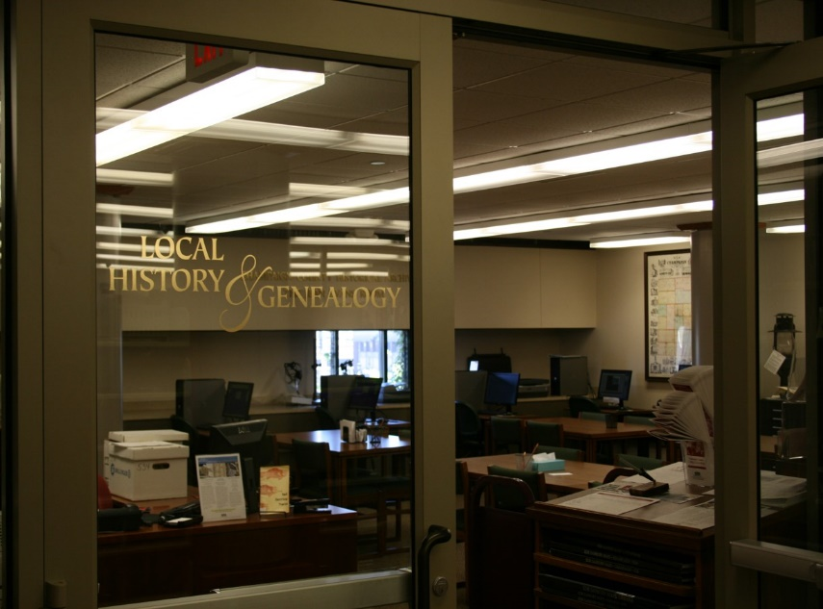
Genealogical Society and Research Night
The Champaign County Genealogical Society uses CCHA as its physical location during non-Covid times.
Speakers 2nd Tuesday of the month at 7pm
Research Night 3rd Wednesday of the month at 7pm
https://ilccgs.org/

Slide 25
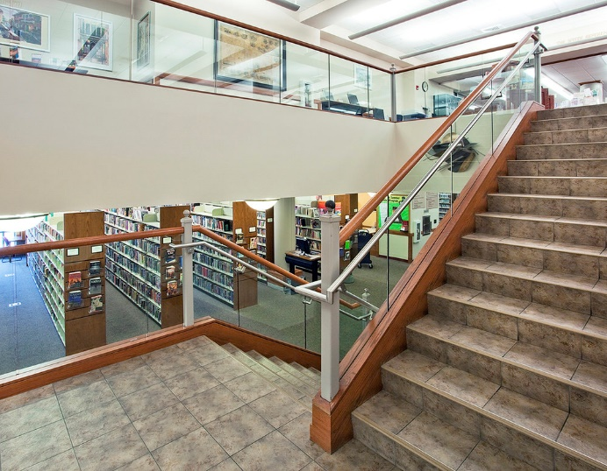
Visit Us
Open by appointment!
We are open 7 days per week:
Monday, Tuesday, Thursday, Friday, Saturday | 11:00 am – 5:00 pm
Wednesday | 11:00 am – 7:00 pm
Sunday | 1:00 – 4:00 pm

Slide 26
Contact Information
The Urbana Free Library
Champaign County Historical Archives
210 W. Green St. | Urbana, IL 61801
217-367-4025
sbennett@urbanafree.org
archives@urbanafree.org
urbanafreelibrary.org/local-history-genealogy

