Slide 1
Climate Change
- A Hot Topic
Why Climate Change
Roy Campbell and Don Fournier, January 8th, 2023

Slide 2
Contents for Weekly Group Sessions
Introduction
Why Climate Change – An Introduction
Fifth National Climate Assessment
Remediation
Adaptation
Politics and Steak Holders
What can individuals do?

Slide 3
Introduction -- Why Climate Change
Moderators
Group Participants
Definitions
Some background on climate
What is happening on the world stage - COP 28
16 Dimensions of climate change problem
Climate awareness timeline
Consequences
References

Slide 4
Moderators
Why Climate Change
Don Fournier: Don has been following climate change issues since the early 1980’s and read many books on the topic and has given lectures and taught courses on climate and the build environment.
Roy Campbell: Roy has been following the science and public debate about the environment and climate change ever since the 1952 Great Smog that smothered London. His interest will be to help explain how science has detailed and predicted the changes that are occurring and the evolving public and corporate response.

Slide 5
Group Members
ZOOM students
Anastasia | Economy
Norman | Klein
Derek | Robinson
Dale | Bauer
Sandra | Leister
Joseph | Sciacca
Mayuree | Sciacca
Anita | Hamburg
Maureen | McCord
Nancy | Benson
Judy | Lachman
Andrea | Klein
Karen | Bush
Beth | Martin
Debra | Karplus
Jean | Weigel
Carol | Dunn
In-person students
Margaret | Maurer
Ann | Campbell
Larry | David
Monica | David
Sandra | Dixon
Chris | Clark
Paul | Benson
Robert | Segebart
Charles | Elder
Frances | Elder
Jeff | Moll
Judith | Moll
Elisabeth | Jenicek
Jon | Liebman
In-person students
Jon | Liebman
william | marshall
Stephen | Marshak
Luis | Cuza
Douglas | Staske
Gregory | Walburg
Alan | Conrad
Max | Kummerow
Mary | Kuetemeyer
Isabel | Cole
anthony | welsh
Joyce | Eisold
Robert | O'Daniell

Slide 6
Definition -- Climate
Why Climate Change
Climate change refers to long-term shifts in temperatures and weather patterns. Such shifts can be natural, due to changes in the sun’s activity or large volcanic eruptions. But since the 1800s, human activities have been the main driver of climate change, primarily due to the burning of fossil fuels like coal, oil and gas.
United Nations Definition:
https://www.un.org/en/climatechange/what-is-climate-change

Slide 7
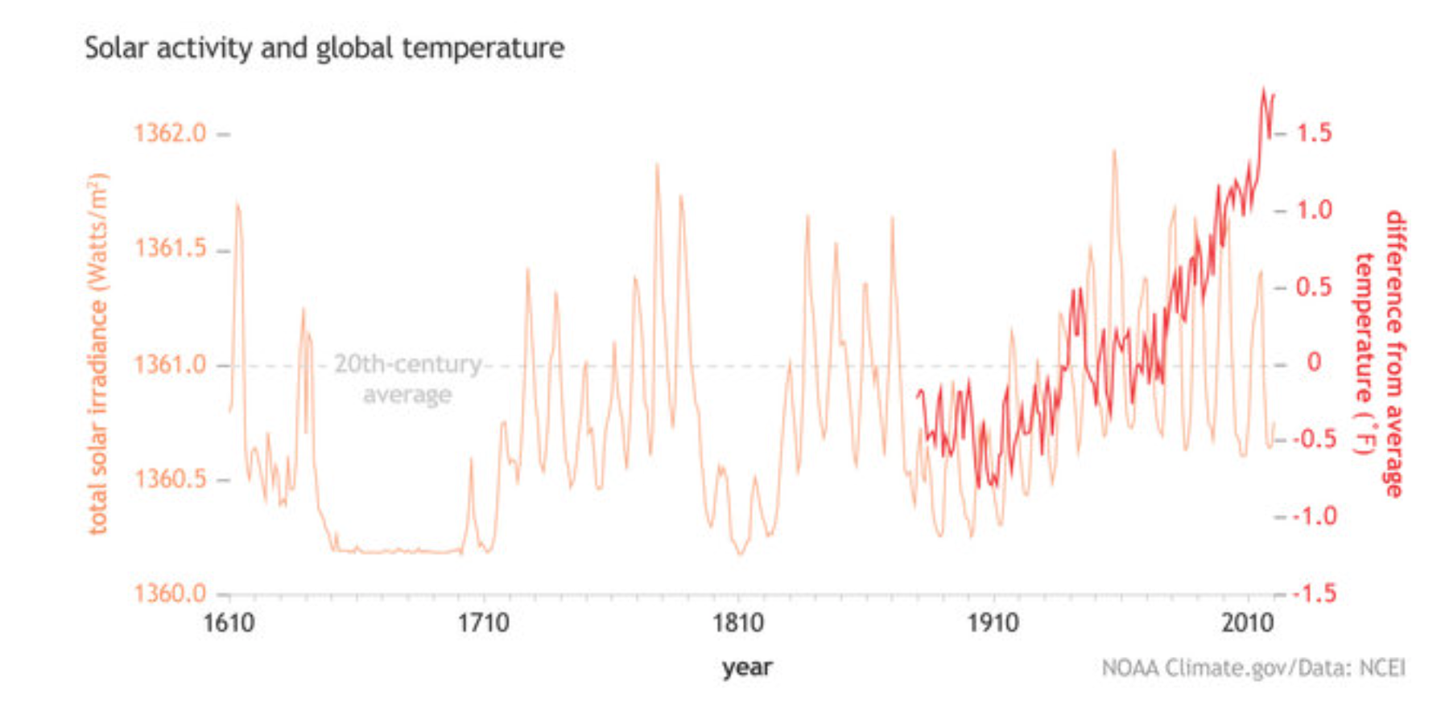

Slide 8
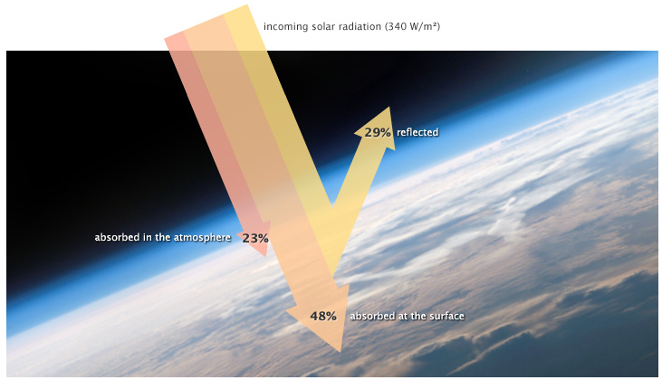
https://www.earthobservatory.nasa.gov/features/EnergyBalance/page4.php

Slide 9
Heat Balance on Earth
Temperature doesn’t infinitely rise, however, because atoms and molecules on Earth are not just absorbing sunlight, they are also radiating thermal infrared energy (heat).
The amount of heat a surface radiates is proportional to the fourth power of its temperature. If temperature doubles, radiated energy increases by a factor of 16 (2 to the 4th power).
If the temperature of the Earth rises, the planet rapidly emits an increasing amount of heat to space.
This large increase in heat loss in response to a relatively smaller increase in temperature—referred to as radiative cooling—is the primary mechanism that prevents runaway heating on Earth.

Slide 10
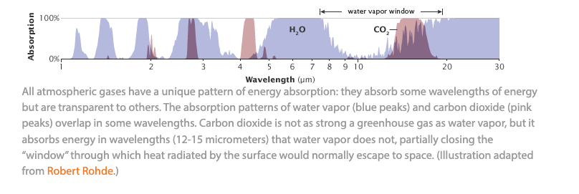
How does heat escape from the earth

Slide 11
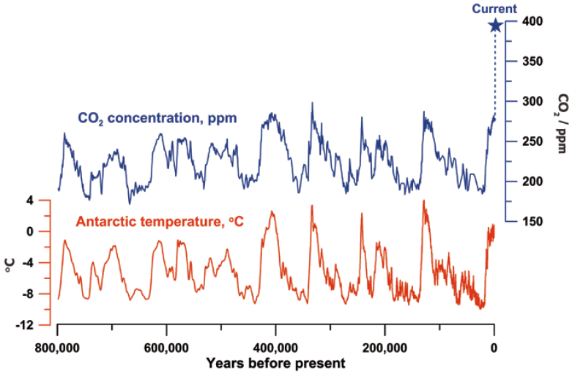
Historical Climate

Slide 12
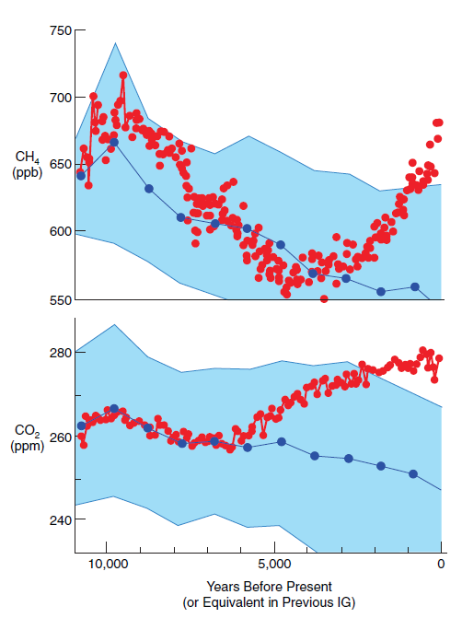
The Holocene
We are taking a different path than previous 7 interglacial periods.
For all GHG gasses.
CO2 & CH4 dominate.
Current Methane Level is 1912 ppb.
Current CO2 Level is 419.
Source: Ruddiman et al. 2011

Slide 13
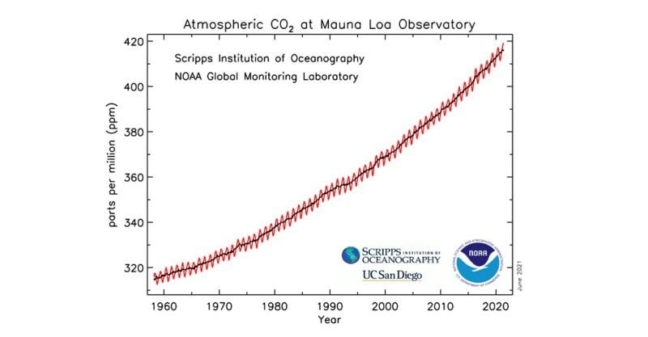

Slide 14
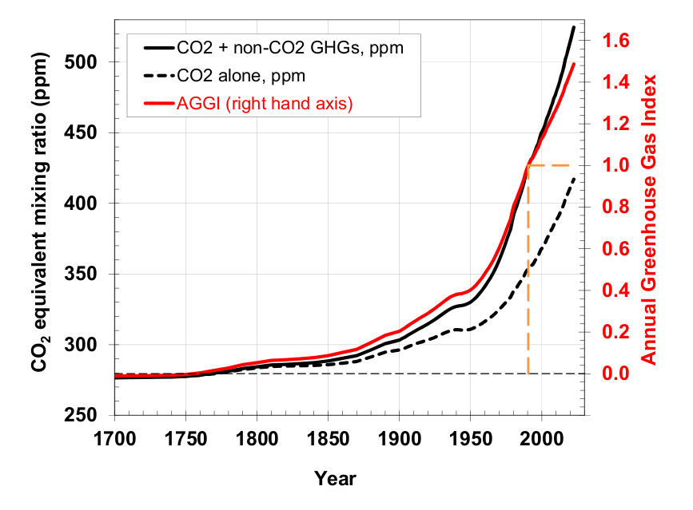
Green House Gas in Atmosphere 1700-2020
https://gml.noaa.gov/aggi/aggi.html

Slide 15
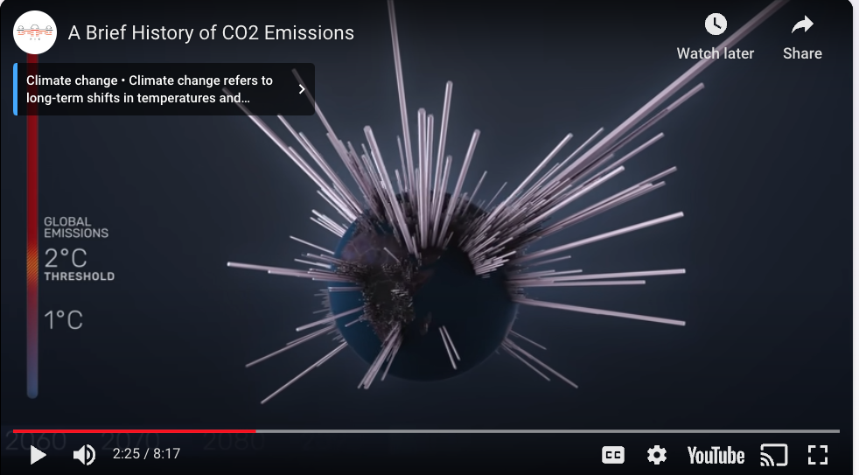
https://youtu.be/EQ7S0D1iucY

Slide 16
16 Dimensions of Climate Change Problem
Climate change is a multidimensional and interconnected issue that affects various aspects of the environment, society, economy, and geopolitics. The dimensions of climate change include:
Temperature Changes:
Global Warming: The overall increase in Earth's average temperature, leading to changes in climate patterns
Extreme Weather Events:
Heatwaves, Storms, and Droughts: More frequent and intense extreme weather events contribute to climate variability.
Melting Ice and Rising Sea Levels:
Glacial Melting: The shrinking of glaciers and ice caps.
Sea Level Rise: The increase in sea levels due to the melting of polar ice and glaciers

Slide 17
16 Dimensions of Climate Change Problem
Ocean Acidification:
Carbon Dioxide Absorption: The oceans absorb carbon dioxide, leading to increased acidity with detrimental effects on marine life.
Biodiversity Loss:
Ecosystem Disruption: Changes in climate can disrupt ecosystems, leading to shifts in the distribution and behavior of plant and animal species.
Water Resource Changes:
Altered Precipitation Patterns: Changes in rainfall and snowfall patterns impact water availability.
Sea Ice Changes: Melting sea ice affects ocean salinity and circulation patterns.

Slide 18
16 Dimensions of Climate Change Problem
Food Security:
Crop Yields: Climate change can affect agricultural productivity, leading to potential food shortages and increased prices.
Health Impacts:
Heat-related Illnesses: Increased temperatures can lead to heat-related illnesses, affecting human health.
Vector-borne Diseases: Changes in climate can influence the distribution of disease vectors.
Economic Consequences:
Losses and Damages: Economic impacts from extreme weather events, affecting infrastructure, agriculture, and industries.
Costs of Adaptation and Mitigation: Expenses associated with adapting to climate change impacts and mitigating greenhouse gas emissions.

Slide 19
16 Dimensions of Climate Change Problem
Social and Cultural Impacts:
Migration and Displacement: Climate-induced migration and displacement of communities.
Cultural Changes: Impact on cultural practices and traditions, especially for communities closely tied to the environment
Policy and Governance:
International Agreements: Frameworks such as the Paris Agreement aim to address climate change through global cooperation.
National Policies: Governments develop policies to reduce emissions, promote renewable energy, and enhance resilience.

Slide 20
16 Dimensions of Climate Change Problem
Technological Solutions:
Renewable Energy: Advancements in renewable energy technologies play a crucial role in mitigating climate change.
Carbon Capture and Storage: Technologies to capture and store carbon dioxide from industrial processes.
Geopolitical Considerations:
Resource Competition: Climate-related resource scarcity can contribute to geopolitical tensions.
Climate Diplomacy: International relations influenced by climate change considerations.
Educational and Awareness Dimensions:
Public Awareness: The importance of educating the public about climate change and fostering a sense of responsibility.
Addressing climate change requires a holistic approach that considers these interconnected dimensions and involves collaboration at local, national, and international levels.

Slide 21
Timeline of Climate Change
19th Century:
1824: | Joseph Fourier proposes the greenhouse effect theory, suggesting that Earth's atmosphere retains heat.
1896: | Svante Arrhenius publishes a paper on the relationship between carbon dioxide and climate, suggesting that burning fossil fuels could lead to global warming.
20th Century:
1950s: Scientific interest grows, and early climate models predict potential warming. |  | 1950s: Scientific interest grows, and early climate models predict potential warming.
1970s: Concerns about global cooling briefly emerge, but by the end of the decade, focus shifts to global warming. |  | 1970s: Concerns about global cooling briefly emerge, but by the end of the decade, focus shifts to global warming.
1980s: The Intergovernmental Panel on Climate Change (IPCC) is established by the United Nations. |  | 1980s: The Intergovernmental Panel on Climate Change (IPCC) is established by the United Nations.
1990s: The United Nations Framework Convention on Climate Change (UNFCCC) is adopted at the Earth Summit in Rio de Janeiro. |  | 1990s: The United Nations Framework Convention on Climate Change (UNFCCC) is adopted at the Earth Summit in Rio de Janeiro.
1992: |  | The United Nations Framework Convention on Climate Change (UNFCCC) is adopted at the Earth Summit in Rio de Janeiro.
1997: |  | The Kyoto Protocol, an international

Slide 22
Timeline of Climate Change (cont.)
2000s:
2001: | The IPCC releases its Third Assessment Report, emphasizing human influence on climate change.
2005: | The Kyoto Protocol comes into force.
2007: | The IPCC releases its Fourth Assessment Report, stating with high confidence that global warming is due to human activities.
2010s:
2015: | The Paris Agreement is adopted at COP21, aiming to limit global warming to well below 2 degrees Celsius above pre-industrial
2016: | The World Meteorological Organization announces that 2016 is likely the warmest year on record at that time.
2020s:
2020: | Despite the COVID-19 pandemic leading to temporary emissions reductions, the year ties with 2016 as the warmest on record.
2021: | The IPCC releases its Sixth Assessment Report, warning of the accelerating impacts of climate change and the urgency of action

Slide 23
Roadmaps to Solving Climate Change
Reduce the population needing energy
Infeasible in the short term
Reduce the production of greenhouse gases [Session 2, 3, 4]
But air, land and sea reservoirs of greenhouse gases and heat
Increase the albedo of the earth [Session 6]
But terraforming the earth could have other dangers
Pull the greenhouse gases from the air [Session 6]:
Carbon sequestration and other approaches

Slide 24
Population
Efforts to slow population growth in the short term will have little impact on sustainability,
Sustainability can be more rapidly achieved with a focus on:
technological and social innovations,
reducing consumption rates,
treating population planning as a long term goal
A fertility-reduction model of one-child per female by 2100 would take at least 140 years to reduce the population to 2 billion people by 2153
Proceedings of the National Academy of Sciences of the United States of America, 2014

Slide 25
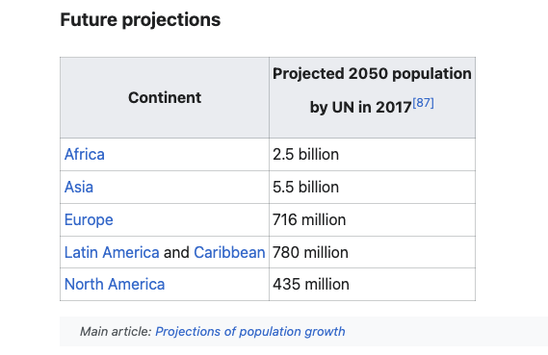
World Future Population Projections
Current North American Population is ~407 million

Slide 26
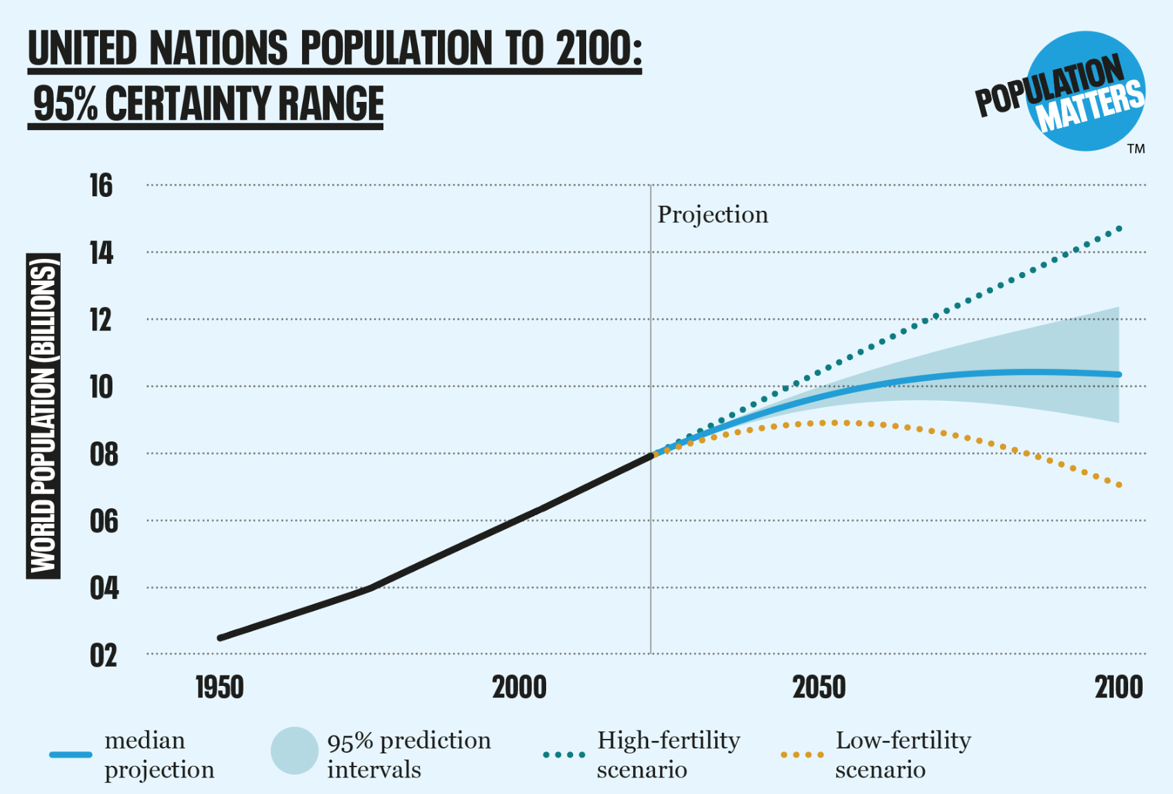
Birth Rates
World population prospects (2022). Note that half a child more or less per woman would cause a difference of about 8 billion people by the end of the century (blue orange dotted lines).

Slide 27
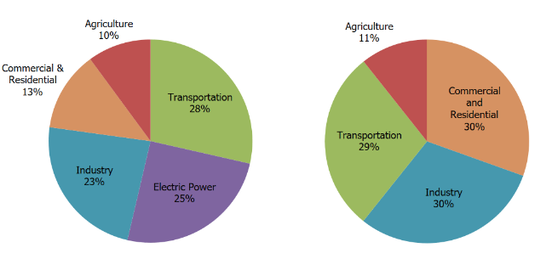
Total U.S. Greenhouse Gas Emissions by Economic Sector in 2021
EPA
Includes Electricity End Use
https://www.epa.gov/ghgemissions/sources-greenhouse-gas-emissions#:~:text=Industry%20

Slide 28
Carbon Emissions per sector
The Transportation Sector (28%):
Electricity Production (25%)
a billion metric tons of carbon dioxide equivalents a year caused by Grid inefficiencies world-wide
Industry (23%)
Commercial and Residential (13%)
Agriculture (10%)
Land Use and Forestry (offsets 12%)

Slide 29
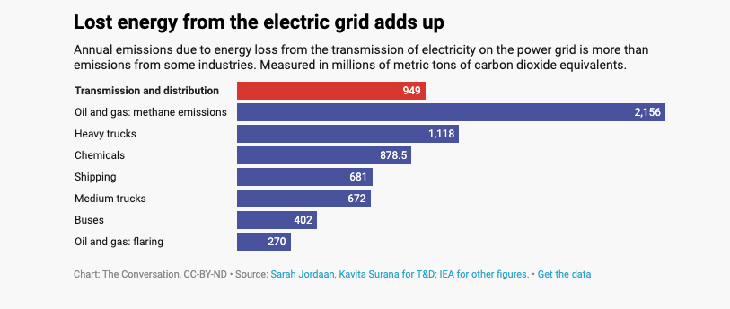
Grid losses in Emissions equivalent
Just distributing energy costs emissions right now (world wide)

Slide 30
Climate Change
- A Hot Topic
Remediation -- The Great Energy Transition
Session 3
Electrify Everything, Everywhere, All at Once!!
Roy Campbell and Don Fournier, January 29th, 2023

Slide 31
Remediation -- Getting off Carbon
The Transportation Sector
Automobiles
Trucks
Aviation
Rail System
Ships
Electricity Production
Nuclear Power
Renewables
The Built Environment
Industry
Commercial & Residential
Agriculture
Land Use and Forestry

Slide 32
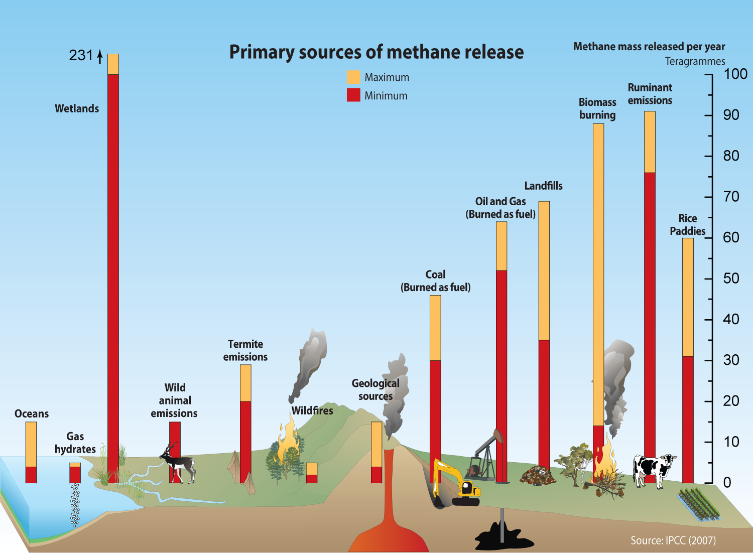

Slide 33
Remediation – Tackling Methane
Fossil Fuel Issues
Agriculture
Biomass
Enteric Methane
Plant Cultivation
Landfills

Slide 34
Climate Change
- A Hot Topic
Adaptation – Session 4
Roy Campbell and Don Fournier, February 5th, 2023

Slide 35
Adaptation
Green Infrastructure
Storm Hardening
Fire Hardening
Flood Design
Sea Level Rise
Managing Drought Conditions
Coping with Atmospheric Rivers

Slide 36
Climate Change
- A Hot Topic
Politics and Stake Holders – Session 5
Roy Campbell and Don Fournier, February 12th, 2023

Slide 37
Climate Change- A Hot Topic
Session 5 will discuss climate change, social systems, and politics.
Items for Discussion:
Climate-social system models – DICE, RICE (See Nature)
Producers
Lobbyists
Big Money
Power Struggles
Small and Island Countries
The Politicization of Science
Global Politics
State Politics

Slide 38
Climate Conference COP28 Summary - December 13, 2023
COP28 Outcome: Transitioning Away from Fossil Fuels
Nations approved a roadmap for transitioning away from fossil fuels at COP28 in Dubai.
However, the deal falls short of a long-demanded call for a phaseout of oil, coal, and gas.
UN Chief António Guterres emphasizes the inevitability of a fossil fuel phaseout for climate change mitigation.
The COP28 conference extended due to negotiations on the terms of phasing down or phasing out fossil fuels.

Slide 39
Key Points from UN Chief and Climate Chief Statements
Limiting global heating to 1.5°C requires the phaseout of all fossil fuels.
Commitments include tripling renewables capacity and doubling energy efficiency by 2030.
Progress on adaptation and finance, with the operationalization of the Loss and Damage Fund.
Calls for a surge in finance for vulnerable countries facing rising seas and drowning in debt.

Slide 40
COP28 Highlights and Achievements (cont.)
Establishment of the Loss and Damage Fund for climate-vulnerable developing countries.
Commitments of $3.5 billion to replenish the Green Climate Fund.
Additional funding for the Least Developed Countries Fund (LDC) and Special Climate Change Fund (SCCF).
World Bank pledges $9 billion annually for climate-related projects in 2024 and 2025.
Endorsement of COP28 UAE Climate and Health Declaration and Declaration on Agriculture, Food, and Climate.
Global Cooling Pledge endorsed by 66 countries to reduce cooling-related emissions by 68%.

Slide 41
What's Next for COPs?
Next round of Nationally Determined Contributions (NDCs) due in 2025.
Baku, Azerbaijan, announced as the host for COP29 in November 2024.
Brazil offers to host COP30 in the Amazon in 2025

Slide 42
Mixed Reactions and Criticisms
Civil society representatives, climate activists, and small island developing countries express dissatisfaction.
Concerns about the outcome lacking a clear course correction and incremental advancements.
Harjeet Singh from Climate Action Network International criticizes COP28's spotlight on fossil fuels but points out loopholes and hypocrisy in the outcome.
Developing countries dependent on fossil fuels lack robust guarantees for financial support in transitioning to renewable energy.

Slide 43
Climate Change - A Hot Topic
What Can Individuals Do - Session 6
Why individual action is important.
What can I do?
How do I make a difference?
Albedo and sequestration questions
Round-out Discussions

Slide 44
Climate Change: Hot Topics 9. References (Green items for introduction)
COP 28 full presentation (verbose) https://unfccc.int/documents/204079
5th US Climate Report (detailed) https://nca2023.globalchange.gov/
Royal Society Climate Change Evidence and Causes(more technical) https://royalsociety.org/~/media/Royal_Society_Content/policy/projects/climate-evidence-causes/climate-change-evidence-causes.pdf
The Carbon Almanac: It's Not Too Late Paperback – July 12, 2022 (reference for terms) The Carbon Almanac Network (Author), Seth Godin
Determinants of emissions pathways in the coupled climate–social system (technical), Frances C. Moore, Katherine Lacasse, Katharine J. Mach, Yoon Ah Shin, Louis J. Gross, Brian Beckage, Nature, Vol. 603, 3 March 2022, https://doi.org/10.1038/s41586-022-04423-8
EPA Climate Change (nice diagrams) https://www.epa.gov/climate-change
NASA CLIMATE CHANGE (interesting videos of climate) https://climate.nasa.gov/
The International Panel on Climate Change IPCC (central scientific world body) https://www.ipcc.ch
United Nations Climate Action (Summaries of impact) https://www.un.org/en/climatechange
The European Commision: Energy, Climate change, Environment(European view) https://commission.europa.eu/energy-climate-change-environment_en

Slide 45
Additional materials

Slide 46
Carbon Dioxide Is Still King
Water vapor provides about 50% greenhouse effect, but it condenses and can easily be removed from the atmosphere.
Carbon dioxide is responsible for a 33% of the total warming of Earth’s climate due to human-produced greenhouse gases.
Small increases in its concentration have major effects.
A key reason is the length of time carbon dioxide remains in the atmosphere.
Methane, carbon dioxide, and chlorofluorocarbons don’t condense, and they aren’t particularly chemically reactive or easily broken down by light in the troposphere.
Heating effects on the earth may take centuries to be noticed to their full effect

Slide 47
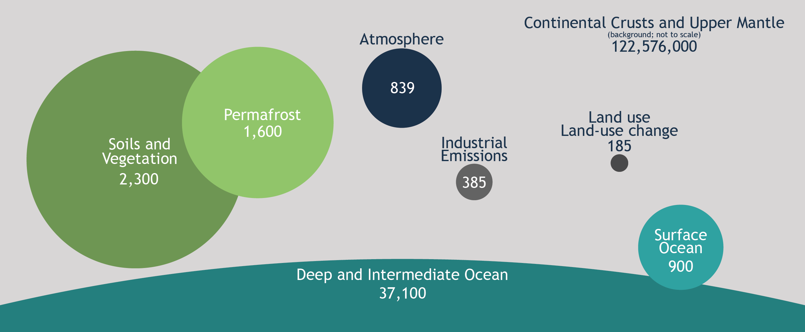
Wikipedia diagram of how much carbon is around

Slide 48
How much carbon in carbon cycle?
Carbon location | Gt C
Atmosphere | 885
Land | 11.1
Gas reserves | 115
Oil Reserves | 230
Coal reserves | 560
Permafrost | 1400
Soils | 1700
Ocean | 37000
Marine biota | 3
Organic Carbon | 700
Surface Sediments | 1750
Coasts | 10-45
1 ppm = 2.124 Gt C
1 Gt C = 3.664 GtCO₂
1000 MtC = 1 Gt C
Ballantyne et al., 2012

Slide 49
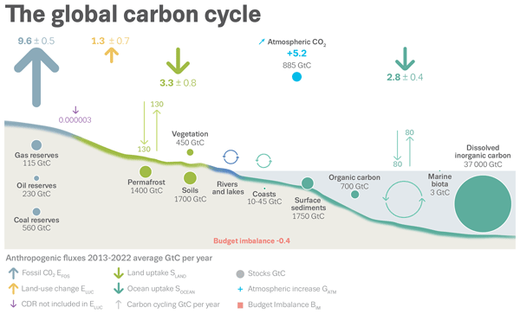

Slide 50
Global Rates of Change Emissions
CHANGE IN | 2022 Gt C yr ⁻¹ | 2023 Gt C yr ⁻¹ | 2023 Gt CO₂ yr⁻¹
Fossil CO₂ Increase | 9.9 | 10.0 | 36.8
Fossil CO₂ % Increase | 0.9% | +1.1 % | +1.1 %
Land Use Change | 1.3 | 1.1 | 4.0
Total Anthropogenic CO₂ | 11.1 | 11.1 | 40.9
Atmospheric ppm CO₂ | 417.1±0.1 ppm | 419.3 ppm or 51% more than 278ppm in 1740s
Atmospheric CO₂ resevoir | 5.2 | 5.1
Ocean CO₂ sink | 2.9 | 2.9
Land CO₂ sink | 3.3 | 2.9
% Total Atmospheric reservoir | Less than 47 % of total emissions | Less than 47 % of total emissions
% Total to Land sink | Absorbs 31 % of total emissions | Absorbs 31 % of total emissions
% Total to Ocean sink | Absorbs 26 % of total emissions | Absorbs 26 % of total emissions

Slide 51
US Rates of Change Emissions
US | 2023 Gt C yr ⁻¹
Fossil CO₂ Increase | 1.3 Gt C yr ^{– 1} (4.9 Gt CO₂ yr⁻¹)
Fossil CO₂ Increase | -3.0 %
Coal | -18.3%
Natural Gas | +1.4%
Cement | -4.0%
International Aviation | 2.8 % of global emissions +11.9 %

Slide 52
References
Global Carbon Budget 2023, ESSD, Volume 15, issue 12, 5301–5369, 2023 https://essd.copernicus.org/articles/15/5301/2023/

