Slide 1
What Can I Do?
Climate Change – A Hot Topic Session 6
It is Not too Late – We Must All Act.
Roy Campbell and Don Fournier February 19, 2024

Slide 3
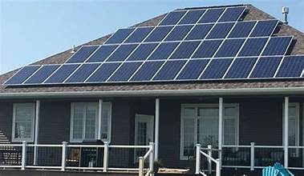
Take Action on Climate Change
Energy
Transportation
Waste
Water
Source for Ideas: epa.gov

Slide 4
Take Action on Energy
Look for the ENERGY STAR certification label on energy-efficient products, including appliances, lighting, heating and cooling equipment, electronics, and office equipment.
Consider an ENERGY STAR certified house or apartment. They are designed and built to standards well above most other homes on the market today.
Heat and cool your home smartly by properly sealing and insulating your home; upgrade windows, doors, and heating and cooling systems, including certified smart thermostats; and maintaining your heating and cooling equipment.
Consider other improvements such as cool roofs and sustainable landscaping (shade trees and native plants).

Slide 5
Take Action on Energy
Convert from Natural Gas to Electricity.
Take advantage of no-to-low cost energy-saving tips whether you own or rent, such as adjusting thermostats and turning off lights when space is unoccupied, unplugging electronics when not in use, using LED lightbulbs, adjusting window shades to reduce heating and cooling requirements, and installing programmable thermostats.
Switch to green power generated from renewable energy sources like solar, wind, and hydropower. You can also consider rooftop solar or Community Solar.

Slide 6
Buy into Green Power
For instance, if you're paying your own utilities, you often can buy clean electricity.
In many states, including California, Texas and most of the Northeast, you can get your power from companies that purchase wind or solar electricity and add it to the grid for you to use.
In many places like Illinois you can also buy a share in a solar project nearby called "community solar.” Nexamp, Clearview Solar, CleanChoice (soon)
Locally see: https://www.ameren.com/illinois/residential/supply-choice/renewables/community-solar

Slide 7
Take Action on Transportation
Use greener transportation: Biking, walking, carpooling, and public transportation can significantly reduce greenhouse gas emissions.
Make fewer trips by grouping errands and teleworking, if available, can reduce both fuel use and greenhouse gas emissions.
Choose an energy-efficient vehicle by looking for models with higher miles per gallon and consider hybrids.
Switch to an electric vehicle. Plug-in electric vehicles produce less greenhouse gas emissions than an gasoline-powered vehicles and are much cheaper to operate and maintain.

Slide 8
Take Action on Transportation
Electric Vehicles Use Much Less Energy Than Gas-Powered Vehicles:
Burning fuel is an inefficient way to harness energy, and that definitely applies to vehicles with internal combustion engines, as.
About 80 percent of the original energy in gasoline gets released as waste heat. This is in contrast to an electric vehicle, which wastes only 11 percent of its energy.
Source: Karin Kirk reports for Yale Climate Connections

Slide 11
Range Anxiety?
Tesla will have 7,500 non-Tesla chargers by the end of 2024.
BMW, Ford, Genesis, General Motors, Honda, Hyundai, Jaguar, Kia, Lucid, Mini, Mercedes-Benz, Nissan, -Polestar, Rivian, Toyota, and Volvo have said that their vehicles will be able to use certain Tesla Superchargers starting as soon as mid-2024 using the either NACS standard or adaptors.
Mazda, Stellantis, and Volkswagen Group of America since announced that its brands—Audi, Porsche, Scout Motors, and Volkswagen—will implement the NACS standard on vehicles starting in the 2025 model year.
Seven major automakers recently announced that they plan to open 30,000 of their own charging stations across the U.S. in the near future.

Slide 12
Take Action on Waste
Think green before you shop and reduce associated greenhouse gas emissions by thinking about the environmental impact of products. For example, consider a product’s durability, sustainability, and ease of recycling when making a purchase.
Reuse or repurpose items such as old clothing, cloth grocery bags, and containers to prevent waste.
Borrow, rent or share items that are used infrequently, like party decorations, tools, or furniture.

Slide 13
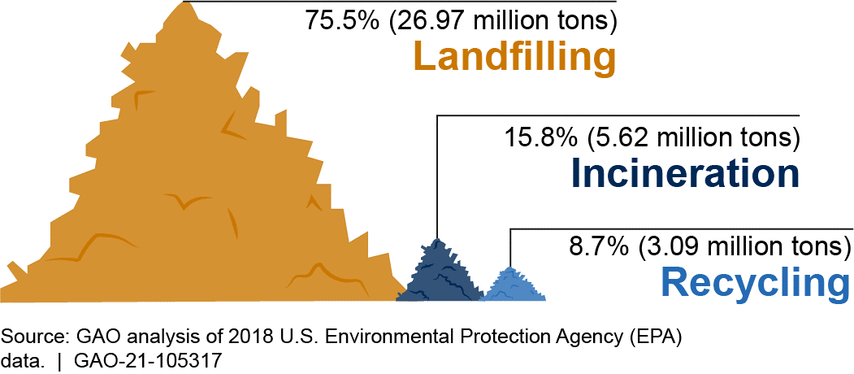
Plastics and CO2
Current U.S. number is 42 Million Metric Tons

Slide 14
How to Enhance Recycling
Plastic recycling technologies reprocess or remanufacture plastic waste for reuse:
The dominant technology for plastic recycling is mechanical recycling, which uses physical processes—such as sorting, grinding, washing, separating, drying, and re-granulating—to recover plastics that can be substituted for virgin, or new, plastics.
Mechanical recycling technology is expensive, labor intensive, and generally results in lower quality plastics than virgin plastics.
Chemical recycling technologies use heat, chemical reactions, or both, to recycle used plastic into virgin-equivalent plastic, fuel, or other chemicals.
Chemical recycling can promote a closed-loop system, known as a circular economy, wherein plastics are reused rather than discarded in landfills or incinerated.

Slide 15
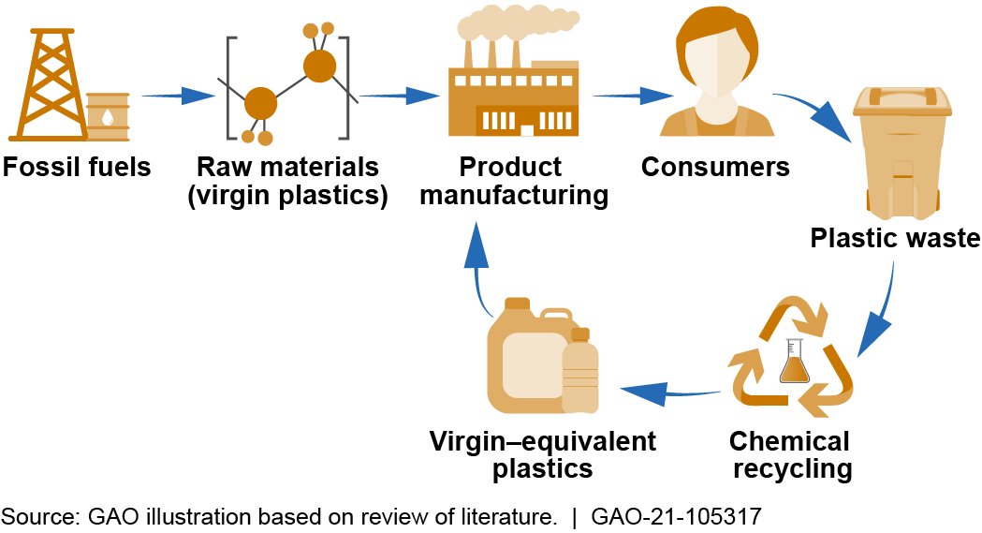

Slide 16
Plastic Production
Plastic production accounts for 3% of total U.S. energy consumption.
Depending on the type of plastic, the energy required to produce it can vary from 1.5 kWh to 5.2 kWh per kilogram.
Most plastic production processes also require additional energy for transportation, cooling, and other support systems.
Recycling plastic waste has a significant energy savings, with an energy saving of 66 percent as opposed to new material production.

Slide 17
Reducing plastic waste is crucial for the environment
1. Reduce Single-Use Plastics:
Say No to Straws: Skip plastic straws or use reusable alternatives like stainless steel or bamboo.
Bring Your Own Bags: Use cloth or reusable bags instead of plastic bags when shopping.
Ditch Disposable Cutlery: Opt for reusable utensils instead of plastic forks, spoons, and knives.
2. Choose Alternatives:
Glass or Stainless Steel Containers: Store food in glass or stainless steel containers instead of plastic.
Beeswax Wraps: Use these reusable wraps to cover food instead of plastic wrap.
Silicone Food Storage Bags: Replace disposable plastic bags with silicone ones.
Recycle Properly:
Understand your local recycling guidelines and sort plastics accordingly.
Rinse containers before recycling to prevent contamination.
Support Legislation and Policies:
Advocate for stricter regulations on plastic production and waste management.
Encourage businesses to adopt sustainable practices.
Educate Others:
Spread awareness about the impact of plastic pollution.
Teach friends and family how to reduce plastic

Slide 18
Shop local and buy sustainable
Buy local and seasonal foods.
Reduces fossil fuel emissions associated with transport and cold chain storage.
Sustainable agriculture uses up to 56 per cent less energy, creates 64 per cent fewer emissions and allows for greater levels of biodiversity than conventional farming.
Reduce your food waste by shopping smart, buying only what you need, composting food scraps, and donating unused food to food banks or shelters. Food is the single largest category of material placed in municipal landfills, where it emits methane.

Slide 19
Don’t Waste Food
One-third of all food produced is either lost or wasted. According to UNEP’s Food Waste Index Report 2021, people globally waste 1 billion tonnes of food each year, which accounts for around 8-10 per cent of global greenhouse gas emissions.
Avoid waste by only buying what you need.
Take advantage of every edible part of the foods you purchase.
Measure portion sizes of rice and other staples before cooking them,
Store food correctly (use your freezer if you have one),
Be creative with leftovers, share extras with your friends and neighbors and contribute to a local food-sharing scheme.
Make compost out of inedible remnants and use it to fertilize your garden.

Slide 20
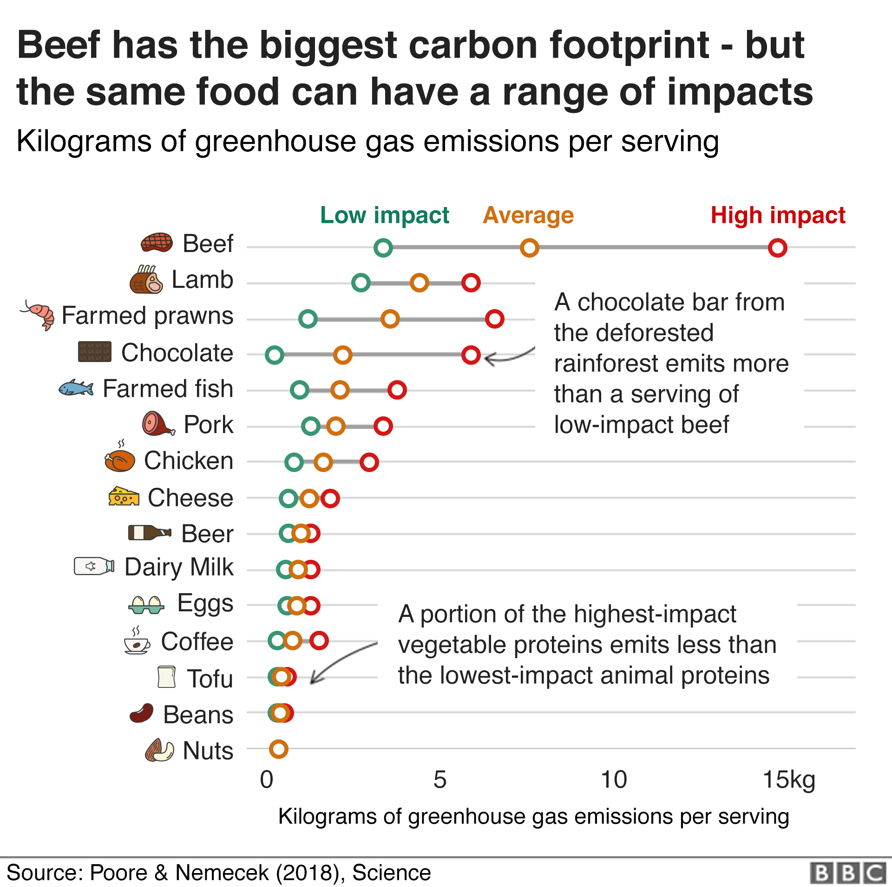

Slide 21
Take Action on Waste
Buy used items to reduce waste as well as the emissions created by producing new materials or disposing of them in landfills. Donate unused clothing, electronics and building materials to make sure others can reuse them too!
Buy products made with recycled content. Check labels to see if a product or its packaging is made from recycled materials.
Know before you throw. Know what items your local recycling program collects and encourage your household to recycle right and recycle more.

Slide 22
Dress (Climate) Smart
The fashion industry accounts for 8-10 per cent of global carbon emissions – more than all international flights and maritime shipping combined – and ‘fast fashion’ has created a throwaway culture that sees clothes quickly end up in landfills.
Buy fewer new clothes and wear them longer.
Seek out sustainable labels and use rental services for special occasions rather than buying new items that will only be worn once.
Recycle pre-loved clothes and repair when necessary.
Donate used clothes to charity.

Slide 23
Take Action on Water Usage
When replacing appliances look for the WaterSense label and the ENERGY STAR label on toilets, dishwashers, and clothes washers to save water, energy, and money.
Install low-flow faucets and showerheads.
Have a water-smart landscape by designing a landscape suitable to your climate, choosing using native and drought-resistant plants, and learning when and how much to water.
Plant native trees.
Check for leaks and use water appliances smartly.

Slide 24
Focus on planet-friendly investments
Choosing financial institutions that do not invest in carbon-polluting industries.
For example:
#ActNow Speak Up has a section on money and so does Count Us In.

Slide 25
Source: Rainforest Action Network

Slide 26
Towards a Climate Solution (UN) https://www.unep.org/news-and-stories/story/10-ways-you-can-help-fight-climate-crisis
Encourage your friends, family and co-workers to reduce their carbon pollution. Join a global organization like https://www.count-us-in.org/en-gb/ or
#ActNow campaign (UN sponsored)
Keep up the political pressure
Lobby local politicians and businesses to support efforts to cut emissions and reduce carbon pollution.
#ActNow Speak Up has sections on political pressure and corporate action - and
Count Us In also has some handy tips for how to do this.

Slide 27
Final Thoughts
We can make a difference.
The technology is here to end reliance on fossil fuels.
Renewables have lower costs than developing using 19th century technology.
The energy transition is well underway, we just need to keep it going and impede the dark side of the force.
We will experience a 2-3°C rise in global average temperature.
This an environmental crisis calling for adaptation.

