Slide 1
Mitigation and Adaptation to Climate Change
Climate Change – A Hot Topic Session 4
Be willing to change because the climate
won’t stay the same.
Roy Campbell and Don Fournier February 5, 2024

Slide 2
Overview Week 4
Mitigation
The Transportation Sector
  Automobiles
  Trucks
  Aviation
  Rail System
  Ships
The Built Environment
                Industry
                Commercial & Residential
      Agriculture
      Land Use and Forestry
Adaptation
  Definition
  Disaster risks, response and preparedness
Vulnerabilities, Exposure, Capacity
Case Studies of Extremes
2

Slide 3
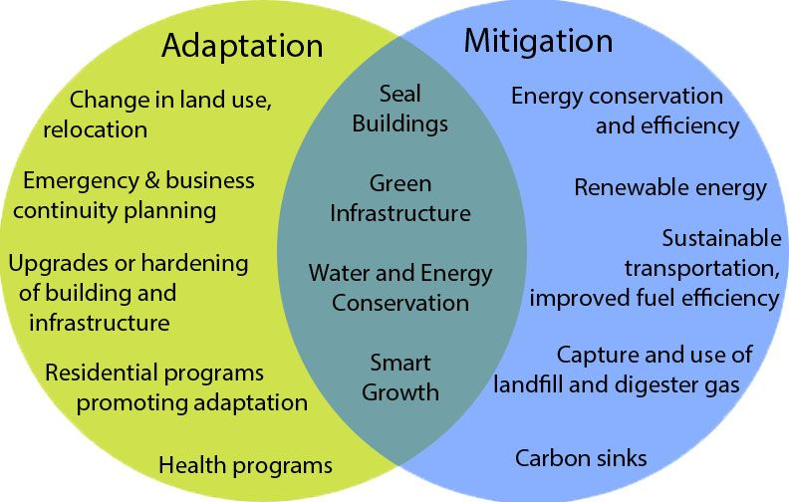

Slide 4
The Transportation Sector creates 29% total US greenhouse emissions 2021
Road Transportation | Truck Transportation | Marine and Rail Transport | Aviation
45.1% | 29.4% | 12.4% | 11.6%
Buses | Freight | Ships
Cars |  | Boats
 |  | Rail

Slide 5
World Wide Freight Moved 2023
Type of freight transport | Amount of freight moved (billions of tonne-kilometers) | CO₂ emissions (millions of tonnes)
Air | 303 | 155
Rail | 10,842 | 170
Road (mainly trucking and urban deliveries) | 26,807 | 2,230
Sea and inland waterways | 101,486 | 657

Slide 6
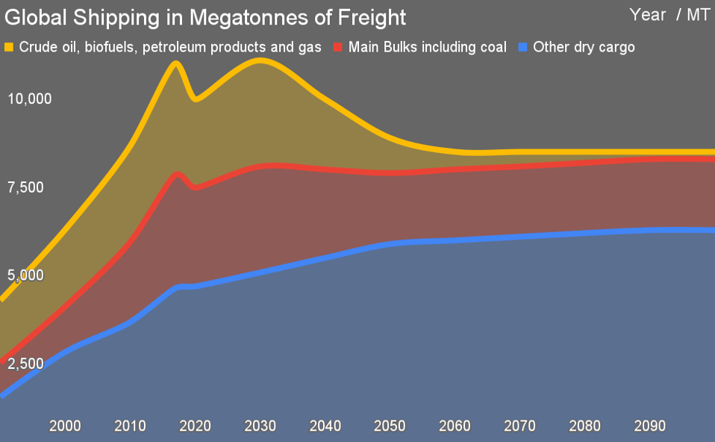
Source: Michael Barnard, Chief Strategist, TFIE Strategy Inc

Slide 7
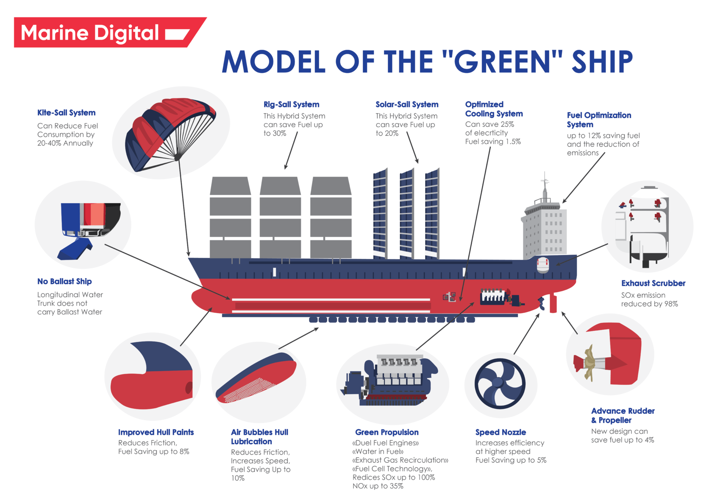

Slide 8
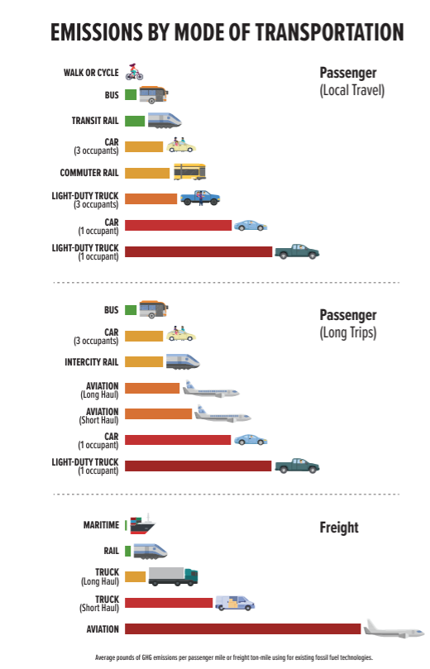
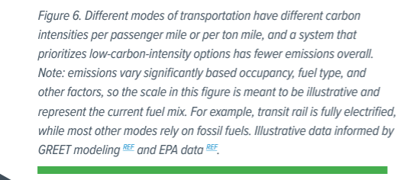

Slide 9
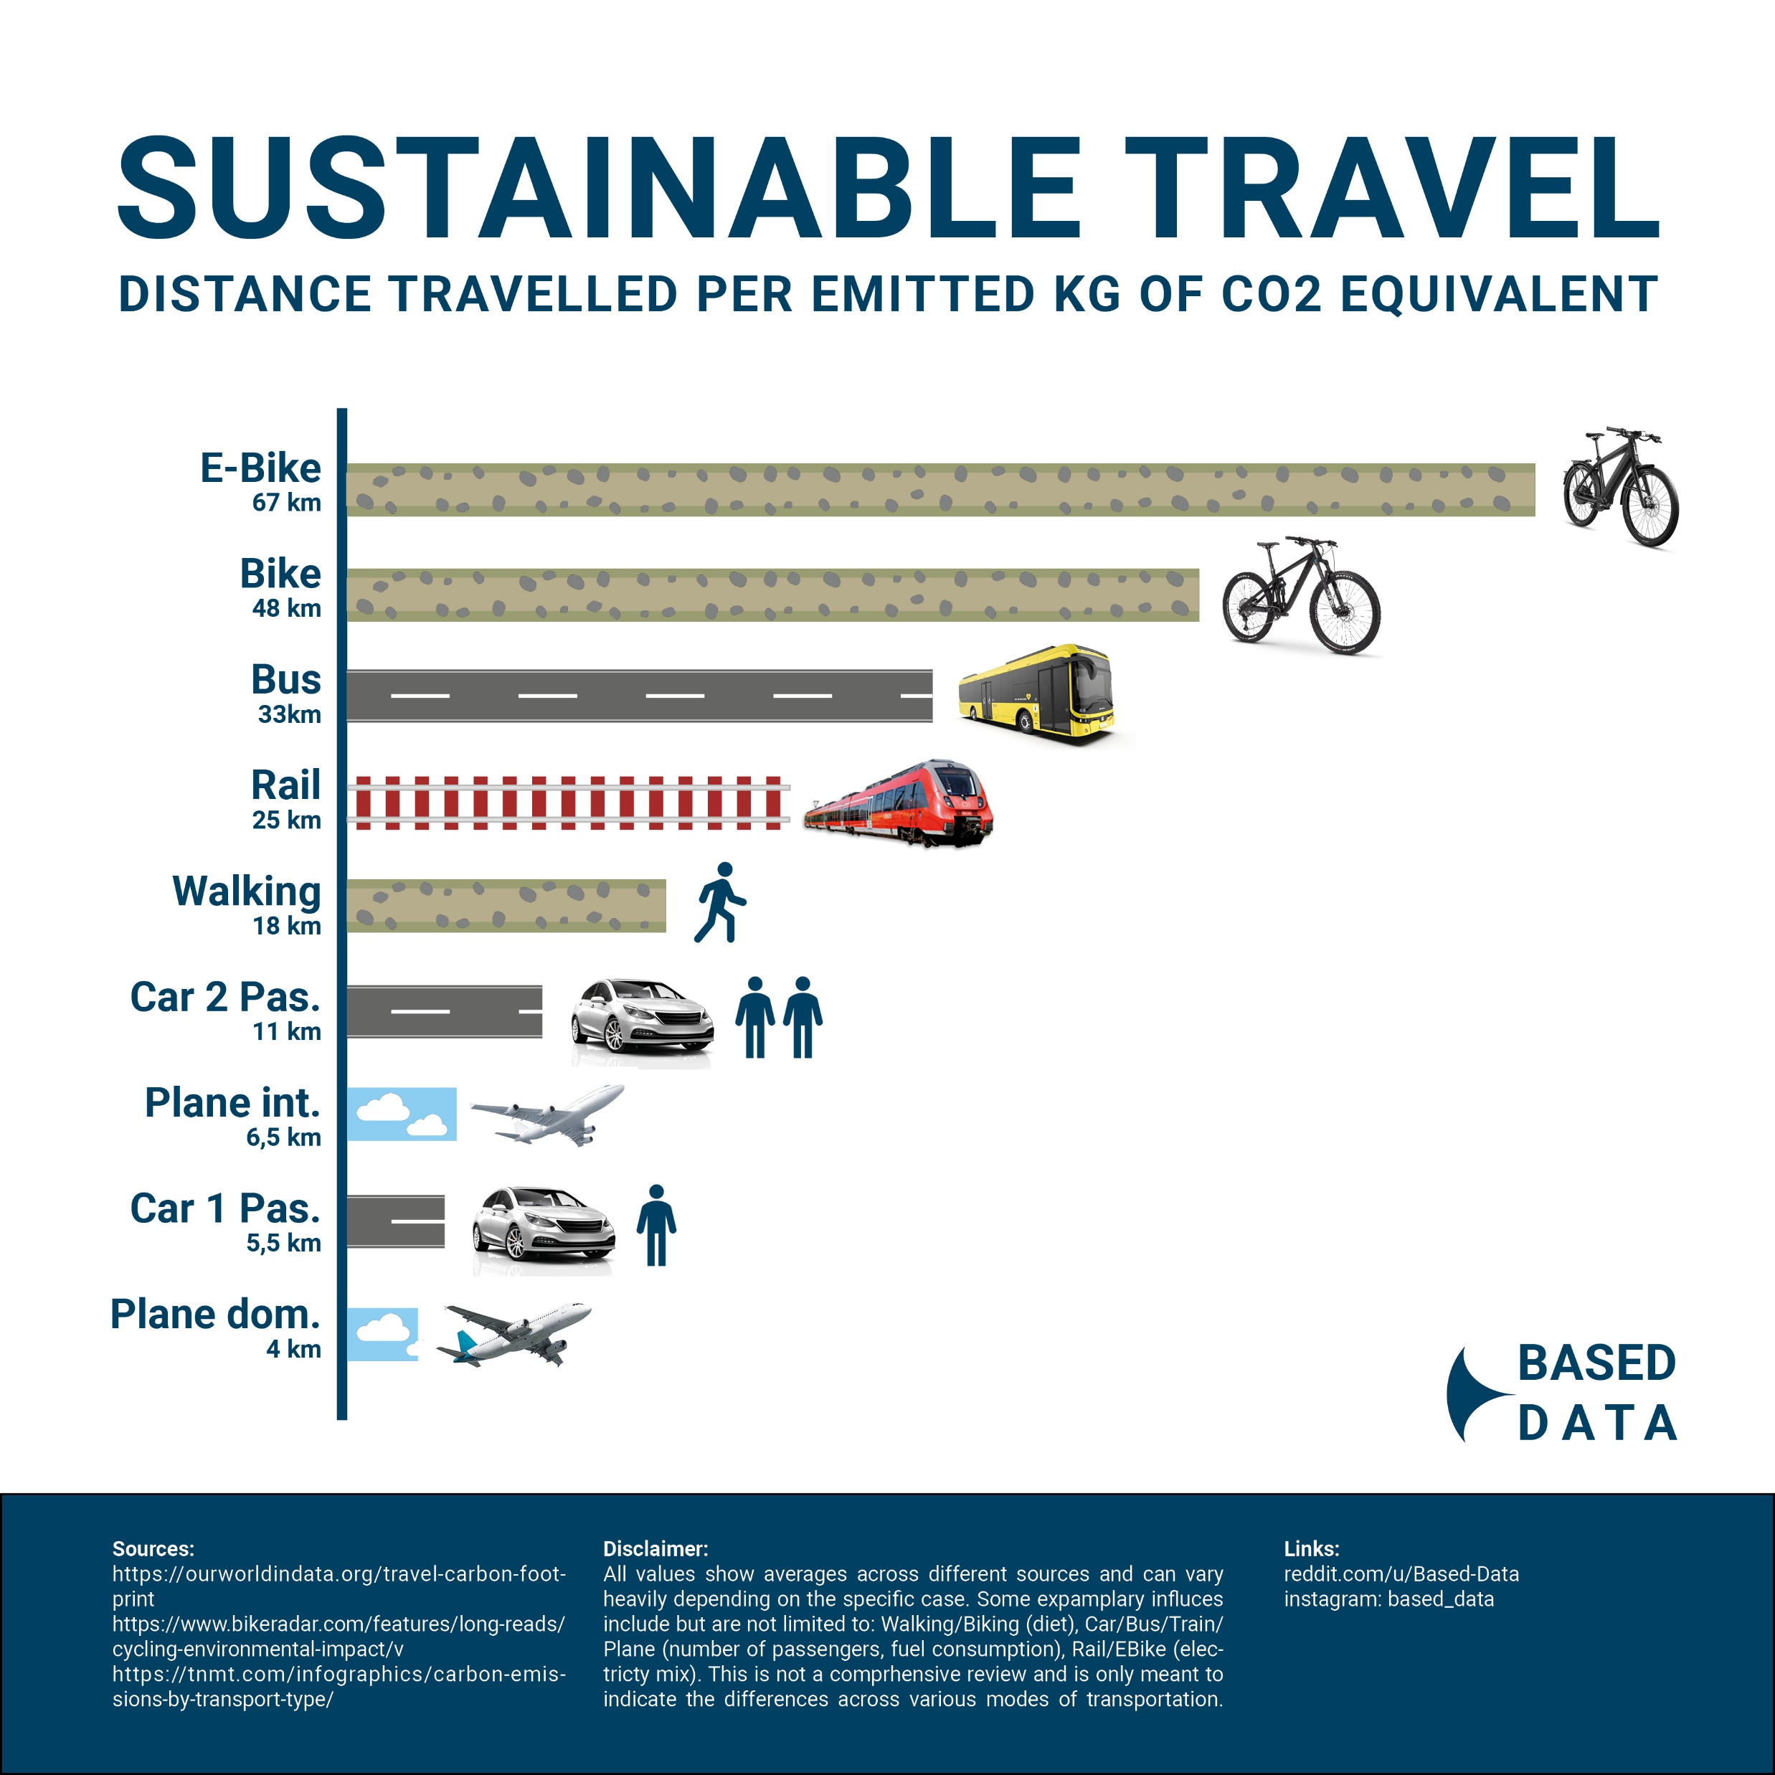
https:ourworldindata.org
https://www.bikeradar.com/features/long-reads/cycling-environmental-impact
Cycling has a carbon footprint of about 21g of CO2 per kilometer.
About three-quarters of cycling’s greenhouse gas emissions occur when producing the extra food required to “fuel” cycling, while the rest comes from manufacturing the bicycle.
Electric bikes have an even lower carbon footprint than conventional bikes because fewer calories are burned per kilometer, despite the emissions from battery manufacturing and electricity use.

Slide 10
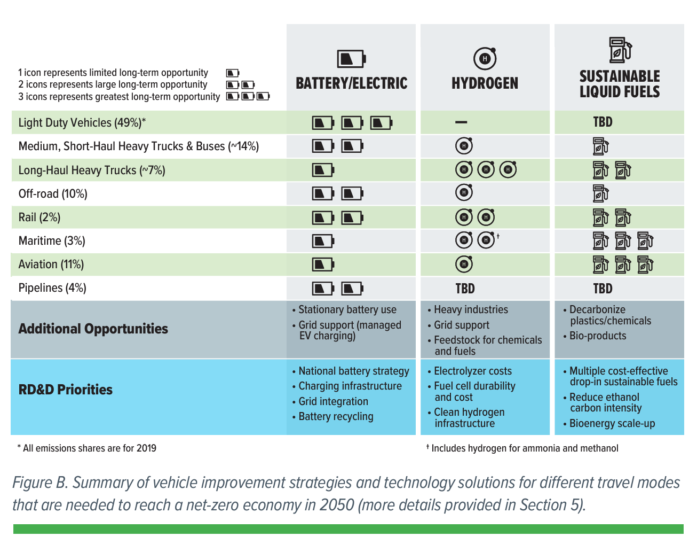
THE U.S. NATIONAL BLUEPRINT FOR TRANSPORTATION DECARBONIZATION (energy.gov) circa 2021
Net 0 or 80-100% reduction in transportation emissions by 2050,
Bipartisan Infrastructure Law (BIL) and Inflation Reduction Act (IRA).

Slide 11
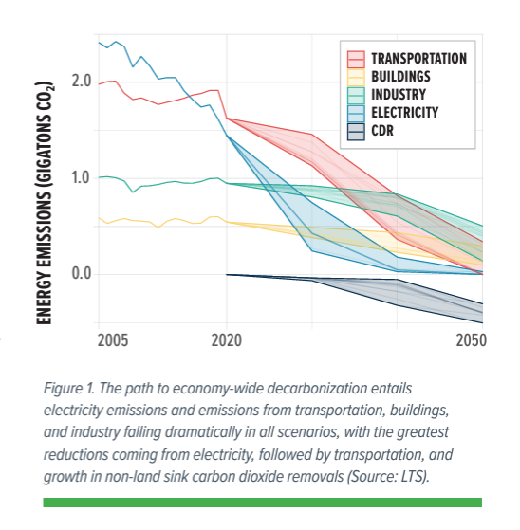

Slide 12
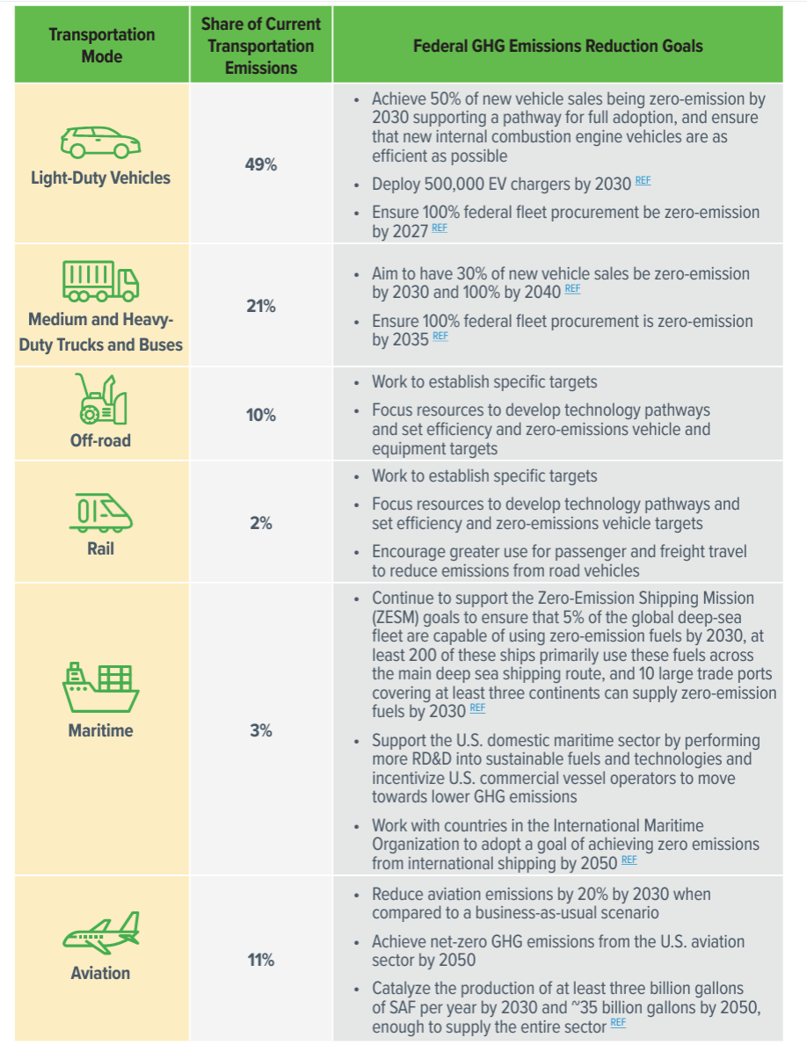

Slide 14
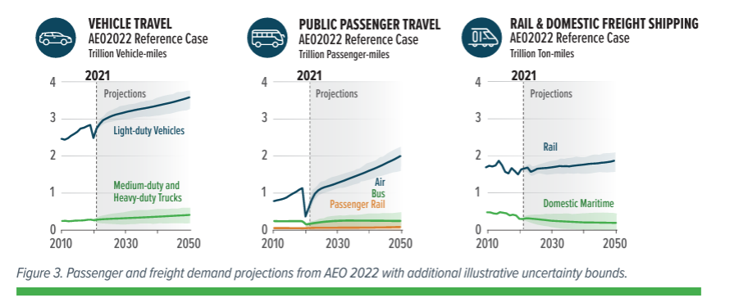

Slide 15
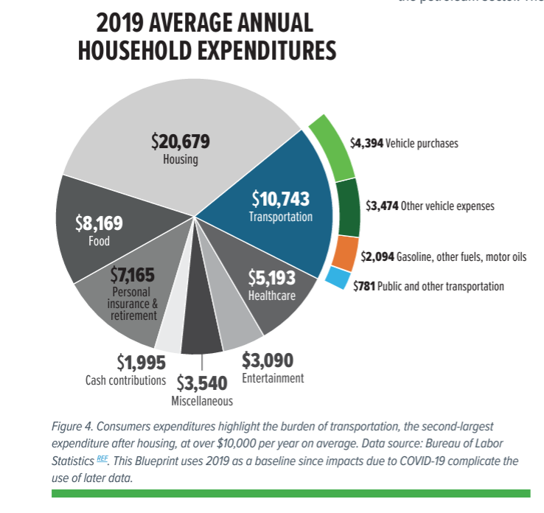

Slide 16
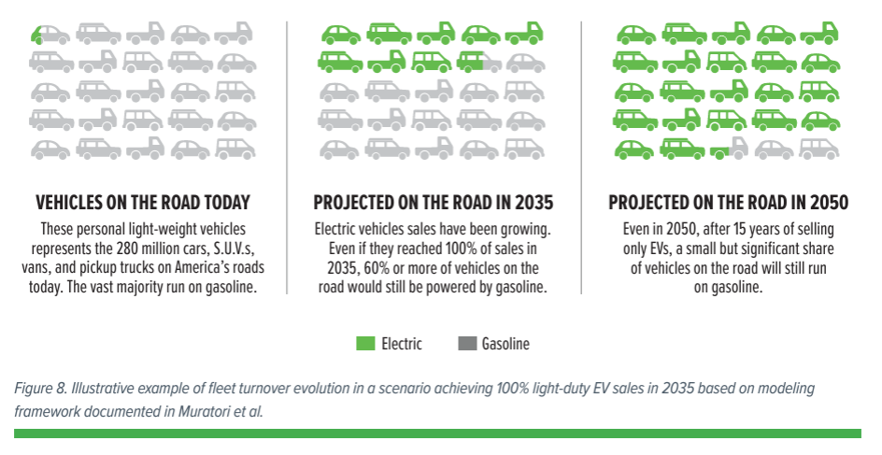
2021 Data

Slide 17
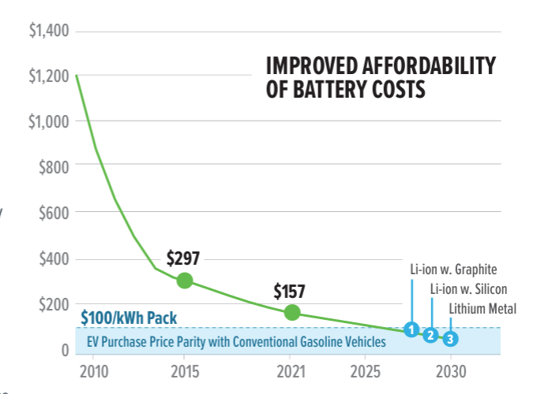

Slide 18
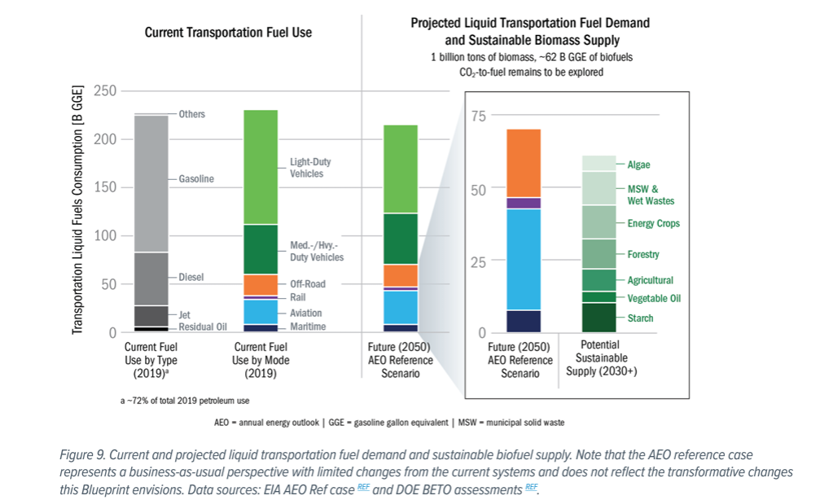

Slide 19
Remediation – The Built Environment
Industrial Sector - 35% of Emissions
Energy efficiency is a foundational, crosscutting decarbonization strategy and is the most cost-effective option for greenhouse gas emission reductions in the near term.
Leveraging advancements in low-carbon electricity from both grid and onsite renewable generation sources will be critical to decarbonization efforts.
Substituting low-and no-carbon fuel and feedstocks reduces combustion associated emissions for industrial processes.
Carbon capture, utilization, and storage refers to the multicomponent strategy of capturing generated CO₂ from a point source and utilizing the captured CO₂ to make value added products or storing it long-term to avoid release.

Slide 20
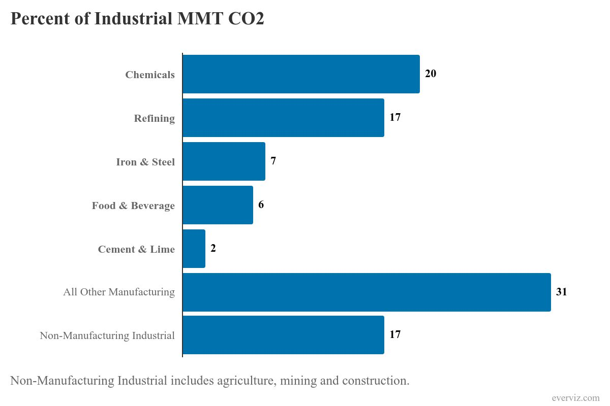

Slide 21
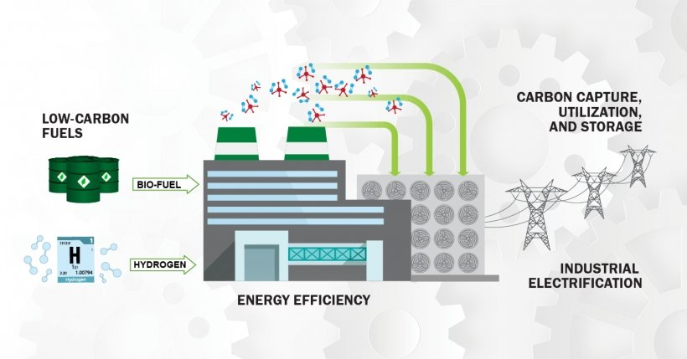
Remediation – The Built Environment
Industry

Slide 22
Remediation – The Built Environment
Commercial & Residential Buildings – 34% Emissions
Building decarbonization encompasses a building’s life cycle, including building design, construction, operation, occupancy, and end of life.
Building construction, energy use, methane, and refrigerants are the primary sources of GHG emissions.
Building life-cycle assessment involves consideration of operational and embodied emissions.
Some state and local government have adopted policies that address building specific operational fuel types and related emissions in the United States.

Slide 23
Remediation – The Built Environment
Commercial & Residential Buildings -- 37% of Emissions
The primary means for reducing GHG emissions are the following:
  Efficiency measures and building electrification
  Decarbonized electrical grid -- Ameren 67% fossil-fired.
  Operations and maintenance.
  Refrigerants: Low-GWP, minimizing volume, and improving management.
  Renewable energy sources (on and off site) and energy storage.
  Building-grid integration and real-time carbon signals.
  Embodied carbon.

Slide 24
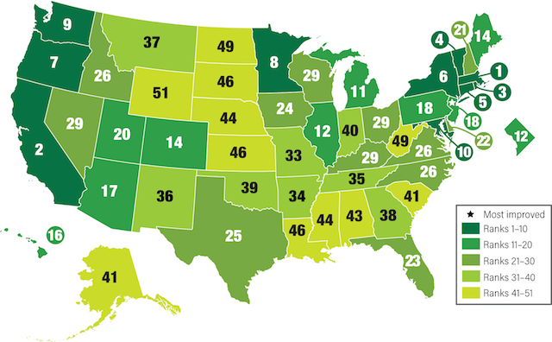
Remediation – The Built Environment
Commercial & Residential Buildings
Building Codes have had a great impact on building energy performance over the past 45 years.
States that accepted energy money during the Great Recession had to agree to keep their building codes current.

Slide 25
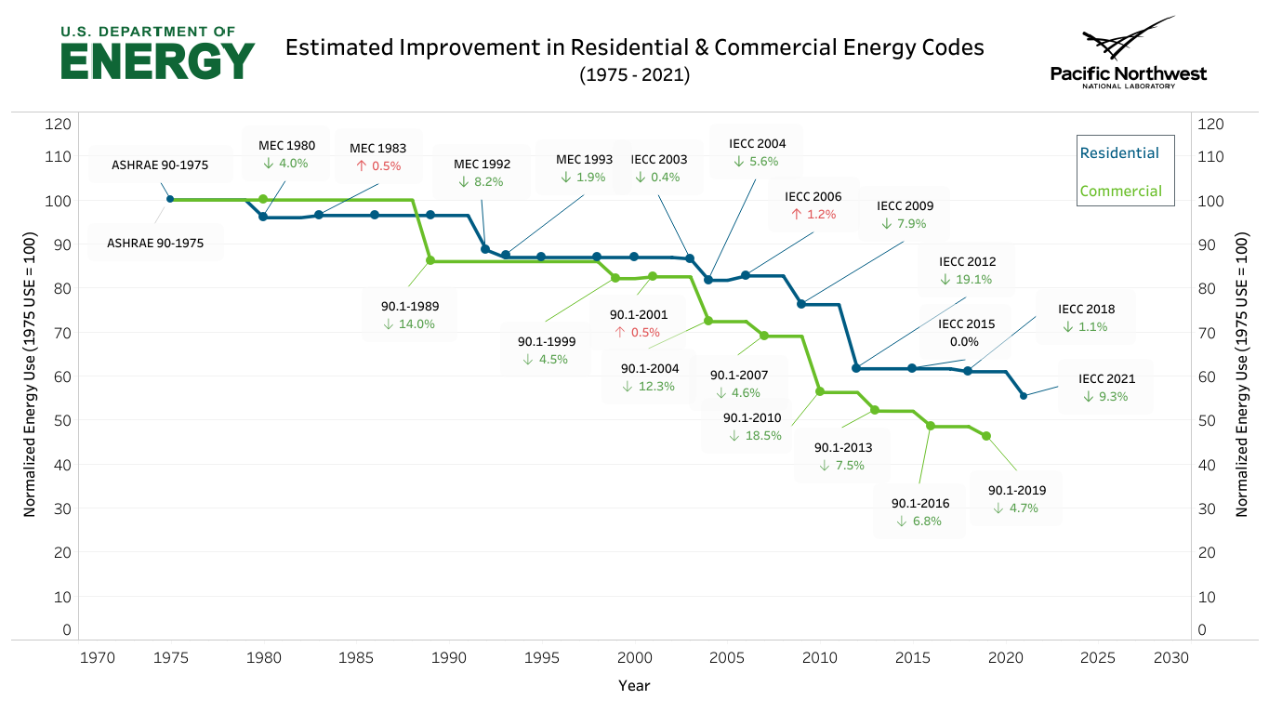

Slide 26
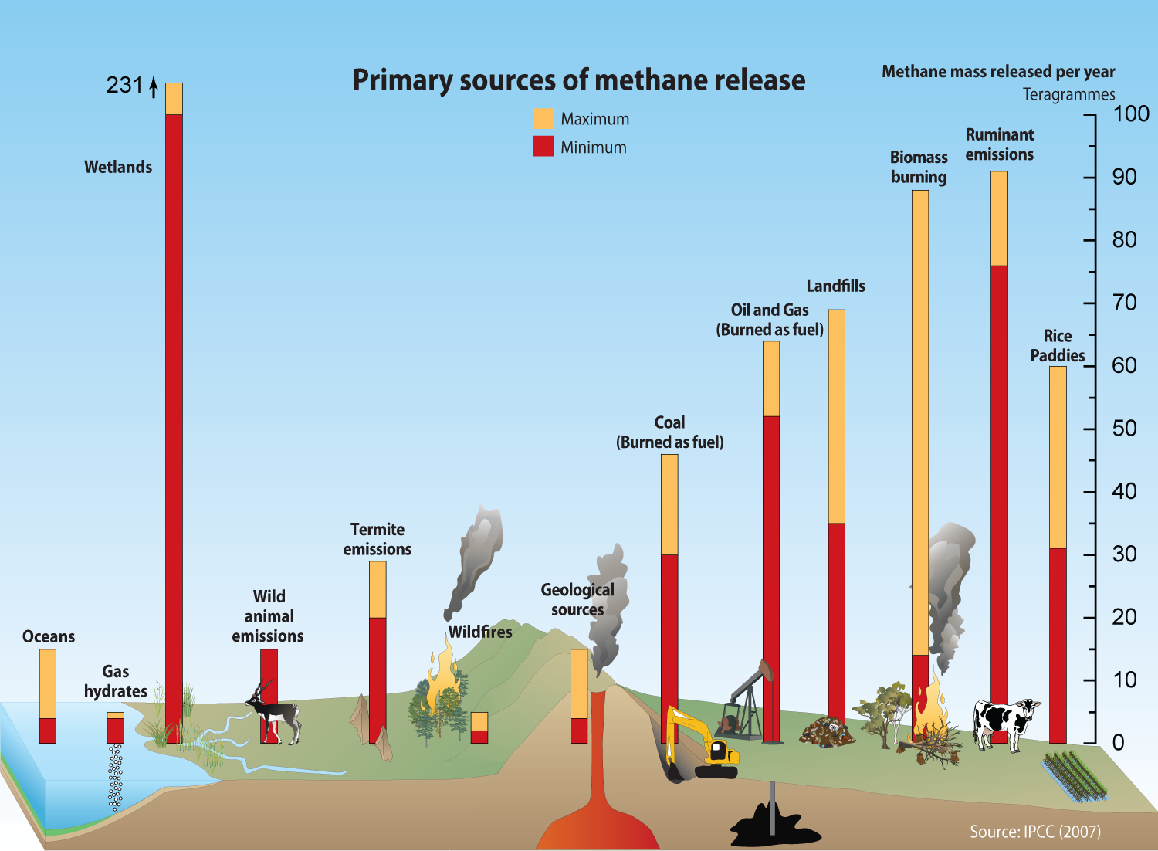

Slide 27
Remediation – Agriculture, Land Use, & Forestry
Reducing Agricultural Emissions – 11% of Emissions
Agriculture is a complicated: climate goals versus biodiversity, nutritional needs, food security, and profits.
By 2030, U.S. farms and ranches can cut agricultural emissions by 23
Cut nitrous oxide emissions by optimizing fertilizer use.
Reduce on-farm emissions by shifting from traditional fossil-fuel equipment and machinery—such as tractors, harvesters, and dryers—to their zero-emission counterparts.

Slide 28
Remediation – Agriculture, Land Use, & Forestry
Reducing Agricultural Emissions – 11% of Emissions
Genetic selection and breeding programs focused on ruminant animals’ enteric fermentation. About 20 percent of a ruminant’s methane emissions rate stems from genetics alone.
Use anaerobic digesters for dairy cow and hog manure. Biogas can be used to generate electricity for the farm or sold back to the grid (electricity).
Combine deep placement of nitrogen with low- and no-tillage practices — such as shallow plowing, fewer tillage passes, chisel coulter drilling, and zone tillage — to reduce fuel usage and denitrification.
Use cover crops to absorb carbon and improve production.

Slide 29
Remediation – Agriculture, Land Use, & Forestry
Land Use & Forestry – 6% of Emissions
Plants, forests, and soil absorb carbon dioxide, making management of forests and land paramount to achieving climate goals. Deforestation is rapidly reducing the planet’s potential to absorb carbon dioxide and mitigate its warming effects.
Keeping all existing forests, wetlands and grasslands intact rather than clearing them for new cropland or urban development.
Increase carbon storage in forests by natural reforesting and afforesting land, improve management of existing forests, and adopt agroforestry practices that integrate trees and shrubs into crop- and pastureland.
U.S. forests can boost carbon storage by 43% by 2030.

Slide 31
Adapting to Climate Change
Adaptation -- Strategies
  Climate change adaptation is the process of adjusting to the effects of climate change.
  These can be both current or expected impacts.^{[1]}
  Adaptation aims to moderate or avoid harm for people.
  It also aims to exploit opportunities.
  Humans may also intervene to help adjustment for natural systems.
https://en.wikipedia.org/wiki/Climate_change_adaptation

Slide 32
Adapting to Climate Change
Adaptation -- Classification
Help manage impacts and risks to people and nature.
Adaptation actions can be classified in four ways:
Infrastructural and technological;
Institutional;
Behavioral and cultural; and
Nature-based options.

Slide 33
Adapting to Climate Change
Adaptation -- Definition
"In human systems, as the process of adjustment to actual or expected climate and its effects in order to moderate harm or take advantage of beneficial opportunities."^{[7]}
"In natural systems, adaptation is the process of adjustment to actual climate and its effects; human intervention may facilitate this."^{[7]}
IPCC, 2022: Summary for Policymakers pp. 3–33,

Slide 34
Adapting to Climate Change
Adaptation -- Disaster Risks, Response, and Preparedness
Climate change contributes to disaster risk. So experts sometimes see climate change adaptation as one of many processes within disaster risk reduction. In turn, disaster risk reduction is part of the broader consideration of sustainable development. Climate change adaptation and disaster risk reduction have similar goals (to reduce potential impacts of hazards and increase the resilience of people at risk). They use similar concepts and are informed by similar sources and studies.

Slide 35
Adapting to Climate Change
Adaptive Capacity
Adaptive capacity in the context of climate change covers human, natural, or managed systems. It looks at how they respond to both climate variability and extremes.
Economic resources: Wealthier nations are better able to bear the costs of adaptation to climate change than poorer ones.
Technology: Lack of technology can impede adaptation.
Information and skills: Information and trained personnel are necessary to assess and implement successful adaptation options.
Social infrastructure:
  Institutions: Nations with well-developed social institutions are likely to have greater adaptive capacity than those with less effective institutions. These are typically developing nations and economies in transition.
  Equity: Some believe that adaptive capacity is greater where there are government institutions and arrangements in place that allow equitable access to resources

Slide 36
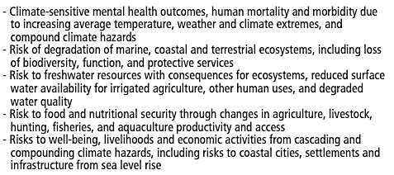
Example North America Risks from Climate Change Requiring Adaptation (IPCC)

Slide 37
Adapting to Climate Change
Air
Indoor Air Quality
Outdoor Air Quality
Temperature
Precipitation
Wind
Wildfires
Water
Drought
Saltwater Intrusion
Sea Level Rise
Flooding
General Utility Preparedness
Stormwater Runoff
Erosion and Sedimentation
Algal Blooms
Waste
Waste Facility Protection adaptation strategies
Waste Management
Public Health
Viruses
Air, Water and Insect born diseases
Heat stroke
Dehydration
Hypothermia

Slide 39
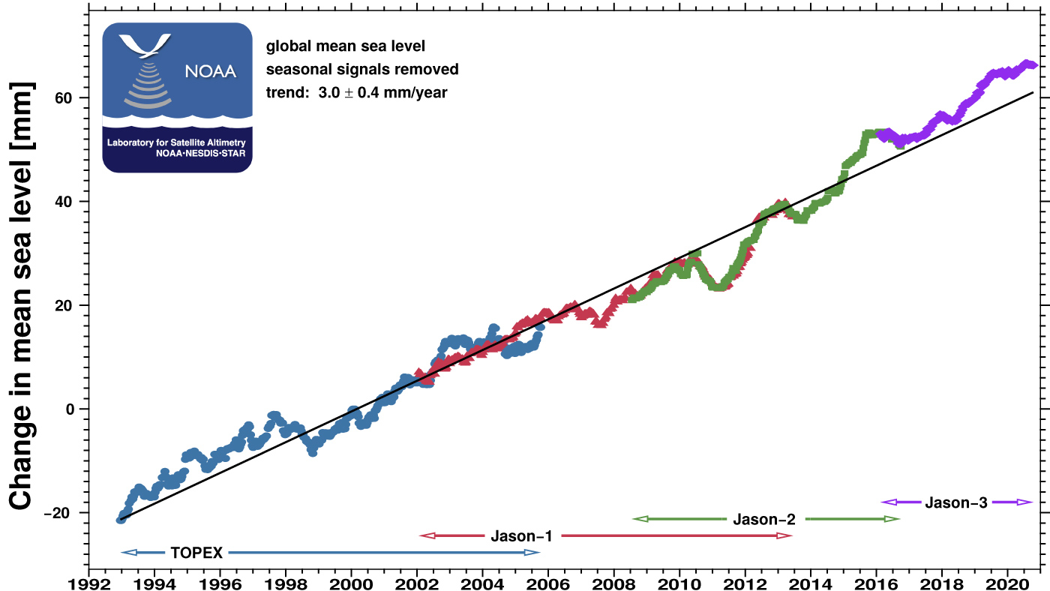

Slide 40
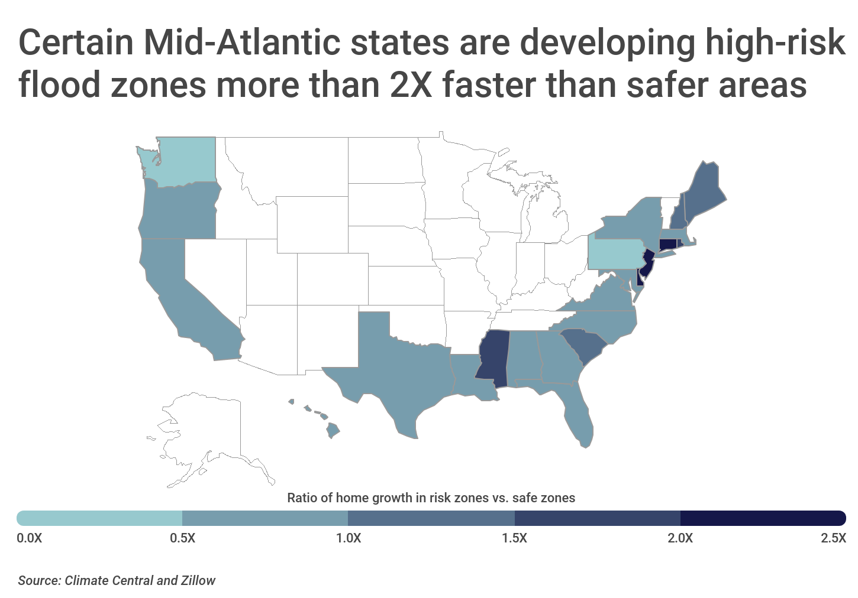

Slide 41
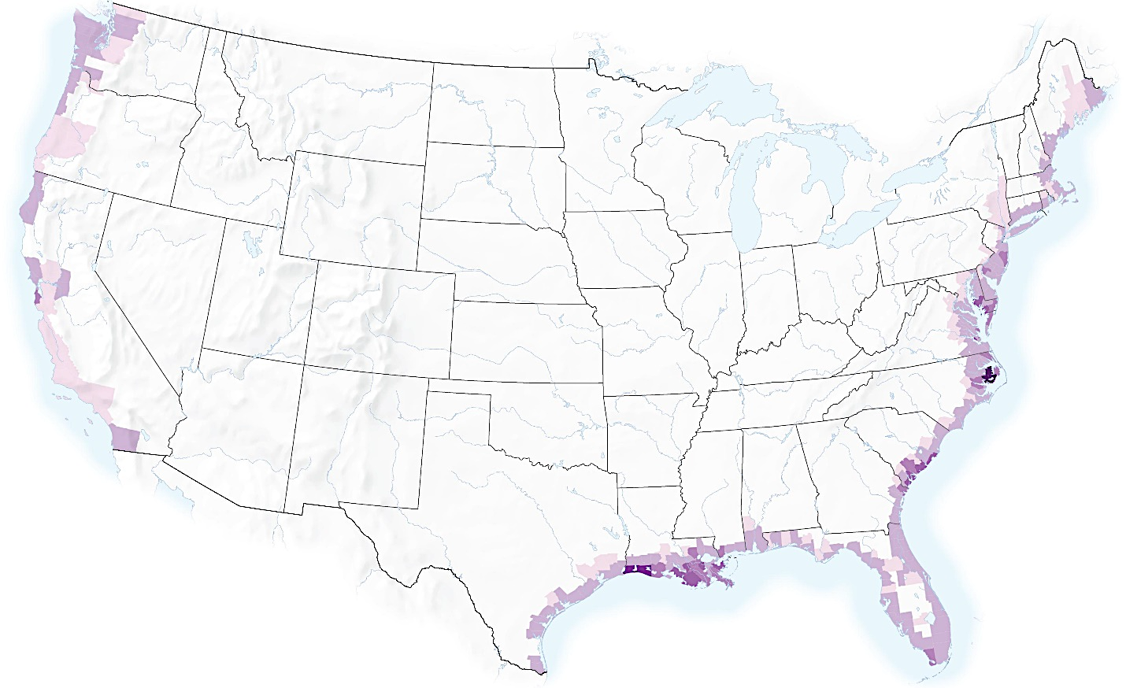
Sea Level Rise: 2040-2060 Percentage of property below high tide
0.05
2
5
10
15
25
Source: ProPublica, September 15, 2020

Slide 42
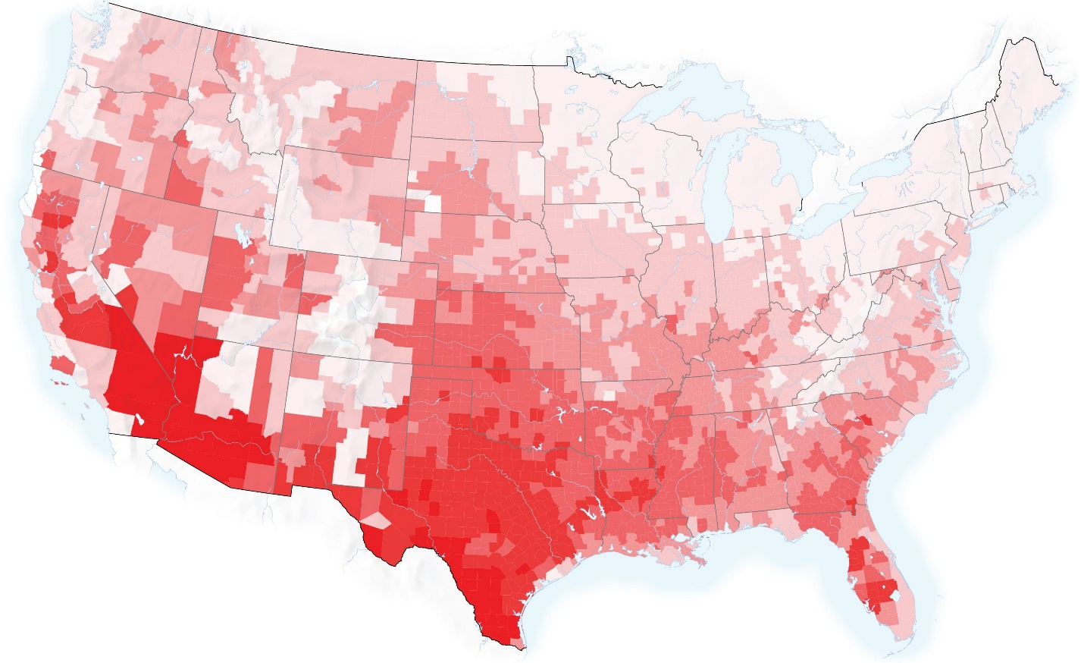
2040-2060 Weeks per year above 95 degrees F
0
2
5
8
11
17
26
Source: ProPublica, September 15, 2020

Slide 43
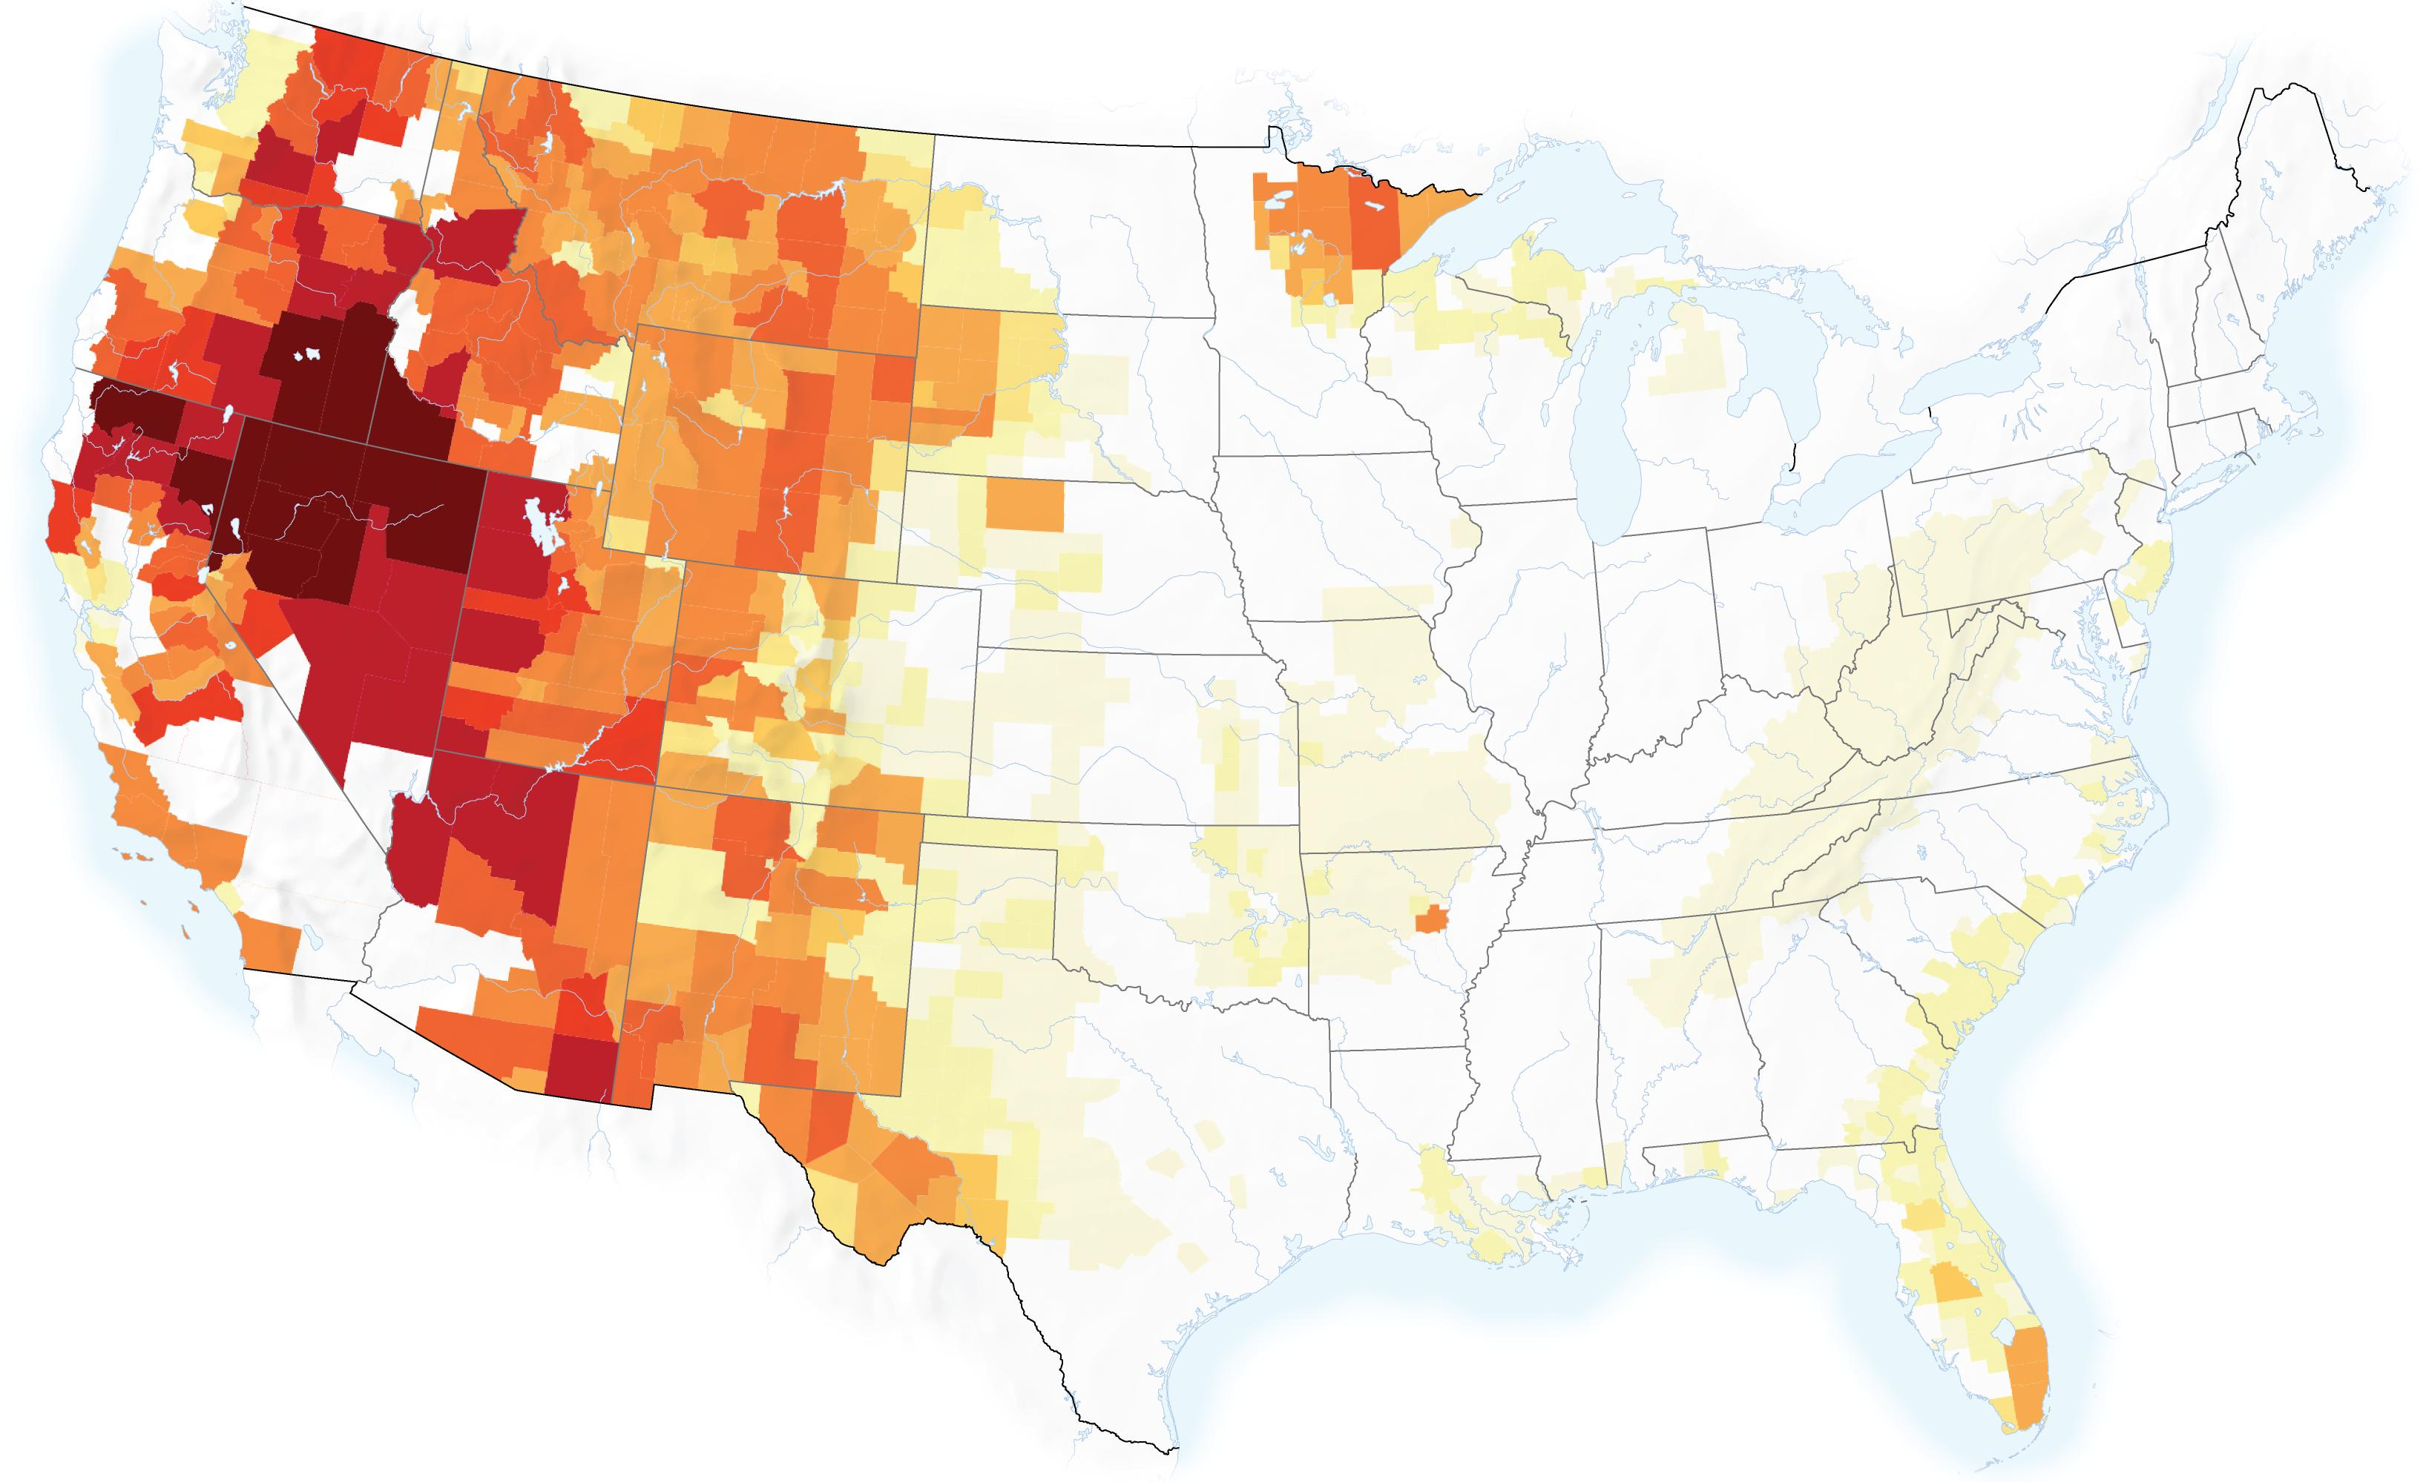
Large Wildfires: 2040-2071 Average number of very large fires per year
0.01
0.03
0.04
0.05
0.1
0.2
0.33
0.5
1
2.45
Source: ProPublica, September 15, 2020

Slide 44
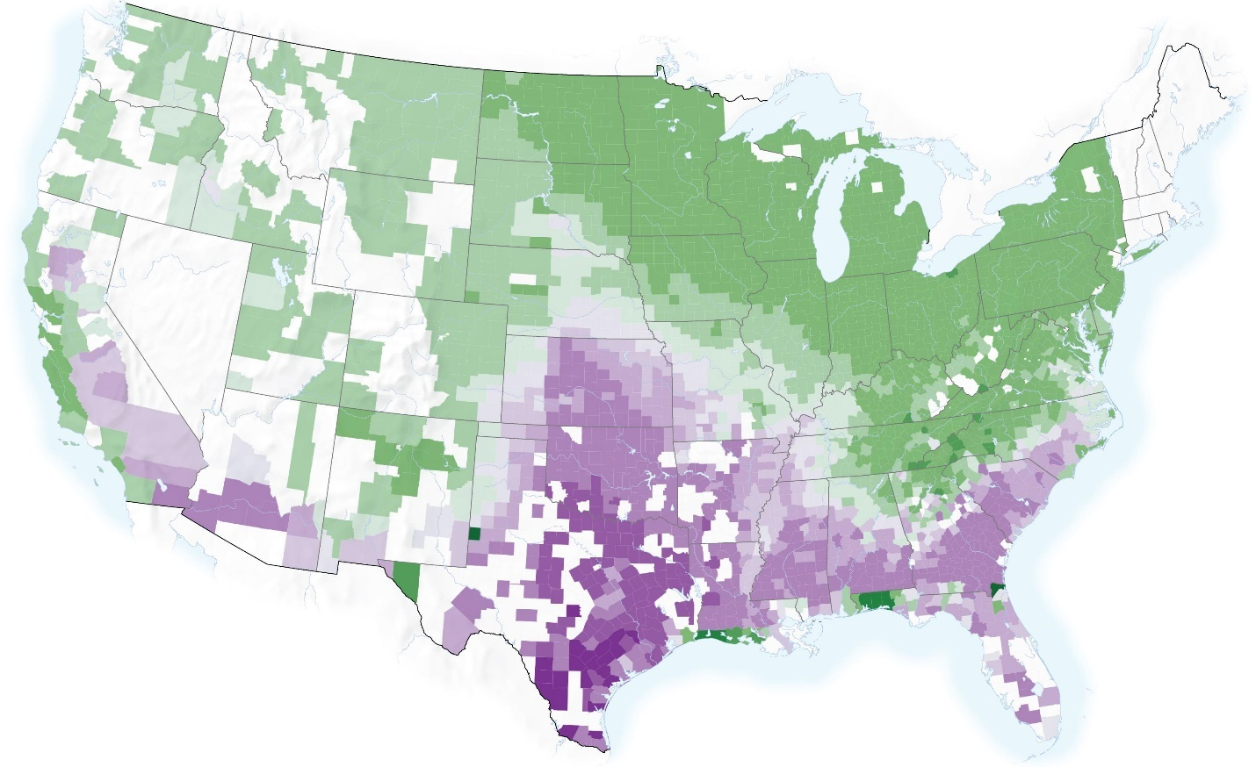
Farm Crop Yields: 2040-2060 Percent decline in yields
-20.5
-15.8
-6.5
-3
0
3
6.5
13
44
67
92
Source: ProPublica, September 15, 2020

Slide 45
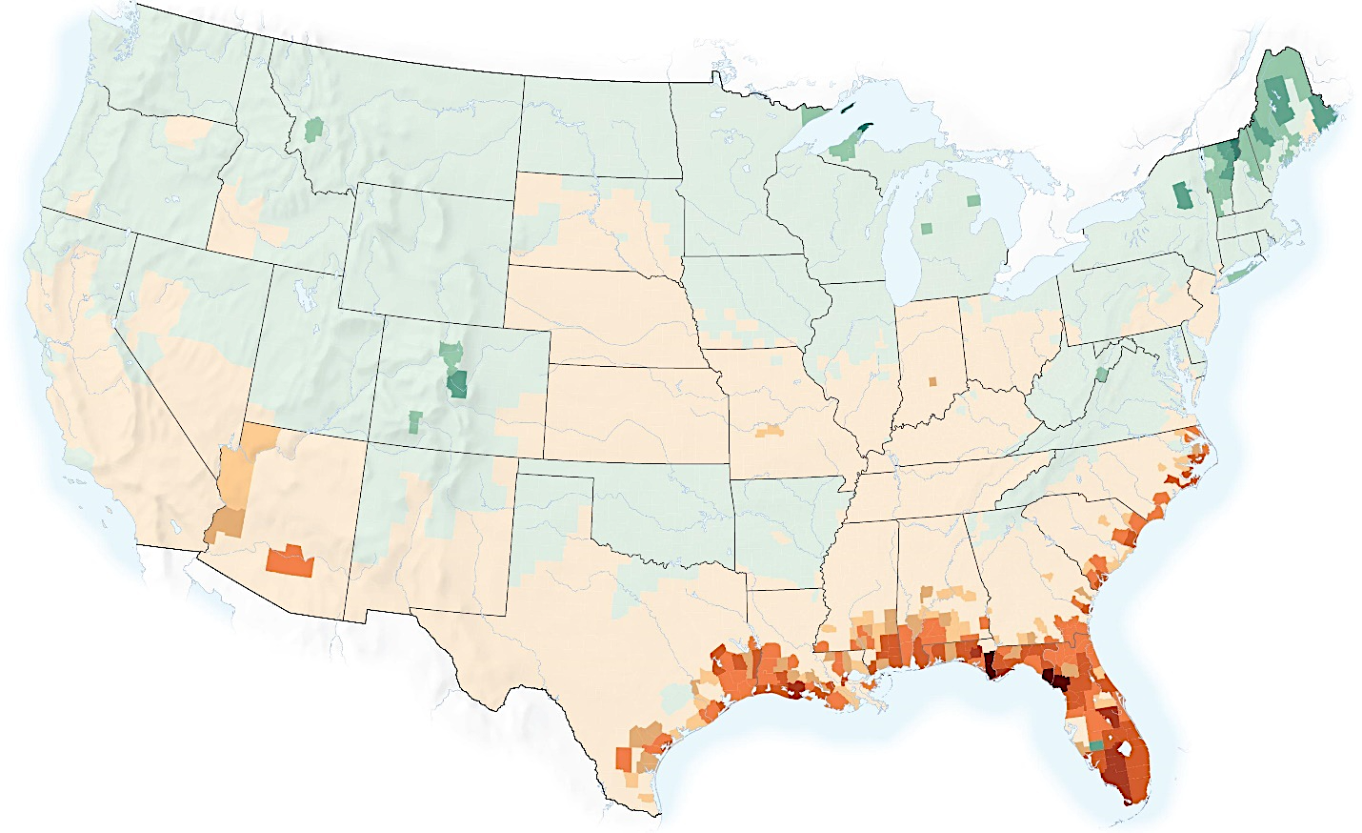
Economic Damages From Climate: 2040-2060 Climate damage as a percent of GDP
-0.5
-0.4
-0.3
0
0.3
0.4
0.5
1
3.5
10
59
Source: ProPublica, September 15, 2020

Slide 46
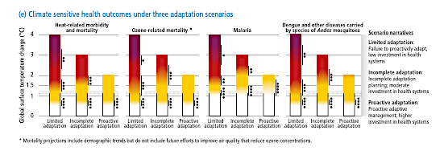
Health

Slide 47
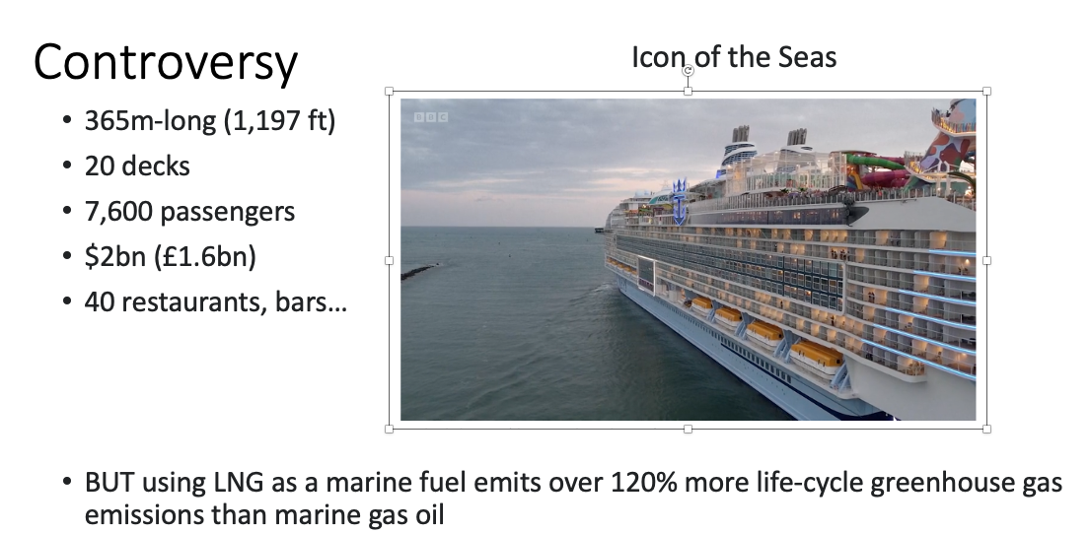
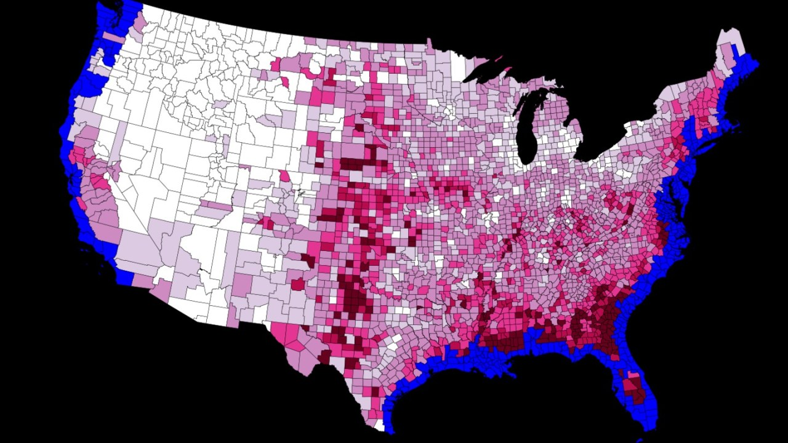
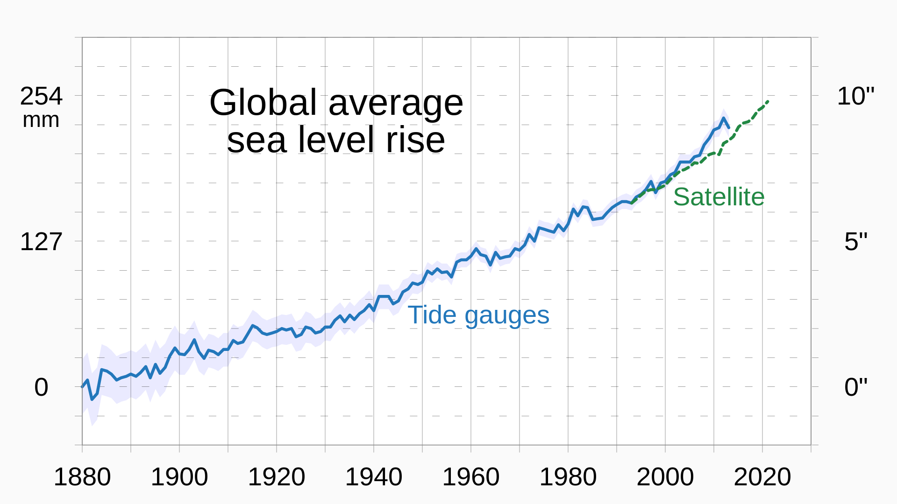
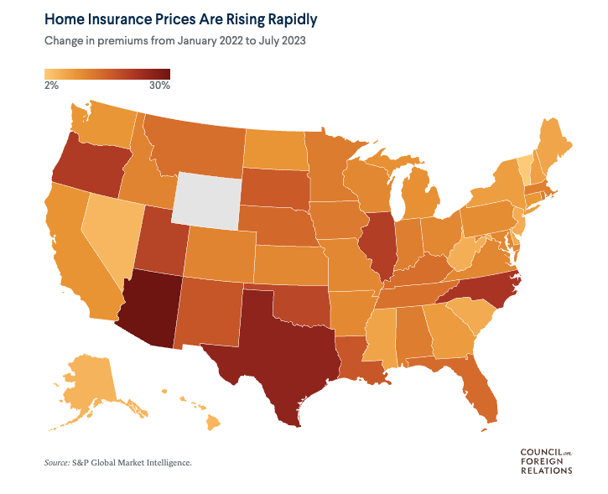
Next Week – Politics versus Science
Politics, Science and Controversy
Methane
Sea Level Rise
Home Insurance
Oil and Fossil Fuels - Follow the money!
Storage – Not near me!
Power Grid – Not where I can see it!
Introduction: https://en.wikipedia.org/wiki/List_of_climate_change_controversies

