Slide 1
The Fifth National Climate Assessment
Climate Change – A Hot Topic Session 2
The state of the science of climate change and its potential impact on the American people.
Roy Campbell and Don Fournier January 22, 2024

Slide 2
How the United States Is Addressing Climate Change
The effects of human-caused climate change are already far-reaching and worsening across every region of the United States. Rapidly reducing greenhouse gas emissions can limit future warming and associated increases in many risks. Across the country, efforts to adapt to climate change and reduce emissions have expanded since 2018, and US emissions have fallen since peaking in 2007. However, without deeper cuts in global net greenhouse gas emissions and accelerated adaptation efforts, severe climate risks to the United States will continue to grow.

Slide 3
How the United States Is Experiencing Climate Change
As extreme events and other climate hazards intensify, harmful impacts on people across the United States are increasing. Climate impacts—combined with other stressors—are leading to ripple effects across sectors and regions that multiply harms, with disproportionate effects on underserved and overburdened communities.

Slide 4
Current and Future Climate Risks to the United States
Climate changes are making it harder to maintain safe homes and healthy families; reliable public services; a sustainable economy; thriving ecosystems, cultures, and traditions; and strong communities. Many of the extreme events and harmful impacts that people are already experiencing will worsen as warming increases and new risks emerge.

Slide 5
The Choices That Will Determine the Future
With each additional increment of warming, the consequences of climate change increase. The faster and further the world cuts greenhouse gas emissions, the more future warming will be avoided, increasing the chances of limiting or avoiding harmful impacts to current and future generations.

Slide 6
How Climate Action Can Create a More Resilient and Just Nation
Large near-term cuts in greenhouse gas emissions are achievable through many currently available and cost-effective mitigation options. However, reaching net-zero emissions by midcentury cannot be achieved without exploring additional mitigation options. Even if the world decarbonizes rapidly, the Nation will continue to face climate impacts and risks. Adequately and equitably addressing these risks involves longer-term inclusive planning, investments in transformative adaptation, and mitigation approaches that consider equity and justice.

Slide 7
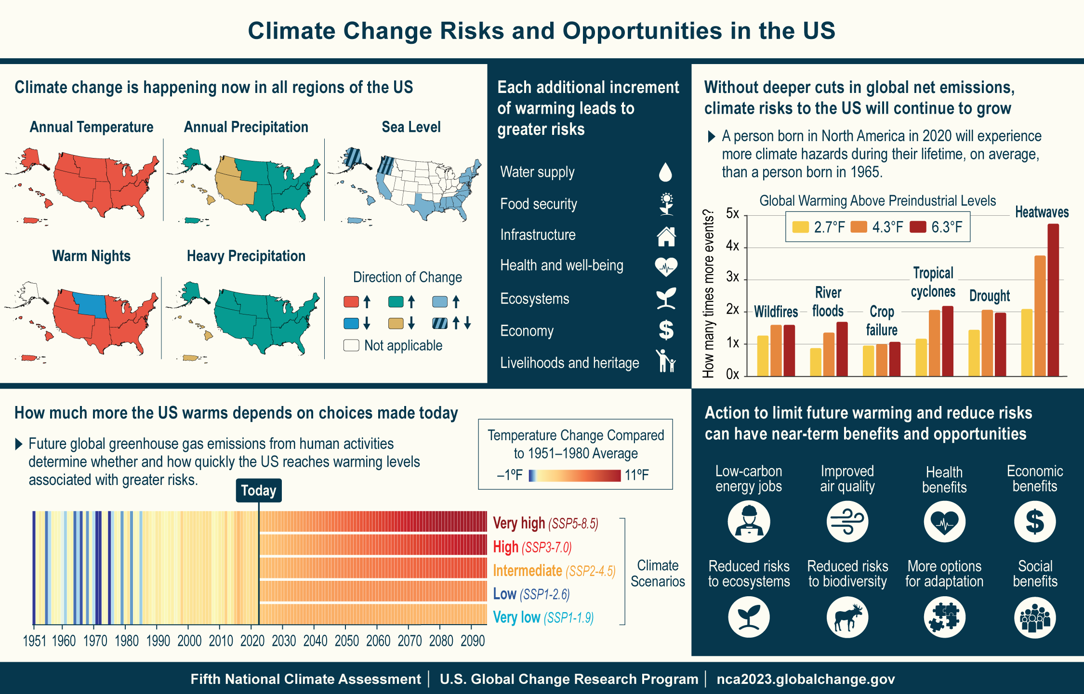
Figure 1.1. Climate change presents risks while action to limit warming and reduce risks presents opportunities for the US.
Notes:
CAPTION: (top left) Changes in multiple aspects of climate are apparent in every US region. The five maps present observed changes for five temperature, precipitation, and sea level rise metrics: 1) warming is apparent in every region (based on changes in annual average temperature in 2002–2021 compared to the 1901–1960 average for the contiguous United States, Hawaiʻi, and Puerto Rico and to 1925–1960 for Alaska); 2) the number of warm nights per year (days with minimum temperatures at or above 70°F in 2002–2021 compared to 1901–1960) is increasing everywhere except the Northern Great Plains, where they have decreased, and in Alaska, where nights above 70°F are not common; 3) average annual precipitation is increasing in most regions, except in the Northwest, Southwest, and Hawai‘i, where precipitation has decreased (same time periods as annual average temperature); 4) heavy precipitation events are increasing everywhere except Hawai‘i and the US Caribbean, where there has been a decrease (trends over the period 1958–2021); and 5) relative sea levels are increasing along much of the US coast except in Oregon, Washington, and Alaska, where there is a mix of both increases and decreases (trends over 1990–2020). {2.2, 9.1; Figures 2.4, 2.5, 2.7, 2.8}
(top right) People born in North America in 2020, on average, will be exposed to more climate-related hazards compared to people born in 1965. How many more extreme climate events current generations experience compared to previous generations will depend on the level of future warming. {Figure 15.4}
(bottom left) This climate stripes chart shows the observed changes in US annual average surface temperature for 1951–2022 and projected changes in temperature for 2023–2095 for five climate scenarios, ranging from a very high scenario, where greenhouse gas emissions continue to increase through most of the century, to a very low scenario, where emissions decline rapidly, reaching net zero by around midcentury (see Figure 1.4 and Table 3 in the Guide to the Report). Each vertical stripe represents the observed or projected change in temperature for a given year compared to the 1951–1980 average; changes are averaged over all 50 states and Puerto Rico but do not include data for the US-Affiliated Pacific Islands and the US Virgin Islands (see also Figure 1.13).
(bottom right) Although climate benefits from even the most aggressive emissions cuts may not be detectable before the middle of the century, there are many other potential near-term benefits and opportunities from actions that reduce greenhouse gas emissions. {2.3, 8.3, 10.3, 13.3, 14.5, 15.3, 19.1, 31.3, 32.4}.
Figure credits: (top left, top center, top right, bottom right) USGCRP, USGCRP/ICF, NOAA NCEI, and CISESS NC; (bottom left) adapted from panel (c) of Figure SPM.1 in IPCC, 2023 (https://doi.org/10.59327/IPCC/AR6-9789291691647.001).

Slide 8
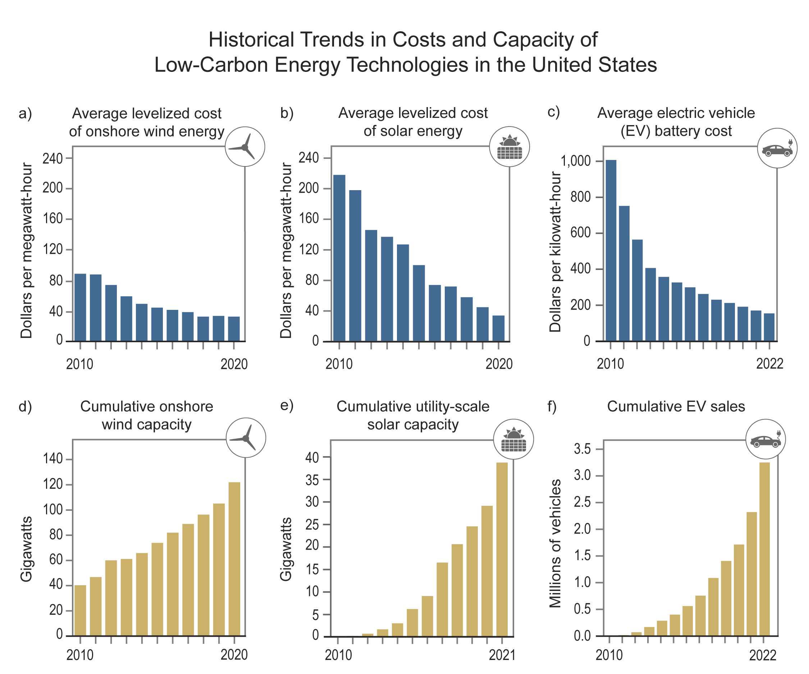
Figure 1.2. Increasing capacities and decreasing costs of low-carbon energy technologies are supporting efforts to further reduce emissions.
Notes:
CAPTION: Costs of onshore wind (a), solar photovoltaics (b), and electric vehicle (EV) batteries (c) have decreased sharply since 2000 (data shown here start in 2010), as the cumulative capacities of wind and solar generation (d and e) and the cumulative number of EVs sold (f) have increased. {Figure 32.8} Figure credit: Electric Power Research Institute, National Renewable Energy Laboratory, NOAA NCEI, and CISESS NC.

Slide 9
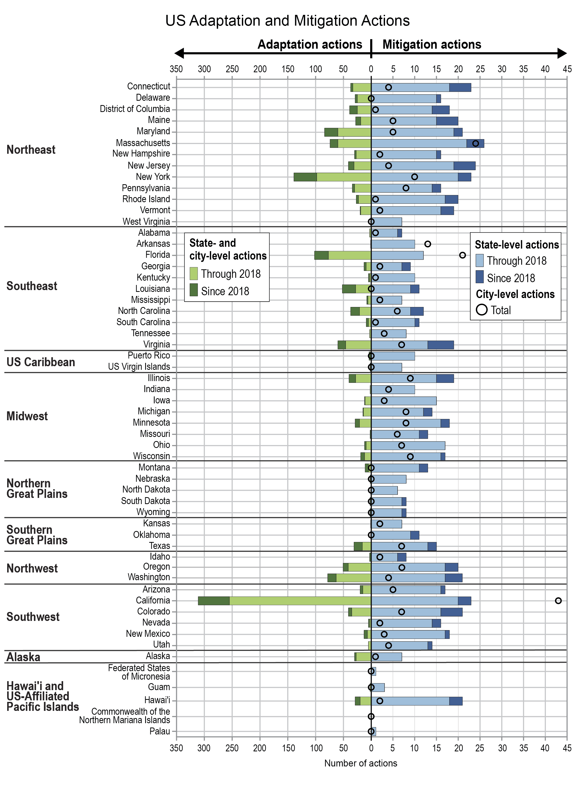
Figure 1.3. Cities and states are acting on climate change, with a substantial increase in new activities underway since 2018.
Notes:
CAPTION: Since 2018, city- and state-level adaptation plans and actions (green bars, left) increased by 32%, complemented by a 14% increase in the total number of new state-level mitigation activities (blue bars, right; 69% have updated their policies). In 2021 there were 271 city-level mitigation actions in place (open circles, right), according to the Global Climate Action Tracker. Renewable energy and energy efficiency projects on Tribal lands have also expanded (not shown). {16.4, 31.1, 32.5; Table 1.1} Figure credit: US Army Corps of Engineers, EPA, Pennsylvania State University, NOAA NCEI, and CISESS-NC.

Slide 10
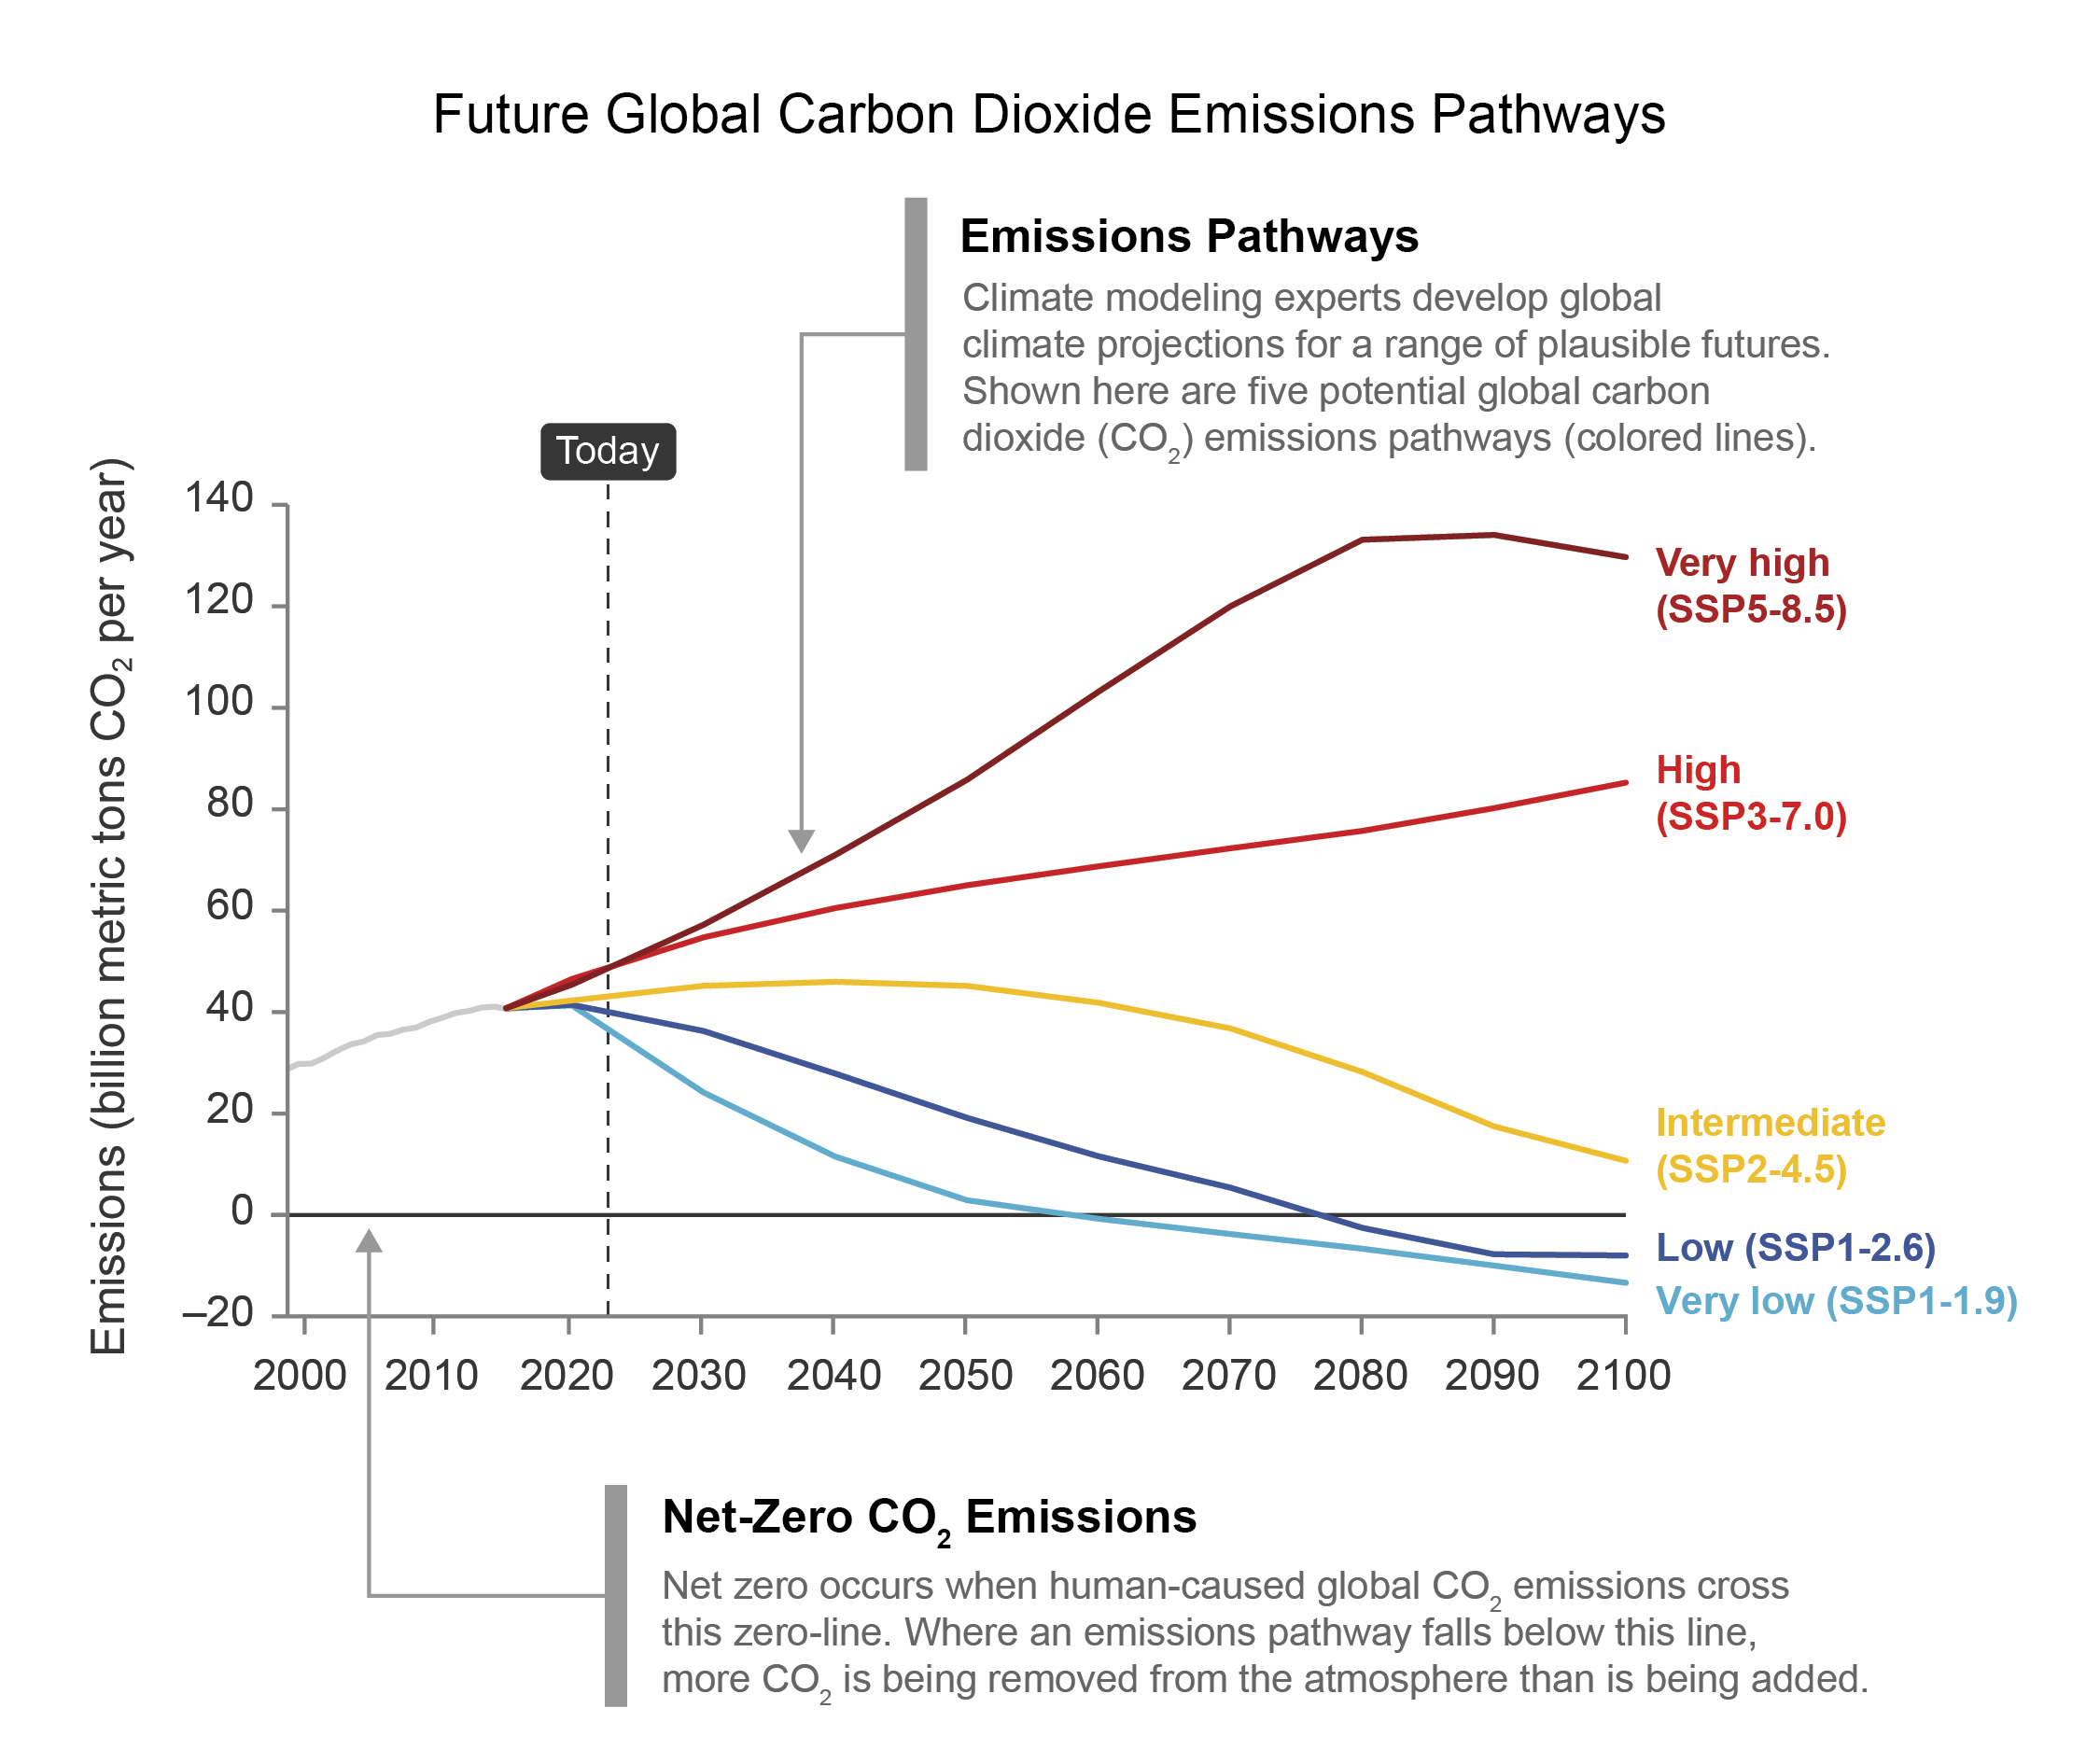
Figure 1.4. Different scenarios of future carbon dioxide emissions are used to explore the range of possible climate futures.
Notes:
CAPTION: The five scenarios shown (colored lines) demonstrate potential global carbon dioxide (CO₂) emissions pathways modeled from 2015 through 2100, with the solid light gray line showing observed global CO₂ emissions from 2000 to 2015. See Table 3 in the Guide to the Report for scenario definitions. Many projected impacts described in this report are based on a potential climate future defined by one or more of these scenarios for future CO₂ emissions from human activities, the largest long-term driver of climate change. The vertical dashed line, labeled “Today,” marks the year 2023; the solid horizontal black line marks net-zero CO₂ emissions. Adapted with permission from Figure TS.4 in Arias et al. 2021.

Slide 11
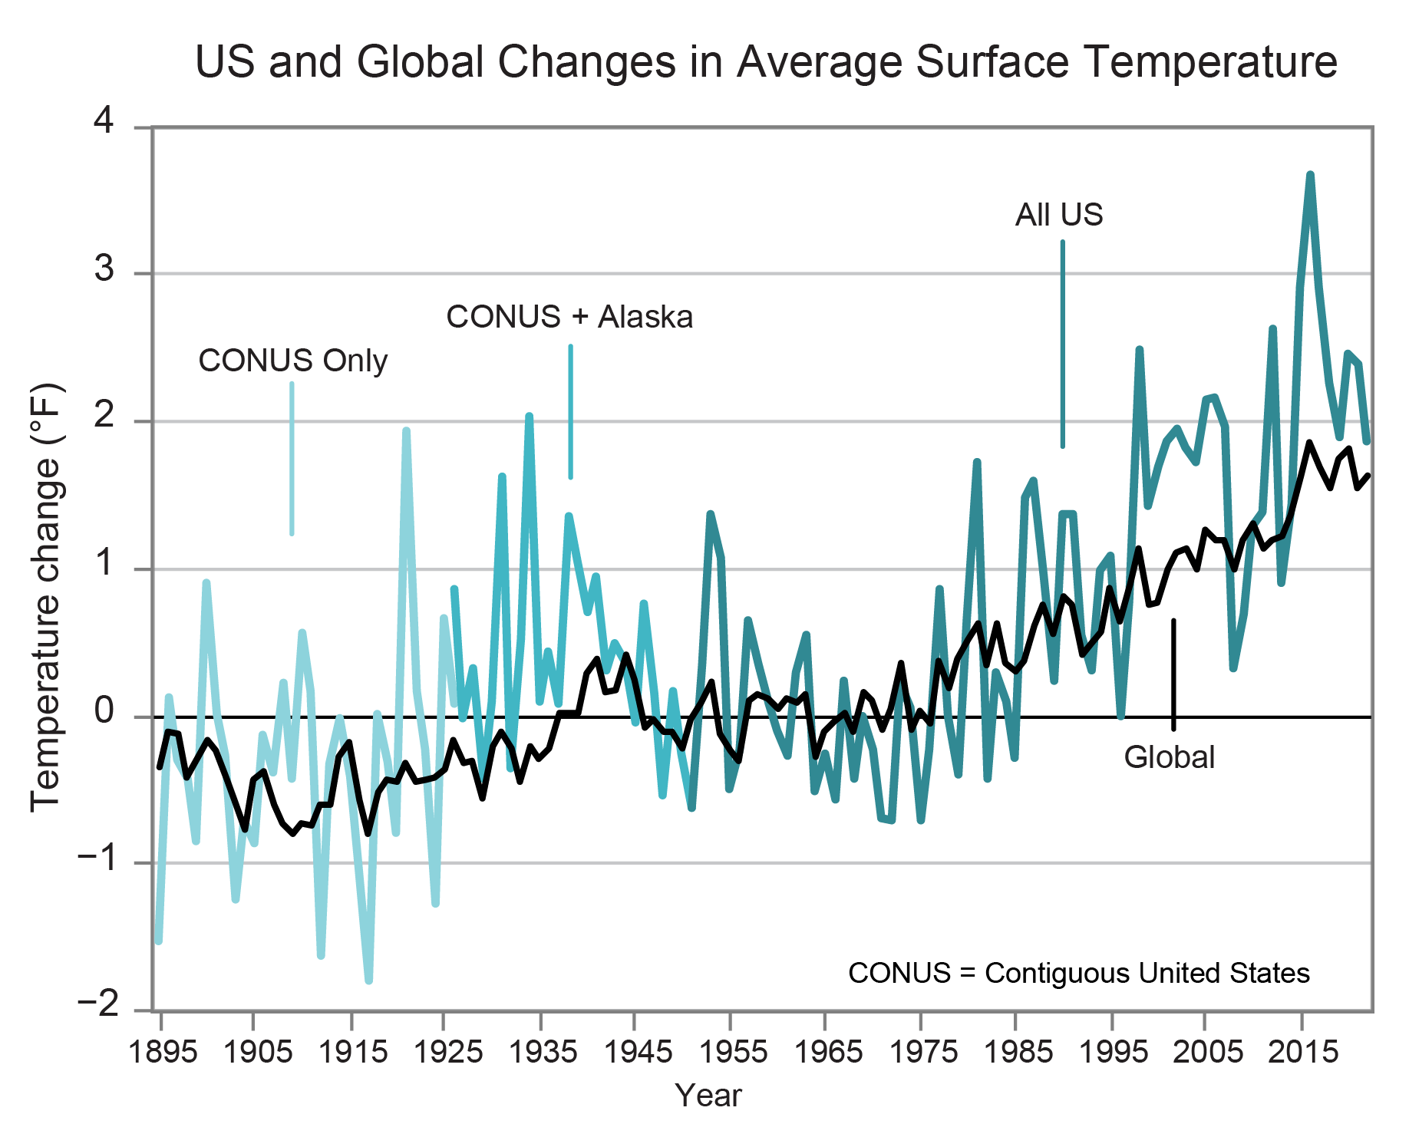
Figure 1.5. The US has warmed rapidly since the 1970s.
2023 was 2.4 degrees above the average.
Notes:
CAPTION: The graph shows the change in US annual average surface temperature during 1895–2022 compared to the 1951–1980 average. The temperature trend changes color as data become available for more regions of the US, with Alaska data added to the average temperature for the contiguous US (CONUS) beginning in 1926 (medium blue line) and Hawaiʻi, Puerto Rico, and US-Affiliated Pacific Islands data added beginning in 1951 (dark blue line). Global average surface temperature is shown by the black line. Figure credit: NOAA NCEI and CISESS NC.

Slide 12
Figure 1.6. Current climate conditions are unprecedented for thousands of years.
Notes:
CAPTION: Human activities since industrialization have led to increases in atmospheric greenhouse gas concentrations that are unprecedented in records spanning hundreds of thousands of years. These are examples of some of the large and rapid changes in the climate system that are occurring as the planet warms. (Greenhouse gas concentrations {2.1}; sea level rise {3.4}; global temperature {2.1}; drought {2.2, 3.5}). Figure credit: USGCRP and ICF.

Slide 13
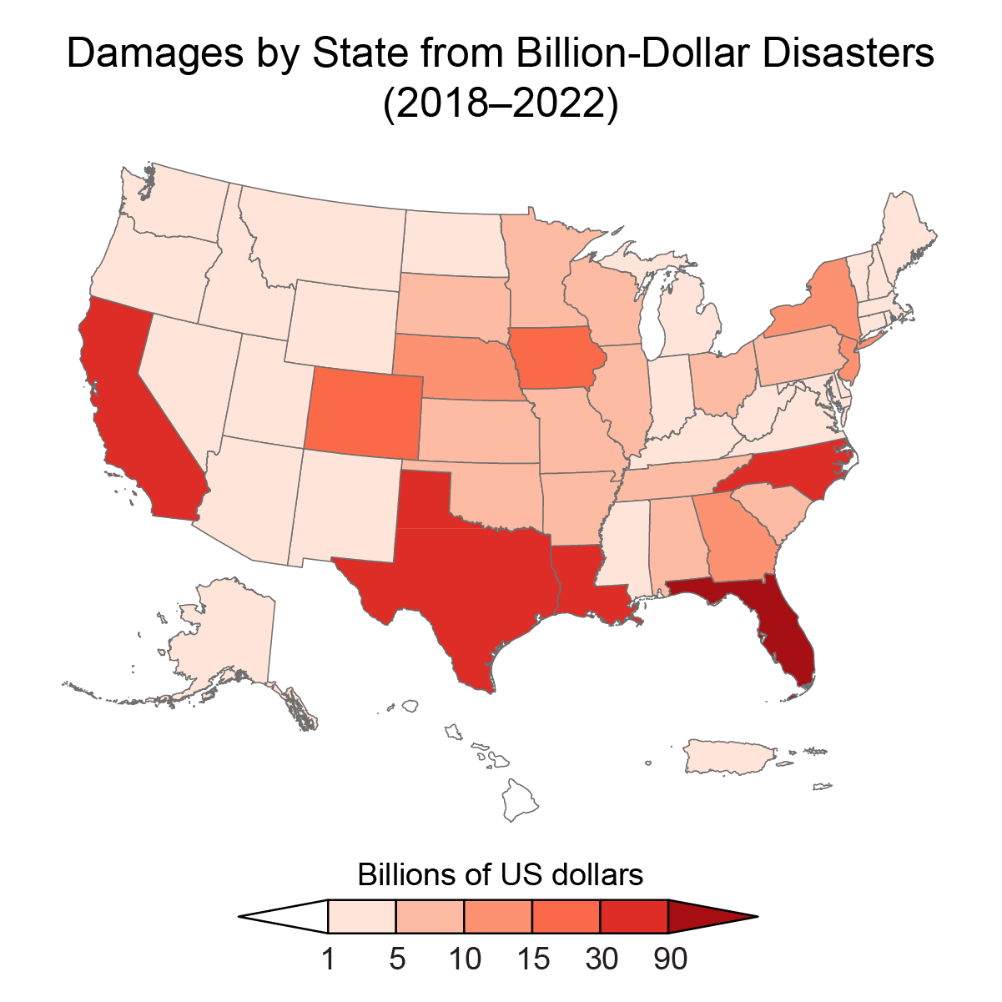
Figure 1.7. The US now experiences, on average, a billion-dollar weather or climate disaster every three weeks.
Notes:
CAPTION: Billion-dollar weather and climate disasters are events where damages/costs reach or exceed $1 billion, including adjustments for inflation. Between 2018 and 2022, 89 such events affected the US, including 4 droughts, 6 floods, 52 severe storms, 18 tropical cyclones, 5 wildfires, and 4 winter storm events (see Figure A4.5 for the number of billion-dollar disasters per year). During this period, Florida had the highest total damages ($140 billion) and experienced the highest damages from a single event—Hurricane Ian ($113 billion). Over the 1980–2022 period, Texas had the highest total damages ($375 billion). While similar data are not available for the US-Affiliated Pacific Islands, Super Typhoon Yutu caused $500 million in property damage alone in Saipan and the northern Marianas in 2018 (NCEI 2019). Increasing costs over time are driven by changes in the assets at risk and the increase in frequency or intensity of extreme events caused by climate change. Adapted from NCEI 2023.

Slide 14
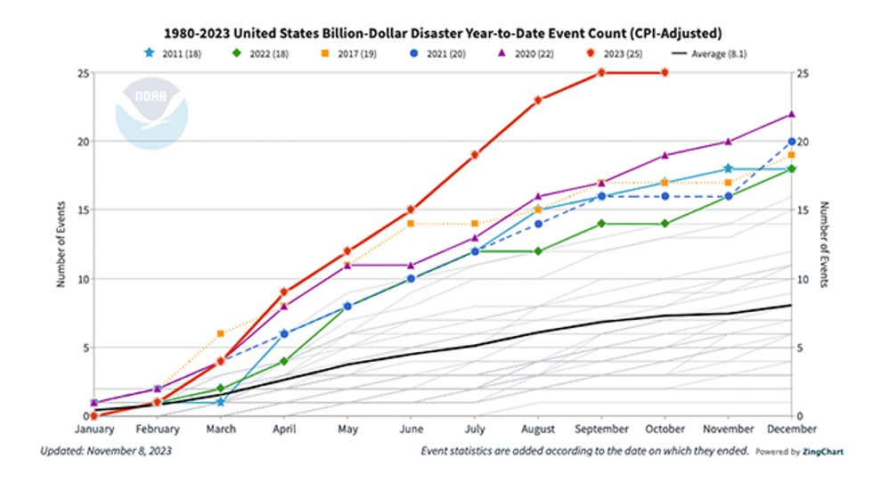
Final 2023 was 28 events
Source: Climate.gov

Slide 15
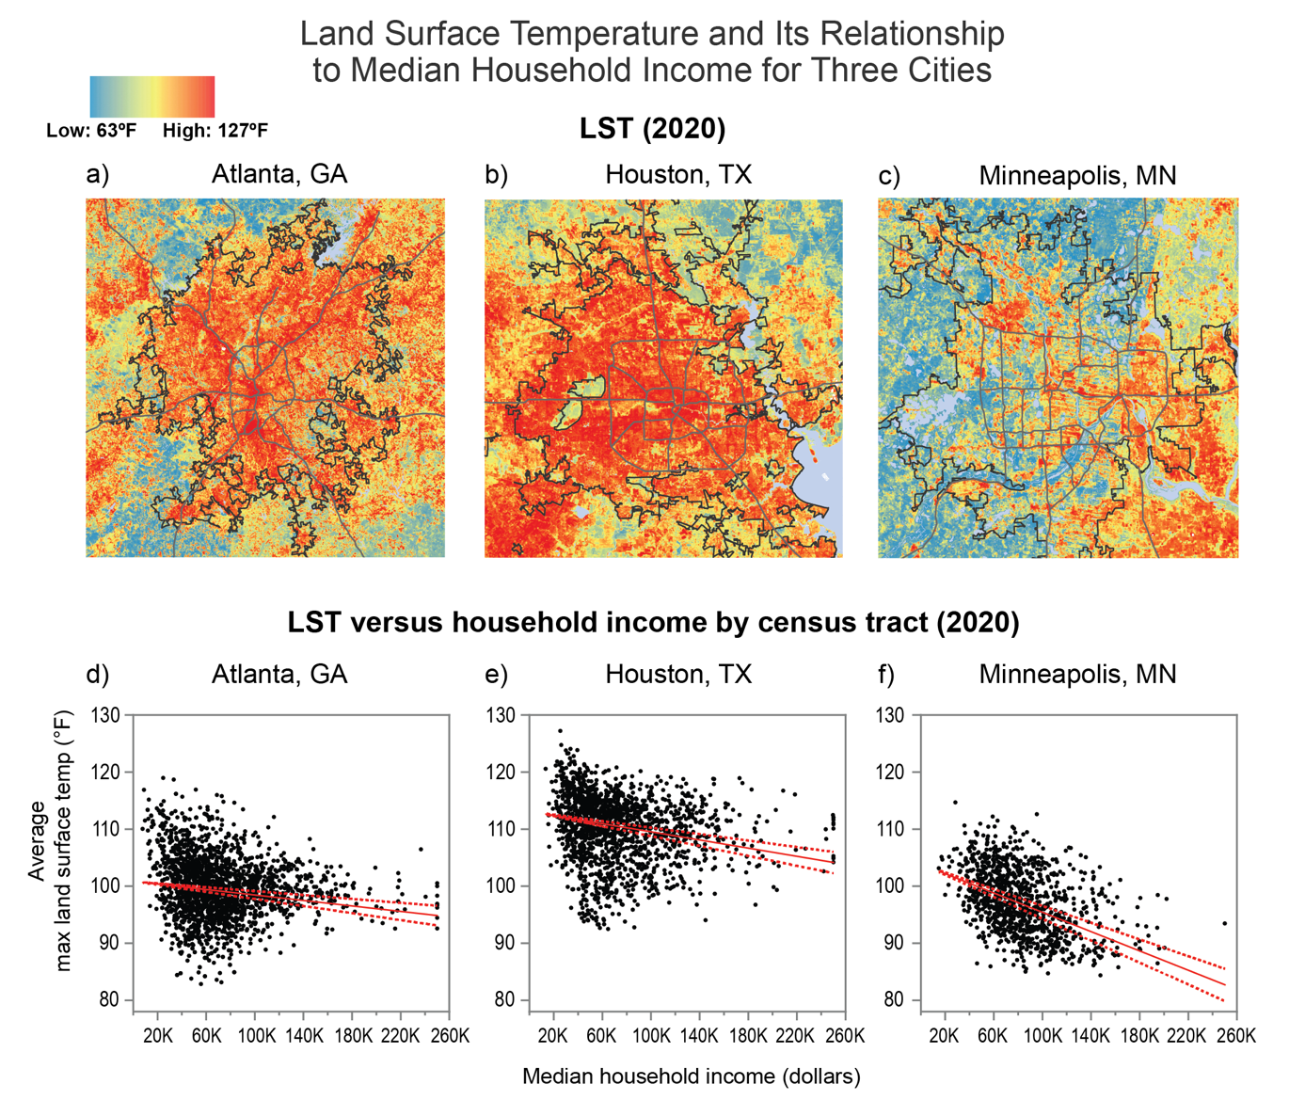
Figure 1.8. Lower-income urban neighborhoods experience higher surface temperatures.
Notes:
CAPTION: The figure shows the spatial distribution of maximum land surface temperature (LST) in 2020 for Atlanta (a), Houston (b), and Minneapolis (c). Graphs (d), (e), and (f) depict the relationship between maximum LST and median household income across census tracts in each city (see also Figure A4.4). A statistical trend analysis (the Theil-Sen estimator) returns negative values for all three cities, indicating that LST decreases as income increases (solid red line). Dashed red lines indicate the 95% confidence interval, meaning that the true slope of the trend is expected to fall within this range. Note that LST is measured at ground level and may differ from surface air temperature, which is measured at a height of 2 meters. {Figure 12.6} Portions of this figure include intellectual property of Esri and its licensors and are used under license. Copyright © 2020 Esri and its licensors. All rights reserved. Figure credit: University of California, Davis; University of Texas at El Paso; Massachusetts Institute of Technology; City of Phoenix, Arizona; and USGS.

Slide 16
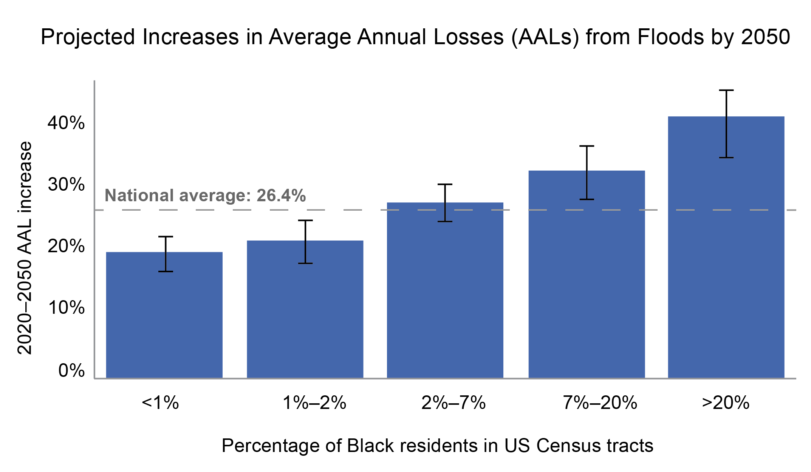
Figure 1.9. Losses due to floods are projected to increase disproportion-nately in US Census tracts with higher percentages of Black residents.
Notes:
CAPTION: The bars show that the average annual losses—or the economic damage in a typical year—due to floods in census tracts with a Black population of at least 20% is projected to increase at roughly twice the rate of that in tracts where Black populations make up less than 1% of population. {Figure 4.14} Adapted from Wing et al. 2022 [CC BY 4.0].

Slide 17
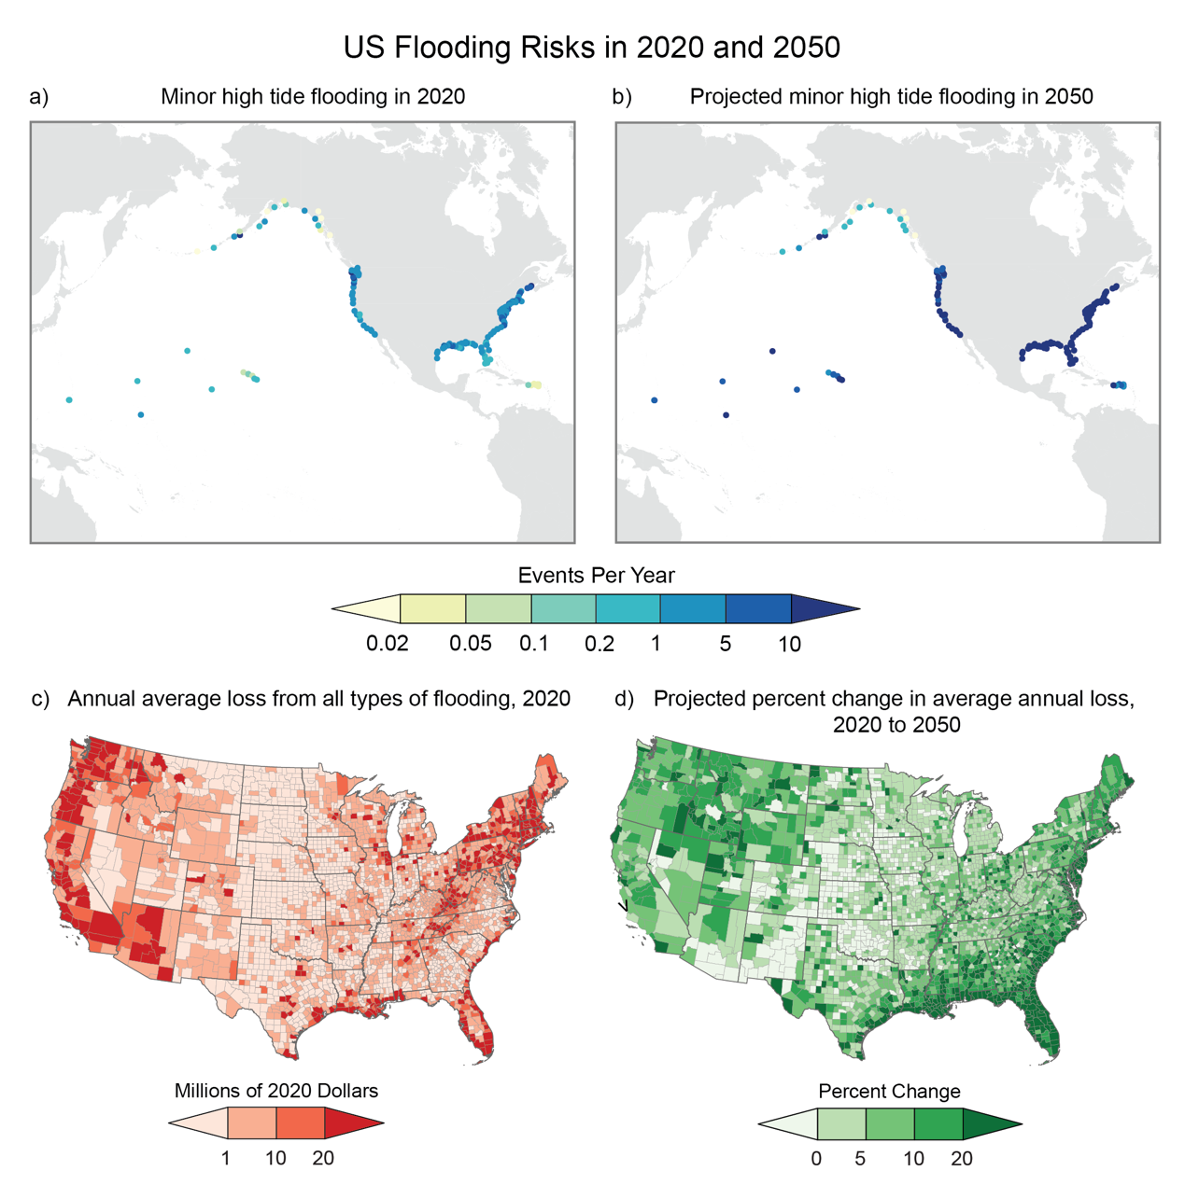
Figure 1.10. Increasing flooding puts more people and assets at risk.
Notes:
CAPTION: (top row) Maps show (a) the average number of minor high tide flooding events per year in 2020 (with historical sea level rise) and (b) the expected number of events per year in 2050 (when driven by extrapolated sea level rise). (bottom row) Maps show (c) average annual loss (AAL) from all types of flooding in millions of dollars in 2020 and (d) the projected changes in AAL in 2050 relative to 2020. AAL estimates were made only for the contiguous US. Over the next three decades, the number of flooding days along all coastlines of the US is expected to increase. These increases in the occurrence of flooding will drive greater AALs, especially in coastal areas of the US. (a, b) Adapted from Sweet et al. 2022; (c, d) adapted from Wing et al. 2022 [CC BY 4.0].

Slide 18
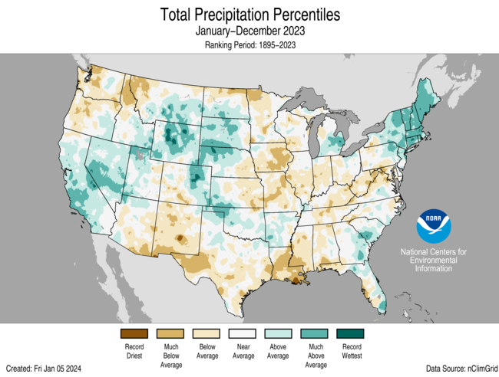

Slide 19
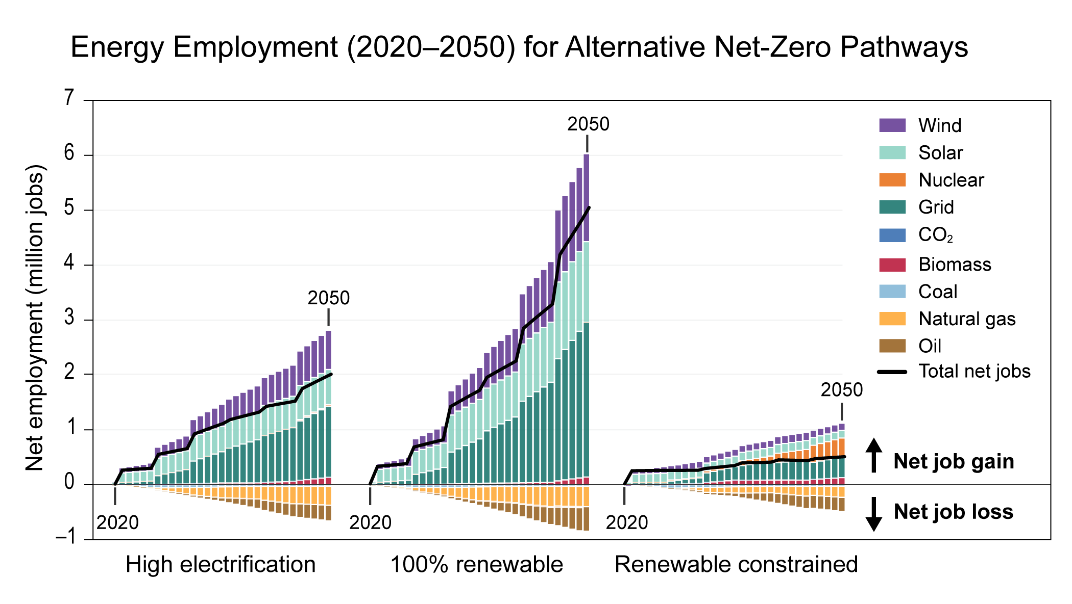
Figure 1.12. Employment gains in electrification and renewable energy industries are projected to far outpace Job losses in fossil fuel industries.
Notes:
CAPTION: Despite decreases in the number of fossil fuel–related jobs, the overall number of energy jobs (specifically those involved in the supply of energy) relative to 2019 is generally projected to increase in net-zero-emissions energy scenarios between 2020 and 2050, although by much more in some scenarios than in others. {Figure 32.17} Adapted with permission from Jenkins et al. 2021.

Slide 20
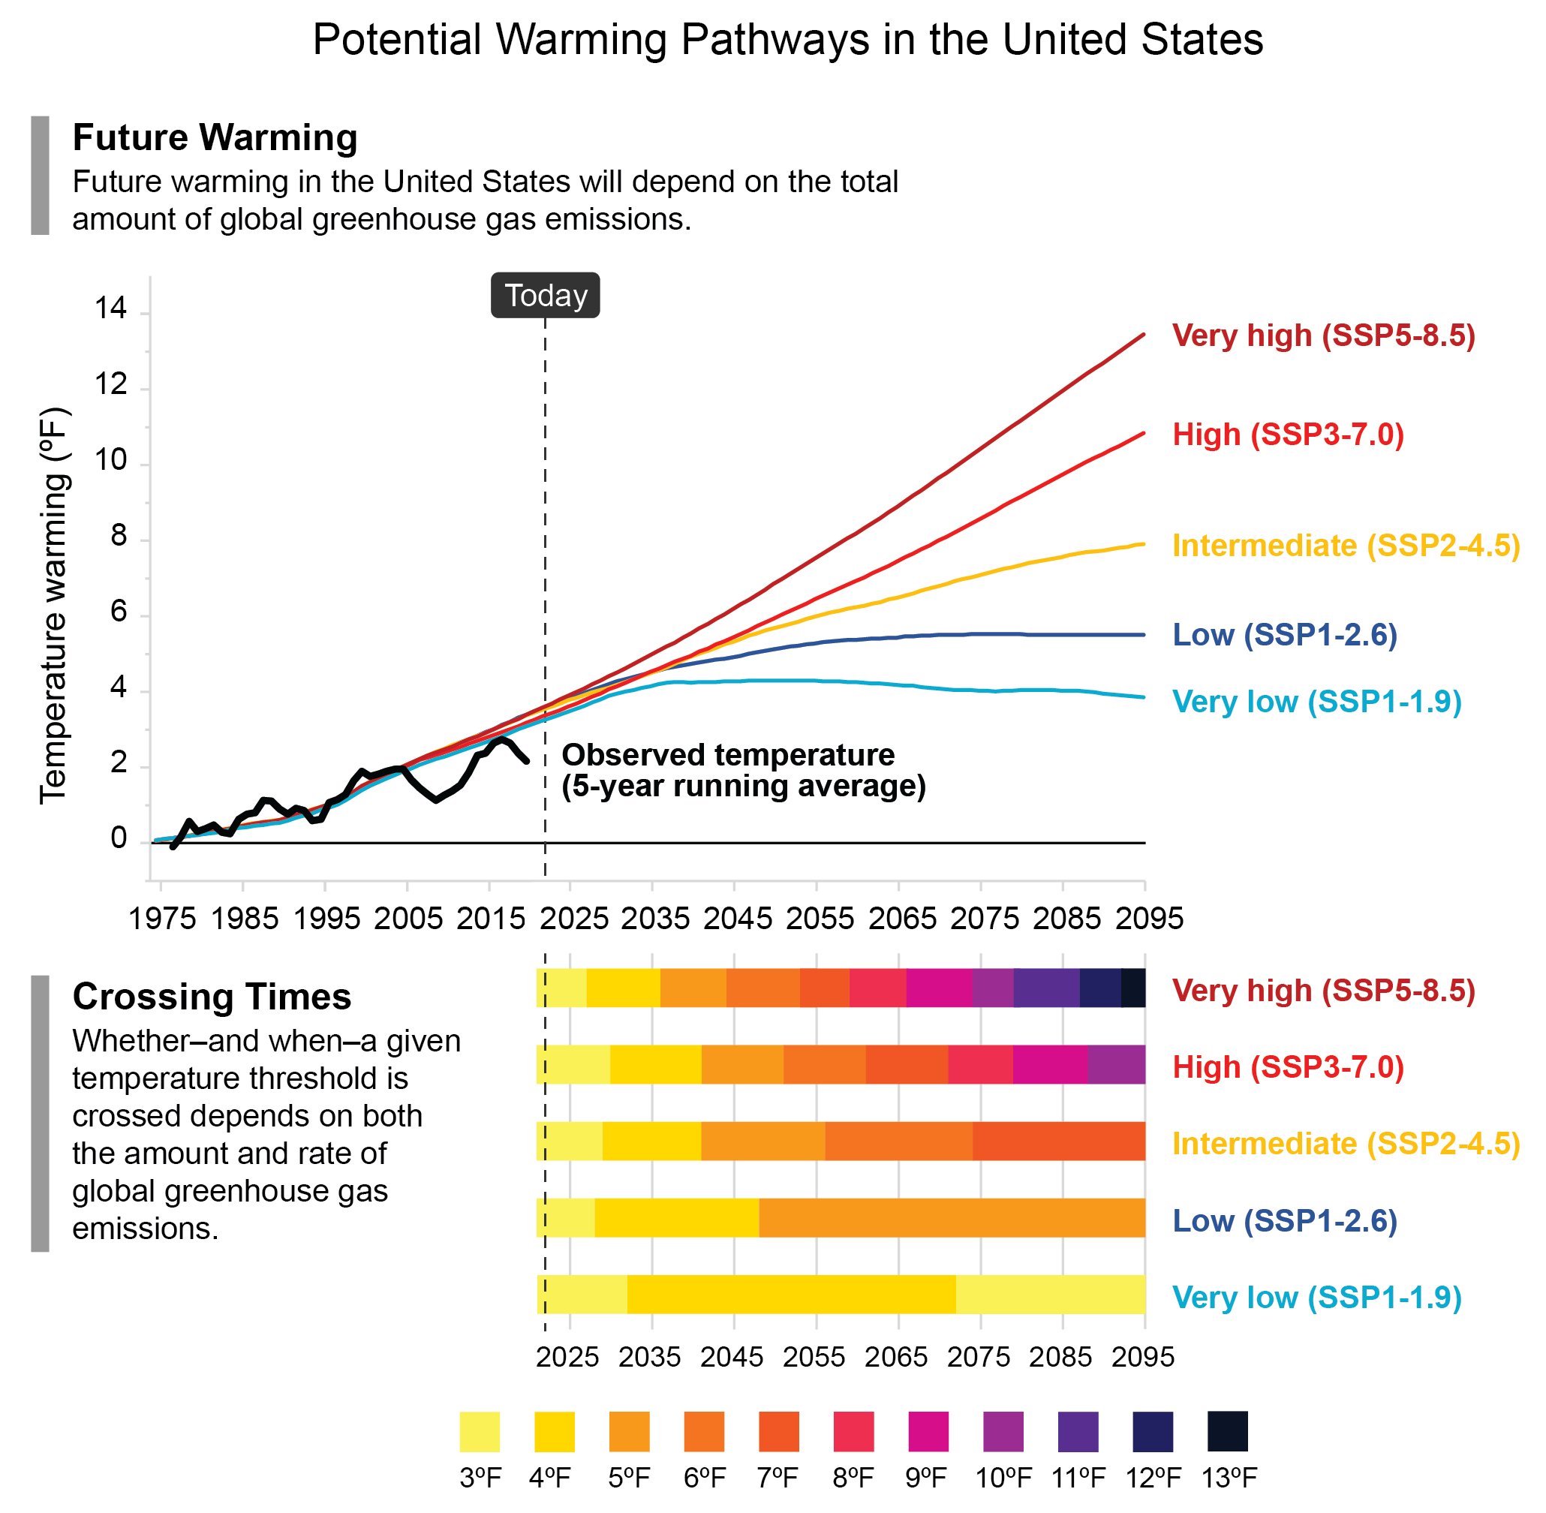
Figure 1.13. When or if the US reaches a particular level of warming depends on global greenhouse gas emissions from human activities.
Notes:
CAPTION: How much warming the US will experience—and when a given temperature threshold is crossed—depends on future global emissions. The top graph shows observed change in US surface temperature during 1975–2022 (black line, 5-year averaged) and modeled historical (1975–2014) and projected (2015–2095) change in surface temperature compared to 1951–1980, annually averaged over all 50 states and Puerto Rico under different climate scenarios (multicolored lines; see Table 3 in the Guide to the Report ). The bottom graph shows the same projections in a different way, highlighting the year in which the US crosses temperature thresholds under each scenario. The vertical dashed line represents the year 2023. Data for the US-Affiliated Pacific Islands and the US Virgin Islands are not available. See Figure 1.5 for observed US and global temperature changes since 1895. Adapted with permission from Figure TS.1 in Arias et al. 2021.
This should be a link when time comes.

Slide 21
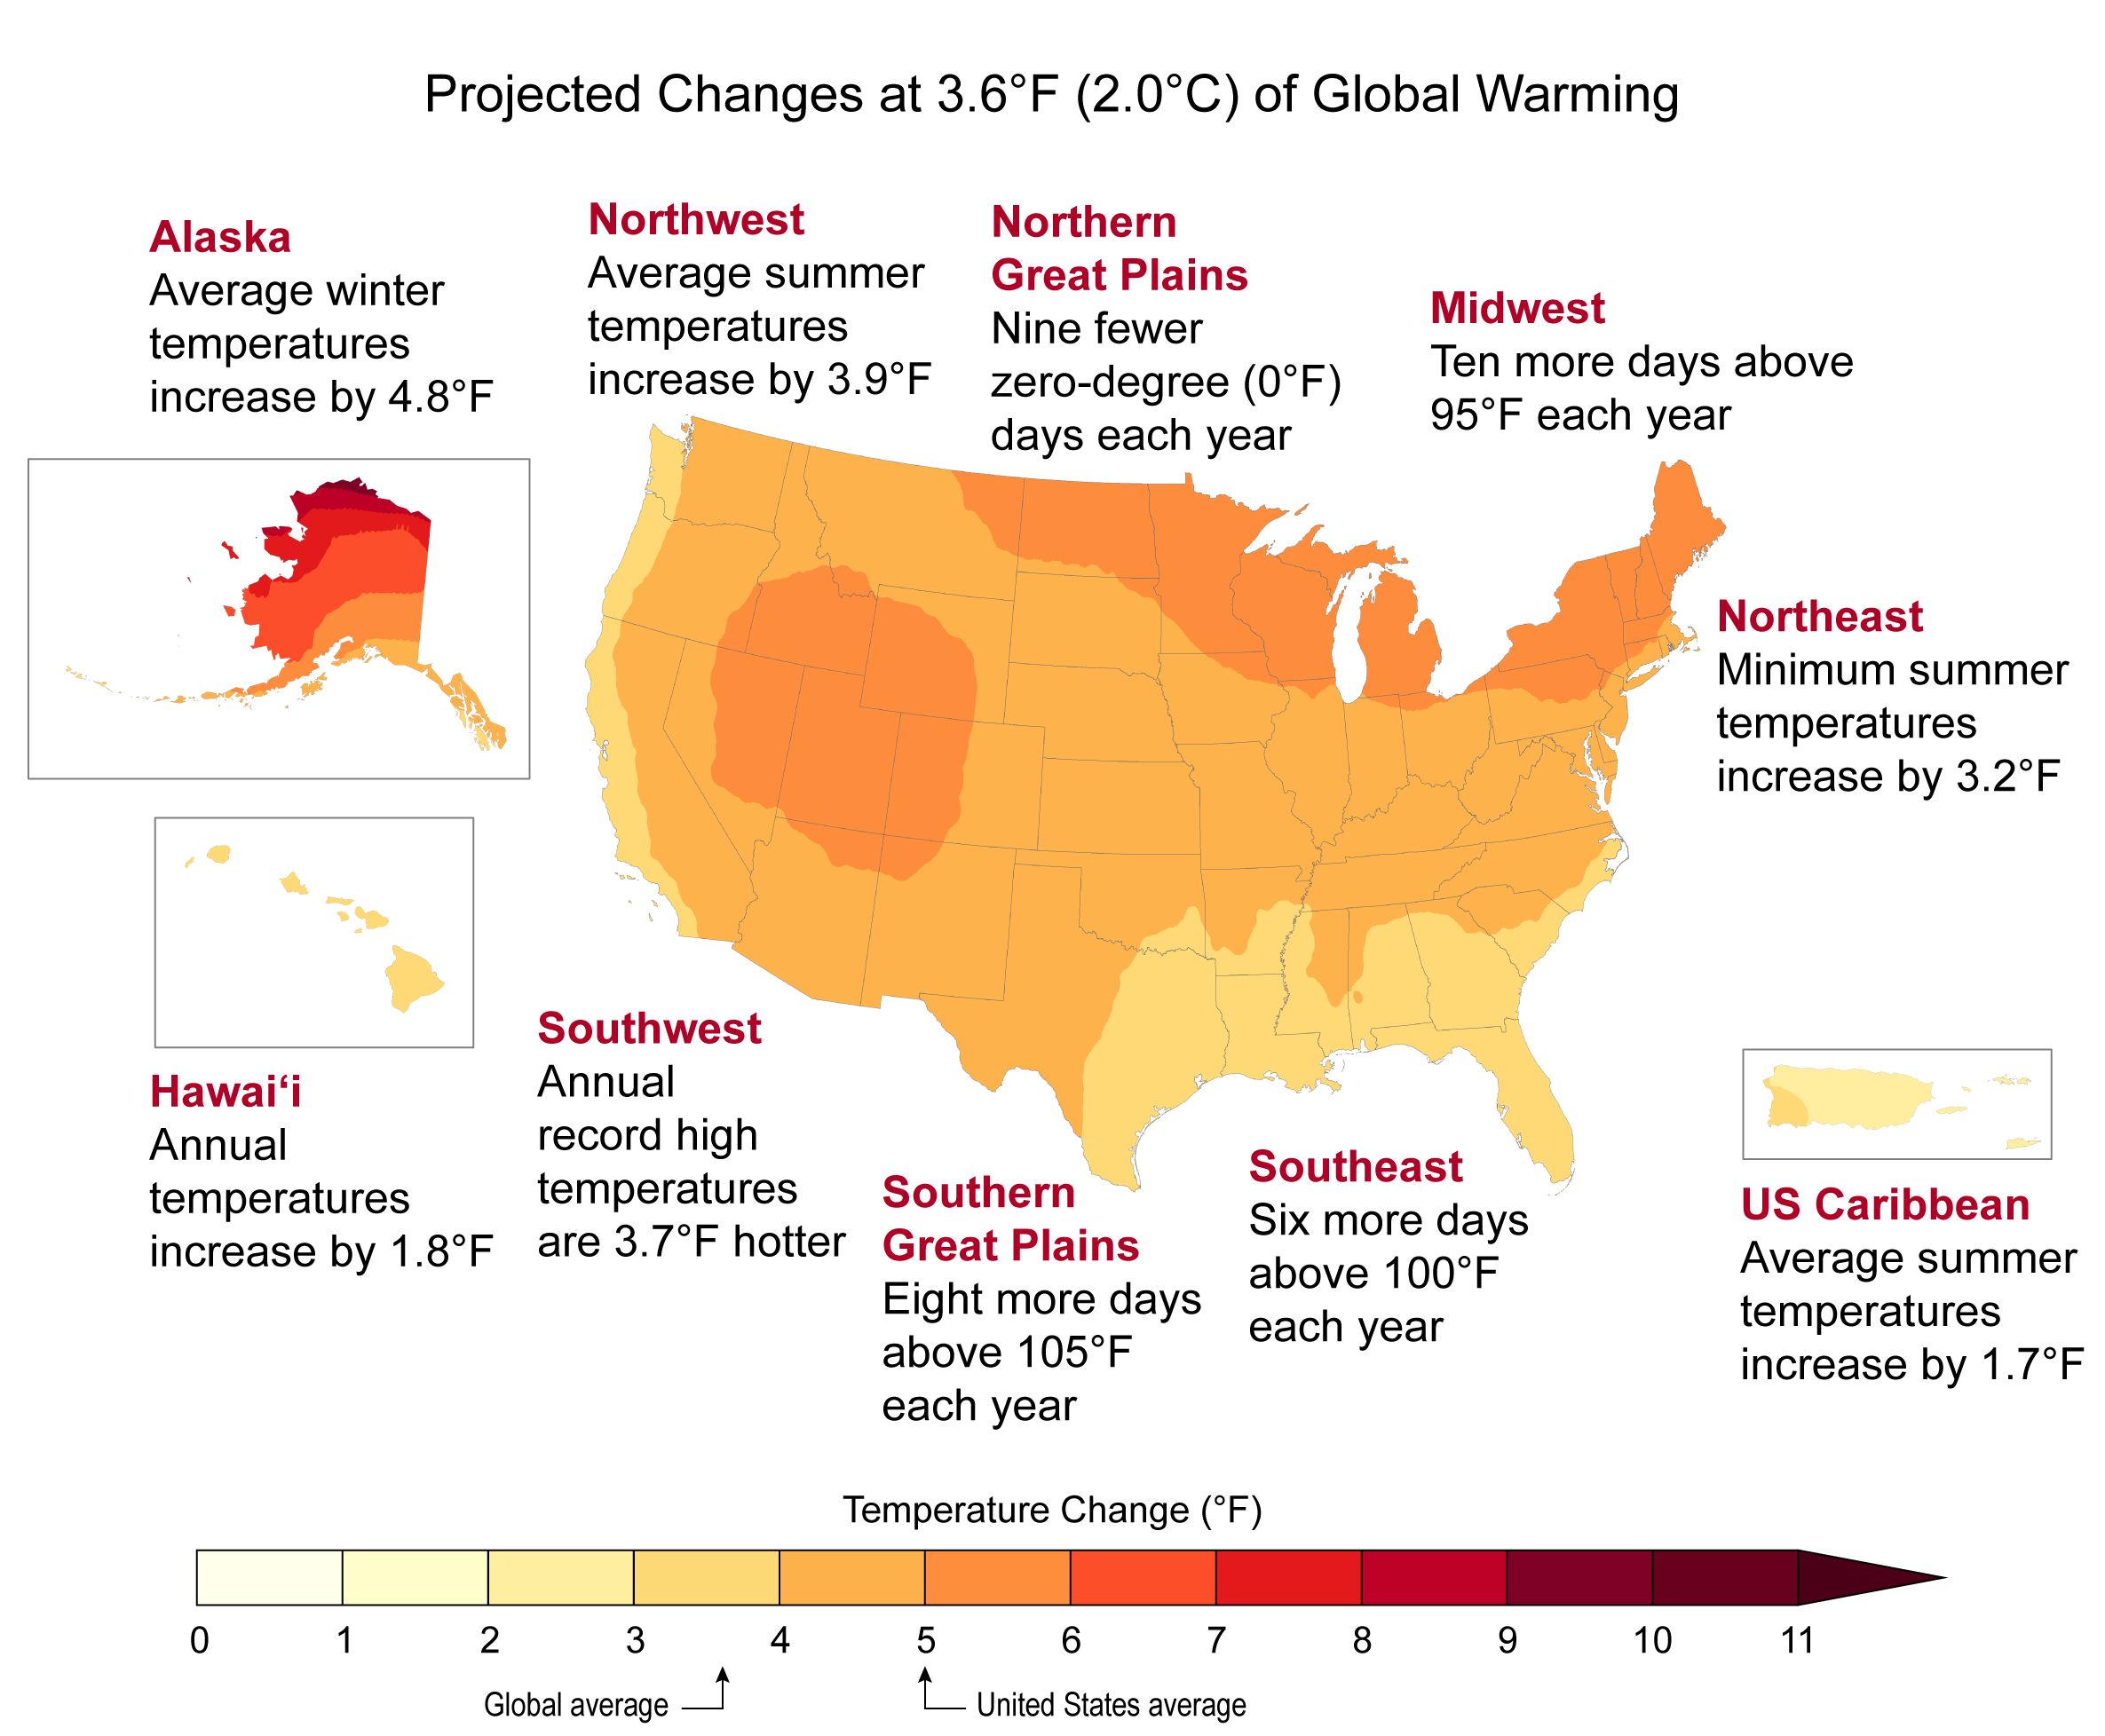
Figure 1.14. What would 3.6°F (2°C) of global warming feel like in the United States?
Notes:
CAPTION: As the world warms, the United States warms more on average. The map shows projected changes in annual surface temperature compared to the present day (1991–2020) under a global warming level of 3.6°F (2°C) above preindustrial levels (see Figure 2.9). Regional examples show how different temperature impacts would be experienced across the country at this level of warming. Figure credit: USGCRP, NOAA NCEI, and CISESS NC.

Slide 22
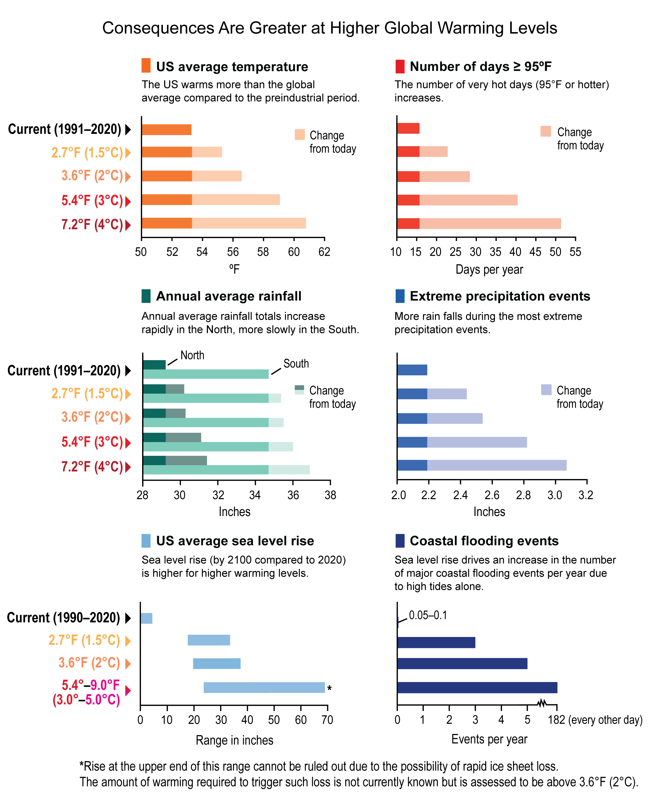
Figure 1.15. At higher global warming levels, the US will experience more severe climate impacts.
Notes:
CAPTION: With each additional increment of global warming, climate impacts in the US are projected to be more severe: US average temperature warms more than the global average (top left), and the number of days per year at or above 95°F in the US increases (top right). Annual average US rainfall increases rapidly in the North and more slowly in the South (center left), and more rain falls during the most extreme precipitation events (center right). Sea level rise (range of projected increases by 2100 compared to 2020) is higher (bottom left), driving an increase in the number of major coastal flooding events per year due to high tides alone (bottom right). Temperature (averages and extremely hot days; top row) and extreme rainfall projections (center right) are averages for all 50 states and Puerto Rico. Average rainfall projections (center left) are shown for both the northern and southern US (above and below 37° latitude, respectively). Sea level rise (bottom left) and coastal flooding (bottom right) projections are averages for the contiguous United States. For sea level change estimates outside of the contiguous US, see Chapter 23 (for Puerto Rico and the US Virgin Islands), Chapter 30 (for Hawaiʻi and the US-Affiliated Pacific Islands), and Sweet et al. 2022 (for Alaska). Global warming levels refer to warming since preindustrial temperature conditions, defined as the 1851–1900 average. Figure credit: USGCRP, NOAA NOS, NASA, NOAA NCEI, and CISESS NC.

Slide 23
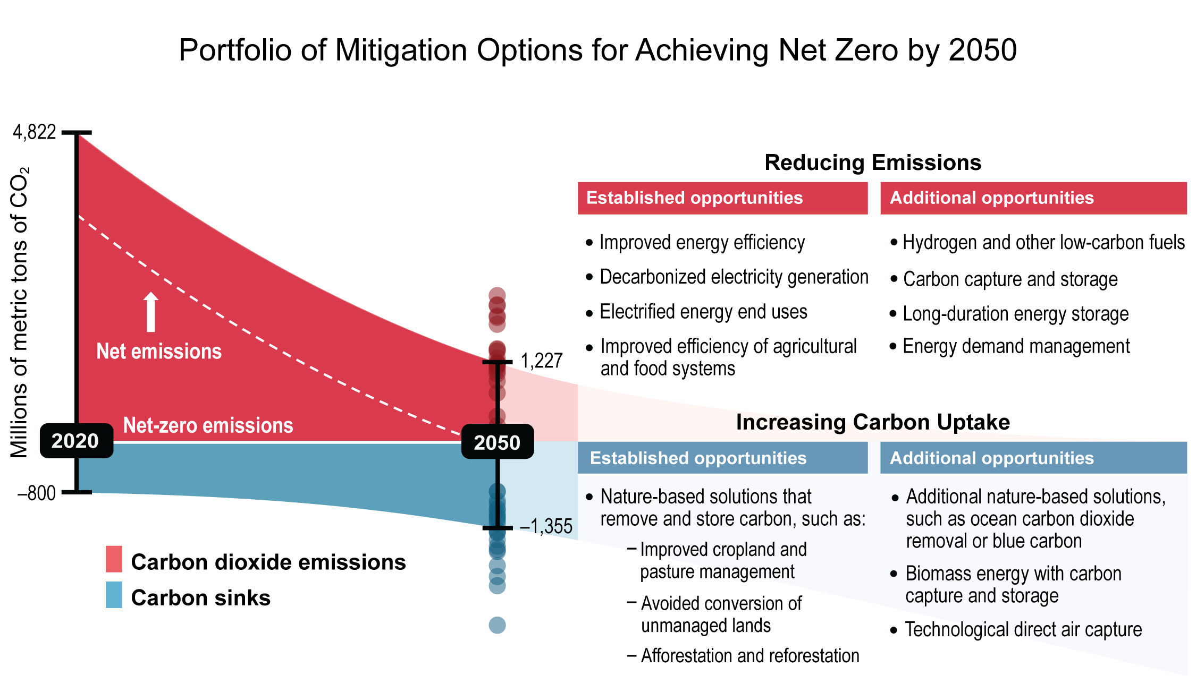
Figure 1.16. Reaching net zero by 2050 in the US will involve a mix of reductions in greenhouse gas emissions and increases in carbon dioxide removal.
Notes:
CAPTION: Reaching net-zero emissions (horizontal white line) by midcentury in the US would mean deep reductions in emissions of carbon dioxide (CO₂) and other greenhouse gases (top side of figure; red), with residual emissions balanced by additional removal of CO₂ from the atmosphere (bottom side of figure; blue). The dashed white line shows net emissions to the atmosphere (the sum of carbon sources and carbon sinks). The dots at 2050 show ranges of emissions and uptake for energy model scenarios explored in detail in Chapter 32. Model scenarios that achieve these targets project a mix of established opportunities for reducing emissions and increasing carbon sinks. Among these, energy efficiency, decarbonized electricity (mainly renewables), and end-use electrification are critical for the energy sector. While not exhaustive, the list also includes additional opportunities, many of which are emerging technologies that will be integral to reaching net zero. These include options like use of hydrogen and low-carbon fuels to further reduce emissions in difficult-to-decarbonize sectors and greatly increasing CO₂ removal. Figure credit: EPA; University of California, Irvine; NOAA NCEI; and CISESS NC.

Slide 24
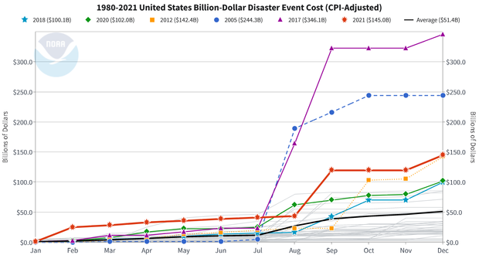
2023 Costs were $92.9 Billion

Slide 25
Global Costs of Climate Change
The global cost of climate change damage is estimated to be between $1.7 trillion and $3.1 trillion per year by 2050.
This includes the cost of damage to infrastructure, property, agriculture, and human health.
This cost is expected to increase over time as the impacts of climate change become more severe.
The poorest countries in the world are at greatest risk from the economic impacts of climate change.
Data from World Economic Forum

Slide 26
Climate Change is Here
The changes required to our Built and Natural Environments over the next few decades will be a tremendous undertaking.
Climate Change has already cost the USA over $2.5 trillion and that will continue to increase each year.
The total cost of U.S. billion-dollar disasters over the last seven years (2017-2023) was $900 billion.
Inaction will exceed the cost of action.
Much can be done at a profit.

Slide 28
