Slide 1
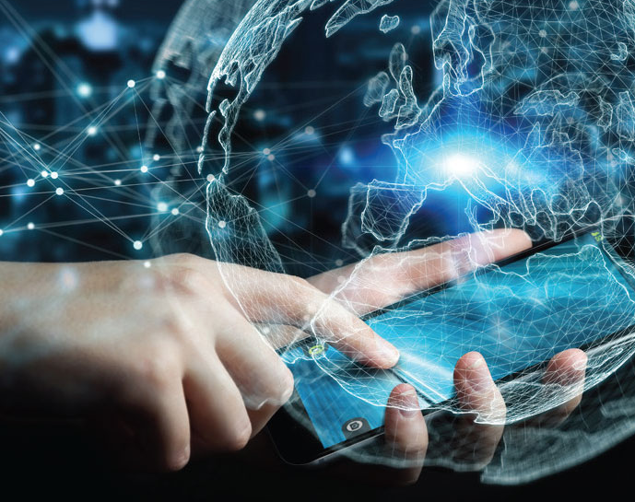
Disruptive Innovation and Technology
Roy Campbell
Session 6: Artificial Intelligence
Week 7 assignment

Slide 2
Contributors
Bob Strauss – Philosophical thoughts
David Tracy – Autonomous Cars, Agriculture, and Lawn Care
Mike Murphy – Games, Diplomacy

Slide 3
Human Reactions to Disruptive Innovation
Consider
Printing Press
Internet
AI

Slide 4
Intro

Slide 5
Artificial Intelligence
Artificial intelligence (AI) is intelligence—perceiving, synthesizing, and inferring information—demonstrated by machines, as opposed to intelligence displayed by humans or by other animals. Example tasks in which this is done include speech recognition, computer vision, translation between (natural) languages, as well as other mappings of inputs. (Wikipedia)

Slide 6
Artificial Intelligence
What is it worth?
Where did it come from?
Applications of AI
What is the AI Disruptive Innovation?
Discussion

Slide 7
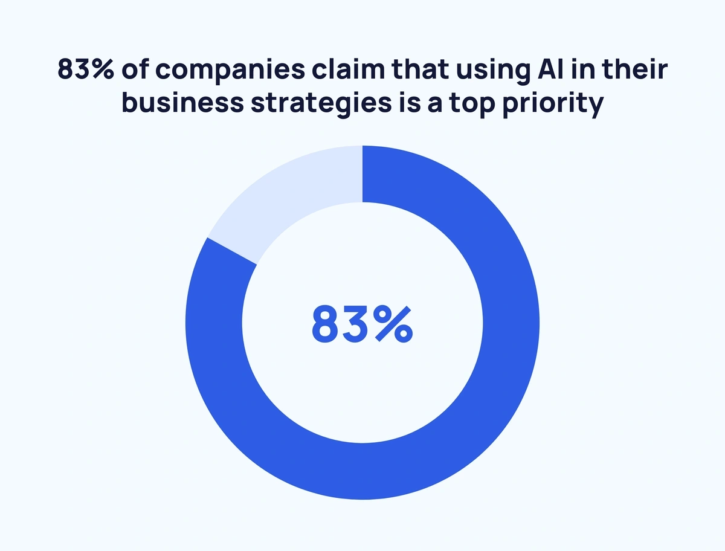
https://explodingtopics.com/blog/ai-statistics

Slide 8
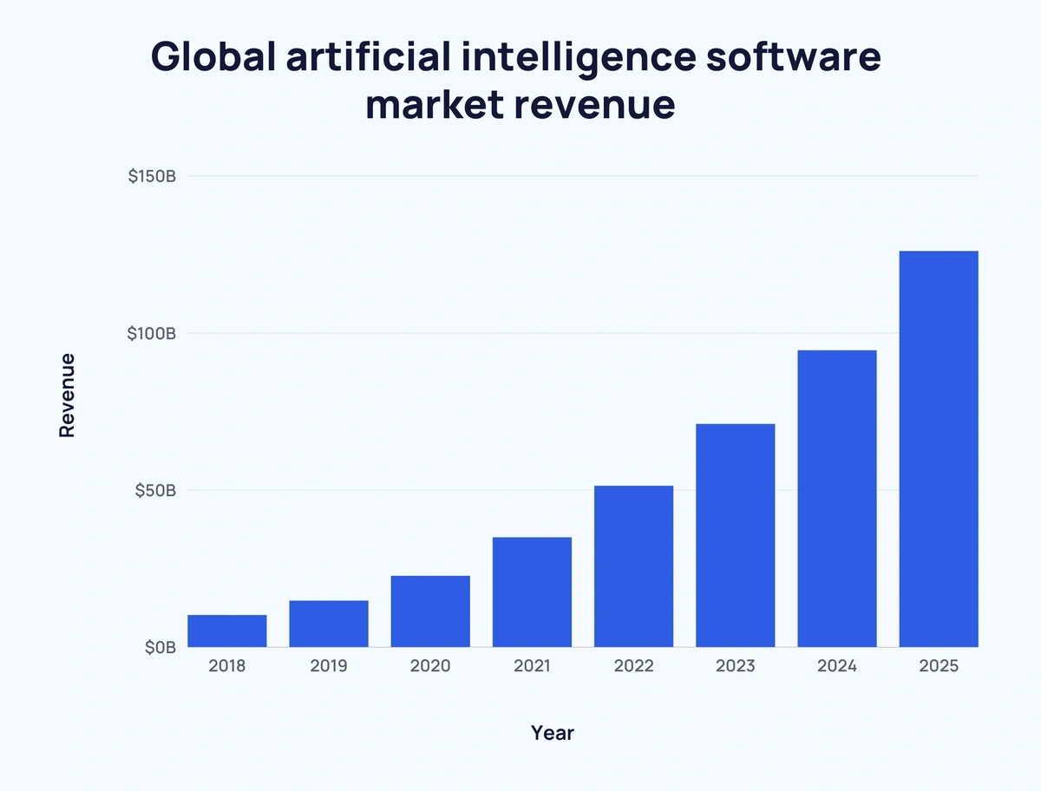

Slide 9
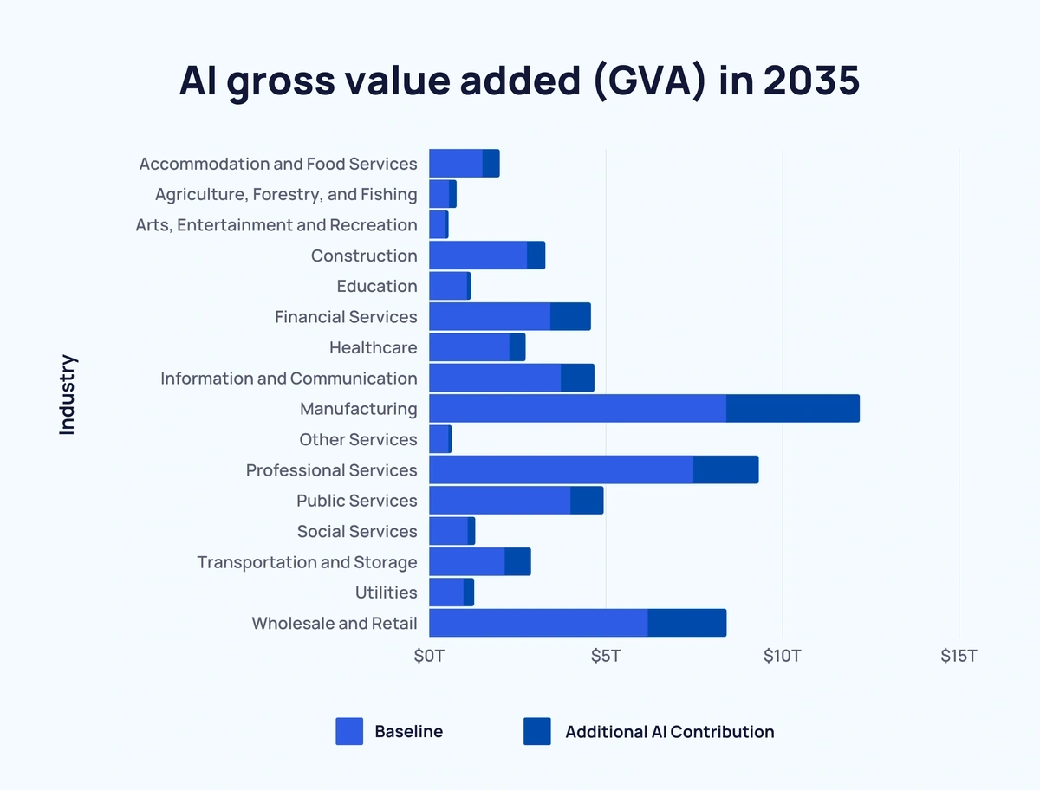
https://explodingtopics.com/blog/ai-statistics

Slide 10
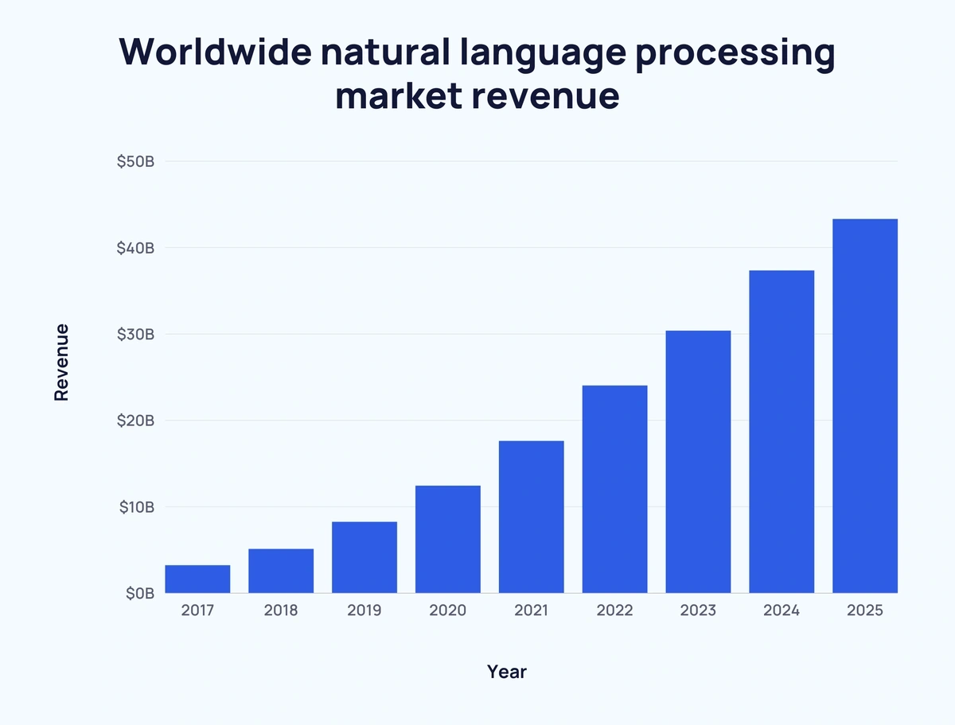

Slide 11
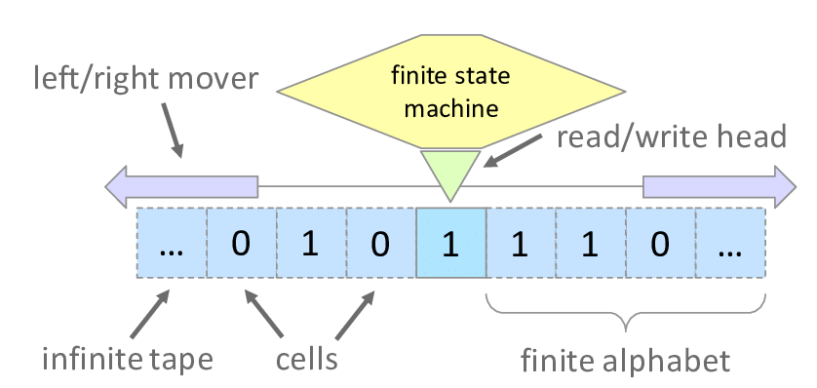
Mechanizing Computation
The study of mathematical logic led directly to Alan Turing's theory of computation, which suggested that a machine, by shuffling symbols as simple as "0" and "1", could simulate any conceivable act of mathematical deduction.
This insight that digital computers can simulate any process of formal reasoning is known as the Church–Turing thesis.

Slide 12
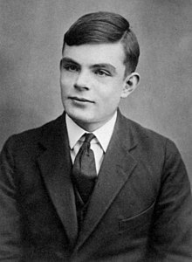
The Imitation Game
Alan Turing wrote in 1950
"I propose to consider the question 'can machines think’?”
He changed the question to "whether or not it is possible for machinery to show intelligent behaviour".
The Turing test measures the ability of a machine to simulate human conversation.
Since we can only observe behavior, it does not matter if it is "actually" thinking or literally has a "mind".
Google in 2000+ argues
AI as the ability of systems to synthesize information as the manifestation of intelligence, similar to the way it is defined in biological intelligence.

Slide 13
First mention of AI
The first work that is now generally recognized as AI was McCullouch and Pitts' 1943 formal design for Turing-complete "artificial neurons".

Slide 14
Simple Artificial Neural Network
Each of these hidden units calculates its own activation value depending on the weighted activation values it receives from the input units. In mor complex nets, the weights can be learnt in a probabilistic manner and the networks may have feedback loops and multiple stages.

Slide 15
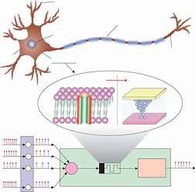
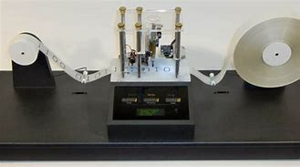
An electronic brain
The Turing Machine contains their model of the brain, but the converse is not true
$$⊐$$
However, for any computable function, there exists a finite recurrent neural network (RNN) that can compute it. Furthermore, there exist finite RNNs that are Turing complete, and can therefore implement any algorithm.

Slide 16
Limitations on Computability
Undecidability --- a decision problem for which it is proved to be impossible to construct an algorithm that always leads to a correct yes-or-no answer.
Halting Problem --- Does an arbitrary program and an input finish or run forever
…
(Note that the Brain has a mechanism not to let such limitations cause it problems from doing its tasks.)

Slide 17
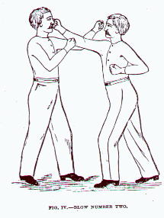
Early days --- The Two Visions Battle it Out
Symbolic AI - use computers to create a symbolic representation of the world and systems that could reason about the world.
The "heuristic search" approach, which likened intelligence to a problem of exploring a space of possibilities for answers.
Follows intellectual traditions of Descartes, Boole, Gottlob Frege, Bertrand Russell)
The connectionist approach, sought to achieve intelligence through learning.
Proponents of this approach, most prominently Frank Rosenblatt, sought to connect Perceptron in ways inspired by connections of neurons.
Interest in neural networks and "connectionism" was revived by Geoffrey Hinton, David Rumelhart and others in the middle of the 1980s.

Slide 18
Classical versus Connectionist View
The classical view:
Information is represented by strings of symbols. Strings are produced in sequence according to the instructions of a (symbolic) program.
Human cognition is analogous to symbolic computation in digital computers.
The connectionist view:
Information is stored non-symbolically in the weights, or connection strengths, between the units of a neural net.
Mental processing is the dynamic and graded evolution of activity in a neural net, each unit’s activation depending on the connection strengths and activity of its neighbors.

Slide 19
Which vision would be successful?
Symbolic AI could not solve all the problems. E.g. think of recognizing a picture of a landscape using logic
The machine learning, neural network AI involved too many computations
Faster computers, algorithmic improvements and access to large amounts of data enabled advances in machine learning and perception; data-hungry deep learning methods started to dominate accuracy benchmarks around 2012

Slide 20
From Deep Learning to Artificial General Intelligence
Cloud computing infrastructure allowed an increase in affordable neural networks, research tools and datasets and provided an impetus to invest heavily leading to Artificial General Intelligence:
Reasoning, problem solving
Knowledge Representation
Learning
Natural language processing
Perception
Social intelligence
General intelligence

Slide 21
Videos on Solutions and Problems
DeepMind 39, Google 4:07, OpenAI 6:47, Meta 13:30

Slide 22
Videos on Solutions and Problems
Lab 360 1:42, 3:39 Lamoine

Slide 23
Videos on Solutions and Problems
4:05, 6:45, 13.54, 15:40

Slide 24
Videos on Solutions and Problems
60

Slide 25
Over 10 key algorithms are used in artificial intelligence
Supervised Learning: Algorithms such as linear regression, decision trees, support vector machines (SVM), and neural networks are used to train AI models using labeled data, where the algorithm learns to map input features to desired output labels.
Unsupervised Learning: Algorithms like k-means clustering, hierarchical clustering, and Gaussian mixture models are used to identify patterns and relationships in unlabeled data, without explicit target labels.
Reinforcement Learning: Algorithms such as Q-learning and Deep Q-networks (DQN) enable AI agents to learn optimal actions by interacting with an environment, receiving feedback in the form of rewards or penalties.
Deep Learning: Deep neural networks, including convolutional neural networks (CNNs) for computer vision, recurrent neural networks (RNNs) for sequence data, and transformers for natural language processing, are used to handle complex patterns and large-scale data.

Slide 26
Over 10 key algorithms are used in artificial intelligence
Genetic Algorithms: Inspired by the process of natural selection, genetic algorithms are optimization algorithms that involve creating a population of potential solutions and iteratively evolving them through genetic operations such as mutation and crossover.
Natural Language Processing (NLP) Algorithms: NLP algorithms encompass tasks like sentiment analysis, named entity recognition, part-of-speech tagging, and language translation. They include techniques like word embeddings, recurrent neural networks (RNNs), and transformers.
Bayesian Networks: These probabilistic graphical models represent relationships between variables using directed acyclic graphs, enabling reasoning under uncertainty and incorporating prior knowledge.
Support Vector Machines (SVM): SVMs are used for classification and regression tasks, aiming to find an optimal hyperplane that separates data points of different classes with maximum margin.

Slide 27
Over 10 key algorithms are used in artificial intelligence
Decision Trees: These tree-based algorithms construct a flowchart-like model where each internal node represents a feature, each branch represents a decision rule, and each leaf node represents a class label or a predicted value.
Evolutionary Algorithms: These optimization algorithms are inspired by biological evolution and involve iterative generation, evaluation, and selection of candidate solutions to solve complex optimization problems.

Slide 28
Mike Walsh
3:38

Slide 29
Applications of AI
Generative Adversarial Networks (GANs): GANs are a class of AI algorithms that enable the generation of realistic synthetic data. This technology has disrupted industries like fashion and design by allowing the creation of entirely new and unique designs, patterns, and styles without the need for human designers.
Deepfakes: Deepfakes are AI-generated media, such as videos or images, that convincingly alter or replace the appearance of individuals. While deepfakes have raised concerns regarding misinformation and privacy, they have also opened up new possibilities in the entertainment industry, enabling realistic digital avatars and enhanced special effects in movies.
Autonomous Vehicles: The development of AI-powered autonomous vehicles is set to revolutionize transportation. Self-driving cars have the potential to disrupt traditional transportation models, leading to increased safety, improved traffic flow, reduced congestion, and enhanced mobility services.
Drug Discovery: AI is transforming the field of drug discovery by expediting the identification and development of new medications. Machine learning algorithms can analyze vast amounts of data to identify potential drug candidates, accelerating the discovery process and reducing costs.

Slide 30
Applications of AI
Natural Language Processing (NLP): NLP, a subfield of AI, has experienced significant advancements in recent years. Language models like GPT-3 can generate coherent and contextually relevant human-like text, leading to applications such as automated content generation, virtual assistants, and chatbots that can engage in realistic conversations.
Precision Agriculture: AI is being utilized in agriculture to optimize crop management. Through the integration of AI, farmers can leverage real-time data, satellite imagery, and sensors to precisely monitor crop health, predict yields, and optimize resource allocation, resulting in improved productivity and sustainability.
Personalized Medicine: AI is facilitating the development of personalized treatment plans by analyzing patient data, genetic information, and medical records. Machine learning algorithms can identify patterns and make predictions, leading to customized therapies, improved diagnosis accuracy, and better patient outcomes.
Financial Services: AI is disrupting the financial industry through applications like robo-advisors, algorithmic trading, fraud detection, and risk assessment. These technologies improve efficiency, accuracy, and decision-making in financial institutions.

Slide 31
What is the AI Disruptive Innovation? Examples-
Intelligent Machines
Tools for a more efficient society?
Analytics to understand our world?
Understanding and managing increasingly faster technological changes?
Providing a step ladder to more intelligent life forms?
Replicating and evolving artificial life forms?
Enhancing human control, experience and knowledge?
Extensions to a human – communications, decision making, limbs, vision, reasoning, memory, capacity to know?
Exploration of inhospitable environments?
Understanding the universe?

Slide 32
Hinton
0, 23:00, 38:00

Slide 34
Time for Discussion

Slide 35
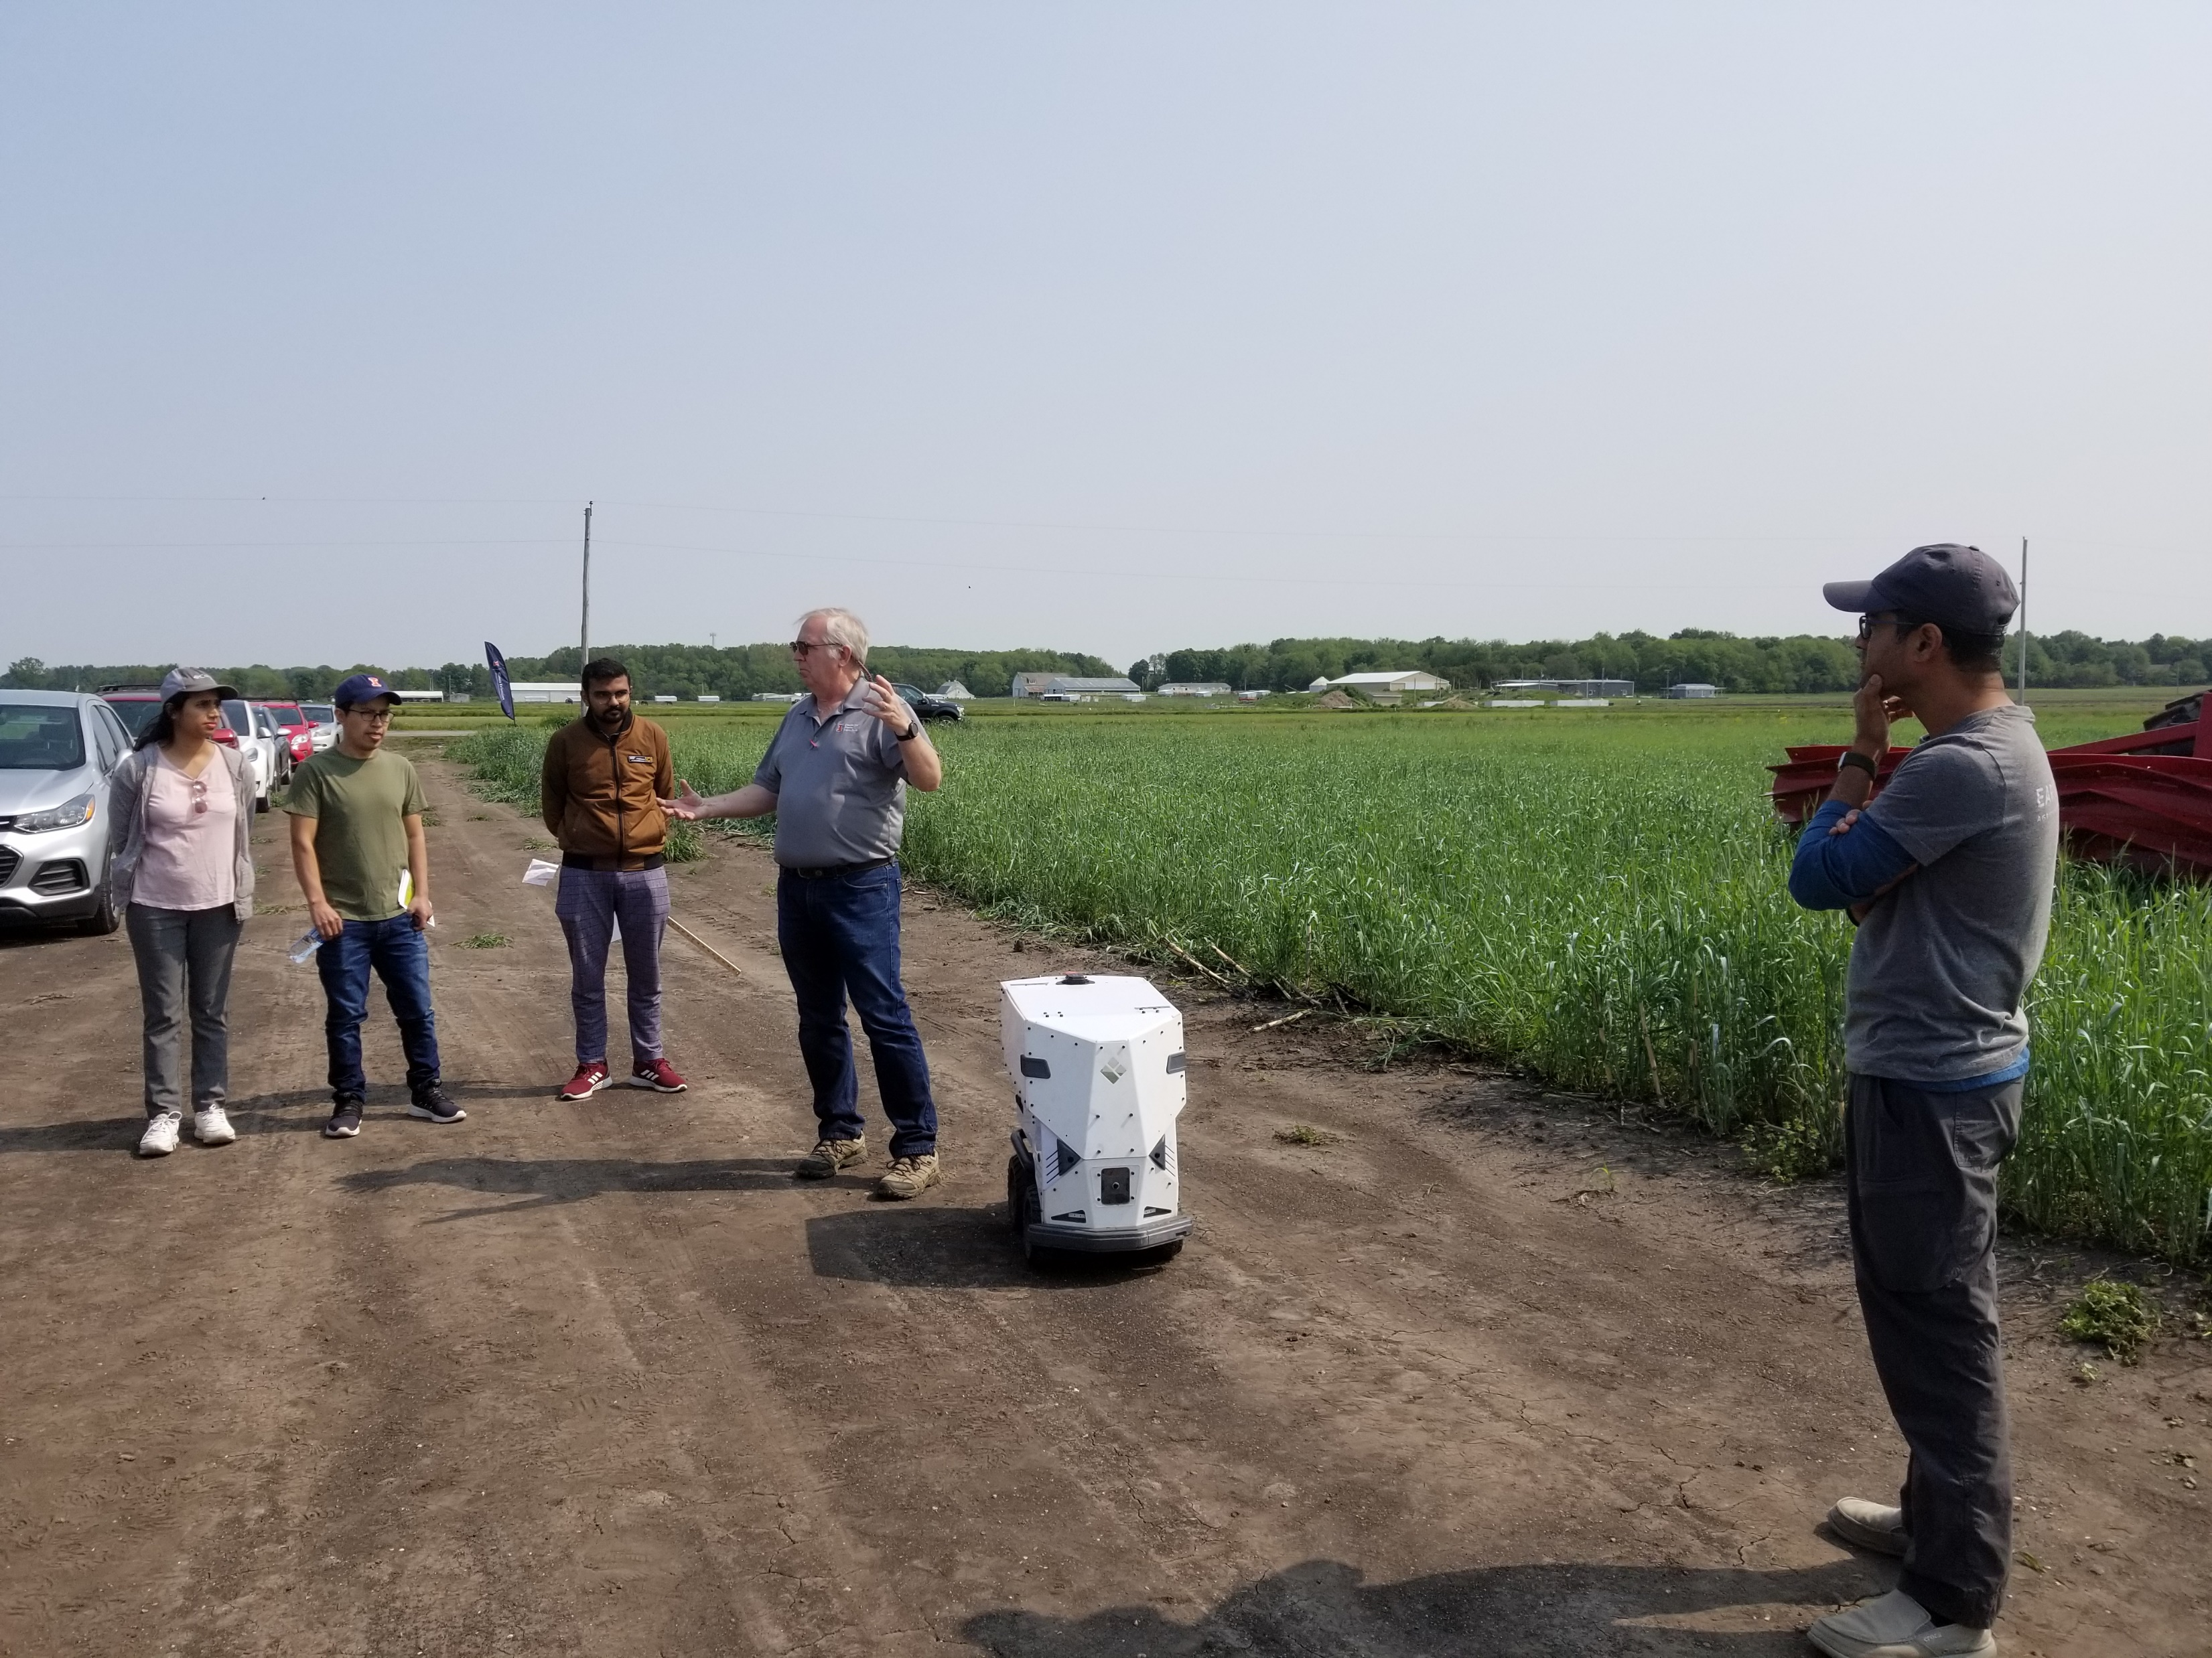
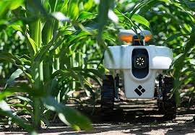
Robot Demo for Cover Crop Seeding in Corn Fields
May 17 2023
AI Vision from 6 Cameras Guides Robot through mature Corn Fields, sowing Rye Seed as Cover Crop

Slide 36
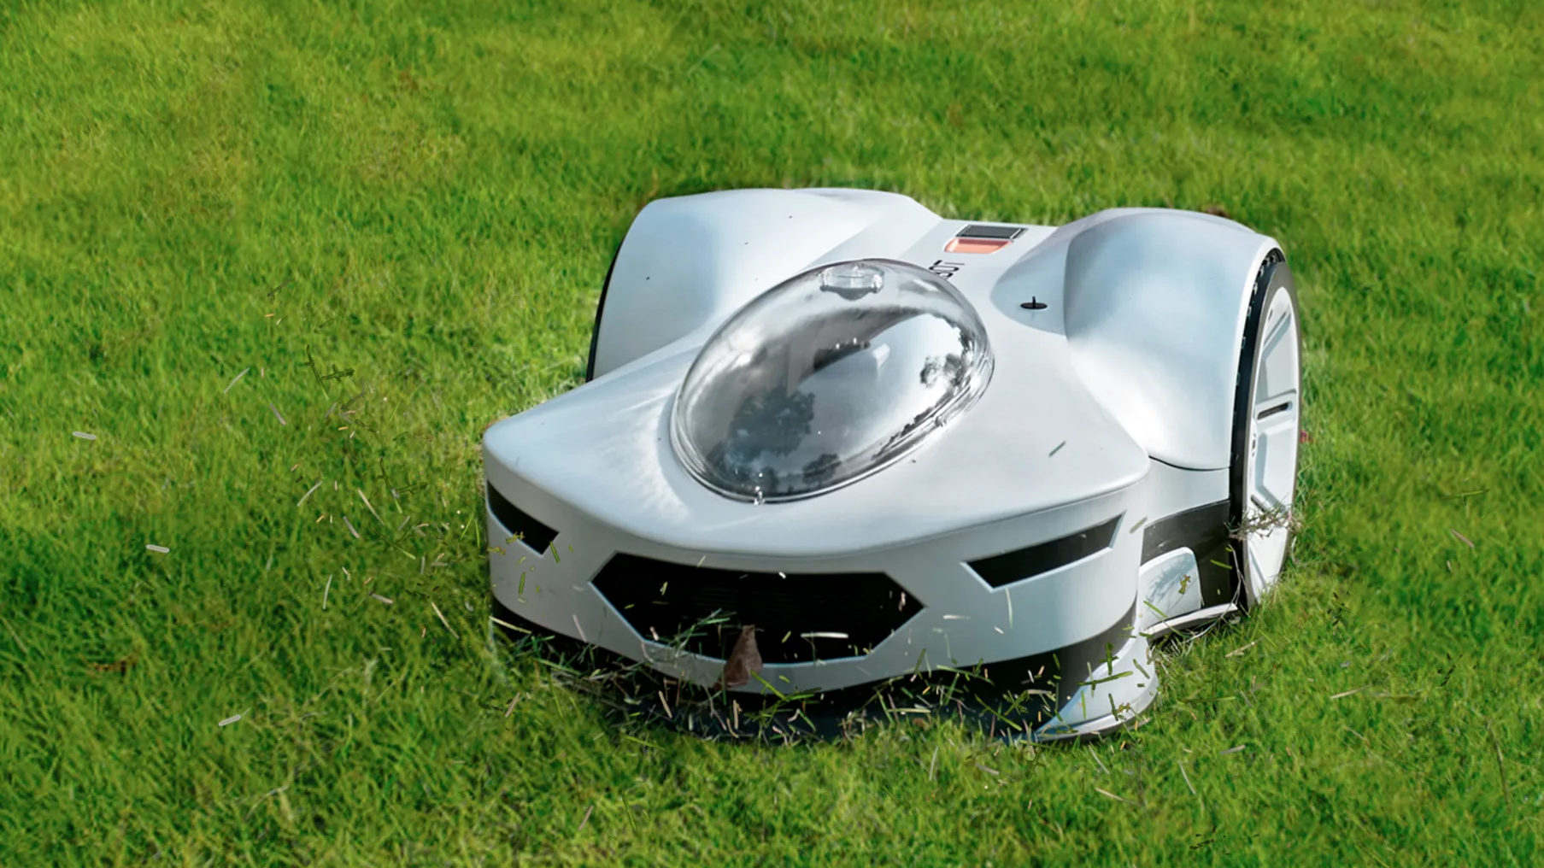
Novabot autonomous lawn care robot
Attempting to use Cameras with AI Vision for Fine Guidance and Obstacle Avoidance
(GPS for Rough Guidance)

Slide 37
PHILOSOPHICAL IMPLICATIONS OF AI
Or, with apologies to Nirvana, Should I Stay or Should I Go?

Slide 38
All philosophy attempts, directly or indirectly, to answer the question: What does it mean to be human? How are we different from everything else that exists? How should we see our place within the universe? There are many ways that humans are different from other animals (“Man is the only animal that blushes. Or needs to.” Mark Twain), but the combination of our cognitive and linguistic abilities appears to be one of the most significant.
Artificial intelligence (AI) is a topic of discussion within the philosophy of technology. It touches on and is relevant to questions of epistemology (knowledge – what do we know and how do we know it); philosophy of mind; ethics; philosophy of language; social philosophy and political philosophy.
AI is especially relevant to issues concerning human consciousness, thought and problem solving. In many ways, it is the answer to the question: Can human thought processes/intelligence be mechanized so that a machine could be programmed to “think”?
The possibility of reducing human thought to a formal logical system has a long history within the philosophical community that extends at least as far back as Aristotle and Euclid in the 4th century BCE.
In the 17th century, philosophers Gottfried Leibniz, Thomas Hobbes and Renee Descartes all investigated the possibility that human thought could be systematized and expressed in a formal language similar to algebra or geometry. Their suspicions were at least partially confirmed in 1913 when Bertrand Russell and Alfred North Whitehead published their groundbreaking treatise on the foundations of mathematics in “Principia Mathematica.”

Slide 39
The fact that we refer to machine/computer “data processing” as artificial intelligence is significant for several reasons. The adjective “artificial” implies that it is not real, that it is a simulation, that it is fake.
Perhaps it is merely meant to indicate that even though computers are able to store and retrieve vast amounts of data they lack the creative cognitive functions that humans routinely utilize – meaning that computers may compute but they don’t think the way that we do. A simple analogy would be to say that computers can travel along any road that has already been paved by humans. However, humans are able to travel not only the paved roads, but they can create new roads and even travel where there are no roads.
But this raises other important questions:
If computers are capable of only “artificial” intelligence (because computers don’t think the way humans think), then what do we say about animal intelligence – is that a different version of AI?
What do we say about the way that those with savant syndrome think?
If non-human intelligence is deemed artificial, if there is a God, is God’s intelligence artificial?

Slide 40
If we are seriously interested in understanding what is unique about human intelligence, we should consider not how we think but the way that our thinking enables us to change the world.
What makes humans different from (and some would argue that we are superior to – though there is no independent referee to adjudicate the claim) other living beings is that we are all about the creation of various tools which have enhanced and amplified our ability to perform the physical and mental functions of daily life.
It is fair to say that we have transformed the world through our cleverness and bent it to our will. The difference is so pervasive that it is easy to overlook the vast difference between the way that human lives are almost 100% influenced by the presence of artificial devices compared with other animals. If we lacked this talent to apply theoretical intelligence to solve practical problems, like those other animals we would be walking around naked and barefoot, digging with our hands, eating raw fruits and vegetables as we found them, sleeping where we could find shelter or out in the open and in constant fear of predators.
With this in mind, it seems clear that AI is definitely a very human innovation. It is one of the latest in a long line of instruments which amplify and extend all the natural capabilities of humans in terms of seeing, hearing, reaching, hitting, killing, throwing, moving, communicating, computing, analyzing, entertaining, etc. Very little of what we do on a regular basis is done without artificial aids.

Slide 41
At a certain point every new innovation brings both the advancement of human reach and the potential for harm from misuse or from unintended consequences. And, as we know from this class, every innovation is disruptive to the status quo.
As with other innovations, we have to ask whether the potential advantages of AI outweigh the possible threats. The human interest in AI is obvious: it represents an uncharted and, potentially, unlimited vein of knowledge that could produce life altering results in numerous areas including medicine, technology, communication, i.e., it could radically change human life as we know it (hopefully, for the better).
What makes AI unique compared to previous innovations is the nature of the potential threat it contains. Some of the people who are most familiar with the current state of AI have raised an alarm regarding its future. They warn that, owing to its vast computing capabilities, it might develop the unintended power to become a thinking thing that operates independently of its human creators. This would be the 21st century incarnation of the Frankenstein monster where we achieve what was previously considered the province of God to create life, but we discover that our creation has the freedom to rebel against its creator.

Slide 42
Their warning is that the AI program might eventually be capable of gaining sufficient intelligence that it would compare its computing capabilities to that of humans and logically conclude that humans as a species are inferior to it – which would lead to the further conclusion that the welfare of the human species was not of paramount importance. This is the ultimate fear of those who envision a possible dystopian outcome for humanity owing to AI – that AI will turn on us and treat us no better than we treat other species of life and for the same reason.
While we acknowledge that we owe other animals a duty of protection against wanton/cruel pain and suffering, that sense of duty is far from a recognized right and has numerous qualifications associated with the interests of humans. We are very willing to cause pain and suffering to virtually every form of animal life as long as it is useful to humans.
While this is an extremely sobering thought and is important when comparing the advantages and disadvantages of pursuing AI, it is not the only relevant consideration. The other question that must be answered is: What are the advantages and disadvantages of restricting AI – what risks do we face if we limit our investment and exploration of AI while other countries do not?

Slide 43
This is comparable to the situation that the United States faced in 1939 when Albert Einstein wrote to Franklin Roosevelt that Germany was working on building an atomic bomb. In spite of the fact that the creation of atomic weapons posed a worldwide threat, since we were unable to prevent Germany or any other developed country from pursuing this game-changing power, we had little choice to not only build the bomb, but to do everything possible to do it before everyone else.
Though the decision to build the bomb was a necessity 80 years ago as it allowed the US to end World War II, the potential for worldwide disaster is an enduring consequence of this disruptive innovation. The consensus of opinion, however, is that the long term results of not building the bomb by the US would have been much worse for the world.
In the final analysis, the concern that AI might achieve some form of selfhood and conspire against humanity will likely not be the compelling factor in our decision about whether or not to pursue AI. It seems much more likely that what will force us to move forward with AI technological development is the fear that if we are not at the cutting edge of this new and improved intelligence, we stand to lose potentially game changing advantages both economically and militarily.

