Slide 1
Disruptive Innovation and Technology
Roy Campbell
Session 5: Fertility
Week 6 assignment

Slide 2
In vitro gametogenesis
In vitro gametogenesis. Possible in mice now, not humans yet
2010 In vitro fertilization (IVF) Nobel Prize in Physiology and Medicine to Robert Edwards

Slide 3
Videos
PBS Amanpour Future of Fertility (Interview with Author Emily Witt) https://www.pbs.org/wnet/amanpour-and-company/video/future-fertility-7jntwm/ (2:43)
How Close Are We to the End of Infertility? https://www.youtube.com/watch?v=JLW6lty0S-A&pp=ygUmMi4JIlRoZSBGdXR1cmUgb2YgRmVydGlsaXR5IiBieSBXSVJFRCA%3D
The Second Reproductive Revolution: Glenn Cohen (author of Disruptive Reproductive Technologies) delivers chair lecture https://youtu.be/c8LoQUfA1lo from 15:00 onwards provides a legal background view of some of the techniques (not very visual unfortunately)

Slide 4
Disruptive Innovations in the field of Fertility
Disruptive innovations in stem cell and embryo technology have the potential to transform the field of medicine and improve the lives of millions of people worldwide.
In vitro fertilization (IVF)
Preimplantation genetic testing (PGT
Egg freezing
Sperm and egg donation
Surrogacy
Artificial insemination

Slide 5
Background. Birth Statistics
Data for United States in 2021
Number of births: 3,664,292
Number of IVF births in 2020: 79,942
Birth rate: 11.0 per 1,000 population
Fertility rate: 56.3 births per 1000 women aged 15-44 years
Prenatal care initiated in the 1st trimester: 78.3%
Percent born preterm (less than 37 completed weeks of gestation): 10.49%
Percent cesarean delivery: 32.1%
Medicaid as source of payment for the delivery: 41.0%

Slide 6
The fertility business is booming (The Economist 8/8/2019
Postponing babies, singles, infertility
2019 the global fertility industry $25bn in sales
1 in 60 in America is born thanks to in vitro fertilisation (ivf) and other artificial treatments
More than 1 in 25 Denmark, Israel and Japan
2020 The global fertility market size was valued at USD 33.1 billion
2023 China revenues about $7bn
2026 the global fertility industry possibly $41bn in sales
2030 the global fertility industry possibly $47.9bn in sales
https://www.economist.com/business/2019/08/08/the-fertility-business-is-booming

Slide 7
Frozen Eggs and Sperm 2017
2017 nearly 11,000 American women froze their eggs
$99 “Dadi kit” from Dadi, a company in Brooklyn (“Store your sperm, stop the clock”)
Children conceived through sperm donation have a birth defect rate of almost a fifth compared to the general population.
In 2017, a lawsuit was brought in U.S. District Court for the Northern District of Illinois regarding autism diagnoses among multiple offspring of Donor-H898.

Slide 8
Sperm Donor History https://en.wikipedia.org/wiki/Sperm_donation
In 1884, Professor William Pancoast of Philadelphia's Jefferson Medical College performed an insemination on the wife of a sterile Quaker merchant, which may be the first insemination procedure that resulted in the birth of a child.
Instead of taking the sperm from the husband, the professor chloroformed the woman, then let his medical students vote which one of among them was "best looking", with that elected one providing the sperm that was then syringed into her cervix.
At the husband's request, his wife was never told how she became pregnant.
As a result of this experiment, the merchant's wife gave birth to a son, who became the first known child by donor insemination.
The case was not revealed until 1909, when a letter by Addison Davis Hard appeared in the American journal Medical World, highlighting the procedure.

Slide 9
Egg Donor History https://en.wikipedia.org/wiki/Egg_donation
The first child born from egg donation was reported in Australia in 1983.
In July 1983, a clinic in Southern California reported a pregnancy using egg donation, which led to the birth of the first American child born from egg donation on 3 February 1984.
This procedure was performed at the Harbor UCLA Medical Center and the University of California at Los Angeles School of Medicine.
In the procedure, which is no longer used today, a fertilized egg that was just beginning to develop was transferred from one woman in whom it had been conceived by artificial insemination to another woman who gave birth to the infant 38 weeks later.
The sperm used in the artificial insemination came from the husband of the woman who bore the baby.

Slide 10
Everyone knows someone facing infertility
12% of women experience difficulties becoming pregnant or carrying a child to term.
1 in 8 couples in America encounter fertility hurdles.
19% of all couples are unable to conceive after a year of unprotected sex.
10% of all couples are unable to conceive after two years of unprotected sex.
33% of Americans have turned to fertility treatments or know someone who has.
https://www.cofertility.com/family-learn/fertility-statistics

Slide 11
Problems of Human Fertility
Infertility: Infertility is defined as the inability to conceive after one year of trying for women under the age of 35, or six months for women over the age of 35. There are many different factors that can contribute to infertility, including age, hormonal imbalances, genetic disorders, and environmental factors.
Pregnancy Loss: Pregnancy loss is a common problem in human fertility. Miscarriage, stillbirth, and ectopic pregnancy are all potential outcomes of a pregnancy loss.
Low Sperm Count: Low sperm count is a common cause of male infertility. It can be caused by a variety of factors, including hormonal imbalances, genetic disorders, and environmental factors.
Polycystic Ovary Syndrome (PCOS): PCOS is a hormonal disorder that affects women and is a common cause of infertility. It can cause irregular periods, cysts on the ovaries, and high levels of male hormones.
Endometriosis: Endometriosis is a condition where the tissue that normally lines the inside of the uterus grows outside of it, which can cause pain and infertility.
Age-related Decline in Fertility: As women age, their fertility declines. This is due to a decrease in the number and quality of eggs, as well as other factors.

Slide 12
Definitions
In vitro fertilization (IVF): IVF is a procedure in which an egg is fertilized by sperm outside the body, in a laboratory dish, and then implanted into the woman's uterus. This technique was first successfully used in humans in 1978 and has since become a common treatment for infertility.
Preimplantation genetic testing (PGT): PGT is a technique used in conjunction with IVF that allows doctors to screen embryos for genetic abnormalities before they are implanted in the uterus. This can help reduce the risk of certain genetic disorders and increase the chances of a successful pregnancy.
Egg freezing: Egg freezing, or oocyte cryopreservation, is a process in which a woman's eggs are frozen and stored for later use. This can be a helpful option for women who want to delay pregnancy for personal or medical reasons.

Slide 13
Definitions
Sperm and egg donation: Donor sperm and eggs can be used in IVF or other fertility treatments to help individuals or couples conceive a child. This can be especially useful for individuals or couples who are unable to produce viable sperm or eggs.
Surrogacy: Surrogacy is a process in which a woman carries a baby for another individual or couple. This can be an option for individuals or couples who are unable to carry a pregnancy themselves, either due to medical reasons or personal choice.
Artificial insemination: Artificial insemination is a technique in which sperm is directly inserted into a woman's cervix, uterus, or fallopian tubes to help facilitate fertilization. This can be a helpful option for individuals or couples who have difficulty conceiving through intercourse.

Slide 14
Economic Costs
High Cost of Fertility Treatments: Fertility treatments can be very expensive, and may not be covered by insurance. This can make it difficult for many couples to afford these treatments, and can result in financial strain.
Lost Productivity: Fertility treatments can be time-consuming, and may require multiple appointments and procedures. This can result in lost productivity for individuals and businesses.
Increased Healthcare Costs: Fertility treatments can result in increased healthcare costs for both individuals and insurance providers. This can have a ripple effect throughout the healthcare system.
Lower Birth Rates: As fertility rates decline, there may be economic consequences, such as a shrinking labor force, and a lower number of consumers.
Need for Paid Leave: Fertility treatments can require time off from work, which may not be covered by existing leave policies. This can result in lost wages for individuals, and can impact their ability to afford treatment.
Ethics and Regulation: There are ethical and regulatory issues associated with fertility treatments, such as the use of donor eggs or sperm, and the potential for genetic manipulation. These issues can impact the availability and affordability of fertility treatments.

Slide 15
How much does an IVF Cycle Cost
A single IVF cycle—defined as ovarian stimulation, egg retrieval and embryo transfer—can range from $15,000 to $30,000, depending on the center and the patient’s individual medication needs. (Forbes)
Frozen donor eggs base cycle fee: $14,000 to $20,000+
Fresh donor eggs base cycle fee: $27,000 to $47,000+
Donor sperm: $300 to $1,600
Embryo storage: $350 to $600 a year.
Frozen embryo transfer (FET): Included in base fee to $6,400.

Slide 16
IVF Facts
1 million babies born in the United States between 1987 and 2015 through the use of IVF or other assisted reproductive technologies, according to a report released in 2017 by the by the U.S. Society of Assisted Reproductive Technology (SART).
The chance of having a full term, normal birth weight and singleton live birth per ART cycle using fresh embryos from nondonor eggs is 21.3 percent for women younger than 35
35 to 37 years old have a 17 percent chance
38 to 40 years old have a 11.1 percent chance
41 to 42 have a 5.7 percent chance
43-44 have 2.3 percent chance
44 and older have a 0.6 percent chance

Slide 17
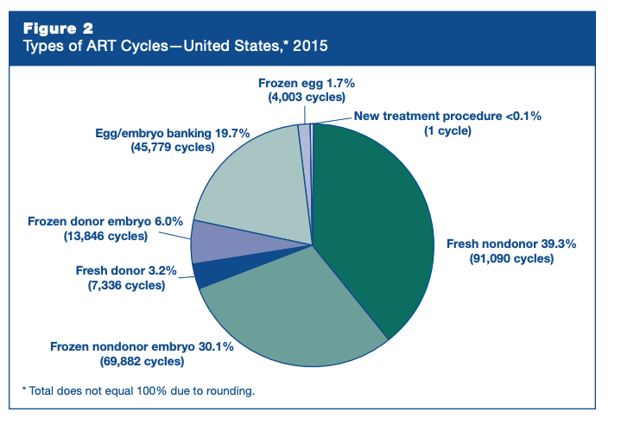
Types of ART Cycles

Slide 18
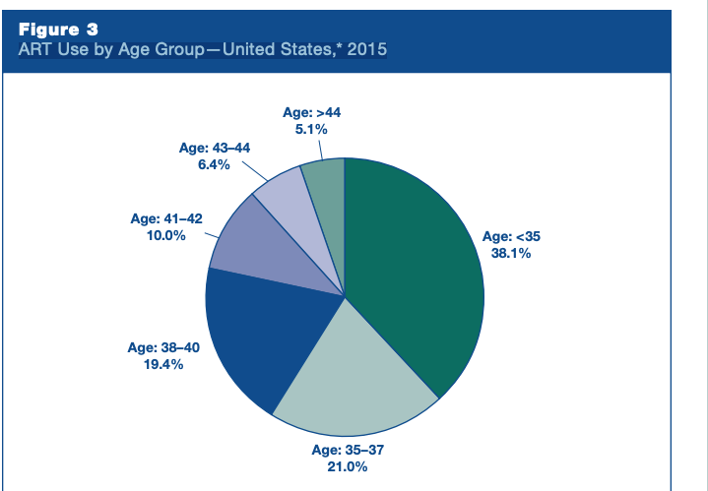
Use By Age

Slide 19
Disruptive innovations in the field of stem cell to emryo tehnology
The field of stem cell and embryo technology is a rapidly evolving area of research that holds great promise for medical advancements. There are several disruptive innovations that have emerged in this field in recent years:
Induced pluripotent stem cells (iPSCs): iPSCs are adult cells that have been genetically reprogrammed to behave like embryonic stem cells, which have the ability to develop into any type of cell in the body. This innovation has the potential to revolutionize the field of regenerative medicine by providing an alternative to embryonic stem cells, which have ethical and logistical challenges associated with their use.
CRISPR-Cas9 gene editing technology: This technology allows scientists to precisely modify the genetic code of cells, including stem cells and embryos, with unprecedented accuracy and efficiency. This could be used to correct genetic defects in embryos or to create new models for studying disease.
3D bioprinting: This technology involves printing living cells and biomaterials in a 3D format, allowing scientists to create complex tissues and organs that can be used for transplantation or drug testing. This could eventually lead to the production of fully functional human organs for transplantation.
Embryo culture systems: New techniques for culturing embryos outside the body are being developed, which could increase the success rates of in vitro fertilization (IVF) and enable better genetic testing of embryos before implantation.
Overall, these disruptive innovations in stem cell and embryo technology have the potential to transform the field of medicine and improve the lives of millions of people worldwide. However, it is important that they are developed and used in an ethical and responsible manner, taking into account the potential risks and benefits for patients and society as a whole.

Slide 20
Is it possible to create embryos from skin tissue
Yes, it is possible to create embryos from skin tissue using a technique called somatic cell nuclear transfer (SCNT). SCNT involves removing the nucleus of an egg cell and replacing it with the nucleus from a somatic (non-reproductive) cell, such as a skin cell. The resulting cell is then stimulated to divide and develop into an embryo.
This technique has been successfully used to create cloned animals, such as Dolly the sheep, and has also been used to create human embryos in the laboratory. In 2013, scientists at Oregon Health and Science University reported that they had successfully created human embryos using SCNT, using skin cells as the source of the somatic cell nucleus.
The creation of embryos using SCNT has potential applications in both reproductive and therapeutic cloning. In reproductive cloning, the resulting embryos could be implanted in a woman's uterus to create a clone of the original donor. In therapeutic cloning, the resulting embryos could be used to create embryonic stem cells that are genetically identical to the donor, which could then be used to treat a range of diseases and injuries.
However, the use of SCNT and the creation of embryos for research and clinical purposes raises ethical questions and concerns, particularly around the potential for exploitation and the moral status of the embryo. As with all emerging technologies, it will be important to carefully consider the potential risks and benefits of this technique as it continues to be developed and refined.

Slide 21
Induced pluripotent stem cells (iPSCs)
Induced pluripotent stem cells (iPSCs) are a type of stem cell that are created by reprogramming adult cells, such as skin cells, back to an embryonic-like state. This is done by introducing certain genes or proteins into
the cells, which can turn back the clock on their development and allow them to become pluripotent, meaning they have the ability to differentiate into any type of cell in the body.
iPSCs were first created in 2006, and their discovery was a major breakthrough in the field of regenerative medicine. Prior to iPSCs, the only source of pluripotent stem cells was from
embryos, which raised ethical concerns and limitations for research.
One of the key advantages of iPSCs is that they can be created from the patient's own cells, which reduces the risk of rejection when used in medical treatments. iPSCs also offer a valuable
tool for studying diseases in the lab, as they can be used to create disease models and test potential treatments.
However, iPSCs are not yet perfect replacements for embryonic stem cells. They are still being studied and improved to ensure their safety and efficacy for use in medical treatments.
There are also concerns about the potential for genetic abnormalities or mutations during the reprogramming process, which could impact their clinical use.
Overall, iPSCs represent a promising area of research and development in the field of regenerative medicine, and they hold great potential for treating a wide range of diseases and conditions.

Slide 22
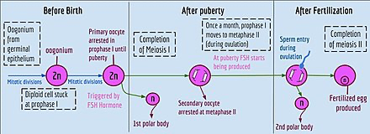
Oogenesis

Slide 23
3D bioprinting
3D bioprinting is an innovative technology that enables the printing of living cells and biomaterials in a three-dimensional format, allowing scientists to create complex tissues and even entire organs that can be used for transplantation or drug testing.
The process of 3D bioprinting involves the creation of a digital design of the desired tissue or organ, which is then translated into a series of precise printing instructions that are loaded into a specialized printer. The printer then deposits layer upon layer of living cells and biomaterials to create the final three-dimensional structure.
One of the key benefits of 3D bioprinting is that it allows for the creation of structures with much greater complexity than could be achieved through traditional tissue engineering techniques. For example, it can be used to create vasculature or blood vessels within printed tissues, which is essential for the delivery of nutrients and oxygen to the cells.
3D bioprinting is still a relatively new technology and there are still many challenges to overcome, such as the need for better printing materials and techniques, as well as the need to develop methods for integrating the printed tissues with existing biological systems. However, the potential applications of 3D bioprinting are vast, ranging from the creation of replacement tissues and organs for transplantation, to the development of personalized drug testing platforms and disease models for research.
Despite its many potential benefits, 3D bioprinting also raises ethical questions about the creation and use of living tissues and organs. As with all emerging technologies, it will be important to carefully consider the potential risks and benefits of 3D bioprinting as it continues to evolve and develop.

Slide 24
Embryo culture systems
Embryo culture systems refer to the techniques used to grow and develop embryos outside the body in a laboratory setting. These systems have been developed and improved over the years, and have become an essential part of in vitro fertilization (IVF) and other assisted reproductive technologies (ART).
In traditional IVF, the fertilization of an egg by a sperm occurs in a petri dish in the laboratory. Once fertilization occurs, the resulting embryos are typically transferred to the woman's uterus to continue their development. However, some embryos may not be suitable for transfer, or there may be a desire to test them for genetic abnormalities before implantation. This is where embryo culture systems come in.
Embryo culture systems involve placing the embryos in a specially designed culture medium that contains all the nutrients and other factors needed for their growth and development. The embryos are kept in incubators that closely mimic the conditions of the female reproductive system, including temperature, humidity, and gas composition. The embryos are closely monitored over several days to ensure that they are developing normally.
Embryo culture systems have several advantages. They allow for better monitoring and selection of embryos for transfer, increasing the success rates of IVF. They also allow for genetic testing of embryos before implantation, which can help to reduce the risk of genetic disorders or other abnormalities being passed on to the child.
However, embryo culture systems also raise ethical concerns. Some argue that the creation and manipulation of embryos in a laboratory setting raises questions about the beginning of life and the moral status of the embryo. Additionally, there are concerns about the potential for abuse or misuse of this technology, particularly in the area of genetic selection and engineering.
Overall, embryo culture systems are an important tool in the field of assisted reproduction and have helped to revolutionize the treatment of infertility. However, it will be important to continue to monitor and regulate their use to ensure that they are used safely and responsibly.

Slide 25
Problems addressed by Innovations
Cost: Fertility treatments can be expensive and are often not covered by insurance. Disruptive innovations in fertility are aiming to make treatments more affordable and accessible.
Success Rates: Traditional fertility treatments, such as in vitro fertilization (IVF), have success rates that can be relatively low. Disruptive innovations are developing new techniques and technologies to improve success rates.
Invasiveness: Many fertility treatments are invasive and can be physically and emotionally taxing for patients. Disruptive innovations are exploring less invasive options, such as non-invasive embryo selection and implantation.
Ethics: Some traditional fertility treatments raise ethical questions, such as the use of donor eggs or sperm. Disruptive innovations are exploring new ethical frameworks and technologies that can address these concerns.
Quality Control: Fertility treatments often involve complex processes and require careful monitoring to ensure quality control. Disruptive innovations are developing new technologies to improve monitoring and quality control, such as lab automation and artificial intelligence.
Overall, disruptive innovations in the field of fertility are focused on making treatments more accessible, affordable, effective, and ethical. These innovations are likely to have a significant impact on the field in the years to come.

Slide 26
Is it possible to create an egg cell
Currently, it is not possible to create an egg cell from scratch in a laboratory setting. Egg cells, or oocytes, are highly specialized cells that require complex interactions with the female reproductive system to develop and mature properly. While there have been some attempts to create artificial egg cells using stem cells, the resulting cells have not been fully functional and have not yet been able to support fertilization and embryo development.
However, there have been some recent advances in the field of oocyte research that may one day lead to the development of artificial egg cells. For example, researchers have been able to isolate and culture immature oocytes from ovarian tissue, which may eventually be matured and used for fertility treatments. Additionally, new techniques for in vitro maturation of human oocytes are being developed, which could potentially be used to improve the success rates of in vitro fertilization (IVF) and other assisted reproductive technologies.
Despite these advances, there are still many challenges to overcome before the creation of artificial egg cells becomes a reality. The development and maturation of egg cells is a complex process that involves a variety of genetic and environmental factors, and it will likely be many years before researchers are able to fully replicate this process in a laboratory setting.

Slide 27
References
Here is a New Yorker reference The Future of Fertility https://www.newyorker.com/magazine/2023/04/24/the-future-of-fertility
Video PBS Amanpour Future of Fertility (Interview with Author Emily Witt) https://www.pbs.org/wnet/amanpour-and-company/video/future-fertility-7jntwm/
Science Translational Medicine Disruptive reproductive technologies https://reproductivetech.stanford.edu/papers/dis-repro.pdf (ask me if you cant find it.)
Video The Second Reproductive Revolution: Glenn Cohen (author of Disruptive Reproductive Technologies) delivers chair lecture https://youtu.be/c8LoQUfA1lo from 15:00 onwards provides a legal background view of some of the techniques (not very visual unfortunately)
Video How Close Are We to the End of Infertility? https://www.youtube.com/watch?v=JLW6lty0S-A&pp=ygUmMi4JIlRoZSBGdXR1cmUgb2YgRmVydGlsaXR5IiBieSBXSVJFRCA%3D

Slide 28
In vitro fertilization (IVF)

Slide 29
Preimplantation genetic testing (PGT)

Slide 30
Egg freezing

Slide 31
Sperm and egg donation

Slide 32
Surrogacy

Slide 33
Artificial insemination

Slide 34
Top ten new disruptive innovations
Quantum Computing: Quantum computing is a new form of computing that is expected to revolutionize industries from finance to healthcare by providing much faster and more powerful computing capabilities than traditional computers. CRISPR Gene Editing: CRISPR is a revolutionary gene editing technology that allows scientists to make precise edits to DNA. It has the potential to cure genetic diseases and transform healthcare. Edge Computing: Edge computing brings computing capabilities closer to the devices and sensors that collect data, reducing latency and enabling faster and more efficient data processing. Internet of Things (IoT): The IoT refers to the interconnected network of devices, sensors, and objects that can communicate with each other and collect and share data. It has the potential to transform industries from healthcare to manufacturing. Digital Twins: Digital twins are virtual replicas of physical objects or systems that can be used to test and optimize performance. They have the potential to revolutionize industries from aerospace to manufacturing. Quantum Encryption: Quantum encryption uses the principles of quantum mechanics to provide secure communications that cannot be intercepted or hacked. Brain-Computer Interfaces: Brain-computer interfaces enable direct communication between the brain and a computer or other device. They have the potential to transform healthcare and enable new forms of communication and interaction. Wearable Technology: Wearable technology such as smartwatches and fitness trackers are becoming more sophisticated, with the potential to revolutionize healthcare and enable more personalized and efficient care. 5G Networks: 5G networks are the next generation of cellular networks, providing faster speeds, lower latency, and more capacity. They have the potential to transform industries from entertainment to transportation. Biodegradable Plastics: Biodegradable plastics are a new type of plastic that can break down naturally in the environment, reducing the amount of plastic waste that ends up in landfills and oceans. They have the potential to transform the packaging industry and reduce environmental impact.

