Slide 1
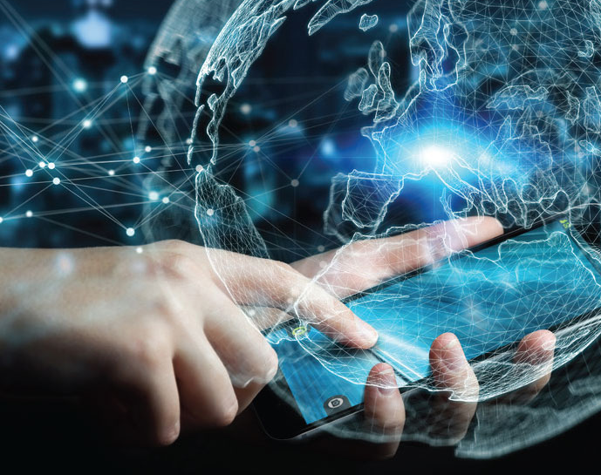
Disruptive Innovation and Technology
Roy Campbell
Session 5: Telecommunications
Week 6 assignment

Slide 2
The Genesis of Telecom: “In the beginning”
Can you help me with this message?
Notes:
https://www.starwars.com/video/help-me-obi-wan-kenobi

Slide 3
May the Fourth
be with you

Slide 4
Telecommunication is a compound noun of the Greek prefix tele- (τῆλε), meaning distant, far off, or afar, and the Latin verb communicare, meaning to share.
At the 1932 Plenipotentiary Telegraph Conference and the International Radiotelegraph Conference in Madrid, the two organizations decided to merge to form the International Telecommunication Union (ITU). They defined telecommunication as "any telegraphic or telephonic communication of signs, signals, writing, facsimiles and sounds of any kind, by wire, wireless or other systems or processes of electric signaling or visual signaling (semaphores)."

Slide 5
The Internet: Wires, Cables & WiFi
https://youtu.be/ZhEf7e4kopM
This video provides a brief history of the internet and how digital packet-switching technology transformed the telecommunications industry. (6:41)

Slide 6
Prehistory
smoke signals
drums.
kerchiefs or flags at intervals along the way back to the high priest to indicate the goat "for Azazel" had been pushed from the cliff. (Radical Judaism)
Greek hydraulic semaphore systems were used as early as the 4th century BC.

Slide 7
History
Pidgeons
550 BC Pigeon post had Persian roots and was later used by the Romans to aid their military.
776 BCE The Greeks sent the names of the victors at the Olympic Games to various cities using homing pigeons.
40-103 AD Frontinus claimed Julius Caesar used pigeons as messengers in his conquest of Gaul.
1810, the Dutch government used the system in Java and Sumatra.
1849, Paul Julius Reuter started a pigeon service to fly stock prices between Aachen and Brussels.
Beacons
1588 Sighting of the Spanish Armada used a beacon chain relayed a signal from Plymouth to London.
1792, Claude Chappe, a French engineer, built the first fixed visual telegraphy system (or semaphore line) between Lille and Paris.

Slide 8
More History
1837, first commercial electrical telegraph demonstrated by English inventor Sir William Fothergill Cooke and English scientist Sir Charles Wheatstone.
1837, Samuel Morse independently developed a version of the electrical telegraph that he unsuccessfully demonstrated.
1866, The first transatlantic telegraph cable was successfully completed allowing transatlantic telecommunication for the first time.
1876, The conventional telephone patent by Alexander Bell (controversy with Elisha Gray)
1901, Marconi showed wireless waves transmitted across the Atlantic Ocean
1920, AM Broadcasting
1925, Logie Baird demonstrated transmission of moving pictures at Selfridges using Nipkow disk
1930-70, FM Stereo Broadcasting
1927, Philo Farnsworth demonstrated cathode ray tube television

Slide 9
Even More History
Thermionic valves:- signal amplification and current rectification.
1904 Diode by John Ambrose Fleming
1940s semiconductor devices
1904 Cats Whisker detector
1947 Transistor Bardeen, Brattain, and Shockley could amplify
transistor radio, cassette tape player, walkie-talkie and quartz watch, computers, mobile phones, microprocessor chip, LED lamp, solar cell, charge coupled device (CCD) image sensor, and semiconductor laser.
1969 A four-node network constituting the beginnings of the ARPANET,
1981 had grown to 213 nodes. ARPANET eventually merged with other networks to form the Internet.
While Internet development was a focus of the Internet Engineering Task Force (IETF) who published a series of Request for Comments documents, other networking advancements occurred in industrial laboratories, such as the local area network (LAN) developments of Ethernet (1983) and Token Ring (1984)

Slide 10
Circuit switching
Circuit switching is a method of implementing a telecommunications network in which two network nodes establish a dedicated communications channel (circuit) through the network before the nodes may communicate. The circuit guarantees the full bandwidth of the channel and remains connected for the duration of the communication session.

Slide 11
Packet Switching
packet switching is a method of grouping data into packets that are transmitted over a digital network. Packets are made of a header and a payload.
1960s, Polish-American engineer Paul Baran distributed adaptive message block switching, fault-tolerant, efficient routing method for telecommunication messages RAND Corporation
1965 Donald Davies at the National Physical Laboratory coined the modern term packet switching and inspired numerous packet switching networks in the decade following

Slide 12
Connectionless and connection-oriented
Packet switching
Connectionless IP protocol (typically a fixed length packet size)
Connection-oriented TCP protocol (arbitrary size message)
However TCP can be implemented on top of IP leading to TCP/IP using
packet disassembly and reassembly,
a connection destination address and source address
routing tables
packet count
sequence number

Slide 13
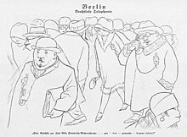
1926 the artist Karl Arnold drew a visionary cartoon about the use of mobile phones in the street

Slide 14
The Evolution of Mobile Phones
https://www.facebook.com/techinsider/videos/826199524245072/
This video traces the evolution of mobile phones from the first handheld device in the 1980s to modern smartphones, highlighting how mobile communication technology disrupted traditional communication methods. (4:07)

Slide 15
Cell Phone History
Mobile communication devices that connect wirelessly to the public switched telephone network.
1908, Professor Albert Jahn and the Oakland Transcontinental Aerial Telephone and Power Company claimed to have developed a w
1917 the Finnish inventor Eric Tigerstedt successfully filed a patent for a "pocket-size folding telephone with a very thin carbon microphone".ireless telephone.
1918, the German railroad system tested wireless telephony on military trains between Berlin and Zossen

Slide 16
More Cell Phone History
Hand-held radio transceivers have been available since the 1940s (2nd World War)
1946 Bell Labs inauguration of mobile service in St. Louis, Missouri.
Almost at same time AT&T offered Mobile Telephone Service (MTS).
December 1947, Douglas H. Ring and W. Rae Young, Bell Labs engineers, proposed hexagonal cells for mobile phones in vehicles.
1957–1961 Leonid Kupriyanovich, an engineer from Moscow, developed and presented a number of experimental pocket-sized communications radios
1979 Japan introduced cellular technology

Slide 17
Mobile Phone History
On 3 April 1973, Martin Cooper, a Motorola researcher and executive, made the first mobile telephone call from handheld subscriber equipment, placing a call to Dr. Joel S. Engel of Bell Labs, his rival.
1990 European developed GSM standard and the U.S. developed CDMA standard. Both used digital transmission.
In 1993, IBM Simon was introduced. This was possibly the world's first smartphone.
The first machine-generated SMS message was sent in the UK on 3 December 1992 followed in 1993 by the first person-to-person SMS sent in Finland.

Slide 18
Even More Cell Phone History
Successive generations
MTS and its successor Improved Mobile Telephone Service, to first-generation (1G) analog cellular networks (1979–),
second-generation (2G) digital cellular networks (1991–),
third-generation (3G) broadband data services (launched commercially in 2001)
fourth-generation (4G) native-IP networks (launched in 2006 in South Korea).
5G began deployment in 2019.

Slide 19
First ring tone sold
1998 the first downloadable content sold to mobile phones was the ring tone, launched by Finland's Radiolinja (now Elisa)
Advertising on the mobile phone first appeared in Finland when a free daily SMS news headline service was launched in 2000
Mobile payments were trialed in 1998 in Finland and Sweden
The first full internet service on mobile phones was introduced by NTT DoCoMo in Japan in 1999.

Slide 20
And so to the Internet Cell Phone
2007, there were 295 million subscribers on 3G networks worldwide
3G Internet connectivity available to multiple computers simultaneously over Wi-Fi
SIM card could be inserted directly into the device itself to access the mobile data services
4th-generation technologies billed as 4G were the WiMAX standard (offered in the U.S. by Sprint) and the LTE standard, first offered in Scandinavia by TeliaSonera.
Elimination of circuit switching, instead employing an all-IP network
The 5G standards include millimetre-band radio spectrum to allow data speeds up to 1 gigabit per second, and reduce latency

Slide 21
Satellite Mobile
Connect directly from the handset to an Earth-orbiting satellite.
+ for remote areas
The Inmarsat system is the oldest, originally developed in 1979 for safety of life at sea, and uses a series of satellites in geostationary orbits to cover the majority of the globe.
An alternative approach is to use a series of low Earth orbit satellites much closer to Earth. This is the basis of the Iridium and Globalstar satellite phone services.

Slide 22
Digital Convergence
Digital convergence refers to the merging of different forms of media and communication technologies into a single digital platform. This has been made possible by the widespread adoption of digital technologies, such as the internet, mobile phones, and social media, and has led to the development of new ways of accessing and sharing information.

Slide 23
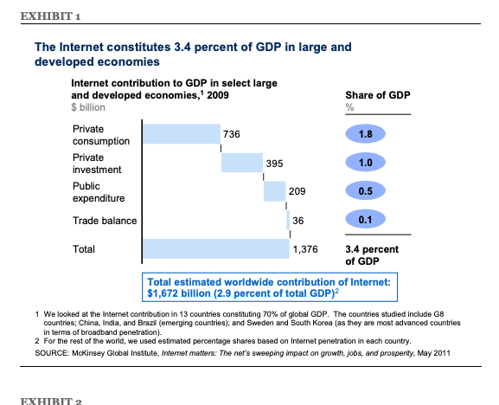

Slide 24
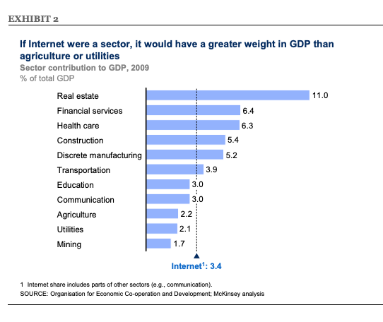

Slide 25
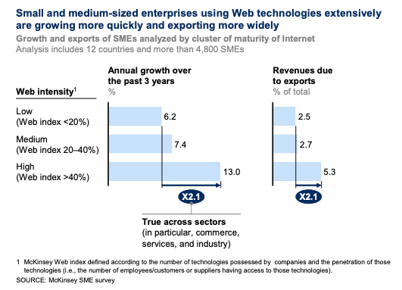

Slide 26
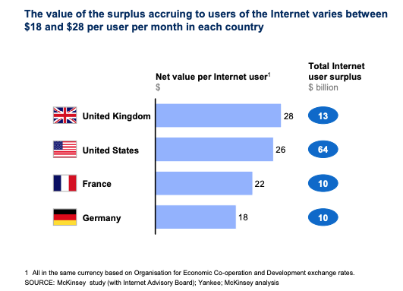

Slide 28
Digital Convergence impact on Disruptive Technology
Convergence of telecommunications and computing enables
Voice over Internet Protocol (VoIP) which has disrupted the traditional phone network.
New platforms for sharing and accessing information
Social media
Streaming video services, music
Web services, Graphics
Cloud Services which integrates supercomputing, telecommunications, and edge computing
and introduces technologies such as
blockchain,
artificial intelligence, and
the Internet of Things (IoT),
which have the potential to transform industries and create new business models.

Slide 29
What is VoIP and How Does It Work
https://youtu.be/5qTTRkLJtLA
This video provides an overview of VoIP technology and how it disrupted traditional telephone communication methods. (2:09)

Slide 30
The History of Social Media
https://youtu.be/GCp-Z1kJl5o
This video provides a brief history of social media platforms and how they disrupted the way we communicate and access information. (1:05)

Slide 31
What is Cloud Computing
https://youtu.be/JzaJj4sUODE
This video provides an overview of cloud computing technology and how it has transformed the telecommunications industry by enabling the storage and processing of data in the cloud. (3:19)

Slide 32
So what are the next Disruptive Innovations in Telecommunications? Maybe-
Ultra Wide Band (UWB) communication – High data rate, low power, precise location tracking, inteference immunity
Low Earth Orbit (LEO) satellites - low latency, remote region, high bandwidth, limited coverage area (security), easily replaced with modern rockets
Internet of Things (IoT) - make every object locatable, part of the internet, aware
Artificial intelligence – provide everyone with a friend, librarian, assistant, ….
Smart Antennas – provide every type of wireless connection service through a managed antenna system, denser receivers, crowd communication
Dependable security – quantum encryption or oetherwise will safeguard communications
Dense low latency networks – device to device, crash avoidance, navigation, safety mechnisms
Embedded information systems – brain to computer, identity, credit, health systems
Mesh networks - decentralized wireless internet
Li-Fi – use of light to transmit data – led systems that transmit data

Slide 33
John Knoblett on Quantum Computing and Telecom
Quantum Computing and Communications: Status and Prospects
https://www.gao.gov/products/gao-22-104422?utm_source=pocket_saves
Quantum Computing Is Coming. What Can It Do?
https://hbr.org/2021/07/quantum-computing-is-coming-what-can-it-do?utm_source=pocket_reader

Slide 34
Top ten new disruptive innovations
Quantum Computing: Quantum computing is a new form of computing that is expected to revolutionize industries from finance to healthcare by providing much faster and more powerful computing capabilities than traditional computers. CRISPR Gene Editing: CRISPR is a revolutionary gene editing technology that allows scientists to make precise edits to DNA. It has the potential to cure genetic diseases and transform healthcare. Edge Computing: Edge computing brings computing capabilities closer to the devices and sensors that collect data, reducing latency and enabling faster and more efficient data processing. Internet of Things (IoT): The IoT refers to the interconnected network of devices, sensors, and objects that can communicate with each other and collect and share data. It has the potential to transform industries from healthcare to manufacturing. Digital Twins: Digital twins are virtual replicas of physical objects or systems that can be used to test and optimize performance. They have the potential to revolutionize industries from aerospace to manufacturing. Quantum Encryption: Quantum encryption uses the principles of quantum mechanics to provide secure communications that cannot be intercepted or hacked. Brain-Computer Interfaces: Brain-computer interfaces enable direct communication between the brain and a computer or other device. They have the potential to transform healthcare and enable new forms of communication and interaction. Wearable Technology: Wearable technology such as smartwatches and fitness trackers are becoming more sophisticated, with the potential to revolutionize healthcare and enable more personalized and efficient care. 5G Networks: 5G networks are the next generation of cellular networks, providing faster speeds, lower latency, and more capacity. They have the potential to transform industries from entertainment to transportation. Biodegradable Plastics: Biodegradable plastics are a new type of plastic that can break down naturally in the environment, reducing the amount of plastic waste that ends up in landfills and oceans. They have the potential to transform the packaging industry and reduce environmental impact.

