Slide 1
Disruptive Innovation and Technology
Roy Campbell
Session 1: Motivation, Introduction, What is disruptive innovation, why does it occur, how does it occur? Some examples. What are disruptive innovations and technologies that concern us today?

Slide 2
About the Facilitator
43 years as Professor of Computer Science
3 years as Associate Dean of Engineering for IT
20 years as Director of NSA approved Center of Educational Excellence on Information Assurance
10 or more Projects in Cyber Security
His PhD advisor was Brian Randell who discovered the existence of the Colossus machine – a British wartime effort at Bletchley Park to decode automatically German Encrypted war messages
Now Emeritus Professor with Wife Ann and 6 grandchildren, 3 sons, 1 daughter
Disclaimer **** I do not have any qualification in economics, finance or business

Slide 3
Rules of the Road
Please ask questions and participate
Email rhc@Illinois.edu for more lengthy suggestions, questions, and comments.
Many slides will have an attribution of the information source. If they don’t, Google and Wikipedia can probably tell you.
My knowledge is typical of some Professors – I know a lot about a very small amount of knowledge.
Please don’t expect me to be able to answer all your questions about Windows 11 or Apple Ventura. They were built after I retired.
I have no idea about the inner motives of the government, industrialists, or innovators. We will see what we can discover.
There are no guarantees implied by anything I might say in class.

Slide 4
Session 1: Introduction
Introduction
Motivation
Core Principles.
What is disruptive innovation
Why does it occur?
How does it occur?
Some examples.
What are disruptive innovations and technologies that concern us today?
Where to read more about the topics and come up with a discussion topic for class.
Notes:
72

Slide 5
Partial List of Innovation Areas
3D Printing
5G + Technology
Additive Manufacturing (Fusion, Jetting, Deposition, Extrusion, Lamination, Polymerization)
Advanced Ground Systems (Satellite)
Advanced Virtual Reality
AirBnB and Vrbo
Analytics for medical data
Antibiotics
Artificial Organs
Artificial Womb
As a service
Audio Streaming
Bendable Concrete
Blockchain
ChatGPT
Circular Economy
Cloth
Clothing
Cloud Computing
Compact Disks
Computational Chemistry
Concrete
Container Shipping
CRISPR
Cyber Currency
Deep Learning
Digital Cameras
Digital Cash
Digital fingerprints
Digital Photography Digital twins (health care)
DNA Storage
Drones
Eco Concrete
Edge Computing
Electric Aircraft
Electric Motors
Electric Power Storage
Electric Vehicles
Email
Extended Reality
Face recognition
Flash (NOR or NAND) Memory
Generative Artificial Intelligence
GPS Navigation
Headless Tech
Healthcare Ecosystems
Heat Pumps
Human Brain Map (Allen)
Human Cell Atlas
Hydrogen power
Hyper-personalization
In-Orbit Services
LED
lidar technology
Lightweight Concrete
Maglev Train
Martian Concrete
Media Streaming
Mobile phones
Nano Machines
Nano Motors
Nanotechnology
News
NVRAM
On-line Retailing for Books
On-line selling
Online education
Online Encyclopedias
Online Retail
Peer-to-peer Accommodation
Personal Computer Systems
Personal Copiers
Personalized medicine and genomics
Pervious Concrete
Plastics
Quantum Computing
Radios – whisker, valve, transistor, internet
Refrigerator Technology
Remote healthcare and Telemedicine
Responsive Materials
Retail medical clinics
Ride Sharing
Robots
Satellite IoT
Search
Self-Driving Cars
Self-Healing Concrete
Ships Steam-powered Ships Diesel-powered
Small Satellites
Smart Cars and Trucks
Smart Cities
Smart Devices
Smart homes
Smart Phones
Smart Watches
Social Media
Solar Energy
Steel mini mills
Streaming – Netflix, Hulu, Pluto TV
Sustainable Materials
Translucent Concrete
Vaccines
Vehicle-To-Vehicle Communication
Video Streaming (Zoom)
Virtual & Augmented Reality
Voice over IP
Voice-Activated Search
Web 2.0 (user-generated content uploaded)
Wikipedia
Wind Energy
Work from home

Slide 6
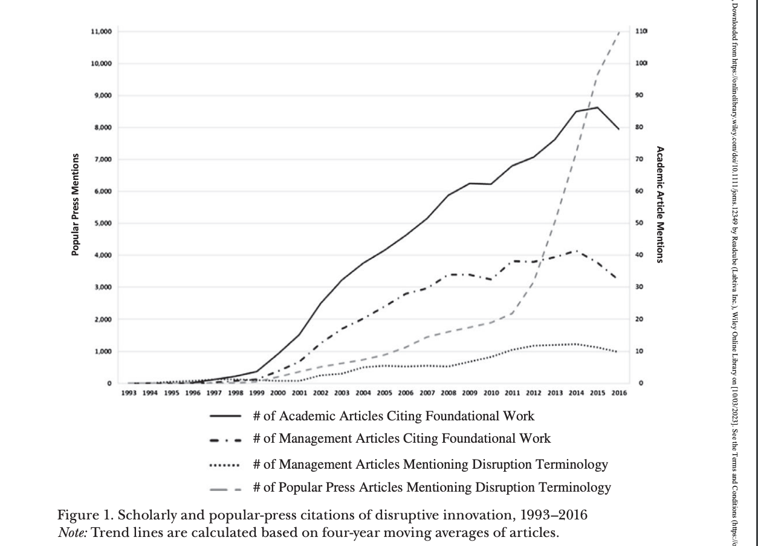
Success of Disruption Innovation Theory
Journal of Management Studies 55:. pp 1044 November 2018

Slide 7
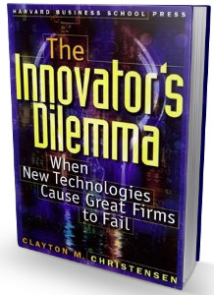
The Innovator's Dilemma
The Innovator's Dilemma: When New Technologies Cause Great Firms to Fail, describes how large incumbent companies lose market share by listening to their customers and providing what appears to be the highest-value products, but new companies that serve low-value customers with poorly developed technology can improve that technology incrementally until it is good enough to quickly take market share from established business.
Christensen recommends that large companies maintain small, nimble divisions that attempt to replicate this phenomenon internally to avoid being blindsided and overtaken by startup competitors.

Slide 8
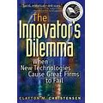
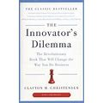
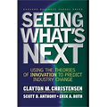
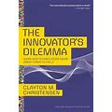
Books by Clayton Christensen
Wikipedia Entry: https://en.wikipedia.org/wiki/Clayton_Christensen

Slide 9
Videos
https://youtu.be/qDrMAzCHFUU Disruptive Innovation Explained Clayton M. Christensen (Harvard Business Review) (7:51)

Slide 10
What Is Disruptive Innovation?
https://hbr.org/2015/12/what-is-disruptive-innovation
Many researchers, writers, and consultants use “disruptive innovation” to describe any situation in which an industry is shaken up and previously successful incumbents stumble. But that’s much too broad a usage.
Different types of innovation require different strategic approaches
basic tenets of disruptive innovation
common pitfalls
Why correctly using the theory matters

Slide 11
A Spectrum
Different types of innovation require different strategic approaches
Disruption describes a process by which a smaller company with fewer resources can successfully challenge existing businesses
The existing businesses improve their products and services for their most demanding (profitable) customers:
Exceeding the needs of some customers
Ignoring the needs of the lower end of the market
Entrants target overlooked segments, offer more suitable functionality to low end of market or create market by turning non-consumers into consumers.
Entrants move upmarket. When mainstream customers start adopting the entrant’s offerings in volume, disruption has occurred.

Slide 12
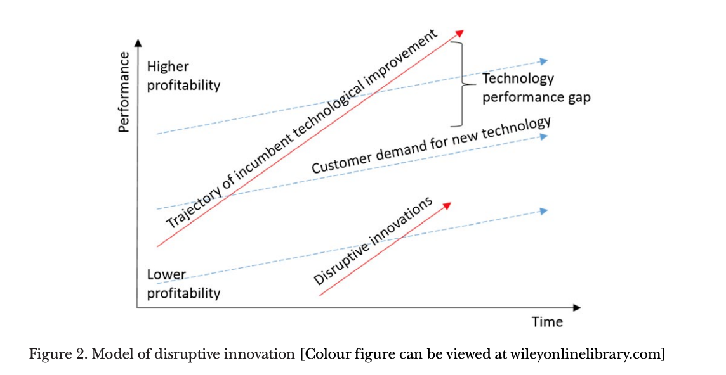
The Disruptive Innovation Model
Entrants on disruptive trajectory improve performance of their product and move upmarket
Product performance trajectories
High End
Customer demand trajectories
Mainstream
Low End

Slide 13
Comparison between innovations: transformation versus disruption
TRANSFORMATION
UBER – taxi business
Fantastic growth and financial success
Transformational
But didn’t originate in low-end or new-market footholds
Didn’t create a market where none existed
DISRUPTION
Xerox – photocopying
Xerox targeted large corporations and charged high prices to provide performance
Small customers like schools, home businesses, ignored. Used carbon paper or mimeographs
Personal copiers offered solution to individuals and small organizations creating new market.

Slide 14
Warning
Reading of the popular literature, in conjunction with the trends in management research noted above, suggests overly broad application of the terms disruption/disruptive innovation to signify:
threat or change of any kind, and
underuse of disruptive innovation as a coherent theoretical concept (Christenson et al.)
The discussion group will make up its own mind about these issues

Slide 15
Origins of a Descriptive Framework: The Disk-Drive Industry
The theory of disruptive innovation began with an observation that generated a research question.
Across industries ranging from computers to retail to steel, leading firms failed to remain dominant in their respective markets. These apparently well-managed firms were widely lauded by analysts and the business press, and yet each of them overlooked something important that precipitated a decline

Slide 16
Reasons given at the time….
Prevailing explanations (1986-1993) blamed
technological complexity,
faulty managerial cognition, and
organizational inertia

Slide 17
Disk drive industry as an example (Christensen, 1997)
When an innovation emerged that improved performance on dimensions that customers historically valued (e.g., the capacity and recording density of disk drives), incumbents tended to lead commercialization and to maintain their market position
When an innovation emerged that did not improve performance along this customer-preference trajectory but introduced a unique constellation of attributes (e.g., small, lightweight, rugged), new entrants led development while incumbents languished or failed.

Slide 18
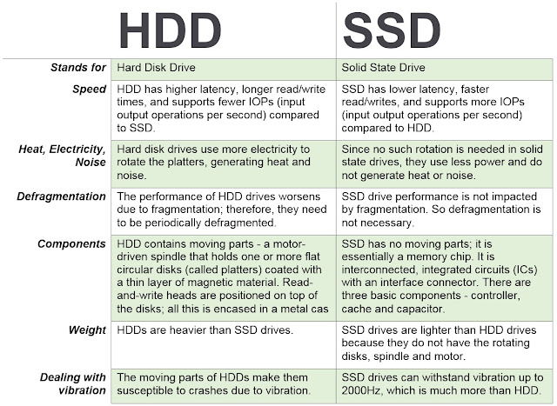

Slide 19
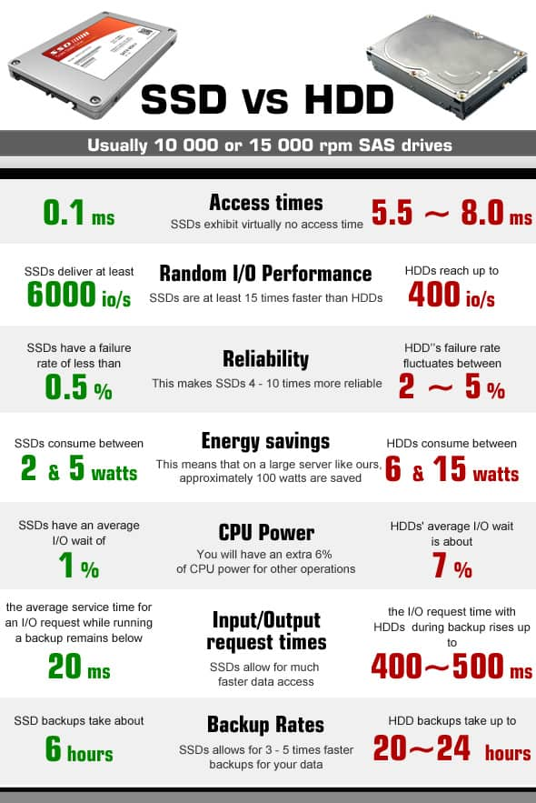

Slide 20
But the new memory systems allow completely new applications
Music
3D 4k and 8k video
Mobile virtual reality
Video editing, scene generation, games
Kindle-like books, maps and libraries
Generative Artificial Intelligence based on learned behaviors, languages
Drones and robots

Slide 21
New Memory Technologies 2021+
NVRAM Non-volatile, Random Access Memory gives persistant storage unlike DRAM (Dynamic Random Access Memory)
High resilient storage using Erasure codes replacing RAID (Redundant Array of Inexpensive Disks)
Storage-based processing
Helium, HAMR (Heat-Assisted Magnetic Recording), Shingled magnetic recording
DNA-based storage --- all 16 GB of Wikipedia have been encoded into synthetic DNA
DNA of Things --- encodes digital data into DNA molecules, which are then embedded into objects. This gives the ability to create objects that carry their own blueprint. Storage objects go off grid.

Slide 22
Summary from Example
The Group will discuss innovations from their own perspective:
Perhaps drawing on Clayton’s work for help in categorizing the innovations
Perhaps adding their own concerns

Slide 23
Three Principles 1) Pace of Progress
The pace of technological progress outstrips customers’ demand for higher-performing technologies
Incumbents can overserve the market by producing more advanced, feature-rich products than customers need;
A gap appears at the bottom of the market between customers’ needs and the performance provided by firms—a gap that provides an opening for entrants

Slide 24
Three Principles 2) Type of Innovation
A strategically crucial distinction between different types of innovation—in technology or in business model—can emerge in an industry.
sustaining innovations, which improve products and services along dimensions of performance that mainstream customers care about and that markets have historically valued.
Such innovations enable incumbents to sell more products to their best existing customers at higher margins and higher profitability.
disruptive innovations, inferior to incumbent products on accepted performance dimensions, but they offer a novel mix of attributes that appeals to fringe customer groups, notably those near the bottom of the market –
smaller,
cheaper,
more accessible,
or more convenient.

Slide 25
Three Principles 3) Constraints in Investment
Existing customers and established profit models constrain established firms’ investments in new innovations
investments unattractive to incumbents may be attractive to entrants who lack many (or any) customers and enjoy fewer competing investment opportunities
Incumbents are typically unmotivated to develop disruptive innovations that promise lower margins, target smaller markets, and introduce inferior products and services that their existing customers cannot use

Slide 26
Summary of Principles (Mine)
Principle | Pace |  | Type of Innovation |  | Constraints
Characteristic | Progress | Appetite | Profitability | Fringe/Niche | Resources | Customers
Issue | Oversee | Gap | sustaining | disruptive | Attractiveness | Motivation

Slide 27
For the Group - Partial List of Innovation Areas
3D Printing
5G + Technology
Additive Manufacturing (Fusion, Jetting, Deposition, Extrusion, Lamination, Polymerization)
Advanced Ground Systems (Satellite)
Advanced Virtual Reality
AirBnB and Vrbo
Analytics for medical data
Antibiotics
Artificial Organs
Artificial Womb
As a service
Audio Streaming
Bendable Concrete
Blockchain
ChatGPT
Circular Economy
Cloth
Clothing
Cloud Computing
Compact Disks
Computational Chemistry
Concrete
Container Shipping
CRISPR
Cyber Currency
Deep Learning
Digital Cameras
Digital Cash
Digital fingerprints
Digital Photography Digital twins (health care)
DNA Storage
Drones
Eco Concrete
Edge Computing
Electric Aircraft
Electric Motors
Electric Power Storage
Electric Vehicles
Email
Extended Reality
Face recognition
Flash (NOR or NAND) Memory
Generative Artificial Intelligence
GPS Navigation
Headless Tech
Healthcare Ecosystems
Heat Pumps
Human Brain Map (Allen)
Human Cell Atlas
Hydrogen power
Hyper-personalization
In-Orbit Services
LED
lidar technology
Lightweight Concrete
Maglev Train
Martian Concrete
Media Streaming
Mobile phones
Nano Machines
Nano Motors
Nanotechnology
News
NVRAM
On-line Retailing for Books
On-line selling
Online education
Online Encyclopedias
Online Retail
Peer-to-peer Accommodation
Personal Computer Systems
Personal Copiers
Personalized medicine and genomics
Pervious Concrete
Plastics
Quantum Computing
Radios – whisker, valve, transistor, internet
Refrigerator Technology
Remote healthcare and Telemedicine
Responsive Materials
Retail medical clinics
Ride Sharing
Robots
Satellite IoT
Search
Self-Driving Cars
Self-Healing Concrete
Ships Steam-powered Ships Diesel-powered
Small Satellites
Smart Cars and Trucks
Smart Cities
Smart Devices
Smart homes
Smart Phones
Smart Watches
Social Media
Solar Energy
Steel mini mills
Streaming – Netflix, Hulu, Pluto TV
Sustainable Materials
Translucent Concrete
Vaccines
Vehicle-To-Vehicle Communication
Video Streaming (Zoom)
Virtual & Augmented Reality
Voice over IP
Voice-Activated Search
Web 2.0 (user-generated content uploaded)
Wikipedia
Wind Energy
Work from home

Slide 28
Group Assignment
Add your own innovations to the partial list
Suggest three or four innovations you would like to discuss in the group. Email them to me rhc2006@gmail.com
Add your own concerns/observations about innovations
Read about Disruptive Artificial Intelligence for discussion (see Gartner slides at end)

Slide 29
References
Disruptive Innovation: An Intellectual History and Directions for Future Research, Clayton M. Christensen, Rory McDonald, Elizabeth J. Altman, Jonathan E. Palmer, First published: 16 June 2018
https://doi.org/10.1111/joms.12349
Video Link: Disruptive Innovation Explained Clayton M. Christensen (Harvard Business Review) https://youtu.be/qDrMAzCHFUU

