Slide 1
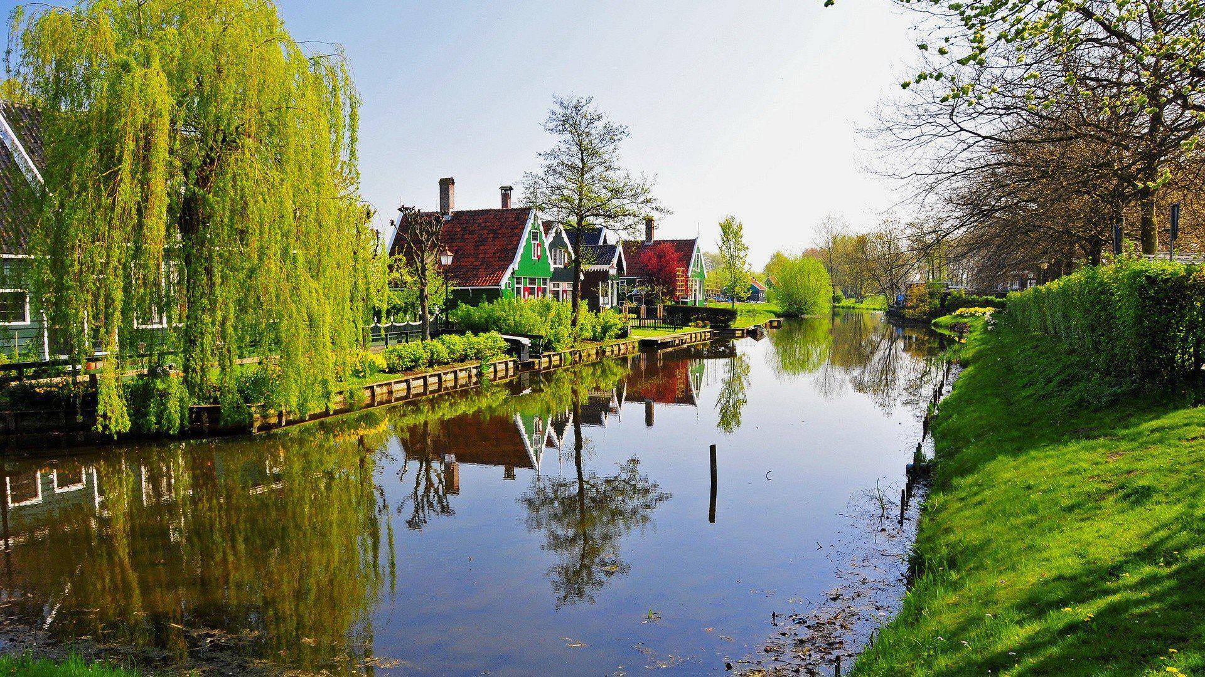
WELCOME

Slide 2
Readings in
The Best American
Science and Nature Writing of 2021
November/December 2022
Facilitators:
Claudia Reich,
Research Assistant Professor in the Department of Microbiology and
Senior Research Scientist at the Institute for Genomic Research.
Dirk Mol, Erstwhile Priest and Retired Psychotherapist
(This is the fourth or fifth time we have don’t this study group)
(we did the 2017, 2018, and 2019 volumes)

Slide 3
Agenda for Session One / 15 Oct 2022
Science Moments / Claudia
Discussion of
The Soft Butch that Couldn’t / OR I Got COVID, p. 72
Heather Hogan
Update on recent research about COVID / Claudia’s PP
Discussion of
The Difference Between Feeling Safe and Being Save, p.22
Amanda Hull

Slide 4
The Soft Butch that Couldn’t
What was your experience with the pandemic?
How did we respond as a culture, as a nation, to the waves that have passed?
Do we have COVID fatigue?

Slide 5
The Difference between Feeling Safe and Being Safe
What have we learned about the virus recently?
What is it that makes it so effective?
Do we feel safe now or are we still living in fear?
How are we going to handle it in the future?

Slide 6
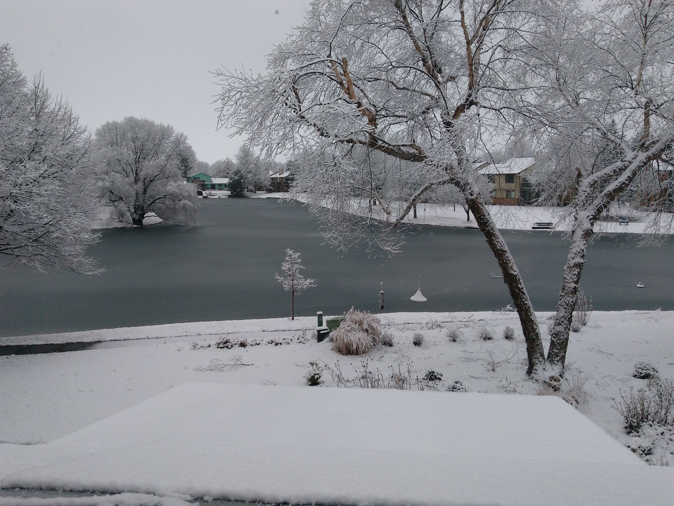

Slide 7
Session 2 / 22 November 2022
Science moment: Impact of Extreme Heat
A NYTimes ;interactive feature on current conditions in the Middle East and what might happen in the future
https://www.nytimes.com/interactive/2022/11/18/world/middleeast/extreme-heat.html?action=click&module=Well&pgtype=Homepage&section=World%20News
Discussion: Do you have a doomsday clock? Do articles like this reset it?

Slide 8
Science Moment 2
Will Twitter survive Elon Musk or will it implode?
Can a complex tech company that had 7500 employee survive with only 2500?
Elon Musk’s Twitter Teeters on the Edge After Another 1,200 Leave
Some internal estimates showed that at least 1,200 full-time employees resigned on Thursday, three people close to the company said. Twitter had 7,500 full-time employees at the end of October, which dropped to about 3,700 after mass layoffs this month.
Now the question is whether Mr. Musk, 51, has gone too far. On Thursday, hundreds of Twitter employees resigned after Mr. Musk gave them a deadline to decide whether to leave or stay. So many workers chose to depart that Twitter users began questioning whether the site would survive
NYTImes 17 Nov 2020

Slide 9
Article One
This is How We Live Now / Emily Raboteau / p. 218
Literary Considerations
  Who did she compose this?
  Is it a useful style for talking about climate change?
  What does it accomplish? Educates us? Motivates us?
  Does it change anyone’s behavior?

Slide 10
Getting personal
How is my life different now than it was
- One year ago
- Ten years ago
- Thirty years ago
How is my life different than that of my parents
- when they were born
- when I was born

Slide 11
Poem for THIS IS HOW WE LIVE NOW
It could have happened.
It had to happen.
It happened earlier. Later.
Nearer. Farther off.
It happened, but not to you.
You were saved because you were the first.
You were saved because you were the last.
Alone. With others.
On the right. The left.
Because it was raining. Because of the shade.
Because the day was sunny.
You were in luck -- there was a forest.
You were in luck -- there were no trees.
You were in luck -- a rake, a hook, a beam, a brake,
A jamb, a turn, a quarter-inch, an instant . . .
So you're here? Still dizzy from
another dodge, close shave, reprieve?
One hole in the net and you slipped through?
I couldn't be more shocked or
speechless.
Listen,
how your heart pounds inside me.
Wislawa Szymborska
1923-2012
Nobel Prize in Literature / 1996

Slide 12
Jack Gilbert says
A BRIEF FOR THE DEFENSE
Sorrow everywhere. Slaughter everywhere. If babies
are not starving someplace, they are starving
somewhere else. With flies in their nostrils.
But we enjoy our lives because that’s what God wants.
Otherwise the mornings before summer dawn would not be made so fine. The Bengel tiger would not
be fashioned so miraculously well. The poor women
at the fountain are laughing together between
the suffering they have known and the awfulness
in their future, smiling and laughing while somebody
in the village is very sick. There is laughter
every day in the terrible streets of Calcutta,
and the women laugh in the cages in Bombay.
If we deny our happiness, resist our satisfaction,
we lessen the importance of their deprivation.
we must risk delight. We can do without pleasure,
But not delight. Not enjoyment. We must have
the stubbornness to accept our gladness in the ruthless
furnace of this world. To make injustice the only
measure of our attention is to praise the Devil.
If the locomotive of the Lord runs us down,
we should give thanks that the end had magnitude.
We must admit there will be music despite everything.
We stand at the prow again of a small ship
anchored late at night in the tiny port
looking over to the sleeping island: the waterfront
is three shuttered cafes and one naked light burning.
To hear the faint sound of oars in the silence as a rowboat
comes slowly out and then goes back is truly worth
all the years of sorrow that are to come.
Jack Gilbert
_____________________
Jack Gilbert (February 18, 1925 – November 13, 2012) was an American poet

Slide 13
Article Two
Periwinkle, The Color of Poison, Modernism, and Dusk / Katy Kelleher / p. 169
More Literary Considerations
- Why does this essay deserve a place in this anthology?
- Who would think to combine a discussion of a plant, with an exploration of color, medicine, and art?
- Her other books look equally unique

Slide 14
More Names
Other Name(s):Common Periwinkle, Earlyflowering, Evergreen, Herbe à la Capucine, Herbe de Fidélité, Lesser Periwinkle, Myrtle, Petite Pervenche, Pervenche Mineure, Small Periwinkle, Vinca minor, Vincae Minoris Herba, Vincapervinca, Violette des Morts, Violette de Serpent, Violette de Sorcier, Wintergreen.

Slide 15
From RXList.com
Periwinkle is an herb. The parts that grow above the ground are used to make medicine. Don't confuse periwinkle with Madagascar periwinkle (Catharanthus roseus).
Despite serious safety concerns, periwinkle is used for “brain health” (increasing blood circulation in the brain, supporting brain metabolism, increasing mental productivity, preventing memory and concentration problems and feebleness, improving memory and thinking ability, and preventing early aging of brain cells).
Periwinkle is also used for treating diarrhea, vaginal discharge, throat ailments, tonsillitis, chest pain, high blood pressure, sore throat, intestinal pain and swelling (inflammation), toothache, and water retention (edema). It is also used for promoting wound healing, improving the way the immune system defends the body, and for “blood-purification.”

Slide 16
Poem for the week to help us contemplate darkness and light
Three darks come down together,
Three darks close in around me:
Day dark, year dark, dark weather.
They whisper and conspire,
They search me and they sound me
Hugging my private fire.
Day done, year done, storm blowing,
Three darknesses impound me
With dark of white snow snowing.
Three darks gang up to end me,
To browbeat and dumbfound me.
Three future lights defend me.
Robert Francis / 1901-1987

Slide 17
Next week
Claudia will be leading discussions of “Cancel Earthworms“, p. 275
and “a Toxic Secret Lurks in Deep Sea”, p. 312
It’s about barrels of DDT that were dumpted in the ocean off LA during the 20th Century.
She will send out an email with more details.

Slide 18
Thought for the season
“For there is always light
If only we’re brave enough to see it
If only we’re brave enough to be it”
Amanda Gorman

Slide 20
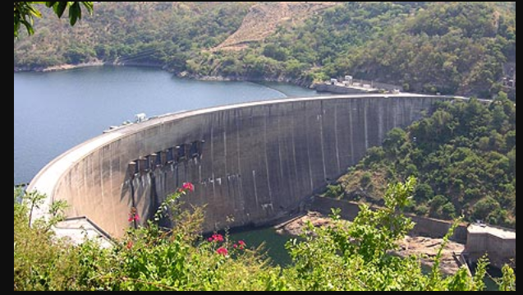
Discussion of THE RIVER OF TIME
Kariba Dam / 1900 ft long

Slide 21
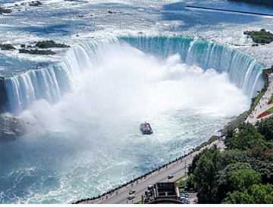
Horseshoe Falls (Canadian side) at Niagara
2590 feet long

Slide 22
Largest Reservoirs in the world by rank
Reservoir Dam River Country Year Volume
KM3
Lake Kariba Zambezi Zambia/Zimb 1958 180.6
4. Manicouagan Canada 1968 141.85
6. Lake Nassar Aswan Nile Egypt 1971 132
22. Lake Ataturk Euphrates Turkey 1992 48.7
27. Three Gorges Yangtze China 2009 39.3
28. Lake Mead / Hoover Colorado US 1936 37.3
Lake Powell / Glen C Colorado US 1964 35.55
41. Lake Sakakawea / Garrison Missouri US 1953 30.22
44. Lake Oahe Missouri US 1966 29.11

Slide 23
Arch-gravity dam
An arch-gravity dam or arched dam is a dam with the characteristics of both an arch dam and a gravity dam. It is a dam that curves upstream in a narrowing curve that directs most of the water pressure against the canyon rock walls, providing the force to compress the dam. It combines the strengths of two common dam forms and is considered a compromise between the two. They are made of conventional concrete, roller-compacted concrete (RCC), or masonry. Arch-gravity dams are not reinforced except at the spillway. A typical example of the conventional concrete dam is the Hoover Dam. Changuinola Dam is an example of the RCC arch-gravity dam. A gravity dam requires a large volume of internal fill.^{[1]} An arch-gravity dam can be thinner than the pure gravity dam and requires less internal fill.^{[2]}

Slide 24
Environmental Impact of Hoover Dam
The changes in water flow and use caused by Hoover Dam's construction and operation have had a large impact on the Colorado River Delta.^{[124]} The construction of the dam has been implicated in causing the decline of this estuarine ecosystem.^{[124]} For six years after the construction of the dam, while Lake Mead filled, virtually no water reached the mouth of the river.^{[125]} The delta's estuary, which once had a freshwater-saltwater mixing zone stretching 40 miles (64 km) south of the river's mouth, was turned into an inverse estuary where the level of salinity was higher close to the river's mouth.^{[126]}
The Colorado River had experienced natural flooding before the construction of the Hoover Dam. The dam eliminated the natural flooding, threatening many species adapted to the flooding, including both plants and animals.^{[127]} The construction of the dam devastated the populations of native fish in the river downstream from the dam.^{[128]} Four species of fish native to the Colorado River, the Bonytail chub, Colorado pikeminnow, Humpback chub, and Razorback sucker, are listed as endangered.^{[129][130]}

Slide 25
Glen Canyon Dam
In addition to its flooding of the scenic Glen Canyon, the dam's economic justification was questioned by some critics.^{[10]} It became "a catalyst for the modern environmental movement,"^{[11]} and was one of the last dams of its size to be built in the United States.^{[12]} The dam has been criticized for the large evaporative losses from Lake Powell and its impact on the ecology of the Grand Canyon, which lies downstream; environmental groups continue to advocate for the dam's removal. Water managers and utilities state that the dam is a major source of renewable energy and provides a vital defense against severe droughts.

Slide 26
More Glen Canyon
Like all dams, Glen Canyon traps sediment (silt), but because the Colorado is an especially muddy river, the dam has posed even more visible consequences for the river within the Grand Canyon. About 100 million US tons (90,700,000 metric tons) of sediment are trapped behind the dam annually, equal to about 30,000 dump truck loads per day.^{[143]} Because of the dam, sediment deposited by the Colorado and its tributaries is slowly filling up the canyon, and projections put the useful life of the reservoir at 300 to 700 years.^{[144][145]} If no action is taken such as dredging or sediment sluicing, in a few hundred years, sediment deposits will begin to build up at the foot of the dam and will gradually block the different outlets, reducing the dam's capacity to store and release water. Thus, it would become more difficult to maintain the required release of 8.23 million acre-feet (10.15 km³) below the dam. The Colorado River would reduce to a trickle in dry seasons as it naturally did before the dam was built, potentially compromising the water supply of the Lower Basin states.^{[145]}

Slide 27
Impact on the Grand Canyon
The Colorado through Grand Canyon now lacks the source of sediment it needs to build sandbars and islands, and these natural fluvial formations within the canyon have now suffered severe damage from erosion. The floods that once scoured the river each year are now contained behind the dam except in extraordinary cases such as 1983–84; the lack of floods has promoted vegetation encroachment which not only has considerably changed the riparian zone environment but has created problems for tourism, as hikers and boaters often cannot find good spots to camp due to overgrowth. Flood control has also caused an inability of the river to carry away the rockslides that are common along the canyons, leading to the creation of incrementally dangerous rapids that pose a hazard to fish and boaters alike. Before damming, the Colorado commonly reached flows of more than 100,000 cubic feet per second (2,800 m³/s) during the spring; this has been limited to less than 25,000 cubic feet per second (710 m³/s) most years with few exceptions.^{[146][147]}

Slide 28
Impact of Garrison Dam / North Dakota
The creation of the lake displaced members of the Fort Berthold Indian Reservation from their villages of Van Hook and (Old) Sanish, which were inundated by creation of the lake. They relocated and founded the villages of New Town, White Shield, and Mandaree. One name that had been proposed for New Town was Vanish (a portmanteau of the two previous towns' names). Elbowoods, a third reservation town where the agency headquarters, boarding school, hospital, and jail were located, was also lost to the lake. These three towns are commemorated in the names of the three campground sections at Lake Sakakawea State Park, a state park located adjacent to Garrison Dam.

Slide 29
Impact of Oahe Dam and Lake / S and N Dakota
As a result of the dam's construction the Cheyenne River Indian Reservation lost 150,000 acres (61,000 hectares) bringing it down to 2,850,000 acres (1,150,000 ha) today. Standing Rock Reservation lost 55,993 acres (22,660 ha) leaving it with 2,300,000 acres (930,000 ha). Much of the land was taken by eminent domain claims made by the Bureau of Reclamation. Over and above the land loss, most of the reservations' prime agricultural land was included in the loss. The regions where the populations were resettled had soil with a higher clay content, and resources such as medicinal plants were less prevalent.^{[5]}
The loss of this land had a dramatic effect on the Natives who lived on the reservations. Most of the land was unable to be harvested (to allow the trees to be cut down for wood, etc.) before the land was flooded over with water.^{[6]} One visitor to the reservations later asked why there were so few older Natives on the reservations and was told that "the old people had died of heartache" after the construction of the dam and the loss of the reservations' land.^{[7]} As of 2015, poverty remains a problem for the displaced populations in the Dakotas, who are still seeking compensation for the loss of the towns submerged under Lake Oahe, and the loss of their traditional ways of life.^{[8]}

