Slide 1
Caper Films
OLLI Fall 2022
Week 5: “Inside Man” (2006)

Slide 2
Caper Films Study Group Outline
Week 1: “Snatch” (2000) 103 minutes
Week 2: ”Thick as Thieves” (1998) 95 minutes
Week 3: “Midnight Run” (1988) 127 minutes
Week 4: “8 Heads in a Duffel Bag” (1997) 95 minutes
Week 5: “Inside Man” (2006) 129 minutes
Week 6: “The Gentlemen” (2019) 119 minutes
Week 7: “Lock, Stock, and Two Smoking Barrels” (1998) 120 minutes

Slide 3
Today’s Film: “Inside Man” (2006)
Director: Spike Lee
Producers: Brian Grazer
Writer: Russell Gewirtz
Principal Cast
Denzel Washington: Detetive Keith Frazier
Clive Owen: Dalton Russell
Jodie Foster: Madeleine White
Christopher Plummer: Arthur Case
Willem Dafoe: aptain John Darius
Chiwetel Ejiofor: Detective Bill Mitchell

Slide 4
“Inside Man” (2006)
Let’s watch the film

Slide 5
“Inside Man” Reception
Budget
$45 million
Box Office ☺
$184.4 million worldwide

Slide 6
“Inside Man” -- Critical Reception
Pretty Good Reviews ☺
86% on Rotten Tomatoes (7.33/10 average rating)
CinemaScore audience poll rated it “B+” (on a scale of F to A+)

Slide 7
“Inside Man” -- Critical Reception
Manohla Dargis (New York Times)
‘"Inside Man" works because it takes a familiar setup -- in this case, a Wall Street bank heist that mutates into a hostage crisis -- and twists it ever so slightly. A particularly solid screenplay helps here, as do stars who can actually act.’

Slide 8
“Inside Man” -- Critical Reception
Wesley Morris, The Boston Globe
"The basic story is elemental, but because Lee and Gewirtz invest it with grit, comedy, and a ton of New York ethnic personality, it's fresh anyway."

Slide 9
“Inside Man” -- Critical Reception
Not Everyone Agreed ☹
Peer Bradshaw, The Guardian
“A supremely annoying and nonsensical film.”

Slide 10
“Inside Man” -- Critical Reception
Rex Reed, The New York Observer
“Inside Man has two things going for it: better actors than usual and a slicker look. Otherwise, it’s no different from nine out of 10 other preposterous, contrived, confusingly written, unevenly directed, pointless and forgettable junk films we’ve been getting these days.”

Slide 11
“Inside Man” – What’s Different?
A. It’s a Heist Film.
This is not a crime comedy. It is amost a classic heist film.
Almost.

Slide 12
“Inside Man” – What’s Different?
B. But as a Heist Film, it’s missing Acts I and III
Act I: Assemble the crew and the plan. (nope)
Act II: Execute the plan
Act III: Everything goes wrong. (nope)

Slide 13
“Inside Man” – What’s Different?
C. How does it pull that off?
By telling the story from the viewpoint of the police, not the robbers. We have some scenes of the robbers, but we never really know what’s going on until the end. We discover it along with the police.

Slide 14
“Inside Man” – What’s Different?
D. How would it have worked if told in the classic Heist Movie structure?
Dull as dirt.

Slide 15
“Inside Man” – What’s Different?
E. Sometimes, the way the storyteller lets the story unfold is as important as the story itself.

Slide 16
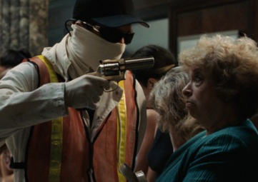
“Inside Man” – Fun Fact
Maria Jean Kurtz plays Miriam Douglas, the elderly hostage who refuses to disrobe.

Slide 17
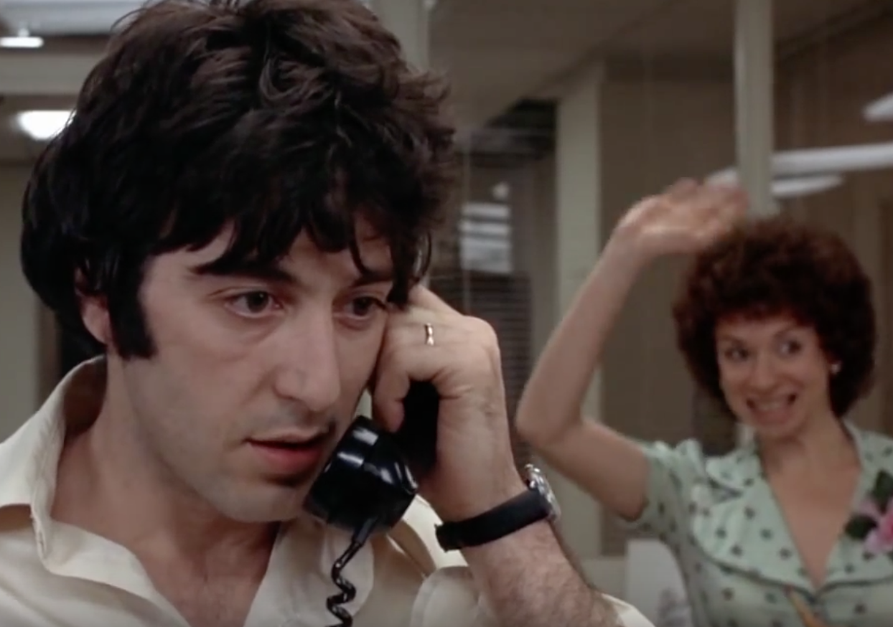
“Inside Man” – Fun Fact
31 years earlier, in 1975 the same actress played the same character, Meriam Douglas in the film Dog Day Afternoon-- also a hostage in a bank robbery.

Slide 18
“Inside Man”
What did you think?

Slide 19
Next Week
“The Gentlemen” (2019) 113 minutes
Charlie Hunnam
Matthew McConaughey
Colin Farrell
Michelle Dockery
Hugh Grant
Jeremy Strong

