Slide 1
Caper Films
OLLI Fall 2022
Week 3: “Midnight Run” (1988)

Slide 2
Caper Films Study Group Outline
Week 1: “Snatch” (2000) 103 minutes
Week 2: ”Thick as Thieves” (1998) 95 minutes
Week 3: “Midnight Run” (1988) 127 minutes
Week 4: “8 Heads in a Duffel Bag” (1997) 95 minutes
Week 5: “The Italian Job” (1969) 99 minutes
Week 6: “Inside Man” (2006) 129 minutes
Week 7: “Lock, Stock, and Two Smoking Barrels” (1998) 120 minutes

Slide 3
Today’s Film: “Midnight Run” (1988)
Producer/Director: Martin Brest (Previous film: Beverly Hills Cop)
Screenplay: George Gallo
Principal Cast
Robert DeNiro (Jack Walsh, bounty hunter)
Chares Grodin (Jonathan “The Duke” Mardukas, mob accountant--retired)
Yaphet Kotto (Special Agent Alonzo Mosely)
John Ashton (Marvin Dorfler, bounty hunter)
Dennis Farina (Jimmy Serrano, mob boss)
Joe Pantoliano (Eddie Moscone, bailbondsman)

Slide 4
“Midnight Run”
Let’s watch the film

Slide 5
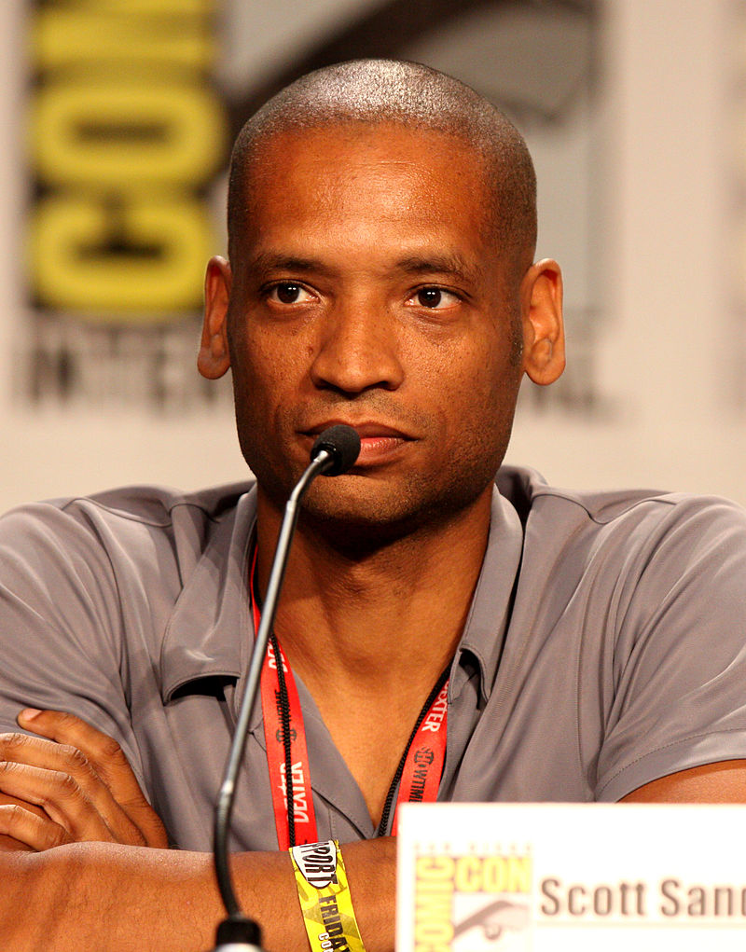
“Midnight Run”
Directorial Debut of Scott Sanders
Followed with Black Dynamite (2009)
Aztec Warrior (2012-2016)

Slide 6
“Midnight Run”--Reception
Budget
$35 million (of which $15 million was promotion)
Box Office
$88 million worldwide
($38 million in USA and Canada)

Slide 7
“Midnight Run”—Critical Reception
Generally Positive Reviews
94% on Rotten Tomatoes (8/10 average rating)
CinemaScore audience poll rated it “A” (on a scale of F to A+)

Slide 8
“Midnight Run”—Critical Reception
Roger Ebert
3.5 out of 4 stars
"What Midnight Run does with these two characters is astonishing, because it's accomplished within the structure of a comic thriller ... It's rare for a thriller to end with a scene of genuinely moving intimacy, but this one does, and it earns it."

Slide 9
“Midnight Run”—Critical Reception
Jay Scott, The Globe and Mail
"De Niro has the time of his acting life lightening up and sending up all those raging bulls that won him all those Oscars ... Charles Grodin, master of the double-take and maestro of the slow burn, (is) the best light character comic since Jack Benny stopped playing himself."

Slide 10
“Midnight Run”—Critical Reception
Alan Sepinwall, Rolling Stone (30-year retrospective on the film)
“the Casablanca of Buddy Comedies"

Slide 11
“Midnight Run”
What did you think?

Slide 12
Next Week
“8 Heads in a Duffel Bag” (1997) 95 minutes
Joe Pesci
David Spade
Kristy Swanson
Andy Comeau
George Hamilton
Dyan Cannon
Ernestine Mercer

