Slide 1
Caper Films
OLLI Fall 2022
Week 2: “Thick as Thieves” (1998)

Slide 2
Caper Films Study Group Outline
Week 1: “Snatch” (2000) 103 minutes
Week 2: ”Thick as Thieves” (1998) 95 minutes
Week 3: “Midnight Run” (1988) 127 minutes
Week 4: “8 Heads in a Duffel Bag” (1997) 95 minutes
Week 5: “The Italian Job” (1969) 99 minutes
Week 6: “Inside Man” (2006) 129 minutes
Week 7: “Lock, Stock, and Two Smoking Barrels” (1998) 120 minutes

Slide 3
Today’s Film: “Thick as Thieves” (1998)
Not to be confused with the 2009 film of the same name starring Morgan Freeman, Antonio Banderas and Radha Mitchell (which is more of a classic heist film).

Slide 4
Today’s Film: “Thick as Thieves” (1998)
Director: Scott Sanders
Screenplay: Scott Sanders and Arthur Krystal, Based on the novel by Patrick Quinn
Producers: John Steingart, Glenn Zoller, Donald Zuckerman
Principal Cast
Alec Baldwin (Mackin “The Thief”)
Andre Braugher (Dink Reeves)
Michael Jai White (Pointy Williams)
Rebecca De Mornay (Detective Louise Petrone)
Interesting Supporting Roles
Jeneane Garofalo (Anne)
Khandi Alexander (Janet Hussein)

Slide 5
“Thick as Thieves”
Let’s watch the film

Slide 6
Caper Movies—An Observation
Q: What’s missing from these films that you find in most other film genres?

Slide 7
Caper Movies—An Observation
A: A romantic subplot.

Slide 8
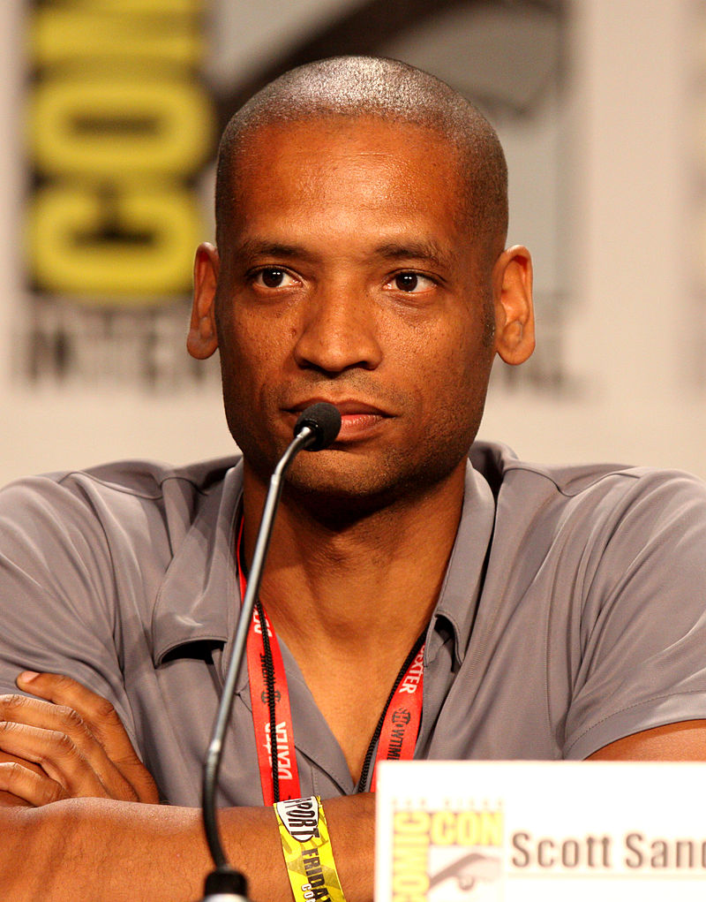
“Thick as Thieves”
Directorial Debut of Scott Sanders
Followed with Black Dynamite (2009)
Aztec Warrior (2012-2016)

Slide 9
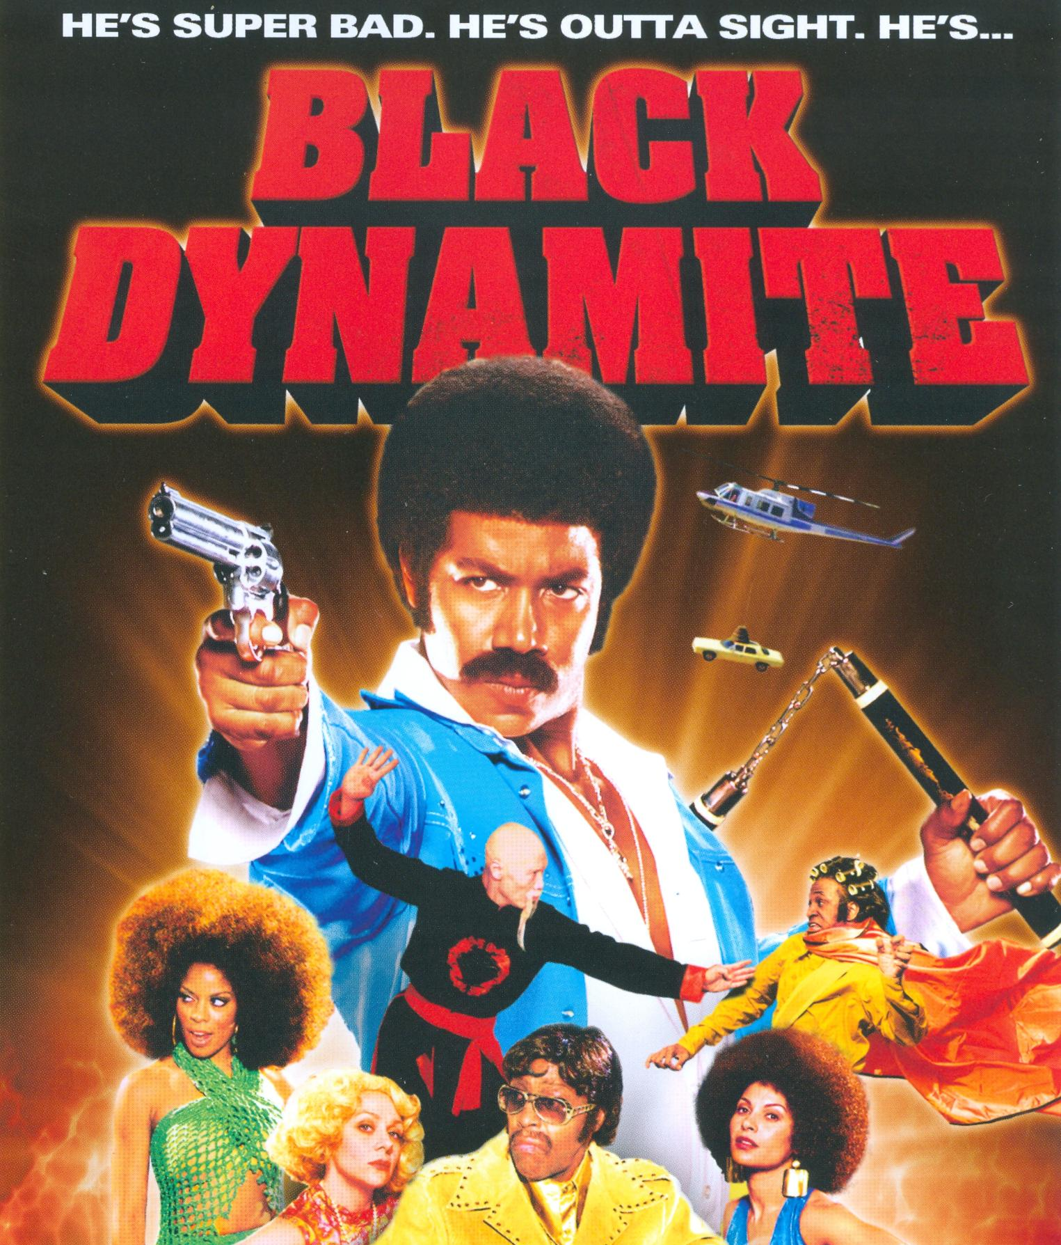

Slide 10
“Thick as Thieves”--Reception
Mixed Reviews
Performances praised, but not award-level.
Director’s debut film showed much potential but still some rough edges.
In general a workman-like production, but notable mostly for its quirky comedy.

Slide 11
“Thick as Thieves”--Reception
“A sexy, cool Alec Baldwin shines throughout as a consummate career thief with a retro taste for quality jazz on vinyl and soft heart for his aging dog. . . . (A) goofy, offbeat noirish crimer, which boasts idiosyncratic humor and deftly drawn characterizations, played by a terrific cast, including Michael Jai White, Rebecca De Mornay, David Byrd, Richard Edson, and others.”
--Emanuel Levy (emanuellevy.com)

Slide 12
“Thick as Thieves”--Reception
“One of those self-consciously quirky crime films that feel more dated as each passing second brings the film world farther away from Pulp Fiction.” --Michael Dequina (TheMovieReport.com)

Slide 13
“Thick as Thieves”
What did you think?

Slide 14
Next Week
“Midnight Run” (1988) 127 minutes
Robert De Niro
Charles Grodin
Yaphet Kotto
Dennis Farina
John Aston
Joe Pantoliano

