Slide 1


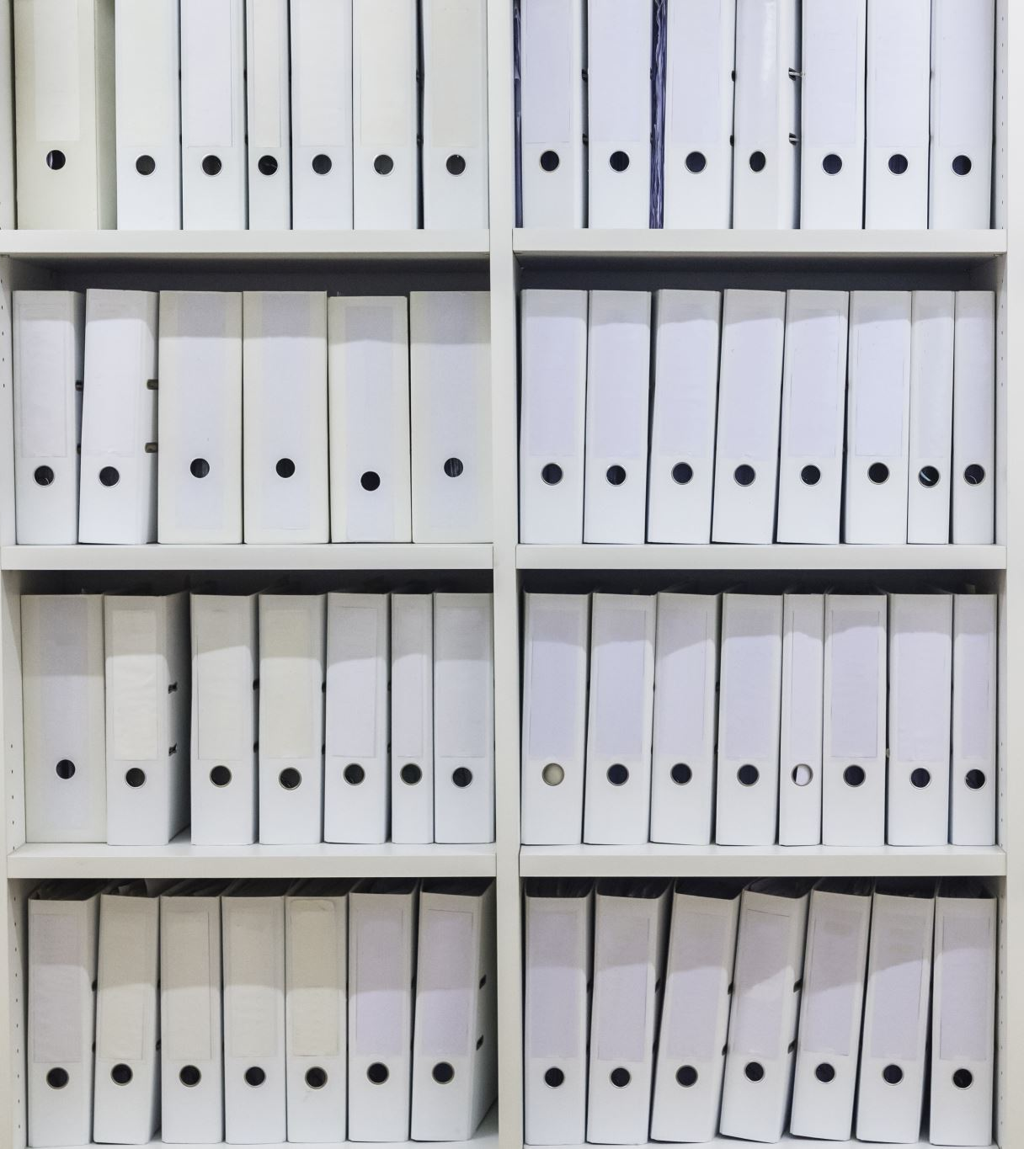
FBI’s Library Awareness Program
Paula Kaufman
November 28, 2022

Slide 2
Remember the cold war?
Spanned from announcement of the Truman Doctrine on March 12, 1947 until the dissolution of the Soviet Union on December 26, 1991
No large-scale fighting between the US and USSR but each supported regional conflicts
Tension that could be nuclear war at any moment
Cuban Missile Crisis, 1962

Slide 3
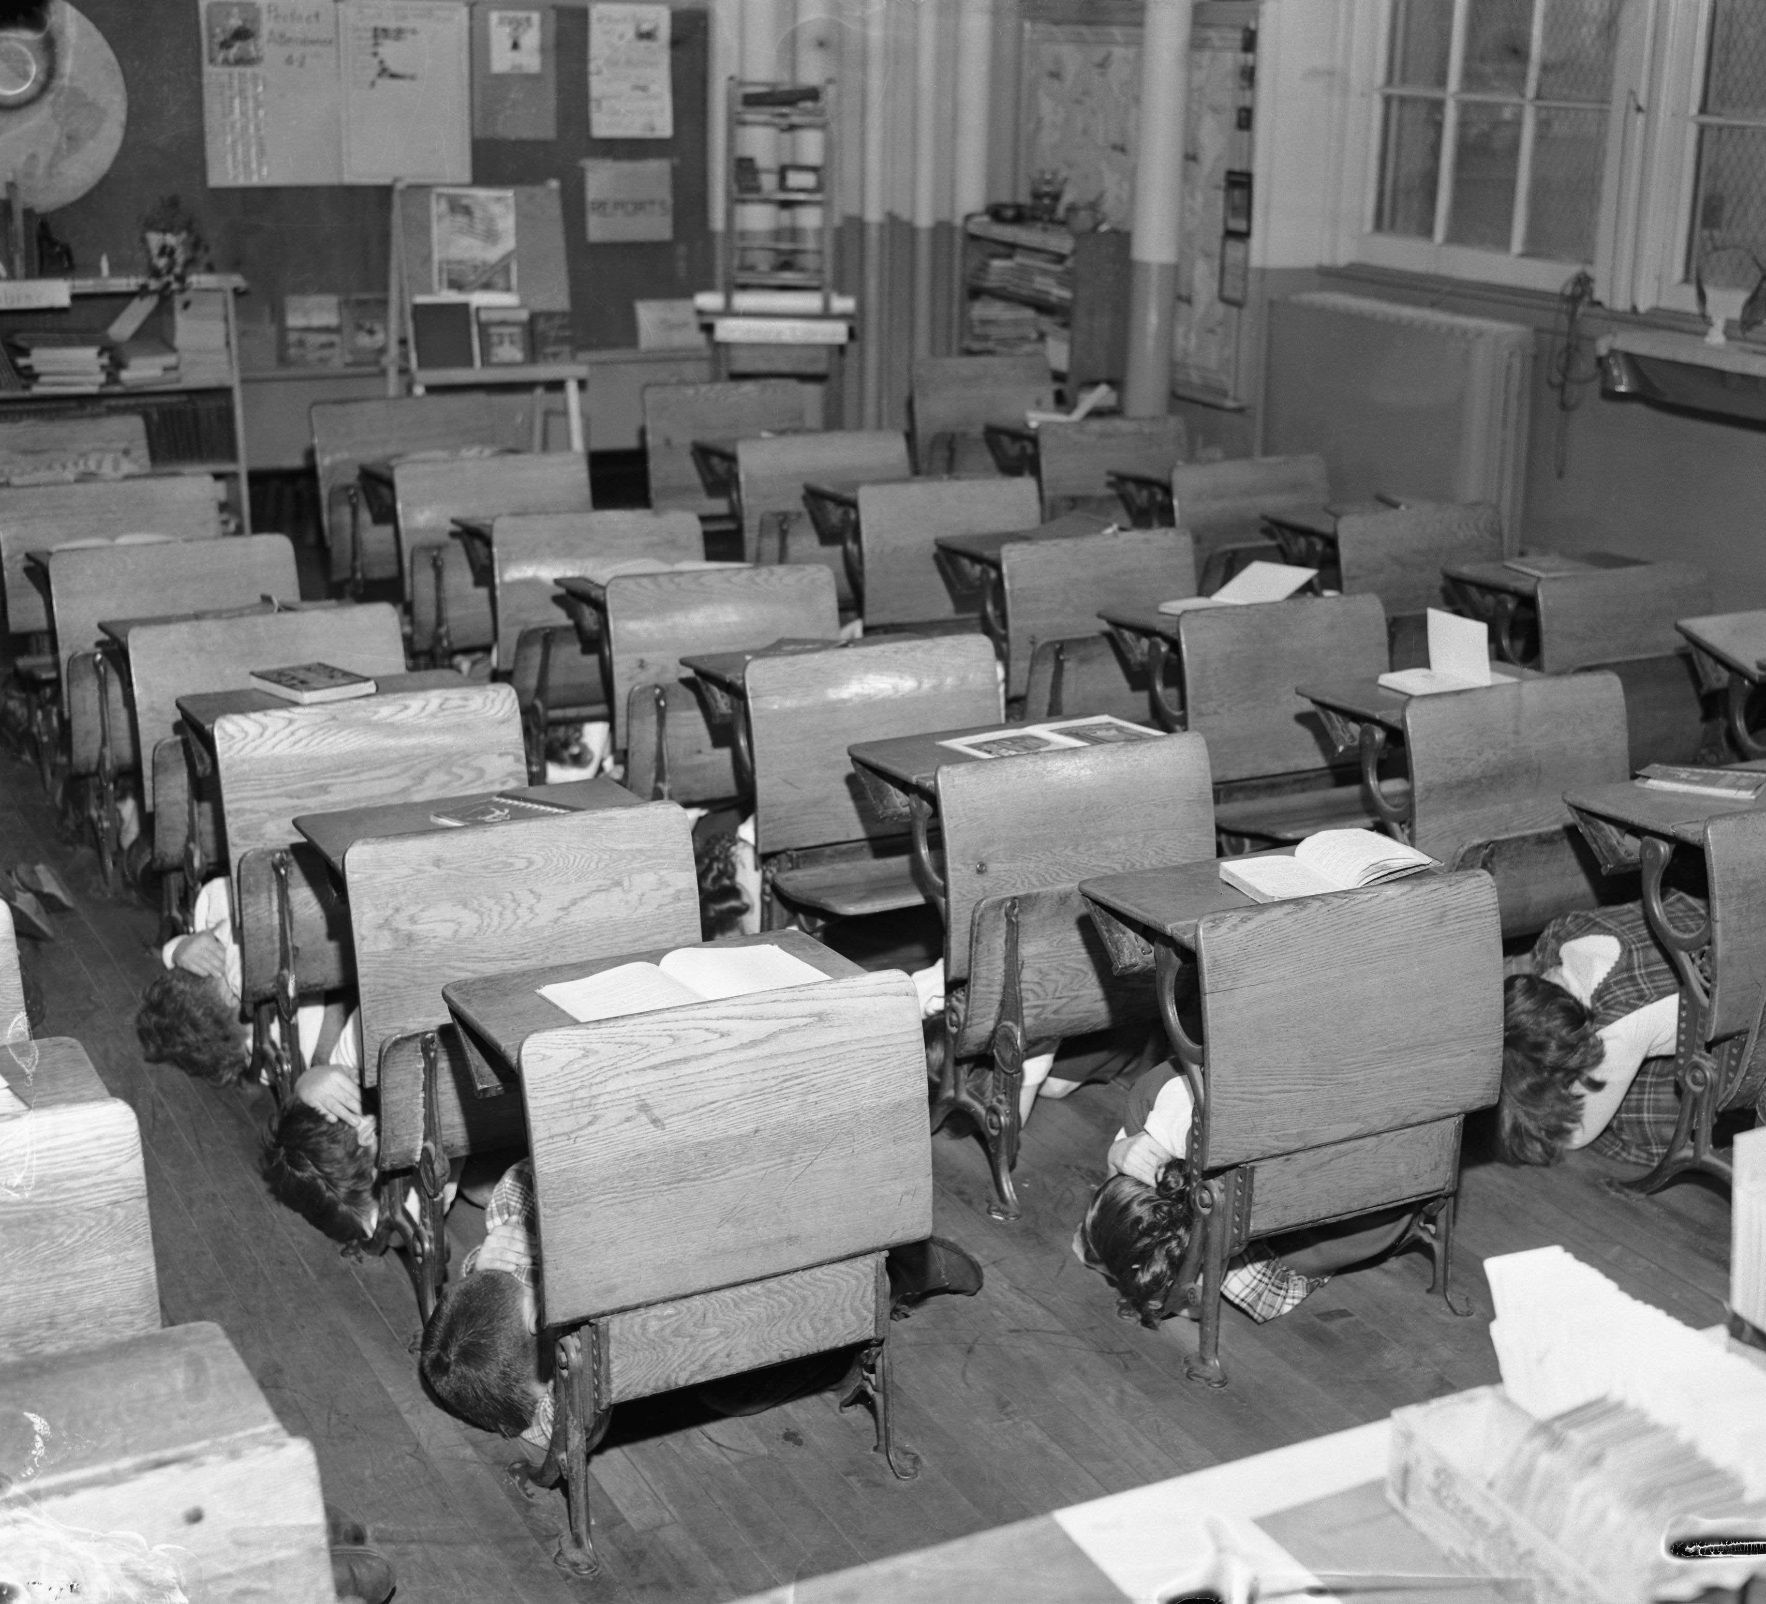
Duck and cover

Slide 4

First Contact June 7, 1987
Two FBI agents asked the clerk in Columbia University’s Math/Science Library to ”be alert to use of the library by persons from countries ‘hostile to the United States’…and to provide the FBI with information about these activities.”
Librarian Mary Kay entered the library, stopped the clerk from agreeing to comply, and sent the agents to see me – I was then responsible for the public-facing operations of the Columbia University Libraries
th

Slide 5
FBI agents visit with me June 7, 1987
Agents visited me and a colleague an hour later. They explained that they were conducting LIBRARY AWRENESS PROGRAM to make librarians in NYC aware of the dangers to national security that were lurking in our libraries
Reasons? Mosaic Theory and recruitment of students and 'underpaid librarians
Request violated state law

Slide 6
ALA Code of Ethics
ALA Principles:
We uphold the principles of intellectual freedom and resist all efforts to censor library resources.
We protect each library user's right to privacy and confidentiality with respect to information sought or received and resources consulted, borrowed, acquired or transmitted.

Slide 7
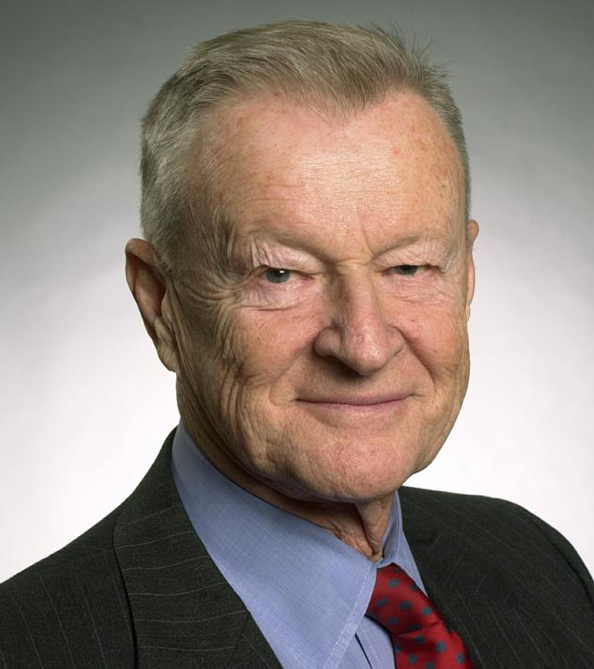
We would have invaded privacy of faculty such as Zbignew Brezhinski

Slide 8
Visit ends
I refused to cooperate and told them they would have to get a subpoena and that Columbia would move to quash the subpoena. They never did.
They left and filed a “call report.”

Slide 9
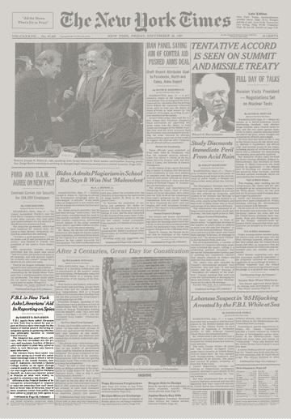
Notified ALA
FBI IN NEW YORK ASKS LIBRARIANS’ AID IN REPORTING ON SPIES
September 18, 1987

Slide 10
Reactions: Mostly Positive
Many supportive editorials in national press
Art Buchwald: I Was a Bookworm for the FBI
Herblock cartoon
Many positive letters emphasizing ‘chilling effect’ of FBI’s request
A University donor made his first large gift to the library
I was interviewed on CNN, CBS, Nightline, and more

Slide 11
But not all were positive
Some editorials in the conservative press (e.g., NY Daily News)
Some hate mail
All emphasized I had “failed to do my patriotic duty”

Slide 12
Congressional Hearing
House Judiciary Subcommittee on Civil and Constitutional Rights
June 20, 1988
https://www.c-span.org/video/?3074-1/fbi-library-awareness-program
Representatives expressed support. Later summoned FBI Director to testify and defend program

Slide 13
FBI Letter to arl September 20, 1988
Library associations continued to work to end Library Awareness program
“When deemed necessary, the FBI will continue to contact certain scientific and technical libraries (including university and public libraries) in the New York City area concerning hostile intelligence service activities at libraries.”
James H. Geer, Assistant Director in Charge, Intelligence Division

Slide 14
Foia, NSA
Foia’ed files. Much redacted
National Security Archives used report of call on me to sue the FBI for failing to produce the call report in a previous FOIA request
One FOIA request revealed that real name of program might have been DECAL, Development of Counterintelligence Among Librarians

Slide 15
Balance of security and access
Protection of information is legitimate government responsibility
Access to information enables rapid scientific development
Program singled out people for their accents and/or surnames

Slide 16
Library awareness program
Abridgement of right to privacy and academic freedom
Resulted in many libraries adopting policies of what to do if asked to comply with FBI. Superceded by US Patriot Act
Presumably program no longer exists

