Slide 1
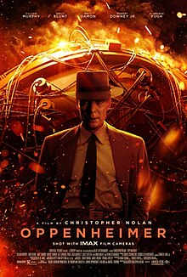
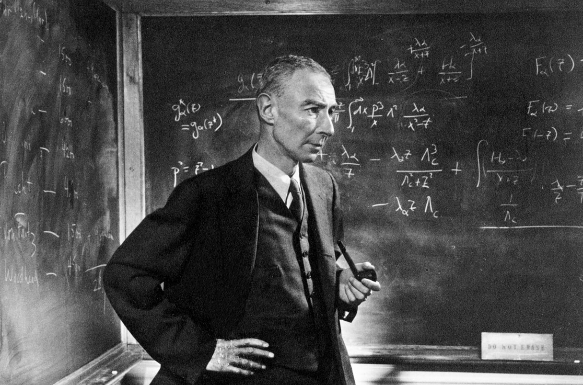

Oppenheimer and Los Alamos:
Beyond the movie
Gordon Baym
University of Illinois
Urbana, Illinois
OLLI
November 8, 2023
Notes:
Neutron stars had roots in Copenhagen, from the first musings of Landau in the beginning of the 1930s, which I spoke about in a Niels Bohr
Archives talk just before the grand lockdown, to a particularly productive time in the early 1970’s, which I will briefly mention today.

Slide 2
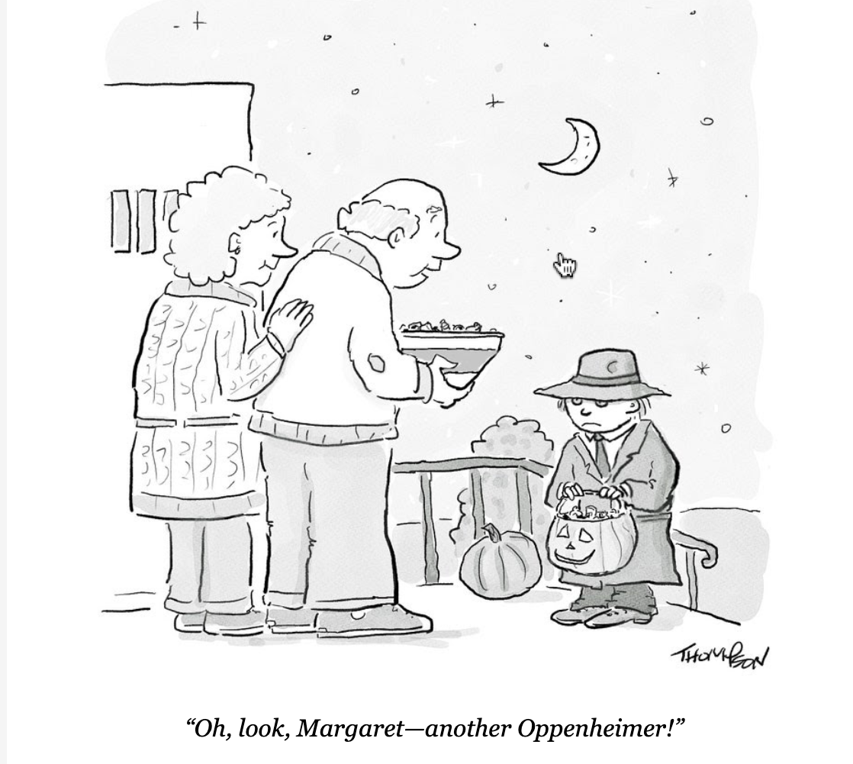

Slide 3
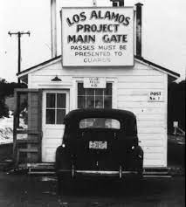
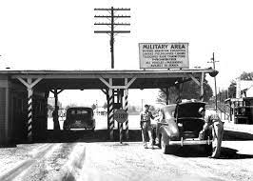
Main Manhattan Project sites
Los Alamos– bomb development
Oak Ridge (TN)
-- uranium separation
Hanford (WA)
-- plutonium reactor
Hanford (WA) plutonium

Slide 4
Issues I will not cover:
Criticisms of the movie
--To physicists, too heavy focus on the 1954 hearings.
--Does not discuss whether dropping bombs on Japan
made sense, or could have been avoided.
--Does not show victims of Hiroshima and Nagasaki
bombings
--Or radiation of the people in nearby Tularosa Basin in
New Mexico by the Trinity test.
--Does not tackle postwar efforts to control atomic
weapons.
The hydrogen bomb

Slide 5
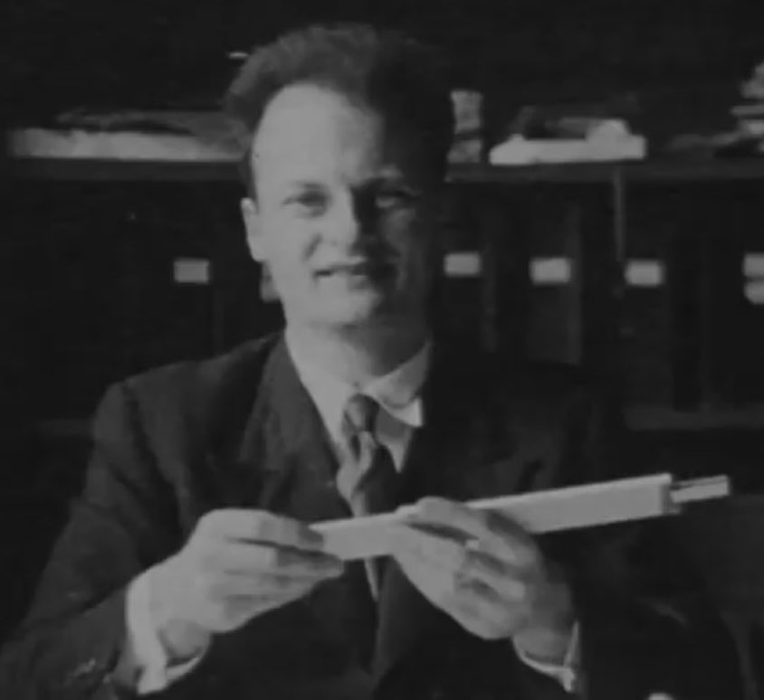
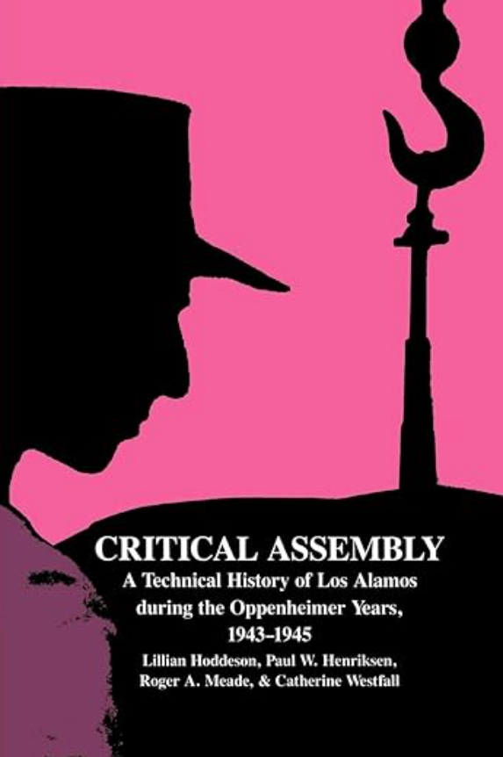
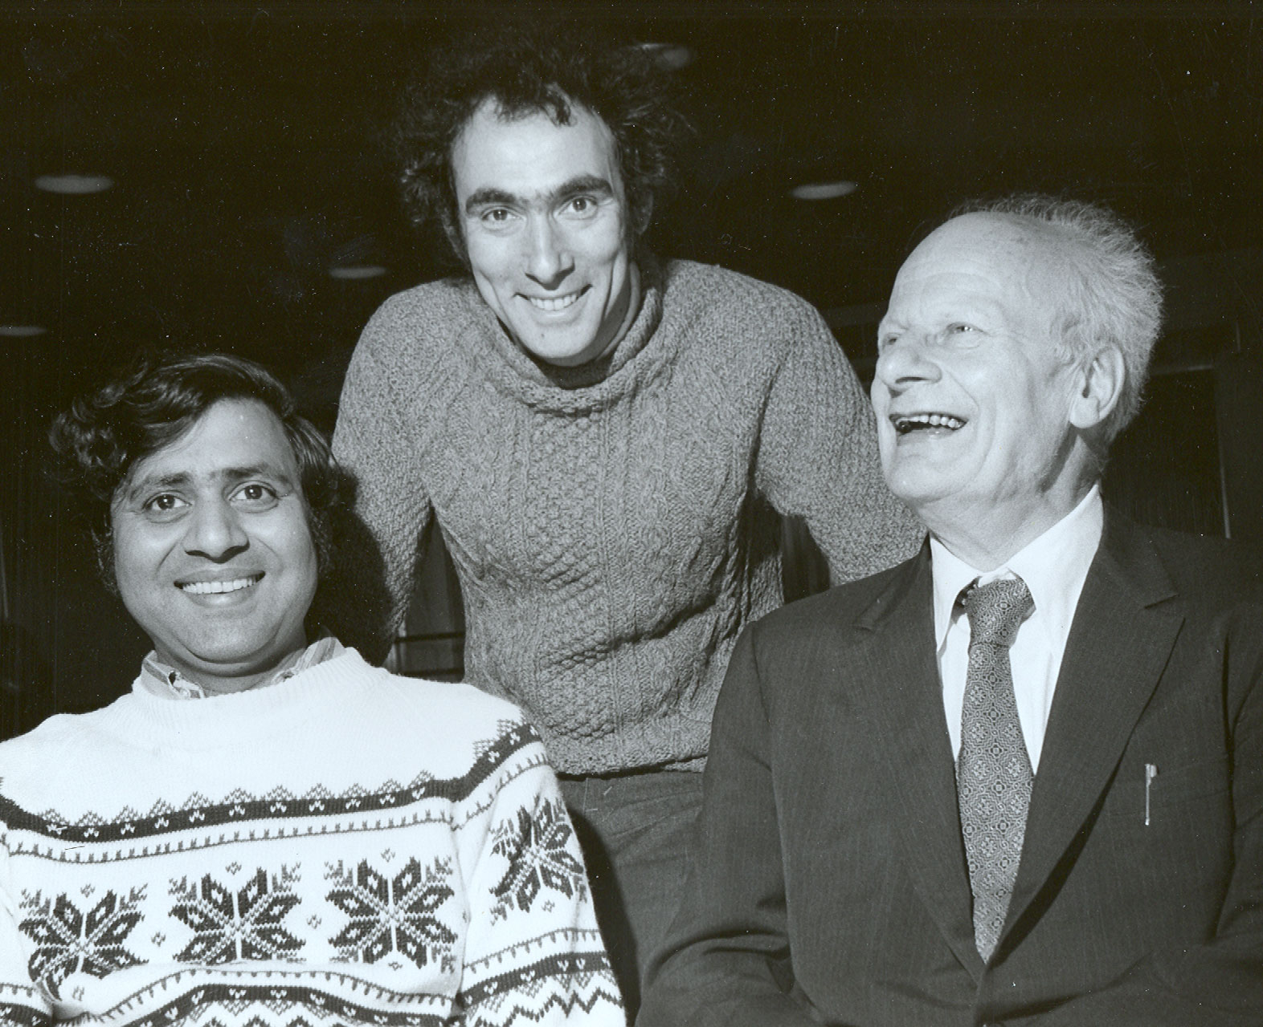
Hans Bethe (1906-2005)
Head, Theory Division,
Los Alamos
Nobel Prize, 1967
Critical assembly:
A technical history of Los Alamos
during the Oppenheimer years,
1943—1945
(Cambridge Univ. Press 1993)
with GB and Vijay
Pandharipande
Urbana, ca 1980

Slide 6
Historical time frame
1941
Dec. 7 Bombing of Pearl Harbor
Dec. 8 U.S. declares war on Japan
Dec. 11 U.S. declares war on Germany
1942
Aug. Start of the Manhattan Project
Fall Start of Project Y (Los Alamos)
1943 April 1 Work begins in Los Alamos
1945
May 8 Germany surrenders
July 16 Trinity test, Alamagordo, New Mexico
Aug 6 Bombing of Hiroshima (uranium bomb)
Aug 9 Bombing of Nagasaki (plutonium bomb)
Aug 14 Japan surrenders

Slide 7
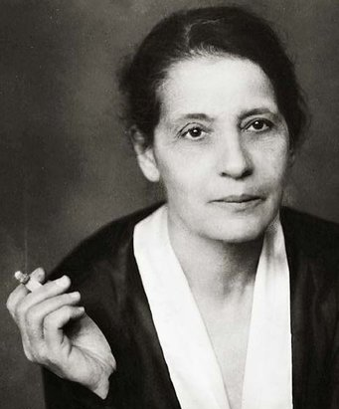
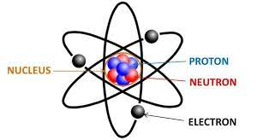
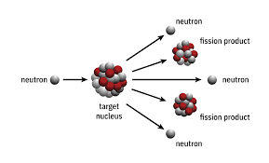
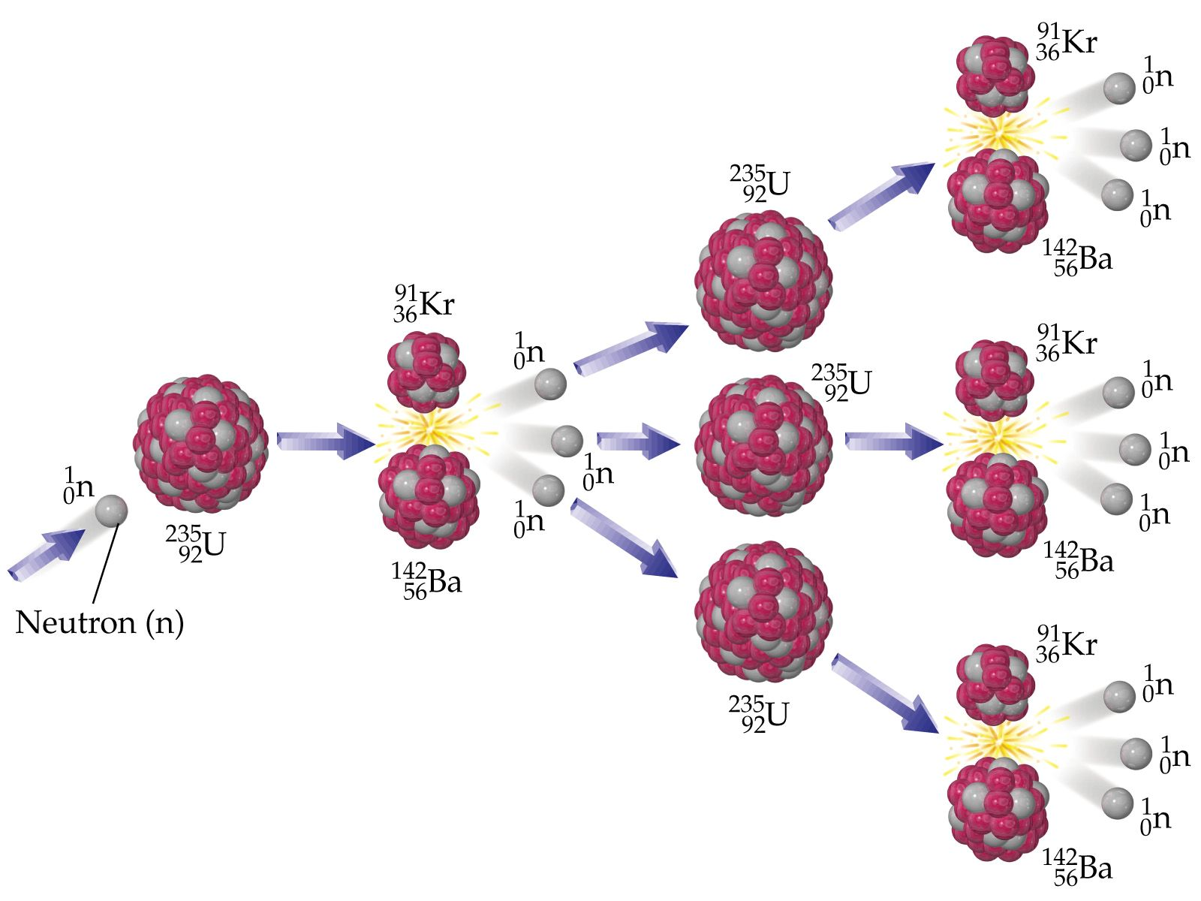
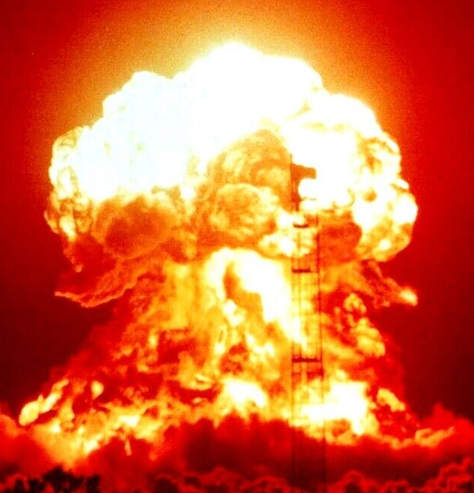
Fission
Discovered by Hahn and Strassman in Germany
in Dec. 1938 (but not understood)
Explained by Lise Meitner (with nephew Otto Frisch)
Atomic nucleus
Chain reaction
Trinity test

Slide 9
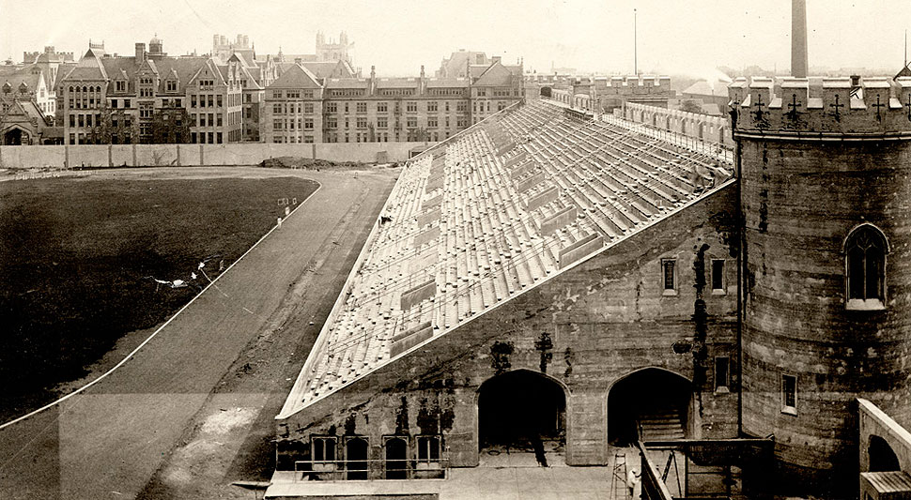
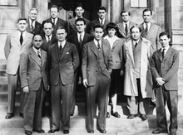
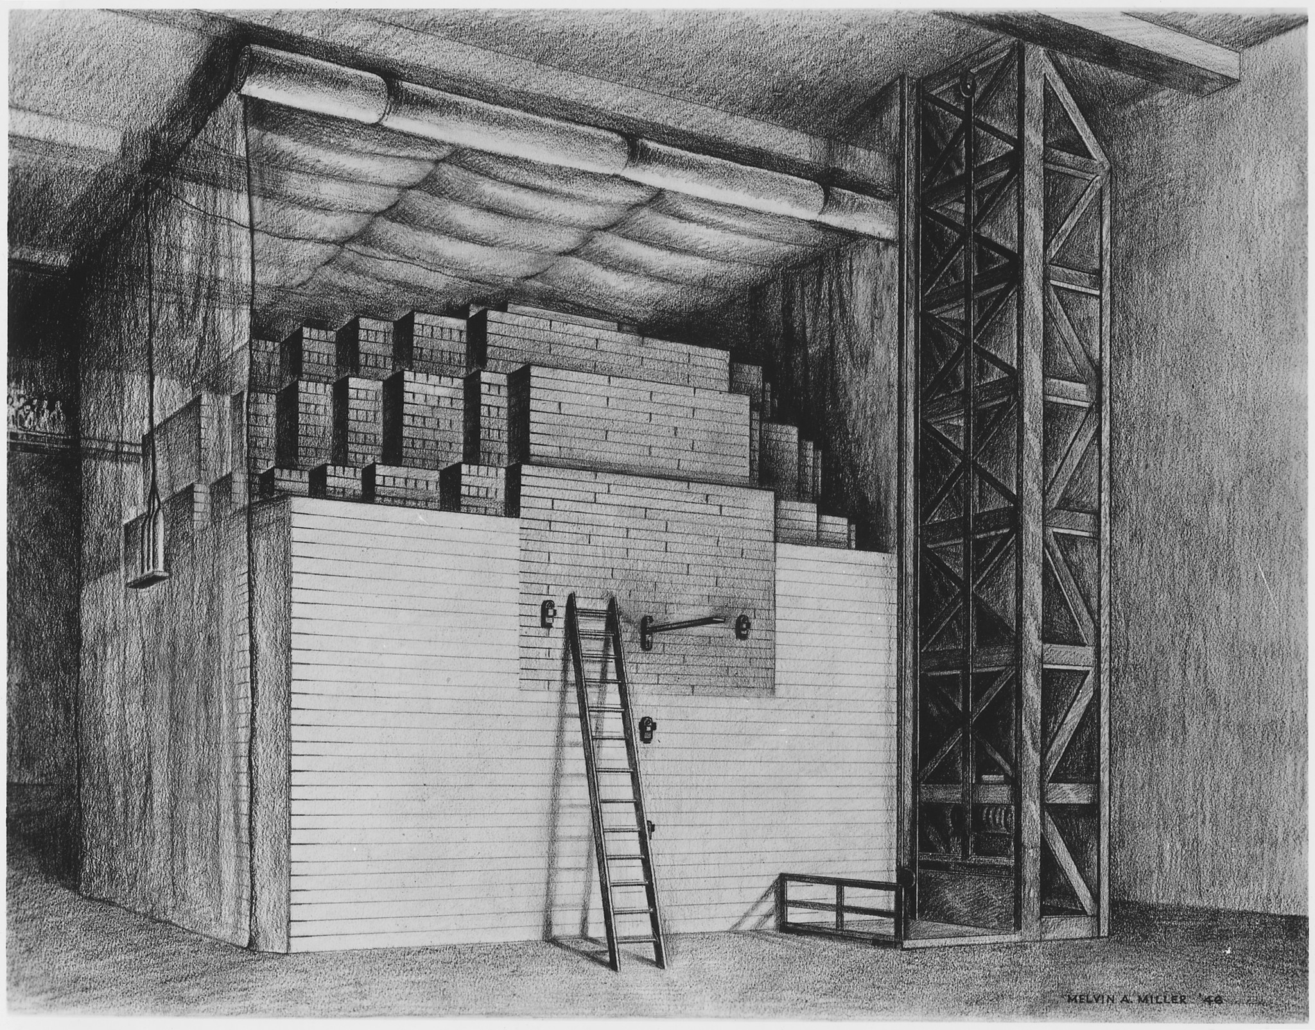
First nuclear chain reaction
Fall 1942 at University of Chicago
(Metallurgical Laboratory or Met Lab)
Enrico Fermi (1901-1954)
Stagg Field
Fermi’s group 1946
Fermi’s pile (CP1) -- predecessor of all nuclear power plants

Slide 10
First nuclear chain reaction
Fall 1942 at University of Chicago
(Metallurgical Laboratory or Met Lab)
Enrico Fermi (1901-1954)
Stagg Field
Fermi’s group 1946
Fermi’s pile (CP1) -- predecessor of all nuclear power plants

Slide 11
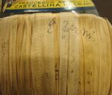
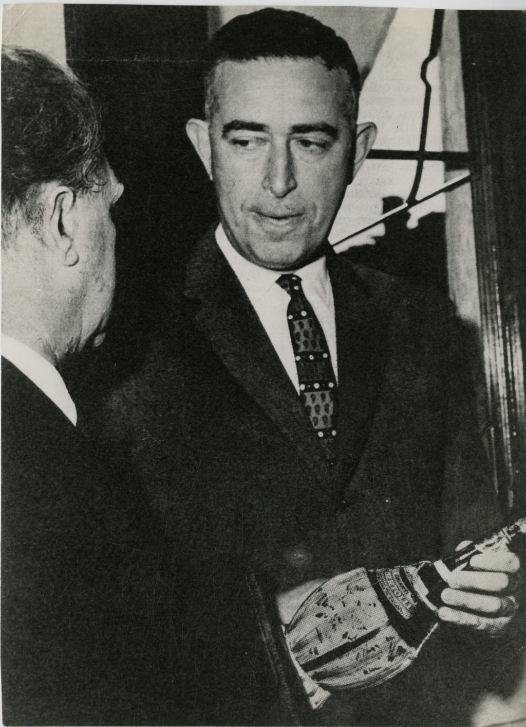
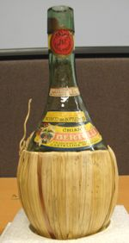
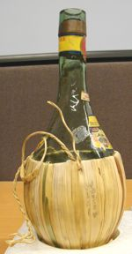
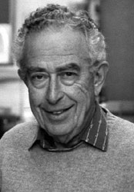
Signed chianti bottle, bought by Eugene Wigner,
and kept in Urbana on Delaware Ave. by Al Wattenberg.
Now in the Smithsonian.
“Fermi”

Slide 12
Leo Szilard (1898-1964)
Trained as chemical engineer, Budapest
Early ideas: electron microscope; cyclotron; with Einstein invents a refrigerator with no moving parts, used in today’s breeder reactors.
1934: conceives and patents idea of neutron-induced nuclear chain reaction (& assigns patent to British Admiralty to keep it secret).
A founder of the Academic Assistance Council in Great Britain to help refugees from Nazi Germany.
1939: Writes warning letter to President Roosevelt, signed by Einstein, of possibility of German fission bomb -- leads to Manhattan Project.
Fermi’s pile: Realizes chemical element boron in commercial graphite
would shut down nuclear reaction. Arranges production of boron-free
graphite!

Slide 13
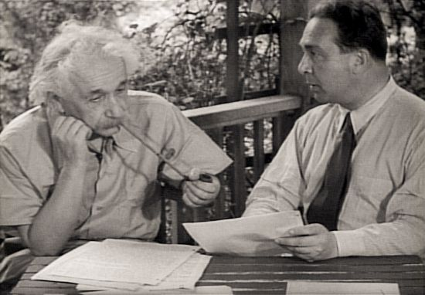
Einstein and Szilard composing letter to Roosevelt
Re-enacted in 1946 March of Time film “Atomic Power”

Slide 14
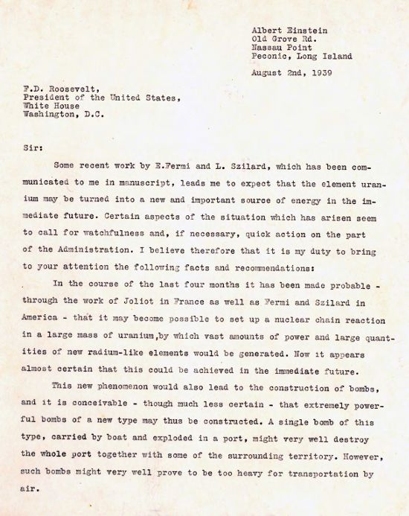
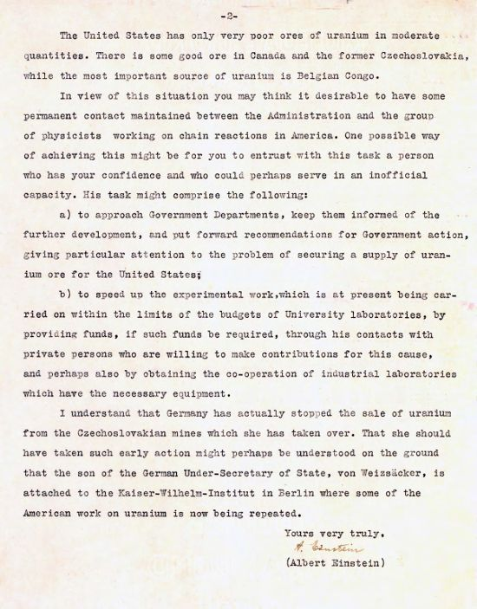
Einstein and Szilard letter to Roosevelt
signed by Einstein alone

Slide 15
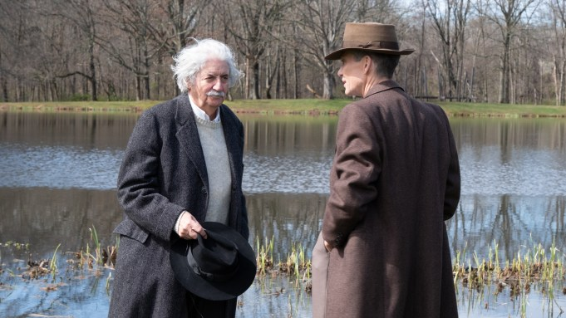
Einstein plays no further role in development of bombs
Einstein and Oppenheimer in “Oppenheimer” movie

Slide 16
Leo Szilard (1898-1964)
Trained as chemical engineer, Budapest
Early ideas: electron microscope; cyclotron; with Einstein invents a refrigerator with no moving parts, used in today’s breeder reactors.
1934: conceives and patents idea of neutron-induced nuclear chain reaction (& assigns patent to British Admiralty to keep it secret).
A founder of the Academic Assistance Council in Great Britain to help refugees from Nazi Germany.
1939: Writes warning letter to President Roosevelt, signed by Einstein, of possibility of German fission bomb -- leads to Manhattan Project.
Fermi’s pile: Realizes chemical element boron in commercial graphite
would shut down nuclear reaction. Arranges production of boron-free
graphite!

Slide 17
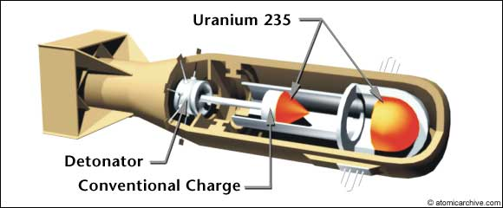
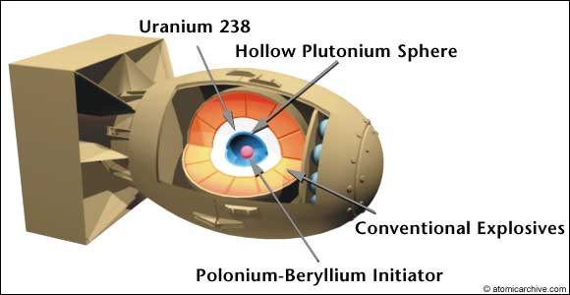
Two types of bombs
Uranium bomb
--gun fires piece of
(rare isotope) U-235
into second piece of
U-235 to form critical
mass
Plutonium bomb
--outer explosives
cause implosion of
plutonium (Pu-239)
shell to form critical
mass

Slide 18
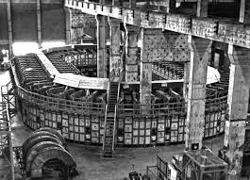
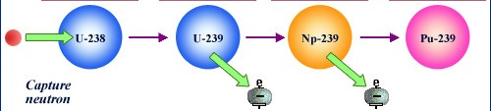
Oak Ridge Laboratory in Tennessee
Separated rare uranium isotope U-235 from heavier common form of
uranium U-238
Calutron (``California cyclotron”)
used in separation. Magnets
made of silver from Fort Knox
and later separation by
``gaseous diffusion”
Hanford Laboratory in Washington (state)
Grow Pu-239 in reactor starting from U-238 by capturing neutrons

Slide 19
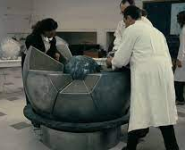
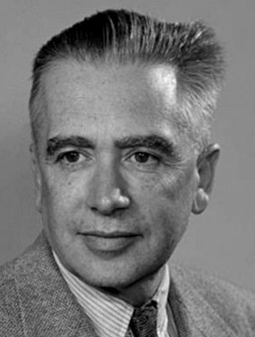
Why is plutonium more complicated to use?
Pu-240 contamination
Pu-239 captures neutron as it sits
in reactor and becomes Pu-249.
Residual Pu-240 gives neutron back
(very very very slowly) but fast enough
to cause plutonium bomb to fizzle if
gun assembly was used.
Trinity bomb in movie
Emilio Segrè (1905-1989) carries out lowest event
rate experiment ever!
Solution would be to implode plutonium shell very
very rapidly and symmetrically! Needed complicated
arrangements of explosives.

Slide 20
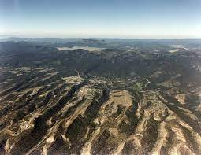
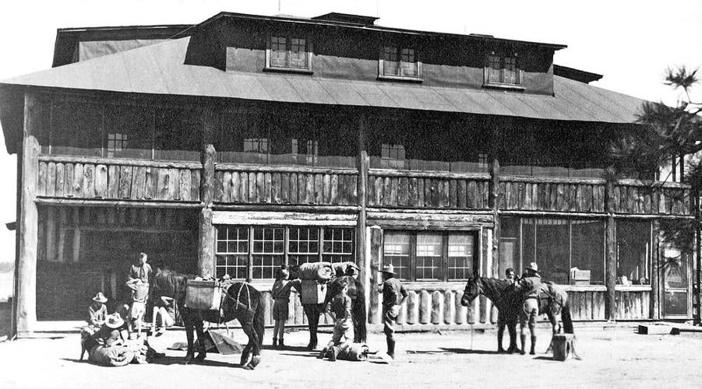
Setting up the Los Alamos lab
Los Alamos
Los Alamos Ranch School
(1917- November 1942)

Slide 21
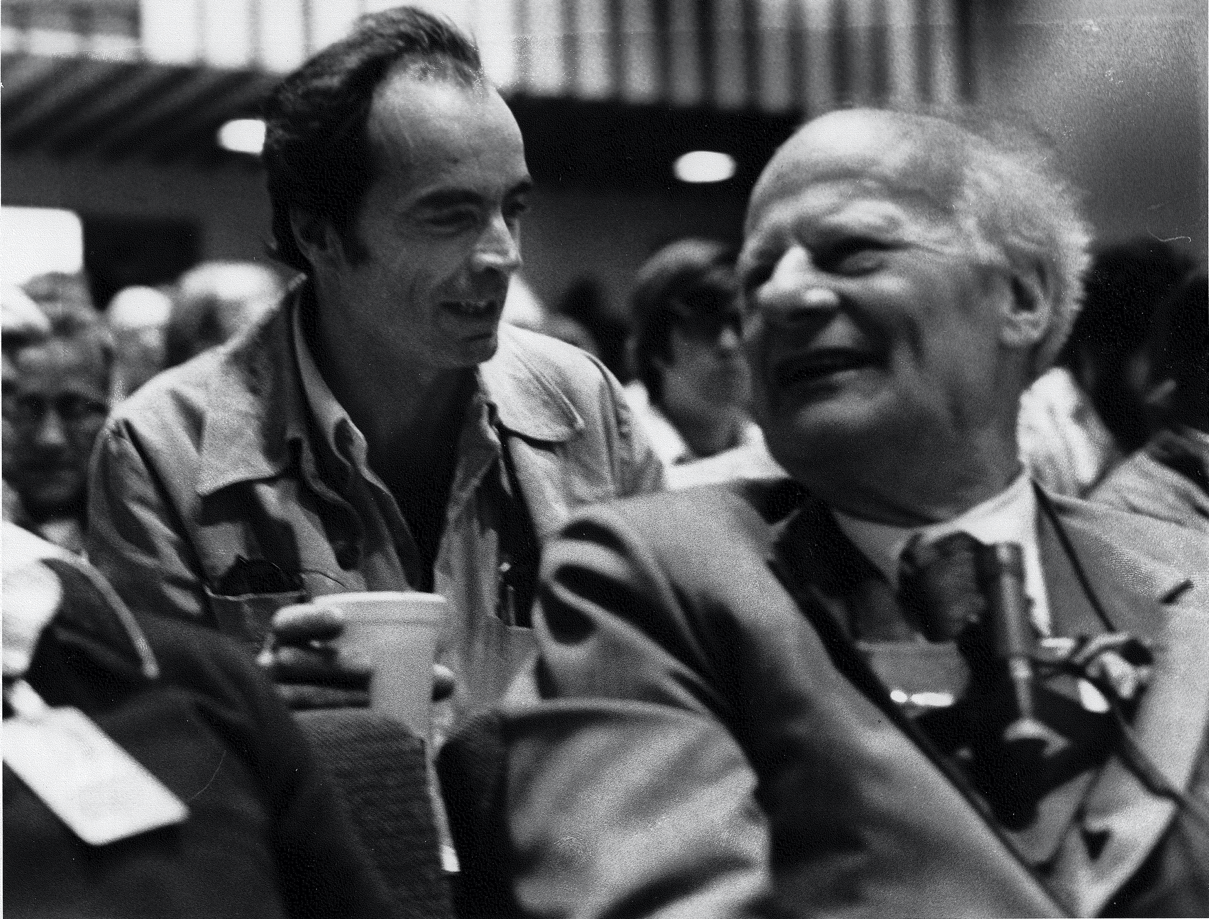
“About December that year (1942), two men showed up at school, and we were required to say our yes sirs to a Mr. Jones, who was wearing a fedora, and to a Mr. Smith, who was wearing a porkpie hat. The names were obviously pseudonyms. Not only was everybody showing them great deference, but Mr. Jones seemed most uncomfortable every time someone referred to him by that name. The four of us who were seniors had studied physics. The pictures in our physics textbook made it easy for us to recognize Mr. Jones as Ernest Lawrence and Mr. Smith as Robert Oppenheimer. Furthermore, the discovery of fission had been big news. In fact, we were even aware of the idea of a chain reaction. Clearly, the school was about to be converted to a laboratory
to work on a very secret physics project.
Why else would top physicists be visiting
a place out at the end of nowhere with no
water, no roads, no facilities? What was
really going on was obvious! We were
secretly amused by the pretense”
Physicist Stirling Colgate (with Hans Bethe)

Slide 22
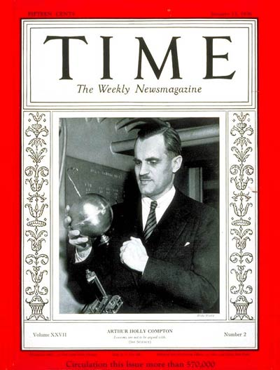
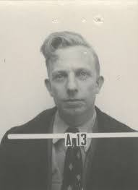
Arthur Holley Compton (1892-1962)
Head of Chicago Met Lab (1942).
--Reorganized atomic weapon research around U.S.
--Appointed Oppenheimer to head theoretical research.
“Bethe told me Oppenheimer was able to direct the effort
at Los Alamos so successfully because he was so much smarter than everyone else, and Bethe, who won the 1967 Nobel Prize in physics, included himself in that comparison. Bethe also told me—a more telling insight, I think—that Oppenheimer had been casually cruel to people who made mistakes around him, including Bethe, before the war and after the war, but that he suspended the hostilities at Los Alamos.” Historian Richard Rhodes
Compton appoints John Manley (1907-1990, BA in physics, University of Illinois, 1929) to be second in command

Slide 23
Starting Los Alamos Laboratory
Some 4000 people (100,000 in Manhattan project) including
good fraction of top physicists in US (and from abroad).
The April Conference (late April 1943), “to analyze the scientific
problems of the Los Alamos Laboratory and to define its schedules
and its detailed experimental program.’’
Lectures by Bob Serber
(1909-1997)
on basic science and
technology necessary.
Serber and Oppenheimer

Slide 24
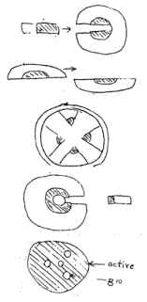
Los Alamos Primer
(report LA-1, 1943)
possible designs

Slide 25
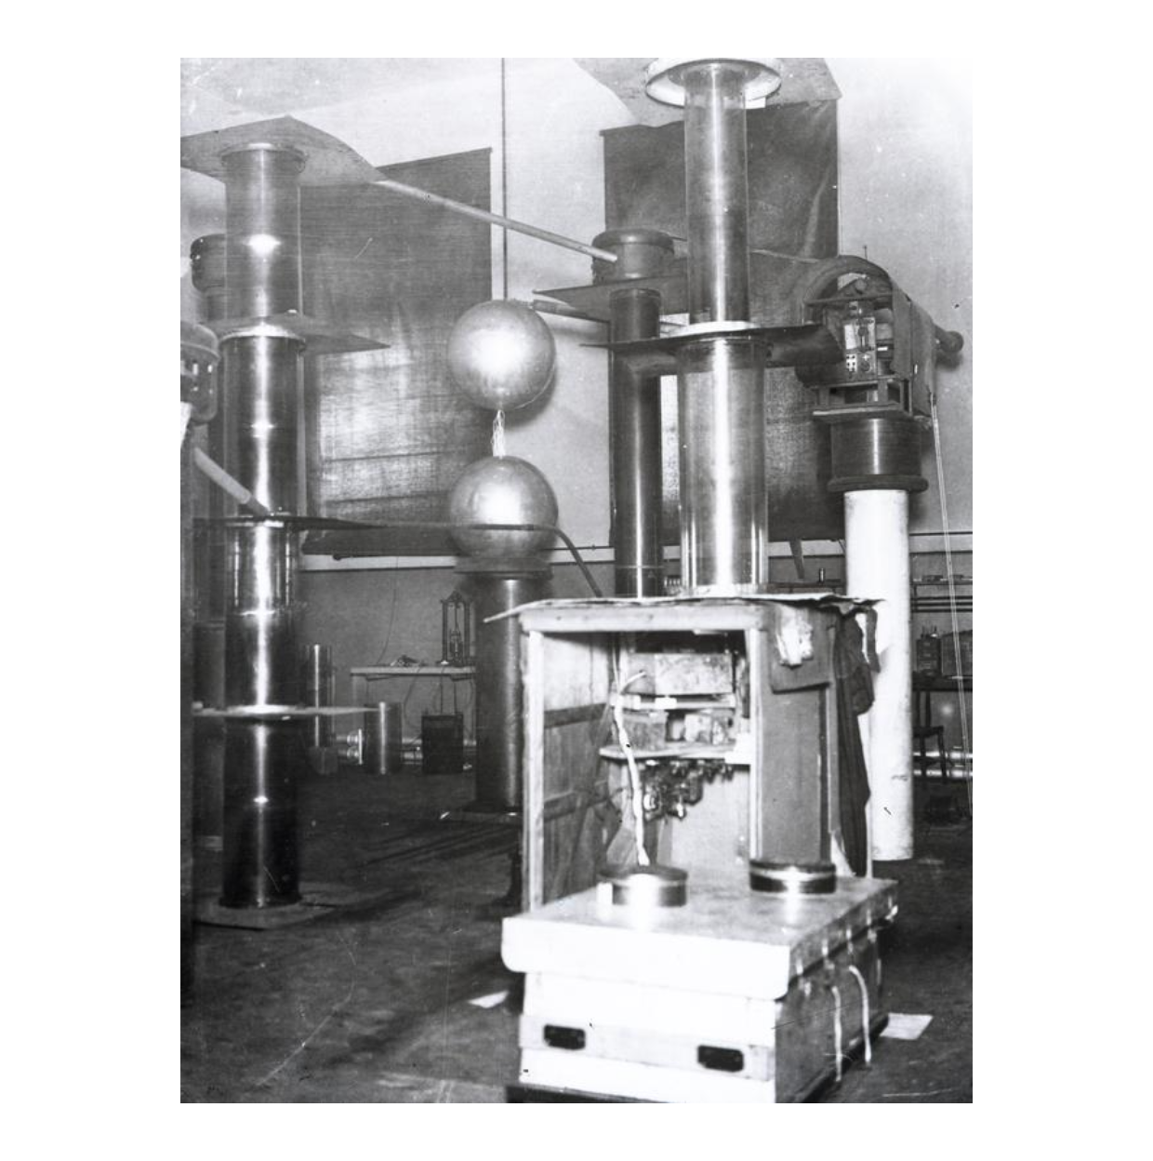
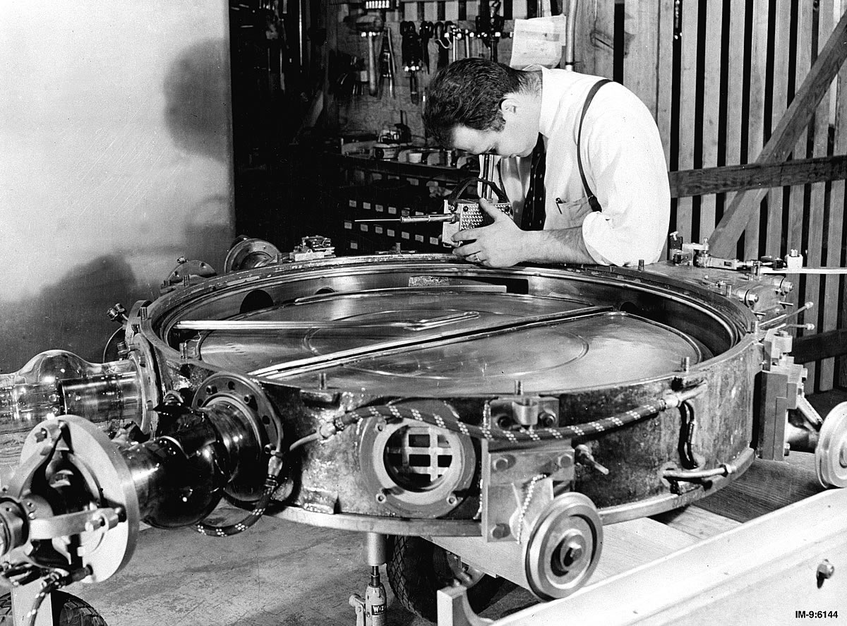
“Borrowing” equipment from university nuclear physics labs
Cockcroft Walton accelerator from Illinois
Cambridge 1932
Donald Kerst, U Illinois,
with the Betatron, ca. 1941
+ from Princeton,
U. Wisconsin
(2 Van de Graaf accelerators)
Harvard cyclotron

Slide 26
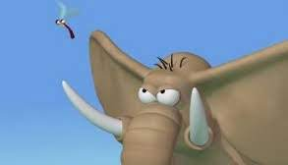
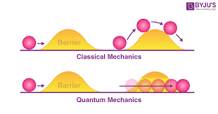
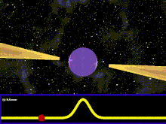
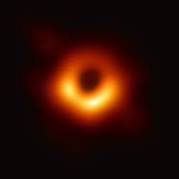
Oppenheimer’s science
1927-- as graduate student in Göttingen.
Born-Oppenheimer theory of solids:
The electrons, like mosquitoes, follow the
heavier nuclei as they move around.
1928 – earlier theory of quantum tunneling
1930 -- realizes theoretically that electrons
have to have antiparticles, called positrons,
--discovered experimentally just two years later.
1939 – theory of neutron stars
1930 – proposes existence of black holes
neutron star as pulsar
black hole in galaxy M87

Slide 27
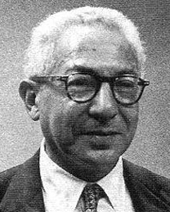
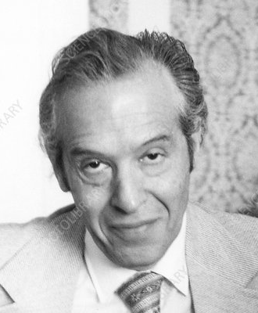
Physicists on Oppenheimer
“I have said of him that he would have been a much better physicist if he had studied the Talmud rather than Sanskrit . . . it would have given him a greater sense of himself.”
I. I. Rabi
“He had a quick brain . . . but the brain must be supplemented by long hours of practice that go into the fluidity and ease. … It became clear that since he no longer concerned himself with the (scientific) details of things, it became more and more superficial, which I regretted very much. It was a lesson to me, never to lose completely your touch with the subject, otherwise it’s all over.”
Julian Schwinger

Slide 28
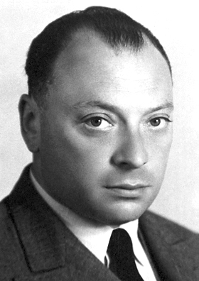
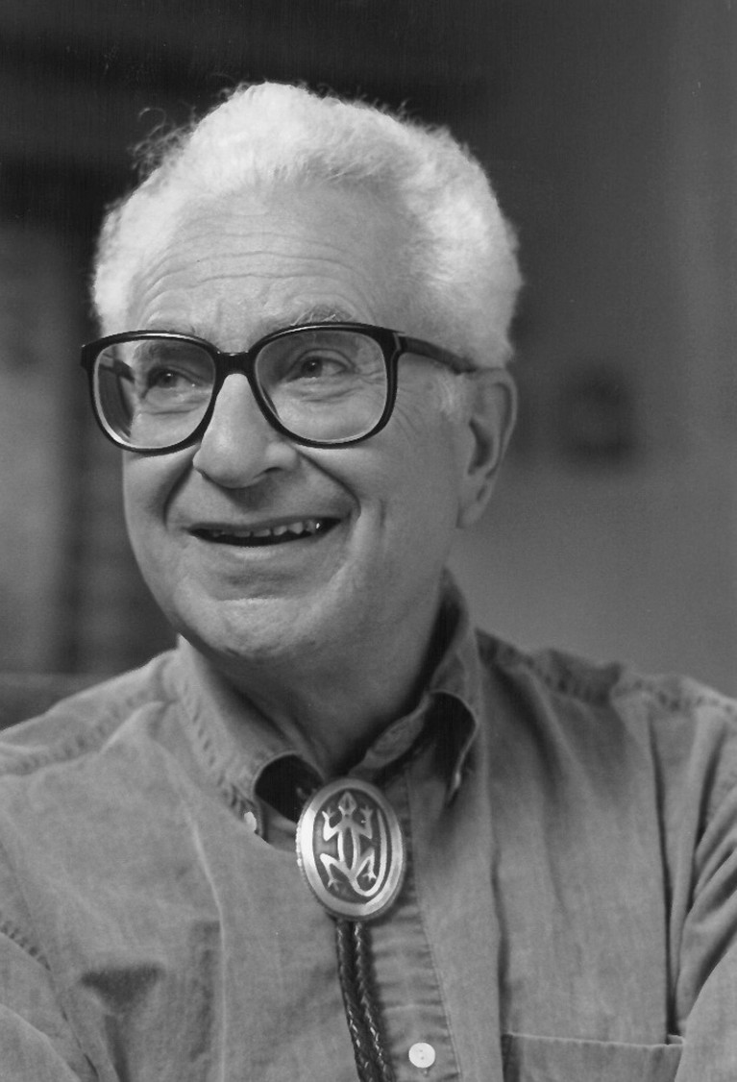
“Oppenheimer considered physics
as an avocation and psychoanalysis
as a vocation.”
Wolfgang Pauli
“He didn’t have Sitzfleisch, . . . As far as I know, he never wrote a long paper or did a long calculation, anything of that kind. He didn’t have patience for that; his own work consisted of little [perceptions or in Murray’s language] aper ̧cus, but quite brilliant ones. But he inspired other people to do things,
and his influence was fantastic.”
Murray Gell-Mann

Slide 29
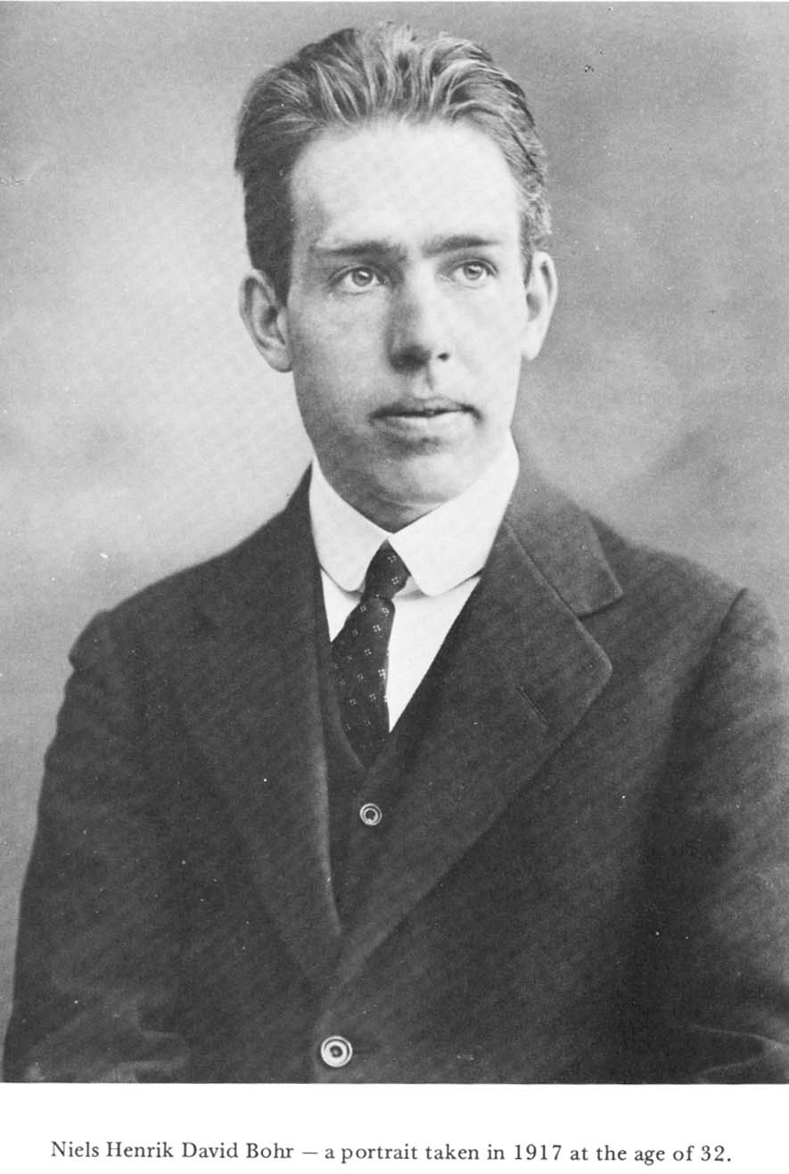
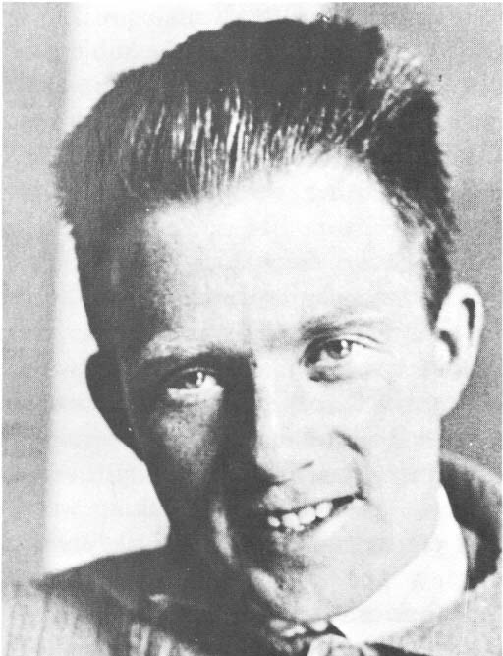

Niels Bohr, 1885-1962
Father of the quantum theory of the microscopic world.
Along with Einstein, reshaped 20th century physics.
1939- theory of nuclear fission (with John Wheeler)
points out that Pu-239 would work very well
1917
Werner Heisenberg, 1901-1976
Worked with Bohr in Copenhagen 1924-27
Uncertainty principle: March 1927
1924
Meeting in Copenhagen, September 1941
Subject of Michael Frayn’s play ”Copenhagen”

Slide 30
Document 1, dictated to Aage Petersen
Dear Heisenberg,
I have seen a book, “Stærkere end tusind sole” [“Brighter than a thousand suns”] by Robert Jungk, recently published in Danish, and I think that I owe it to you to tell you that I am greatly amazed to see how much your memory has deceived you in your letter to the author of the book, excerpts of which are printed in the Danish edition.
Personally, I remember every word of our conversations, which took place on a background of extreme sorrow and tension for us here in Denmark. In particular, it made a strong impression both on Margrethe and me, and on everyone at the Institute that the two of you spoke to, that you and Weizsäcker expressed your definite conviction that Germany would win and that it was therefore quite foolish for us to maintain the hope of a different outcome of the war and to be reticent as regards all German offers of cooperation. I also remember quite clearly our conversation in my room at the Institute, where in vague terms you spoke in a manner that could only give me the firm impression that, under your leadership, everything was being done in Germany to develop atomic weapons and that you said that there was no need to talk about details since you were completely familiar with them and had spent the past two years working more or less exclusively on such preparations. I listened to this without speaking since [a] great matter for

Slide 31
mankind was at issue in which, despite our personal friendship, we had to be regarded as representatives of two sides engaged in mortal combat. That my silence and gravity, as you write in the letter, could be taken as an expression of shock at your reports that it was possible to make an atomic bomb is a quite peculiar misunderstanding, which must be due to the great tension in your own mind. From the day three years earlier when I realized that slow neutrons could only cause fission in Uranium 235 and not 238, it was of course obvious to me that a bomb with certain effect could be produced by separating the uraniums. In June 1939 I had even given a public lecture in Birmingham about uranium fission, where I talked about the effects of such a bomb but of course added that the technical preparations would be so large that one did not know how soon they could be overcome. If anything in my behaviour could be interpreted as shock, it did not derive from such reports but rather from the news, as I had to understand it, that Germany was participating vigorously in a race to be the first with atomic weapons.
Besides, at the time I knew nothing about how far one had already come in England and America, which I learned only the following year when I was able to go to England after being informed that the German occupation force in Denmark had made preparations for my arrest.

Slide 32
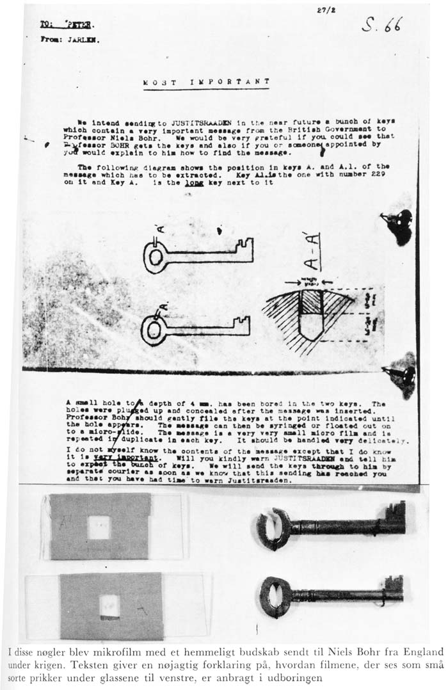
Secret message from Cockcroft
in England to Bohr, early 1943,
asking him to work on bomb.
Key was buried in garden in
Carlsberg (Bohr residence)
during the war, and now hangs
on the wall in Niels Bohr Institute
in Copenhagen

Slide 33


Bohr to Los Alamos
with son Aage (1922-2009)
By fighter plane from Sweden to England, Oct. 1943
Stops in England, Washington
General Groves ride with Bohr to Los Alamos to learn what
Heisenberg might have told him.
Participated actively in many
discussions, particularly on
initiating the plutonium implosion
Bohr skiing in Los Alamos

Slide 34
Memo from John Lansdale, Jr., the head of Manhattan Project intelligence and security, to Richard Tolman, a physicist advisor to General Leslie Groves:
“Both the father and son appear to be extremely absent-minded individuals, engrossed in themselves, and go about paying little attention to any external influences. As they did a great deal of walking, this Agent had occasion to spend considerable time behind them and observe that it was rare when either of them paid much attention to stop lights or signs, but proceeded on their way much the same as if they were walking in the woods. On one occasion, subjects proceeded across a busy intersection against the red light in a diagonal fashion, taking the longest route possible and one of greatest danger. The resourceful work of Agent Maiers in blocking out one half of the stream of automobile traffic with his car prevented their possibly incurring serious injury in this instance.”

Slide 35


Plan to shoot Heisenberg, 1944
Heisenberg was to lecture in Zurich at Paul Scherrer’s institute in Villingen, Switzerland, in late 1944
Baseball player Moe Berg trained by Hans Bethe and Vicki Weisskopf to recognize if Heisenberg understood about making bombs. If so, Berg was to shoot him on the spot!
Paul Scherrer
Renowned Swiss
physicist, who worked
for US OSS (predecessor
of the CIA)
“It was crazy what we did then.”
Bethe in Atlanta, 1999
Scherrer and Berg in Zurich

Slide 36




Moe Berg, 1902-1972
1926-1939:
White Sox, Cleveland Indians, Washington Senators,
Red Sox
Fluent in German, spoke Japanese, French, Latin.
Spy with U.S. Office of Strategic Services.
On All-Star team in Japan, 1934, with Lou Gehrig and Babe Ruth: took movies from hospital roof of Tokyo skyline, used in Doolittle’s bombing of Tokyo, 1942.

Slide 37
``I once sat next to Oppie (Oppenheimer) on the commute from
Princeton to New York. He said that when the trial [the security
hearing] was going on he was sure it was happening to someone
else."
``Before he died Oppie had taken part in how he wanted his memorial
service to be presented. There was music by Stravinsky and
Beethoven, and three talks, by George Kennan, Henry Smyth and
Bethe. [Henry Smyth, who served on the Atomic Energy Commission,
was the sole dissenter at the Oppenheimer hearing.] I was invited and
indeed have saved my invitation. I talked a good deal to Oppie’s
younger brother Frank. He was standing next to Oppie at Trinity and
I wanted to know what he really said. I never believed the stuff about
the Gita, Frank said; I guess it works. Ken Bainbridge [the Harvard
nuclear experimentalist who oversaw the TrinityTest] came up to the
group and said, `Now we are all sons of bitches.' "
Jeremy Bernstein, physicist and staff writer for the New Yorker

Slide 38


Slide 39
THANK YOU

Slide 40



Lawrence, Fermi, and Rabi

