Slide 1
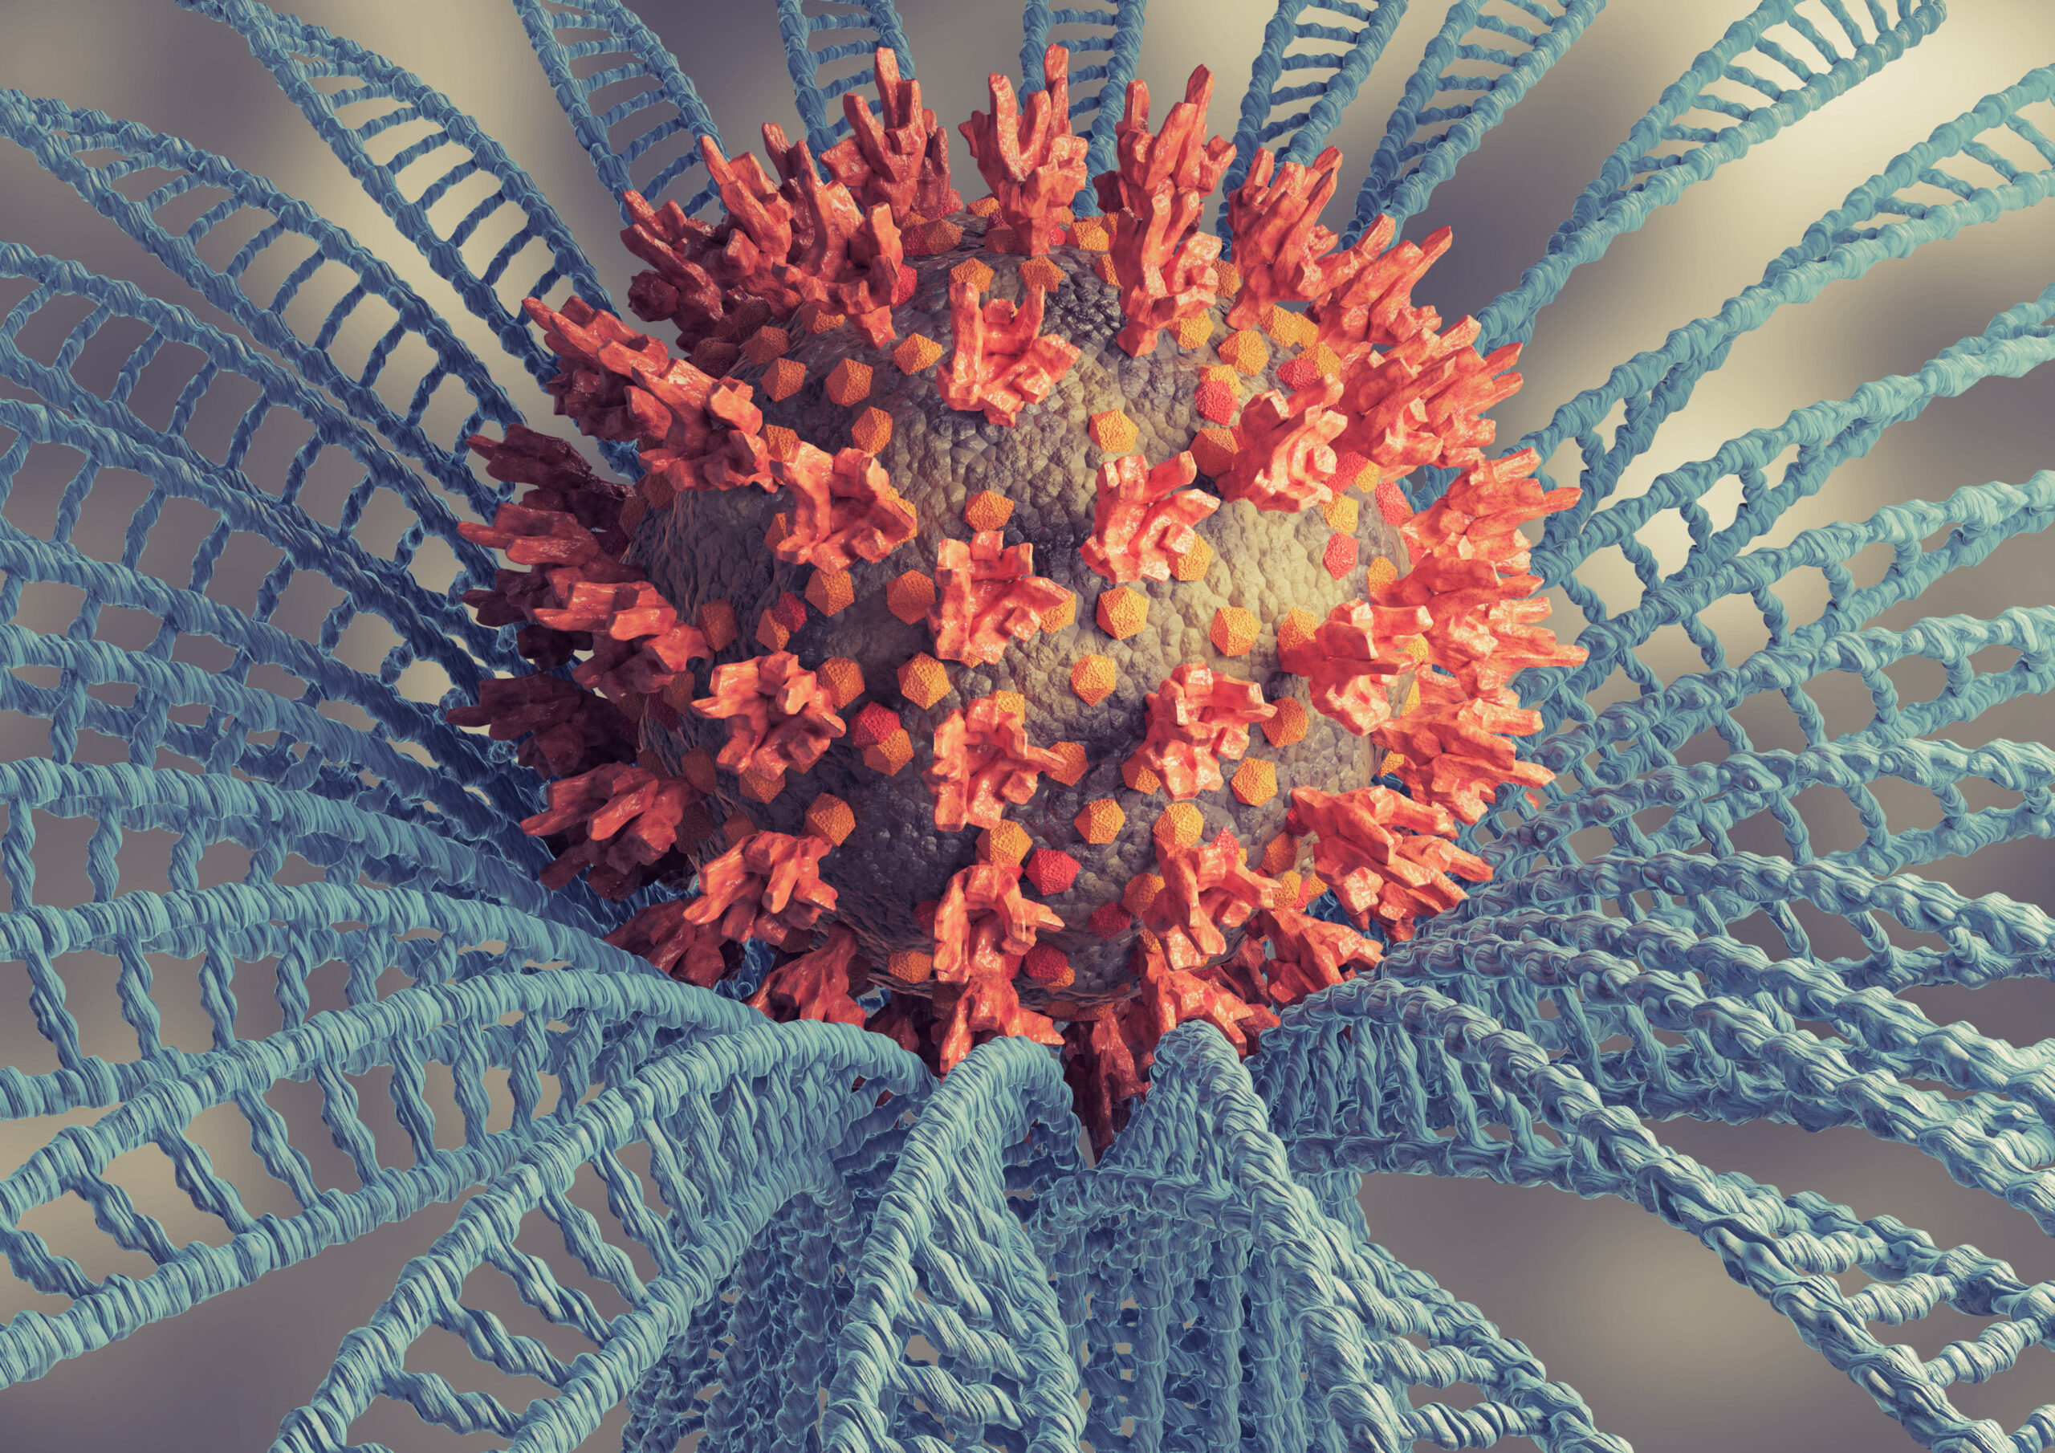
Three Vaccine-Preventable Diseases
Influenza
Covid-19
Monkeypox
Dr. James Dobbins
OLLI, 26 September 2022

Slide 3
Topics That We’ll Discuss Today
Influenza: 2022 -2023 Season
Covid-19: Status of the outbreak
Monkeypox Outbreak: Who is at risk?
Questions, questions, questions…???

Slide 4
1. Influenza: 2022 – 2023 Season*
*Note that the influenza season in the Northern Hemisphere begins on October 1st and ends on September 30th.

Slide 5
Influenza Viruses Circulating in the U.S., 2021-2022
Influenza A 99.5%
  A (H1N1)pdm09 0.1%
  A (H3N2) 99.9%
Influenza B 0.5%
  B (Victoria) 97.8%
  B (Yamagata) 2.4%

Slide 6
Influenza Viruses Circulating in the U.S., 2021-2022
Influenza A 99.5%
  A (H1N1)pdm09 0.1%
  A (H3N2) 99.9%
Influenza B 0.5%
  B (Victoria) 97.8%
  B (Yamagata) 2.4%

Slide 7
Influenza Vaccine Target Viruses for 2022 – 2023
Egg-based vaccines
A (H1N1)pdm09 A/Victoria/2570/2019 (no change)
A (H3N2) A/Darwin/9/2021
B (Victoria) B/Austria/135941/2021
B (Yamagata) B/Phuket/3073/203 (no change)
Cell- or recombinant-based Vaccines
A (H1N1)pdm09 A/Wisconsin/588/2019 (no change)
A (H3N2) A/Darwin/6/2021
B (Victoria) B/Austria/135417/2021
B (Yamagata) B/Phuket/3073/2013 (no change)

Slide 8
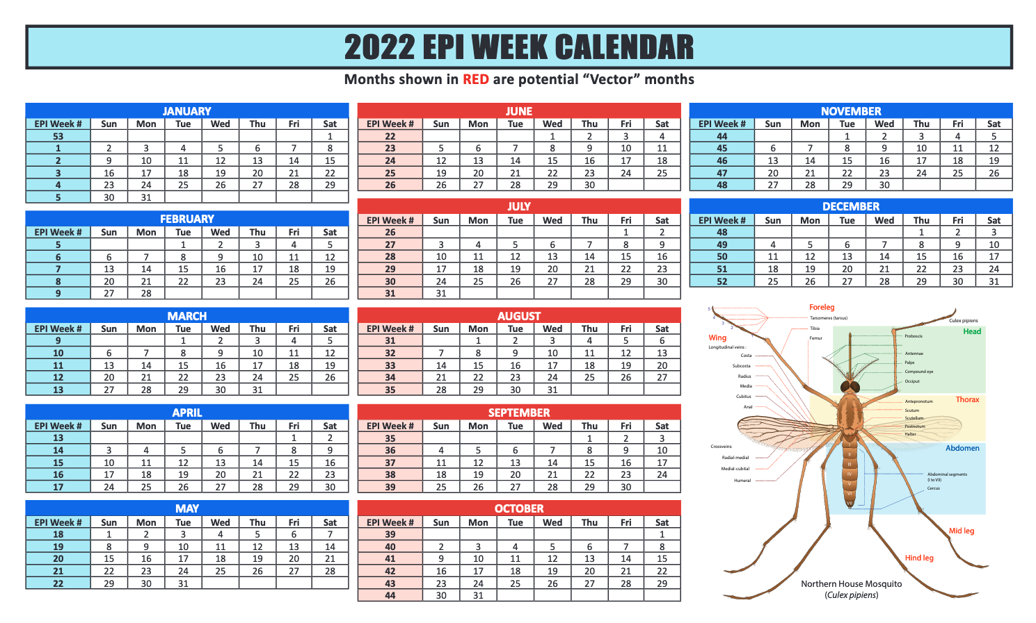

Slide 10
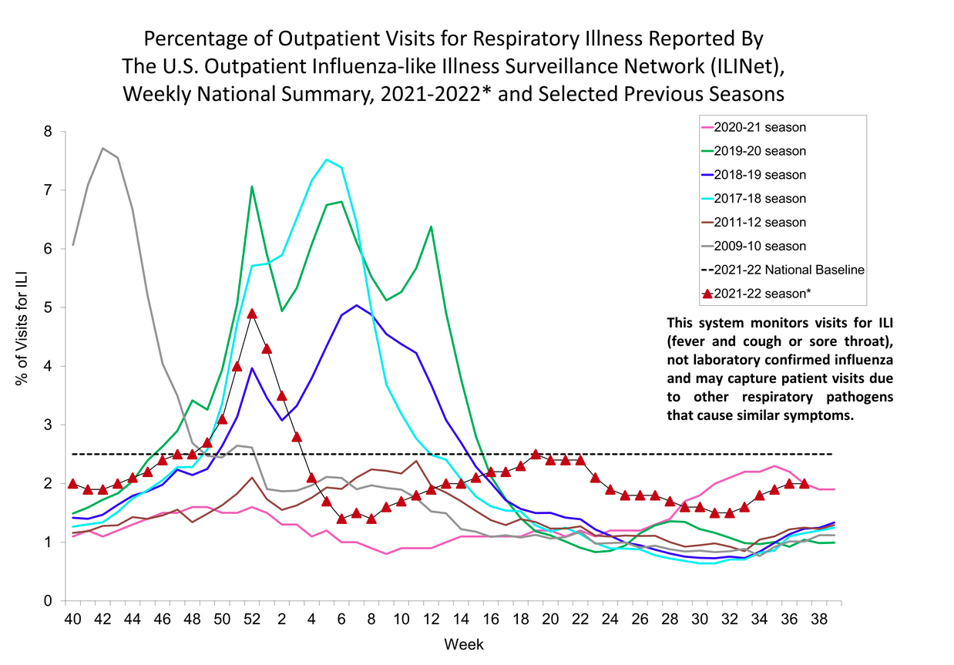

Slide 14
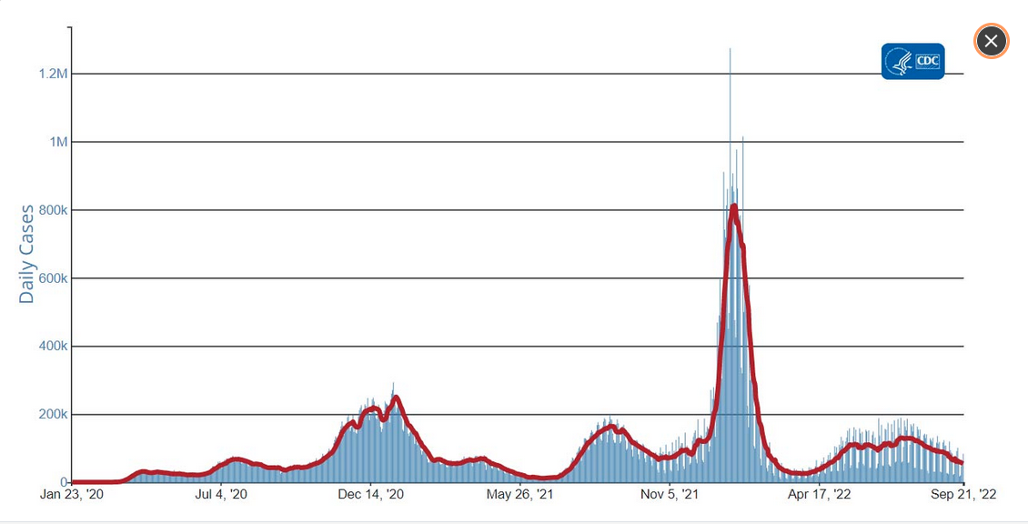
Daily Trends in COVID-19 Cases in the United States Reported to CDC
7-Day moving average
CDC Data Tracker
9/21/22

Slide 16
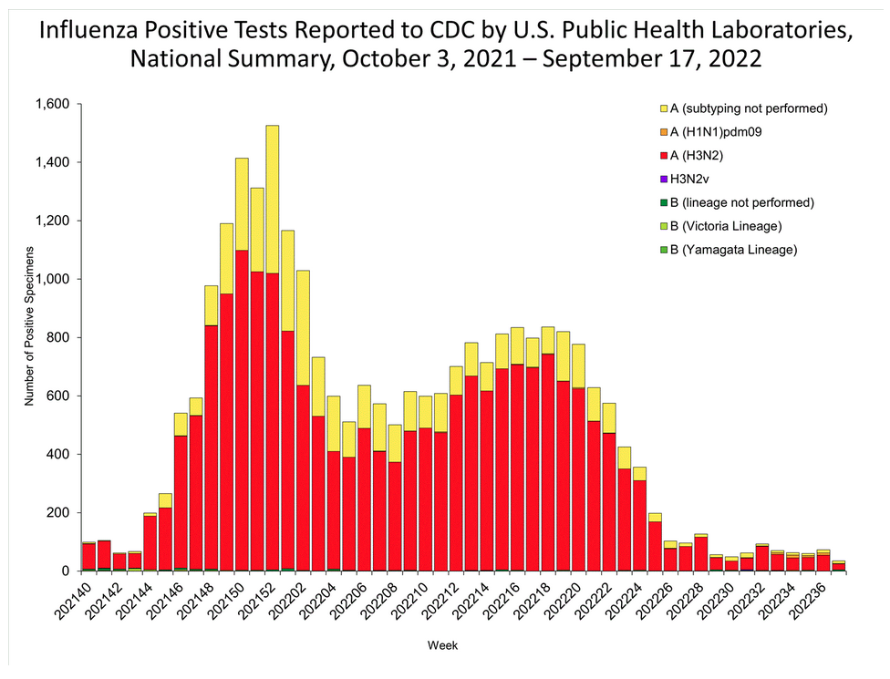

Slide 18
The 2022 Influenza Season in Australia

Slide 19
What Can We Learn From Australia?
“In fact, data shows Australia has had its worst flu season in five years.”
Karli Barnett, CBS News Miami – 06 Sept 2022
“The impact for the [2022] season…is low to moderate.”
Australia Influenza Surveillance Report, 11 Sept 2022

Slide 20
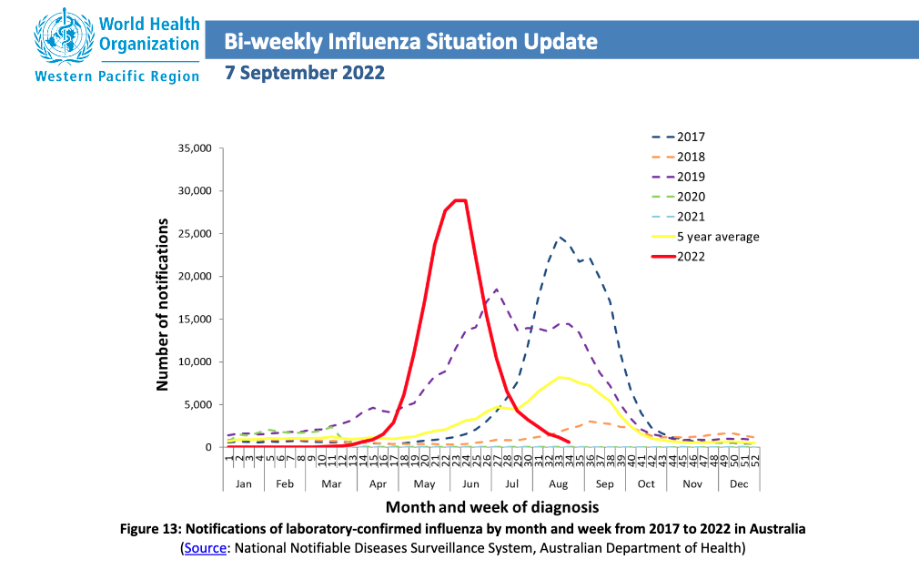

Slide 21
Influenza Vaccines Recommended for 65+ Years
Fluzone high-dose quadrivalent vaccine
Flublok quadrivalent recombinant vaccine
Fluad quadrivalent adjuvented vaccine

Slide 22
Influenza Vaccines Recommended for 65+ Years
Fluzone high-dose quadrivalent vaccine
Flublok quadrivalent recombinant vaccine
Fluad quadrivalent adjuvented vaccine

Slide 23
Influenza Vaccines Recommended for 65+ Years
Fluzone HD 4x dose (60 µl) egg-based
Flublok 3x dose (45 µl) recombinant
Fluad 1x dose (15 µl) egg-based

Slide 24
  Conclusions for Influenza: The Good News
The strength of the anticipated viral strains appear to be moderate
The 2022-2023 vaccine has been modified for these anticipated strains
There is an adequate supply of vaccine
It is possible that only one subtype of influenza will circulate this season, A (H3N2)

Slide 25
  Conclusions for Influenza: The Bad News
The subtype that will probably dominate the outbreak this year is the more dangerous of the four subtypes
The majority of the available vaccines continue to be produced in eggs
Still no universal influenza vaccine that would negate the need for annual immunization

Slide 26
  Should you Receive Influenza Vaccine?
Yes
(But not yet…wait another 6 to 8 weeks, depending on the timing of the outbreak)

Slide 27
2. Covid-19: Status of the Outbreak

Slide 28
SARS-CoV-2 Outbreak
The trends for cases and deaths
Changes in SARS-CoV-2 variants
New and updated vaccines

Slide 29
Trends for Cases and Deaths

Slide 30
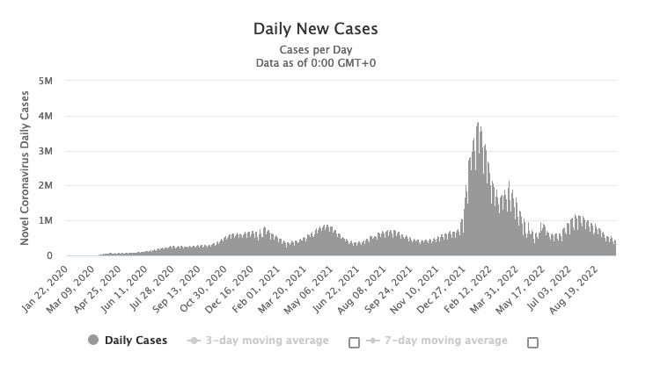
Covid-19 Cases Worldwide
As of 24 September 2022
From www.worldometer.info

Slide 31
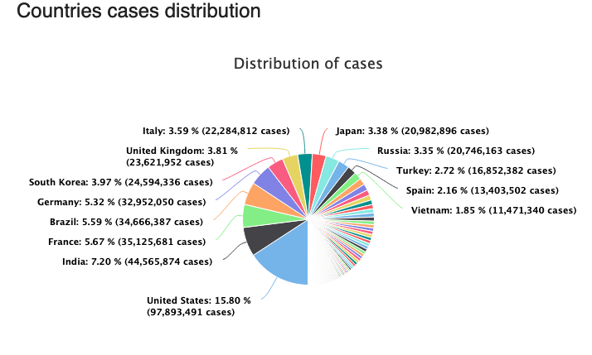
As of 24 September 2022
From www.worldometer.info

Slide 32
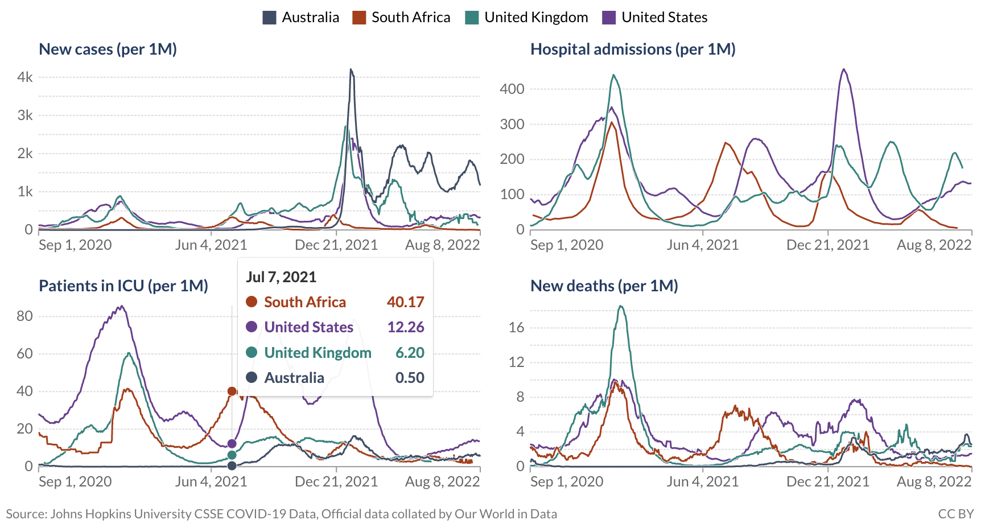
Washington State DOH, 23 Feb 2022

Slide 33
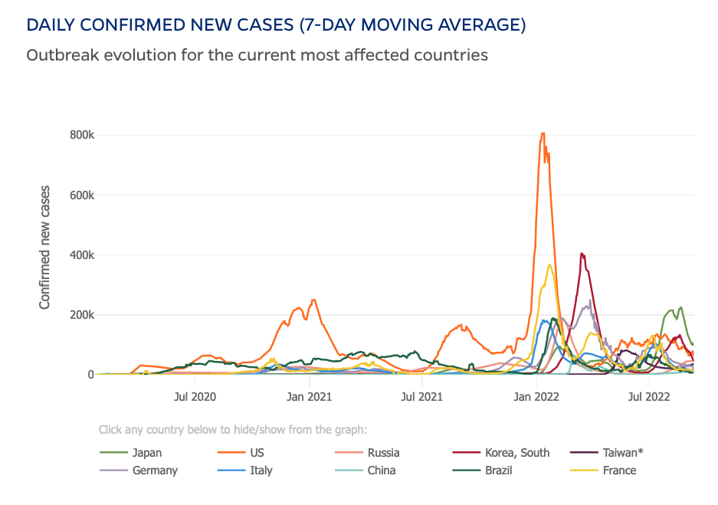
Johns Hopkins Corona Virus Resource center 9/12/22

Slide 34
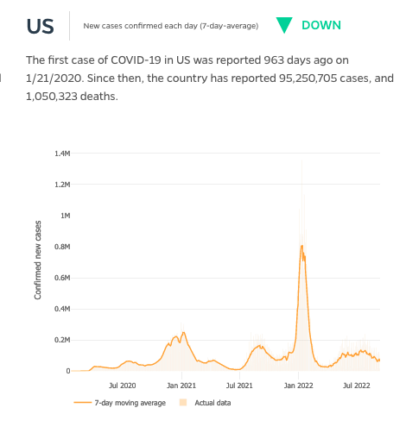
Johns Hopkins Corona Virus Resource center 9/12/22

Slide 35
Johns Hopkins Corona Virus Resource center 9/12/22

Slide 36
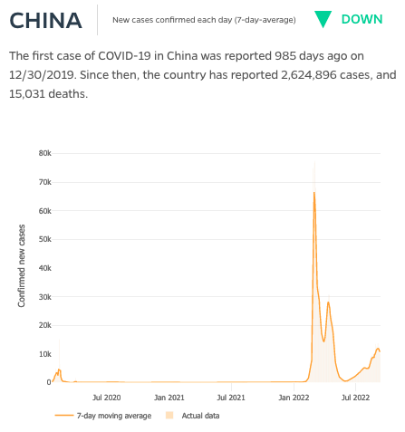
Johns Hopkins Corona Virus Resource center 9/12/22

Slide 37
Johns Hopkins Corona Virus Resource center 9/12/22

Slide 38
Johns Hopkins Corona Virus Resource center 9/12/22

Slide 39
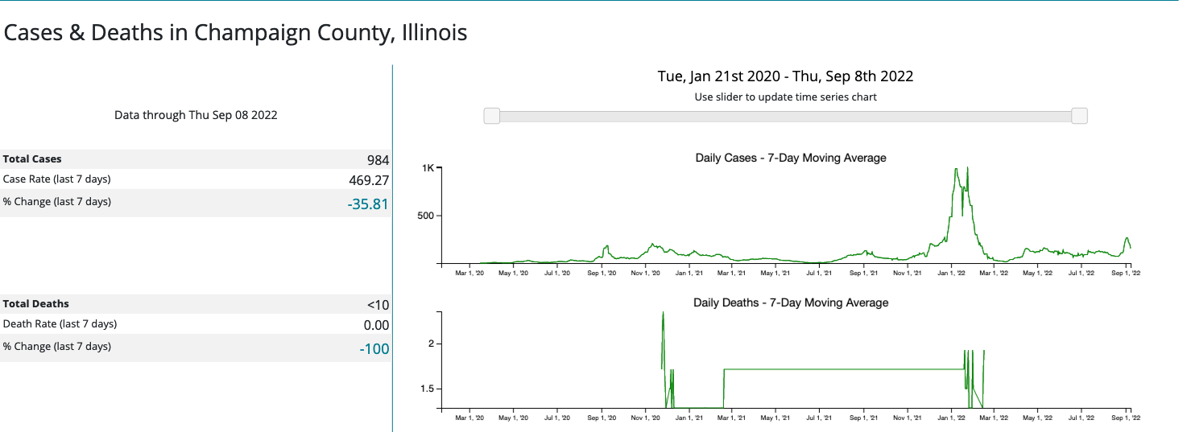
CDC Data Tracker
9/12/22

Slide 40
CDC Data Tracker
9/12/22

Slide 41
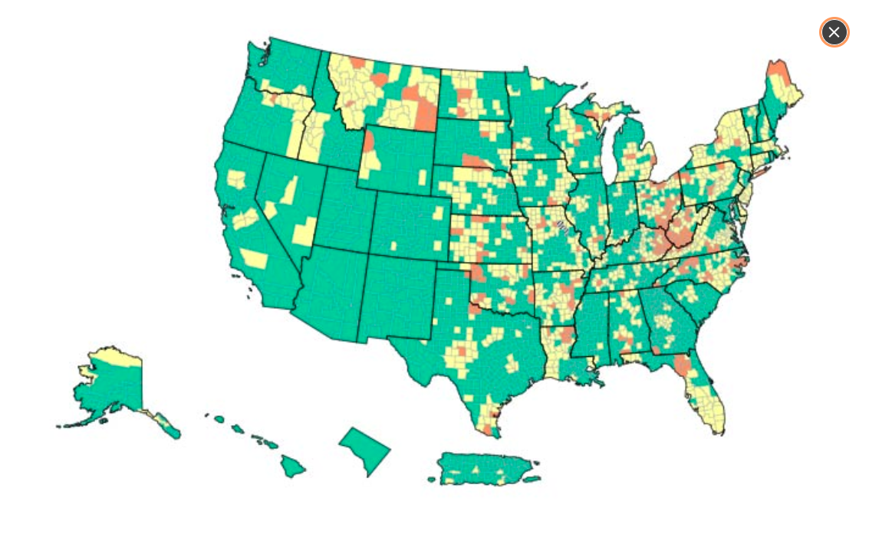

U.S. COVID-19 Community Levels by County
CDC Data Tracker
9/21/22

Slide 42
Changes in SARS-CoV-2 Variants

Slide 43
  First, Let’s Get the Names of Variants Straight
The initial specimens of SARS-CoV-2 were collected from patients in Wuhan on 24 Dec 2019 and 26 December 2019
These specimens were thought to have descended from an earlier recombination of a bat virus and a pangolin virus
The original, ancestral coronavirus type that had evolved to produce the Wuhan specimens was labeled “Type A”
All subsequent variants that had descended from this mythical, original virus were labelled “Type B”
[Note that each country uses different labels]

Slide 44
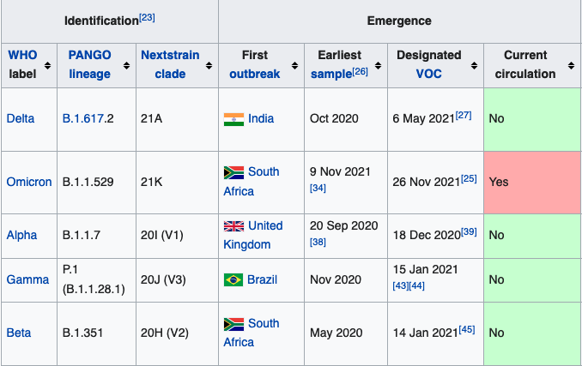

Slide 46
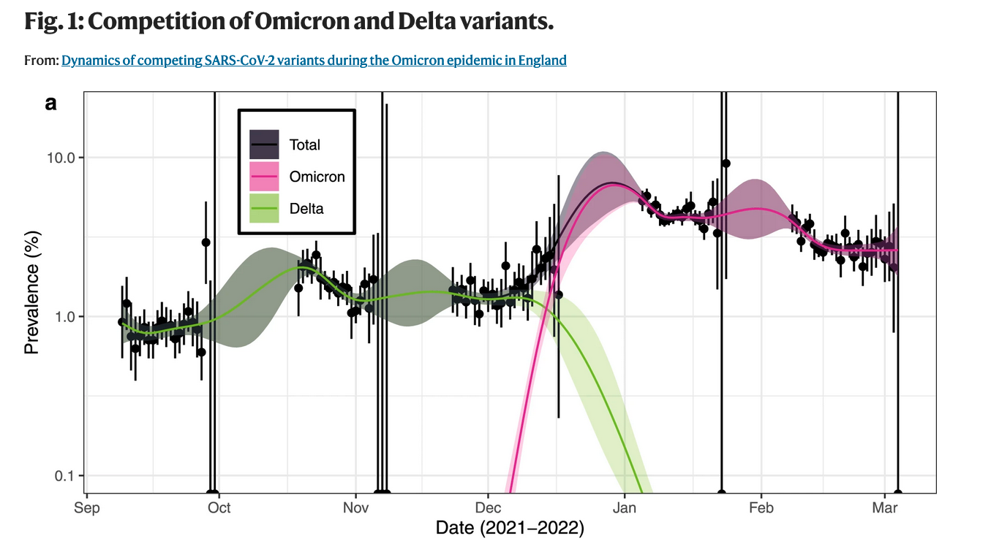
Washington State DOH, 23 Feb 2022

Slide 47
  Current SARS-CoV-2 Omicron Subvariants
BA.5 83.1% slight decrease
BA.4.6 10.3% slight increase
BF.7* 2.3% increasing
BA.4 1.8% increasing
BA.2.75.2 1.7% slight increase
BA.2.12. 1.1% slight increase
BQ.1.1 0.5% increasing
*Also referred to as BA.5.2.1.7

Slide 48
  Current SARS-CoV-2 Omicron Subvariants
BA.5 83.1% slight decrease
BA.4.6 10.3% slight increase
BF.7* 2.3% increasing
BA.4 1.8% increasing
BA.2.75.2 1.7% slight increase
BA.2.12. 1.1% slight increase
BQ.1.1 0.5% increasing
*Also referred to as BA.5.2.1.7

Slide 49
  Current SARS-CoV-2 Omicron Subvariants
BA.5 83.1% slight decrease
BA.4.6 10.3% slight increase
BF.7* 2.3% increasing
BA.4 1.8% increasing
BA.2.75.2 1.7% slight increase
BA.2.12. 1.1% slight increase
BQ.1.1 0.5% increasing
*Also referred to as BA.5.2.1.7

Slide 50
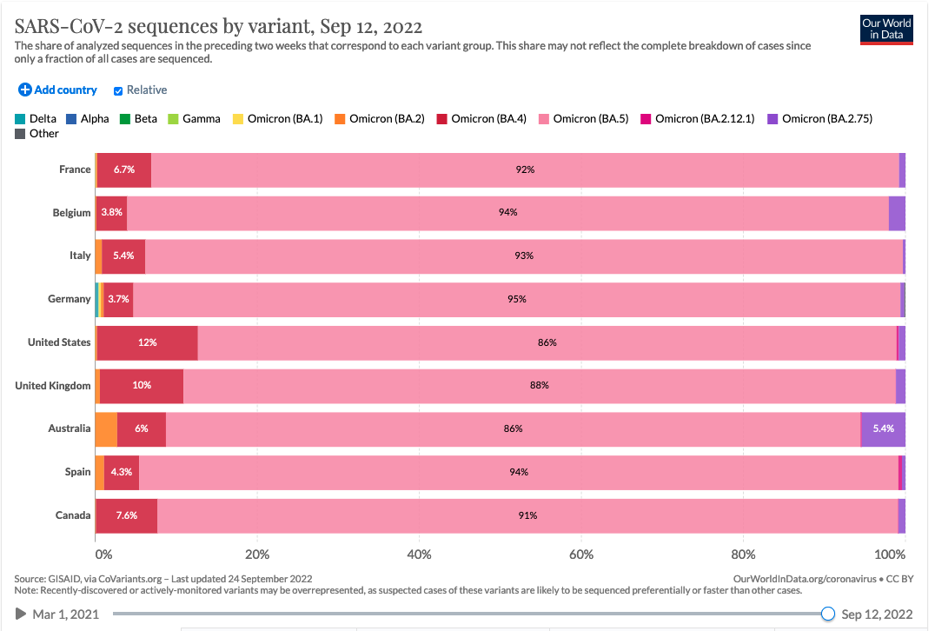

Slide 51
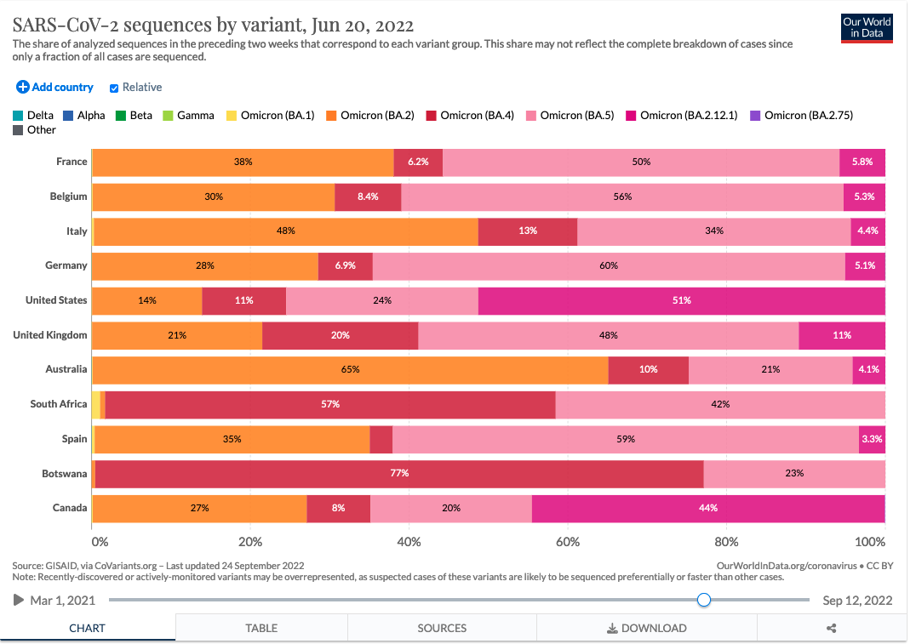

Slide 52
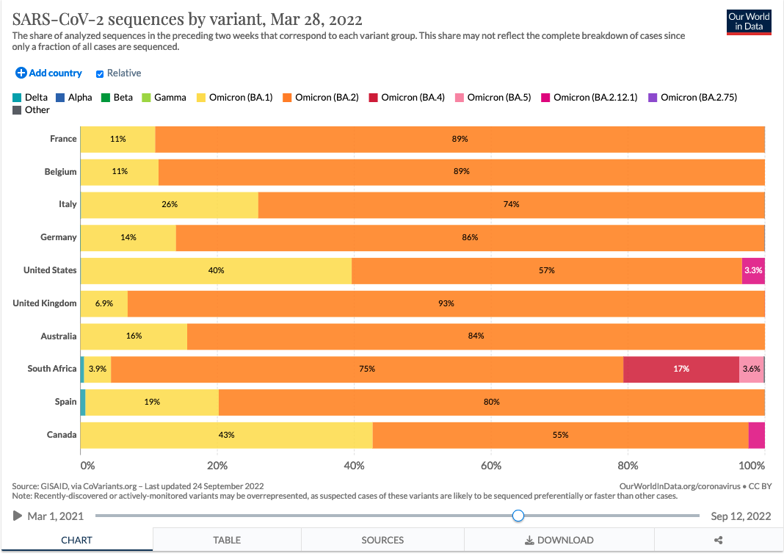

Slide 54
New and Updated SARS-CoV-2 Vaccines

Slide 55
  Monovalent SARS-CoV-2 Vaccines in the U.S.
Produce antibodies that target the spike protein on the original B.1 virus found in Wuhan
Pfizer BioNTech mRNA
Moderna mRNA
Johnson & Johnson viral vector
Novavax subunit

Slide 56
  Bivalent SARS-CoV-2 Vaccines in the U.S.
Produce antibodies that target the spike proteins on the B.1 virus AND Omicron BA.5 and BA.4 subvariants
Pfizer BioNTech mRNA Age 12+ 30 µg
Moderna mRNA Age 18+ 50 µg

Slide 57
Nasal SARS-CoV-2 Vaccine

Slide 58
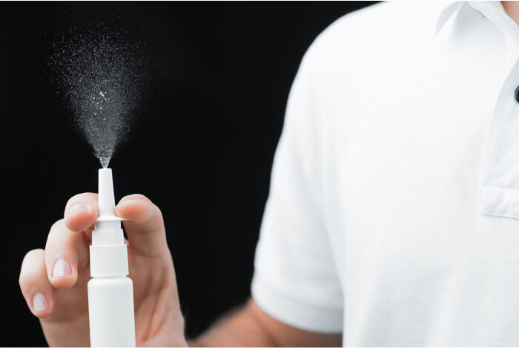

Slide 59
  iNCOVACC Nasal Vaccine
Licensed by Washington University in St. Louis
Manufactured Bharat Biotech in India
Currently only licensed in India for primary immunization – not yet as a booster
Subunit vaccine using Ad26 as the vector
Designed to evoke an IgA antibody response in the nose
Stop the virus from entering the lower respiratory tract; stop infection

Slide 60
Oral SARS-CoV-2 Vaccine

Slide 61
  Convedicia Air Oral Vaccine
Manufactured CanSino Biologics in China
Uses the same platform as their injectable vaccine
A subunit vaccine using an adenovirus as the vector
In clinical trial, 58% effective at stopping all symptoms of Covid-19; 92% effective at preventing serious disease
Currently licensed in China only as a booster
Currently 90% of population has been vaccinated but protection is beginning to wane

Slide 62
Universal SARS-CoV-2 Vaccines

Slide 63
  Two “Universal” or “Pan” Vaccines
We discussed these two potential vaccines six months ago:
U.S. Army pan-coronavirus Vaccine
  This vaccine exists but is still undergoing clinical trials
  Spike ferritin nanoparticle vaccine (SpFN)
NIAID Universal Coronavirus Vaccine
  Still just vapor (and $200 million)
  I can’t see that there has been any progress from six months ago

Slide 64
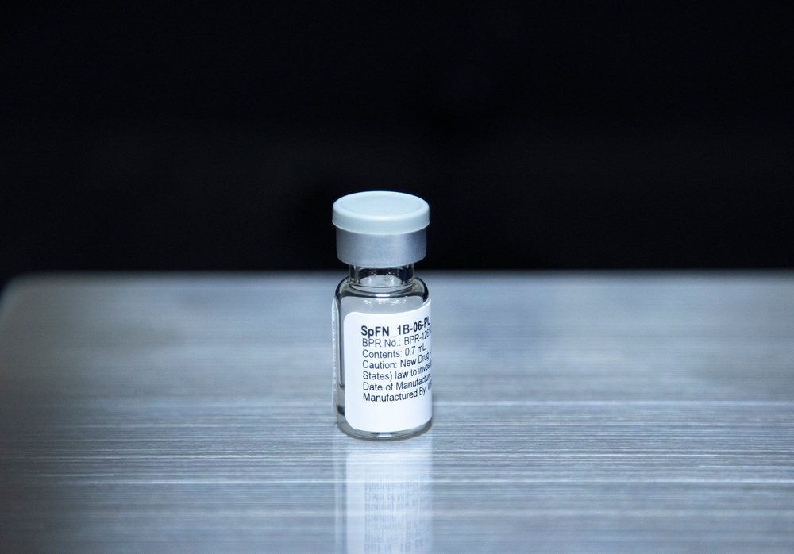

Slide 65
  Conclusions for Coronavirus: The Good News
Cases, hospitalizations, and deaths, are all decreasing globally, in the U.S., and in Illinois
Almost five million people in the U.S. have received a new bivalent vaccine
Only one subvariant is driving the outbreak, and that variant is susceptible to the new vaccine
A nasal vaccine has now been licensed and is in use in India
The pan coronavirus vaccine is closer to being approved for use in the U.S.

Slide 66
  Conclusions for Coronavirus: The Bad News
Three potential subvariants are increasing in Europe and the U.S.
All three of these subvariants are able to evade antibodies from current vaccines and from prior infection
Change from one subvariant to the next can take place within just a few months
We are about to enter the cold season when circulation of the virus is reputed to increase

Slide 67
  Should you Receive Bivalent Covid-19 Vaccine?
Yes
(Unless you have had Covid-19 in 2022 or you have received a monovalent booster in the last 2 to 4 months)

Slide 68
3. Monkeypox: Who is at Risk?

Slide 69
Monkeypox Outbreak
Monkeypox virus
Transmission of the virus
Orthopox vaccines
Beginning of the outbreak
  Gay raves
  International spread
Current status of the outbreak
Changing the name? Seriously?

Slide 70
  Monkeypox Virus
Caused by an orthopox virus, the genus which includes smallpox and vaccinia [but does NOT include chickenpox!]
Disease is endemic in the rainforests of Central and West Africa
Sporadic human cases occur there with no large outbreaks
Identified in 1958 in outbreaks in two research monkey colonies
The normal reservoir for the virus is unknown
Identified in small rodents and some primates in Africa

Slide 71
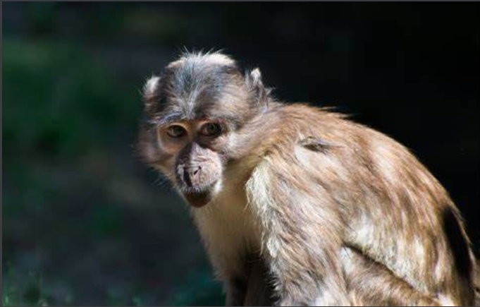
  Sooty Mangabey

Slide 72
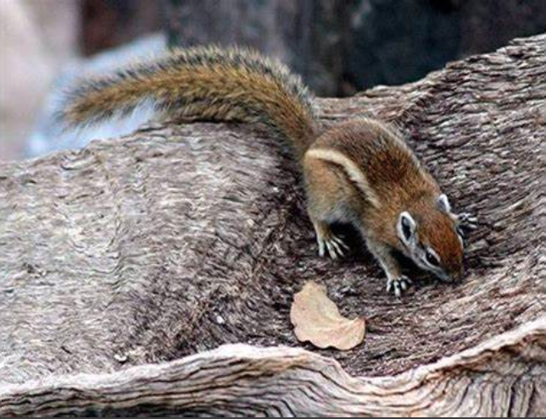
  Congo Rope Squirrel

Slide 73
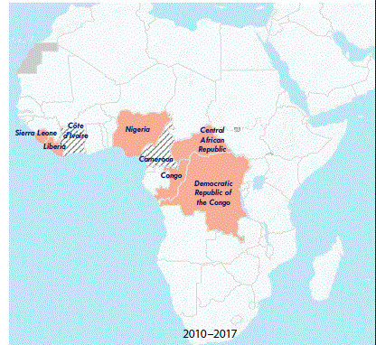
Countries reporting monkeypox cases in humans and animals — West and Central Africa, 2010 –2017
CDC. MMWR, March 16, 2018

Slide 74
Countries reporting monkeypox cases in humans and animals — West and Central Africa, 2010 –2017
CDC. MMWR, March 16, 2018

Slide 75
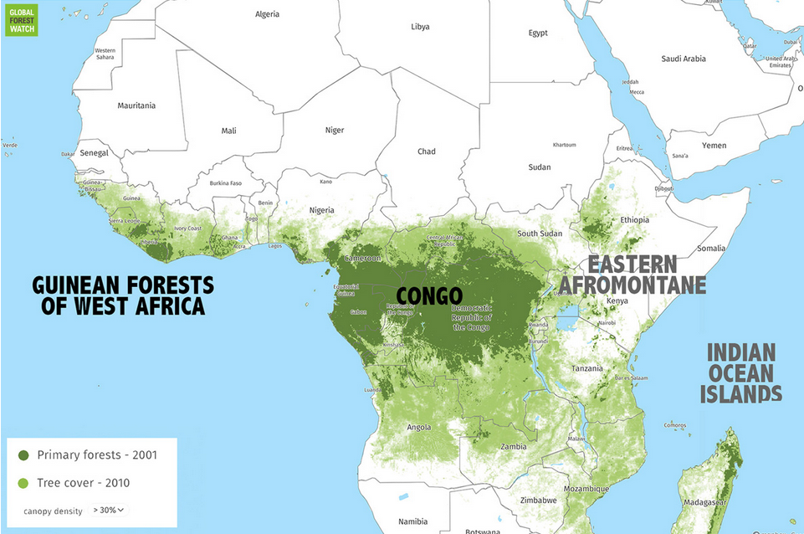

Slide 76
  Transmission of the Monkeypox Virus
Sylvatic human cases are from contact with infected animals
Human-to-human transmission is by skin-to-skin contact, by bodily fluids, and by contact with contaminated clothing
For the current outbreak, almost all transmission has been among men who have sex with men (MSM)
Actually, it has been among men who have lots of sex with men (MLSM)

Slide 77
  Monkeypox Disease
Incubation period of 3 to 17 days, average time = 8.5 days
Painful rash develops, beginning around the mouth, palms of the hands, soles of the feet, and genitals
Rash can spread to all areas of the body
Illness slowly resolves as blisters dry up and fall off, usually after 14 to 28 days
Can be treated with an injectable antiviral drug, Tpoxx
Can be prevented with a vaccine

Slide 78
  Monkeypox Disease
Incubation period of 3 to 17 days, average time = 8.5 days
Painful rash develops, beginning around the mouth, palms of the hands, soles of the feet, and genitals
Rash can spread to all areas of the body
Illness slowly resolves as blisters dry up and fall off, usually after 14 to 28 days
Can be treated with an injectable antiviral drug, Tpoxx
Can be prevented with a vaccine

Slide 79
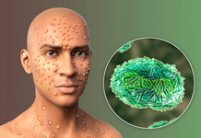
  Monkeypox Lesions

Slide 80
  Orthopox Vaccines
ACAM2000
Jynneos
Aventis Pasteur smallpox vaccine (APSV)

Slide 81
  Orthopox Vaccines
ACAM2000
Jynneos
Aventis Pasteur smallpox vaccine (APSV)

Slide 82
  ACAM2000 Smallpox Vaccines
Live vaccinia virus (not variola) that can reproduce in the body
Significant side effects, including death
Essentially the same vaccine that was used in the U.S. until the 1970s
The U.S. has a large stockpile of this vaccine
Now considered too dangerous to use for the monkeypox outbreak

Slide 83
  Jynneos Smallpox Vaccine
Attenuated vaccinia virus that cannot reproduce in the body, approved in U.S. in 2019
Safe for use in immunocompromised individuals
The U.S. had a limited supply of Jynneos vaccine
Prior to this outbreak, the U.S. had purchased a large supply from Denmark but in bulk containers, not vials
That supply was relinquished to other countries that had the capacity to fill and finish the vaccine vials
Now an agreement to fill and finish 2.5 million doses in the U.S.

Slide 84
  Administration of the Jynneos Vaccine
Normally given subcutaneously between the skin and muscle (0.5ml dose)
Now being given intradermally between the outer layers of the skin (0.1ml dose)
Uses only one-fifth amount of vaccine so supply lasts longer
Much more difficult to administer at precisely the correct angle of the needle
Given in two doses, 4 weeks apart

Slide 85
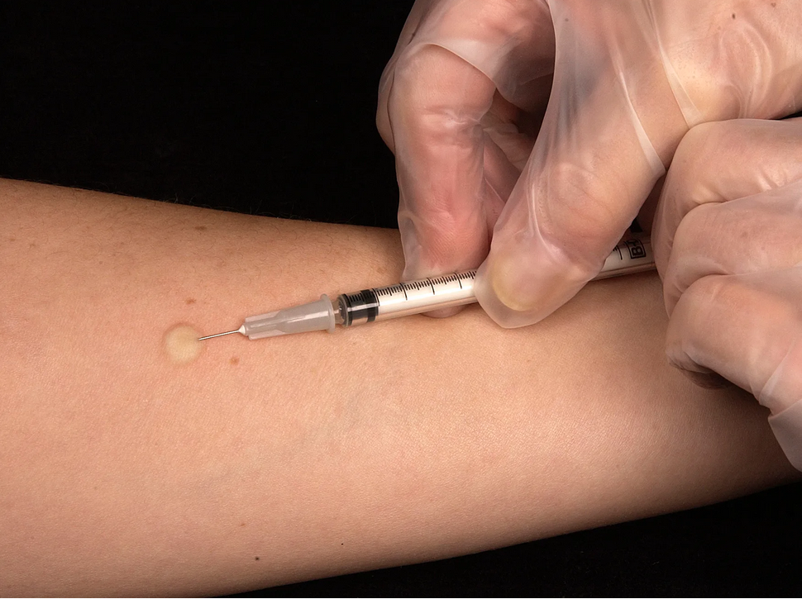
  Intradermal
  Immunization

Slide 86
  Aventis Pasteur Smallpox Vaccine
Another live vaccinia vaccine that can reproduce in the body
Similar to the ACAM2000 vaccine
Anticipated to have the same side effects as ACAM2000
Not currently licensed for use in the U.S.
Investigational vaccine so would only be available for emergency use

Slide 87
  Beginning of the outbreak
The virus had slowly spread out of West Africa, probably from Nigeria, to England, Israel, and Singapore
Occasional, isolated cases were identified in 2019 - 2021
Then the international spread of the virus was amplified at two gay raves in 2022
  One, a 10-day event in the Canary Islands in May 2022, attended by over 80,000 people
  The other one, also a 10-day event, in Belgium in May 2022, attended by over 100,00 people

Slide 88
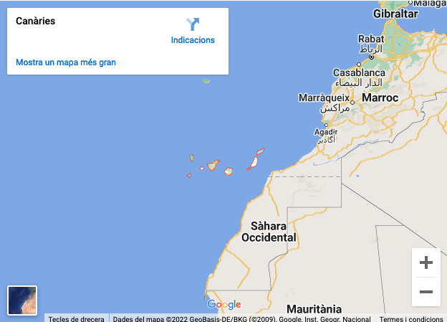

Slide 89
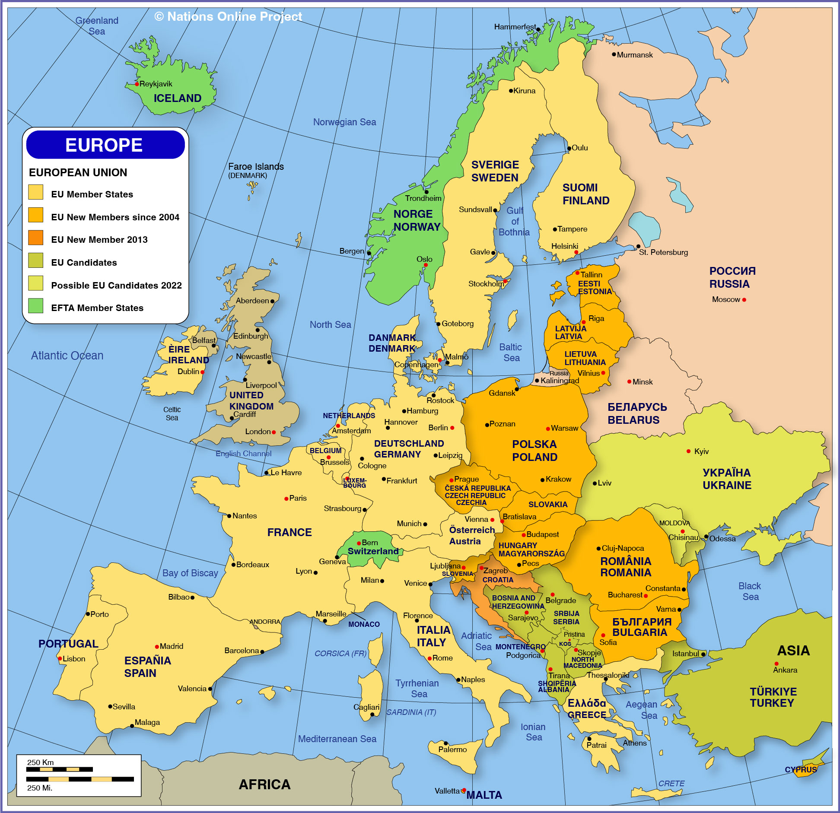

Slide 90
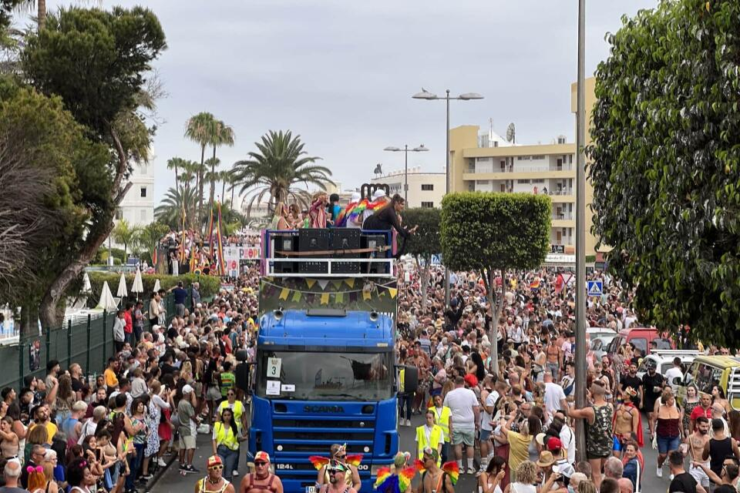

Slide 91
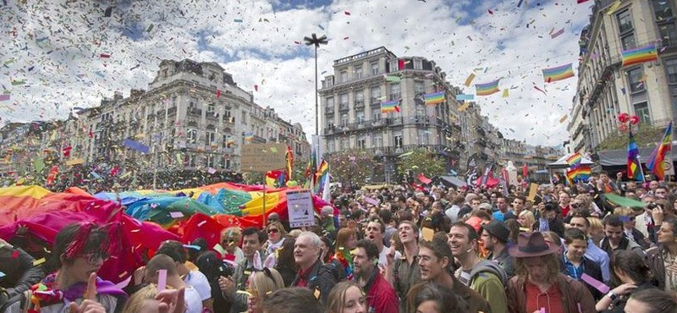

Slide 92
  Current status of the outbreak
Globally, there have been approximately 65,000 cases
In the U.S., there have been approximately 25,000 cases
Weekly cases in the U.S. have now declined by approximately 50%
Globally, new cases have declined 22%
Some behavioral changes have been made
Vaccination has been a key reason for decline

Slide 93
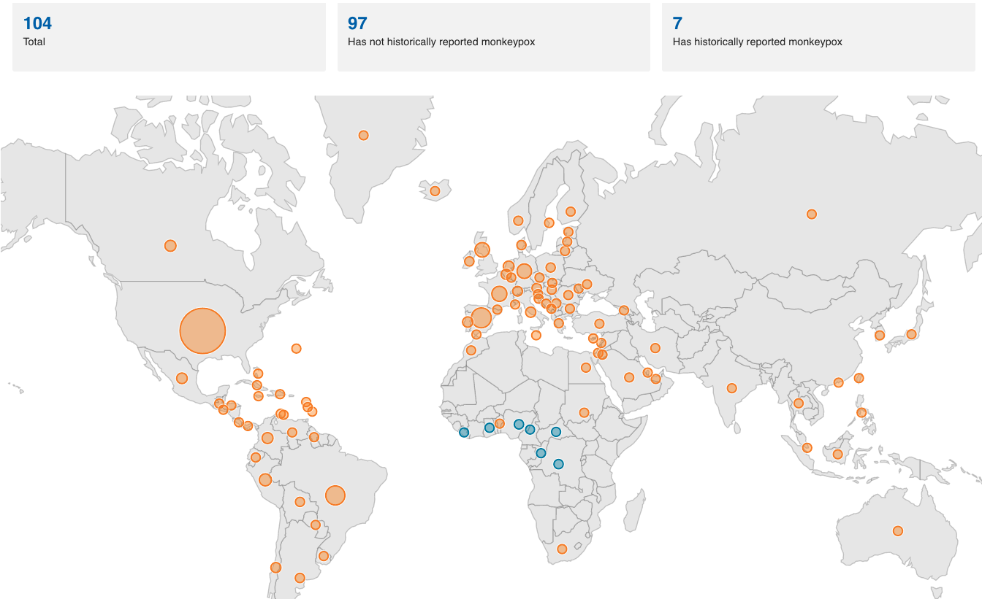
CDC, 16 Sep 2022

Slide 94
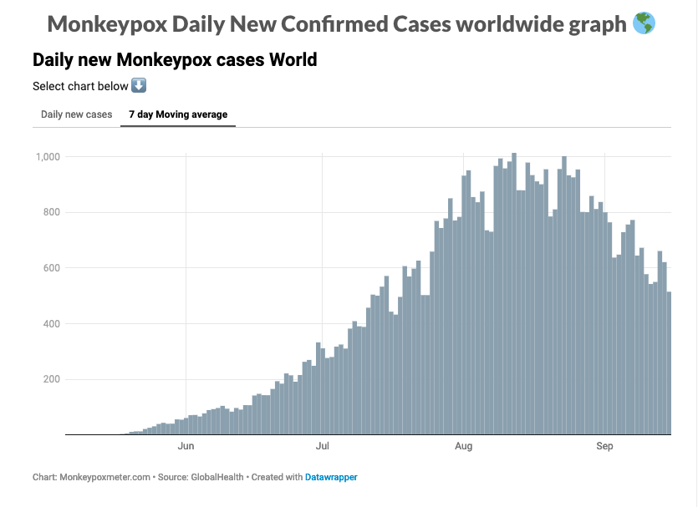

Slide 95
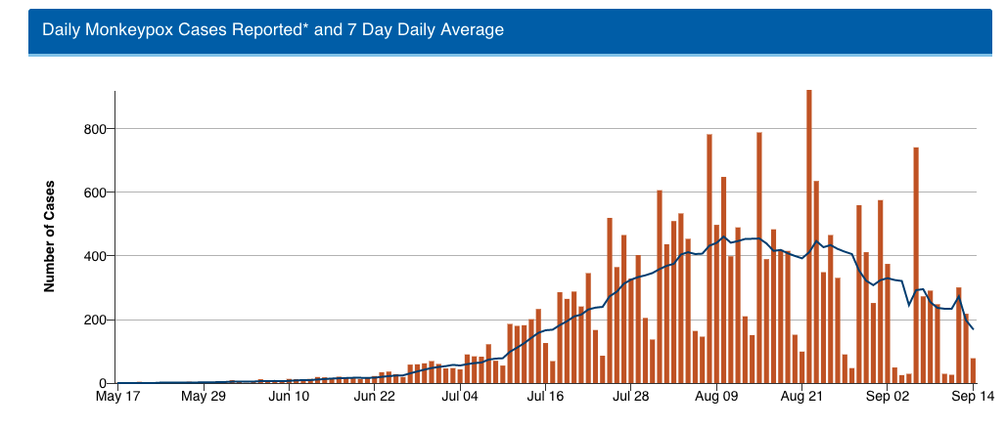

Slide 96
Peak immunization

Slide 97
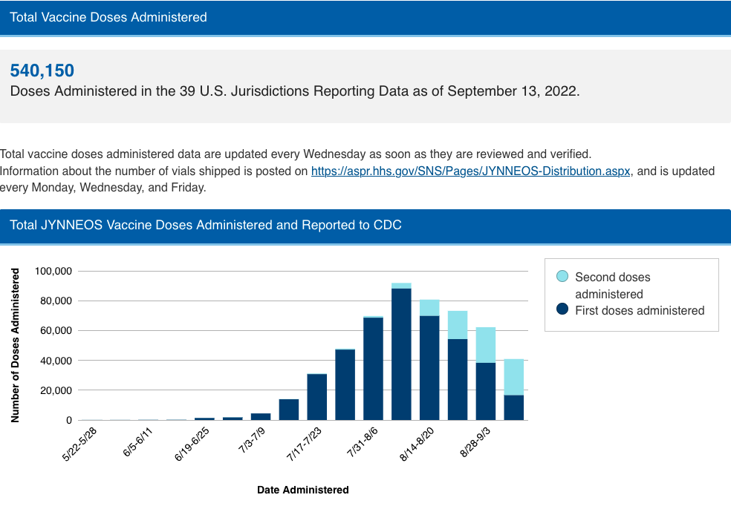

Slide 99
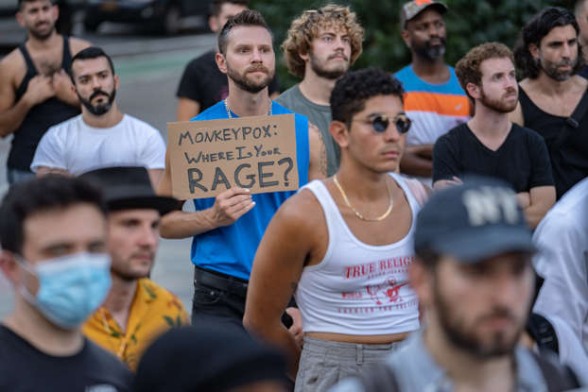

Slide 100
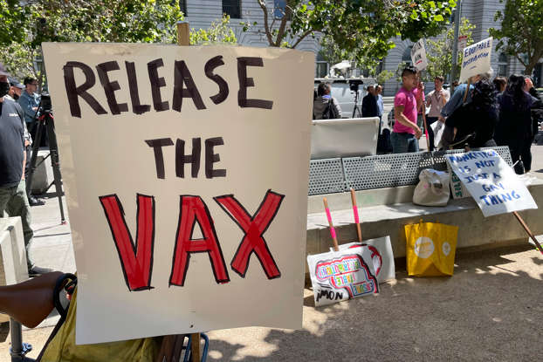

Slide 101
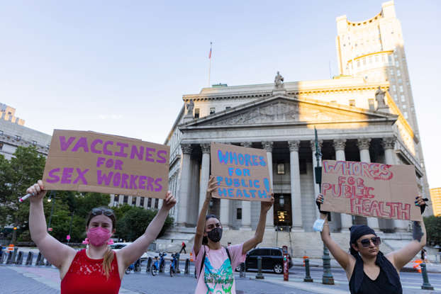

Slide 102
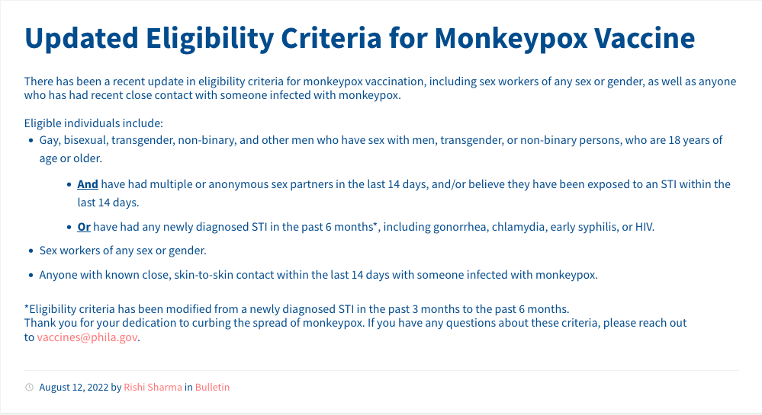

Slide 105
  Conclusions for Monkeypox: The Good News
We have an excellent vaccine
We now have an adequate supply of vaccine
There is a finite number of people at high risk
The outbreak is declining rapidly

Slide 106
  Conclusions for Monkeypox: The Bad News
There really isn’t any bad news

Slide 107
  Should you Receive Monkeypox Vaccine?
No
(But you probably couldn’t get it even if you wanted the vaccine)

Slide 108
  Changing the Name? Seriously?
Push to change the name comes from some public health and LGBTQ activists
These activists claim to know that the name “stigmatizes” gay Black men and the entire continent of Africa
There is no data to support this claim
This is basically an expenditure of time, effort, and money that should be spent on controlling the actual outbreak ⎼ change the name later if it’s really necessary

Slide 109
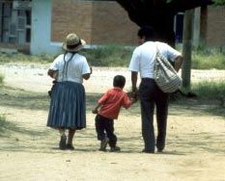
Thank You!
NB: Please don’t forget to turn your cell phones back on!
Notes:
Little Luis…my constant inspiration!

Slide 110
Questions, questions, questions…???

Slide 111
Special thanks to my administrative assistant for keeping this project going…

Slide 112


