Slide 1
OLLI Citizen Scientist Program
Danny Ryerson
IGB outreach coordinator

Slide 2
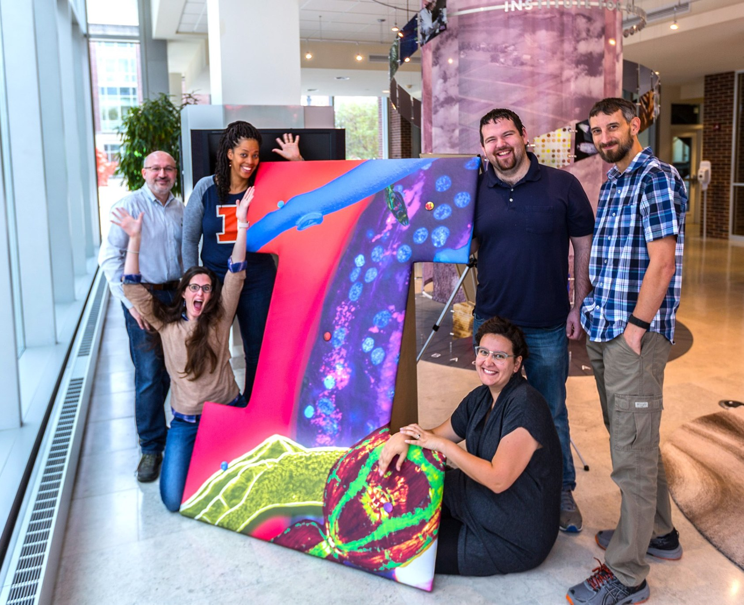
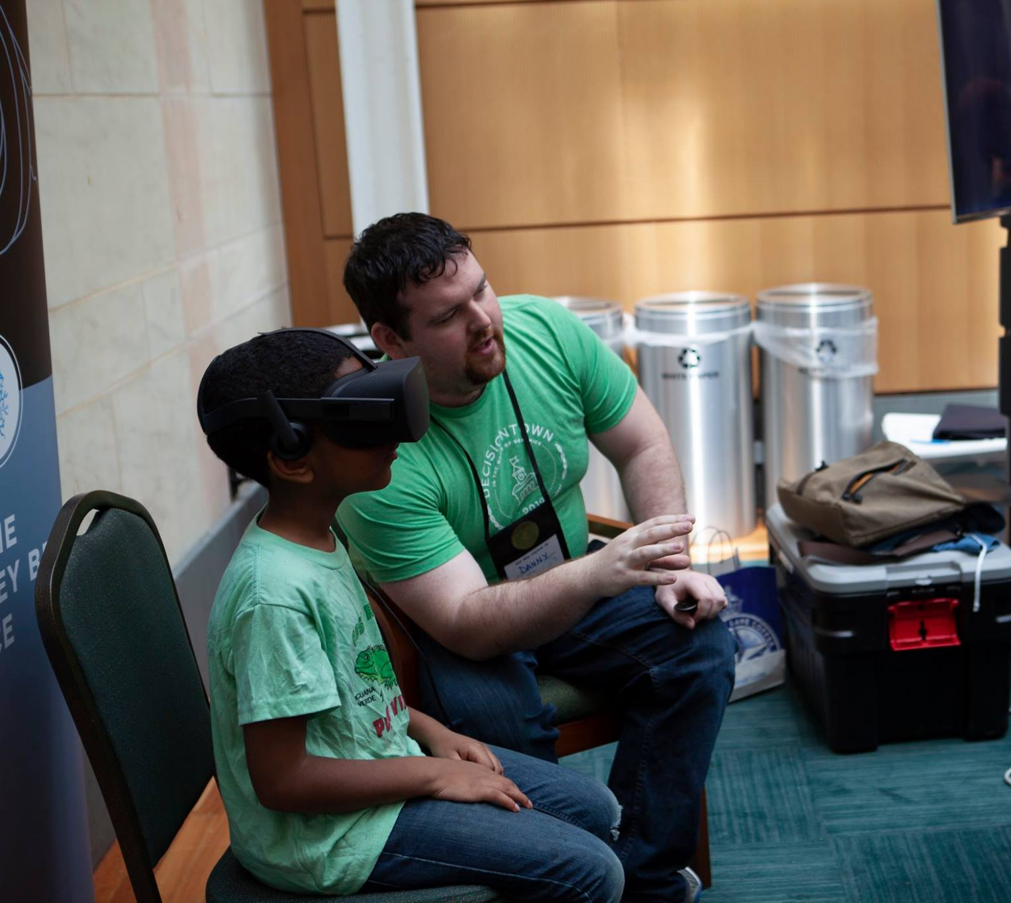
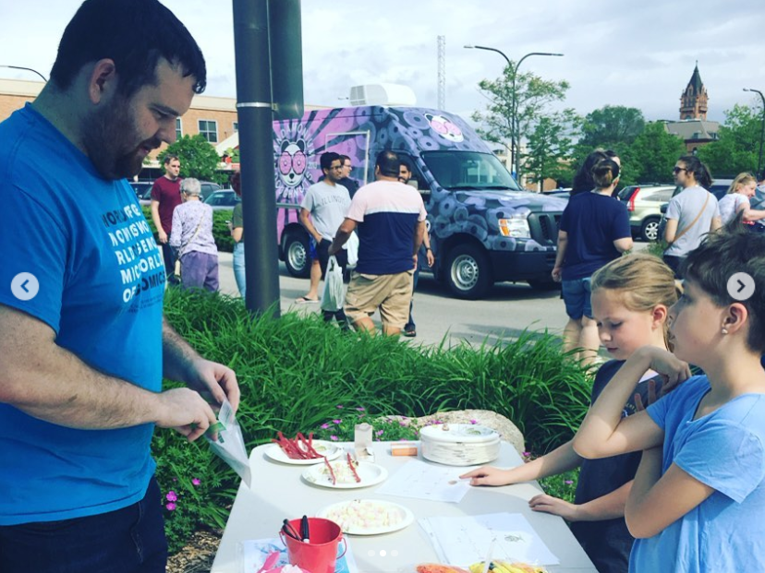
Who am I?
Danny Ryerson
University of Iowa
University of Illinois at Urbana Champaign
Carle R. Woese Institute for Genomic Biology
Working in science outreach since 2017

Slide 3
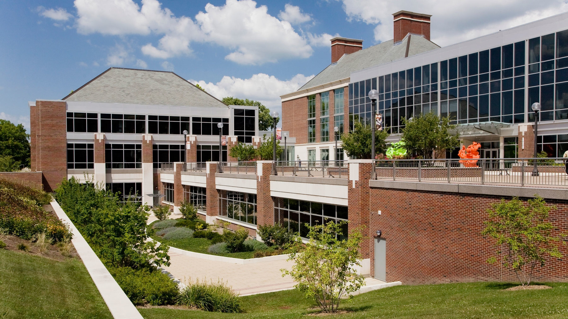
Carle R Woese Institute for Genomic Biology
One of the largest research institute on campus
Focuses on collaborative team research
15 research themes
ACPP
GEGC
MMG

Slide 4
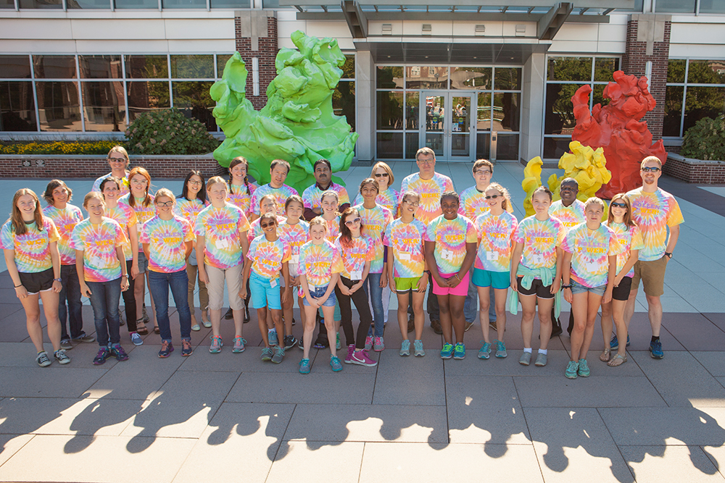
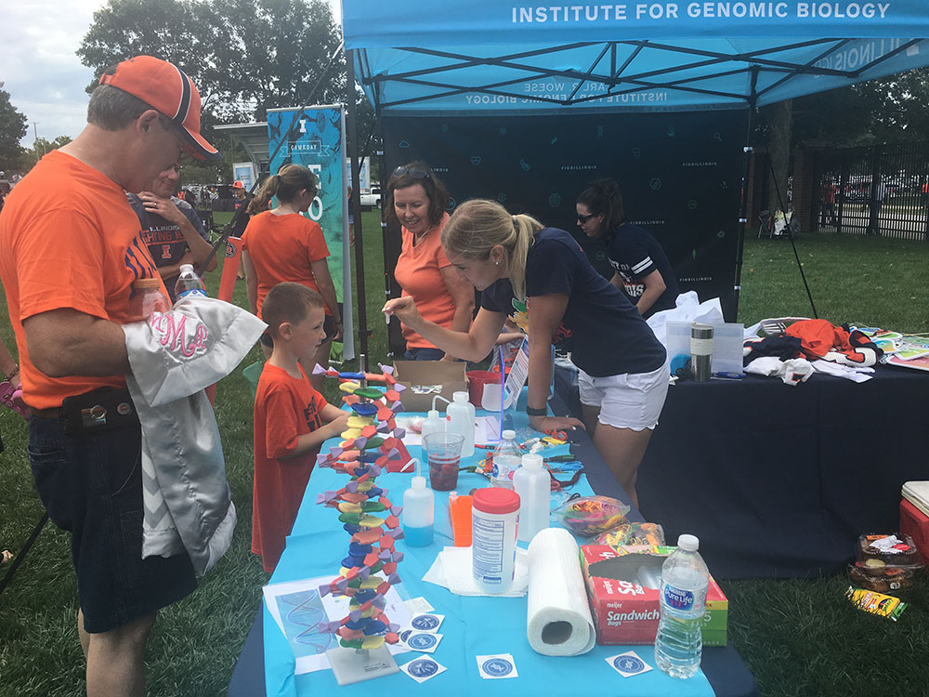
IGB Science Outreach
Where Science Meets Society
Continuing education
Genomics for series
Summer camp
Pollen Power
Science Unexpected
Game Day Genomics
Science Café
Art of Science
Opening in May
https://www.igb.illinois.edu/acquainted

Slide 5
OLLI Partnership
OLLI course
Team taught 8 week course
Rotation of IGB researchers presenting different topics
Next session this Fall
Tours of university labs and facilities
https://www.igb.illinois.edu/acquainted/see-igb
Citizen Scientist Program!

Slide 6
Citizen Scientist Program
Started in 2009
Collaboration between:
Osher Lifelong Learning Institute
Beckman Institute for Advanced Science and Technology
Carl R. Woese Institute for Genomic Biology
Foster challenging intellectual and creative experiences
https://www.igb.illinois.edu/acquainted/olli-citizen-scientist-program

Slide 7
How does it work?
Sponsor labs provide descriptions of research projects
OLLI members are matched with labs fitting their interests
OLLI members are paired with lab member
Volunteer in labs ~ 5-10 hours per week

Slide 8
OLLI Citizen Scientist Program Coordinator
Facilitate matching and integration into the lab groups
Follow progress and ameliorate issues as they arise
Provide regular updates on potential seminars of interest
Host annual meeting

Slide 9
Benefits for All
Members:
Advance their own scientific knowledge
Acquire new technical skills
Learn about cutting edge projects at the university
Directly contribute to the research process
Host laboratories:
Receive experimental assistance
Work with unique lab members with a wealth of knowledge
Learn from life experience of OLLI members
Gain novel perspectives to research problems

Slide 10
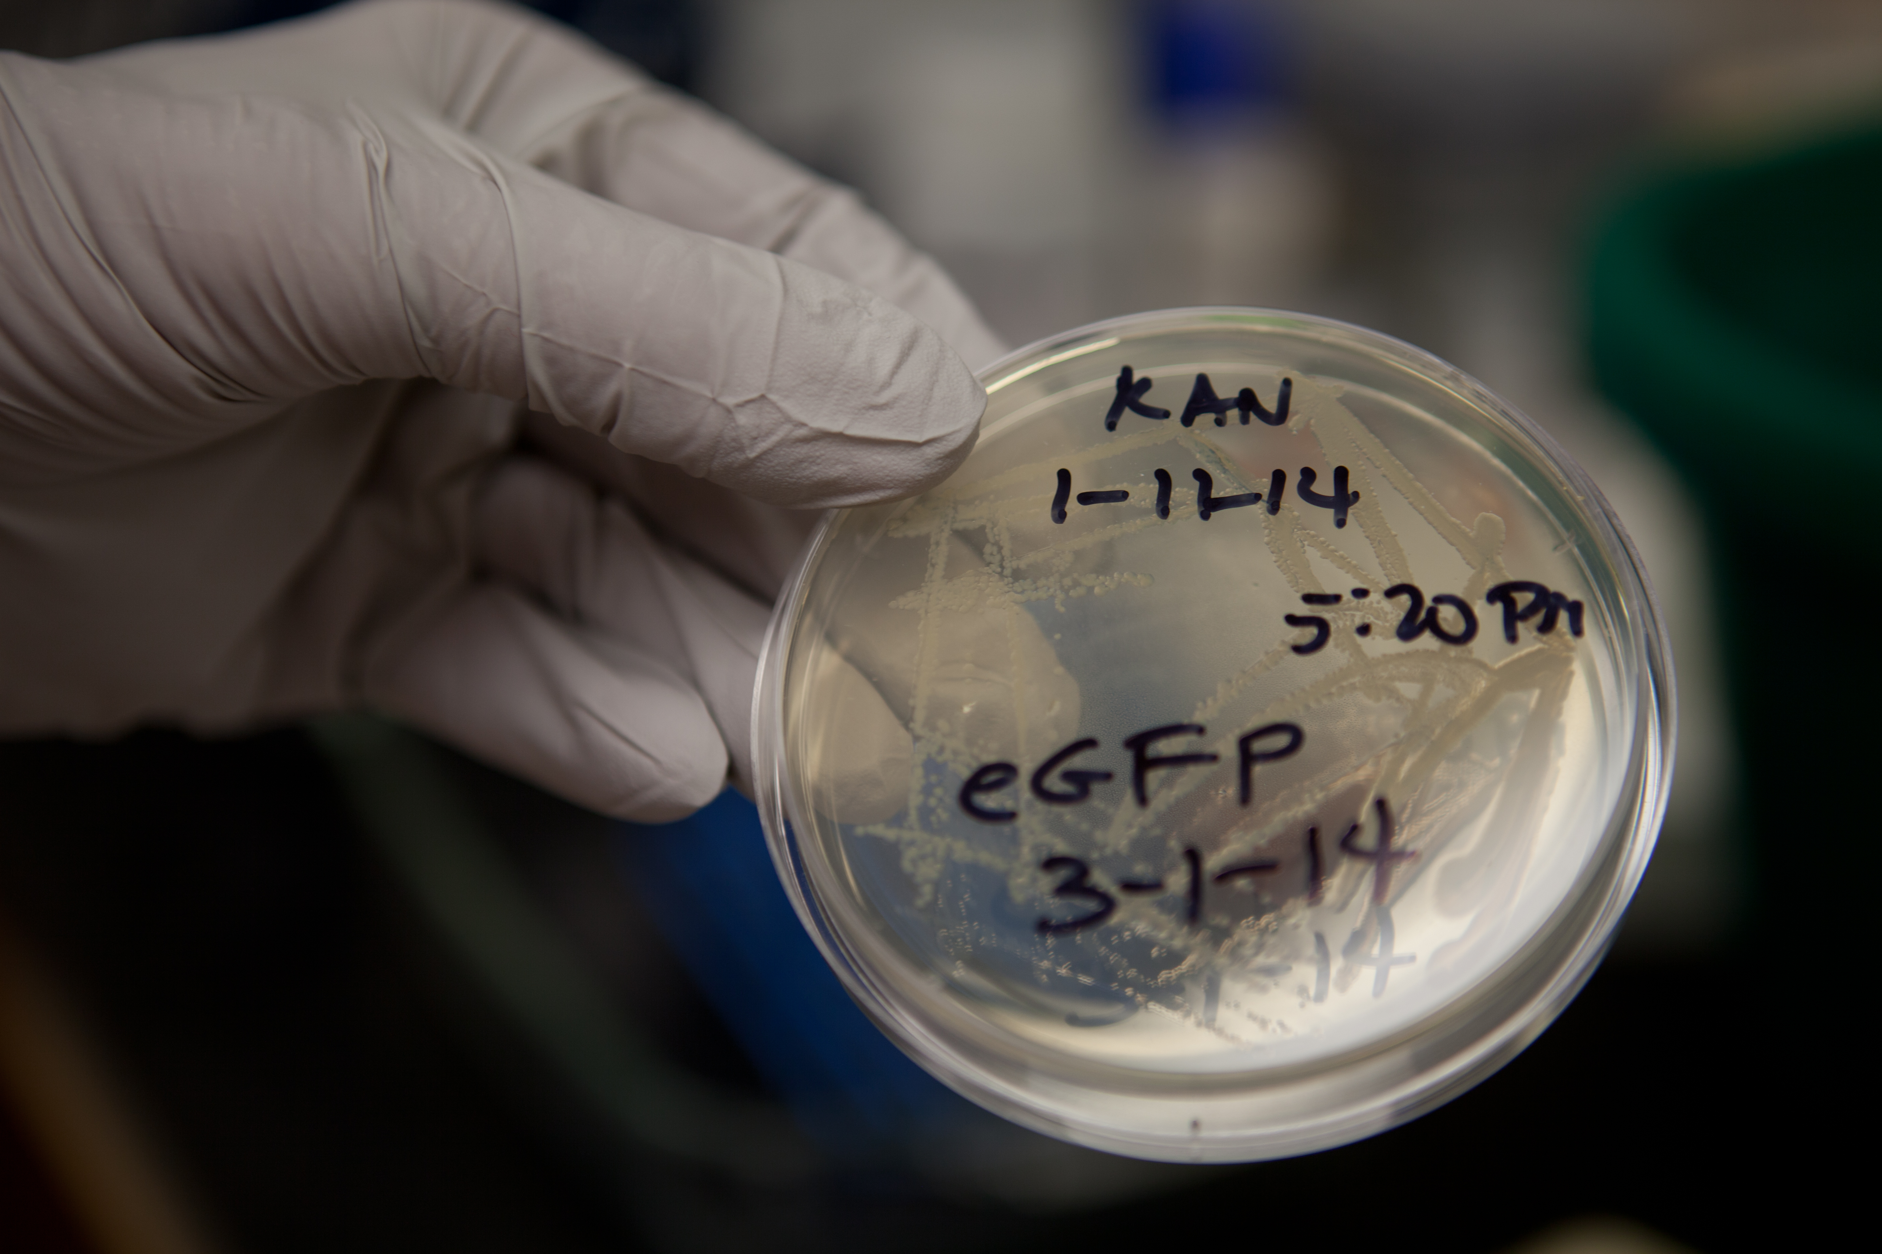
Citizen Scientist Program External Review
Most members would recommend program to their colleagues
Majority of labs reported meaningful and productive contributions to research progress
Recommendations resulted in:
Rigorous matching process between members and labs
Establishment of specific duties
Appointment of designated lab contacts

Slide 11
Diverse backgrounds of citizen scientists
Similar field: 8.1%
Novel field: 91.9

Slide 12
Research Topics
Artificial intelligence
Auditory neuroscience
Behavioral neuroscience
Biological computing
Biomechanics
Cognitive neuroscience
Cross-modal plasticity
Developmental neuroscience
Educational psychology
Evolutionary biology
Human-computer and human-robot interactions
Microbial genomics
Motor control and behavior
Neuroimmunology
Plant genomics and ecology
Psycholinguistics
Science education
Zoonotic ecology

Slide 13
Sample of Specific Research Projects
Evolutionary development and genetic regulation of mammalian morphology
Effects of traumatic brain injuries on decision-making and hippocampal-dependent cognitive processes
Science education: development of evolution and climate change curricula and activities for K-12
Neuroplasticity and cognition: effects of physical and cognitive training on brain function
Plant genomics, physiology, and ecology: crop success and suitability by genetic background
Genomic sequencing techniques for pathogen identification in tick-borne disease

Slide 14
Feedback from Citizen Scientists
“I was amazed by the complex projects and intrigued that OLLI members might get involved in such a meaningful way.”
“For people who like me have a curiosity about science, it’s an absolutely tremendous opportunity.”
“I’ve absorbed a lot of background information that allows me to appreciate its potentially far-reaching implications, and I’ve enjoyed relating to the university in a significant way.”
“I have been able to put my toe in the ocean of knowledge that’s going to surround us in the decades to come.”
“I know I could be slowing down, but I like doing this. It keeps me active and it keeps my mind sharp. Why wouldn’t I take advantage of that?”

Slide 15
Feedback from Sponsoring Labs
“We are so grateful for our OLLI volunteers. They truly make the wheels turn in our lab so we’re able to get the work done.”
“It’s been a great synergy because they work side by side with the students and it’s turned into a very diverse group.”
“When our Citizen Scientist does these tasks, and we know they are done right, that’s gold. That unburdens me, and that unburdens the graduate students.
“There’s a tremendous wealth of knowledge among retirees. If you want to become a scientist at age 65—why not? The OLLI members in our labs are extremely enriching for both the faculty and the students.”
“Adding a citizen scientist to the lab can be very enriching for both social and scientific reasons.”

Slide 16
Upcoming Projects

Slide 17
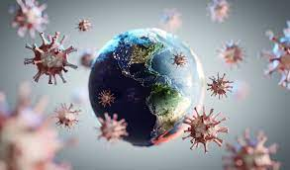
The Pandemic
COVID19 forced pause on the citizen scientist program
Our number 1 priority is safety
We are excited to be able to open up the program again
Following University Guidelines
https://covid19.illinois.edu/

Slide 18
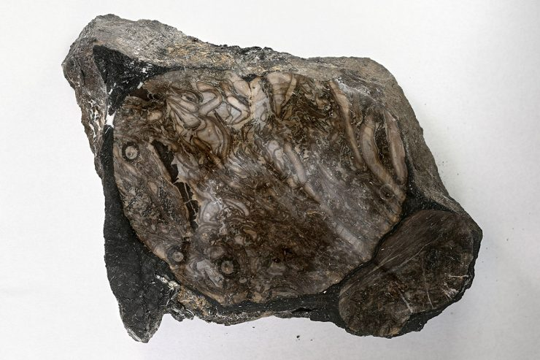
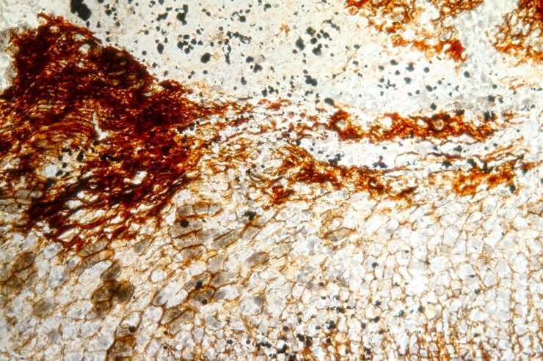
Paleobotany Lab
Digitally archiving a collection of 320 million year old plant fossils
Participants will be trained to use the microscope and to identify the fossil plants contained within the peels
https://paleo.prairie.illinois.edu/coal-ball-collection/

Slide 19
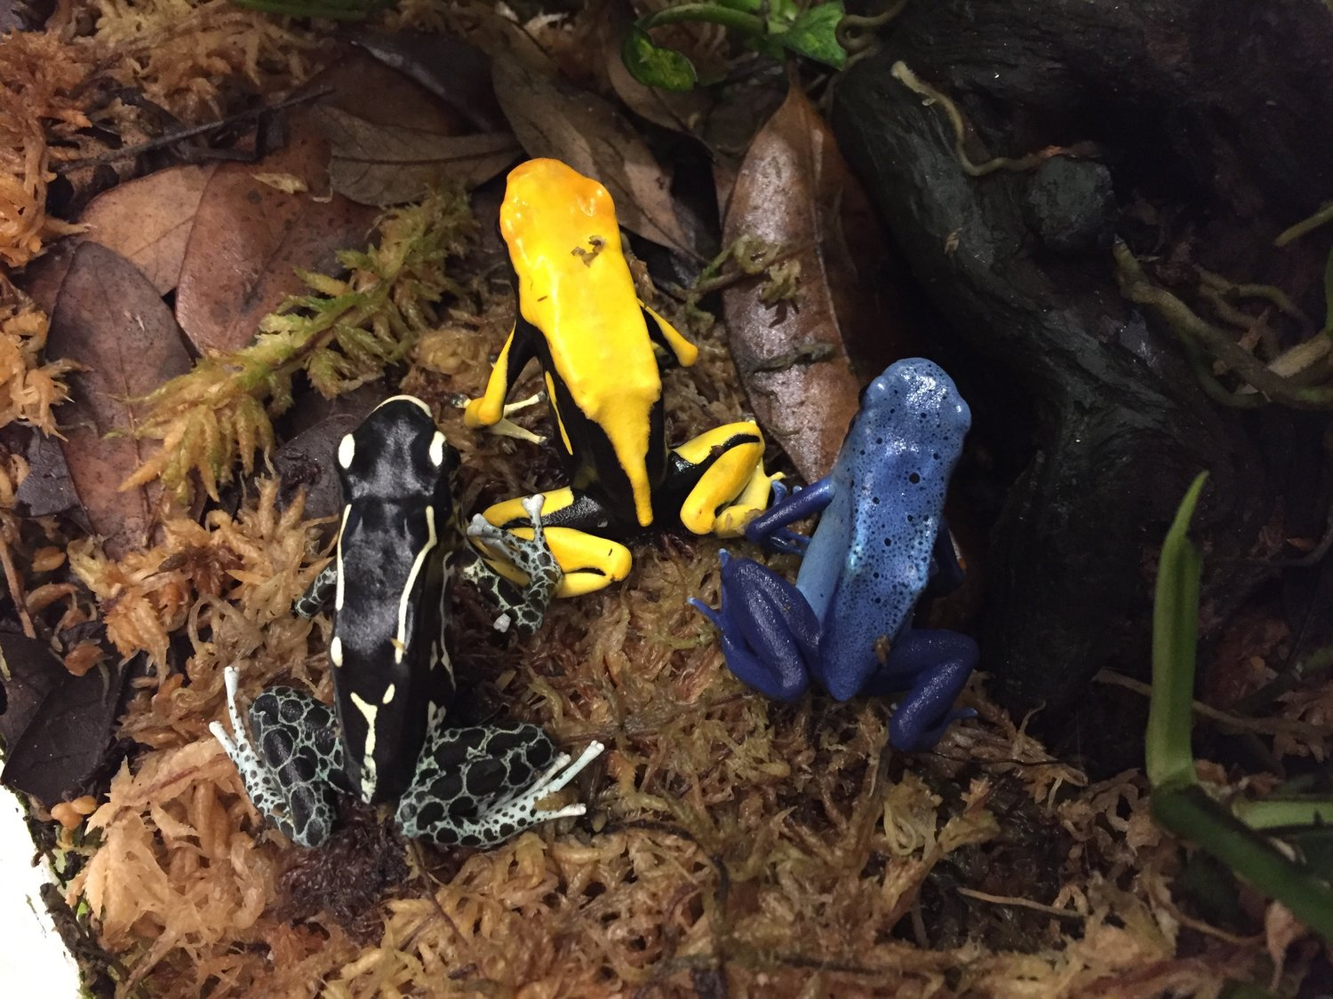
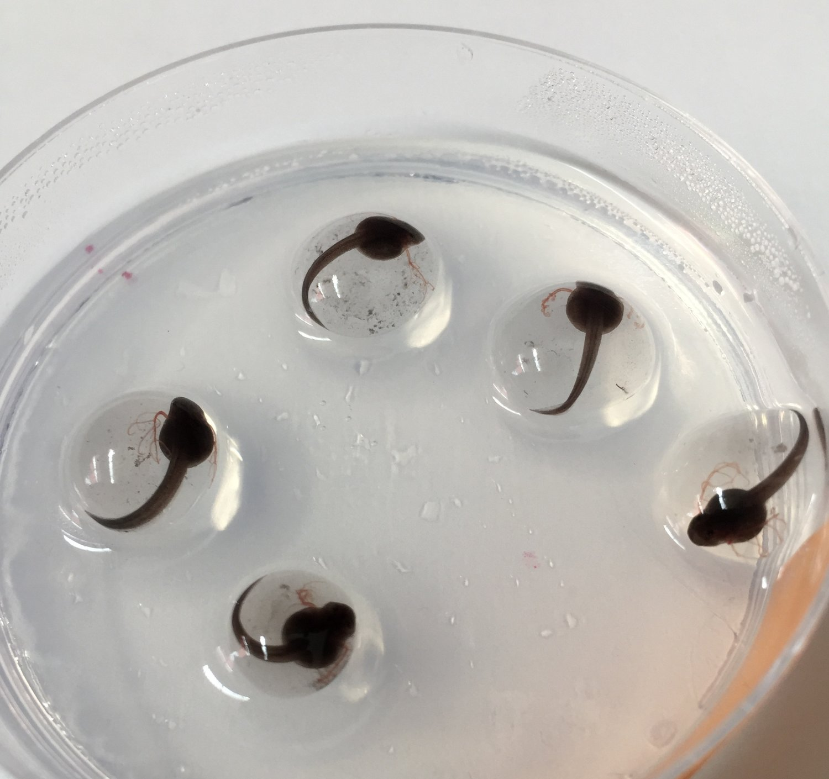
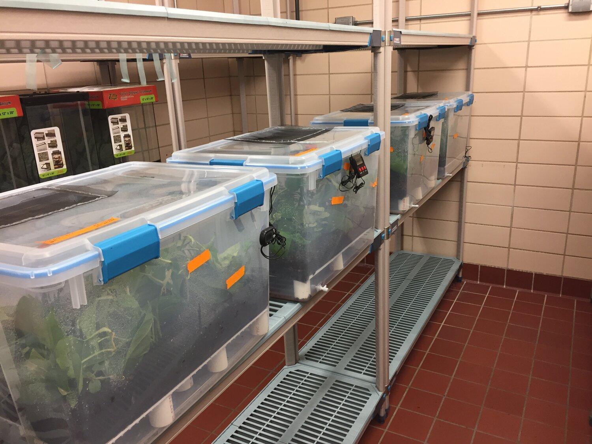
Behavioral evolution
Working to understand the evolution of parental care behaviors
Participants will be trained in the handling and care of animal models

Slide 20
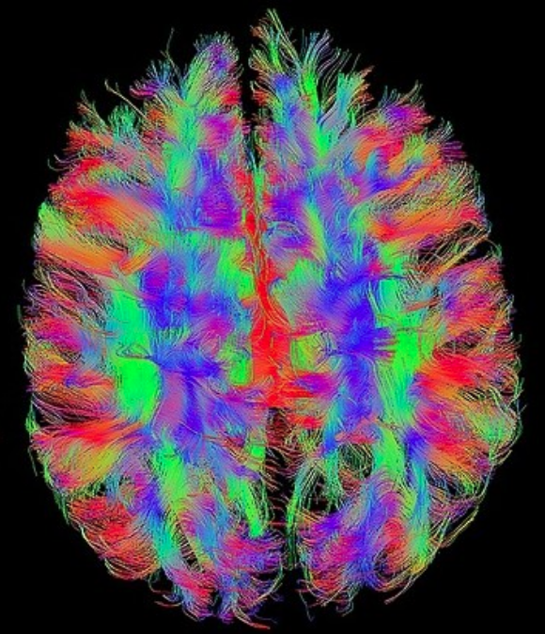
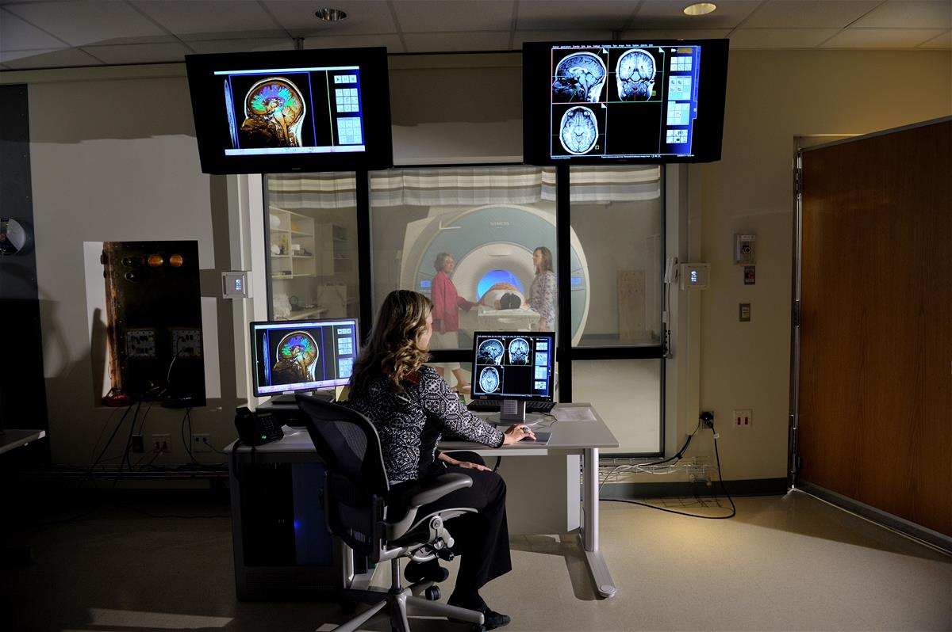
Beckman Institute for Advanced Science and Technology
Imaging facilities
Microscopy
MRI
Neuroscience focus
https://beckman.illinois.edu/

Slide 21
If you would like to participate
Name
Brief descriptions of your interests
What you are hoping to get out of the citizen scientist program
Lab name if known
Availability
Ryerson1@illinois.edu

Slide 22
Thank you!!!
Ryerson1@illinois.edu

