Slide 1
Is It Over Yet?
Dr. James Dobbins
OLLI, 24 February 2022

Slide 2
Is It Over Yet?
Dr. James Dobbins
OLLI, 24 February 2022

Slide 3
Topics That We’ll Discuss Today
Pandemic decision-making in the absence of data
Current status of SARS-Cov-2 and Covid-19
New research on SARS-CoV-2 and Covid-19
The future of SARS-CoV-2 and Covid-19
The current status of two other outbreaks
Seasonal influenza
Avian Influenza H5N1
Questions, questions, questions…???

Slide 4
Topics That We’ll Discuss Today
Pandemic decision-making in the absence of data
Current status of SARS-Cov-2 and Covid-19
New research on SARS-CoV-2 and Covid-19
The future of SARS-CoV-2 and Covid-19
The current status of two other outbreaks
Seasonal influenza
Avian Influenza H5N1
Questions, questions, questions…

Slide 5
Pandemic Decision-making in the Absence of Data

Slide 6
Accusation:
“You’re just making this stuff up as you go along”

Slide 7
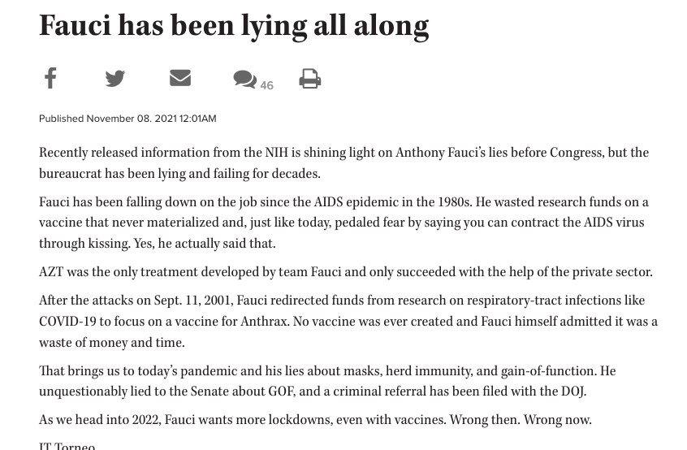
TheDay.com

Slide 8
TheDay.com

Slide 9
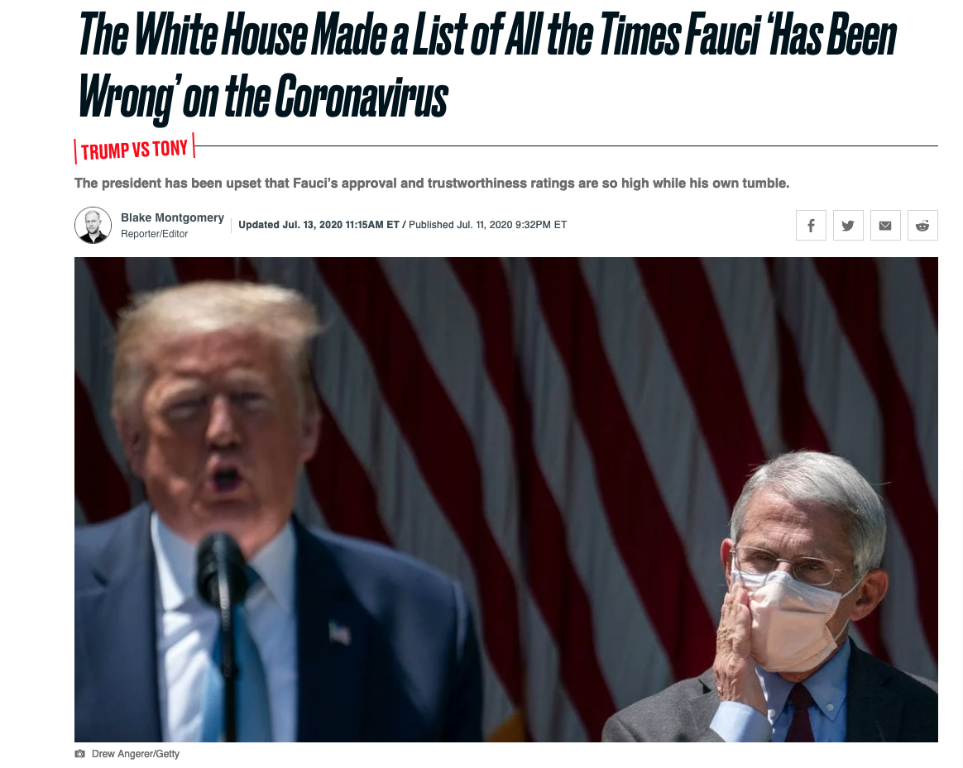

Slide 10
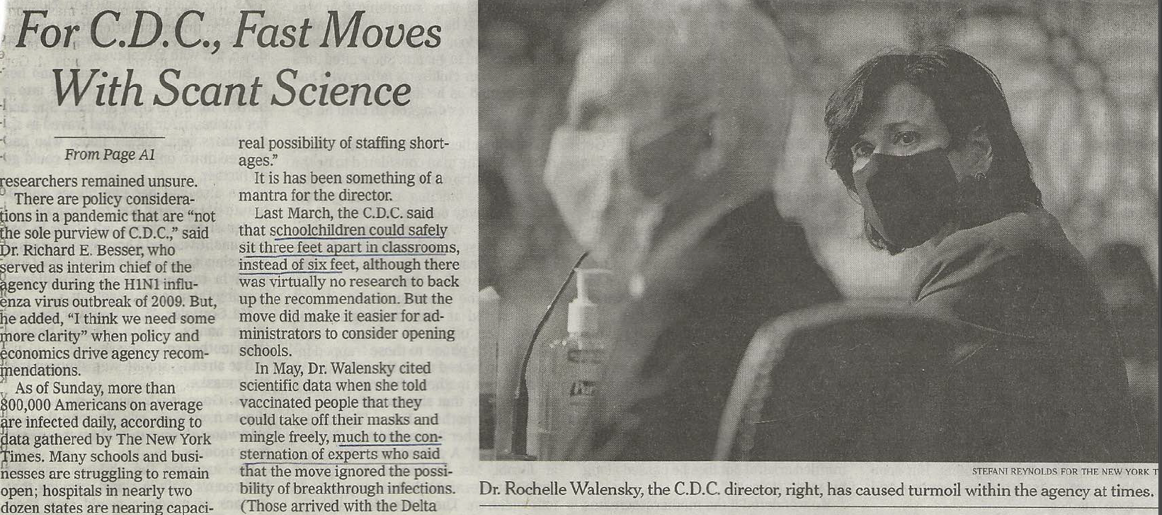
NY Times, 17 January 2022

Slide 11
Response:
“Yes, that’s exactly what we’re doing”

Slide 12
Why are Scientists Making Stuff up?
A brand-new virus with unknown properties of transmission and control
A brand-new disease with unknown means of treatment or prevention
The best that we can do is to rely on our collective knowledge based on similar viruses that produce similar diseases
Constantly update our advice as we learn more about both the virus and the disease

Slide 13
What would be the alternative?
Sit back and do nothing while we collect data on the outbreak until we are relatively sure that we understand both the virus and the disease enough to make clear, data-driven recommendations?
In my opinion that would have been far worse than what actually took place

Slide 14
Current status of SARS-Cov-2 and Covid-19

Slide 15
Epidemic Curves by Location
Worldwide
United States
Illinois
Champaign County

Slide 16
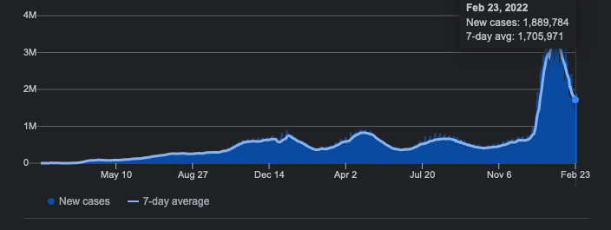
Covid-19 Cases Worldwide
As of 23 February 2022
From www.worldometer.info

Slide 17
Covid-19 Cases Worldwide
As of 23 February 2022
From www.worldometer.info

Slide 18
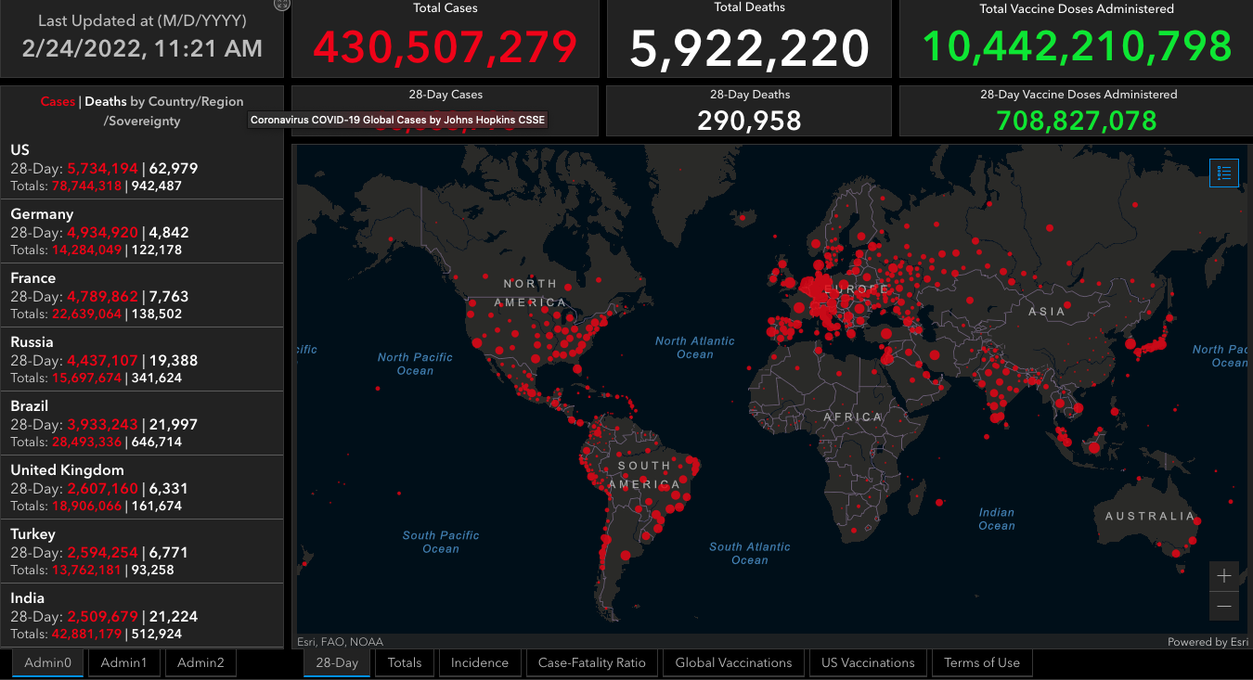

Slide 19
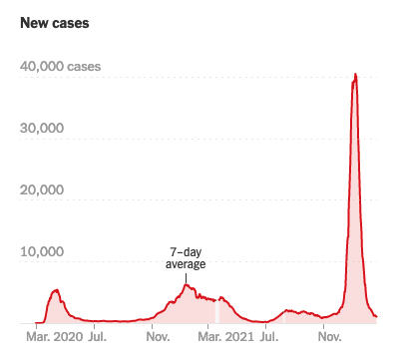
Covid-19 Cases in the U.S.
As of 24 February 2022
From the NY Times dashboard

Slide 20
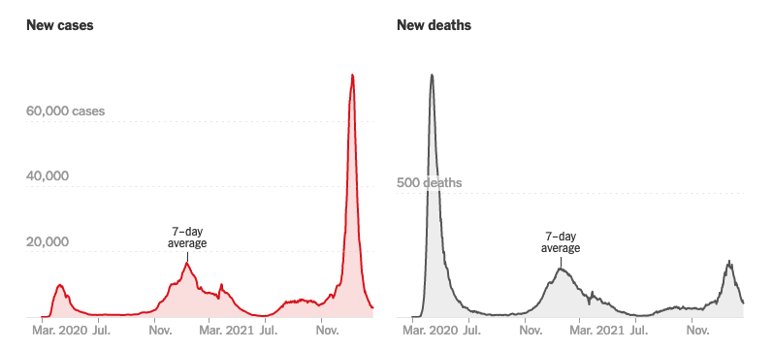
Covid-19 Cases in New York City
As of 24 February 2022
From the NY Times dashboard

Slide 21
Covid-19 Cases in New York City
As of 24 February 2022
From the NY Times dashboard

Slide 22
Covid-19 Cases in New York City
As of 24 February 2022
From the NY Times dashboard

Slide 23
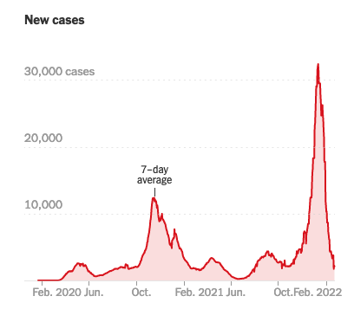
Covid-19 Cases in Illinois
As of 24 February 2022
From the NY Times dashboard

Slide 24
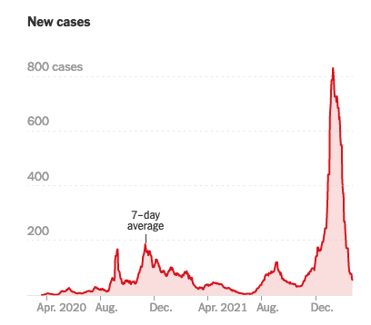
Covid-19 Cases in Champaign County
The average number of new cases in Champaign County fell to 56 yesterday, a 4 percent decrease from the day before. Since January 2020, at least 1 in 3 people who live in Champaign County have been infected.
As of 24 February 2022
From the NY Times dashboard

Slide 25
Covid-19 Cases in Champaign County
The average number of new cases in Champaign County fell to 56 yesterday, a 4 percent decrease from the day before. Since January 2020, at least 1 in 3 people who live in Champaign County have been infected.
As of 24 February 2022
From the NY Times dashboard

Slide 26
Covid-19 Cases in Champaign County
The average number of new cases in Champaign County fell to 56 yesterday, a 4 percent decrease from the day before. Since January 2020, at least 1 in 3 people who live in Champaign County have been infected.
As of 24 February 2022
From the NY Times dashboard

Slide 27
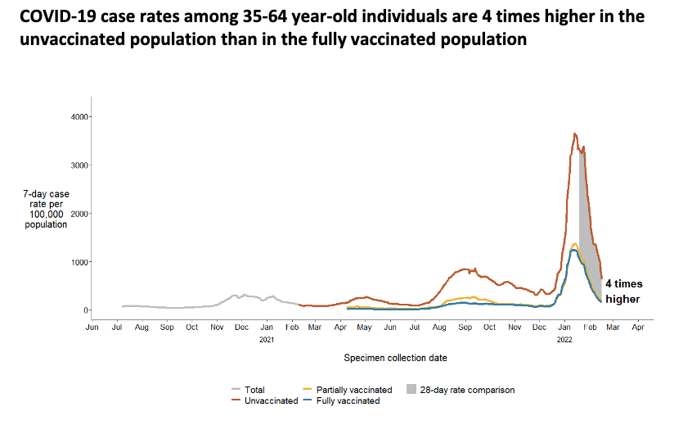
Washington State DOH, 23 Feb 2022

Slide 28
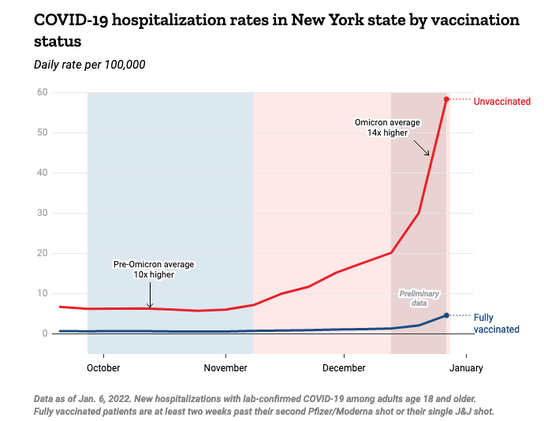
Washington State DOH, 23 Feb 2022

Slide 29
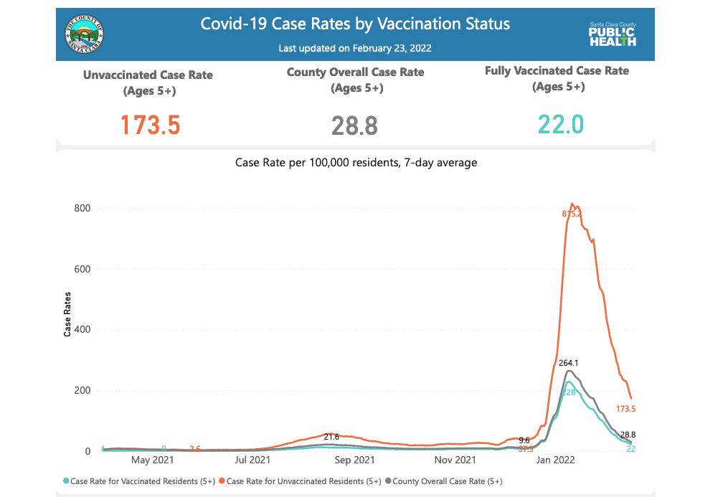
Washington State DOH, 23 Feb 2022

Slide 30
New research on SARS-CoV-2 and Covid-19

Slide 31
New research on SARS-CoV-2 and Covid-19
SARS-CoV-2 challenge study in England
SARS-CoV-2 variants: Omicron vs Delta
New SARS-CoV-2 vaccines

Slide 32
SARS-CoV-2 Challenge Study in England
If you want to prevent infection with SARS-CoV-2 and transmission of Covid-19, then you need to understand exactly how both of these processes occur
Now, finally, thanks to anew, ground-breaking study from England, we know the answers
Killingly B, Mann A, Kalinova M, et al. Safety, tolerability, and viral kinetics during SARS-CoV-2 human challenge. Natureportfolio (preprint) DOI: 10.21203/rs.3.rs-1121993/v1

Slide 33
Study Design
36 volunteers ages 18 – 29 with no prior infection and no prior vaccination
Infected intranasally with original wild-type SARS-CoV-2
Subjects were monitored daily for viral load, viral shedding, and symptoms
[NB: The study began before the emergence of the delta variant in England]

Slide 34
Study Results
18 subjects of the 36 subjects became infected
Virus was detectable within 2 days post-inoculation and peaked around day 7
Virus continued to be detectable up to 19 days post-inoculation
The viral load was significantly higher in the nose than in the throat

Slide 35
Study Results (continued)
Peak viral load was reached at 4.7 days in the throat and 6.2 days in the nose
Viral shedding, particularly from the nose, was still present at 14 days post-inoculation
At 28 days, 33% of the subjects were still shedding virus from the nose; 11% from the throat
Note that the infections were in the upper respiratory tract and NOT in the lungs

Slide 36
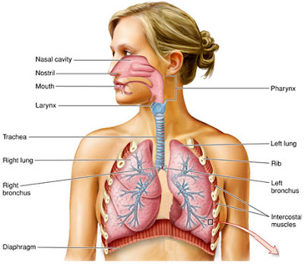

Slide 39
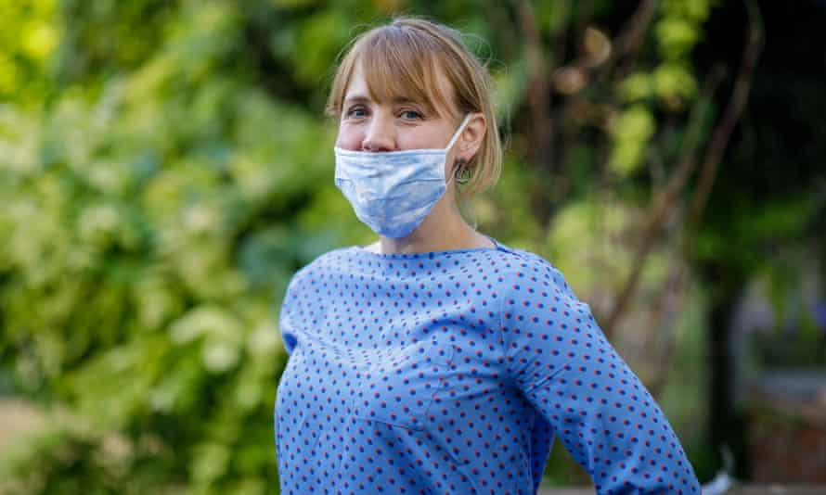

Slide 41
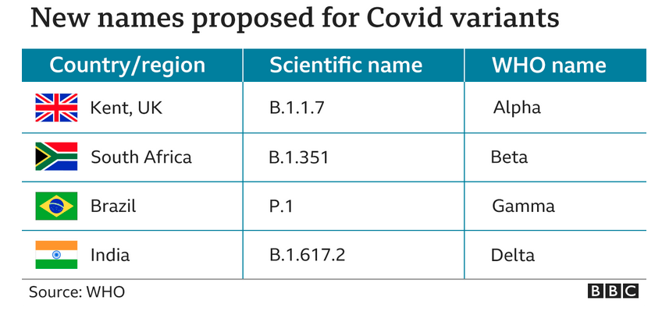

Slide 42
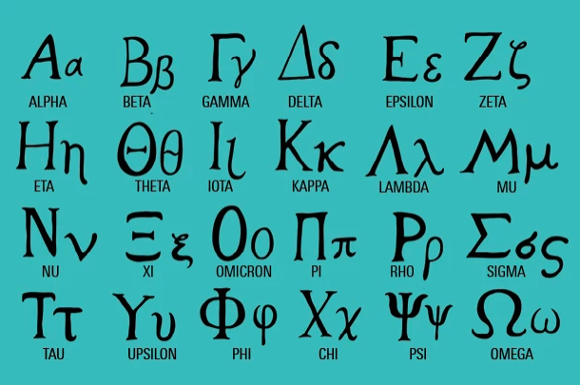

Slide 45
Omicron vs Delta (continued)
Omicron is much more infectious so a huge number of cases
Omicron produces milder illness so more post-infection survivors

Slide 46
SARS-CoV-2 variants: Omicron vs Delta -2
Omicron produces a much stronger and longer-lasting immune response
Omicron immune response is considerably stronger than that induced by vaccination, while the response from infection with the delta variant is weaker than from vaccination

Slide 47
New SARS-CoV-2 Vaccines
“Universal” coronavirus vaccines
Nasal vaccines

Slide 48
Universal Coronavirus Vaccines
“Universal” or “pan-” coronavirus vaccine
Target surface proteins that are common to all coronaviruses
Two major efforts:
NIAID-funded effort
U.S. Army vaccine

Slide 49
NIAID Universal Coronavirus Vaccine
Funded by NIAID [$36 million in grants]
Three universities collaborating on its developments:
University of Wisconsin
Duke University
Harvard University
Currently there is no actual vaccine

Slide 50
U.S. Army Pan-coronavirus Vaccine
Developed by Walter Reed Army Institute of Research
Attaches spike proteins from a number of coronaviruses to a protein called ferritin
Spike Ferritin Nanoparticle (SpFN) vaccine
Vaccine includes a potent adjuvant that was also developed the Army Institute of Research

Slide 51
U.S. Army Pan-coronavirus Vaccine (continued)
In preclinical studies, the vaccine elicited a potent immune response against previous SARS-CoV-2 variants
Stimulated both humoral and cellular immune systems
Designed to also block new variants of concern
Began enrolling 72 subjects for a phase I clinical trial in December 2021
24 subjects have already received the vaccine

Slide 52
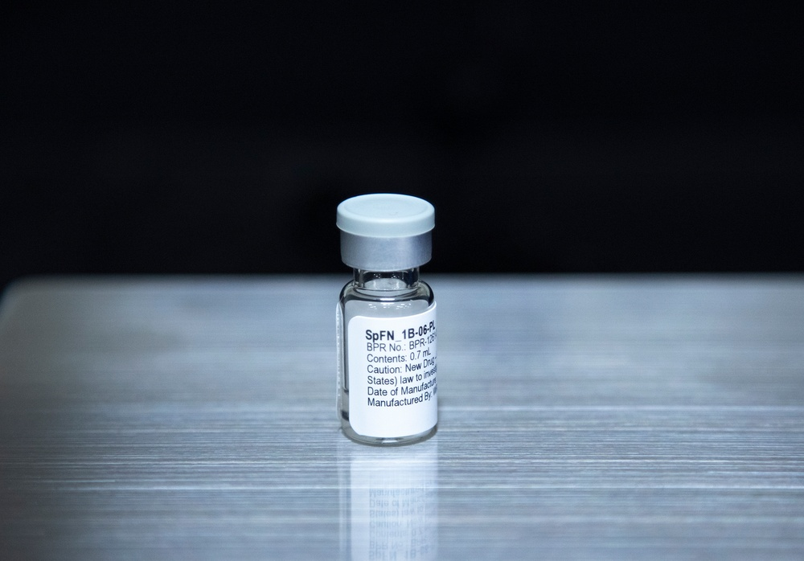

Slide 53
Nasal SARS-CoV-2 Vaccine
We now know that the nose is the principal site of transmission of SARS-CoV-2 virus
Existing Covid-19 injectable vaccines do not prevent colonization of the virus in the nose and therefore do not block transmission

Slide 54
Nasal SARS-CoV-2 Vaccine (continued)
A number of nasal vaccines are currently being tested in clinical trials in the U.S. and overseas
These vaccines stimulate the production of immunoglobulin A in the nasal mucosa
They also stimulate the production of IgG inside the lungs

Slide 55
ChAd-SARS-CoV-2-S
This nasal vaccine is currently undergoing phase III clinical trials in India by Bharat Biotech
Based on a chimpanzee adenovirus vector that contains the genome for the SARS-CoV-2 spike protein
The same delivery system as the AstraZeneca Covid-19 vaccine (but with a slightly different viral vector)

Slide 56
ChAd-SARS-CoV-2-S (continued)
The viral vector replicates in the nose where it expresses the spike protein that then stimulates the production of both IgA and IgG antibodies
As a result, it prevents infection in both the upper and lower respiratory tracts

Slide 57
Other Covid-19 Nasal Vaccines
Clinical trials have begun on a vaccine specifically targeted to children ages 6 months to 5 years
Based on a weakened parainfluenza virus that contains the genome for the SARS-CoV-2 spike protein
This particular vaccine would not work on older adults because by age 5 most people have already been exposed to the vector virus so that it would by neutralized by their immune systems

Slide 58
Other Covid-19 Nasal Vaccines (continued)
Other vaccines using various techniques are currently being developed at a number of laboratories in the U.S. and overseas

Slide 59
The future of SARS-CoV-2 and Covid-19

Slide 60
Four Key Points to Keep in Mind
Vaccine-acquired immunity
Naturally-acquired immunity
Universal vaccines
Nasal vaccines

Slide 61
Vaccine-induced Immunity
High level of vaccine-induced immunity
Approximately two-thirds of the U.S. population has been fully vaccinated
Although antibodies slowly wane over time, other components of the immune system remain in place to identify and destroy any invading viruses
One of these components, B cells, produce new antibodies

Slide 62
Naturally-acquired immunity
High level of naturally-acquired immunity from exposure to the omicron variant
Approximately one-third of the population has been infected with the omicron variant
The immune response to the omicron variant is much stronger that the response to the delta variant as well as to any of the present vaccines
Thankfully, we are also running out of bozos

Slide 63
Universal Vaccines
These are vaccines that are directed towards a number of proteins that are present on the surface of all coronaviruses
This means that no new variants of SARS-CoV-2 would be able to circulate in countries where such a vaccine is widely used
One vaccine is already in field trials and could possibly be available in the near future

Slide 64
Nasal Vaccines
We now know that infection and transmission are focused on the nose
A nasal vaccine would stimulate an immune response of IgA antibodies that are present in nasal mucosa, and SARS-CoV-2 would not be able to enter the respiratory system
Transmission of the virus into the environment would be blocked
Hopefully, large number of vaccine-hesitant individuals would accept such a vaccine

Slide 65
The Basic Conclusion From All of This
It’s not over yet
…but things are looking mighty fine!

Slide 66
What Could Possibly go Wrong? #1
The appearance of a new variant…BA.2?... that can break through the protective barrier established by the BA.1 omicron variant
Studies released on February 22nd indicate that almost all reinfections in Denmark with BA.2 occurred in unvaccinated individuals
Laboratory data indicate that BA.2 could be a problem but so far there is no indication that it is
This would also no longer be a problem after the use of a universal coronavirus vaccine

Slide 67
What Could Possibly go Wrong? #2
Dropping behavioral constraints too soon so that another group of non-vaccinated individuals continues to become infected
This would be a self-limiting problem
A nasal vaccine would help to limit the size of such a group

Slide 68
What Could Possibly go Wrong? #3
Constant reintroduction of the virus into local populations
Existing herd immunity from vaccines and omicron should stop transmission

Slide 69
And One More Thing…
A number of people have stated categorically, without the least bit of evidence, that SARS-CoV-2 will become endemic
I can see no particular reason why would this would be true

Slide 70
The Current Status of Two Other Outbreaks

Slide 71
The Current Status of Two Other Outbreaks
Seasonal influenza
Avian Influenza H5N1

Slide 72
Seasonal Influenza

Slide 73
Seasonal Influenza
This year’s flu season began normally
Almost all tested specimens were A/H3N2
Unfortunately, most of the influenza vaccines against H3N2 have been ineffective
The season ended abruptly around January 1st

Slide 74
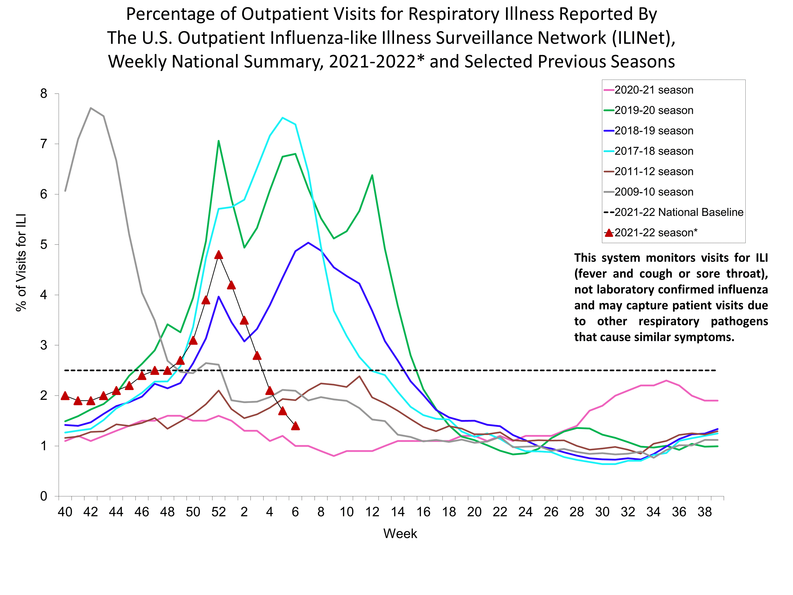

Slide 75
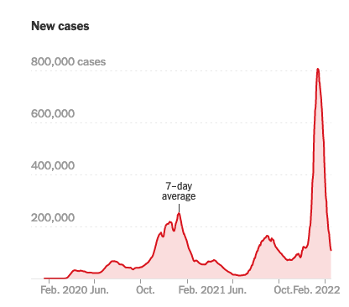
Covid-19 Cases in the U.S.
As of 19 February 2022
From the NY Times dashboard

Slide 76
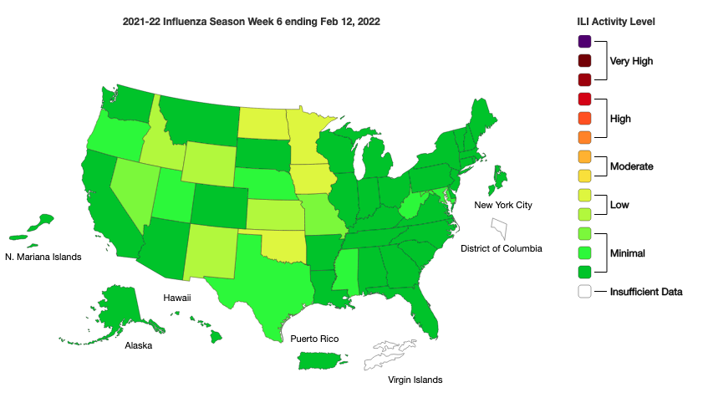

Slide 78
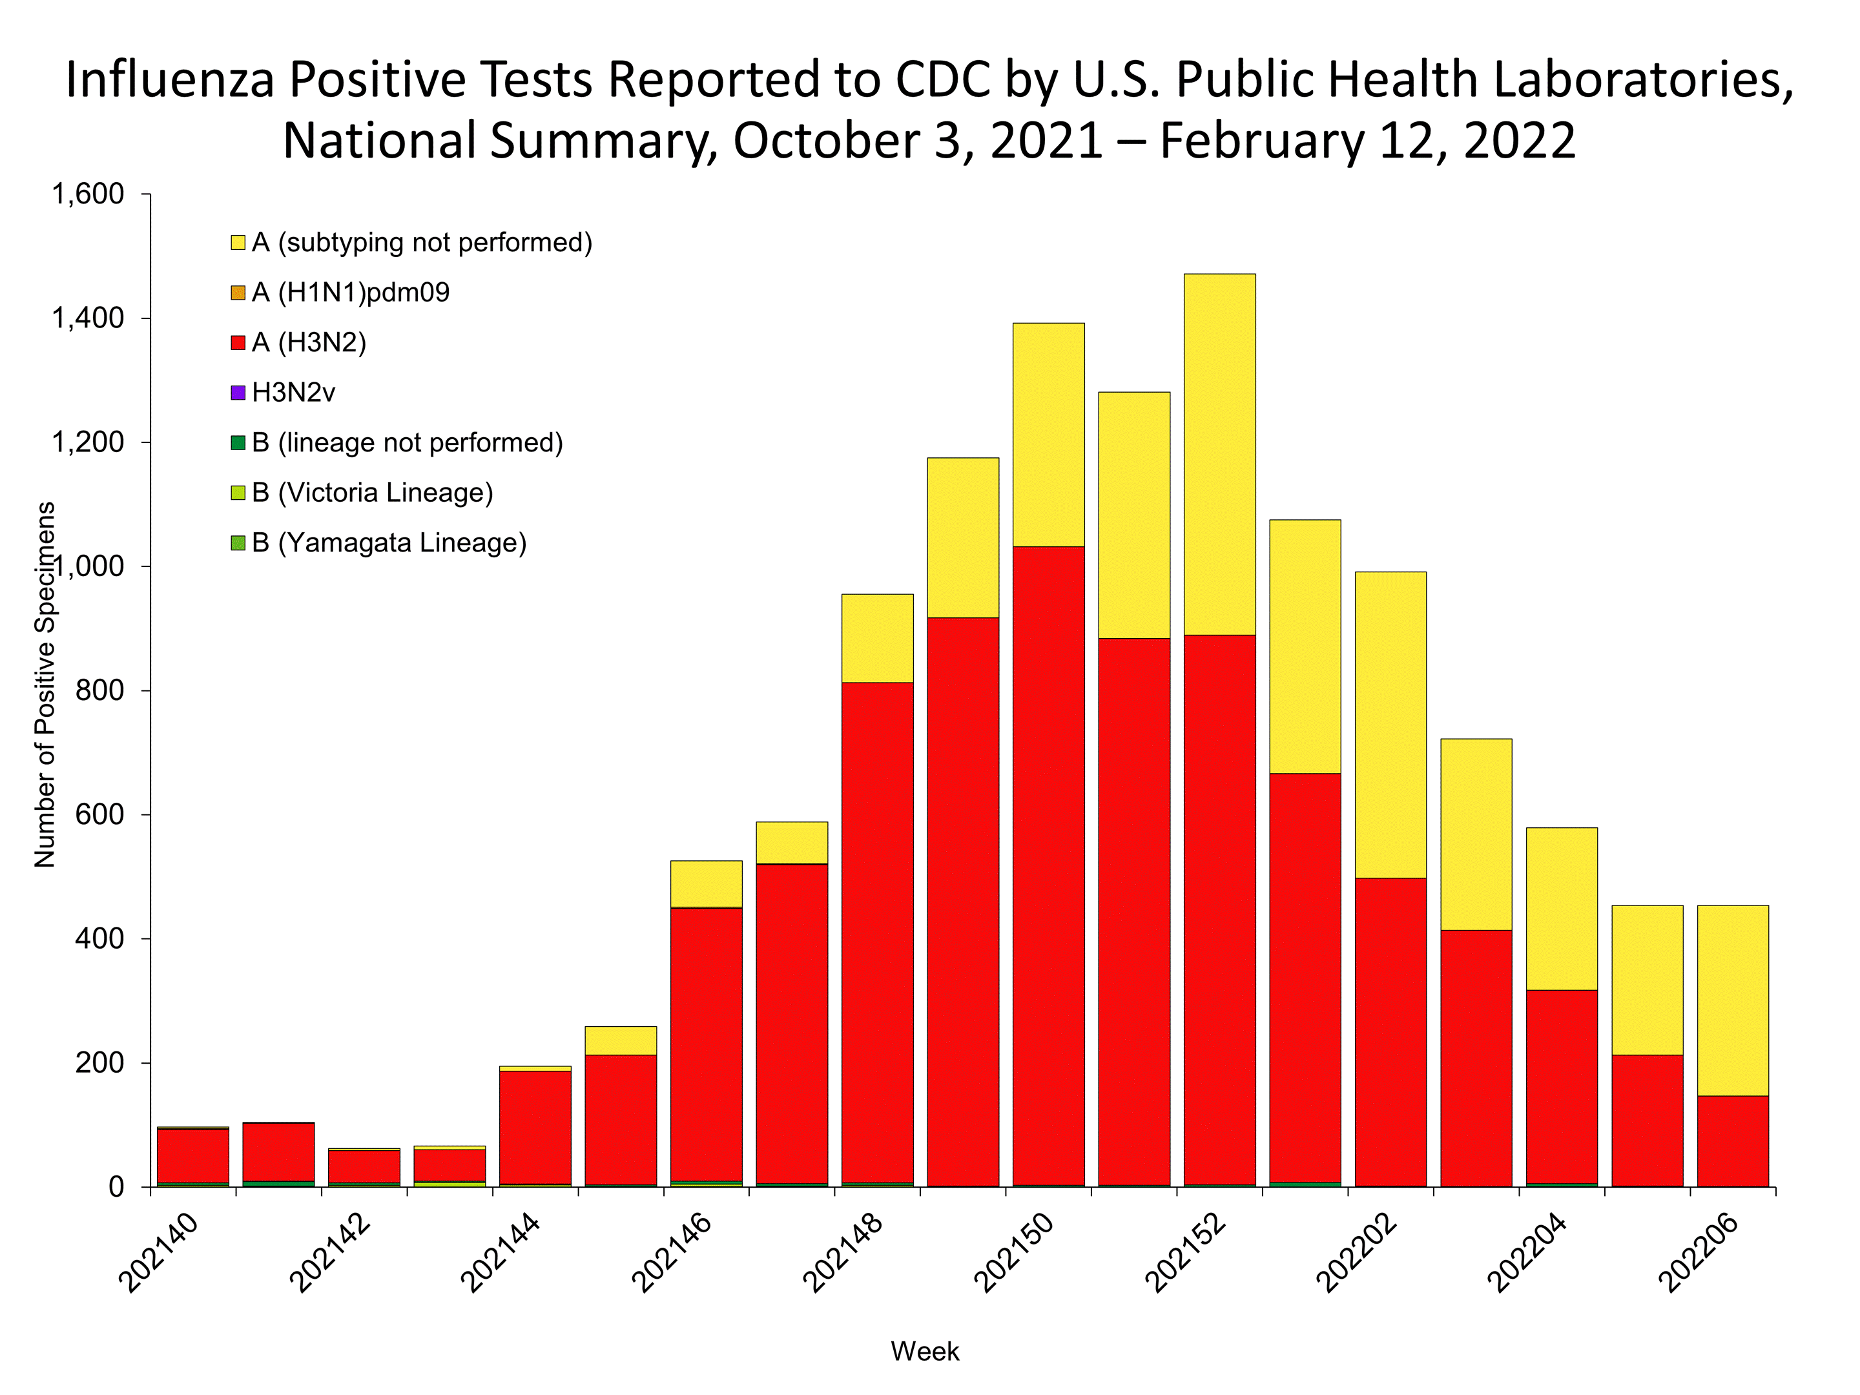

Slide 80
2021-2022 Influenza Vaccine Effectiveness
Three basic types of influenza vaccines
Egg-based vaccines (all standard vaccines)
Recombinant vaccines (Flublok)
Cell-based vaccines (Flucelvax)

Slide 81
Egg-based Vaccines
As the virus replicates in egg cells, it can become adapted to those cells rather than human lung cells
When this occurs, the vaccine will produce antibodies that are directed against a different virus than the target human influenza virus
For the 2021-2022 flu season this unintended consequence occurred for the A/H3N2 component
Non-egg-based vaccines were not affected

Slide 82
Egg-based Vaccines
As the virus replicates in egg cells, it can become adapted to those cells rather than human lung cells
When this occurs, the vaccine will produce antibodies that are directed against a different virus than the target human influenza virus
For the 2021-2022 flu season this unintended consequence occurred for the A/H3N2 component
Non-egg-based vaccines were not affected

Slide 83
Avian Influenza H5N1

Slide 84
Highly Pathogenic Avian Influenza H5N1
Avian influenza has evolved in ducks from viruses found in pigs and humans (primarily in Guangdong Province, China)
The current virus emerged around 1996 and since 2003 has moved throughout southeast Asia and much of the eastern hemisphere
Controlled by destroying entire flocks where infections have been identified

Slide 85
HPAI H5N1 Infections in Humans
Human infection first detected in Hong Kong in 1997
There have now been over 700 confirmed cases in humans, almost all of whom had extensive contact with birds
Approximately half of the cases have died
Sustained human-to-human transmission has not occurred

Slide 86
HPAI H5N1 Infections in the United States
February 2022, local farm outbreaks found in Maine, New York, Virginia, Indiana, Kentucky
Found in commercial poultry farms, backyard flocks, and in surveillance among wild birds
No human cases have been detected in the U.S. to date
This will NOT be a problem in the U.S.
The silver lining of this cloud: Canada geese are susceptible to this virus!

Slide 87
Thank You!

