Slide 1

An Ear for Music
Session 1
Building Blocks
Alien Trumpets Slides only
OLLI at Illinois
Spring 2024
D. H. Tracy

Slide 2
To View Alien Trumpets
Open this file in Powerpoint
Start “Slideshow” from Beginning
Wait for Arrow in lower right corner of each slide.
  Then advance slide by hitting Spacebar or →
  just once, then wait for next arrow

Slide 3



What Sounds Can We Distinguish?
1
Remember this one?
A little Different
2
3

Slide 4
What Sounds Can
We Distinguish?
1
2
A little Different
3

Slide 5
What Sounds Can We Distinguish?
1
And this one?
2
A tiny bit Different
3

Slide 6
1
What Sounds Can
We Distinguish?
2
3
A tiny bit Different

Slide 7
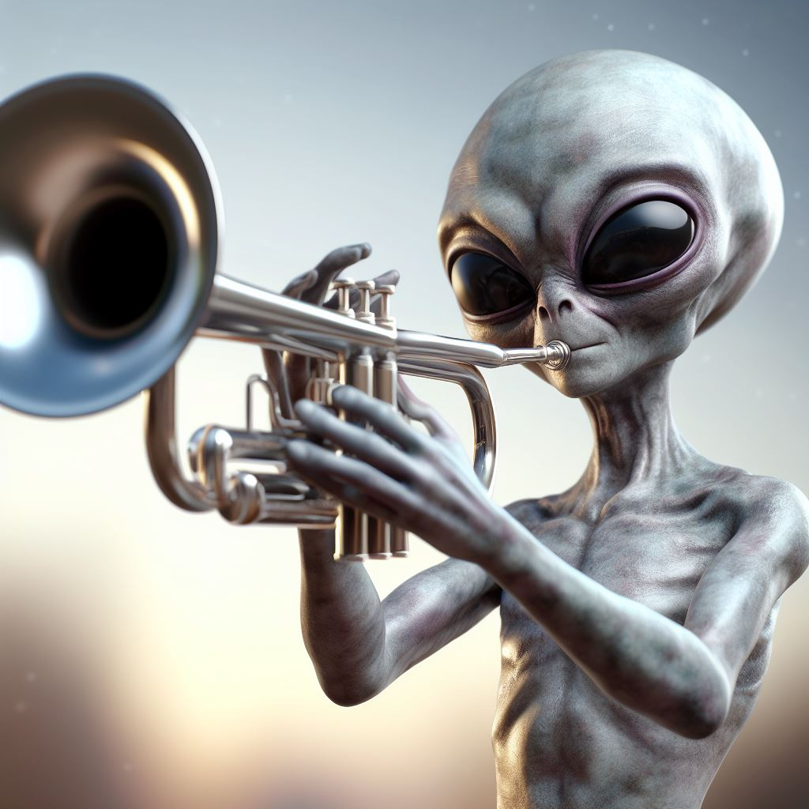
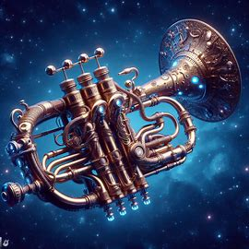
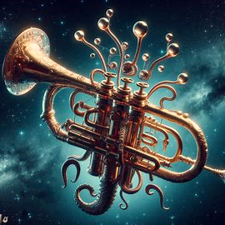
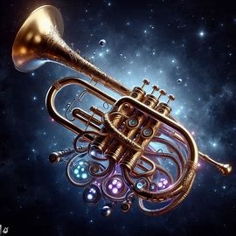
What Alien Sounds Can We Distinguish?
0
p:-180-R1R2
1
DALL-E3
2
3

Slide 8

What Alien Sounds Can We Distinguish?
0
1
All 4 are Very Different Sounds
DALL-E-3
DALL-E3
2
None !
3

