Slide 2
We can all be sequenced: Tools for DNA and RNA sequencing
Prof. Xing Wang
Woese Institute for Genomic Biology
Holonyak Micro and Nanotechnology Laboratory
Department of Bioengineering
Department of Chemistry

Slide 3
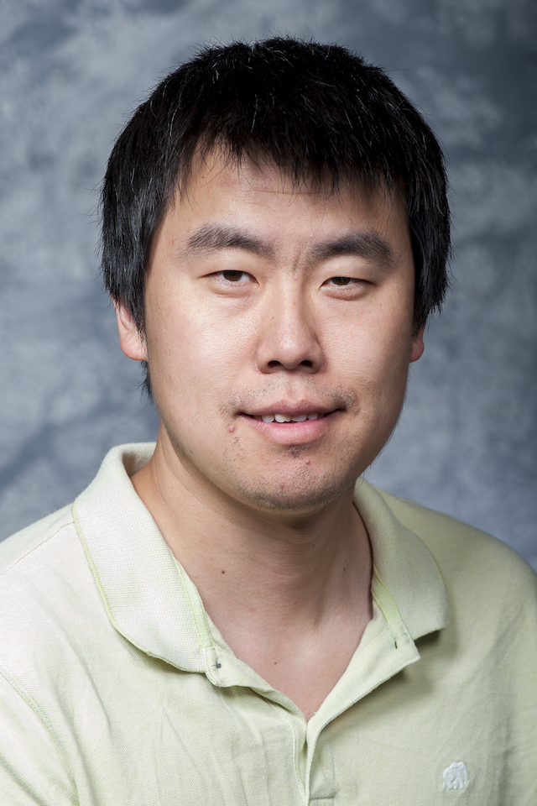
Greetings! Introduction to your instructor
Prof. Xing Wang
Department of Bioengineering
Department of Chemistry
Joined Illinois faculty in 2019
Before that a faculty in Rensselaer Polytechnic Institute
Research topics
Platform technology development for rapid and sensitive disease diagnosis
Nucleic acids (DNA/RNA) based cancer therapy
I do not have any financial ties to any of the companies mentioned today and I am not making recommendations about their products

Slide 4
Outline for today
Overview of DNA, RNA, protein, RNA transcription, and protein synthesis
Overview of genes and genome
Why DNA/RNA sequencing matters for biology and the health
Next generation sequencing technology
Third generation sequencing technology
Discussion

Slide 5
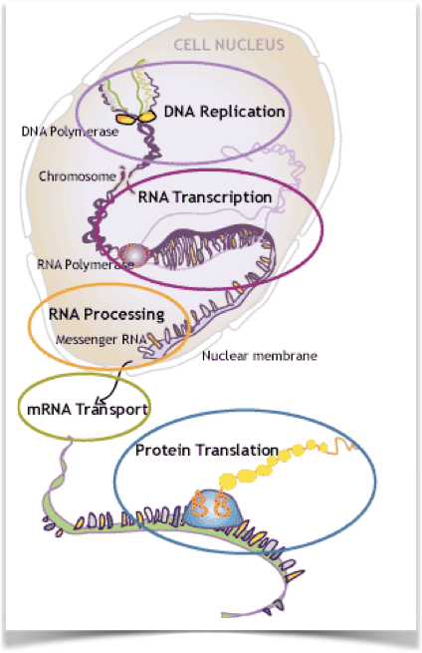
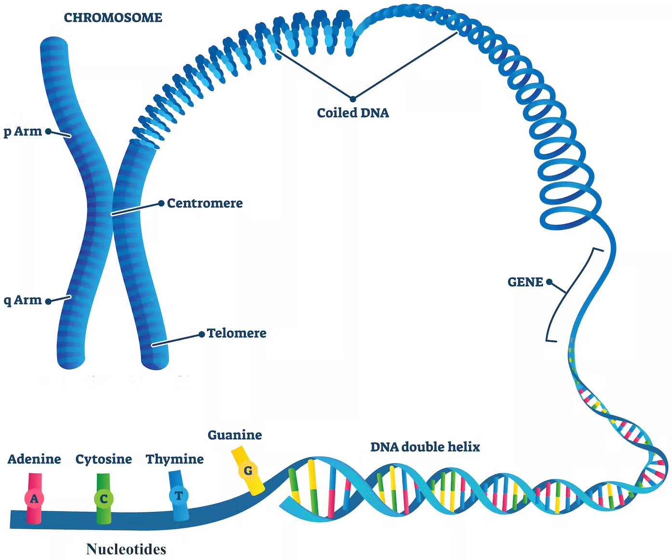
DNA, RNA, and protein
~ 3.2 billion bases long for entire genome
~ 20k to 25 K genes

Slide 6
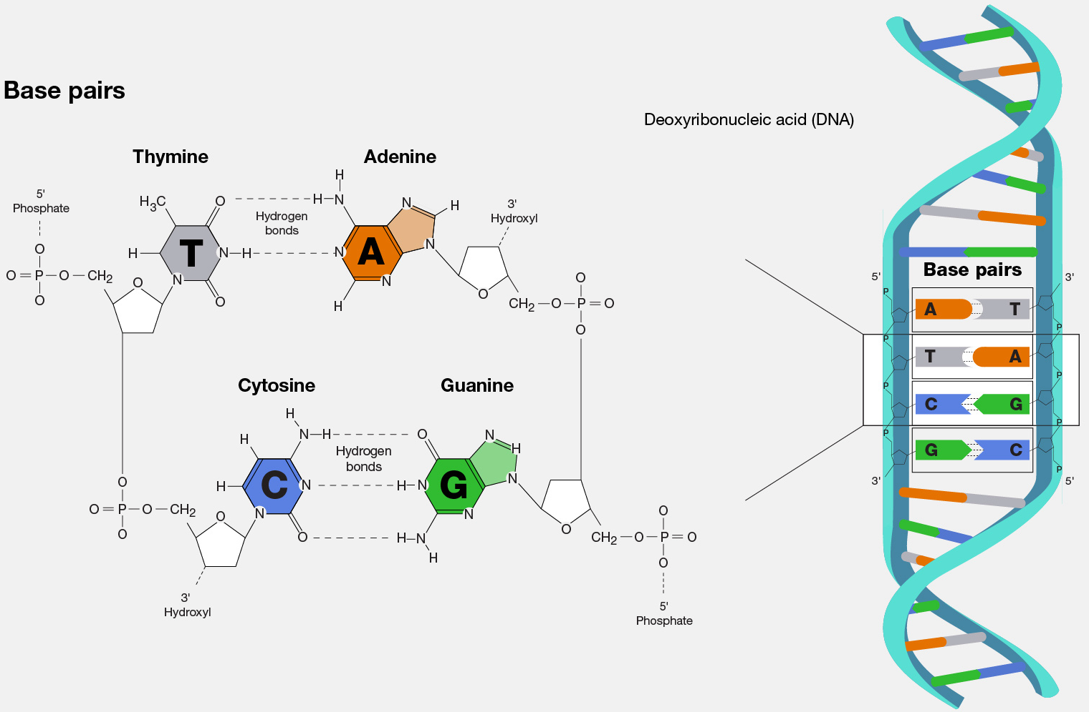
DNA base pairs
Sources: NIH

Slide 7
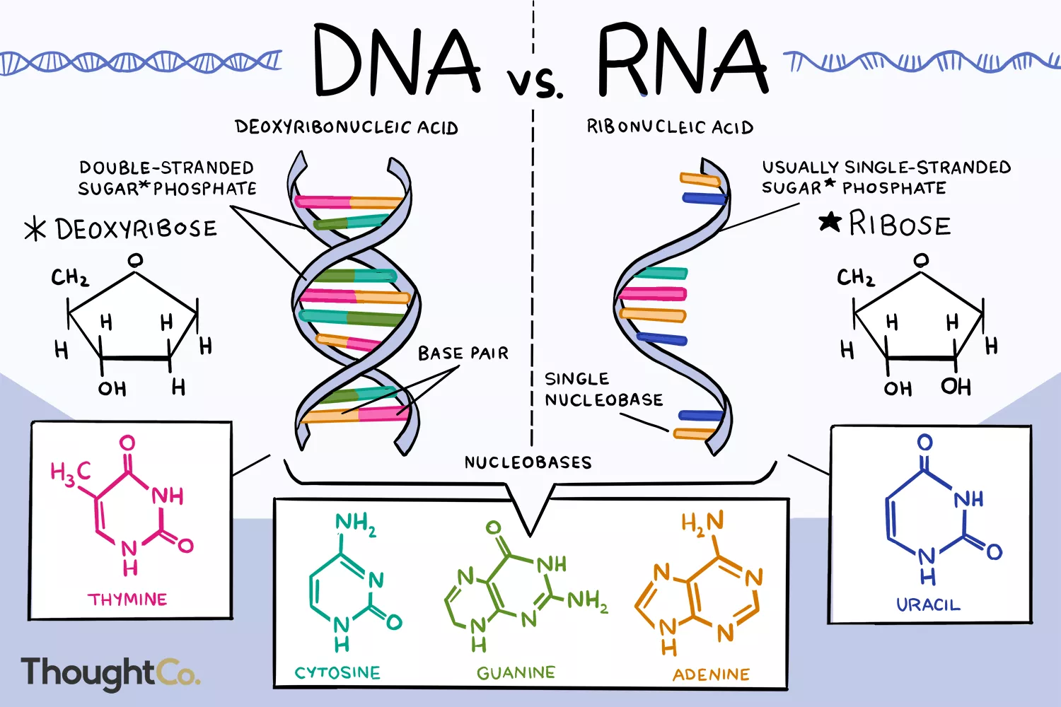
DNA to RNA

Slide 8
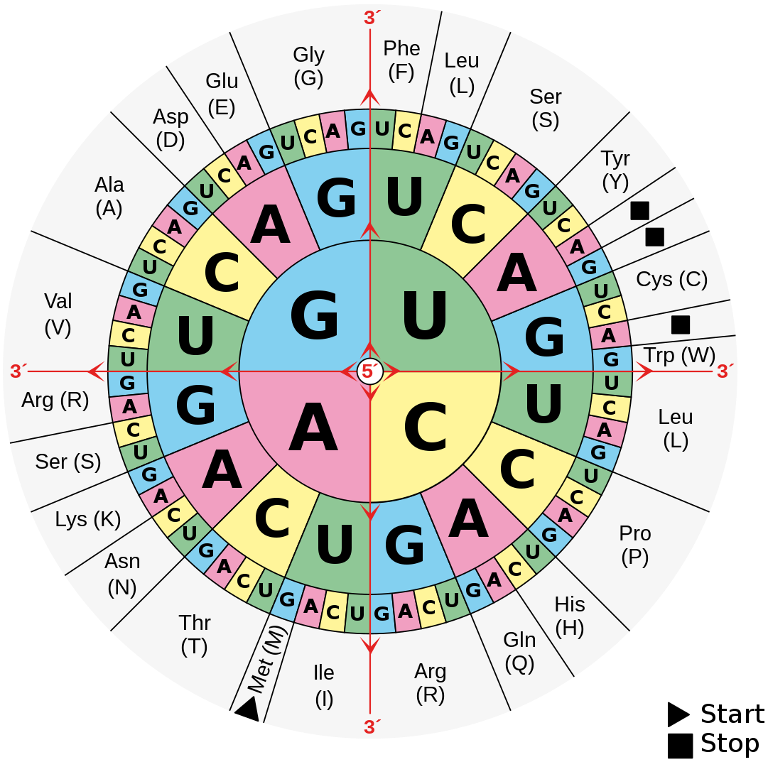
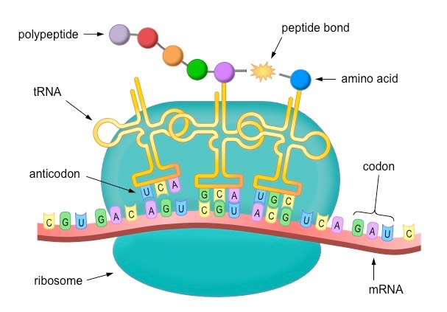
RNA to protein
Sources: Wikipedia

Slide 9
DNA to RNA to protein (video demo)
Sources: American Book Company

Slide 10
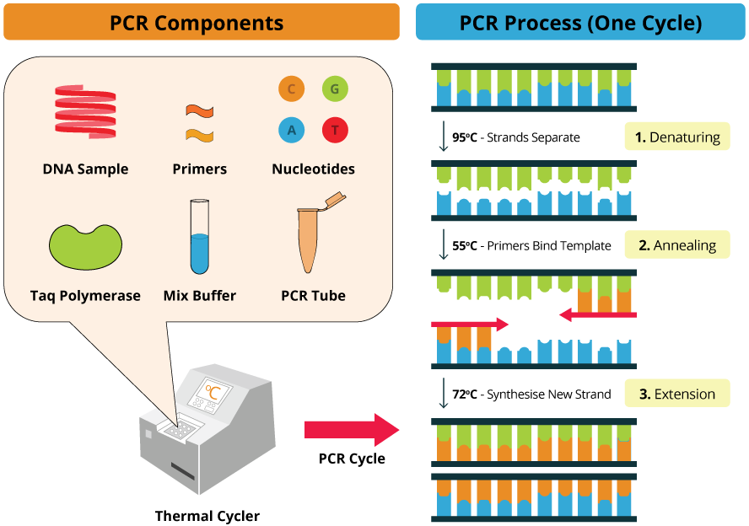
Polymerase chain reaction (PCR)
Sources: BosterBio

Slide 11
Why DNA/RNA sequencing matters for biology and the health
A genome is the complete set of DNA sequences in an organism and contains all of the instructions required for that organism to function.
Whole-genome sequencing enables us to read a person's individual genome and, among other things, identify differences from the average human genome. Such differences (mutations) are often associated with disorders and disease but can also be associated with other factors like disease resistance or sensitivity to an environmental perturbation like sunlight or exercise.
Can be applied in:
Phylogenetics
Emerging organism (e.g., pathogens like microbiome and virus) identification
Disease diagnosis and likelihood score/prediction
Monitor efficacy of disease treatments
Gene therapy design
Forensic

Slide 12
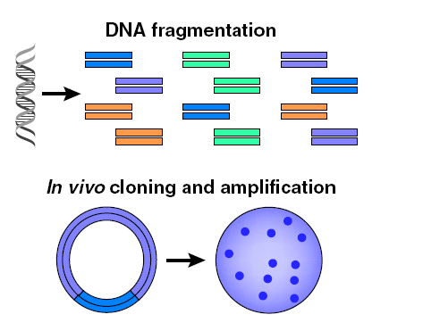
DNA sequencing: Sanger sequencing (prior NGS era)
Invented by Dr. Frederick Sanger (two-time Nobel Laurate in Chemistry) in 1977.
Most widely used method for 40 years before the next generation sequencing (NGS) era.
Low throughput, high cost/read.
Begin by preparing the DNA to be sequenced
Fragment DNA to be cloned
Chop DNA into millions of smaller segments
Clone into plasmid, insert into bacterial cultures
Amplify DNA fragments
Figure source: Wikipedia

Slide 13
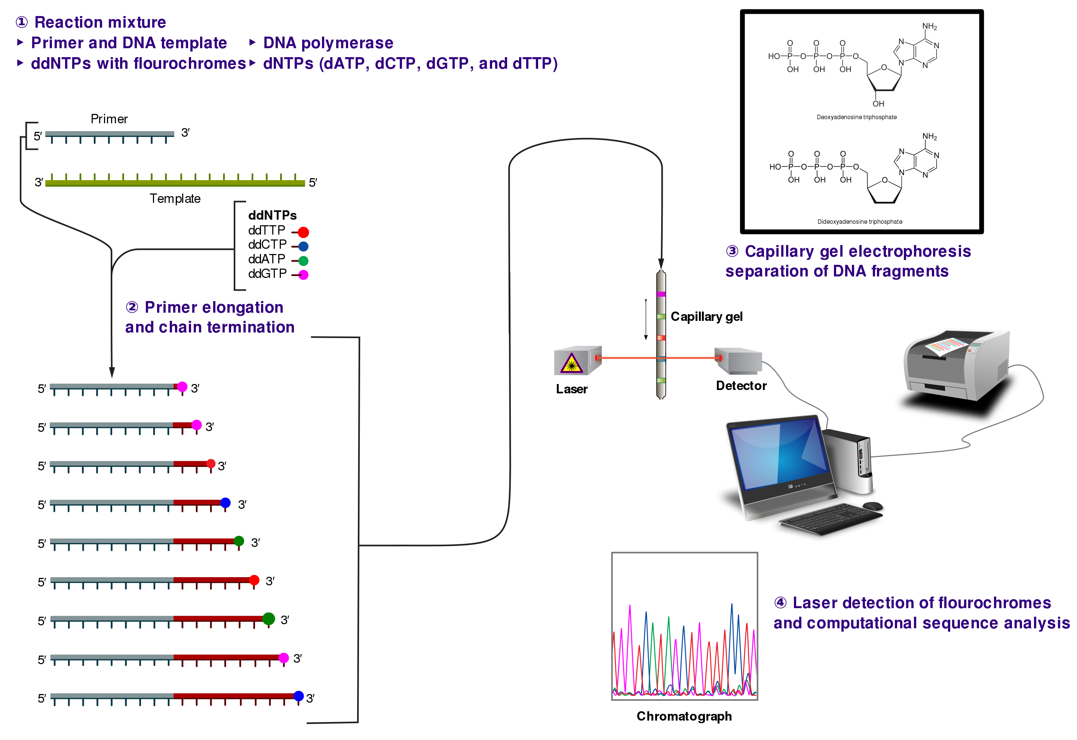
DNA sequencing: Sanger sequencing (prior NGS era)
Template is denatured to separate the two strands
Primer is annealed to the template
Primer is extended
Microliter volume
Add polymerase, nucleotides and fluorescently labeled terminating nucleotides
Stochastically terminated by incorporating labeled nucleotide
Generate a ladder of labeled products
Source: Wikipedia

Slide 14
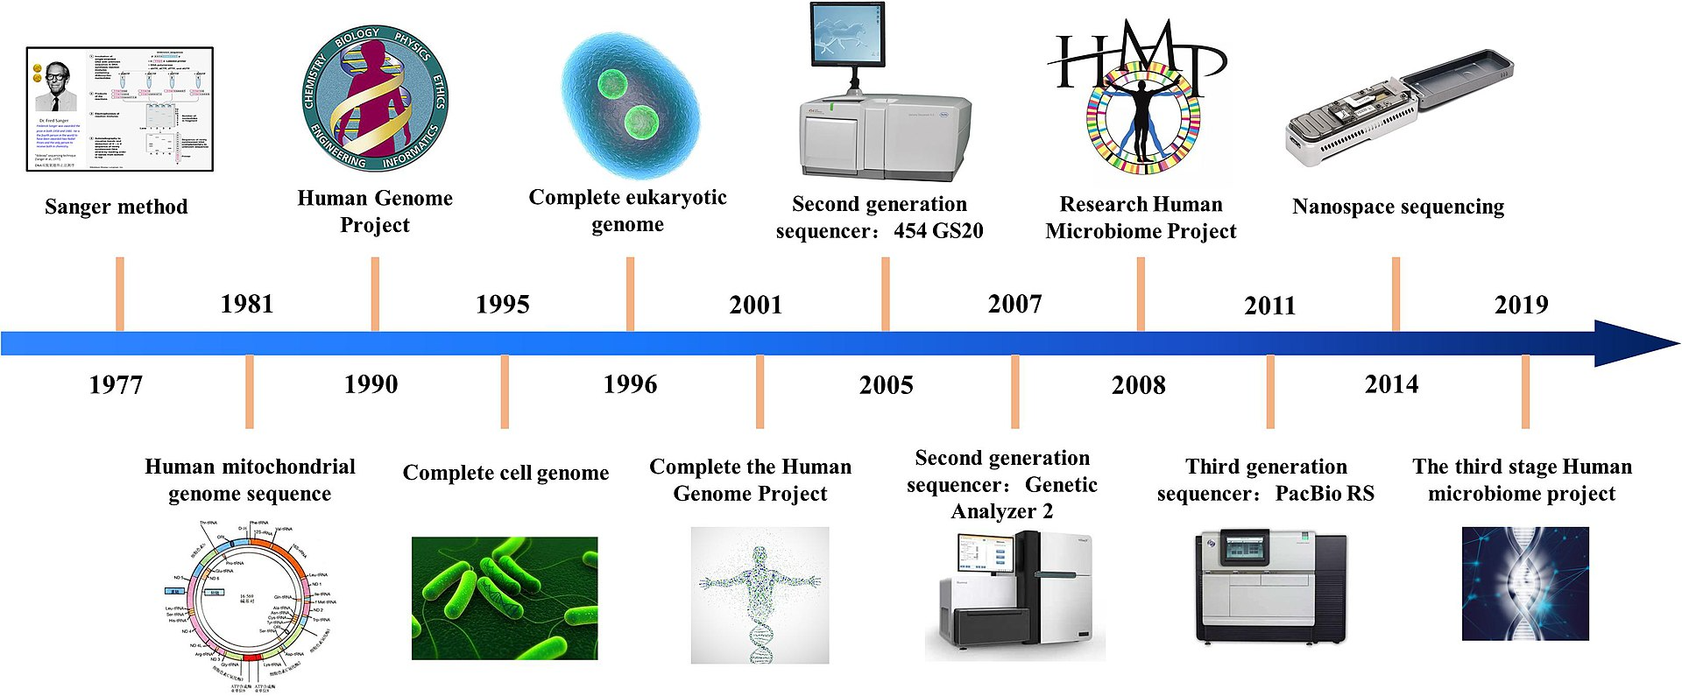
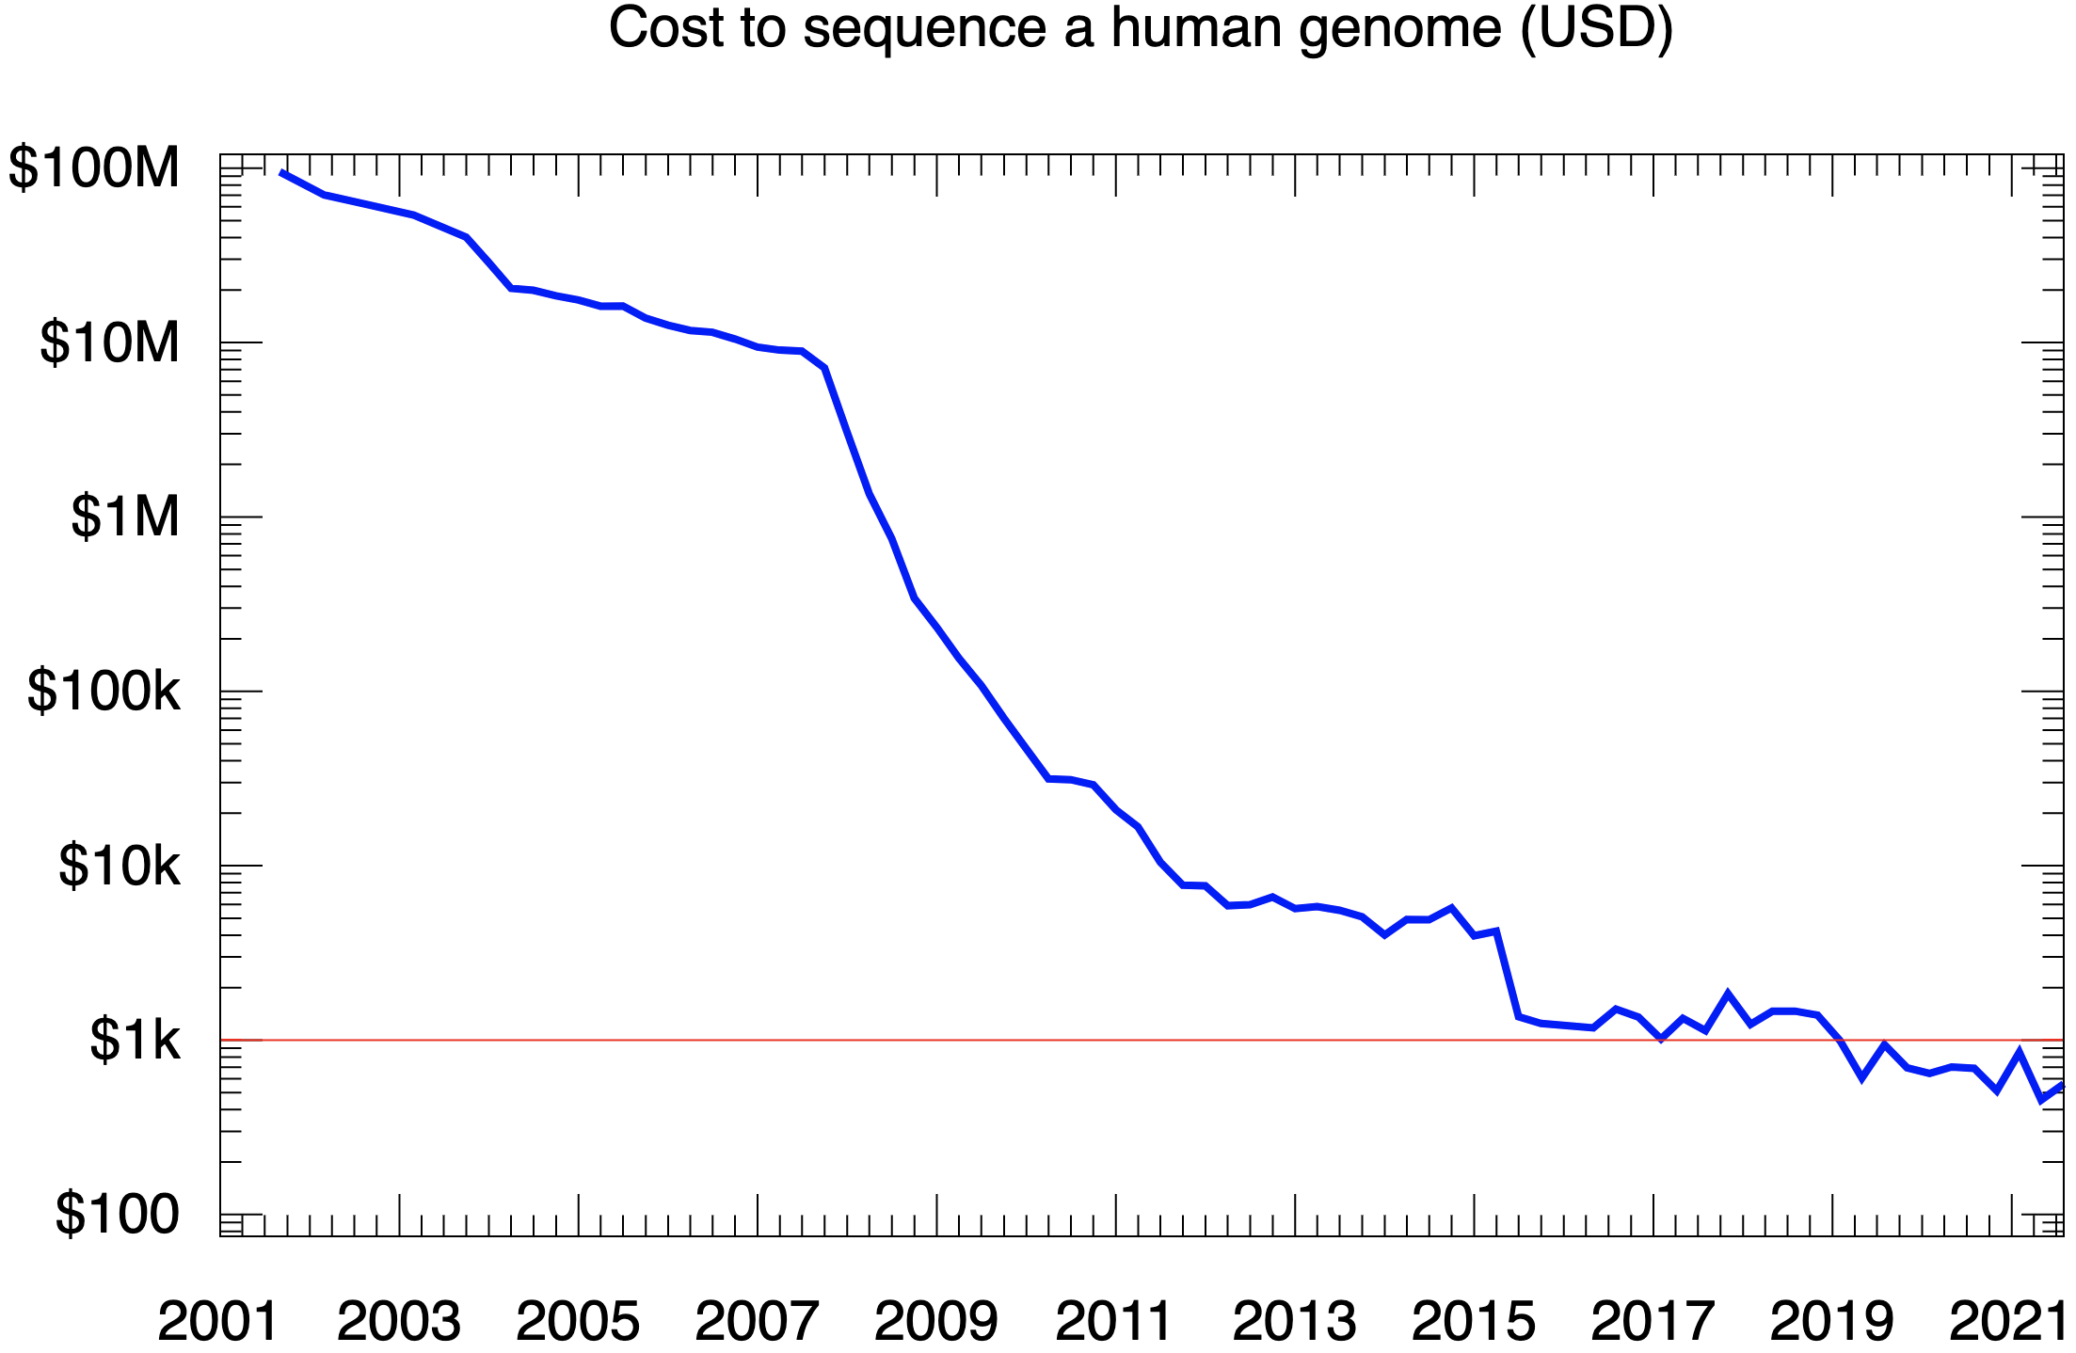
Next generation sequencing (NGS): Illumina sequencing
Illumina sequencing technology: a massively parallel sequencing technology that offers ultra-high throughput, scalability, speed, and ultra-low cost/read.
High throughput, lost cost/read
Shorter reads
Need genome assembly (de novo or mapping)
PCR bias
Figure sources: Wikiwand

Slide 15
Illumina sequencing - sequencing by synthesis (SBS)
Currently the market leader for “next generation” sequencing
Key innovations:
“Bridge” amplification to create small “colonies” of DNA
Reversible fluorophore-labeled terminators
Random, high-density attachment of DNA to a glass slide using special “adaptor” sequence stuck on the ends of the DNA to be sequenced
4-color fluorescence imaging

Slide 16
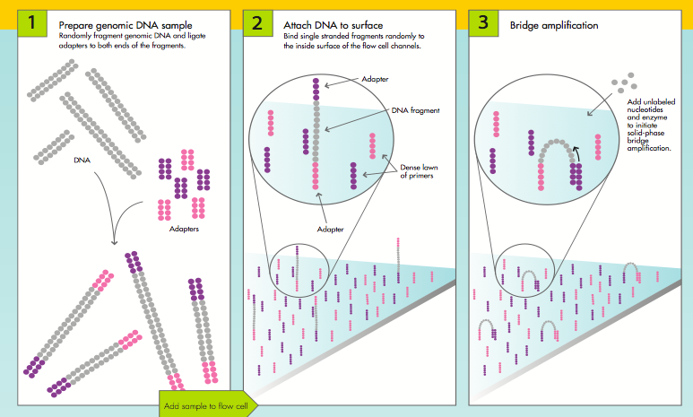
Illumina sequencing – adaptors and attachment

Slide 17
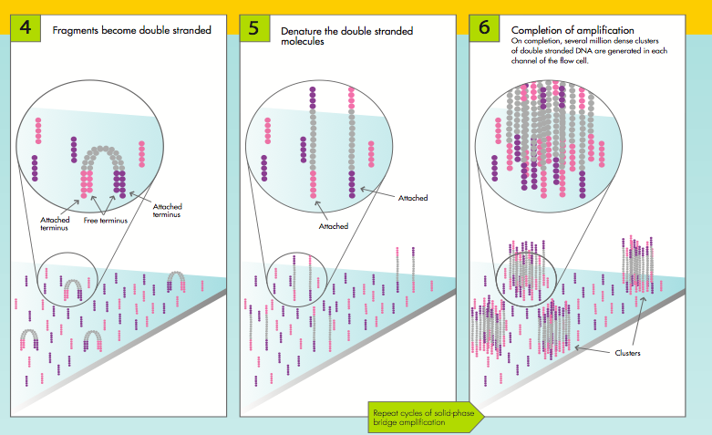
Illumina sequencing – bridge amplification

Slide 18
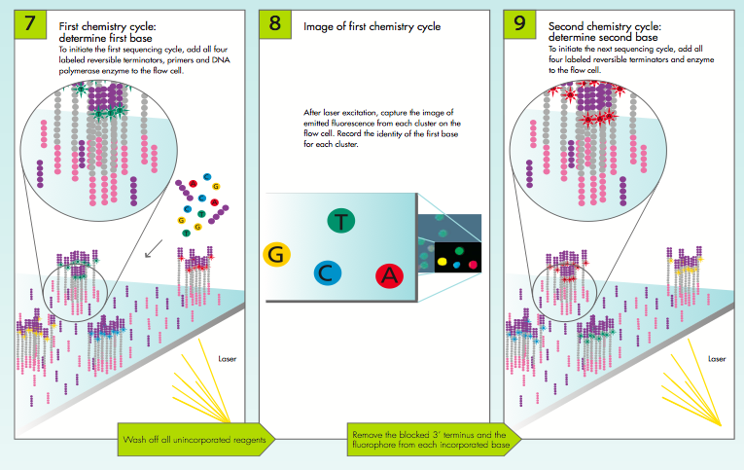
Illumina sequencing – removable dye-labeled terminators

Slide 19
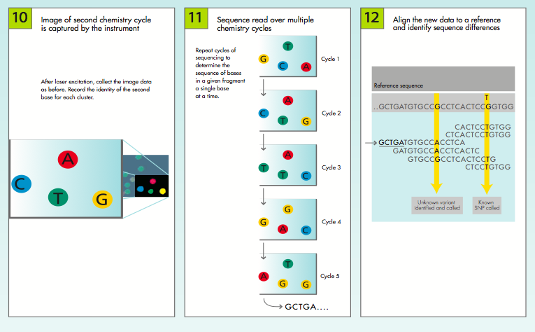
Illumina sequencing – four color fluorescence imaging

Slide 20
Illumina sequencing – “polonies”
Each nucleotide has a dye with a different color
4-color fluorescent image of chip gathered after each chemical flows through
Register each image and follow color change of each colony to determine sequence

Slide 21
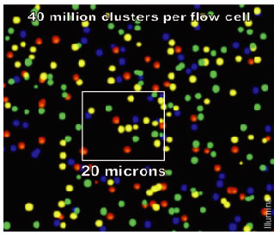
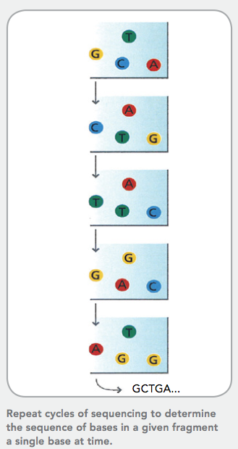
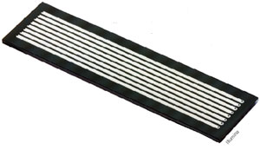
Illumina sequencing
Source: Illumina, Inc.

Slide 22
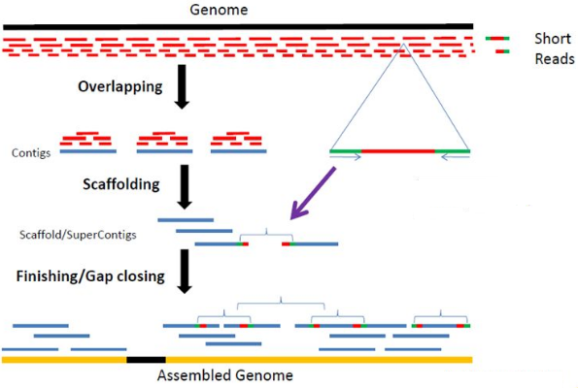
Illumina sequencing – reads, mapping, and assembly
No accurate reference sequence available
Applications…
Reference sequence is available
Source: Illumina, Inc.

Slide 23
Mapping to a reference sequence (applications)
Identify allelic information, or site mutations, deletions, insertions, and chromosomal rearrangements: Many of these changes to specific genes can induce diseases like genetic disorders (e.g., Down syndrome, cystic fibrosis, and sickle cell anaemia), cancers (most not inheritable), and health conditions (can be inheritable). Reflected in abnormal proteins derived from these genes.
Disease diagnosis and likelihood score and prediction.
Monitor efficacy of drug treatments.
Gene therapy design.

Slide 24
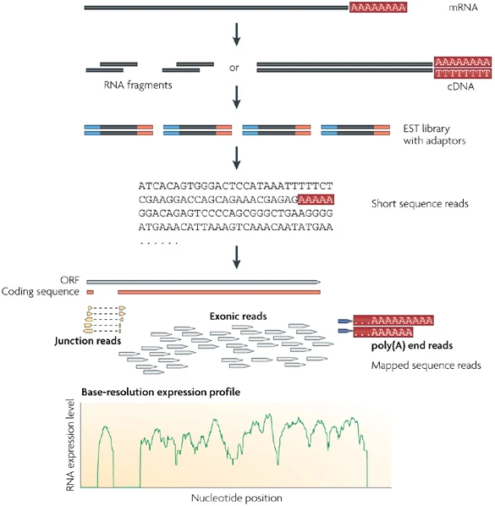
RNA sequencing (transcriptomics)
Quantify gene expression level for protein functional study and monitor drug effect at the molecular level.
De novo Assembly and distinguish different gene isoforms.
Distinguish allelic expression preference
Identify impactful gene mutations for the design of gene therapy.
Identify new non-coding RNA class and its sequence signatures.
Nat Rev Genet, 10, 57-63 (2009)

Slide 25
Third generation sequencing - long read sequencing Selected as the method of the year 2022 by nature methods
Use in sequencing complete genomes, transcriptomes, and epigenomes in human and other species.
The sheer length used for NGS, presence of highly repetitive segments, and high complexity of many genomes pose severe hurdles in generating complete sequences by using NGS technology and sequence assembly, resulting in many missing parts and errors.
Two most widely used commercial technologies:
Pacific Bioscience Single Molecule Real-Time (SMRT) sequencing: average read length ~ 20 kb now with >99.99% accuracy for high fidelity reads.
Oxford Nanopore Technology Nanopore sequencing: average read length ~ 100kb for ultra-long reads with ~ 99% accuracy for R10.4.
In addition to platform technology development, computational methods development involving advanced statistical and machine learning, is critical to the success of long read seq tasks ranging from identifying different bases and chemical modifications in DNA and RNA to genome assembly and genome variation detection.
To be continued…

Slide 26
Third generation sequencing - long read sequencing
Applications of long read seq tech in almost all the major areas of genomics:
Discovery of many previously unknown or unclear regions of the genome: such as telomeres (ends of the chromosome important for understanding aging and disease predictions) and other highly repetitive regions, and complex structural variations.
Promote the study of transcriptomes which are dynamic and tissue- and cell-type specific: unveil hidden complexity of transcriptomes, such as isoform structure and expression, down to the single cell level, leading a more complete understanding of transcriptomic dynamics and its underlying mechanisms.
Detect chemical modifications in DNA (epigenomics) and RNA (epitranscriptomics): accurately identify the vast number of different DNA and RNA modifications and their distribution and functions, which are critical for biology and medicine.
Use in microbial genomics and metagenomics: enable genome sequencing of individual species to accelerate the exploration of genomic information spanning the whole tree of life.

Slide 27
PacBio – zero mode waveguides
A DNA polymerase is immobilized onto a surface
Single strand DNA molecule to be sequenced runs through the polymerase
Dye-labeled nucleotides are exposed to the DNA/polymerase combination
Each time a nucleotide is incorporated, the dye is held near the surface for a short time
After incorporation, the dye is cleaved away
Source: Nat Rev Gene

Slide 28
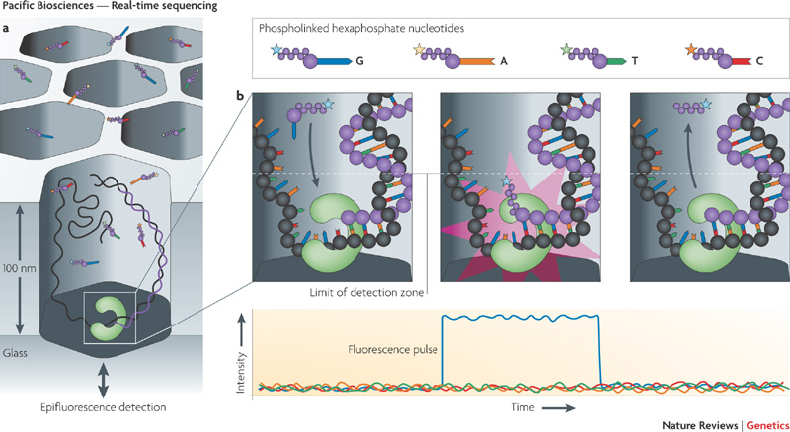
PacBio – zero mode waveguides
Zero mode waveguide: a nm-scale hole in a thin metal film
Volume of hole is big enough to hold only one polymerase molecule at a time
Source: Nat Rev Gene

Slide 29
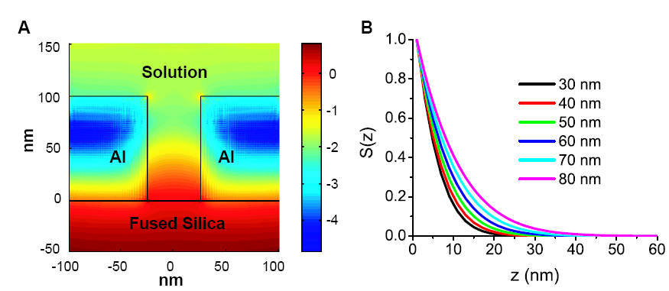
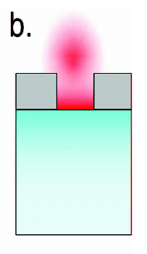
PacBio – zero mode waveguides
Illuminating with fluorescent excitation laser from below, obtain a strong electric field only near the bottom of the well
Fluorophore outside this ~10 nm region will not be excited

Slide 30
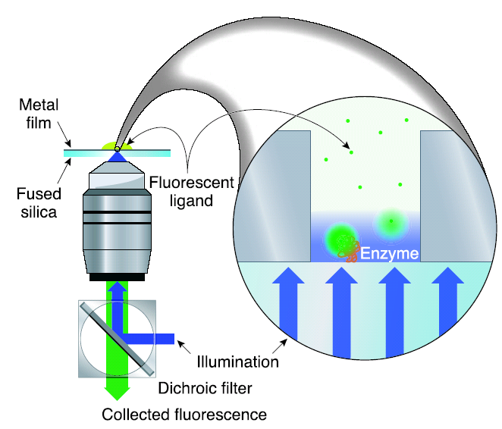
PacBio – zero mode waveguides
Detection: fluorescence microscopy imaging from below

Slide 31
Sequencing with zero mode waveguides
Sequencing using single polymerase molecule
Direct observation of DNA polymerization with base-pair resolution
4 different fluorescently labeled nucleotides
All four labeled nucleotide components are present at the same time
Need 4-color detection
Advantages over other approaches
Low observation volumes (zL)
Allows for isolating molecules
High concentration of nucleotides – reduced diffusion time, better temporal resolution
No washing step
Speed of sequencing is self-limited by the rate of polymerase-DNA interaction

Slide 32
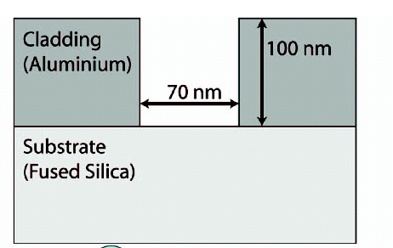
Sequencing with zero mode waveguides
Chip fabrication
Custom process
Holes (e-beam + RIE)

Slide 33
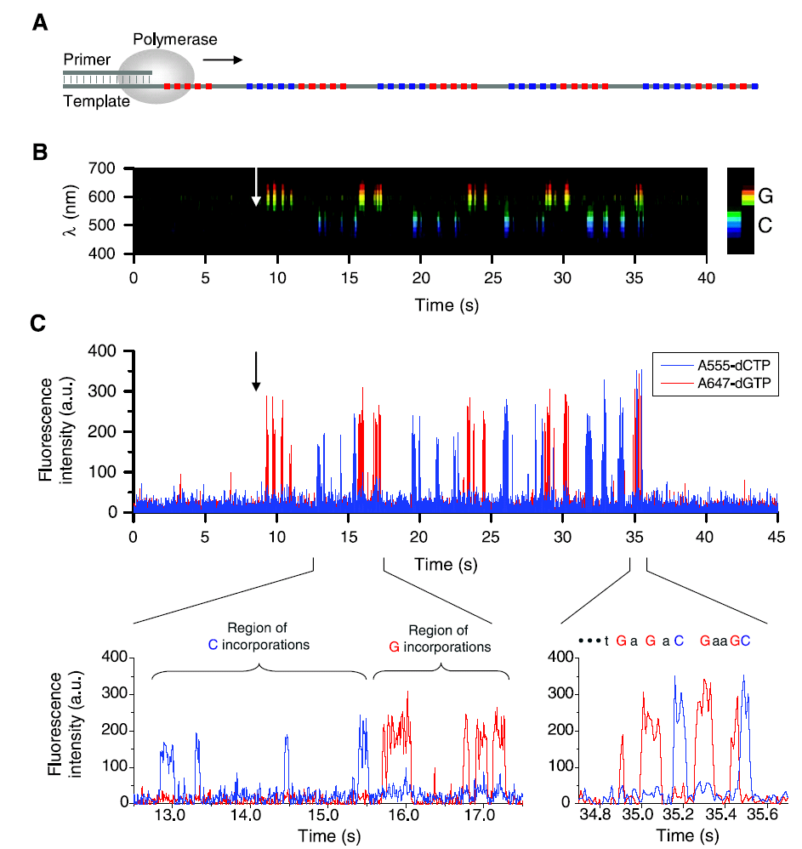
PacBio Sequencing data (example)
Two base sequence pattern
2 Phospholinked nucleotides interspersed with 2 unmodified nucleotides

Slide 34
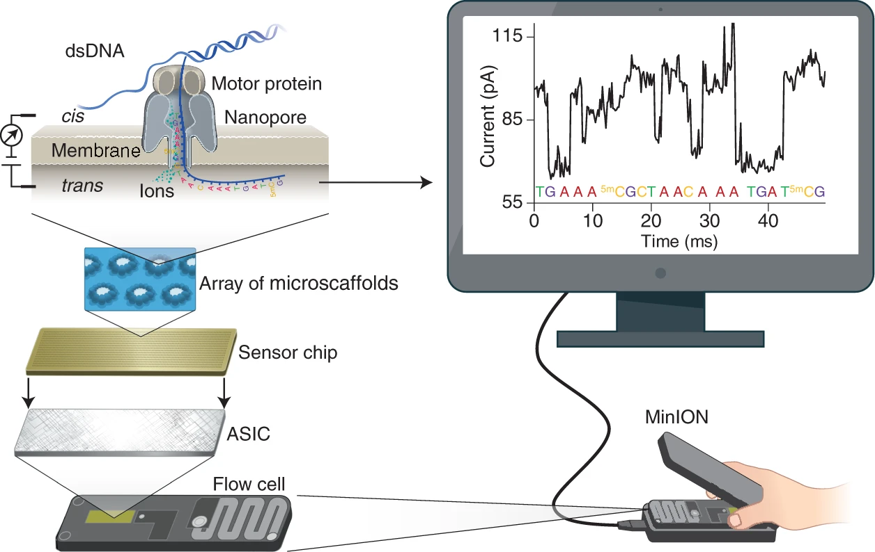
Nanopore sequencing technology
Nat Biotechnol, 39, 1348-1365 (2021)

Slide 35
Nanopore sequencing technology
Source: Oxford Nanopore Tech

Slide 36
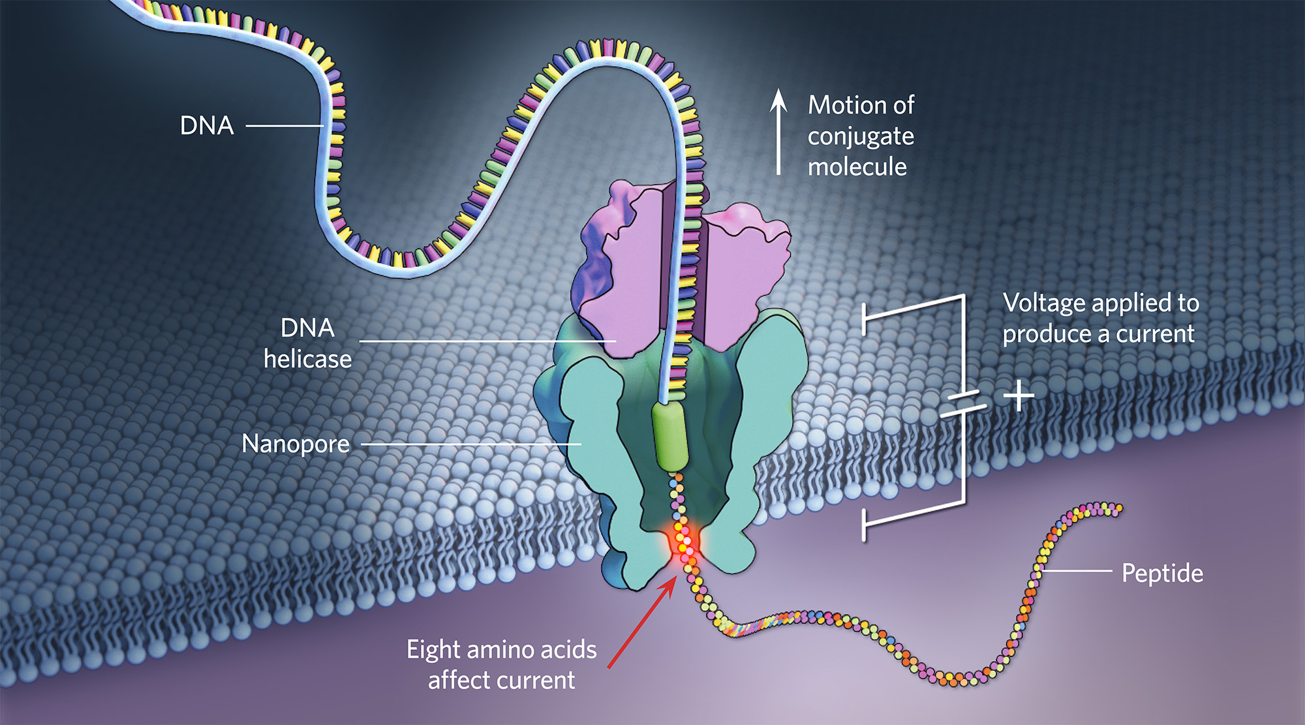
Protein sequencing with nanopore (research stage)
Source: TheScientist

Slide 37
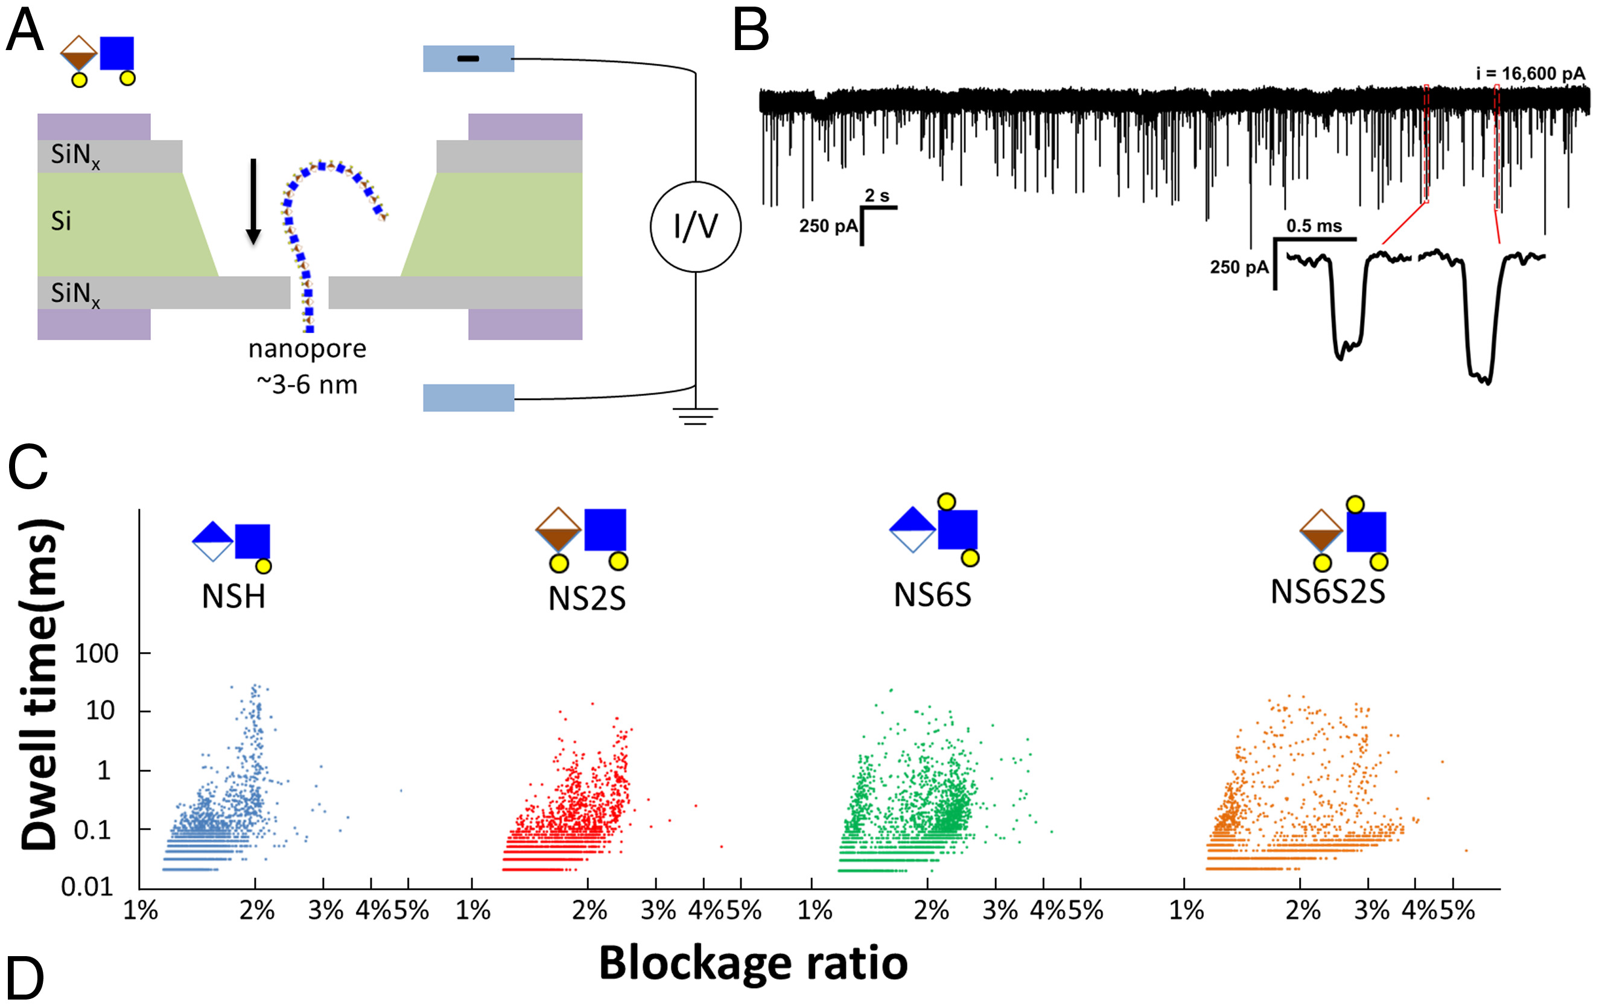
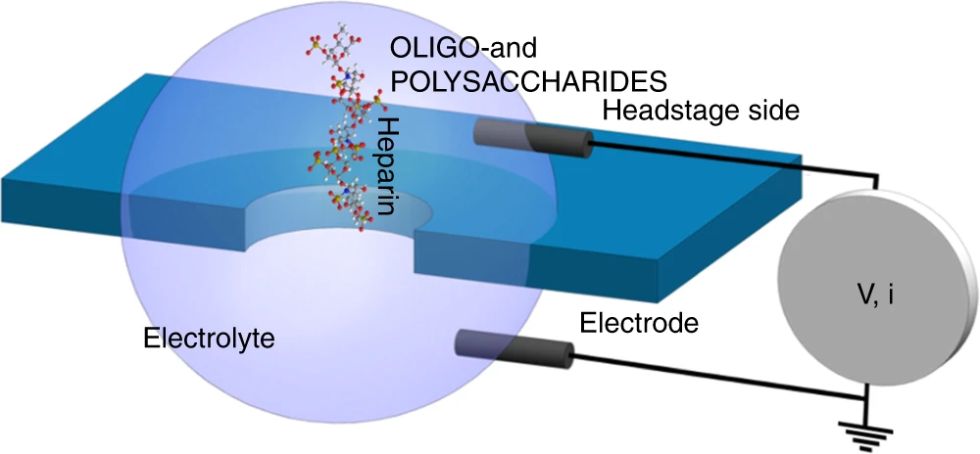
Glycans sequencing with nanopore (research stage)
Nat Commun, 9, 3278 (2018)
PNAS, 118, e2022806118 (2021)

Slide 38
Commercial products and services
www.illumina.com
www.pacb.com
www.nanoporetech.com

Slide 39
Thank You!

