Slide 2
Gene Tests for sale: Discovering ancestry and inherited health risks
Prof. Brian T. Cunningham
Woese Institute for Genomic Biology
Holonyak Micro and Nanotechnology Laboratory
Cancer Center at Illinois
Dept. of Electrical and Computer Engineering
Dept. of Bioengineering
Dept. of Chemistry

Slide 3
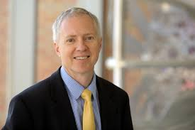
Greetings! Introduction to your instructor
Prof. Brian Cunningham
Department of Electrical and Computer Engineering
Department of Bioengineering
Professor at Illinois since 2004
Before that…15 years in Industry in Boston
Raytheon
Draper Laboratory
Founder of a startup company
Research topics
Technologies for detecting cancer
Infectious disease diagnostics
I do not have any financial ties to any of the companies mentioned today and I am not making recommendations about their products

Slide 4
Outline for today
Quick review of genes, gene sequences, and proteins
How gene sequencing works
What genes can tell us about our origins
What genes can tell us about inherited health risks
Commercially available services
Discussion

Slide 5
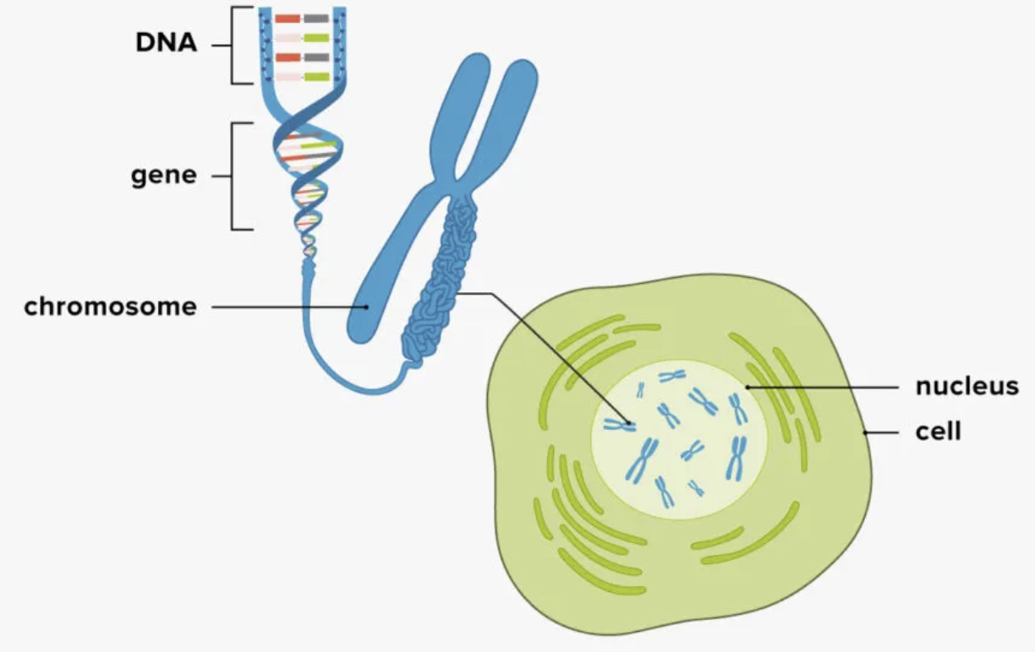
What are genes?
Every cell in your body (except red blood cells and platelets) has a copy of your DNA in the nucleus
Folded up into 23 pairs of chromosomes
Would be ~2 meters long if stretched out in a line
Super-long double helix molecule
3.2 billion bases long
4 “letter” alphabet: A, G, C, T
“Genes” are the sections within a DNA molecule that give instructions for making proteins
Humans are estimated to have between 20,000-25,000 genes
Sources: Ancestry.com, Medical News Today, melixgx.com

Slide 6
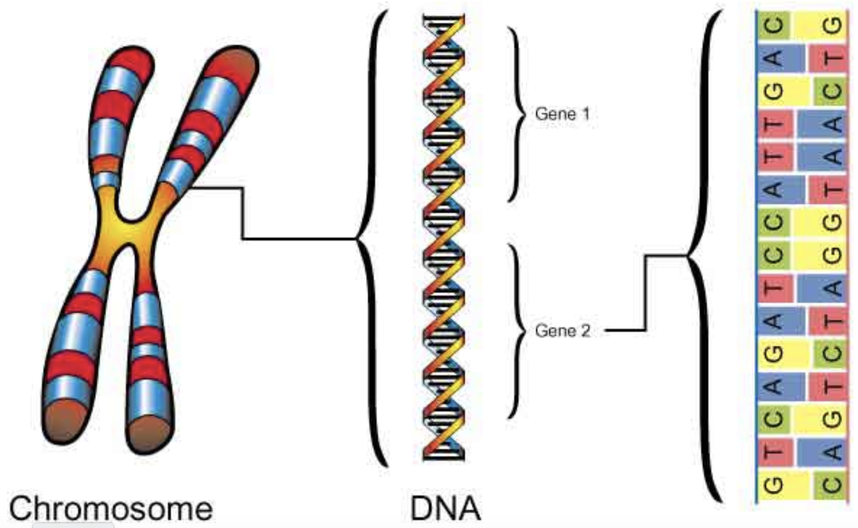
What are genes?
Every cell in your body (except red blood cells and platelets) has a copy of your DNA in the nucleus
Folded up into 23 pairs of chromosomes
Would be ~2 meters long if stretched out in a line
Super-long double helix molecule
3 billion bases long
4 “letter” alphabet: A, G, C, T
“Genes” are the sections within a DNA molecule that give instructions for making proteins
Humans have 20,000-25,000 genes
Sources: Ancestry.com, Medical News Today

Slide 7
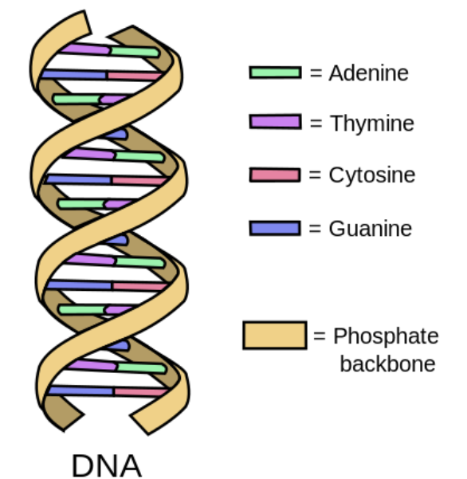
What are genes?
Every cell in your body (except red blood cells and platelets) has a copy of your DNA in the nucleus
Folded up into 23 pairs of chromosomes
Would be ~2 meters long if stretched out in a line
Super-long double helix molecule
3 billion bases long
4 “letter” alphabet: A, G, C, T
“Genes” are the sections within a DNA molecule that give instructions for making proteins
Humans have 20,000-25,000 genes
Sources: Ancestry.com, Medical News Today

Slide 8
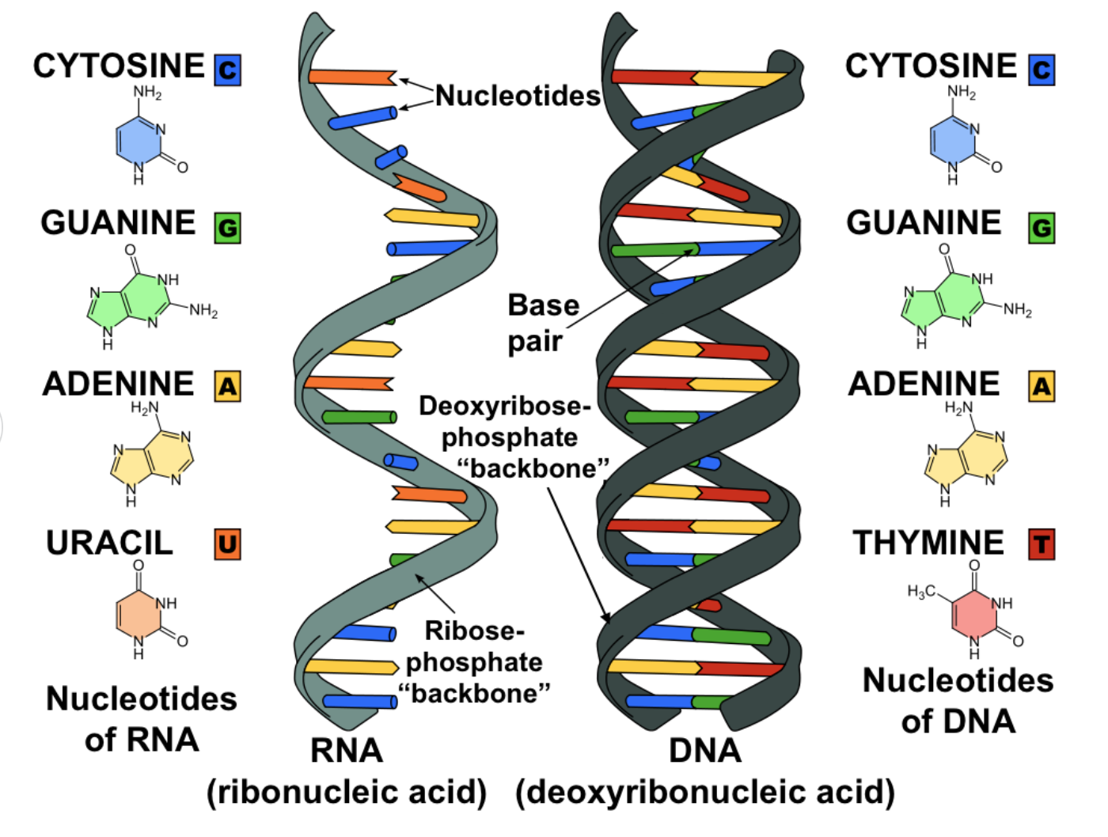
What are genes?
RNA is made in the nucleus, using the DNA as the template
Carries instructions for making proteins into the cell’s cytoplasm
RNA is single stranded
4 letter alphabet: A, G, C, U
Sources: Ancestry.com, Medical News Today, Khan Academy

Slide 9
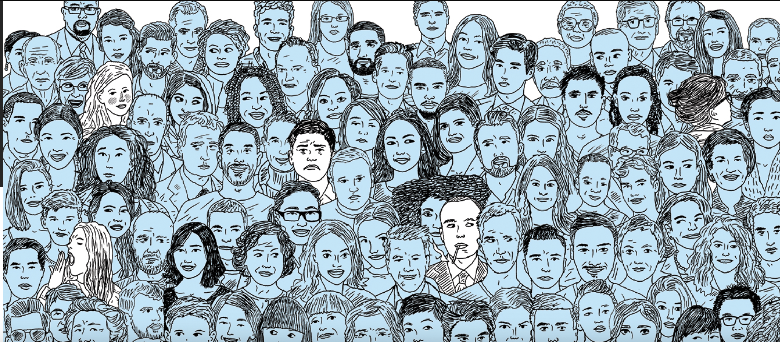
Genes and ourselves
Genes contain the biological instructions to help the body build specific proteins
Proteins are the building blocks that help construct and maintain your cells, your organs, and your body as a whole.
Many genes work together in complex ways to build and maintain our bodies.
Even the simplest traits are affected by many different genes—and a single gene can be involved multiple traits
The DNA of any two humans is 99.4% identical
The remaining 0.4% accounts for all our individual differences
Source: Science magazine

Slide 10
Making proteins from the DNA code
2m, 30 sec video animation from Khan Academy:

Slide 11
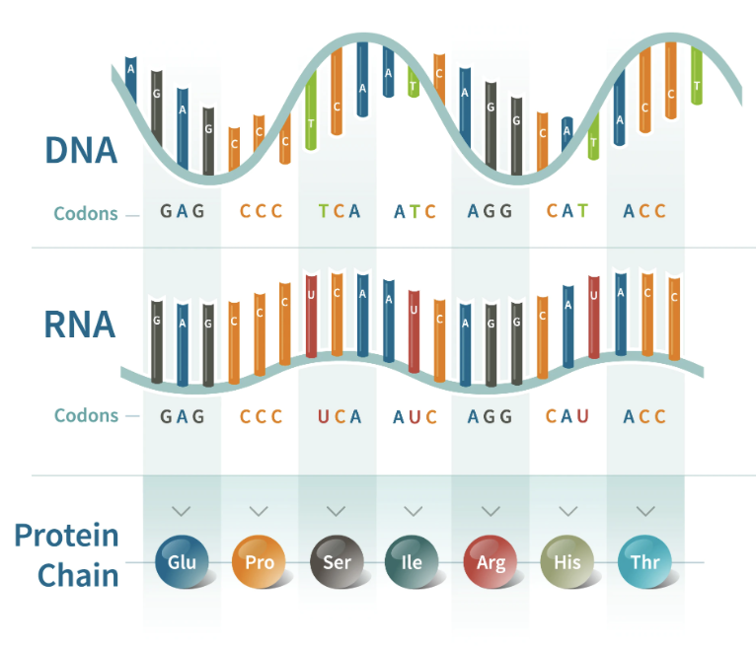
DNA’s language: Making proteins from the DNA code
”Codons” are the 64 possible 3-letter words and 4 possible letters
3 “Stop” codons… like punctuation…tell the system when a protein’s code ends
TAG, TGA, TAA
61 codes for 20 unique amino acids
Redundancy: multiple codes produce the same amino acid
Source: ancestry.com

Slide 12
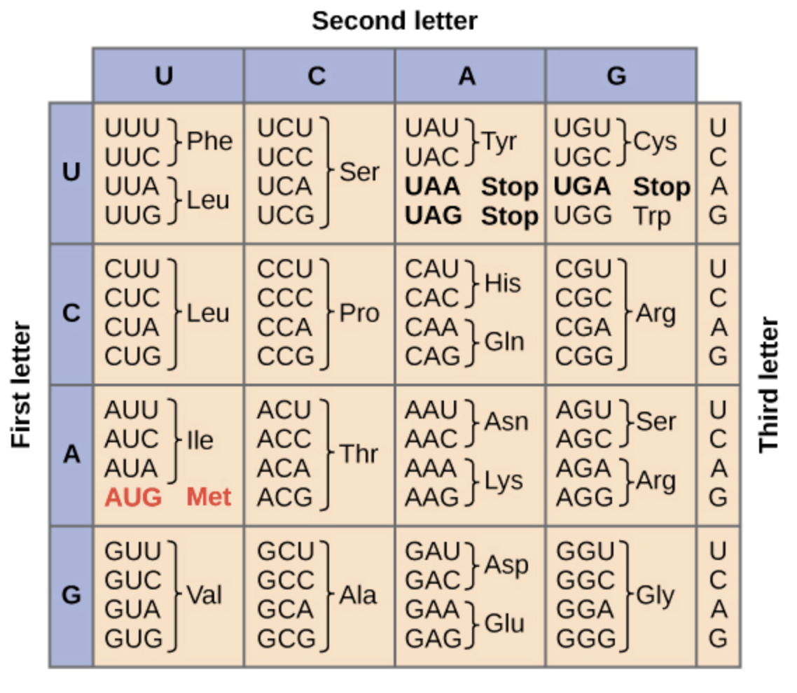
DNA’s language: Making proteins from the DNA code
”Codons” are the 64 possible 3-letter words and 4 possible letters
3 “Stop” codons… like punctuation…tell the system when a protein’s code ends
UAG, UGA, UAA
61 codes for 20 unique amino acids
Redundancy: multiple codes produce the same amino acid
Source: Khan Academy

Slide 13
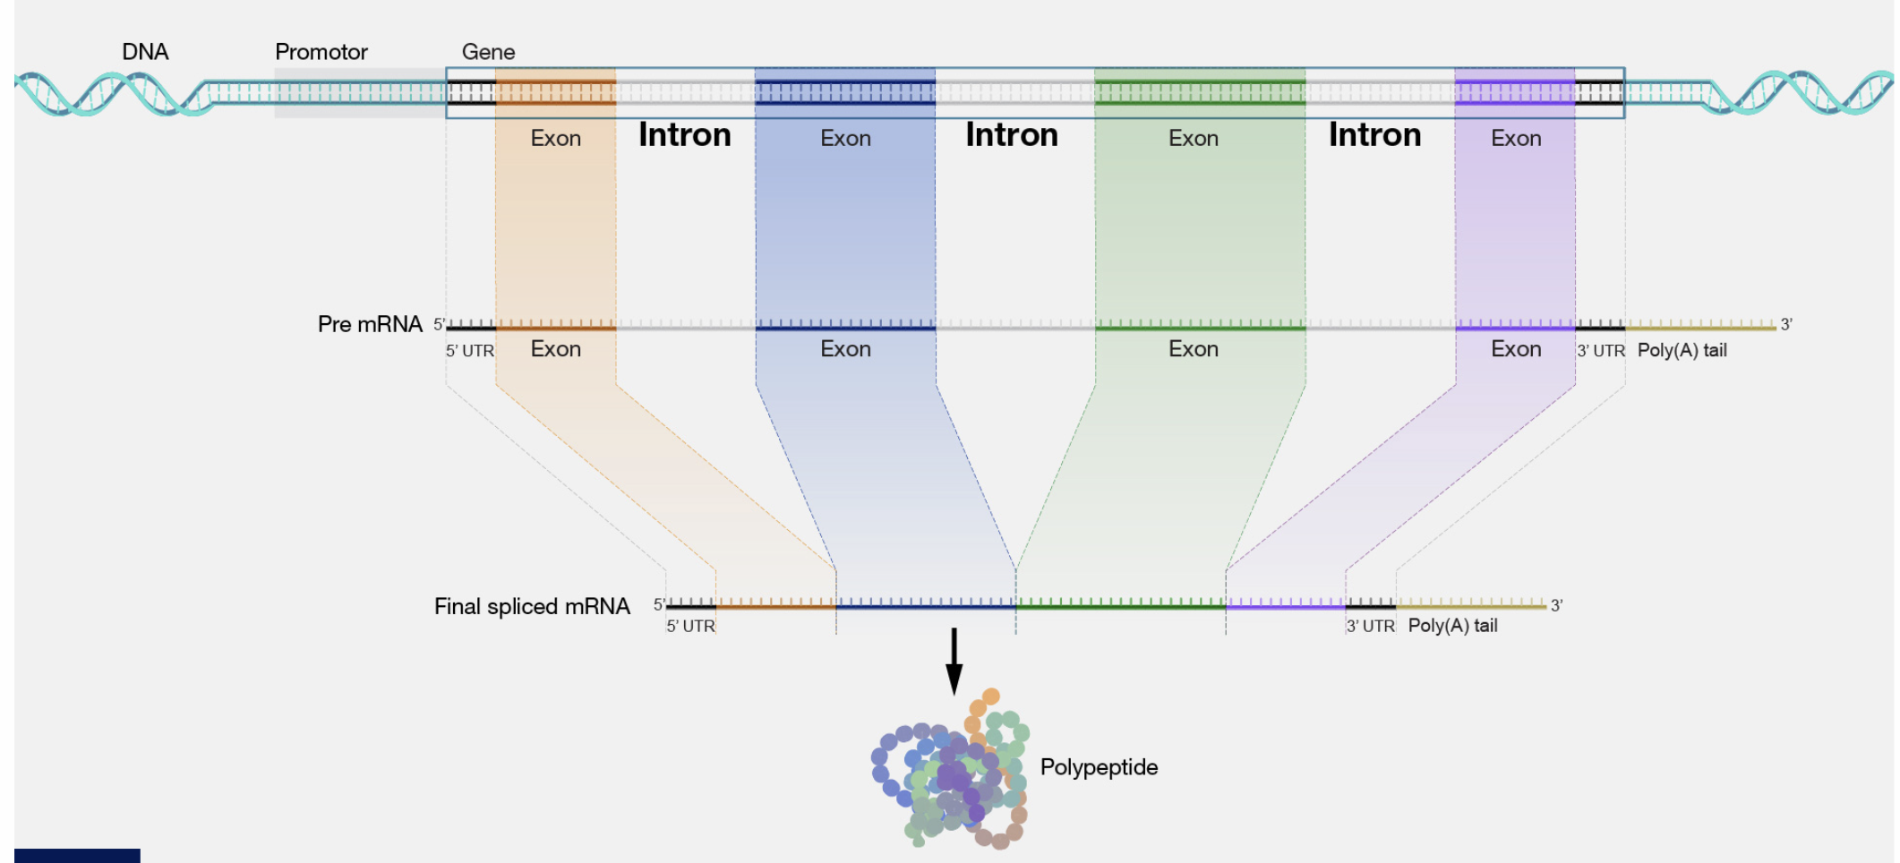
Exons and Introns
Exon: Part of DNA in a gene: used to make a protein
DNA sequence
Introns: Part of DNA in between the exons
Pre-Messenger RNAv
Only ~2% of all your DNA contains genes
The other 98%???
Final Messenger RNA
Protein
Source: NHGRI

Slide 14
Mutations: Making changes in the code
Cells can make mistakes when copying the genetic code
Example: Changing one letter
”Single Point Substitution”
“Single Nucleotide Variant” (SNV)
The protein produced by the gene is now different than intended

Slide 15
Other types of mutations
Point mutations
Insertions: Letters get added
Deletion: Letters get removed
Chromosomal mutations
Inversion: A region of a chromosome gets removed, flipped, and re-inserted
Deletion: A region of the chromosome is lost
Translocation: A region from one chromosome gets inserted in a different chromosome

Slide 16
A mutation MIGHT result in a disease or health condition …but it’s not guaranteed to
Genetic Disorders
Example: Down Syndrome – people born with extra chromosome 21
Cancer
Typically not inherited
Usually an accumulation of many mutations
Occurring in a specific tissue
Health Conditions
Can be inherited
You can inherit genes that change the likelihood of health conditions

Slide 17
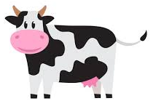
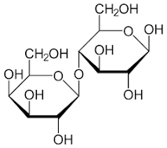
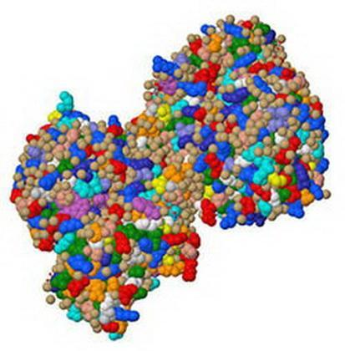
Example: Lactose Intolerance in adults
A gene called LCT contains the instructions for producing the protein lactase
Lactase is an enzyme that, produced by cells in the small intestine, helps break down the lactose, a sugar found in milk and dairy products
Most humans are actually lactose-intolerant
A single mutation in the LCT gene in which a “C” is replaced by a “T” nucleotide allows them to digest milk
People with this mutation most often have ancestors from northwest Europe or certain parts of Africa
It is estimated that this mutation occurred ~6000 years ago and has been passed down since
Lactose
Lactase

Slide 18
Genotypes and Alleles Dominant and recessive traits
Gene Variants or Alleles
Genes have different variations, which are known as alleles. Humans inherit alleles in pairs: you inherit one allele from your mom and one allele from your dad. Each allele pair represents a genotype, which can be described as homozygous or heterozygous. If the pairs of alleles are the same, the genotype is homozygous. If the alleles in the pair are different, the genotype is heterozygous. It is the particular combination of alleles in a genotype that contributes to an organism's distinct, observable characteristics

Slide 19
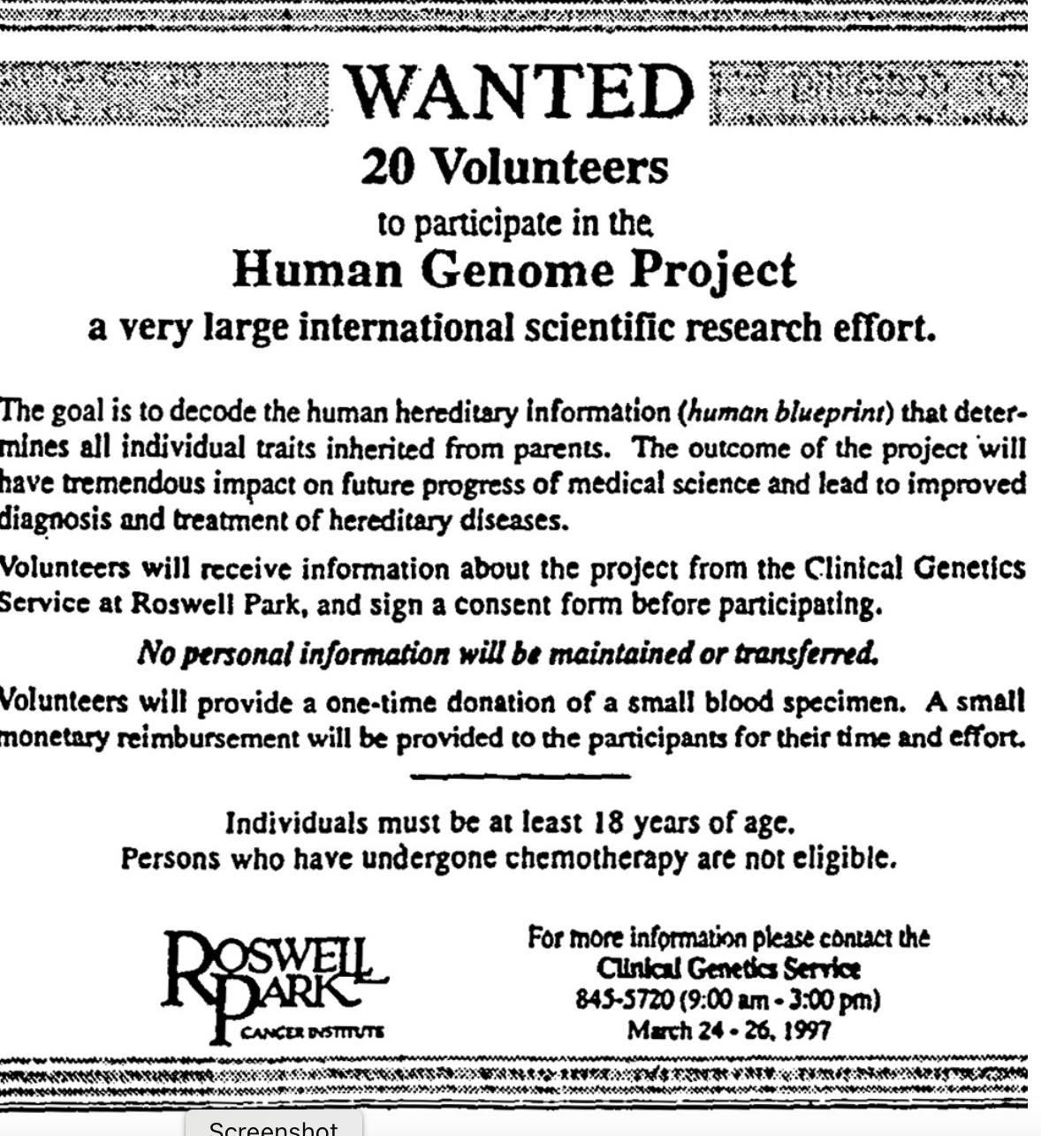
The Human Genome Project One of the greatest scientific feats in history
International collaboration 1990-2003
Cost: ~$3B
Purpose: Determine the sequence of the ~3.2 billion bases in a human DNA
Actually the genome was not from just one person… there were 12 anonymous volunteers from Buffalo, NY
Related effort: The Cancer Genome Atlas
Determine the genetic mutations associated with cancer (both exons and introns)

Slide 20
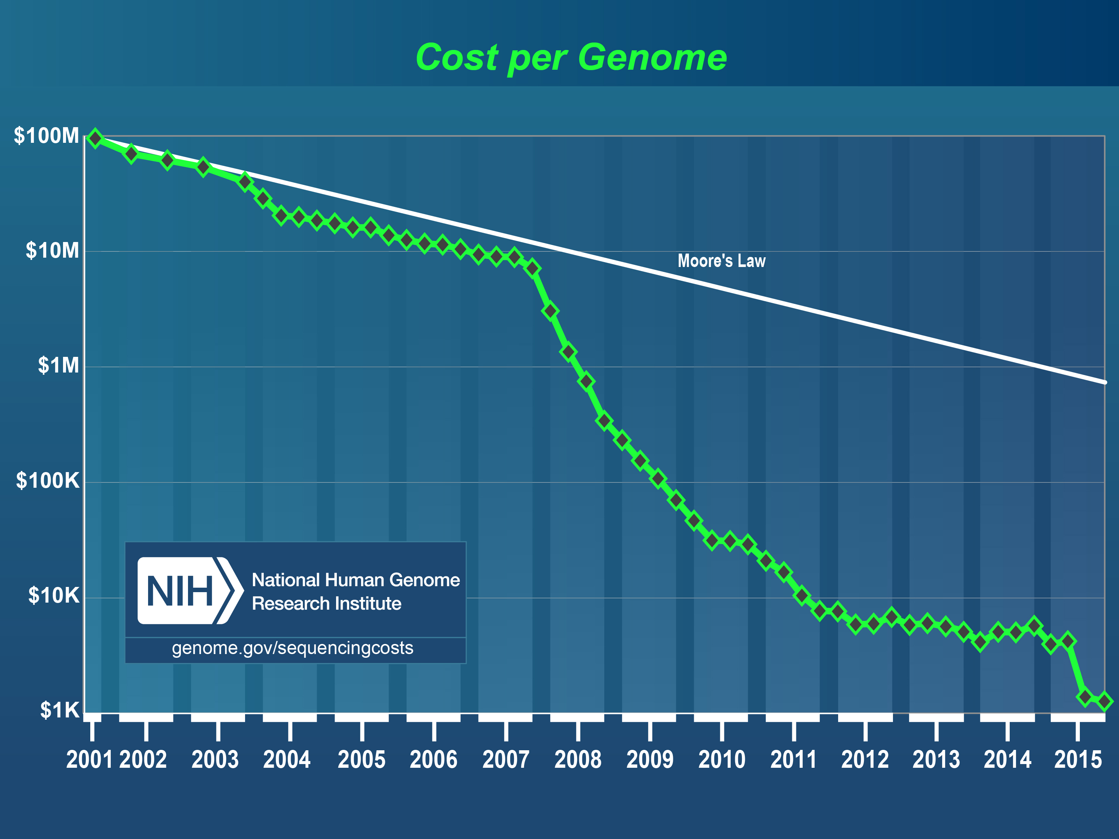
2004: 1 Genome in 5 years
2009: 1 Genome in 2 weeks
2015: 16 Genomes every 3 days

Slide 21
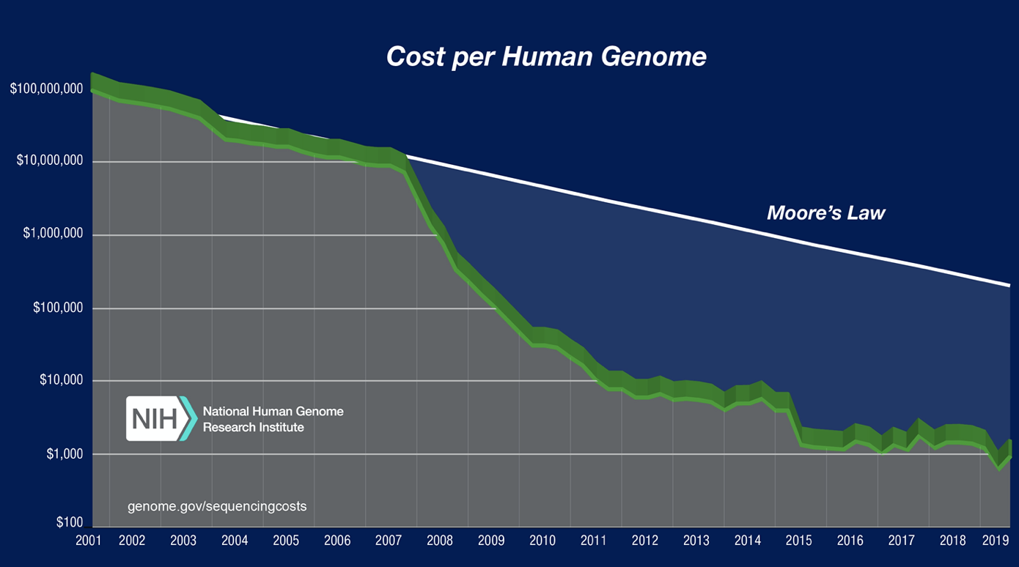
Now, the cost of sequencing a genome is <$1000

Slide 22
How gene sequencing technology works Company: Illumina
Start with genomic DNA (all 3.2 billion bases)
Use enzymes to break it into millions of small fragments
Each fragment ~100-200 bases long
All mixed up together… like scrambling a jigsaw puzzle
The Illumina technology can determine the sequence of each of the fragments
The sequence of each of the millions of fragments is called a “Read”

Slide 23
How gene sequencing technology works Company: Illumina
The challenge: Putting the jigsaw puzzle back together again
We have millions of “Reads”. But where do they belong?
Using a “Reference Sequence” compiled from another humans
Search for unique place where the “Read” belongs
It gets a little complicated when you factor in mutations and the 0.4% of the genome that is unique to the person being sequenced

Slide 24
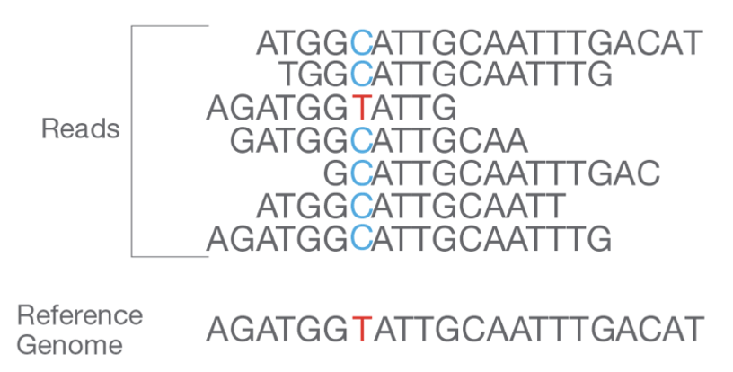
Alignment: Matching up Reads with the Reference Genome
Any small difference to the Reference can be identified

Slide 25
Coverage: More “Reads” makes the process more accurate
>30x coverage is considered excellent, but greater coverage sequencing is more expensive

Slide 26
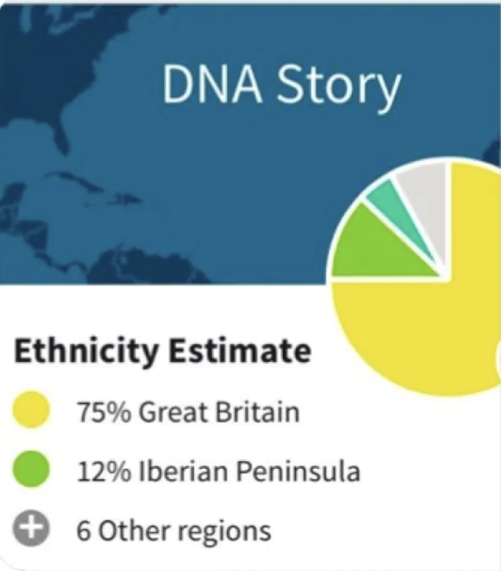
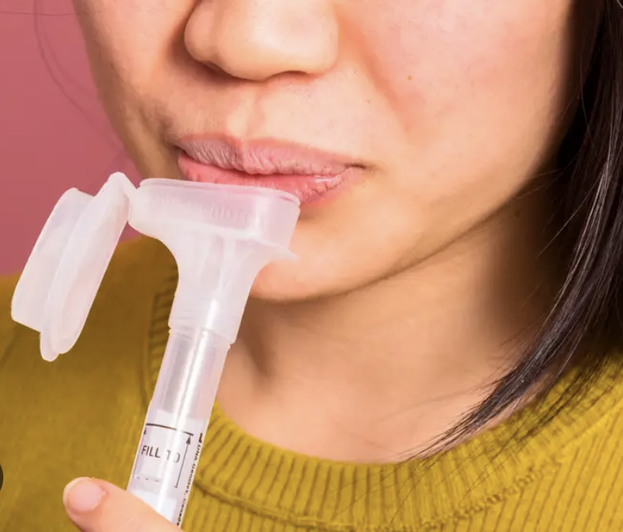
Ancestry tests
Receive a report that estimates where your ancestors came from
Provide a saliva sample (that contains some of your cells)
~100 million people doing this in the next two years!

Slide 27
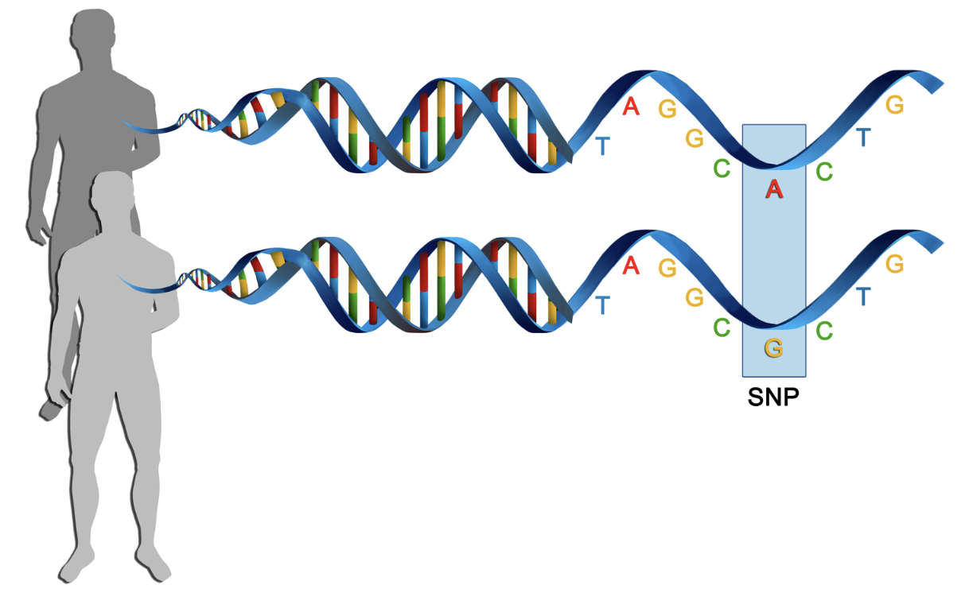
Ancestry tests – how do they work?
With ~0.4% differences in DNA sequence among humans, there are still ~600,000 bases that can be analyzed
Single Nucleotide Polymorphisms (SNPs, pronounced “snips”)
Place in the genome where one base “letter” is different
We inherit SNPs from our parents
Does not need to be in an exon
The more SNPs you share in common with someone, the more likely it is that you have a common ancestry
Limitations: Recombination, database participants,
https://www.youtube.com/watch?v=YiydsMxOdM8
Excellent short summary of the tests
https://www.youtube.com/watch?v=UqC8aStX0ps

Slide 28
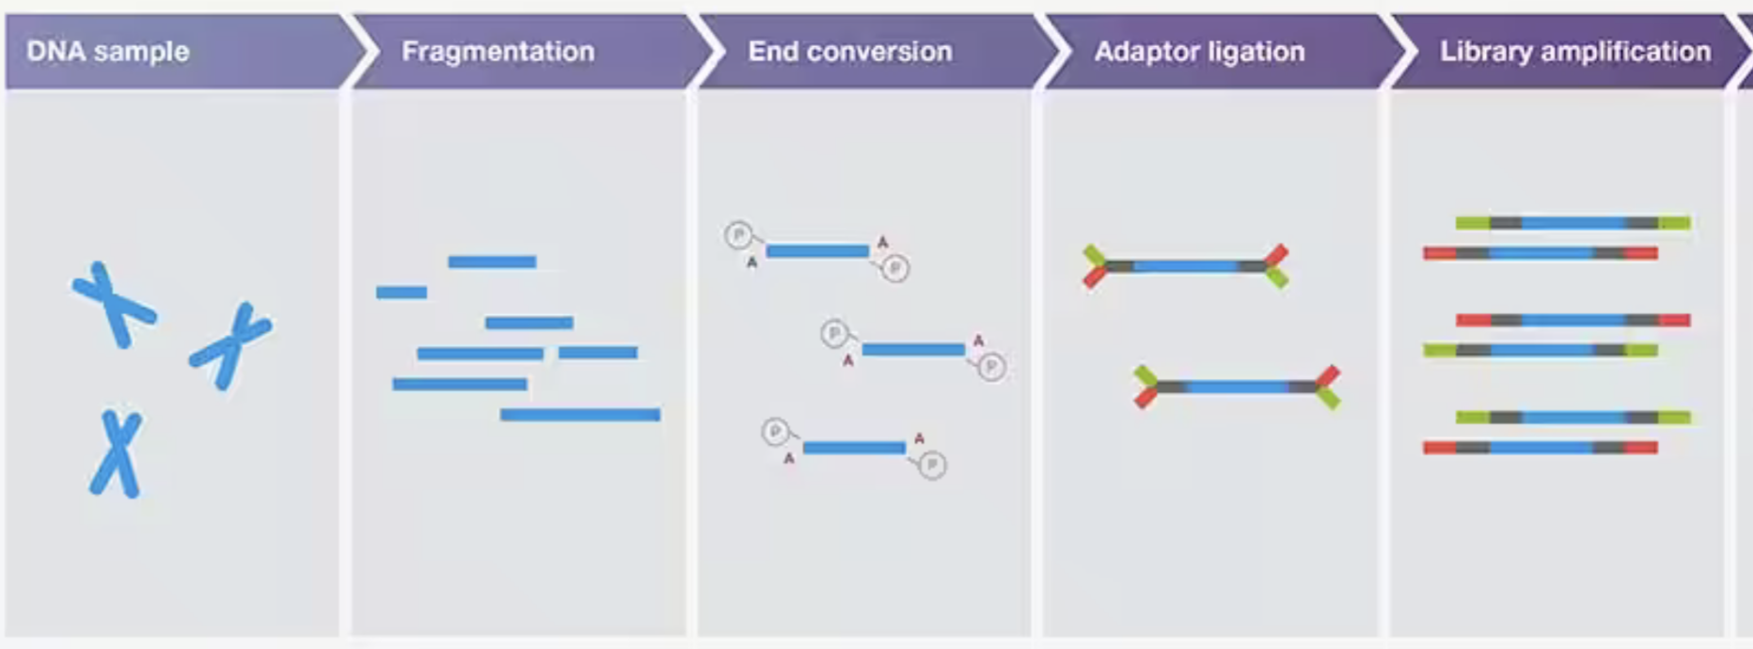
Ancestry Tests: Preparing your sample
Extracted from saliva
Add begin/end segments to assist the sequencing process
Break your DNA into millions of small fragments
Makes many copies of each fragment
Source: ThermoFisher.com

Slide 29
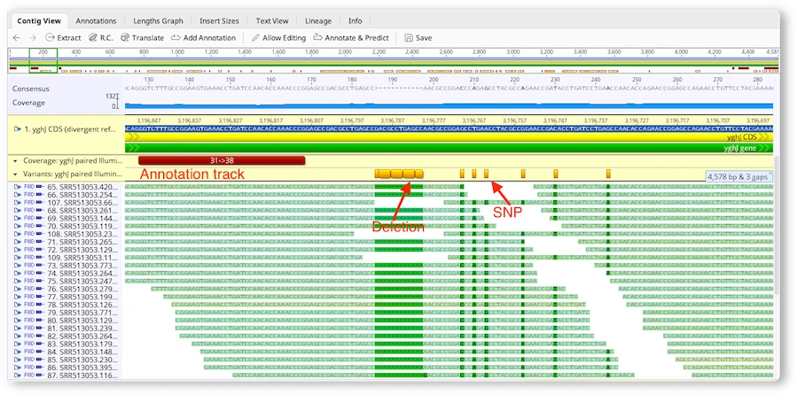

Slide 30
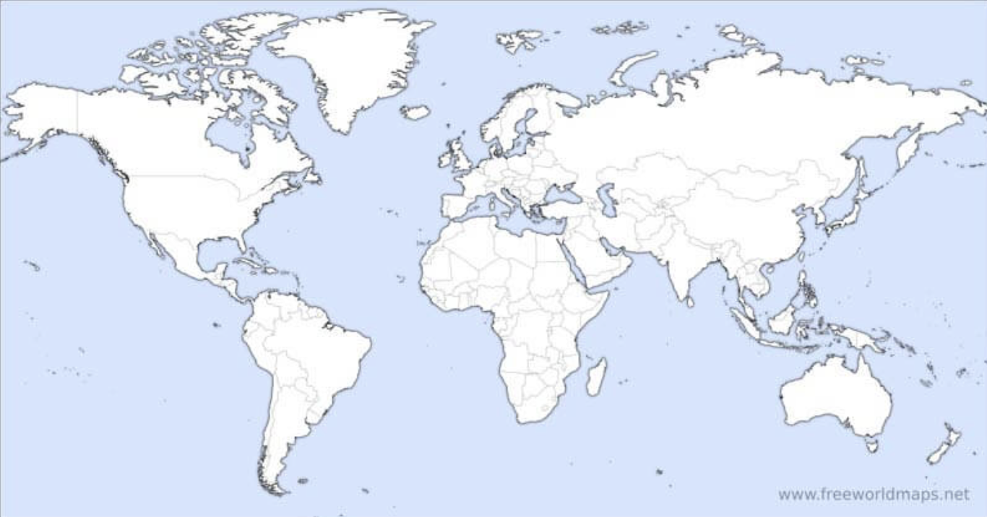
Ancestry tests – Compare your SNPs to those of reference populations
Reference populations
People of known ancestral origin whose DNA has been sequenced
For 23andMe, the reference population is ~11,000 people from 45 regions of the world
Assign an ancestry percentage to each of your SNPs
Compute overall ancestry composition by incorporating the percentage of each SNP

Slide 31
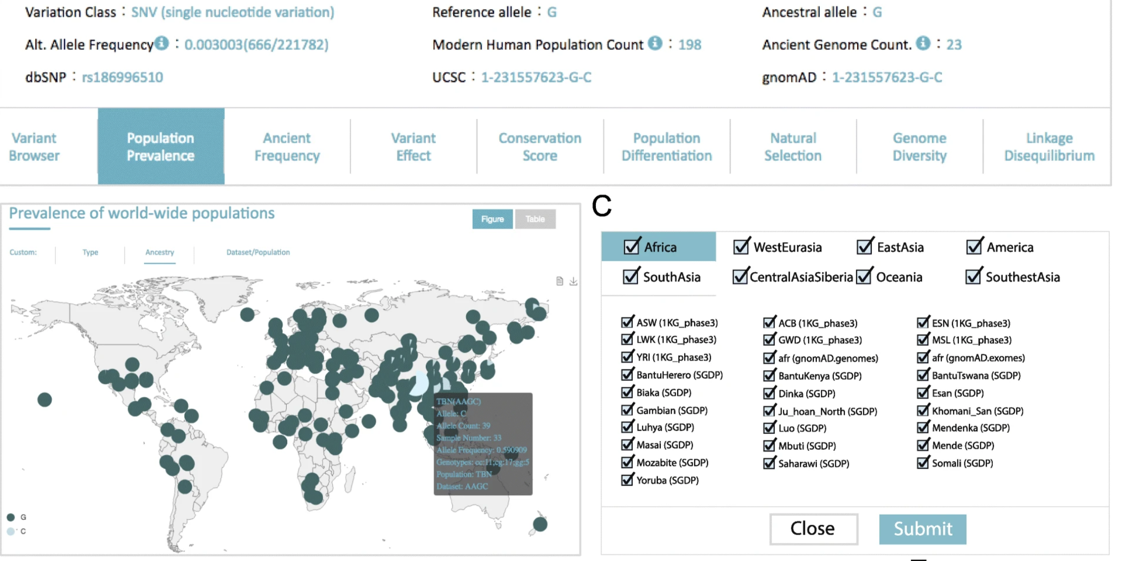
One example SNP A single SNP can occur in many populations
Genome Biology volume 20, Article number: 215 (2019)

Slide 32
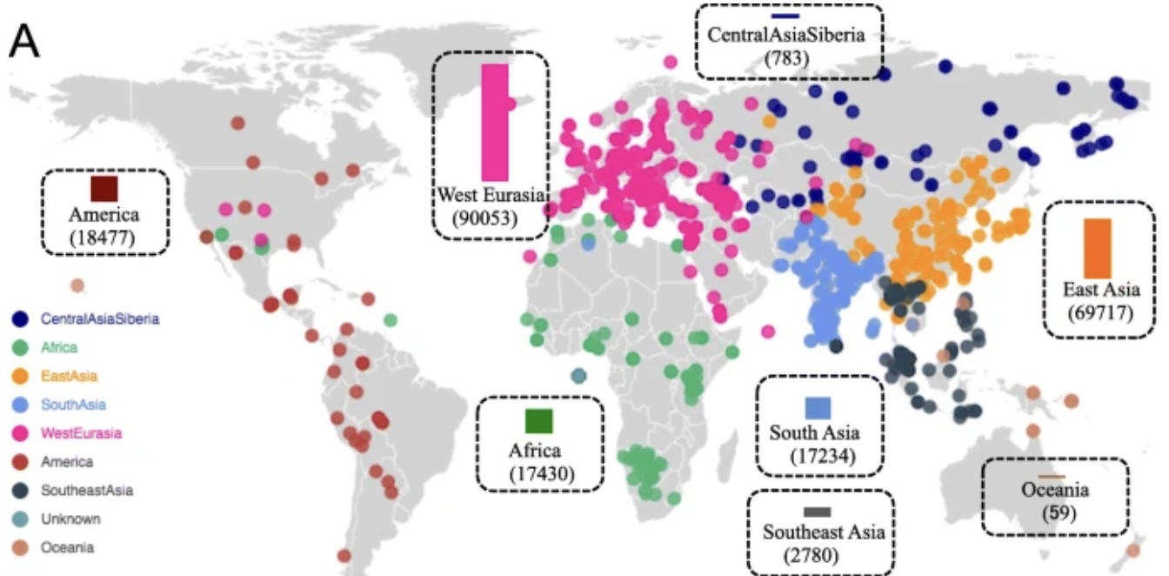
Issue – Geographic regions not equally represented in the database
Genome Biology volume 20, Article number: 215 (2019)

Slide 33
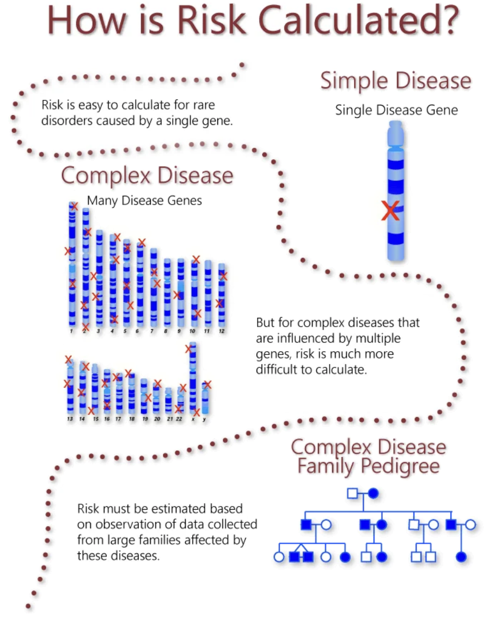
Genetic predisposition and risks
Children, parents, and grandparents often share similar health problems
Inherited genes can put a person at a greater risk of a disease
Environmental factors and lifestyle greatly impact a person’s risk
It’s complicated!
“Polygenic” means many genes are involved
Genes interacting with each other
Combined effects of several genetic variations that each, on their own would increase risk only slightly
Risk can be roughly estimated, but not accurately calculated
https://medlineplus.gov/genetics/understanding/mutationsanddisorders/predisposition/
Genetic predisposition and risks
https://learn.genetics.utah.edu/content/history/geneticrisk

Slide 34
Genetic predisposition example: BRCA1
Specific variants in BRCA1 and BRCA2 genes result in increased risk for breast and ovarian cancer
What does the BRCA gene do?
It’s a “tumor suppressor” gene that produces a protein that is used to repair damaged DNA
A mutation in a specific part of the BRCA gene is associated with a highly elevated risk
5x greater than normal risk for breast cancer
30x greater than normal risk for ovarian cancer
Mutations can be inherited from either parent and passed to sons or daughters
https://en.wikipedia.org/wiki/BRCA_mutation

Slide 35
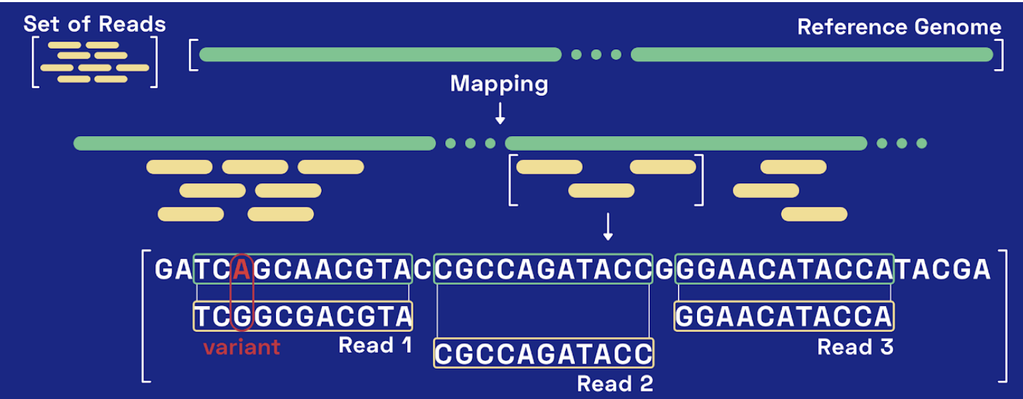
Comparing ”reads” from your DNA sequence to a reference genome to identify variants

Slide 36
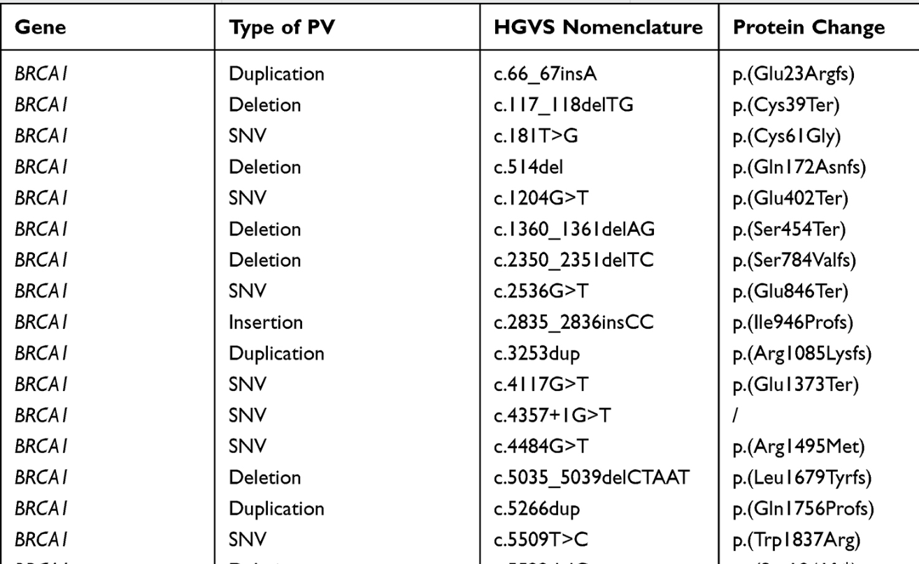
“Pathogenic Variants” (PV) in BRCA1
Mutational Analysis of BRCA1 and BRCA2 Genes in Breast Cancer Patients from Eastern Sicily
https://doi.org/10.2147/CMAR.S348529

Slide 37
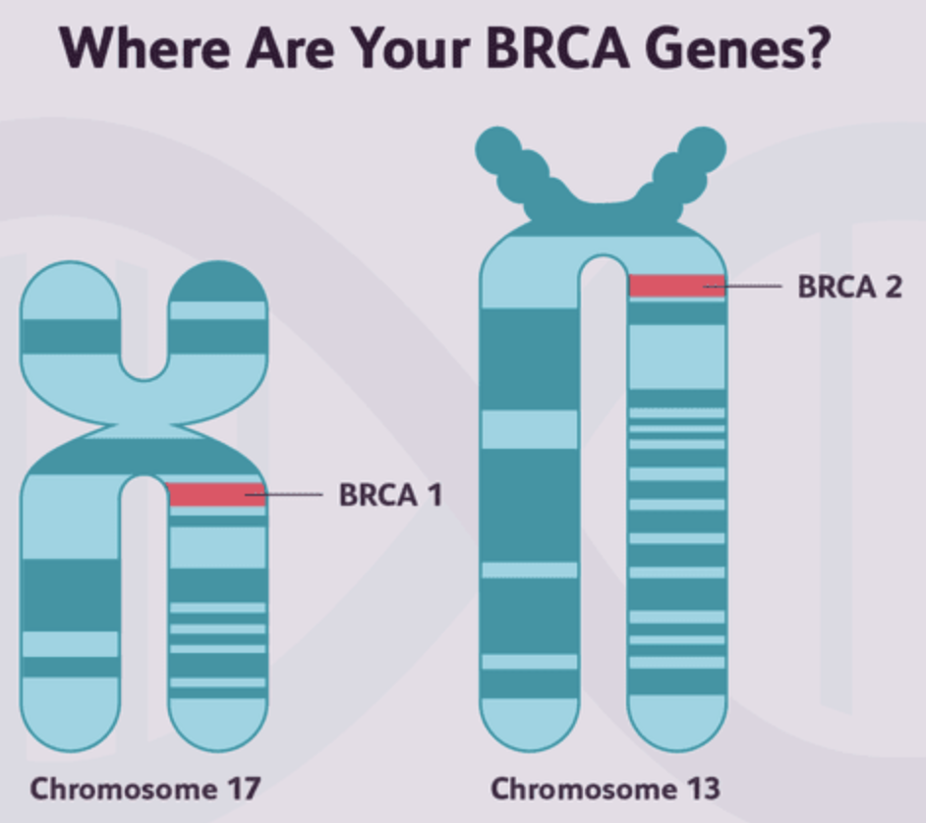

Slide 38
Where the mutations occurred in the BRCA1 gene
Study involving 455 breast cancer patients, aged 23-89 (median = 49 years old) in Eastern Sicily
Mutational Analysis of BRCA1 and BRCA2 Genes in Breast Cancer Patients from Eastern Sicily
https://doi.org/10.2147/CMAR.S348529

Slide 39
Commercial products and services
23andMe
Ancestry.com
Nebula Genomics

Slide 40
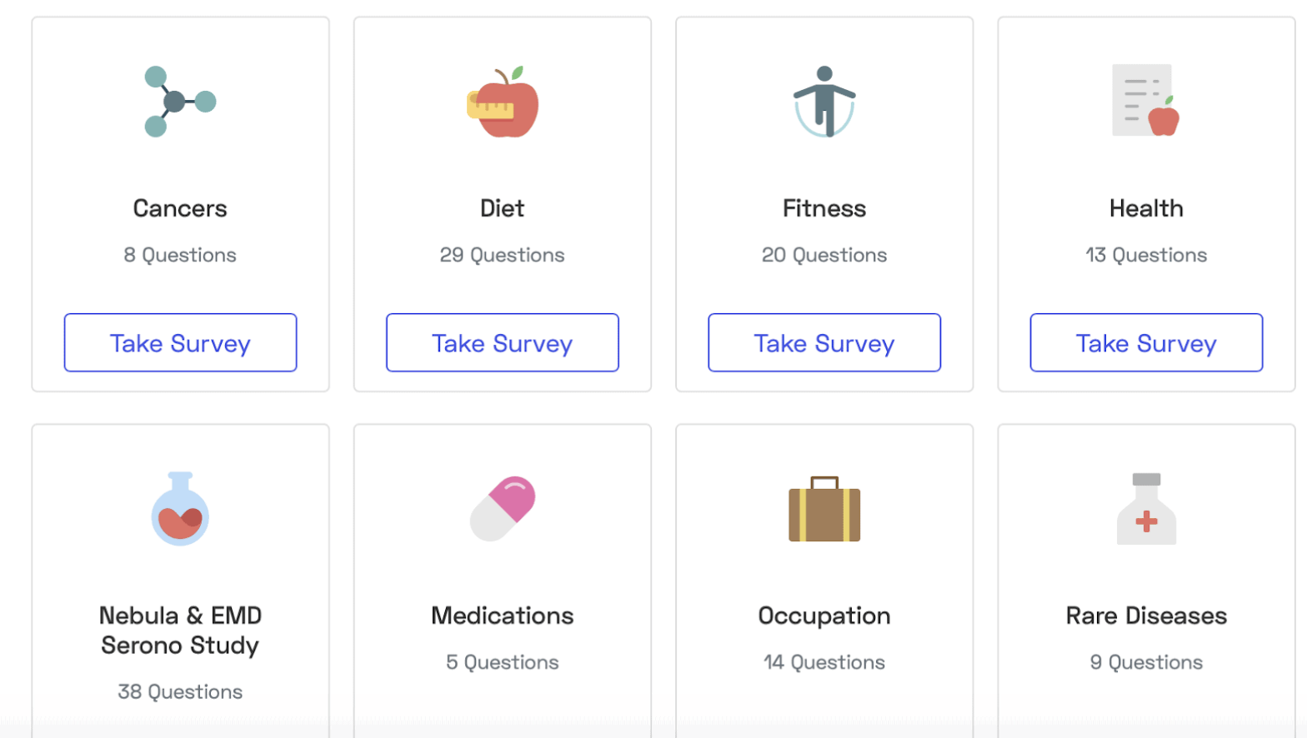
Example: Nebula Genomics
Send in your cheek swab sample and answer survey questions

Slide 41
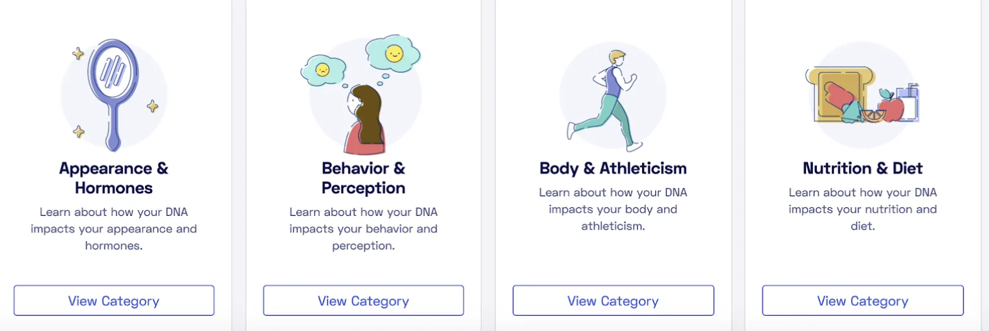
Example: Nebula Genomics
Get your report in 8-10 weeks
Learn about your physical traits
Examples
Earwax Type (“You likely have wet earwax”)
Freckling (“You have an average chance to have or develop freckles”)
Hair Thickness (“You likely have average hair thickness”)
Testosterone (“You most likely have average serum testosterone levels”)

Slide 42
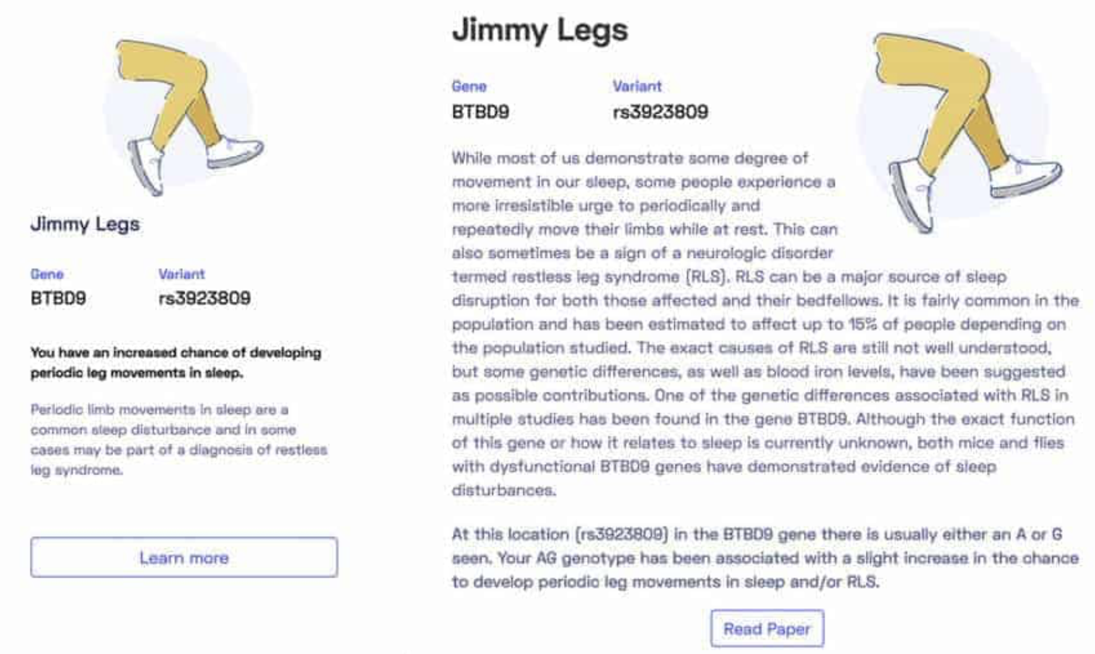
There’s a gene for “Jimmy Legs”!
https://nebula.org/blog/a-look-at-our-reporting/

Slide 43
Discussion

Slide 44
Thank You!

