Slide 1
War in the Twenty-First Century
Lecture Eight
“In the Long Run the Sabre is Always Defeated By The Mind”
Tuesday, March 21

Slide 2
History repeating itself? Two quotes from an op-ed in The Daily Telegraph, Saturday, March 18, 2023
“Two authoritarian powers, one in Europe and the other in Asia, are determined to overturn the global order. Both are resentful towards the Western democracies and believe the international system is rigged against them. With war already raging in Europe, the situation in Asia is increasingly precarious. The world stands on the brink of a great power conflict. It is December 1941, and Germany and Japan are wrestling with the decision of whether to confront the global hegemons before it is too late.”
“The 1941 analogy illustrates how bellicose a determinedly revisionist power can turn if it feels war is inevitable and the time to act is now. A great-power war today is far from inevitable. But only by communicating this fact while providing a credible deterrence can we prevent it.”
Brendan Simms and Charlie Lederman, authors of Hitler’s American Gamble: Pearl Harbor & the German March to Global War (New York: Basic Books, 2021)

Slide 3
The twenty-first century, like the five centuries that preceded it, is being shaped by the struggle between revisionist and status-quo powers

Slide 4
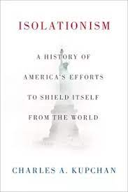
The United States will continue to be the world’s preeminent military power, although there is always a possibility it will retract and self-isolate
“The nation now confronts a seemingly unlimited array of foreign entanglements, two decades of errant war in the Middle East, and a pandemic that is causing an economic debacle of a sort not experienced since the Great Depression. The United States needs to rediscover the history of isolationism and apply its lessons, shrinking its footprint abroad and bringing its foreign commitments back into line with its means and purposes.”
Charles A. Kupchan, “Rediscovering Isolationism,” The Atlantic, September 27, 2020
https://www.cfr.org/expert/charles-kupchan

Slide 5
Clients and allies: What is the difference?

Slide 6
Military spending by the world’s ten most powerful states in 2022
US
China

Slide 7
The US armed forces serve as a model for actual and aspirant great powers from China and Russia to Turkey and Poland. And then there is…

Slide 8
…asymmetric warfare

Slide 9
China’s armed forces, untested in war for 40 years, lack the battlefield experience of the US military. The fate of Russia’s gleaming new kit and nicely ironed dress uniforms in the spring 2022 is a reminder that the ferocity of modern combat can defeat the capabilities of even a veteran army

Slide 10
Private Military Contractors (PMCs)
“The nation-states of the world are just going to outsource all their defense needs so they can watch more television […]”

Slide 11
Blackwater was a PMC that had a prominent presence in Iraq during the US occupation. Since then it has operated under the names of Xe, Academi (sic!) and Constellis
Blackwater personnel convicted in 2014 for perpetrating the massacre in Baghdad’s Nisour Square seven years earlier. They were pardoned by President Trump in December 2020

Slide 12
PMCs will play an increasingly prominent part in twenty-first century warfare, though here China may remain an outlier (see Lecture Three, Slides 16-17)
A revealing turn of phrase:
“From taking care of Soldiers
to taking care of our customers”
Another PMC, Blackstone Defense Services
Corporation, “provides intelligence, counterintelligence, counterterrorism and law enforcement contracting support to the US government and commercial clients” while advertising itself as “a woman-owned small business […] dedicated to delivering outstanding client support”

Slide 13
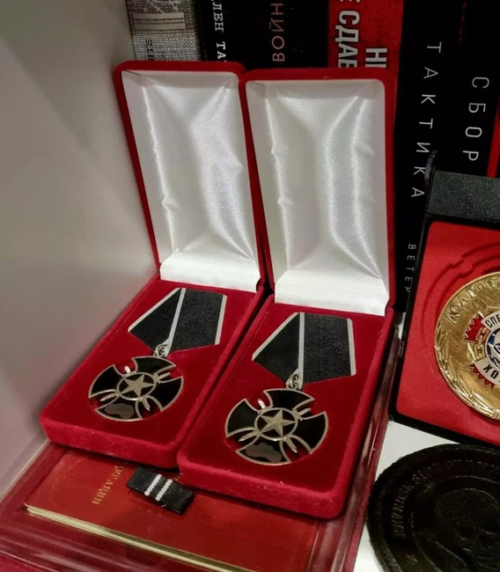
Blackstone’s PR, however, is innocent corporate guff when compared with this advert from Russia’s Wagner group, which was placed on PornHub, a leading adult site “We’re the most bad-ass private army in the world. We’re hiring in all regions of Russia. Don’t jerk off, get a job with PMC Wagner”
Money Shot: The Pornhub
Story is a new documentary
on Netflix. The film was
released before Wagner’s
recent advertising campaign
Because Wagner is a private company, its members are ineligible to receive military decorations. As a result, the group had to invented its own. One of these Wagner medals is the Black Cross.

Slide 14
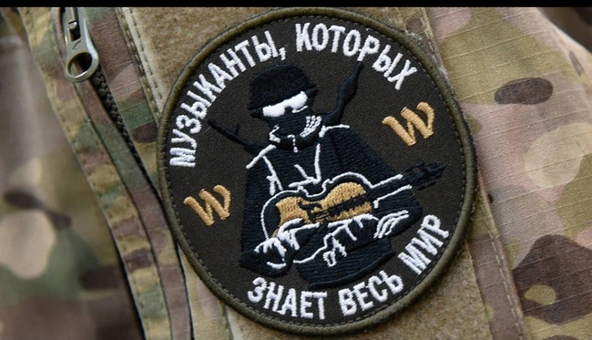
In Russian military circles, the Wagner group is known as “the orchestra,” and its personnel as “the musicians.”
“Musicians who are known the world over”

Slide 15
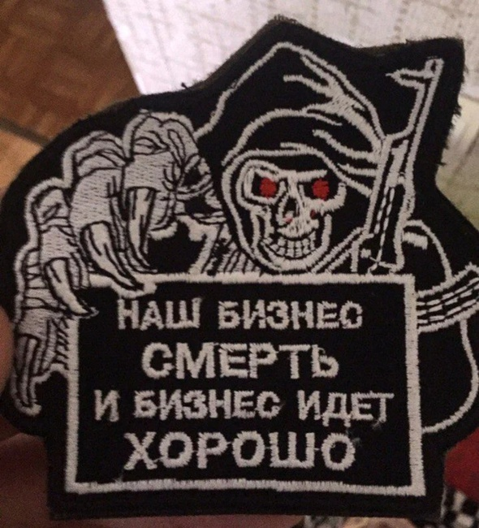
Wagner shoulder patches
It’s nothing personal. We are paid to do this.
Our business is death, and
business is good

Slide 16
The Landsknecht: the PMCs of the fifteenth century

Slide 17
Twenty-first-century trench warfare: https://www.newyorker.com/magazine/2023/01/02/trapped-in-the-trenches-in-ukraine

Slide 18
The violent aesthetics of military strategy and operational planning. Cannae…

Slide 19
Austerlitz…

Slide 20
The Manstein plan, which led to the fall of France in 1940, represented a version of Napoleon’s winning maneuver at Austerlitz. However, the input from Guderian and, of course, Hitler was decisive…

Slide 21
Stalingrad…

Slide 22
Media distance and a foreign perspective can generate useful insights for the news consumer. Warning: Le Monde’s English-language edition is partially translated by AI

Slide 23
Bellingcat is an online, open-source investigative site led by Christo Grozev, who is on the Russian government’s wanted list
https://www.bellingcat.com/
https://twitter.com/christogrozev

Slide 24
The 2021 free-trade agreement between New Zealand and the UK specified “a commitment by the UK to cooperate with New Zealand to identify appropriate ways to advance recognition and protection of the haka Ka Mate […].” Image shows the New Zealand rugby All Blacks performing the haka prior to one of their matches

Slide 25
The Black Ferns, New Zealand women’s rugby team, can do a mean haka as well https://www.youtube.com/watch?v=ihoMC8607yE

Slide 26
The Beating Retreat ritual at the Attari-Wagan checkpoint on the Pakistan-India border takes place every evening. Pakistani Rangers (L) and Indian Border Security soldiers theatrically confront one another as tens of thousands of spectators from both countries watch and whoop from the stands

