Slide 1
War in the Twenty-First Century
Lecture Seven
“Victorious Warriors Win First and Then Go to War”
Tuesday, March 14, 2023

Slide 2
Napoleon’s Ulm-Austerlitz campaign of 1805…

Slide 3
.. NATO’s dispositions against a possible Warsaw Pact invasion of western Europe…

Slide 4
…and the US-led coalition victory in the Persian Gulf War of 1990-91

Slide 5
…all illustrate the truth of Sun Tzu’s proposition

Slide 6
Yesterday in San Diego, AUKUS (Australia, UK, US) announced a multi-decade three-stage nuclear-powered submarine plan. The industrial maritime backdrop was a message to the three countries’ electorates as well as the People’s Republic of China

Slide 7
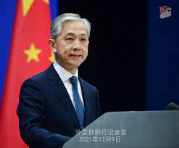
Earlier today, Chinese foreign ministry spokesman Wang Wenbin commented on this development
“The latest joint statement from the US, UK and Australia demonstrates that the three countries, for the sake of their own geopolitical interests, completely disregard the concerns of the international communities and are walking further and further down the path of error and danger.”

Slide 8
In The Second World War, Winston Churchill wrote: “The only thing that ever really frightened me during the war was the U-boat peril.”

Slide 9
By mid-1943, Allied convoys and escort carriers had defeated the U-boat menace

Slide 10
Unlike the Kriegsmarine’s U-boat operations, the unrestricted submarine warfare waged by the US Navy against Imperial Japan was a brilliant, brutal success

Slide 11
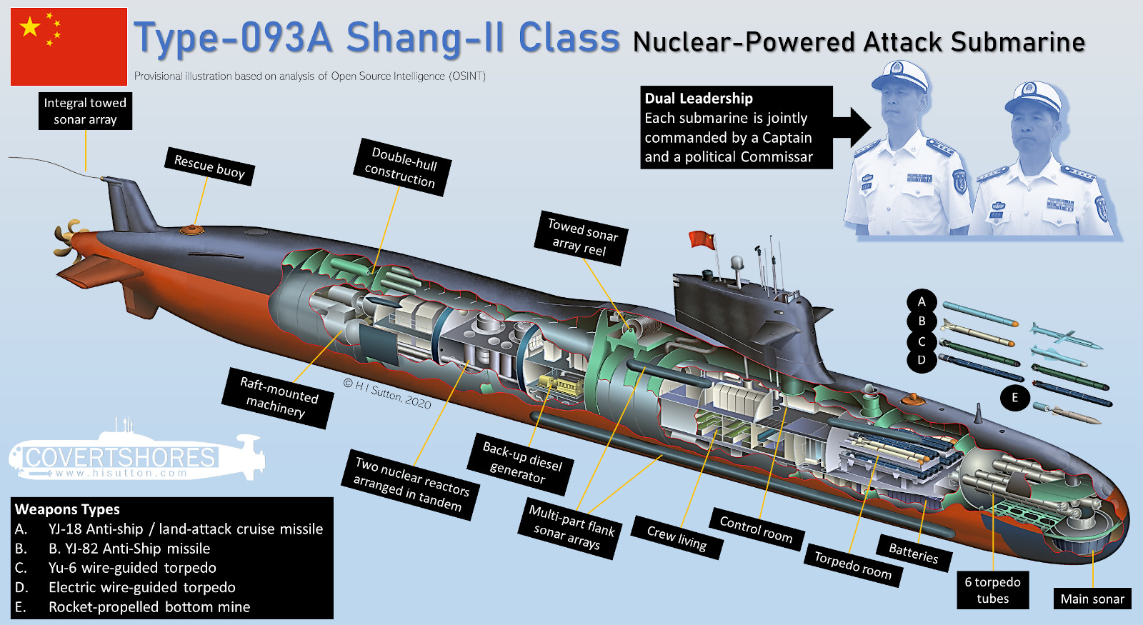
The AUKUS project is meant to counterbalance the threat posed by China’s rapidly expanding navy and, in particular, its submarine branch
Ballistic missile submarines: 6
Nuclear-powered attack submarines: 6
Diesel-powered attack submarines: 44

Slide 12
Stage One: US Navy submarines will increase the frequency of their visits to Australian ports starting this year, with “rotational forces” of US and UK submarines commencing as early as in 2027. The US and UK submarine contingents will be comprised of Virginia and Astute class vessels respectively. Stage Two: Beginning in the early 2030s, the US will sell Australia three Virginia class submarines, with another two a possibility. Stage Three: Australia’s own new attack submarines will combine cruise missile and torpedo launch systems and will be based on existing US and British designs. The AUKUS project, which enjoys bipartisan support in Australia, is anticipated to cost that country 0.15% of GNP per annum

Slide 13
While the West’s Pacific and Indian Ocean maritime trade routes are susceptible to interdiction by enemy air and naval forces, so are China’s own sea communications. In fact, their vulnerabilities parallel those of Imperial Japan before and during World War II, though China’s position as a continental power and its vast hinterland is an important difference between the two

Slide 14
Ideological and policy statements by governing individuals and parties, whatever the political system in question, are a valuable source and ought not to be dismissed as mere propaganda or PR. China’s attitude to international law is an extension of its juridical practices at home
“[…] Xi Jinping is dismantling [the de jure separation between the Chinese Communist Party and the state] through assertion of comprehensive party leadership over everything, including law. Yet, his push to codify party leadership into law and making explicit the party’s command of “socialist rule of law with Chinese characteristics” suggest[s] that Xi appreciates the legitimating power of law. […]. The party, while demanding “absolute” leadership of political-legal work, continues to delegate to state legal institutions the responsibility to address and resolve complex matters on a day-to-day basis in a professional, efficient, fair, and autonomous manner to help maintain social stability and promote economic development. […]. The party’s conditional attitude toward law, reflected in its continued resort to extra-legal means in dealing with perceived enemies, creates uncertainty over the reliability of the party-state’s legal commitments both at home and abroad.
Jamie B. Horsley, “Party Leadership and Rule of Law in the Xi Jinping Era,” https://www.brookings.edu/research/party-leadership-and-rule-of-law-in-the-xi-jinping-era/

Slide 15
The “one country, two systems” formula emerged during negotiations between the PRC and the UK over the return of Hong Kong to Chinese sovereignty, which occurred on July 1, 1997. (Where the West is concerned, the 1990s were a decade of passivity, drift and, often, self-indulgence, nationally as well as internationally. Many of the problems we are confronting today are due to the choices our leaders made — or failed to make — during that period)

Slide 16
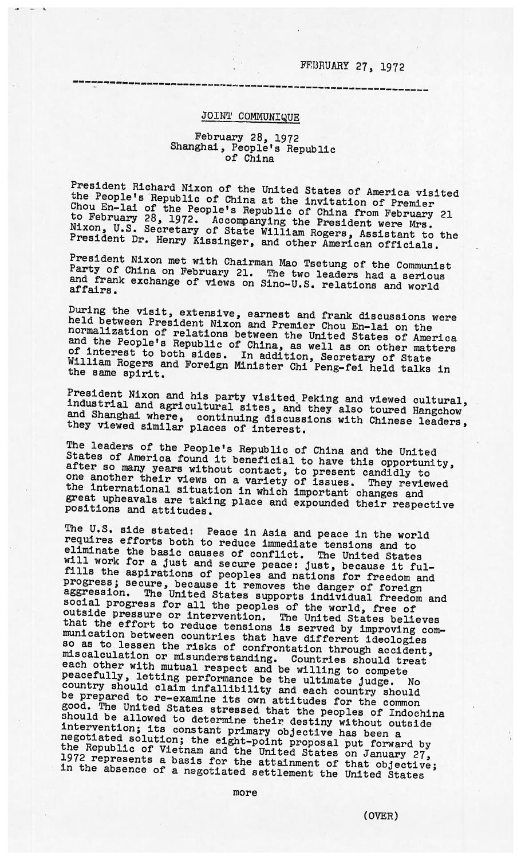
On February 27, 1972 President Richard Nixon and Premier Zhou Enlai signed the Shanghai Communique at the Jin Jiang Hotel

Slide 17
July 2020. Taiwan’s president Tsai Ing-wen of the Democratic Progressive Party addresses a Marine Corps battalion in Kaohsiung. Her term will end in 2024, when the country will hold its next presidential election

Slide 18
Taiwan’s geography, the current state of its military, as well as the history of the Pacific Campaign in World War II suggest that a different strategy may be preferable

Slide 19
Current military planning envisions the Republic of China Armed Forces defeating a Chinese invasion along the coastline

Slide 20
A confrontation across a narrow stretch of water

Slide 21
The impact of the Russia-Ukraine war on Chinese, Taiwanese, and US military thinking has been manifold and is still evolving

Slide 22
24 war games!
CSIS [Center for Strategic and International Studies] developed a wargame for a Chinese amphibious invasion of Taiwan and ran it 24 times. In most scenarios, the United States/Taiwan/Japan defeated a conventional amphibious invasion by China and maintained an autonomous Taiwan. However, this defense came at high cost. The United States and its allies lost dozens of ships, hundreds of aircraft, and tens of thousands of servicemembers. Taiwan saw its economy devastated. Further, the high losses damaged the U.S. global position for many years. China also lost heavily, and failure to occupy Taiwan might destabilize Chinese Communist Party rule. Victory is therefore not enough. The United States needs to strengthen deterrence immediately
CSIS Wargame report available at: https://www.csis.org/analysis/first-battle-next-war-wargaming-chinese-invasion-taiwan

Slide 23
Did the West promise the Soviet Union not to expand NATO?

Slide 24
“All political lives end in failure” (Enoch Powell)

Slide 25
Poland: an economic success story, but with a populist twist

Slide 26
On left, Jaroslaw Kaszynski, leader of the Justice and Law party and the power behind the current Polish government; on right, a ceremony commemorating the victims of the Smolensk air disaster of April 10, 2010, in which 96 people died. Those killed included Polish President Lech Kaszynski (Jaroslaw’s twin brother), his wife Maria, high-ranking military officers, prominent government officials, 18 members of parliament, senior figures in the Polish Catholic Church, and relatives of those murdered in the Katyn massacre

Slide 27
Poland: Europe’s newest military power

Slide 28
Poland, which has a long tradition of guerrilla resistance against occupying forces such as the Russian Empire, Nazi Germany, and the Soviet Union, has instituted a “Train with the Army” program that aims to teach military skills to its civilian population. “I have said many times that it is better to be in debt, and even have to make cuts to budgets in other areas, than to be occupied,” Jaroslaw Kaczynski recently declared

Slide 29
March 2023. Polish gunners conduct a live-fire drill with K-55A1 self-propelled howitzers at Paju, South Korea

