Slide 1
War in the Twenty-First Century
Lecture Six
“The Warrior’s Way”
Tuesday, March 7

Slide 2
Putin’s Munich Speech in 2007 laid down the essentials of Russia’s new geopolitical and, by implication, geocultural doctrine
“[…] the unipolar model is unacceptable […] in today’s world”
the US is guilty of an “almost uncontained hyper use of force”
referring to China, India, Brazil, and Russia, “the economic potential of the new centers of economic growth will inevitably be converted into political influence”
NATO expansion is a “serious provocation”

Slide 3
The Russian World is a cultural notion as well as an ideological and geopolitical program

Slide 4
The 2021 Victory Day parade in Red Square conveyed the image of a rising military power on the march

Slide 5
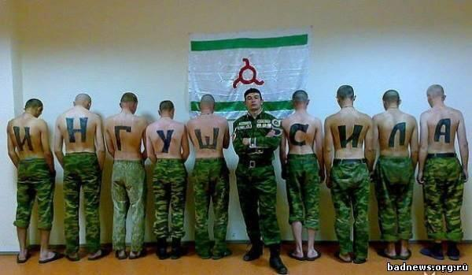
Historically, dedovshchina (hazing) degraded, sometimes severely, the military effectiveness of Russia’s armed forces

Slide 6
Conscript Ramil Shamsutdinov, who in 2019 murdered 8 members of his military unit. In 2021 he was sentenced to 24.5 years in a strict-regime prison camp

Slide 7
At the Chinese Communist Party’s XIX Congress in 2017, Xi Jinping pledged to transform the PLA (People’s Liberation Army) into “a world-class force” by 2049

Slide 8
China’s Belt and Road Initiative, revisited

Slide 9
Among other things, the Initiative is meant to counteract the perceived threat of geostrategic encirclement

Slide 10
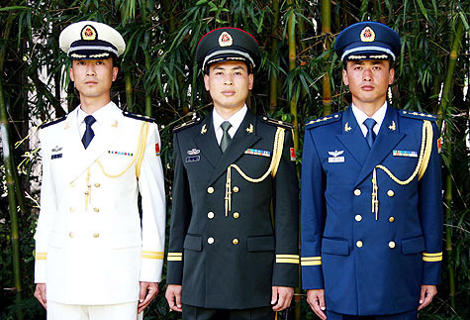
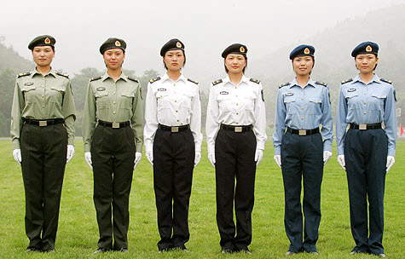
In addition to its institutional, technological, and training aspects, the de-guerrillaization and professionalization of China’s People’s Liberation Army involved the introduction of uniforms carrying badges of rank and other insignia. On left, a 1960 PLA officer’s uniform. On right, PLA officers and troops in their Model 2021 uniforms

Slide 11
…a reform that recalls the restoration of tsarist uniforms in the Red Army following the Battle of Stalingrad, when its personnel changed from the “proletarian” look below to…

Slide 12
…a hierarchically structured style of military dress

Slide 13
In the twenty-first century, few states have been able to use their armed forces effectively. The reasons for this are variously domestic-political, budgetary, or military-structural
This 2006 study is a rigorous examination of the
factors that make for a successful military and a
a war-winning performance on the battlefield

Slide 14
Biddle writes that military effectiveness depends on force deployment, which in its modern form dates from World War I
“Increasing lethality” on the battlefield as a function of technological progress. Thus, open movement on the battlefield has been “suicidal” since WWI
Protecting troops from hostile fire at the tactical level by means of “cover, concealment, dispersion, suppression, small-unit maneuver, combined arms” to “damp the effects of technological change”
Ensuring the maneuverability of one’s own forces while interdicting that of the enemy
“States’ relative economic, demographic, or industrial strength are poor indicators of real military power”
Materiel just one criterion in assessing military effectiveness (see Iraq 1991 and 2003 vs. North Vietnam 1965-75 or Afghanistan 2002-2021). There is no such thing as a war-winning wonder weapon
“Projections of future warfare are now dominated by the claim that technology is creating a ‘revolution in military affairs’”: this is wrong
“The mercantilist position […] is based on the proposition that economic preponderance conduces to military power”: this is wrong. The US and China, NB!

Slide 15
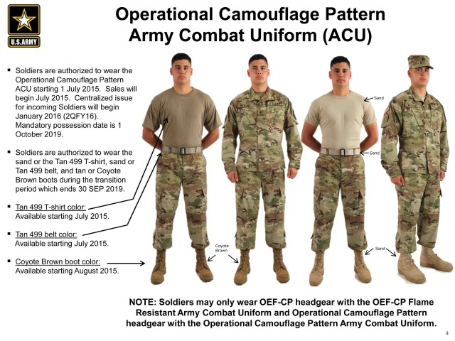
The aesthetics of battlefield display or concealment

Slide 16
Civilian fashion outcomes of the modern military’s concealment imperative

Slide 17
One might add that military effectiveness depends on…
The ratio of fighting troops to logistical support
Military logistics and battlefield force application, shaped by current industrial and economic processes
The economic impact of military operations on the country that sends troops into battle
Quality of government communication or, if your like, propaganda as disseminated by the media

Slide 18
The PLA has tried to strengthen its non-commissioned officer corps, but with mixed success. It is not clear whether China’s leaders understand that a cadre of experienced NCOs enjoying high status within the armed services as well as in society at large is essential for ensuring military effectiveness

Slide 19
Audie Murphy (1925-1971) In addition to being a highly decorated World War II hero, Sgt. Murphy, born into a poor farming family, was an actor, songwriter, and horse-breeder

Slide 20
Members of the US Army’s Audie Murphy Club in 2022

Slide 21
An Officer and a Gentleman (1982). Gunnery Sgt. Emil Foley (Louis Gossett Jr.) confronts Officer Candidate Zack Mayo (Richard Gere)

Slide 22
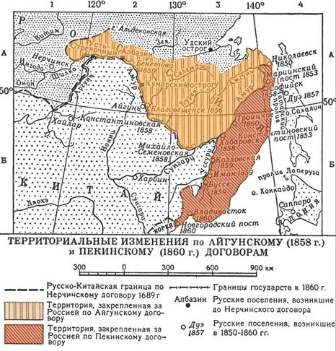
China is a revisionist power with irredentist claims against its neighbors to the north, east, south, and west

Slide 23
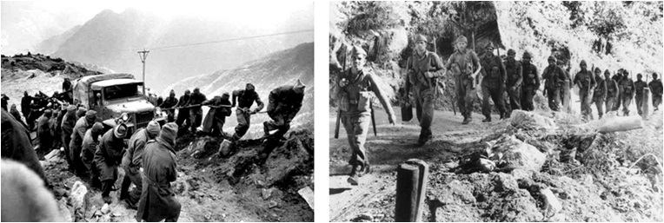
The Sino-Indian War of 1962 was followed by decades of military confrontation along the China-India border

Slide 24
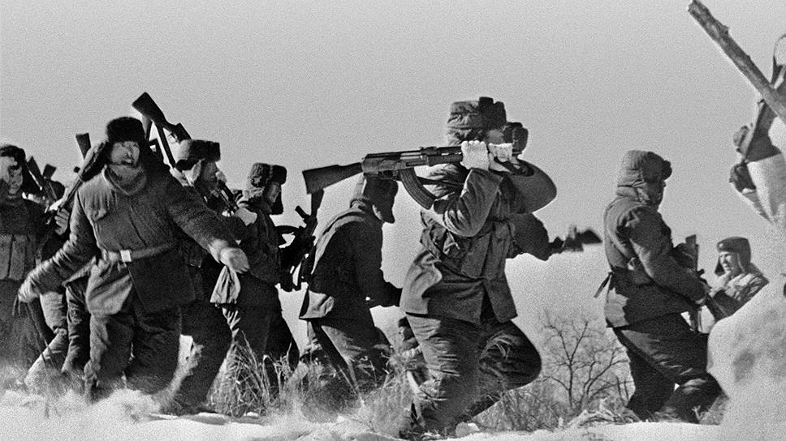
In the 1960s and 1970s, tensions along the Sino-Soviet border occasionally erupted into armed conflict, as on Damansky Island on March 2, 1969

Slide 25
The Third Indochina War was fought in February-March 1979. Among the factors that led to the Chinese attack were the latter’s conquest of Cambodia in 1978, ideological differences with Vietnam and its Soviet patron, China’s de facto alliance with the United States, as well as the traditional Chinese fear of geostrategic encirclement. The war ended after the PLA had advanced about 25 miles into Vietnamese territory and with the “road to Hanoi” “open,” according to China

Slide 26
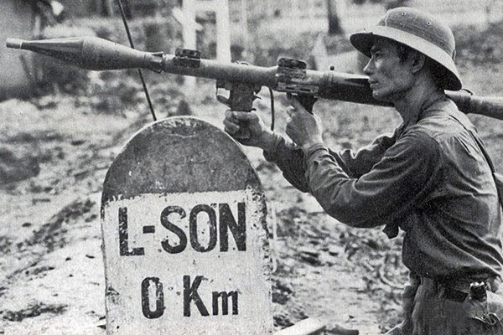
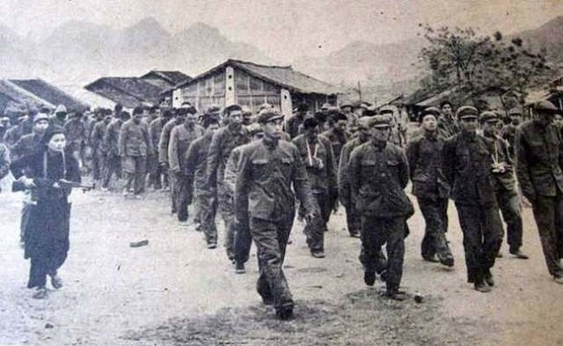
Left to right: Chinese Type 62 tank destroyed during the Battle of Lang Son, a Vietnam People’s Army soldier armed with a RPG-7 grenade launcher defending Lang Son, Chinese POW’s guarded by Vietnamese troops

Slide 27
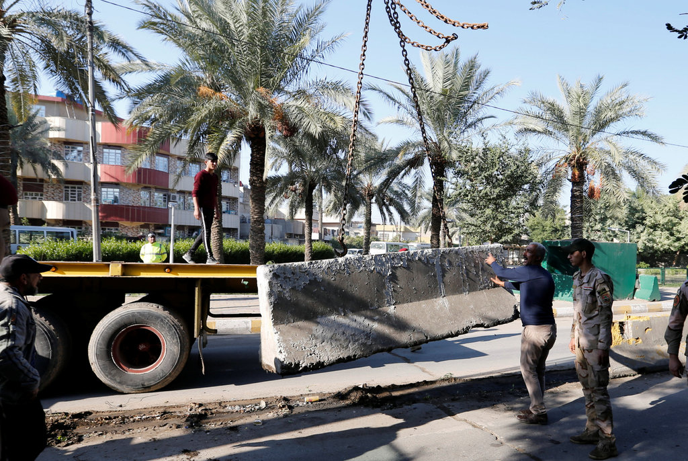
If, according to Clausewitz, war is the continuation of politics by other means, then what was the political outcome of Operations Enduring Freedom (Afghanistan) and Iraqi Freedom (Iraq)?

