Slide 1
War in the Twenty-First Century
Lecture Five
“Abstract, Serene Satisfaction”
Tuesday, February 28

Slide 2
The Battle of Bakhmut: Russia’s Verdun, or the perils of confusing the political, the strategic, the operational, and the tactical

Slide 3
The Prigozhin vs. Gerasimov conflict is evidence of a the fracture in Russia’s chain of command

Slide 4
The military vs. civilian cultural and lifestyle divide
A different sociolect, or language
Strict rules and expectations
Focus on unit and relationships therein
Many life decisions made for you
Financial support from a paternalistic,
hierarchical organization

Slide 5
Yet, the chief difference lies elsewhere
Men who have survived close-quarter
killings know that humans are possessed
of a deep-seated, innate reluctance to
kill their own species. […]. […] The fundamental purpose of basic training for most soldiers is to employ classical and operant conditioning techniques to suppress
the reluctance. Barry Eisler, Hard Rain, p. 156
Barry Eisler, bestselling
author, fluent Japanese speaker, and judo black belt. Before he became a writer, his career trajectory took him from a posting with the CIA’s Directorate of Operations to a job as the in-house lawyer at Panasonic’s Osaka headquarters to an executive position with a Silicon Valley startup

Slide 6
The first important civilian-military command fracture in the post-World War II era
Harry Truman and Douglas MacArthur meeting at
Wake Island on October 15, 1950, when the five-star general
assured the commander-in-chief that Communist China would
not intervene on behalf of North Korea against the advancing
UN forces

Slide 7
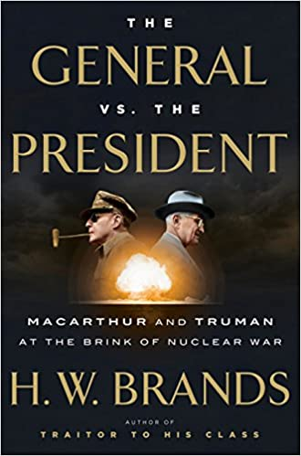
“This looks like the last straw,” Truman wrote in his diary on April 6, 1951, after MacArthur openly declared his differences with the president in a letter to House Republican leader Joseph Martin
“With deep regret I have concluded that General of the
Army Douglas MacArthur is unable to give his wholehearted
support to the policies of the United States Government and
of the United Nations in matters pertaining to his official
Duties.” President Truman, April 11, 1951
Rep. Joseph Martin
This 2016 study is the best source
on the Truman-MacArthur relationship

Slide 8
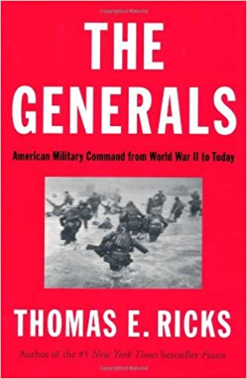
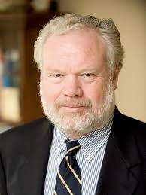
Thomas E. Ricks’s books are polemical investigations of the modern US military and its successes and failures of command
2006
2012

Slide 9
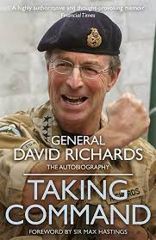
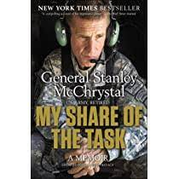
Gen. David Richards (UK; on left) and Gen. Stanley A. McChrystal (US): Parallel lives and problems In Iraq and Afghanistan, as earlier in Vietnam, the West’s military has had to contend with a failure of command at the political and strategic level. This is a concern that Richards and McChrystal were unable to resolve while on active duty but have addressed in retirement

Slide 10
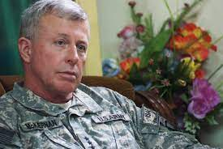
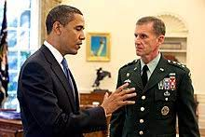
On left, Gen. David McKiernan, on right, President Obama meeting with Gen. McChrystal in the Oval Office
After entering the White House, President Obama worked to fulfill his campaign pledge to refocus on Afghanistan in order to “disrupt, dismantle, and defeat Al Qaeda in Pakistan and Afghanistan.” To that end, he dismissed Gen. McKiernan, commander of US and Nato forces in Afghanistan (the first time a top field commander had been relieved of duty since the MacArthur firing in 1951), appointing in his stead Gen. McChrystal

Slide 11
Gen. Stanley McChrystal: Effortlessly charismatic, intellectually brilliant, flamboyantly anti-intellectual, but in the end — hubristic

Slide 12
COIN = Population-centric counterinsurgency, a guerrilla and terrorism-fighting doctrine associated with Gens Petraeus and McChrystal and officially adopted by the US Army and Marine Corps in the FM 3-24, released in December 2006. The quotation below is from the Foreword in the draft of this document
The Army and the Marine Corps recognize that every
insurgency is contextual and presents its own set of
challenges. You cannot fight former Saddamists and
Islamic extremists in the same way you would have fought
the Viet Cong, the Moros, or the Tupamaros. […] Nonetheless,
all insurgencies, even today’s highly adaptable strains, remain
wars amongst peoples, employ variations of standard themes,
and adhere to elements of a recognizable revolutionary
campaign plan. […]. A counterinsurgency campaign is […] a mix
of offensive, defensive and stability operations […]. It requires
soldiers and Marines to to employ a mix of both familiar combat
tasks and skills more often associated with non-military agencies […].
The devil is in the contexts

Slide 13
The Malayan Emergency of 1948-60 saw the wide-ranging deployment of the SAS, Britain’s special forces unit, though it would become a household name only in the 1980s

Slide 14
In the Battle of Hedaspes, May 326 BCE, Alexander defeated Porus, an Indian king

Slide 15
A victorious Alexander made Porus the satrap of his Indian conquests

Slide 16
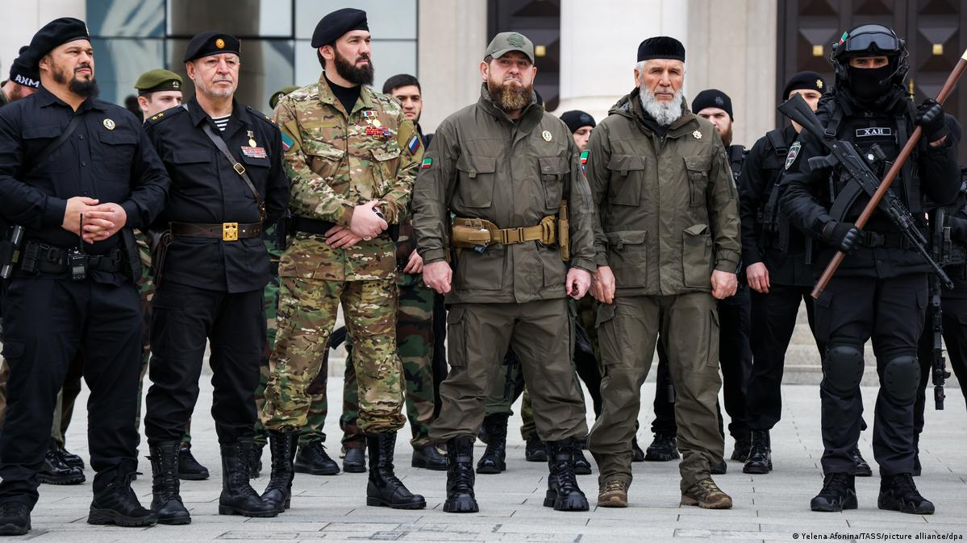
The Second Chechen War, 1999-2009 Chechnya is now governed by Ramzan Kadyrov (at center in photo on right), the son of pro-Russian president and former guerrilla leader Ahmed Kadyrov, who was assassinated in 2004. To all effects, Kadyrov’s fief is an independent state that is only nominally subject to Russian Federation control

Slide 17
The Chechen capital, Grozny, then and now

Slide 18
The Syrian civil war, a bloody, multi-sided conflict involving several foreign powers, began in 2011 and is still ongoing

Slide 19
The guerrilla war against Myanmar’s military junta and its army (the Tatmadaw) may last for years or even decades

Slide 20
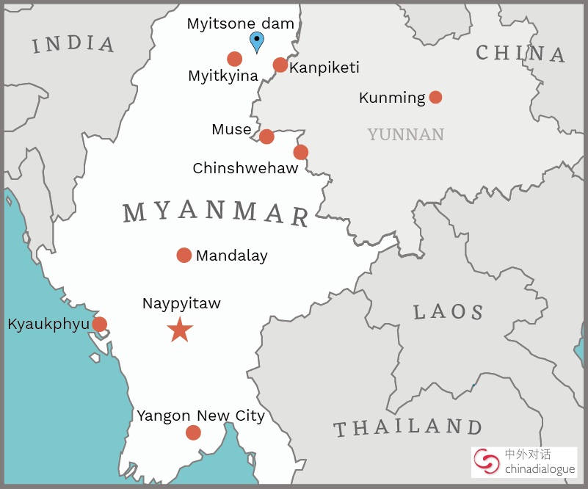
China has a strategic stake in that conflict

Slide 21
Khomeini’s fatwa
“I am informing all brave Muslims of the world that the author of The Satanic Verses, a text written, edited, and published against Islam, the Prophet of Islam, and the Koran, along with all the editors and publishers aware of its contents, are condemned to death. I call on all valiant Muslims wherever they may be in the world to kill them without delay, so that no one will dare insult the sacred beliefs of Muslims henceforth. And whoever is killed in this cause will be a martyr, Allah willing. Meanwhile, if someone has access to the author of the book but is incapable of carrying out the execution, he should inform the people so that [Rushdie] is punished for his actions.”

Slide 22
The Ayatollah Khomeini knew his Plato…

Slide 23
…but not his literary theory

Slide 24
“How do you defeat terrorism? Don’t be terrorized.” Thus novelist Salman Rushdie, who on August 12, 2022 himself became the object of terrorist violence

Slide 25
Hadi Matar, Salmon Rushdie’s twenty-four-year-old alleged attacker, was a transcontinental cliché in search of a c(l)ause. Yet in a strange way, the New Jersey basement-dweller and the world-famous author were in the same line of business

Slide 26
…which is…

Slide 27
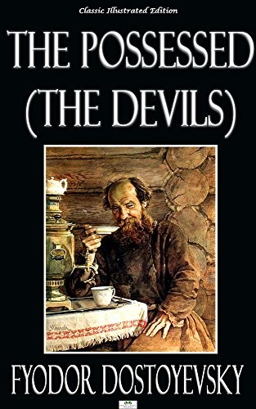
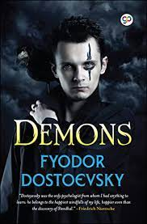
The best source on the terrorist mentality and modus operandi is a nineteenth-century novel that is known in English under three different titles

Slide 28
Stepan Verkhovensky Jr. (on left) tries to make an impression on Nikolai Stavrogin. A still from a Russian film version of The Possessed

Slide 29
Al Qaeda leader Osama Bin Laden (L) and his successor Aymun al-Zawahiri. Note the zabiba, or prayer callus, on Zawahiri’s forehead

Slide 30
Beware the terrorist charismatic

Slide 31
Global rage and despair will be a potent geopolitical factor in the twenty-first century

