Slide 1
War in the Twenty-First Century
Lecture Four
“War is What Happens When Language Fails”
Tuesday, February 21

Slide 2
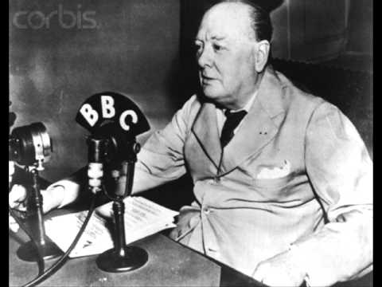
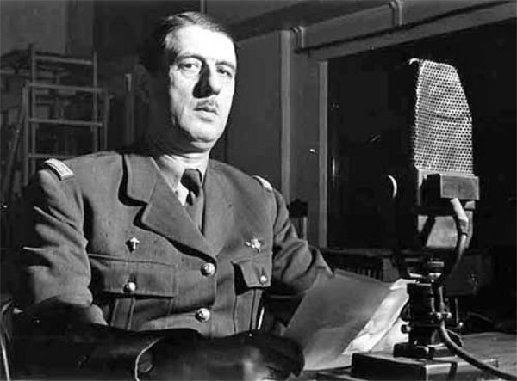
“When arms speak, the muses are silent,” Cicero reputedly said. Churchill’s wartime speeches, de Gaulle’s address of June 18, 1940, and Putin’s de facto declaration of war on Ukraine of February 23, 2022 showed the impact of words, rhetorically arranged, on the course of military events. The lesson is that, contrary to Cicero and Margaret Atwood, war may happen when language succeeds, for good or for ill

Slide 3
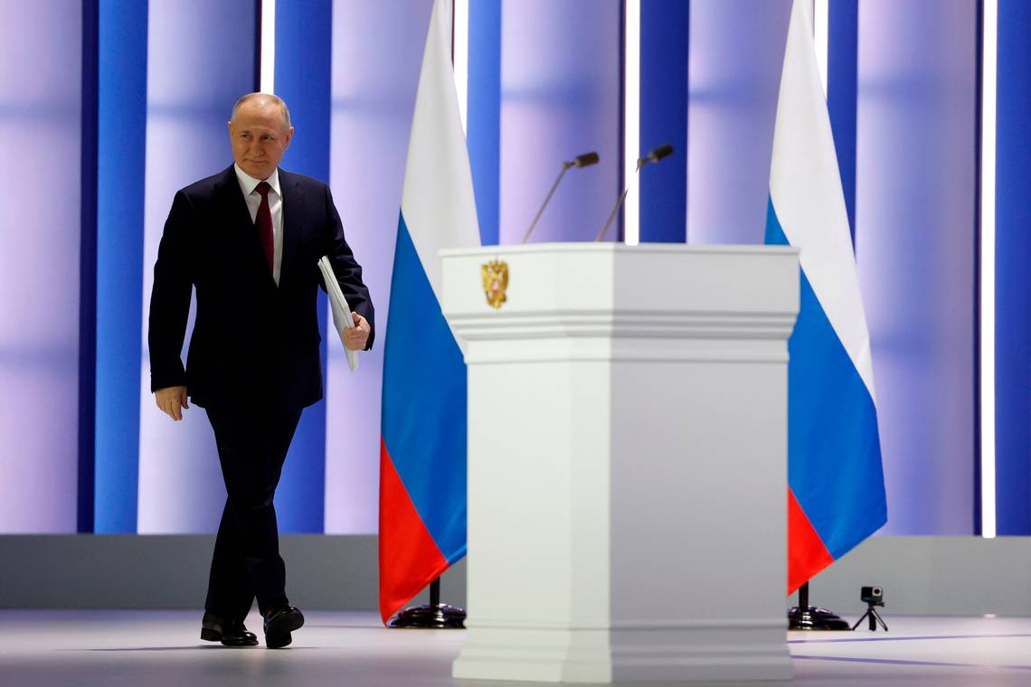
February 20-21, 2023: Putin vs. Biden

Slide 4
From wag the dog to whack the balloon, when PR considerations guide military decisions, disaster often follows
General Mark Clark’s decision to liberate Rome
(June 4, 1944) rather than outflank the reeling German army was an operational blunder that would cost thousands of Allied lives

Slide 5
Speaking at the Munich security conference on February 17, State Councilor Wang Yi, who oversees China’s foreign policy, called the shootdown of his country’s balloon “absurd and hysterical”

Slide 6
The Northern Illinois Bottlecap Balloon Brigade reported that one of its hobby craft went “missing in action” on 10 February, the same day a US F-22 jet downed an unidentified airborne object over Alaskan coastal waters. Price of missile: $439K. Price of balloon: $13

Slide 7
At a Nato meeting in Brussels on February 15, 2023, UK Defense Secretary Ben Wallace commented on Ukrainian field tactics. (Picture shows Wallace, sitting, with Italian defense minister Guido Crosetto)
“The Russian, or the Soviet, way of fighting is very ammunition-heavy [with] massive artillery barrages. That’s never how we have organized ourselves to fight in the West and in Nato. Ukraine uses huge amounts of ammunition to defend itself […]. If they can be very accurate in their use of artillery instead of having to use hundreds of shells to pin down a Russian unit, they can only use two or three because they can see exactly where the shot falls.”

Slide 8
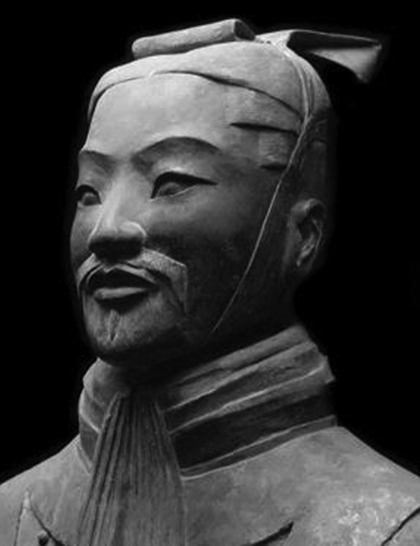
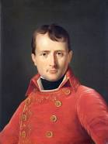
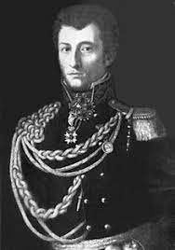
Sun Tzu, Julius Caesar, Napoleon, Clausewitz

Slide 9
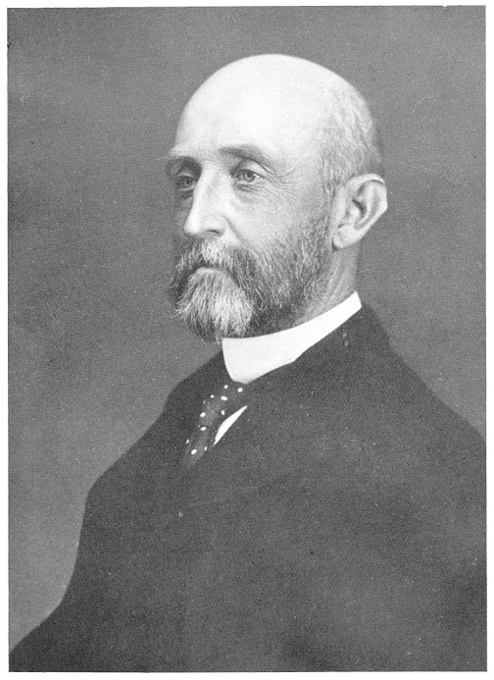
As a strategist, Alfred Thayer Mahan (1840-1914) was a figure of the same order as Sun Tzu or Carl von Clausewitz. However, in Mahan’s case, his element was the world’s seas and oceans

Slide 10
Mahan’s principles of naval strategy
The sea is a connector, not a moat. Hiding behind a saltwater barrier in the hope of securing safety in isolation will lead to defeat
The foundations of naval power rest on land and reside in a strong economy and the possession of overseas territories and bases
From the Punic Wars to the Napoleonic ones, naval supremacy has been strategically decisive
Naval supremacy rests on the freedom to operate armed vessels while denying it to the enemy. A powerful navy is essential, but a large commercial fleet will undergird naval supremacy
Coastal defense begins at the enemy’s coast. Naval strategy must be global
Commercial raiders are a distraction
Guarding convoys will not win a war
Battleships must be prioritized
A naval commander ought to seek victory in a decisive fleet engagement

Slide 11
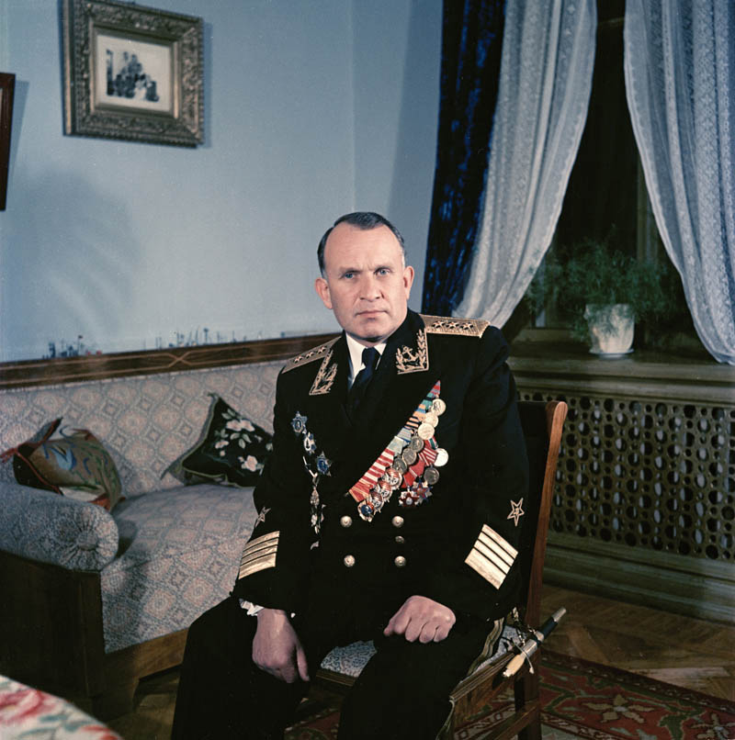
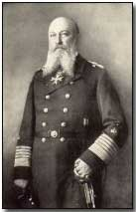
Mahan’s doctrine influenced Adm. Alfred von Tirpitz (1849-1930; on left), Japanese naval leaders prior to and during World War II, and Adm. Sergei Gorshkov (1910-1988), who created the Soviet Union’s ocean-going navy

Slide 12
Mahan’s principles of naval strategy explain the logic behind the rise of the People’s Liberation Army Navy (PLAN). Its name indicates the secondary importance historically attached to this branch of China’s armed services. The initial stage of that country’s naval expansion was overseen by Adm. Wu Shengli (commander of the PLAN, 2006-17), here seen with Adm. John Richardson, US Chief of Naval Operations. Under Wu, the Chinese navy left behind its origins as a coastal defense force and strove to attain regional naval supremacy over the United States and its allies. In the fullness of time, China aims to attain global naval parity with the West
Photo taken in 2016

Slide 13
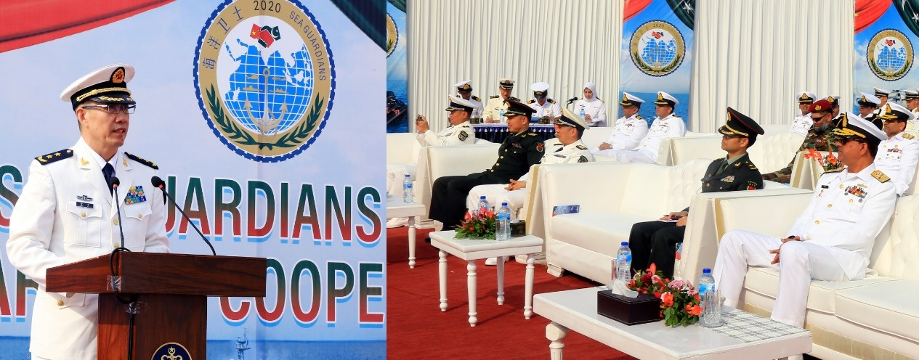
Admiral Shen Jinlong, commander of the Chinese navy in 2017-2021 (on left), who was recently succeeded by Adm. Dong Jun (on right). China’s ambitions to create a blue sea navy along Mahanian lines have not changed, however

Slide 14
Last summer China launched the Fujian, its third aircraft carrier. Current plans call for the construction of three more flat tops. The Fujian may be the most capable non-US aircraft carrier ever built. According to published estimates, it will carry some 60 aircraft

Slide 15
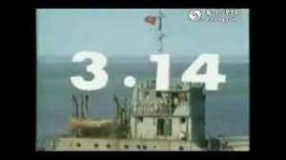
Like China’s land and air forces, its navy has not fought in a “hot” war in decades. The last time the PLAN saw action was during China’s capture of the Paracel Islands from South Vietnam in 1974, when the Chinese sank an enemy frigate. The occupation of the Johnson South Reef in the Spratly Islands in 1988 by a PLAN task force, which easily overcame North Vietnamese resistance, was more in the nature of a skirmish
Still from 3.14, a
Chinese progaganda film about the Johnson South Reef incident
Battle of the Paracel Islands

Slide 16
Does China’s expansion in the South China Sea indicate a shift to a navalist global strategy?

Slide 17
As per Mahan, a global naval strategy requires overseas bases and supply depots

Slide 18
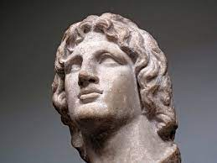
A useful definition, although it does not apply to divine or semi-divine individuals such as Alexander and Caesar
Charisma [is] a certain quality of an individual personality by virtue of which he is set apart from ordinary men and treated as endowed with supernatural, superhuman, or at least specifically exceptional powers or qualities. These are such as are not accessible to the ordinary person, but are regarded as of divine origin or as exemplary, and on the basis of them the individual concerned is treated as a leader.
Max Weber

Slide 19
Mussolini declaring war on the United States from his oratorical balcony in Rome’s Piazza Venezia. As events were to show, the fascist dictator proved unable to sustain this attempt to transform his political charisma into the military kind

Slide 20
Prince Rupert of the Rhine (1619-1682)

Slide 21
Marshal Joachim Murat (1767-1815; with feathers) and General Antoine de Lasalle (1775-1809)

Slide 22
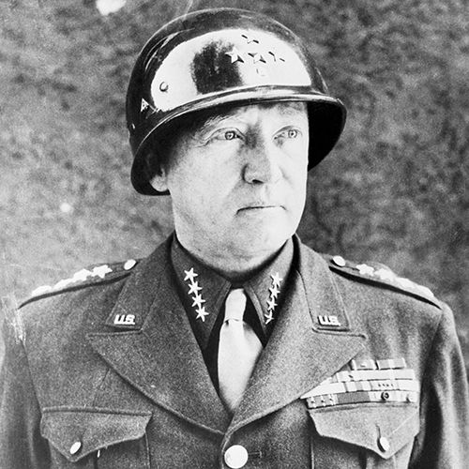
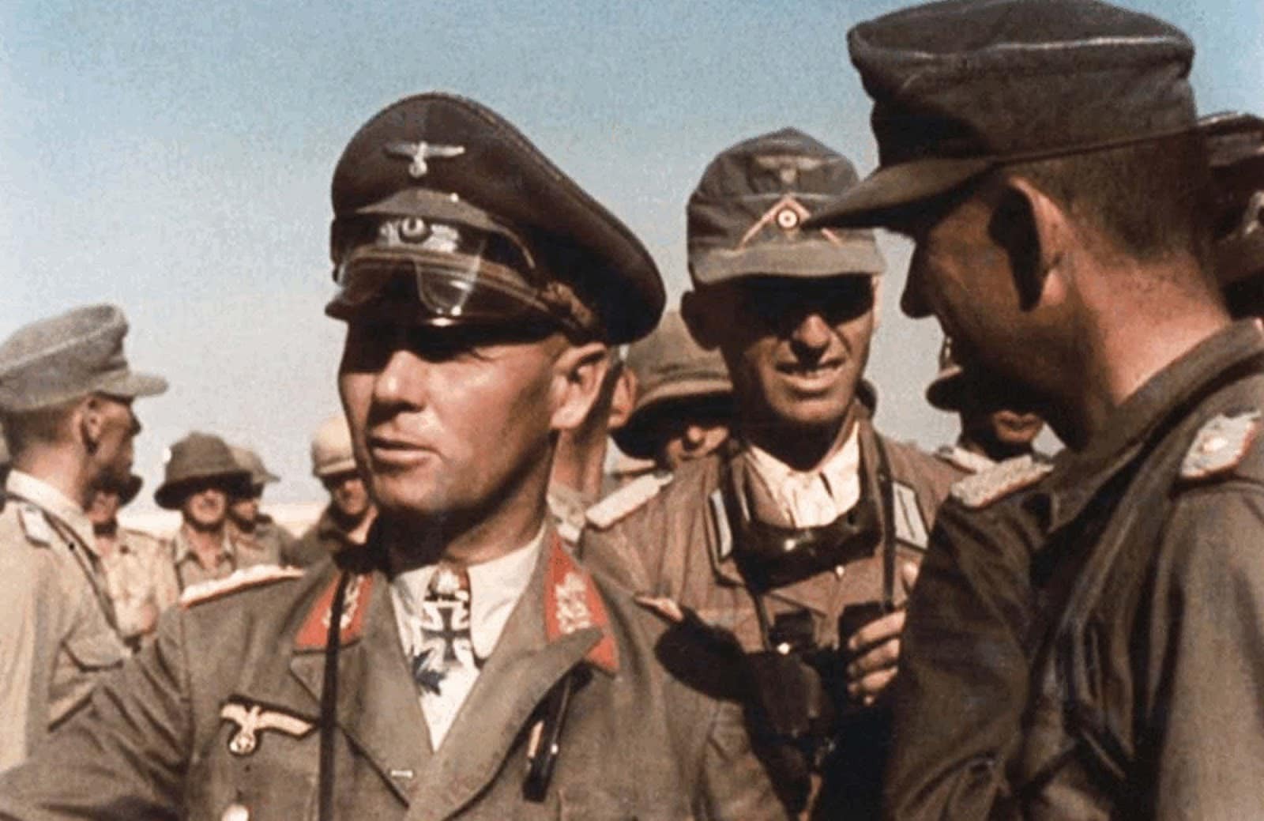
Montgomery, Rommel, Patton

Slide 23
Gen. Norman Schwarzkopf (1934-2012), here seen with Gen. Colin Powell

Slide 24
Gen. David Petraeus (b. 1952) commanded the 101st Airborne Division in Iraq (2003-04), and subsequently Central Command (2008-10) and the International Security Assistance Force in Afghanistan (2010-11), where he succeeded Gen. Stanley McChrystal. In 2011-12 he was Director of the CIA but was forced to resign following an affair with his biographer, Paula Broadwell. In retirement, he has been critical of the foreign and military policies of the Trump and Biden administrations

Slide 25
The tradition of special forces operations goes back to World War II or even World War I (more about this in Lecture 5). Iranian Gen. Qasem Soleimani (1957-2020; shown here), commander of the Islamic Revolutionary Guard’s Quds force, was a skilled practitioner of hybrid and asymmetric warfare

Slide 26
Gen. Valery Zaluzhny (b. 1973; here shown with President Zelensky), Commander-in-Chief of the Ukrainian armed forces since July 27, 2021

Slide 27
Bo Silai and Gu Kailai: The perils of charisma, including the military variety, in post-Maoist China

Slide 28
Tom Cotton fought in Iraq with the 101st Airborne division under General Paetreus and went on to serve in Afghanistan, attaining the rank of captain. Elected to the US Senate in 2014, he is one of its most hawkish voices in the area of foreign policy

