Slide 1
War in the Twenty-First Century
Lecture Three
“I Do Not Know With What Weapons World War III Will Be Fought, But World War IV Will Be Fought With Sticks and Stones”
Tuesday, February 14

Slide 2
Historically, the cultures of nuclear war have varied from country to country

Slide 3
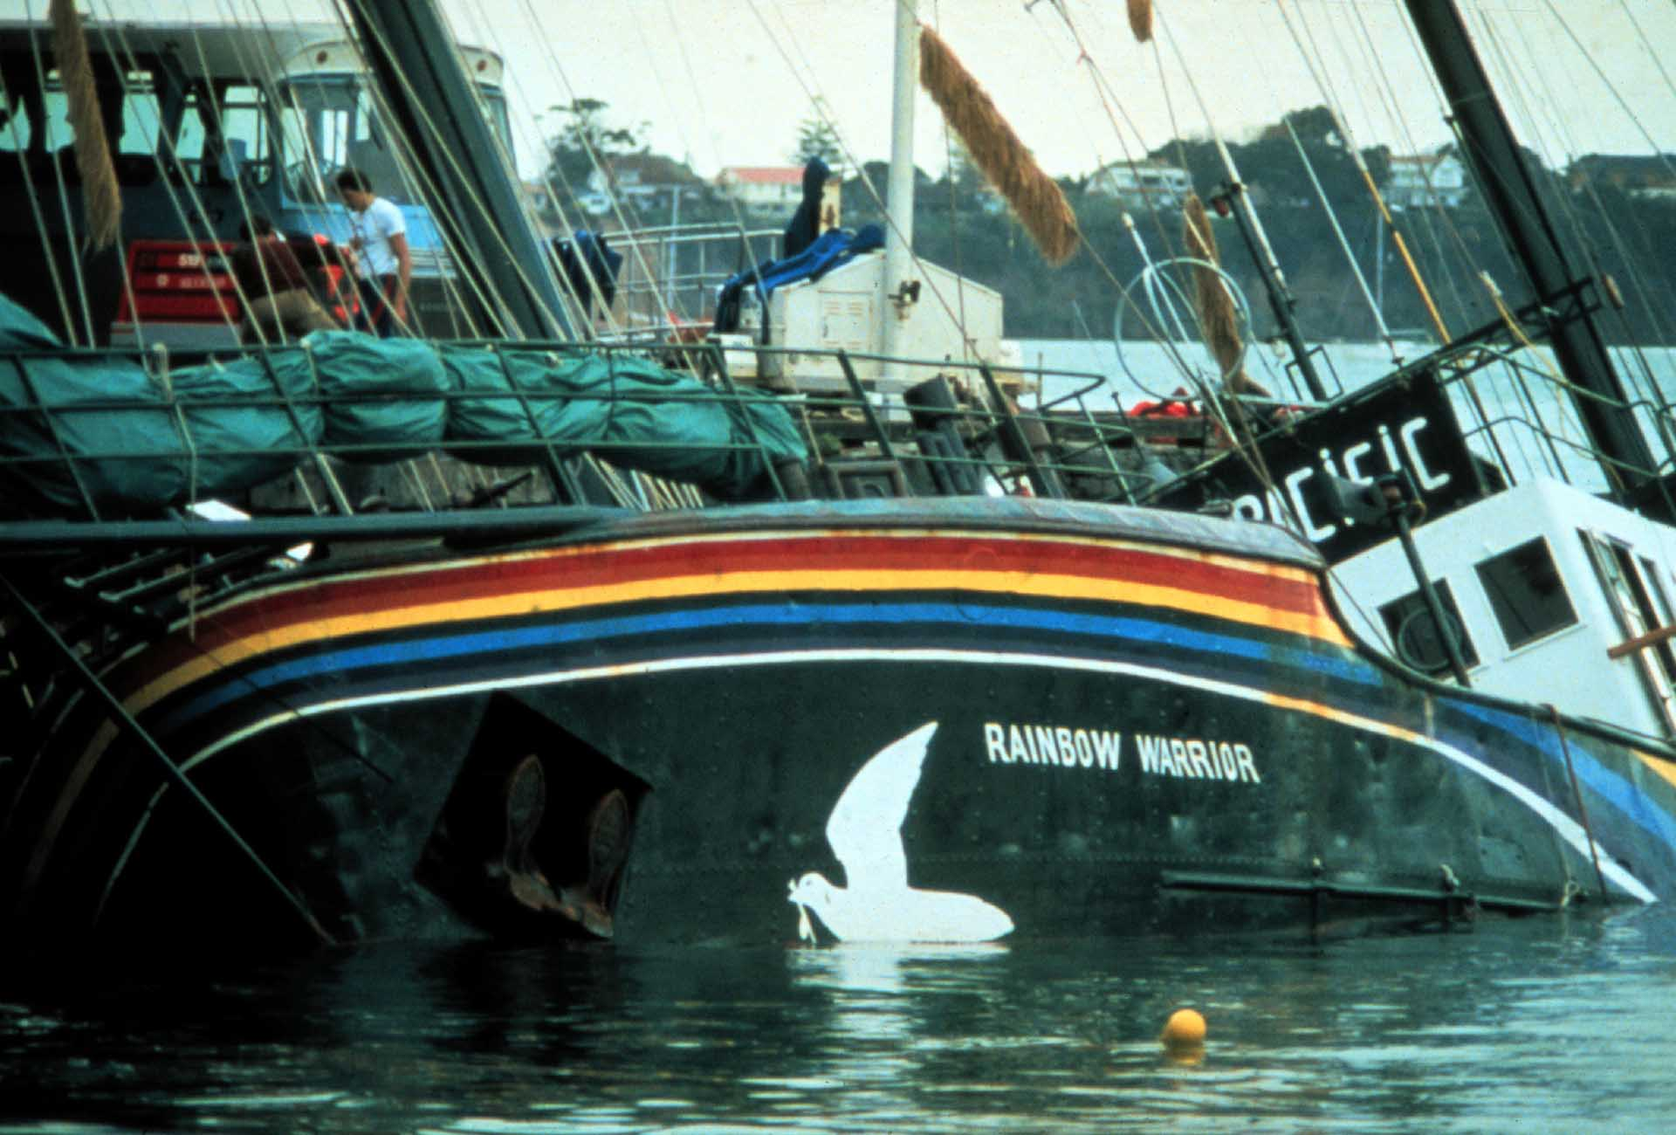
A strong US ally, since 1984 New Zealand has been a nuclear-free zone
The lethal bombing of the Rainbow Warrior, flagship of
Greenpeace, carried out by agents of France’s DGSE.
The attack took place in the port of Auckland on July 10, 1985
During the Cold War, New Zealand would have been global refuge in case of nuclear Armageddon

Slide 4
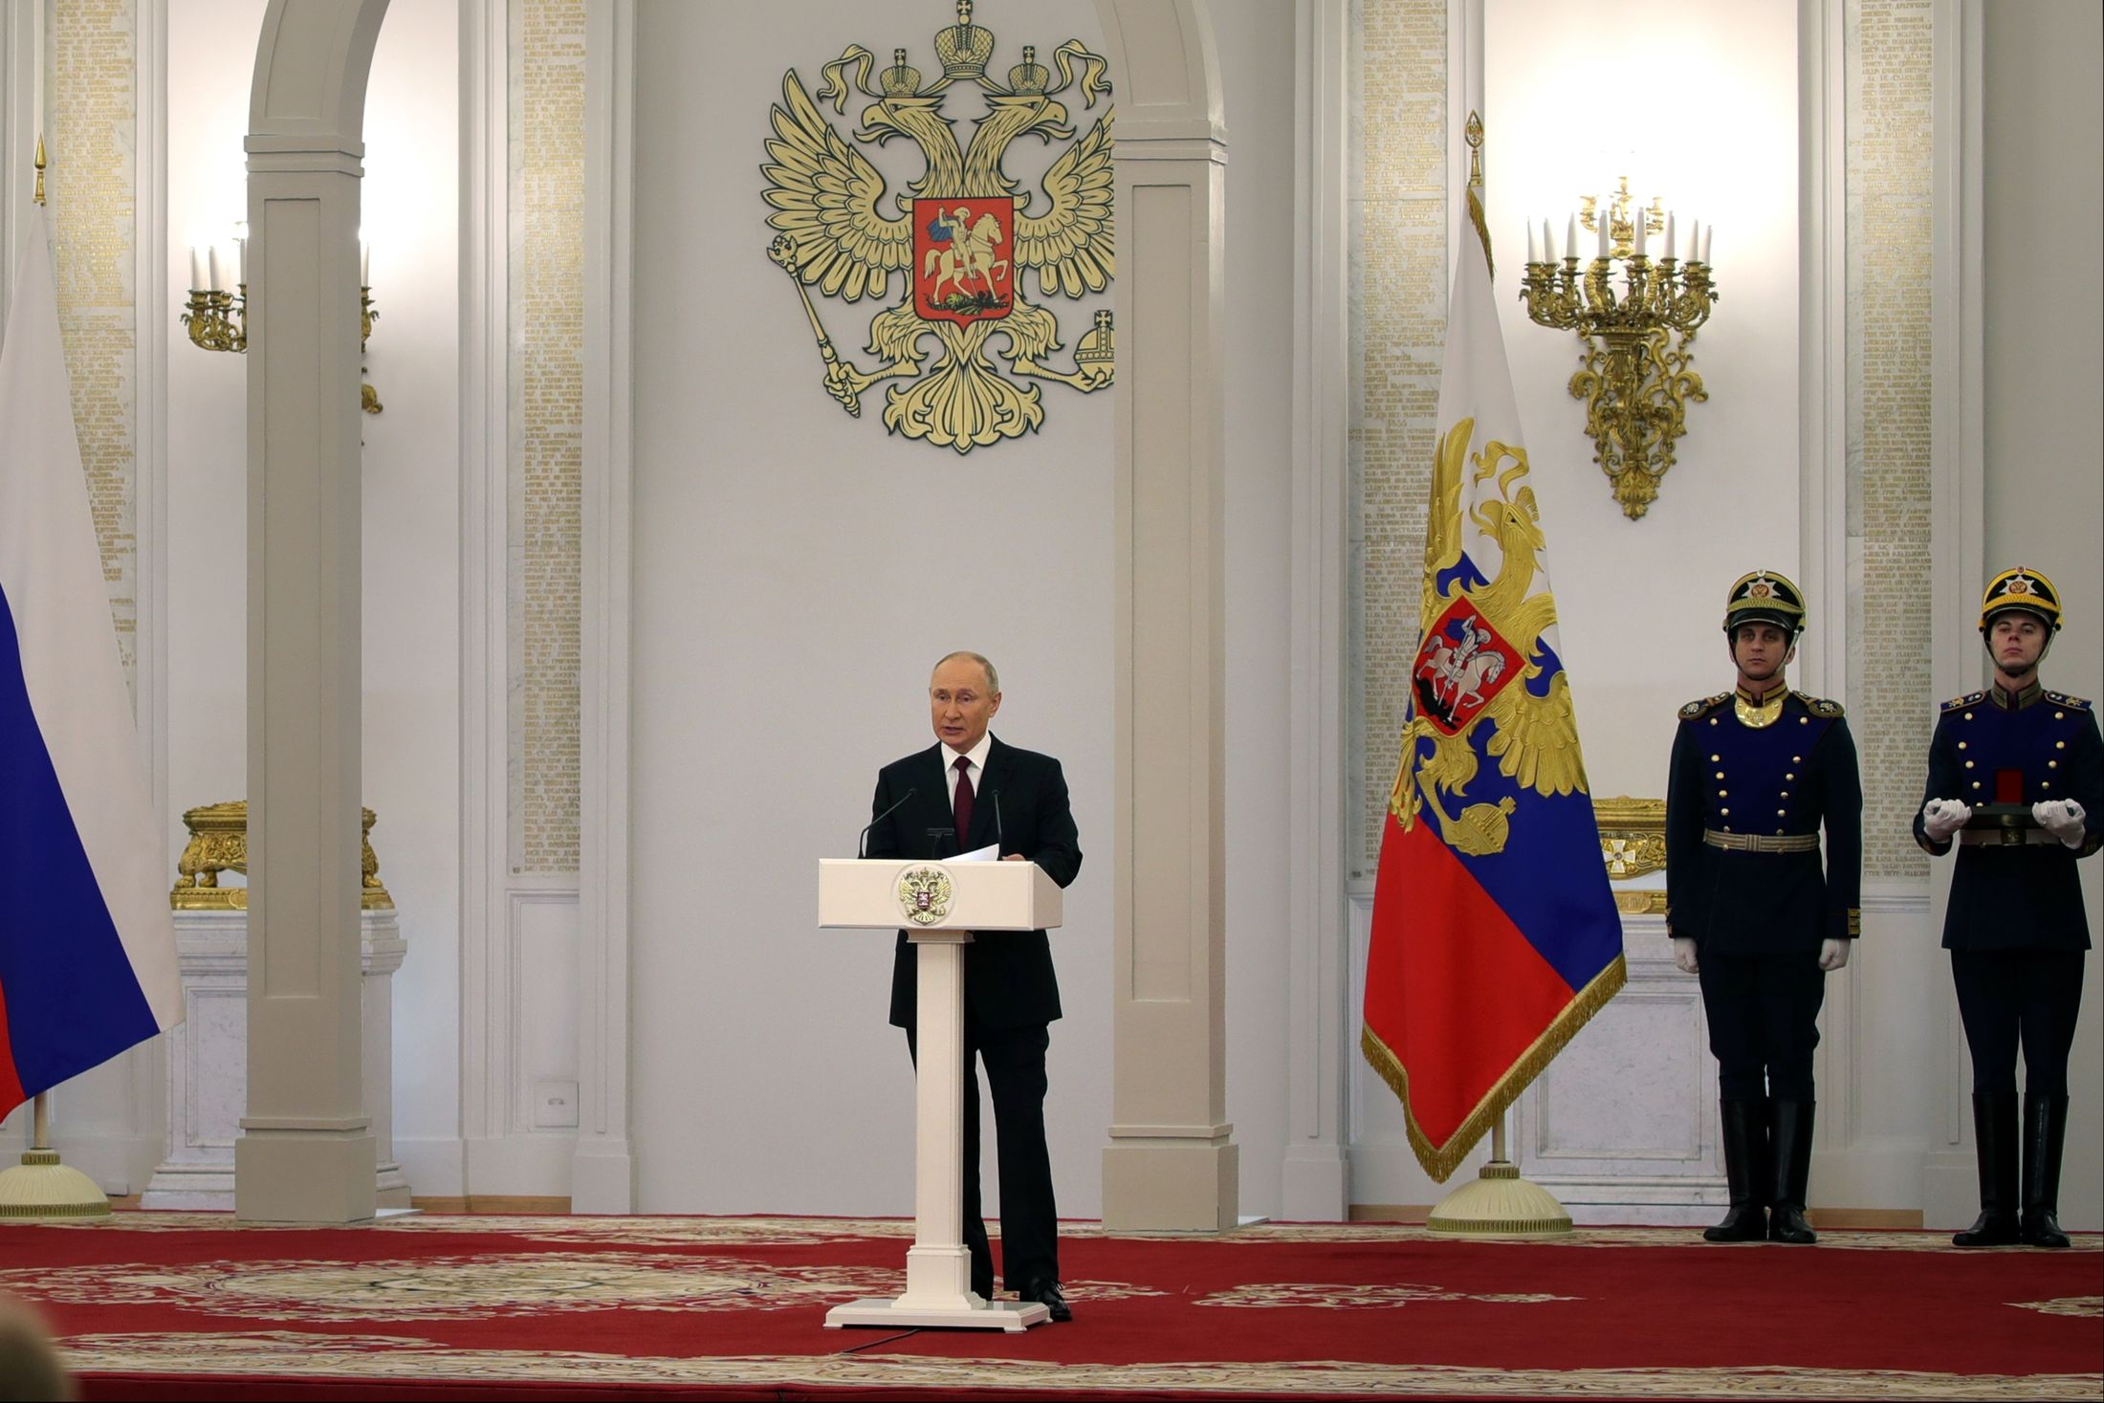
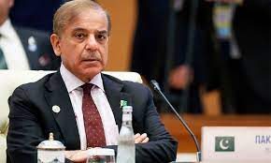
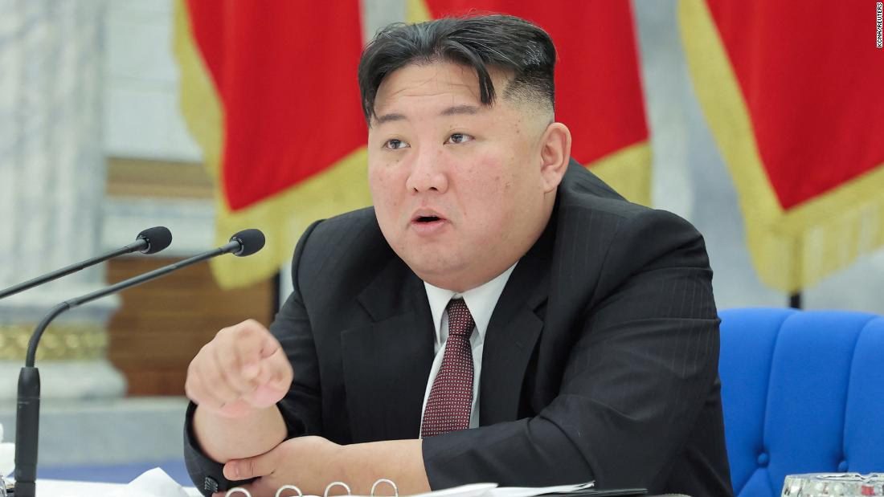
Clockwise from left to right: President Xi Jinping (China), President Vladimir Putin (Russia), Supreme Leader Ali Khamenei (Iran), Prime Minister Narendra Modi (India), Prime Minister Shehbaz Sharif (Pakistan), Prime Minister Benjamin Netanyahu (Israel), Supreme Leader Kim Jong-un (North Korea)

Slide 5
The Battle of Jutland (May 31—June 1, 1916) holds lessons about the combat deployment of tactical nuclear weapons

Slide 6
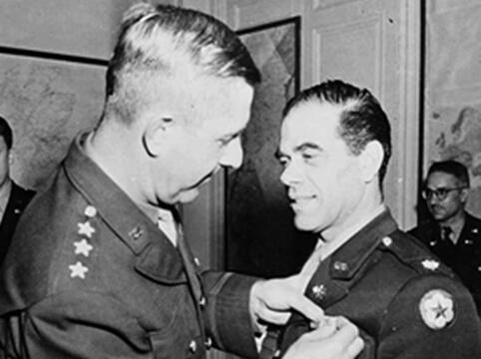
Why We Fight was a series of seven films produced by Frank Capra during World War II: https://www.youtube.com/watch?v=wcAsIWfk_z4&list=PLugwVCjzrJsXwAiWBipTE9mTlFQC7H2rU

Slide 7
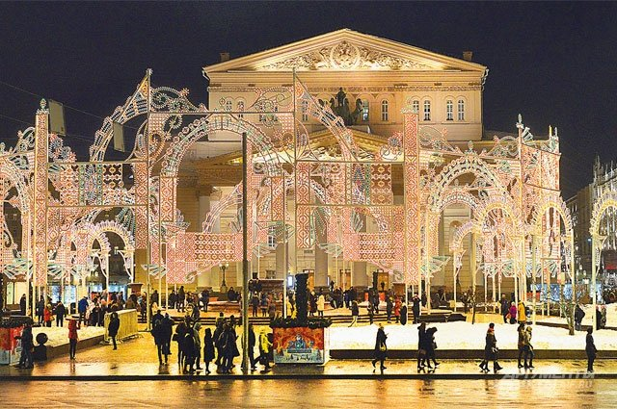
In the public mind these days, war is fought over there by someone else. Civilian society remains remote from the realities of combat, except in the PR / propaganda / cultural sphere. This is as true of the United States as it is of China and even Russia. The latter’s ”Special Military Operation” is a striking example of the disconnect between the lives of the Russian people and the war that is fought in their name in Donbas and Zaporizhzhya

Slide 8
The Iliad

Slide 9
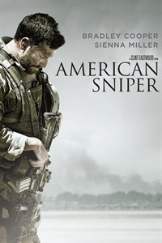
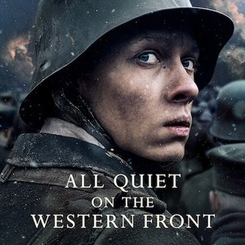
World War I and its aftermath saw the emergence of explicitly antiwar poetry, prose, and film. The “good war” the Allies waged against the Axis was followed by deheroizing artistic treatments of combat in English, French, and even Russian. The Vietnam War and the second war in Iraq generated its own narratives of battlefield distress, particularly in film and on TV

Slide 10
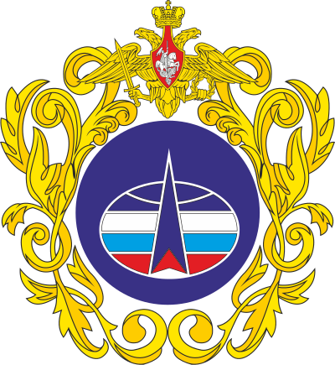
Before World War I, combat was two-dimensional. That conflict extended it into the air, while the twenty-first century has seen the militarization of low-orbit space by the US, China, and Russia. This trend will continue, altering the conduct of military operations on earth
China’s Strategic Support
Force (founded 2015) comprises
space, cyber, and psychological
warfare branches
The US Space Force
(founded 2019) descends from the Air
Force Space Command, which was established in 1982
The Russian Space Forces (founded 2015)

Slide 11
The Ukrainians’ use of Elon Musk’s Starlink satellite-based communication system has been remarkably effective. Image shows a consignment of Starlink dishes being delivered to the Ukrainian army. The use of low-cost, off-the-shelf technology is a feature of asymmetric warfare

Slide 12
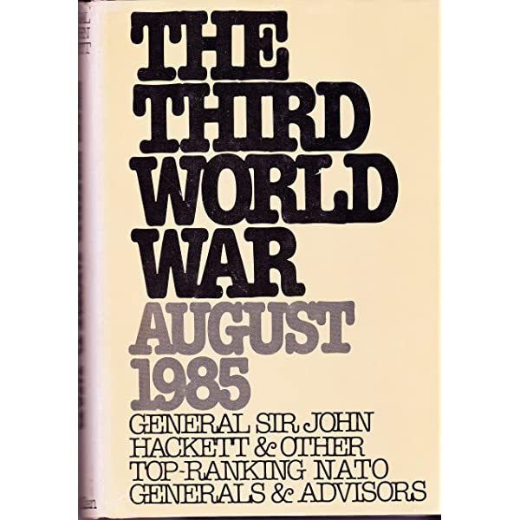
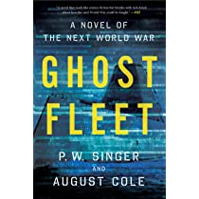
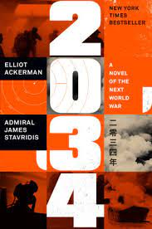
Military thrillers as a professional resource

Slide 13
SIGMA was founded by former White House Science Office member Arlan Andrews, Sr. See: http://www.sigmaforum.org
“Sigma is a group of science fiction writers who offer futurism consulting to the
United States government […]. […]. Most of us have earned PhDs in high tech fields and
some presently hold Federal and defense industry positions. Each is an accomplished
science fiction author who has postulated new technologies, new problems, and
new Societies […]”

Slide 14
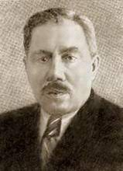
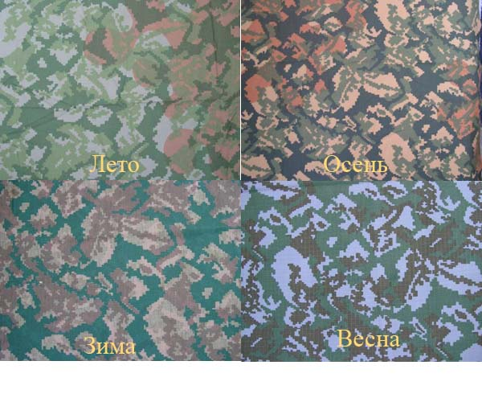
Prof. Shvanvich (Schwanwitsch) taught Stalin lepidoptery and helped the Red Army defeat Nazi Germany
Boris Shvanvich
(1899-1957)
Prof. Shvanvich’s grave in St. Petersburg
Soviet camouflage
patterns in World War II
(clockwise from top left:
summer, autumn, spring, winter)

Slide 15
Fighting the last war, or, the perils of operational plagiarism. On February 24, 2022 Russia attempted to mount a version of Operations Desert Storm and Iraqi Freedom. It did not work. In consequence, the Russian army reverted to its traditional, attritional manner of waging war. NB: the principles of strategy never change, but operational and tactical methods evolved through the ages
“Shock and Awe”
Shaping the battlefield
Land- and sea-based cruise missiles
Deployment of special forces
“Light footprint” (associated with the 2003 Iraq war)
PMC’s (private military contractors)
Battalion-sized tactical groups
Pixelated camo patterns that are machine-engineered

Slide 16
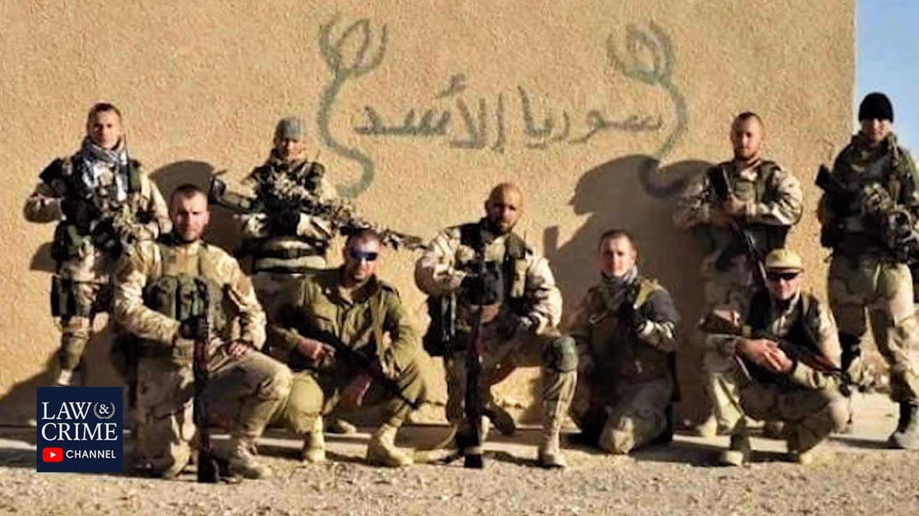
Under Russian law, the Wagner Group should be illegal as it is a private military company. Its owner, “Putin’s Chef” Yevgeny Prigozhin, has emerged as an important political player. “Gordon Ramsey was not in charge of Blackwater” (Atomic Cherry, a Russian military affairs Telegram channel). That said, or quoted, the privatization of military action will be a central feature of twenty-first century warfare. In this regard, however, China may prove to be something of an exception…

Slide 17
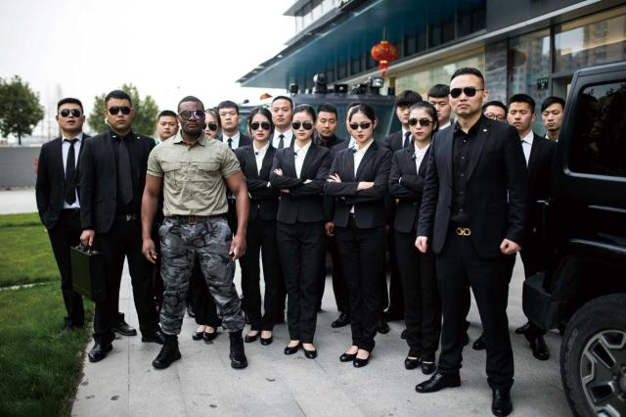
…because its privatization of the state’s monopoly on violence is lonfined to PSCs (private security contractors). These images shows Tianzun Special Guard owner Wang Haichun leading a company exercise in Hangzhou, China in 2018 (on left), and posing with his employees in front of company headquarters (on right). As in the case of the Wagner Group or, earlier, America’s Blackwater company (now operating as Constellis), private security or military work carries with it a certain aesthetic

Slide 18
Total war and the three models of a war economy
Soviet model: Economic and human resources prepared and mobilized
prior to start of military operations (World War II, Cold War)
American model: Said resources mobilized after military operations
commence (Civil War, World Wars I & II, Korea; in the case of Vietnam,
Iraq (twice), and Afghanistan, economic and human mobilization was
partial and limited)
Japanese model: across-the-board integration of civilian population
and the entire economy into the war effort (World War II)
Takeaway for the twenty-first century: A successful wartime
economic policy will aim at imposing as minimal a burden as possible on the
civilian sector and the country’s population. Efficiency rather than
size or scale!

Slide 19
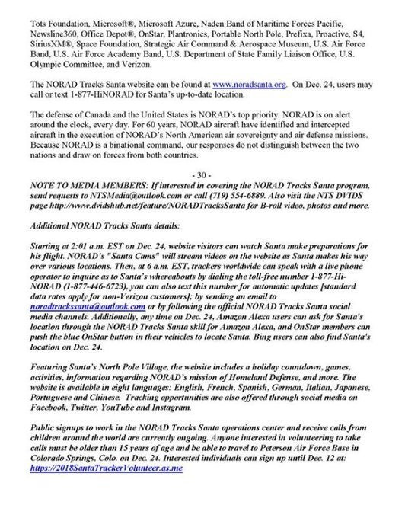
Tracking Santa Claus is harder than it seems!

Slide 20
Nato Secretary General Jens Stoltenberg’s warning of Monday, February 13
“It is clear that we are in the race of logistics. Key capabilities like
ammunition [ . . ]. must reach Ukraine before Russia can seize the
initiative on the battlefield.”
“A war of attrition becomes a battle of logistics.”

Slide 21
In most NATO armies, the standard ammunition load for an infantryman is 210 rounds of the 5.56 x 45 mm cartridge = seven magazines. Actual loads will vary depending on weapons or equipment carried by the soldier, or the nature of the mission

Slide 22
In the second Iraq war it took, on average, 300K rounds of ammunition to kill one insurgent
The Lake City Army Ammunition
Plant in Independence, MO is the
single largest manufacturer of
small caliber ammunition for the US Armed Forces. Current production capacity: + 1,6B rounds per year

Slide 23
The GAO/NSIAD-95-89 “Inventory and Requirements for Artillery Projectiles” report (1995) stated that the United States had a manufacturing capacity of 450,000 artillery shells per month. Currently this is much lower. Yet the Russia-Ukraine war has shown that shortages of artillery ordnance and missiles will severely degrade combat performance. According to Western sources, the Ukrainian army expends 3000-6000 artillery rounds a day, about a third of Russia’s estimated expenditure. The Pentagon says that as of January 2023, the United States had sent Ukraine over 1M 155 mm rounds alone
The US is now supplying the
M777 howitzer to Ukraine
See also Fact Sheet on US Security Assistance to Ukraine of January 23, 2023: https://media.defense.gov/2023/Jan/25/2003149684/-1/-1/1/UKRAINE-FACT-SHEET-JAN-25.PDF

Slide 24
“Artillery is the god of war” (Joseph Stalin, in 1944)
Russian artillery has traditionally been of high quality,
going back to the Napoleonic wars. During World War II, the Red Army relied, to a much greater extent than the Axis or the Allies, on the deployment of massed artillery at the level of the army and Front (army group): a World War I operational practice adapted for the mechanized war of maneuver on the Eastern Front. The other operational skill the Red Army displayed was maskirovka, or military deception: see Operation Uranus (the Battle of Stalingrad) or Operation Bagration (the destruction of Army Group Center in June-July 1944). In Ukraine, the Russians have attempted to use both artillery and maskirovka, with mixed results. The Ukrainians, whose armed forces, like those of Russia, are descended from the Red Army, have shown themselves to be much better at using both

Slide 25
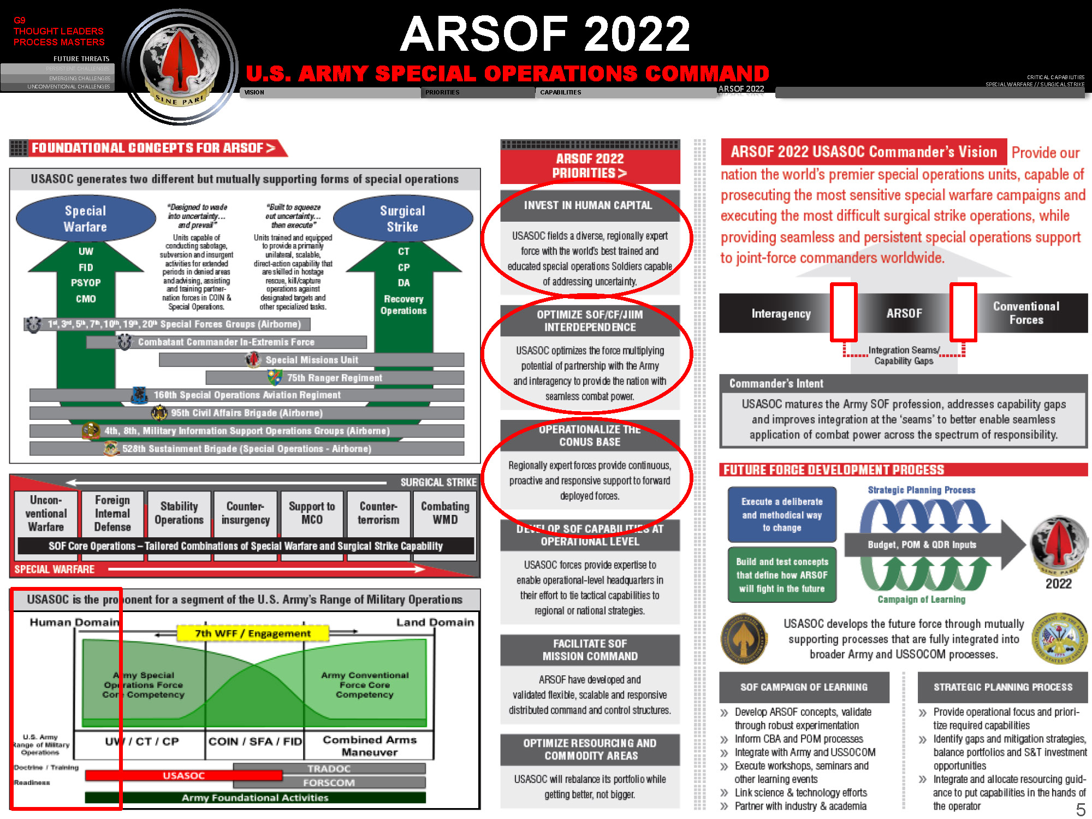
Joint force capabilities
The coming together of assets and resources from different service branches, which produces synergies, improves efficiency, and avoids duplication. US military doctrine defines joint operations as comprising: C2 (Command and Control), information, intelligence, fires, movement and maneuver, protection, and sustainment
Example: ARSOF, or the US Army
Special Operations Command

