Slide 1
War in the Twenty-First Century
Lecture Two
“The Two Most Powerful Warriors Are Patience and Time”
Tuesday, February 7

Slide 2
The alleged decline and projected fall of the West
The People’s Liberation Army Daily: “Not only has the United States been severely impacted by Covid-19 and an economic recession, but its political system and society are experiencing a deep crisis” (01-08-2022)
Dmitry Medvedev: in Ukraine, Russia is fighting “crazy Nazi drug addicts” whose Western allies have “saliva running down their chins from degeneracy” (speech of 06-29-2022)
Vladimir Putin: “The repression of freedom [in the West]
is taking on the outlines of a ‘reverse religion,’ of real
Satanism. […] Do we really want to see perversions that
lead to degradation and extinction to be imposed on
children […] for it to be drilled into them that there are
supposedly some genders besides women and men, and
offered the chance to undergo sex-change operations?”
(speech of 09-30-2022)

Slide 3
State of the world’s military: The United States
Active personnel: 1,390,000
Tanks: 5,500
Aircraft: 2800 (excludes helicopters)
Navy: 484 ships, including 11 aircraft carriers, 92 destroyers, 68 submarines
Note: concern about the rise of China cuts across the country’s political divisions. Armed forces leadership can be bureaucratic and beholden to powerful interest groups. Quality of personnel and equipment continues to be high

Slide 4
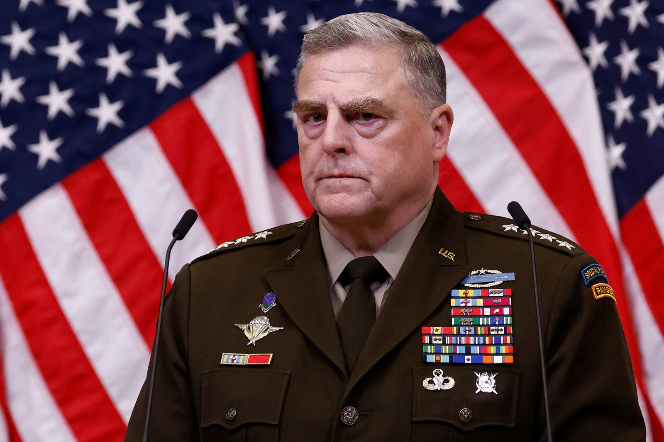
Current leadership at the Pentagon. On left, Secretary of Defense Lloys Austin; on right, General Mark Milley, Chairman of the Joint Chiefs of Staff

Slide 5
Barbara Starr: Pentagon’s voice in the main stream media?

Slide 6
Fareed Zakaria: spokesman for America’s foreign policy establishment

Slide 7
State of the world’s military: The Chinese People’s Republic
Active personnel: 2,000,000
Tanks: 5,000
Aircraft: 1600 (excluding helicopters)
Navy: 730 ships, including 2 aircraft carriers, 3 helicopters carriers, 50 destroyers, 43 frigates, 78 submarines
Note: aims to replace the United States as the preeminent global power by 2050 or earlier. Military expanding rapidly, but untested since 1979 Sino-Vietnamese war

Slide 8
The South China Sea is experiencing direct Chinese territorial expansion

Slide 9
The Belt and Road Initiative as an instrument of geopolitical strategy

Slide 10
Concern is growing about a possible Chinese attack on Taiwan

Slide 11
China’s new Type 20 service rifle

Slide 12
The Chengdu J-20 Mighty Dragon fifth-generation fighter is a stealth aircraft that is meant to compete with America’s own stealth jets, the F-22 Raptor (tactical fighter) and F-35 Lightning II (multipurpose attack)

Slide 13
The Harbin Z-20 Divine Eagle helicopter, which derives from the American S-70 Black Hawk. A stealth version is under development

Slide 14
Chinese defense minister Wei Fenghe, who was appointed in 2018, is very much Xi Jinping’s man

Slide 15
State of the world’s military: The Russian Federation
Active personnel: 1,000,000
Tanks: 12,000
Aircraft: 1,500 (excludes helicopters)
Navy: 598 ships, including 1 aircraft carrier, 15 destroyers, 11 frigates, 70 submarines
Note: owing to the war in Ukraine, Russia’s military, which prior to 2022 was ranked #3 in the world, has suffered considerable manpower, material, and reputational losses

Slide 16
President Vladimir Putin with defense minister Sergei Shoigu

Slide 17
Gen. Valery Gerasimov (on right), Russia’s chief of the general staff, was recently appointed commander of Russia’s expeditionary force in Ukraine. Here seen in conversation with his predecessor, Gen. Sergei Surovikin, aka General Armageddon

Slide 18
Evgeny Prigozhin, the oligarch who heads Russia’s Wagner paramilitary group and is known as “Putin’s Chef,” is in some ways a visionary figure

Slide 19
State of the world’s military: India
Active personnel: 1,500,000
Tanks: 4,600
Aircraft: 700 (excludes helicopters)
Navy: 295 ships, including 2 aircraft carriers, 11 destroyers, 12 frigates, 18 submarines
Note: continuing confrontation with Pakistan and tensions on the border with China. The Modri administration is nationalist and authoritarian, but flexible in its diplomatic dealings

Slide 20
Modri vs. Xi

Slide 21
India: tensions and threats to the west, north and south

Slide 22
State of the world’s military: South Korea
Active personnel: 550,000
Tanks: 2,331
Air force: 400 aircraft (excludes helicopters)
navy: 157 ships, including 2 helicopter carriers, 13 destroyers, 18 frigates, 22 submarines
Note: continuing confrontation with North Korea, rapidly expanding arms industry, South Korea aims to become one of the world’s #4 arms exporter. Currently it holds the #6 position, after the US, Russia, France, Germany, and Spain

Slide 23
K2 Black Panther Main Battle Tank

Slide 24
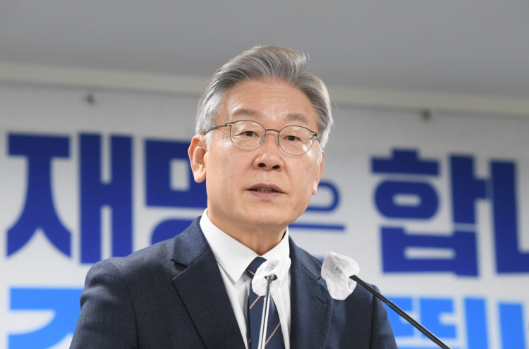
Conservative president Yoon Suk-yeol, a political novice, has a different geopolitical vision from that of opposition leader Lee Jae-myung, who once said he aimed to be a “successful Bernie Sanders”

Slide 25
State of the world’s military: Japan
active personnel: ca. 300,000
land forces: 1000 tanks
air force: ca. 250 (excludes helicopters)
navy: 155 ships including 4 helicopter carriers, 36 destroyers, 21 submarines
Note: under the late prime minister Shinzo Abe and his successor Fumio Kishida, Japan is rearming at a rapid pace and pursuing a more assertive foreign policy

Slide 26
State of the world’s military: Israel
Active personnel: 173,000
Tanks: 2,200
Aircraft: 270 (excludes helicopters)
Navy: 7 corvettes, 5 submarines, 45 patrol vessels
Note: the ongoing reconfiguration of the Middle-Eastern geopolitical map has placed Israel, which continues to enjoy a qualitative military edge over its regional adversaries, in a stronger military position than at any point in its history. Israel’s internal political situation is a different story

Slide 27
The drone attack on Iran of January 28, 2023 appears to have been carried out by Israel

Slide 28
State of the world’s military: Turkey
Active personnel: 425,000
Tanks: ca. 2,200
Strike aircraft: ca. 200
Navy: 154 ships, including 16 frigates and 12 submarines
Note: strong ambitions in the Middle East and Caucasus. Under President Recep Tayyip Erdogan, a canny geopolitician but a terrible economic manager, Turkey is displaying more than a whiff of revanchism and irredentism

Slide 29
The Ottoman legacy

Slide 30
State of the world’s military: Brazil
Active personnel: 360,000
Tanks: 466
Aircraft: 120 (excludes helicopters)
Navy: 112 ships, including 1 helicopter carrier, 6 frigates, and 7 submarines

Slide 31
Unlike other geopolitical actors such as China, Russia, Turkey and Iran, Brazil is not a revisionist power

Slide 32
State of the world’s military: Australia
Active personnel: 60,500
Tanks: 59
Aircraft: 120
Navy: 43 ships, including 2 helicopter carriers, 3 destroyers, 8 frigates, and 6 submarines
Note: the rise of China is of paramount concern to Australia, which together the US, Canada, UK and New Zealand is part of the Five Eyes intelligence-gathering alliance. In 2021 Australia signed AUKUS, a military agreement with the US and UK, under which it will acquire a fleet of nuclear submarines instead of the 12 diesel submarines it had agreed to buy from France

