Slide 1
War in the Twenty-First Century
Lecture One
“Only the Dead Have Seen the End of War”
Tuesday, January 31

Slide 2
FYI!
READINGS
Elliot Ackerman and James Stavridis, 2034: A Novel of the Next World War (New York: Penguin Press, 2021)
David Fisher, Can War Be Just in the Twenty-First Century? (Oxford: Oxford University Press, 2011)
F.X. Holden, Future War Novels (Kobani, Golan, Bering Strait, Okinawa, Orbital) (Kindle)
Anthony King, Urban Warfare in the Twenty-First Century (Cambridge, UK: Polity Press, 2021)
Jeffrey A. Larsen, Kerry M. Katcher, On Limited Nuclear War in the 21st Century (Stanford: Stanford University Press, 2014)
Jerry Lewis, The 2020 Commission Report on the North Korean Nuclear Attacks Against the US: A Speculative Novel (Boston/New York: Mariner Books, 2018)
Linda Nagata, The Last Good Man (Kula, HI: Mythic Island Press, 2017)
Trina Marie Phillips and August Cole (ed.), Visions of Warfare 2036 (Norfolk, VA: Allied Command Transformation, 2016)
P.W. Singer and August Cole, Ghost Fleet: A Novel of the Next World War (Boston/New York: Mariner Books, 2015)
ONLINE ITEMS
United States Marine Corps, Science Fiction Futures; Marine Corps Security Environment Forecast: Futures 2030-2045 (Quantico, VA: Marine Corps Warfighting Laboratory, 2016), https://www.mcwl.marines.mil/Portals/34/Documents/FuturesAssessment/Marine%20Corps%20Science%20Fiction%20Futures%202016_12_9.pdf?ver=2016-12-09-105855-733
https://www.act.nato.int/images/stories/events/2012/fc_ipr/visions-of-warfare-2036.pdf
VIEWINGS
Generation Kill (2008)
Top Gun: Maverick (2022)
Wolf Warrior (2015)
Wolf Warrior 2 (2017)
Zero Dark Thirty (2012)

Slide 3
Captain Ewart V. Tempest with his bride Marcelle-Julienne in 1918

Slide 4
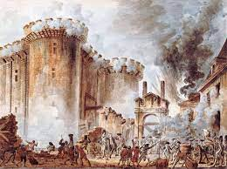
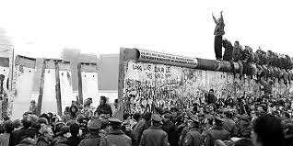
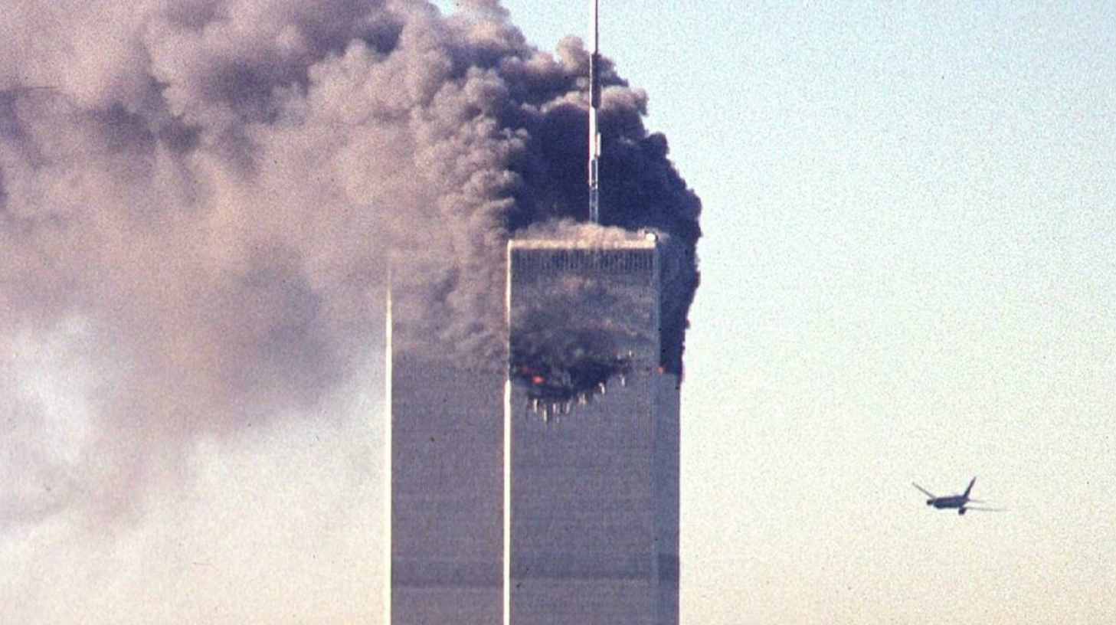
First, let’s decide on our temporal parameters: The long twenty-first century?
Nineteenth century: 1775 or 1789 — 1914
Twentieth century: 1914 — 1989 or 1991
Twenty-first century: 1989 or 1991 — ?

Slide 5
Every one of these sayings, whether wise or facile or humorous, possesses serious meaning in the year 2023
In peace, sons bury their fathers. In war, fathers bury their sons (Herodotus)
War is hell (William Tecumseh Sherman)
The best armor is staying our of gun range (Italian proverb)
All war is a symptom of man’s failure as a thinking animal (John Steinbeck)
The true soldier fights not because he hates what is in front of him, but because he loves what is behind him (G.K. Chesterton)
Do not touch anything unnecessarily. Beware of pretty girls in dance halls and parks who may be spies, as well as bicycles, revolvers, uniforms, arms, dead horses, and men lying on roads — they are not there accidentally (Soviet infantry manual from the 1930’s)
The journey of a thousand miles begins with one step. And lots of bitching (Anonymous)
There is no hunting like the hunting of man, and those who have hunted armed men long enough and liked it, never care for anything else (Ernest Hemingway)
Interdum feror cupidine partium magnarum Europae vincendarum = Sometimes I get this urge to conquer large parts of Europe (Anonymous)

Slide 6
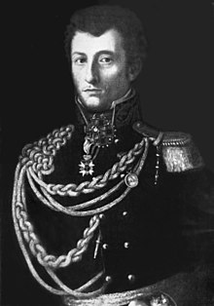
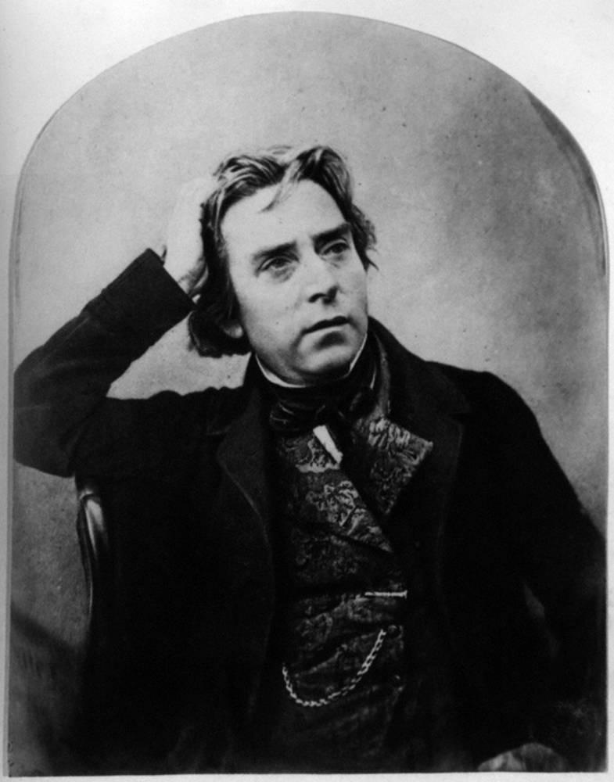
Carl von Clausewitz + Douglas Jerrold Mashup
war is politics by other means (Clausewitz) + war is murder in uniform (Jerrold) = murderous politics

Slide 7
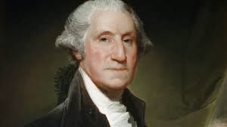
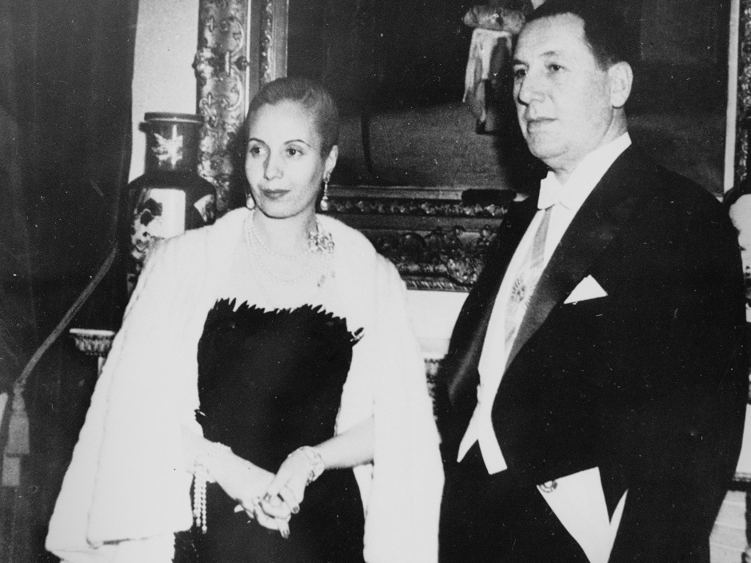
Out of war, order? Military leaders as state builders

Slide 8
Studiedly, and misleadingly, bland. America’s greatest soldier-statesman of the modern era paraphrases Napoleon’s “In war, moral power is to the physical as three parts out of four”

Slide 9
Were Russia’s defeats in the war with Ukraine due to damaged morale? (Image shows the sinking of the cruiser Moskva, the flagship of Russia’s Black Sea Fleet, on April 14, 2022)

Slide 10
Napoleon’s Grande Armée enters Berlin on October 27, 1806

Slide 11
The Revolution of March 8-12, 1917 led to the collapse of the Russian Imperial Army and, after the Bolsheviks seized power in November 1917, to a separate and humiliating peace with Germany

Slide 12
August 8, 1918. Erich Ludendorff, Germany’s de facto commander in the west, described the opening of the Battle of Amiens, which began the Allies’ Hundred Days Offensive in World War I, as “the black day of the German Army”

Slide 13
The Fall of France in 1940

Slide 14
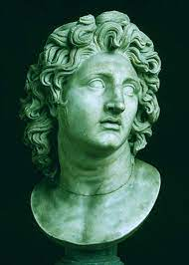
Firm and informed leadership
“An army of sheep led by a lion is better than an army of lions led by a sheep” (Alexander the Great)

Slide 15
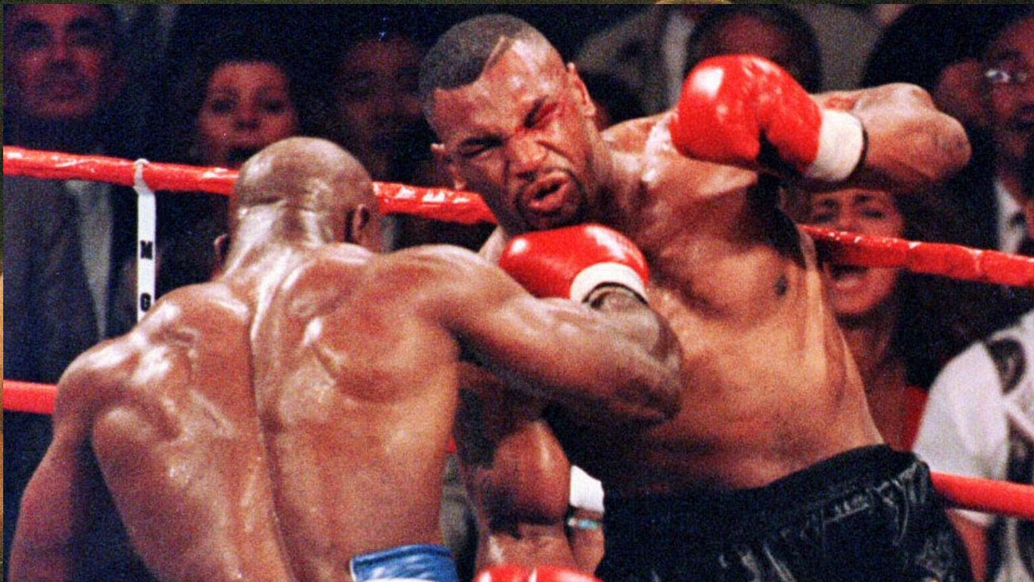
A plan
It ought to be focused but flexible, i.e., provide for surprise developments. “You want to take Vienna? Then take Vienna (Napoleon); “Everyone has a plan until they get punched in the mouth” (Mike Tyson); “Never interrupt your enemy when he is making a mistake” (Napoleon)

Slide 16
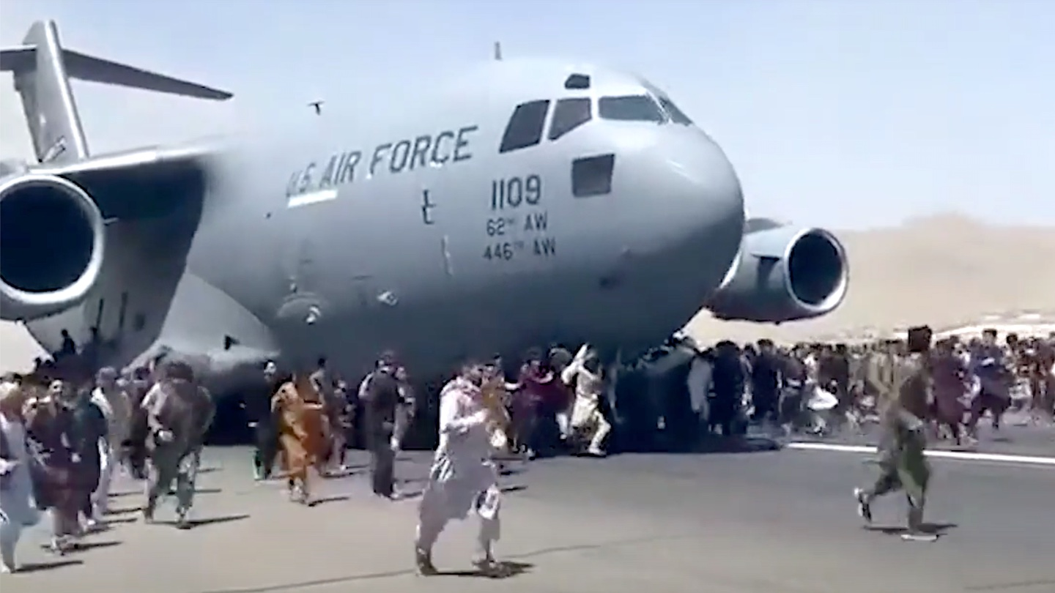
Fetichizing THE PLAN is a recipe for disaster. Germany’s invasion of Belgium and France in 1914, and the Western Allies’ flight from Afghanistan in August 2021, are a case in point

Slide 17
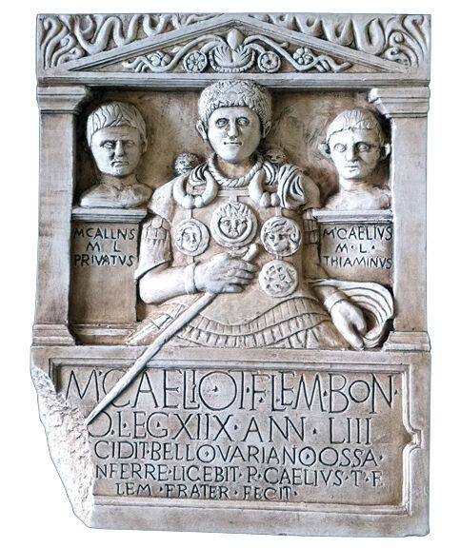
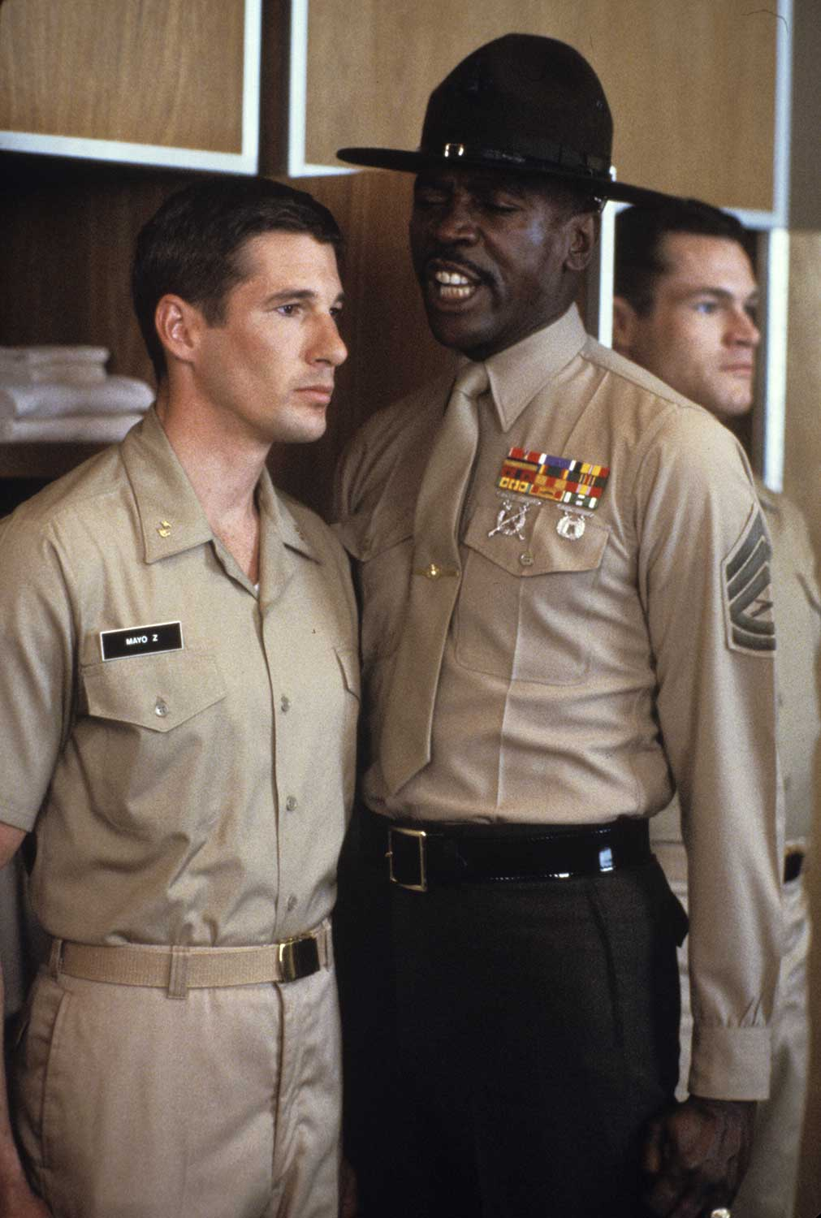
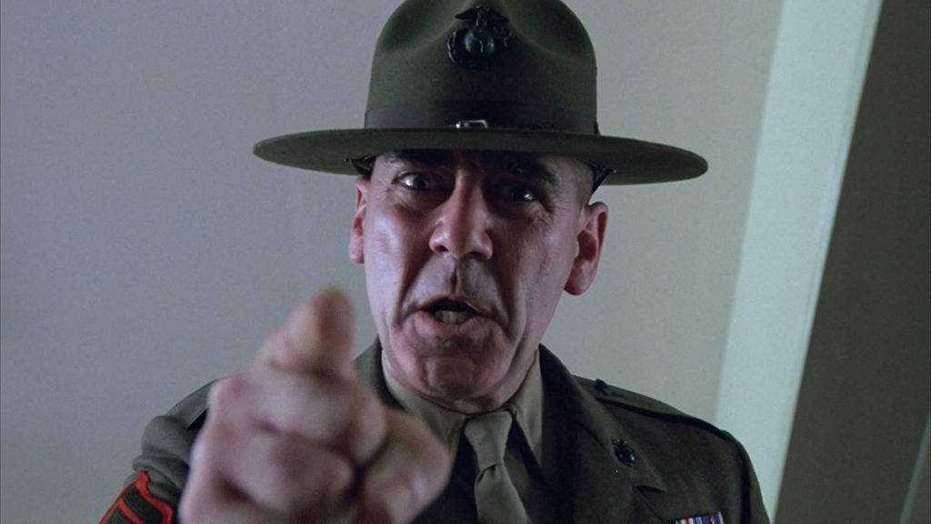
A strong non-commissioned officer corps
...which requires that the society in question possess a functional, intermediate social stratum rather than just a crude, hierarchical “vertical of power.” Left to right: frieze relief of Roman centurion, Gunnery Sgt. Emil Foley/Louis Gossett Jr. confronts Officer Candidate Zack Mayo/Richard Gere (An Officer and a Gentleman; 1982), Gunnery Sgt. L. Hartman/R. Lee Ermey gives Marine recruits a piece of his mind (Full Metal Jacket; 1987)

Slide 18
Comradeship and unit cohesion, as in foxhole buddies

Slide 19
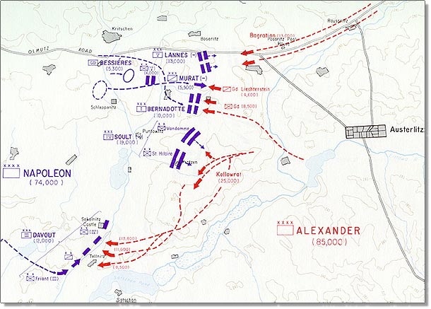
Treating your service men and -women with respect. Napoleon’s proclamation to his army of December 1, 1805 is an example
Soldiers: The Russian army has presented itself before you to revenge the disasters of the Austrians at Ulm. They are the same men that you conquered at Hollabrunn, and on whose flying trails you have followed. The positions which they occupy are formidable. While they are marching to turn my right, they must present their flank to your blows.

Slide 20
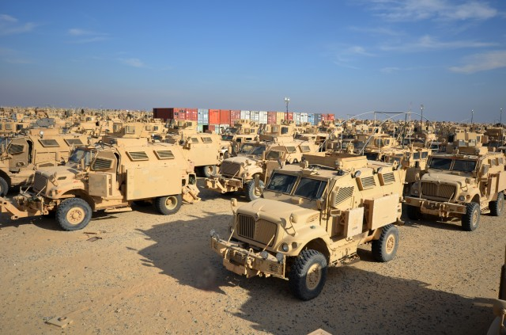
Logistics
“An army marches on its stomach” (Napoleon)

Slide 21
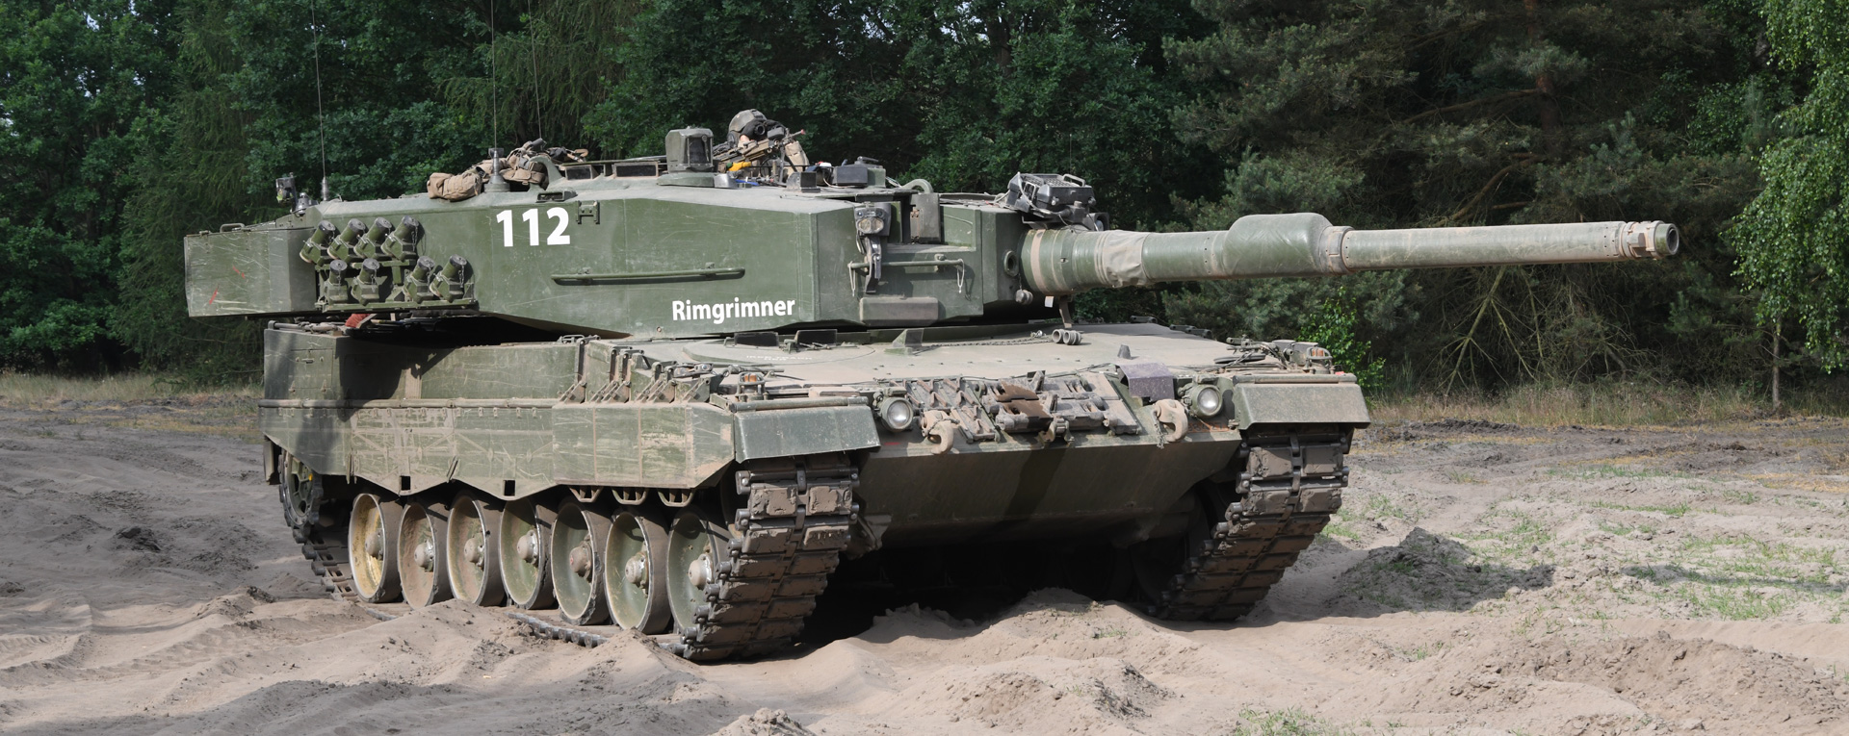
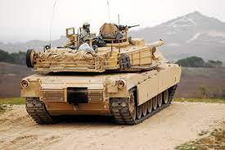
Quality of equipment. Left to right, NATO’s three main battle tanks: Abrams M1 A2 (US), Leopard 2 (Germany), Challenger 2 (UK)

Slide 22
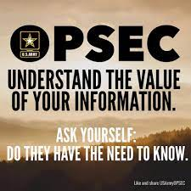
…but also ask, do they KNOW what they NEED to know?

Slide 23
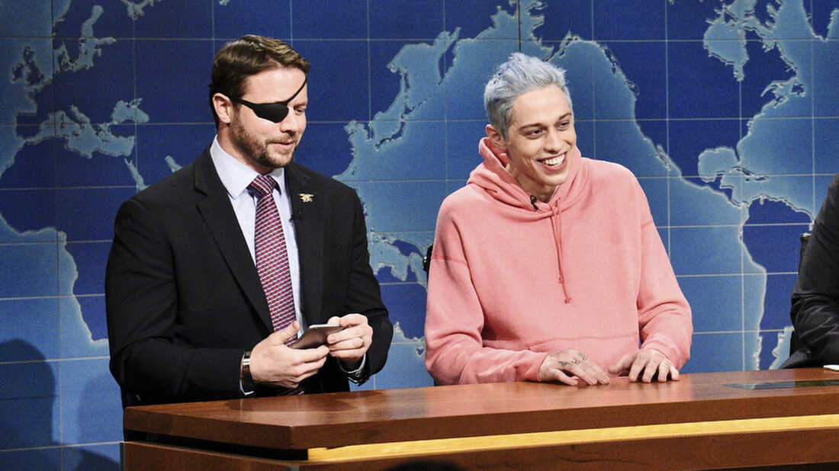
What does it mean to be a veteran in the United States ca. 2023?

Slide 24
The Stolen Valor channel on YouTube has 828K subscribers

Slide 25
Gen. Mike Minihan, Commander Air Mobility Command. Known for soundbites such as “Killing the enemy makes life better” and, most recently, “My gut tells me we will fight in 2025” (a reference to China)

