Slide 1
Navigating the National Archives CLASS TWO
Brant Houston
University of Illinois
brant.houston@gmail.com

Slide 2
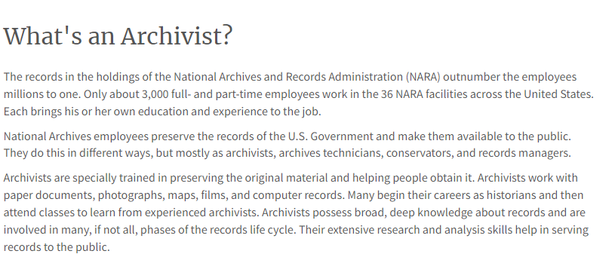
The Archivist
http://www.bbc.com/news/blogs-trending-42724320

Slide 3
Archivists
What’s one thing you wish the general public knew about archives?
It’s not just large nondescript buildings that have workers wearing glasses with chains. It’s small archives in the back of museums, it’s cubbies at libraries that are full of documents you can’t check out, it’s in your grandmother’s’ attic (we all have that grandmother who has collected everything about something). Archives can be everywhere and of every size.
https://archivesaware.archivists.org/2020/04/28/archives-audiences-andretta-schellinger-historian-and-author/

Slide 4
Archivists
Also, archivists don’t just love the material they are processing, but they love sharing it with others. I have had archivists who were giddy with excitement to show me something they found while digging for something I asked for. And in some cases, digging is exactly what happens, because there are not enough days, man hours, or people to process all the archival material that’s being made on a daily basis. Be kind to the archivists in your life, they are the keepers of the materials you may need.
https://archivesaware.archivists.org/2020/04/28/archives-audiences-andretta-schellinger-historian-and-author/

Slide 5
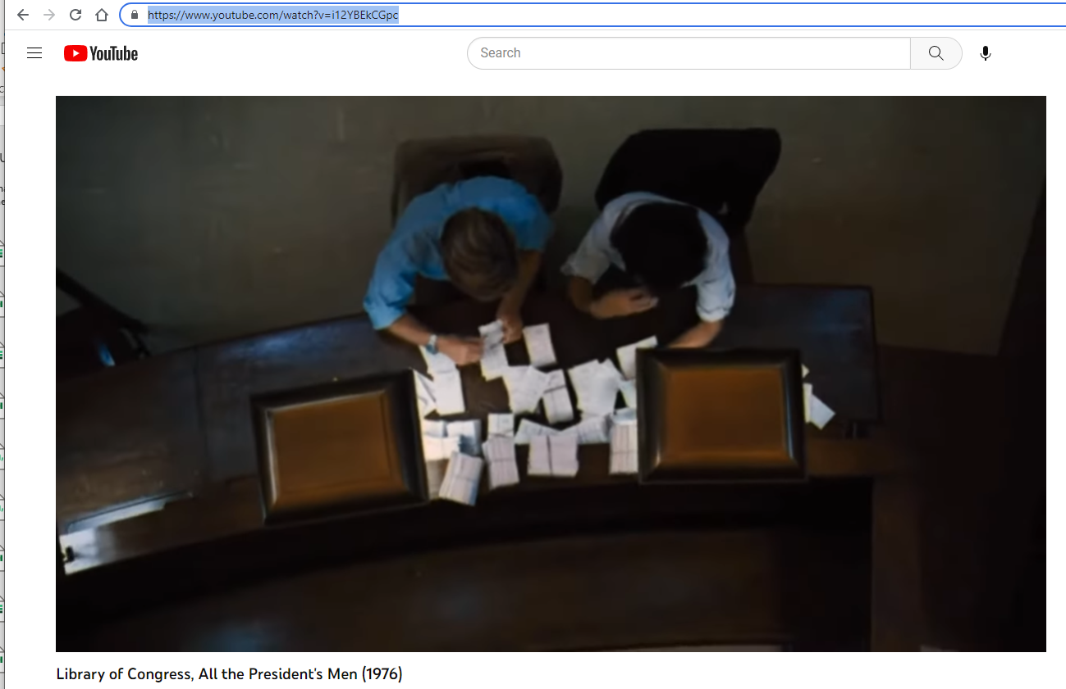
Library of Congress
http://www.bbc.com/news/blogs-trending-42724320

Slide 6
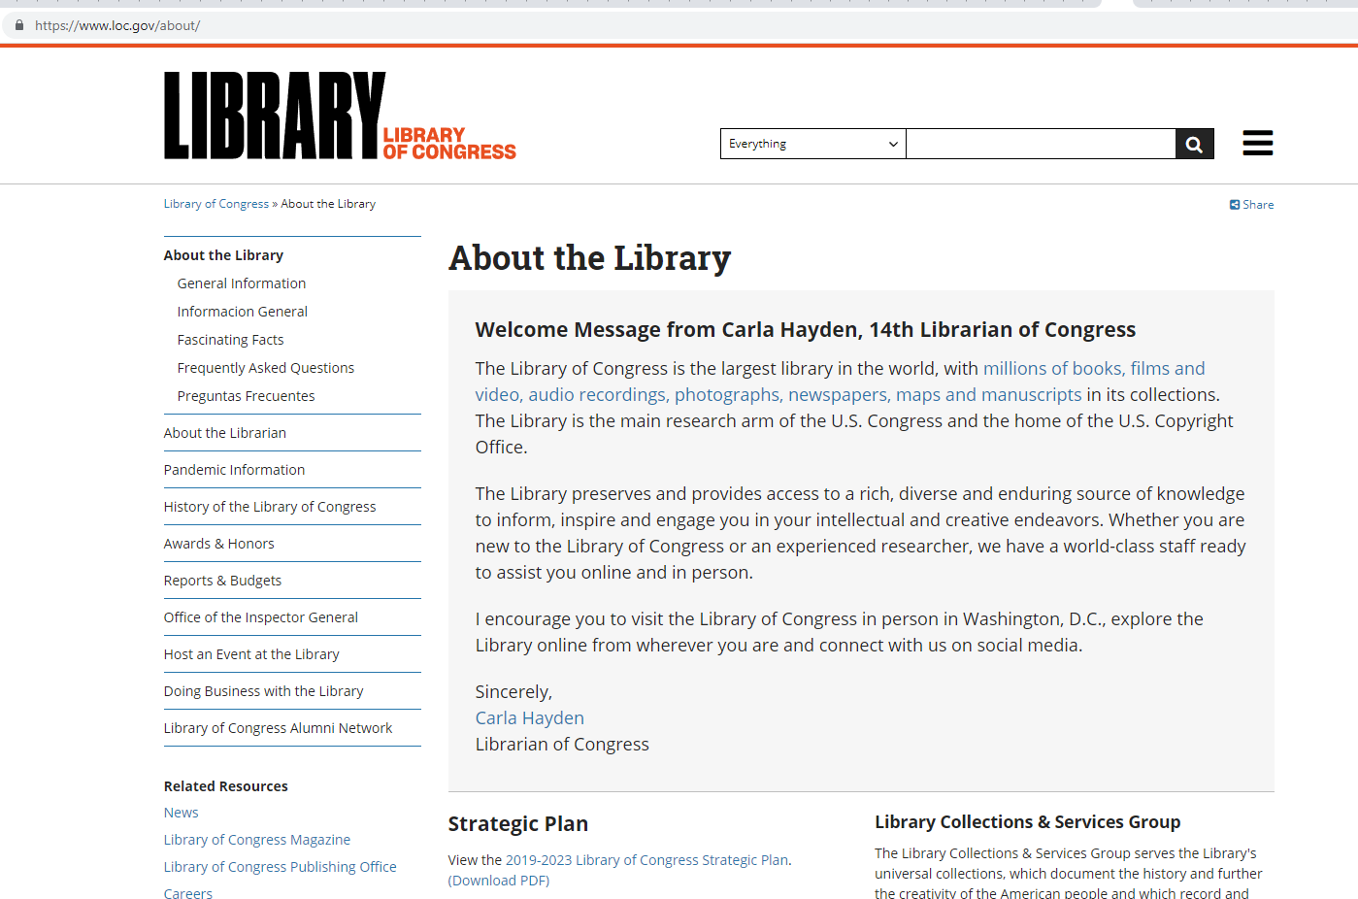
Library of Congress
http://www.bbc.com/news/blogs-trending-42724320

Slide 7
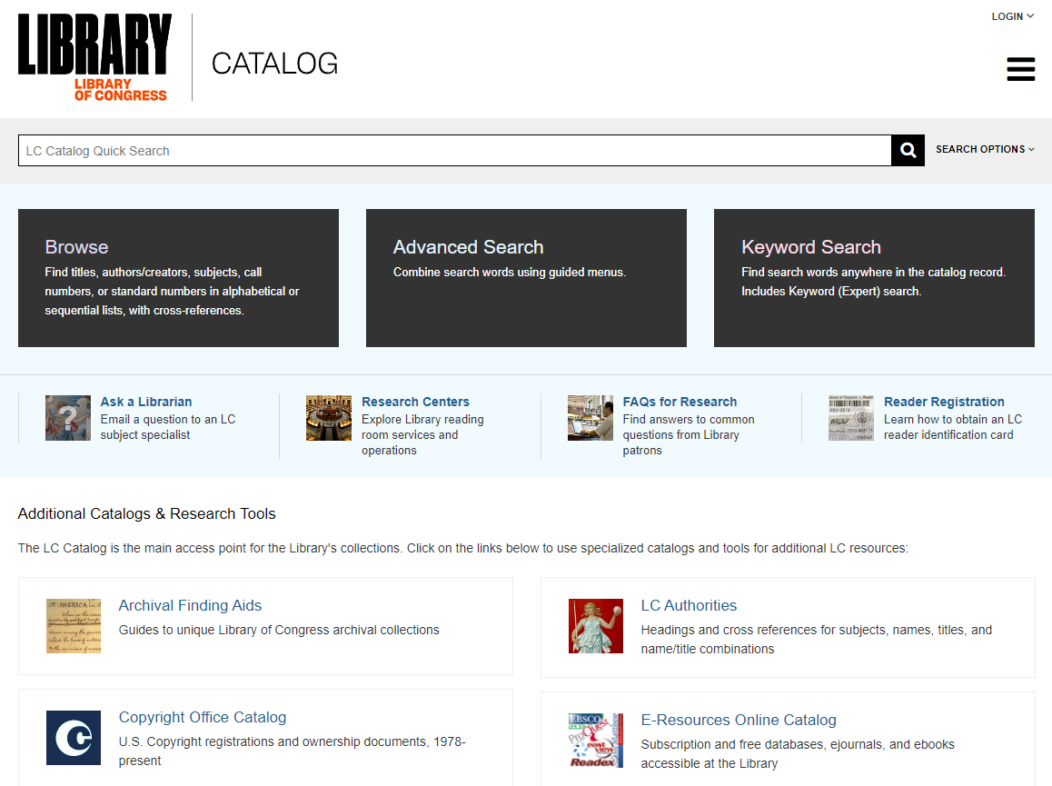
Library of Congress
http://www.bbc.com/news/blogs-trending-42724320

Slide 8
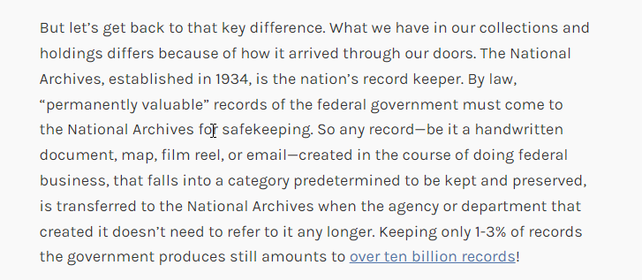
National archives and Library of Congress
http://www.bbc.com/news/blogs-trending-42724320

Slide 9
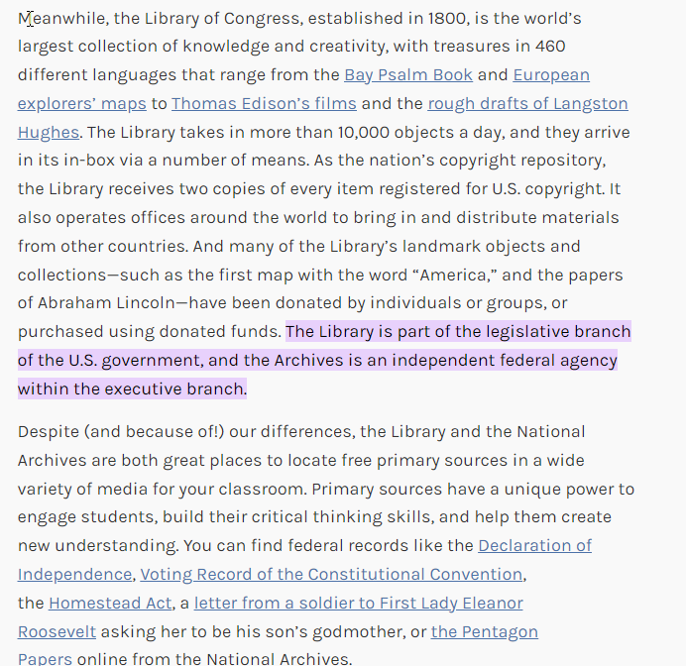
Library of Congress
http://www.bbc.com/news/blogs-trending-42724320

Slide 10
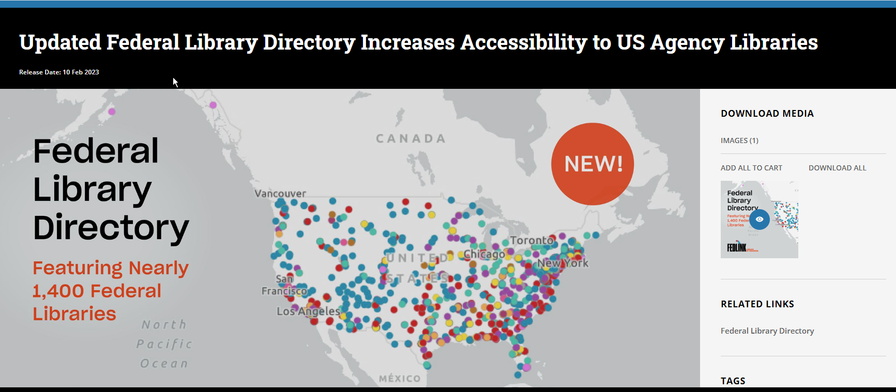
Library of Congress
http://www.bbc.com/news/blogs-trending-42724320

Slide 11
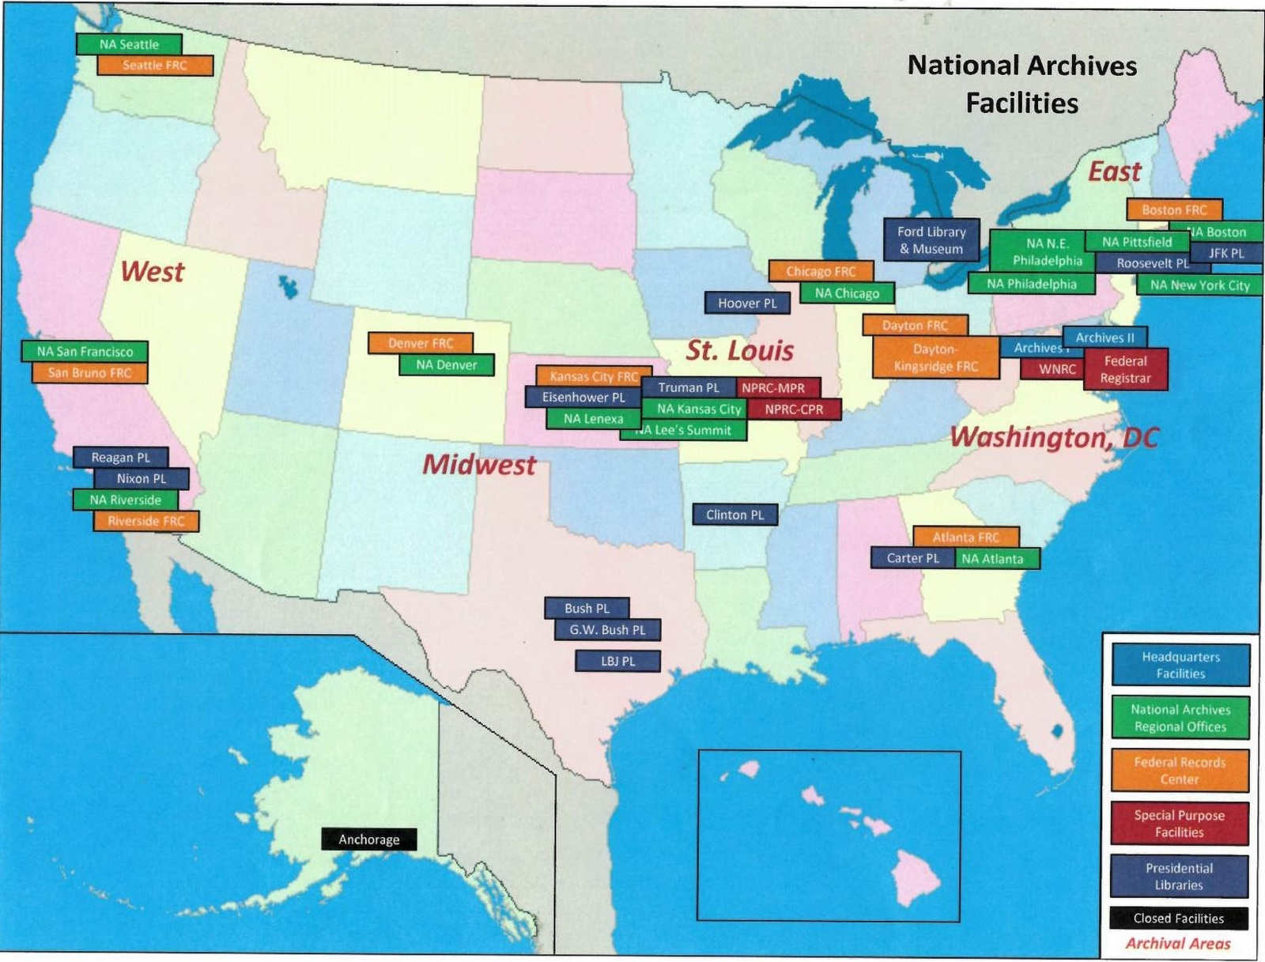
National archives MAP
http://www.bbc.com/news/blogs-trending-42724320

Slide 12
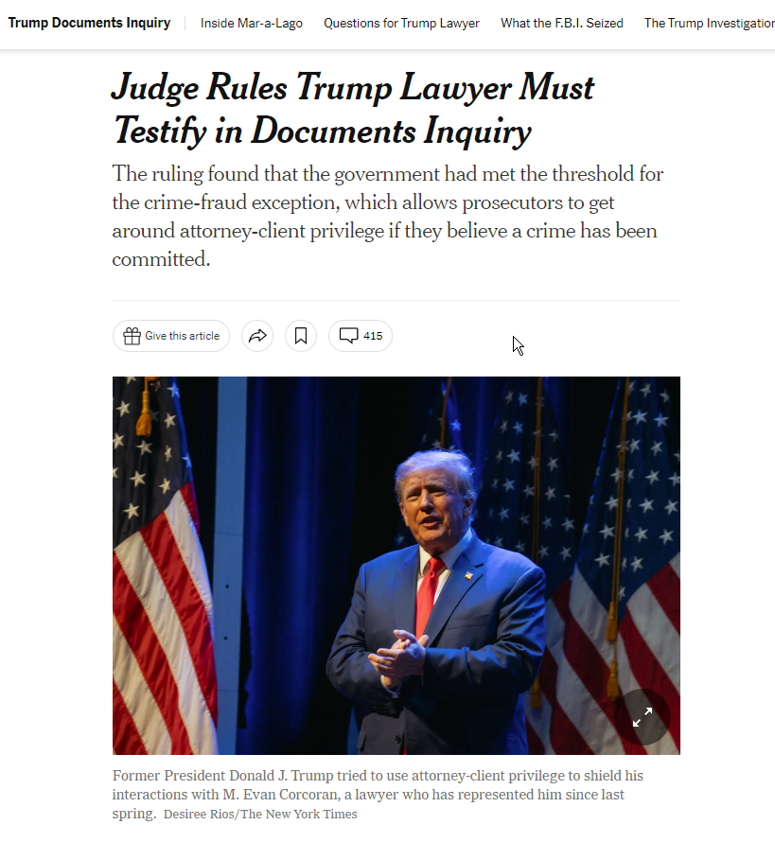
Archives in the news
http://www.bbc.com/news/blogs-trending-42724320

Slide 13
Archives in the news
http://www.bbc.com/news/blogs-trending-42724320

Slide 14
Archives in the news
http://www.bbc.com/news/blogs-trending-42724320

Slide 15
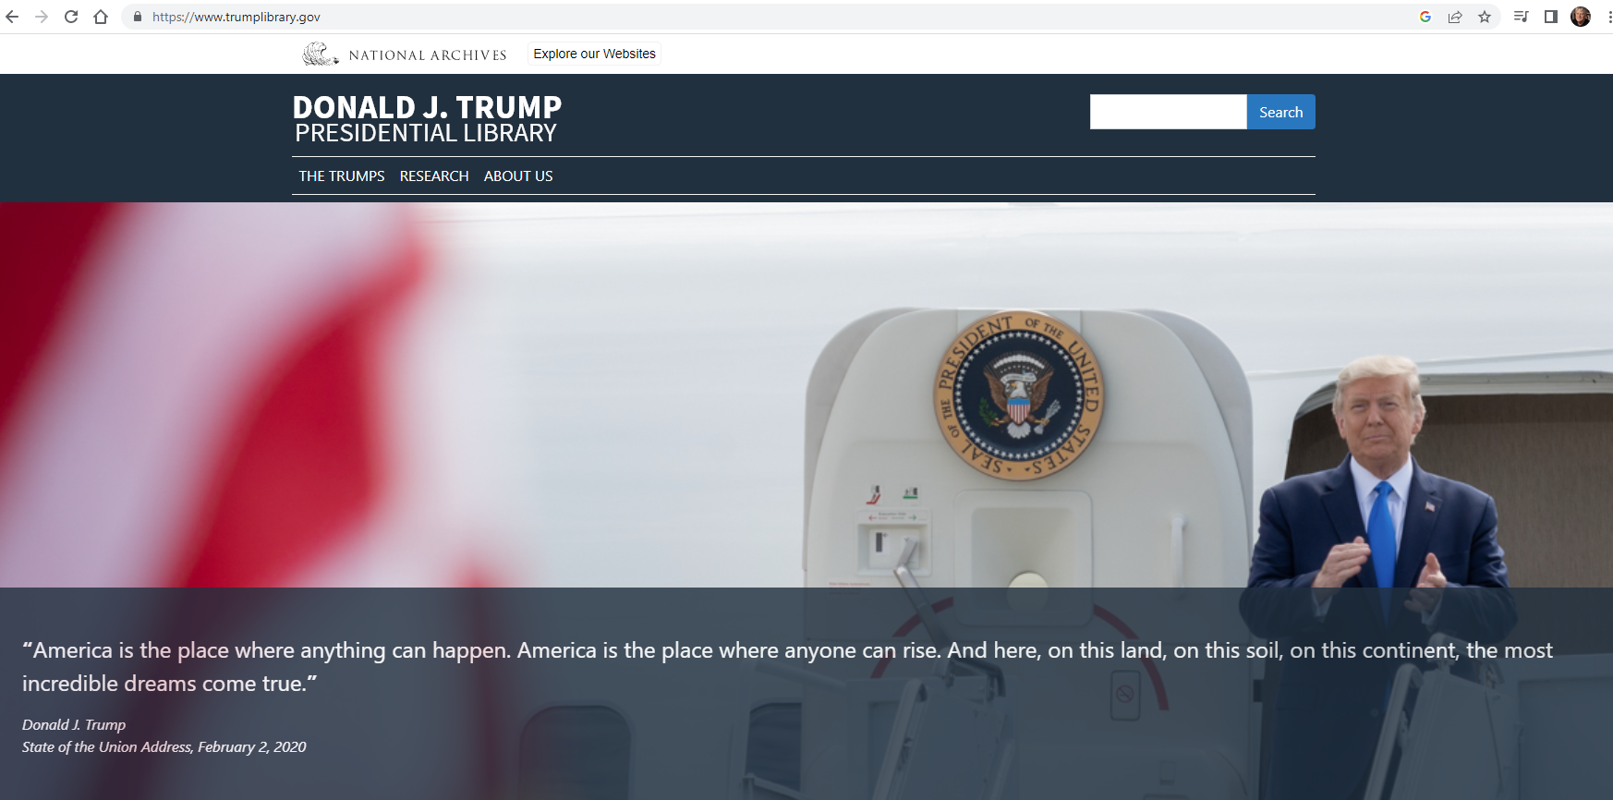
Archives in the news
http://www.bbc.com/news/blogs-trending-42724320

Slide 16
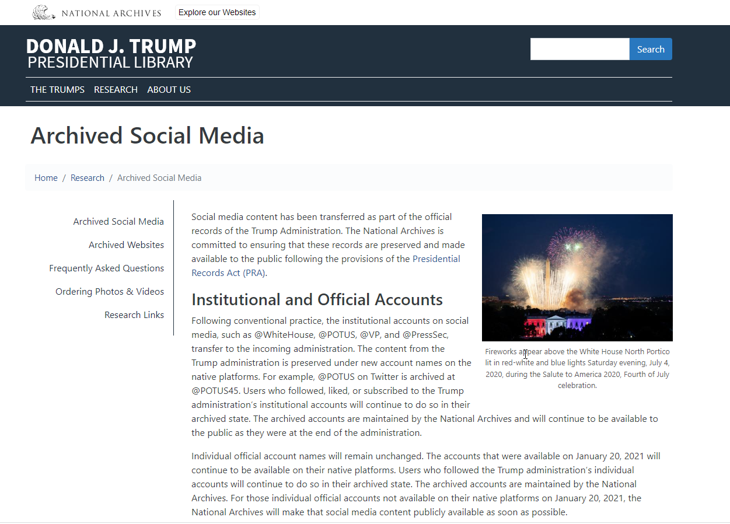
Archives in the news
http://www.bbc.com/news/blogs-trending-42724320

Slide 17
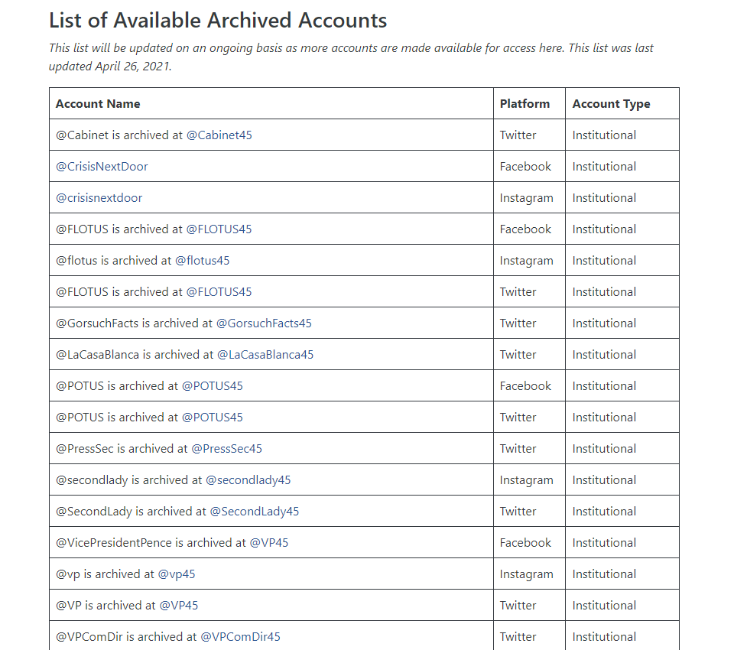
Archives in the news
http://www.bbc.com/news/blogs-trending-42724320

Slide 18
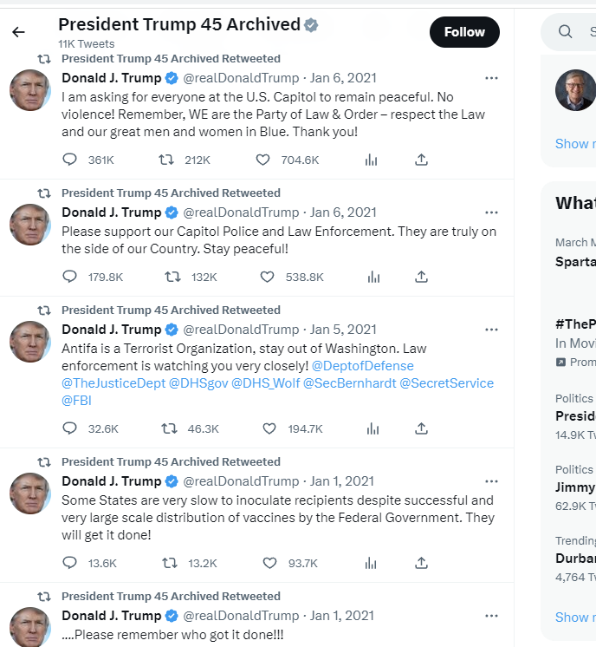
Archives in the news
http://www.bbc.com/news/blogs-trending-42724320

Slide 19
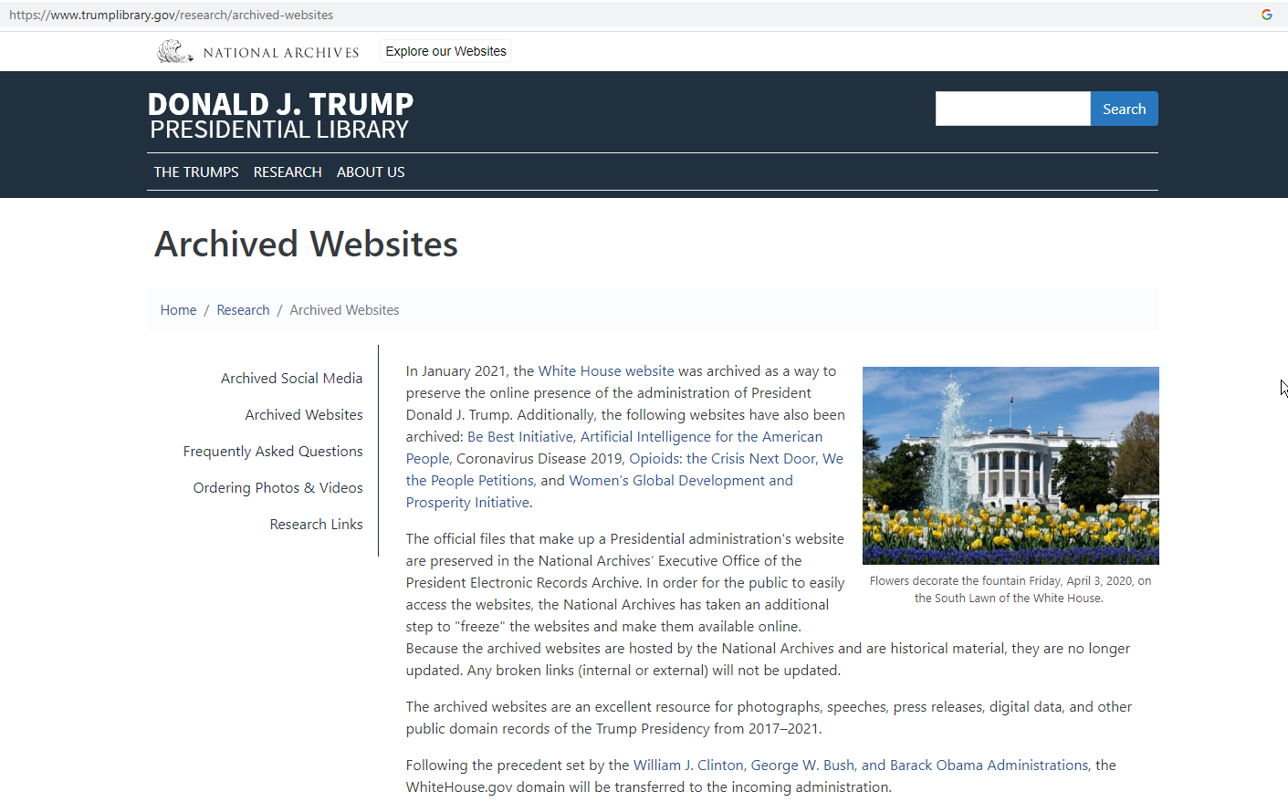
Archives in the news
http://www.bbc.com/news/blogs-trending-42724320

Slide 20
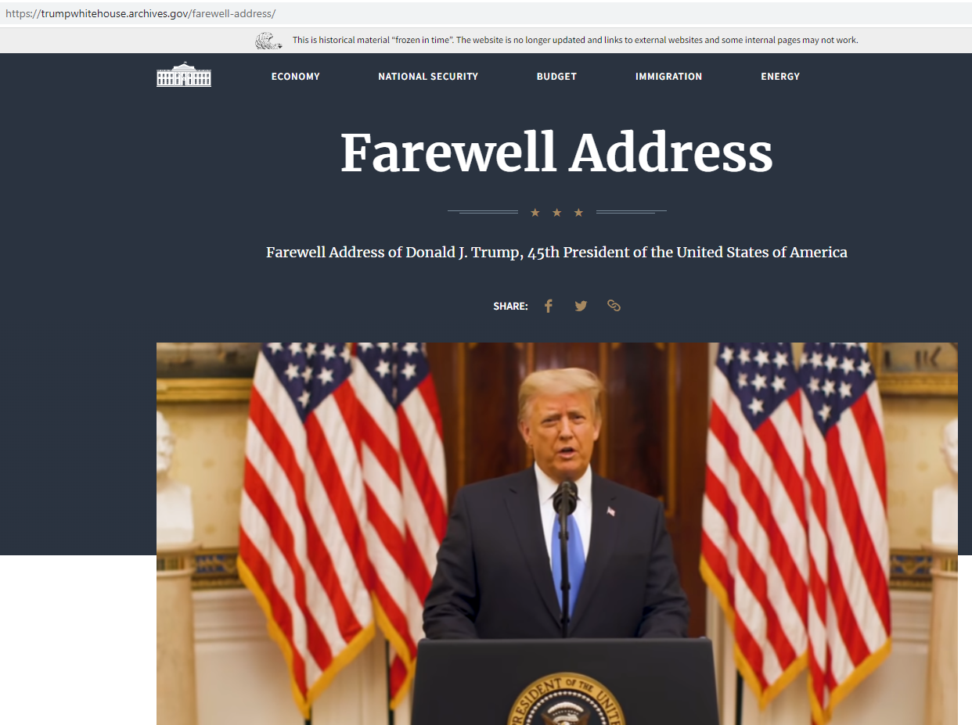
Archives in the news
http://www.bbc.com/news/blogs-trending-42724320

Slide 21
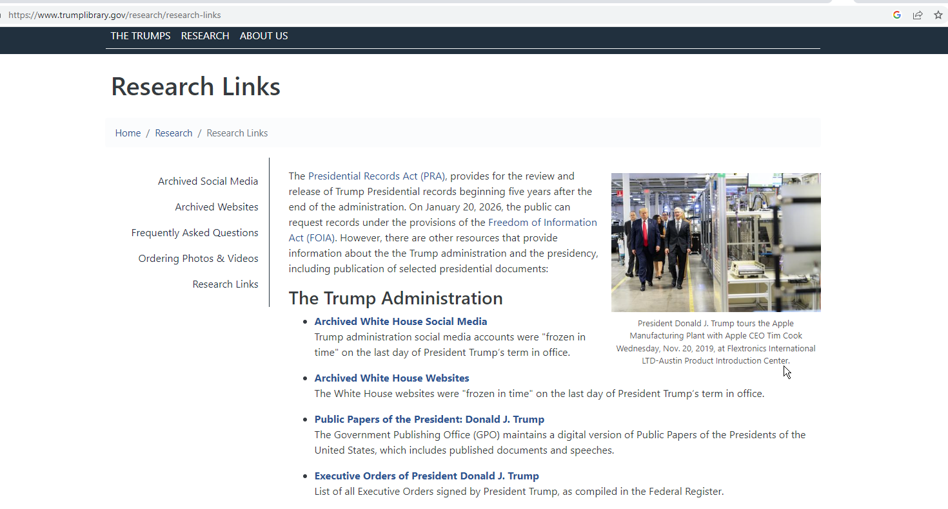
Archives in the news
http://www.bbc.com/news/blogs-trending-42724320

Slide 22
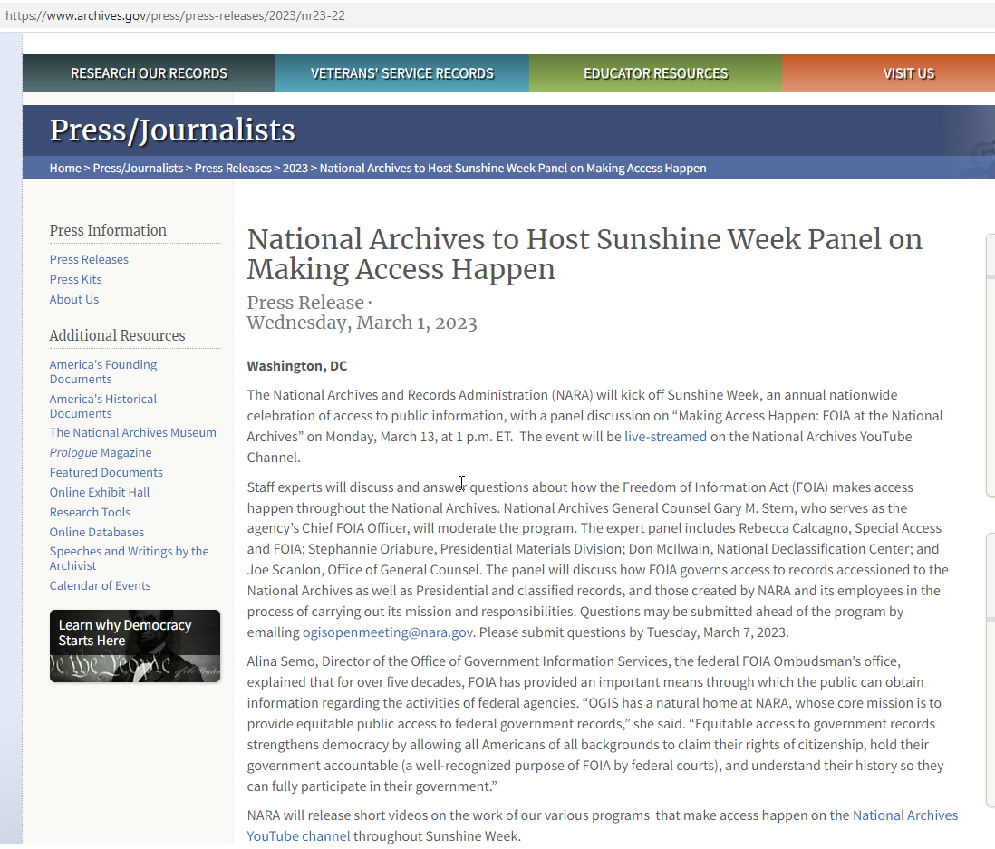
National archives in the news
http://www.bbc.com/news/blogs-trending-42724320

Slide 23
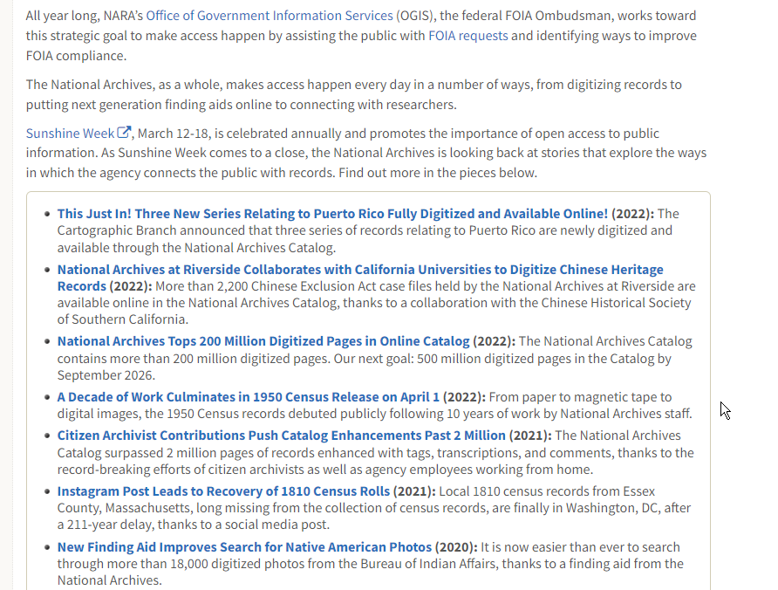
National archives in the news
http://www.bbc.com/news/blogs-trending-42724320

Slide 24
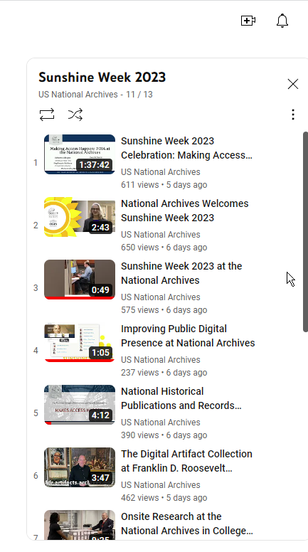
National archives in the news
http://www.bbc.com/news/blogs-trending-42724320

Slide 25
National archives in the news
http://www.bbc.com/news/blogs-trending-42724320

Slide 26
National archives in the news
http://www.bbc.com/news/blogs-trending-42724320

Slide 27
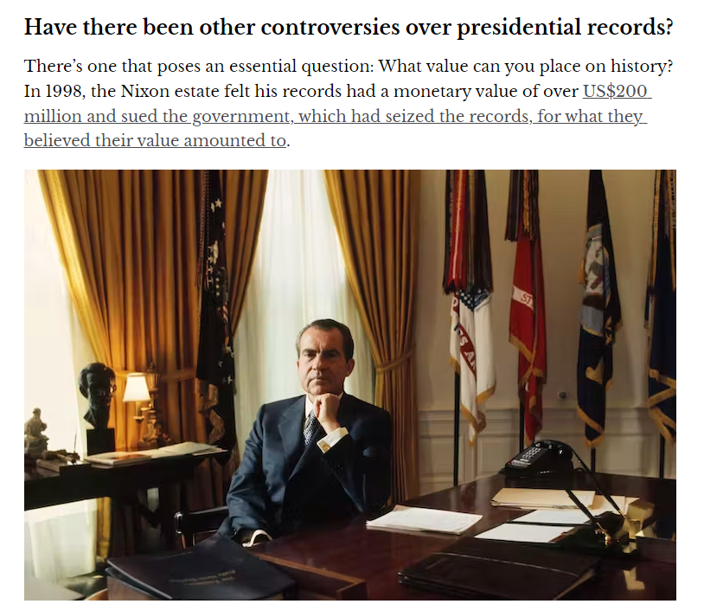
Archives in the news
http://www.bbc.com/news/blogs-trending-42724320

Slide 28
Archives in the news
http://www.bbc.com/news/blogs-trending-42724320

Slide 29
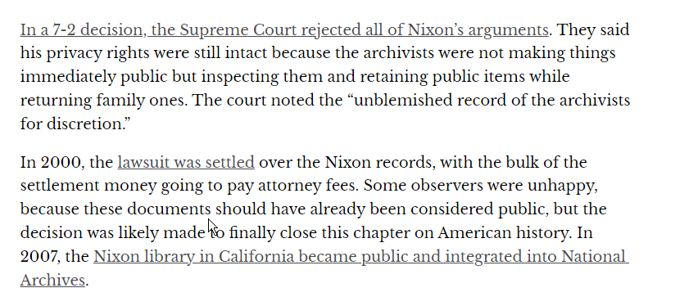
Archives in the news
http://www.bbc.com/news/blogs-trending-42724320

Slide 30
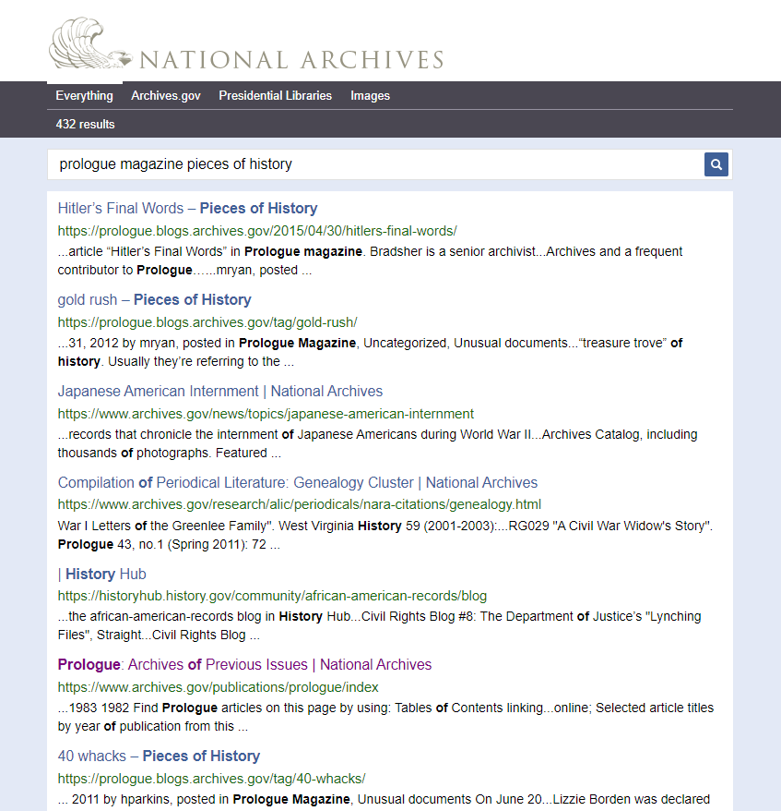
Archives in the news
http://www.bbc.com/news/blogs-trending-42724320

Slide 31
Archives in the news
http://www.bbc.com/news/blogs-trending-42724320

Slide 32
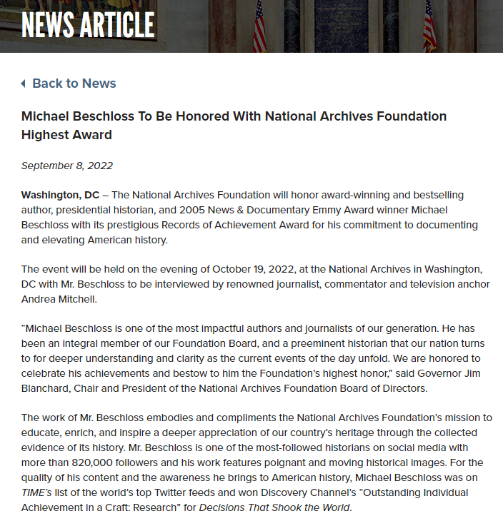
Archives in the news
http://www.bbc.com/news/blogs-trending-42724320

Slide 33
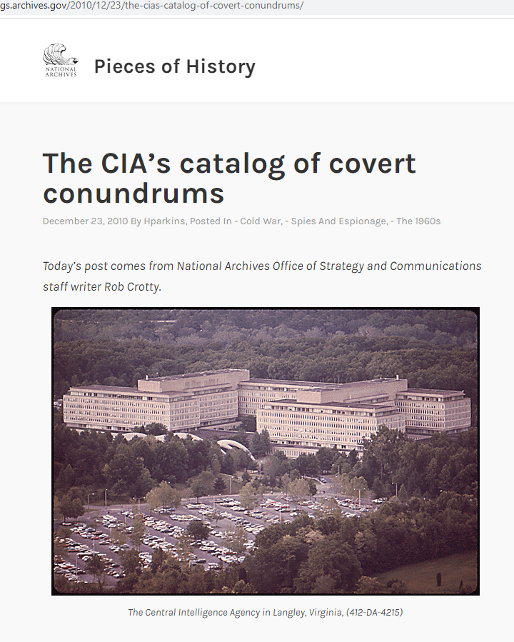
Archives in the news
http://www.bbc.com/news/blogs-trending-42724320

Slide 34
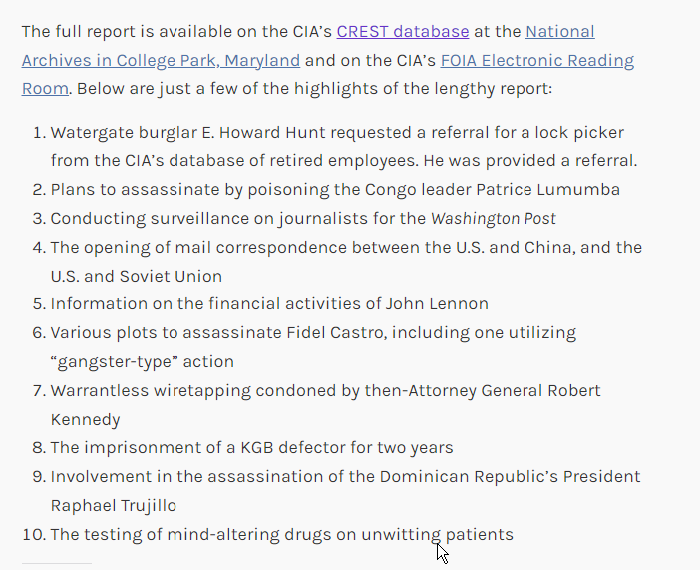
Archives in the news
http://www.bbc.com/news/blogs-trending-42724320

Slide 35
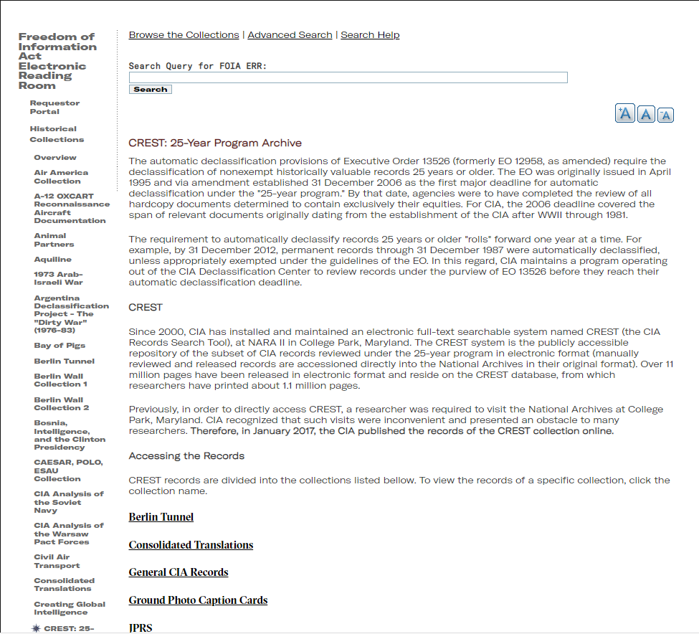
Archives in the news
http://www.bbc.com/news/blogs-trending-42724320

Slide 36
Archives in the news
http://www.bbc.com/news/blogs-trending-42724320

Slide 37
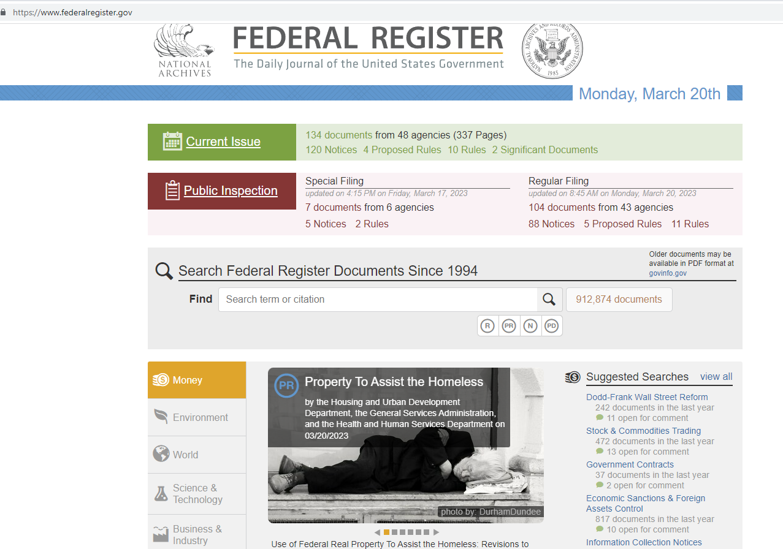
Tracking government at the archives
http://www.bbc.com/news/blogs-trending-42724320
https://www.federalregister.gov/

Slide 38
Coming up: Journalists and authors using the Archives
What were your most surprising finds in the extensive research you did at the National Archives?
I could not have written this book without the amazing holdings at the National Archives, where I spent hours upon hours researching this largely forgotten chapter in American history. There were so many surprising documents—accounts from the Osage that revealed the breadth of the killings; reports from private eyes who had investigated and, in some cases, covered up the crimes; and documents showing how a young J. Edgar Hoover handled his and the bureau’s first major homicide case. Often I would spend several days going through boxes, not finding anything relevant, and then open up a folder to discover something astonishing, like the secret grand jury testimony.
http://www.bbc.com/news/blogs-trending-42724320

Slide 39
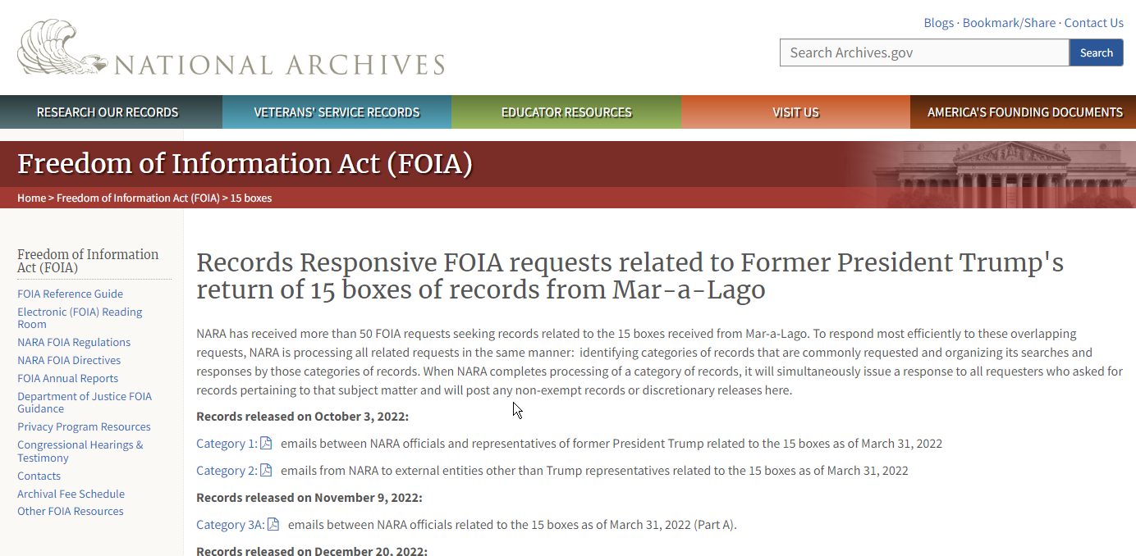
Coming up: Use of Freedom of Information act and Classification
http://www.bbc.com/news/blogs-trending-42724320

