Slide 1
Navigating the National Archives CLASS three
Brant Houston
University of Illinois
brant.houston@gmail.com

Slide 2
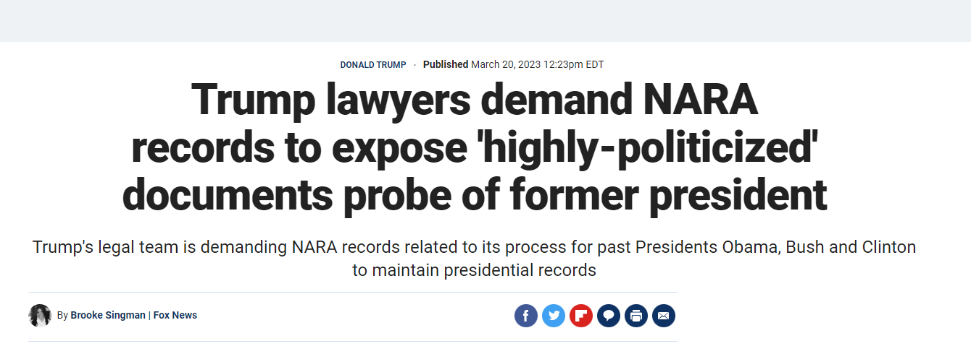
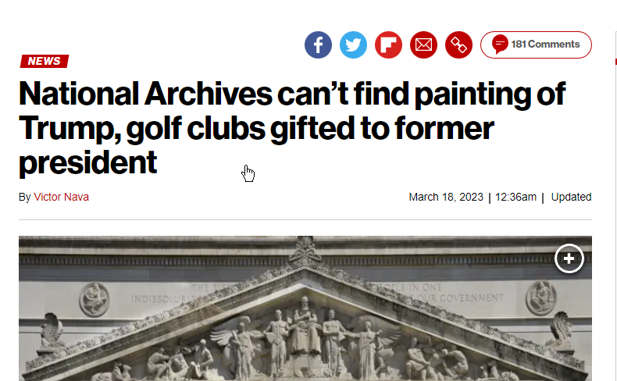
Archives in the News

Slide 3
Archives in the News

Slide 4
Archives in the News
https://www.c-span.org/video/?320514-1/1953-documentary-your-national-archives

Slide 5
Archives in the news
http://www.bbc.com/news/blogs-trending-42724320

Slide 6
Archives in the news
The International Council on Archives (ICA; French: Conseil international des archives) is an international non-governmental organization which exists to promote international cooperation for archives and archivists. It was set up in 1948, with Charles Samaran, the then director of the Archives nationales de France, as chairman, and membership is open to national and international organisations, professional groups and individuals.^{[1]} In 2015, it grouped together about 1400 institutional members in 199 countries and territories. Its mission is to promote the conservation, development and use of the world's archives.
ICA has close partnership links with UNESCO, and is a founding member of the Blue Shield, which works to protect the world's cultural heritage threatened by wars and natural disasters, and which is based in The Hague.^{[2]}
http://www.bbc.com/news/blogs-trending-42724320

Slide 7
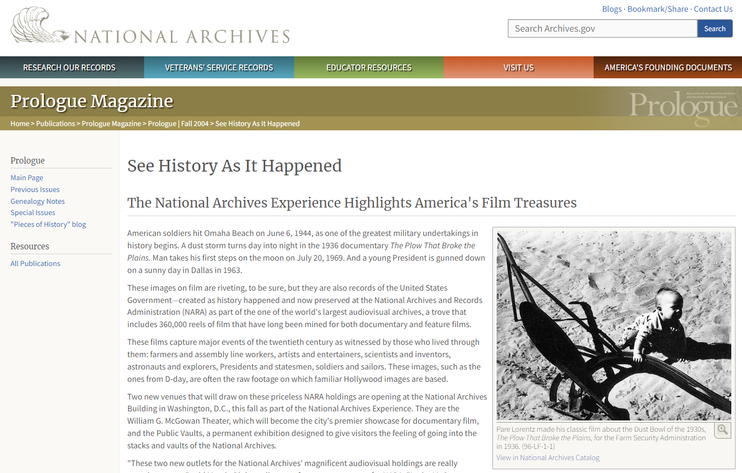
Visual archives
http://www.bbc.com/news/blogs-trending-42724320

Slide 8
Visual archives
http://www.bbc.com/news/blogs-trending-42724320

Slide 9
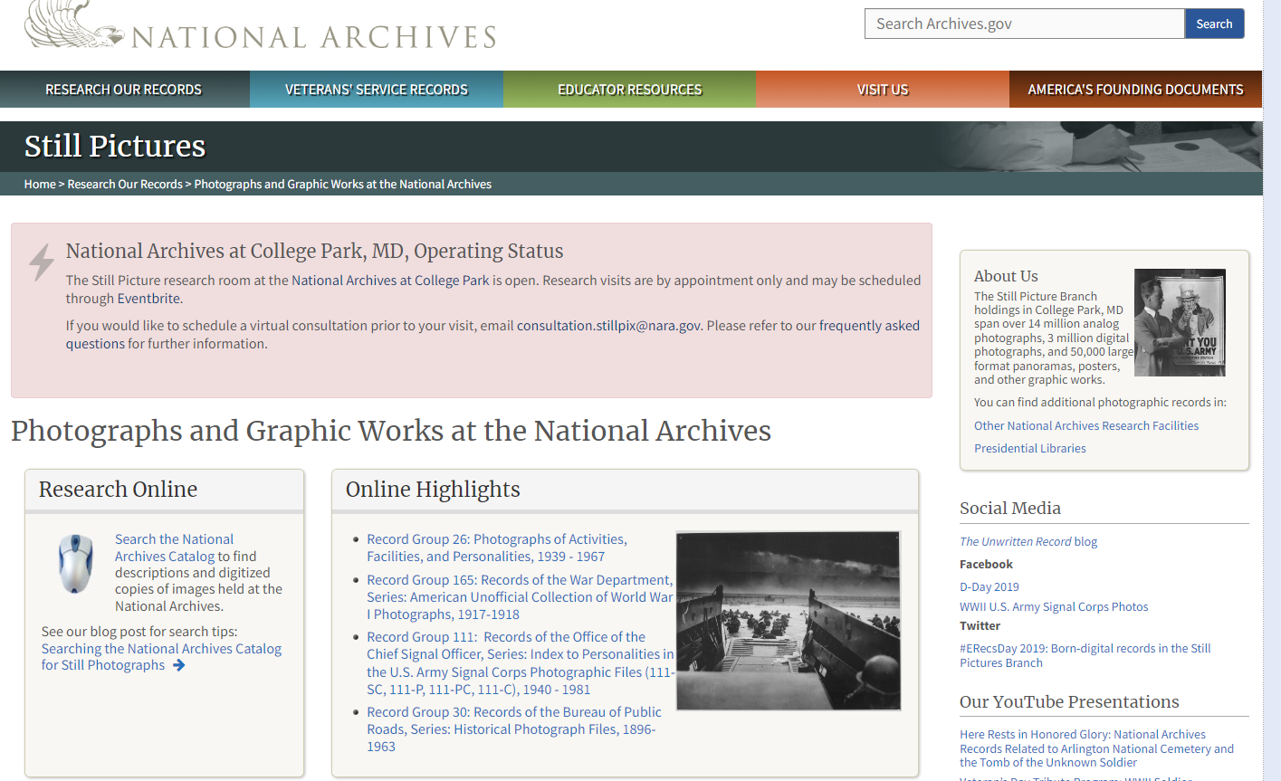
Visual archives
http://www.bbc.com/news/blogs-trending-42724320

Slide 10
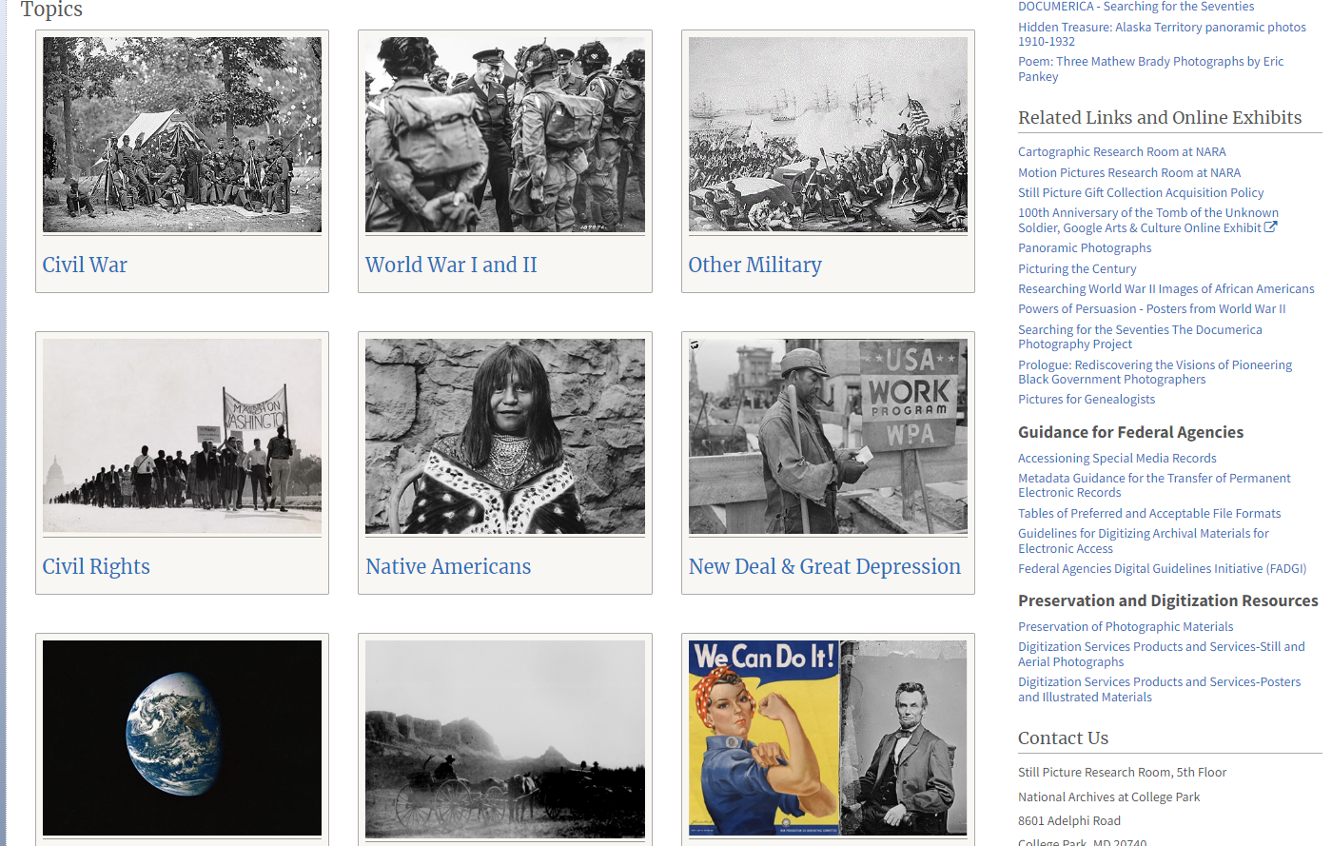
Visual archives
http://www.bbc.com/news/blogs-trending-42724320

Slide 11
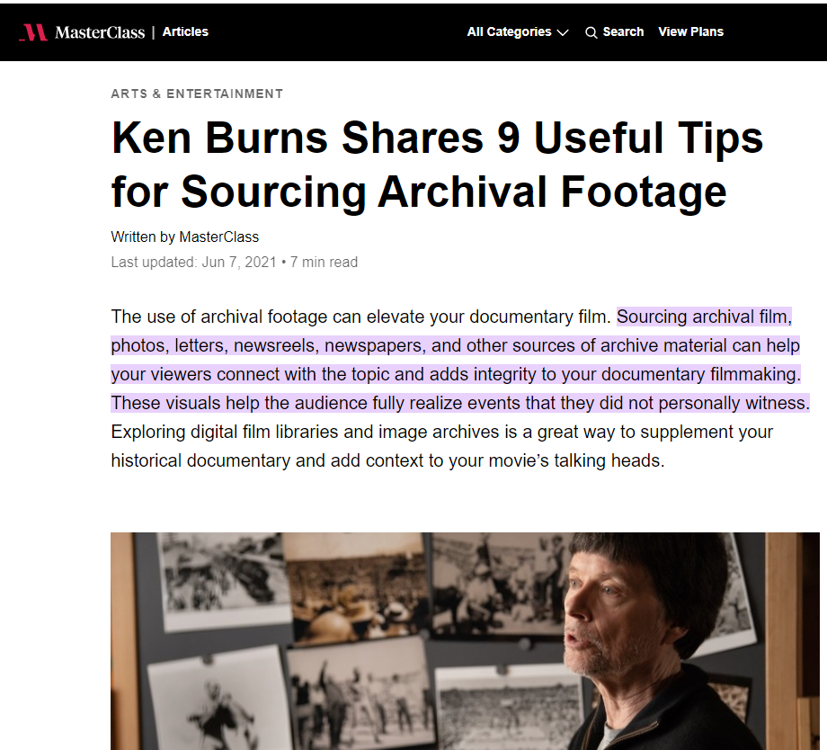
Visual archives
http://www.bbc.com/news/blogs-trending-42724320

Slide 12
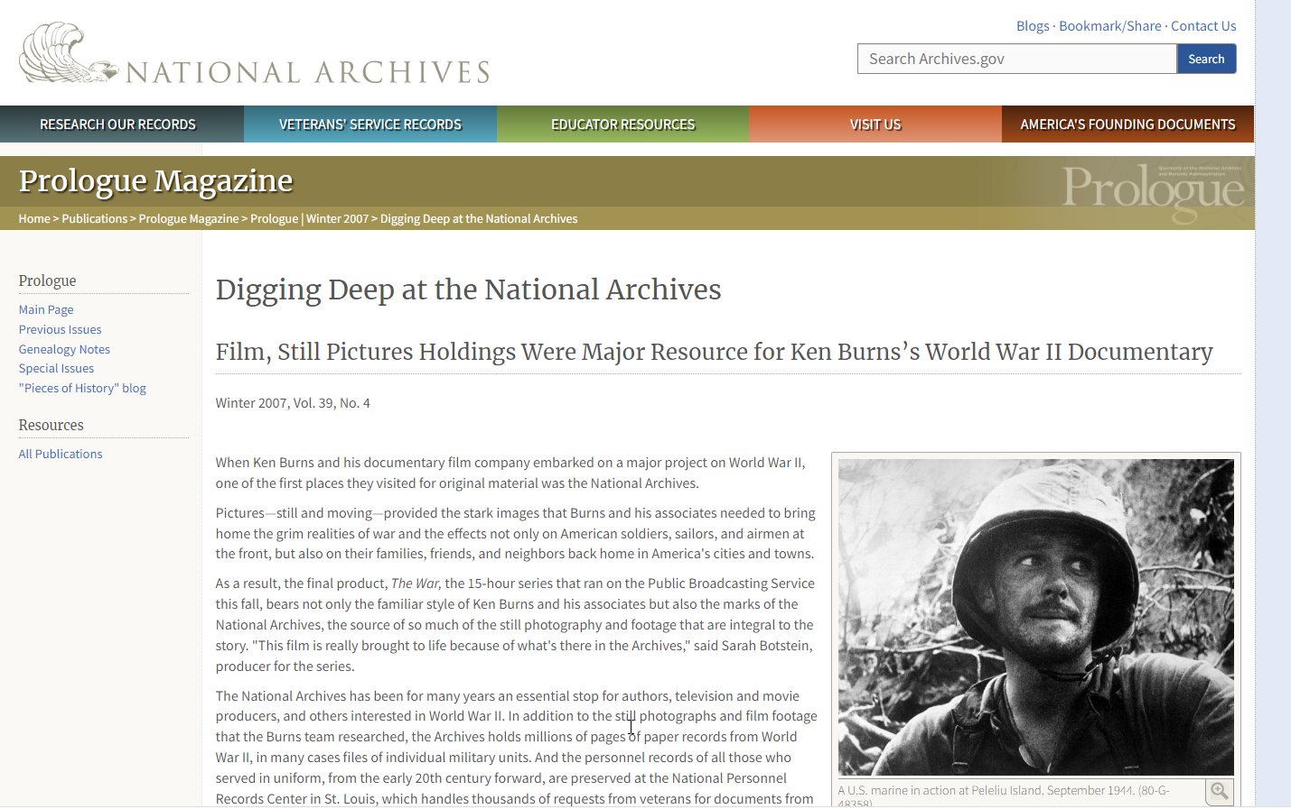
Visual archives
http://www.bbc.com/news/blogs-trending-42724320

Slide 13
Visual archives
The National Archives has been for many years an essential stop for authors, television and movie producers, and others interested in World War II. In addition to the still photographs and film footage that the Burns team researched, the Archives holds millions of pages of paper records from World War II, in many cases files of individual military units.
And the personnel records of all those who served in uniform, from the early 20th century forward, are preserved at the National Personnel Records Center in St. Louis, which handles thousands of requests from veterans for documents from their files every year.
http://www.bbc.com/news/blogs-trending-42724320

Slide 14
Visual archives
What's jaw-dropping (there's no other word for it) is combat footage we've never seen before that Burns and his team uncovered during five years of digging in the National Archives and other repositories around the world," wrote Sam Allis in the Boston Globe.
Co-producer/director Lynn Novick said that film research was mostly done by Botstein and co-producer Peter Miller. Having six years to work on finding footage from archives all over the world, she said, allowed them to uncover some that hadn't been seen much.
"Most of the footage, however, comes from the National Archives of the United States, which has an extraordinary collection," she told questioners in an online chat on the Washington Post web site. "And Sarah and Peter were able to find original camera rolls and material that really hadn't seen the light of day in the vaults of the National Archives." In the end, Botstein said, The War used more than a thousand clips of NARA footage.

Slide 15
Visual archives
Ed McCarter, head of the Still Pictures Branch at the National Archives at College Park, said that the National Archives has between 9 million and 9.5 million still photographs, and about 1.5 million of them involve World War II. They come from all branches of the service: the Army, the Navy, the Army Air Corps, the Marines, and the Coast Guard. A small number of them are in color.
"The World War II stuff has always been active," he said. "There's a pretty constant flow of requests." For example, of the 10 most requested photographs from the National Archives that Prologue featured in its Winter 2004 issue, seven were World War II related.
Holly Reed, an archivist in the Still Pictures Branch, said that one of Burns's researchers, co-producer David McMahon, spent weeks at a time over several years researching photographs at the National Archives in College Park. And, she added, he was looking for something different.

Slide 16
Visual archives
"They [Burns's team] did try to get the iconic type images that everybody knows about," Reed said, "but they were also looking for that good image that isn't known.“
While most researchers do not want to go through box after box and settle for the ones frequently seen, according to Reed, that wasn't the case with Burns's team. They tackled the boxes and came up with many still images that have been seen only rarely or not at all over the years.
Eventually, Botstein said, The War used about 330 still photographs from the National Archives.

Slide 17
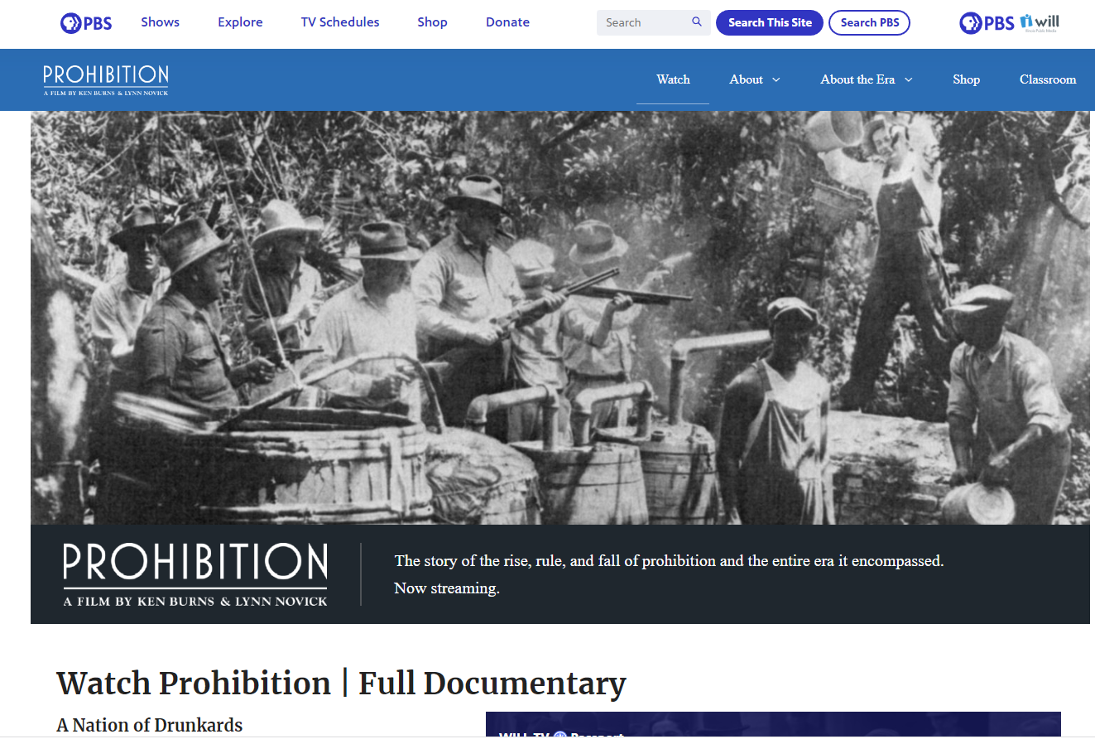
Visual archives
http://www.bbc.com/news/blogs-trending-42724320

Slide 18
Visual archives
http://www.bbc.com/news/blogs-trending-42724320

Slide 19
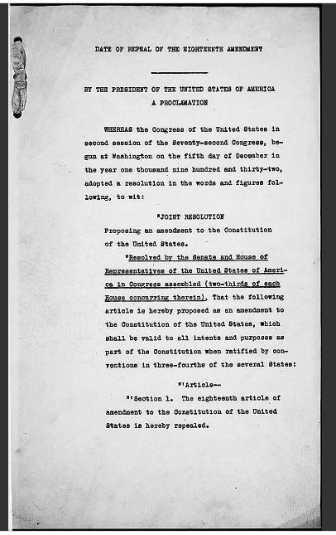
Archives hiighlight
http://www.bbc.com/news/blogs-trending-42724320

Slide 20
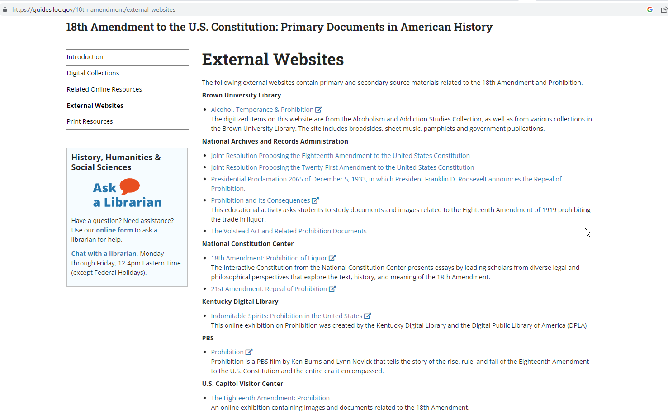
Visual archives
http://www.bbc.com/news/blogs-trending-42724320

Slide 21
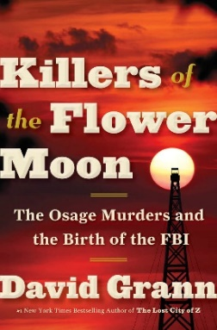
Journalists and authors using the Archives
What were your most surprising finds in the extensive research you did at the National Archives?
I could not have written this book without the amazing holdings at the National Archives, where I spent hours upon hours researching this largely forgotten chapter in American history.
There were so many surprising documents—accounts from the Osage that revealed the breadth of the killings; reports from private eyes who had investigated and, in some cases, covered up the crimes; and documents showing how a young J. Edgar Hoover handled his and the bureau’s first major homicide case. Often I would spend several days going through boxes, not finding anything relevant, and then open up a folder to discover something astonishing, like the secret grand jury testimony.
http://www.bbc.com/news/blogs-trending-42724320

Slide 22
Journalists and authors using the Archives
Among the unexpected documents I found in a box here was the secret grand jury testimony from the prosecution of some of the murderers of the Osage. This testimony proved invaluable in telling the history of what happened and being able to record the voices of many of the participants. It’s why I think it’s important when doing archival research to look through boxes that may not be precisely catalogued, because you don’t know what you might turn up.

Slide 23
Journalists and authors using the Archives
ArchivesAWARE: Did anything in the collections surprise you or spark an “a-ha!” moment?
Grann: At the archives in Fort Worth, I also came across a tattered logbook, which contained the names of white guardians. Because of extraordinary racism, the U.S. Congress had passed legislation requiring many Osage to have white guardians to oversee their wealth. The logbook listed the Osage who had been assigned to each guardian, and if one of these Osage had passed away under the guardianship system, a single word was usually scrawled by his or her name: Dead. I noticed that one guardian was assigned to five Osages, and all five of their names were followed by that word. Another guardian had thirteen wards, more than half of whom had been listed as deceased. And so it went. The numbers were staggering and clearly defied a natural death rate. I began to get a sense of the breadth of the systematic murder campaign against the Osage.
https://archivesaware.archivists.org/2018/04/04/archives-audiences-journalist-david-grann-on-killers-of-the-flower-moon/

Slide 24
Journalists and authors using the Archives
ArchivesAWARE: How would you describe the overall impact of archival collections on the writing of the book?
Grann: This book is born out of archives. It could not have been written without the benefit of these collections, and the many archivists who kindly guided me to hidden troves.
ArchivesAWARE: Is there anything else you would like to share about your archival research experience in connection with Killers of the Flower Moon?
Grann: Perhaps the most remarkable discovery happened when I told a librarian at the New York City Public Library about my research. To my astonishment, he told me that some members of his family were from Oklahoma and were related to several of the victims and the murderers I was writing about. He put me in touch with them, which led to a wealth of information.

Slide 25
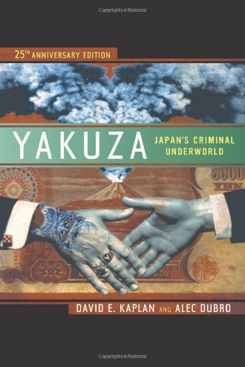
International investigations
Originally published in 1986, it was so controversial in Japan that it could not be published there for five years. But in the west it has long served as the standard reference on Japanese organized crime and has inspired novels, screenplays, and criminal investigations. This twenty-fifth anniversary edition tells the full story or Japan's remarkable crime syndicates, from their feudal start as bands of medieval outlaws to their emergence as billion-dollar investors in real estate, big business, art, and more.
http://www.bbc.com/news/blogs-trending-42724320

Slide 26
International investigations
“First, see the 2nd to last paragraph on p.337 (of the revised paperback edition), which gives a description of our use of the National Archives. This research was in 1984-85, so little was electronic. As we wrote, "The records of the Supreme Commander of the Allied Powers, or SCAP, are still stored in the boxes in which they were packed in Tokyo in 1952. Indexing is crude at best..."

Slide 27
International investigations
“If you look at the Bibliography on pp. 384-385 you'll see all the documents we used from SCAP. These were all mined from the Archives in College Park, MD. I remember vividly going there and getting one of the Occupation boxes to go through. The archivists were almost always super-helpful. It's important to explain to them what you're doing and get them on board.”
Co-author David E. Kaplan

Slide 28
International investigations
“We found detailed files, including interrogations, of accused Japanese war criminals, including two of the key men who rebuilt the Japanese far-right and underworld during the Occupation (Sasakawa and Kodama). There were also invaluable intelligence and political reports. These were full of revelations and confirmed contemporaneous accounts by journalists and diplomats, later studies by scholars, and interviews we did with a handful of US Army Intelligence officers (who have now passed on). We also cite them in the footnotes to those two chapters.
As I recall, my co-author Alec also went to the Truman Presidential Library and the MacArthur library. And we filed FOIA reports and got more recent documents on Sasakawa from the State Dept., which were great.”
Co-author David E. Kaplan

Slide 29
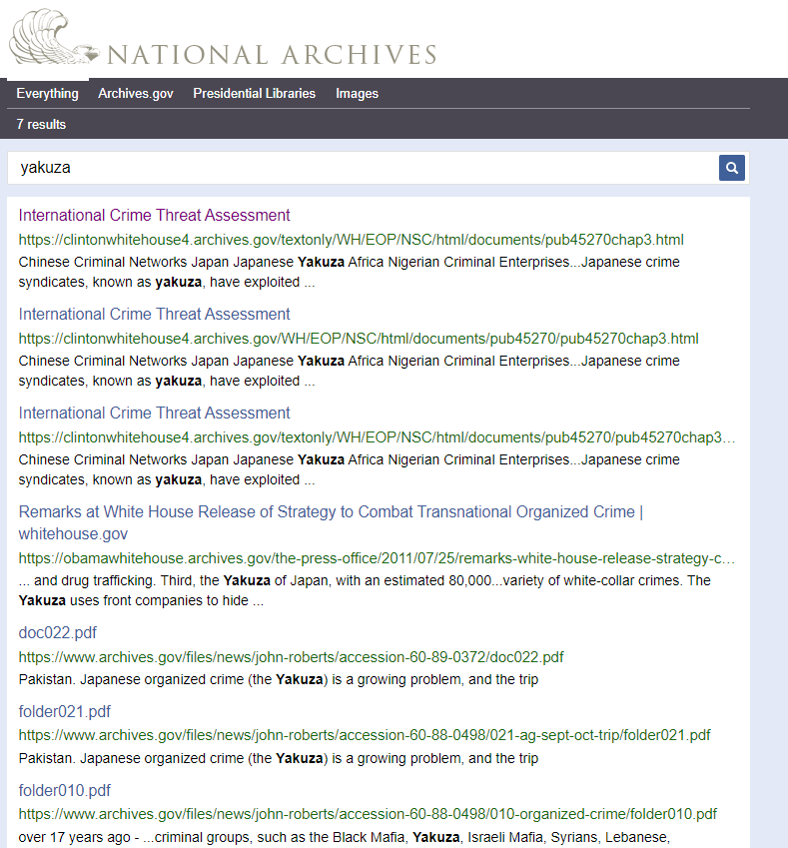
International investigations

Slide 30
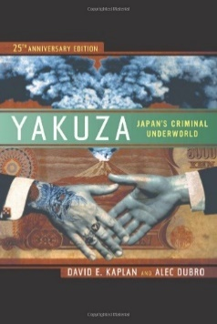
International investigations

Slide 31
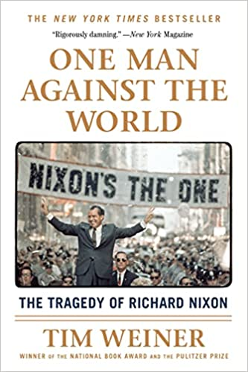
national investigations
Based largely on documents declassified only in the last few years, One Man Against the World paints a devastating portrait of a tortured yet brilliant man who led the country largely according to a deep-seated insecurity and distrust of not only his cabinet and congress, but the American population at large. In riveting, tick-tock prose, Weiner illuminates how the Vietnam War and the Watergate controversy that brought about Nixon's demise were inextricably linked

Slide 32
National investigations
“The collected works of Richard Nixon include 2,636 hours of taped White House conversations open to the public….
Harry Robbins Haldeman produced handwritten and dictated diaries that describe in detail the mind of Richard Milhous Nixon.”
…This book is based in great part on documents declassified between 2007 and 2014. I read them with growing excitement. I felt like an archaeologist unearthing the palace of a lost empire….The transcripts of federal grand jury testimony by Nixon himself , the only president ever compelled to answer questions under oath in a criminal case, were now public records.”

Slide 33
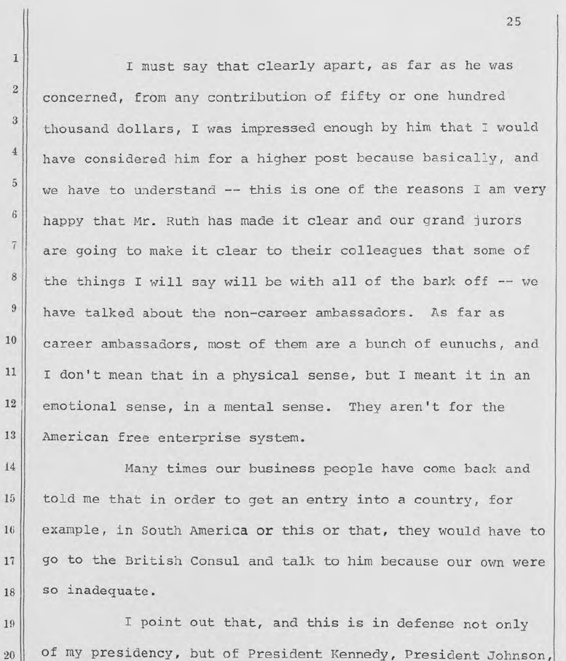
Nixon Grand jury Testimony

Slide 34
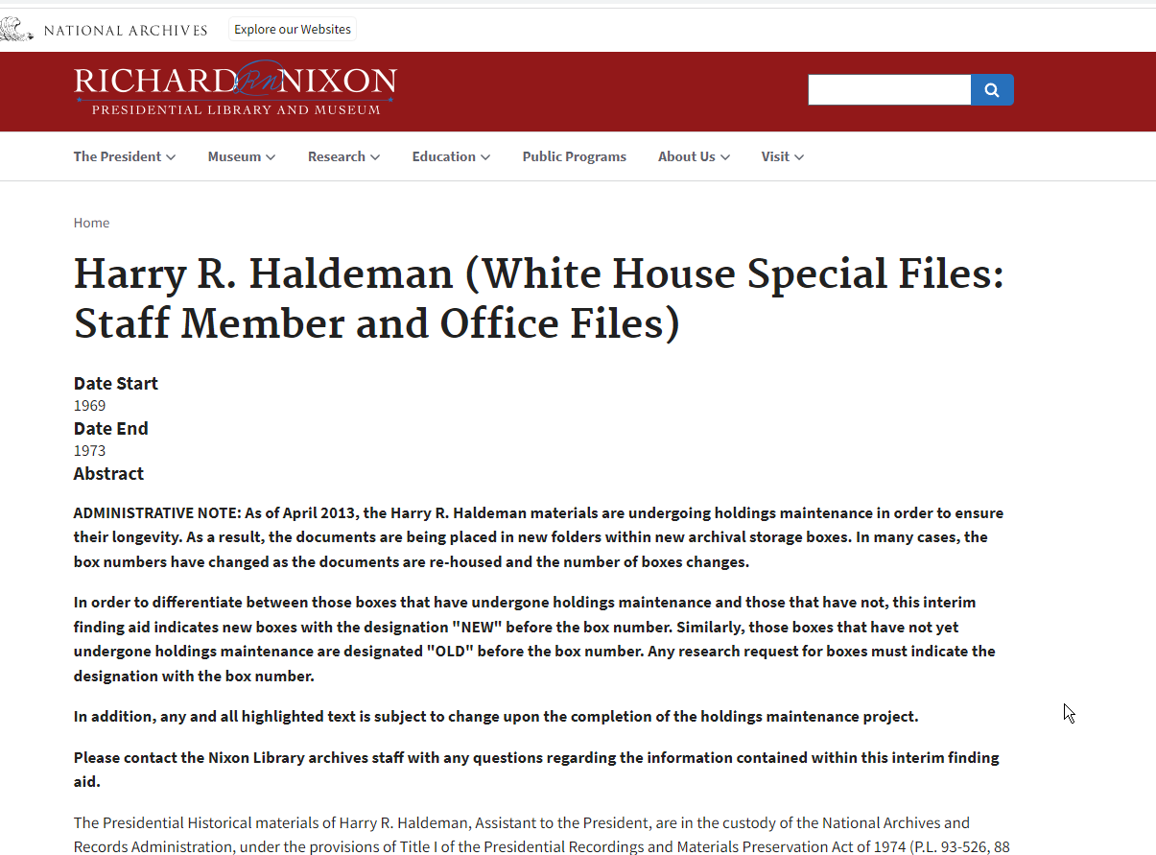
National investigations

Slide 35
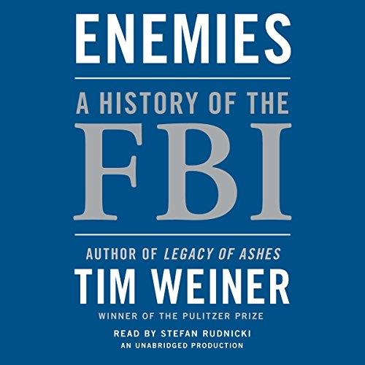
National investigations
We think of the FBI as America’s police force. But secret intelligence is the Bureau’s first and foremost mission. Enemies is the story of how presidents have used the FBI as the most formidable intelligence force in American history.
Here is the hidden history of America’s hundred-year war on terror. The FBI has fought against terrorists, spies, anyone it deemed subversive—and sometimes American presidents. The FBI’s secret intelligence and surveillance techniques have created a tug-of-war between protecting national security and infringing upon civil liberties. It is a tension that strains the very fabric of a free republic.

Slide 36
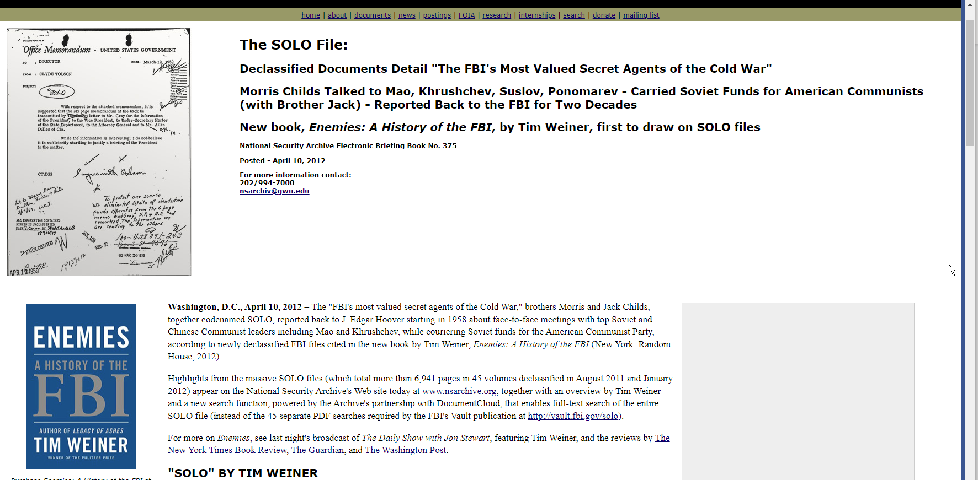
National investigations

Slide 37
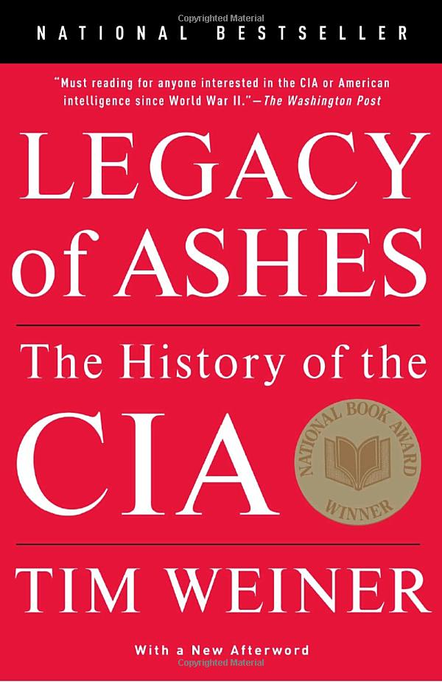
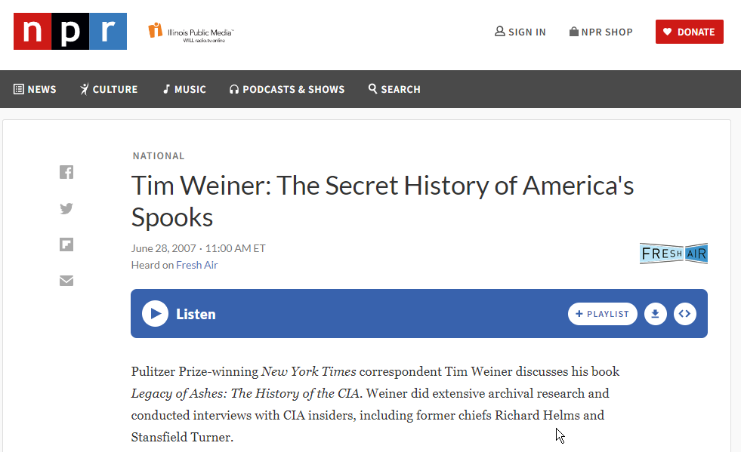
National investigations
https://www.npr.org/2007/06/28/11509999/tim-weiner-the-secret-history-of-americas-spooks

Slide 38
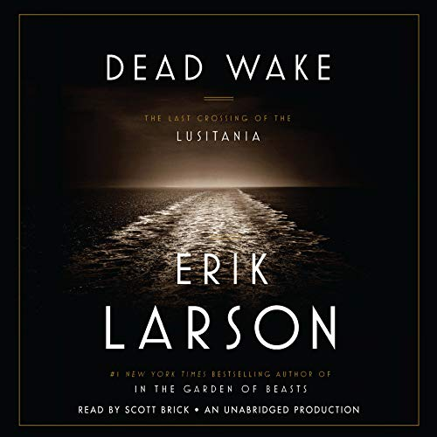
National investigations
On May 1, 1915, a luxury ocean liner as richly appointed as an English country house sailed out of New York, bound for Liverpool, carrying a record number of children and infants. The passengers were anxious. Germany had declared the seas around Britain to be a war zone, and for months its U-boats had brought terror to the North Atlantic. But the Lusitania was one of the era's great transatlantic "Greyhounds", and her captain, William Thomas Turner, placed tremendous faith in the gentlemanly strictures of warfare that for a century had kept civilian ships safe from attack. He knew, moreover, that his ship--the fastest then in service--could outrun any threat.

Slide 39
National investigations
Meanwhile an ultra-secret British intelligence unit tracked Schwieger's U-boat,but told no one. As U-20 and the Lusitania made their ways toward Liverpool, an array of forces both grand and achingly small--hubris, a chance fog, a closely guarded secret, and more--all converged to produce one of the great disasters of history.

Slide 40
National investigations
Erik Larson on the joys of digging through archives
"You never know what you’re going to find in the next folder."
The Library of Congress is stop one. The manuscript division. It’s a bad thing to plan too far and with too much detail about how much you need and where you should go. There’s no substitute for parachuting in and flailing. Inertia is a powerful force in my life. I can put off anything for a long time. Just ask my wife.
https://creativenonfiction.org/writing/erik-larson-on-the-joys-of-digging-through-archives/

Slide 41
National investigations
LARSON: So then you go to the archives. I love it. I love going through boxes filled with files that are full of stuff. You never know what you’re going to find in the next folder. The problem with online research is you always know what’s coming. Somebody else has selected what’s online. The serendipity effect is crucial, finding things that are potentially really valuable to you. Say, an envelope with nothing in it, nothing associated with it, could be valuable because it might have so-and-so’s return address on it. Or it might confirm a contact. Little detective-like things. I just love those.

Slide 42
National investigations
I just love those. In the case of In the Garden of Beasts, Martha Dodd, the central character, has seventy linear feet of documents, letters, writings. The first couple of files in the first box, if I remember correctly, were calling cards that she collected. Hundreds of calling cards. They were common currency in that period; they were very important to the ebb and flow of social life. So here they are, and I’m going through them, and here’s the calling card for Hermann Göring. I’m holding this calling card that Martha held at one time, that Göring held and gave to her. There’s this little electric charge that comes from stuff like that, and that’s the fun that keeps you going.

Slide 43
National investigations
My MO is to read far enough into a document or book to think, “This could be valuable,” and then I photocopy it. Or, today, I take a digital photograph. So I make hundreds and hundreds of copies and bring them home. Some will be worthless, but it’s still cost-effective. Then I find the highlights in those things, and I index each document, and each collection of documents, with little tabs, so I know that’s where the best quotes are. And as I’m doing this, I create a chronology, in which everything is tied to specific times and days.

Slide 44
National investigations
The result, before I start to write, is about a hundred single-spaced pages covering everything day-by-day-by-day, with little references to each of the indexes of the copied documents. So it might say “Tiergarten,” and then there would be the name of the source and a Roman numeral, and then just a couple of notes about that particular quote, enough to make me remember it. I know exactly where it is; I can go right to it.

Slide 45
National investigations

Slide 46
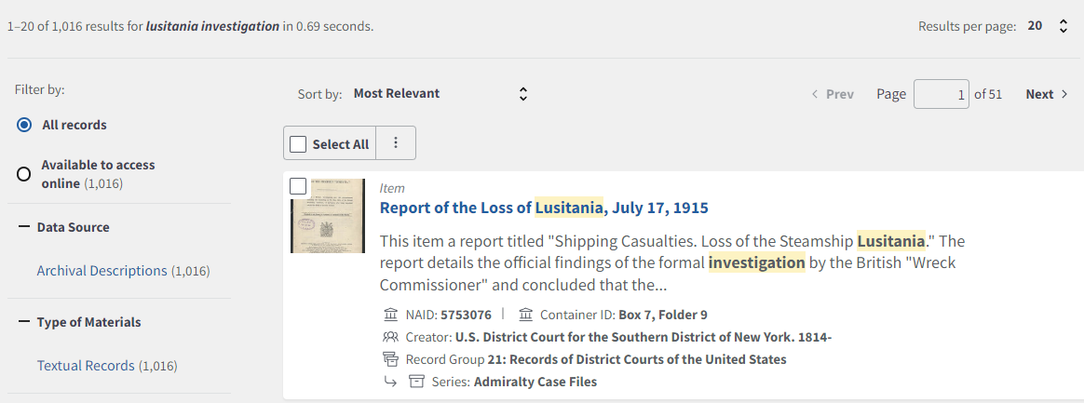
National investigations

Slide 47
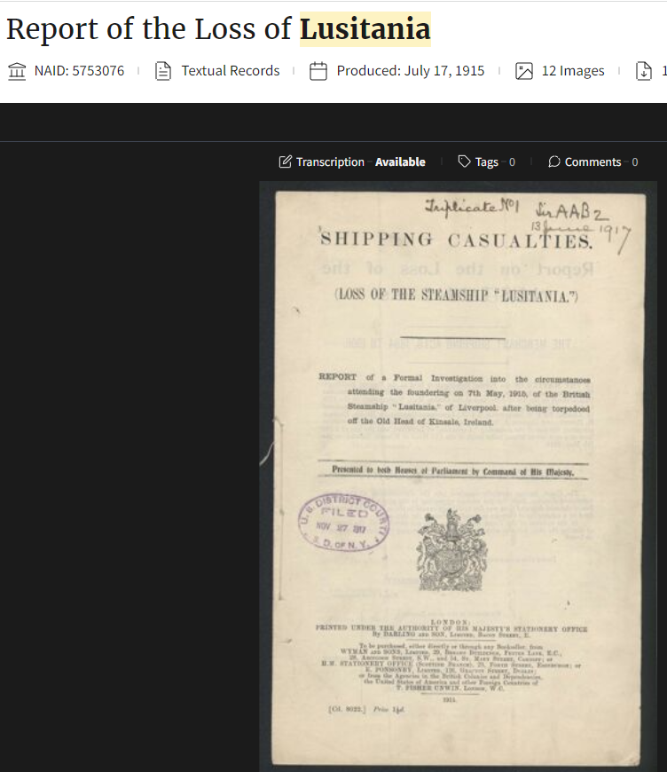
National investigations

Slide 48
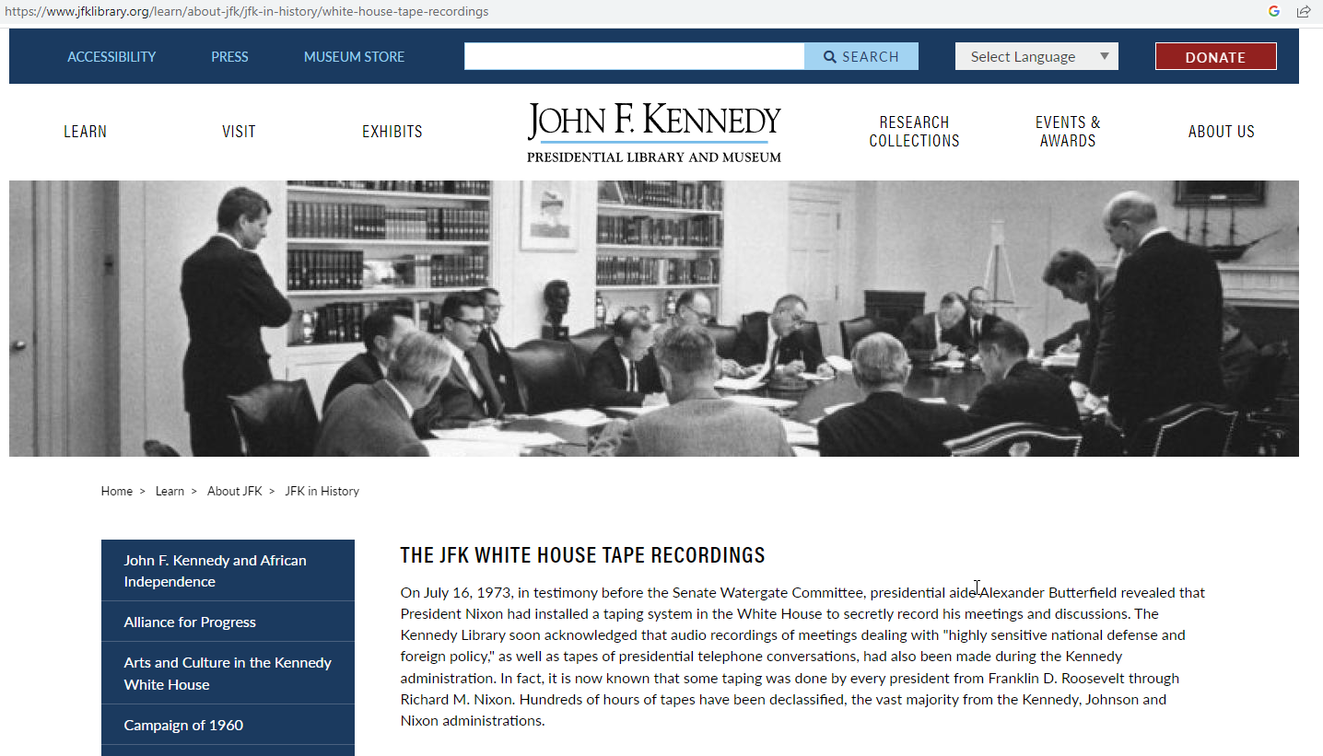
Presidential recordings
https://www.youtube.com/watch?v=qk6BpI-qc08

Slide 49
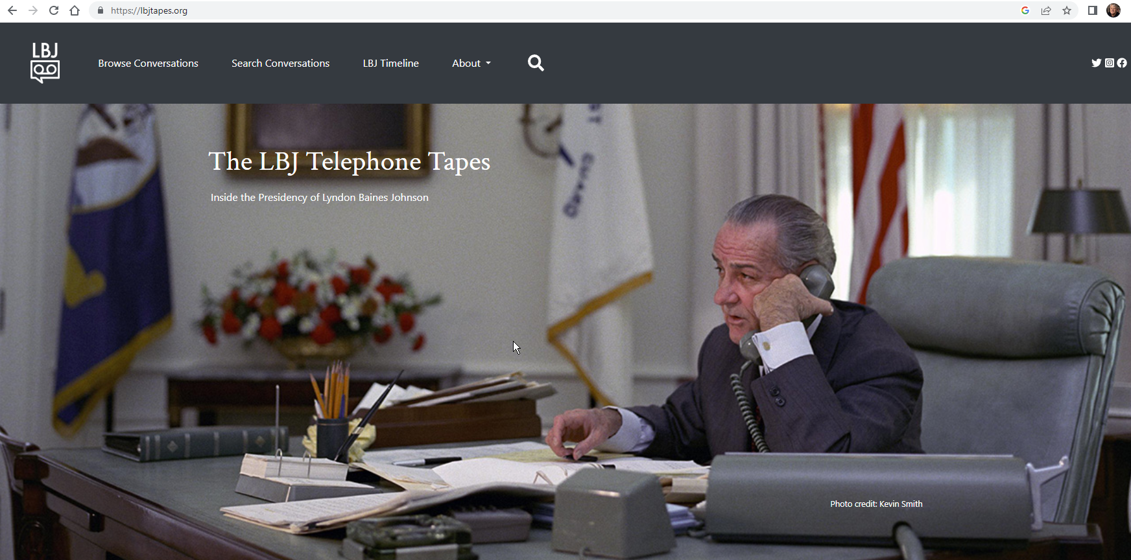
Presidential recordings

Slide 50
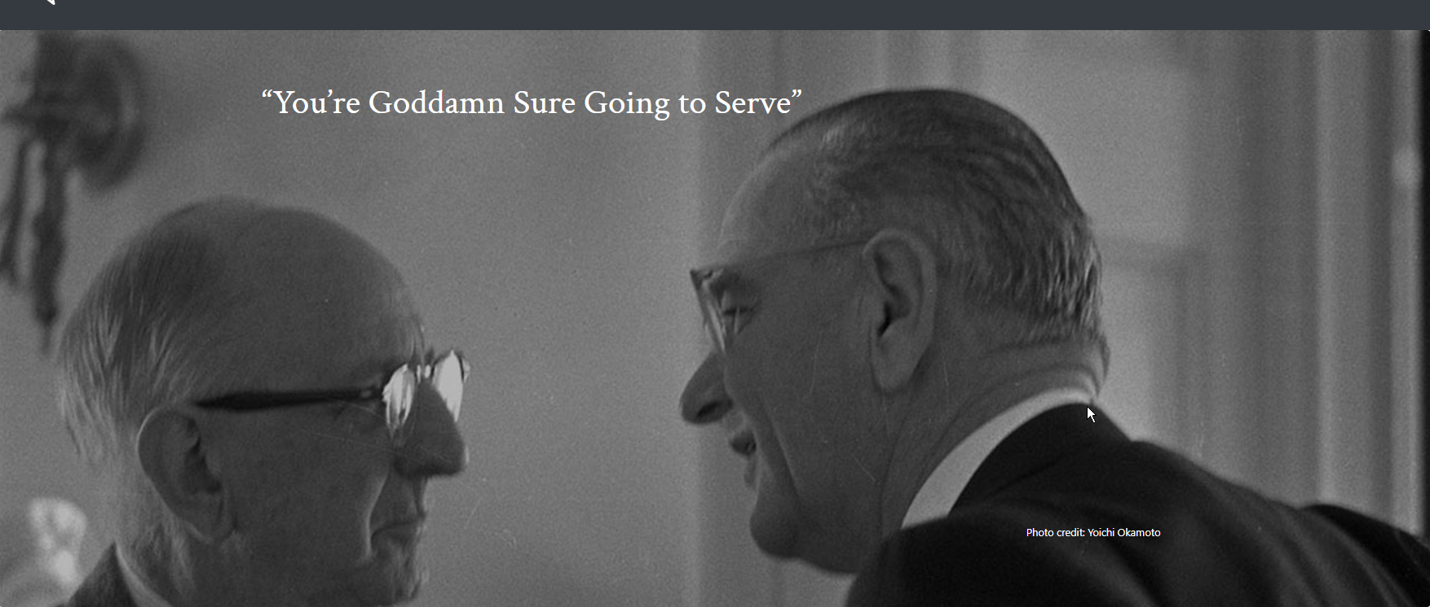
Presidential recordings
https://lbjtapes.org/conversation/youre-goddamn-sure-going-serve

