Slide 1
Navigating the National Archives
Brant Houston
University of Illinois
brant.houston@gmail.com

Slide 2
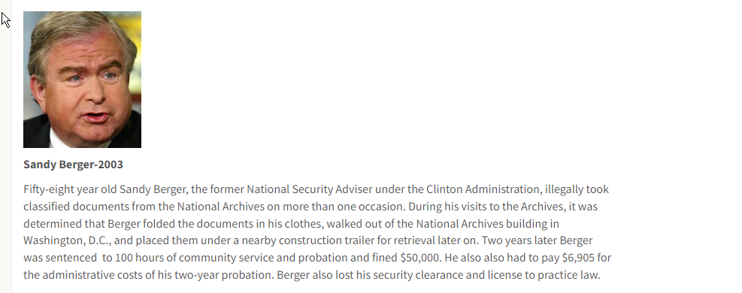
National archives in the news
http://www.bbc.com/news/blogs-trending-42724320

Slide 3
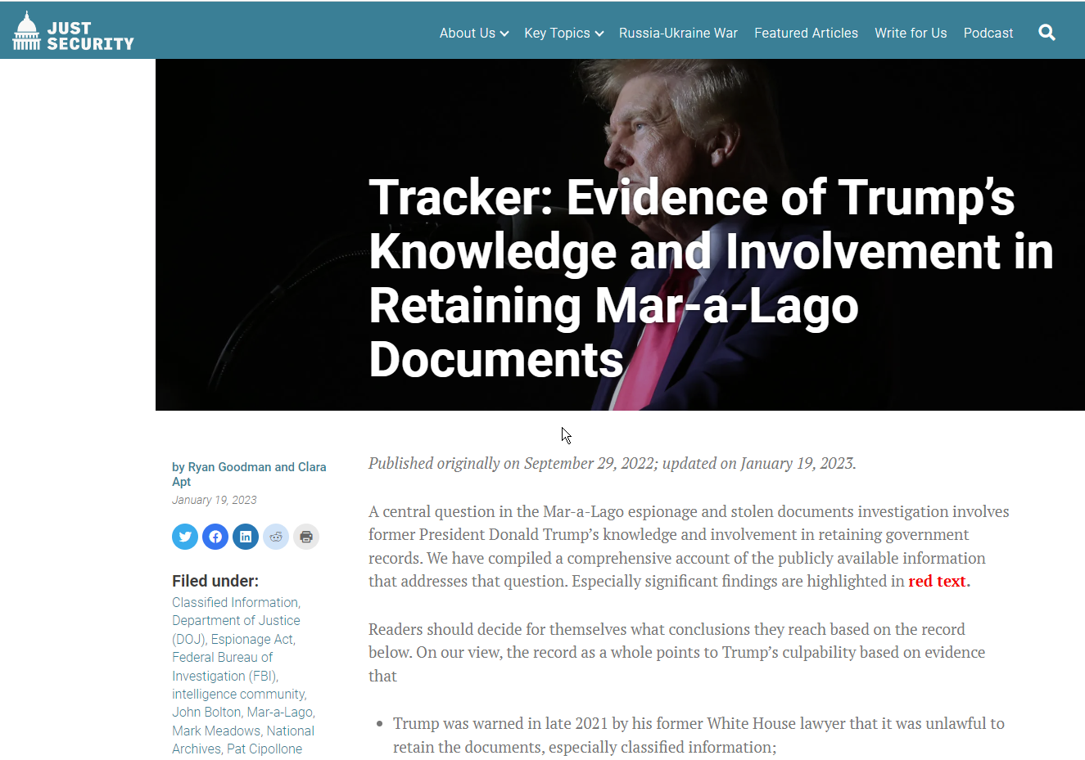
Archives in the news
http://www.bbc.com/news/blogs-trending-42724320

Slide 4
Archives in the news
http://www.bbc.com/news/blogs-trending-42724320

Slide 5
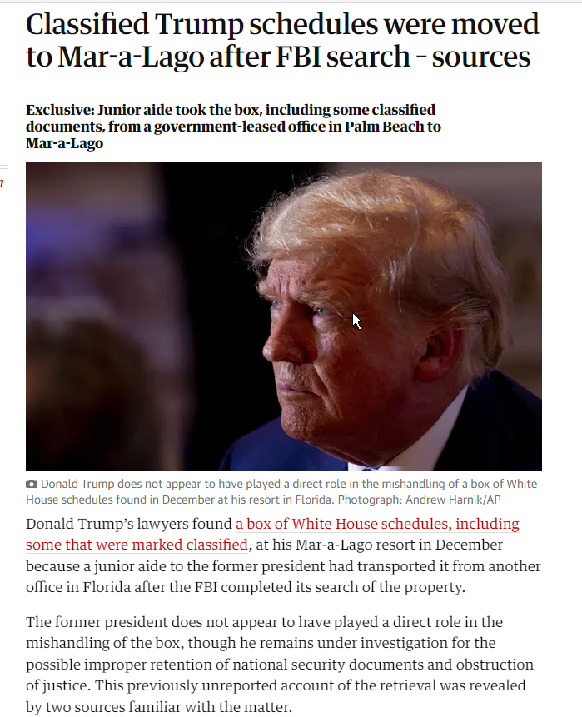
Archives in the news
http://www.bbc.com/news/blogs-trending-42724320

Slide 6
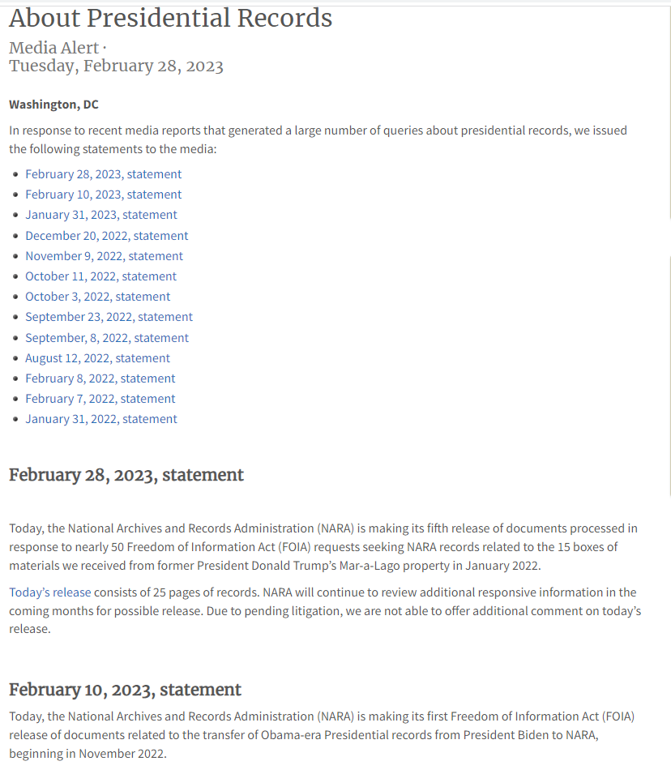
Press releases
https://www.archives.gov/press/press-releases/2022/nr22-001

Slide 7
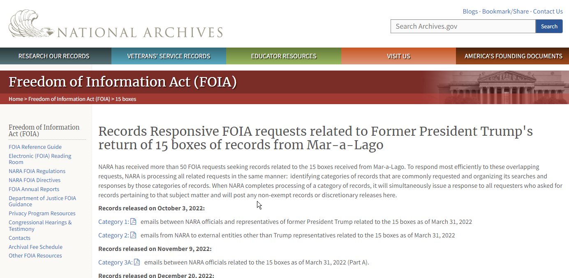
Archives in the news
http://www.bbc.com/news/blogs-trending-42724320

Slide 8
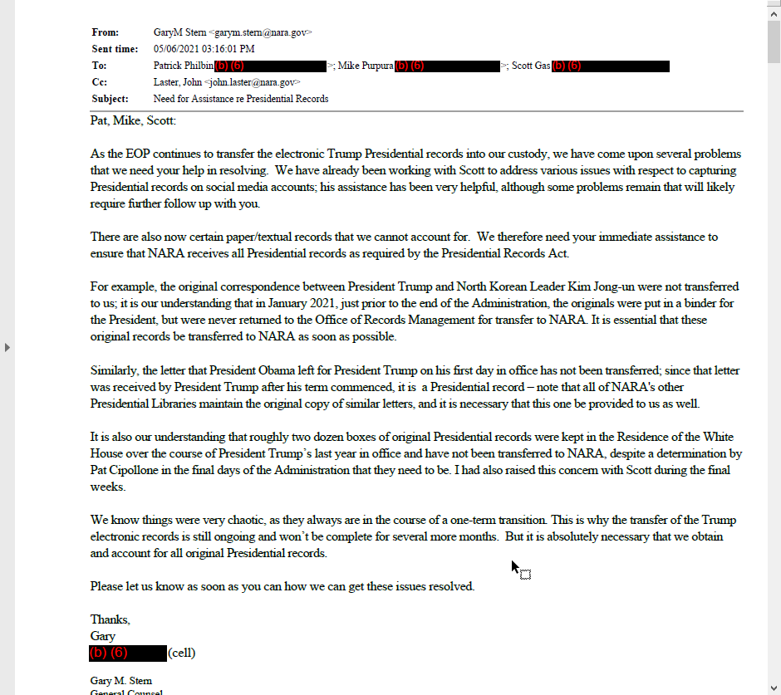
Archives in the news
http://www.bbc.com/news/blogs-trending-42724320

Slide 9
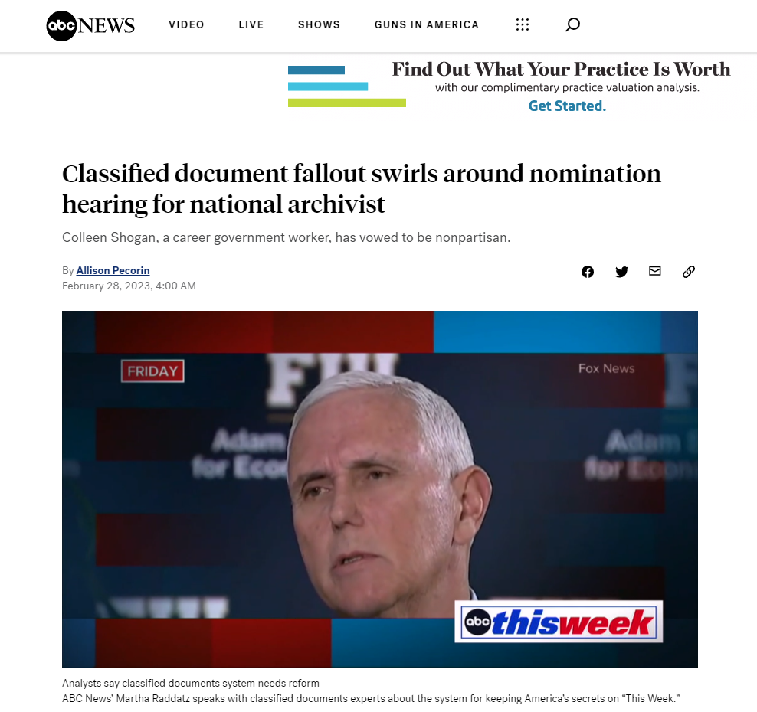
Archives in the news
http://www.bbc.com/news/blogs-trending-42724320

Slide 10
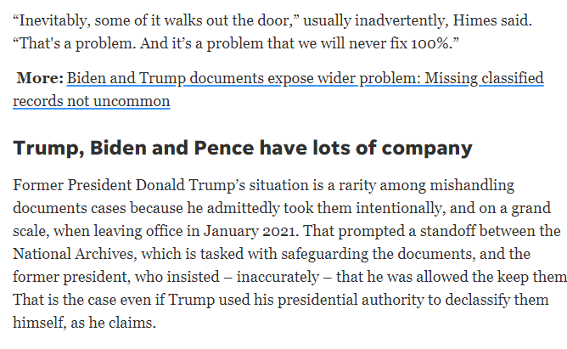
The broader issue of classfication
http://www.bbc.com/news/blogs-trending-42724320

Slide 11
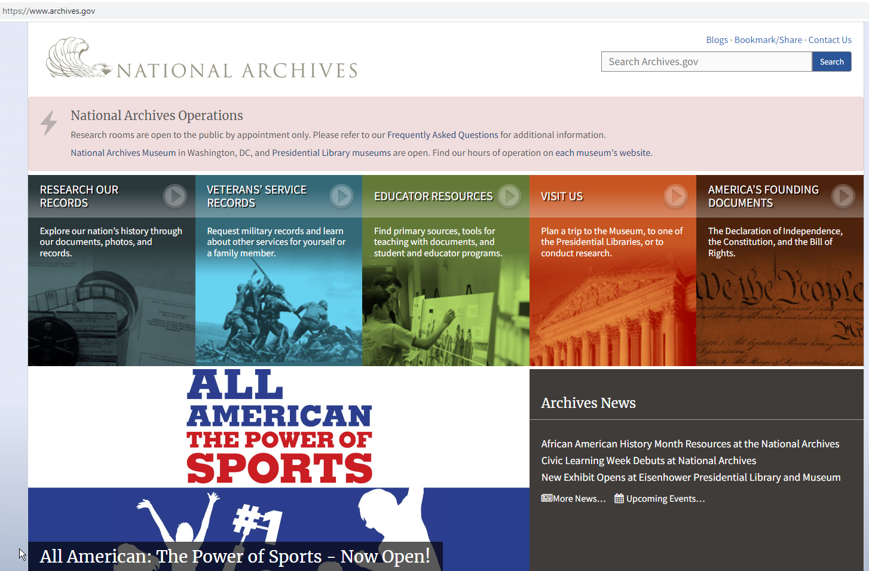
A Vast Network
http://www.bbc.com/news/blogs-trending-42724320

Slide 12
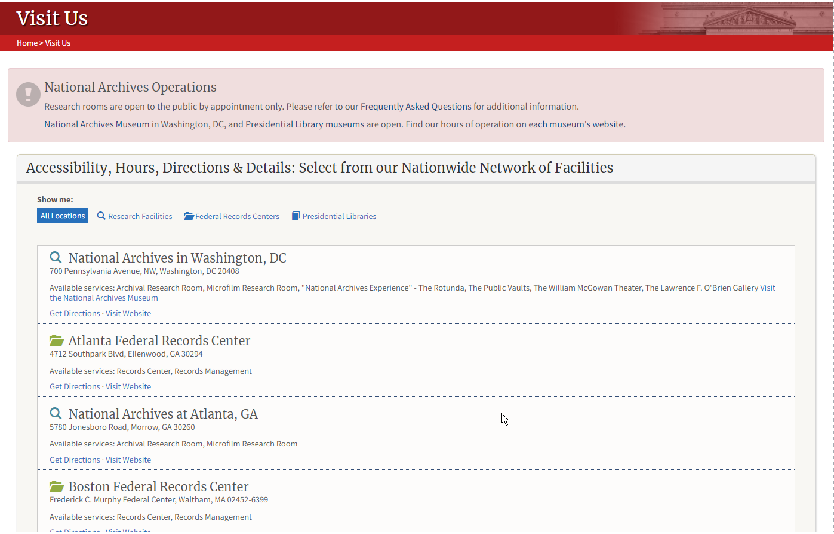
A Vast Network
http://www.bbc.com/news/blogs-trending-42724320

Slide 13
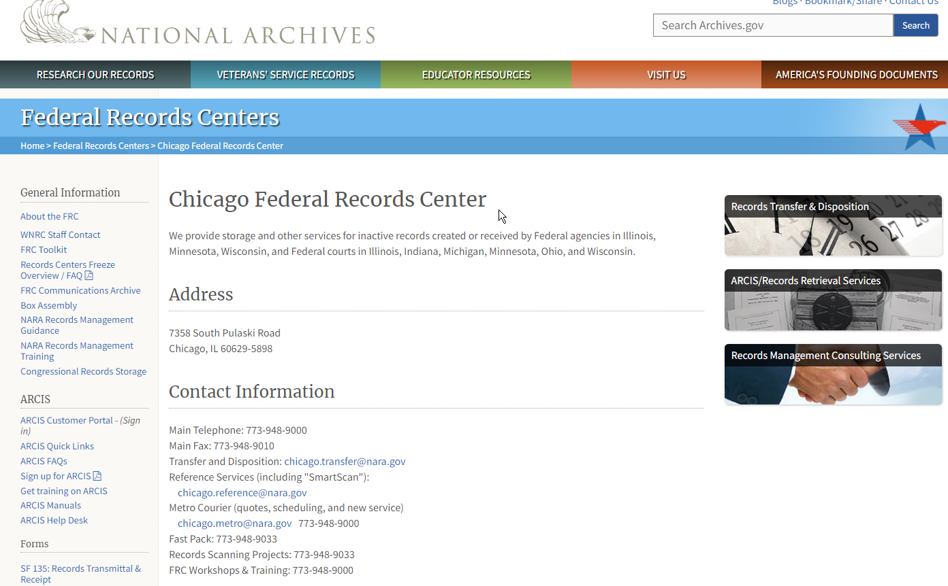
A Vast Network
http://www.bbc.com/news/blogs-trending-42724320

Slide 14
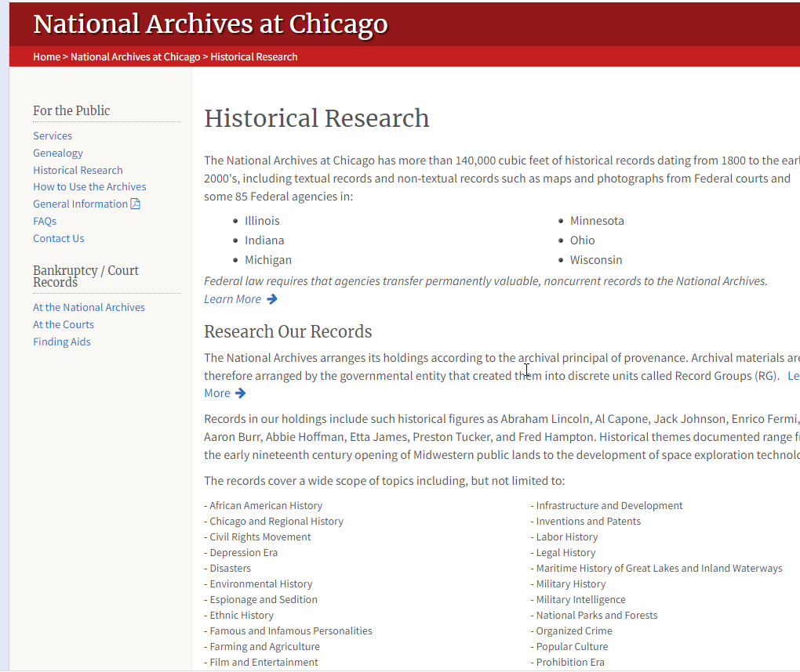
A Vast Network
http://www.bbc.com/news/blogs-trending-42724320

Slide 15
HIGH VALUE Criteria
What high value criteria does it meet?
Access to the government's permanent records:
can be used to increase agency accountability and responsiveness
improves public knowledge of the agency and its operations
furthers the core mission of the agency
creates economic opportunity
responds to need and demand as identified through public consultation
http://www.bbc.com/news/blogs-trending-42724320

Slide 16
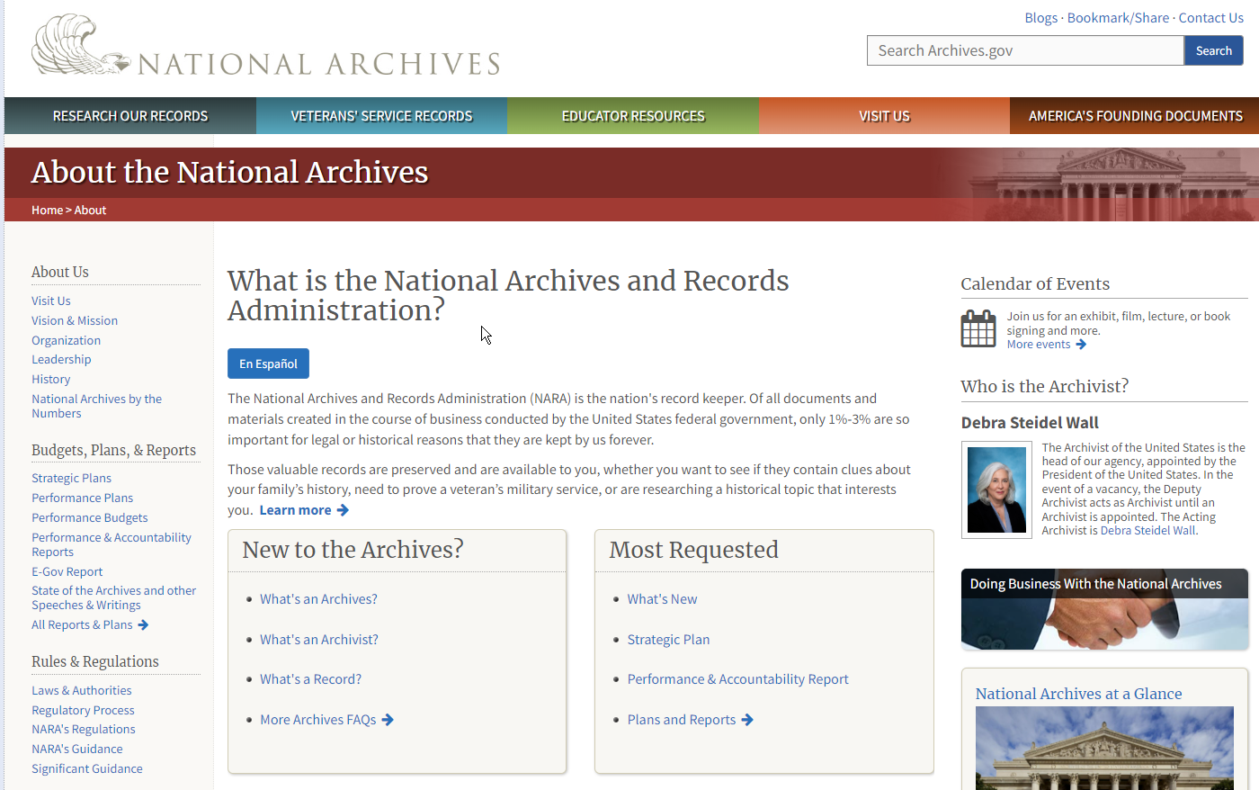
Overview
http://www.bbc.com/news/blogs-trending-42724320

Slide 17
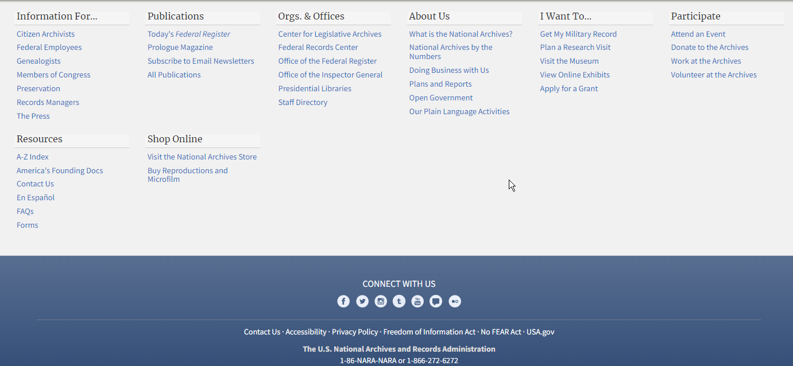
Overview
http://www.bbc.com/news/blogs-trending-42724320

Slide 18
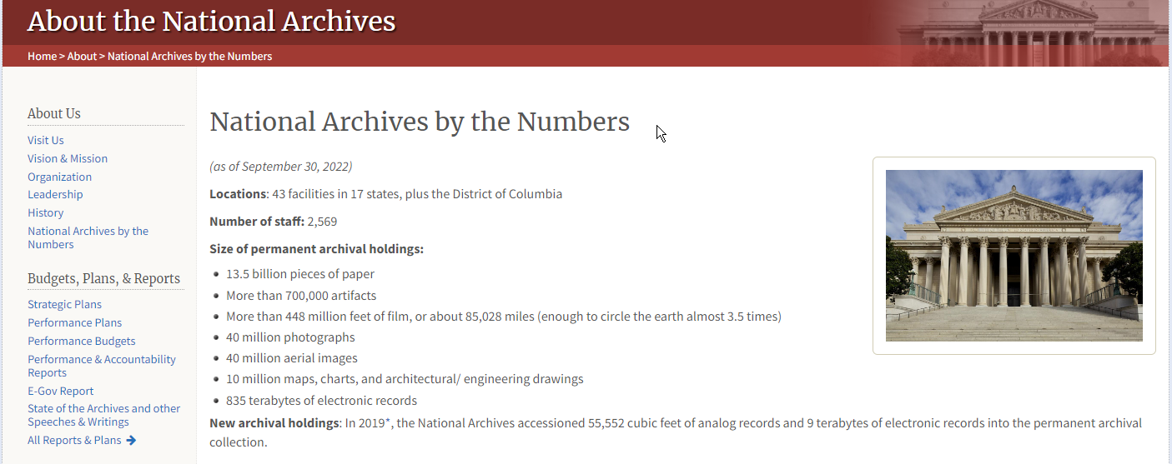
By the numbers
http://www.bbc.com/news/blogs-trending-42724320

Slide 19
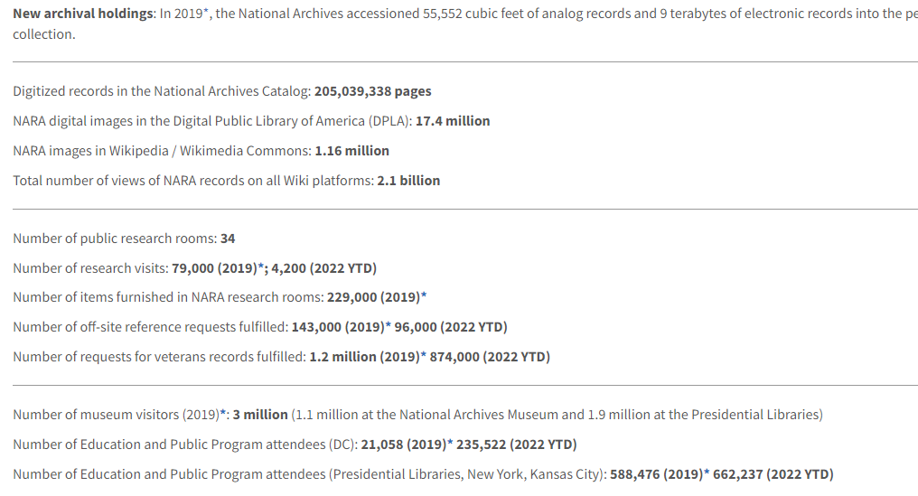
By the numbers
http://www.bbc.com/news/blogs-trending-42724320

Slide 20
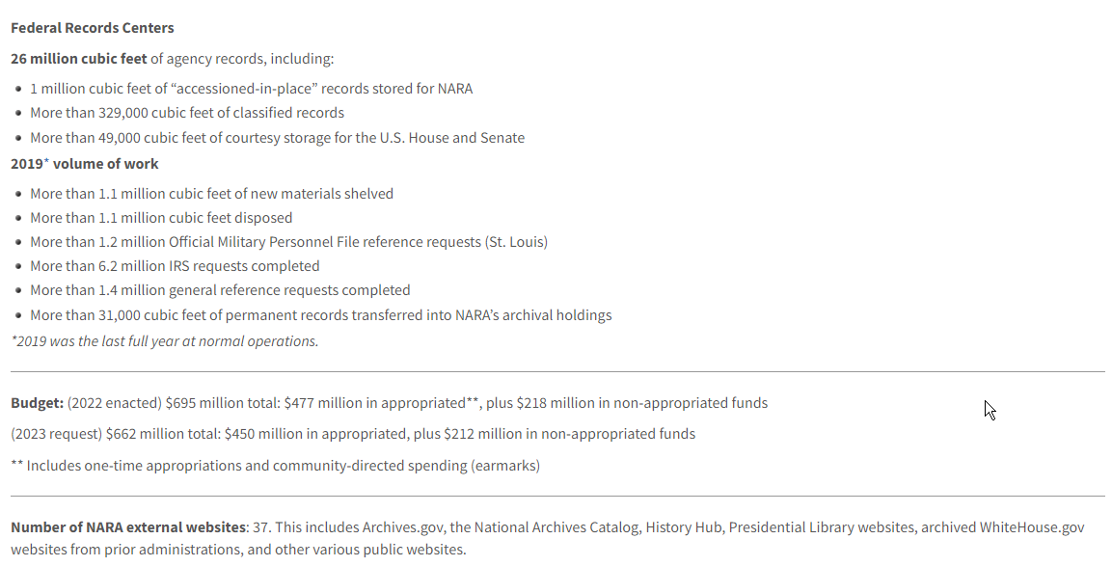
By the numbers
http://www.bbc.com/news/blogs-trending-42724320

Slide 21
History
http://www.bbc.com/news/blogs-trending-42724320

Slide 22
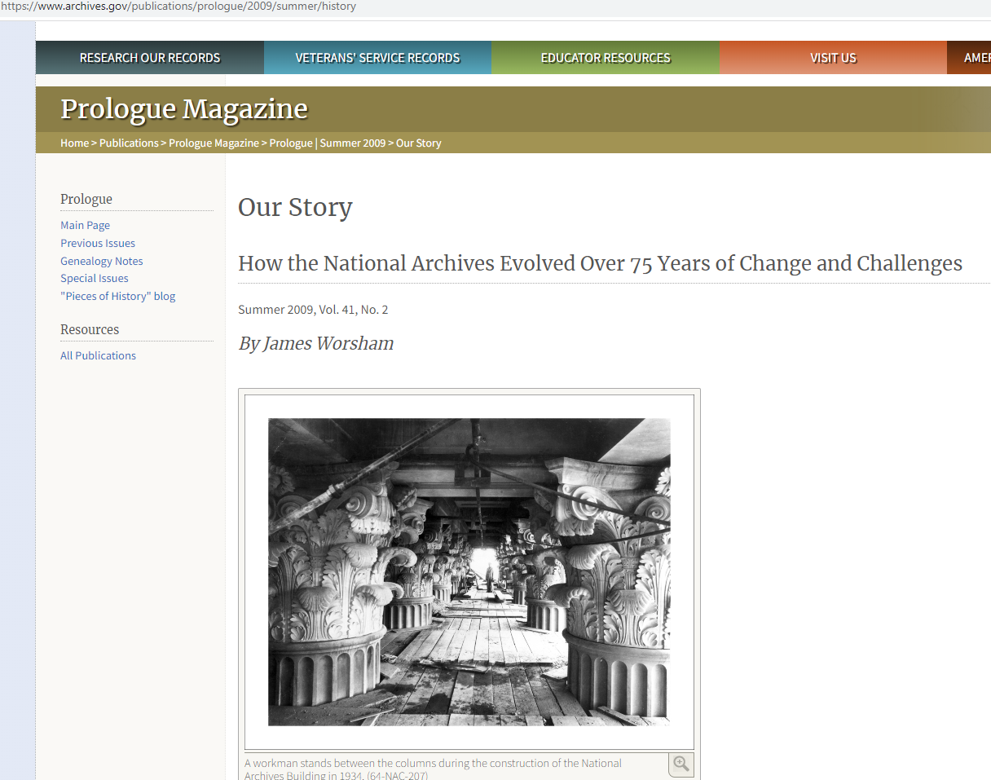
History
http://www.bbc.com/news/blogs-trending-42724320

Slide 23
More History
http://www.bbc.com/news/blogs-trending-42724320

Slide 24
Key Figure
http://www.bbc.com/news/blogs-trending-42724320

Slide 25
Presidents’ Materials
http://www.bbc.com/news/blogs-trending-42724320

Slide 26
Presidential Act
http://www.bbc.com/news/blogs-trending-42724320

Slide 27
Electronic Records
http://www.bbc.com/news/blogs-trending-42724320

Slide 28
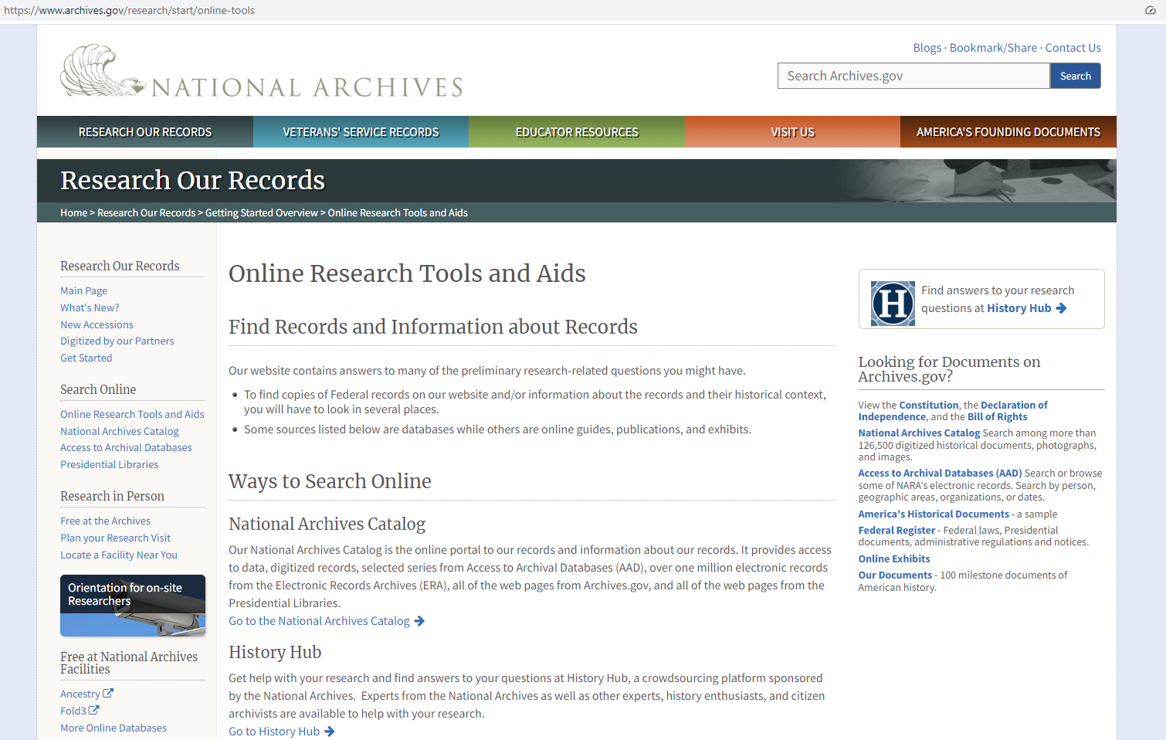
Research Tools
http://www.bbc.com/news/blogs-trending-42724320

Slide 29
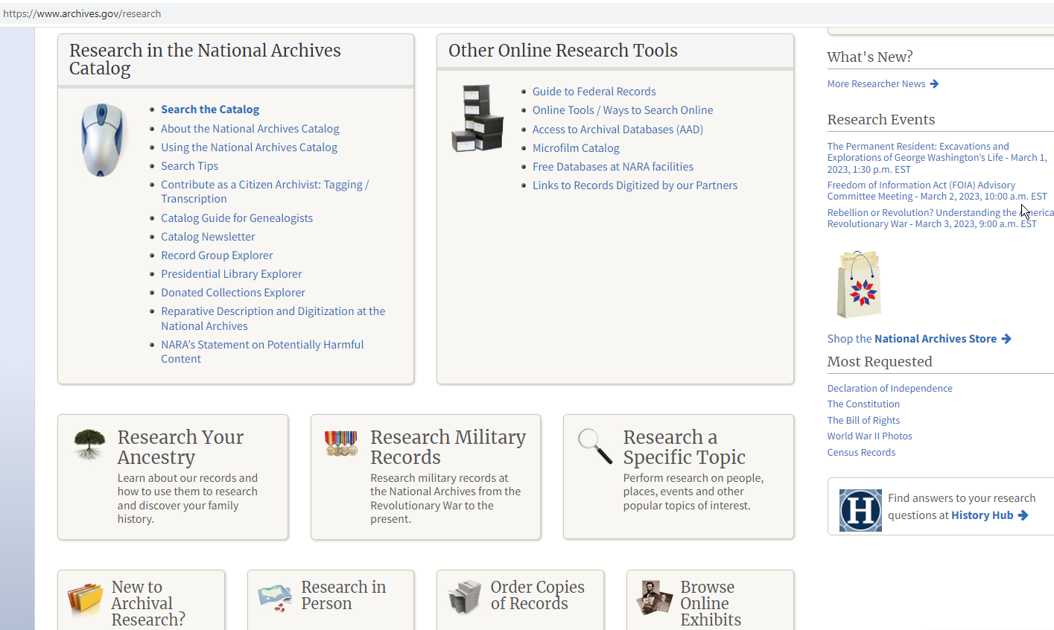
Research tools
http://www.bbc.com/news/blogs-trending-42724320

Slide 30
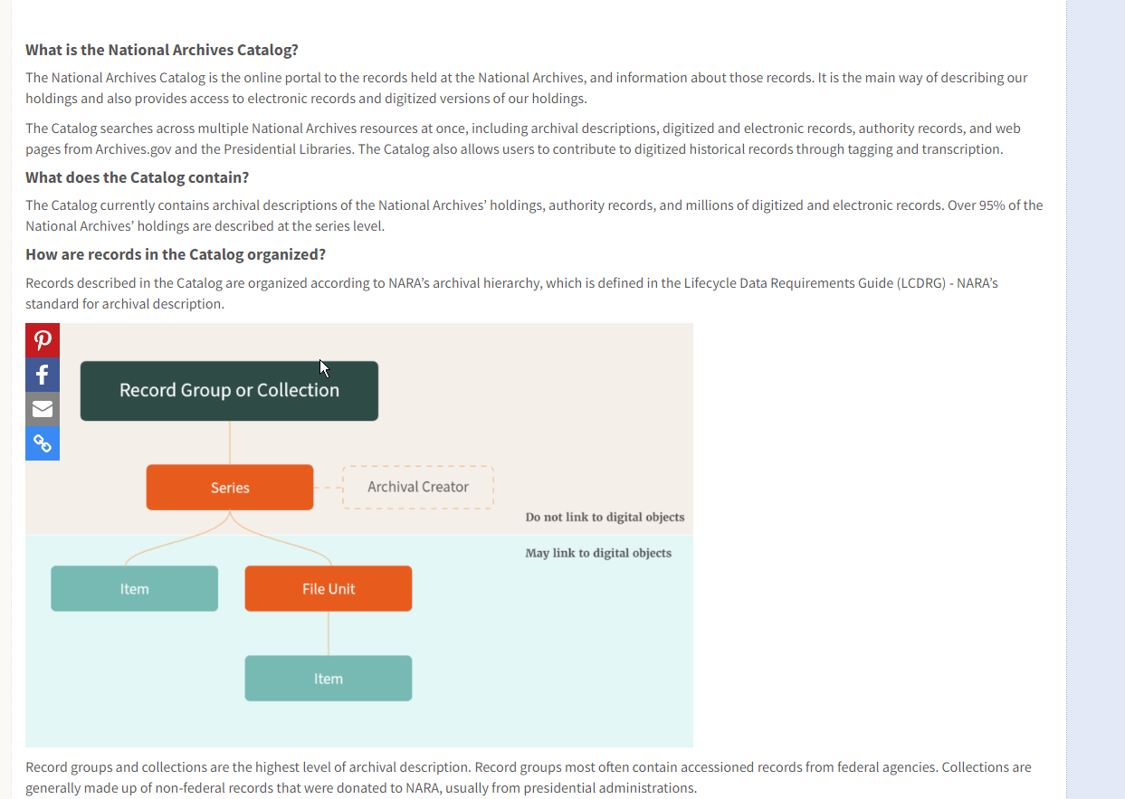
Research tools
http://www.bbc.com/news/blogs-trending-42724320

Slide 31
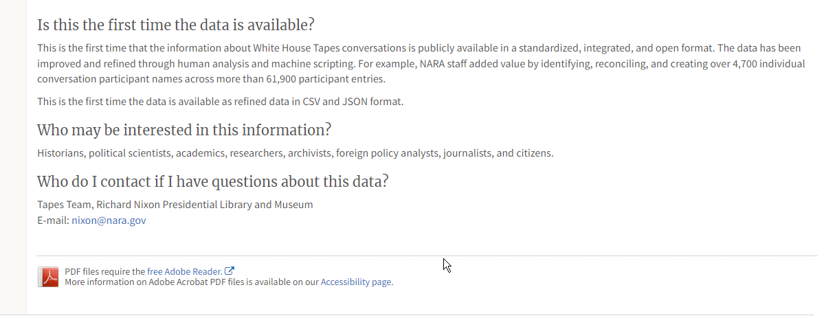
Starting points
http://www.bbc.com/news/blogs-trending-42724320

Slide 32
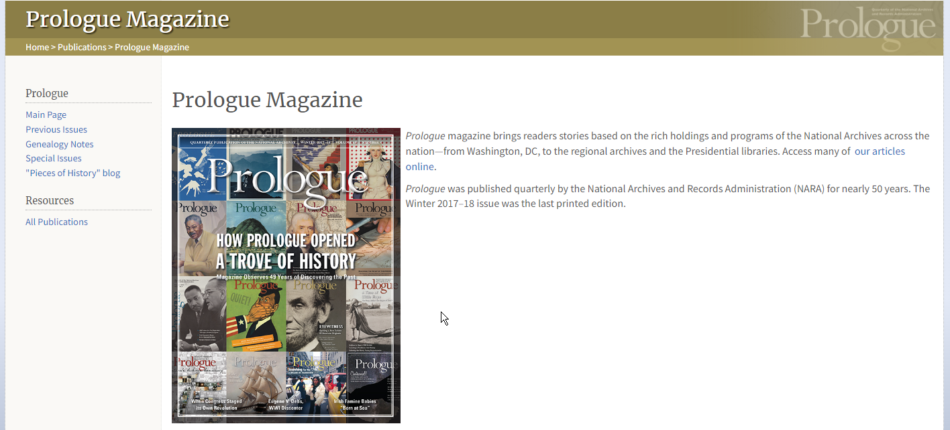
Highlighted material
http://www.bbc.com/news/blogs-trending-42724320

Slide 33
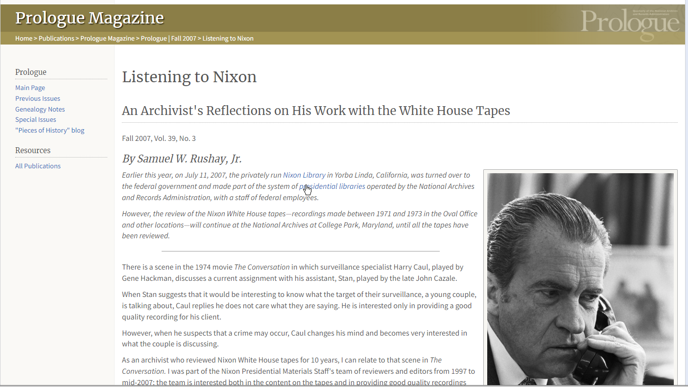
Nixon sample
http://www.bbc.com/news/blogs-trending-42724320

Slide 34
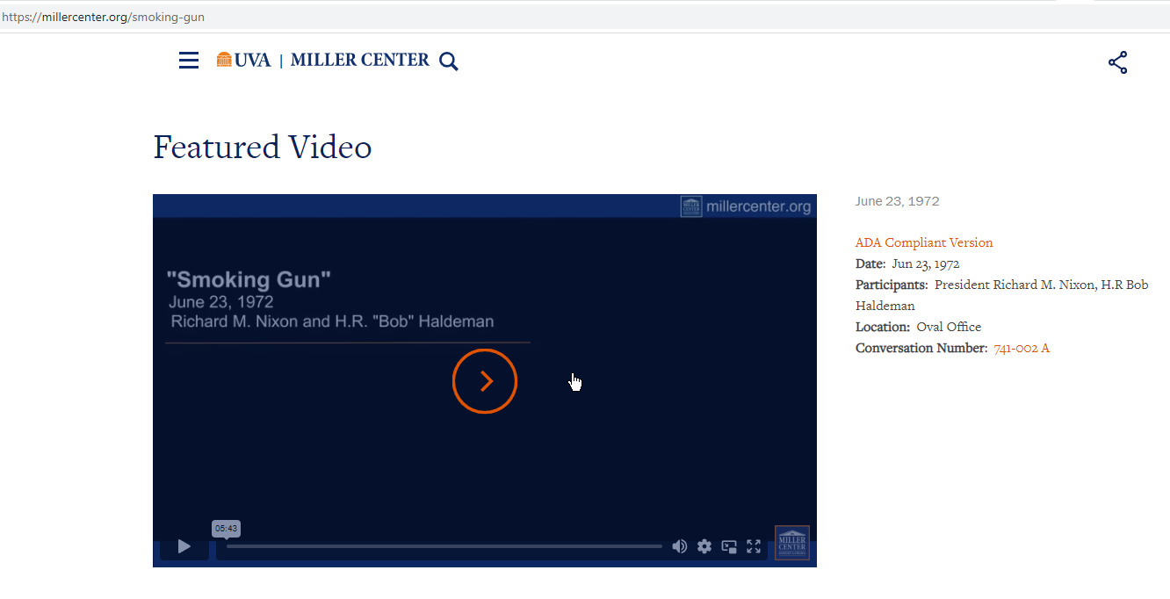
Use of Network of Archives
https://millercenter.org/smoking-gun
http://www.bbc.com/news/blogs-trending-42724320

Slide 35
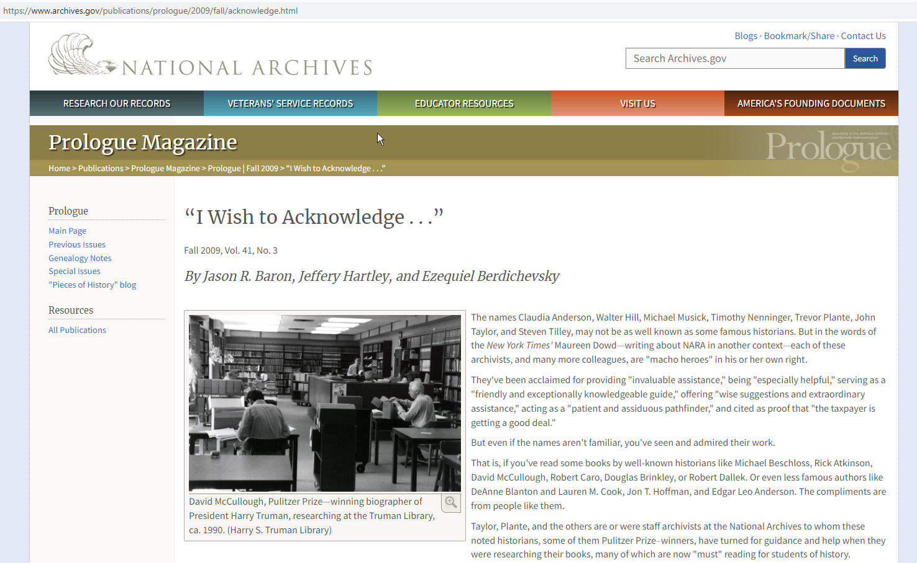
Impact and books
http://www.bbc.com/news/blogs-trending-42724320

Slide 36
Impact and books
http://www.bbc.com/news/blogs-trending-42724320

Slide 37
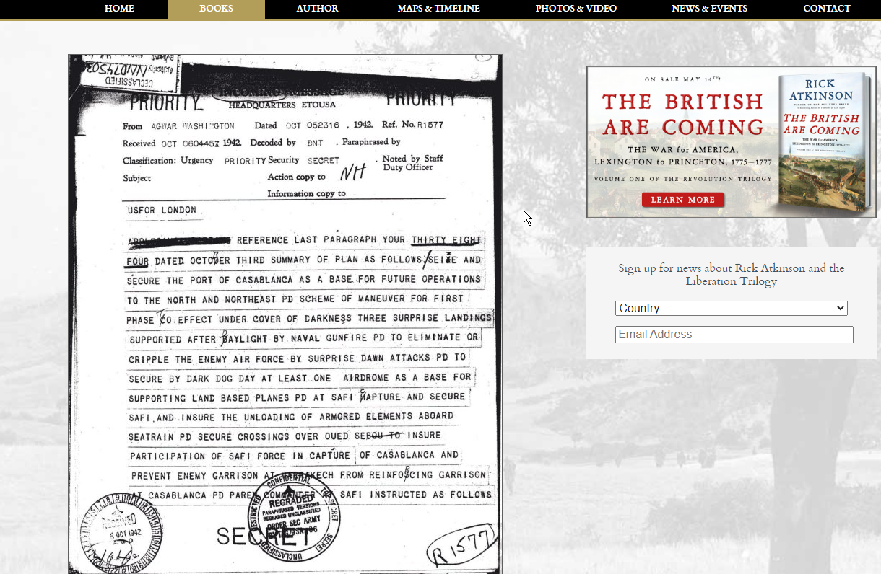
Impact and books Army at Dawn – Rick Atkinson
http://www.bbc.com/news/blogs-trending-42724320

Slide 38
Funding issues
http://www.bbc.com/news/blogs-trending-42724320

Slide 39
Access issues
Yet, Connelly reports, the archives confronts a backlog of some 600 million unexamined presidential records, and it will take 250 years for its staff to process Freedom of Information Act requests for documents at the George W. Bush Presidential Library alone. The tradition of presidential libraries serving as oases for invaluable research is crumbling; the Bush library may be the last to fulfill that purpose.
http://www.bbc.com/news/blogs-trending-42724320

Slide 40
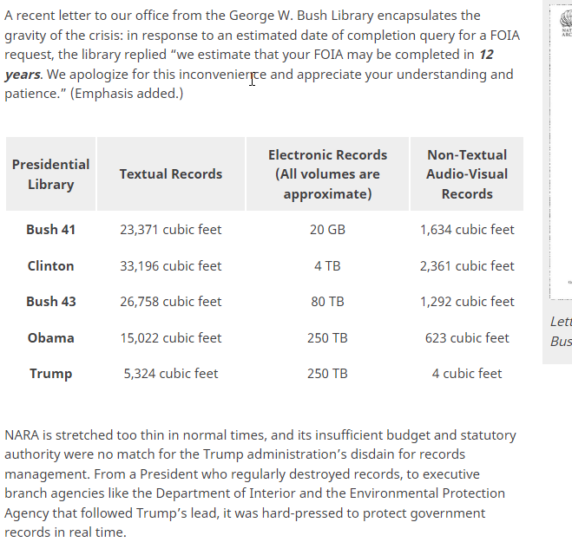
Access issues
http://www.bbc.com/news/blogs-trending-42724320

