Slide 1
Navigating the National Archives CLASS Four
Brant Houston
University of Illinois
brant.houston@gmail.com

Slide 2
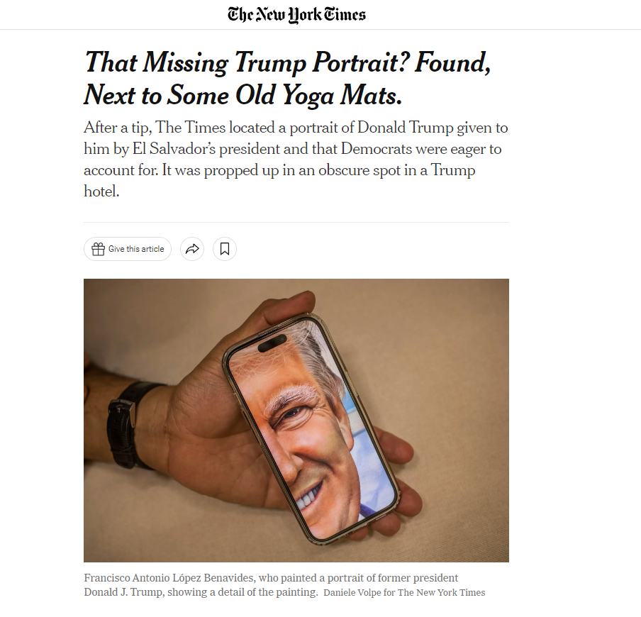
Archives in the News

Slide 3
Archives in the News
In the bowels of the Trump National Doral hotel in Miami, in a small space leading to electrical rooms, an enormous portrait of the 45th president of the United States rests on a piece of deteriorating purple-colored foam.
Stored next to a stack of old yoga mats, the former president’s portrait sits underneath a halogen light and the metal sheen of air ducts, propped between two doors with placards that read “ELECTRICAL ROOM No Storage.”
The tiny room is overwhelmed by the grandiose portrait, standing about eight feet tall and featuring a grinning Donald J. Trump.
While the portrait has apparently sat there ignored for months, back in Washington, it is at the center of a debate over the laws and ethics covering presidential gifts.

Slide 4
Archives in the News
Under the Foreign Gifts and Decorations Act, foreign gifts given to federal officials or their families become the property of the U.S. government if their worth exceeds a certain value. (For most of Trump's time in office, the value was $415. It's currently $480.) The White House is responsible for reporting gifts given to the president, vice president and their families to the State Department, which publishes a report about all gifts given to government employees every year.
The law stipulates that recipients can keep the gifts if they purchase them from the General Services Administration (GSA), but they are still required to be disclosed to the State Department. The rules are meant to prevent foreign governments from influencing U.S. officials.
Many of the foreign gifts given to Trump or his family members are still in the possession of the GSA, National Archives and other federal agencies, according to the committee's report. Some were auctioned off to the public, and others were subsequently purchased by members of the Trump family, including a $24,000 Saudi dagger and a $13,500 vase that Kushner purchase

Slide 5
Archives in the News Unhappy Letter to Wall Street Journal
Does Alan Mikhail think that Egypt’s National Archives are the only archives run by petty tyrants? (“Doing History Under Tyranny,” Bookshelf, March 13). Has he ever tried to do research at the U.S. National Archives in College Park, Md.?
They have rules for everything. Are you wearing a fleece and are now hot working in the reading room? Don’t try taking off the fleece and hanging it on the back of your chair. That isn’t allowed. You must either leave your work and go down from the third floor to the basement to put the fleece in a locker, or you must take the fleece off, zip it up and tie the arms around your waist. That is the only way you can take off an outer garment while remaining in the reading room.

Slide 6
Letter protesting rule continued
A few of the archivists are nice people who genuinely love documents. But most have no sense whatsoever that they are there to serve the public. They are determined to remind you ceaselessly that you are on their turf and you had better follow the rules.

Slide 7
Archives in the news

Slide 8
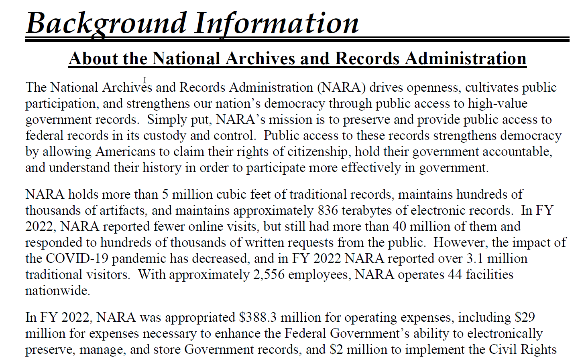
Reminder of challenge
http://www.bbc.com/news/blogs-trending-42724320

Slide 9
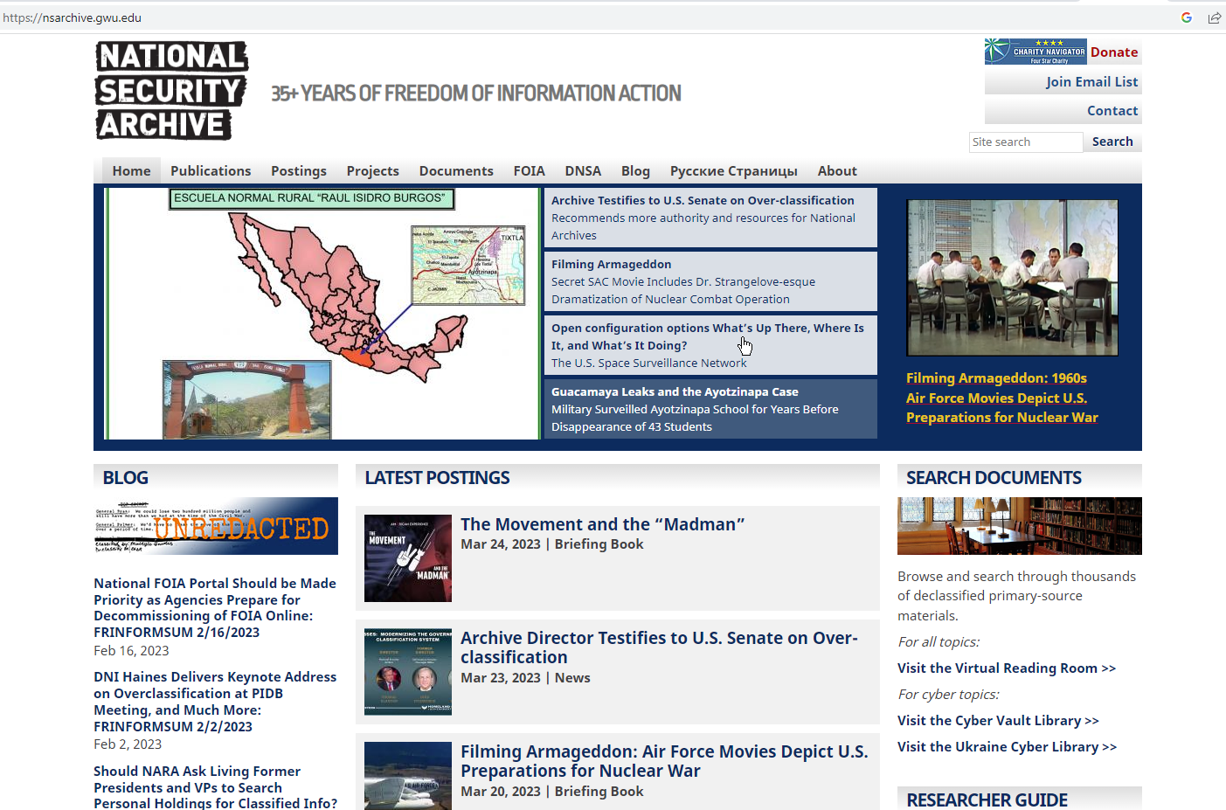
Archives in the News

Slide 10
Archives in the News

Slide 11
Archives in the News
The Archive statement emphasized findings from our 2022 Freedom of Information Act (FOIA) audit showing the National Archives suffering from 30 years of an almost flat-lined budget while the number of records for which it is responsible has increased exponentially. The Archive highlighted four key components of the National Archives that, if fully funded, would be more prepared to meet these challenges, but that at present – together with the entire National Archives system – are funded at the level of two of the Marine One helicopters that ferry the President (roughly $217 million apiece). “The National Archives needs at least another chopper,” the Archive said.

Slide 12
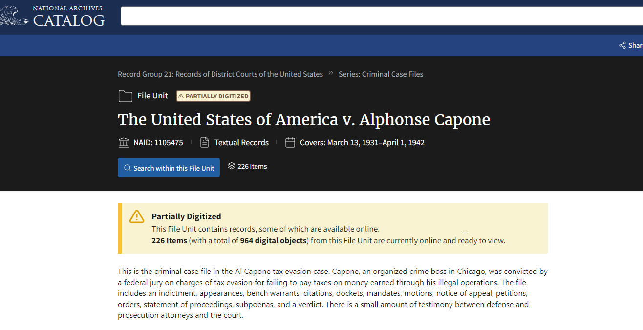
Archives highlights

Slide 13
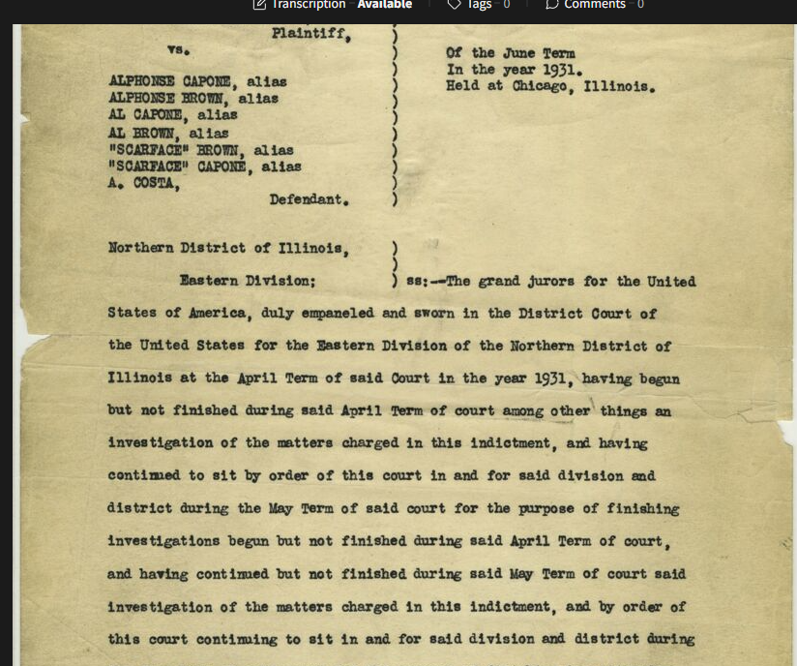
Archives highlights

Slide 14
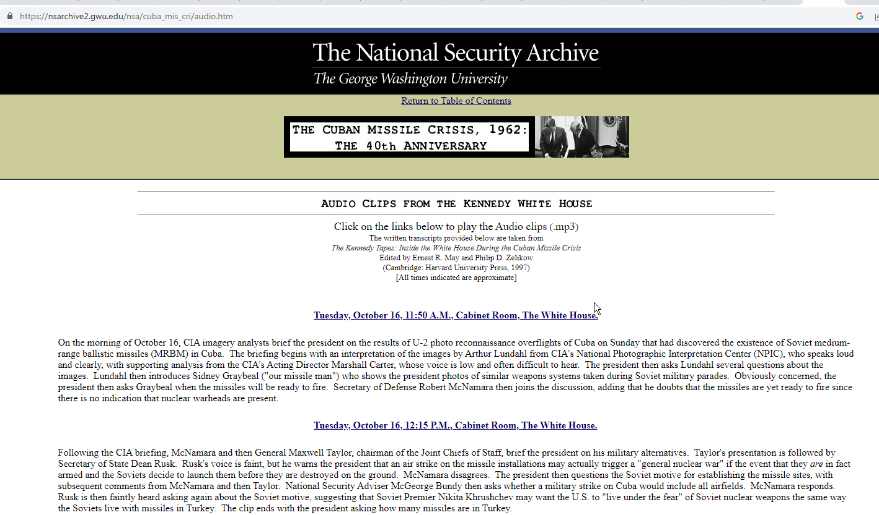
Alternative archives

Slide 15
Archives in the News
JFK: It looks really mean, doesn't it? But on the other hand there wasn't any choice. If he's going to get this mean on this one, in our part of the world [unclear], no choice. I don't think there was a choice RFK: Well, there isn't any choice. I mean, you would have been, you would have been impeached. JFK: Well, I think I would have been impeached. [Unclear exchange] If there had been a move to impeach, I would have been under [unclear], on the grounds that I said they wouldn't do it, and . . . RFK: [Unclear] something else. They'd think up some other step that wasn't necessary. You'd be . . . But now, the fact is, you couldn't have done any less.
https://nsarchive2.gwu.edu/nsa/cuba_mis_cri/cmc06.mp3

Slide 16
Archives in the News
RFK: He said this is, this is a defensive base for the Russians. It's got nothing to do with the Cubans. JFK: Why are . . . They're lying [unclear] that. Khrushchev's horseshit about the election. Anyway, the sickening thing that's so very bad is what this revealed about . . . This horror about embarrassing me in the election. Who said [unclear]? RFK: Well, you know, he [Bolshakov] probably heard it. I hadn't seen him. Then he came back to see me, and he said Khrushchev had a message for you. And I followed it up. The [Soviet] ambassador kept telling me: "Don't pay attention to Georgi." JFK: But they didn't tell you that there were missiles there. RFK: No. Remember, I told you that.

Slide 17
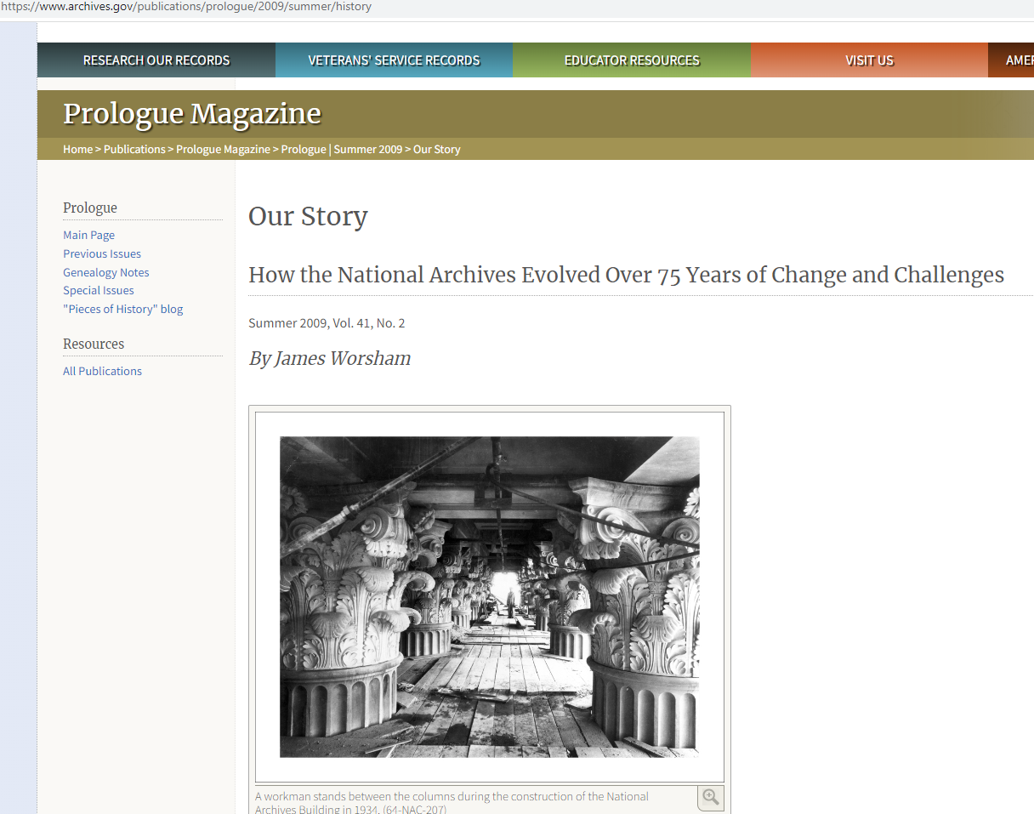
History
http://www.bbc.com/news/blogs-trending-42724320

Slide 18
More History
http://www.bbc.com/news/blogs-trending-42724320

Slide 19
Key Figure
http://www.bbc.com/news/blogs-trending-42724320

Slide 20
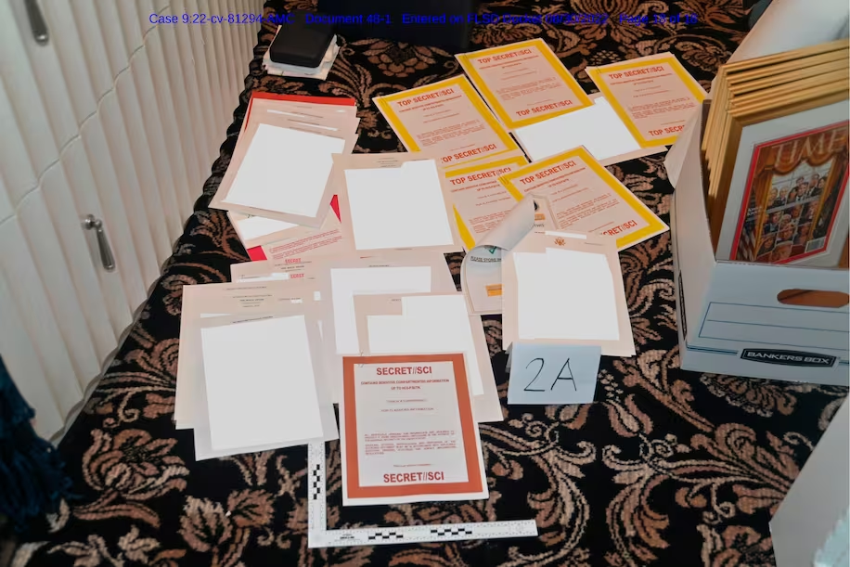
classification

Slide 21
classification

Slide 22
classification
1) Top Secret. Information may be classified “Top Secret” if its unauthorized disclosure could reasonably be expected to cause exceptionally grave damage to the national security. This classification should be used with the utmost restraint. Examples of “exceptionally grave damage” include armed hostilities against the United States or its allies; disruption of foreign relations vitally affecting the national security; the compromise of vital national defense plans or complex cryptologic and communications intelligence systems; the revelation of sensitive intelligence operations; and the disclosure of scientific or technological developments vital to national security

Slide 23
classification
2) Secret. Information may be classified “Secret” if its unauthorized disclosure could reasonably be expected to cause serious damage to the national security. This classification should be used sparingly. Examples of “serious damage” include disruption of foreign relations significantly affecting the national security; significant impairment of a program or policy directly related to the national security; revelation of significant military plans or intelligence operations; and compromise of significant scientific or technological developments relating to national

Slide 24
classification
(3) Confidential. Information may be classified “Confidential” if its unauthorized disclosure could reasonably be expected to cause damage to the national security. Except as otherwise provided by statute, no other terms shall be used to identify classified information. Terms or phrases such as “For Official Use Only” or “Limited Official Use” shall not be used to identify national security information. No other term or phrase shall be used in conjunction with these national security information designations, such as “Secret Sensitive” or “Agency Confidential” to identify national security information

Slide 25
Back to Secrecy

Slide 26
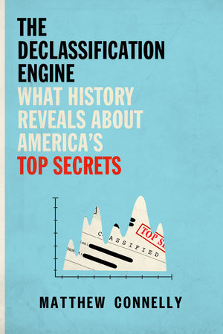
Secrecy
https://www.penguinrandomhouse.com/books/545793/the-declassification-engine-by-matthew-connelly/

Slide 27
Secrecy
ABOUT THE DECLASSIFICATION ENGINE
Every day, thousands of new secrets are created by the United State government. What is all this secrecy really for? And whom does it benefit? Before World War II, transparent government was a proud tradition in the United States. In all but the most serious of circumstances, classification, covert operations, and spying were considered deeply un-American. But after the war, the power to decide what could be kept secret proved too tempting to give up.
https://www.penguinrandomhouse.com/books/545793/the-declassification-engine-by-matthew-connelly/

Slide 28
Secrecy
Since then, we have radically departed from that open tradition, allowing intelligence agencies, black sites, and classified laboratories to grow unchecked. Officials insist that only secrecy can keep us safe, but its true costs have gone unacknowledged for too long.
https://www.penguinrandomhouse.com/books/545793/the-declassification-engine-by-matthew-connelly/

Slide 29
Secrecy
A crucial examination of the self defeating nature of secrecy and the dire state of our nation’s archives, The Declassification Engine is a powerful reminder of the importance of preserving the past so that we may secure our future.

Slide 30
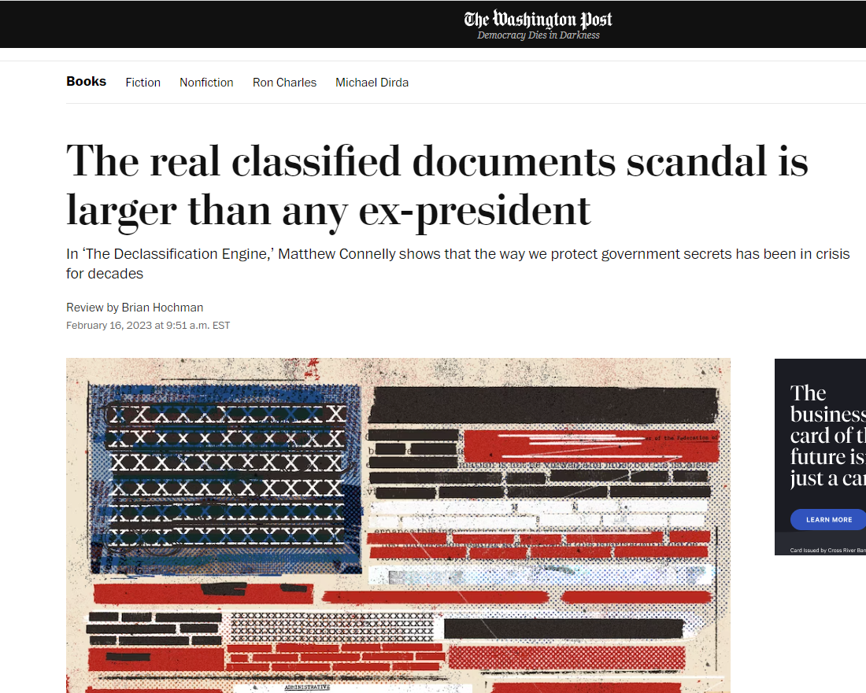
secrecy
https://www.washingtonpost.com/books/2023/02/16/declassifcation-enginge-connelly-review/

Slide 31
secrecy
The U.S. government classifies three documents every second — a rate that has accumulated enough paper to fill the Washington Monument more than 26 times. The digital footprint of the state’s top-secret data, meanwhile, is so vast that officials lack the capacity to estimate its size. Government officials can hardly keep track of the information they designate as classified. No wonder, then, that classified files keep turning up where they shouldn’t: at a beachfront resort in Florida, in a think tank office in D.C. and at a private residence in Indiana.
http://www.bbc.com/news/blogs-trending-42724320

Slide 32
secrecy
Connelly’s computer-assisted approach is useful in upending the narratives of government transparency on which American politicians often campaign. Every president since Franklin Roosevelt has issued new protocols for protecting government secrets, often while portraying their administrations as more open than those of their predecessors. In practice — and at big-data scale — the numbers belie those stories. Jimmy Carter turns out to have classified documents at the same rate as Richard Nixon.

Slide 33
secrecy
Connelly regards the book’s catalogue of secrets as evidence that the U.S. government operates as a “dark state.” The turn of phrase is catchy, but its connotations of coordinated conspiracy tend to obscure the book’s account of the quotidian workings of power. As Connelly shows, most of the government’s classified documents are created out of negligence and inertia. Secrets provide a front-line defense against liability, and, as such, they reinforce the status quo.

Slide 34
secrecy
.The most secretive president of all was Barack Obama, who campaigned on a platform promising “open government.” (The Obama White House classified more documents and prosecuted more leakers than any in history.) For all his bluster about releasing all of the CIA’s Kennedy assassination files, Trump absorbed Obama’s classification guidelines wholesale. Trump also continued a long-standing presidential tradition of hollowing out the institutions that work to manage classified information. Since the 1980s, librarians and archivists around the country have had to follow a familiar bureaucratic imperative: Do more with less.
http://www.bbc.com/news/blogs-trending-42724320

Slide 35
secrecy
Several generations’ worth of classified information now languishes in an outdated record-keeping apparatus that costs more than $18 billion per year to maintain. The government’s efforts to release redacted tranches of formerly classified papers — a process required by law, in some cases — have all but ground to a halt. Many of its classified electronic records will end up lost, either buried under mountains of new data or deleted in the replacement of legacy storage systems.

Slide 36
History lab
http://history-lab.org/declassificationengine/

Slide 37
History lab
http://www.bbc.com/news/blogs-trending-42724320

Slide 38
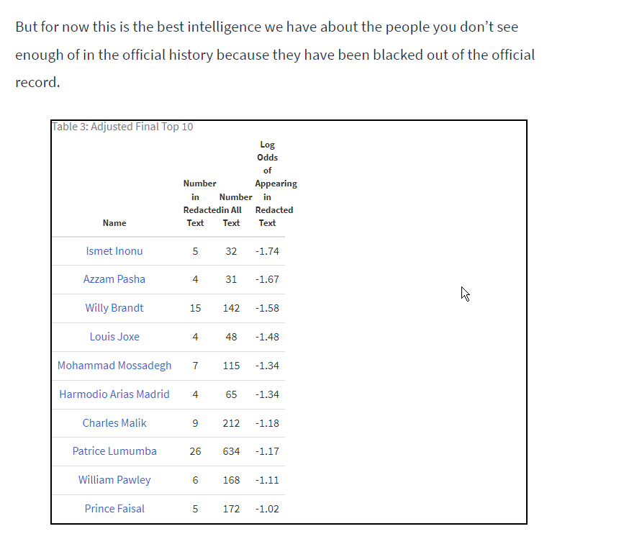
History lab
http://www.bbc.com/news/blogs-trending-42724320

Slide 39
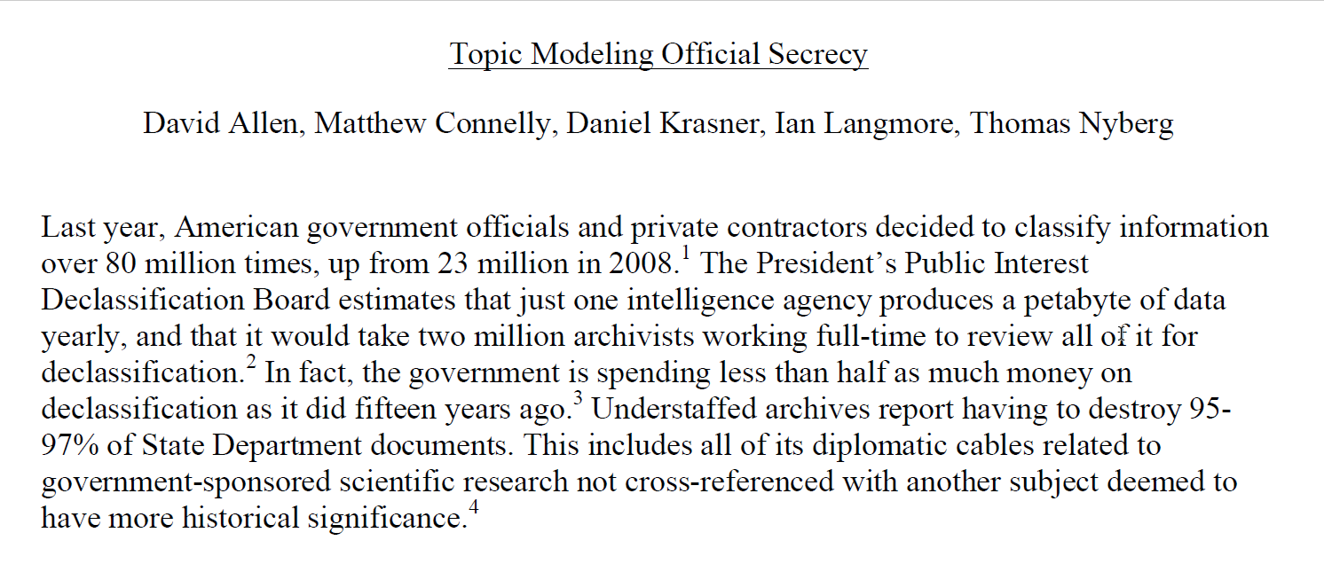
History lab
http://www.bbc.com/news/blogs-trending-42724320

Slide 40
History lab
For the 1952-60 period, the group of documents with the largest percentage of redactions is most
strongly associated with the words“oil, day, man, times, companies, arabia, construction.” Many of the documents most representative of this topic concern the CIA-backed overthrow of the democratically-elected government of Guatemala in 1954. What is more surprising is the
prevalence of documents about U.S. oil companies. Some relate to their concern about the emergence of OPEC, but also how “their local man” would help the CIA eliminate Guatemala’soil supplies (often measured in “barrels per day.”)
http://www.bbc.com/news/blogs-trending-42724320

Slide 41
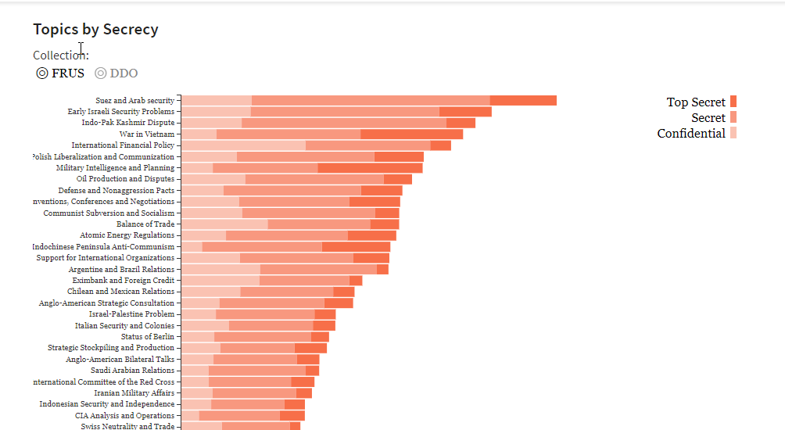
History lab
http://www.bbc.com/news/blogs-trending-42724320

Slide 42
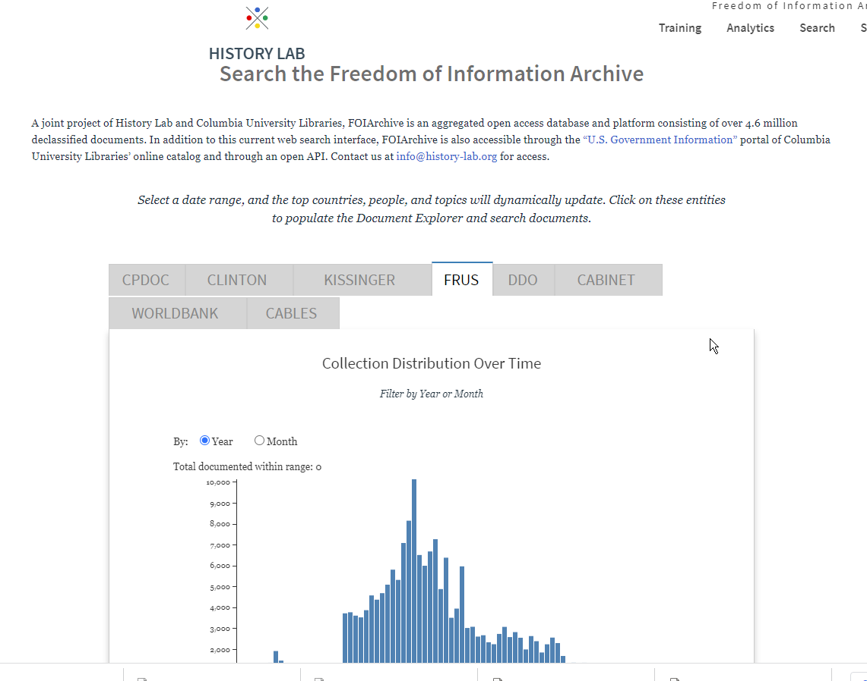
Freedom of Information archive
http://www.bbc.com/news/blogs-trending-42724320

Slide 43
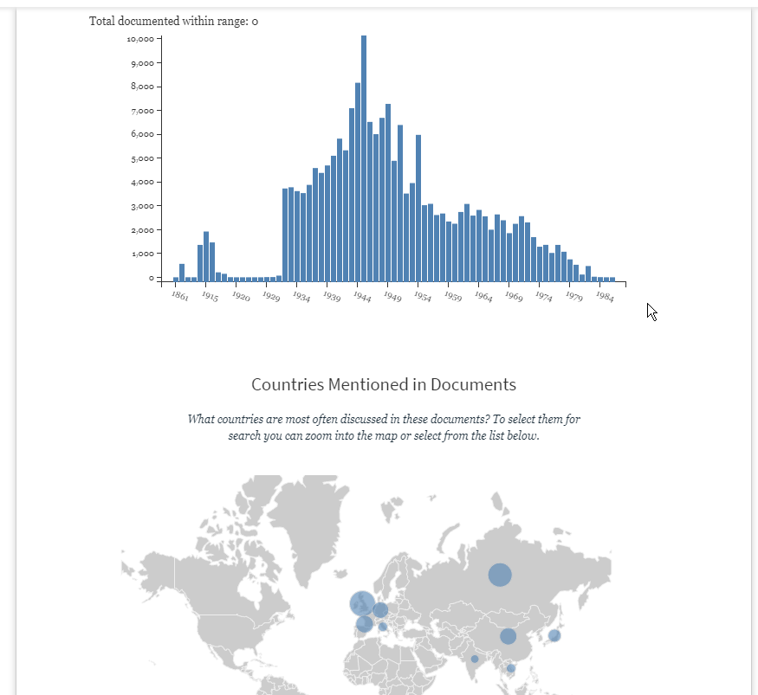
Freedom of Information archive
http://history-lab.org/search
http://www.bbc.com/news/blogs-trending-42724320

Slide 44
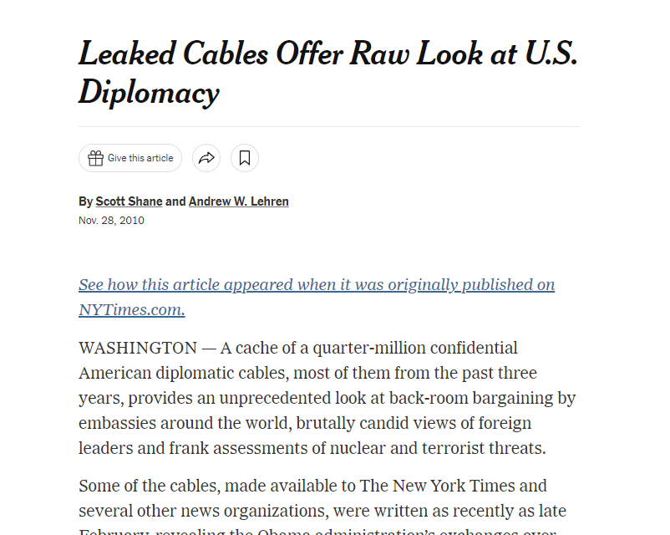
Alternative archives - Leaks
http://www.bbc.com/news/blogs-trending-42724320

Slide 45
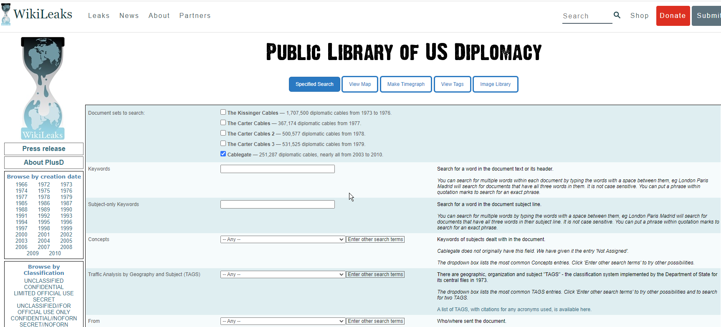
Alternative Archives
https://wikileaks.org/plusd/?qproject[]=cg&q=
http://www.bbc.com/news/blogs-trending-42724320

Slide 46
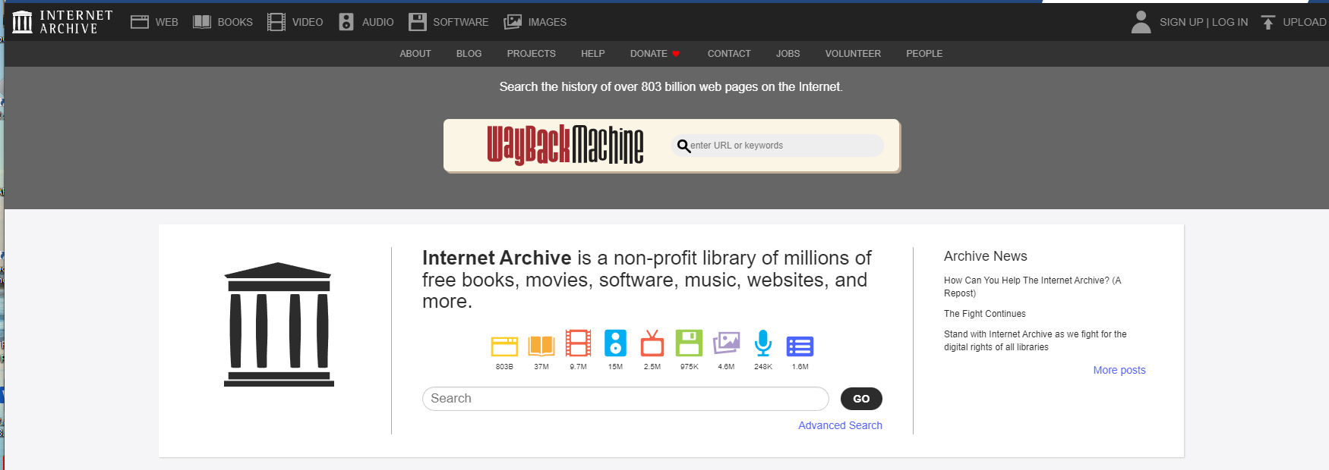
Alternative Archives
https://archive.org/
http://www.bbc.com/news/blogs-trending-42724320

