Slide 1
“A Good Day To Die” Indian Wars in the American West

Slide 2
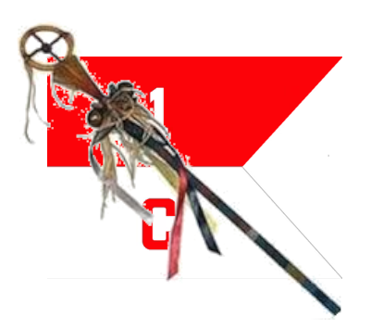
Course Outline
Week 1: What Came Before (From Christopher Columbus to Manifest Destiny)
Week 2: A House Divided (Genesis of the Western Wars)
Week 3: The Opponents (The US Army and the Natives)
Week 4: Red Cloud’s War, the Lakota, and the Northern Plains
Week 5: Hancock’s War, Commancheria, and the Southern Plains
Week 6: The Long Struggle for Apacheria and the Southwest
Week 7: The Forgotten Wars (The Great Basin and Pacific Northwest)
Week 8: Finale (From the Little Bighorn to Wounded Knee)

Slide 3
“A Good Day To Die” Indian Wars in the West
OLLI “Spring” 2021
Week 8: Finale
From the Little Bighorn to Wounded Knee

Slide 4
The Finale From Lil Bighorn to Woundd Knee
The Great Sioux Rising
Little Bighorn Campaign
Battle of Rosebud Creek
Battle of the Little Bighorn
End of the Great Sioux Rising
6) Wounded Knee

Slide 5
PART 1: The Great Sioux Rising

Slide 6
What Caused It? (Guess)
Northern Pacific Railroad: Pushing past the Missouri into Sioux territory. Stanley expedition summer 1872 pushed across with very large escorts. Indians believe the railroad will destroy the buffalo herds and their way of life. The US government thinks so as well.
The Panic of 1873: caused major depression. Government needed gold to restart the economy.
1874 Gold in the Black Hills: Black Hills expedition. 800 miners by 1875. Mineral survey in 1875 confirms rich mineral deposits.
1875 Allison Commission: Negotiations over sale or lease of he Black Hills break down.
1875 Army withdraws from Black Hills: green light for miners to move in. 15,000 of them by winter 1875-76
1875 Indian Bureau Ultimatum to Sioux: December 6, all bands that do not return to reservations by January 31, 1876, will be considered hostile.

Slide 7
PART 2: The Little Bighorn Campaign

Slide 8
The Plan
Th original plan was a vigorous winter campaign, but the winter was so severe the Army was unable to carry it out.
In the spring, the revised plan was to launch a converging attack from three directions, with a force totaling about 2,500 men.
Major General Alfred Terry (the overall commander) coming west from Fort Abraham Lincoln with 850 men, mostly from the 7th Cavalry under Custer.
Colonel John Gibbon with 400 men, coming east from Fort Ellis in Montana.
Brigadier General George Crook coming north from Fort Fetterman in Wyoming with 1,200 men.

Slide 9
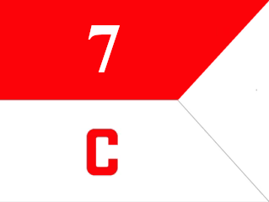
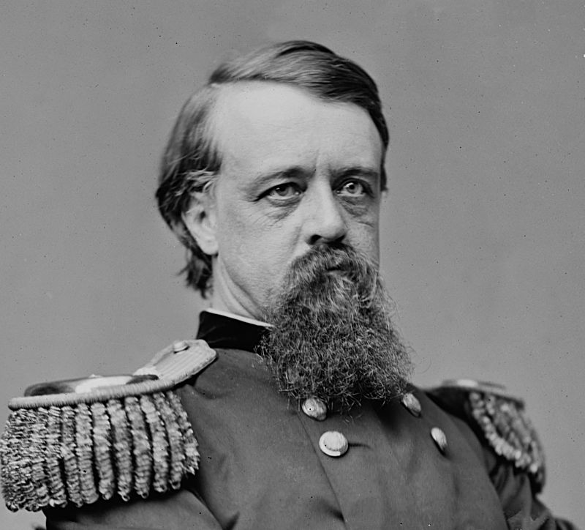
The Dakota Column
Major General Alfred Terry
Total: 44 officers, 800 men
Battalion, 6th Infantry (cos D, I): 3 officers, 67 men
Battalion, I7th Infantry (cos C, G): 6 officers, 89 men
Gatlng Gun Battery, 20th Infantry: 2 officers, 23 men
7th Cavalry Regiment (all twelve companies): 31 officers, 586 men
Indian Scout Detachment (attached to 7th Cavalry): 2 officers, 35 enlisted scouts.

Slide 10
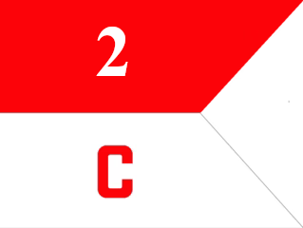
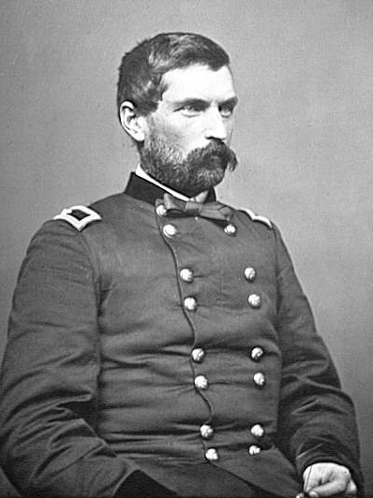
The Montana Column
Colonel John Gibbon
Total: 23 officers, 374 men
Freeman’s Battalion, 7th Infantry (cos A, B, H, I, K): 12 officers, 174 men
Brisbin’s Battalion, 2nd Cavalry (cos F, G H, L): 9 officers, 157 men
Gatling Gun Detachment, 7th Infantry: 1 officer, 6 men
Crow Indian Scouts: 1 officer, 25 enlisted scouts, 12 mounted infantry, 7th Infantry

Slide 11
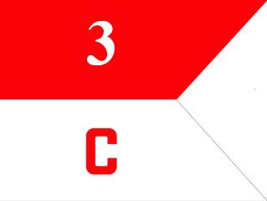
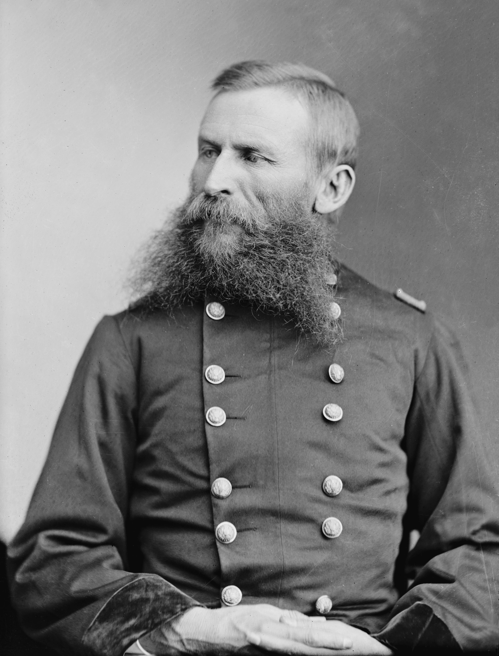
Crook’s Column
Brigadier General George Crook
Total: 47 officers, 950 men 262 enlisted scouts, 100 armed mule packers
Chambers’ Infantry Battalion
4th Infantry (cos D, F)
9th Infantry (cos C, G, H)
2nd Cavalry Regiment
Noyes’ (cos A, B, D, E, I)
3rd Cavalry Regiment
Royall’s Battalion (cos B, D, F, I, L)
Mills’ Battalion (cos A, E, M)
Van Vliet’s Battalion (cos C, G)
Crow Scout Battalion: 175 enlisted scouts
Shoshoni Scout Battalion: 86 enlisted scouts

Slide 12
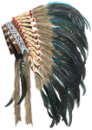
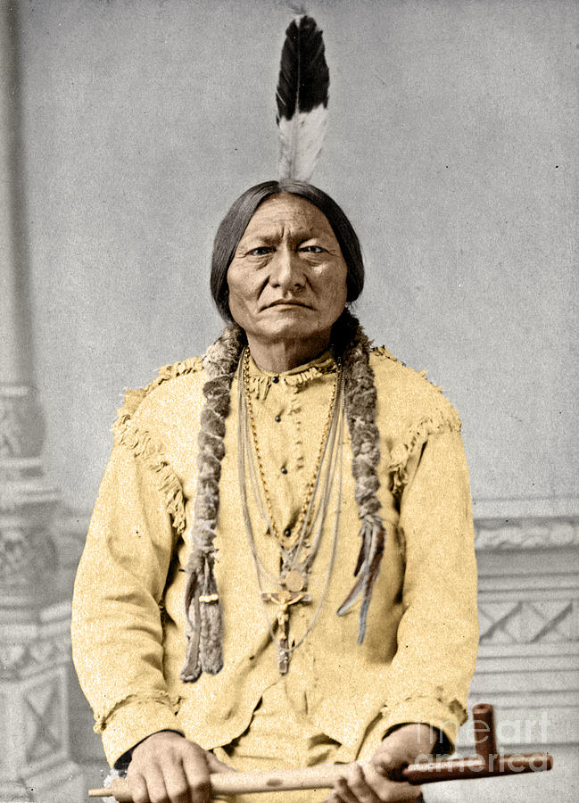
The Opponent
Sitting Bull (1831--1890)
Hunkpapa Lakota shaman and chief.
1868: Refused to sign the treaty ending Red Cloud’s War. "I wish all to know that I do not propose to sell any part of my country.“
Heavily involved in attacks on railroad surveying parties, all of which were moving through Hunkpapa land. Became the most influential leader of the non -reservation Lakota, and the most eloquen voice for resistance.
In 1875 he had a spiritual vision in which soldiers “as thick as grasshoppers” would die in the Lakota camp.

Slide 13
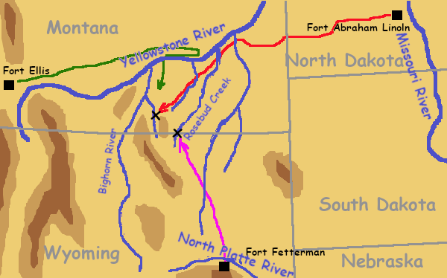
Opening Moves
Gibbon left Fort Ellis on April 1, Terry left on May 17, and Crook marched north on May 29.
Gibbon was in contact with Lakota scouts and raiding parties from mid April and in May, bu dos not follow them or report his o Terry.
Crook encounters Indians June 17 at Rosebud Creek.
Custer does so a week later at the Little Bighorn River.

Slide 14
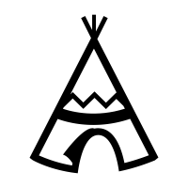
PART 3: Battle of the Rosebud,
June 17, 1876

Slide 15
Crook’s Column
Brigadier General George Crook
Total: 1,360 officers and men
Chambers’ Infantry Battalion
4th Infantry (2 cos 90 men)
9th Infantry (3 cos 135 men)
2nd Cavalry Regiment
Noyes’ (5 cos 225 men)
3rd Cavalry Regiment
Royall’s Battalion (5 cos 225 men)
Mills’ Battalion (3 cos 135 men)
Van Vliet’s Battalion (2 cos 90 men)
Crow Scout Battalion: (175 men)
Shoshoni Scout Battalion: (86 men)
Pack Train (100 armed mule packers)

Slide 16
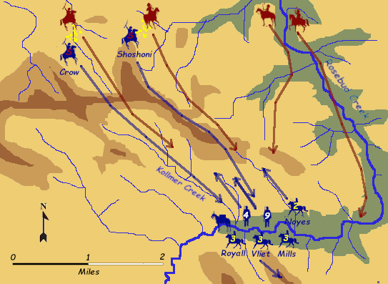
The Battle of the Rosebud 8:30 AM
Crook’s troops are resting with no security out, but the scouts move forward across a large ridge.
Crook receives a warning of the coming attack from the Crow and Shoshoni scouts acting as a screen.
The scouts retreat back to the main body, pursued by Indians.
Crook orders the infantry and Noyes’ cavalry to advance dismounted as a skirmish lne to drive the Indians back.

Slide 17
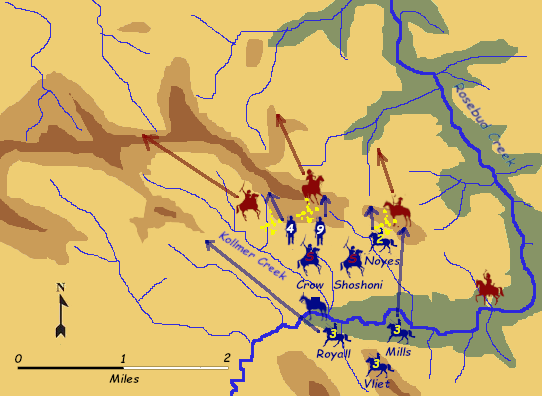
The Battle of the Rosebud 9:30 AM
The skirmish line takes fire from th ridge to their right flank and slows.
Crook orders Mills’ cavalry to charge the Indians on the ridge and drive them back.
As more Indian warriors begin skirmishing against the left flank, Crook sends Royall’s cavalry to attack and drive them back.
Vliet’s cavalry is detailed to guard the southern flank in case of an attack from that direction.

Slide 18
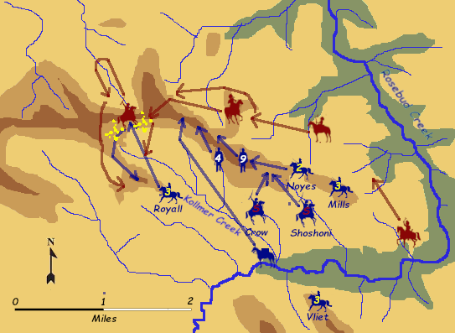
The Battle of the Rosebud 10:30 AM
Mills holds the low ridge on the right and most of the rest of the command moves forward and occupies the long ridge.
Royall chases the Indians about a mile to the Northwest but then comes under heavy fire and falls back.
Crook realizes the Indians simply withdraw before his charges and then attack elsewhere. He orders the command to go on the defensive.

Slide 19
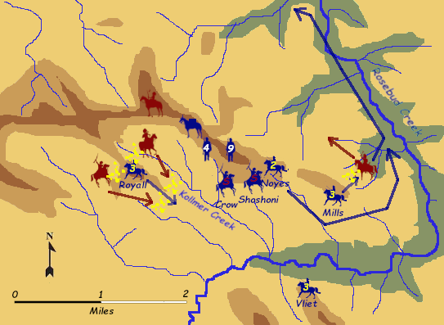
The Battle of the Rosebud 11:30 AM
Crook reasons the Indians would not fight this hard unless they were protecting a nearby village. He sends Noyes and Mills to follow the Rosebud north and try to find the village.
Royall tries to rejoin the command but the Indian fire is too intense to cross Kollmer Creek. Instead he pauses and defends a prominent ridge to the east of the creek.

Slide 20
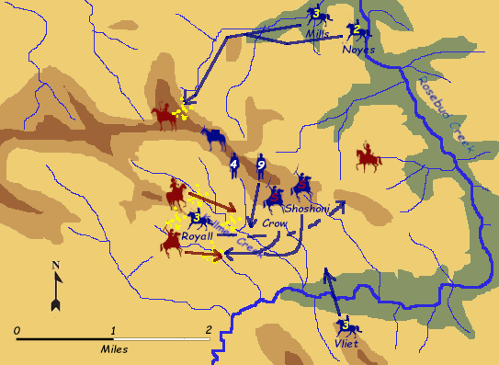
The Battle of the Rosebud 12:30 PM
Royall again tries to withdraw under heavy fire. His men show sgns of pan.
Crook orders the two cavalry battalions searching for a village to return and attack the main Indian force from the north.
Two companies of the 9th Infantry move south to some high ground overlooking Kollmer Creek.
The Scout battalions move south to cover Royall’s withdrawal across the creek.
The Indian scout charge lets Royall fight his way back to friendly lines.

Slide 21
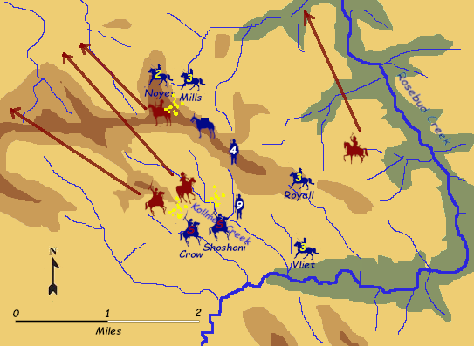
The Battle of the Rosebud 1:30 PM
The cavalry arriving from the north and the scouts from the south cause the Indians to break off the action and retreat to the north.
By 2:30 the battle is over.

Slide 22
The Battle of the Rosebud--Aftermath
Crook’s Indian scouts saved him from disaster twice: first when they alerted him to the attack with enough time to get the troops formed up and ready, and second when their charge drove back the Lakota and Cheyenne and allowed Royall’s battalion to escape.
Crook clamed The Rosebud as a victory, because he ended in possesion of the field of battle. But he then withdrew back to his base camp to wait seven weeks for additional supplies and reinforcements. This removed the southern column, which was the strongest of the three forces, from the campaign.
Inexcusably, he made no effort to inform the other columns that he had broken off.
The Lakota and Cheyenne also celebrated this as a great victory, and with much better reason.

Slide 23
The Battle of the Rosebud—The Butcher Bill
Army casaualties are disputed, with several different numbers given by different sources who were present. Between 10 and 28 soldiers were killed and between 21 and were wounded. Most of the casualties were in Royall’s cavalry battalion, which probably lost between a quarter and a third of its strength.
The Shoshoni scouts suffered between one and eight dead while the more numerous Crow suffered between one and five killed. No sources list numbr of wounded among the scouts.
The Lakota and Cheyenne casualties probably amounted to over thirty killed and sixty wounded, although estimates vary.

Slide 24
The Battle of the Rosebud—Ammunition
Crook’s main need for resupply was ammunition. Although record keeping was imprecise, he appears to have used between 10,000 and 25,000 rifle and carbine rounds at the battle.
This was significant enough to attract attention. In our era of automatic weapons, this is a fairly modest number for an action this size. But Crook’s men were all armed with single shot rifles and carbines, and presumably most fire was aimed fire.
It took between 100 and 250 aimed shots to cause each enemy casualty.
The most important result was that within a few years marksmanship training went from a very low training priority to the highest.

Slide 25
PART 4: Battle of the Little Bighorn
June 25, 1876

Slide 26
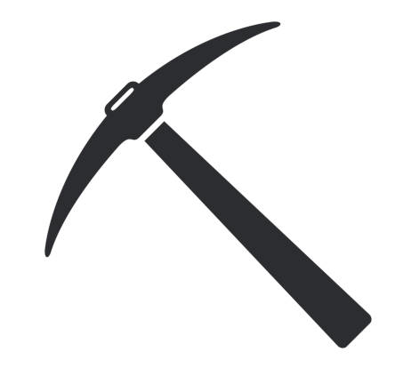
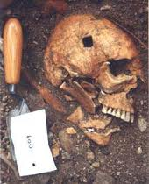
Archaeology is Our Friend
In 1983 a massive fire burned off most of the vegetation on the battlefield. This allowed a period of intensive archaeological study, starting with a systematic large-scale dig in 1984.
Each marker on the battlefield indicating where a fallen soldier had been buried was examined. Almost every one had human remains under it which were exhumed, forensically examined to determine age, heigh, race, and likely cause of death, and then reburied in the park cemetery.
https://kb.gcsu.edu/cgi/viewcontent.cgi?article=1189&context=thecorinthian

Slide 27
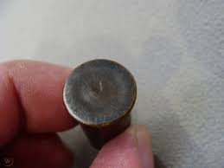
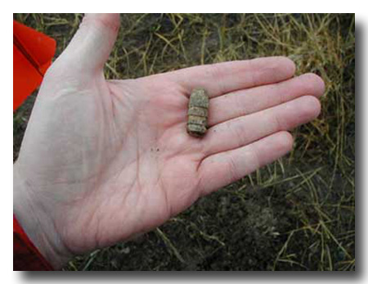
Archaeology is Our Friend
Thousands of metallic artifacts were located using metal detectors, each one numbered and its exact location logged on a surveyed excavation grid.
Modern forensic analysis of firing pin signatures on spent cartridges allowed identification of specific firearms and where they were used.
Examination of bullets, and linking them to shell casings of the same caliber, allowed historians to estimate where fire was delivered and where the rounds came down (i.e. the direction of fire).

Slide 28
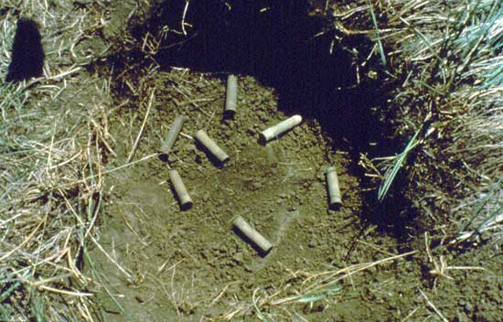
Archaeology is Our Friend
The fact that tourists have been finding and removing artifacts for years means the remaining artifacts are not an intact record of every round fired during the battle.
Nevertheless, this represents the most detailed forensic analysis of a single battle in history. It has allowed a more mplee reonsgtruion of the movement of troops on the battlefield and the ourse of the battle.

Slide 29
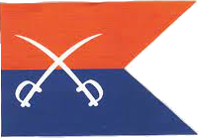
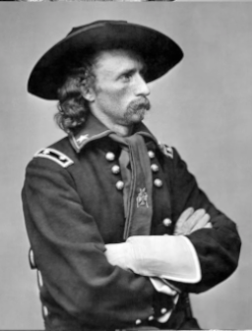
The 7th Cavalry Regiment
Lieutenant Colonel George Armstrong Custer
TOTAL: 31 officers, 583 men, 35 Arikara and Crow scouts
Custer’s Battalion
Keogh’s Wing (cos C, I, L)
Yeats’s Wing (cos E, F)
Reno’s Battalion (cos A, G, M)
Benteen’s Battalion (cos D, H, K)
Indian Scouts Detachment
Pack Train (co B as escort)

Slide 30
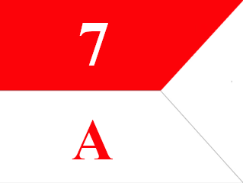
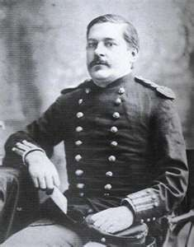
The 7th Cavalry Regiment:
Major Marcus Reno (1834-1889)
A career soldier and West Point graduate, he served with merit in the Civil War, by the end rising to command a brigade.
After the Civil War he served in a variety of administrative roles until assigned to the 7th Cavalry late in 1875.
Drank heavily, depressed by death of wife, not respected by most officers in the regiment including Custer.
Reno’s Battalion (132 officers and men)
Company A (CPT M. Moyan): 2 officers 41 men
Company G (1LT D. Mcintosh): 2 officers, 36 men
Company M (CPT T. French): 1 officer 50 men

Slide 31
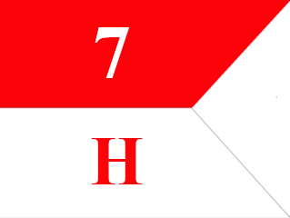
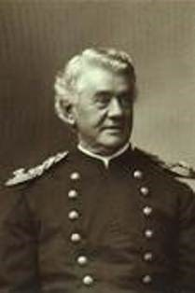
The 7th Cavalry Regiment:
Captain Frederic Benteen(1834-1898)
A volunteer officer in the CivIl War, he rose to the brevet (honorary in recognition of meritorious service) rank of lieutenant colonel during the war and afterwards was commssioned a captain in the regular army, assigned to the 7th Cavalry..
Intensely disliked Custer, and was the leading figure in the anti-Custer clique within the regiment. Despite this, Custer respected Benteen’s professionalism and military judgement.
Benteen’s Battalion (122 officers and men)
Company D (CPT T. Wier): 2 officers 45 men
Company H (CPT F. Benteen): 2 officers, 38 men
Company K (1LT E. Godfrey): 1 officer 34 men

Slide 32
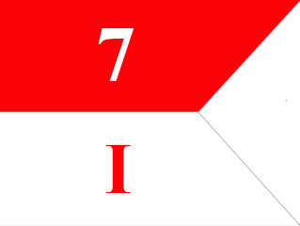
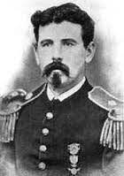
The 7th Cavalry Regiment:
Captain Miles Keogh (1840-1876)
Born in Ireland, Keogh served in the Army of the Papal Staes and then the Union Army during the Civil War. After the war he was commissioned a captain in the regular army and was assigned to the 7th Cavalry.
A Custer supporter, but also liked and respected throughout the regiment.
Keogh’s Wing of Custer’s Battalion (138 officers and men)
Company C (CPT T. Custer): 2 officers 43 men
Company I (CPT M. Keogh): 2 officers, 39 men
Company L (1LT J. Calhoun): 2 officer 50 men

Slide 33
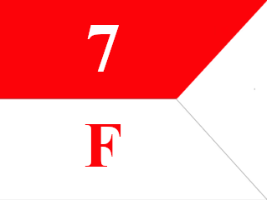
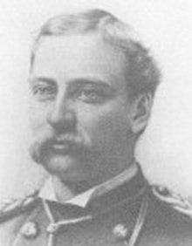
The 7th Cavalry Regiment:
Captain George Yates(1843-1876)
From Michigan and a close friend of Custer since before the Civil War. Entered the Army as a lieutenant of volunteers, served in staff positions with merit, commissioned a captain after the war in the 7th Cavalry.
Definitely a member of the Custer Clan.
Yates’s Wing of Custer’s Battalion (87 officers and men)
Company E (1LT A. Smith): 2 officers 39 men
Company F (CPT G. Yates): 2 officers, 44 men

Slide 34
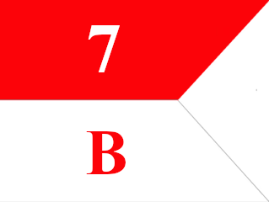
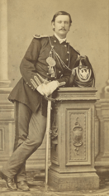
The 7th Cavalry Regiment:
Captain Thomas McDougal(1845-1909)
From an Army family, served as an officer of volunteers in the Civil War and after the Civil War was commissioned an infantry lieutenant. Transferred to the 7th Cavalry in 1870 and promoted to Captain 1875, only a few months before the campaign.
Custer assigned his company to guard the pack train as a punishment. Because, "Captain McDougall had fallen asleep prior to officer's call and had been the last to report to Adjutant Cooke.” Some of his men wept because it meant they would probably not see action.
The Pack Train (126 officers and men)
Company B (CPT T. McDougal): 1 officers 41 men
Pack Train Detachment (7 men from each company): 84 men

Slide 35
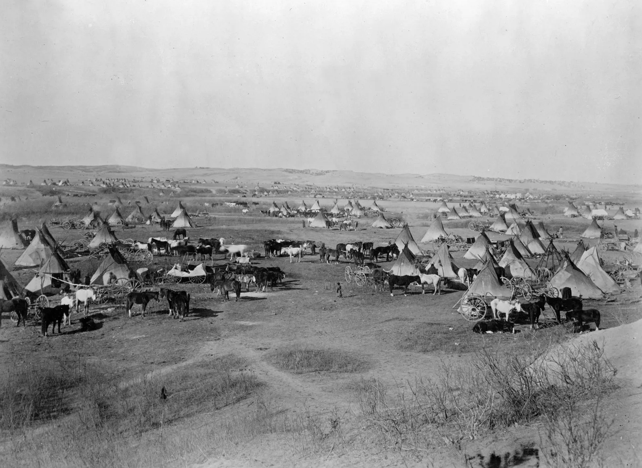
The Indian Camp
Hunkpapa Lakota: 225 lodges
Yanktonai and Santee Sioux: 35 lodges
Blackfoot Lakota: 34 lodges
Two Kettle Lakota: 18 lodges
Brule Lakota: 68 lodges
Miniconjou Lakota: 150 lodges
Sans Arc Lakota: 110 lodges
Oglala Lakota: 240 lodges
Northern Cheyenne: 120 lodges
6,000 to 8,000 people total
1,500 to 2,000 warriors

Slide 36
A Good Day to Die
QUESTIONS?

Slide 37
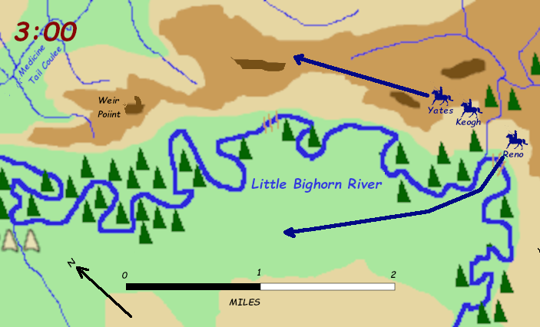
Reno’s Fight 3:00 PM
Reno’s battalion fords the Little Bighorn and follows the withdrawing Cheyenne village.
Custer’s battalion moves along the heights to the east.

Slide 38
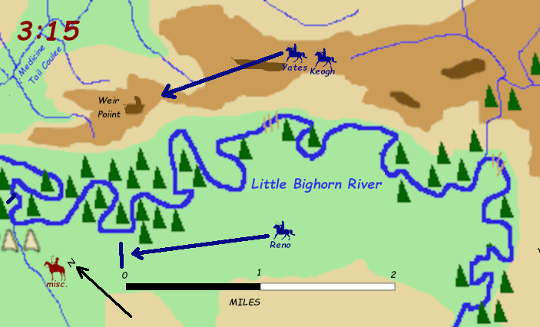
Reno’s Fight 3:15 PM
Reno advances past the bend of the river and has his first view of the village. It is not a small village.
Reno dismounts his command, forms a skirmish line, and begins firing on the village.

Slide 39
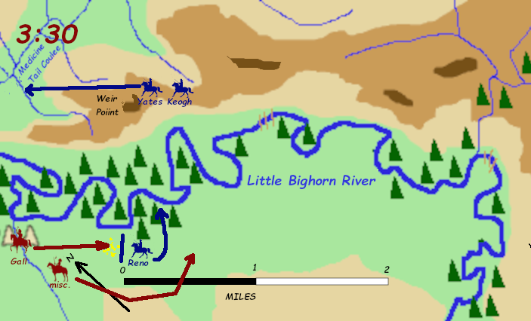
Reno’s Fight 3:30 PM
Custer reaches Weir Point. Has his first clear view of the enormous size of the Indian village.
Mounting pressure on Reno from the front, and mounted Indians sweeping around his open left flank, causes him to withdraw to the woods by the river.

Slide 40
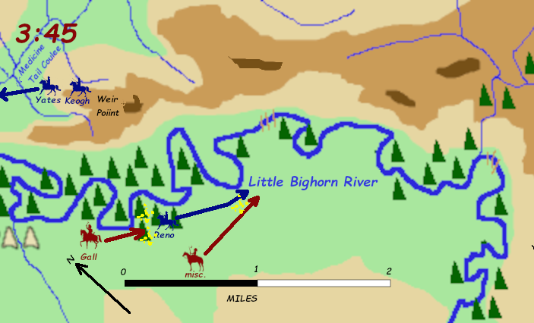
Reno’s Fight 3:45 PM
Custer’s battalion moves down Medicine Tail Coulee.
Reno begins retreating back toward the original ford, but mounted warriors to his right drive him east toward the river.
The retreat becomes a route.

Slide 41
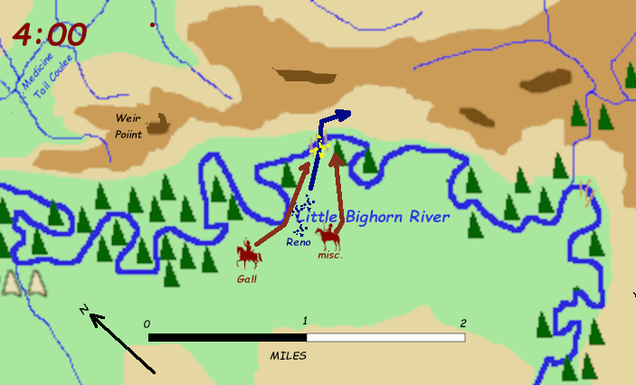
Reno’s Fight 4:00 PM
With Reno in th lead, he disorganizd mob of troopers reahed the ford and began splashing across.
The mountd warriors caught up with them and the fight became a melee.

Slide 42
The Fight Crossing the River
Many of Reno’s casualties were suffered when the warriors overtook his men while trying to ford the river. A chaotic and deadly hand-to-hand struggle took place there.

Slide 43
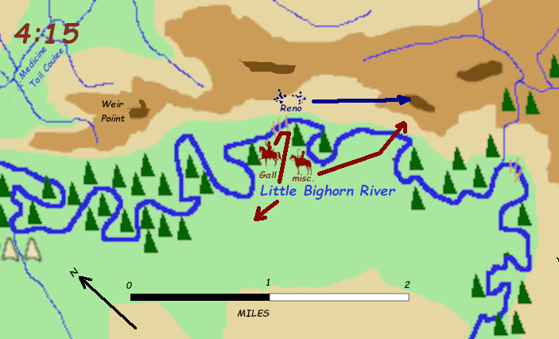
Reno’s Fight 4:15 PM
Reno’s demoralized survivors struggle up a steep slope to a dominating hill (now called Reno Hill).
The command begins to reorganize there.

Slide 44
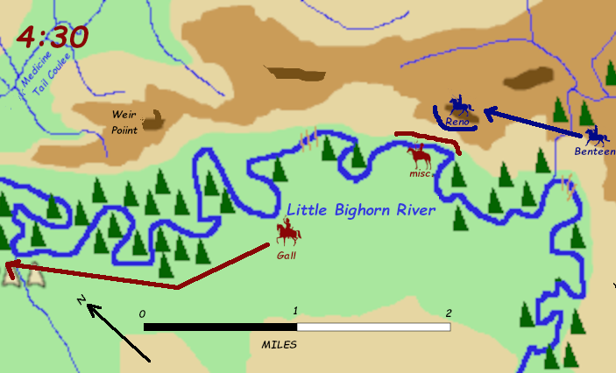
Reno’s Fight 4:30 PM
Benteen arrives. His firt though I o push on and join Custer, but Reno onvnes hm to renforce th hill position.
Most of the Indians have withdrawn north and the men n th hill an hear gunfire from that direction. Custer is engaged.

Slide 45
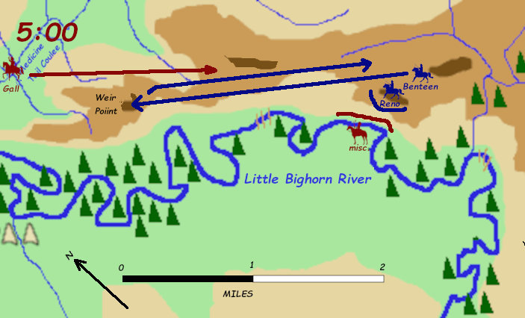
Reno’s Fight 5:00 PM
The pack train arrives with needed ammunition.
Benteen, prodded by his subordinate Lieutenant Weir, moves north with his command.
When they get to the high ground, they see Custer’s battlefield, but they see no sign of him. They hear scattered gunfire which dies out as they listen.
They conclude Custer has withdrawn and they saw his rearguard covering the retreat.

Slide 46
Custer’s Fight
At about 4:00 Custer’s battalion moved down Medicine Tail Coulee toward the Lakota and Cheyenne village.
At about this time he sent his last message back to the trailing units, signed by his adjutant Lieutenant Cooke.
Benteen.
Come On. Big Village. Be quick. Bring Packs.
P.S. Bring packs. W.W. Cooke

Slide 47
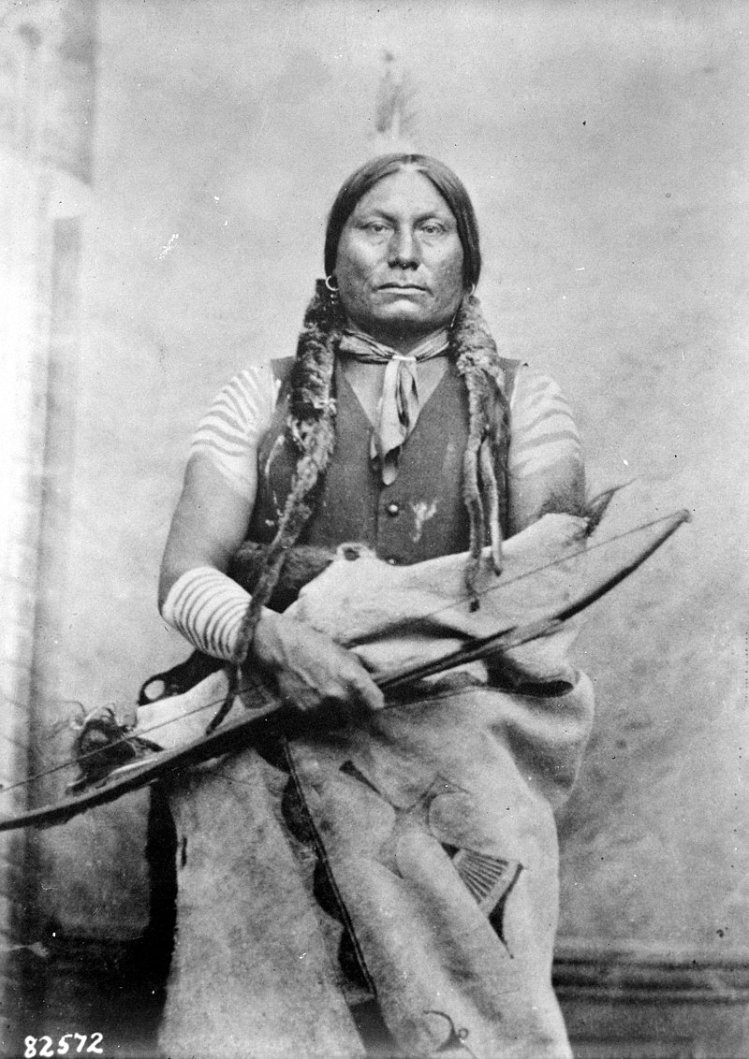
The forces against Custer
Gall (Man Who Goes in the Middle) 1840-1893
Prominent Hunkpapa war chief.
His two wives and three children were all killed by Reno’s carbine fire into the Hunkpapa camp. Fought thIs battle for revenge.
Accompanied by between 200 and 400 warriors mostly Hunkpapa, but with some from the other tribes as well.

Slide 48
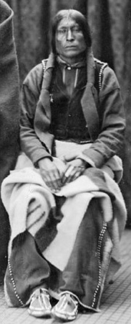
The forces against Custer
Lame White Man (known to the Lakota as Bearded Man) 1839-1876
Prominent Northern Cheyenne war chief and head of the Elk warrior society. His various Cheyenne and Lakota names suggest he was probably the offspring of a white captive.
Accompanied by between 200 and 400 warriors mostly Northern Cheyenne, but with some from the other tribes as well.
Late in the battle he was killed and then scalped by the Lakota warrior Little Crow. Little Crow mistook him for an Arikara or Crow Army scout, probably because he had put on the jacket of a cavalry soldier he had just killed.

Slide 49
The forces against Custer
Crazy Horse (Tȟašúŋke Witkó) c.1846-1877
Senior Oglala war chief. Rose to prominence after leading Red Cloud’s decoy party at the Fetterman Fight (1866)
Took a number of warriors southeast to fight Reno but when he arrived he was told “You are too late.”
He took his warriors back to the Oglala lodges and told them to complete their medicine rituals. Joined the fight against Custer about 4:30.
Accompanied by between 100 and 200 warriors mostly Oglala, but with some from the other tribes as well.

Slide 50
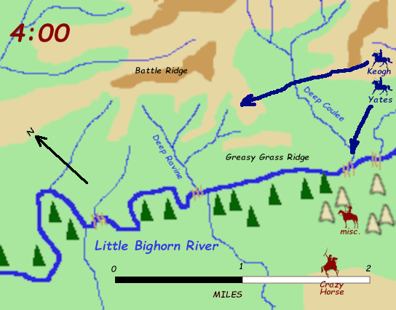
Custer’s Fight 4:00 PM
Custer’s Battalion Total: 10 officers, 211 enlisted
Keogh’s Wing moves northwest to the high ground (now called Calhoun Hill).
Companies C, I, and L
6 officers,, 131 enlisted
Custer leads Yates’s Wing west to reconnoiter the fords at the mouths of Medicine Tail Coulee and Deep Coulee, or perhaps to draw troops away from Reno.
Companies E and F
4 officers, 80 enlisted

Slide 51
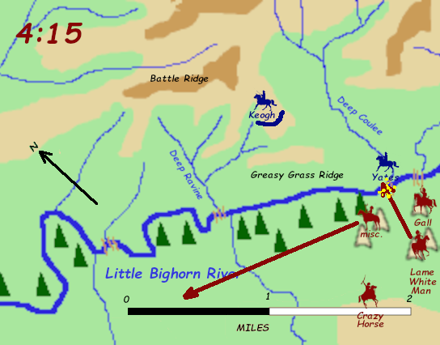
Custer’s Fight 4:15 PM
Keogh’s Wing deploys on the high ground.
Some warriors accompany non-combatants west to safety while others return from the Reno fight.
More Indians are beginning to mass around the two southwestern fords, but they do not try to cross.
Yates exchanges fire with Indians across the river.
Crazy Horse and the men with him prepare for combat.

Slide 52
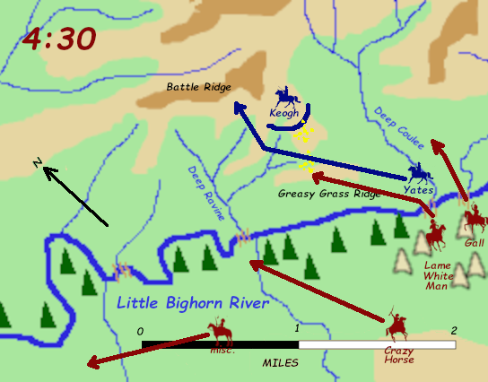
Custer’s Fight 4:30 PM
Yates moves north and Custer’s two wings briefly link up.
Once Yates withdraws from the fords, Lame White Man and Gall cross and move toward the Army.
Crazy Horse finishes his medicine ritual and moves north toward the Deep Ravine ford.
Other warriors continue to accompany non-combatants west to safety.

Slide 53
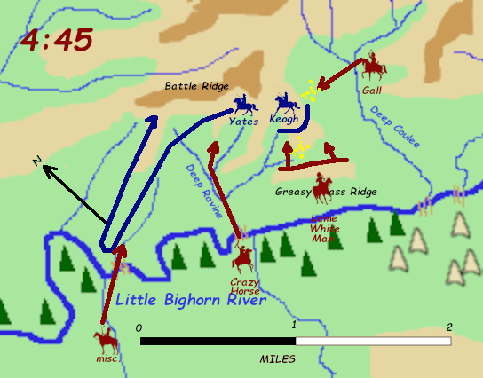
Custer’s Fight 4:45 PM
Custer leads Yates’s wing west, apparently looking for other crossing points. Quickly double back.
Lame White Man occupies Greasy Grass Ridge and begins infiltrating forward through gullies.
Gall begins pressuring Keogh’s left flank.
Crazy Horse crosses river and begins moving against Keogh’s right flank.
Warriors with noncombatants move toward the battle.

Slide 54
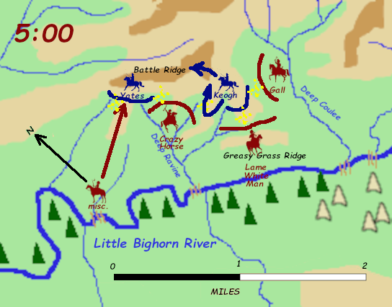
Custer’s Fight 5:00 PM
Pressure builds on all of the battalion.
Keogh launches a mounted charge to clear the ravines to his right (west) but it is met with a wall of fire, and falls back in disorder.
Mounted Indians follow up and are in the main position. Cavalry horses of dismounted men spook and mostly stampede away.
Keogh orders a retreat to higher ground, but troops are surrounded and Indians press closely. Troopers begin bunching up.

Slide 55
Custer’s Fight 5:10 PM
Warriors charge Keogh’s wing from all sides and the unit disintegrates. Organized resistance ceases. All troops flee toward Custer’s position with Yates, but are mostly cut down before getting there.
About 20 men (out of 130) made it to Yates’s position.
Many dead horses in this area.
A number of Indians report that many soldiers killed themselves before the warriors could get to them.

Slide 56
Destruction of Keogh’s Wing
“These solders became fools many throwing away their guns and raising their hands saying ‘Sioux pity us; take us prisoners.’” –Red Horse
“When we rode into these soldiers I really felt sorry for them, they looked so frightened. Many of them lay on the ground with their blue eyes open waiting to be killed.” –Standing Bear

Slide 57
Custer’s Fight 5:20 PM
Indians converge on Yates from all directions.
Yates’s F Troop with some men of E Troop hold Custer Hill. Most of the horses panicked and escaped. Only five horses were shot there and used as cover.
Most of Yates’s wing killed by rifle and bow fire fairly quickly. Some kill themselves.
About 40 men make a dash on foot for the Deep Ravine as the last solders on Custer hill are overrun. About half made it to the ravine.
This may have been the remnants of E Troop, led by its only surviving officer 2LT James G. Sturgis.
The fugitives in the deep ravine are the last ones killed.
By 5:20, every man in Custer’s battalion is dead.

Slide 58
“Custer’s Last Stand”
Too many horses. This shows four, and there were only a total of five dead horses on the entire hill.
The bugler. Many paintings show a bugler signaling for Benteen and Reno to come, but nobody ever heard that.
Custer still fighting. He probably went down early.
It gets his personal guidon right.

Slide 59
“Custer’s Last Stand”
If the officer in buckskins is meant to be Tom Custer and the mortally wounded officer is his brother George, this may be closer to reality.
Note very little hand-to-hand fighting. Most of the soldiers were downed by fire before being overrun.
Most of the Indians are on foot.

Slide 60
“Custer’s Last Stand”
Too concentrated. Shoot in their general direction and you’re bound to hit someone. Soldiers did bunch up, but then were shot down immediately.
Too organized.
Too manty mounted warriors.
Again with the bugle.

Slide 61
“Custer’s Last Stand”
Thus may be close to what it was like toward the end on Custer Hill—absolute chaos.
No real evidence of organized resistance—every man fighting his own battle.
Horses escaping, some men mounted for the dash to the Deep Ravine.

Slide 62
PART 5: End of the Great Sioux Uprising

Slide 63
The End
The Lakota won a great battlefield victory at the Little Bighorn, but they lost the war there. The defeat did not terrify and cow the United Sates; it hardened them and filled them with a desire for vengeance. More importantly, it gave the government the excuse to take everything it wanted.
The remaining Army forces, once heavily reinforced, conducted an autumn and then winter campaign, but with little effect. The Lakota and Cheyenne simply dispersed into small bands and spread over the landscape.

Slide 64
The End
But t’was out upon the Yellowstone we had the damnedest time,
Faith, we made the trip with “Rosebud George,” six months without a dime.
Some eighteen hundred miles we went, through hunger, mud and rain.
Wid backs all bare and rations rare, no chance for grass or grain.
Wid bunkies starving by our side, no rations was the rule.
Sure t’was ate your boots and saddles, ye brutes, but feed the packers
and the mules.
But you know full well that in your fight, no soldier lad was slow,
And it wasn’t the packers that won ye a star, in the Regular Army-O

Slide 65
Colonel Nelson A. Miles
Brilliant and very ambitious officer, with an excellent Civil War record. Eventually became Army Chief of Staff. Theodore Roosevelt later described hm as a “brave peacock.”
Aggressive but meticulously organized, he producd dramatic results in his own winter campaign, winning a signal victory over the Cheyanne at Wolf Mountain.
Using many of the echniques Crook had used agains he Apache, Miles chased Lakota and Cheyenne bands to exhaustion.

Slide 66
The End
When it became clear the Army would continue to campaign against them, Sitting Bull and many others went to Canada.
Within a year or two, most had returned to their reservation and given themselves up. Sitting Bull was one of the la holdouts, surrendering with his band in 1881.
Crazy Horse surrendered in May of 1877. Four months later he was killed by a Lakota tribal policeman, allegedly for resisting arrest.

Slide 67
PART 6: Wounded Knee

Slide 68
The Ghost Dance
Catastrophic societal collapse tends to produce apocalyptic religious prophets.
Wovoka, Paiute shaman, preached peace, a version of his native religion but with elements of Christianity.
By singing Ghost songs, dancing Ghost dances, and adhering to a rigorous code of non-violence, worshipers would be rewarded with a world where they would again see heir dead loved ones and where there would be no white people.
By 1889 and 1890 his theology had spread throughout the west.
In the case of the Lakota, however, some adherents thought that hurrying white people on their way to the hereafter might help the project along.

Slide 70
The “Battle”
December 28, 1890, a detachment of the 7th Cavalry detained a band of Miniconjou and Hunkpapa Lakota due to concern their Ghost Dancing was a prelude to an armed uprising.
The following day 490 men of the 7th Cavalry, with four artillery pieces in support, surrounded the band and insisted on disarming them. One member of the band resisted giving up his rifle, it apparently discharged during the struggle, and then everyone started shooting.

Slide 71
The “Battle”
Although some of the warriors had already been disarmed, those with weapons returned fire but the “battle” was very lopsided.
25 soldiers were killed and 39 were wounded. Some of them may have ben the victims of friendly fire.
Of the 120 men in the band, 90 were killed and four wounded.
Of the 250 women and children in the band, 200 were killed and 46 wounded.
Twenty soldiers were awarded the Congressional Medal of Honor.

Slide 72
The End
“After depriving the Indian of his lands and proper means of subsistence, a what point in his subsequent career of starvation, misery, and desperation shall you regard him as a public enemy?”
Colonel Orlando B. Wilcox

Slide 73
A Good Day to Die
QUESTIONS?

