Slide 1
“A Good Day To Die” Indian Wars in the American West

Slide 2
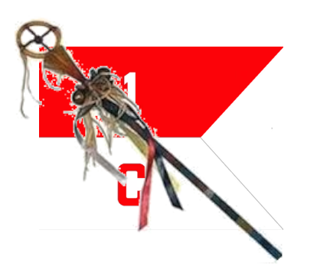
Course Outline
Week 1: What Came Before (From Christopher Columbus to Manifest Destiny)
Week 2: A House Divided (Genesis of the Western Wars)
Week 3: The Opponents (The US Army and the Natives)
Week 4: Red Cloud’s War, the Lakota, and the Northern Plains
Week 5: Hancock’s War, Commancheria, and the Southern Plains
Week 6: The Long Struggle for Apacheria and the Southwest
Week 7: The Forgotten Wars (The Great Basin and Pacific Northwest)
Week 8: Finale (From the Little Bighorn to Wounded Knee)

Slide 3
“A Good Day To Die” Indian Wars in the West
OLLI “Spring” 2021
Week 5: Hancock’s War, Commancheria, and the Southern Plains

Slide 4
Hancock’s War, Commancheria, and the Southern Plains
Overview: The Southern Plains
Hancock’s War
Sheridan’s War
Grant’s Peace Policy
The Red River War

Slide 5
PART 1: The Southern Plains

Slide 6
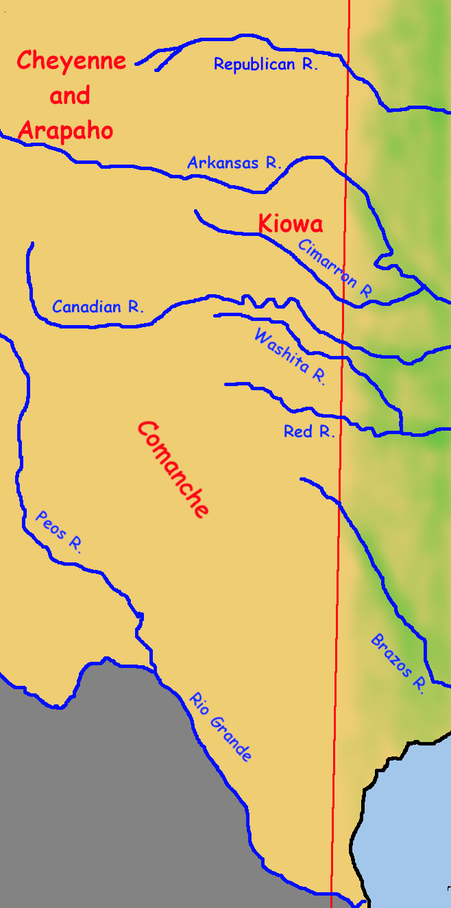
The Southern Plains
Southern Cheyenne and Arapaho
Cheyanne originally lived in Minnesota.
Migrated southwest and reached the upper Missouri River. There they formed a close alliance with the Arapaho.
Lakota aggression caused the tribes to split in 1832, with those moving south becoming the Southern Cheyanne and Southern Arapaho. They settled on the headwaters of the Republican and Arkansas rivers.
Fought against Kiowa at first but forged alliance with them by 1840, and with the Comanche soon after.

Slide 7
The Southern Plains
Southern Cheyenne Dog Soldiers
One unusual aspect of Cheyenne social organization was that one of the six Cheyenne warrior societies (The Dog Soldiers) formed their own band within the tribe.
After the 1852 cholera epidemic, most survivors of the Masikota band of the Southern Cheyenne joined the Dog Soldiers, and most Dog Soldiers in other bands moved to his one.

Slide 8
The Southern Plains
Southern Cheyenne Dog Soldiers
They were consistently the most warlike faction within the tribe, the one that never agreed to accept reservation life.
One practice was to stake themselves to the ground on a tether. Once they did so, they could not retreat unless and until another Dog Soldier cut the tether.

Slide 9
The Southern Plains
Kiowa & Plains Apache (or Kiowa Apache)
Kiowa originally lived in the mountains of Montana
Migrated southeast and reached the Black Hills about 1775
Pushed south by Lakota to the Arkansas River valley. Excellent game and lots of horses. Became closely allied with local Plains Apache.
Fought against Comanche at first but forged very strong alliance with them between 1790 and 1806. (Sometimes called a confederation.)
By 1840 also allied with Cheyenne, Arapaho, and Lakota.
By 1850 there were about 2,000 Kiowa and Kiowa Apache.

Slide 10
The Southern Plains
The Comanches and the Comancheria
Originally Shoshoni living in the Great Basin and Rockies, expanded southeast due to population pressure (The Shoshonean Expansion, 1500 on).
1680 Pueblo Revolt freed thousands of horses into the Great Plains, where they multiplied.
In 1725 the Comanche were still using some dog travois. By 1795 they were selling horses to Anglo-American traders.
In 1800, there were 20,000 Comanche. Cholera and Smallpox epidemics reduced that to 10,000 by mid-century.

Slide 11
The Southern Plains: Comanches
Their name for themselves was Nermernuh (The People). The name Comanche comes from the Ute word kimantsi, which means enemy.
They make the Lakota look like a highly regulated, rule-bound society.
No warrior societies.
No hereditary religious class.
No hint of a Comanche-wide council or chief of any kind.
Very little formal organization at he band level, aside from a War chief and a Peace chief, neither with much formal authority.

Slide 12
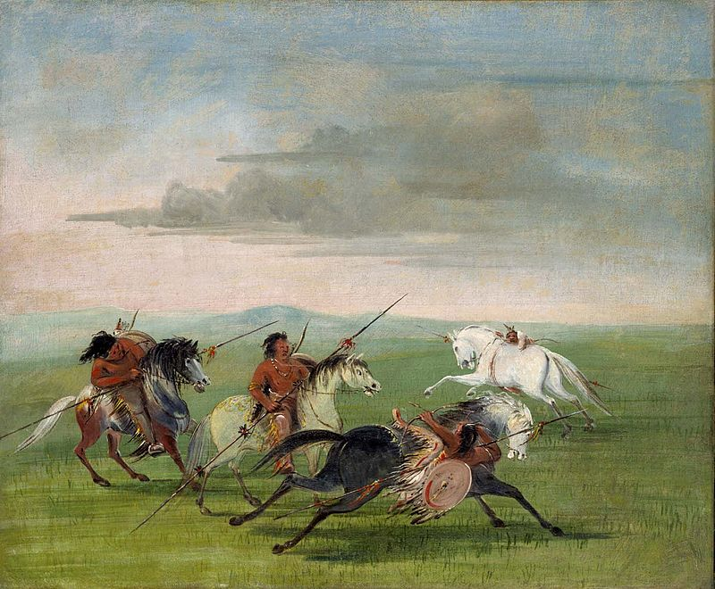
The Southern Plains: Comanches
They were one of the first Native nations to domesticate and ride horses, and they remained the best riders on the American Plains. Many US cavalry officers called them the finest horsemen in the world.
Even Lakota often dismounted to fight, but the Comanches fought spectacularly from horseback.
By George Catlin - Smithsonian American Art Museum: Public Domain,

Slide 13
The Southern Plains: Comanches
They drove the Apache from the southern plains and into the mountains of he southwest.
They stopped Spanish colonial expansion north and French colonial expansion west from Louisiana.
When Mexico became independent, they raided Texas and nearly overran the colony. Only the introduction of thousands of Anglo settlers from the USA enabled the Texans to stand off the raids. But that also lost Texas to Mexico.
The friction points with Texas were mostly along the 98th Meridian, and none of that involved the USA . . . until Texas was annexed.

Slide 14
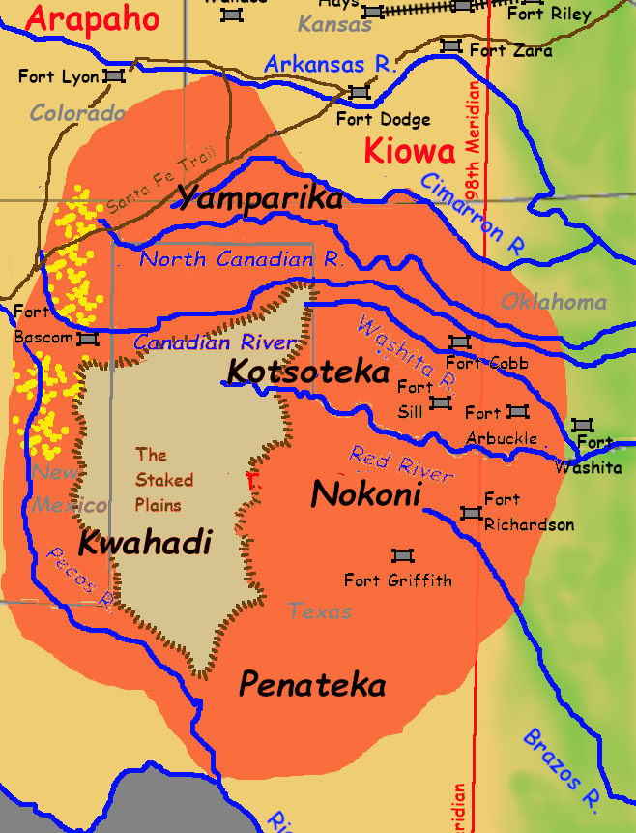
Comancheria
Five main bands
Yamparika (Yap-root Eaters)
Kotsoteko (Buffalo Eaters)
Nokoni (Wanderers)
Penateka (Honey Eaters)
Kwahadi (Antelopes)
Anchored on the Staked Planes (El Llano Estacado).
Northwest area (shown with yellow dots) main range of the Commancheros, traders based in Santa Fe, and main middlemen for Comanche horses and other trade items.

Slide 15
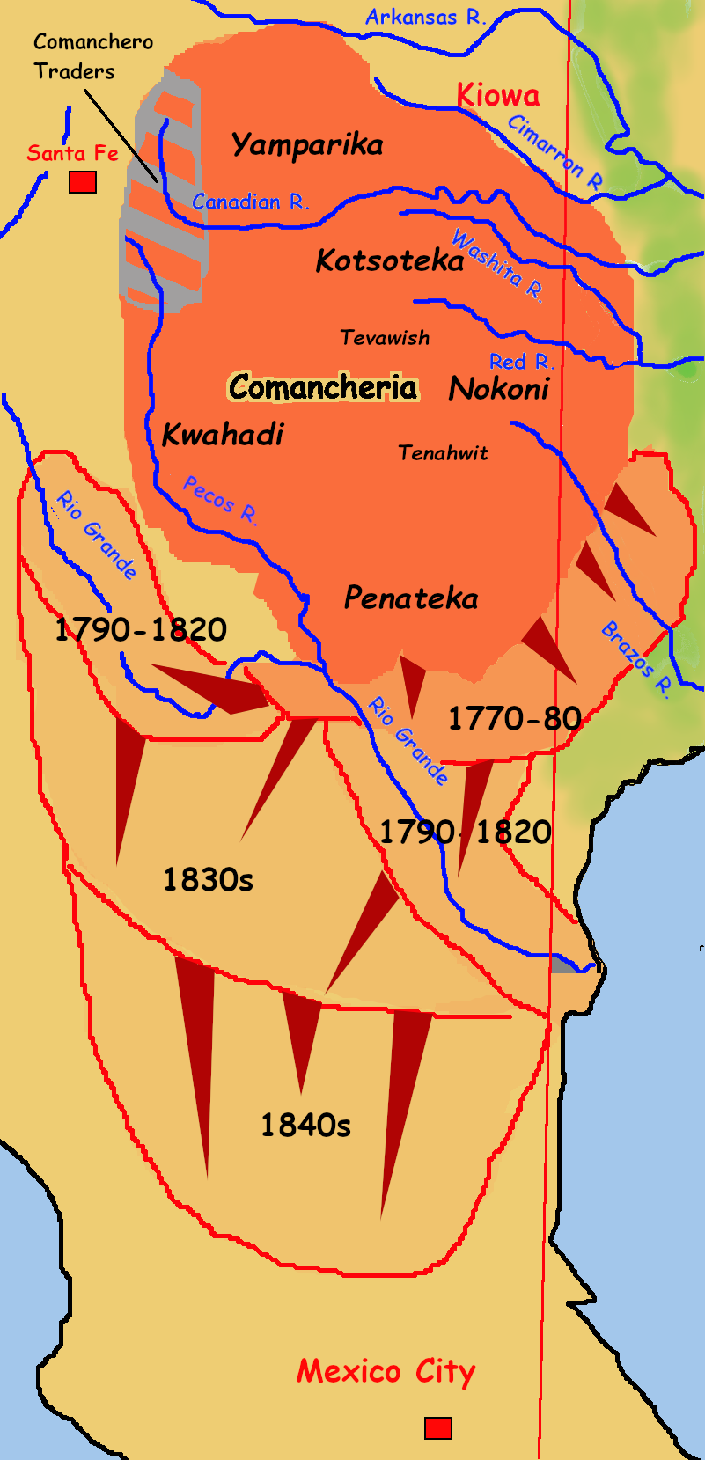
The Southern Plains
Comancheria, first half of the 19th Century
Comanches relied on trade with the US and Mexico through Santa Fe--the Comancheros. So the Comanches did not harass the Santa Fe Trail.
They also slowed their raids on Texas when they were told the Texans had suddenly become Americans, although the Comanche found that very confusing. But they did switch to raiding even farther south into Mexico instead, nearly to the gates of Mexico City.
When the Civil War started, and the US Army withdrew, the Comanches drove back the frontier in Texas by over 100 miles--the only time in US history that happened.

Slide 16
PART 2: Hancock’s War

Slide 17
Hancock’s War: Winfield Scott Hancock
Chivington’s massacre of Black Kettle’s village of Southern Cheyanne (Sand Creek Massacre) in 1864 and set the frontier ablaze with retaliatory raids by the Cheyenne, but also their allies the Arapaho and the Lakota.
It also severely damaged the Indians’ faith in the peace process and their expectations of the Army treating them fairly or speaking the truth.
By 1867 the level of violence had declined significantly as the Indian desire for vengeance had been largely satisfied. That’s when a new commander in the Southern Plains came west.

Slide 18
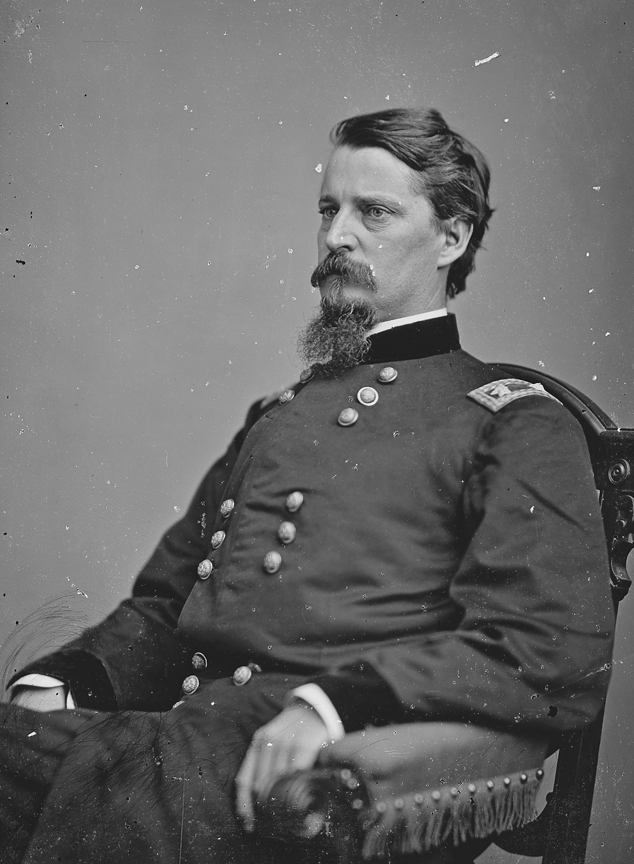
Hancock’s War: Winfield Scott Hancock
Heroic and successul career with the Army of the Potomac in the Civil War. One of the best corps commanders in the Union Army. Admired, liked, and respected throughout the Army.
Knew nothing about Indian fighting, or Indian psychology, but was firmly onvined that all they were apable of understanding was force and thepower of a dominating personality.,
A number of Chiefs of the Cheyenne, Arapaho, and Kiowa tried to meet with him on April 12, shortly after he arrived. He refused to hear what they had to say. He instead delivered a harangue.

Slide 19
Hancock’s War: Meeting at Fort Larned
You know very well, if you go to war with the white man you will lose….I have a great many chiefs with me that have commanded more men than you ever saw, and they have fought more great battles than you have fought fights.
I have a great deal to say to the Indians, but I want to talk with them all together. I want to say it at once.

Slide 20
Hancock’s War: Meeting at Fort Larned
Two days later Hancock and his escort (the 7th Cavalry under LTC George Armstrong Custer) rode west to meet with the leaders of a very large village of Cheyenne and Lakota. Hancock ignored advice to camp a respectful distance away, and instead brought his cavalry right up to the edge of the village to intimidate the Indians.
Afraid of a repetition of the Sand Creek massacre, the village’s women and children fled, which Hancock interpreted as a deliberate slight. He refused to talk peace unless the warriors brought them back.
A number of warriors tried, but either could not find them (unlikely) or could not persuade them to return (very likely).
Hancock sent the 7th Cavalry out after them as well, but they couldn’t find anyone.

Slide 21
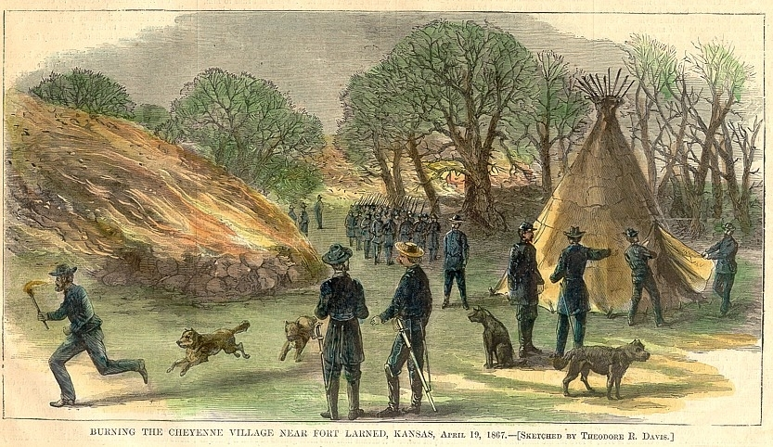
Hancock’s War: Meeting at Fort Larned
So Hancock burned the village, destroying all of the worldly possessions of between eight and twelve thousand Indians, thinking this would cow them into surrender.

Slide 22
Hancock’s War: More War
It might have in winter, but not in spring, when there was still plenty of time to hunt and collect enough food and hides for shelter to at least survive the next winter. Instead, it just enraged them, and all of the tribe members who were not there.

Slide 23
Hancock’s War: Two Results
1. The frontier exploded again in numerous Indian raids on settler wagon trains, farms, army supply convoys, and attacks on isolated army patrols. In the next three months there were ten serious engagements in Kansas alone, with many fatalities.
2. In August Hancock was relieved of command and transferred to other duties. He was replaced by General Phillip Sheridan.

Slide 24
PART 3: Sheridan’s War

Slide 25
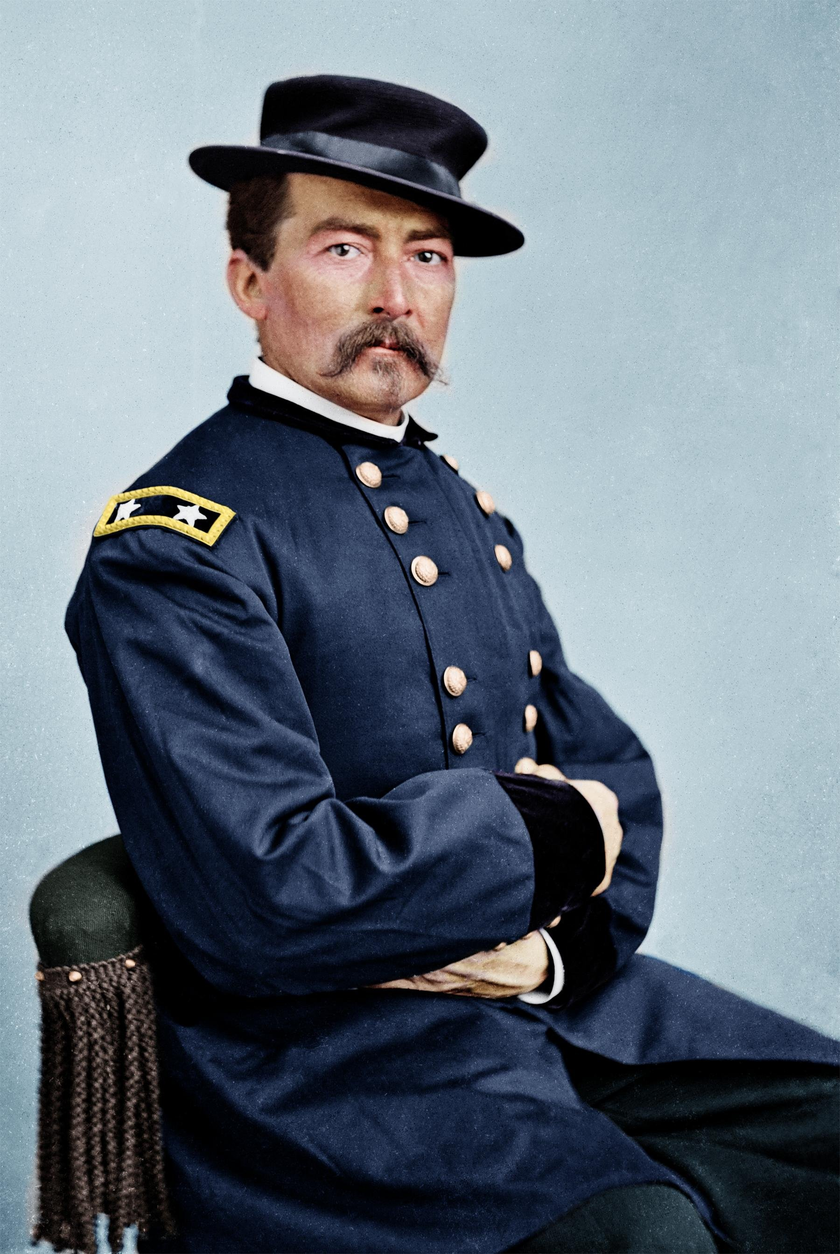
Sheridan’s War—The Man and the Plan
The Man: Outstanding Union General in the Civil Wat; trusted subordinate of both Sherman and Grant. (Played very well by J. Carrol Naish in several John Ford western films.) Commanded the cavalry of the Army of the Potomac and forced Lee to abandon th Petersburg defenses and then pursued his army effectively to destruction, resulting in the surrender at Appomattox.
The Plan: Take the war to the enemy using their own methods, but take advantage of the Army’s two major advantages: superior Firepower and Logistics.

Slide 26
Sheridan’s War—Battle of Beecher Island
As a first step. Sheridan authorized the formation of a unit of experienced Indian scouts, serving under handpicked officers and armed with Spencer repeating rifles, to seek out Native raiding bands and destroy them.
By early September of 1868, Major Forsyth’s Scout Company had begun hunting Indian bands.

Slide 27
Sheridan’s War—Battle of Beecher Island
It found them almost immediately—and followed them to a very larger encampment of Arapaho and Cheyenne, as well as both Oglala and Brulé Lakota.
Grossly outnumbered, they dug in on a sand bar in a shallow river and fought off numerous attacks for three days before relived.

Slide 28
Sheridan’s War—Battle of Beecher Island
The Battle of Beecher Island (named for the unit’s second-in-command, who was killd in th action) was hailed as a heroic defense, which it was. But it was hardly he decisive victory sometimes claimed.
Forsyth’s unit of fifty men suffered six killed and nineteen wounded, half the unit’ strength, and with wo of its three officers dead and the commander critically wounded, the unit was disbanded.
By the time relief came, their ammunition was almost exhausted and the men were on the verge of collapse from dehydration, fatigue, and exposure. Another day and the command would have been wiped out.

Slide 29
Sheridan’s War—Battle of Beecher Island
The Indians may have suffered between nine (known by name to have did) and thirty-five (the Army’s claim) dead. For once, the Army claim may be close to correct. There were multiple mounted charges against a well-armed force of experienced fighters, who expended somewhere between six and ten thousand rounds of ammunition.
Each man carried 140 rounds of carbine ammunition and 30 rounds of revolver ammunition. (about 7,000 carbine rounds and 1,500 revolver)
4,000 additional rounds were carried by pack mule.
Not all of these were expended and some, particularly the pack mule, may have been lost.

Slide 30
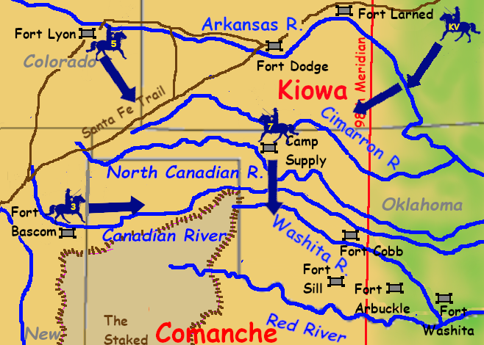
Sheridan’s War—The 1868 Winter Campaign
Sheridan’s Plan
Major Evans with 560 men, mostly from the 3rd Cavalry, from New Mexico.
Major Carr with 650 men, mostly from 5th Cavalry (but one third of the command from 10th Cavalry) from Colorado.
Lieutenant Colonel Custer with 800 men of the 7th Cavalry From Kansas.
Colonel Crawford with 900 men of the newly-formed 19th Kansas Volunteer Cavalry, from eastern Kansas.

Slide 31
A Good Day to Die
QUESTIONS?

Slide 32
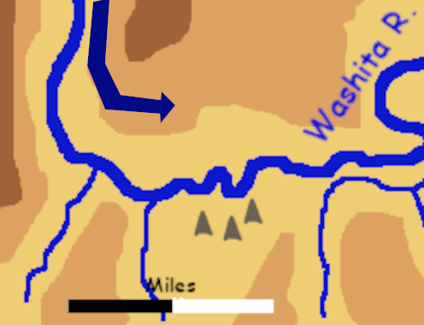
Sheridan’s War—Battle of the Washita November 27, 1868
Four days after leaving Camp Supply, Custer’s Osage scouts located an Indian encampment. Custer left his supply train behind and moved the regiment to the north of the village in the predawn hours.
He did not carry out a more detailed reconnaissance for fear of alerting the Indians to his presence.
He divided the command into four columns.

Slide 33
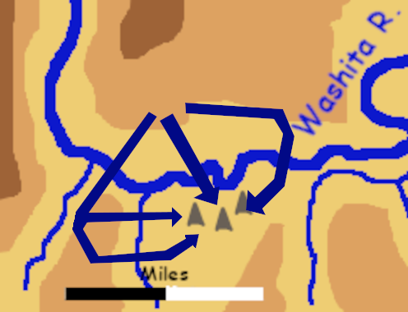
Sheridan’s War—Battle of the Washita
Custer attacked at dawn from four directions.

Slide 34
Sheridan’s War—Battle of the Washita
Complete surprise. Village of 0 lodges, almost all Cheyenne, under Chief Black Kettle (again).
This time Black Kettle and his wife were killed trying to escape.

Slide 35
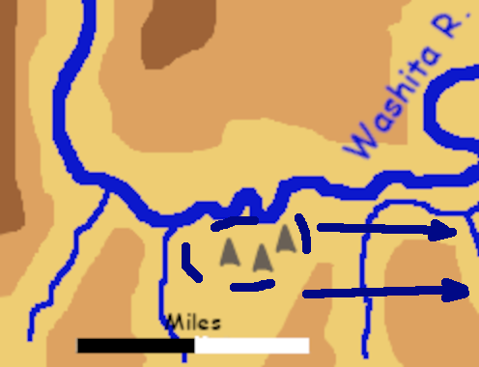
Sheridan’s War—Battle of the Washita
As the regiment finished killing most of the warriors in the village, two detachments pushed further east
Major Elliott with 18 men followed fleeing fugitives close by the river bank.
Lieutenant Godfrey with aboutt the same number of men pushed east toward the crest of a ridge where two Natives appear to be signalling.

Slide 36
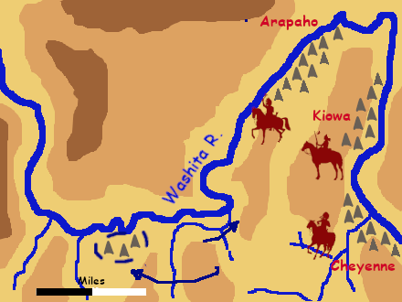
Sheridan’s War—Battle of the Washita
When Godfrey crested the ridge He saw a very large Indian encampment to the northeast, with many Indian warriors emerging and moving west.
Godfrey retired with his men, was caught by pursuing Indians, but dismounted, drove them back with fire, and then retired by squads--one covering the other—to safety.
Elliott continued forward in pursuit.

Slide 37
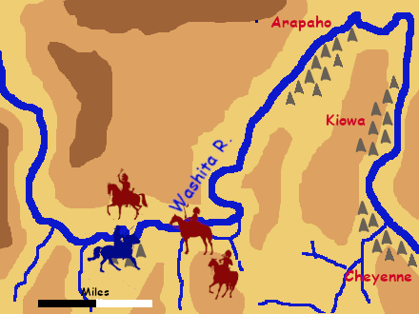
Sheridan’s War—Battle of the Washita
Custer burned all material in the village, including 50 lodges, almost 1,000 buffalo robes and unanned hides, 80 firearms, 20 lbs. of lead (and 90 bullet moulds), and 4000 arrows.
The pony herd of over 800 head was shot.
Increasing numbers of Indian warriors on the surrounding high ground were visibly distraught at the slaughter of the horses.

Slide 38
Sheridan’s War—Battle of the Washita
The increasing number of warriors soon outnumbered Custer’s command, but they were unwilling to close with so many soldiers armed with Spencer repeating carbines.
Custer’s men ran dangerously short of ammunition, and the Natives had cut him off from his supply train. The commander of the baggage wagons made the heroic (and probably reckless) decision to drive the ammunition wagons full speed right through the surrounding Indians and break through to Custer, which he did, and just in time. The soldiers began grabbing handfuls of cartridge as quickly as they could open the ammo boxes.
At dusk, Custer mounted up and marched the regiment toward the larger village. The warriors withdraw to reinforce the villages against attack. As darkness falls Custer reversed direction, broke contact, and withdrew safely.
Later they learned that Elliott and all of his men were killed.

Slide 39
Sheridan’s War—the Washita Aftermath
Custer lost twenty-two dead (including all of Elliott’s command) and sixteen wounded. Indian casualties are disputed, but must have been about one hundred killed (out of a likely total of four hundred in Black Kettle’s village), fifty women and children captured, and many wound, some of whom would later die of their wounds.
The destruction of the village and its horse herd would be nearly as significant a blow, given hat this was the start of a long, bitterly cold winter.
The other columns patrolled and occasionally found enemy bands and destroyed their camps. Although there were few casualties, the results were decisive.

Slide 40
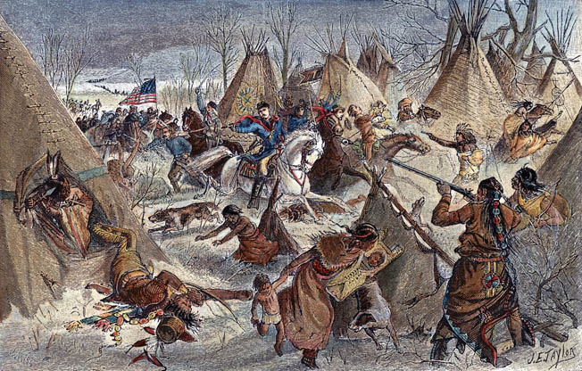
Sheridan’s War—the Washita Aftermath
The Natives had assumed they were secure from attack during the winter. The disproof of that ended Indian resistance in the Southern Plains.
The Arapaho and Kiowa made peace.
Most of the Comanche did as well, except for the Kwahadi, secure in their remote fortress, the Staked Plains.

Slide 41
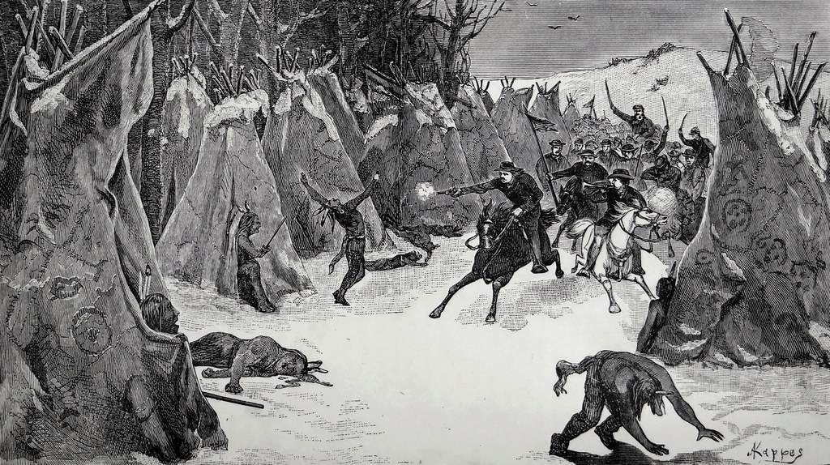
Sheridan’s War—the Washita Aftermath
The Cheyenne split deeply over war and pace, but almost all opted for peace except the Dog Soldiers, who vowed to move north and fight on with the Lakota.
They were caught by he cavalry along the way and destroyed.

Slide 42
Sheridan’s War—Assessment of Custer
Custer succeeded, but in part due to the famous “Custer Luck.” This was his first important battle against Indians. What did he do wrong?
Failed to adequately scout the enemy. He was ignorant of the opposing strength and dispositions.
Lost control of battle. A divided command and complicated maneuver orders insured confusion. Elliott became separated and was killed along with his men.
Became separated from his supplies. He ran dangerously short of ammunition during the battle. Only the commander of the baggage wagons’ heroic decision saved him.
Perhaps he learned valuable lessons from those mistakes.

Slide 43
PART 4: Grant’s Peace Policy

Slide 44
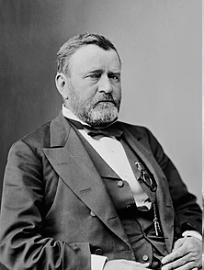
Grant Becomes President
Ulysses S. Grant elected President in November 1868. Grant governed as a powerful advocate of civil rights. He backed passage of the 15th Amendment, used the Reconstruction Act to support Black civil right in the south, crushed the Ku Klux Klan, and appointed many African-Americans and Jewish-Americans to prominent federal office.
Okay. But what about the Indians?

Slide 45
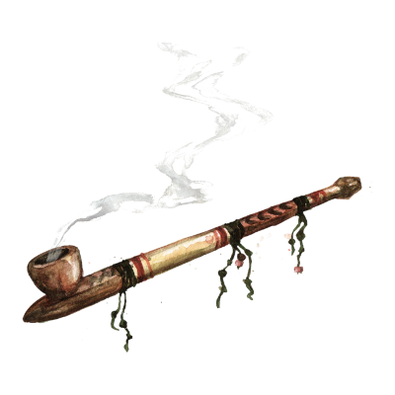
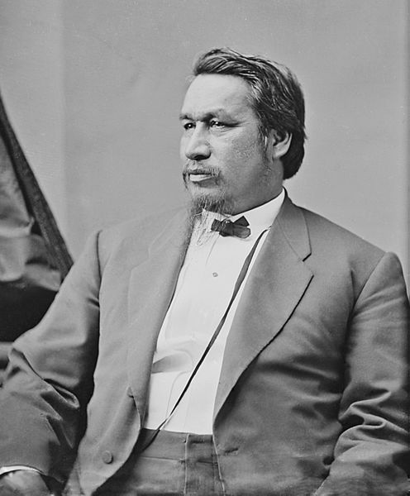
Grant’s Peace Plan
Grant appointed his former aid, Colonel Ely S. Parker, a full-blooded Seneca, as Commissioner of Indian Affairs (the first Native to hold that post).
Indian agents had a reputation as deeply corrupt. Grant mandated that in the central and southern Great Plains, Indian agents be selected by a board of clergymen. (All of the agents nominated were Quakers.) In all other regions, they were appointed from serving regular army officers.
He established a board of wealthy philanthropists, serving without pay, to oversee all funds appropriated for the benefit of Natives, especially for rations at reservations.
He ended the policy of negotiating treaties.

Slide 46
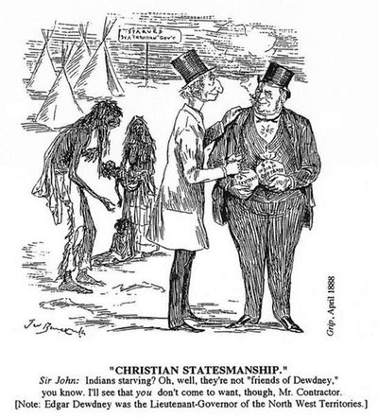
Grant’s Peace Plan
But replacing corrupt Indian agent with principled, idealistic ones could not solve the problem because the the problem was not a good policy derailed by corrupt administration.
The problem was that US Indian policy still made no legal or moral sense, unless you ignored the nation’s growing commitment to equality before the law and full participation in society, including government.

Slide 47
The Problems With Peace
Reservation life was dull. Without war and hunting as releases, the Natives increasingly turned to liquor.
The pressures to learn a new language, new a new religion, and a new occupation all at once became psychologically overwhelming.
Without weapons they had no ability to protect their herds from white horse thieves and cattle rustlers. What wealth they had was being stolen daily.
Surveyors kept surveying the land the Indians had been promised “in perpetuity,” which made them nervous—and with good reason.
Hunters had now begun the mass extermination of the great Buffalo herds in ther own hunting grounds, and that both saddened and enraged them.

Slide 48
The Problems With Peace
But the big problem was starvation during the winter of 1973-74. The government rations just stopped arriving.
Indians began slaughtering and eating their own horse herds just to keep their families alive.
Frantic calls from Indian agents for supplies and dire warnings about what might happen if they were withheld, went unanswered.
The problem was not government corruption. It was the Panic of 1873, which caused a global economic crash on a par with the Great Depression and left US government coffers nearly empty.
Now all the Natives needed to rise up in rebellion was a leader.

Slide 49
PART 5: The Red River War 1874-75

Slide 50
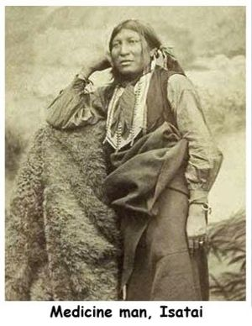
The Leader . . . Well, Two Leaders
Isa-tai was a young Kwahadi Comanche medicine man. He made a number of predictions which came true, and some of his followers claimed to witness magical feats he had performed.
(One of these was vomiting up an entire wagon load of rifle ammunition, and then swallowing it again.)
He was also a close friend of a rising Kwahadi war chief named Quanah Parker.

Slide 51
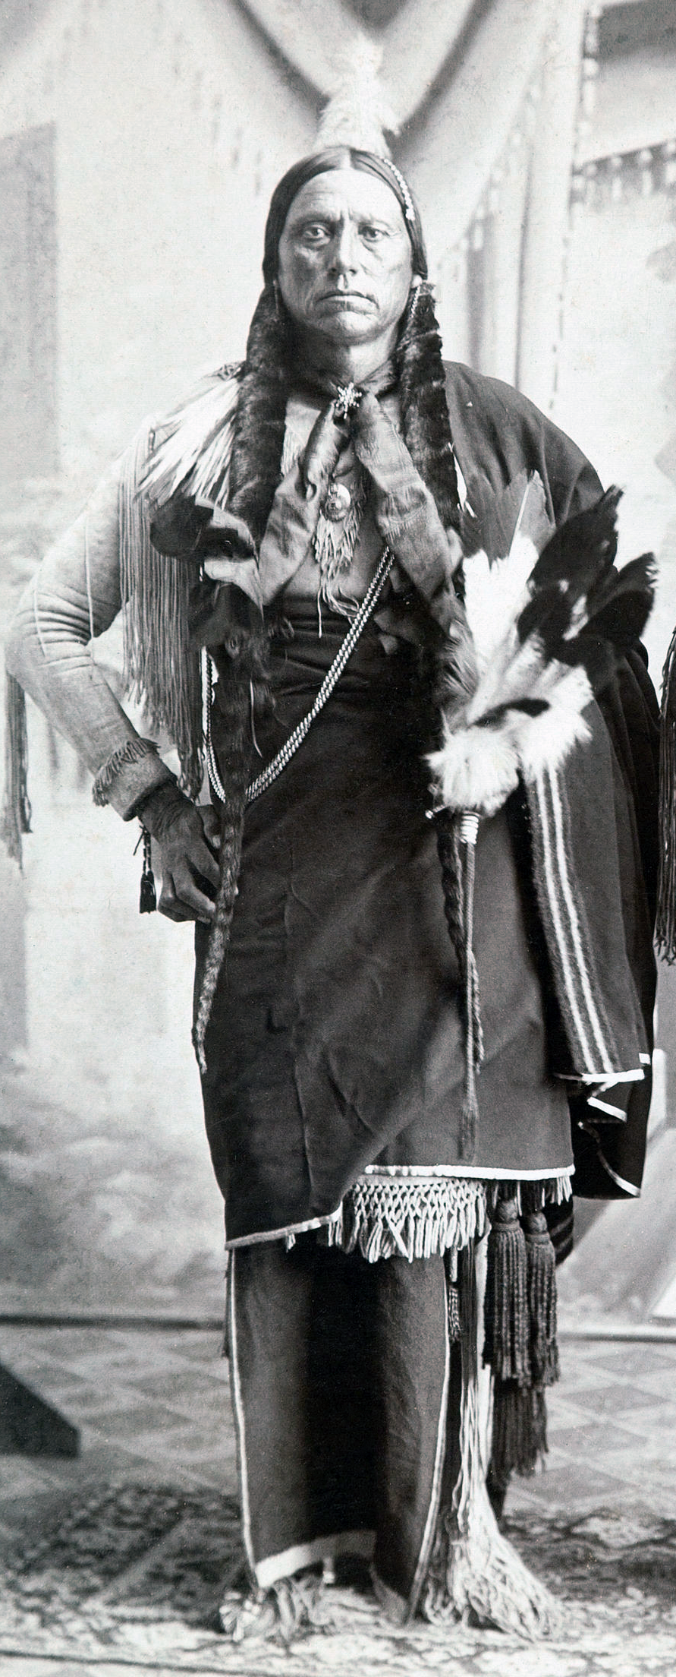
Quanah Parker
Son of the Kwahadi chief Peta Nokona and the captured White girl Cynthia Ann Parker (who had been adopted into the Nokoni band of the Comanches).
Hus mother had been recaptured by Texas Rangers in an attack on their village. (His mother never gave up trying to reunite with her Comanche family, but did before being able to.)
His father may have died in the same attack, but more likely lived another three or four years before succumbing to old wounds.
Parker was never formally chosen by the Khwahadi as “chief,” but he was the man they came to follow.

Slide 52
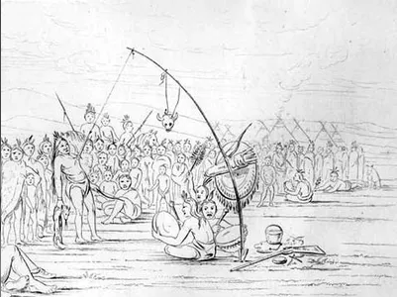
The War Begins
For the Kwahadi, it had never really ended, but now they were joined with Comanches and other Native allies from the reservations. The trigger had been when the government ended the policy of prohibiting troops onto a reservation unless specifically requested by the agent.
Isa-tai, the mystic medicine man, announced that for the first time in history, a Comanche medicine man (himself) would perform the sacred Sun Dance. He invited all the tribes of the southwest visit and watch the dance, and then decide if they would join him.

Slide 53
The Forces: Natives
By this time there were only 3,000 Comanches left alive. One third of those lived in the Staked Plains—either Kwahadi or families from other bands who had joined them to escape reservation life. The others lived on the reservation but half of thse jned the rising. The 2,000 Comanches at large would have 500-600 warriors.
About 1,800 Southern Cheyenne lived off the reservation, with about 450-550 warriors.
About 1,000 Kiowas and Kiowa Apaches were off the reservation , with about 250-300 warriors.
The Arapaho had by now completely surrendered to reservation life.
Total: 4,800 people, 1200-1450 warriors.

Slide 54
The Forces: Army
Fort Siill: Col Davidson, 10th Cavalry
Fort ? : Col Buell, 11th Infantry
Fort Concho: Col Mackenzie 4th Cavalry
Fort Bascom: Major Price, 8th Cavalry (half)
Fort Dodge: Col Miles 5th Infantry (half) and 6th Cavalry
Total: about 2,500 officers and men

Slide 55
Battle of Adobe Walls: June 27, 1874
War party of about 500 warriors attacked a party of 29 buffalo hunters in several sod and adobe buildings.
Isa-tai (the mystic medicine man) informed the Natives his medicine would protect all of them, that the White bullet would just stop inside their guns and the Indians would “slaughter them like grandmothers.”

Slide 56
Battle of Adobe Walls: June 27, 1874
Instead the buffalo hunters started hitting men at several hundred yards. Repeated charges were unable to overrun them and caused little damage afer the first charge due to the excellent cover.
Before braking off the attack, several chiefs thrashed Isa-tai with branches, yelling hat hs medicine was n good.
The Natives probably suffered about thirty deaths and at least as many wounded. It was also a serious blow to their morale.
Four hunters died but two of those were killed sleeping in a wagon during the first attack and one accidentally shot himself in the head climbing down a ladder.

Slide 57
Subsequent Actions
A number of additional engagements were fought and many followed a smilar pattern: the Army found an encampment and attacked, the Indians resisted, then retreated, and the Army then burned all of the captured lodges.
Casualties in the battles, on both sides, were generally low.
Climactic battle was Battle of Palo Duro Canyon on September 28, 1874. Colonel Ranald Mackenzie’s 4th Cavalry attacked a large camp of Comanches and Cheyenne, over 200 lodges. They successfully drove the Natives away and then burned all of the lodges and slaughtered the captured horse herd of over a hundred head.
Indians only lost three men killed, but they also lost the war that day.

Slide 58
Palo Duro Canyon and Afterwards
In the following days the converging Army columns fought more skirmishes and burned over 500 additional lodges, close to all the lodges of all the Indians off the reservation.
With winter approaching, the Indians had no remaining options except surrender, and they did so, a trickle at first, but then a torrent beginning in January of 1875. By spring, the entire southern plains were peaceful, and would reman so.
The Army faced severed logistical problems, but they overcame them. The Natives could not overcome the inherent limitation of having to bring their supply source with them and risk losing it.
The Army had discovered how to break Indian resistance without killing hundreds of them.

Slide 59
A Good Day to Die
QUESTIONS?

