Slide 1
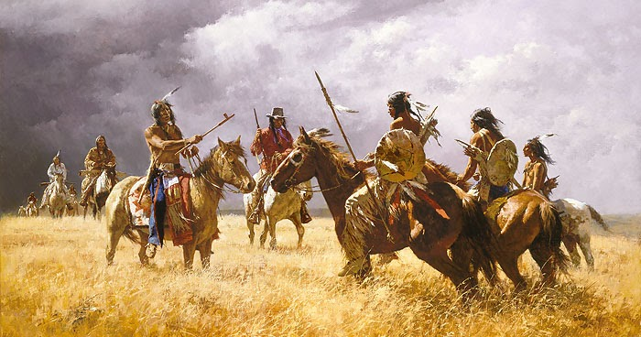
“A Good Day To Die” Indian Wars in the American West

Slide 2
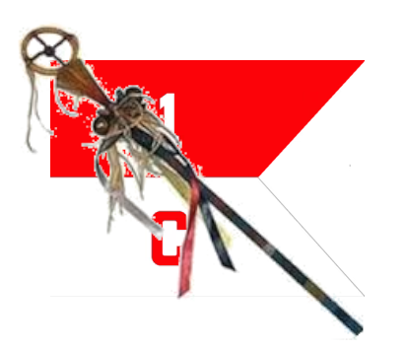
Course Outline
Week 1: What Came Before (From Christopher Columbus to Manifest Destiny)
Week 2: A House Divided (Genesis of the Western Wars)
Week 3: The Opponents (The US Army and the Natives)
Week 4: Red Cloud’s War, the Lakota, and the Northern Plains
Week 5: Hancock’s War, Commancheria, and the Southern Plains
Week 6: The Long Struggle for Apacheria and the Southwest
Week 7: The Forgotten Wars (The Great Basin and Pacific Northwest)
Week 8: Finale (From the Little Bighorn to Wounded Knee)

Slide 3
“A Good Day To Die” Indian Wars in the West
OLLI “Spring” 2021
Week 4: Red Cloud’s War
And the Northern Plains

Slide 4
Red Cloud’s War
1) Red Cloud and the Lakota
2) The Bozeman Trail and the Army
3) The Fighting Begins
4) Fetterman’s “Massacre”
5) The Second Year: Wagon Box and Hayfield
6) Peace (For a while)

Slide 5
PART 1: Red Cloud and the Lakota

Slide 6
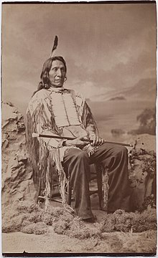
Who Was Red Cloud?
Born 1822, son of Lone Man, a Brulé chief, and Walks as She Thinks, an Oglala of the Bad Face band.
Shortly before he was born a bright red meter streaked across the sky. Hi father named him Makhpiya-luta: Red Cloud.
His father died of alcoholism when Red Cloud was four and his mother rejoined her Oglala band. He was raised in the lodge of maternal uncle, Old Smoke, a chief of the Bad Faces, the largest band of the Oglala.
Note that ancestry was traced matrilineally, and so Red Cloud was considered an Oglala rather than Brulé.

Slide 7
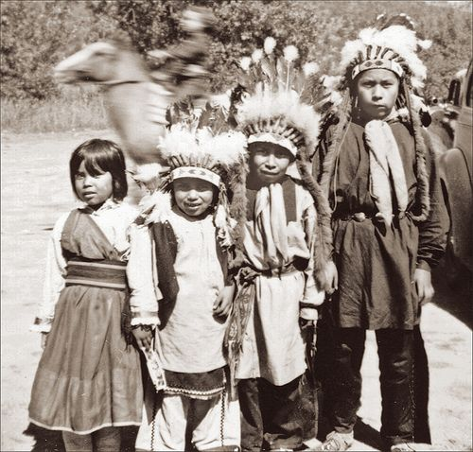
Who Was Red Cloud?
Despite his uncle’s status as a chief, Red Cloud’s own father’s membership in a different tribe, and his death by alcohol, remained a blot on the boy’s reputation.
As a result, Red Cloud strove harder than any of the others, and as a young man soon gained a reputation as the bravest and most clever warrior in the band.
Red Cloud taught himself to track at night by walking for hours on moonless nights barefoot, to learn what the ground felt like where men had walked.

Slide 8
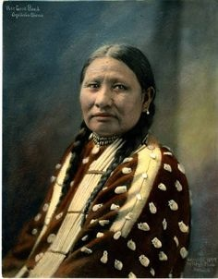
Who Was Red Cloud?
He also understood tribal politics and knew he had to marry well in order to rise in the leadership. He wooed and wed Pretty Owl, the daughter of one of the most respected families in the band.
He paid a bride price of twelve horses, one of them his favorite pony.
She was his only wife and they remained together his entire life. They had five or six children together. Their eldest (possible only) son Jack succeeded him as Head Man of the Oglala.

Slide 9
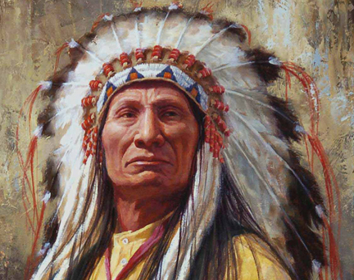
Who Was Red Cloud?
In the early 1840s, at the age of about twenty, Red Cloud was acknowledged as the blotahunka of the Bad Faces, a term meaning foremost warrior, usually translated as war chief.
In 1855 he had become the blotahunka of the Oglala tribe and was honored by the entire Lakota nation by elevation to the chieftain class, a prerequisite for advancing from war leader to tribal elder.
By 1866 he had become the blotahunka ataya, war chief of the entire Lakota Naion.

Slide 10
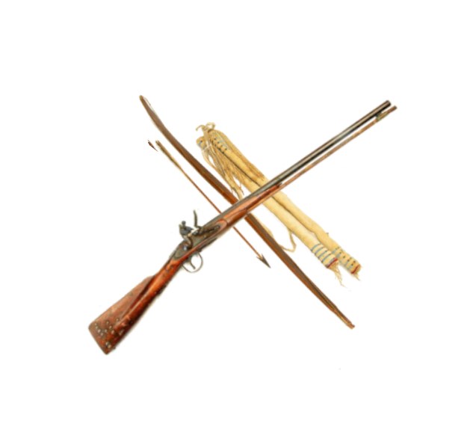
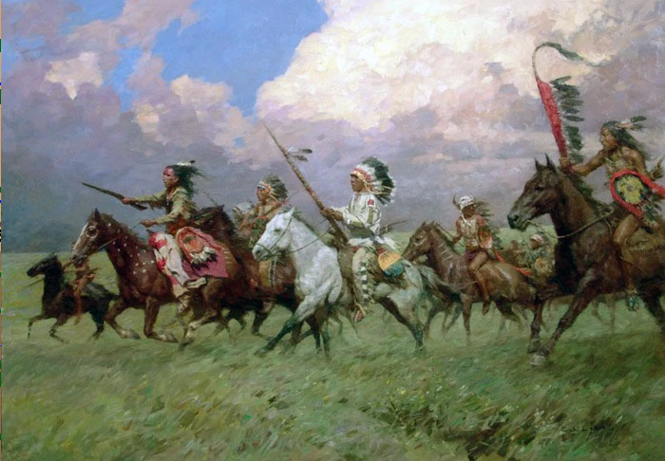
Red Cloud’s Army
TOTAL: c. 1800 warriors
Oglala Lakota: c. 600
Brulé Lakota: c. 500
Miniconjou Lakota: c. c. 200
Northern Cheyenne: c. 350
Northern Arapaho: c. 150
But very few firearms.

Slide 11
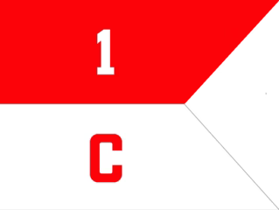
PART 2: The Bozeman Trail and the Army

Slide 12
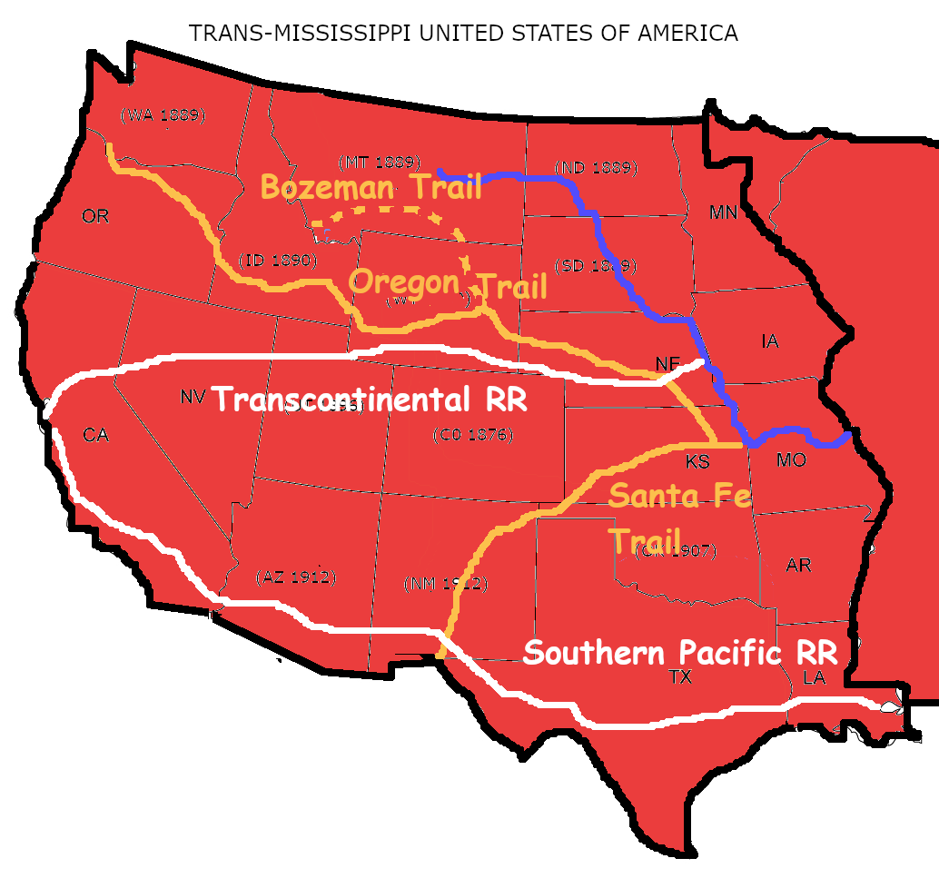
The Bozeman Trail (Guess what? It’s all about gold!)
New gold finds in western Montana required a new trail for miners to move north.
The resulting extension off the Oregon Trail was called the Bozeman Trail, after John Bozeman, who blazed it.
The USA believed the 1851 Treaty of Fort Laramie gave them the right to build forts along new trails as well as the ones that existed before.
This was news to the Natives.

Slide 13
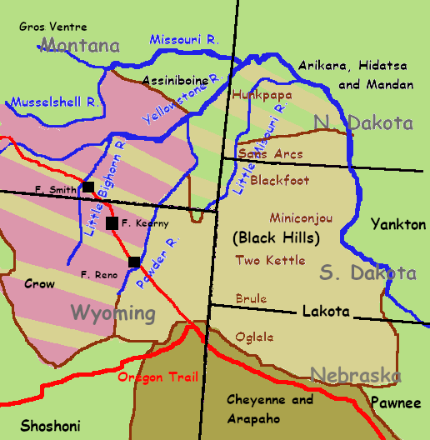
Whose Land is It?
In 1866 the Army began establishing forts along the Bozeman Trail in “Crow” territory.
The Crow were generally friendly to the USA.
But in the fifteen years since the Fort Laramie Treaty, most of the Crow land south of the Yellowstone River had become Lakota land.
The Bozeman trail runs through the heart of the best hunting grounds in the region.

Slide 14
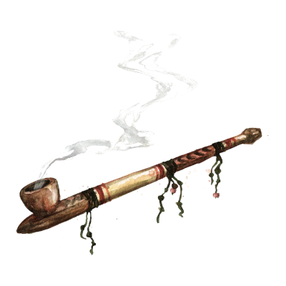
Negotiations
The provision of the 1851 traty allowing the Army to open new trails and build additional forts was actually added during the ratification process in Washington. The Indians had never seen it and had never agreed to it.
The Army belatedly attempted to gain permission to build the forts as they were already marching troops there to begin construction.
The obvious fact that they intended to build the forts with or without permission was not lost on the Lakota. Red Cloud spoke for most of the assembled chiefs when he said,

Slide 15
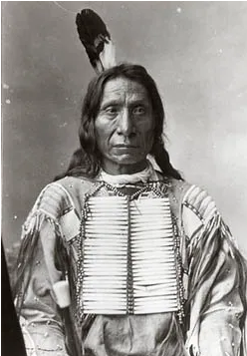
Red Cloud’s Declaration of War
“The Great Father sends presents and wants a new road. But the White Chief already goes with soldiers to steal the road before the Indian says yes or no. I will talk with you no more. I will go now, and I will fight you. As long as I live I will fight you for the last hunting grounds.”

Slide 16
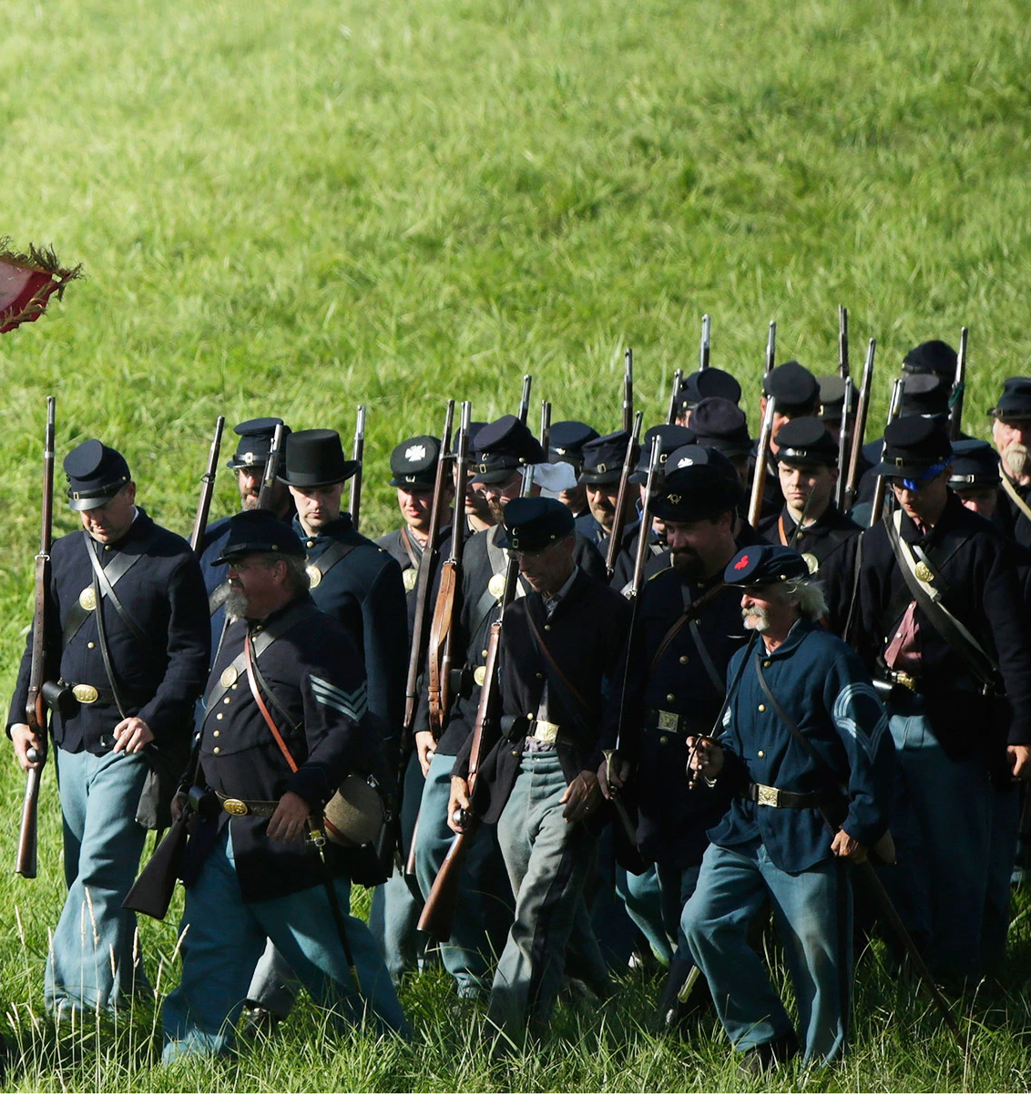
The Army
The II Battalion, 18th Infantry Regiment (soon to be reorganized as a separate regiment) under Colonel Henry Carrington was assigned the mission of constructing and defending the forts. The force had a strength of 700 men along with 300 civilian contractors.
Carrington assigned a quarter of his men to garrison the ramshackle Fort Reno, another quarter to build Fort C. F. Smith, and kept the bulk of the command to build the main post, Fort Phil Kearny.

Slide 17
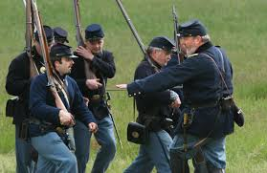
The Army
Most of the infantry had been taught how to ride, so they could function as mounted infantry if necessary.
But 500 of Carrington’s 700 total troops (at all three forts) were untrained recruits, the first wave of enlistees after the large post-Civil-War demobilization.
In June he began building Fort Phil Kearny. The nonstop labor left no time for additional training. There wasn’t enough ammunition for marksmanship training anyway.

Slide 18
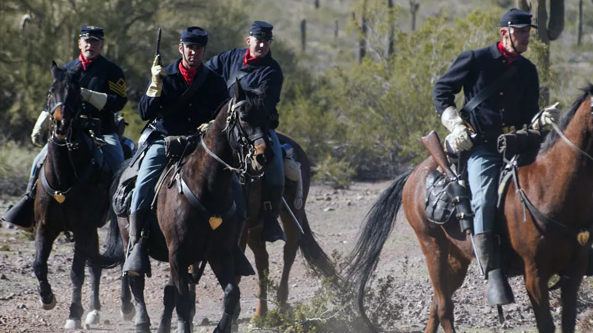
The Army
In November he was reinforced with a 63-man troop (company) of the 2nd Cavalry Regiment.
About half of the cavalry troopers were green recruits who hardly know how to ride.

Slide 19
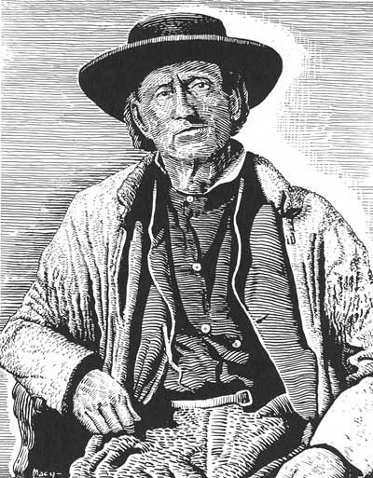
The Army
The legendary mountain man Jim Bridger, now serving as Colonel Carrington’s senior scout summed up the officers and troops of the command succinctly:
“These soldiers don’t know anything about fighting Indians.”

Slide 20
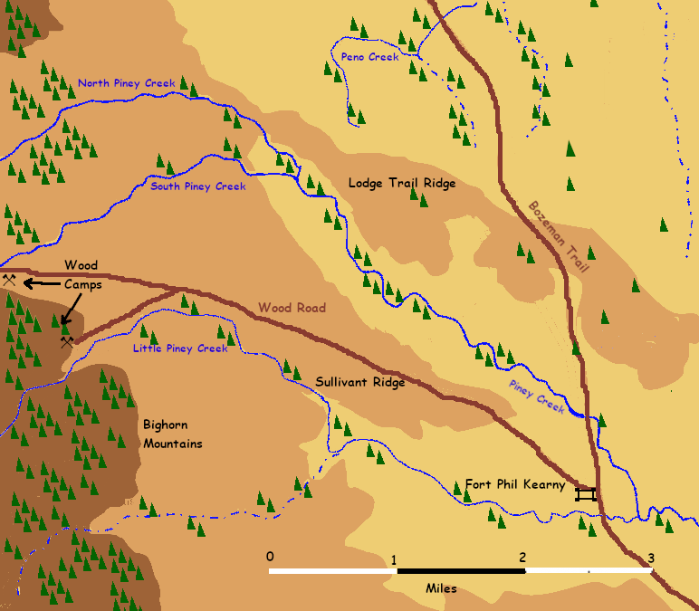
Fort Phil Kearny
The Fort had to be close to the trail, close to fresh water, and close to timber (for construction and for firewood in winter).
The site had that, but was overlooked by several surrounding ridges and the eastern slopes of the Bighorn Mountains.
A road linked the fort to the logging camps.

Slide 21
PART 3: The Fighting Begins

Slide 22
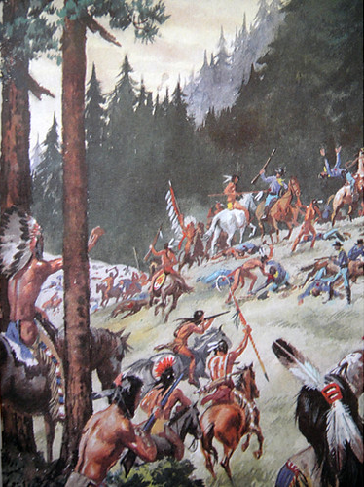
The Fighting Begins
Both the troops at the forts and the wagon trains of settlers began suffering attacks almost at once.
Most Indian war parties were between twenty and a hundred men. They seldom pressed home an attack. Instead they stole horses and cattle, picked off stragglers, hit and ran.
Red Cloud did not try to impose a single policy on the raids. Instead he encouraged war party leaders to try different tactics each time. This meant the settlers and Army never knew what to expect from one attack to the next.
By November, about twenty soldiers and over a hundred and thirty civilians had been killed, and 800 head of cattle and horses had been stolen.

Slide 23
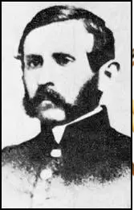
The Bickering Begins as Well
Colonel Carrington was a talented administrator and engineer, but had never seen combat.
His second in command, Captain William J. Fetterman, had an outstanding combat record in the Civil War but had never fought Indians. He believed Carrington should be more aggressive.
Fetterman and many of the junior officers soon came to despise Carrington for his preoccupation with building he fort and his disinterest in attacking the Indians.
Fetterman reportedly said, “Give me eighty men and I’ll ride through the whole Sioux Nation.”

Slide 24
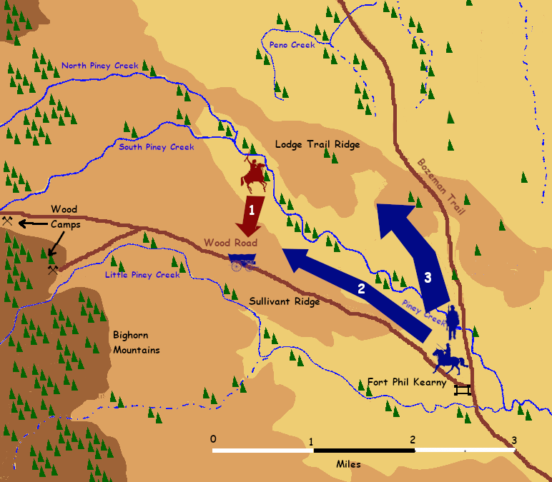
December 6
1) The wagons carrying wood, escorted by almost 100 troops, are attacked by Indians from the north.
2) A relief party of 50 infantry and cavalry under Fetterman leaves the fort to support the wood party.
3) A flanking party of 25 mounted infantry under Carrington moves north and then west to hit the Indians from behind.

Slide 25
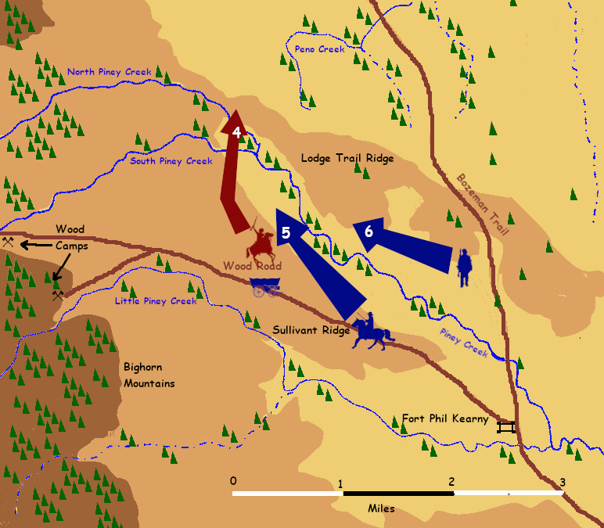
December 6
4) The Indians withdraw north.
5) Fetterman pursues the Indians, but many men sraggle behind the leaders.
6) Carrington advances west to the sound of gunfire, but some of his men straggle behind as well.

Slide 26
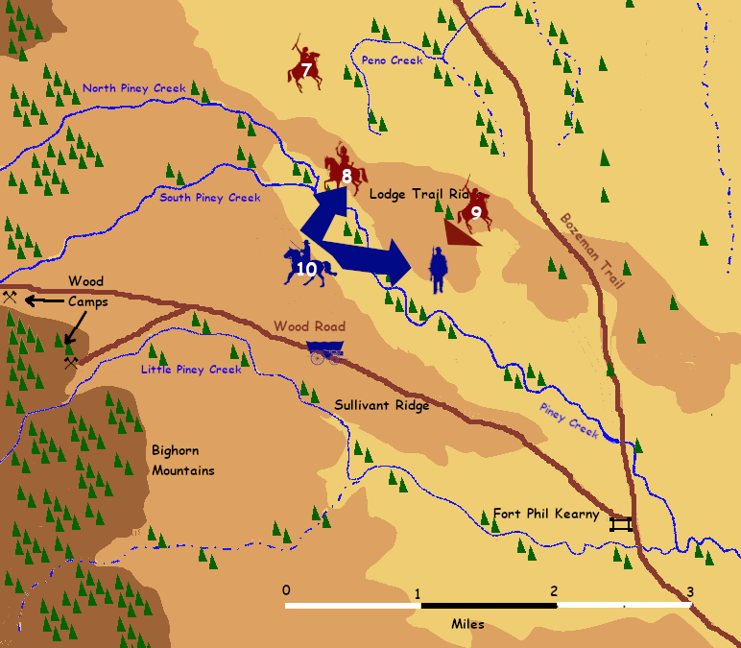
December 6
7) Indians withdraw north.
8) Indian decoy party appears on ridge. Parts of Fetterman’s command pursue.
9) Party of 100 warriors attacks Carrington.
10) Fetterman joins Carrington. Indians withdraw.
11) Pursuit force attacked and defated by Indians.

Slide 27
December 6 Results
One cavalry officer and one infantry sergeant killed (in the defeated pursuit force). Perhaps a dozen wounded. Indians suffered a few wounds, no known fatalities (although the Army claimed six.)
Junior officers ignored orders, dashed out ahead.
Enlisted personnel straggled to avoid combat, refused orders to attack.
Commanders rapidly lost control of the battle, were lucky to escape with as few casualties as they did.
Fetterman’ revised assessment: "This Indian war has become a hand-to-hand fight requiring the utmost caution."

Slide 28
December 6 Results
Red Cloud’s assessment:
“These foolish soldiers are ready to be slaughtered.”

Slide 29
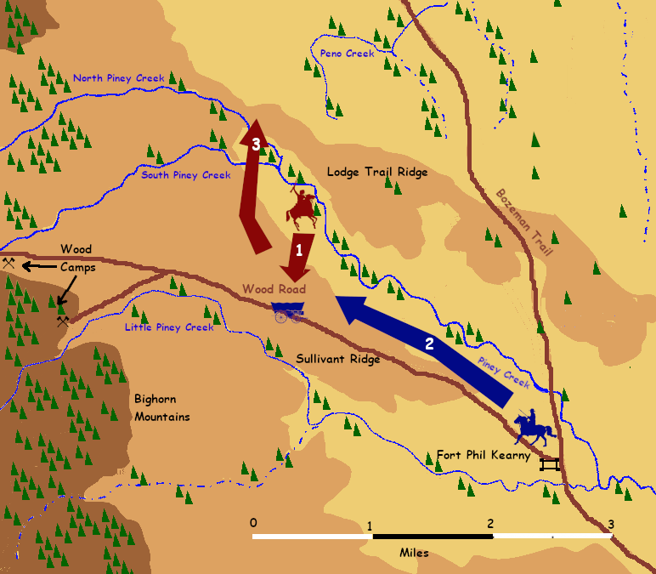
December 19
1) The wagons carrying wood, escorted by almost 100 troops, are attacked by Indians from the north.
2) A relief party of infantry and cavalry, under one of Carrington’s more cautious officers, leaves the fort to support the wood party.
3) Indians break off and withdraw north. Wood party arrives safely.

Slide 30
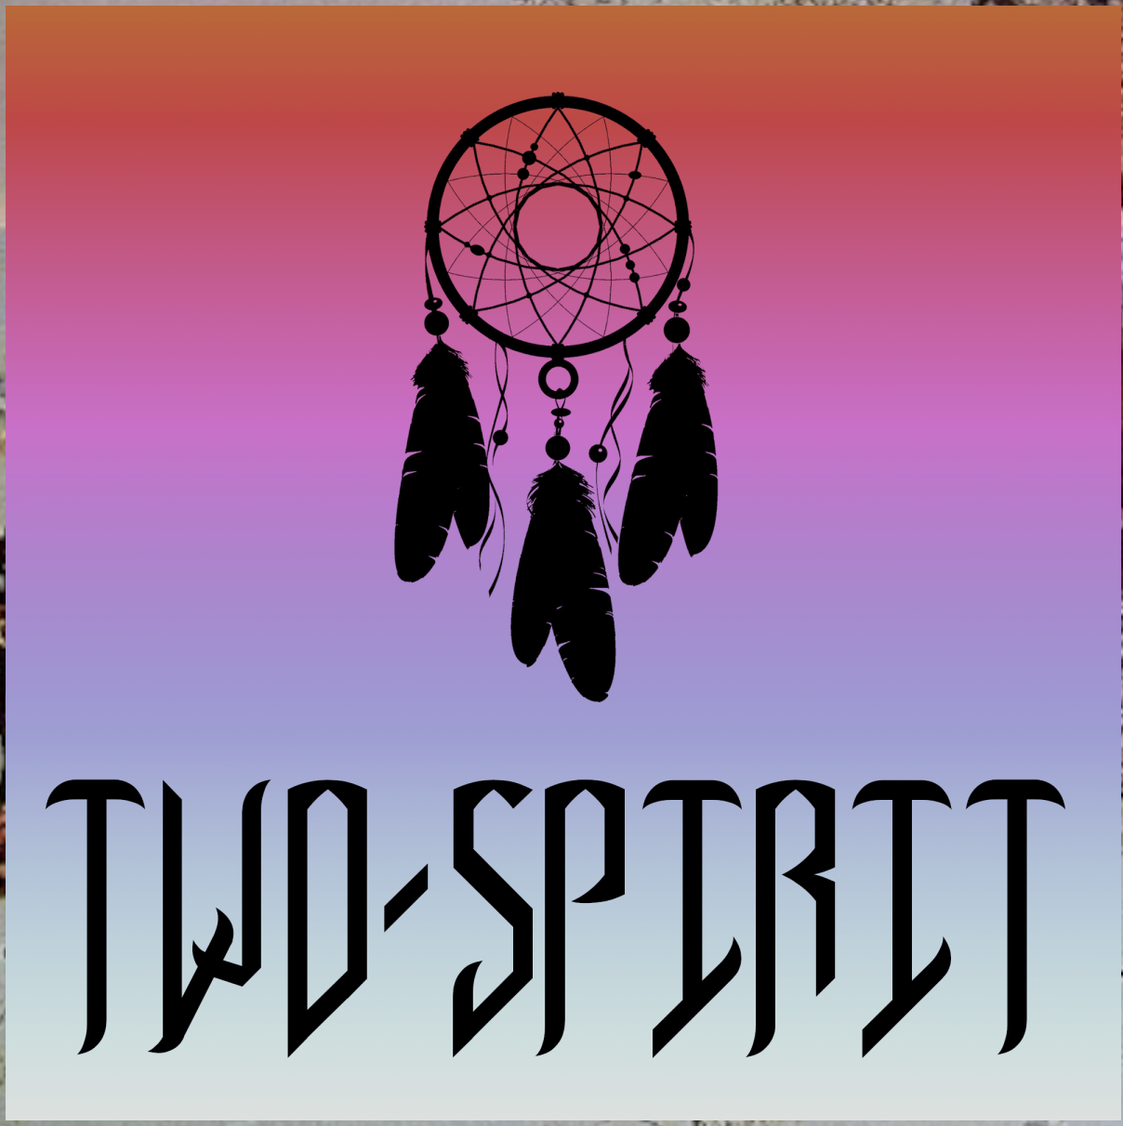
December 20: The Prophecy
Red Cloud decided to try for a decisive battle before the winter snows came and forced the Native army to disperse.
He called for the most respected Lakota Winkte (Two-Spirit Shaman) to view the ambush site and give him advice.
The Winkte rode around the assembled warriors four times, his arms waving wildly, and then he said he had gathered a hundred soldiers in his arms, “too many to hold.”
Red Cloud took this as a powerful prophecy of victory.

Slide 31
A Good Day to Die
QUESTIONS?

Slide 32
PART 4: Fetterman’s “Massacre”

Slide 33
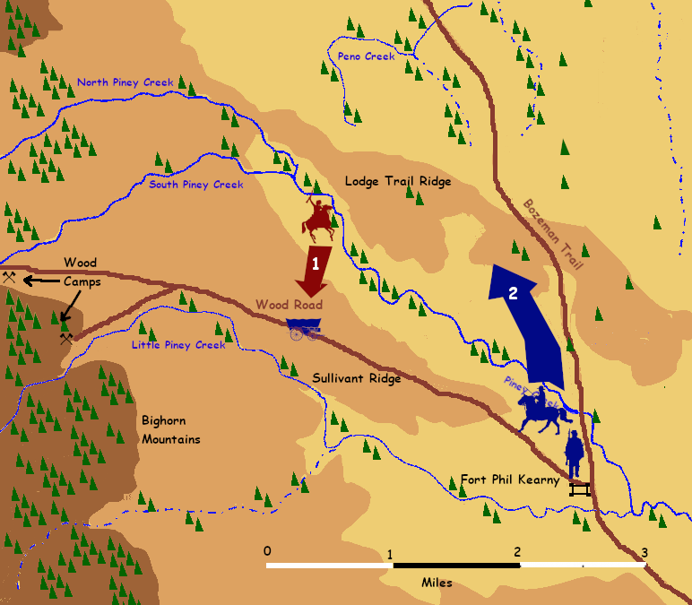
December 21
1) The wagons carrying wood, escorted by almost 100 troops, are attacked by Indians from the north.
2) A relief party of infantry and cavalry leaves the fort to support the wood party. Fetterman commands this time. The column heads north instead of west, perhaps to cut off the Indian attackers.

Slide 34
Fetterman’s Command
Fetterman’s infantry were drawn from all four infantry companies stationed at Fort Phil Kearny: companies A, C, E, and H of 2nd Battalion, 18th Infantry. One quarter of them (14 out of 46 enlisted men) were sergeants or corporals. This was over a third of the total infantry sergeants and corporals in the garrison. Hastily assembled from better trained men, but not used to working together.
Fetterman’s cavalry were all drawn from the only cavalry unit in the garrison, Company C, 2nd Cavalry. Since the company had a strength of over 60, but half of them were virtually untrained, this was probably the better trained half of the company.

Slide 35
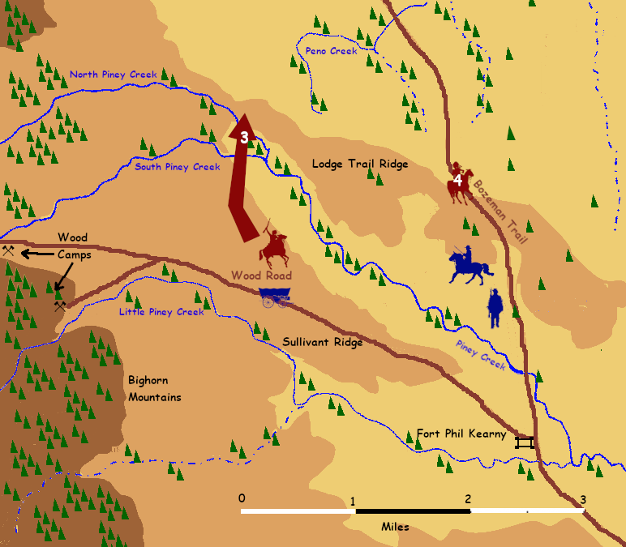
December 21
3) The attacking Indian war party withdraws to the north.
4) Ten Indian riders appear on the crest of Lodge Trail Ridge and begin taunting the relief column. Although the soldiers do not know it, one of the riders is the young Oglala warrior Crazy Horse.

Slide 36
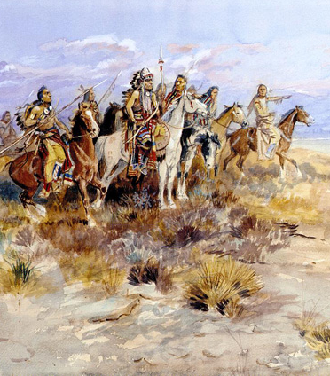
The Ten Riders
Red Cloud’s Army was made up of warriors from five distinct groups: Northern Cheyenne, Northern Arapaho, and three subtribes of Lakota--the Oglala, Brulé, and Miniconjou.
Red Cloud’s decoy party consisted of two riders from each of these five groups, so every group would share equally in the danger and in the glory.
This is how brilliant leaders successfully wage coalition warfare.

Slide 37
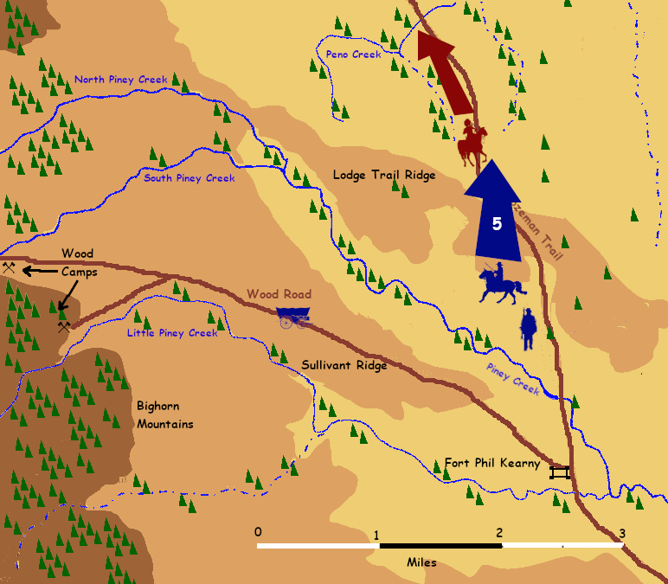
December 21
5) The relief column pursues the ten riders, who retreat down the north slope of the ridge. The relief column follows them and disappears from view of the fort.
Fetterman’s column includes about 50 infantry and 30 cavalry, a total of 81 men.

Slide 38
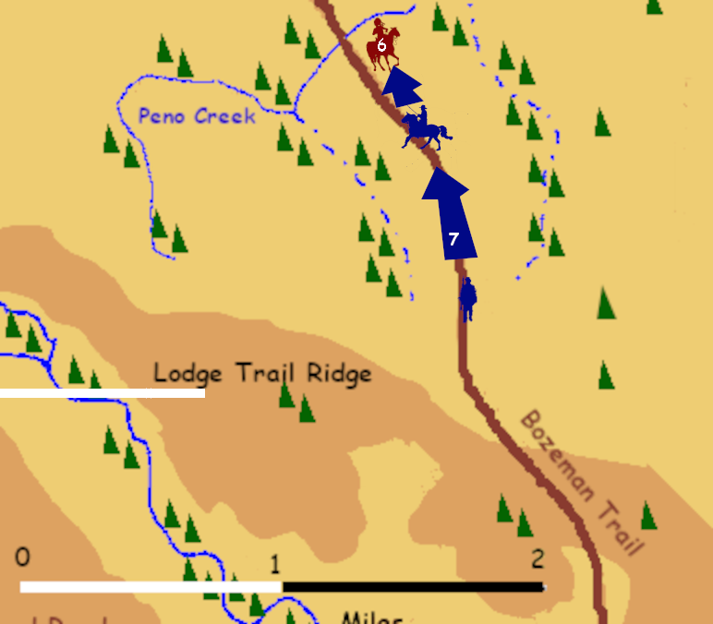
December 21
6) The ten riders continue to retreat down the north slope toward Peno Creek.
7) The cavalry pursuing them becomes separated from the infantry, and both are increasingly spread out and disorganized.

Slide 39
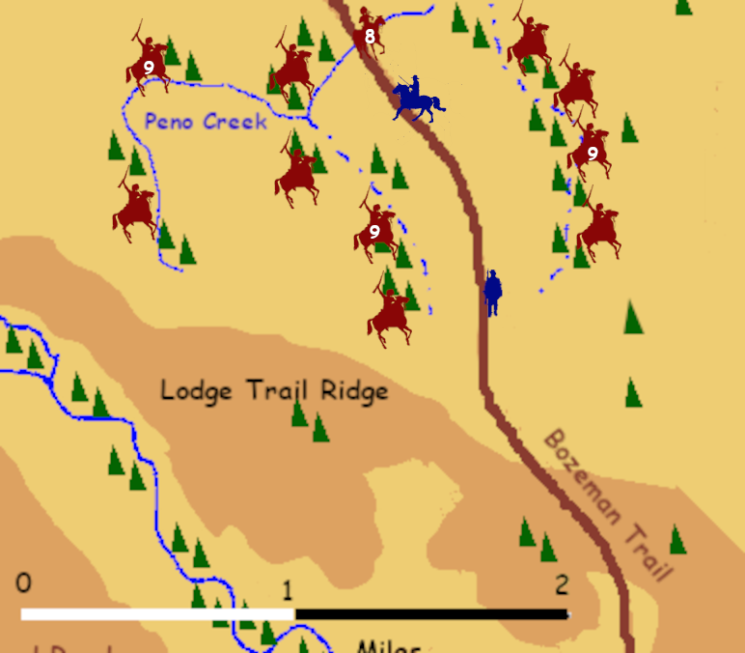
December 21
8) The ten riders stop retreating and ride in a figure eight pattern, the prearranged signal for the attack.
9) Over one thousand Lakota, Cheyenne, and Arapaho warriors emerge from the concealment of the wooded stream beds.

Slide 40
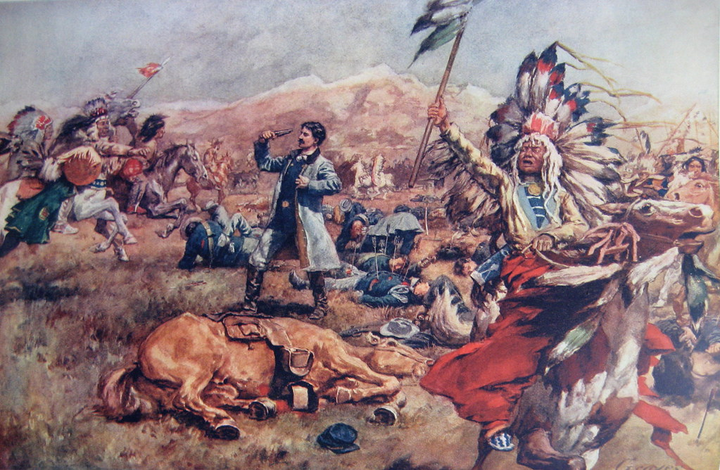
“Fetterman’s Massacre”
The soldiers attempted to escape from the trap, and were cut down to the man.
One Lakota warrior said that the sky was so full of arrows, it reminded him of swarms of grasshoppers.
Of the 81 men of Fetterman’s command, only six died from gunshot wounds, and one of these was self-inflicted. The rest were killed by arrows or war clubs.

Slide 41
“Fetterman’s Massacre”
The destruction of Fetterman’s force was the costliest defeat inflicted on the US Army by western Indians in history, and would remain so until the Battle of the Little Bighorn, ten years later.
The 81 men killed represented eight percent of all casualties suffered by the Army fighting the Indians west of the Mississippi up to that time.
Indian losses are estimated as between 13 (the actual known dead, by name) and 60 (an estimate, probably high). A reasonable guess would be between 30 and 40 dead.
As most of the soldiers put up a very brief resistance, it would have been even lower, but there were a number of Indian “friendly fire” casualties due to the large volume of arrow fire and the fact that the Indians were on all sides of the cavalry, so shots that went long fell among friendly warriors.

Slide 42
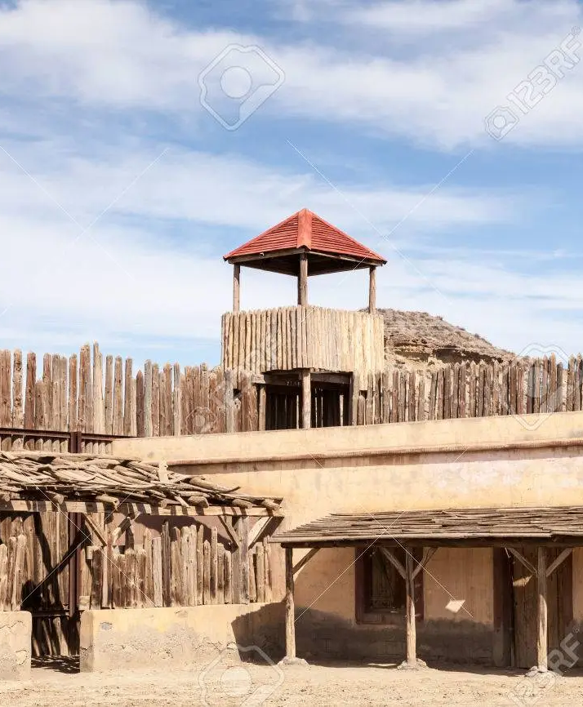
Immediate Aftermath
The garrison was severely crippled by the loss of so many non-commissioned officers (sergeants and corporals) and most of the best trained privates. Carrington prepared for a desperate defense of the fort with his remaining men and dwindling ammunition.
He made provision for blowing up th epowder magazine, along wih all of the women and children, if the Indians got over the walls.

Slide 43
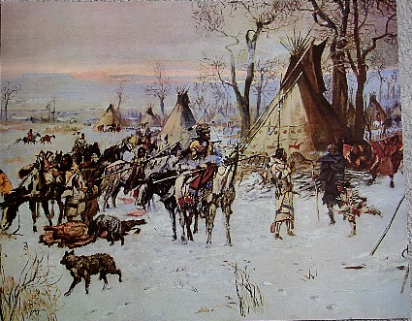
Immediate Aftermath
The attack never came. With winter weather coming on, Red Cloud withdrew his army into winter encampments.
Colonel Carrington was relieved of command and the garrison was reinforced with two additional companies of infantry. More troops went to the other forts as well.

Slide 44
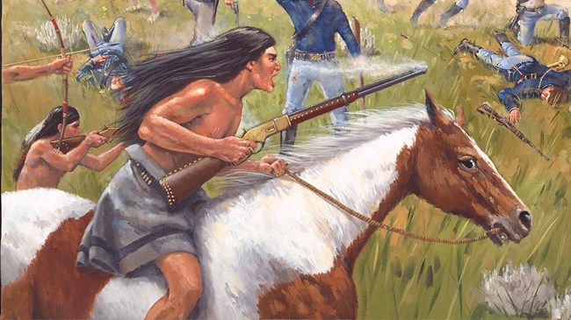
Immediate Aftermath
In honor of the Two-Spirit Wikte’s prophesy, Red Cloud named it Battle of the Hundred-in-the-Hands.
Before dispersing the army for the winter, Red Cloud celebrated the victory, showering praise on each of the war leaders who had distinguished themselves.
He insisted that a shy and softspoken warrior recount his own important part in the fight to the assembled army.
That warrior was named Crazy Horse, and that’s when he began his rise to leadership of the Oglala.

Slide 45
PART 5: The Second Year

Slide 46
More Soldiers and Weapons
The troops along the Bozeman trail were reinforced with more men and were reequipped with the new Allin conversion breach-loading Springfield rifles, along with a shipment of 100,000 rounds of ammunition.
New commanders took charge, as well, and they studied the lessons of he previous year’s defeat.

Slide 47
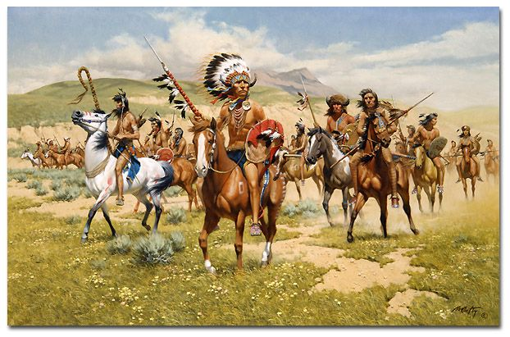
Divided Indian Counsel
Red Cloud wanted to concentrate against Fort Phil Kearny, while the Cheyenne and Arapaho wanted to attack Fort C. F. Smith.
Unable to reach agreement on a single joint target, Red Cloud compromised by timing the two attacks to take place as close to simultaneously as possible.
New Tactic: Charge home, regardless of losses, and overwhelm the soldiers.

Slide 48
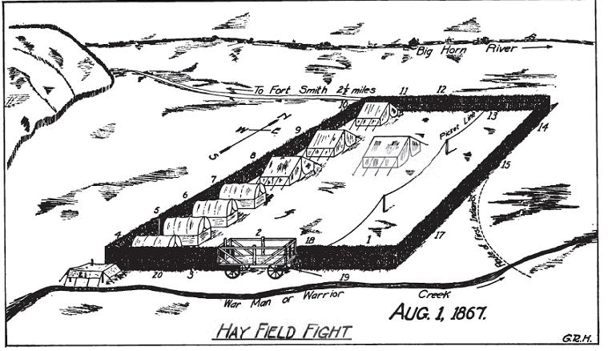
The Hayfield Fight : August 1, 1867
Fort C. F. Smith regularly sent out parties of soldiers and hired civilians to cut grass and dry it for hay to use as winter feed for the animals.
Due to increasing Indian attacks, the Hayfield was provided with a fortified corral, a low log breastwork with entrances blocked by wagons.

Slide 49
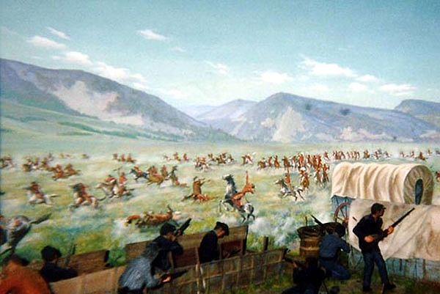
The Hayfield Fight : August 1, 1867
On August 1, the Hayfield work party consisted of 21 soldiers under a lieutenant and 9 civilians.
When the Cheyenne and Arapaho attacked, they drew a full volley fo rifle fire from the defenders and then charged home, confident they would catch the soldiers while reloading their muskets.
Instead the soldiers fired again in seconds, broke the charge, and the fired again.

Slide 50
The Hayfield Fight : August 1, 1867
The Indians fell back to regroup but then charged again, and were again driven back by the conentrated fire of the defenders. The Indians had not known he infantry had reequipped with breach-loaders. The fact that most of the civilian contractors were equipped with Spencer 7-shot repeating rifles also added to the defenders’ firepower.
The wooden breastwork provided excellent cover against Indian arrows, and very few of the attackers had firearms of any type.
The siege went on most of the day, but one soldier slipped through he Indian lines and brought a relief column in late afternoon. The Indians then broke off the action.
The thirty defenders suffered 3 killed (including the lieutenant commanding the unit) and nine wounded.
Indian casualties were reported as between 8 and 23 Indians killed and an uncertain number wounded.

Slide 51
The Wagon Box Fight: August 2, 1867
As at Fort . F Smith, civilian contractors and soldiers at Fort Phil Kearny had built a makeshift corral and entrenchment about a mile from the logging camps, by placing fourteen wagon boxes in an oval.
The soldiers and civilians were spread out at several different sites. Red Cloud intended to use a decoy force to lure any relief column into an ambush while hitting the coral itself in much greater strength than previously.
Surprise was lost when a small party of warriors disobeyed orders and hit an outlying logging camp before the rest of the force was in place. This first attack killed three soldiers and one civilian, but the survivors from the camp sounded he alarm.
By the time the main attack force under Crazy Horse was ready, the remaining 6 civilians and 26 soldiers were concentrated at the corral behind cover.

Slide 52
The Wagon Box Fight: August 2, 1867
Red Cloud had about 1,000 warriors available, but some of them were kept concealed to spring a trap on any relief force. Probably between 300 and 600 were actually involved in the assault on the corral.
They were almost entirely bow-armed. In the entire force of 1,000 warriors, there were at most 100 firearms, almost all old trade muskets, and fewer than 200 rounds of ammunition total.

Slide 53
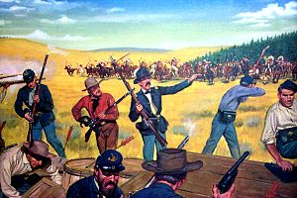
The Wagon Box Fight: August 2, 1867
All of the soldiers in the corral were armed with the new breach-loading Springfield rifles, and the civilians were mostly armed with Spencer 7-shot repeaters, with one or two 15-shot Henry repeaters.
The wooden sides of the wagon boxes gave excellent protection against arrows.
Although the fight went on all morning and part of the afternoon, and the Indians launched several charges, they could make no headway against the intense firepower generated by the defenders.

Slide 54
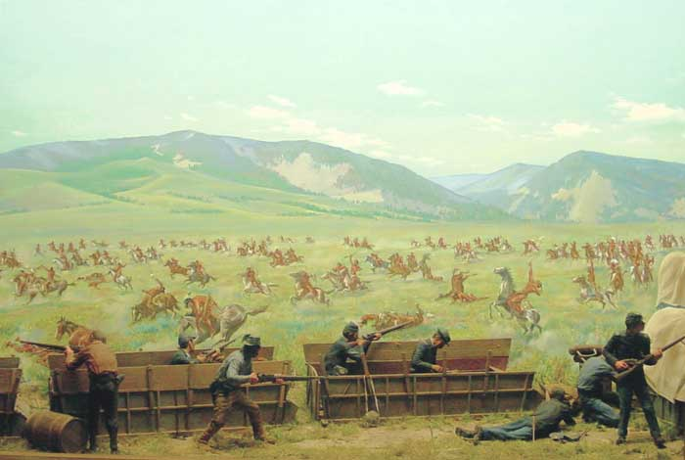
The Wagon Box Fight: August 2, 1867
When a relief olumn finally arrived, I was not lured away by the decoys and so the Indians broke off the action.
Army casualties were 7 killed and 2 wounded. The official report does not list any civilian casualties, but at least one was killed at the logging camp, so there may have ben other unreported losses as well.

Slide 55
The Wagon Box Fight: August 2, 1867
Indian casualties are a matter of dispute. The Army claimed 60 Indians killed and 120 wounded. Many modern historians believe the number was far less. At least one historian puts it at only 6 dead.
60 dead and 120 wounded, and nothing to show for those losses, would have shattered the spirit of his army and resulted in most of it breaking off the campaign. His losses were clearly less than that.
But Red Cloud continued launching small scale attacks on the settler wagon trains for the rest of the year, but did not launch another major attack on the forts. So he probably did not suffer catastrophic casualties.
But he did suffer substantial casualties, enough that he completely changed his tactics for the rest of the war. He returned to guerilla warfare and no longer sought a decisive battlefield victory to end the war in one stroke.

Slide 56
PART 6: Peace (For a While)

Slide 57
Red Cloud’s View
The Native forces under Red Coud had suffered two tactical reverses in as many days, but Red Cloud understood that he still held the the strategic advantage.
He could not take the forts by direct assault, but he could harass them and conduct raids to drive off their horses and cattle.
Most importantly, he could choke off the movement of civilian settlers along the Bozeman Trail. That, after all, was what the war was about: closing the Bozeman Trail.
Red Cloud’s clear strategic insight remains the quality that makes him unique among Native Indian war leaders.

Slide 58
The Army’s View
The Army was genuinely worried that Red Cloud seemed able to draw together significant coalitions of tribes and keep them united in the field for more than a single campaign season.
They also were alarmed that he seemed able to coordinate nearly simultaneous strikes separared by great distances. The attacks had been unsuccessful this time, but there was no guarantee they would fail the next time.
Finally, the Army undestod Red Cloud’s grasp of the core strategic objective of the war: the Bozeman Trail. While the Army could hold the forts along the trail, they did not have the strength to take the field against Red Cloud and defeat his warriors in the open.
The Transcontinental Railroad was nearing completion, but coming under attack. The Army could not defend both, and the Railroad took precedence.

Slide 59
Negotiations
In the spring of 1868, peace commissioners asked to negotiate a settlement with Red Cloud.
He answered that he would not talk peace as long as the three forts were still occupied in Lakota land.
In August of that year the US Army withdrew from all three forts. Then Red Cloud negotiated.
The 1868 Treaty of Fort Laramie guaranteed Indian ownership of the Powder River country (the land the Bozeman Trail passed through) and, most importantly, guaranteed that “no white person or persons shall be permitted to settle upon or occupy any portion of the Powder River country . . . or without the consent of the Indians first had and obtained, to pass through it”.
This was an unqualified strategic victory—the first an Indian nation had ever achieved against the USA through warfare.
And the last.

Slide 60
A Good Day to Die
QUESTIONS?

