Slide 1
“A Good Day To Die” Indian Wars in the American West

Slide 2
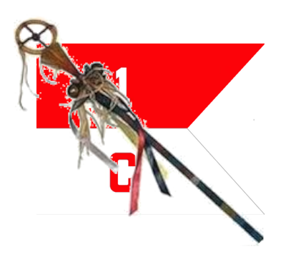
Course Outline
Week 1: What Came Before (From Christopher Columbus to Manifest Destiny)
Week 2: A House Divided (Genesis of the Western Wars)
Week 3: The Opponents (The US Army and the Natives)
Week 4: Red Cloud’s War, the Lakota, and the Northern Plains
Week 5: Hancock’s War, Commancheria, and the Southern Plains
Week 6: The Long Struggle for Apacheria and the Southwest
Week 7: The Forgotten Wars (The Great Basin and Pacific Northwest)
Week 8: Finale (From the Little Bighorn to Wounded Knee)

Slide 3
“A Good Day To Die” Indian Wars in the West
OLLI “Spring” 2021
Week 3: The Opponents

Slide 4
The Opponents
1) The Natives
2) “The Regular Army-O”

Slide 5
PART 1: The Natives
Cultural and Linguistic Regions
Familial and tribal structure
Spirituality
Torture
Warrior ethos (and Warrior societies)
Weapons
Military Tactics
Weaknesses

Slide 6
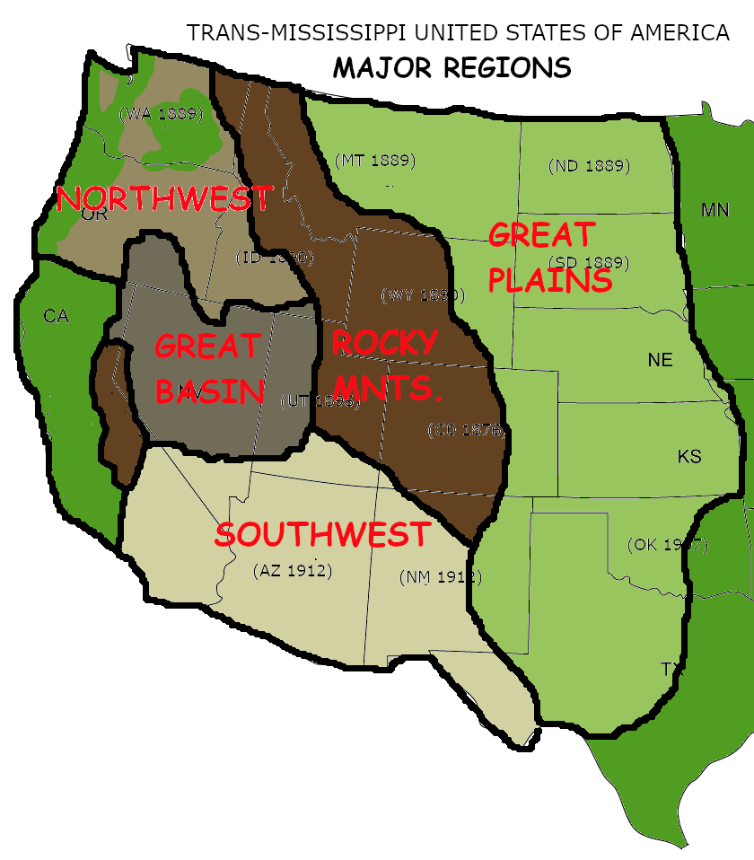
Native Geographic and Cultural Regions
Great Plains: Rolling grassland, limited water. More suitable for grazing than farming. Excellent horse country.
Southwest: Desert, little or no water.
Great Basin: Surrounded by mountains, limited water, rocky and broken.
Rocky Mountains: Tall, timbered mountains, mostly unsuitable for farming.
Northwest: Mix of coastal farmlands and inland wooded hills and mountains.

Slide 7
Major Linguistic and Tribal Groups

Slide 8
Familial and Tribal Structure
Patriarchal: Western Native tribes, particular of the Plains, were patriarchal. The senior male of the family made all important decisions—in theory. In practice, it was always more complicated.
One Size Does Not Fit All: The Cherokee (for example) were not patriarchal
Bands: Several family groups made up Bands, usually named. (Red Cloud’s band was known as the Bad Faces.) Typically included a few dozen to several hundred people.
Tribes: Several bands made up a Tribe. (Red Cloud’s tribe was the Oglala).
Nations: Several tribes made up a Nation. (Red Cloud’s nation was he Lakota.)

Slide 9
Familial and Tribal Structure
Tribes and bands within a Nation never made war on each other, only with other nations.
Sometimes nations at war found a way to make peace and become allies. The Cheyenne and Arapaho were allies when the Lakota moved onto the plains. After a half-dozen years of war, the Cheyenne and Arapaho made peace with the Lakota and remained their allies from then on.

Slide 10
Governance
Tribal elders choose emerging leaders to manage the hunt and wage war.
Successful leaders then become elders. In the Lakota, a band had a set number of elders elected for life. When one died, the surviving elders elected his replacement.
Police power limited to the hunt and the camp. War was less regulated.
In most cases, the only power a leader has is to persuade. His recognition by the elders, however, encourages the members of the tribe to give his words respect.

Slide 11
Spirituality
Transactional: Everything is dynamically alive, with relationships rather than rules as its laws.
Nature-attuned: Animism strongly present.
Spirit Beings: Power (“Medicine”)derived as gifts from spirit beings. Magical power to avoid injury, cure illness, sueed at the hunt.
Spirit Guides (“Medicine Men”): Shamans, Priests.
Spirit Quest: Search for personal spirit being.

Slide 12
“Medicine”
Medicine means the power of a person’s spirit guardians. It is a personal physical protection, in the case of warriors, but also indicates the general good disposition toward the person by the spirit world.
Good Medicine: Good fortune in war suggests good fortune in general.
Bad Medicine: The death of a war leader often ended a raid by a war party. The death learly demonstrated the leader’s Medicine had failed him, which suggested the venture he had planned and led was also doomed.

Slide 13
Torture
“Each man calls barbarism whatever is not his own practice.”
-- Michel de Montaigne
1637 Jesuit missionaries: Hurons torturing and executing an Iroquois captive.
Why Torture Prisoners?
A warrior surrenders his life when he mbarks on a raid.
Proof of stronger Medicine than the defeated captive.
Teacching moment for Children.
Grieving/Closure for th relatives of the slain.

Slide 14
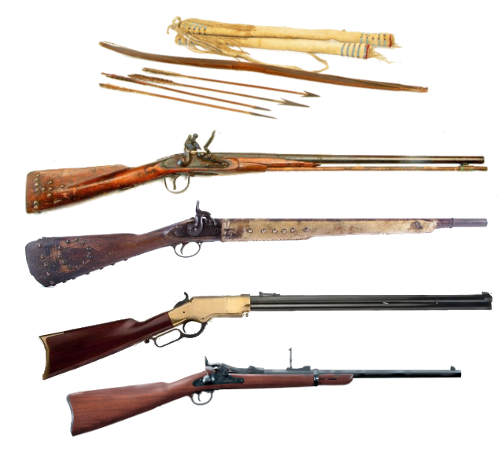
Warrior Ethos
Courage: There are four cardinal virtues (for the Lakota), courage, generosity, truthfulness, and begetting children. But of the four, courage is by far the most important.
The Purpose of War: War serves many material aims (protection of hunting grounds, capture of horses) but its spiritual aim is the display of courage and the demonstration of the power of a warrior’s Medicine.
Counting Coup: A pure expression of the spiritual aim of War.
A Minority View: The Apache, and some other non-plains tribes, viewed war as more important materially than spiritually. More like a hunt; less like a spirit quest.

Slide 15
Warrior Societies
Each had Particular Approach to War: Stealth, defiance, planning.
Did not to fight together on the battlefield: One reverse to cripple the society. Trying to show the society’s prowess to others, not compete with own members.
Some Societies were also Police: Among the Lakota, the term Akicita liteally means warrior, but had the particular meaning of warriors serbing th tribal leaders.
Akicita policed the hunts, making sure no one spooked the herds before everyone was in position.
Akicita also maintained order in the camp. If someone killed another tribe member in the camp, the Akicita killed him.

Slide 16
Weapons
Bow and arrow
Parker, Field & Co. c.1871 flintlock trade musket
Tower 1861 .58 cal Rifled Musket (percussion cap)
Henry Rifle Model 1860, .44-26 cal (15-shot repeater)
Springfield Model 1873 Breach-loading Carbine, .45-55 (captured)

Slide 17
Weapons
Sitting Bull learned to read and write English after his surrender, and he carved his name on the stock of his flintlock musket.

Slide 18
Military Tactics
CIrcle the enemy to draw his fire, then close in.
Charge toward the enemy but pull back before contact (unless the enemy panics and runs).
Draw the enemy’s fire, then charge while reloading.
Stay mobile. Surge, fall back and regroup, attack again from a different direction.
Move around the flank, where their fire is not concentrated.
Use a small fore to draw the enemy into a larger force.

Slide 19
Weaknesses
Dependent on Whites for Arms and Ammunition
Lack of a secure base when at war
Inter-Tribal Rivalry
Intra-Tribal Disunity
Ritualization of war (counting coup, etc.)
Inability to enforce tight discipline on campaign
Sentries
Informal authority of leaders

Slide 20
A Good Day to Die
QUESTIONS?

Slide 21
PART 2: “The Regular Army-O”
Three years ago this very day, we went to Governor’s Isle,
To stand betwixt the cannons, in the military style.
Seventeen American dollars each month, we surely will get,
To carry a gun and bayonet, with a military step.
There was Sergeant John McCaffery and Captain Donahue.
They make us march and tow the mark, in gallant Company “Q.”
Oh the drums would roll, upon my soul, this is the style we’d go,
Forty miles a day on beans and hay in the Regular Army-O.
--Harrigan and Hart, 1875

Slide 22
“The Regular Army-O”
1) Strength and Organization
2) The Soldiers
3) The Officers
4) Weapons
5) Tactics
6) Complications

Slide 23
1866 Organization
The postwar Regular Army was much larger than it had been before the war. I 1866 the Army size was set at:
37 infantry regiments (1 to 37, 34th through 37th raised from Black Freedmen)
10 cavalry regiments (1 to 10, 9th and 10th raised from Black Freedmen)
5 artillery regiments (1 to 5)
The authorized strength of the army had increased from 13,000 in the 1850s to 54,000 in 1866, although the Army only had 38,000 in uniform by the end of the year due to difficulty recruiting up to the authorized strength.

Slide 24
1869 Organization
In 1869 the Army’s strength (primarily its infantry strength) was substantially reduced due to a lessened requirement to enforce Reconstrution.
25 infantry regiments (1 to 25, 24th and 25th raised from Black Freedmen)
10 cavalry regiments (1 to 10, 9th and 10th raised from Black Freedmen)
5 artillery regiments (1 to 5)
The authorized strength of the army fell from 54,000 in the 1866 to 37,000 in 1869.
Further cuts in 1874 reduced its total strength to 27,000.

Slide 25
Unit Organization
Infantry regiments each had ten lettered companies, A to K (skipping the letter J).
Cavalry and Artillery regiments had twelve lettered companies, A to M (skipping the letter J). Companies were called Troops in cavalry regiment and Batteries in artillery regiments.
J was not used as a company designation because it was too easy to confuse with I.
Each company had a captain, two lieutenants, a first sergeant, two musicians (buglers in cavalry and artillery, drummers in infantry) and four squads.
Each squad had a sergeant, a corporal, and from six to twelve privates.

Slide 26
The Soldiers
Ethnic Makeup: A majority were foreign-born immigrants.
Over 1/3 of enlisted men were Irish-born.
Germans also were a substantial part of the enlisted strength.
Terrible Pay: Privates made $16.00 a month ($17.00 according to the song.) In 1870 the pay was cut to $13.00 a month. It was usually late, and it was in paper money, whih was usually disounted 10 perent on he frontier.
Army contracted mule packers were paid $50.00 a month

Slide 27
The Soldiers
Poorly Trained: Received minimal basic training at the recruit depots, and then spent most of their time with their regiment either on labor details or patrols, not training.
Many recruits arrived at cavalry regiments unable to ride.
Infantry recruits did not know how to load their rifles.
Over-worked: Army posts were built and maintained by the troops stationed there. As there was a massive expansion of army posts and frts at this time, that left little time to train.
Bad Shots: Until the 1880s the army was chronically short of ammunition, and so there was little marksmanship training.
8 rounds per man per month were authorized, but were seldom available.
Officers who wanted to train their men as better shots usually had to pay for the ammunition 0ut of their own pocket.

Slide 28
The Soldiers
Personnel Turbulence: Enlistment terms were three years, but in pratice many men reenlisted for additional terms. Till, a unit could suffer as much as 20 percent turnover each year just from expired enlistments.
Desertion: From 1866 to 1891, 34. percent of all soldiers who enlisted were officially listed as having deserted, a total of 88,712 men, or an average of 3,550 each year. That works out to an average of 10 percent of the total army strength deserting each year. Many men joined the army just to get safely nar th goldfields, and then deserted to become miners. Low pay and poor training also contributed to desertion.
Average Unit Turnover: Taking into account deaths from disease and hostile action (by far the lowes source of loss) thr average unit turned ober 25 to 33 percent of its personnel each year.

Slide 29
The Soldiers—The Bright Spots
The Noncommissioned Officers: Those soldiers who did not desert or let their enlistment expire became the cadre of long-service professional sergeants and corporals who held units together and passed on as much lore to new recruits as time and duties allowed. They were the true backbone of the frontier army.

Slide 30
The Soldiers—The Bright Spots
The Buffalo Soldiers: The four regiments of Black Freedmen (two infantry and two cavalry) were consistently the best regiments in the army at this time. They had high morale, a high reenlistment rate, and a very low desertion rate.
In 1877 the eight White regiments of cavalry averaged 156 desertions per regiment. The two Black regiments averaged 12.

Slide 31
The Officers
Excellent . . . At First: Young, well-educated, with experience of war. Most officers had commanded several grades above their post-war assignments.
George Custer had commanded a cavalry division of over a dozen regiments in the Civil War. Now he commanded one regiment, the 7th.
Promotion by seniority: But they’re all young, so they all got old together. The few promotions available on merit encouraged glory-hunting.
Monotony of Army Life: It made a lot of officers alcoholics.
In-fighting: The scarcity of promotion meant jealousy, favoritism, and cliquishness.

Slide 32
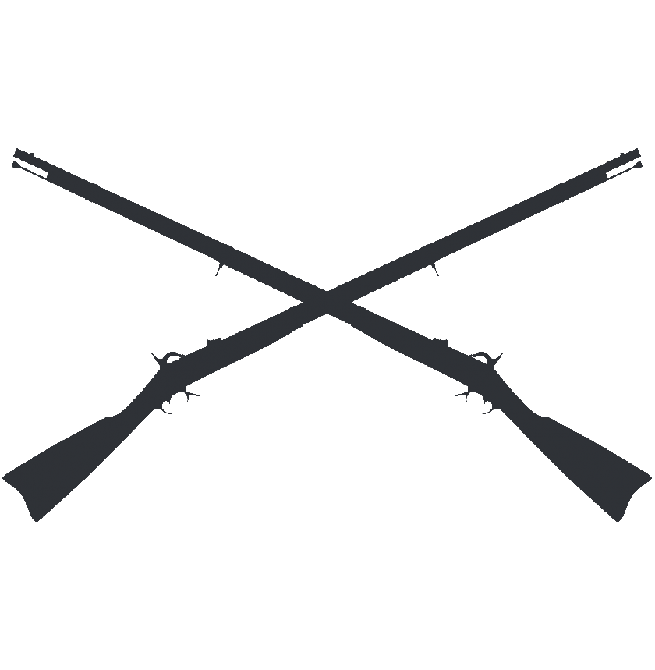
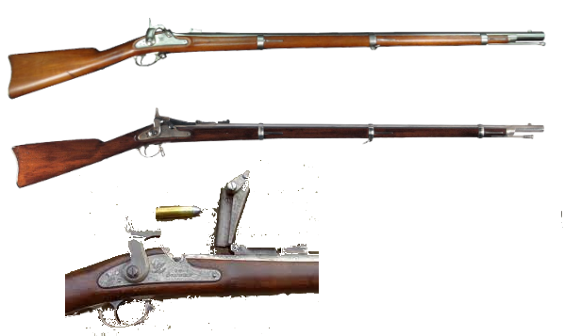
Infantry Weapons
Springfield 1861 .58 cal, Muzzle-loading rifle-musket
Springfield 1866 .50-70 cal, Allin Conversion Breach-loading rifle.
Springfield 1873 .45-70 cal, Allin Conversion Breach-loading rifle.

Slide 33
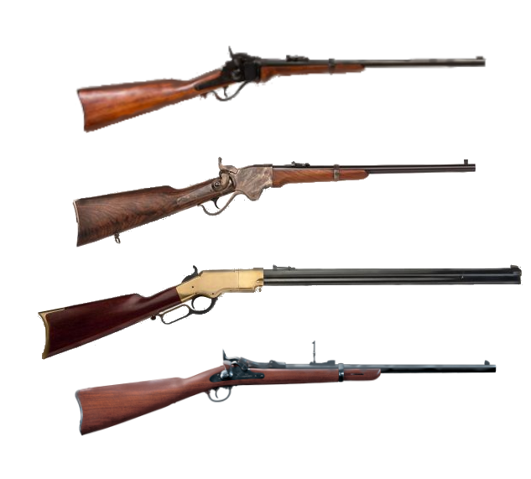
Cavalry Weapons
Sharps Carbine, .52 cal, Breach-loading Carbine, converted to .50-70 in 1867, .45-55 in 1874
Spencer Repeating carbine .56-50 cal. (7-shot repeater)
Henry Rifle Model 1860, .44-26 cal. (15-shot repeater)
Springfield Model 1873 Breach-loading Carbine, .45-55

Slide 34
Weapons
The War Department conducted very realistic fields trials for three years, the trials onsisting of just arming different regiment with different weapons and then evaluating the results. Sharps Carbine: 1st, 3rd, 5th
Spencer Carbine: 2nd, 4th, 7th, 8th, 9th
Mixed of Sharps and Spencers: 6th, 10th
Result: Spencer Repeating Carbine is clearly the best.
Place orders for enough to completely equip all ten regiments of cavalry.
What do you mean that’s not possible?

Slide 35
Total wartime production of the Spencer rifle approached 100,000 units. Veterans took them home when the war was over and demand for the rifle collapsed.
Spencer had invested heavily to increase his manufacturing capacity. Now he could not met his loan payments. In 1868 he declared bankruptcy.
In 1869 Oliver Winchester acquired the assets of the company (including its patents) for $200,000.
He shelved the Spencer—the only real competition for the Henry (which he also had purchased out of bankruptcy)—and put all his resources into the Henry, which he soon renamed the Winchester.
No more Spencers for the cavalry.

Slide 36
Close-In Weapons
For mounted actions, troopers were issued with sabers at first, but they seldom had time to train in their use. Despite the fact that some Natives really did call them “Long Knives,” sabers were usually left behind when on campaign.
The preferred weapon for mounted combat was the Colt .45 caliber single-action revolver. Every man was issued one along with a carbine.

Slide 37
Tactics
US cavalry almost always fought as mounted infantry; they used horses for movement but dismounted to fight.
The smallest tactical unit was the “Set of Four.” When the set dismounted, one man held the reins of the four horses while the other three men joined the firing line.

Slide 38
Tactics
Beause of the uneven level of training and experience in most cavalry units, commanders often posted their most reliable squad (two or three “sets of four”) at the head of the column, where they could deal with any sudden emergency.

Slide 39
Complications: Reconstruction
The immediate post-war army was heavily weighted toward reconstruction duties.
Example: Troops in Texas were responsible for internal policing (Reconstruction), border security (with Mexico) and frontier security, mostly against the Commanches.
In 1867, there were the equivalent of six regiments of Federal troops in Texas. Over half were occupied with the business of Reconstruction.
Reconstruction: 3 ½ regiments
Border: 1 regiment
Frontier: 1 ½ regiments
Was this level of commitment of troops to Reconstruction necessary?

Slide 40
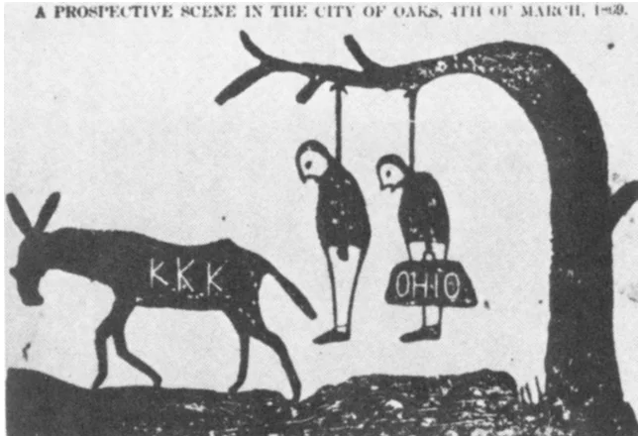
Complications: Reconstruction
Yes! One of the Army’s main Reconstruction tasks was to prevent violence by Texans against Freedmen (formerly enslaved Blacks).
In his final report for that year (1867) on the military forces in Texas, General Joseph J. Reynolds (then in command of Texas) noted that the deaths by violence in Texas that year had included:
Texans killed by Indians: 26
Texans killed by other Texans: 384

Slide 41
A Good Day to Die
QUESTIONS?

