Slide 1
“A Good Day To Die” Indian Wars in the American West

Slide 2
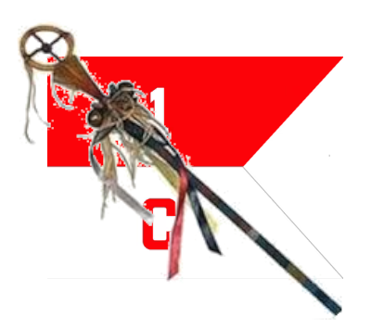
Course Outline
Week 1: What Came Before (From Christopher Columbus to Manifest Destiny)
Week 2: A House Divided (Genesis of the Western Wars)
Week 3: The Opponents (The US Army and the Natives)
Week 4: Red Cloud’s War, the Lakota, and the Northern Plains
Week 5: Hancock’s War, Commancheria, and the Southern Plains
Week 6: The Long Struggle for Apacheria and the Southwest
Week 7: The Forgotten Wars (The Great Basin and Pacific Northwest)
Week 8: Finale (From the Little Bighorn to Wounded Knee)

Slide 3
“A Good Day To Die” Indian Wars in the West
OLLI “Spring” 2021
Week 2: A House Divided
Genesis of the Western Wars

Slide 4
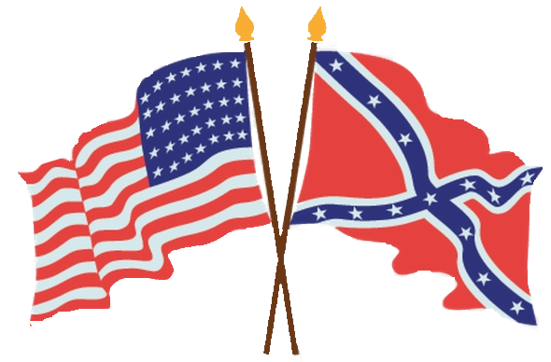
A House Divided
1) What Price Manifest Destiny?
2) Changing of the Guard in the West
3) The Dakota War of 1862
4) Sand Creek
5) “... and dedicated to the proposition ...”

Slide 5
PART 1: What Price Manifest Destiny?

Slide 6
Manifest Destiny
1844: James Knox Polk elected 11th President of the United States on the platform of expanding US territory to the Pacific, including California (then part of Mexico).
“. . .by any means necessary.”

Slide 7
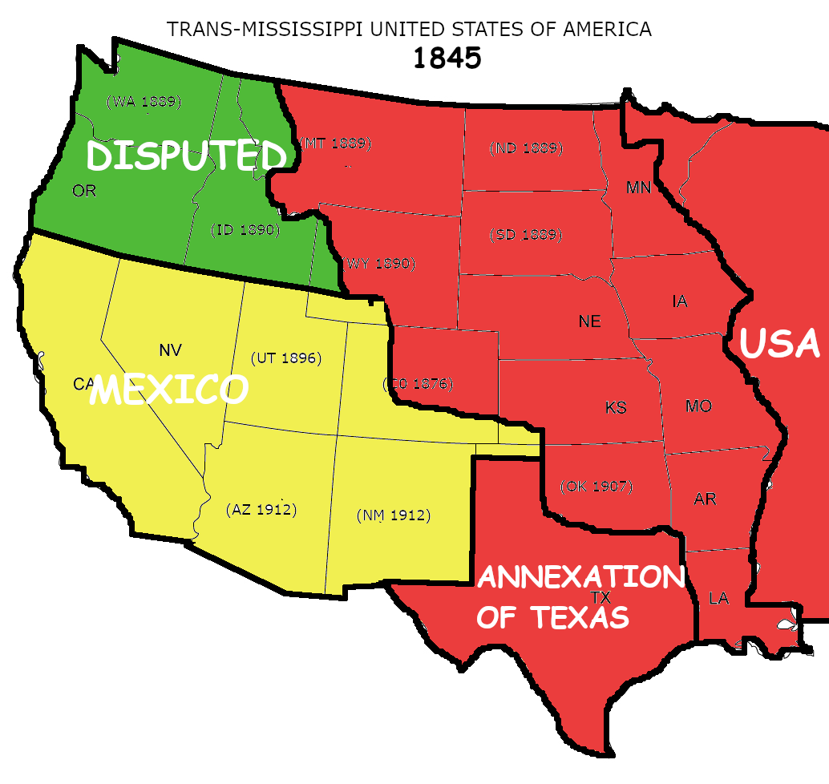
1845: Annexation of Texas
1845: Texas annexed as a slave state.
Polk tips the political balance toward the South.
US Population: 17 Million
(400,000 Native Indians)

Slide 8
1845: Irish Potato Famine
By 1852, when the Irish Potato Blight ends, over one million Irish will have died of starvation, out a a pre-famine population of eight million.
Triggers a massive emigration wave, mostly the USA. By 1855 a total of one and a half million, reducing Ireland’s population to less than million.
They will become the largest single ethnic component of the post-Civil War US Army.

Slide 9
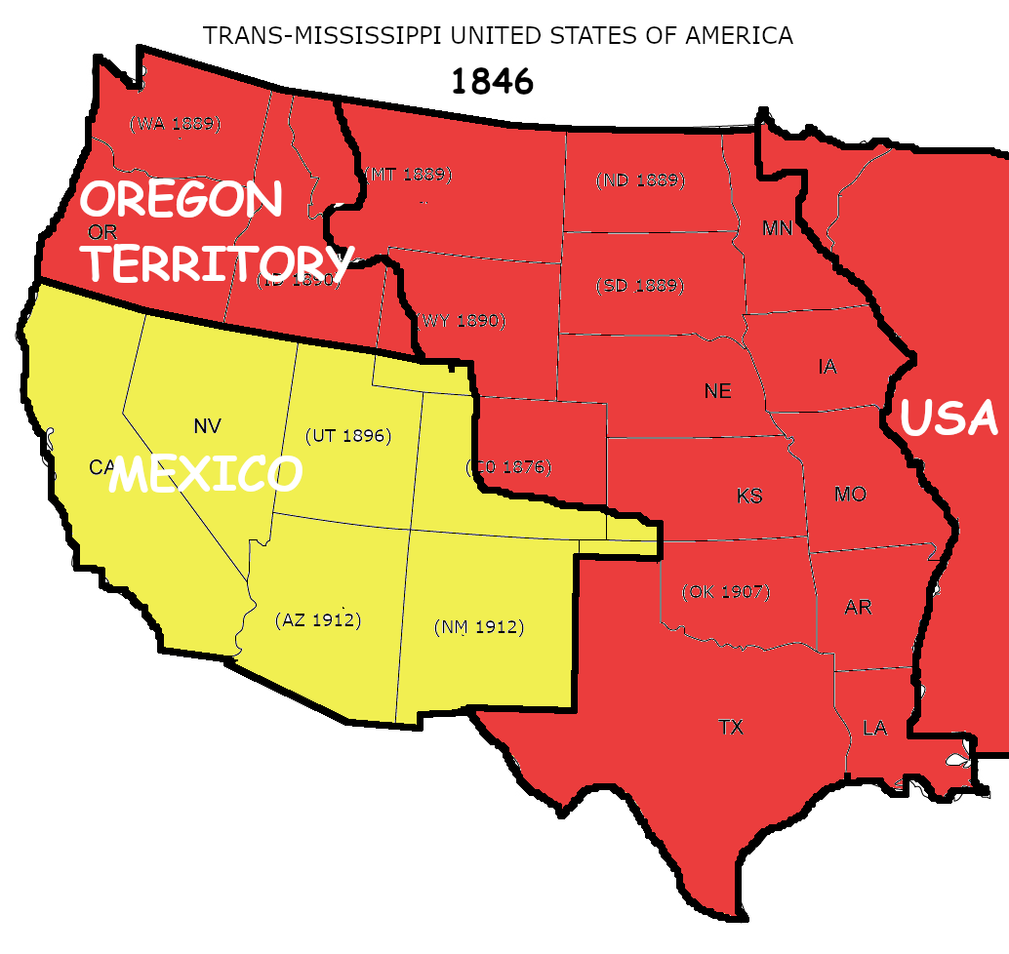
1846: Oregon Treaty
Polk steps up diplomatic initiative to gain clear title to Oregon Territory.
Great Britain and USA agree to extend formal boundary between USA and Canada to the Pacific coast.
US Population: 18 Million
(400,000 Native Indians)

Slide 10
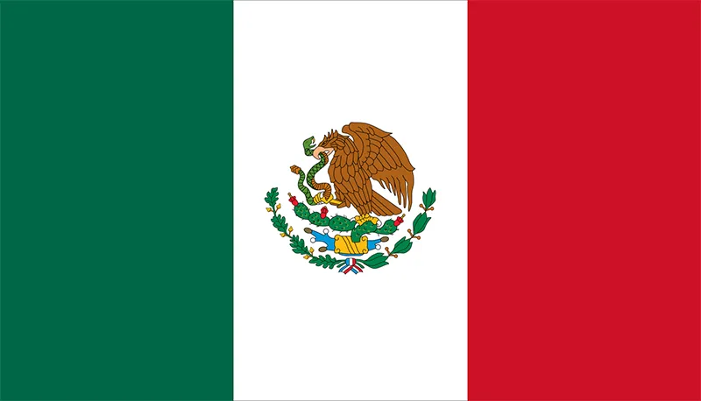
1846-1848 Mexican-American War
1846: Dispute with Mexico over southern border of Texas used as excuse to declare war.
1848: Military defeat and capture of Mexico City forced Mexico to relinquish most of it northern territory.

Slide 11
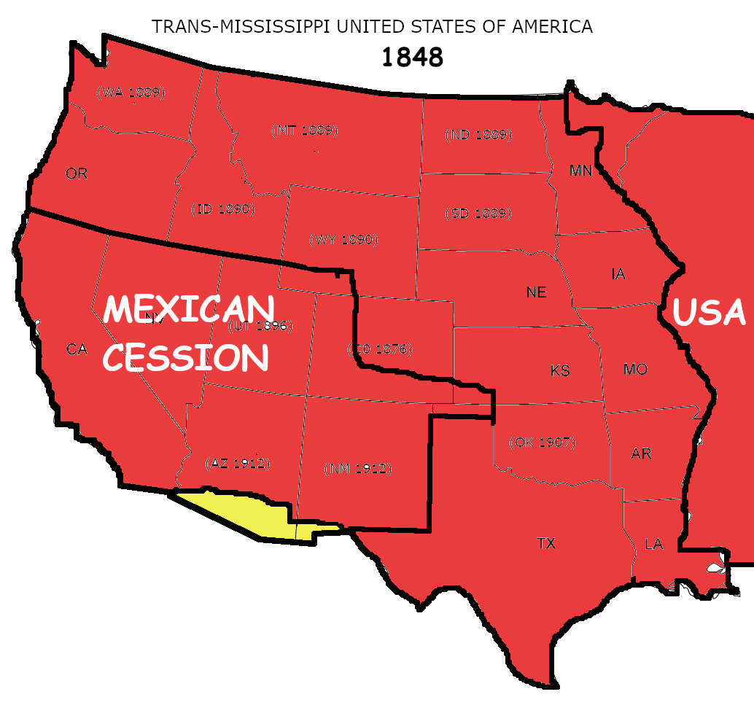
1848: Mexican Cession
Mexico cedes California, Arizona, and New Mexico to USA.
US Population: 21 M
(400,000 Native Indians)

Slide 12
1848: GOLD!
1848: Gold discovered in California.
1849: California Gold Rush begins.
300,000 immigrants move to California in the next seven years, about a third of them in the first year, the famous “Forty-Niners.”
Since US currency was tied to gold, the rapid increase in the money supply started a major economic boom.

Slide 13
1848: GOLD!
The effect on the Native population of California was catastrophic, and is never a part of the Gold Rush story.
In 1848, when California became US territory, its native population was approximately 90,000, some living on the coast as part of the Spanish mission system, but the majority living in the mountains, taking a meager but peaceful living from the earth.
They were called “Digger Indians” (a demeaning term) because dug-up roots formed an important part of their diet.

Slide 14
1848: GOLD!
They lived almost exactly where the richest veins of gold were found.
The “Diggers” had no warrior tradition, no tight tribal organization, no effective means of waging war. They provided no atrocities to use as an excuse for what happened. They were simply in the way.

Slide 15
1848: GOLD!
In 1851, California’s governor declared, “That a war of extermination will continue to be waged, until the Indian race becomes extinct, must be expected.”
Within five years, the Native population had shrunk to 30,000, one third of its pre-gold rush level.
Perhaps a third of the deaths were due to violence. The rest were the result of disease, starvation and exposure brought about by forced relocation.

Slide 16
1848: GERMAN REBELLIONS
A series of rebellions break out across Germany.
Increasing hostility between Austria and Prussia , as well as fear of further revolutionary violence, leads to major expansion of German armies.
This triggers a wave of emigration, mostly to the United States, by Germans wishing to avoid military service.
Many of these immigrants will end up in the Union Army during the Civil War and the post-war army fighting the Indians.

Slide 17
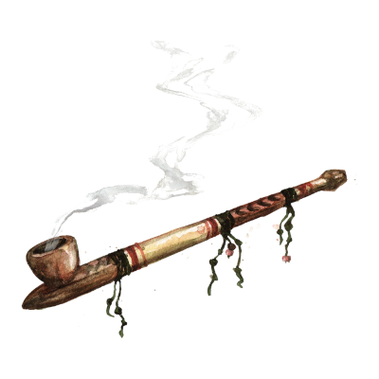
1851: Peace in Our Time?
The US Government negotiates a treaty with seven tribes of the Northern Plains at Fort Laramie. It recognizes an enormous swath of territory, from western Kansas to the Rockies, as the legal territory of those tribes forever.
In return, the tribes promise to stop warring among themselves and not to wage war against the whites.

Slide 18
1853: Peace in Our Time?
Two years later, at Fort Atkins, the US negotiates a similar treaty with the tribes of the Southern Plains.
No parties to either the treaties expect to honor their obligations under them.

Slide 19
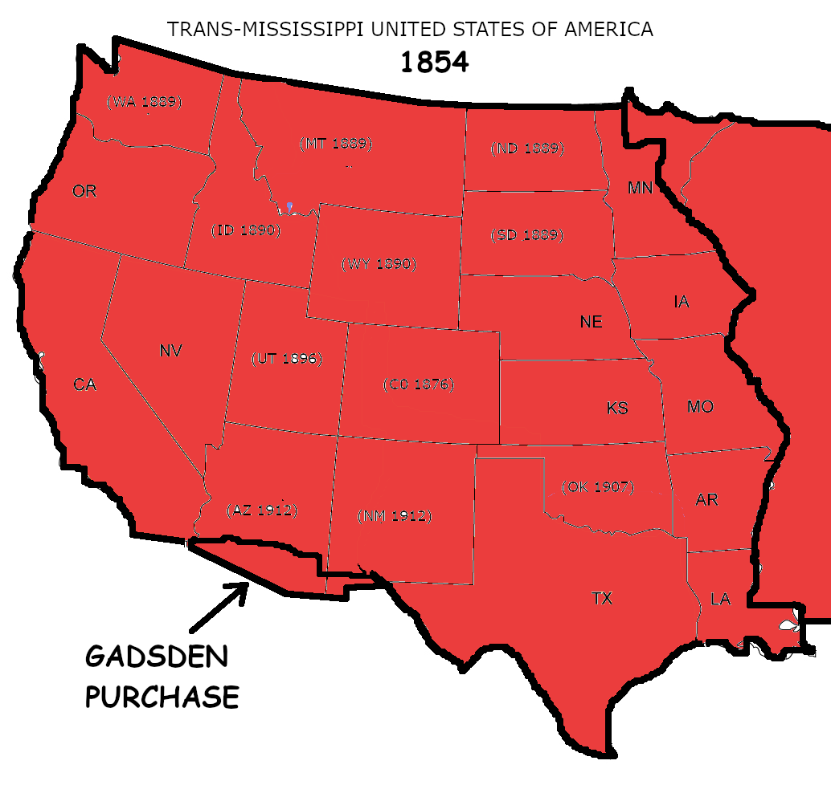
1854: Gadsden Purchase
Surveys showed the area south of the Gila River in Arizona as the only practical route for a southern transcontinental railroad.
Mexico was nearly bankrupt and could not defend the two settlements in the area from Apache raids.
Mexico agreed to sell the land to the USA. Its inhabitants became US citizens. The United States promised the US Army would protect them from Apache raids.
Delivering on that promise took thirty years.
US Population: 27 M
(360,000 Indians)

Slide 20
1854: Kansas-Nebraska Act
Repealed the Missouri Compromise by allowing states above the former limit to enter as Slave states.
Discarded the commitment to political balance by potentially adding more Slave state senators.
Triggered a violent guerrilla war in “Bleeding Kansas” along Abolitionist/Pro-slavery lines, a precursor to the Civil War. Total deaths: about 200.

Slide 21
1858: Gold Discovered in Colorado
An immediate gold rush through Cheyenne and Arapaho territory violated the provisions of the 1851 Treaty of Fort Laramie.
The USA proposes another treaty by which the tribes would give up claim to all but 1/13 of the original grant. A handful of chiefs sign it, which the USA declares binds all of the tribes.

Slide 22
Settlers<->Army<->Indians
The army spent as much of its time keeping white settlers out of Indian country as it did fighting Indians.
Settlers resented Army “inaction.”
A grudging sense of respect developed between Natives and US Army troops grew.

Slide 23
Indian Fighting?
In 1860 there were thirty clashes between the US Army and Native warriors.
Total US casualties in all of those actions were:
Killed: 6 enlisted men
Wounded: 2 officers, 30 enlisted men
Estimated Indian deaths (probably exaggerated) were between 85 and 100.

Slide 24
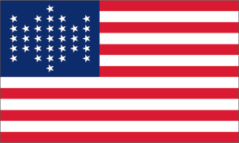
What Price (Manifest) Destiny?
Rapid expansion of the USA and dramatic population growth meant new states entering the Union.
New states meant destabilization of the balance of power between Slave and Free states.
The rising tide of abolitionist sentiment meant the Free States would inevitably win that contest, if it were conducted along purely democratic lines.
The willingness of pro-slavery adherents to resort to violence to discourage Free State voters, and armed response by Abolitionists, further eroded national unity and commitment to the rule of law.
Where did it all lead?

Slide 26
A Good Day to Die
QUESTIONS?

Slide 27
PART 2 1861: Changing of the Guard
Departure of the Frontier Regulars

Slide 28
Changing of the Guard
Outbreak of War: 19 regiments (15,000 men), mostly in the west.
The Shift East: All but three regiments withdrawn east of the Mississippi.
Their Replacements in the West: Over 20 locally-raised regiments of volunteers.
With the three regiments of regulars already there and the newly-raised regiments of volunteers, the US Army maintained a force of between 15,000 and 20,000 men in the Trans-Mississippi throughout the Civil War.

Slide 29
Changing of the Guard

Slide 30
Changing of the Guard
How were the Volunteers different than the Regulars?
Better educated.
Higher morale: They fought with a purpose, and the goal of finishing so they could get back to their pre-war lives.
Less disciplined. They were still civilians at heart.
Politically connected: Raised and commanded by influential men of the community, many of them elected officials. They had clout, and they knew it.
They hated Indians. The Indians were in the way of their civilian goals.

Slide 31
PART 3 1862: The Dakota War
A Spark Finds Tinder

Slide 32
1862: The Dakota War
Treaties of 1837, 1851 and 1858 restricted the Eastern Dakota/Santee Sioux to a reservation only twenty miles wide along he Minnesota River.
Crop failure in 1861 and harsh winter led to widespread starvation.
Government treaty annuity payments in 1862 were late and local merchants refused to extend credit to the Indians to purchase food.
Hunting could not feed the tribes as the game had been depleted by he large influx of settlers.
Starvation grew worse.

Slide 33
1862: The Dakota War
Most of the US Army had ben withdrawn to fight in the Civil War, although Minnesota volunteer regiments were forming up.
August 17, 1862: Four young Sioux men on an unsuccessful hunting trip kill a settler family of five after they are refused food.
Little Crow and several other chiefs decide hat sine there will be reperussions from this direted at the entire tribe, their best ourse I t attack the setters first and try to drive them entirely out of former Sioux territory.

Slide 34
1862: The Dakota War
Out of a total Eastern Dakota/Santee population of 7,000, Little Crow led a faction of about 1,000. Most tribal leaders considered the attack suicidally stupid.
In one day, most of he farms and villages around the Sioux Agency were burned, but the majority of settlers escaped, due to the attackers concentrating on carrying off food.
A small detachment of soldiers sent to put down the uprising was defeated and nearly wiped out (34 men killed).

Slide 35
1862: The Dakota War
A force of Minnesota Volunteer Infantry defeated Little Crow by late September.
2,000 Santees (about 400 warriors) surrendered by the end of September. At the same time 269 “hostages” were released by the peaceful Santee.
358 settler had been killed, but many more were driven from their homes and never returned. Abut 200-400 more died in later raids. 19 western counties depopulated.
Army casualties were 108 dead.

Slide 36
1862: The Dakota War
A tribunal of Minnesote Volunteer officers tried 392 Santee men in six days and condemned 303 of them death. He proediing were never explained to he defendants.
President Lincoln reviewed the finding and commuted the death sentence of 264 defendants and confirmed the sentence of 39, one of whom was also later given a reprieve.
The remaining 38 were all hung on December 2, 1862. It remains the largest mass execution in US history.

Slide 37
The Dakota War: Myths
It was NOT a general rising of the Eastern Sioux.
Many settlers esaped due to being warned the day before the attack by Eastern Sioux friends.
All four bands of the Eastern Sioux rescued 269 settler refugees and protect them from the bands that were rising.
It had NOT been planned in advance.
The week before the rising, Little Crow had traded his three shotguns to a local farmer for two cows.
It was NOT accompanied by widespread torture, mutilation, or sexual assault.
Lincoln’s first criterion in reviewing the convictions was that any man who had raped a woman must die. He was surprised to find only two incidences of rape in all of the charges.
The settlers were NOT well-armed rugged frontiersmen prepared for trouble.
The community to which Little Crow traded his three shotguns then had a total of five shotguns, but only four shotgun shells.

Slide 38
The Dakota War: Legacy
The Republican Party lost votes in the next election due Lincoln’s leniency.
He was warned at the time by the state’s governor he would lose votes if he didn’t hang more of the Indians. Lincoln replied, “I can’t hang people for votes.”
In April of 1863 the US Congress renounced all previous treaties with the Eastern Sioux and expelled all of them from Minnesota.
The State of Minnesota offered a $25.00 bounty per Dakota scalp as an additional inducement to leave.
Fighting continued along the Minnesota border and into Dakota Territory for the next two years, in part by warriors who had not surrendered, in part by previously peaceful tribes who had been forceable expelled.
Panic spread all through the Trans-Mississippi settlements further south and west at the fear of a massive Indian uprising everywhere.

Slide 39
PART 4 1864: Sand Creek
“Burn villages and kill Cheyennes whenever and
wherever found.“
--Colonel John Chivington

Slide 40
Sand Creek
Despite the fears of a general Indian uprising, most Plains tribes remained peaceful through 1863 and into 1864. Nevertheless, anti-Indian sentiment among settlers in the Trans-Mississippi grew.
In the spring of 1864, Governor John Evans of Colorado and his military commander Colonel John Chivington (a former Methodist clergyman) decided on a military campaign against the Cheyenne and Arapaho to break their resistance to further settlement.
They began their campaign by striking at a number of Indian camps.

Slide 41
Sand Creek
July 1864: Some Cheyenne and Arapaho war parties began striking back.
September 1864: Black Kettle and other peace chiefs meet with Governor Evans. If they want peace, take their people to nearest Army Fort to show they are not hostile.
November 1864: Black Kettle takes his village to Fort Lyon, whose commander says he has orders to fire on any Indians trying to approach. Tells Black Kettle to camp near Sand Creek while he asks for instructions from his superiors.

Slide 42
Sand Creek
“I want you to get all the chiefs of the soldiers to understand that we are for peace, and we have made peace, that we may not be mistaken by them for enemies.”
Black Kettle

Slide 43
Sand Creek
Late November 1864: Colonel Chivington arrives at Fort Lyon with a regiment of locally-raised volunteer cavalry, is told of Black Kettle’s location, and sets out to attack his village.
Several of his officers question the morality of the attack.
“I believe it to be right and honorable to use any means under God’s heaven to kill Indians that would kill women and children, and damn any man who is in sympathy with Indians.”
Colonel (former Reverend) John Chivington

Slide 44
Sand Creek
November 29, 1864: Black Kettle raised an American flag and a white flag on a flagpole in the center of the camp. Chivington attacked.
“They were scalped, their brains knocked out; the men used their knives, ripped open women, clubbed little children, knocked them in the head with their guns, beat heir brains out, mutilated their bodies in every sense of the word.”
John Smith, Army Interpreter

Slide 45
Sand Creek -- Aftermath
Over two hundred Cheyenne died at Sand Creek, two thirds of them women and children. Somehow, Black Kettle escaped, but nine other peace chief died.
Faced with the evidence of how Whites would treat Indians committed to peace, a great council of the chiefs of the Cheyenne, Arapaho, and Lakota met and smoked the war pipe.
In the winter of 1864-65, war parties raided all along the Platte River, burned stage stations, sacked settlement, killed settlers, and wiped out one Army supply wagon train.
Far from breaking Cheyenne resistance, Sand Creek set the frontier ablaze.

Slide 46
PART 5: “... and dedicated to the proposition ...”
For a long time, the issue that had divided America was what to make of the phrase,
“All men are created equal.”

Slide 47
Lincoln’s Gettysburg Address
“Fourscore and seven years ago, our fathers brought forth, on this continent, a new nation, conceived in liberty, and dedicated to the proposition that all men are created equal.”
Abraham Lincoln, November 19, 1863

Slide 48
The Reconstruction Amendments
13th (1865): Ended Slavery
14th (1866): Equal Protection under the Law
14.4 The validity of the public debt of the United States, authorized by law, including debts incurred for payment of pensions and bounties for services in suppressing insurrection or rebellion, shall not be questioned.
15th (1870) : Prohibited Federal and State governments from denying a citizen the right to vote based on “race, color, or previous condition of servitude.”.

Slide 49
Anoher Reconstruction Amendment (kinda’)
19th Amendment (1878-1920): Gave women the vote.

Slide 50
The Dilemma
If all people are created equal and are entitled to equal protection under the law, doesn’t that include Native American Indians?
And if so. . .
now what do we do?

Slide 51
A Good Day to Die
QUESTIONS?

