Slide 1
“A Good Day To Die” Indian Wars in the American West

Slide 2
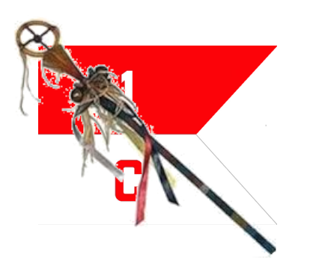
Course Outline
Week 1: What Came Before (From Christopher Columbus to Manifest Destiny)
Week 2: A House Divided (Genesis of the Western Wars)
Week 3: The Opponents (The US Army and the Natives)
Week 4: Red Cloud’s War, the Lakota, and the Northern Plains
Week 5: Hancock’s War, Commancheria, and the Southern Plains
Week 6: The Long Struggle for Apacheria and the Southwest
Week 7: The Forgotten Wars (The Great Basin and Pacific Northwest)
Week 8: Finale (From the Little Bighorn to Wounded Knee)

Slide 3
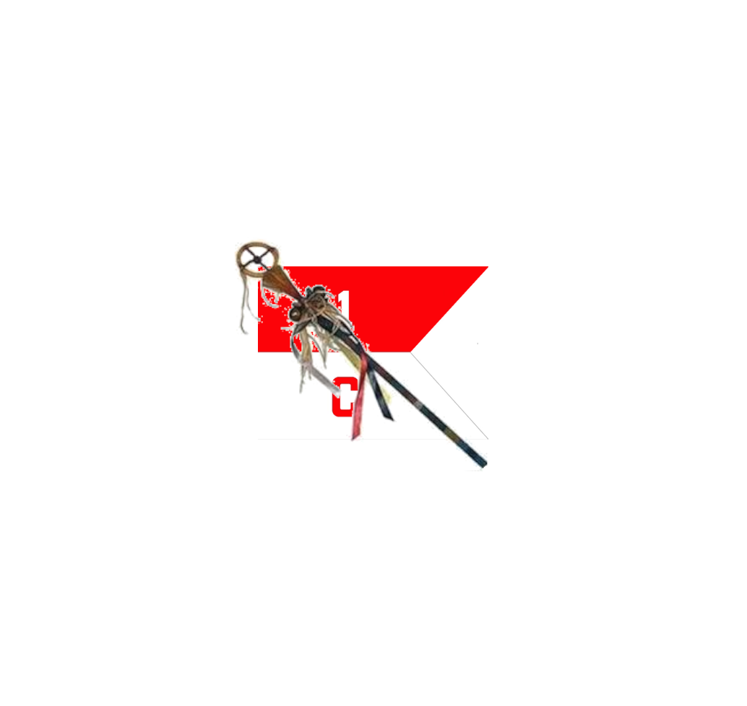
“A Good Day To Die” Indian Wars in the West
OLLI “Spring” 2021
Week 1: What Came Before

Slide 4
What Came Before
1) North America Before Columbus
2) The Coming of Europeans
3) How Did Native Life Change?
3) America Expands Westward

Slide 5
PART 1: Before Columbus
A (Mostly) Green and (Mostly) Pleasant Land

Slide 6
Before Columbus
The territory that now forms the contiguous 48 states of the USA had a population of about 3.5 to 4 million in 1490.
Lowest estimate 700,000, highest estimate 15 million
Total population in the Western Hemisphere estimated at 50 million.

Slide 7
Before Columbus
They comprised a wide variety of linguistic groups and cultures, adapted to the specific environments where they lived.
They were uniformly Stone Age material cultures. They did not work metal for tools or weapons. Although some cultures were on the cusp of the bronze age, all of them still relied on stone and bone.

Slide 8
Before Columbus
Tribes which lived in agriculturally rich areas were accomplished farmers. Those in more arid regions were hunters and gatherers, often nomadic.
Nomadic tribes, as with similar societies from Europe and Asia, tended to be warrior cultures.

Slide 9
Before Columbus
These are things they did not have:
Horses (or any other large draft animals)
Metal tools or weapons
Written language
Sense of racial identity
Firearms
Distilled liquor
Absolutist monarchies
Obsession to make everyone worship like they did
Smallpox

Slide 10
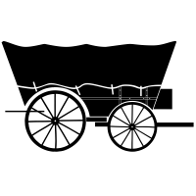
PART 2: The Europeans Come
And they’re hungry.

Slide 11
First Contact
Early explorers of the Atlantic coast of North America found the natives to be friendly, hospitable, generous, and healthy.
Their conclusion was that the Natives would make excellent slaves.

Slide 12
First Contact
Many early colonies failed, and the ones that survived did so largely due to the generosity and support of the Native people who lived near them.
Despite this, war broke out in fairly short order.

Slide 13
First Contact

Slide 14
ROOTS OF CONFLICT
Was conflict due to the radical differences between the two cultures?
While that probably played a role, two striking similarities between them were at the root of most of the conflicts.
Neither side could prevent some of their own people from breaking the terms of agreements reached in good faith.
Both sides tended to hold all members of the other group responsible for the actions of any members of that group.

Slide 15
PART 3: How Did Native Life Change?
Not Always Better, But More Interesting

Slide 16
HOW DID NATIVE LIFE CHANGE?
There were three main drivers of change for Native Americans:
Horses
Firearms
Disease

Slide 17
1. Horses
Before Columbus, Indians had no large draft animals.
Nomadic tribes in the Great Plains used dogs towing travois to carry their posessions.

Slide 18
1. Horses
1519: Spanish begin conquest of Mexico. Horses used for cavalry and draft animals. Some escape, some are stolen or sold.
1700s: Wild horses spread north through the Great Plains.

Slide 19
1. Horses
Horse-drawn travois travelled faster and carried much larger loads.
Nomadic tribes could accumulate more material possessions, and carry more preserved food.

Slide 20
1. Horses
The horse revolutionized the buffalo hunt. For the first time the hunter could keep up with a stampeding herd and continue to attack.

Slide 21
1. Horses
And of course it revolutionized warfare.
Mounted warriors could travel farther and faster, and so raid enemy camps at much greater ranges.
In tactical combat, the horse gave warriors the ability to strike quickly and then withdraw if the enemy was in greater strength.

Slide 22
2. Firearms
Firearms were superior to bows in range, accuracy, and lethality.
Although horses arrived from the south, firearms arrived from the east, mostly as trade items.
This also meant eastern tribes (with firearms) were able to push western tribes further west.

Slide 23
3. Disease
Early explorers brought diseases against which the Native population had limited immunity.
Loss of life through disease was greatly increased in areas of active warfare and olonial subjugation.
Mexico lost 90 percent of its pre Columbian population between 1500 and 1600.
Population decline in the current territory of the USA started later, because French and English colnies were established later than Spanish colonies further south, and was less dramatic, but still devastating.

Slide 24
3. Disease
1770s: Smallpox breaks out in the Pacific Northwest, brought by sea. Total population in Northwest reduced by 30 per cent. (tens of thousands)
Western Washington tribes reduced from 37,000 to 26,000.
1780-82: Smallpox breaks out in the Upper Missouri Valley. Over 30,000 Native Indians die in the outbreak.
Arikara tribe reduced from 30,000 to 6,000.
Mandan tribe reduced from 10,000 to 2,000.
1789 the total Native population of the current territory of the USA had probably sunk to less than 1 million.

Slide 25
A Good Day to Die
QUESTIONS?

Slide 26
PART 4: USA Expands Westward
There Goes the Neighborhood

Slide 27
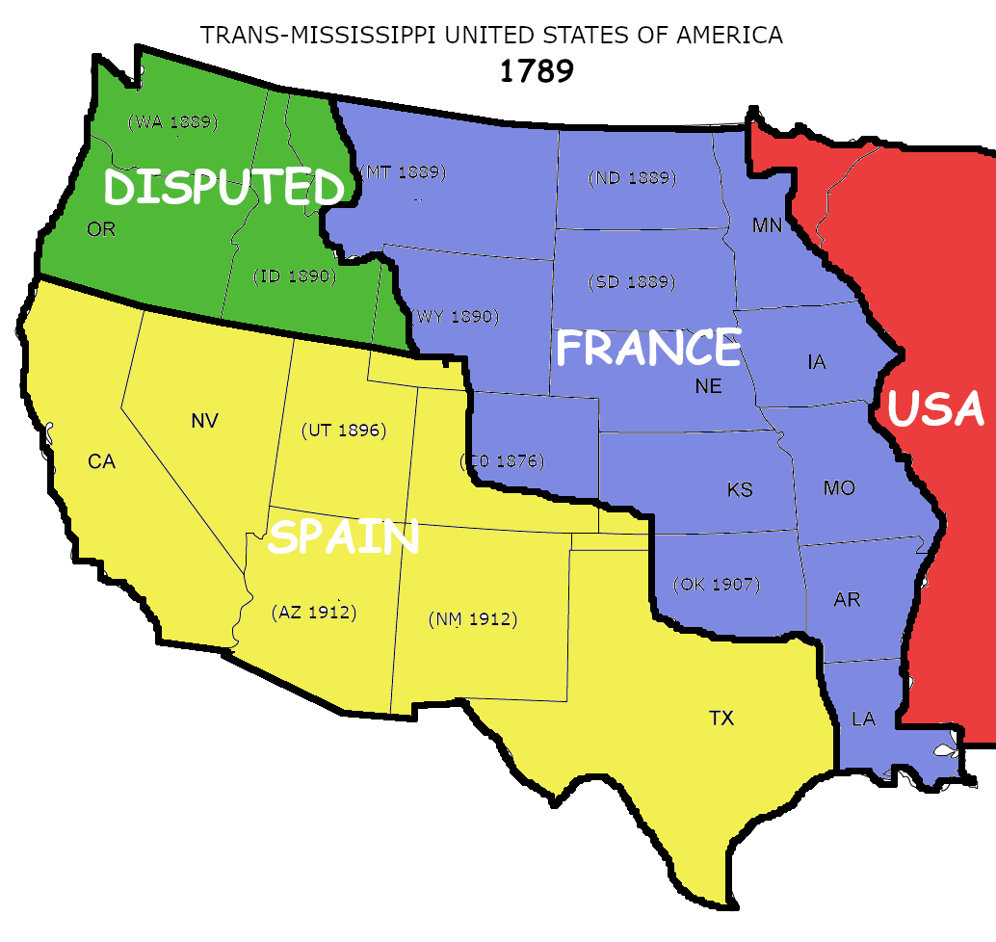
A New Nation
1789: The United States when the Constitution was ratified.
US Population: 4 Million
(625,000 Native Indians)

Slide 28
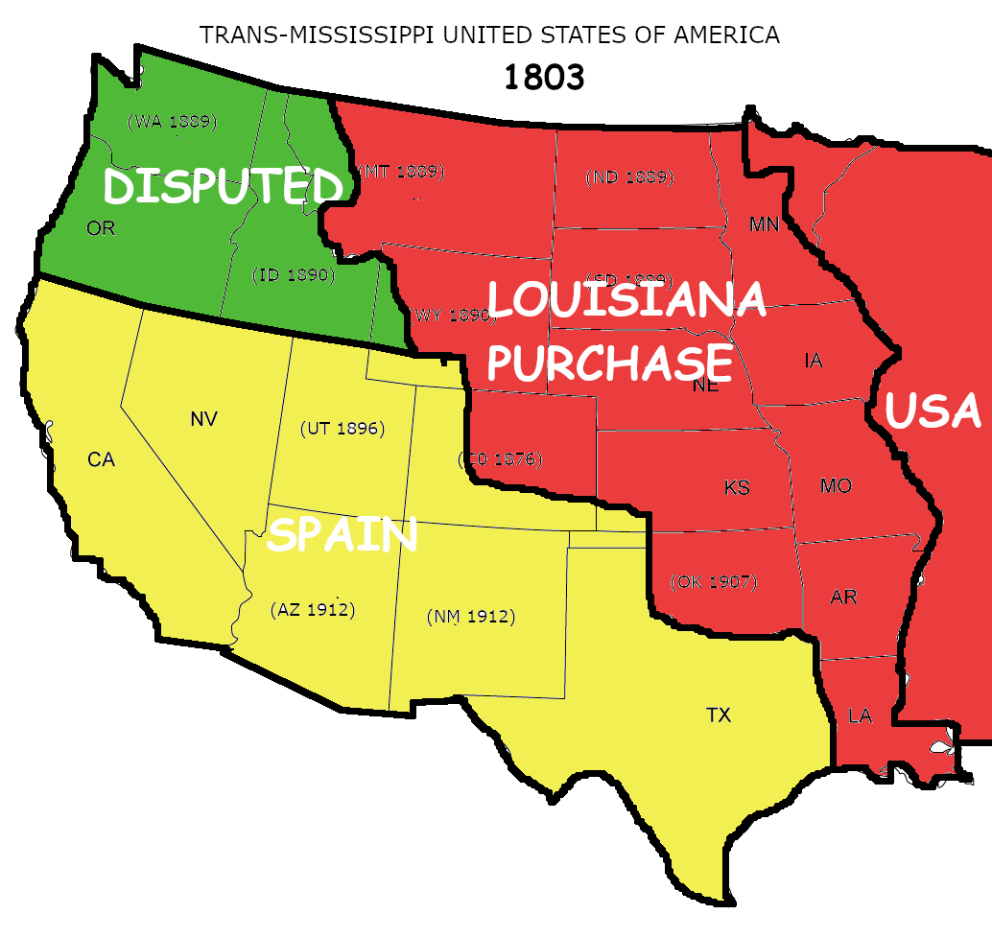
Louisiana Purchase
1803: Louisiana Territory purchased from France.
1804-1806: Lewis and Clark Expedition explores the northern part of the territory and into Oregon Country, at that time claimed by the USA, Great Britain, Russia, and Spain.
Russia and Spain later relinquished their claims in favor of the United States.
US Population: 5.3 M
(600,000 Native Indians)

Slide 29
Missouri Compromise
1820: US admits Missouri as a Slave state and Maine as a Free state at the same time.
Prohibits slavery above 36 degrees, 30 minute latitude line for the rest of the Louisiana Territory.
Maintained pro-slavery balance in the Senate and pro-Free State balance in the House.
Generally credited with delaying the start of the Civil War for several deades.

Slide 30
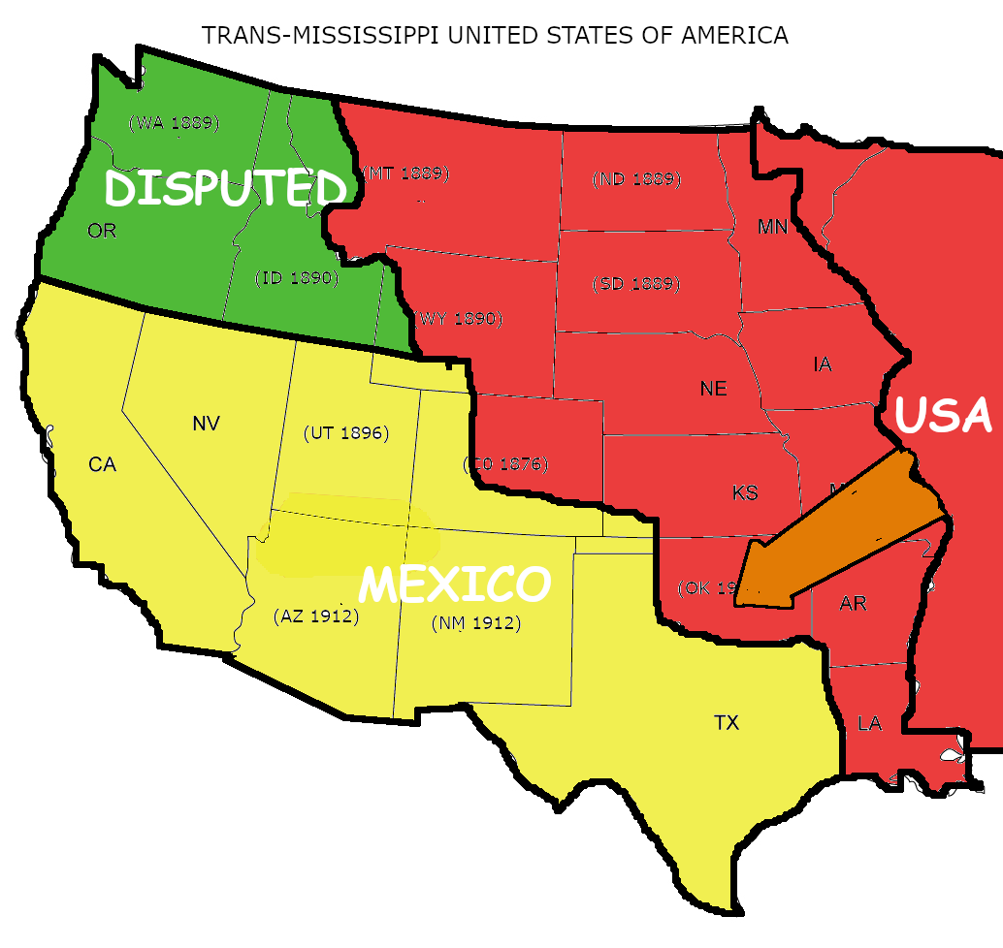
The Trail of Tears
1830: US Congress passes the Indian Removal Act.
Five tribes from the US Southeast are forcibly relocated to “Indian Territory” (later Oklahoma) across the Mississippi.

Slide 31
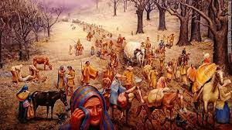
The Trail of Tears
1831-33: 17,000 Choctaw relocated in severe winter; 2,500-6,000 die along the way.
1832-42: 2,800-4,000 Seminoles relocated; 250-400 die.
1835-36: 19,600 Creeks relocated. 3,500-4,500 die.

Slide 32
The Trail of Tears
1837: over 4,000 Chickasaw relocated, 500-800 die.
1838: 16,000 Cherokee relocated. 4,000-8,000 die along the way in a very harsh winter.

Slide 33
The Trail of Tears
The irony of the Relocation of the five Southeastern tribes to Indian Territory, is that the land they were relocated to was already occupied by other Indian tribes, who were themselves simply pushed further west.
One of the main demands the US government would later make on the tribes of the Great Plains was that they stop making war on each other. But the US never stopped pushing eastern tribes further west.

Slide 34
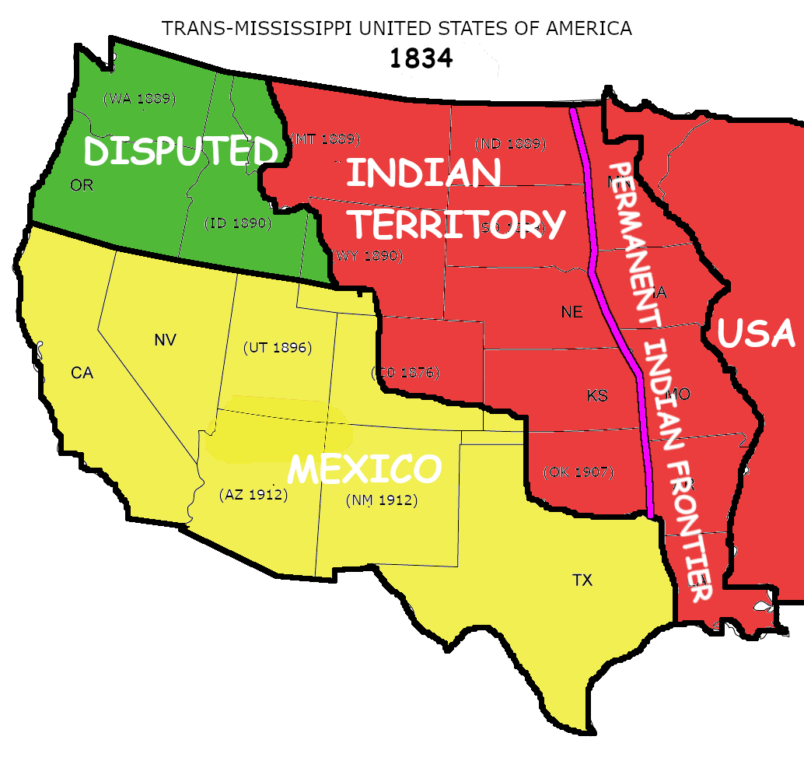
The “Permanent Indian Frontier”
1834: The US established a Permanent Indian Frontier along the western border of the states at that time, and began building a string of forts to enforce it.
“The Great Amerian Desert” Most of the land west of the Mississippi was considered too arid, and the sod too thick, to farm. No further westward settlement was envisioned.

Slide 35
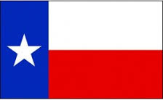
Trouble in Texas
1835: First clashes of Texas Revolution.
1836: Alamo falls but Mexican Army defeated at Battle of San Jacinto. Texas becomes independent republic.
Texas applies for annexation to USA, but as a slave state. Both US political parties opposed annexation for fear of upsetting the political balance between slave and free states.

Slide 36
More Smallpox
1837: 17,200 Native Indians die in the Upper Missouri valley. Deaths elsewhere on the Great Plains raise the total to about 34,000.
Mandan tribe reduced from 1600 members to either 125 or 30 adults (depending on the source).
1840s: Additional epidemics in the Pacific Northwest reduced the Western Washington Native population to only 6,000 by 1850.

Slide 37
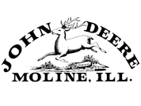
John Deere of Illinois
1837: John Deere developed the first steel plow suitable for large-scale production.
Called “self-scouring,” the lower friction smooth steel blade prevented the dense wet soil of the prairie from clumping on the blade.
So much for the “Permanent” frontier.

Slide 38
Oregon Trail
1841: Oregon Trail opens. Large-scale immigration to the Pacific Northwest begins.
Steel plows are still not in wide enough use to make the prairie attractive for farming.
Ownership of Oregon Territory still disputed by Great Britain and USA.

Slide 39
Manifest Destiny
1844: James Knox Polk elected 11th President of the United States on the platform of expanding US territory to the Pacific, including California (then part of Mexico).
“. . .by any means necessary.”

Slide 40
A Good Day to Die
QUESTIONS?

