Slide 1
Violence and Film in the US

Slide 2
Complexities in Film Violence
“Violence” is not a single thing.
Is only physical violence violence, or are emotional and psychological violence to be considered?
How violence is defined and the steps taken to regulate it are political actions.

Slide 3
Complexities in Film Violence
Elements to be considered in analysis:
  the act
  the actor (perpetrator and performer)
  the victim
  the motivation of the act
  the representation of the act
  the narrative context in which the act occurs
  the tone or mood of the film
  the purpose for which the act is presented
  strategies of spectator attachment
  reception situation

Slide 4
How Violence Is Made Palatable
narrative and style
  constructive versus destructive violence
  secure/paranoid endings
  violence as ritual
  iconic stars
  iconic weapons
  displacement in time and/or space
  stylized violence, cartoony excess
  non-realistic cinematic style: nondiegetic music, obtrusive cinematography and/or editing, obvious CGI and SFX

Slide 5
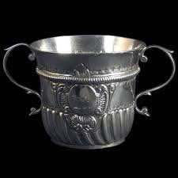
De Quincey’s two-handled cup

Slide 6
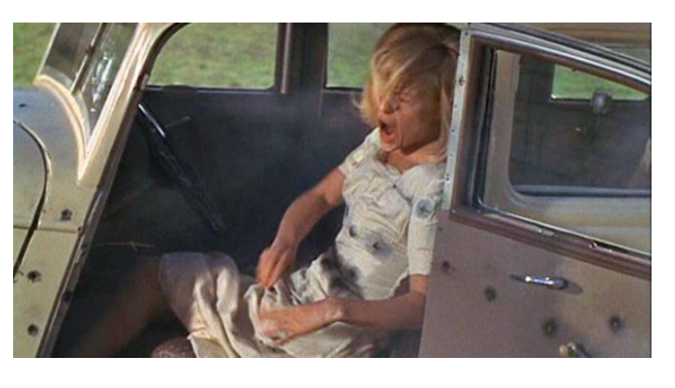
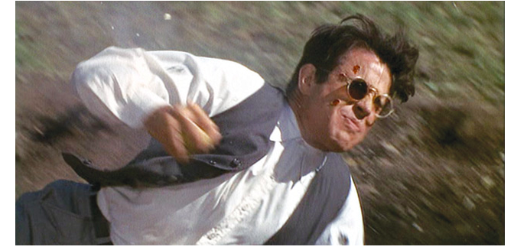
Example: Bonnie and Clyde (1967)

Slide 7
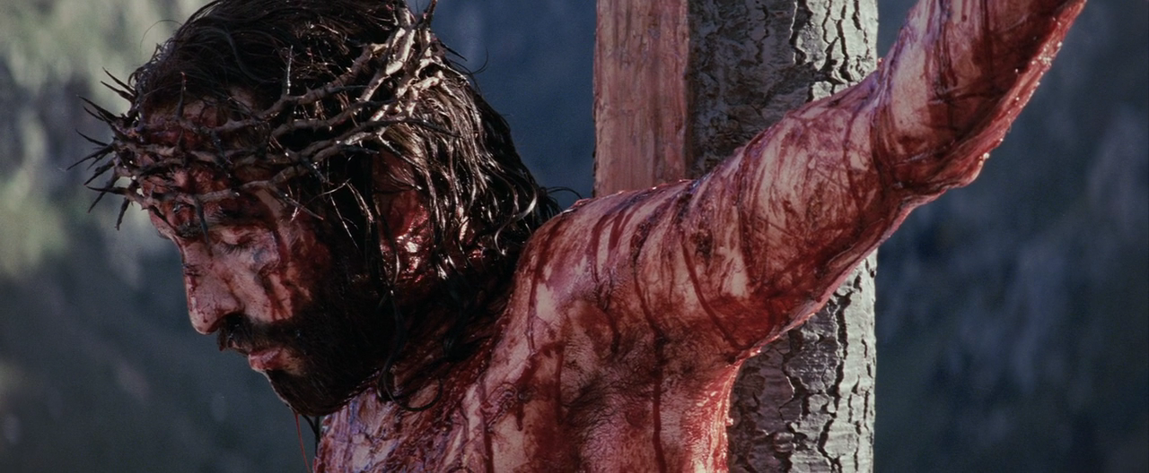

Violence as Ritual

Slide 8
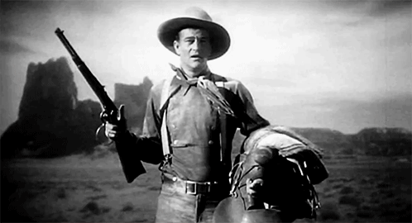
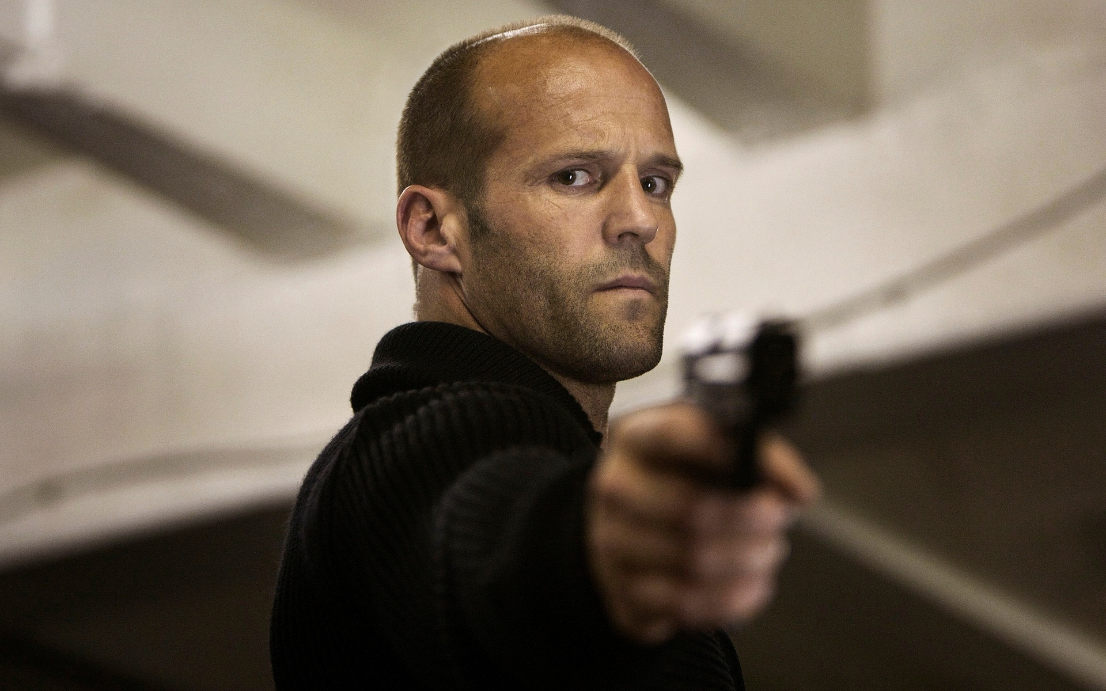
Iconic Stars

Slide 9
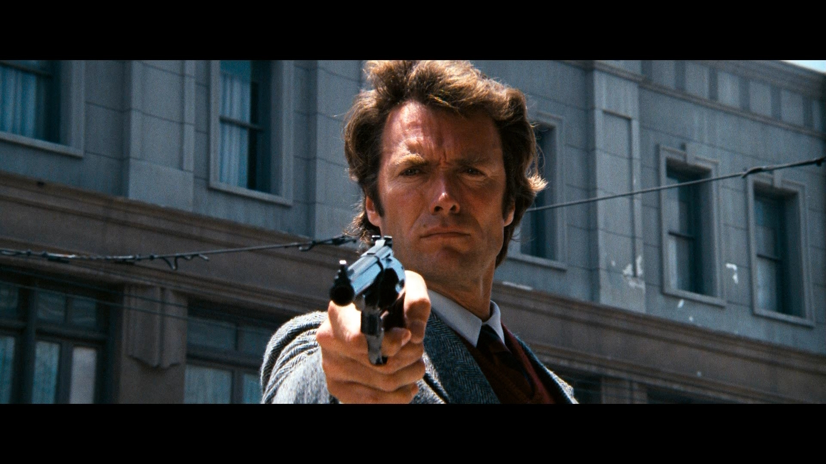
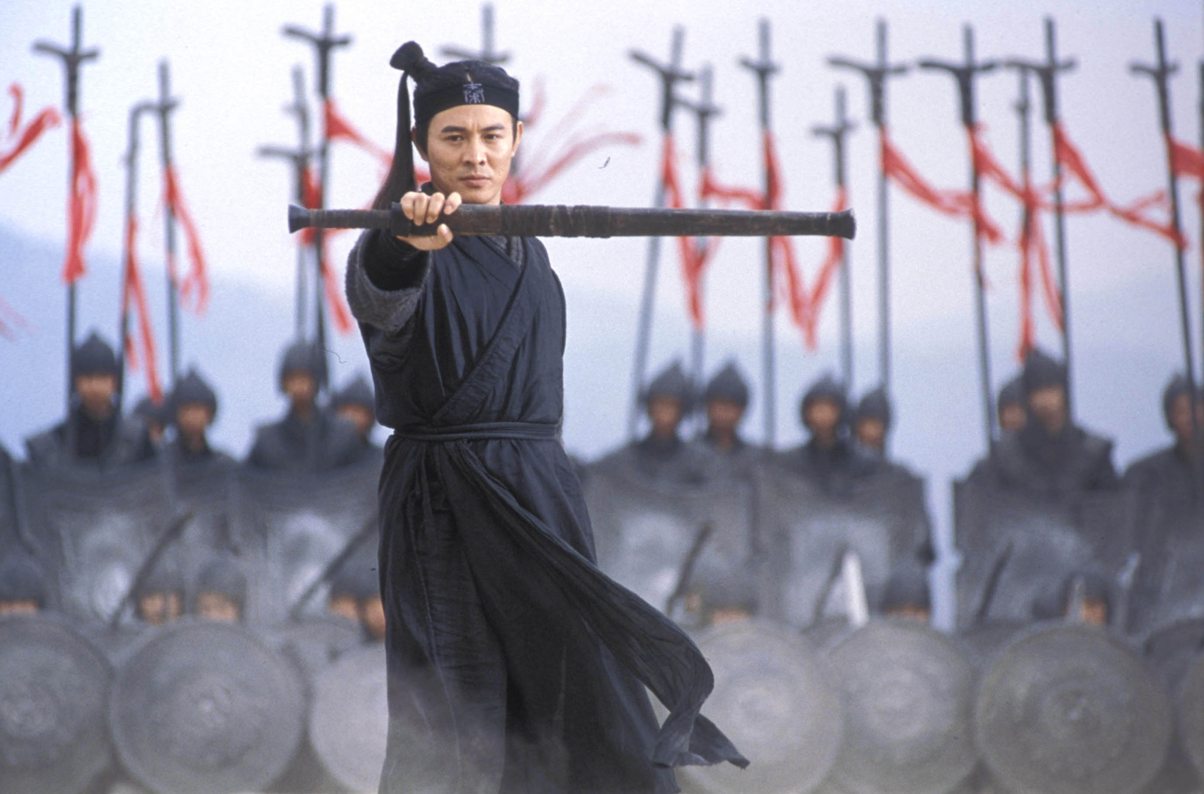
Iconic Weapons

Slide 10
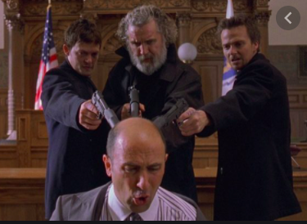
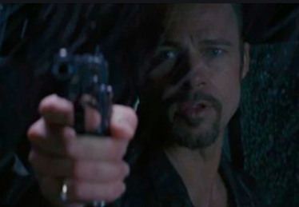
Stylized Violence

Slide 11
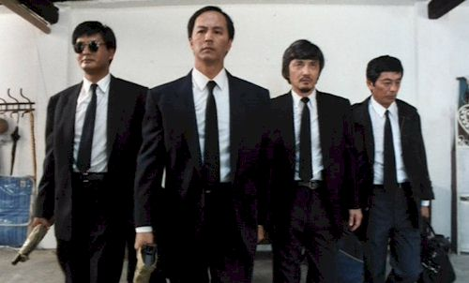
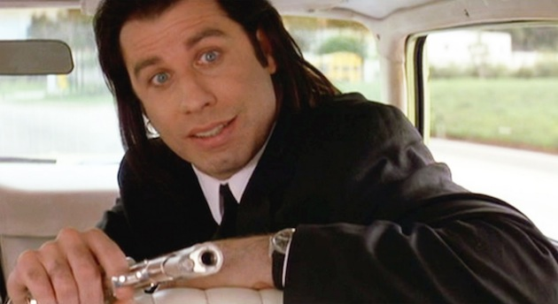
Tarantino and the 1990s:
Balletic Bloodshed and Mixed Responses

Slide 12
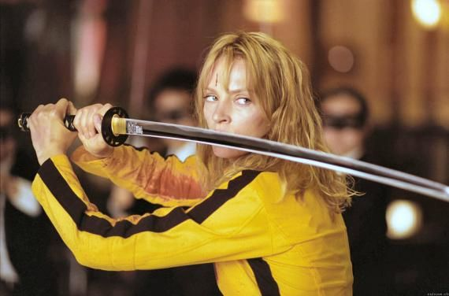
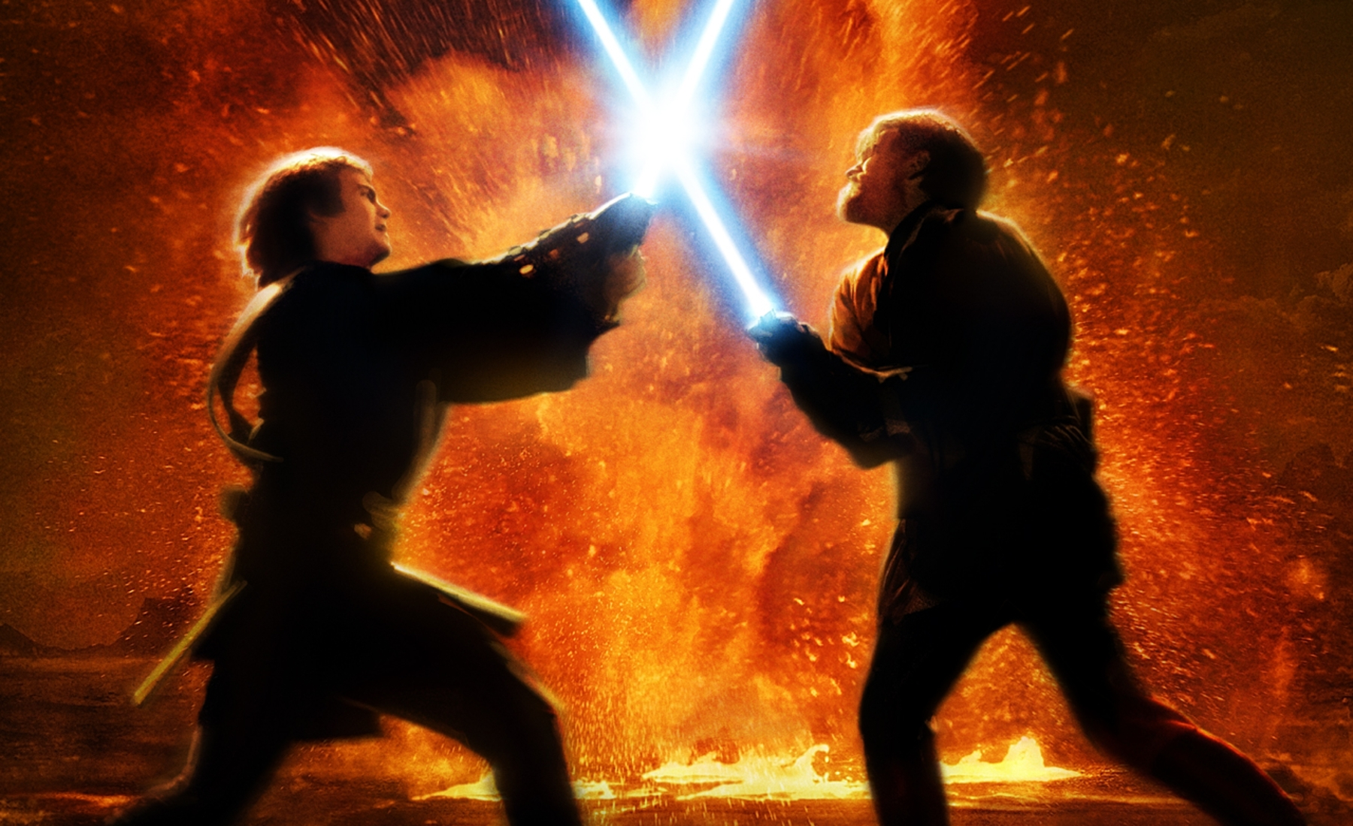
Cartoony Violence

Slide 13
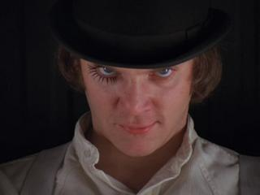
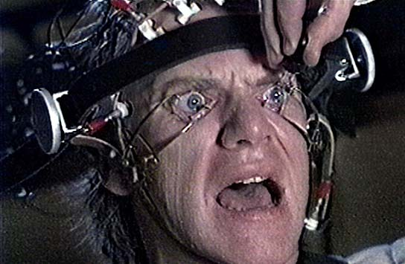
Problematic Example:
Spectator Attachment

Slide 14
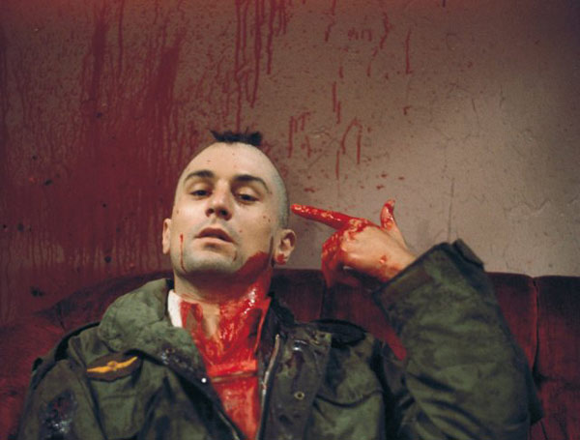
Problematic Example:
Using Violence to Critique Violence

Slide 15
Criticism of the MPAA
“Ratings creep”
most apparent in PG-13 and R categories
filmmakers push for PG-13 ratings for commercial reasons
nonviability of NC-17 → R ratings for extreme content

Slide 16
Common Beliefs about Mediated Violence
A cathartic way to cope with fears
  no evidence for this
Viewers attach to perpetrators of violence
  little evidence for this in horror films
A social safety valve for aggression
  no evidence for this

