Slide 1
Arbitrariness of Whiteness

Slide 2
Grounds for Xenophobia
foreignness / immigration
religion
race
labor competition
sex / racial purity / miscegenation
political power
“social invasion”

Slide 3
Ideology of race
race and political power
race and wealth
race and perception/decoding
race and sexual competition
race and the struggles of certain groups
political whiteness
social whiteness
probationary whiteness

Slide 4
Legal Xenophobia
1790: Only “free white persons” could become naturalized US citizens
1840s: Irish immigration waves
1870s: the Great Migration; revision of legal status
1882: Chinese Exclusion Act
1924: Johnson-Reed Immigration Act

Slide 5
Late 19C–Early 20C Contexts
collapse of Reconstruction / Jim Crow laws
westward expansion / Indian wars
Chinese immigration / anti-Chinese movement
Midwest labor unrest / anti-Irish views
corrupt Irish politicians / anti-Irish views
US imperial presence in Asia, Africa, and the Pacific

Slide 6
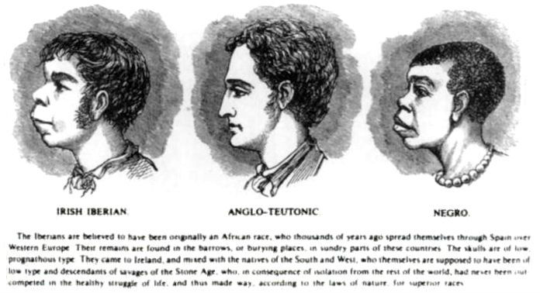
“Race Science”

Slide 7
Race Science
racial identity = physiognomy & character
yardsticks for whiteness: civilization & self-government / savagery and barbarism
biology = destiny
eugenics
whiteness as monolithic signifier of privilege
unequal access to whiteness

Slide 8
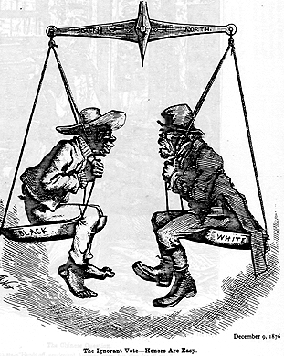
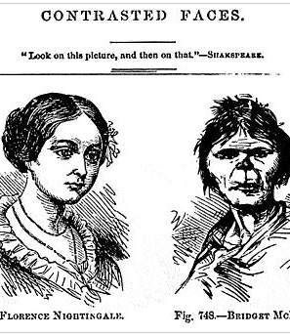
Racist Images 1870s

Slide 9
Anglo-Saxon White as Ideal
Charles Dudley Warner visiting the Holy Land:
“we find it easier to feel that Christ was born in New England than in Judea”
Warner on “new whites”:
“not at all the faces of the fair-haired race from which our Saviour is supposed to have come”

Slide 10
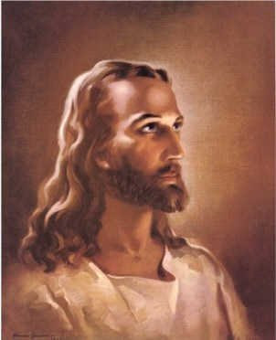
Victorian Image of Jesus

Slide 11
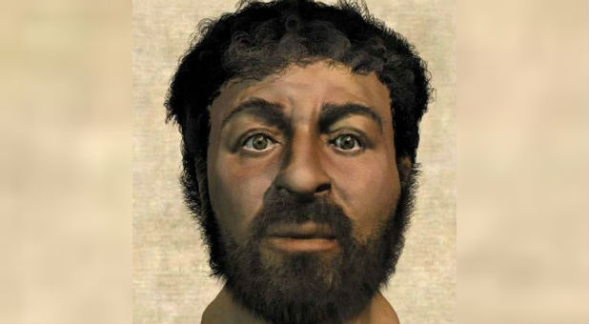
Modern Possible Facial Reconstruction

Slide 12
Post–World War II Race Science
shock over the Holocaust
end to biological race theory
ethnicity replaces biology
racial characteristics / race relations

Slide 13
Political whiteness does not automatically lead to
social whiteness

