Slide 1
Arabs in Hollywood Films 2

Slide 2
The Silent Era

Slide 3
1920s: 87 films
Exotic adventure melodramas à la The Sheik →
violence and sex
Light comedies: Arabs as buffoons

Slide 4
The Early Sound Era

Slide 5
1930s–1940s
Horror films
Foreign Legion films
Casablanca

Slide 7
Post–World War II

Slide 8
1950s
Light comedies
Strong-man films
Biblical epics

Slide 9
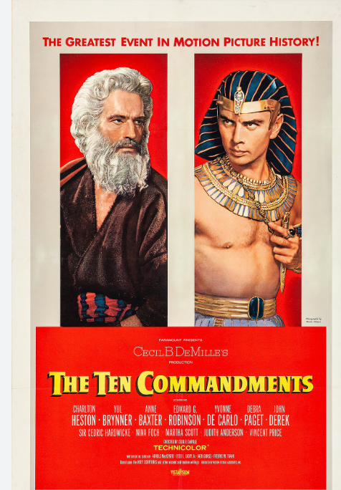

Slide 10
1960s
1920s stereotypes continue
Historical epics

Slide 11
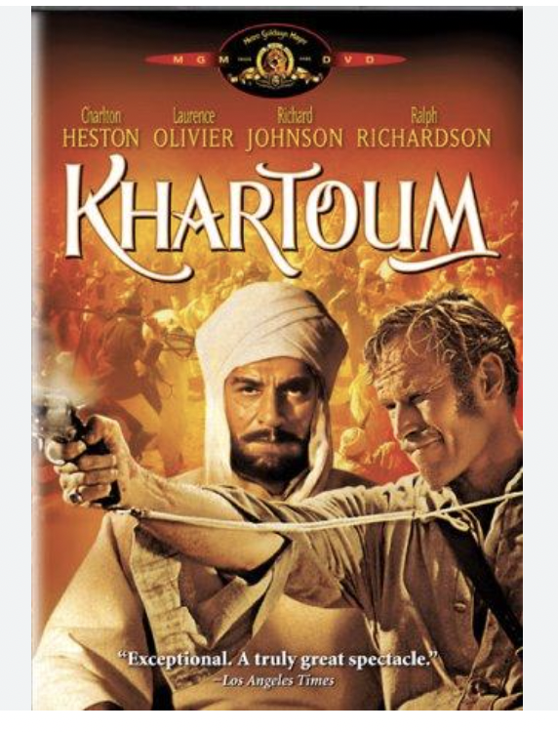

Slide 12
1970s Key Events
Oil embargo by OPEC
1972 the Munich Olympics
Arabs represented as direct enemies of the US

Slide 13
Black Sunday (1977)

Slide 14
1980s
While earlier decades gave us the Thief, the Sheik, the Mummy, the Foreign Legion, and the Arab-Israeli melodrama, the 1980s gave us the Terrorist.

Slide 15
Aladdin (Disney, 1992; 90 mins)
Key characters
Aladdin, a street urchin
a Genie (Robin Williams)
Jasmine, a princess
Jafar, the Grand Vizier
the Sultan, Jasmine’s father
Abu, Aladdin’s monkey
Iago, Jafar’s parrot (Gilbert Gottfried)
Gazeem, Jafar’s henchman
Prince Achmed, a suitor for Jasmine
Razoul & Farouk, palace guards

Slide 16
Considerations
How does the film represent Arabs and the Arab world?
The role and power of Disney in relation to Arab stereotypes
What sorts of values would you say that Disney, as a brand, embodies? What kinds of messages do Disney films send to children? to White children? to children of color?
What messages does Aladdin send to White children and to children of color?
Consider the Disney Princess as a trope: note that Jasmine is the first nonwhite Disney princess.

Slide 17
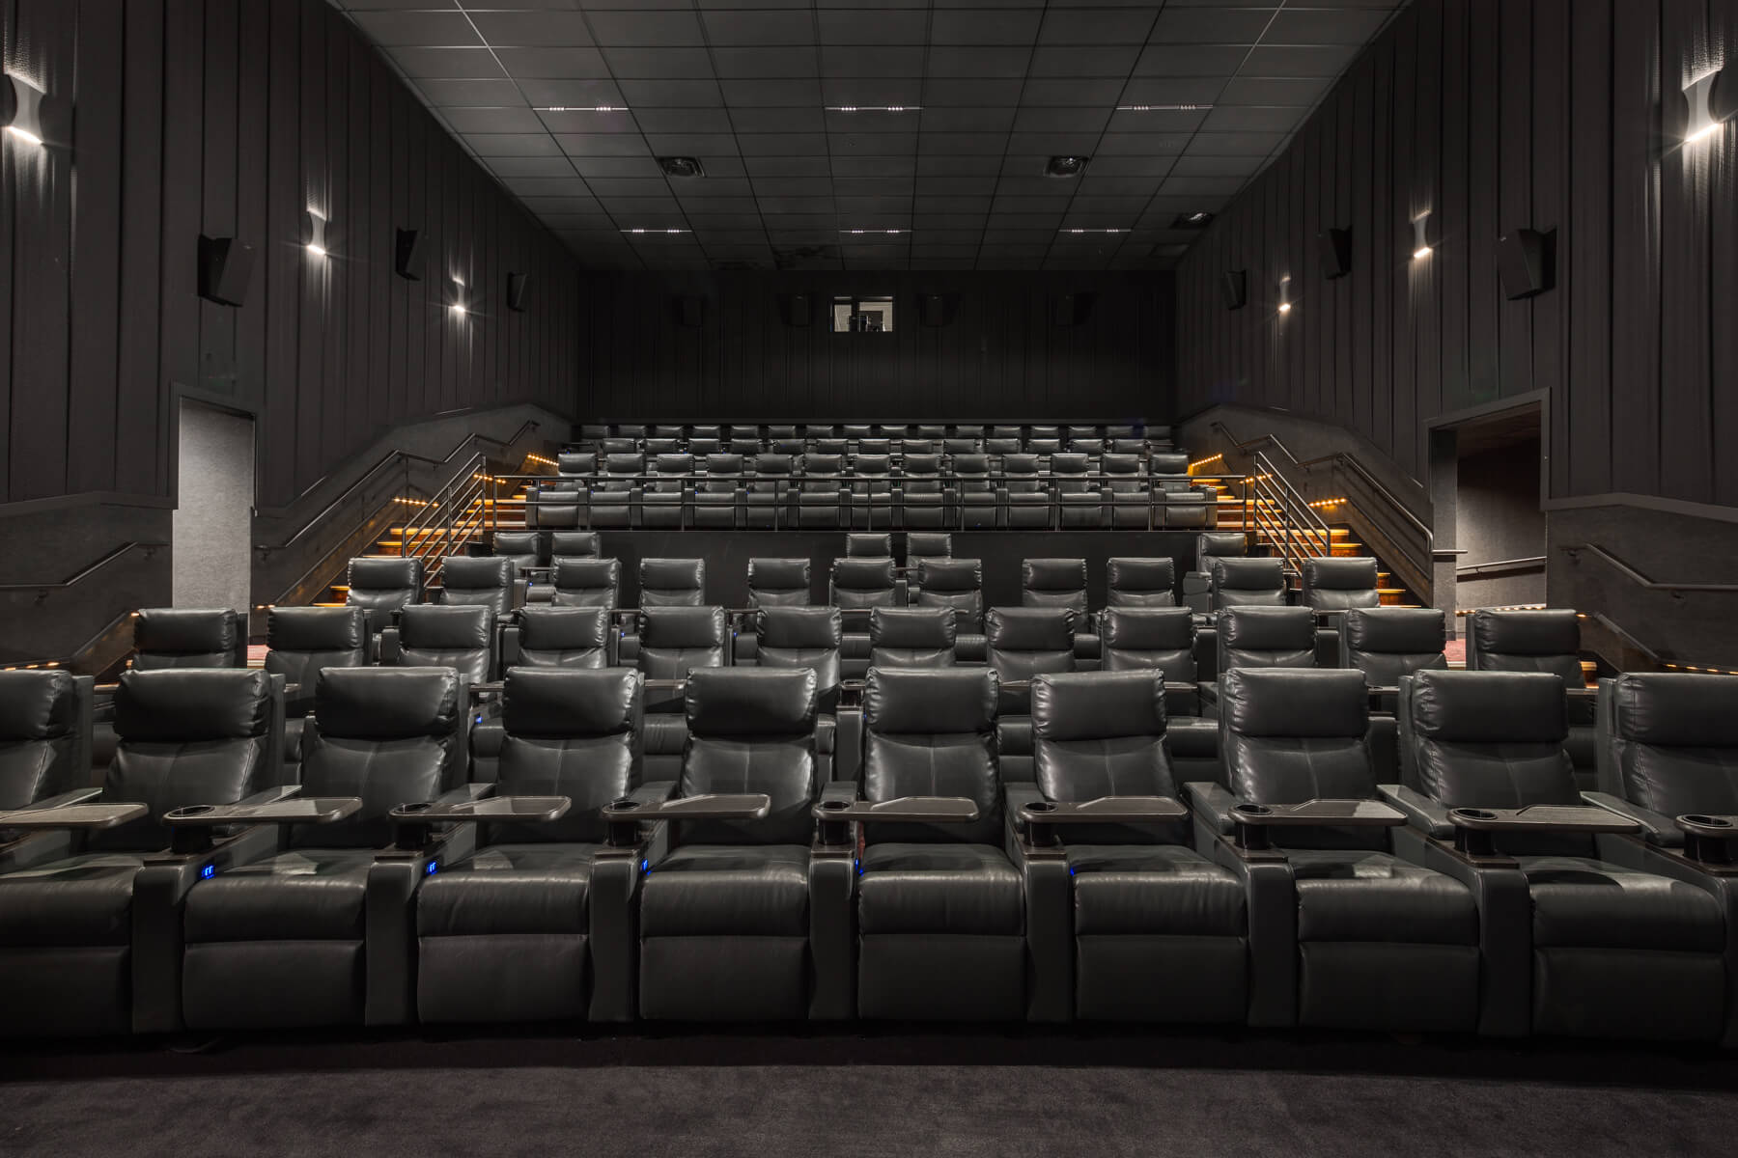
Let’s Watch the Movie
This Photo by Unknown Author is licensed under CC BY-SA

