Slide 1
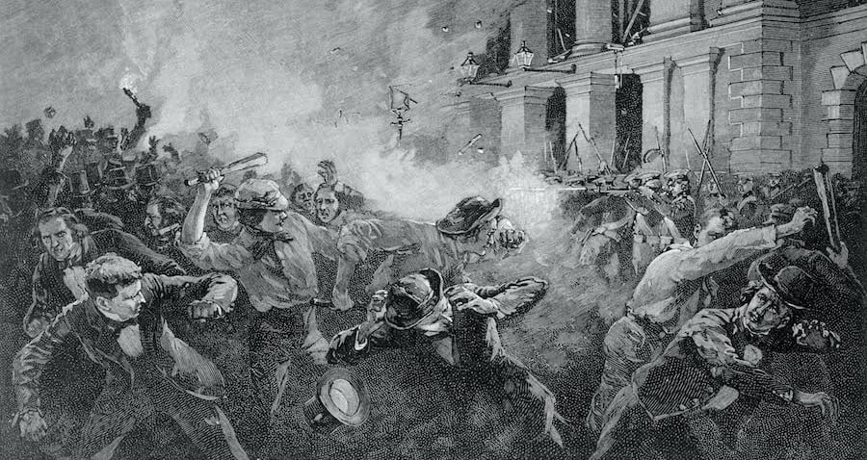
The “Shakespeare Riots,” New York City
May 1849

Slide 2
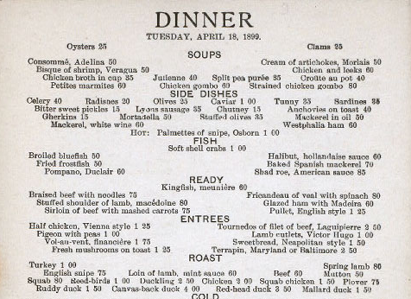
DELMONICO’S, NEW YORK’S MOST FAMOUS GILDED AGE RESTAURANT

Slide 3
B
A
C
K
G
R
O
U
N
D
S
FOR THE
NYC
B
L
O
W
U
P
THE RISE OF THE CELEBRITY ACTOR
THE STRUGGLE TO ELEVATE ‘THEATRE’ AND ’SHAKESPEARE’
THE SPECIAL PROBLEM OF ‘THE SCOTTISH PLAY’
RIVAL HOUSES AND RIVAL PERFORMERS IN LONDON AND AMERICA
A CLASH OF NEIGHBORHOODS AND SOCIAL CLASSES
US TROUBLES WITH BRITAIN IN THE 1840’S
FIVE POINTS: THE CATASTROPHE IN THE VERY RECENT PAST
PR AMATEURS AND INCITING A RIOT

Slide 4
IMMEDIATE PROVOCATIONS
THE NYC MAYOR, CALEB WOODHULL: THE WRONG MAN FOR THE JOB?
AFTERMATH: THE FATE OF FIVE POINTS, ASTOR PLACE, LOWER MANHATTAN -- AND THEATRE IN NEW YORK AND LONDON

Slide 5
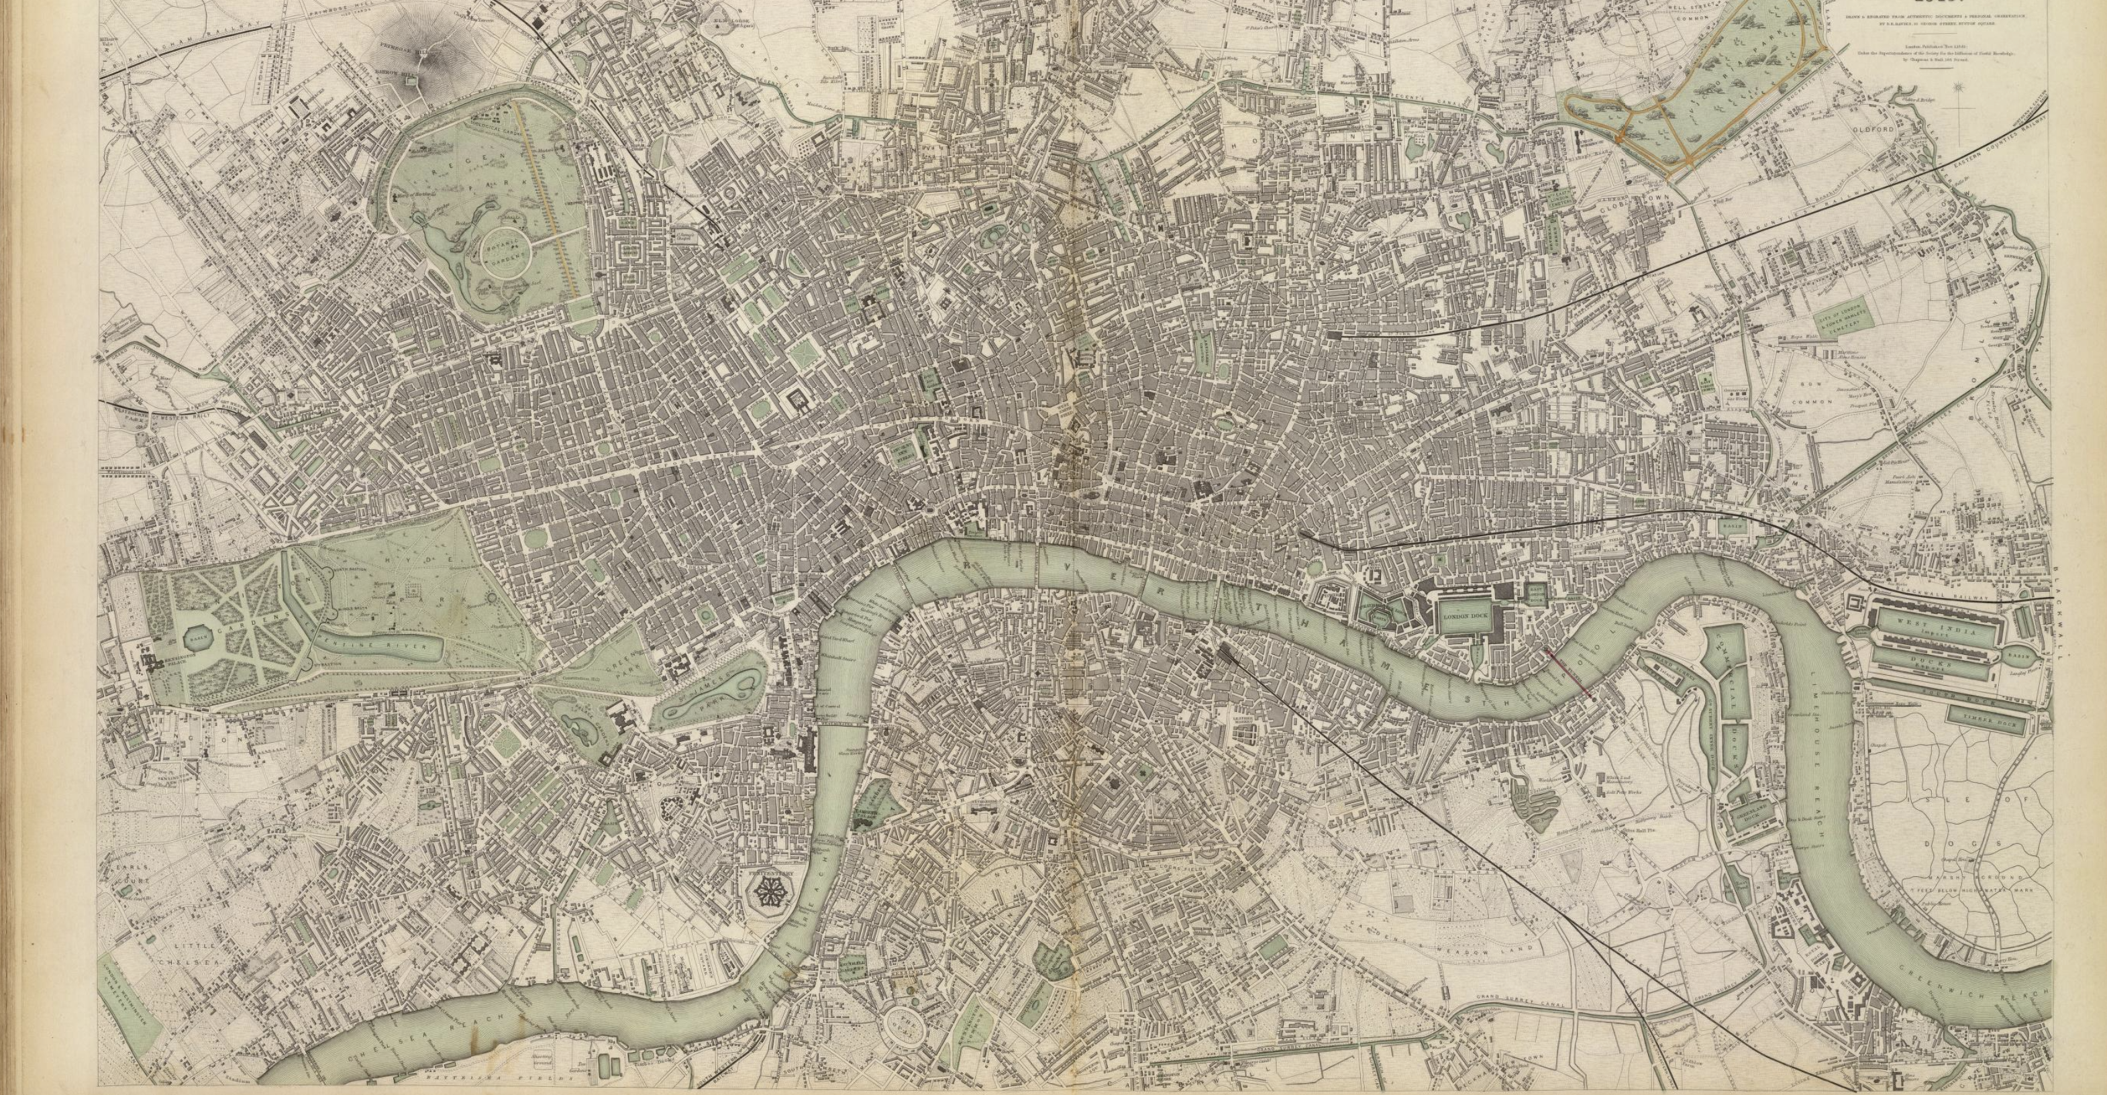

Slide 6
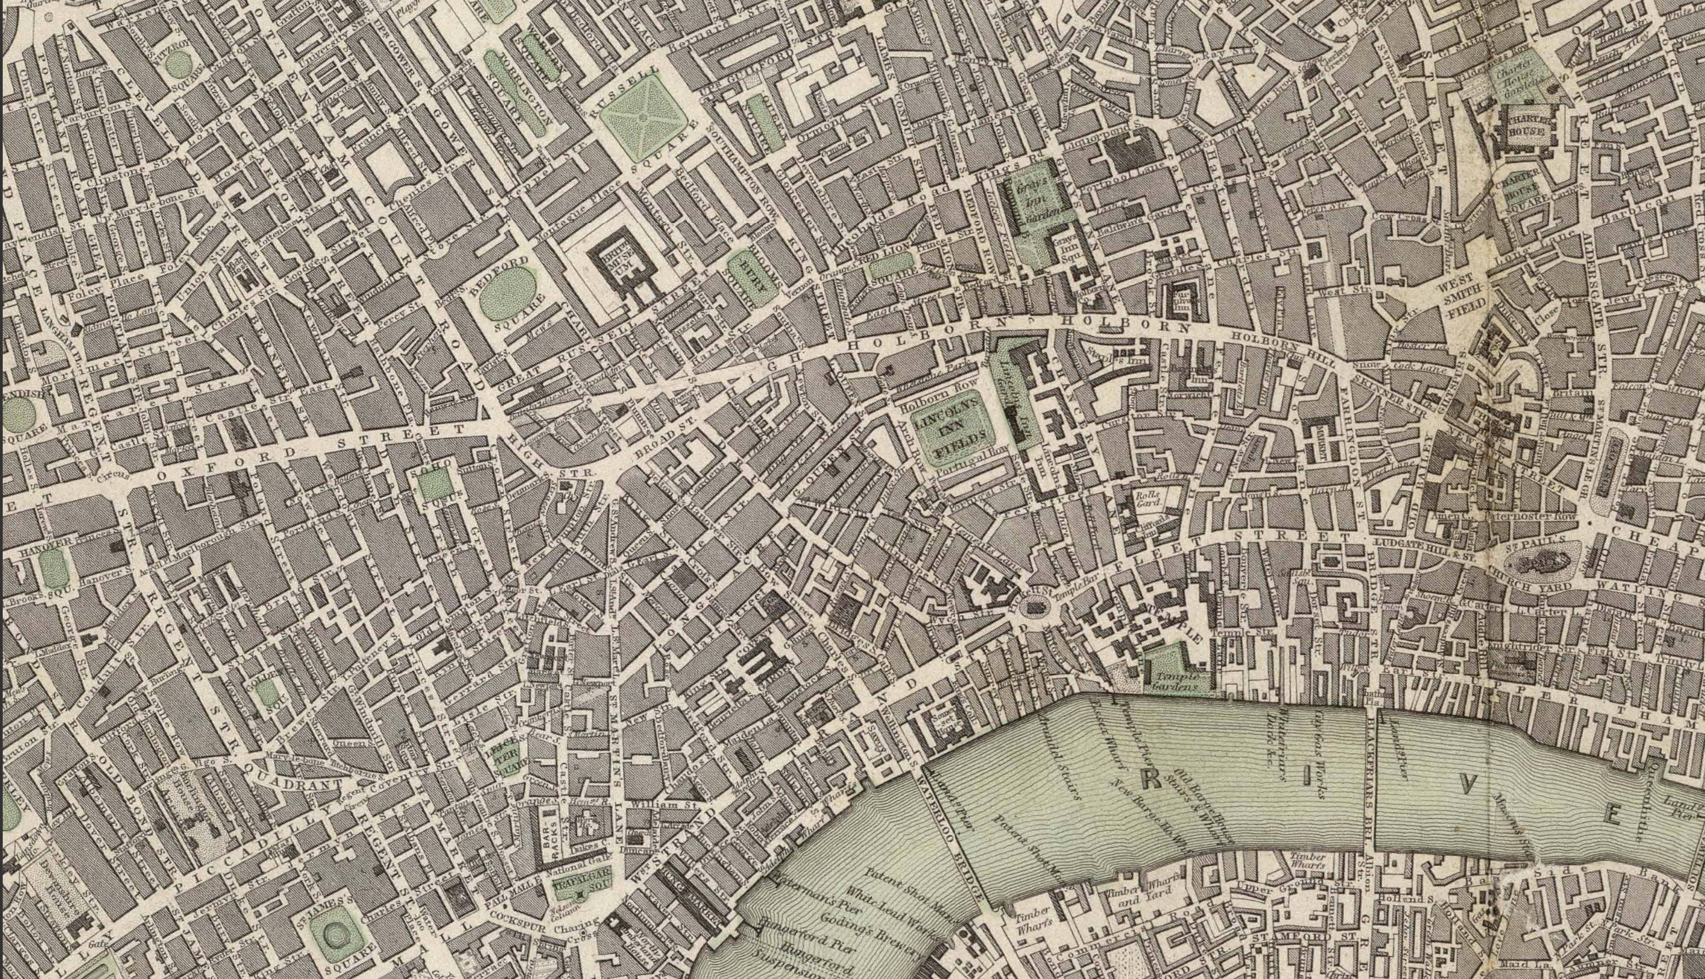

Slide 7
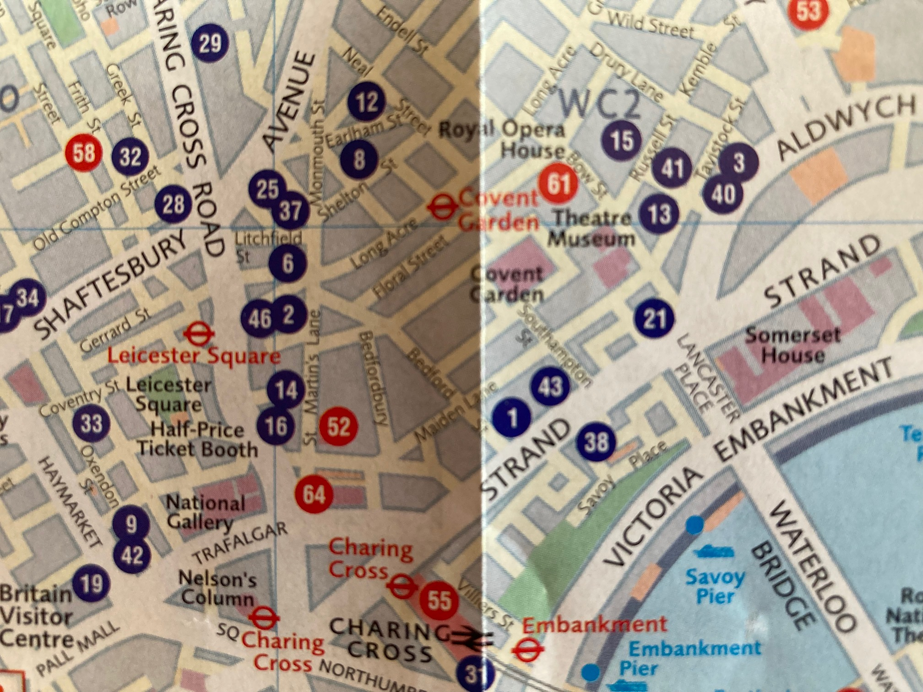
Theatre Royal Drury Lane, and Theatre Royal Covent Garden, then and now.

Slide 8
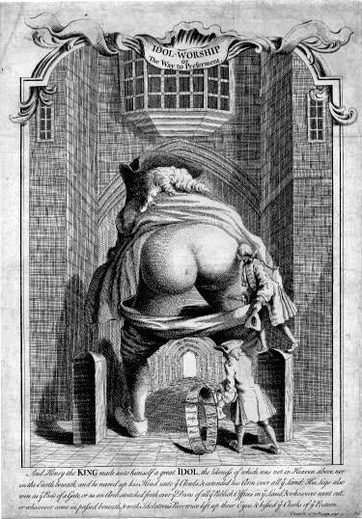
Possibly the stage-set for ‘The Golden Rump,’ Haymarket Theatre, 1737

Slide 9
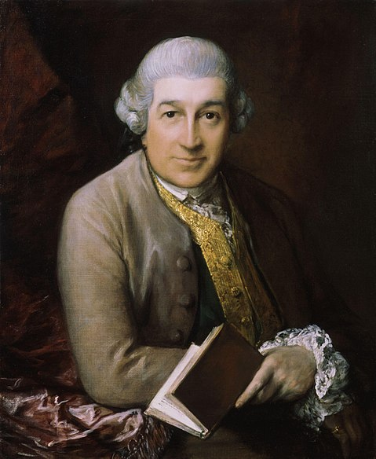
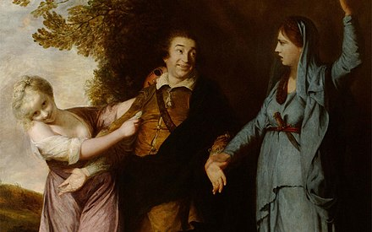
By Sir. Joshua Reynolds
David Garrick (1717-1779), the first ‘high-class’ English actor
By Gainsborough

Slide 10
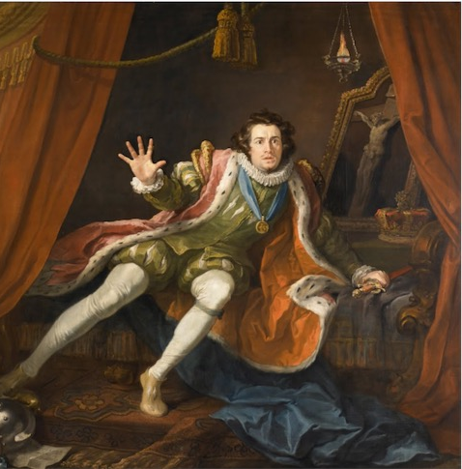
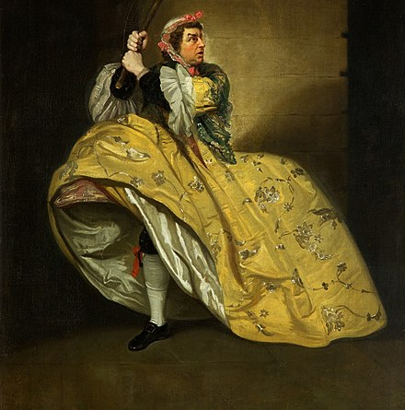
As Richard III (Hogarth)
In drag, in a Vanbrugh comedy

Slide 11
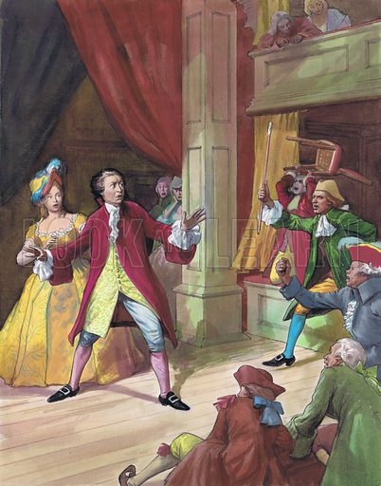
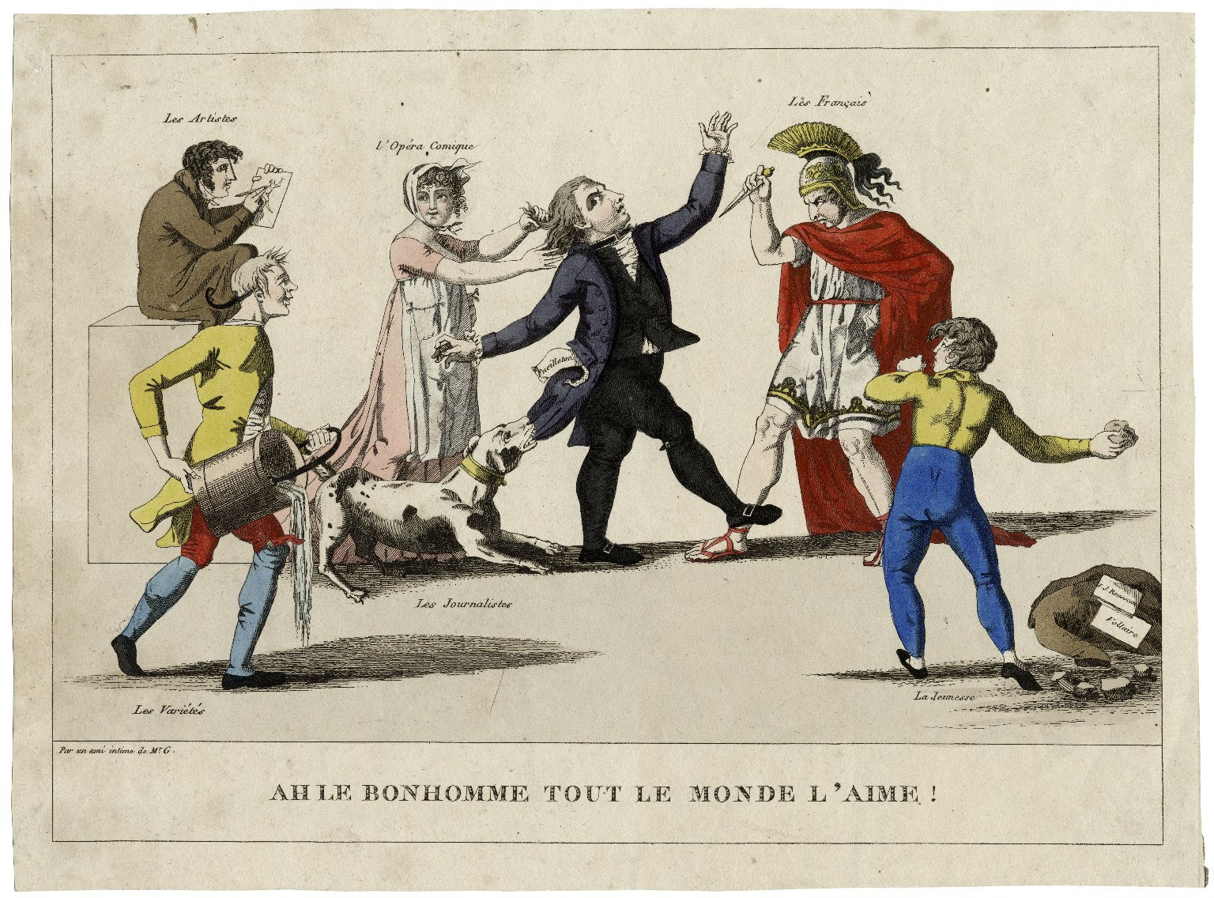

Slide 12
"Swiss!--what the devil do we know of Swiss! -- a Swiss is a foreigner, and all foreigners are Frenchmen; so damn the lot of them!”
From an audience riot, Garrick’s “Chinese Festival,” Drury Lane Theatre, 1755

Slide 13
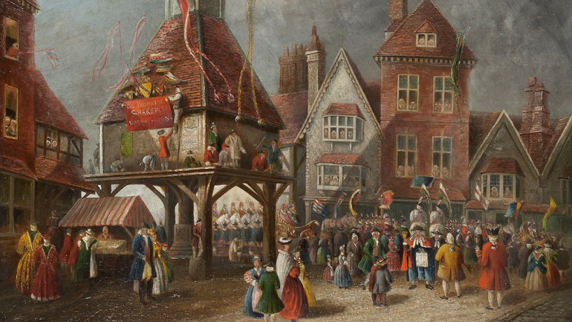
Garrick’s 3-day Shakespeare Festival at Stratford, 1769

Slide 14
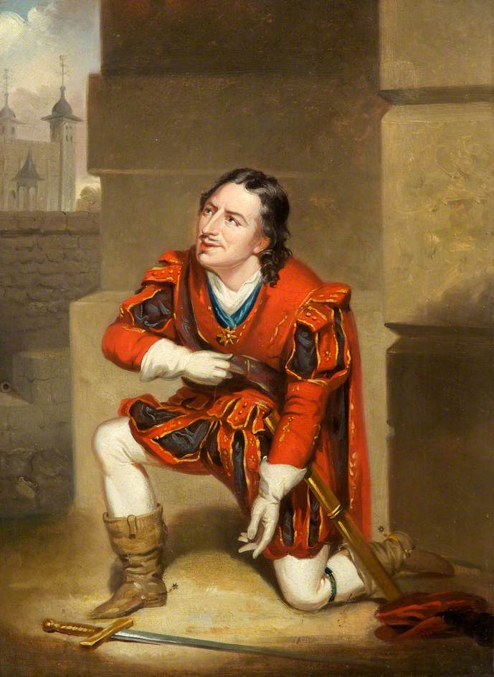
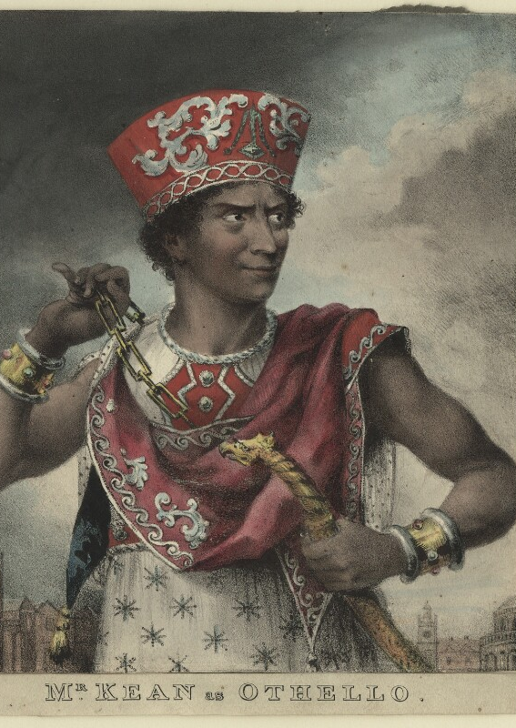
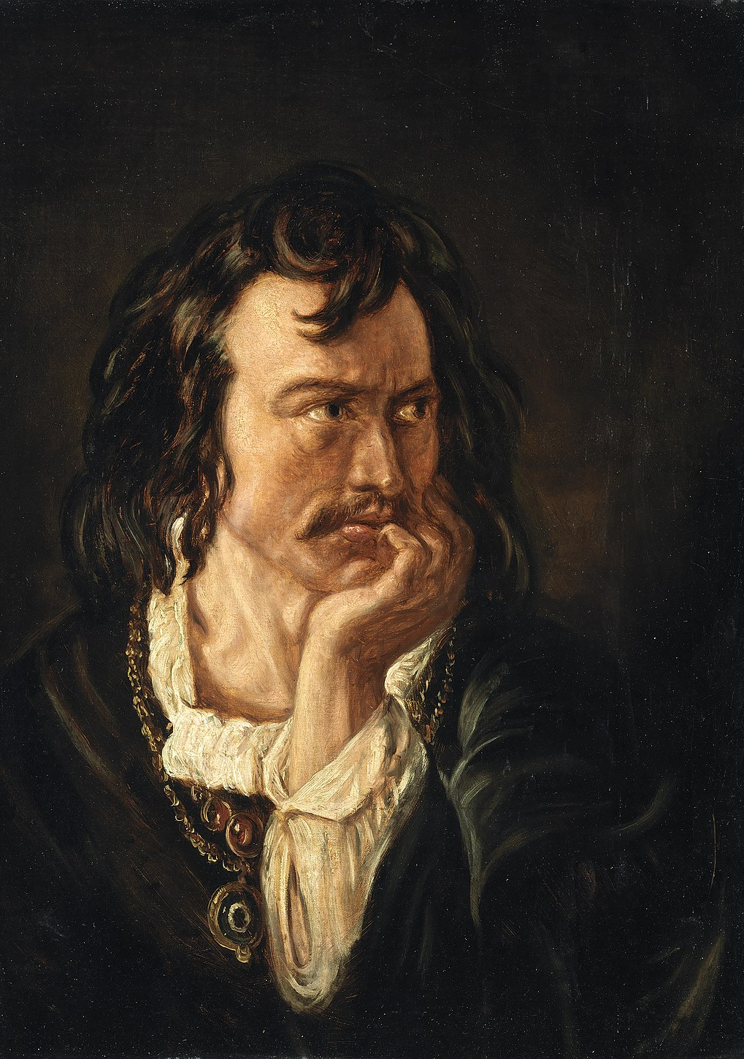
Edmund Kean (1787-1833)
As Othello
As Hamlet
As Richard III

Slide 15
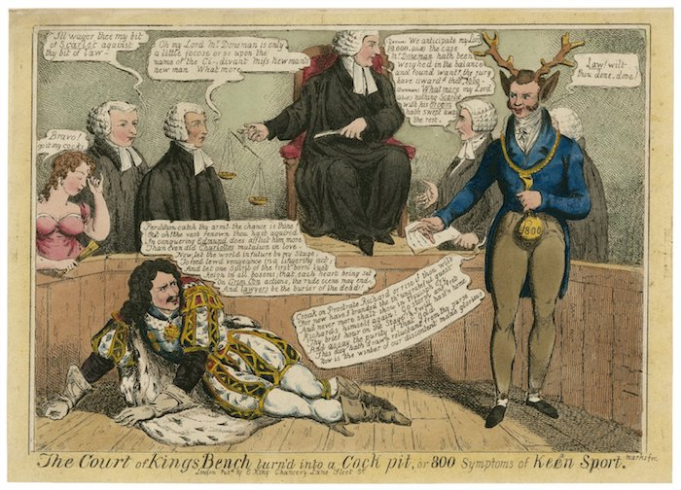

Slide 16
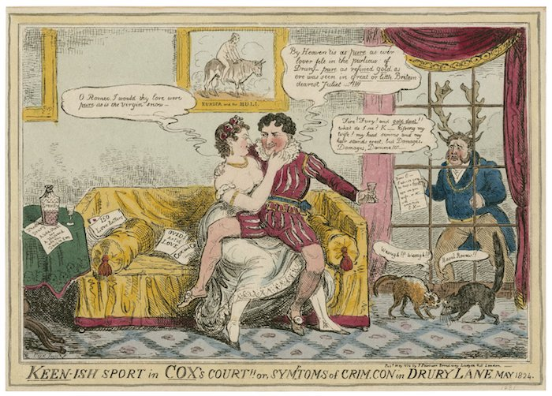

Slide 17
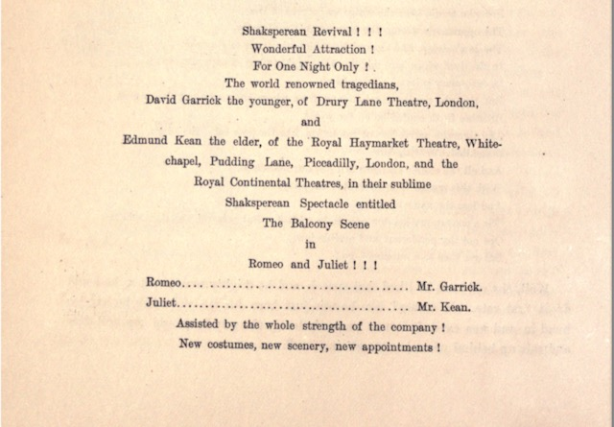

Slide 18
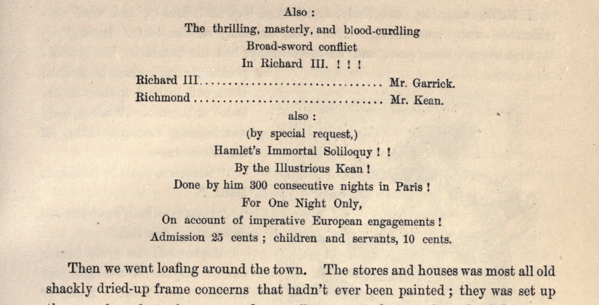

Slide 19
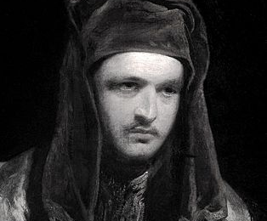
The Brit:
William Macready,
1793-1873
Wil

Slide 20
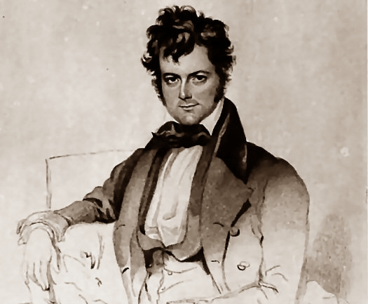
The upstart Yank:
Edwin Forrest
1806-1872

Slide 21
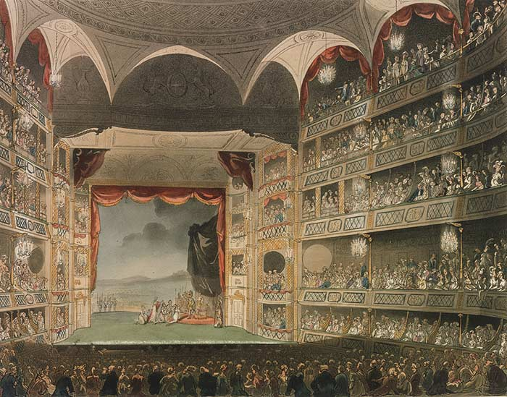
The Drury Lane Theater in 1808

Slide 22
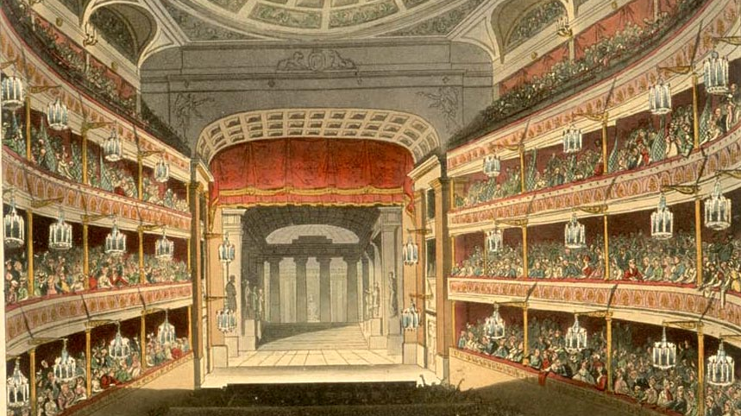
Covent Garden Theatre, early 19th century

Slide 23
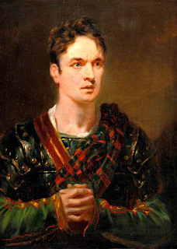
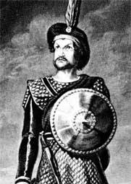
Macready as Macbeth

Slide 24
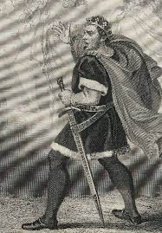
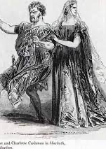
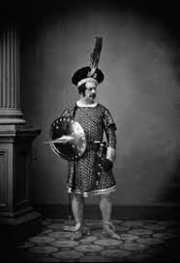
Edwin Forrest as Macbeth

Slide 25
“The pit would surge with excitement at the sight of
Forrest foaming at the mouth, his veins bulging, his voice roaring like the angry sea, lashed into fury by a storm; till, as it reached its boiling, seething climax... it was like the falls of Niagara, in its tremendous down-sweeping cadence: it was a whirlwind, a tornado, a cataract of illimitable rage! His performances were as big as his biceps, and since he had taken up boxing those were beefier than ever. Women, it was
said, fainted at his sheer power, and he made tough men cry. “
Walt Whitman

Slide 26
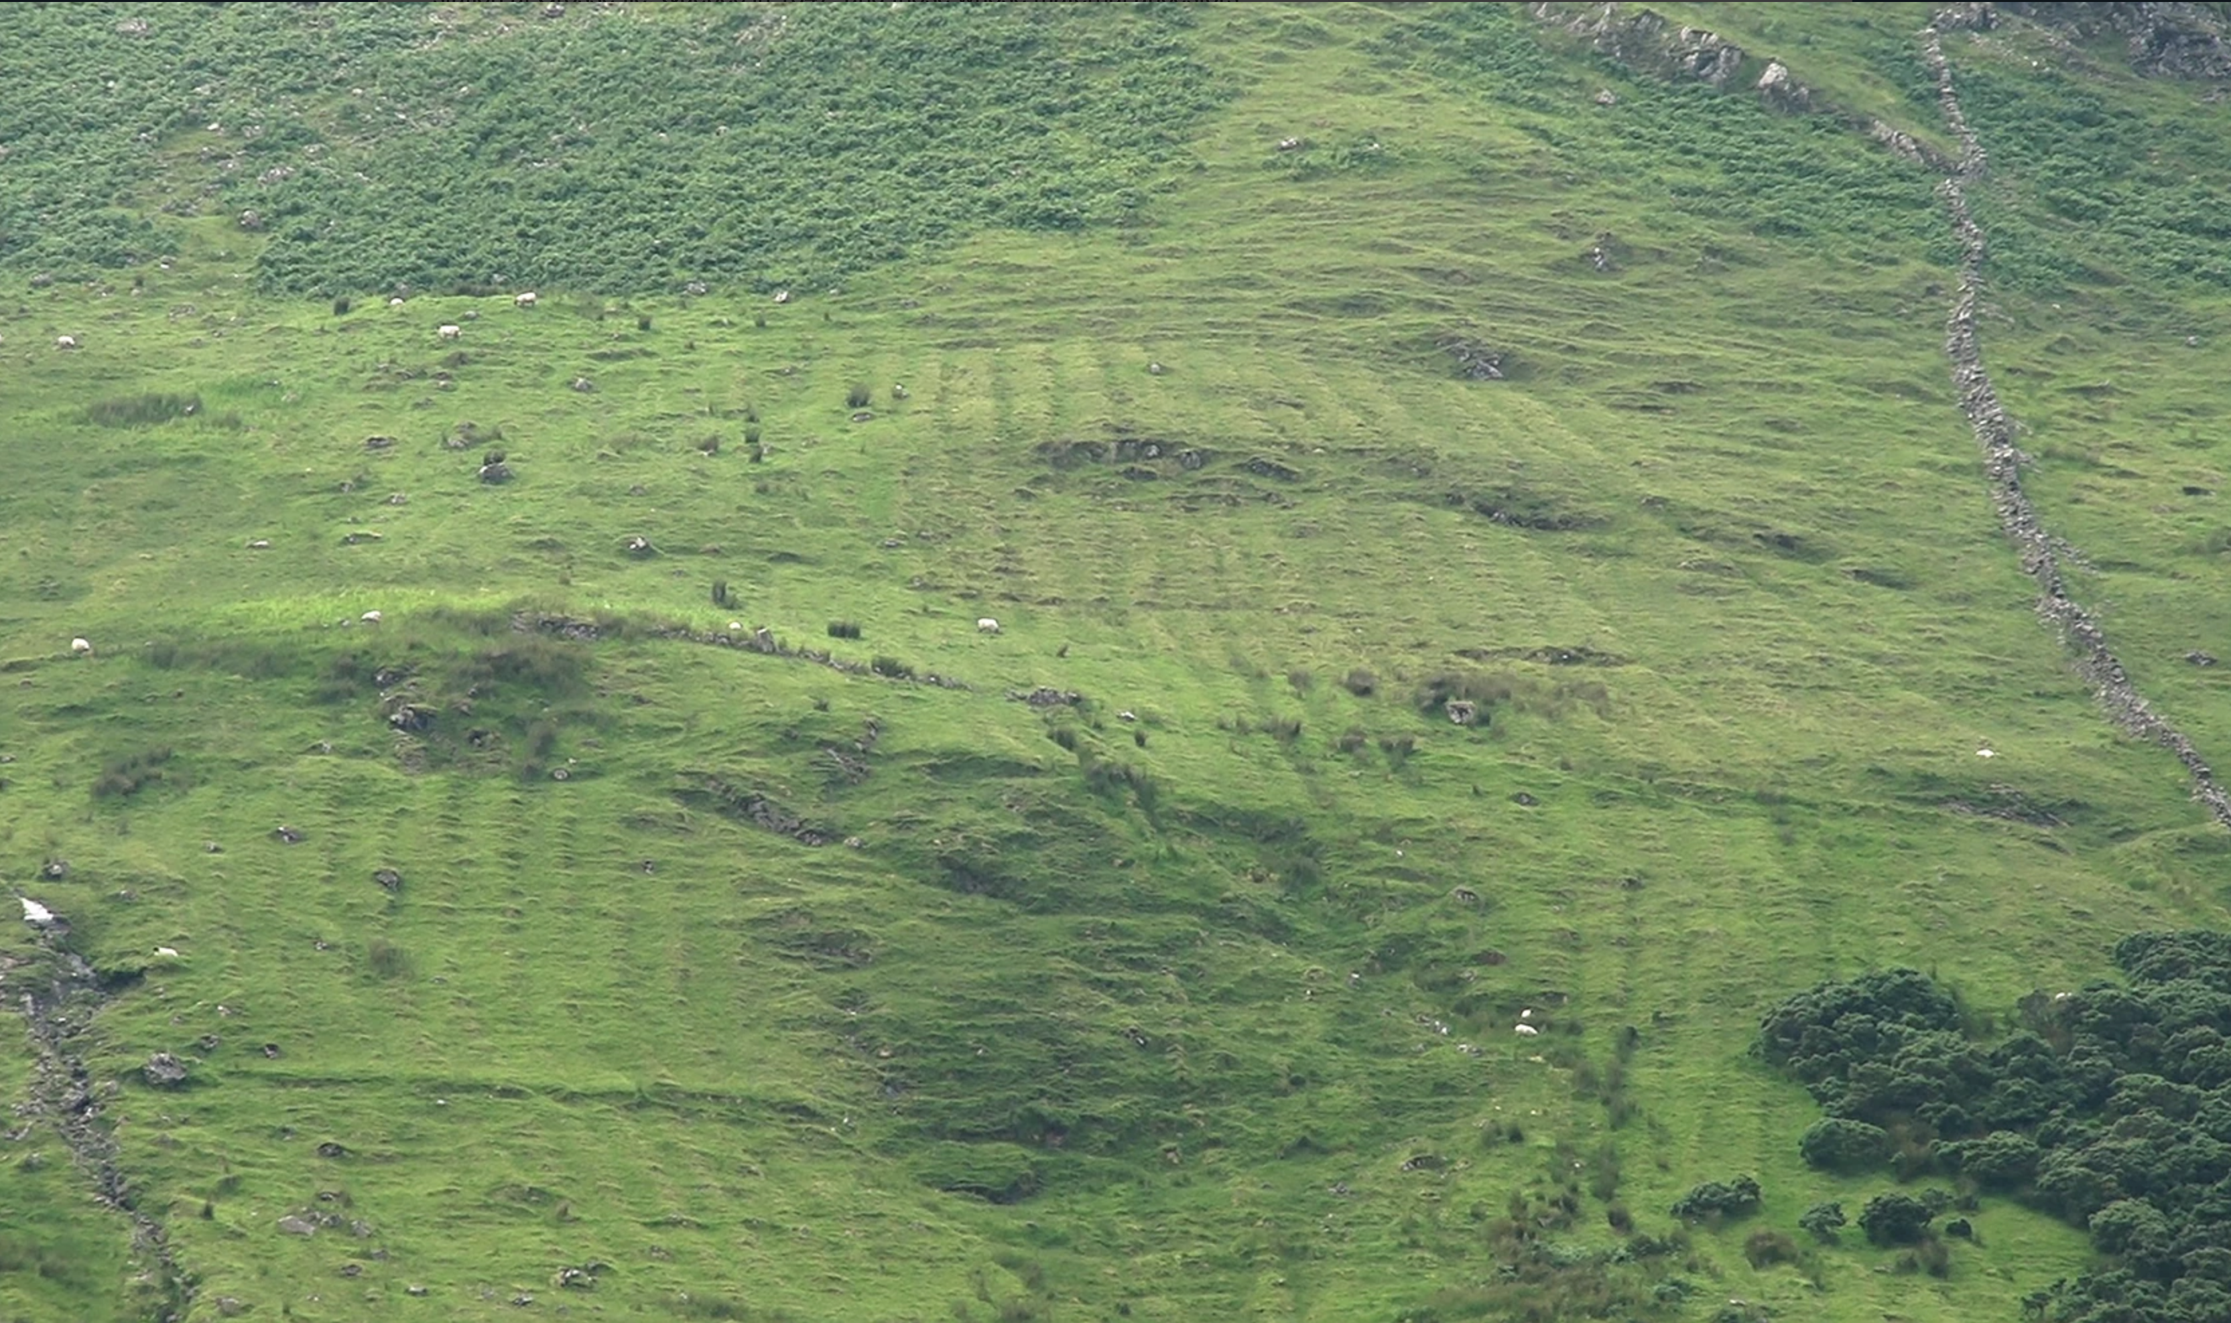

Slide 27
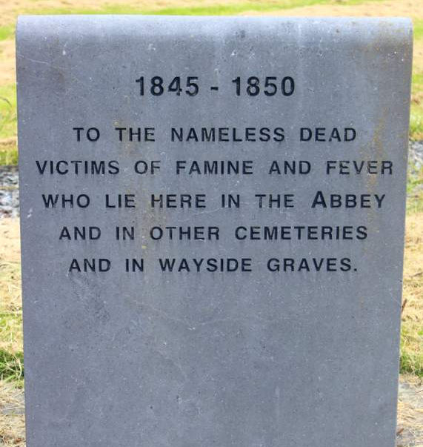
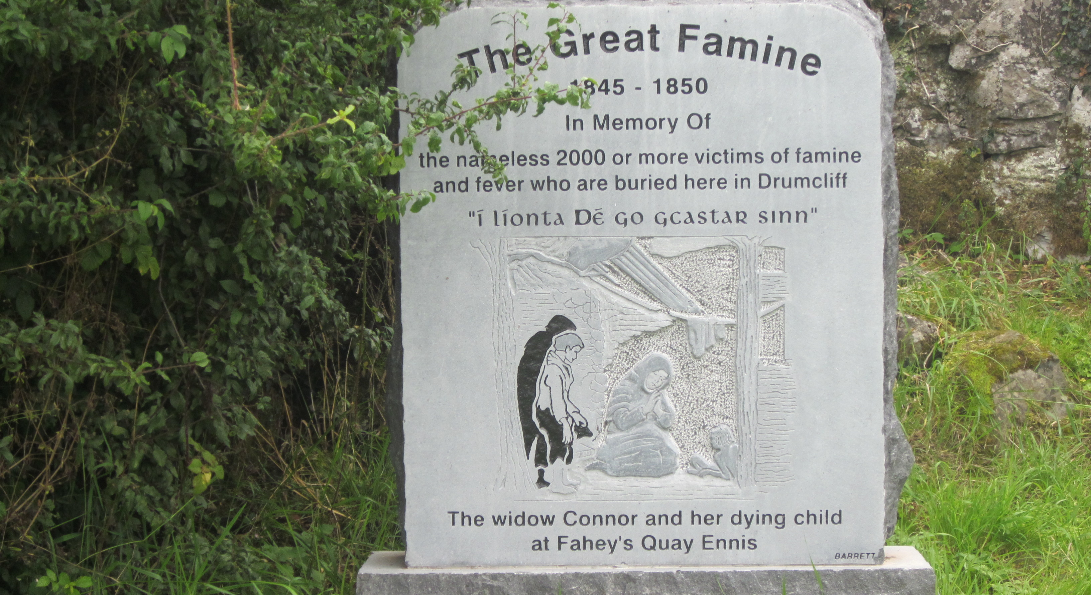

Slide 28
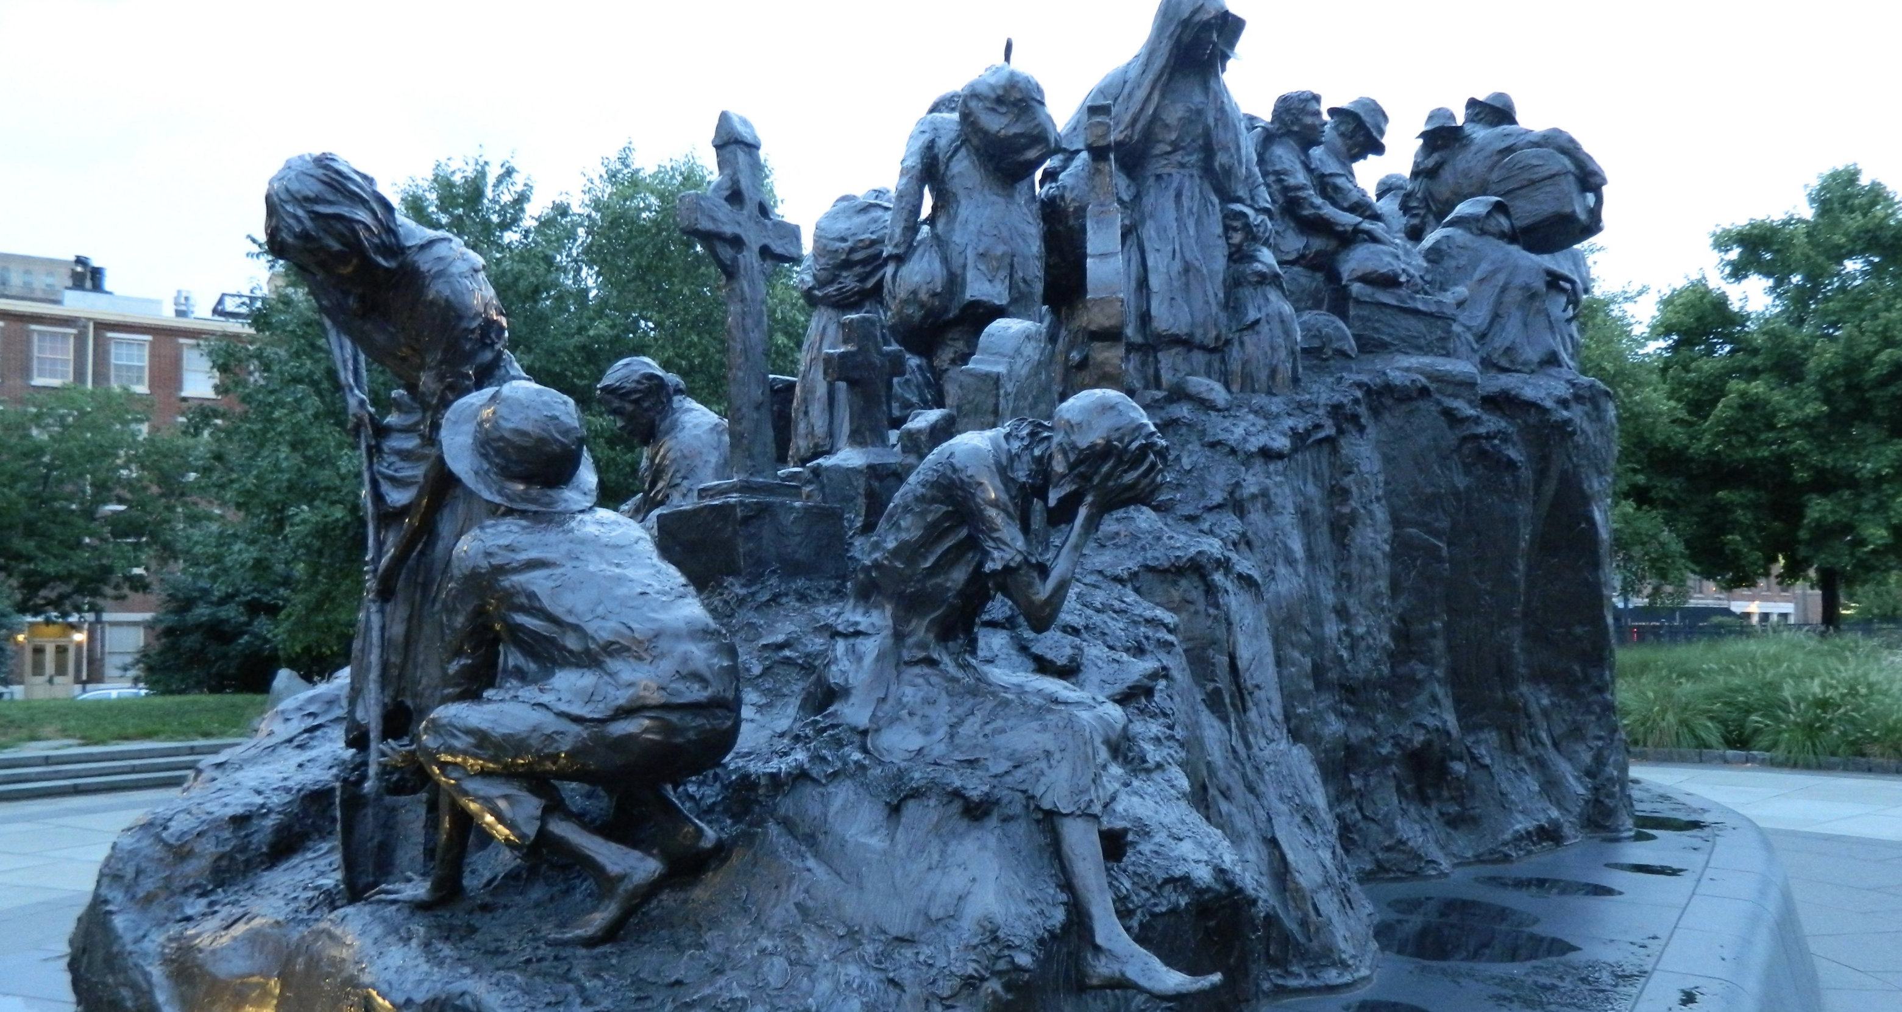
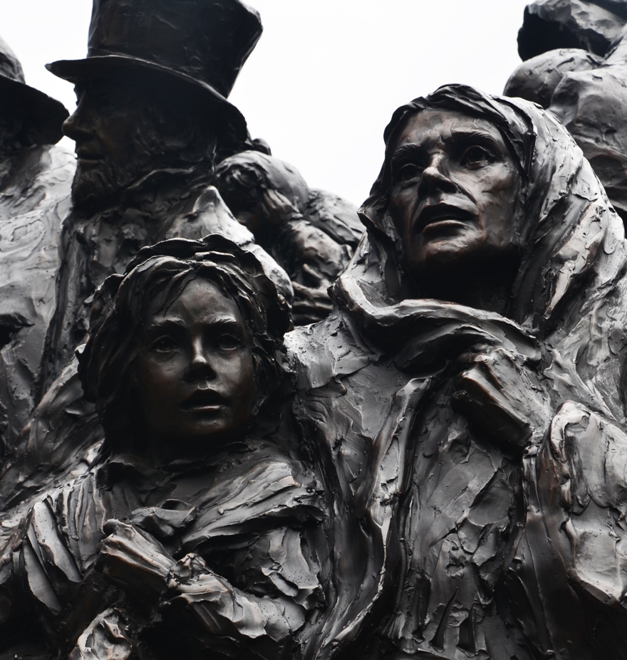
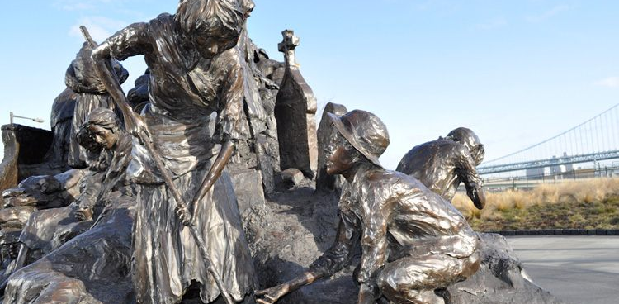
IRISH IMMIGRATION MEMORIAL, PENN’S LANDING, PHILADELPHIA

Slide 29
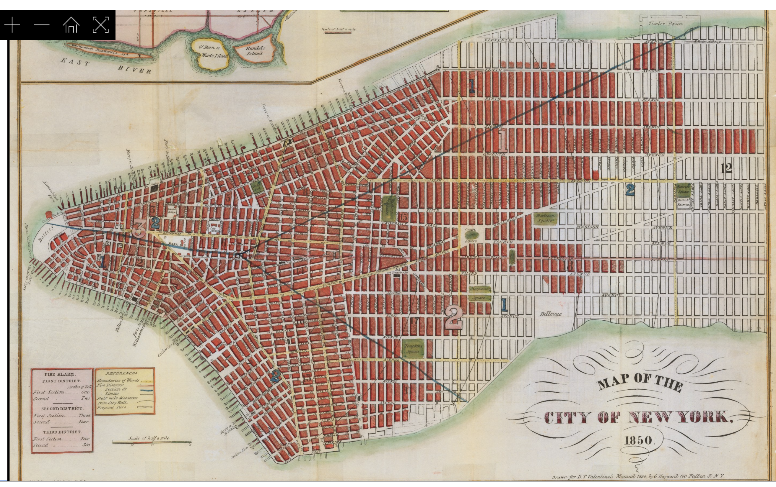

Slide 30
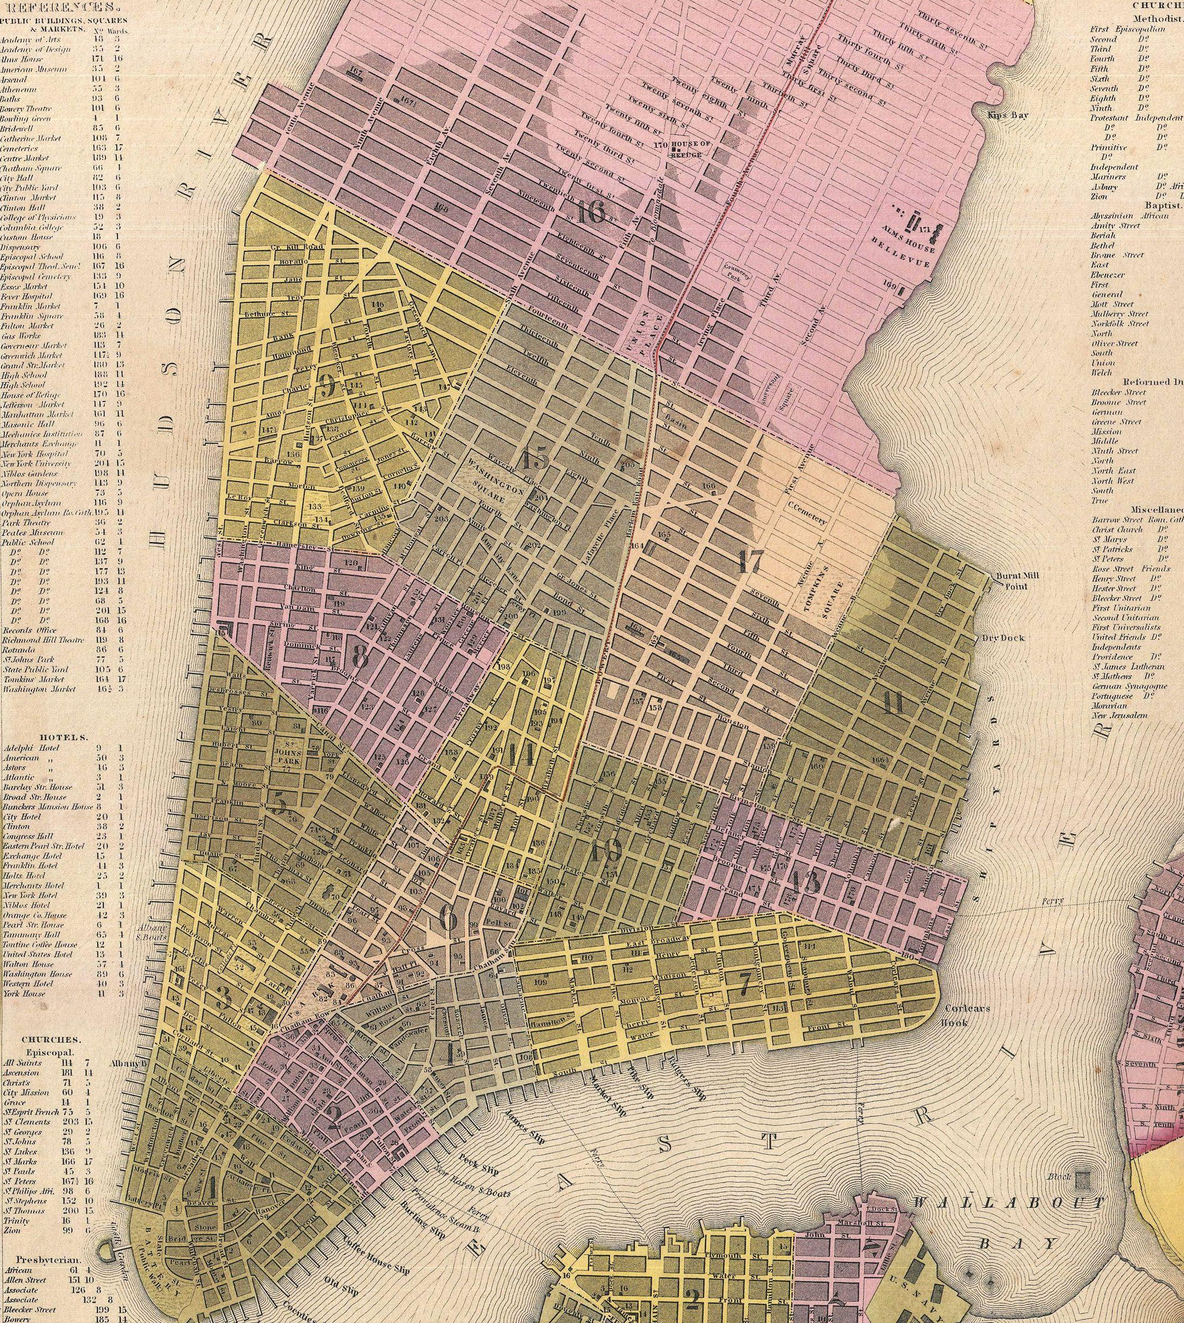
Manhattan in 1850.
Blocks in pink are as yet unoccupied.

Slide 31
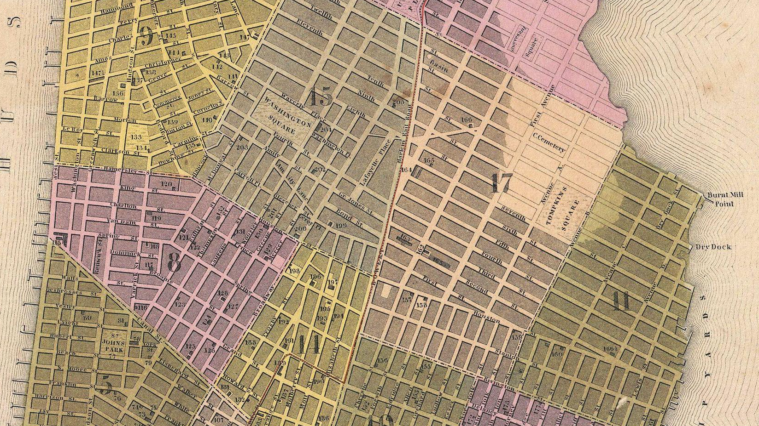

Slide 32
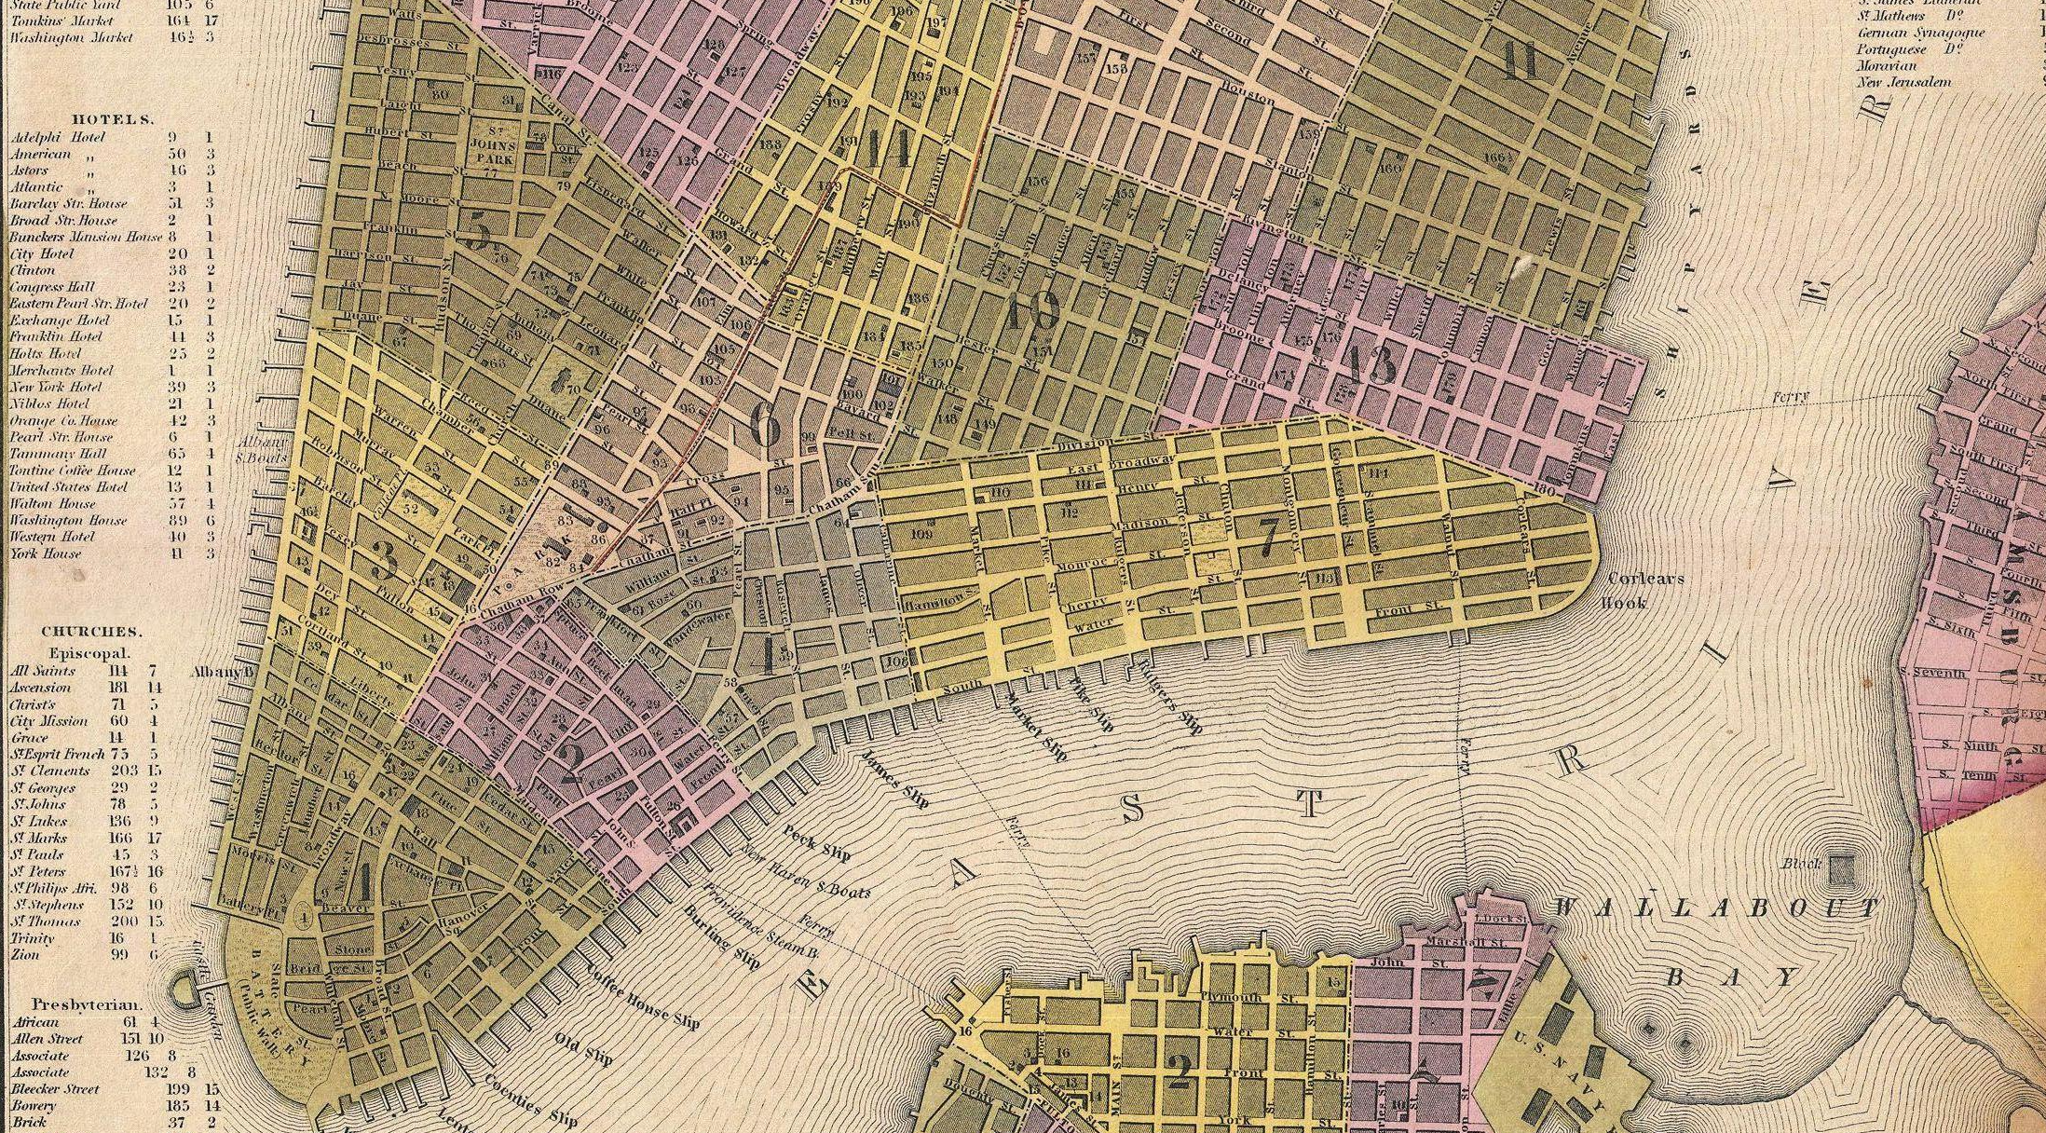

Slide 33
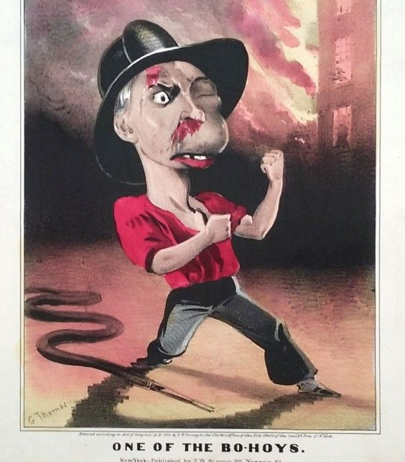
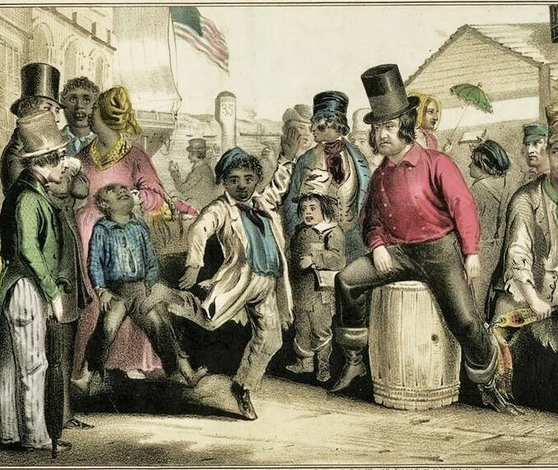
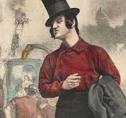
THE “B’HOYS” -- AROUND 1850

Slide 34
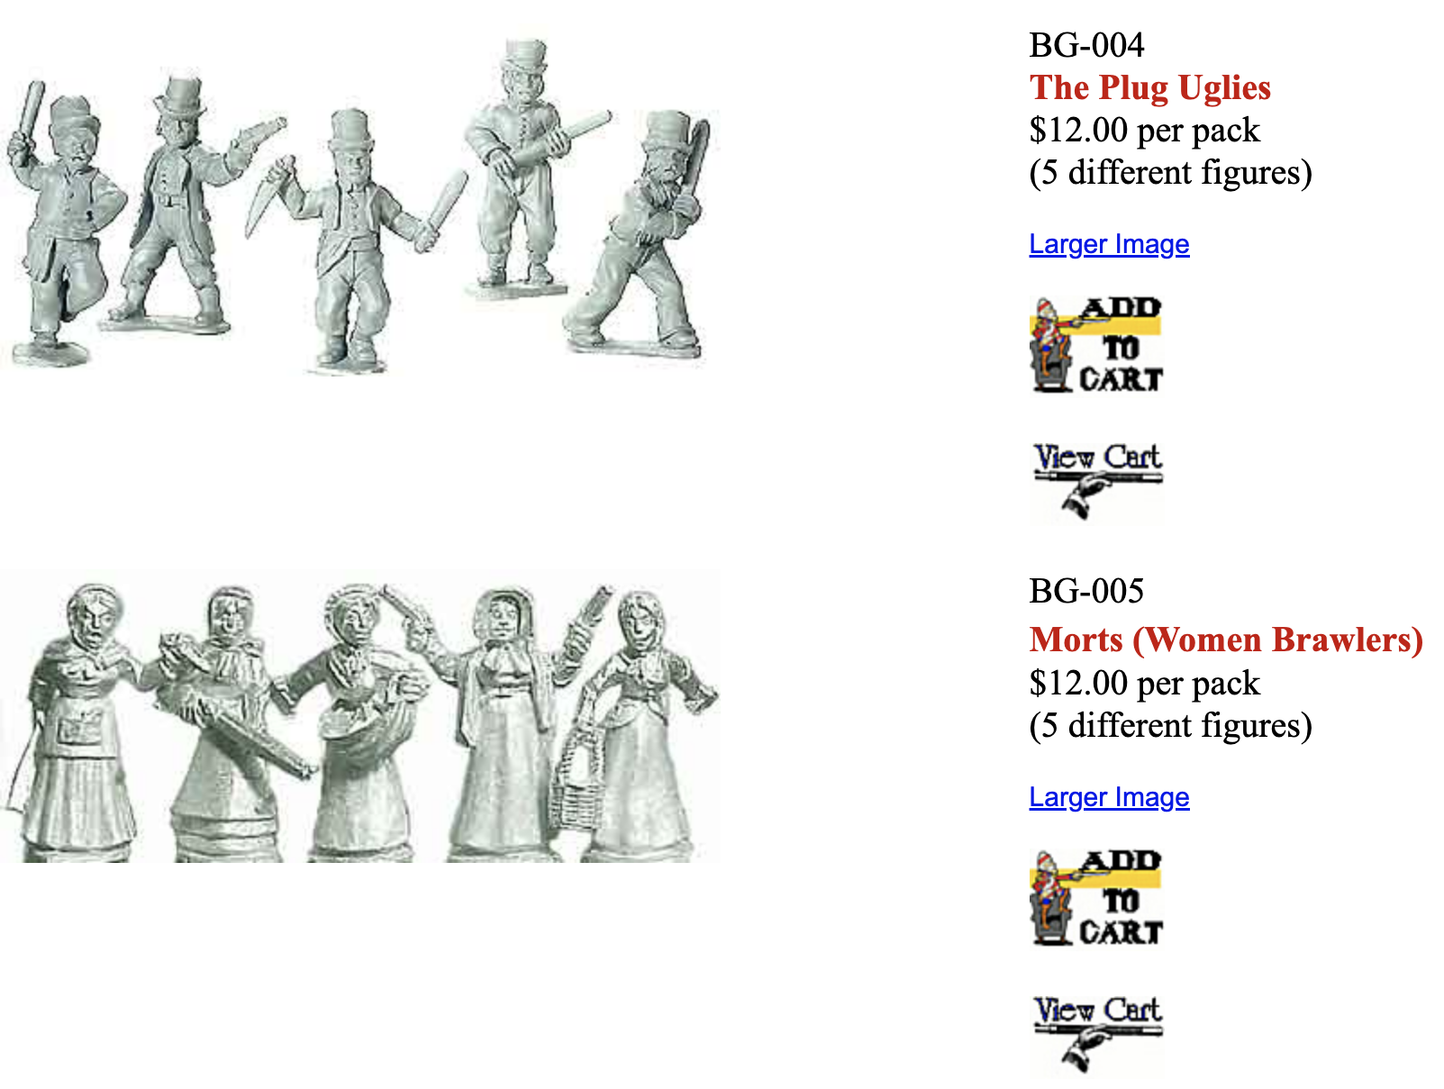

Slide 35
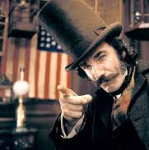
Daniel Day Lewis and Cameron Diaz, Gangs of New York 2002

Slide 36
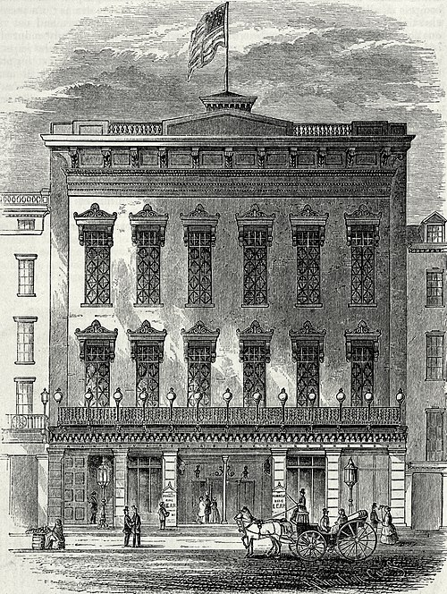
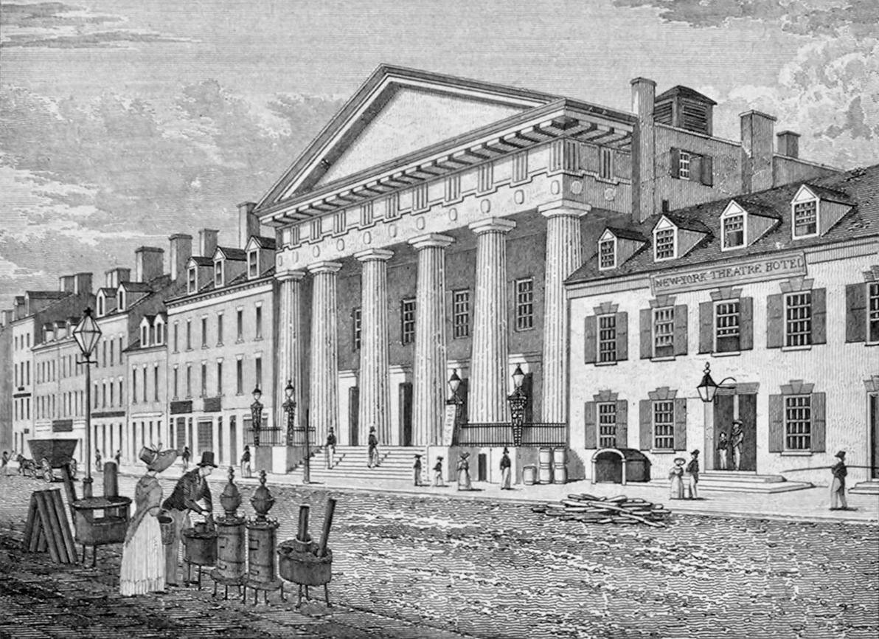
The Bowery Theatre, c.1830
The Broadway Theatre, c.1847

Slide 37
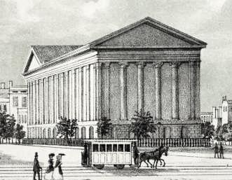
The brand new & lavish Astor Place Theatre, 1849

Slide 38
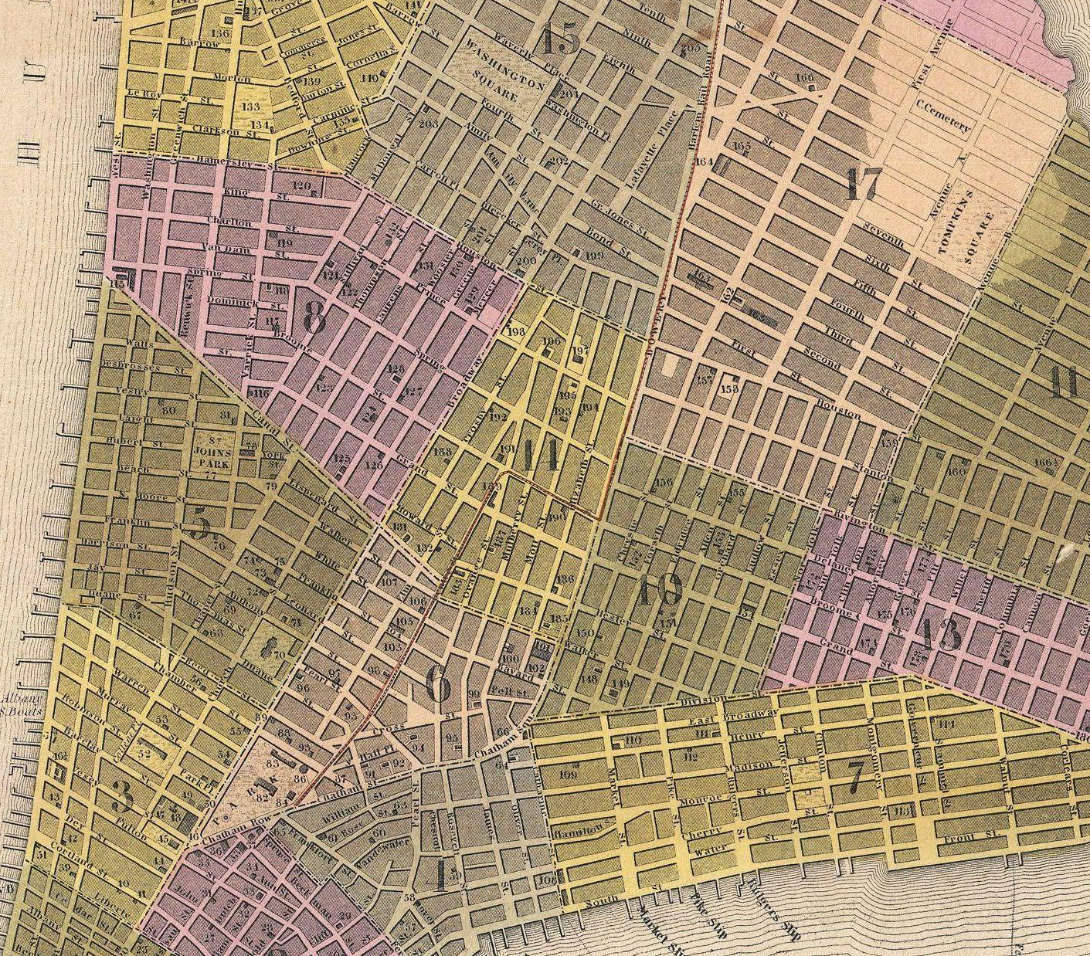
Astor Place
The “Five Points” Slum

Slide 39
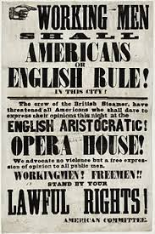

Slide 40
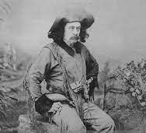
Edward Zane Carroll Judson, AKA
Ned Buntline, after the riots and a year in jail

Slide 43
Sag Harbor, Long Island
October 2022

