Slide 1
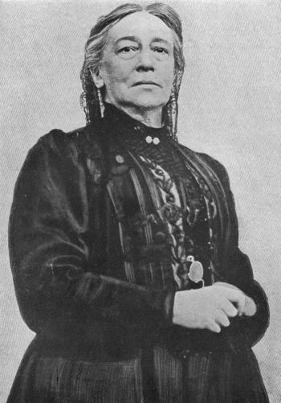
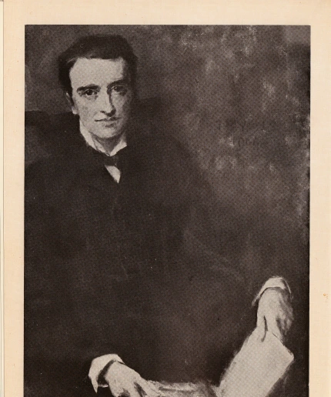
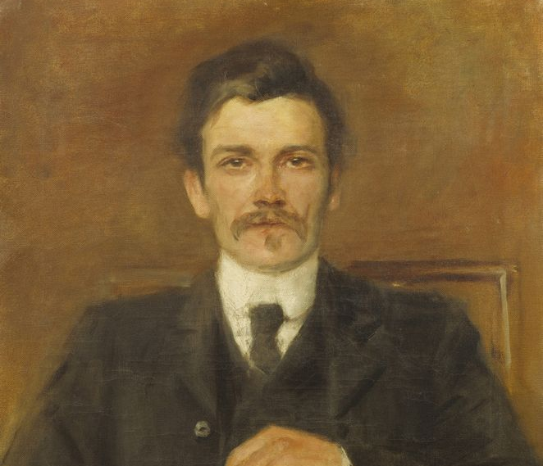
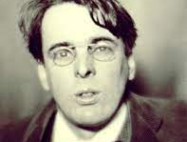
The “Playboy of the Western World” riots,
January, 1907

Slide 2
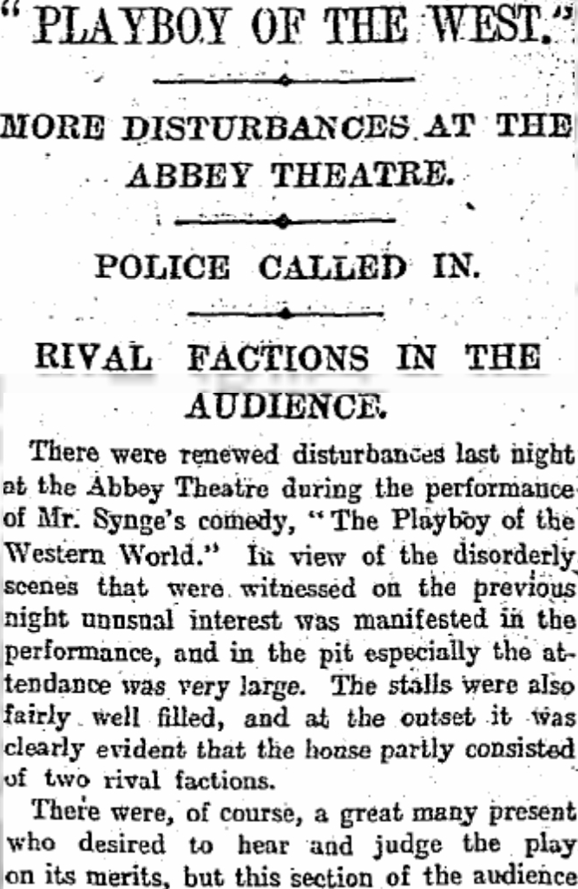
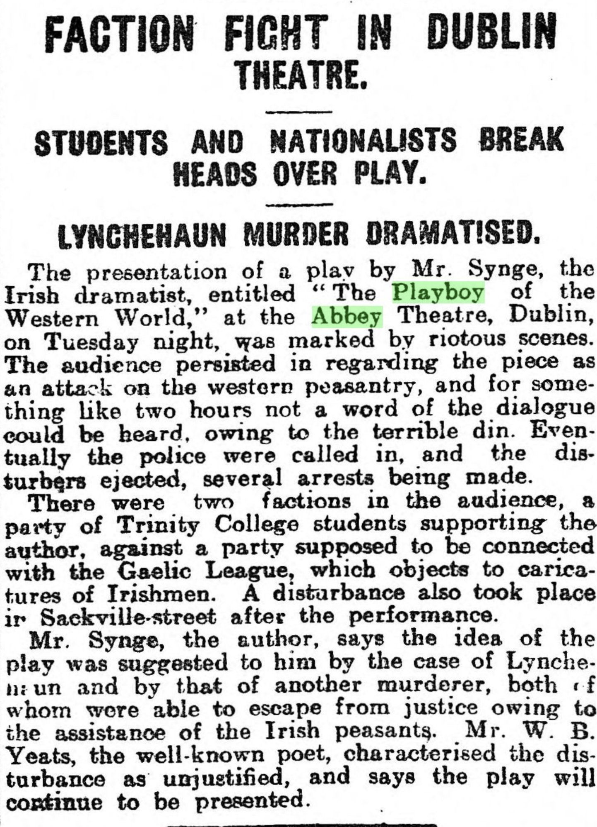

Slide 3
Ireland: political turmoil and cultural predicaments, c.1860-1907.
The Irish National Theatre (The Abbey Theatre): origins, money, and leadership, 1899-1907.
Looming large:
William Butler Yeats and John Millington Synge
Lady Augusta Gregory
. . . and even George Bernard Shaw [?]
Synge’s sojourns in the Aran Islands, 1898-1901.
Successes and controversies at the Abbey Theatre before The Playboy of the Western World.
The Playboy ruckus, reviews, & recriminations.
The death of Synge in 1909; Irish theater in the Rebellion years and after.
The Playboy today.

Slide 4
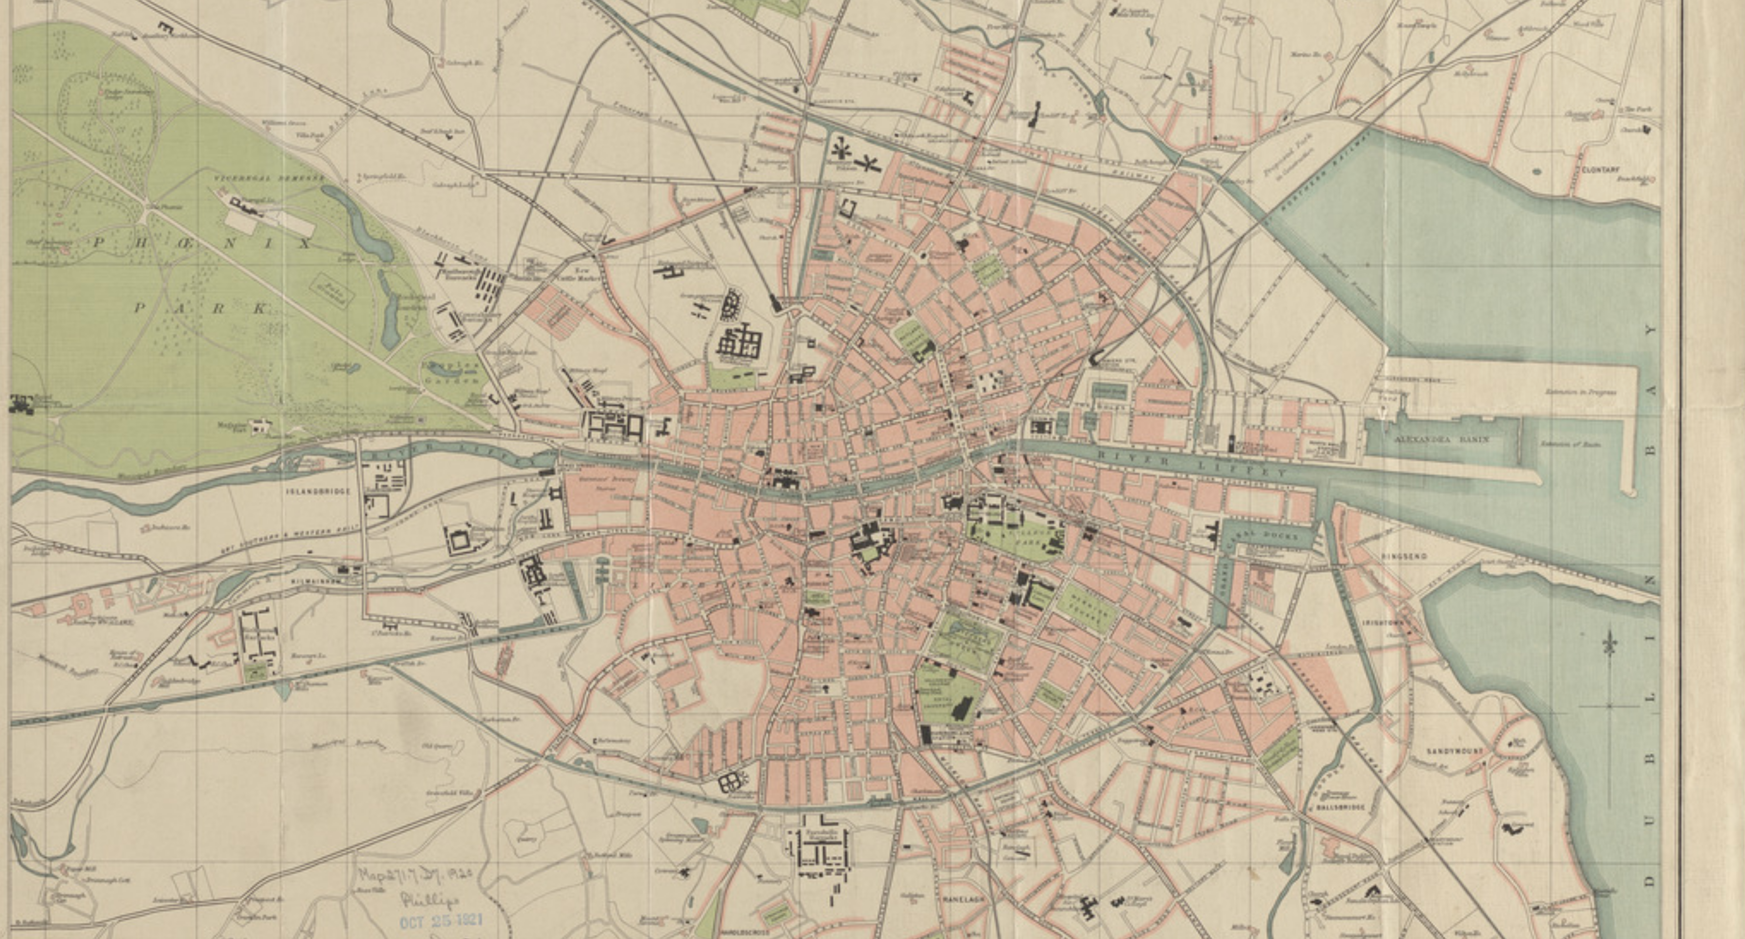
Dublin, c.1910
Population, c. 300,000

Slide 5
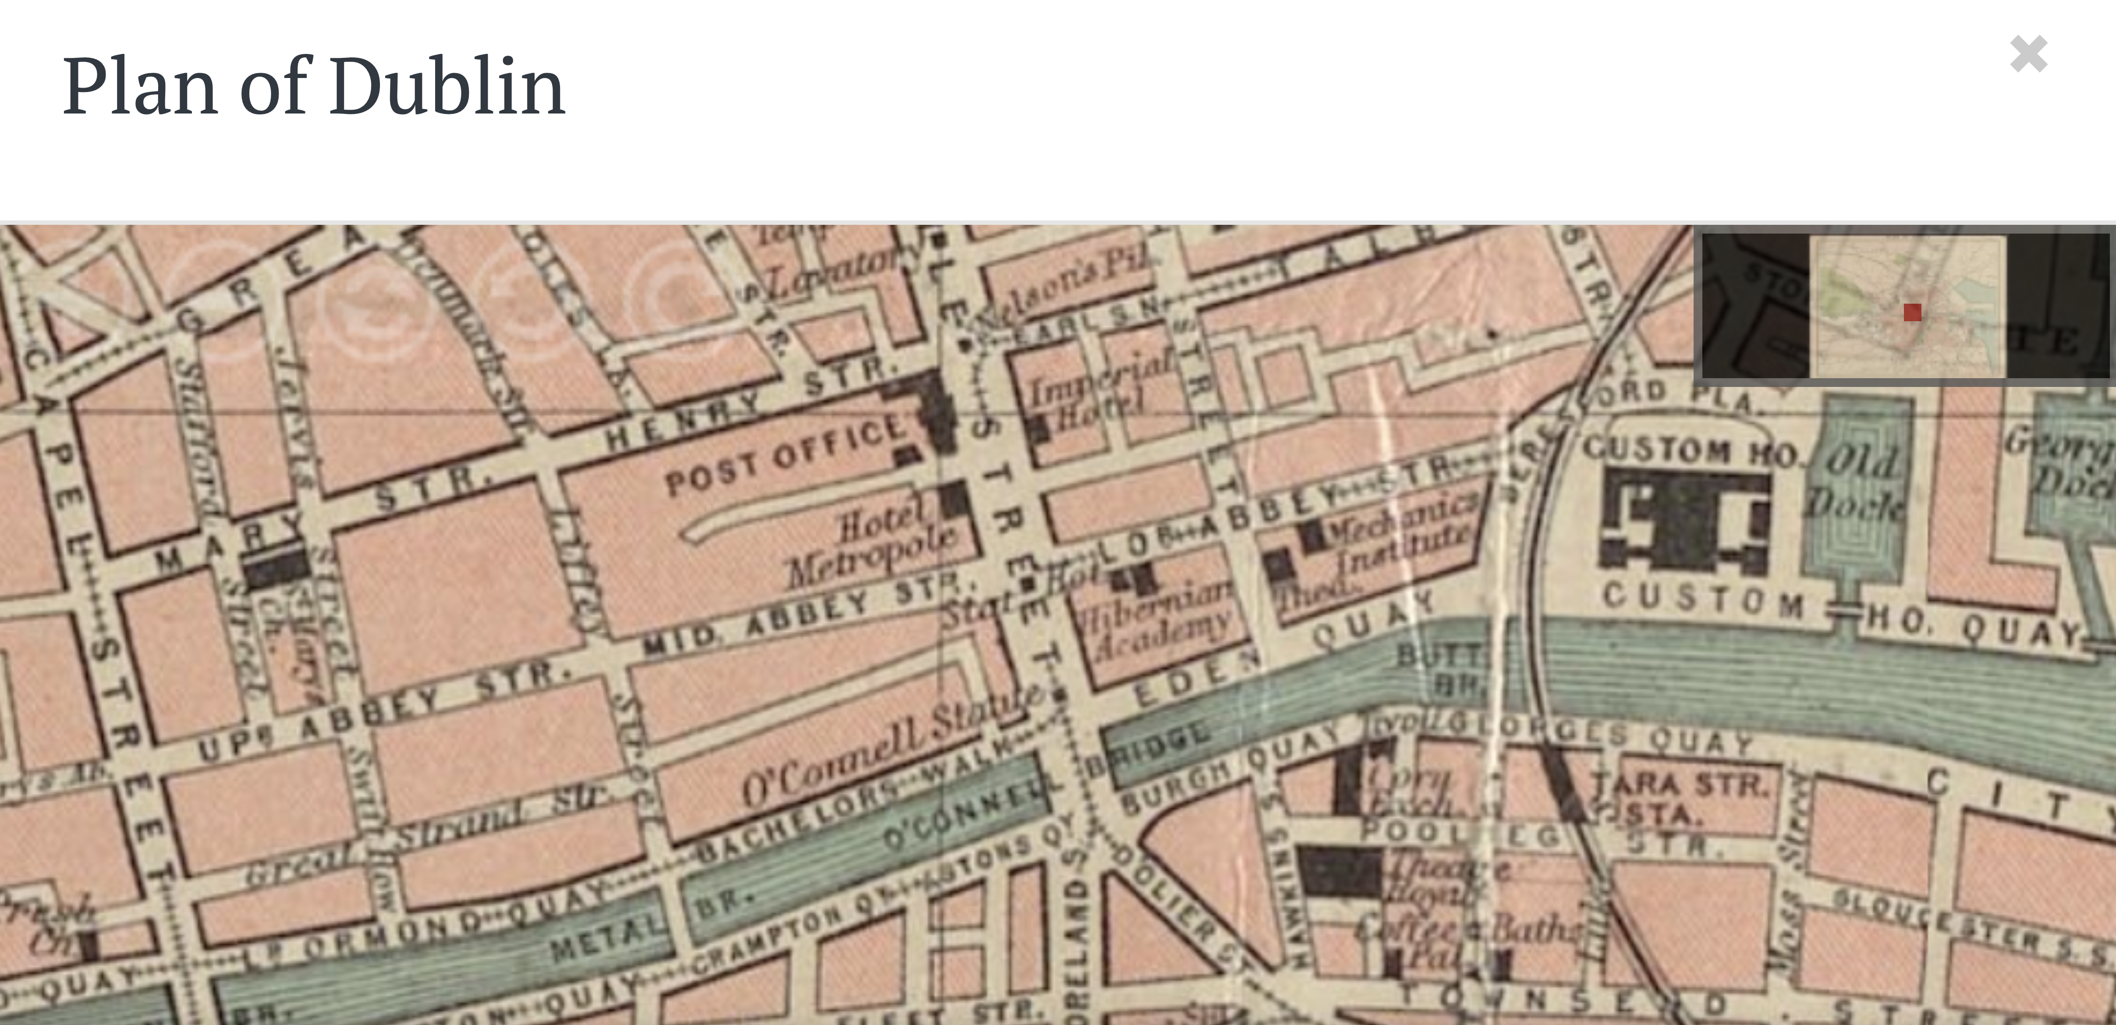

Slide 6
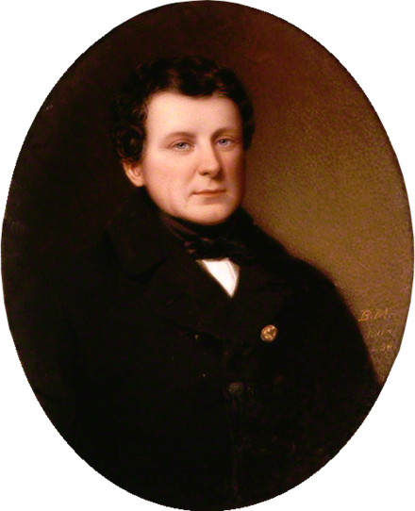
Daniel O’Connell
1775-1847
“I am sufficiently utilitarian not to regret [the] gradual abandonment [of Irish]... Although the language is associated with many recollections that twine round the hearts of Irishmen, yet the superior utility of the English tongue, as the medium of all modern communication is so great, that I can witness, without a sigh, the gradual disuse of Irish”

Slide 7
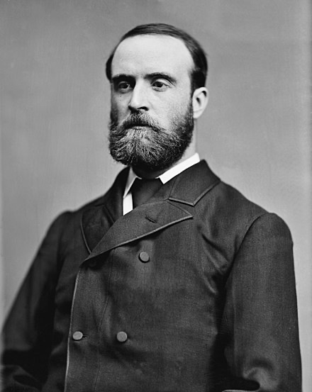
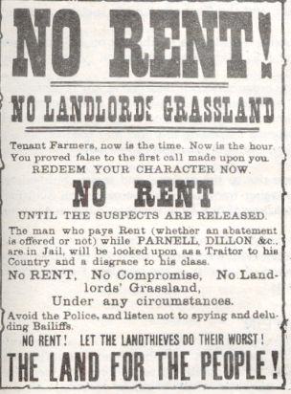
Charles
Stewart Parnell
1846-1891

Slide 8
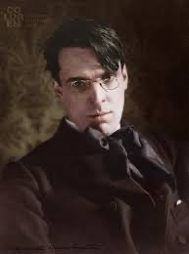
From “Come Gather Round Me Parnellites”
William Butler Yeats, 1903
And here's a cogent reason, And I have many more, He fought the might of England And saved the Irish poor, Whatever good a farmer's got He brought it all to pass; And here's another reason, That Parnell loved a lass.
The Bishops and the party That tragic story made, A husband that had sold his wife And after that betrayed; But stories that live longest Are sung above the glass, And Parnell loved his country And Parnell loved his lass.

Slide 9
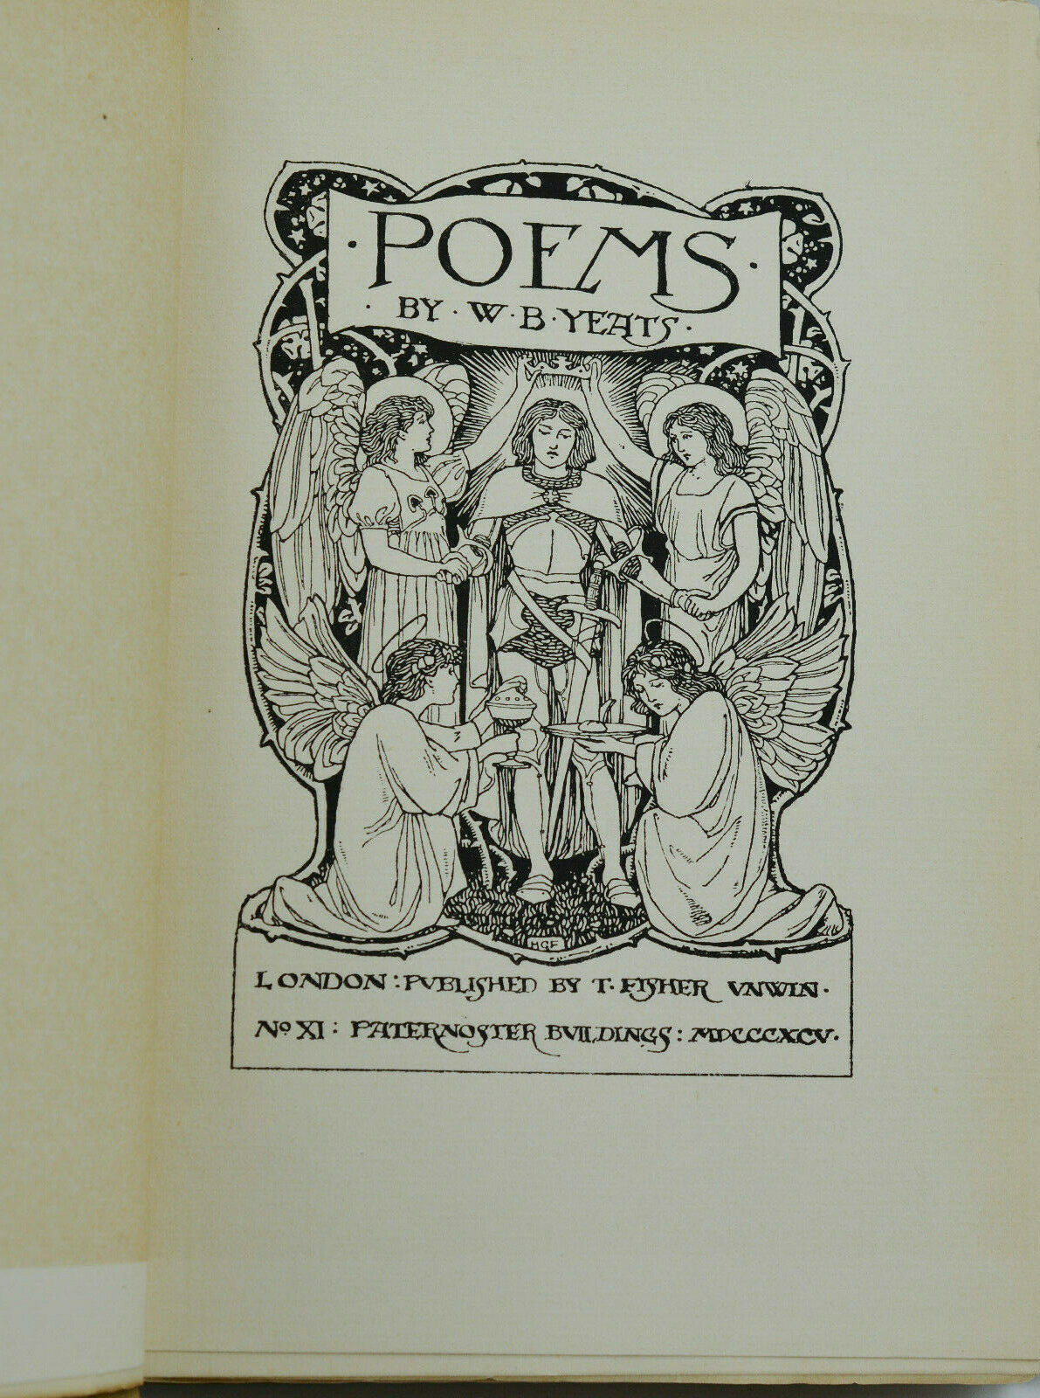

Slide 10
I will arise and go now, and go to Innisfree, And a small cabin build there, of clay and wattles made. Nine bean rows will I have there, a hive for the honey bee, And live alone in the bee-loud glade.
And I shall have some peace there, for peace comes dropping slow, Dropping from the veils of the morning to where the cricket sings; There midnight's all a glimmer, and noon a purple glow, And evening full of the linnet's wings.
I will arise and go now, for always night and day I hear lake water lapping with low sounds by the shore; While I stand on the roadway, or on the pavements grey, I hear it in the deep heart's core.
“The Lake Isle of Innisfree,” 1890

Slide 12
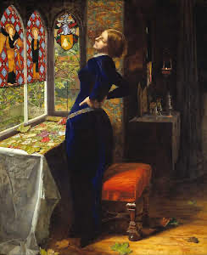
From “Adam’s Curse”
1903
We sat grown quiet at the name of love;
We saw the last embers of daylight die,
And in the trembling blue-green of the sky
A moon, worn as if it had een a shell
Washed by time’s waters as they rose and fell
About the stars and broke in days and years.
I had a thought for no one’s but your ears:
That you were beautiful, and that I strove
To love you in the old high way of love;
That it had all seemed happy, and yet we’d grown
As weary-hearted as that hollow moon.

Slide 13
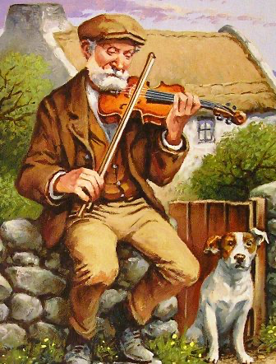
From “The Fiddler of Dooney” 1892
When we come at the end of time, To Peter sitting in state, He will smile on the three old spirits, But call me first through the gate;
For the good are always the merry, Save by an evil chance, And the merry love the fiddle And the merry love to dance: And when the folk there spy me, They will all come up to me, With ‘Here is the fiddler of Dooney!’ And dance like a wave of the sea.

Slide 14
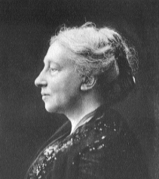
Lady Augusta Gregory,
1852-1932

Slide 15
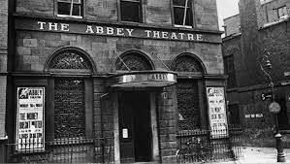
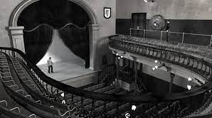
The Abbey Theatre c.1907

Slide 16
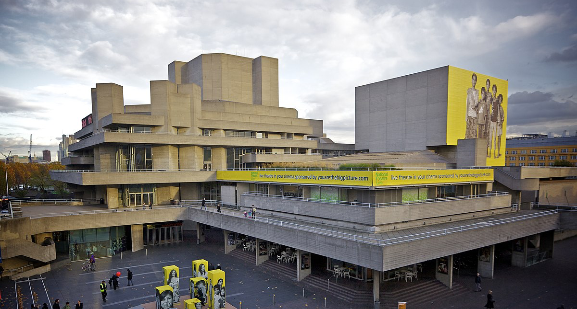
National Theatre (London) : 1962-76 at the Old Vic, and then on the South Bank of the Thames

Slide 17
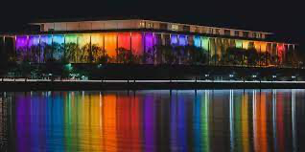
Kennedy Center, Washington DC, 1971 --

Slide 18
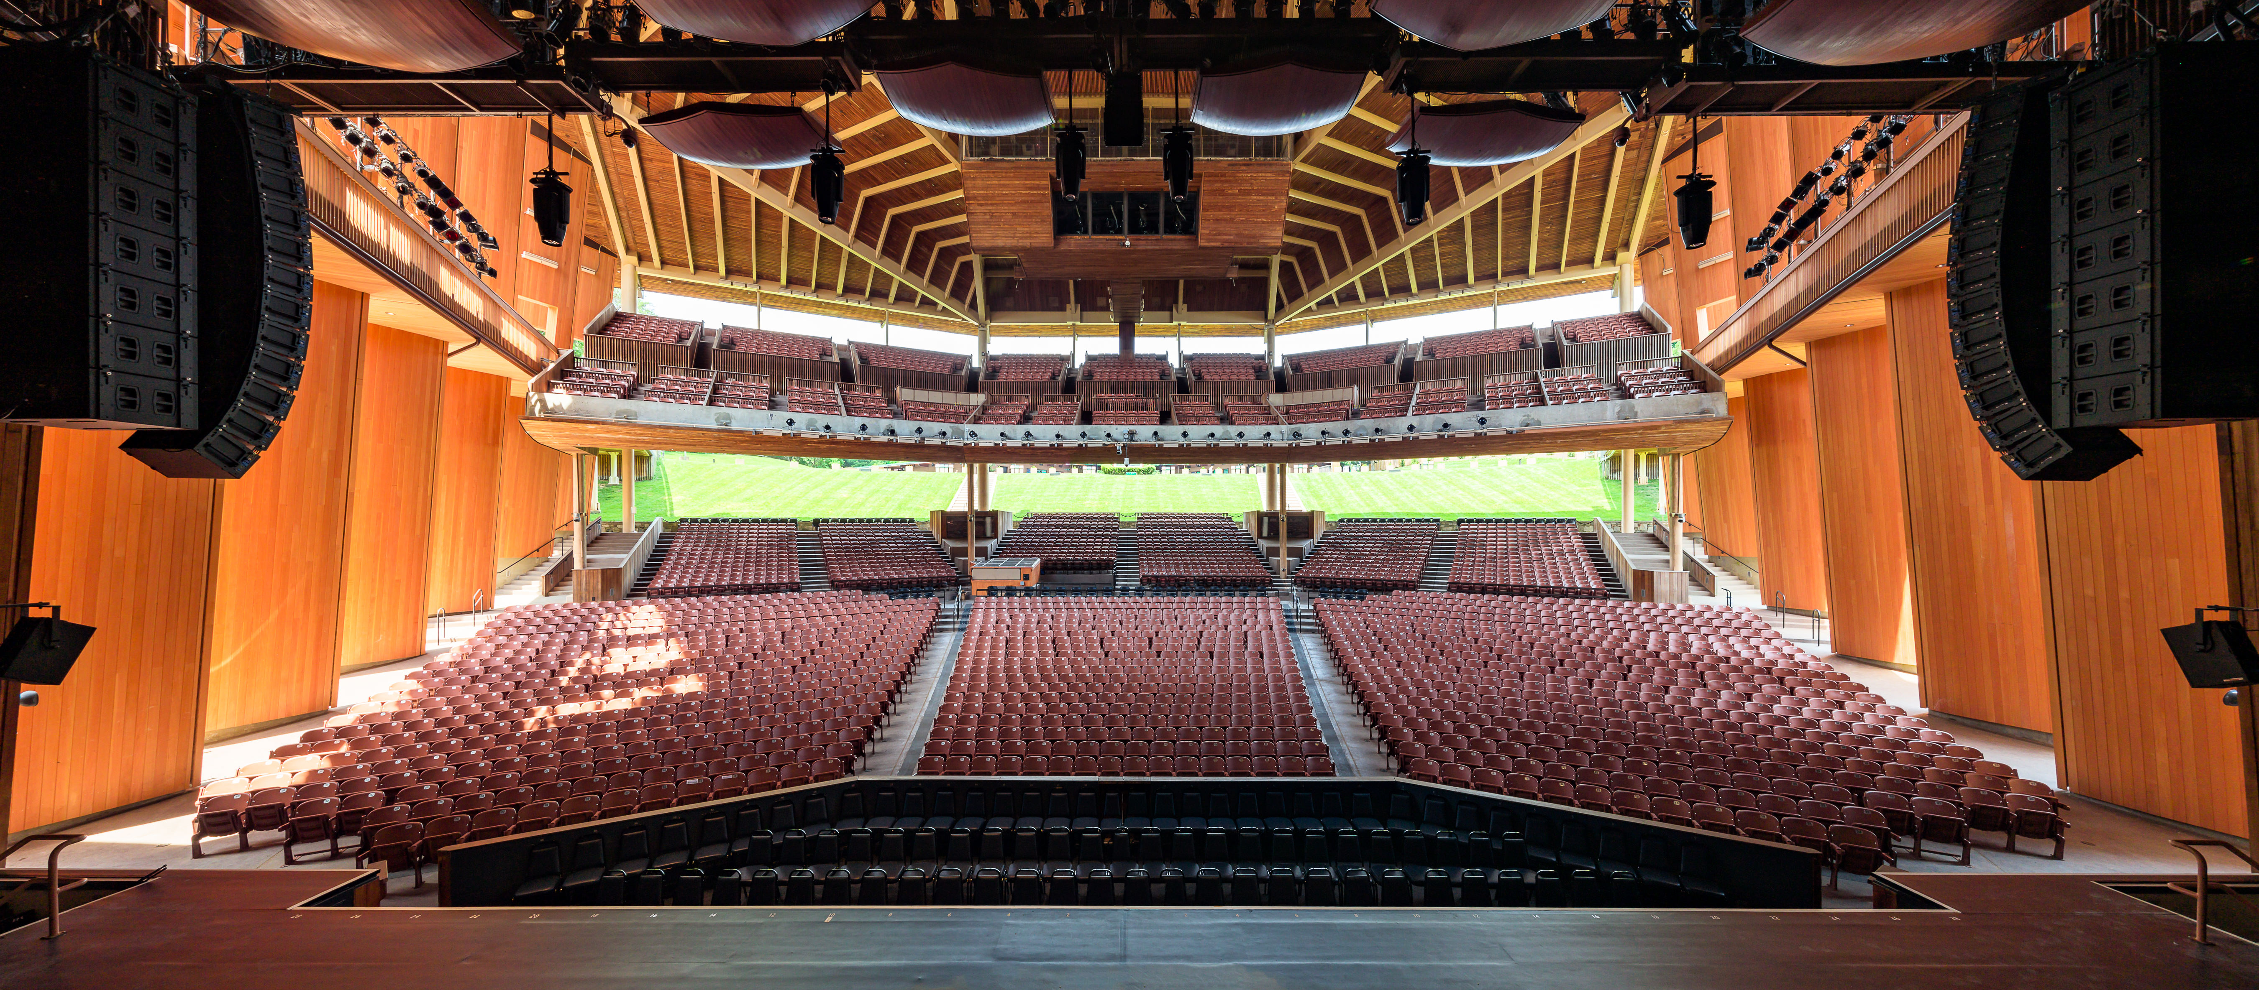
Wolf Trap National Park for the Performing Arts, 1968 --

Slide 19
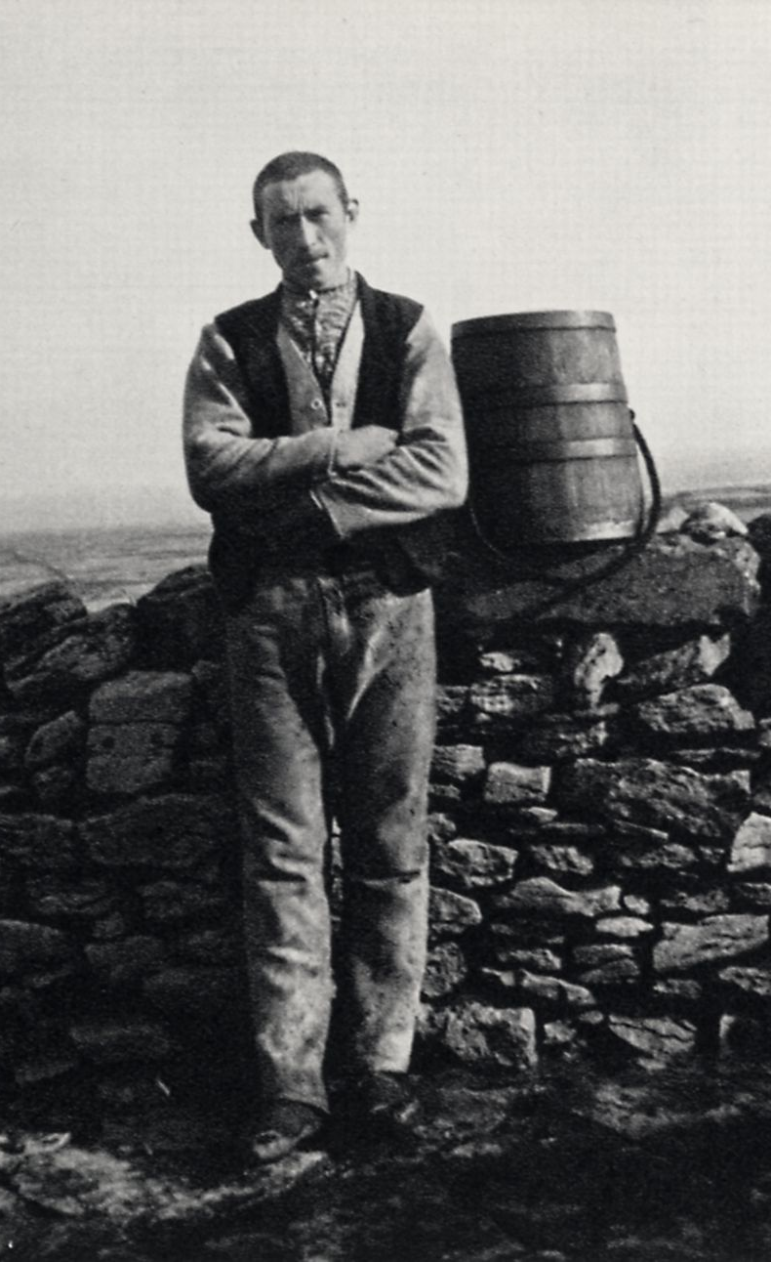
Synge in the Aran Islands, 1898-1901

Slide 20
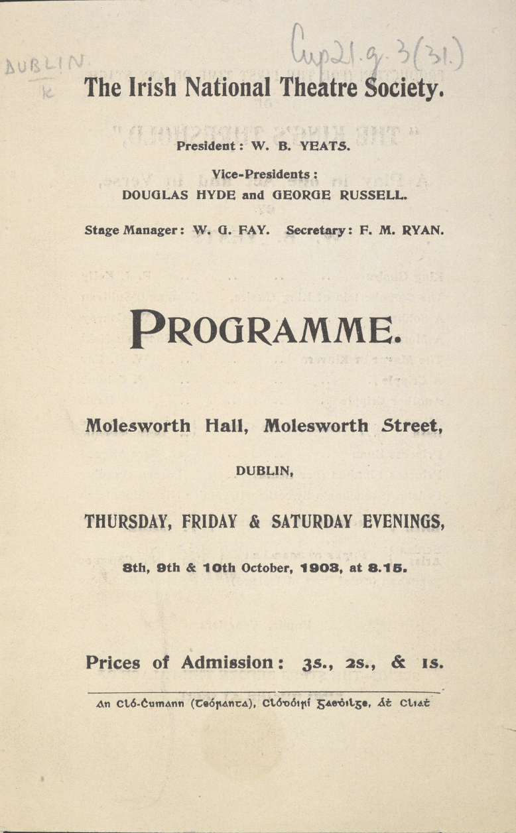
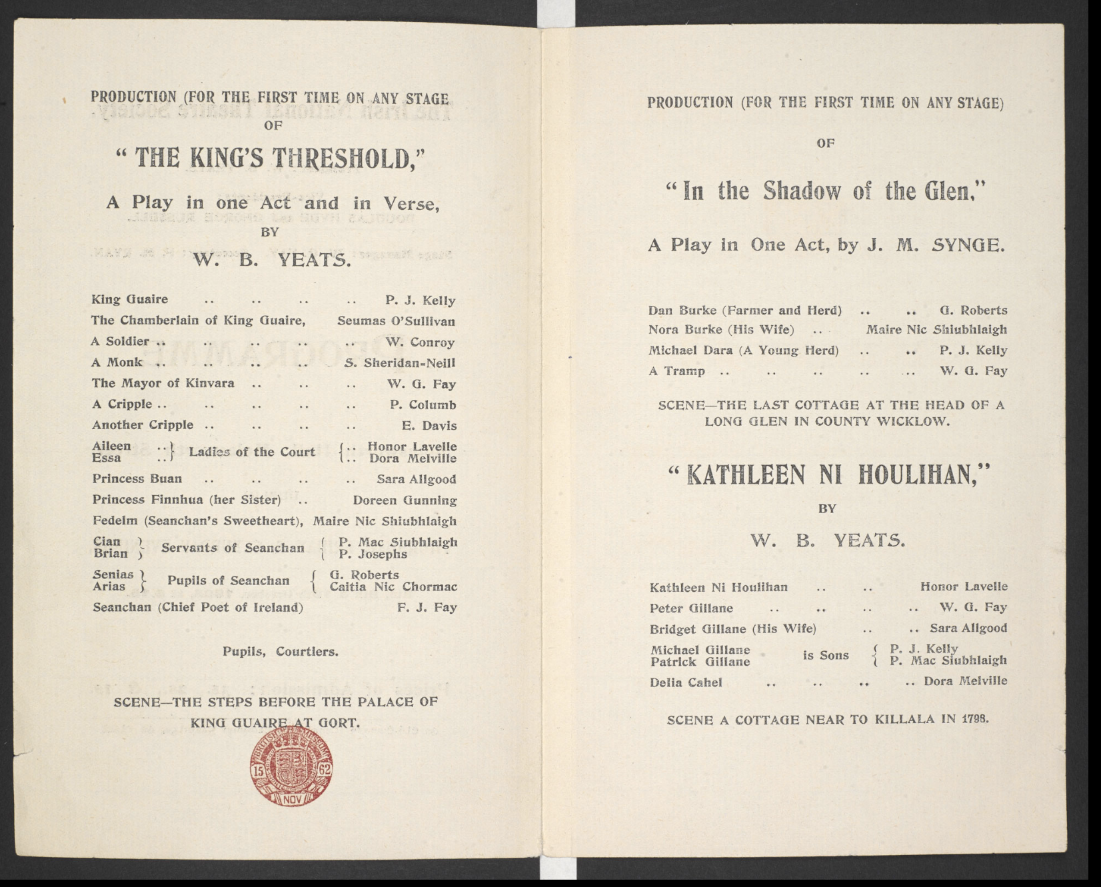
Program from the 1903 Season

Slide 21
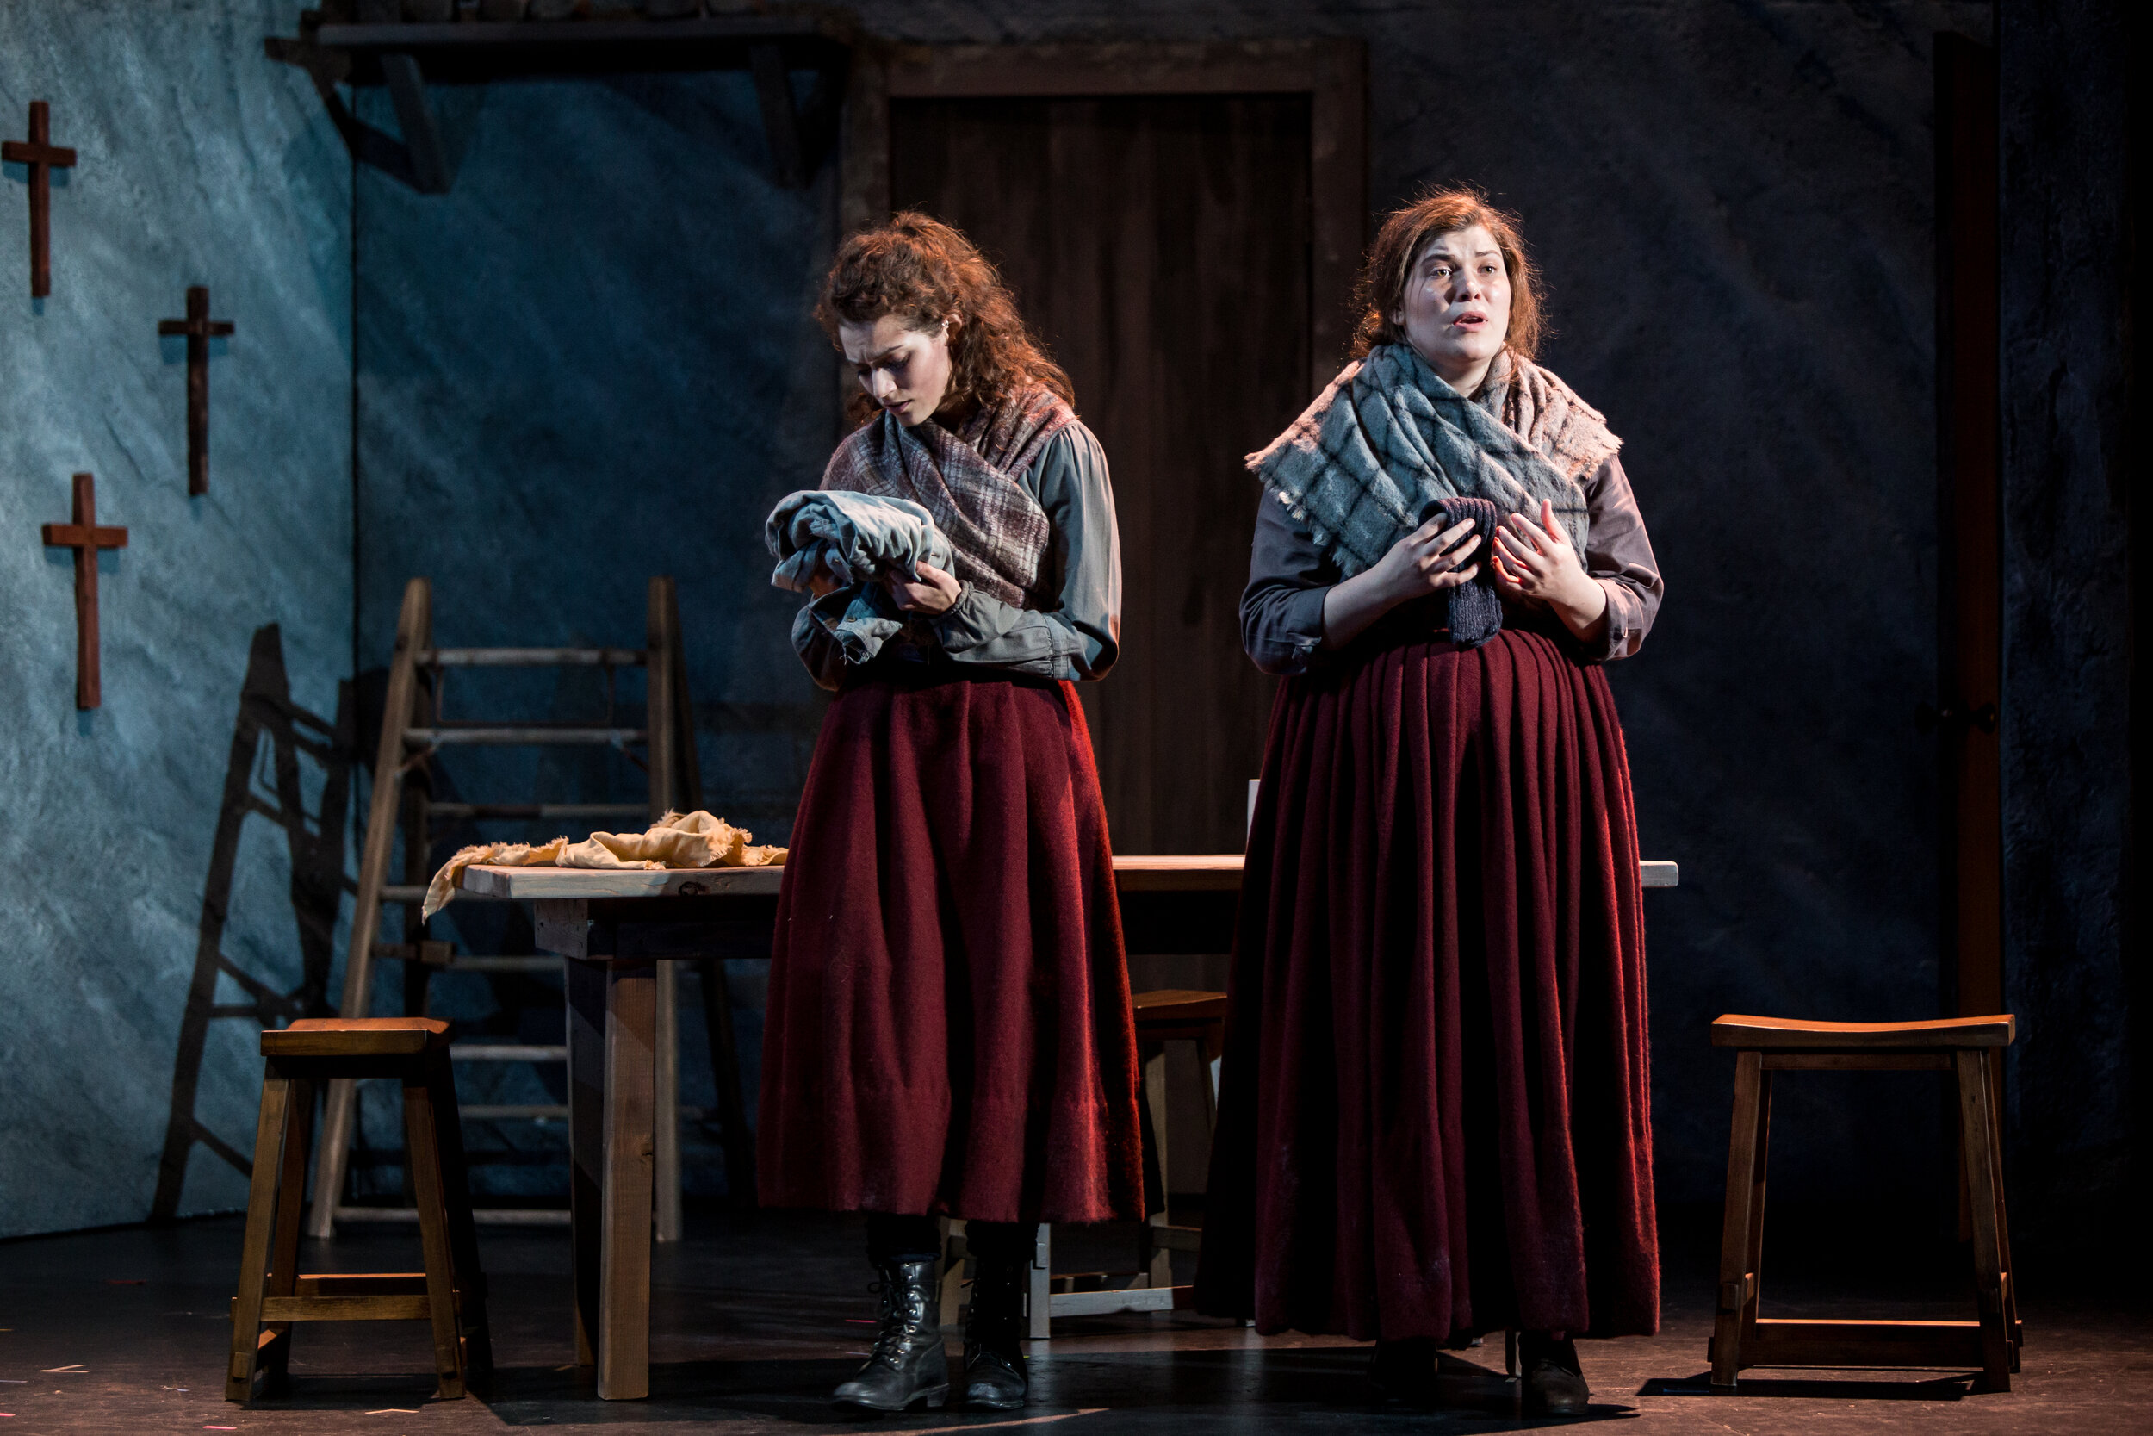

Slide 23
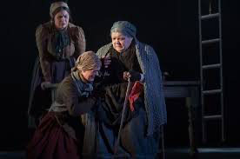
MAURYA: (continues without hearing anything) There was Sheamus and his father, and his own father again, were lost in a dark night, and not a stick or sign was seen of them when the sun went up. There was Patch after was drowned out of a curagh that turned over. I was sitting here with Bartley, and he a baby, lying on my two knees, and I seen two women, and three women, and four women coming in, and they crossing themselves, and not saying a word. I looked out then, and there were men coming after them, and they holding a thing in the half of a red sail, and water dripping out of it--it was a dry day, Nora--and leaving a track to the door.
…
They're all gone now, and there isn't anything more the sea can do to me.... I'll have no call now to be up crying and praying when the wind breaks from the south, and you can hear the surf is in the east, and the surf is in the west, making a great stir with the two noises, and they hitting one on the other. I'll have no call now to be going down and getting Holy Water in the dark nights after Samhain, and I won't care what way the sea is when the other women will be keening. (To NORA) Give me the Holy Water, Nora; there's a small sup still on the dresser.

Slide 24
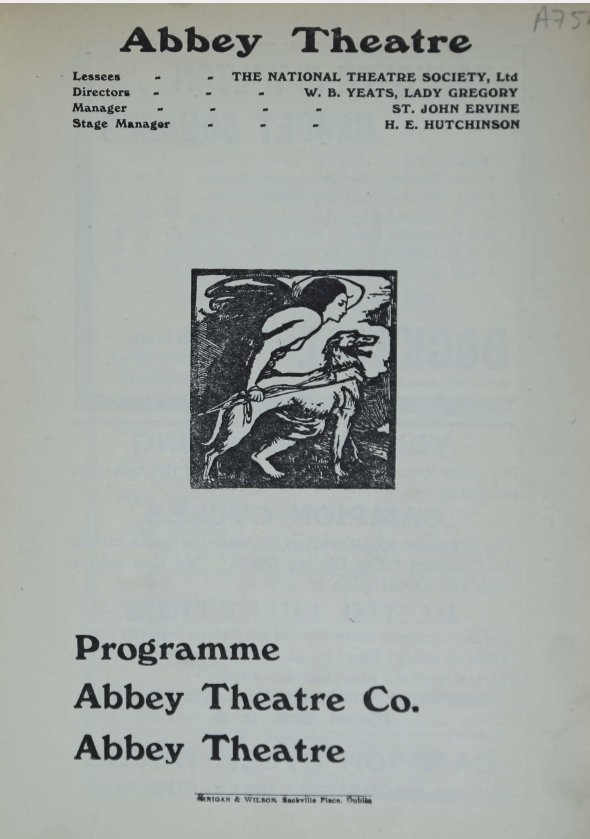

Slide 25
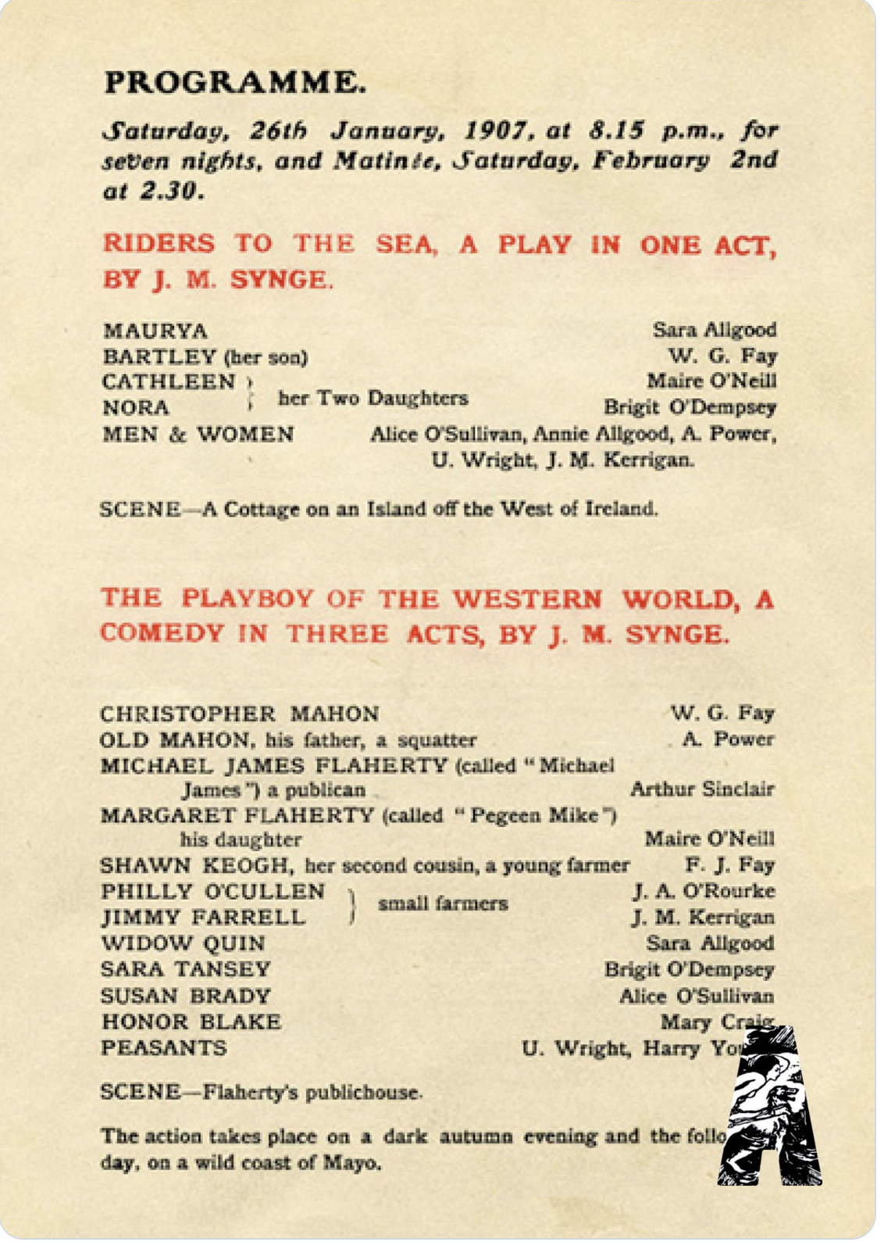
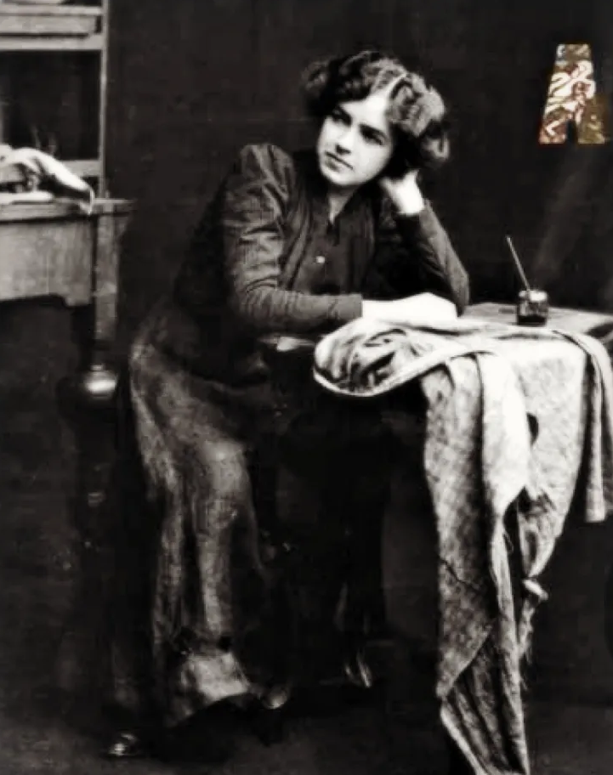
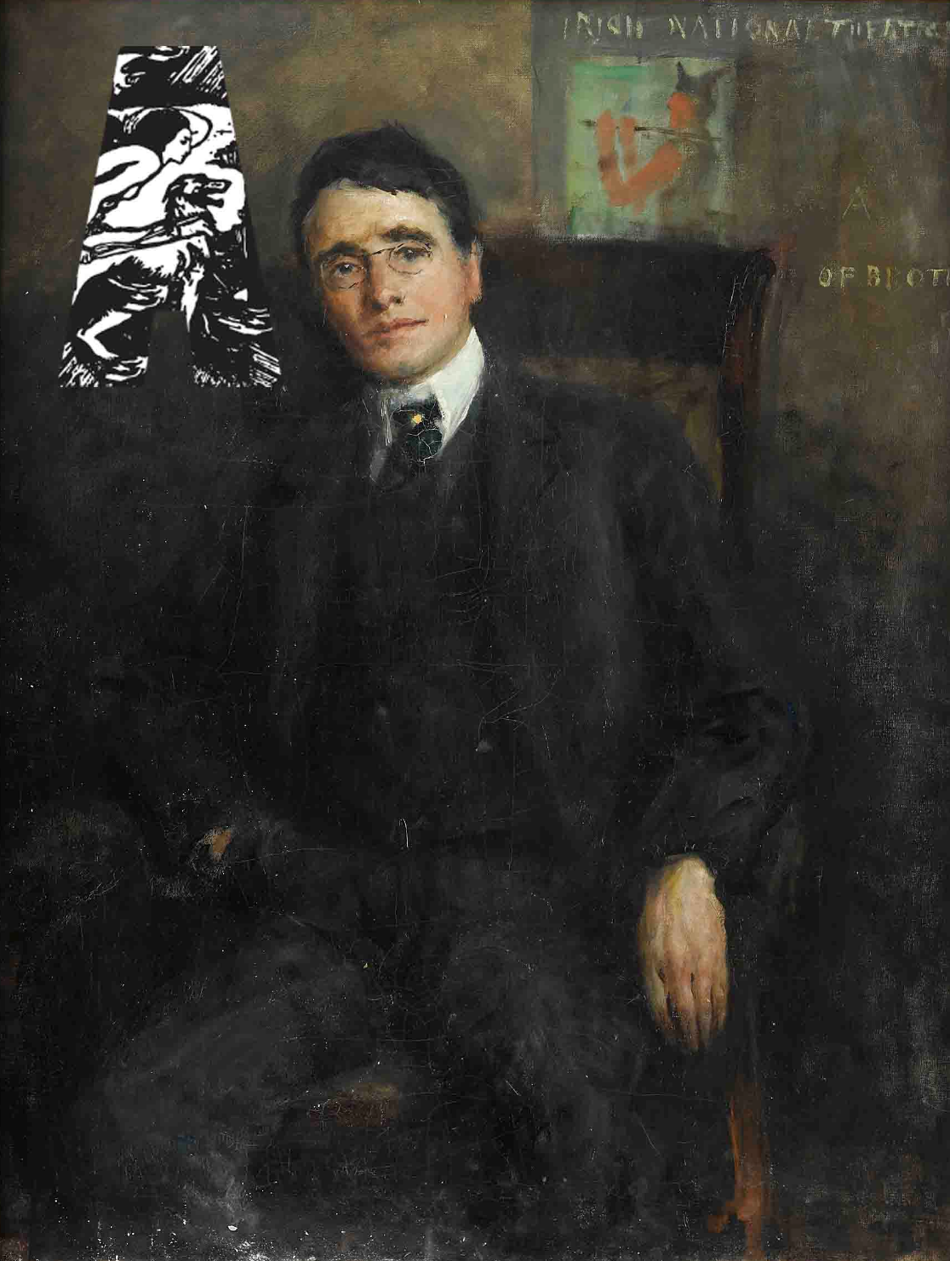
Maire O’Neil as Pegeen Mike
W. G. Fay as Christy Mahon

Slide 26
From Scene 1
PEGEEN. putting letter in envelope.—It’s above at the cross-roads he is, meeting Philly Cullen; and a couple more are going along with him to Kate Cassidy’s wake.
SHAWN. looking at her blankly.—And he’s going that length in the dark night?
PEGEEN. impatiently.—He is surely, and leaving me lonesome on the scruff of the hill. (She gets up and puts envelope on dresser, then winds the clock.) Isn’t it long the nights are now, Shawn Keogh, to be leaving a poor girl with her own self counting the hours to the dawn of day?
SHAWN. with awkward humour.—If it is, when we’re wedded in a short while you’ll have no call to complain, for I’ve little will to be walking off to wakes or weddings in the darkness of the night.
PEGEEN. with rather scornful good humour.—You’re making mighty certain, Shaneen, that I’ll wed you now.

Slide 27
SHAWN. Aren’t we after making a good bargain, the way we’re only waiting these days on Father Reilly’s dispensation from the bishops, or the Court of Rome.
PEGEEN. looking at him teasingly, washing up at dresser.—It’s a wonder, Shaneen, the Holy Father’d be taking notice of the likes of you; for if I was him I wouldn’t bother with this place where you’ll meet none but Red Linahan, has a squint in his eye, and Patcheen is lame in his heel, or the mad Mulrannies were driven from California and they lost in their wits. We’re a queer lot these times to go troubling the Holy Father on his sacred seat.
SHAWN. scandalized.—If we are, we’re as good this place as another, maybe, and as good these times as we were for ever.
PEGEEN. with scorn.—As good, is it? Where now will you meet the like of Daneen Sullivan knocked the eye from a peeler, or Marcus Quin, God rest him, got six months for maiming ewes, and he a great warrant to tell stories of holy Ireland till he’d have the old women shedding down tears about their feet. Where will you find the like of them, I’m saying?

Slide 28
After Christy enters:
PEGEEN. with a sign to the men to be quiet.—You’re only saying it. You did nothing at all. A soft lad the like of you wouldn’t slit the windpipe of a screeching sow.
CHRISTY. offended.—You’re not speaking the truth.
PEGEEN. in mock rage.—Not speaking the truth, is it? Would you have me knock the head of you with the butt of the broom?
CHRISTY. twisting round on her with a sharp cry of horror.—Don’t strike me. I killed my poor father, Tuesday was a week, for doing the like of that.
PEGEEN. with blank amazement.—Is it killed your father?
CHRISTY. subsiding.—With the help of God I did surely, and that the Holy Immaculate Mother may intercede for his soul.
PHILLY. retreating with Jimmy.—There’s a daring fellow.
JIMMY. Oh, glory be to God!

Slide 29
MICHAEL. with great respect.—That was a hanging crime, mister honey. You should have had good reason for doing the like of that.
CHRISTY. in a very reasonable tone.—He was a dirty man, God forgive him, and he getting old and crusty, the way I couldn’t put up with him at all.
PEGEEN. And you shot him dead?
CHRISTY. shaking his head.—I never used weapons. I’ve no license, and I’m a law-fearing man.
MICHAEL. It was with a hilted knife maybe? I’m told, in the big world it’s bloody knives they use.
CHRISTY. loudly, scandalized.—Do you take me for a slaughter-boy?

Slide 30
End of the play:
CHRISTY. kicking and screaming.—O, glory be to God! [He kicks loose from the table, and they all drag him towards the door.]
JIMMY. seeing old Mahon.—Will you look what’s come in? [They all drop Christy and run left.]
CHRISTY. scrambling on his knees face to face with old Mahon.—Are you coming to be killed a third time, or what ails you now?
MAHON. For what is it they have you tied?
CHRISTY. They’re taking me to the peelers to have me hanged for slaying you.
MICHAEL. apologetically.—It is the will of God that all should guard their little cabins from the treachery of law, and what would my daughter be doing if I was ruined or was hanged itself?
MAHON. grimly, loosening Christy.—It’s little I care if you put a bag on her back, and went picking cockles till the hour of death; but my son and myself will be going our own way, and we’ll have great times from this out telling stories of the villainy of Mayo, and the fools is here. (To Christy, who is freed.) Come on now.

Slide 31
. . .
MAHON. walking out and looking back at Christy over his shoulder.—Glory be to God! (With a broad smile.) I am crazy again! [Goes.]
CHRISTY. Ten thousand blessings upon all that’s here, for you’ve turned me a likely gaffer in the end of all, the way I’ll go romancing through a romping lifetime from this hour to the dawning of the judgment day. [He goes out.]
MICHAEL. By the will of God, we’ll have peace now for our drinks. Will you draw the porter, Pegeen?
SHAWN. going up to her.—It’s a miracle Father Reilly can wed us in the end of all, and we’ll have none to trouble us when his vicious bite is healed.
PEGEEN. hitting him a box on the ear.—Quit my sight. (Putting her shawl over her head and breaking out into wild lamentations.) Oh my grief, I’ve lost him surely. I’ve lost the only Playboy of the Western World!

Slide 32
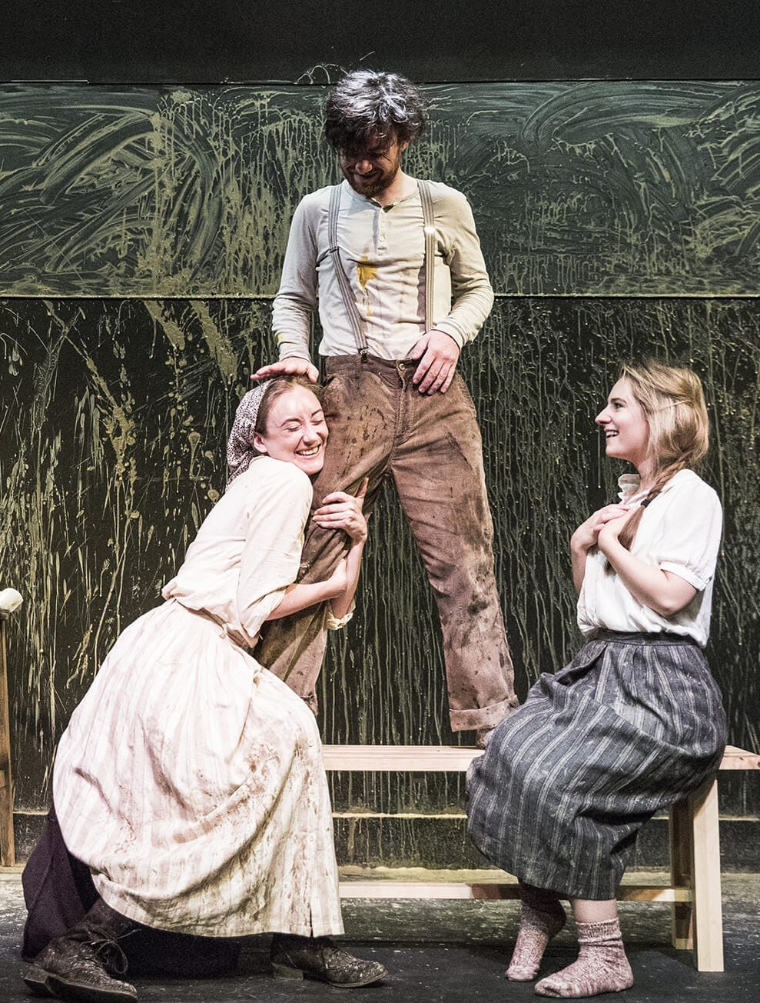
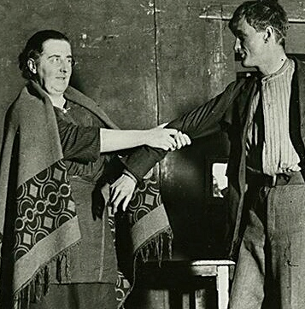
Fighting over Christy, 1907 and 100 years later

Slide 33
Mr. W. G. Fay now came forward to the footlights. He was the recipient of anything but a cordial reception. When a sort of comparative calm had been obtained,
Mr. Fay said-_-Now, as you are all tired, I suppose I may speak
(boos, and yells of We won't have it.')
Mr. Fay--There are people here who have paid to see the piece. Anyone who does not like the play can have his money returned.
Cries of ‘Irishmen do not harbour murderers!
A Voice: We respect Irish virtue.
Mr. Fay-Who are the men who speak about Irish virtue? Let the play go on to the end of the act. I say again you can get your money back. We don't want to keep it. There are people who want to see the play. If they are not permitted to do so I will pull the curtain down, and have the disturbers removed. The piece will be played.
Voice- If you don't pull the curtain down we will pull it down for
you! (deafening cheers).
Cries were then raised of “Where is the author? Bring him out, and we will deal with him!”

Slide 34
Mr. Fay--What do you want the author for? You can have your
money back.
Hundreds of Voices-_We don't want the money. It is a libel on the National Theatre. We never expected this of the Abbey!
Amidst the tumultuous applause which followed, cries of
"Sinn Fein forever' were strenuously uttered.
A Voice- Such a thing as is represented could not occur in Ireland.

Slide 35
[YEATS tries to intervene …]
A gentleman standing up in the body of the hall said -
-I have one word to say; it is this….’
Mr. Yeats--I shall be delighted to hear you in a moment. We have
put this play before you to be heard and judged. Every man has a right
To hear and condemn it if he pleases, but no man has a right to interfere
with another man who wants to hear the play. We shall play on and
in, and I assure you our patience will last longer than their patience.
(applause and groans).
At this stage a number of Trinity College students entered the stalls with the avowed object of suppressing all interruption of the play.
The overcoated gentleman then shouted to his friends: “Come on and have a drink.” and left the hall.
The orchestra played some Irish airs, and at three minutes past nine the curtain rose on The Playboy of the Western World.

Slide 36
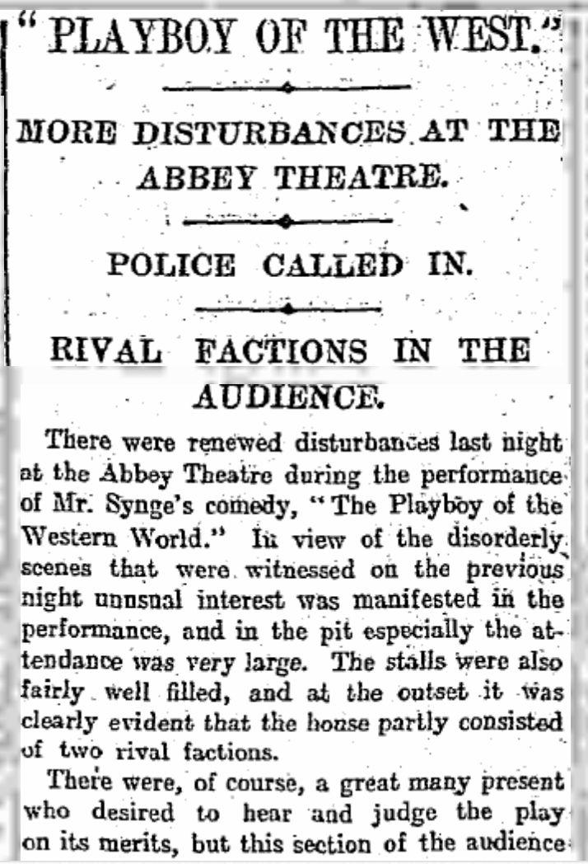
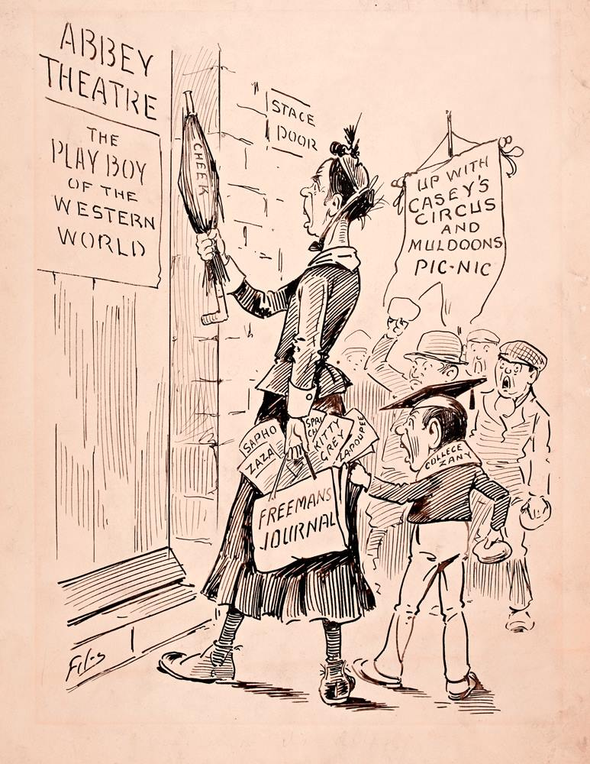

Slide 37
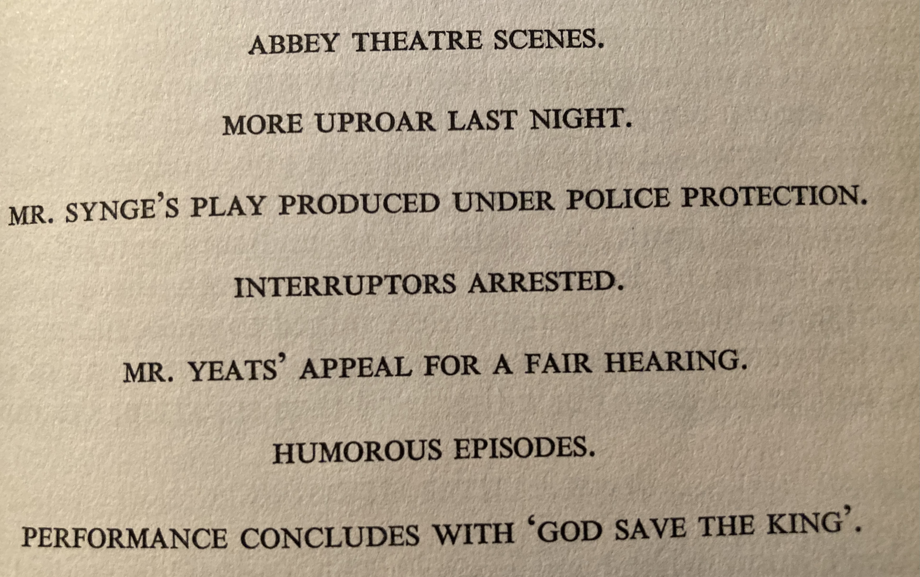

Slide 38
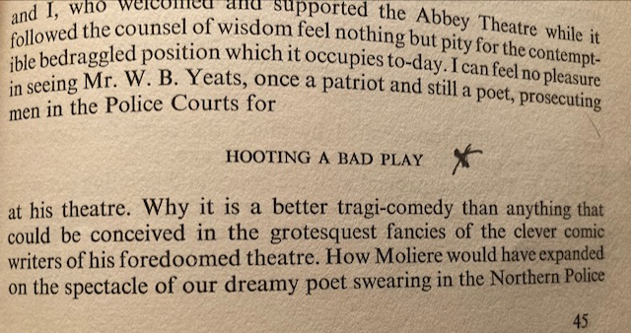

Slide 39
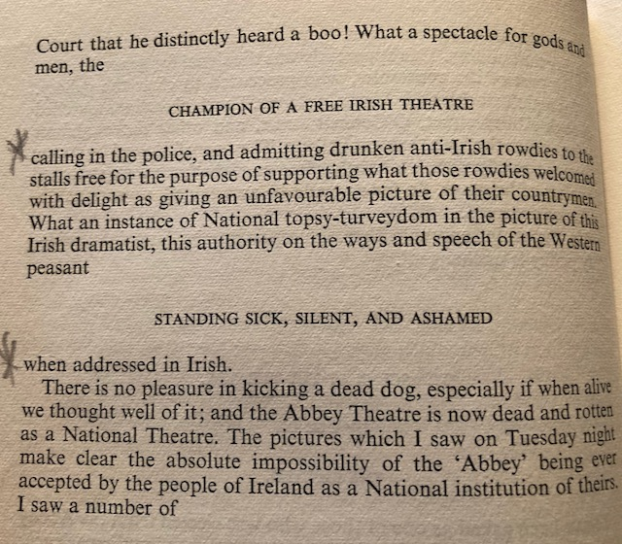
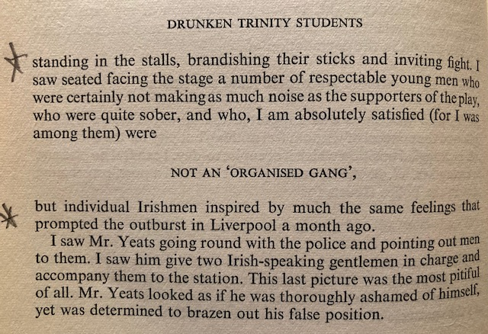

Slide 40
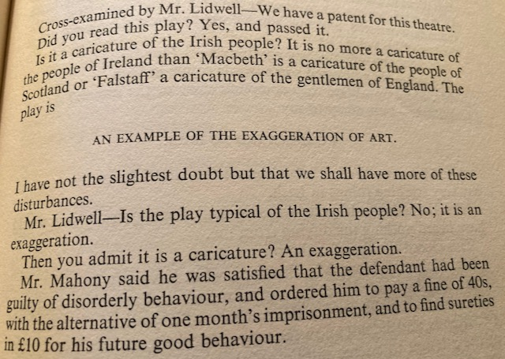
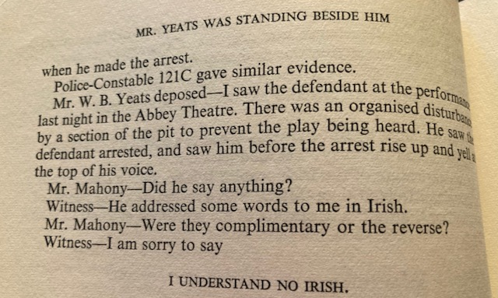

Slide 41
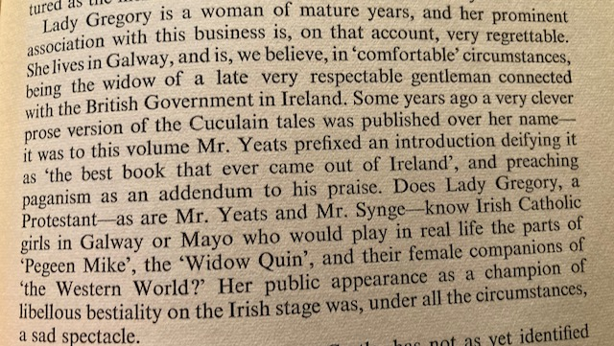

Slide 42
On Those That Hated "The Playboy Of The Western World"
Once, when midnight smote the air,
Eunuchs ran through Hell and met
From thoroughfare to thoroughfare,
While that great Juan galloped by;
And like these to rail and sweat
Staring upon his sinewy thigh.
Yeats, 1907

Slide 43
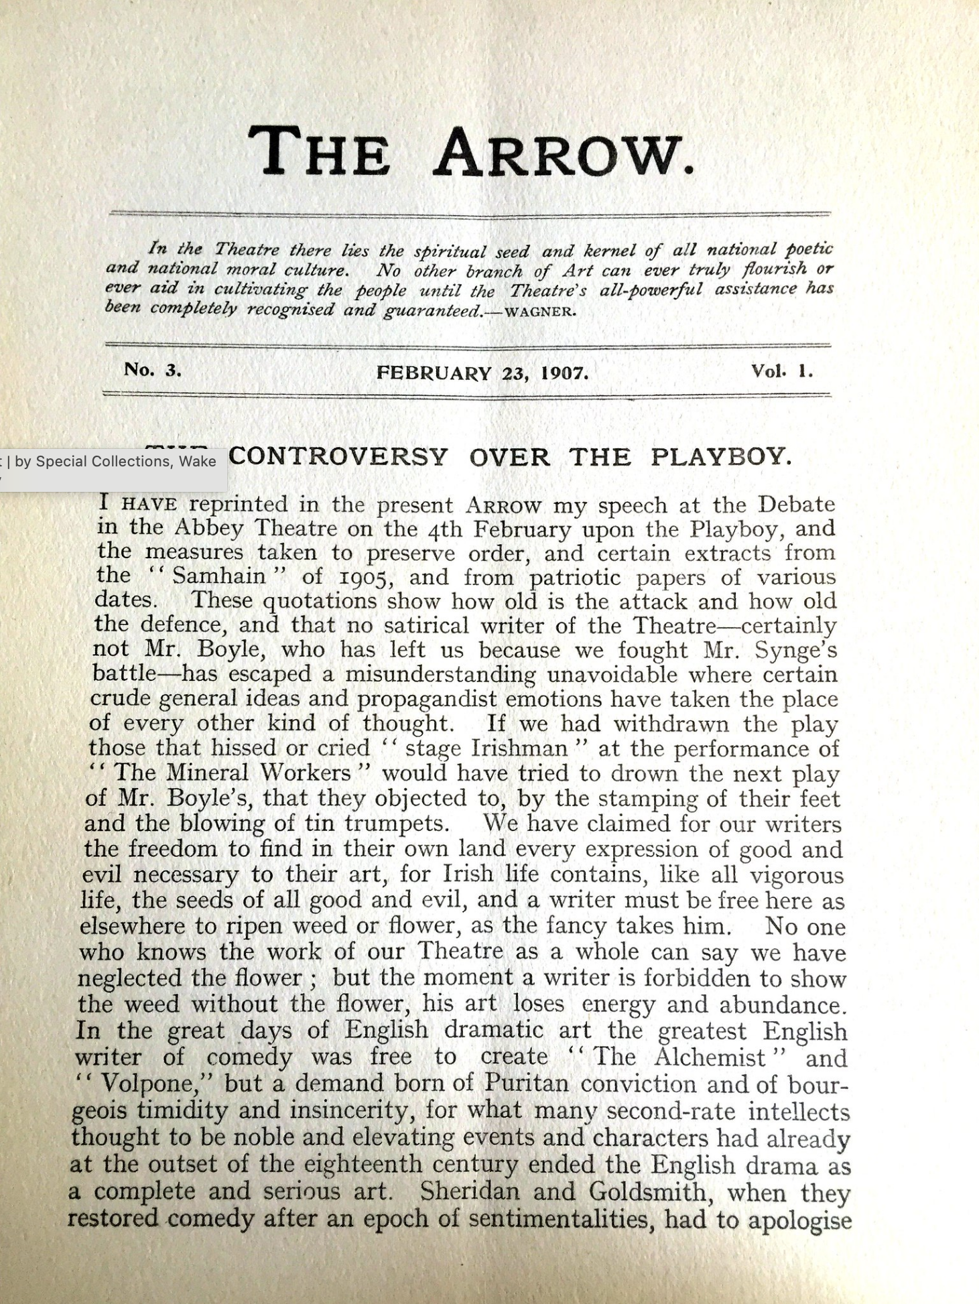
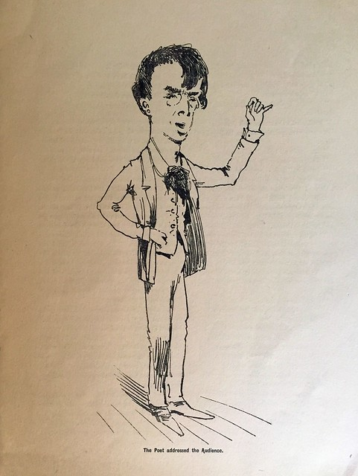
A (sweaty)
Rejoinder from
Yeats

Slide 44
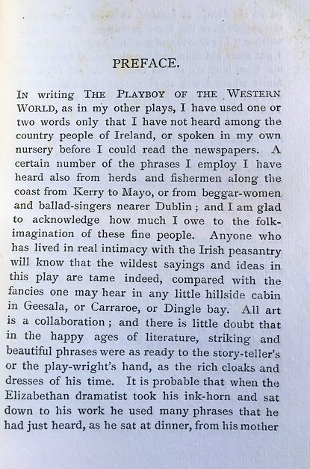
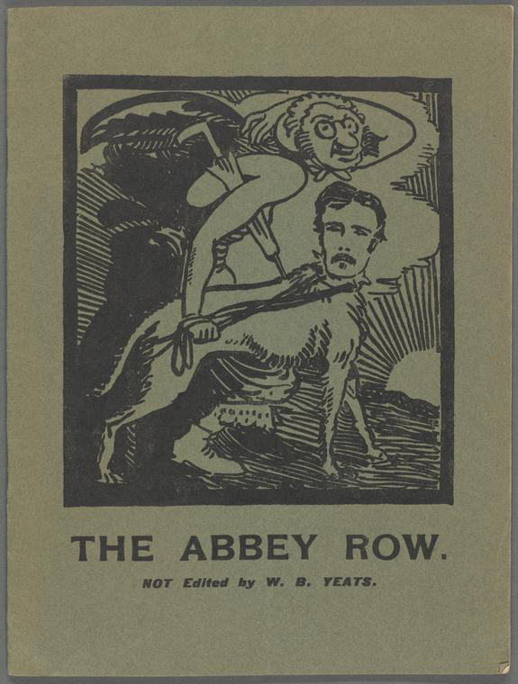
Synge’s quieter apologia…
…and a third-party intervention

Slide 45
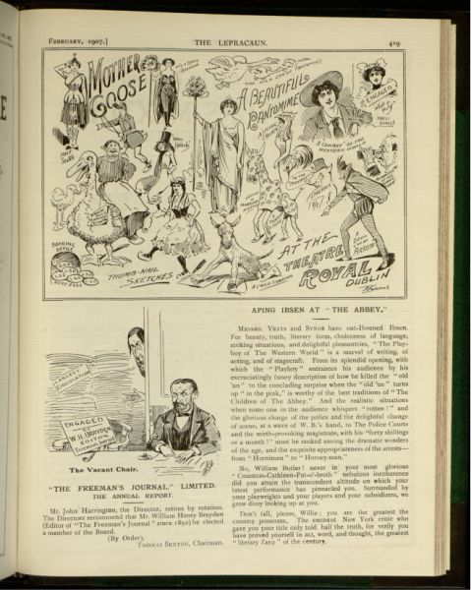
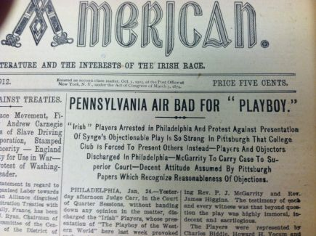

Slide 46
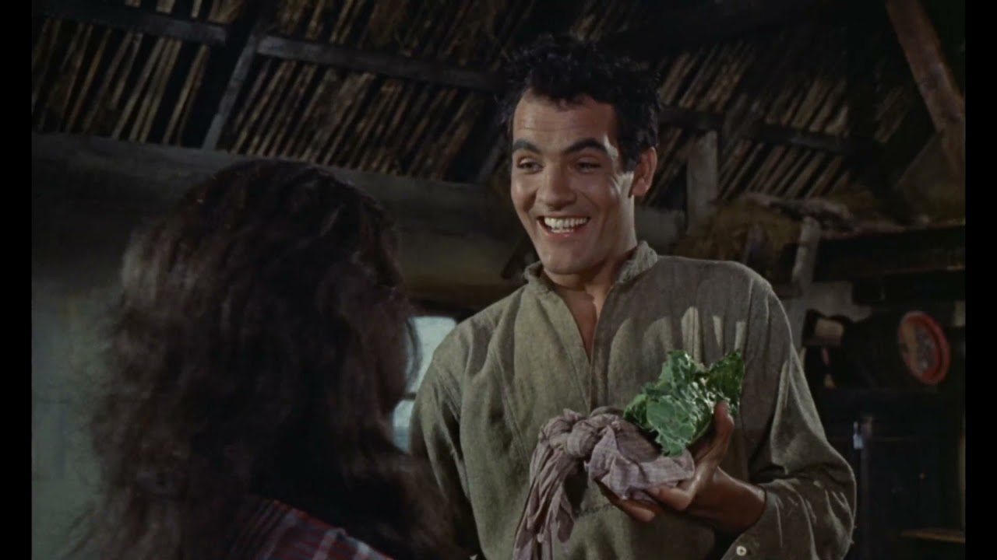
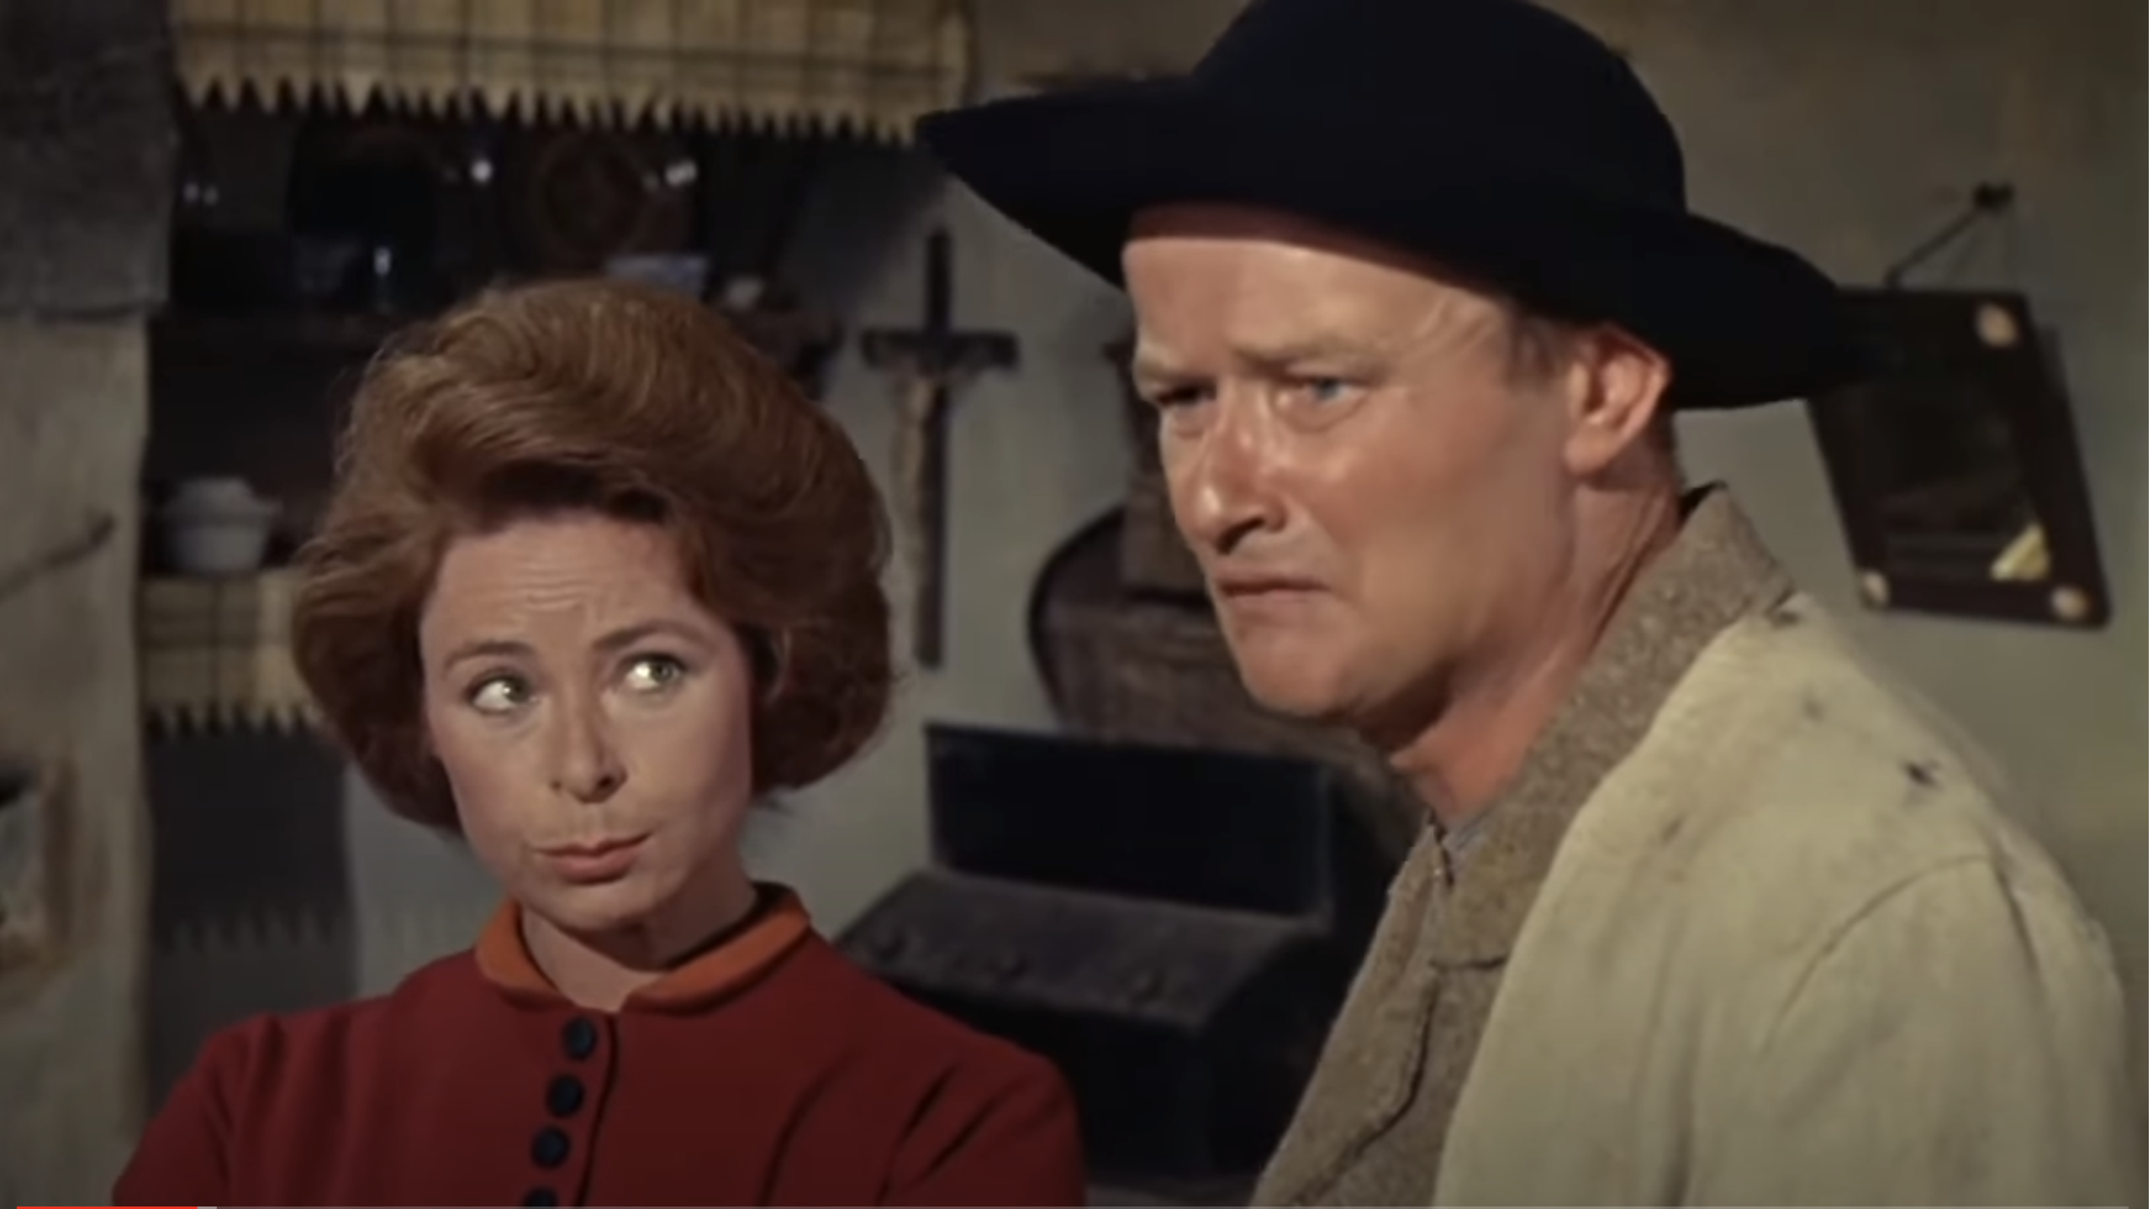

Slide 47
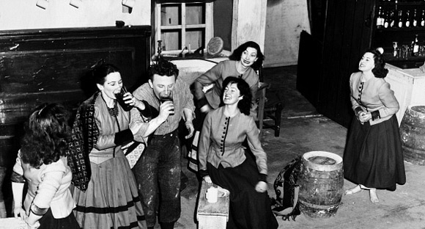

Slide 50
Washington DC, November 2022

Slide 51
The Easter Rising 1916

Slide 52
1926

Slide 56
The Island of Ireland Peace Park, Ypres, 1998

Slide 58
https://www.youtube.com/watch?v=l3XmKvA7nlk

