Slide 1
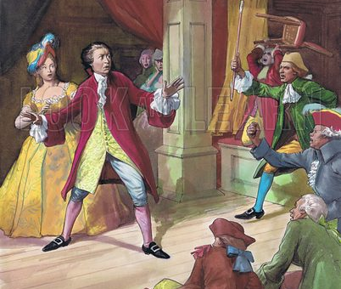
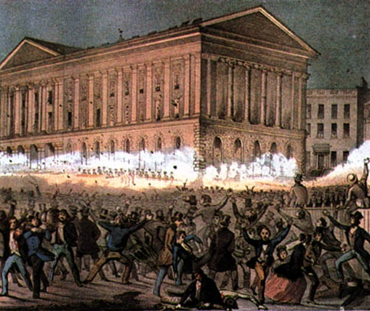
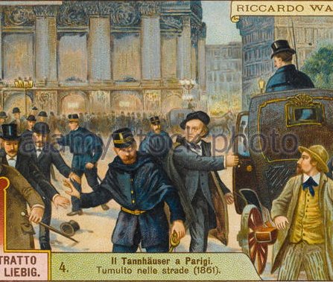
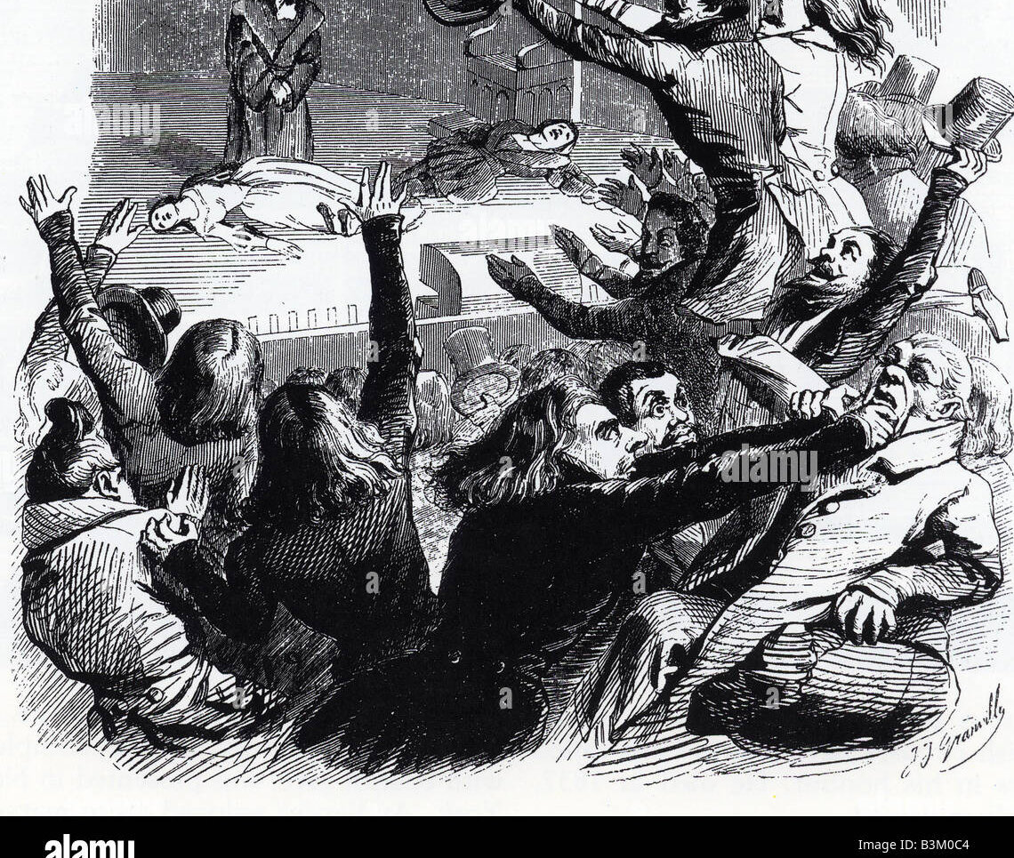
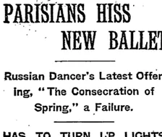
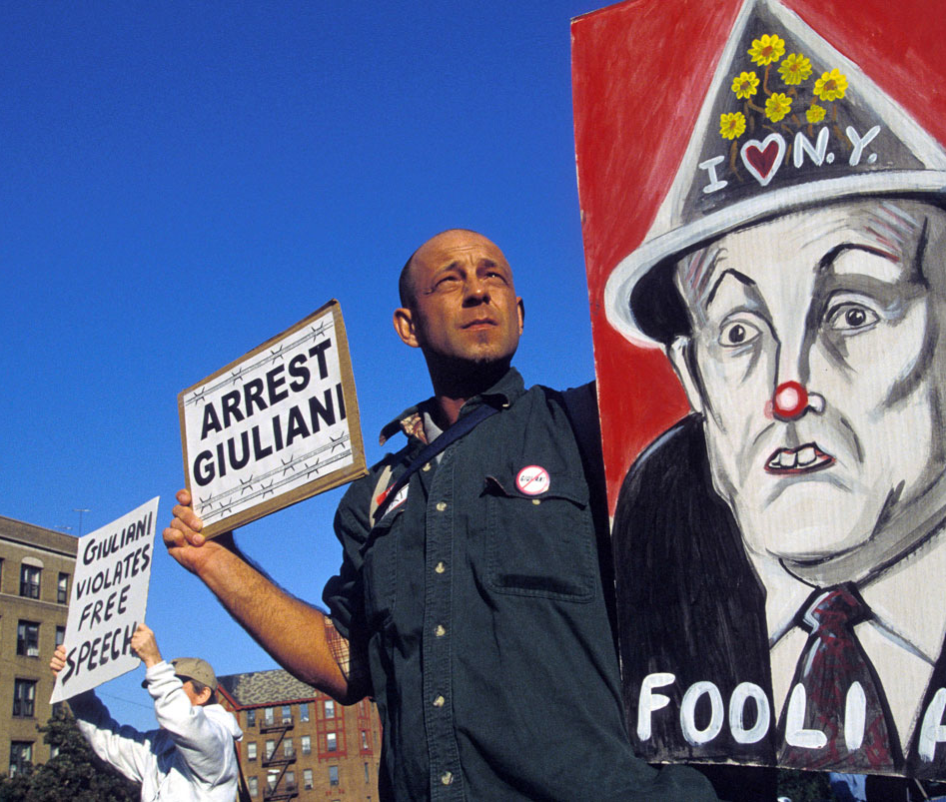
GALLERY BRAWLS
OLLI SPRING
2023
BRUCE MICHELSON

Slide 2
“Together, we must determine
for what drama
this setting
is the setting!”
Situationist Manifesto, Paris, 1968

Slide 3
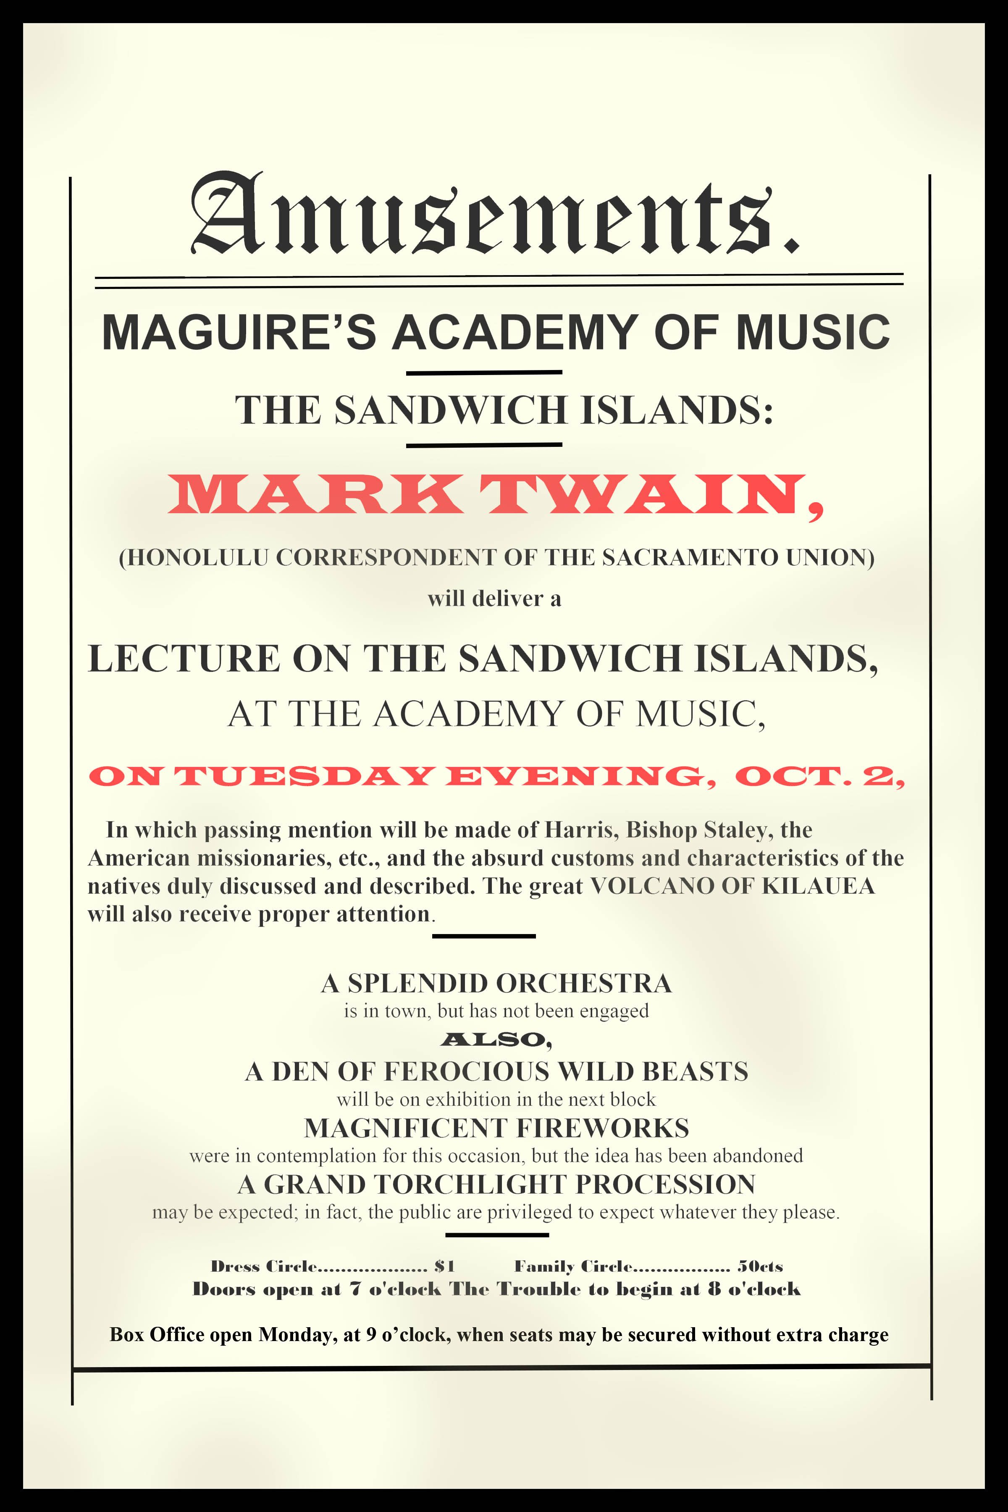
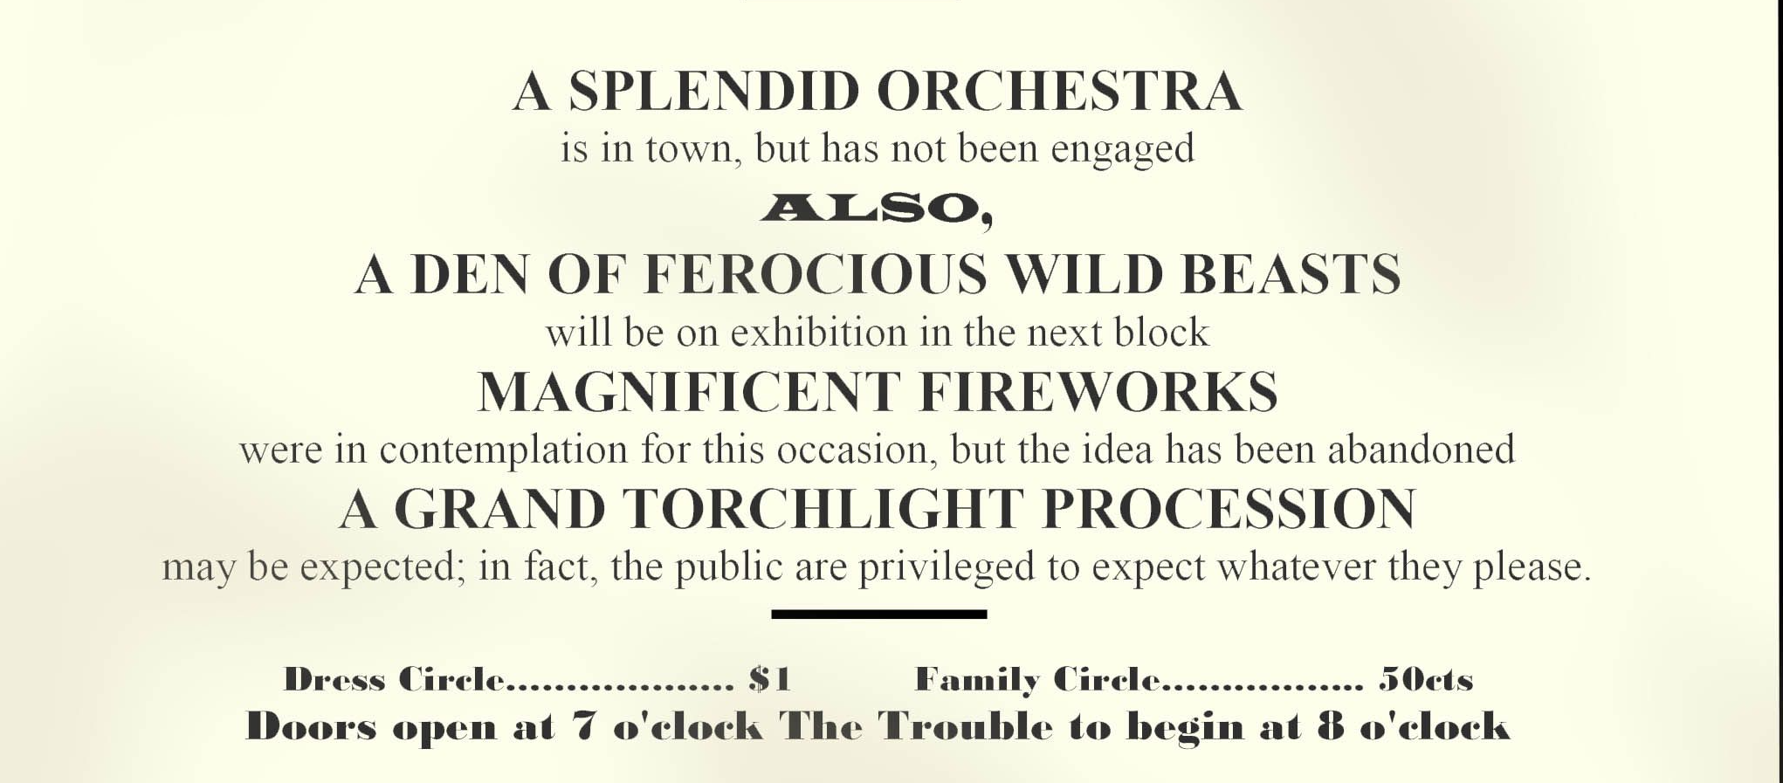


Slide 4
“And whereas it hath been reported, that I gave a licence to certain vicars to assist at a club of fiddlers in Fishamble Street, I do hereby declare that I remember no such licence to have been ever signed or sealed by me; and that if ever such pretended licence should be produced, I do hereby annul and vacate the said licence; intreating my said Sub-Dean and Chapter to punish such vicars as shall ever appear there, as songsters, fiddlers, pipers, trumpeters, drummers, drum-majors, or in any sonal quality, according to the flagitous aggravations of their respective disobedience, rebellion, perfidy, and ingratitude.”
Dean of St. Patrick’s Cathedral, Dublin, 1742

Slide 5
In a specific historical moment, what assumptions and values can we say were prevalent about the nature, purpose, and culture of
ART?
THEATRE?
OPERA AND BALLET?
LITERATURE?
-- and how and why did conflicts break out?

Slide 6
  What codes of conduct – written or otherwise – have guided, constrained, or unleased audiences at key moments in the past? And what can we say those codes are now?
  What can we know about the social and economic fabric and climate of cultural centers when these conflicts have broken out?
  Where do we see interesting reactions – friendly or hostile or both – to new ideas rolling in from outside sources?

Slide 7
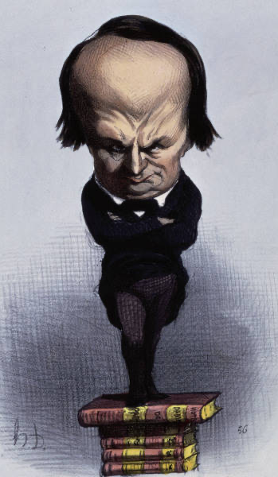

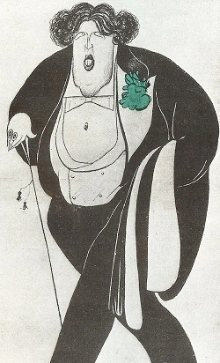
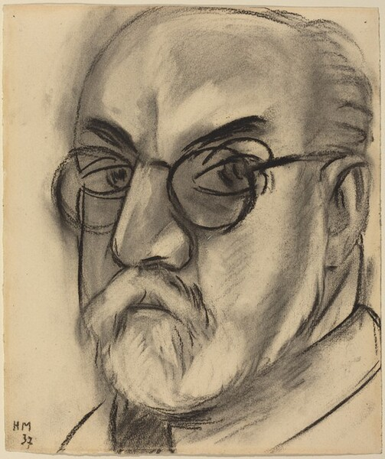
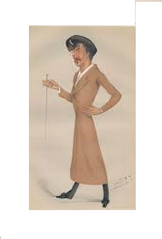
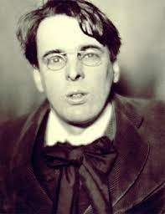
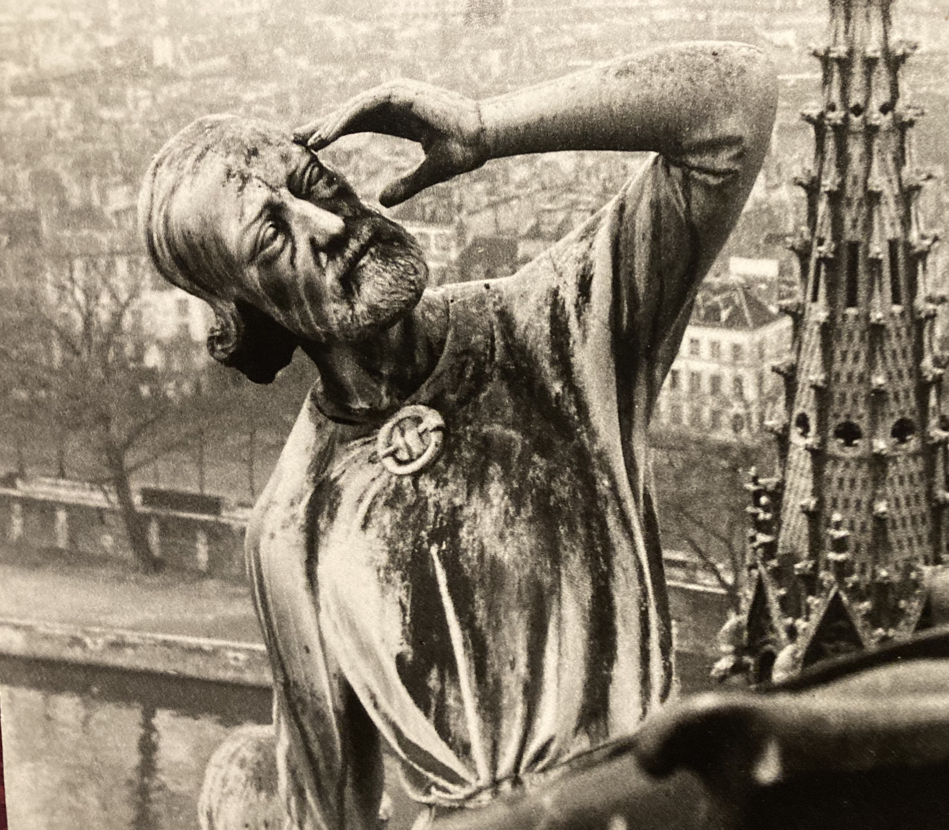
Bigger-than-life personalities

Slide 8
Big Personalities – talents, egos, earned and un-earned reputations: what kind of impacts have celebrity, public pronouncements, and gossip had on a blow-up?
In each case, can we figure out ‘Who Won?’ – either right away, or down the road? Have any “losers” been absolved by History? Do any “victories” look diminished now, or even ridiculous?
When has causing a ruckus been beneficial?
When might it be actually useful, rather than merely destructive?
And -- in our golden age of manipulate hype, how can we know, or guess, the authenticity of discontent about the arts?

Slide 9
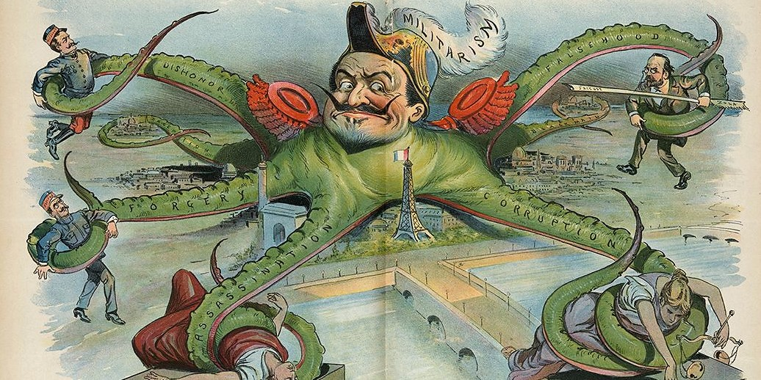
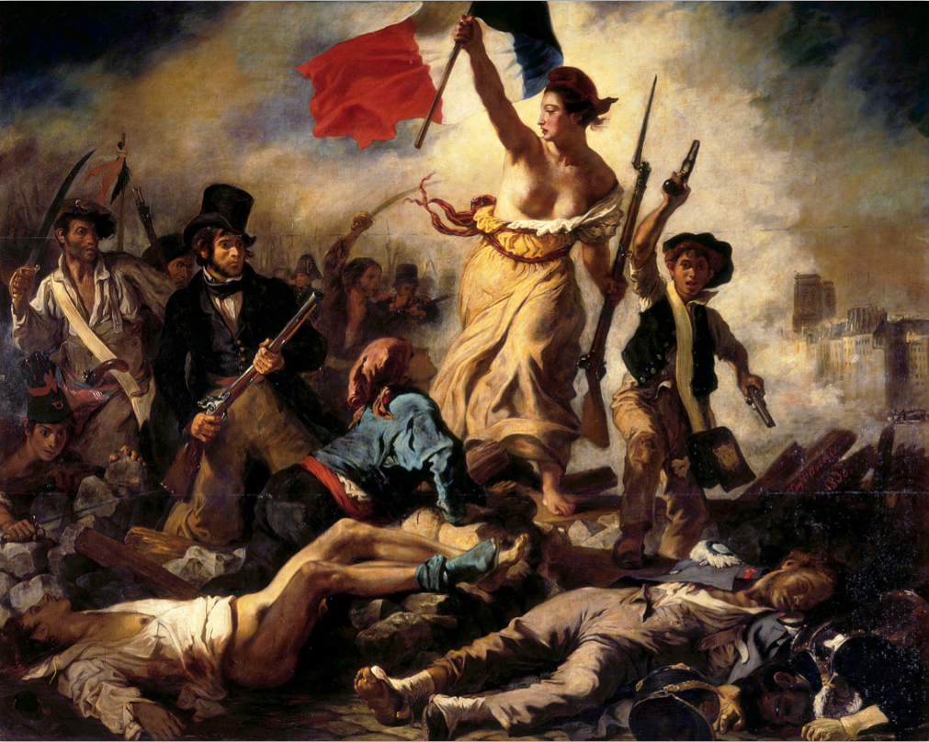
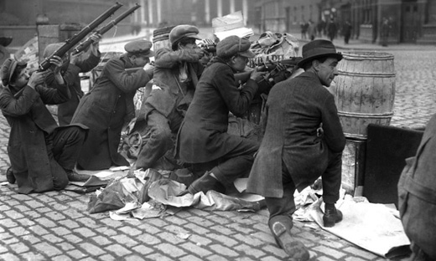
Political and social powder kegs

Slide 10
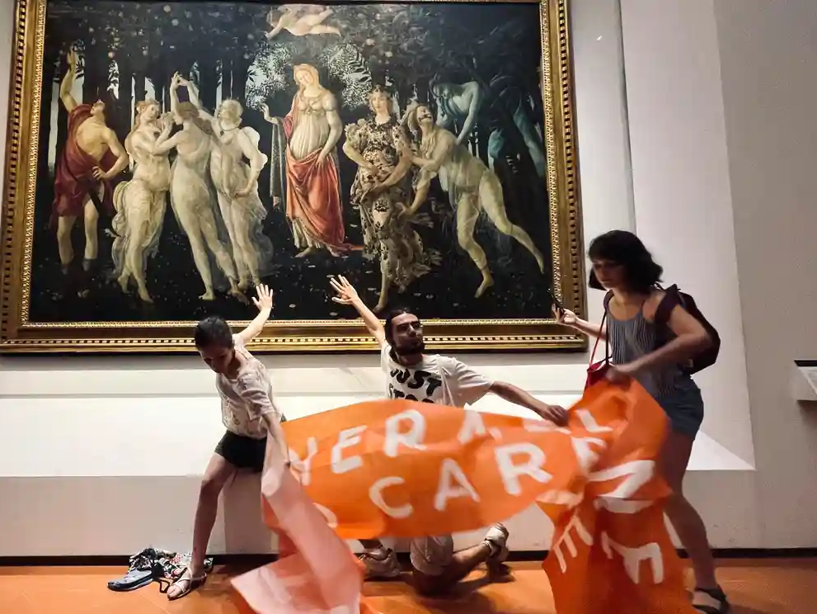
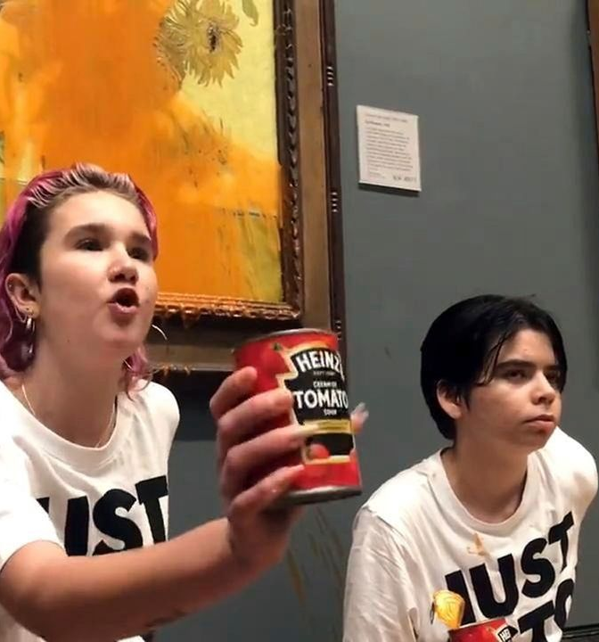
Soft-target treasures and contemporary discontents

Slide 11

August, 2022
Irene Theorin Gives Middle Finger to Booing Audience at Bayreuth Festival
(More fun at the opera than we have at Krannert?)

Slide 12
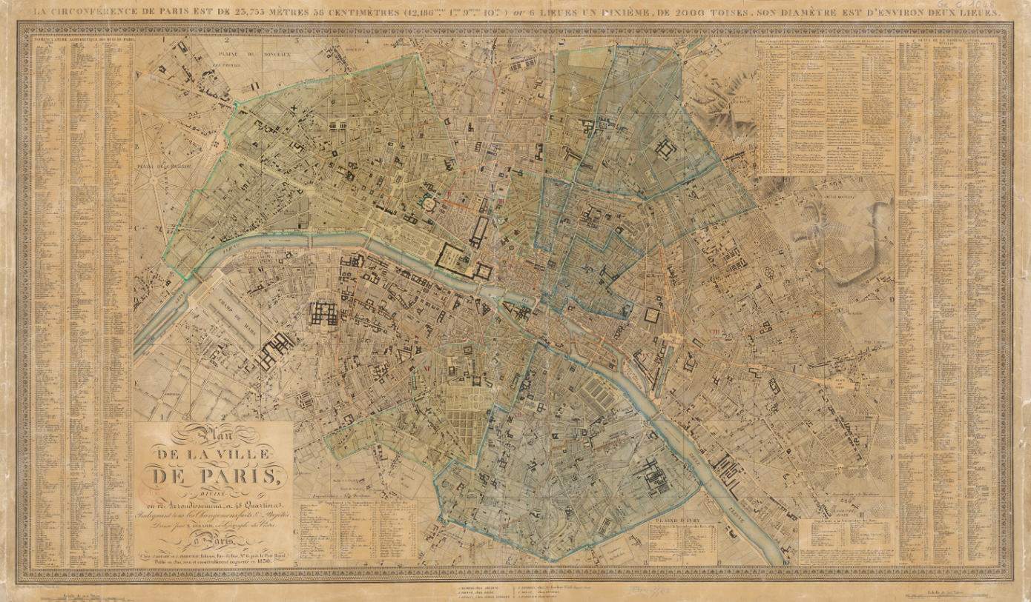

Slide 13
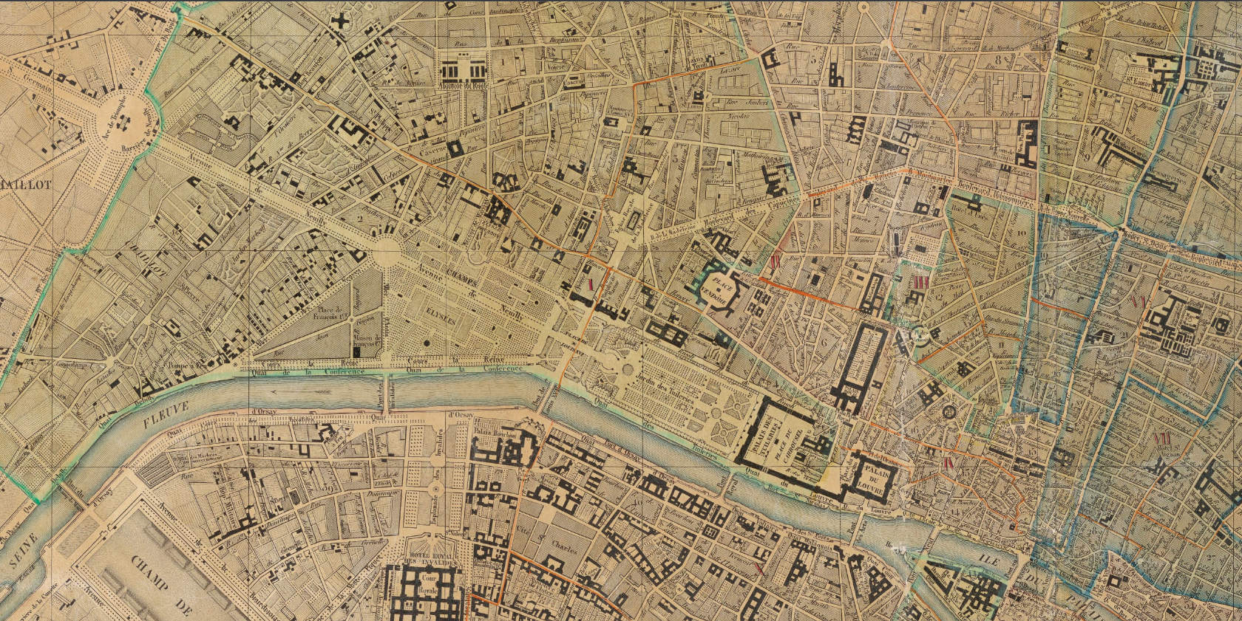

Slide 14
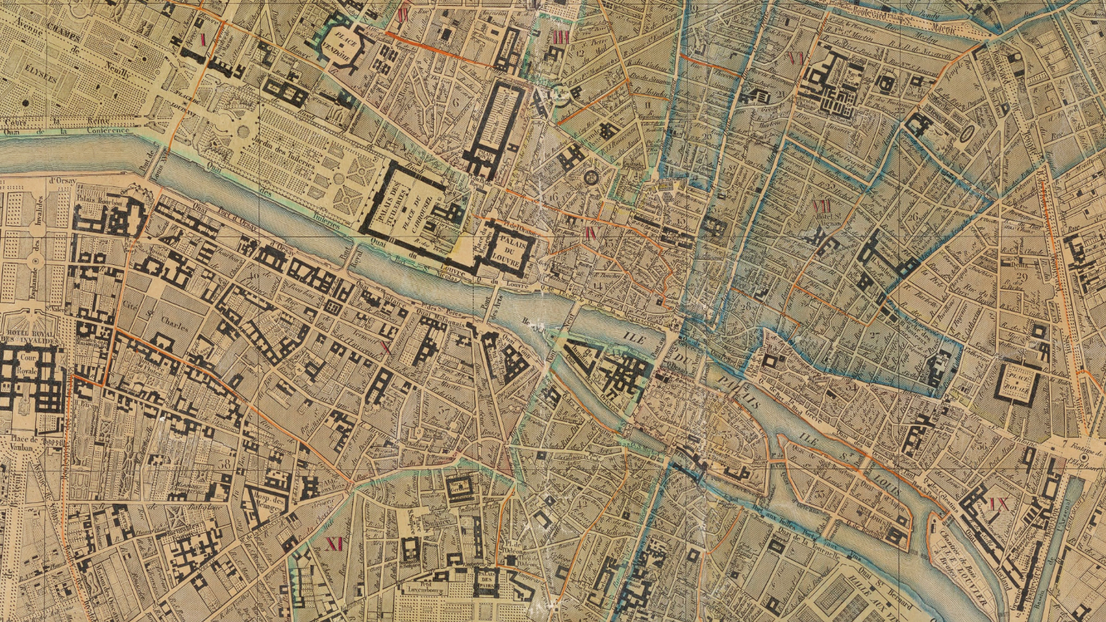

Slide 15
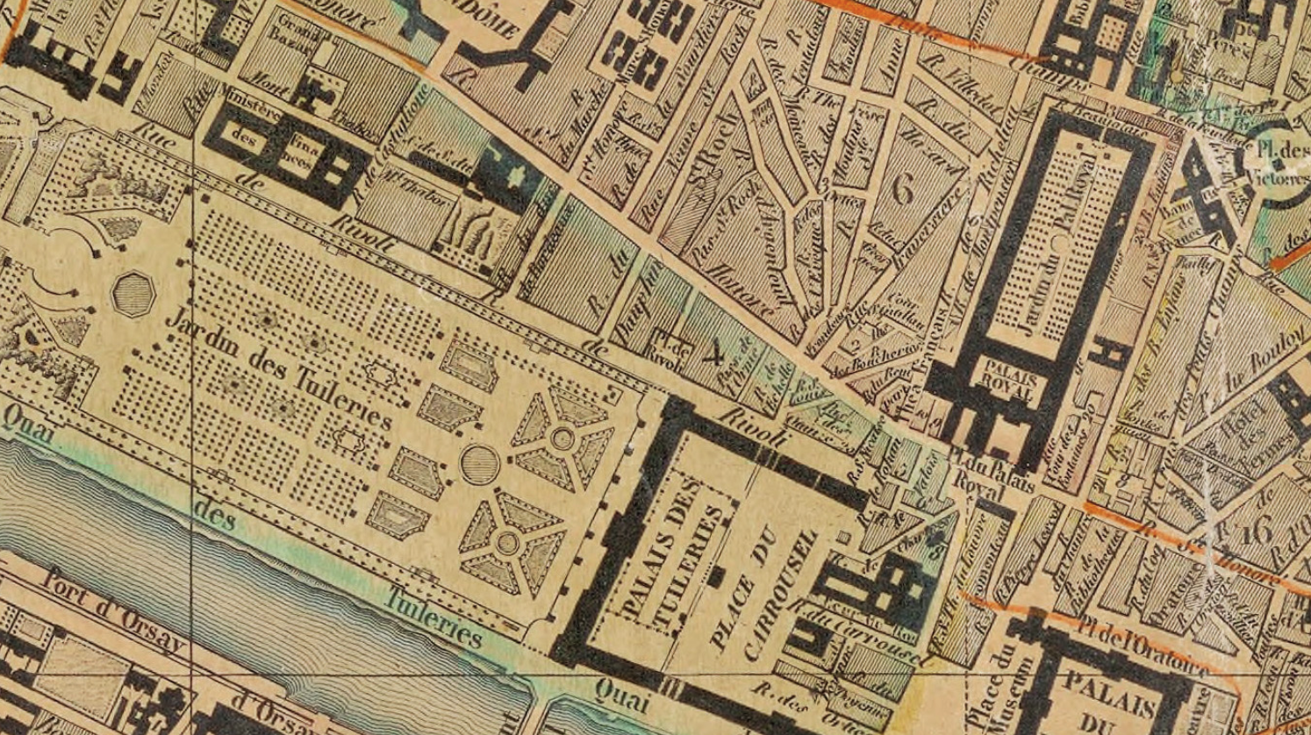


Slide 16
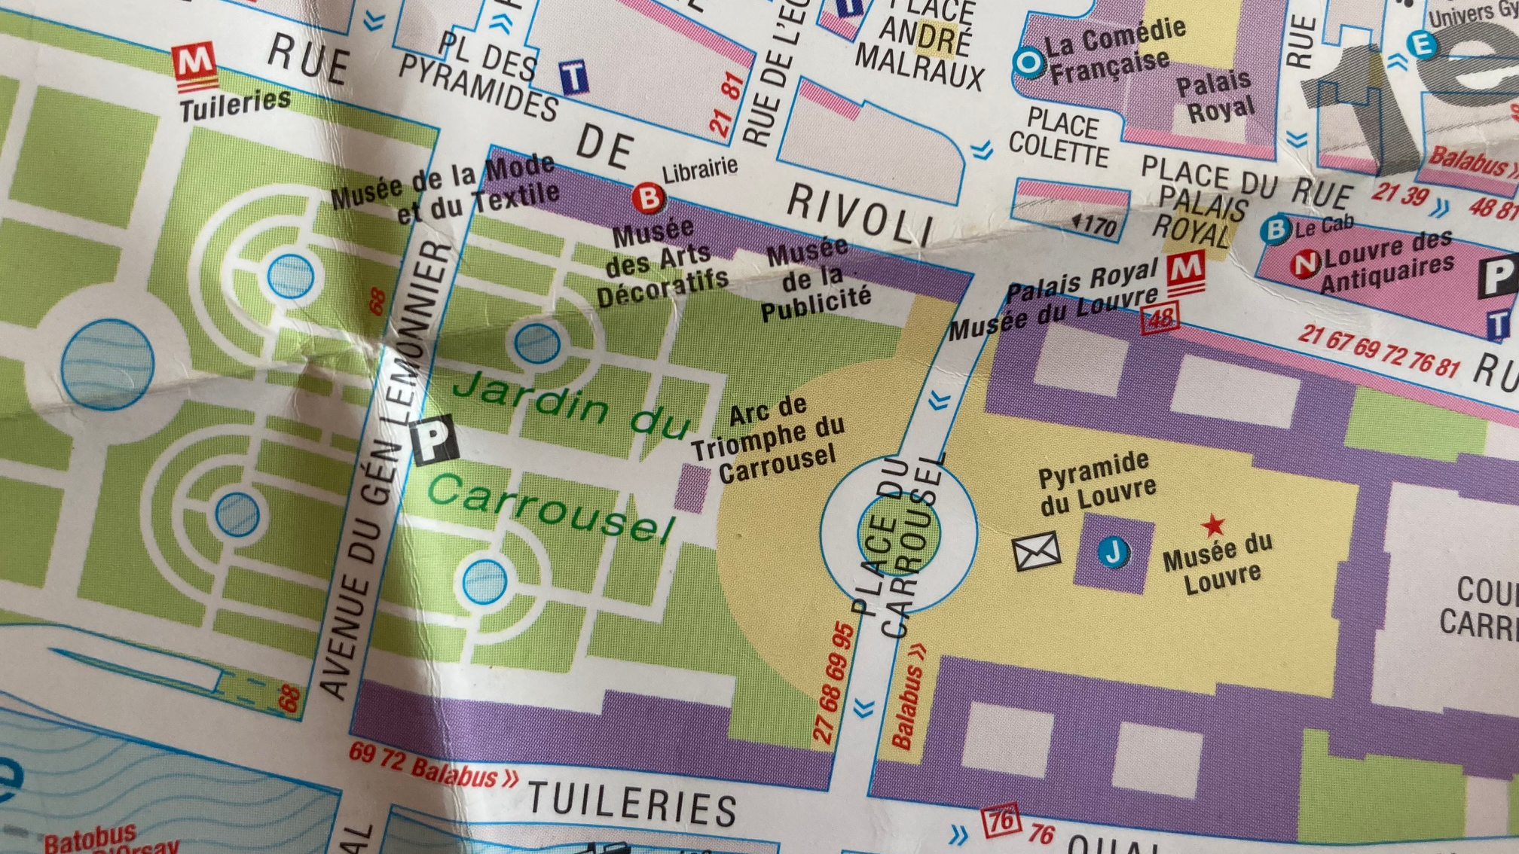

Slide 17
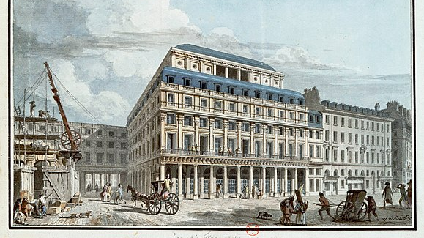

Slide 18
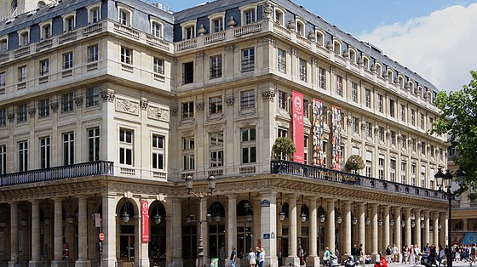

Slide 19
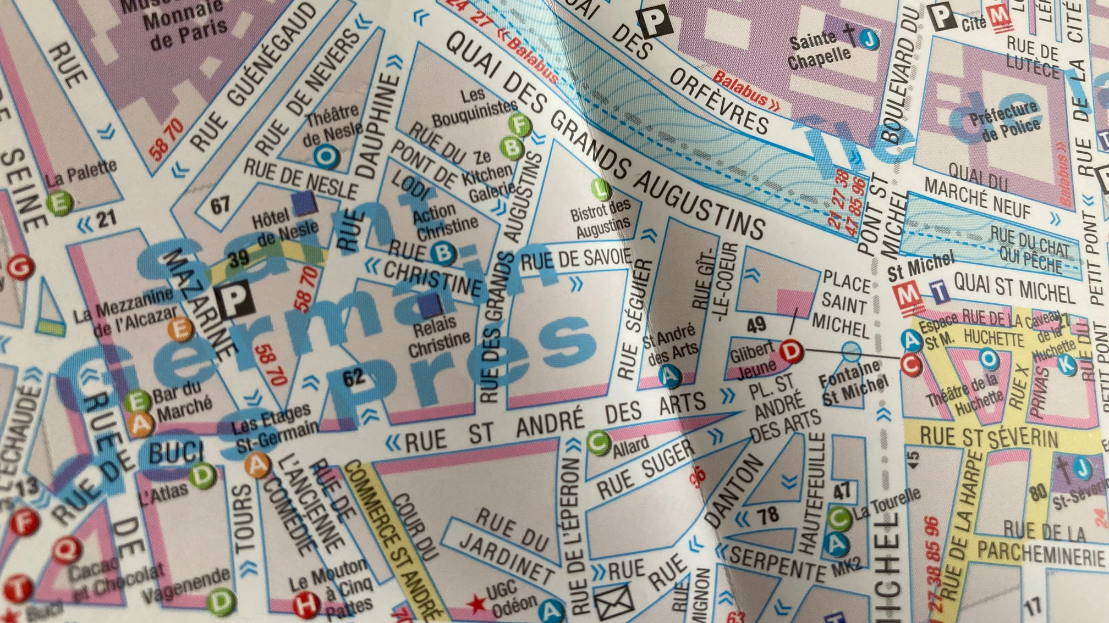


Slide 20
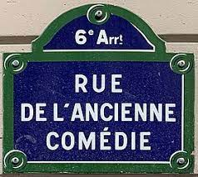
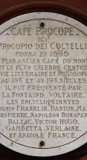
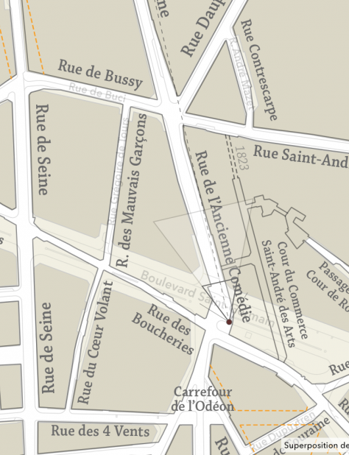
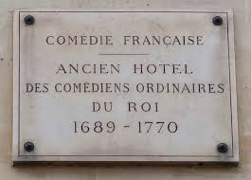
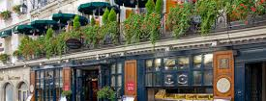

Slide 21
“All nations begin to regard as barbarous those times when even the greatest geniuses, such as Lope de Vega and Shakespeare, were ignorant of this system, and they even confess the obligation they are under to us for having rescued them from this barbarism. . . . The fact that Corneille, Racine, Molière, Addison, Congreve, and Maffei have all observed the laws of the stage, that ought to be enough to restrain anyone who should entertain the idea of violating them.”
Voltaire, 1730

Slide 22
July 14, 1789: Storming of the Bastille. Dawn of the [First] Republic.
September, 1792: Battle of Valmy. A French “people’s army” defeats
invading forces from Prussia and Austria.
January, 1793: Beheading of Louis XVI
July 13, 1793: Murder of Marat in his bathtub by Charlotte Corday
October, 1793: Beheading of Marie Antoinette
September 5, 1793
– July 27, 1794: Reign of Terror, led by Danton and Robespierre.
April 6, 1794: Beheading of Danton, endorsed by Robespierre
July 28 1794: Beheading of Robespierre; The Directory takes over
December 1799: Napoleon becomes Consul
December 2, 1804: Napoleon becomes Emperor of France
F
R
E
N
C
H
P
O
L
I
T
I
C
S
1789-
1830

Slide 23
1814: Napoleon, defeated in Russia and at Leipzig, is exiled to Elba. Louis XVIII’s coronation.
1815: Napoleon returns for the Hundred Days, ending with the Battle of Waterloo.
1815: Louis XVIII returns to power; Napoleon exiled to St. Helena, dies there in 1821.
1820: Abortive rebellion against Louis XVIII.
1824: Louis XVIII dies; Charles X becomes King of France.
Late July – Early August 1830:
Street rebellion against Charles X, who abdicates.
Louis-Philippe becomes “King of the French,” a constitutional monarch.
Thrown out by a much bloodier revolution in 1848.

Slide 24
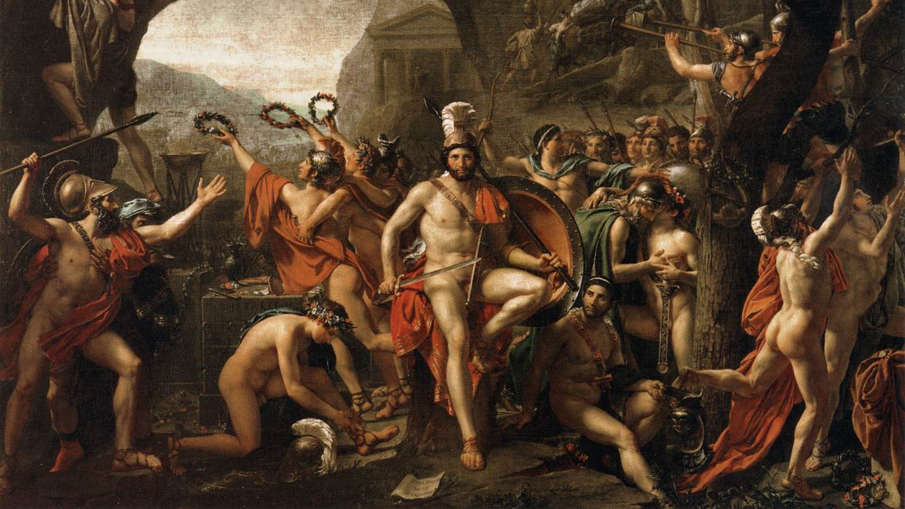

Slide 25


Slide 26
[Act III Scene 2 of Thomson’s Sophonisba, 1730 version]
SCENE II.
MASINISSA, NARVA.
MASINSSSA.
Welcome again, my friend,—Come nearer, Narva;
Lend me thine arm, and I will tell thee all,
Unfold my secret heart, whose every pulse
With Sophonisba beats.—Nay hear me out—
Swift, as I mus'd, the conflagration spread;
At once too strong, too general, to be quench'd.
I love, and I approve it, doat upon her,
Even think these minutes lost I talk with thee.
Heavens! what emotions have possess'd my soul!
Snatch'd by a moment into years of passion.
NARVA.
Ah Masinissa!—

Slide 27
MASINISSA.
Argue not against me.
Talk down the circling winds that lift the desart;
And, touch'd by Heaven, when all the forests blaze,
Talk down the flame, but not my stronger love.
I have for love a thousand thousand reasons,
Dear to the heart, and potent o'er the soul.
My ready thoughts all rising, restless all,
Are a perpetual spring of tenderness;
Oh! Sophonisba! Sophonisba! oh!

Slide 28
From Tom Thumb the Great, Henry Fielding, 1730
Enter LORD GRIZZLE.
Griz. [Kneeling.] Oh, Huncamunca! Huncamunca, oh!
Hunc. This to my rank,—bold man!
Griz. Ah, beauteous princess!
Love levels rank,—lords down to cellar bears,
And bids the brawny porter walk up stairs.—
Nought is for love too high, nor aught too low—
Oh, Huncamunca! Huncamunca, oh!
Hunc. My lord, in vain, a-suitoring you come,
For I'm engaged this instant to Tom Thumb.
Griz. Play not the fool! that less than baby shun,
Or you will ne'er be brought to bed of one.
Hunc. Am I thus fobb'd?—then I my words recal.
Griz. Shall I to Doctors' Commons?
Hunc. Do so, pray—
I now am in the mood, and cannot stay.

Slide 29
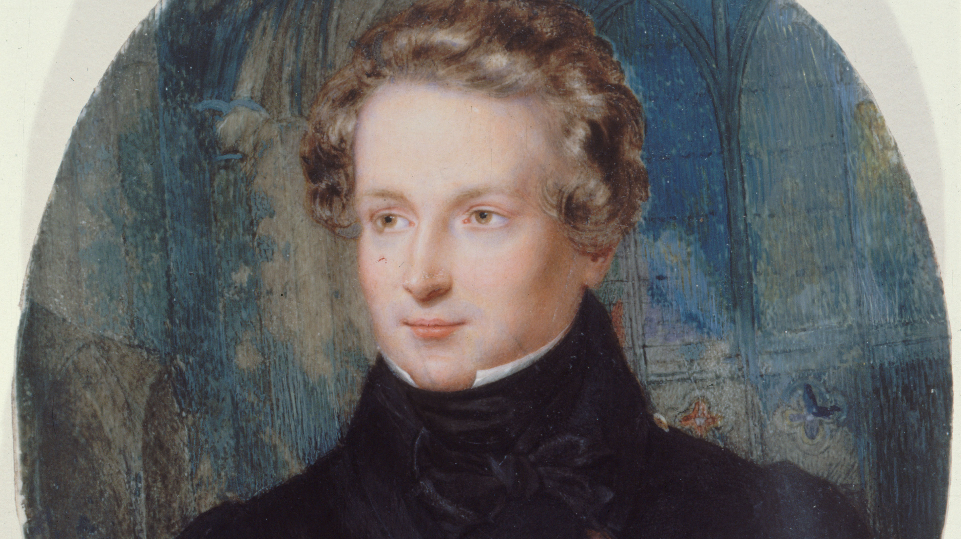
Victor Hugo, around 1825

Slide 30
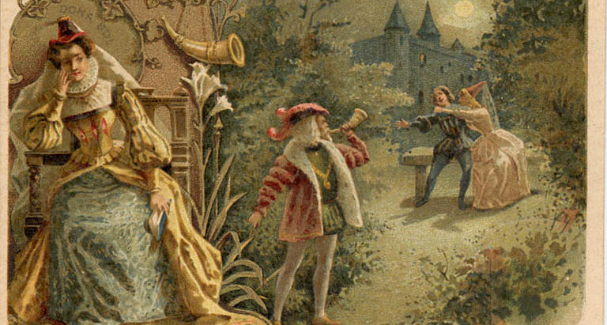
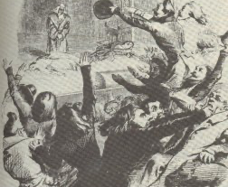
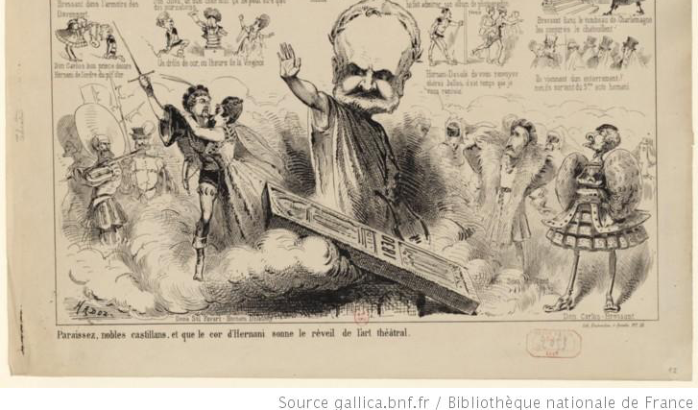
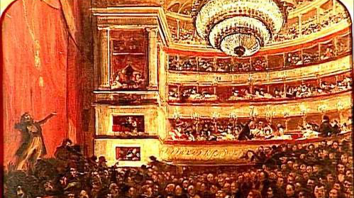

Slide 33
Final scene
excerpt

Slide 35
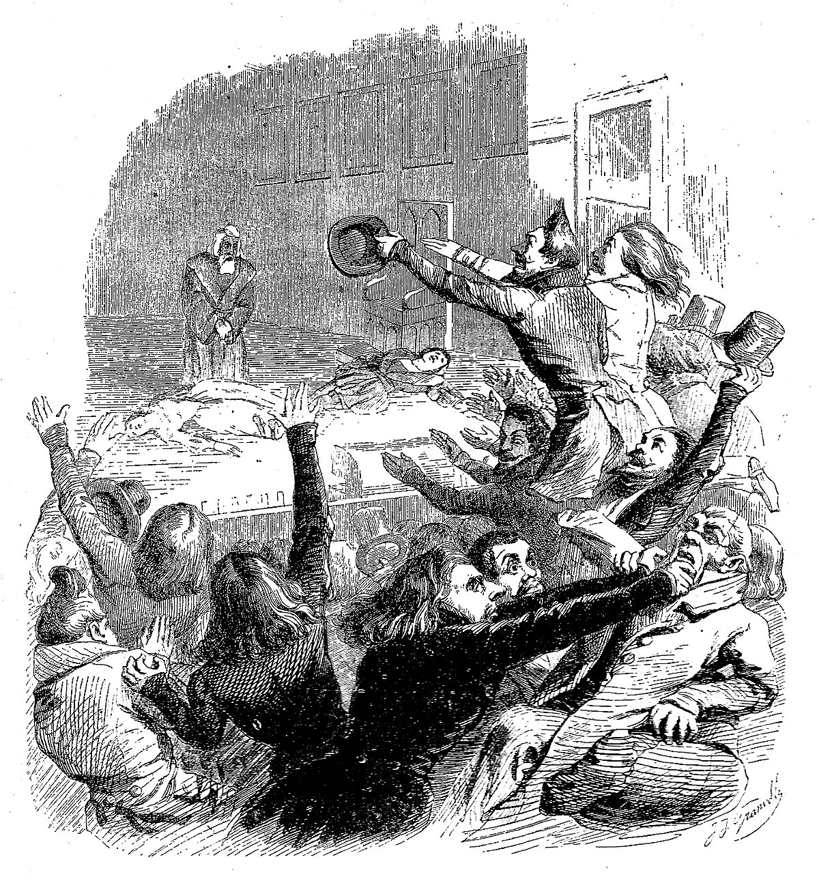
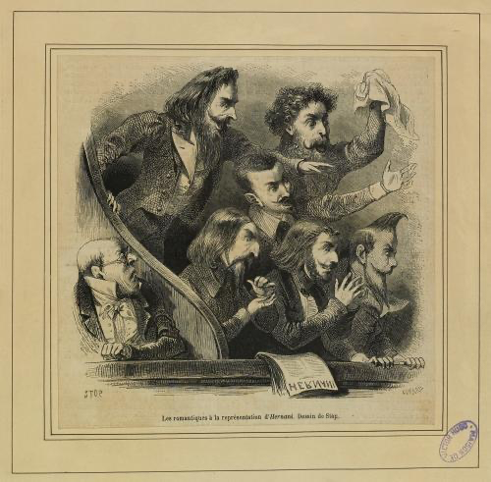

Slide 36
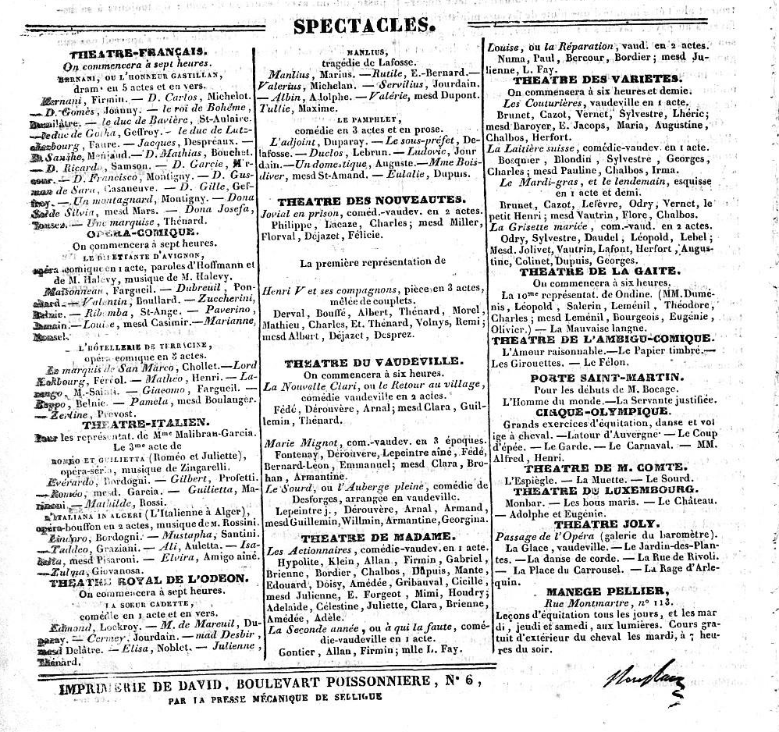
Le Figaro,
February 27, 1830

Slide 37
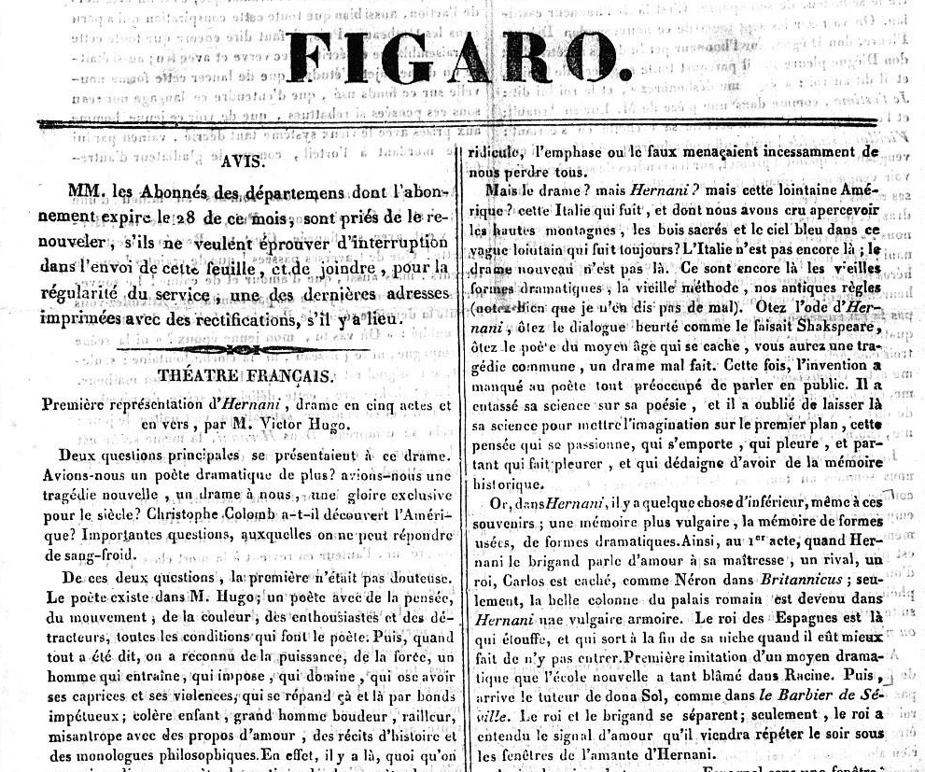

Slide 38
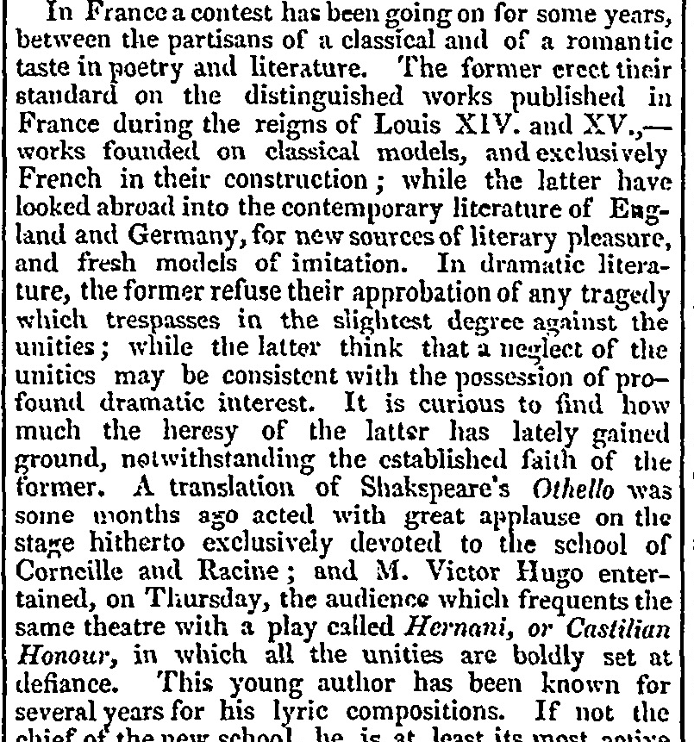
London Times March 4, 1830

Slide 39
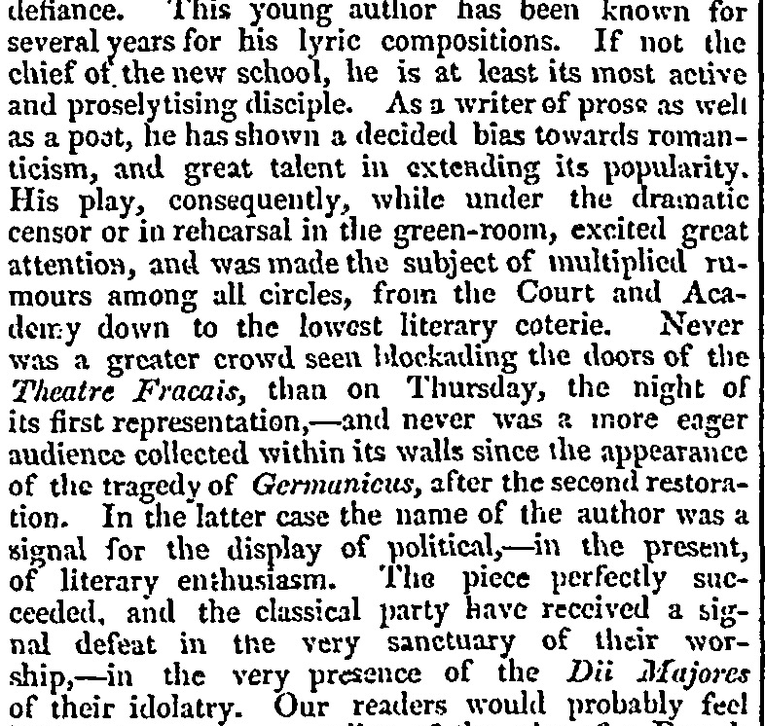

Slide 40
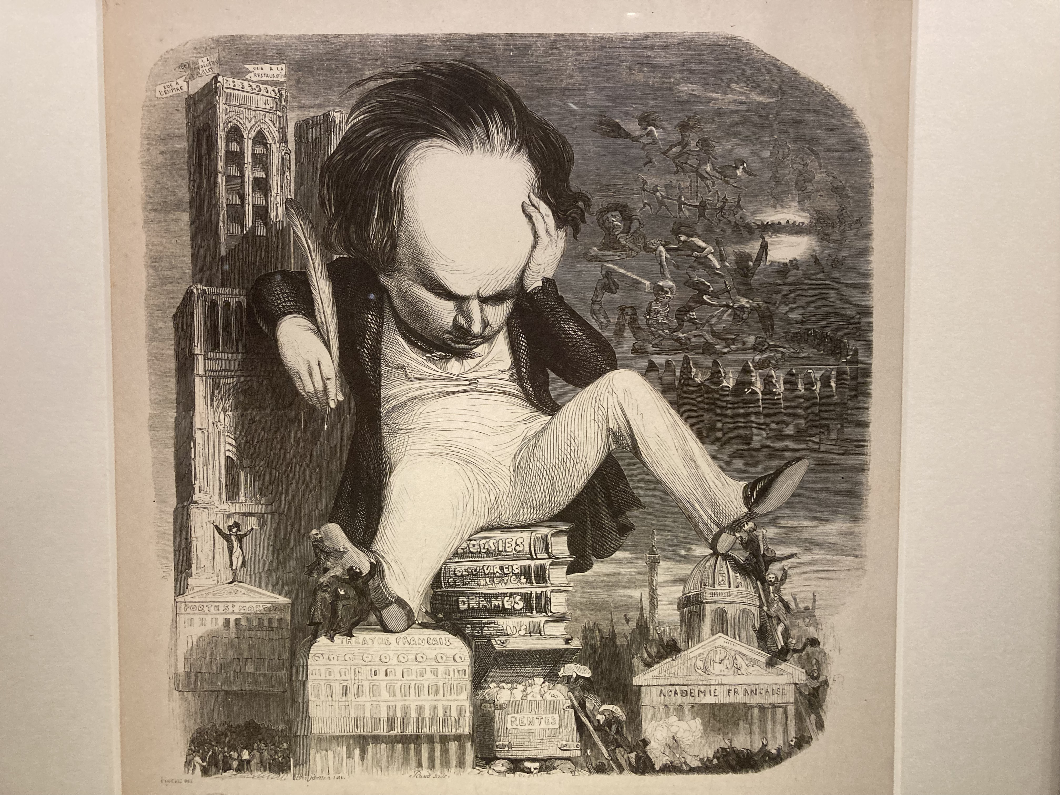
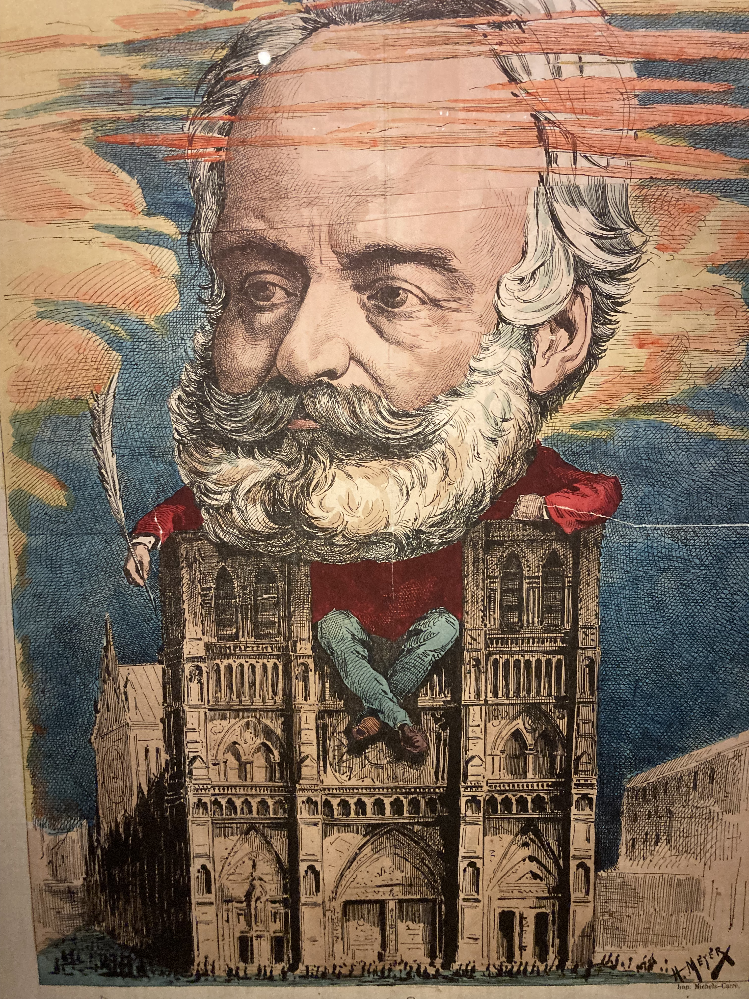

Slide 41
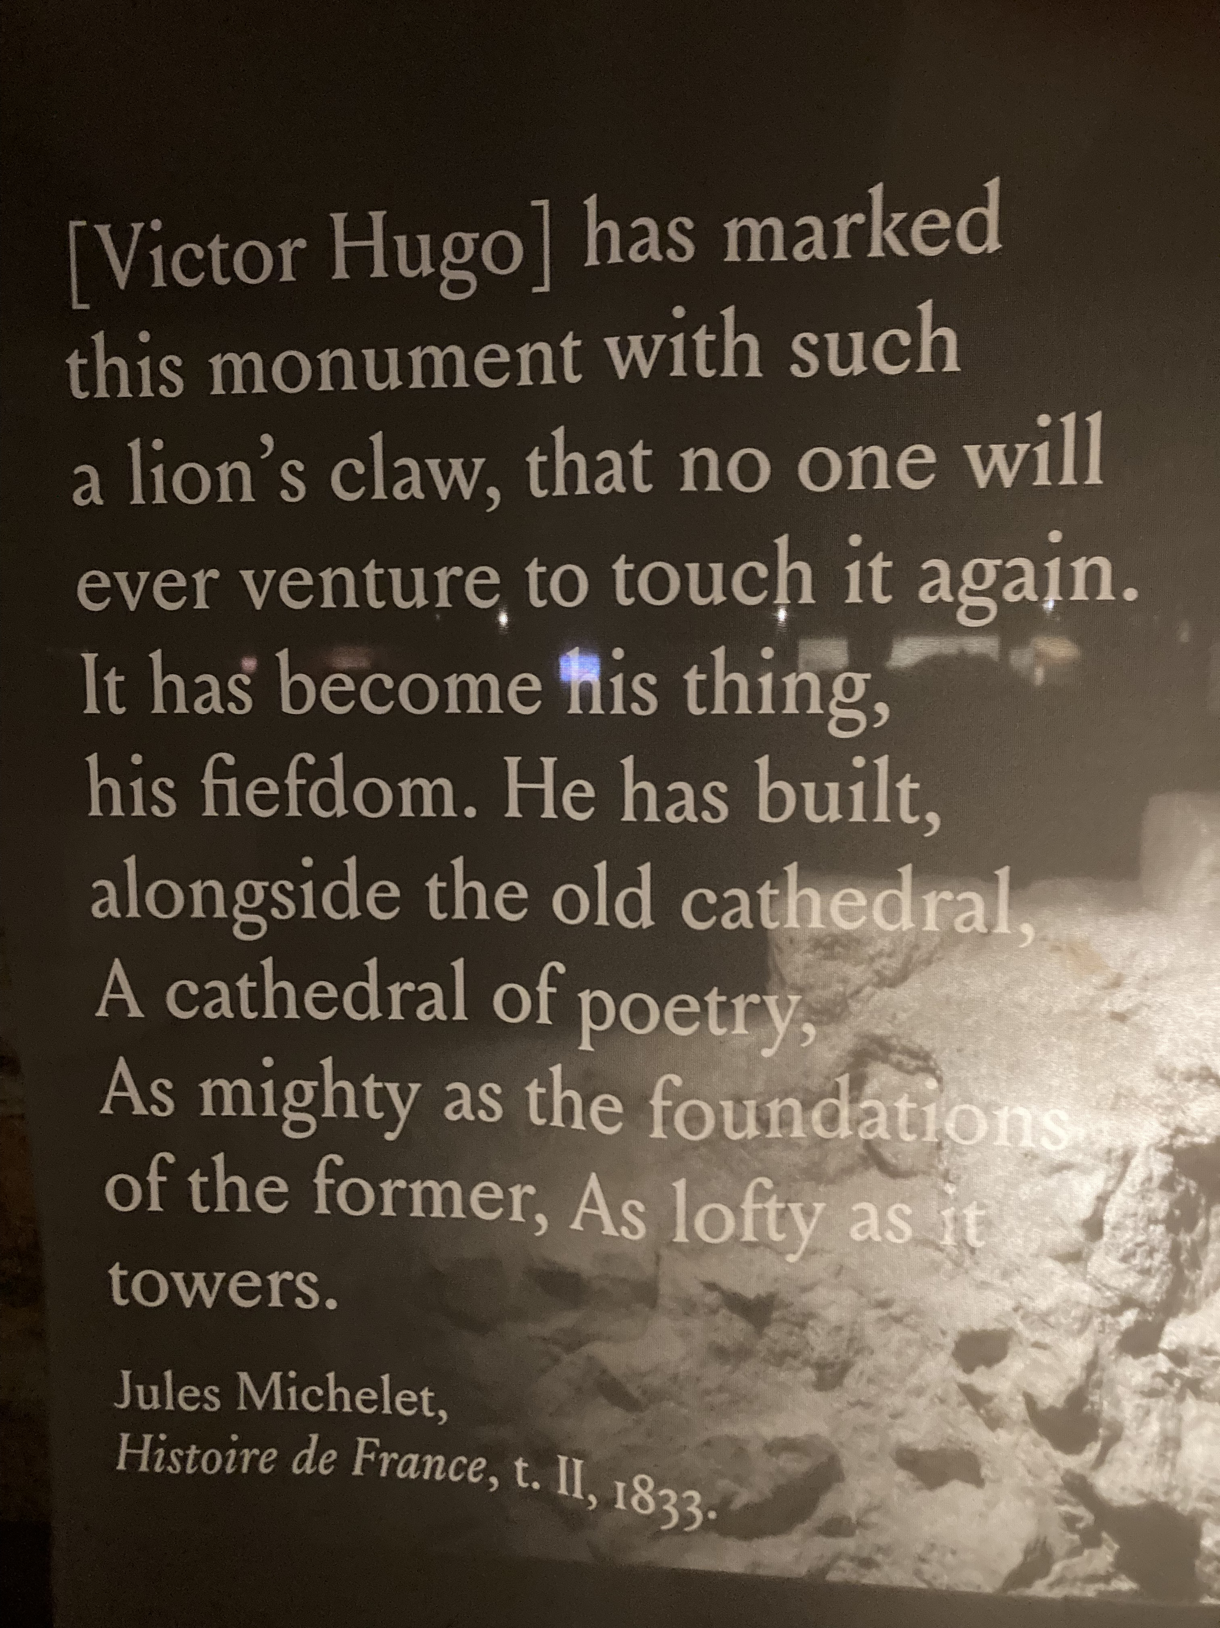

Slide 42
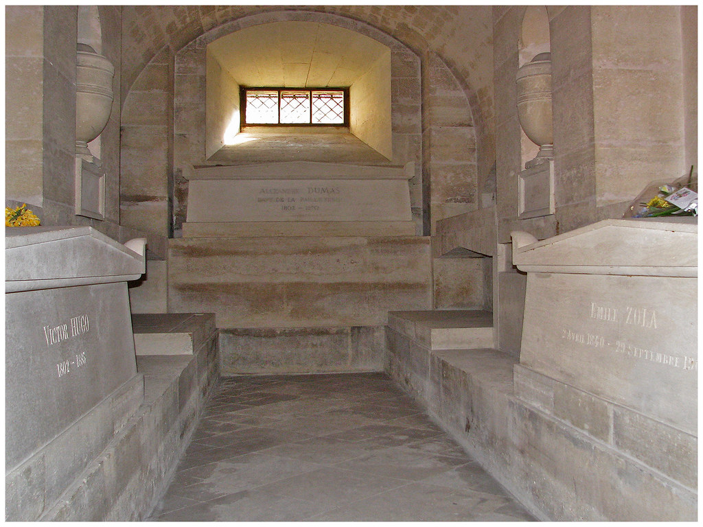
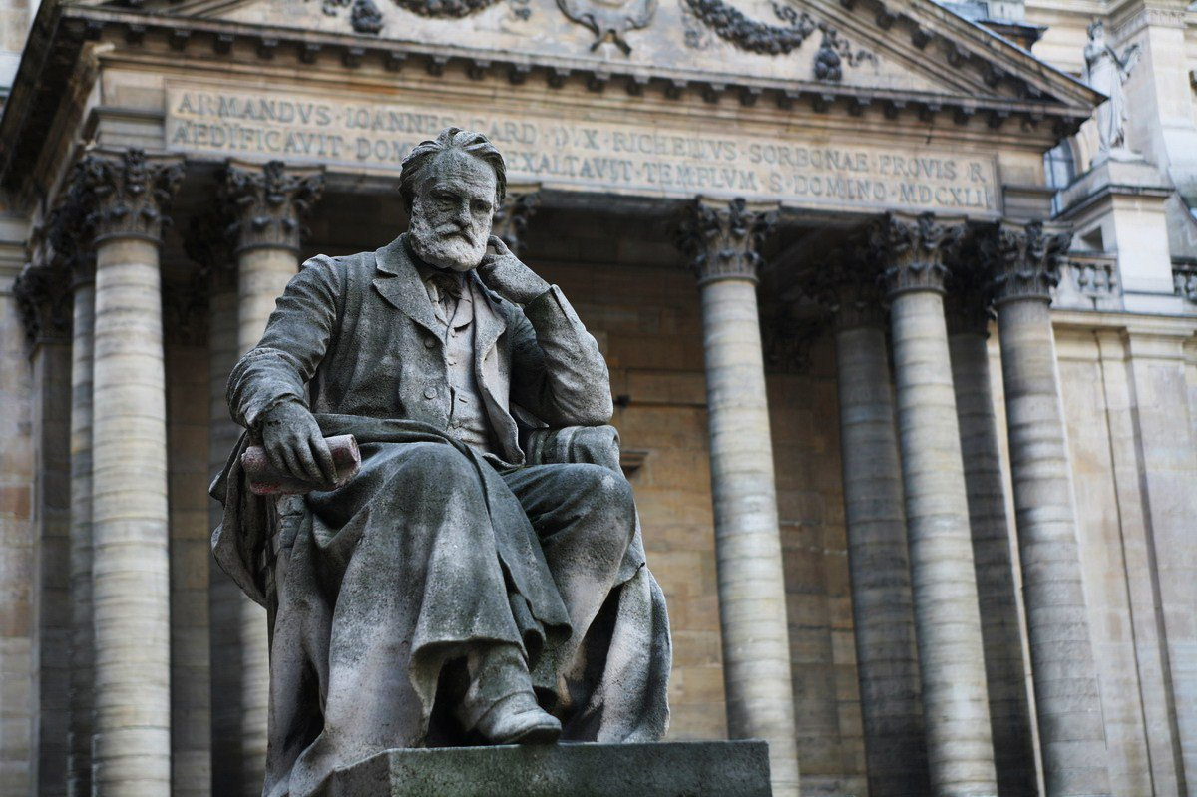
In good company in the Panthéon
Outside the Sarbonne

Slide 43
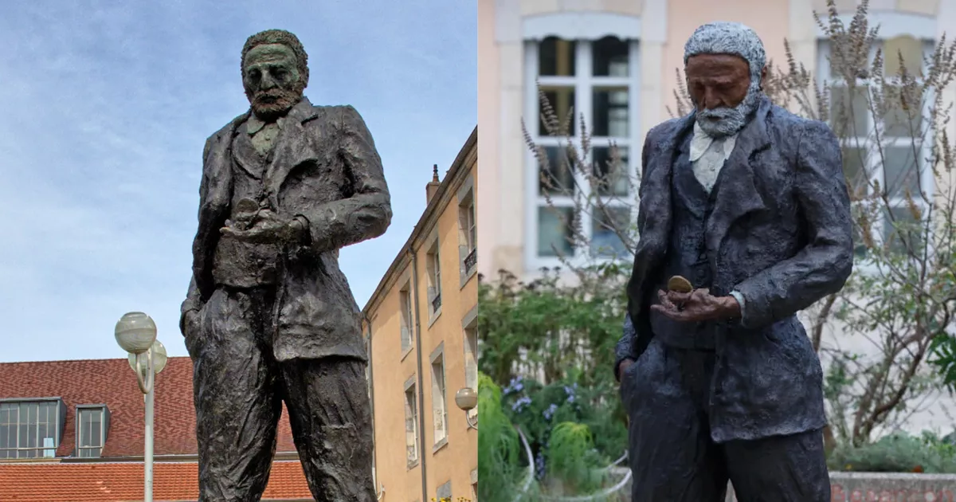
The Besançon squabble, 2022-2023

