Slide 1
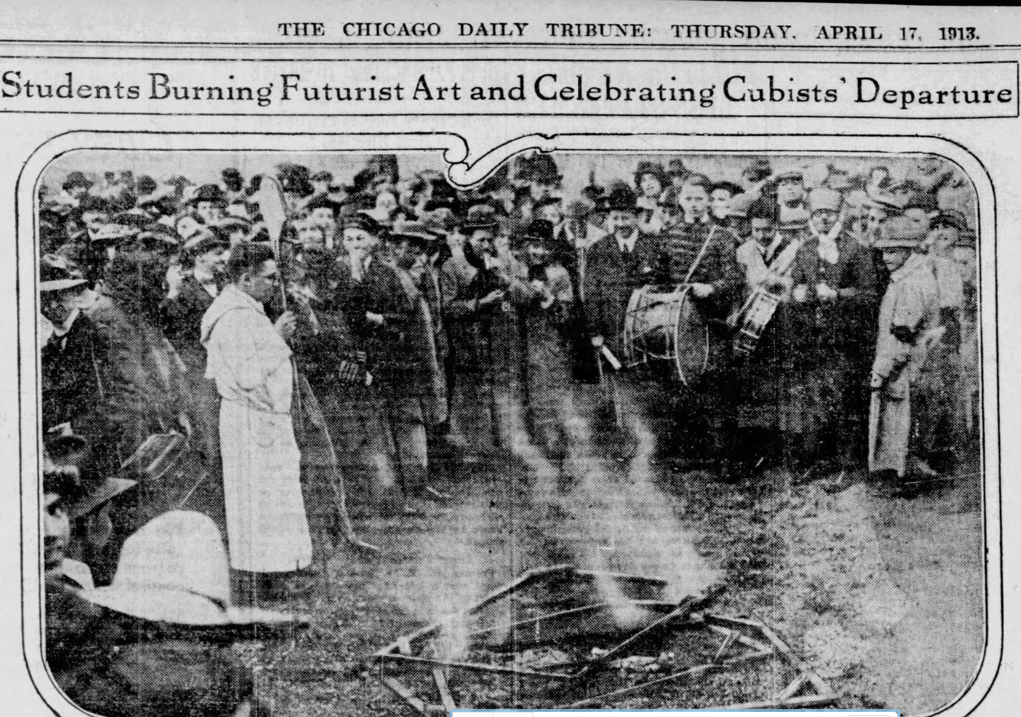
The Armory Show
New York
And Chicago,
Spring, 1913

Slide 2
“Skill without imagination is craftsmanship and gives us many useful objects such as wickerwork picnic baskets. Imagination without skill gives us modern art.” Tom Stoppard, Artist Descending a Staircase
“Nothing so needs minding as other people’s business.”
Mark Twain (apocryphal)

Slide 3
The rise of national and big-city art museums.
Official endorsing (and bankrolling) of Art, c. 1850-1920.
Art and cultural disruptions in the spring of 1913
Stravinsky & Co.’s “The Rite of Spring” -- right on the Champs Elysées
Comstockery and the “September Morn” ruckus
The Armory Show as insurrection and enterprise.
Major players, and administrative skirmishes.
Paintings that drew maximum fuss in New York.
The Chicago Art Institute and the City of Chicago react to The Modernist Invasion

Slide 4
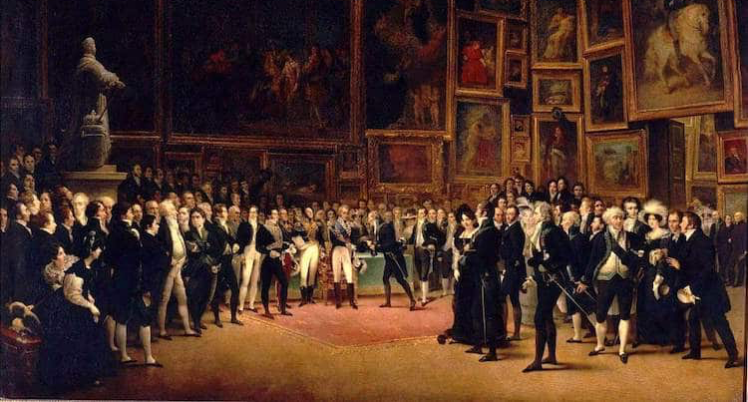
Académie royale de peinture et de sculpture, 1827

Slide 5
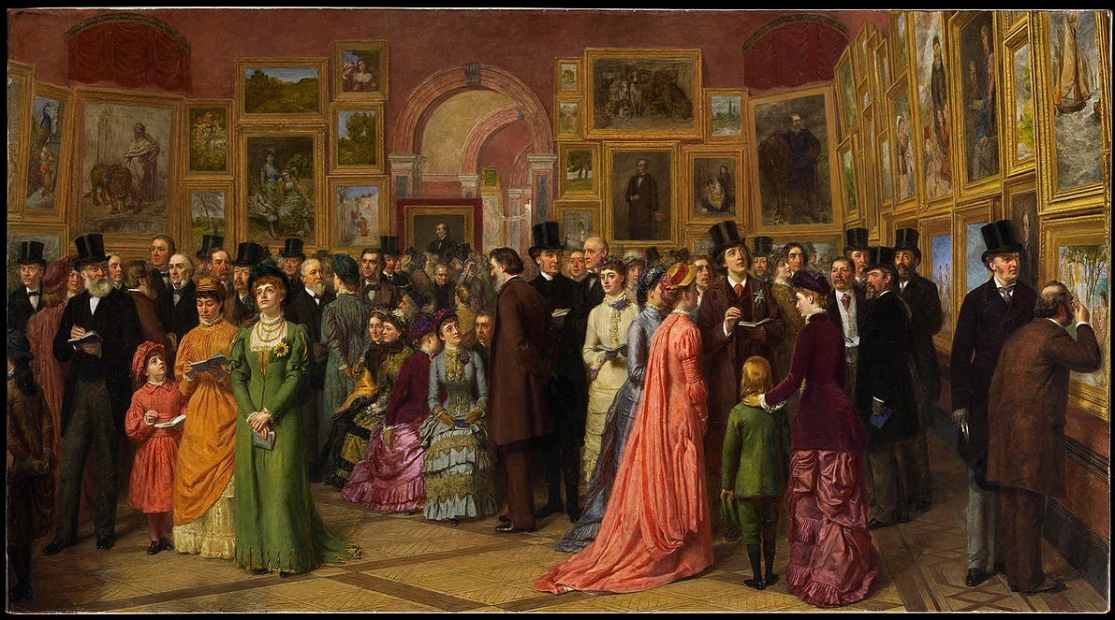

Slide 6
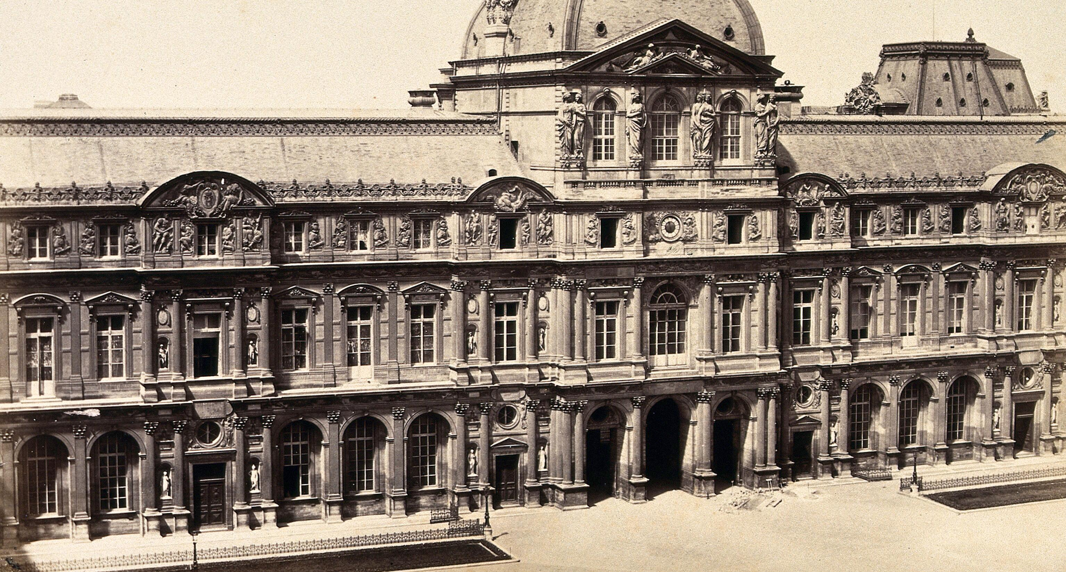
3,069 × 2,437
The Louvre around 1870

Slide 7
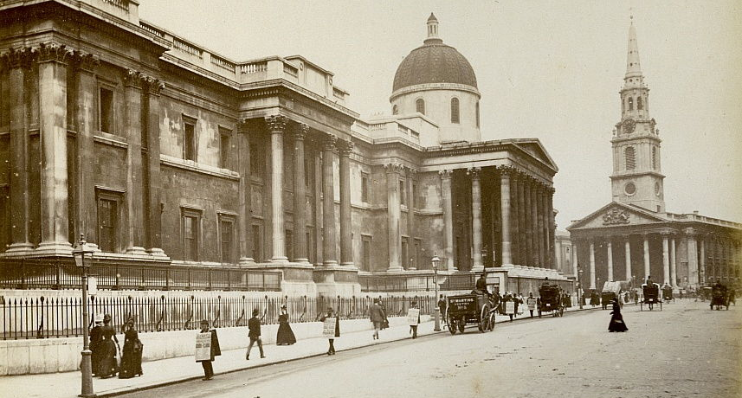
National Gallery (London), c.1882

Slide 8
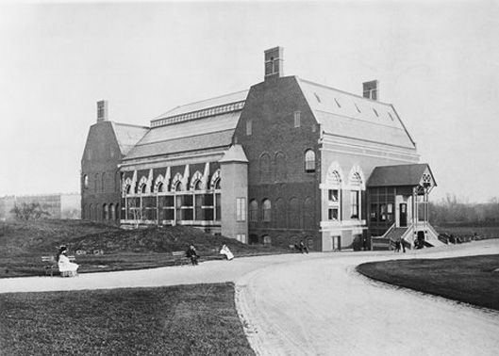
Pop Quiz
1880

Slide 9
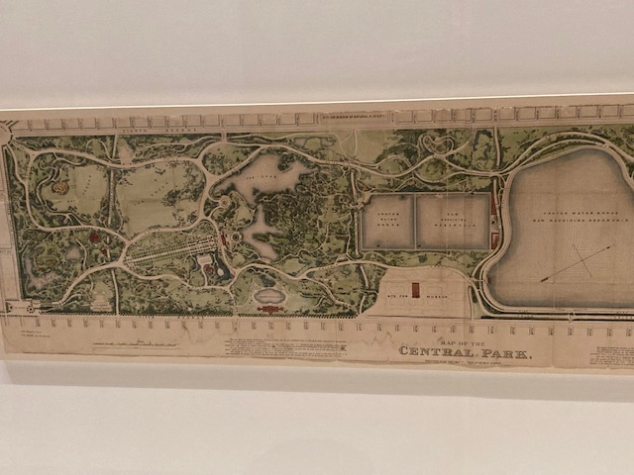
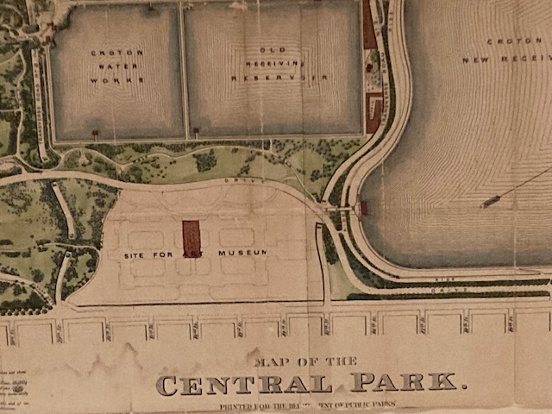
Central Park map, 1874

Slide 10
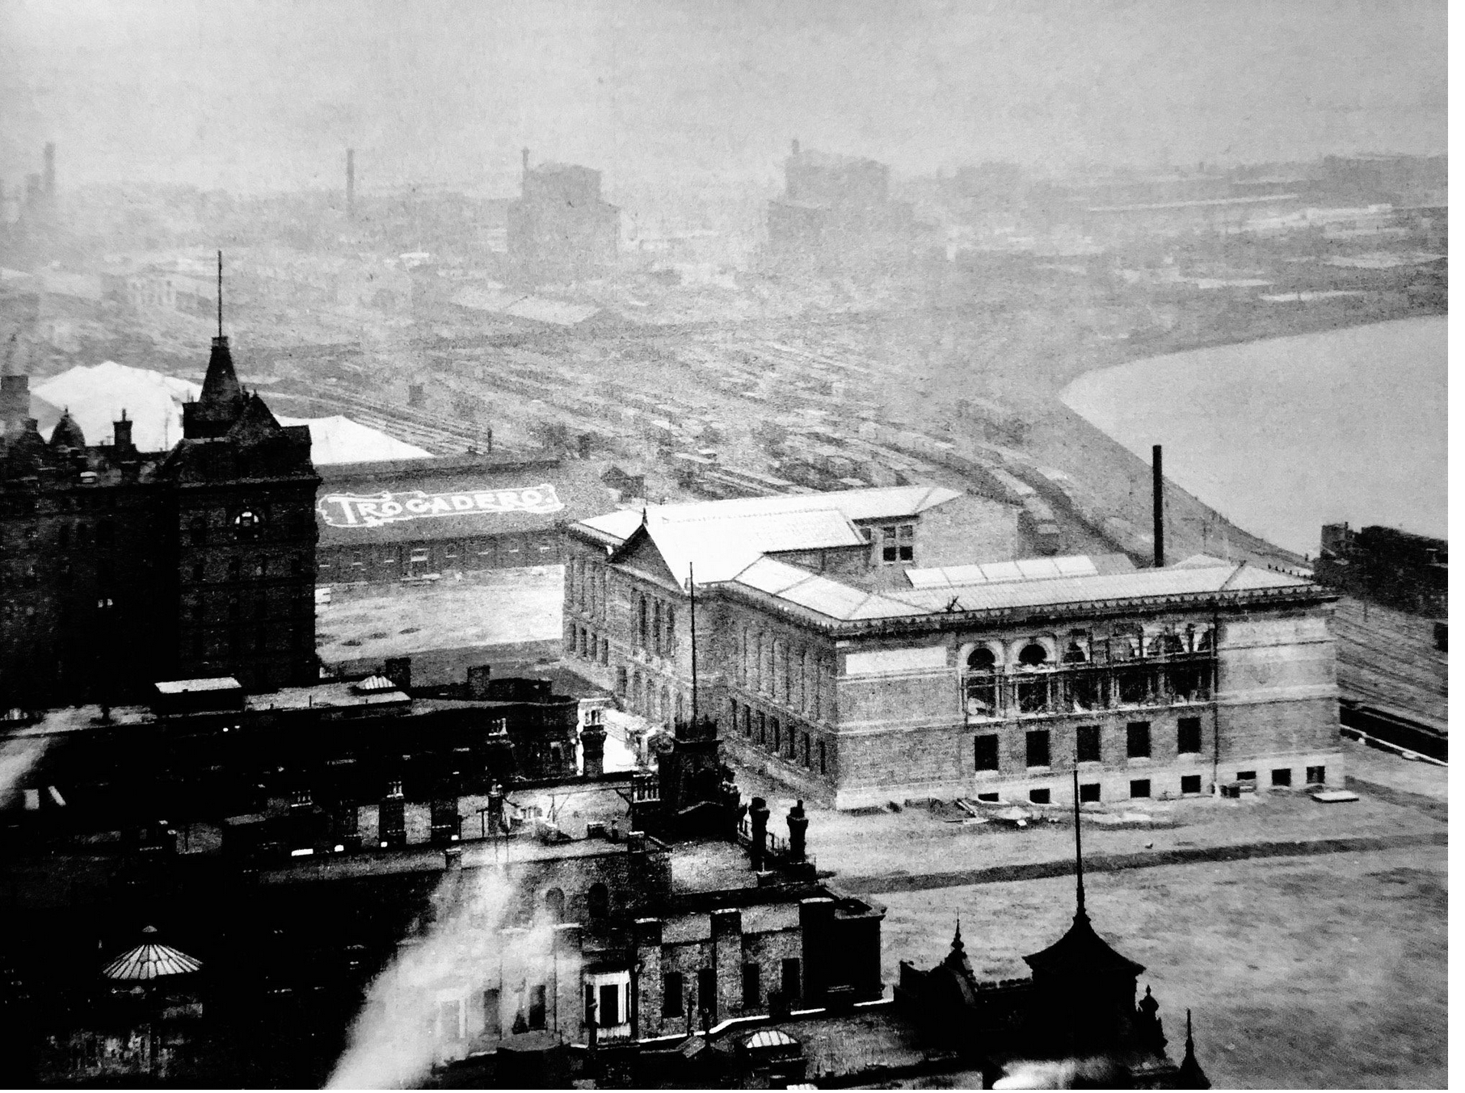
Another Pop Quiz

Slide 11
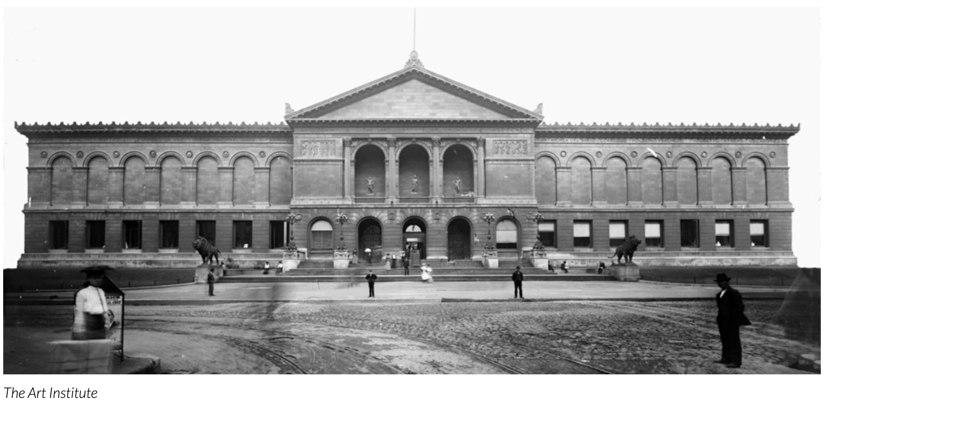

Slide 12
Other arts fusses in 1913:
Paul Émile Chabas, “September Morn”-- in the US (especially Chicago!)
Igor Stravinsky et. al., The Rite of Spring- -- on the Champs-Élysées.

Slide 13
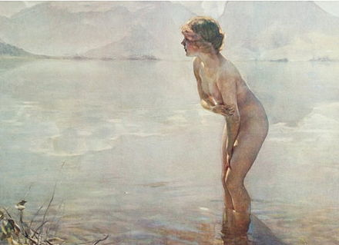
Chabas’s obscene (?)
“September Morn”

Slide 14
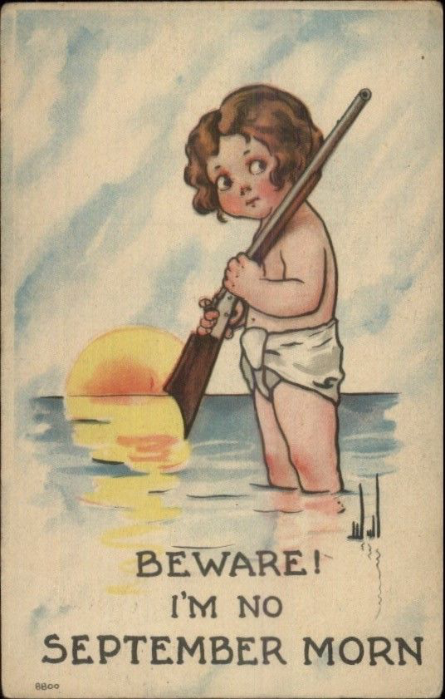
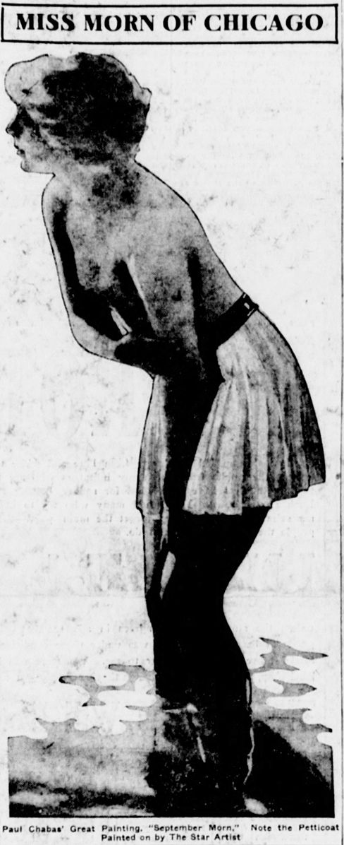
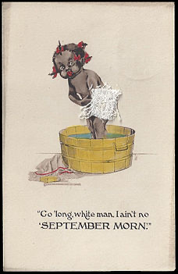
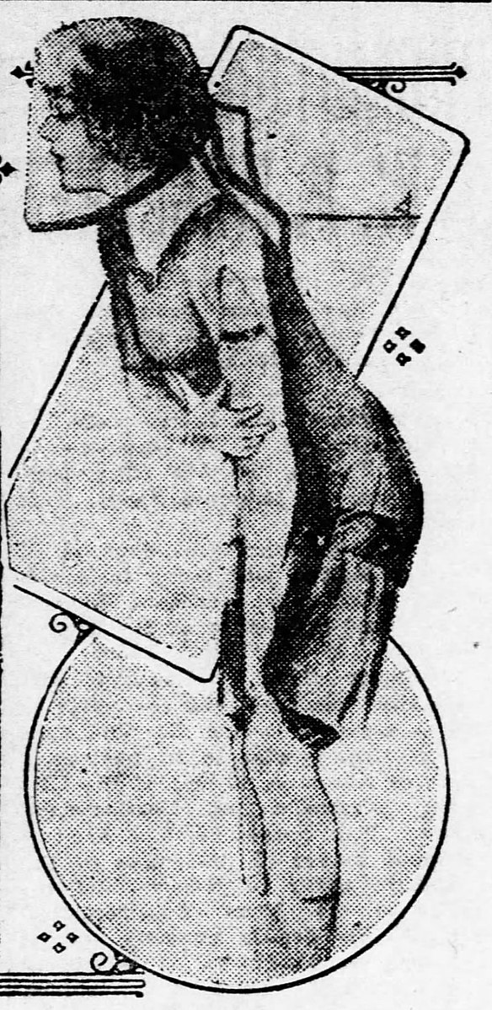
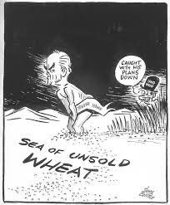

Slide 15
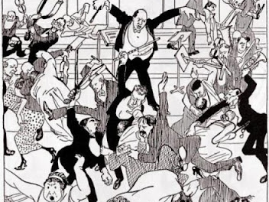
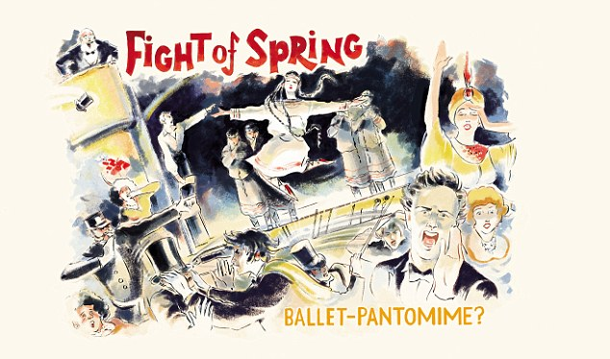
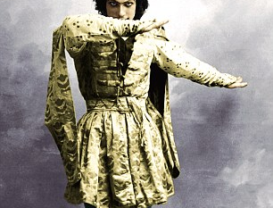
February,
1913

Slide 16
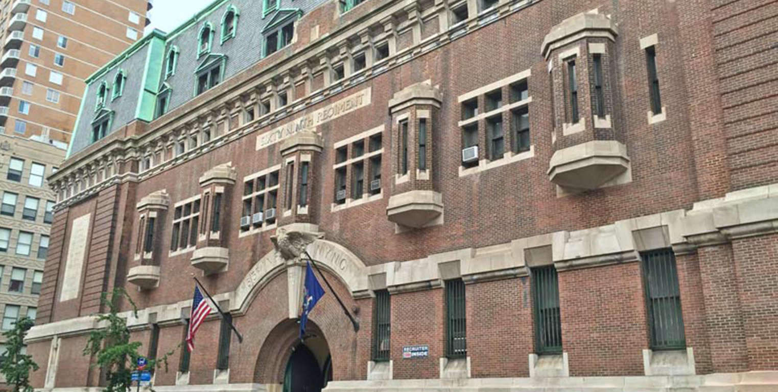

Slide 17
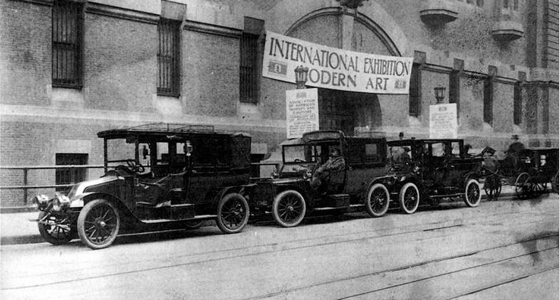

Slide 18
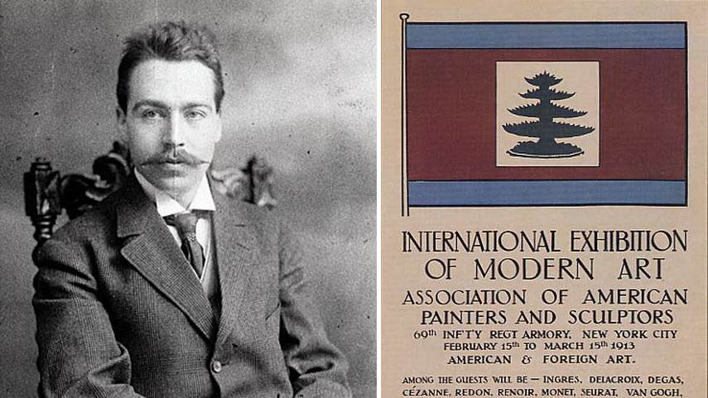
Walter Pach, key organizer, friend of Duchamp and his circle

Slide 19
“I have received the minutes of the board meeting held recently, during my absence from the city, in which I find that a resolution adopted previously by the same gentlemen, sitting as executive committee, in response to my plea that sculpture be adequately represented at the exhibition had been revoked, and I feel that I cannot continue to hold the farcical position of head of the sculpture department.”
“I cannot consider these things lightly. This may be a color orgy, ‘getting the best of the Academy!' ‘putting one over’ --whom? It ought to be a great large spirited movement bulwarked by sincerity and unselfishness, or else it is a fake and a masquerade. We have led the public to expect something, and we are fooling them, deceiving them. We have got their interest on false pretenses. Sculpture as it really exists in America will not be shown, because it has not been given a chance, not a fair chance.” --Gutzon Borglum

Slide 20
J. Alden Weir, in an open letter to the New York Times:
“I was greatly surprised to find in your columns this morning the statement that I am the president of a new society" openly at war with the Academy of Design." I have been a loyal member of the Academy for more than twenty-five years, and I am now a member of its Council. I believe … it to be doing everything in its power for the promotion of art in this country, and it would be impossible for me to take such a position as that which the new society is said to occupy.
I have attended no meetings of this society …”

Slide 21
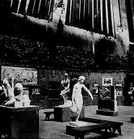
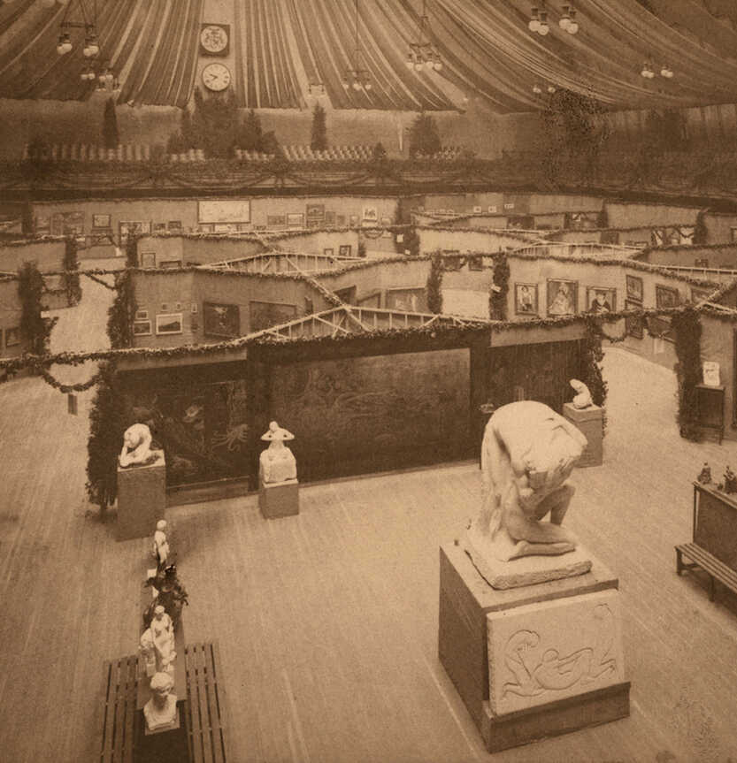

Slide 22
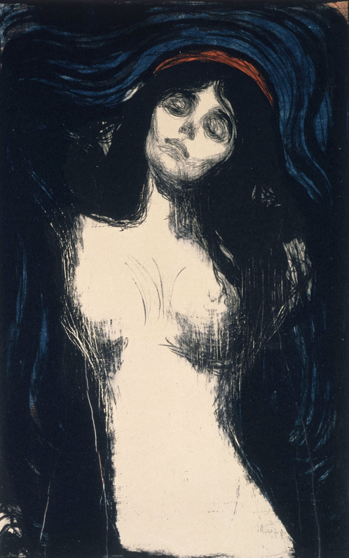
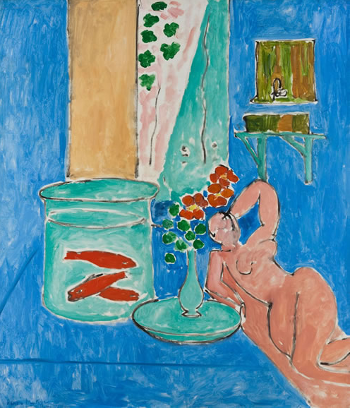
Munch. . .
And Matisse …

Slide 23
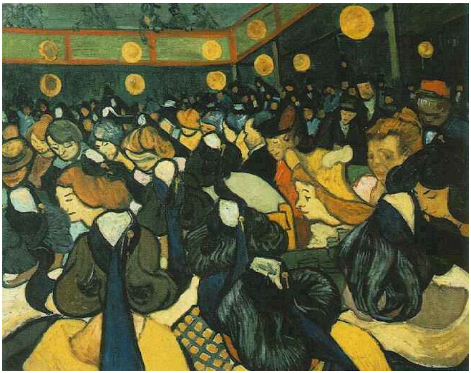
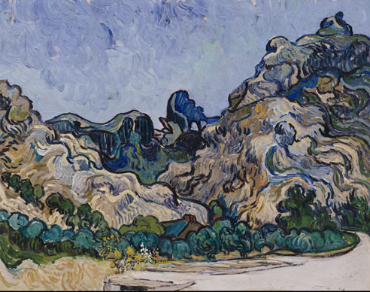
Van Gogh – as Toulouse …
And as himself …

Slide 24
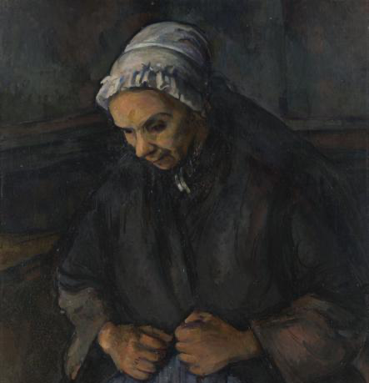
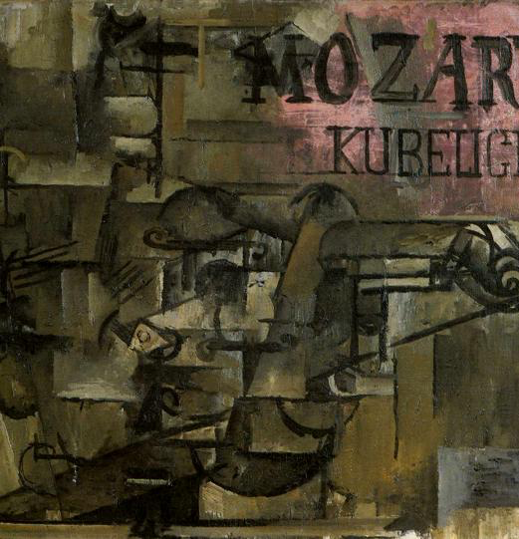
Cezanne’s Old Woman with a Rosary George Braque’s Violin

Slide 25
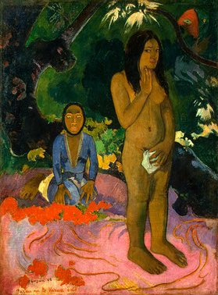
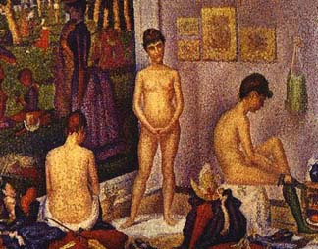
Benign and troublesome nudes (Seurat and Gaugin)

Slide 26
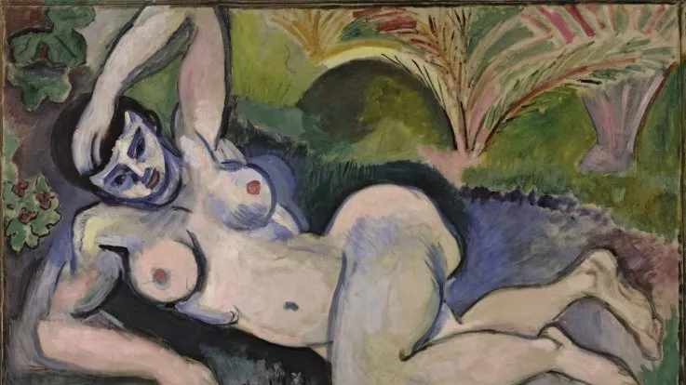
Matisse, ”Blue Nude,” big trouble

Slide 27
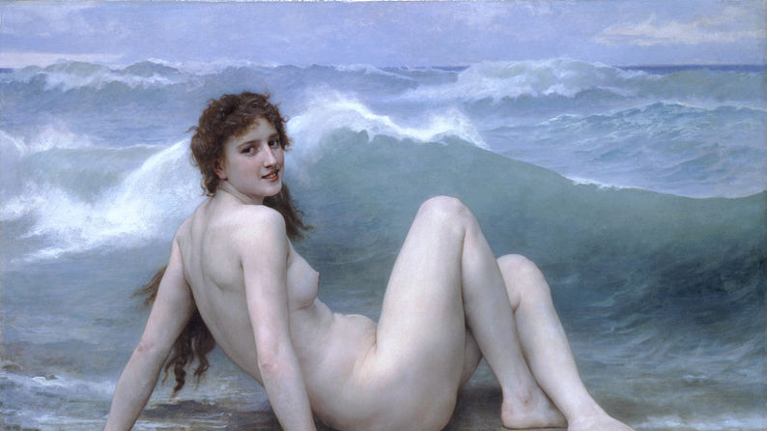
But Bouguereau got away with this …

Slide 28
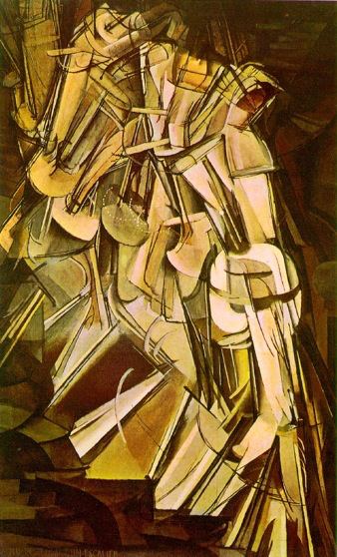
Marcel Duchamp
“Nude Descending
a Staircase”

Slide 29
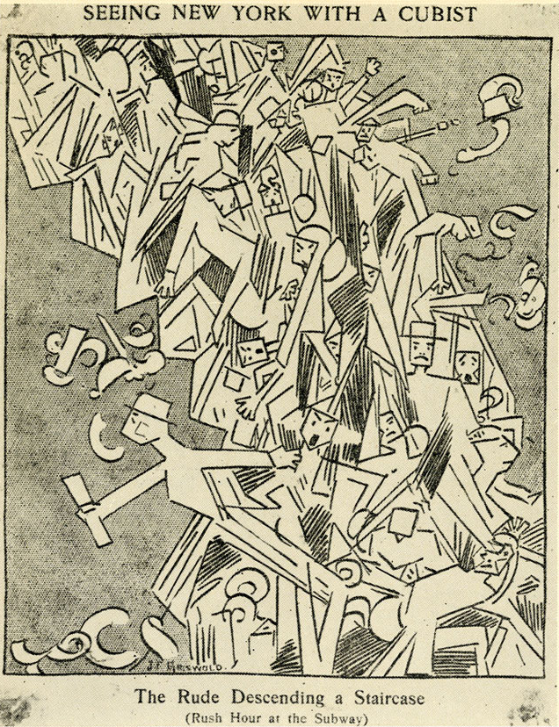
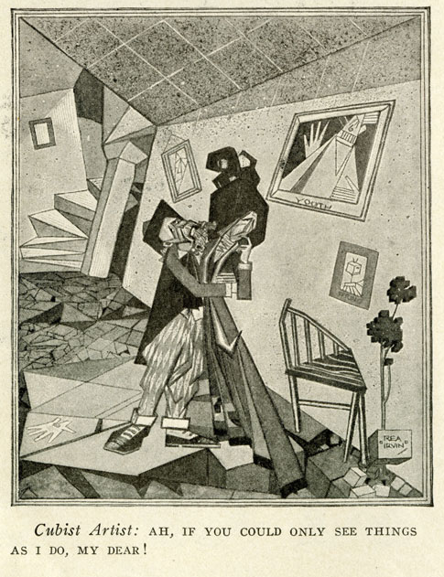

Slide 30
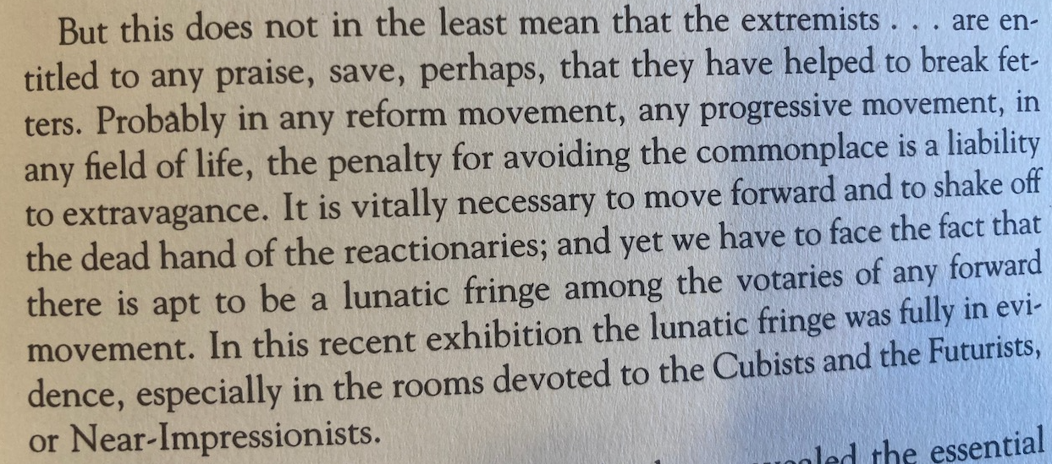
Theodore Roosevelt weighs in …

Slide 31
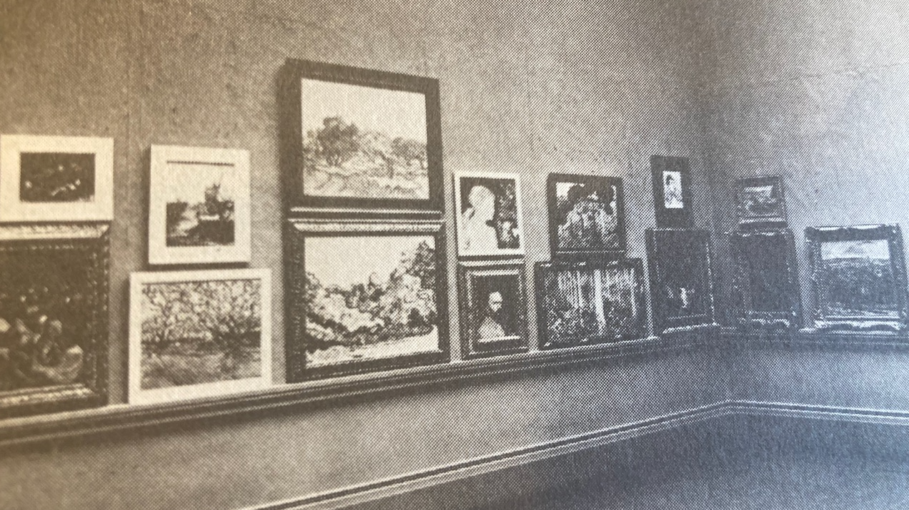
Gallery 52 at the Art Institute

Slide 32
Letter to the Chicago Examiner:
Our splendid Art Institute is being desecrated. This has been going on for a week. It is likely to continue two weeks more. This blasphemous innovation in our museum is taking place in some of the galleries occupied by the International Exhibition of Modern Art, under the auspices of the Association of American Painters and Sculptors. This pollution is materialized in several paintings of the nude; portrayals that unite in an insult to the great, self-respecting public of
Chicago. Just who is responsible for this showing of dishonor to sensitive great art that finds expression in the chaste and beautiful painting of the human figure in the nude in our Institute? Paul Gauguin's "The Spirit of Evil" is as obscene as it is vile. The nude woman is profanely suggestive, even the face is detestable in its evil leer.

Slide 33
Walter Kuhn on the Art Institute students:
The art students and public are a lot of rowdy rough-necks. You
would get sick at heart if you were here. Gregg and I are not over popular because we refuse to surrender our goats and meet the most vicious
attacks with the usual smile. The press here is what I would expect at
Paducah, Kentucky. All the instructors at the Institute are mad through,
one even went so far as to take a big class of the students into the
French room and threw a virtual fit condemning Matisse. We three
stood in the hall and laughed at him. However, I had this stopped and
after this the lecturing will be done outside the exhibition rooms.

Slide 34
American art, under conservative management, is getting too pallid, nerveless, coldly correct, photographic. Better the wildest extravagances of the cubists than the vapid works of certain artists who ridicule them. Better the most remote and mysterious symbolism than a cameralike fidelity to appearances. We are in an anemic condition which requires strong medicine, and it will do us good to take it without kicks and wry faces.
Also in a profound sense these radical artists are right. They represent the revolt of the imagination against nineteenth century realism, they represent disgust with the camera, outrage over superficial smoothness which covers up weakness of structure. They represent a search fo new beauty, impatience with formulae, a reaching out toward the inexpressible, a longing for new versions of truth.
Harriet Monroe, founder and editor of Poetry (Chicago)

Slide 35
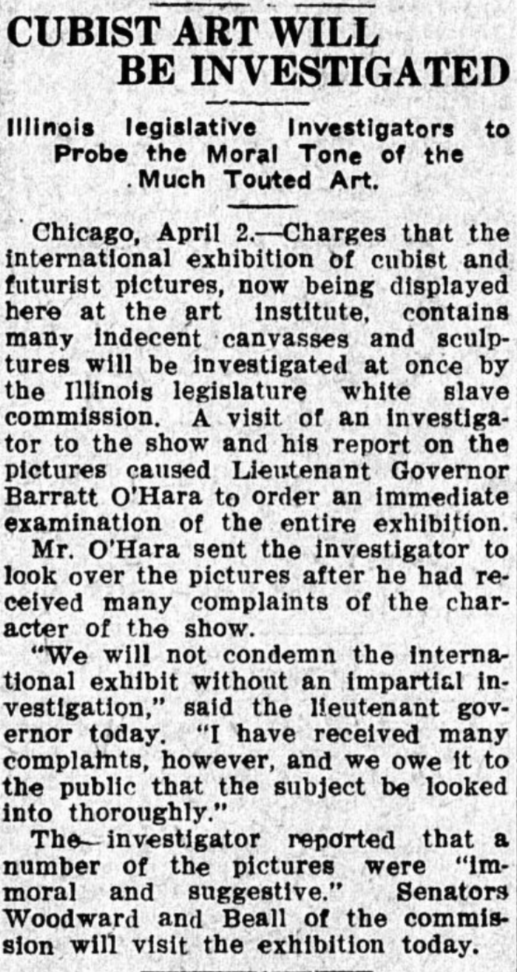
Ottumwa Tri-Weekly Courier,
April 3, 1913

Slide 37
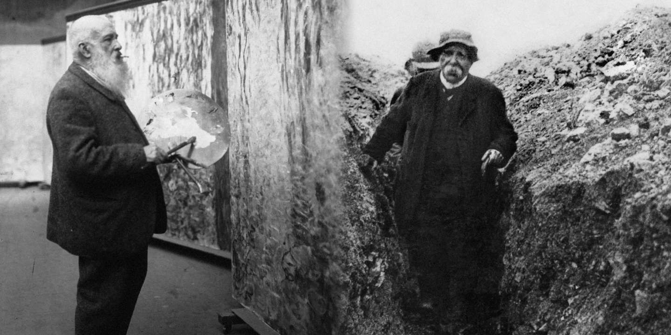

Slide 38
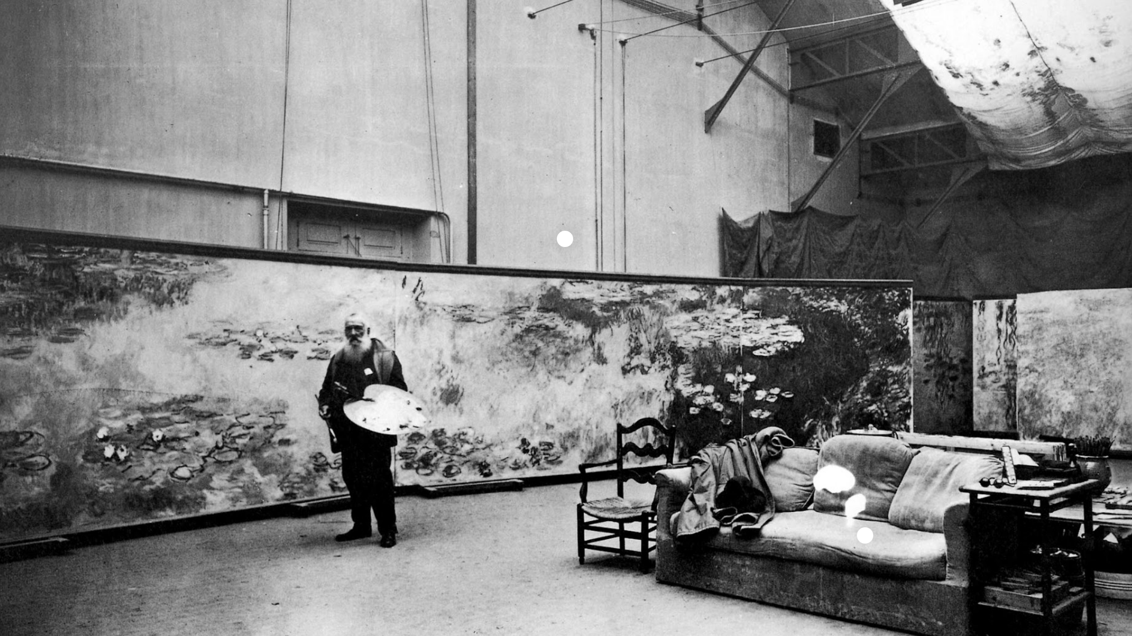

Slide 39
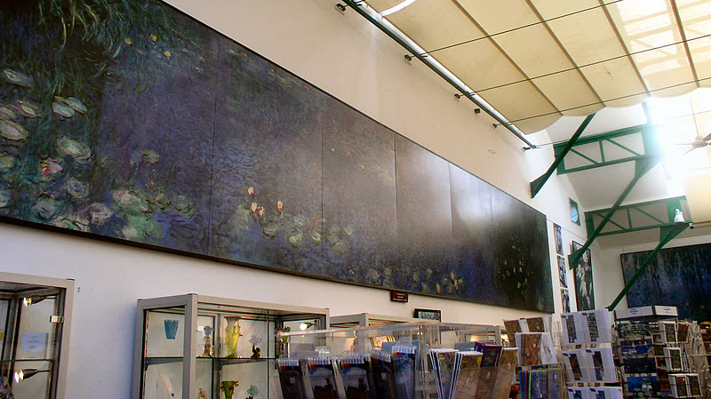

Slide 40
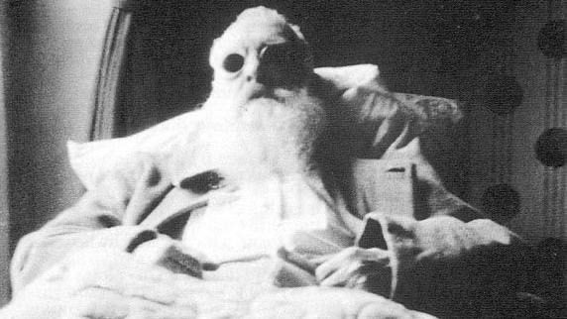
After the cataract operation

Slide 41
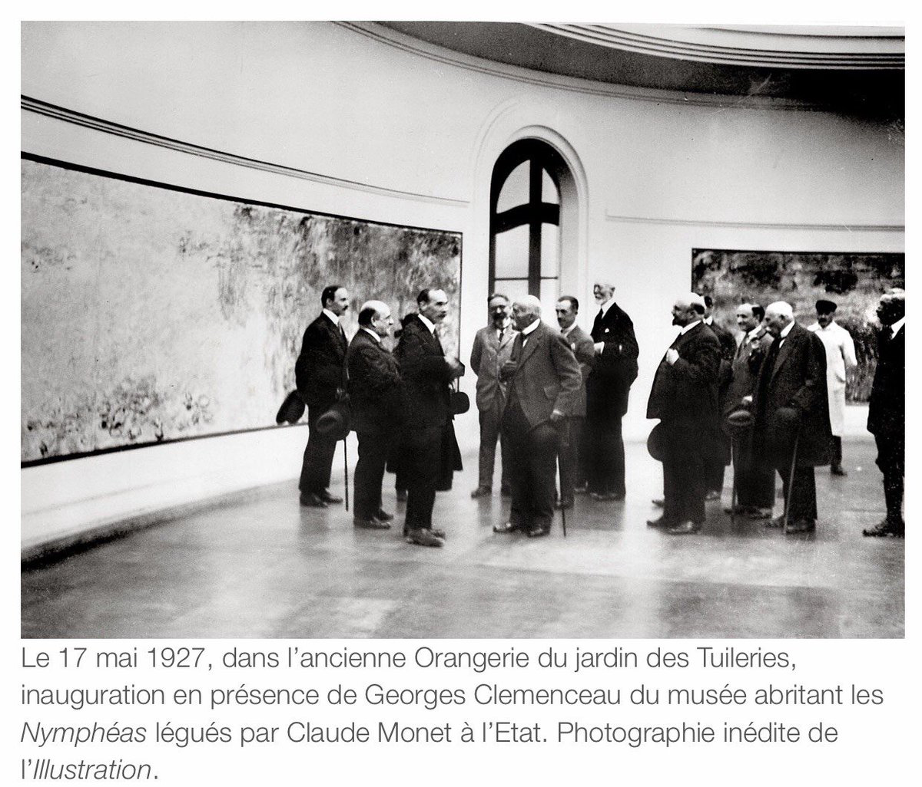
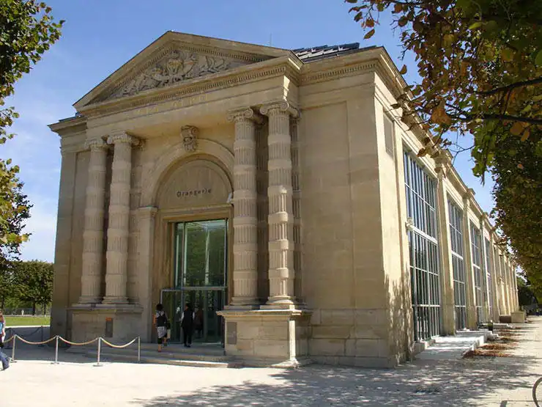

Slide 42
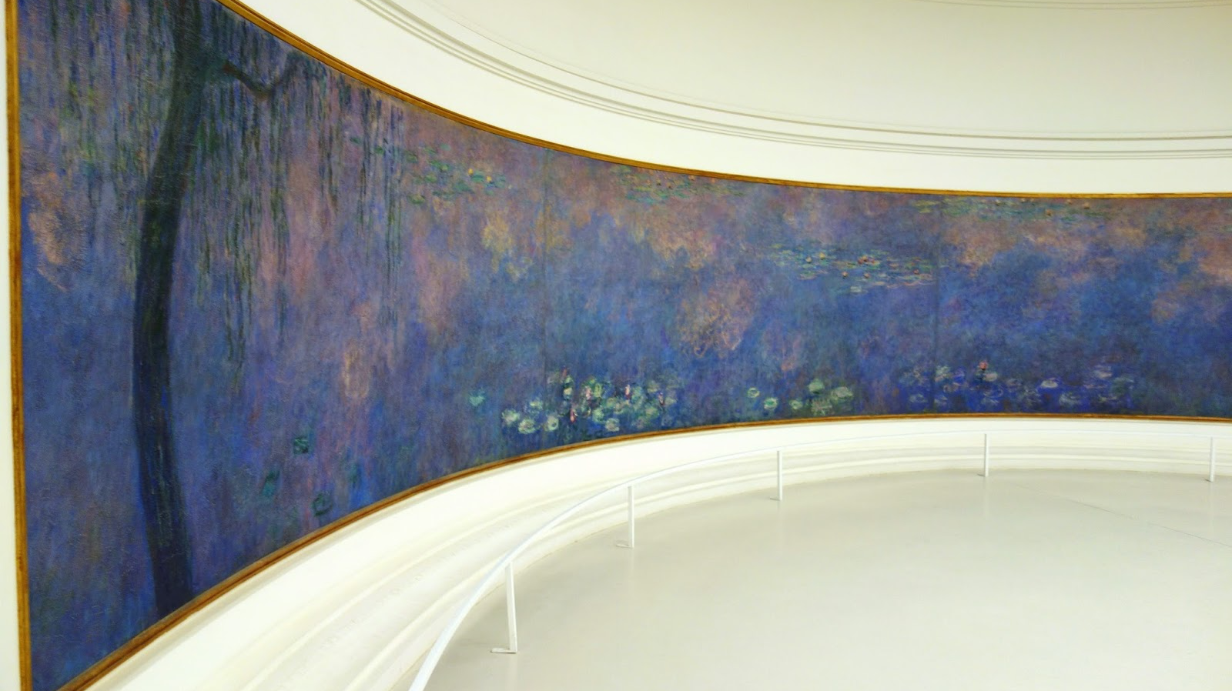

Slide 43
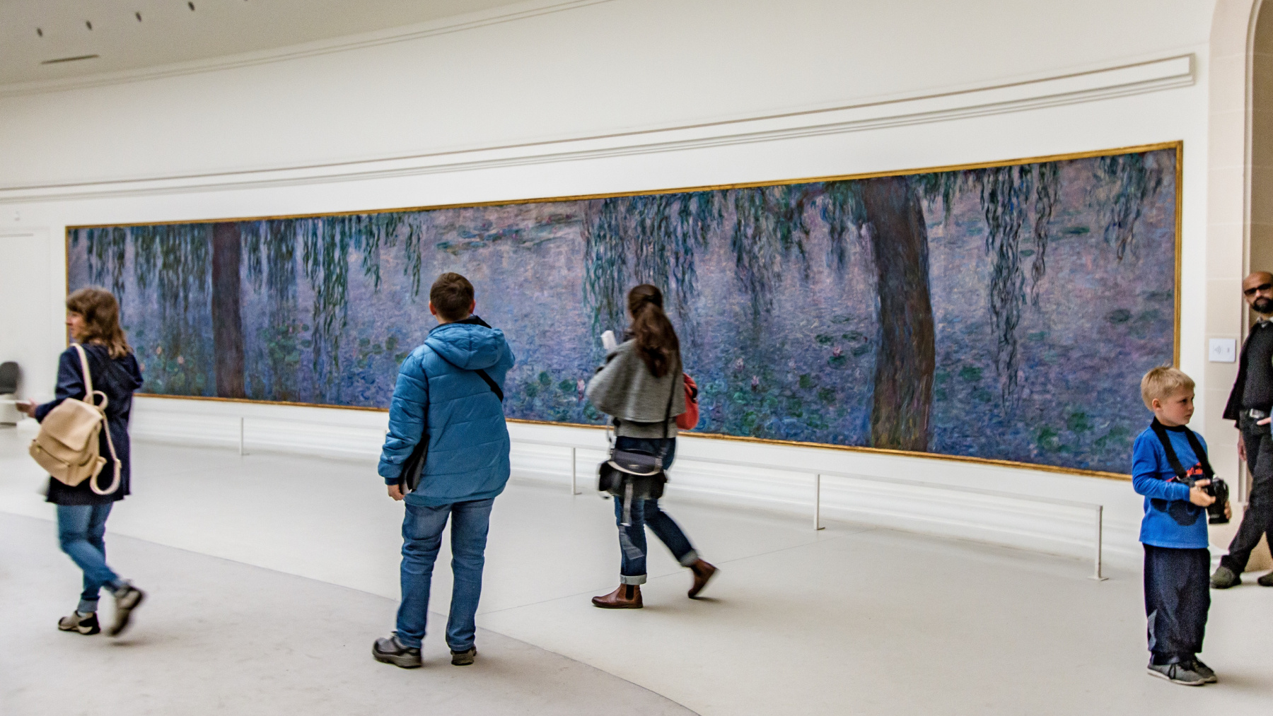

Slide 44
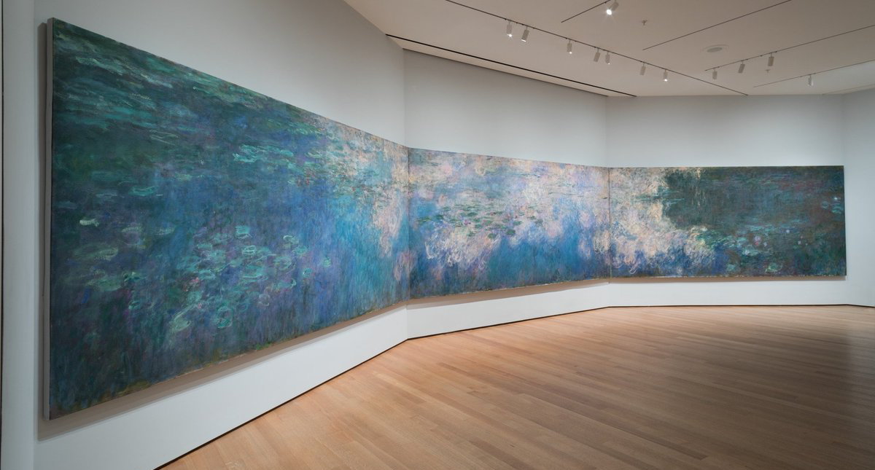
Museum of Modern Art, New York City

Slide 45
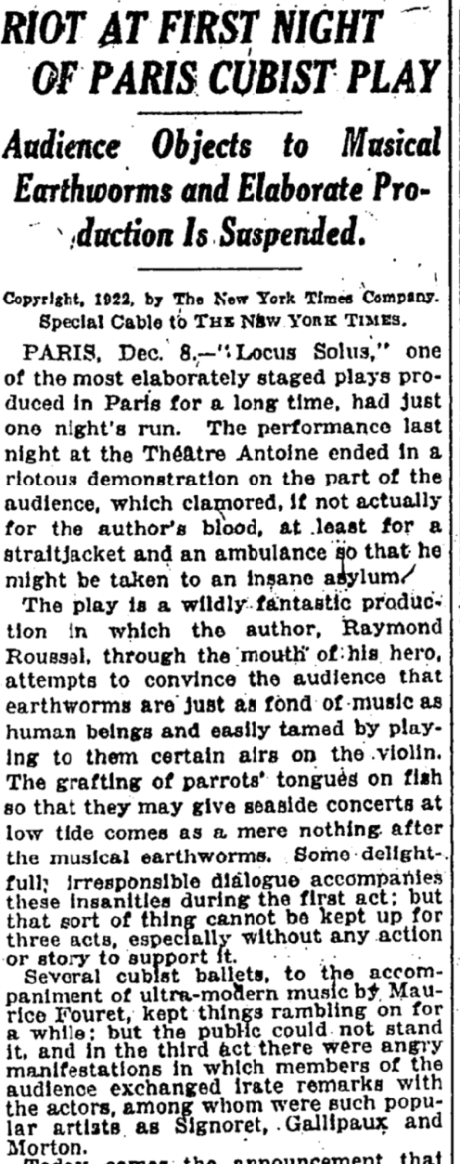
Cubism (very briefly) on the stage in Paris

Slide 47
The ‘Mirth and Girth’ raid on the School of the Art Institute, 1988

