Slide 1
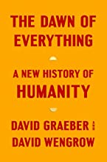
Philosophical and Religious Implications of the Dawn of Everything, by David Graeber and David Wengrow, Syllabus
Week 1: Intro.: Inequality, Indigenous Critique and the Myth of Progress, referencing Chapters 1 & 2, pp. 1-77.
Week 2: The possibilities of Human Politics, including Anarchism; Private Property and Culture(s), referencing Chapters 3 & 4, pp. 78-163.
Week 3: The problem with “modes of production”, referencing Chapter 5, pp. 164-209.
Week 4: How Neolithic people’s avoided agriculture and the spread of farming, referencing Chapters 6 & 7, pp. 210-275.
Week 5: Eurasia first urbanites—cities without kings, referencing Chapter 8, pp. 276-327.
Week 6: the indigenous origins of social housing and democracy in the Americas, referencing Chapter 9, pp. 328-358.
Week 7: The beginnings of sovereignty, bureaucracy, and politics, referencing Chapter 10, pp. 359-440.
Week 8: Summary: the historical foundations of the indigenous critique and the irony of the source of our source-book’s title—“The Dawn of Everything,” referencing Chapters 11 & 12, pp. 441-526.

Slide 2
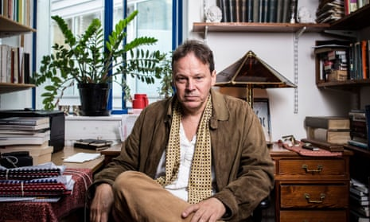
inequality is not the price of civilisation
An archaeologist and an anthropologist dismantle received wisdom about the way early societies operated by David Priestland, review in The Guardian, Oct. 23, 2021
Meanwhile, the so-called “agricultural revolution” – the Neolithic Faustian bargain when humanity swapped egalitarian simplicity for wealth, status and hierarchy – simply didn’t happen. The shift from foraging to agriculture was slow and patchy; much of what has been thought of as farming was actually small-scale horticulture, and perfectly compatible with flat social structures. Similarly, the rise of cities did not necessitate kings, priests and bureaucrats. Indus valley settlements such as Harappa (c2600BC) show no signs of palaces or temples and instead suggest dispersed, not concentrated power. While Graeber and Wengrow are open about the very limited evidence and the disputes over its interpretation, they build a compelling case.
[David] Graeber was, until his death last year at the age of 59, among the world’s most famous anarchists and an intellectual leader of the Occupy Wall Street movement (now celebrating its 10th anniversary). The Dawn of Everything certainly follows a long tradition of anti-statist anthropology. An early example was Mutual Aid (1902) by the anarchist geographer Prince Kropotkin, which provided an alternative to the fashionable evolutionary histories of his era, and defended “savage” peoples against the harsh judgments of imperialists and Marxists alike. And in his 1972 essay The Original Affluent Society, the American anthropologist Marshall Sahlins wondered whether the Kalahari foragers, with their two- to four-hour working day, were really so much worse off than the nine-to-five office or factory worker.Pictured: David Rolfe Graeber (February 12, 1961 – September 2, 2020) was an American anthropologist and anarchist activist. His influential work in economic anthropology, particularly his books Debt: The First 5,000 Years (2011) and Bullshit Jobs (2018), and his leading role in the Occupy movement, earned him recognition as one of the foremost anthropologists and left-wing thinkers of his time.

Slide 3
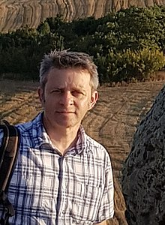
Human History Gets a Rewrite
A brilliant new account upends bedrock assumptions about 30,000 years of change.
By William Deresiewicz, review in The Atlantic, 11/2021
On September 2, 2020, at the age of 59, David Graeber died of necrotizing pancreatitis while on vacation in Venice… In his foreword, Graeber’s co-author, David Wengrow, an archaeologist at University College London, mentions that the two had planned no fewer than three sequels… The Dawn of Everything is written against the conventional account of human social history as first developed by Hobbes and Rousseau; elaborated by subsequent thinkers; popularized today by the likes of Jared Diamond, Yuval Noah Harari, and Steven Pinker; and accepted more or less universally… The Dawn of Everything is not a brief for anarchism, though anarchist values—antiauthoritarianism, participatory democracy, small-c communism—are everywhere implicit in it. Above all, it is a brief for possibility, which was, for Graeber, perhaps the highest value of all. The book is something of a glorious mess, full of fascinating digressions, open questions, and missing pieces. It aims to replace the dominant grand narrative of history not with another of its own devising, but with the outline of a picture, only just becoming visible, of a human past replete with political experiment and creativity.
Pictured: David Wengrow (born 25 July 1972) is a British archaeologist and Professor of Comparative Archaeology at the Institute of Archaeology, University College London. Wengrow has conducted archaeological excavations in Africa and the Middle East, most recently with the Sulaymaniyah Museum in Iraqi Kurdistan. He has conducted archaeological fieldwork in Africa and the Middle East, and is the author of books including The Archaeology of Early Egypt: Social Transformations in North-East Africa, c. 10,000 - 2650 BC (Cambridge UP); What Makes Civilization? The Ancient Near East and the Future of the West (Oxford UP); The Origins of the Monsters: Image & Cognition in the First Age of Mechanical Reproduction (Princeton UP), as well as academic articles on topics such as the origins of writing, ancient art, Neolithic societies, and the emergence of the first cities and states.

Slide 4
“A New Understanding of Human History and the Roots of Inequality,” David Wengrow, TED
In a 17 ½ minute presentation Wengrow presents the basic thesis of “The Dawn of Everything”, which attempts to change previous historical analyses of the development of societies. According to Wengrow, hierarchical societies are not the inevitable result of the invention of farming and urbanization. Variety of societies have evolved from prehistoric times to this day.
https://youtu.be/8SJi0sHrEI4
https://youtu.be/8SJi0sHrEI4

Slide 5
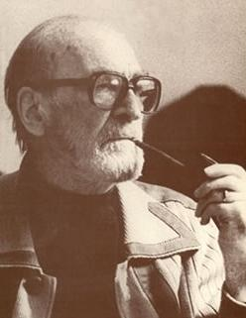
The Origin of the Books Title, Mircea Eliade’s, “illo tempore”, The Dawn of Everything, the time of creation
Eliade proposed that traditional societies lived in cyclical time, innocent of history. In traditional societies everything important had already happened. All the great founding gestures go back to mythic times, the “illo tempore”, the dawn of everything, when animals could talk or turn into humans, sky and earth wer enot yet separated, and it was possible to create genuinely new things (marriage, or cooking, or war)….Eliade contrasted that with the more recent innobation in human thought of a linear sense of time. According to Eliade, embracing the notion that events unfold in cumulative seuences, as opposed to recapitulating some deeper pattern, rendered us less able to weather the vicissitudes of war, injustice, and misfortune, plunging us instead into an age of unprecedented anxiety; and ultimately, nihilism.
Interestingly, Graeber and Wengrow, while they clearly found the words “Dawn of Everything,” made a catchy title, they find this view of cyclical vs. linear history both absurd and antisemitic [Eliade, a member of the Romanian fascist Iron Guard, blames linear thinking on the Tanach, or Old Testament]. They ask, does this mean that many great early discoveries—the first weaving of fabrics, the first navigations of the Pacific Ocean, the invention of metallurgy, were made by people who didn’t believe in discovery? [The Dawn of Everything, hereinafter DE, Ch. 12, pp. 497-498]
Mircea Eliade (Romanian: March 13 [O.S. February 28] 1907 – April 22, 1986) was a Romanian historian of religion, fiction writer, philosopher, and professor at the University of Chicago. He was a leading interpreter of religious experience, who established paradigms in religious studies that persist to this day.

Slide 6
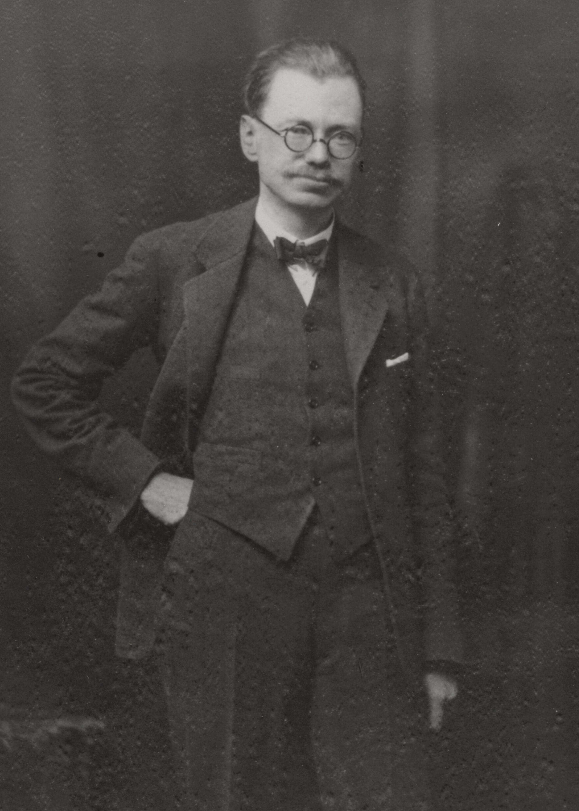
Prehistorian V. Gordon Childe’s 1936 book entitled “Man Makes Himself”
The authors like the spirit (not the sexism) inherent in the book title, “Man Makes Himself.” They say, “We are projects of collective self-creation…What if we treat people, from the beginning, as imaginative, intelligent, playful creatures who deserve to be understood as such? [DE, Chap. 1, pp. 8-9]
Vere Gordon Childe (14 April 1892 – 19 October 1957) was an Australian archaeologist who specialised in the study of European prehistory. Known as "the Great Synthesizer",Childe is primarily respected for developing a synthesis of European and Near Eastern prehistory at a time when most archaeologists focused on regional sites and sequences.[Childe believed the study of the past could offer guidance for how humans should act in the present and future.He spent most of his life in the United Kingdom, working as an academic for the University of Edinburgh and then the Institute of Archaeology, London. He wrote twenty-six books during his career. Initially an early proponent of culture-historical archaeology, he later became the first exponent of Marxist archaeology in the Western world… His socialist convictions led to an early denunciation of European fascism, and he was outraged by the Nazi co-option of prehistoric archaeology to glorify their own conceptions of an Aryan racial heritage…OnChilde was an atheist and critic of religion, viewing it as a false consciousness based in superstition that served the interests of dominant elites 19 October 1957, Childe went to the area of Govett's Leap in Blackheath, an area of the Blue Mountains where he had grown up. Leaving his hat, spectacles, compass, pipe, and Mackintosh raincoat on the cliffs, he fell 1000 feet (300 m) to his death.
Picture: Childe in the 1930s

Slide 7
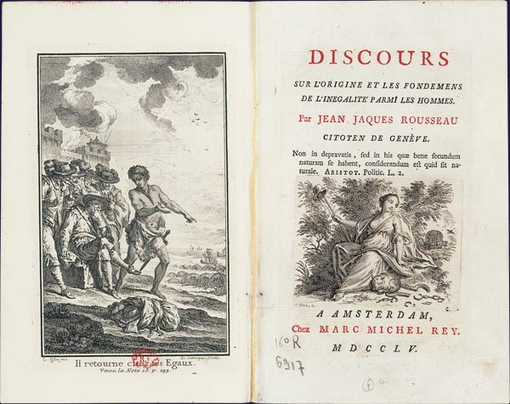
The “Lessons” of Prehistory are variations on the Christian Interpretation of the Garden of Eden
“People once lived in a state of innocence, yet were tainted by original sin. We desired to be godlike and have been punished for it; now we live ina fallen state wile hoping for future redemption. Today the popular version of this story is some updated variation on Jean-Jacques Rousseau’s “Discourse on the Origin and Foundation of Inequality Among Mankind [1754].” [DE, Chapter 1, p. 2]
Pictured: Frontispiece and title page of an edition of Rousseau's Discourse on Inequality (1754), published by Marc-Michel Rey in 1755 in Holland.

Slide 8
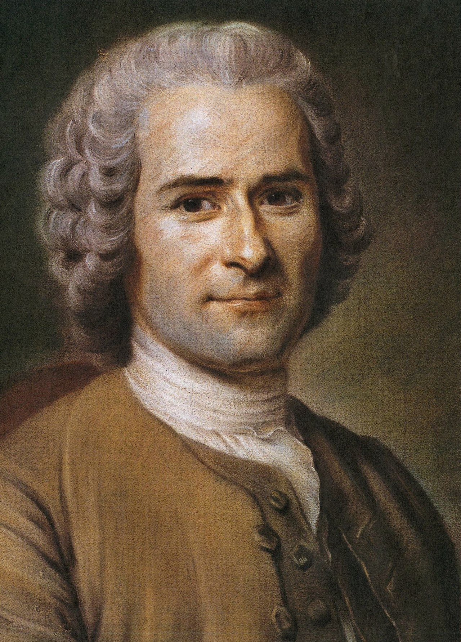
Rousseau’s version of the Garden of Eden Myth
Once upon a time…we were hunter-gatherers, living in a prolonged state of childlike innocence, in tiny bands. These bands were egalitarian; they could be for the very reason that they were so small. It was only after the “Agriculural Revolution”, and then still more the rise of cities, that this happy condition came to an end, ushering in “civilization” and “the state—which also meant the appearance of written literature, science and philosophy, bu at the same time, almost everything bad in human life: patriarchy, standing armies, mass executions and annoying bureaucrats… [DE, Chap. 1, p.2]
Pictured: Portrait by Maurice Quentin de La Tour, 1753 of Jean-Jacques Rousseau (28 June 1712 – 2 July 1778) was a Genevan philosopher, writer, and composer. His political philosophy influenced the progress of the Age of Enlightenment throughout Europe, as well as aspects of the French Revolution and the development of modern political, economic, and educational thought .

Slide 9
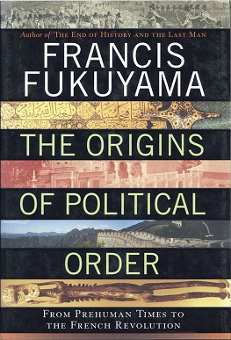
Modern Variations on Rousseau
Fukuyama: “In its earliest stages human political organization is similar to the band-level society observed in higher primates like chimpanzees.” Then he goes on to assert that Rousseau was largely correct in pointing out that the origin of political inequality lay in the development of agriculture, since hunter-gatherers (according to Fukuyama) have no concept of private property, and so little incentive to mark out a piece of land and say, “This is mine.” Band-level societies of this sort, he suggests are “highly egalitarian.” [Fukuyama, 211, p. 48].
Francis Fukuyama’s “The Origin of Political Order: From Prehuman times to the The French Revolution” (2011)…[DE, chap. 1, pp. 9-10]

Slide 10
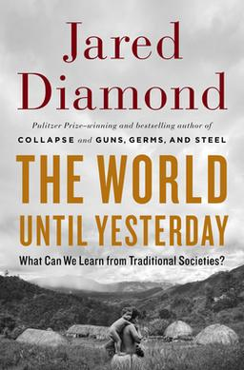
Modern Variations on Rousseau
The World Until Yesterday: What Can We Learn from Traditional Societies? is a 2012 popular science book by American intellectual Jared Diamond. It explores what people living in the Western world can learn from traditional societies, including differing approaches to conflict resolution, treatment of the elderly, childcare, etc.
Diamond suggests that that these hunter-gatherer bands, comprised of a few dozen individuals, mostly biologically relatedled a fairly meagre existence, “hunting and gathering whatever wild animal and plant species happen to live in an acre of forest”. Decisions were reached through face-to-face discussion; there were few personal possessions and no formal political leadership or strong economic specialization…Sadly, it is only within such primordial groupings that humans ever achieved a significant degree of social equality. [Diamond, 2012, p. 11 in DE, p. 10]
. Jared Mason Diamond (born September 10, 1937) is an American geographer, historian, ornithologist, and author best known for his popular science books The Third Chimpanzee (1991); Guns, Germs, and Steel (1997, awarded a Pulitzer Prize); Collapse (2005), The World Until Yesterday (2012), and Upheaval (2019). Originally trained in biochemistry and physiology,^{[1]} Diamond is known for drawing from a variety of fields, including anthropology, ecology, geography, and evolutionary biology. He is a professor of geography at UCLA.

Slide 11
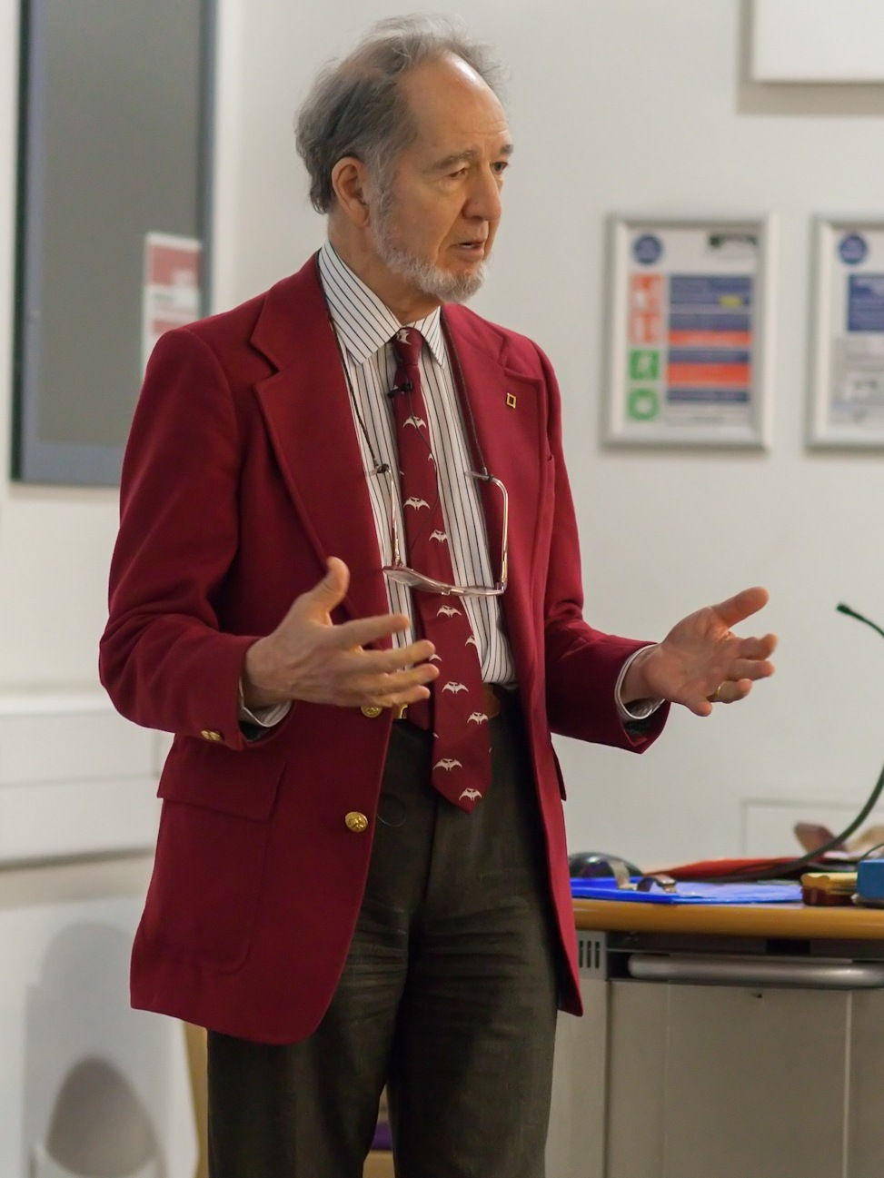
Hierarchy is inevitable, according to these followers of Rousseau once humans adopt large, complex forms of organization
Diamond explains, “Large populations can’t function without leaders who make the decisions, executives who carry out the decisions, and bureaucrats who administer the decisions and laws. Alas for all of you readers who are anarchists and dream of living without any state government, those are the reasons why your dream is unrealistic: you’ll have to find some tiny band or tribe willing to accept you, where no one is a stranger, and where kings, presidents, and bureaucrats are unnecessary.” Diamond, 2012, p. 11].
Graeber and Wengrow’s response is devastating: “The Truly remarkable thing is that…such pronouncements are not actually based on any kind of scientific evidence…There is simply no reason to believe that small-scale groups are especially likely to be egalitarian—or conversely, that large ones must necessarily have kings, presidents or even bureaucracies. Statements like these are just so many prejudices dressed up as facts, or even as laws of history.” [DE, Chapter 1, p. 11].
Jared Diamond speaking at University College London

Slide 12
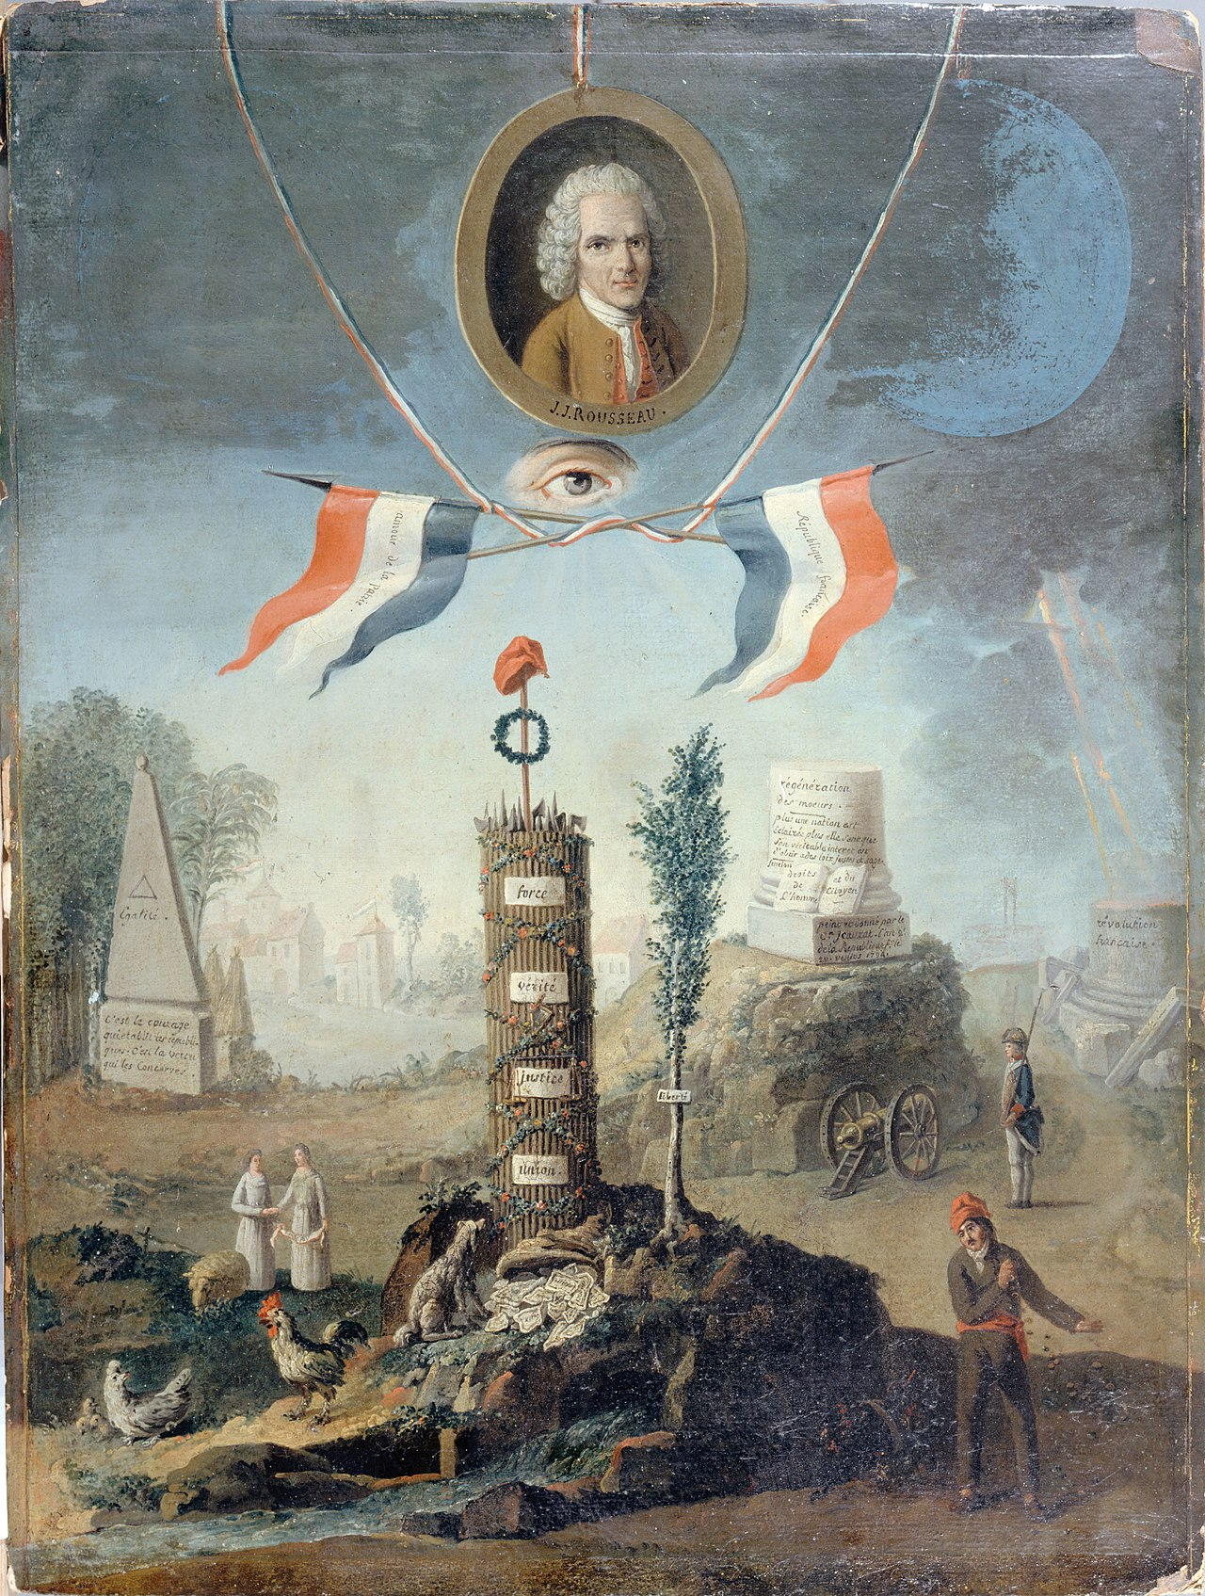
Rousseau himself never suggested that the innocent State of Nature really happened.
Rousseau insisted he was engaging in a thought experiment: “One must not take the kind of research which we enter into as the pursuit of truths of history, but solely as hypothetical and conditional reasonings, beter fitted to clarify the nature of things than to expose their actual origins…” In no sense was Rousseu imagining different states of being—savagery, or barbarism, as levels of social and moral development, corresponding to historical changes in modes of production: foraging, pastoralism, farming, industry. Rather, what Rousseau presented was more of a parable by way of an attempt to explore a fundamental lparadox of human politics: how is it that our innate drive for freedom somehow heads us, time and again, on a spontaneous march to inequality.
Rousseau did not invent the concept “State of Nature” It had been used for a century in European philosophy by natural law theorists such as Rousseau and Hobbes, and John Locke, all those interested in the origins of government to come up with one’s own variant on humanity’s original condition. [DE, Ch. 1, p. 12]
Allegory of the French Revolution in honor of Rousseau, by Nicolas Henri Jeaurat de Bertry (1794). The final version of the painting was offered to the National Convention

Slide 13
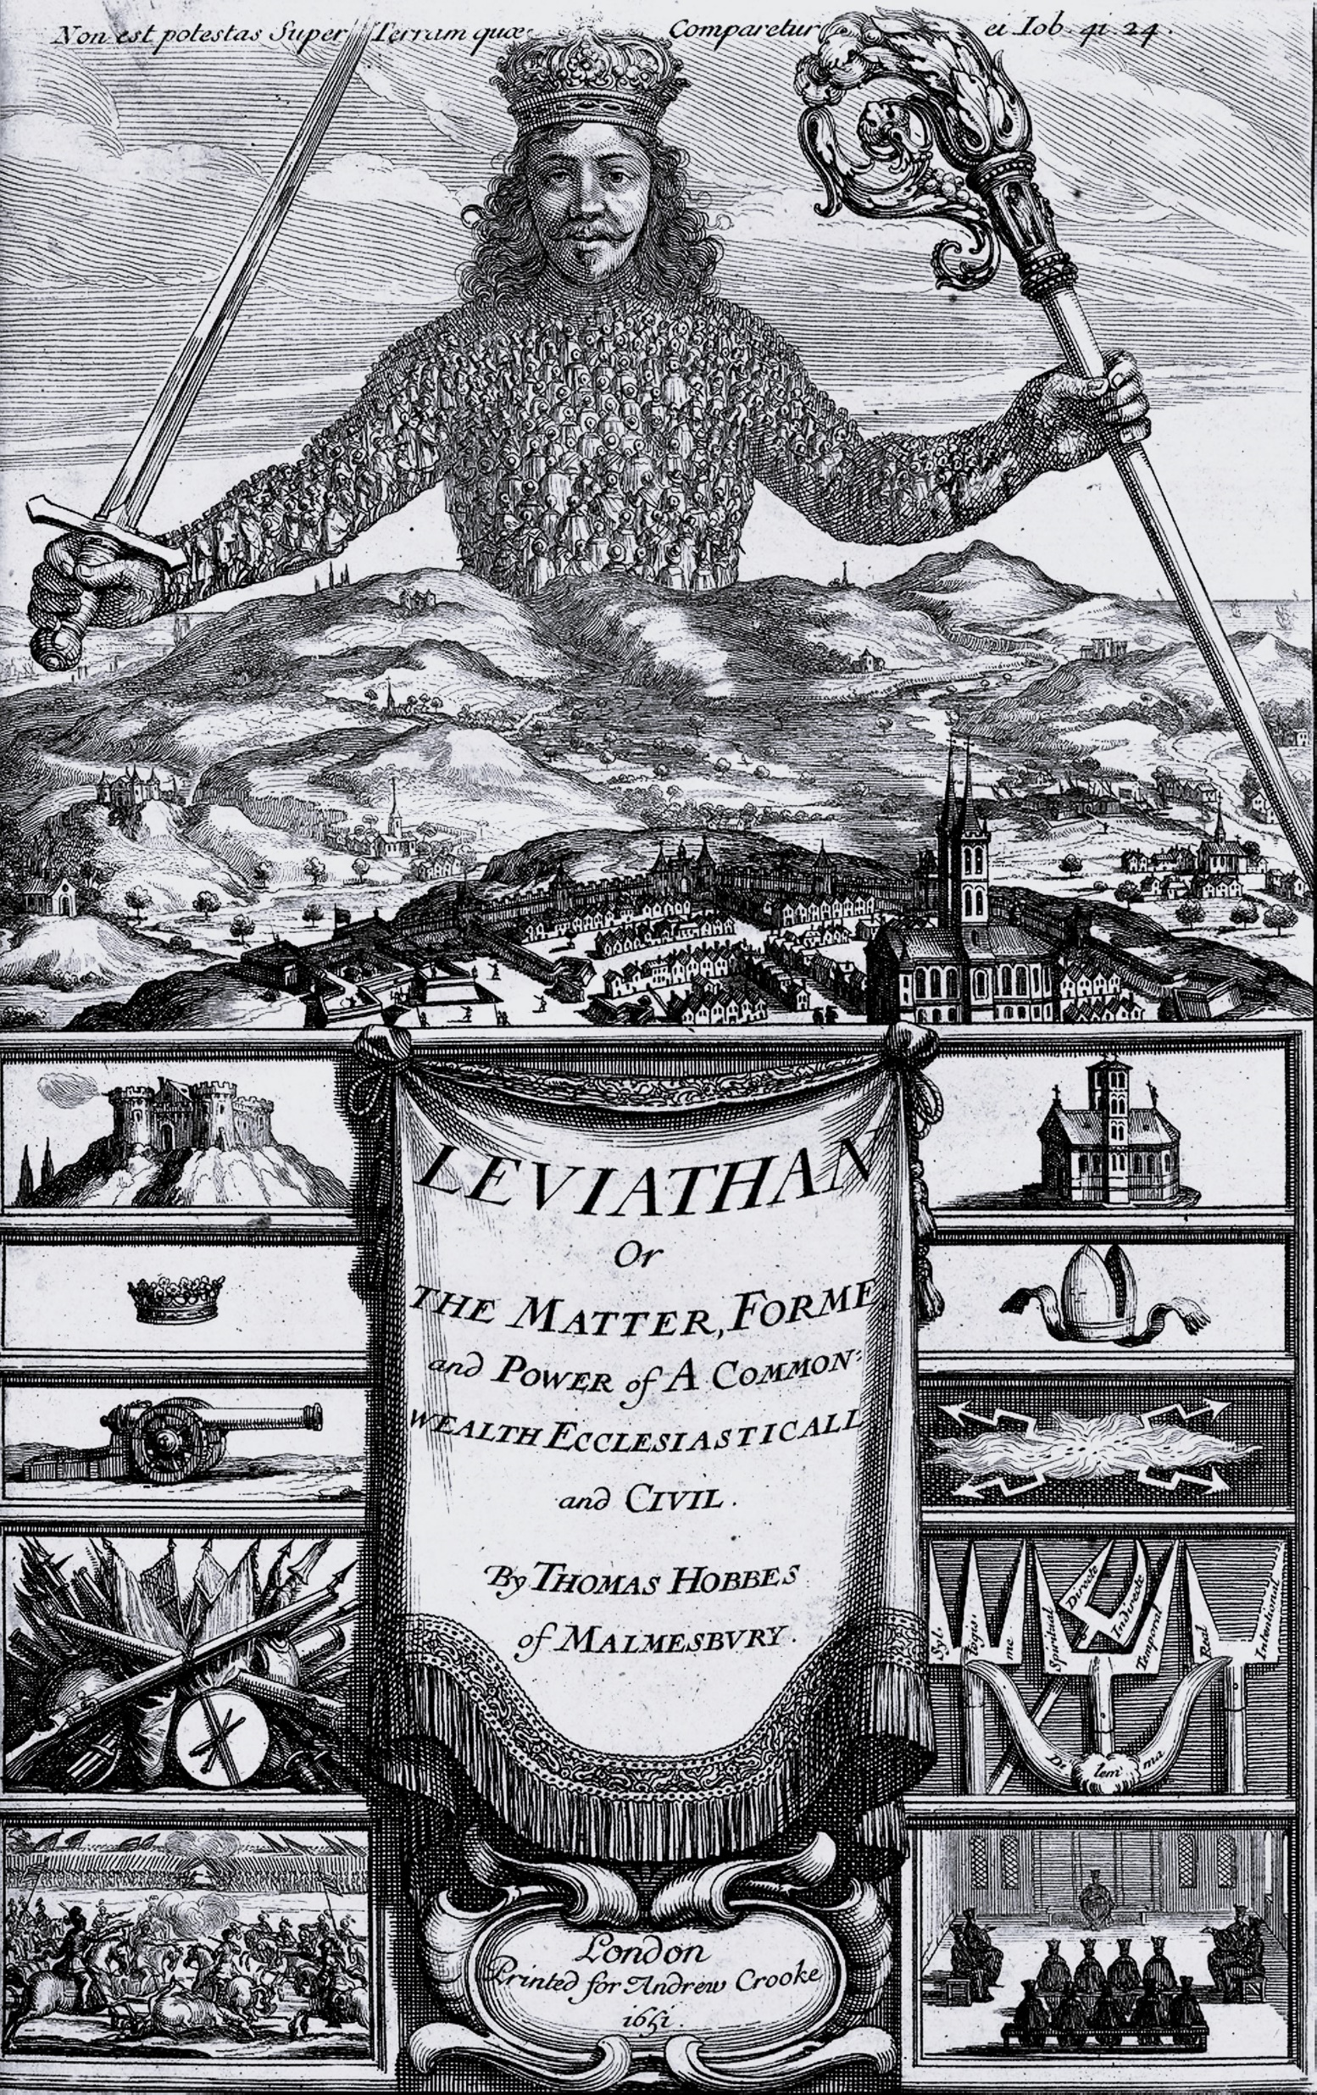
The Default Alternative to Rousseau’s version of the myth regarding human prehistory is Thomas Hobbes’ “Leviathan”
Thomas Hobbes’s “Leviathan” [1651]… is in many ways the founding text of modern political theory. It held that, humans being the selfish creatures that they are, life in an original State of Nature was in no sense innocent; it must instead have been “solitary, poor, nasty, brutish, and short.”—basically, a state of war, with everybody fighting against everybody else. Insofar as there has been any progress from this benighted state of affairs, it has been largely due to exactly those repressive mechanisms that Rousseau was complaining about: governments, courts, bureaucracies, police. [DE,Chap. 1, p. 3].
Hobbes imagined in Leviathan gthat the primordial state of human society would necessarily have been a Bellum omnium contra omnes”, a war of all against all, which could only be obercome by the creation of an absolute sovereign power. He wasn’t saying that there had ACTUALLY been a time when eeyone lived in such a primordial state. Some suspect that Hobbes’s sate of war was really an allegory for his native England’s descent into civil war in the mid 17th c., which drove the royalist author into exile in Paris. [DE, Chap. 1, p. 12]
Pictured: The frontispiece of the book Leviathan by Thomas Hobbes; engraving by Abraham Bosse

Slide 14
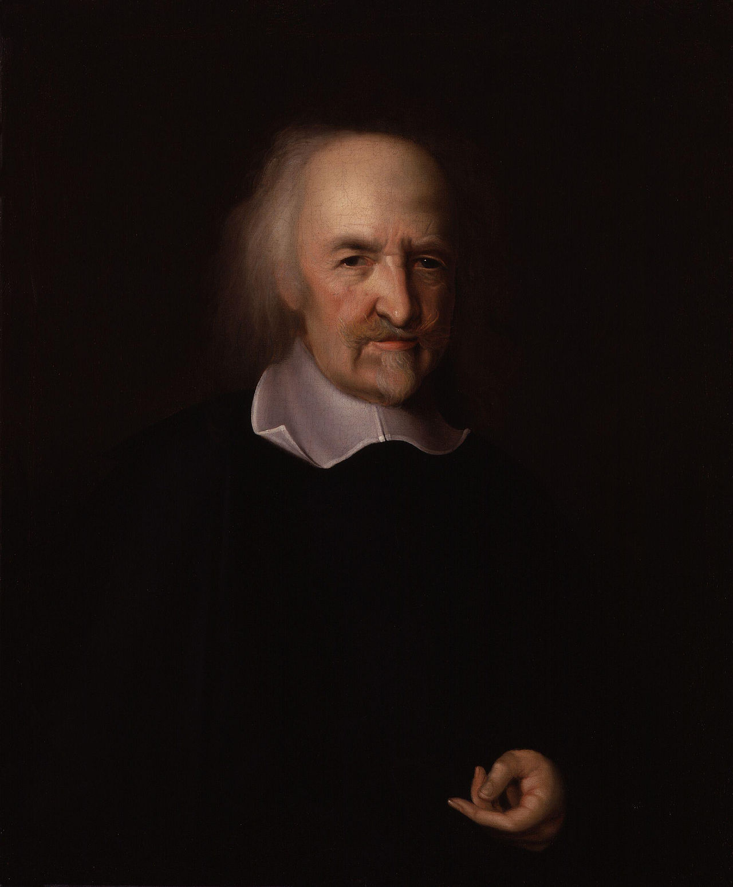
Graeber and Wengrow’s Telling of the Modern Hobbesian Viewpoint
Human society, in this view, is founded on the collective repression of our baser instincts, which becomes all the more necessary when humans are living in large numbers in the same place. The modern-day Hobbesian, then, would argue that, yes, we did live most of our evolutionary history in tiny bands, who could get along mainly because they shared a common interest a common interest in the survibal of their offspring…But even these were in no sense founded on equality. There was always, in this version, some “alpha-male” leader. Hierarchy and domination, and cynical self-interest, have always been the basis of human society. It’s just that, collectively, we have learned it’s to our advantage to prioritize our long-term interests over our short-term instincts; or, better, to create laws that force us to confine our worst impulses tgo socially useful areas like the economy, while forbidding the everywhere else. [DE, Chap. 1, p.3].
Portrait: Thomas Hobbes by John Michael Wright. Hobbes (5/15 April 1588 – 4/14 December 1679) was an English philosopher. Hobbes is best known for his 1651 book Leviathan, in which he expounds an influential formulation of social contract theory. In addition to political philosophy, Hobbes contributed to a diverse array of other fields, including history, jurisprudence, geometry, theology, and ethics, as well as philosophy in general.

Slide 15

A Quintessential Modern Hobbesian
Steven Arthur Pinker (born September 18, 1954) is a Canadian-American cognitive psychologist, psycholinguist, popular science author, and public intellectual. He is an advocate of evolutionary psychology and the computational theory of mind. The Better Angels of Our Nature: Why Violence Has Declined is a 2011 book by Steven Pinker, in which the author argues that violence in the world has declined both in the long run and in the short run and suggests explanations as to why this has occurred.
Like Hobbes, Pinker is concerned with the origins of the state; his key point o transition is not the rise of farming but the emergence of cities. He writes, “Archeologists tell us that humans lived in a state of anarcy until the emergence of civilization some five thousand years ago, when sedentary farmers first coalesced into cities and states and developed the fist governments.” [Pinter, p. 42]
He asks, referring to the 1991 find of the Tyrolean Iceman, Otzi, with an arrow in his side, “What is it about ancients, that they couldn’t leave us an interesting corpse without resorting to foul play.
Graeber and Wengrow point out how much Pinker is cherry picking an incident. Far more common, they point out, is how early humanity cared for the disabled, as has been discovered commonly in both Neanderthal and Homo sapien remains of deformed human bodies buried caringly after years after their disabilities manifested themselves, evidencing care. [DE, Ch. 1, pp. 13-14]

Slide 16
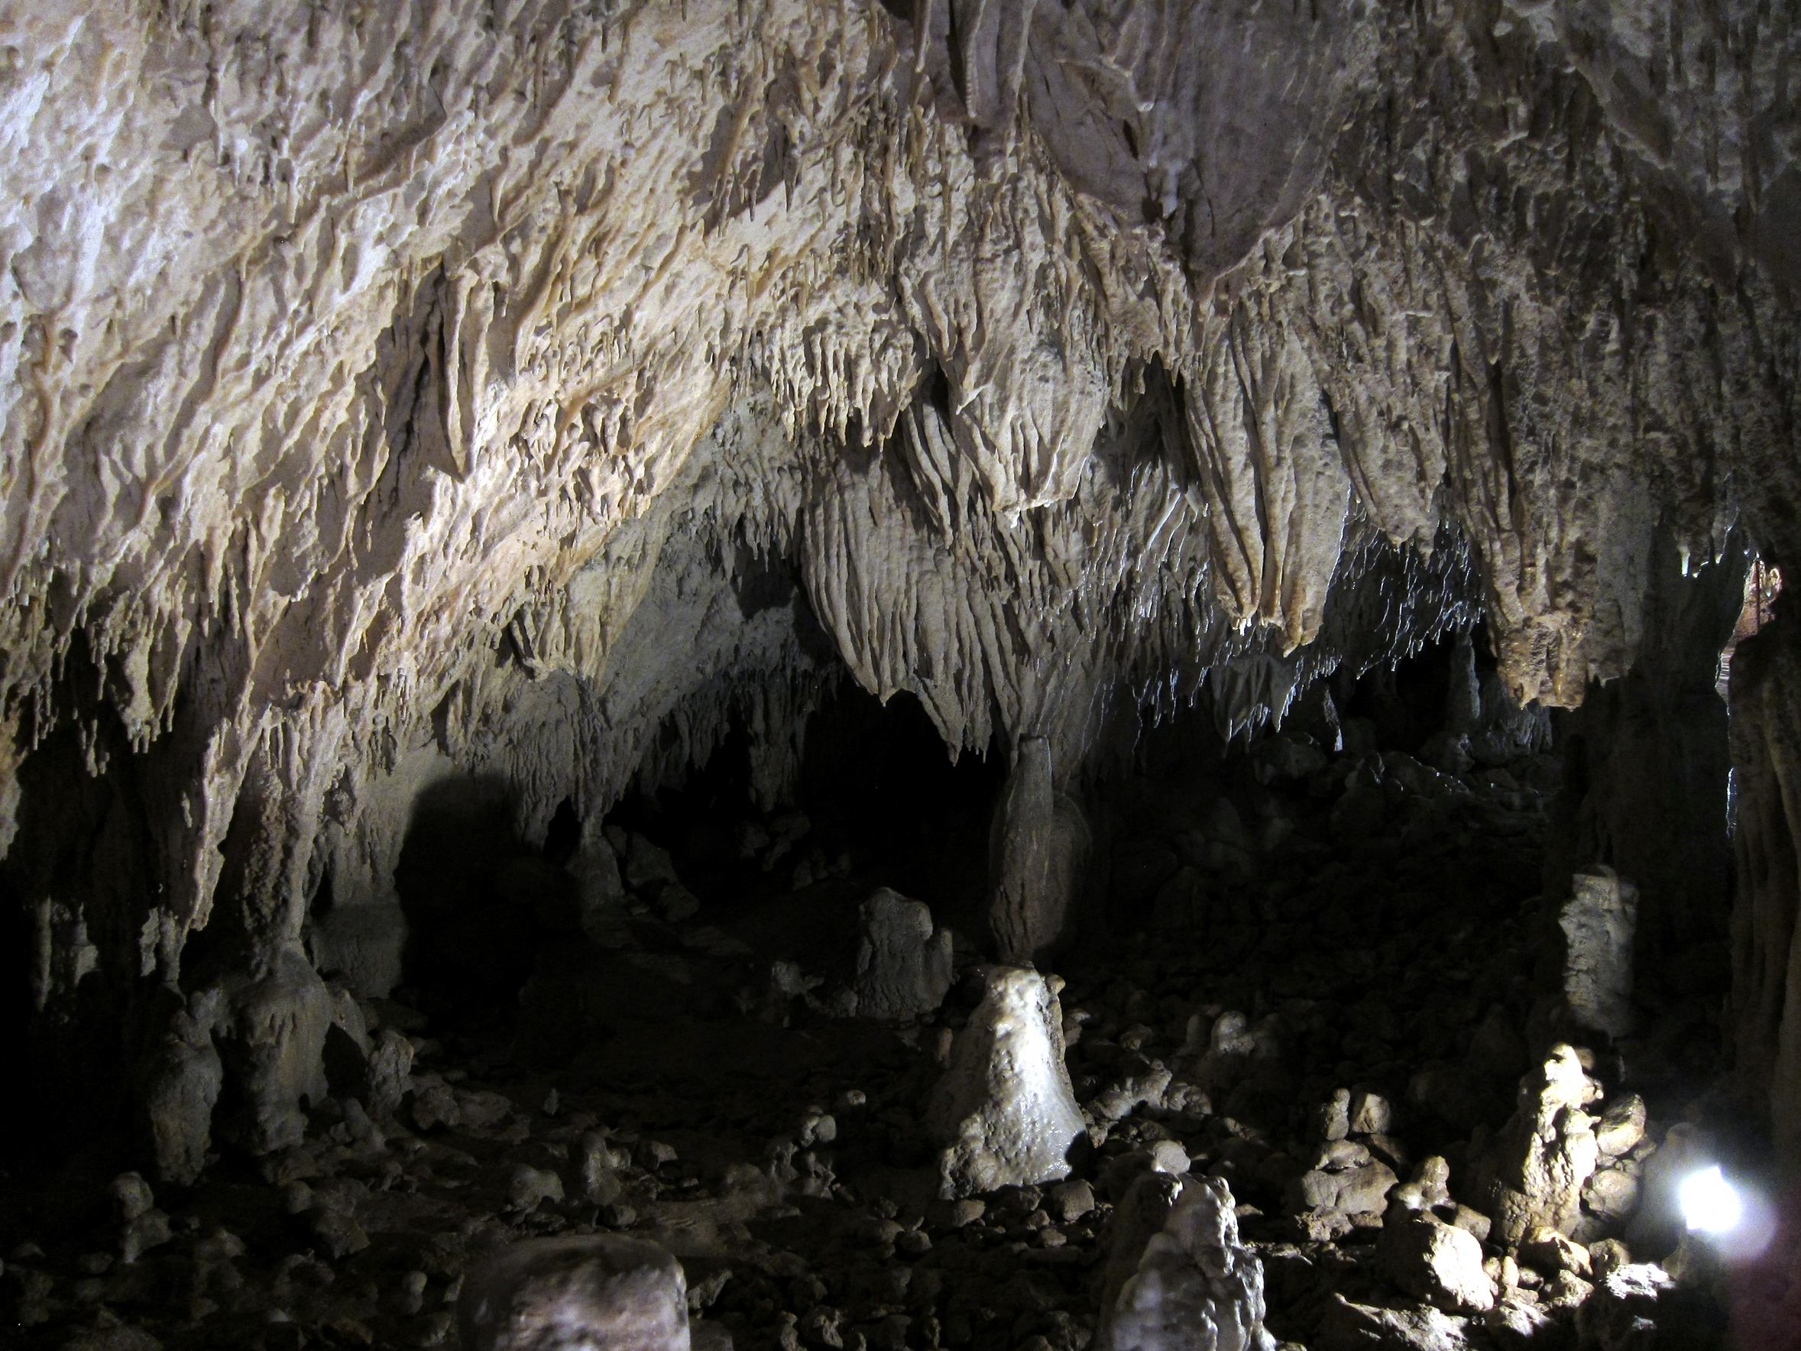
Romito 2, remains found in a Calabrian rock-shelter
Romito 2 is the 10,000-year-old butrial of a male with a rare genetic disorder (acromesomelic dysplasia): a severe type of dwarfism, which in life would have rendered him both anomalous in his community and unable to participate in the kind of high-altitude hunting that was necessary for their survival…These hunter-gatherers took pains to support this individual through infancy and into early adulthood, granting him the same share of meat as everyone else, and ultimately according him a careful, sheltered burial…Neither is Romito 2 an isolated case. When archaeologists undertake balanced appraisals of hunter-gatherer burials from the Palaeolithic, they find high frequencies of health-related disabilities—but also surprisingly high levels of care until the time of death (and beyond, since some of these funerals were remarkably lavish… Graeber and Wenhrow assert, “our species is a nurturing and care-giving species, and there was simply no need for life to be nasty, brutish or short. [DE, Ch. 1, p.14]
The Romito cave (Italian: Grotta del Romito) is a natural limestone cave in the Lao Valley of Pollino National Park, near the town of Papasidero in Calabria, Italy. Stratigraphic record of the first excavation confirmed prolonged paleo-human occupation during the Upper Paleolithic since 17,000 years ago and the Neolithic since 6,400 years ago.

Slide 17
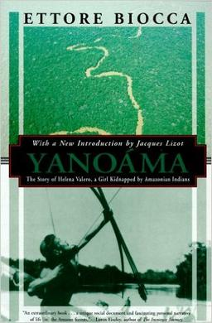
The Case of Helena Valero
If Pinker is correct that life is on average secure and prosperous in modern Western civilization, vs. chaotic and poverty-stricken in the tribal stage of human development, than how might he grapple with choices of Helena Valero, which are far from unusual.
Yanoama: The Story of Helena Valero, a Girl Kidnapped by Amazonian Indians (original Italian title Yanoáma: dal racconto di una donna rapita dagli Indi) is a biography of Helena Valero, a white woman who was captured in the 1930s as a girl by the Kohorochiwetari, a tribe of the Yanomami indigenous people, living in the Amazon rainforest on the border between Venezuela and Brazil. Valero recounted her life's story to Italian biologist and anthropologist Ettore Biocca, who published the account in 1965. She lived with the Yanomami for about two decades, eventually achieving some importance in her community…While Pinker repeats Valero’s description of the brutal Yanomami raid when she was abducted in 1932, he fails to mention that when she was given the ability to make a fully infgormed decision, Helen Valero decided she would prefer life among the Yanomami.
The colonial history of North and South America is full of accounts of setlers, captured or adopted by indigenous societies, being given the choice of where they wished to stay and almost invariably choosing to stay with the latter… This is attested in a letter to a friend by Benjamin Franklin: “When an Indian Child has been brought up among us, taught our language and habituated to our Customs, yet if he goes to see his relations and make one Indian Ramble with them there is no persuading him eber to return, and that this is not natural merely as Indians, but as men, is plain from this, that when white persons of either sex have been taken prisoner young by the Indians… if they are ransomed by their Friends, ..they take the first opportunity of escaping again into the Woods…[DE, Ch. 1, pp. 18-20].

Slide 18
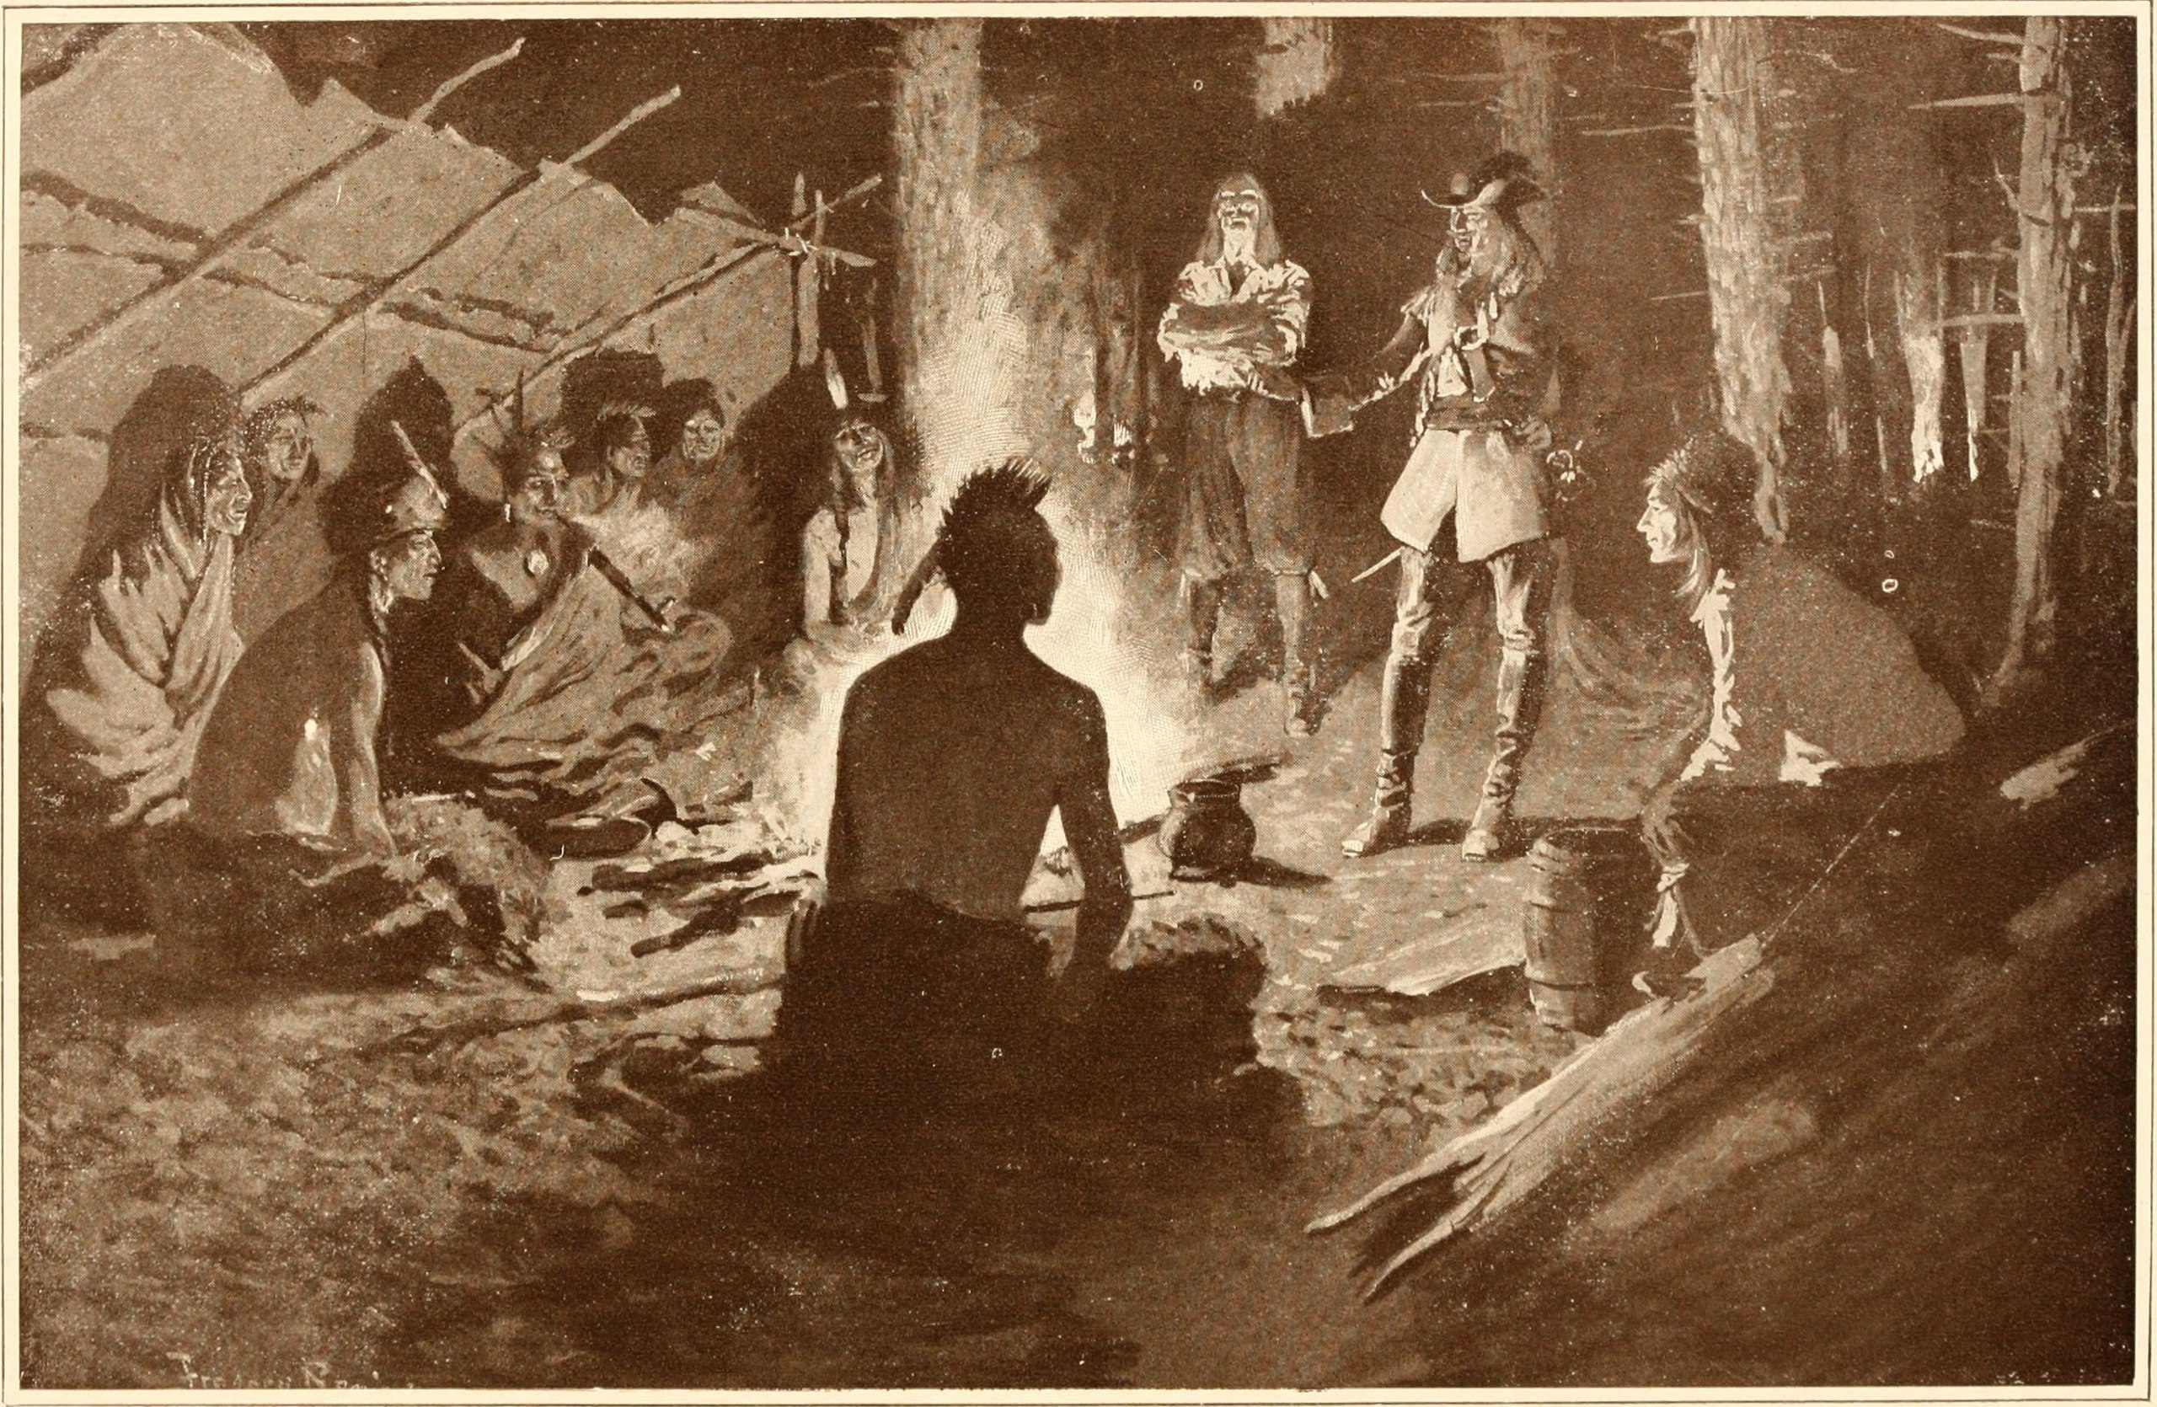
Our modern notion of social evolution is a conservative reaction against the “Indigenous Critique” such as that of Huron-Wendat statesman Kandiaronk
Our modern notion of social evolution: the idea that human societies could be arranged according to stages of development, each with their own characteristic technologies and forms of organization (hunter-gatherers, farmers, urban-industrial society, and so on).
The Indigenous Critique was a broad logical dismissal of Western European Christian claims of superiority to Indigenous peoples, focusing on the illogic of Western claims of the importance of land ownership, use of money, and claims to individual freedom when it was clear that their social hierarchy made everyone except the king 9of Frnace) subservient to someone
The Indigenous Critique against European civilization began to gain ground in the early decades of the 18th c. The origins of that critique, however, lie not with the philosophers of the Enlightenment, …but with indigenous commentators and observers of European society. [DE, Chap. 2, pp. 49 ff.]
Pictured: Kondiaronk speaking to the captured Iroquois diplomats, 1688. Kondiaronk (c. 1649–1701) (Gaspar Soiaga, Souojas, Sastaretsi), known as Le Rat (The Rat; Kandiaronk literally means muskrat), was Chief of the Native American Wendat people at Michilimackinac in New France. …Noted as a brilliant orator and a formidable strategist, Kondiaronk led the pro-French Petun and Huron refugees of Michilimackinac against their traditional Iroquois enemies. Kondiaronk realized the only way to establish security was to maintain a war between their enemies, the Iroquois, and the French in an attempt to keep the Iroquois occupied and the Hurons safe from annihilation. Kondiaronk succeeded in killing the peace; however, once he had secured the preservation of his people he favored a vast peace settlement.This effort concluded in what is known as The Great Peace of Montreal (1701) between France, the Iroquois, and the other Indian tribes of the Upper Great Lakes. This ended the Beaver Wars and helped open up the interior of North America to deeper French exploration and commerce. Kondiaronk made them see the advantages such a peace would bring them.

Slide 19
Why this book is subtitled “A New History of Humanity”
The authors promise, “In this book we will not only be presenting a new history of humankind, but inviting the reader into a new science of history, one that restores our ancestors to their full humanity…As the stories of one-time captives escaping back to the woods again make clear, Rousseau—in his essay submitted to win 1754 contest set up by the Academie des Sciences, Arts et Belles-Lettres de Dijon, on the topic “what is the origin of inequality among men, and is it authorized by natural law”-- was not entirely mistaken. Something has been lost…What does it imply about the possibilities for social change today?”
We begin by tracing the historical roots of the question Rousseau addressed--what is the origin of social inequality, back to a series of encounters between European colonists and Native American intellectuals in the 17th c. Because of the European colonial encounters in the Americas, writers like Thomas Hobbes, Hugo Grotius [1583-1645, Dutch humanist who laid the foundations for international law based on natural law], or John Locke [1632-1704, Enlightenment philosopher, the English founder of liberalism] could skip past the biblical narratives …and begin instead with the question, “what might humans have been like in a State of Nature, when all thy had was their humanity?” We explore the impact of these encounters upon the European Enlightenment and on how we make sense of the human past today, including the origins of farming, property, cities, democracy, slavery and civilization itself by considering the perspective of indigenous thinkers. [DW, Ch. 1, pp. 24-26].Ch. 2, p. 33.

Slide 20

“…There was a reason why so many key Enlightenment thinkers insisted that their idealsof individual liberty and polditical equality were inspired by Native American sources and examples. Because it was true.” [DE, Ch. 2, p. 37]
As Father Lallemant, whose correspondence provided an initial model for “The Jesuit Relations” [here depicted from 1662-1663], noted of the Wendat (Huron) in 1644: Wendat captains urge their subjects to provide what is needed; no one is compelled to it, but those who are willing bring publicly what they wish to contribute; it seems as if they vied with one another according to the amount of their wealth, and as the desire of glory and of appearing solicitous for the public welfare urges them to do on like occasions…This form of justice restrains all these peoples and seems more effectually to repress disorders than the personal punishment of criminals does in France.” [DE, Ch. 2, p. 42]
The Jesuit Relations, also known as Relations des Jésuites de la Nouvelle-France, are chronicles of the Jesuit missions in New France. The works were written annually and printed beginning in 1632 and ending in 1673.

Slide 21
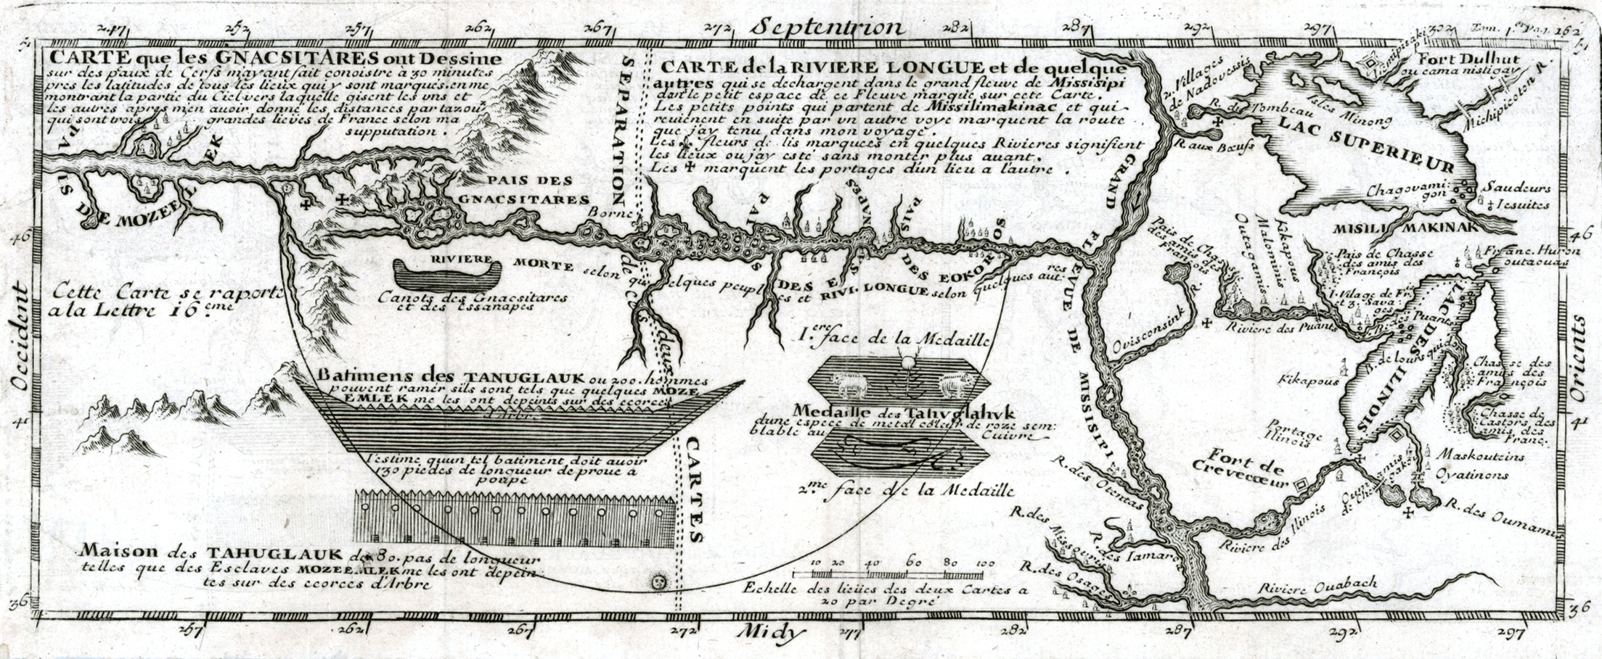
The social coherence among the Wendat and the Five Nations of the Haudenosaunee (Iroquois) was created through persuasive arguments and social consensus
A chief illustration of the importance of reasoned debate in insuring the personal freedom and in illustrating the refusal of arbitrary power on the part of the Wendat, is found in the work of Louis-Armond de Lom D’Arce, Baron de lat Hontan. Lahontan (9 June 1666 – prior to 1716) served in the French military in Canada, starting in 1683 when he was 17 years old, where he traveled extensively in the Wisconsin and Minnesota region and the upper Mississippi Valley. Upon return to Amsterdam in 1703 he published his three most famous works: Nouveaux Voyages dans l’Amerique Septentrionale, Memoires de l’Amerique Septentrionale, and Supplement aux Voyages ou Dialogues avec le sauvage Adario. Nouveaux Voyages dans l’Amerique Septentrionale provides a thorough and detailed account of de Lahontan's life and stay in New France, while Memoires de l’Amerique Septentrionale describes his observations of geography, institutions, commerce as well as information about native tribes. He wrote at length and in very positive terms about Native American culture, portraying Indian people as free, rational, and generally admirable. Supplement aux Voyages ou Dialogues avec le sauvage Adario lambasts institutional Christianity by means of a dialogue between de Lahontan and a Huron Chief named Adario (The Rat). The author attempts to contrast the injustice of Christianity with the freedom and justice of native people.
Lahontan, deputy to the Governor-General of New France (French Canada), Comte de Frontenac, became fluent in Algonkian and Wendat. He later claimed that because he was something of a sceptic in religious matters and a political enemy of the Jesuits, several indigenous political figures, Kandiaronk, among them, were willing to share with him their actual opinions on Christian teachings.
Picture: Map depicting Baron de Lahontan's west-east Long River (Riviere Longue), rising in distant western mountains and emptying into the upper Mississippi.

Slide 22
While many scholars assume Lahontan’s dialogues with Kandiaronk are fictional recreations, Barbara Alice Mann, a noted authority, says they are genuine
There are first-hand accounts of Kandiaronk’s oratorical skills and dazzling wit. Father Pierre de Charlevoix described Kandiaronk as so “naturally eloquent” that “no one perhaps ever exceeded him in mental capacity…He was the only man in Canada who was a match for the [Governor of New France} Count de Frontenac, who often invited him to his table to give his officers this pleasure.” [Barabara Alice Mann, “Native American Speakers of the Eastern Woodlands: Selected Speeches and Critical Analysis”, Westport, Conn.:Greenwood Press, 2001, p. 55, in DE, Ch. 2, pp. 50-51]
An example of Kondiaronk’s persuasiveness: “Do you seriously imagine that I would be happy to live like one of the inhabitants of Paris, to take two hours every morning just to put on my shirt and make-up, to bow and scrape before every obnoxious galoot I meet on the street who happened to have been born with an inheritance? Do you really imagine I could carry a purse full of coins and not immediately hand them over to people who are hungry; that I would carry a sword but not immediately draw it on the first band of thugs I see rounding up the destitute to press them into naval service? “ If, on the other hand, Lahontan were to adopt the American (indigenous) way of life, it might take a while to adjust—but in the end he’d be far happier. (Kandiaronk had a point..settlers adoped into indigenous societies almost never wanted to go back.) [DE, Ch. 2, 55]

Slide 23
An example of Lehontan’s dialogue with Kandiaronk
Lehontan: This is why the wicked need to be punished, and the good need to be rewarded. Otherwise, murder, robbery and defamation would spread everywhere, and, in a word, we would become the most miserable people upon the face of the earth.
Kandiaronk: For my own part, I find it hard to see how you could be much more miserable than you already are. What kind of human, what species of creature, most Europeans be, that they have to be forced to do good, and only refrain from evil because of fear of punishment?...
You have observed that we lack judges. What is the reason for that? Well, we never bring lawsuits against one another. And why do we never bring lawsuits?
[K continues] Well, because we made a decision neither to accept or make use of money. And why do we refuse to allow money into our communities? The reason is this: we are determined not to have laws—because, since the world was a world, our ancestors have been able to live contentedly without them. [While the Wendat most certainly did have a legal code, Kandiaronk is referring to laws of a coercive or punitive nature. Ultimately Kandiaronk criticizes the French for their focus on money, property rights, and their pursuit of material self-interest which leads to a judicial system rife with judicial persecution, false testimony, torture, witchcraft accusations and differential justice for rich and poor.] (DE, Chapter 2, p. 54, from Lehontan, “Dialogues”.)

Slide 24
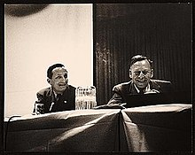
Anthropologist Gregory Bateson’s term “Schismogenesis”
Bateson coined the term schismogenesis--the emergence of divisions within social groups-- to describe people’s tendency to define themselves against one another—e.g. defining boys’ behavior in contrast to girls’ behavior in Papua, New Guinea. It’s not just by imitating their elders that boys and girls learn to behage as they do; it’s because boys and girls each learn to find the behaviour of the opposite sex distasteful and try to be as little like them as possible…So too, people want to define themselves against their neighbor. [DM, Chap. 2, pp. 56-57]
Gregory Bateson (May 9, 1904 – July 4, 1980) was an English anthropologist, social scientist, linguist, visual anthropologist, semiotician, and cyberneticist whose work intersected that of many other fields. His writings include Steps to an Ecology of Mind (1972) and Mind and Nature (1979).In Palo Alto, California, Bateson and colleagues developed the double-bind theory of schizophrenia.Bateson's interest in systems theory forms a thread running through his work. He was one of the original members of the core group of the Macy conferences in Cybernetics (1941–1960), and the later set on Group Processes (1954–1960), where he represented the social and behavioral sciences. He was interested in the relationship of these fields to epistemology. His association with the editor and author Stewart Brand helped widen his influence.
Picture: Rudolph Arnheim (L) and Bateson (R) speaking at the American Federation of Arts 48th Annual Convention, 1957 Apr 6 / Eliot Elisofon, photographer

Slide 25
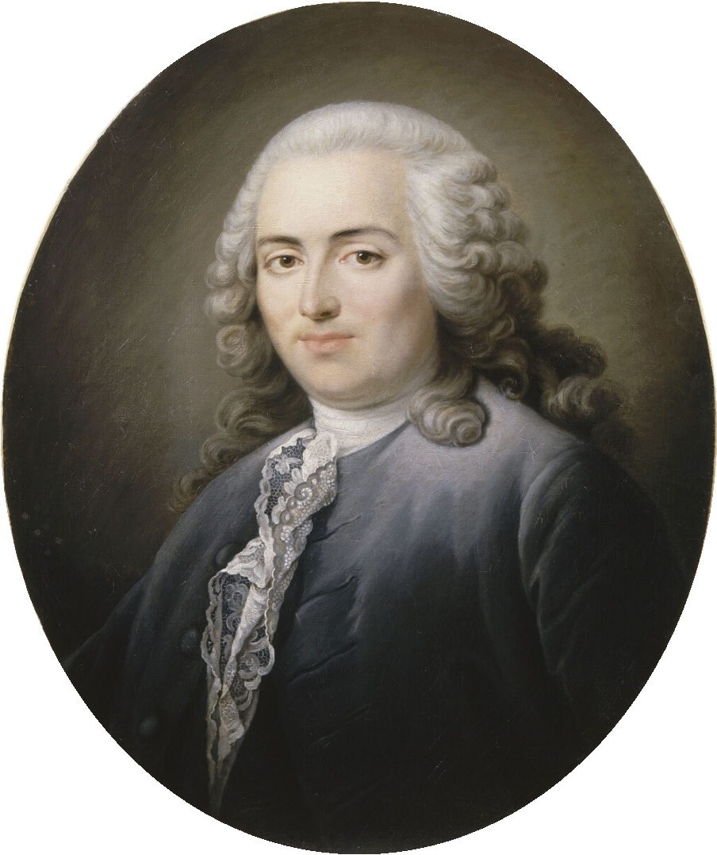
A.R. J. Turgot turned the Indigenous Critique on its head, laying the basis for most modern views of Social Evolution; Arguments on Freedom became those on Equality
Anne Robert Jacques Turgot, Baron de l'Aulne^{[a]} (May 10, 1727 – March 18, 1781), commonly known as Turgot, was a French economist and statesman. Originally considered a physiocrat (economists who believed agriculture was the source of all wealth), he is today best remembered as an early advocate for economic liberalism. We progress from simple societies like those of the Wendat to our own complex “commercial civilization”, in which the poverty and dispossession of some—however lamentable it may be—is nonetheless the necessary condition for the prosperityof society as a whole. In a series of lectures on world history he proposed a theory of stages of economic development: social evolution, he reasoned, always begins with hunters, than moves on to a stage of pastoralism, then farming, and only then finally passes to the contemporary stage of urban commercial civilization. [DE, Ch. 2, p. 60]
Portrait of Turgot Attributed to Antoine Graincourt from-- Versailles

