Slide 1
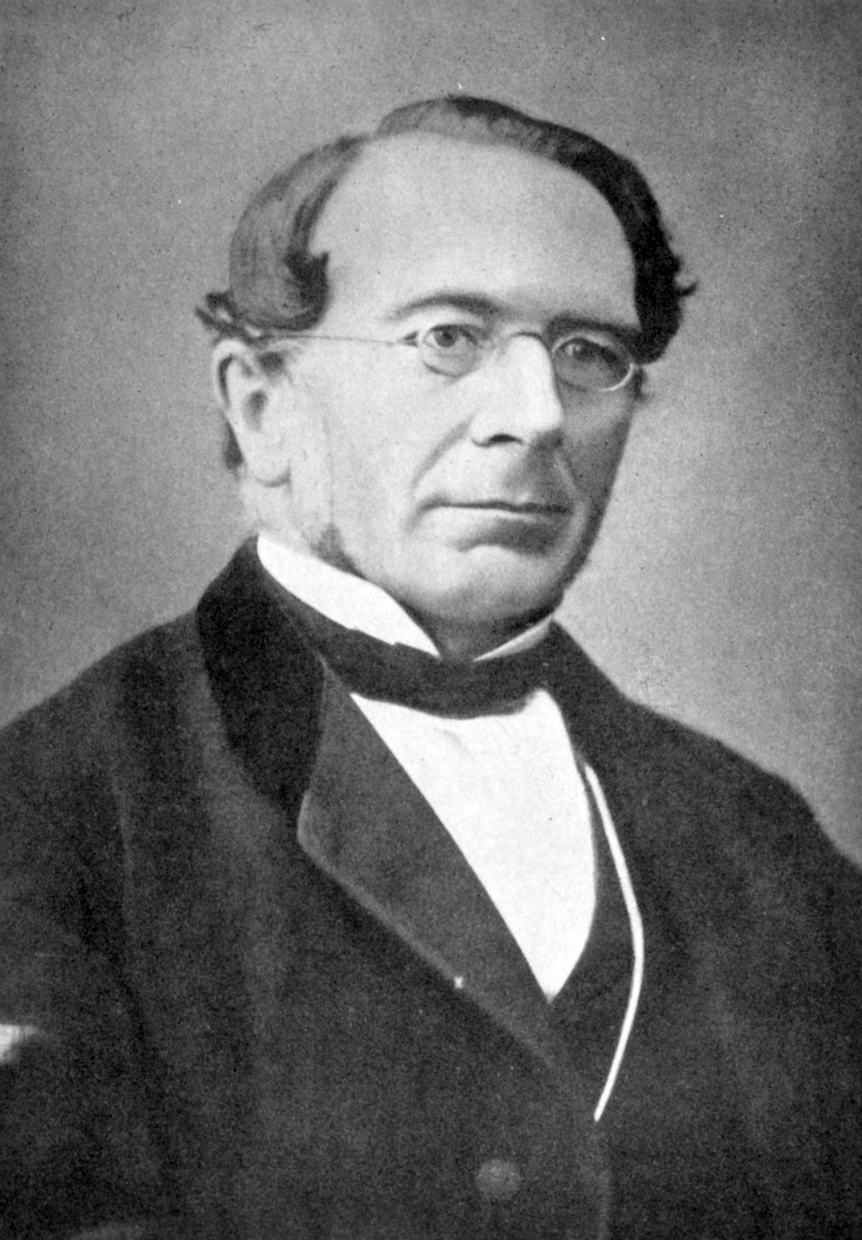
The first systematic definition of the state
Rudolph von Ihering proposed that a state should be defined as any institution that claims a monopoly on the legitimate use of coercive force within a given territory (this definition has since come to be identified with the sociologist Max Weber, 1864-1920, German sociologist, historian, jurist and political economist ). On this definition, a government is a “state” if it lays claim to a certain stretch of land and insists that, within its borders, it is the only institution whose agents can kill people, beat them up, cut off parts of their body or lock them in cages; or, as von Ihering emphasized, that can decide who else has the right to do so on its behalf. [DE, p. 359]. More recently, social scientists have used what Graeber and Wengrow identify as a logically circular description of a state. Basically, since states are complicated, any complicated social arrangement must therefore be a state. [DE, pp. 360-361] They then ask, “If it is possible to have monarchs, aristocracies, slavery and extreme forms of patriarchal domination, even without a state…; and if it’s equally possible to maintain complex irrigation systems, or develop science and abstract philosophy without a state…, then what do we actually learn about human history by establishing that one political entity is what we would like to describe as a “state” and another isn’t?” They prefer to examine what various governments—e.g. bureaucratic or heroic-- have to tell us about human freedom and equality. [DE, pp. 361-362].
Picture, Wikipedia: Caspar Rudolph Ritter von Jhering (also Ihering) (1818 – 1892) was a German jurist. He is best known for his 1872 book Der Kampf ums Recht (The Struggle for Law), as a legal scholar, and as the founder of a modern sociological and historical school of law. In this, his most famous work, Jhering based his theory of duty in the maintenance of one's rights, firstly, on the connection between rights and personality; and secondly, on the solidarity of law and rights. The relationship of rights to personality is explored. Our rights involve a parcel of our social worth, our honor. Whoever violates our rights, attacks our worth, our honor. His oldest son was the German-Brazilian zoologist Hermann von Ihering (1850–1930). He was also the great-great-grandfather of Australian singer and actress Olivia Newton-John through his daughter Helene Ehrenberg and her marriage to the German jurist Victor Ehrenberg.

Slide 2
The Three Elementary Forms of Domination
The three primary forms of freedom (a review): the freedom to move; the freedom to disobey orders; the freedom to reorganize social relations.
The three principles or forms of domination or bases for social power are control of violence, control of information, and individual charisma
Each of these three principles has become the basis for institutions now seen as foundational to the modern state. That is why the secret agent has become the mythic symbol of the modern state. James Bond, with his licence to kill, combines charisma, secrecy and power to use unaccountable violence, underpinned by a great bureaucratic machine. [DE, pp. 363-366].

Slide 3
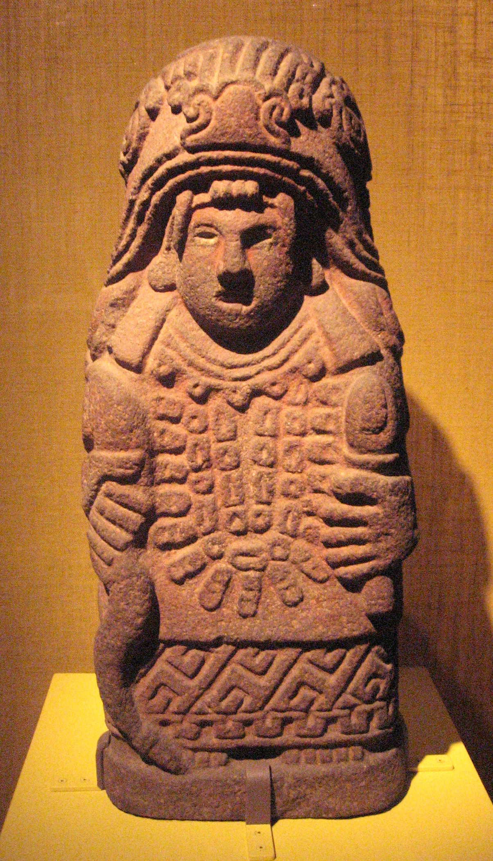
Aztec imperial expansion as an expression of gender roles
Regarding the raising of children in the Aztec capital of Tenochtitlan, shortly before it fell to Spanish forces (1519-1521). At birth boys were given a shield with four arrows. The midwife prayed that they might be courageous warriors. They were presented four times to the sun and told of the uncertainties of life and the need to go to war. Girls…were given spindles and shuttles as a symbol of their future dedication to homely tasks. Women still occupied important positions in Tenochtitlan as merchants, doctors and priestesses; but they were excluded from an ascendant class of aristocrats whose power was based on warfare, predation and tribute. Certain lines of evidence, such as the obligation for high-ranking advisors at court to take on the cultic role of Cihuacoatl—or Snake Woman—suggest that this erosion of female political power was fairly recent. In any case, masculinity, often expressed through sexual violence, became part of the dynamics of imperial expansion. The rape and enslavement of conquered women were maong the primary girevances repoted to Cortes and his men by Aztec subjecgs in Veracruz.
Sculpture, Wikipedia: Stone statue of Cihuacōātl, or Snake woman, showing her framed by the mouth of a serpent, holding an ear of maize in her left hand. Cihuacóatl was one of a number of motherhood and fertility goddesses. Cihuacōātl was sometimes known as Quilaztli. She helped the patron god of the priests, related to the Sun, Venus, merchants, arts, crafts, knowledge and learning, Quetzalcoatl, to create the current race of humanity by grinding up bones from the previous ages, and mixing it with his blood. Although she was sometimes depicted as a young woman, similar to the goddess of fertility, beauty and love, Xōchiquetzal, she is more often shown as a fierce skull-faced old woman carrying the spears and shield of a warrior.

Slide 4
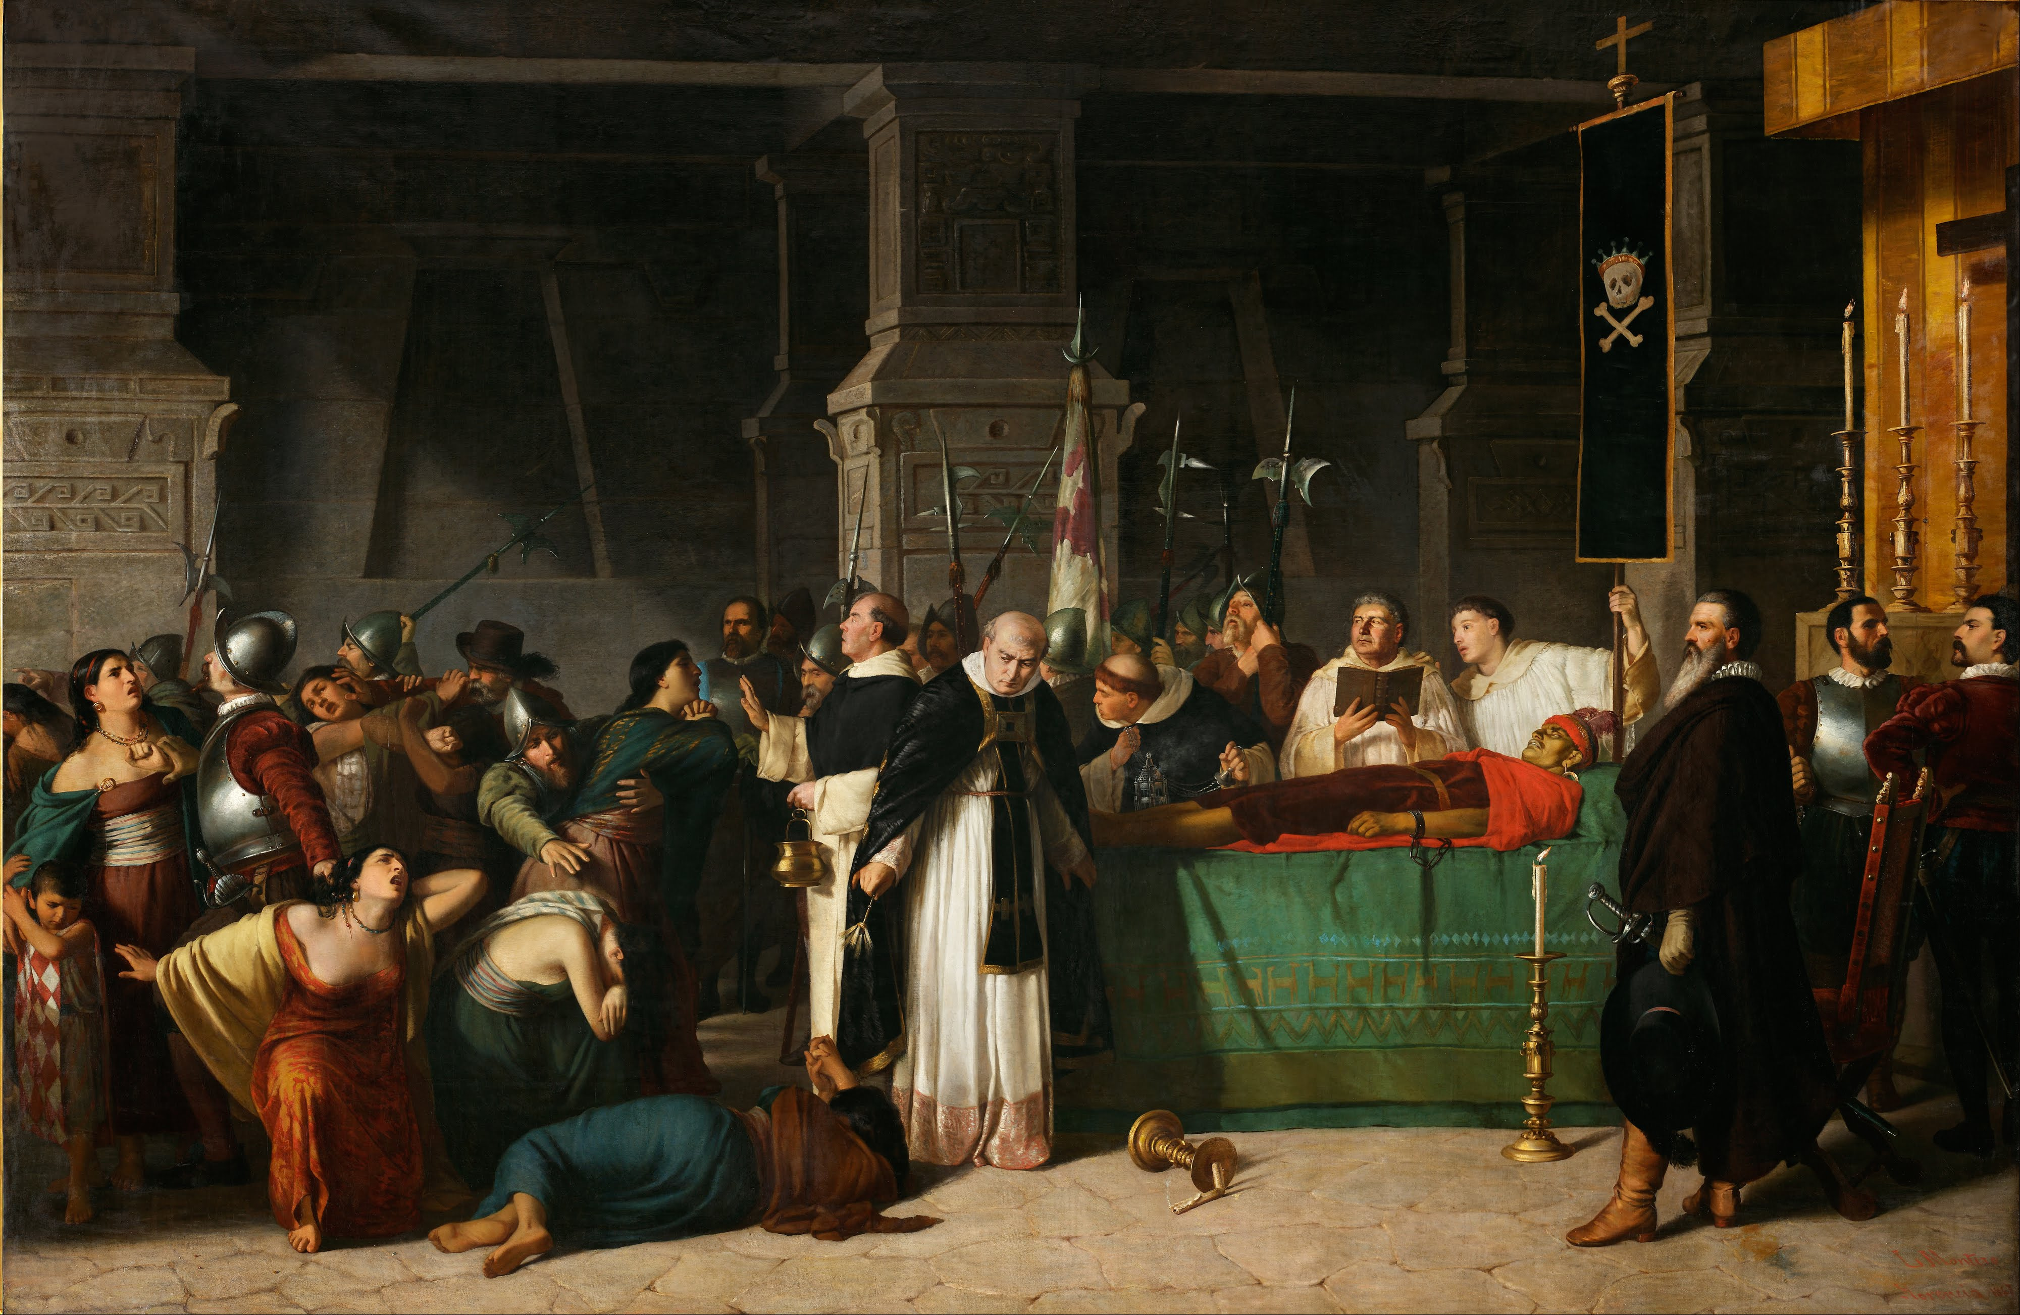
The Inca had absolute power
The Sapa Inca (from Quechua Sapa Inka "the only emperor") was the monarch of the Inca Empire (Tawantinsuyu), as well as ruler of the earlier Kingdom of Cusco and the later Neo-Inca State. Being a god, the Sapa Inca never really died. The bodies of former kings were preserved, wrapped and mummified, much like pharaohs of ancient Egypt; like the pharaohs too, they held court from beyond the grave, receiving regular offerings of food and clothing from their former rural estates. They were also brought out to attend public events and sponsored festivals. One reason why each new ruler was obliged to expand the empire was that they only inherited the old ruler’s army. His court, lands and retainers remained in the dead Inca’s hands. Ths extraordinary concentration of power around the Inca’s body had a flip side: royal authority was extremely difficult to delegate. {DE, pp. 373-374].
Painting (Luis Montero 1826-1869), Wikipedia: Atahualpa, the last Sapa Inca of the empire, was executed by the Spanish on 29 August 1533. While the term Inka nowadays is translated as "ruler" or "lord" in Quechua, this term does not simply refer to the "King" of the Tawantinsuyu (Realm of the Four Parts) or Sapa Inka but also to the Inca nobles, and some theorize its meaning could be broader. In that sense, the Inca nobles were a small percentage of the total population of the empire, probably numbering only 15,000 to 40,000, but ruling a population of around 10 million people.

Slide 5
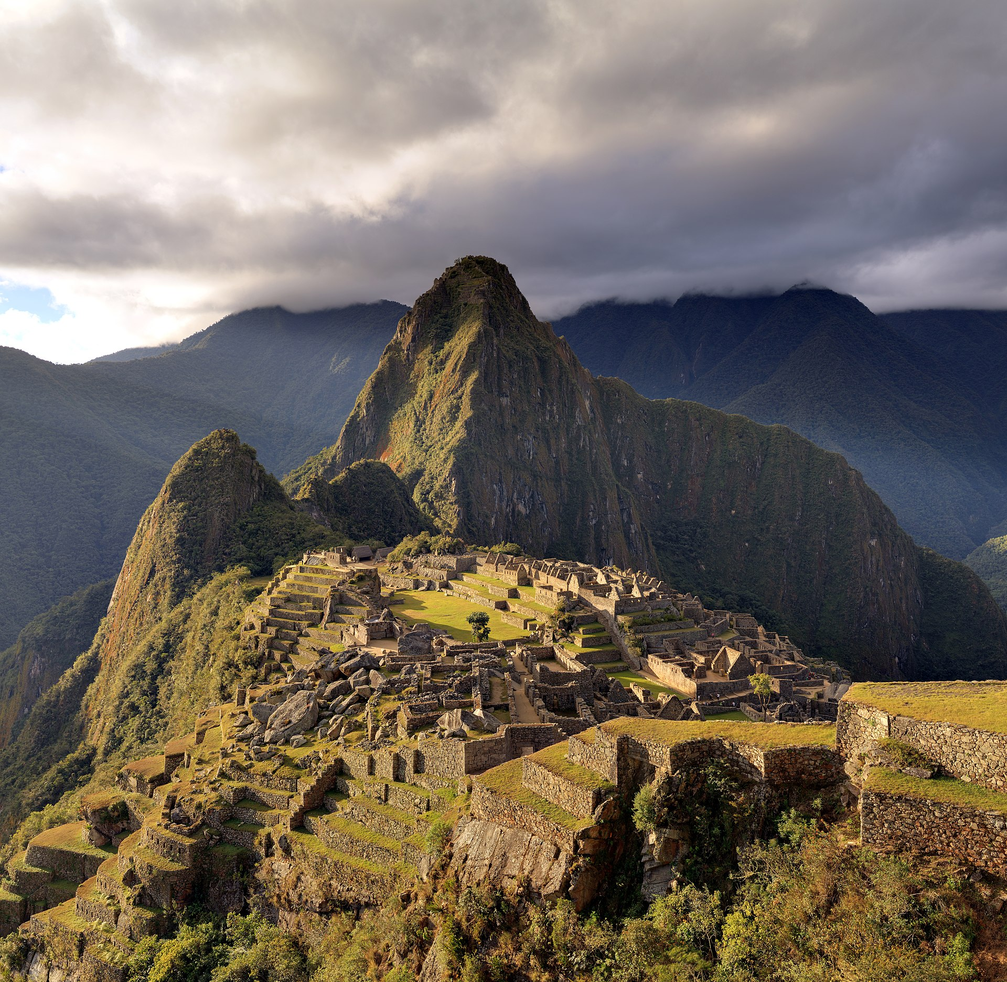
Ayllu, the family clan
The ayllu, a family clan, was based on a strong principle of equality, their members lierally wore uniforms, with each valley having its own traditional design of cloth, and is the traditional form of a community in the Andes, especially among Quechuas and Aymaras. They are an indigenous local government model across the Andes region of South America, particularly in Bolivia and Peru. Ayllus functioned prior to Inca conquest, during the Inca and Spanish colonial period, and continue to exist to the present day. Ayllus had defined territories and were essentially extended family or kin groups, but could include non-related members. One of the ayllu’s main functions was to redistribute agricultural land as families grew larger or smaller, to ensure none grew richer than any other. Ayllu also helped families avoid seasonal labor crunchs and kept track of the number of able-bodied young men and women in each household, so as to ensure not only that none were short-handed at critical moments, but also that the aged or infirm, widows, orphans or disabled were taken care of. Their primary function was to solve subsistence issues, and issues of how to get along in family, and the larger community. Ayllus descended from stars in the Inca cosmogony, and just like stars had unique celestial locations, each ayllu had a terrestrial location defined by the paqarina, the mythical point of emergence of the lineage huaca (a revered monument). It was the pre-existing ayllu system that continued to provide social security under Inca rule. [DE, pp. 423-424]
Picture, Wikipedia: The Macchu Picchu, a UNESCO World Heritage Site near Cusco in Peru, at twilight.

Slide 6
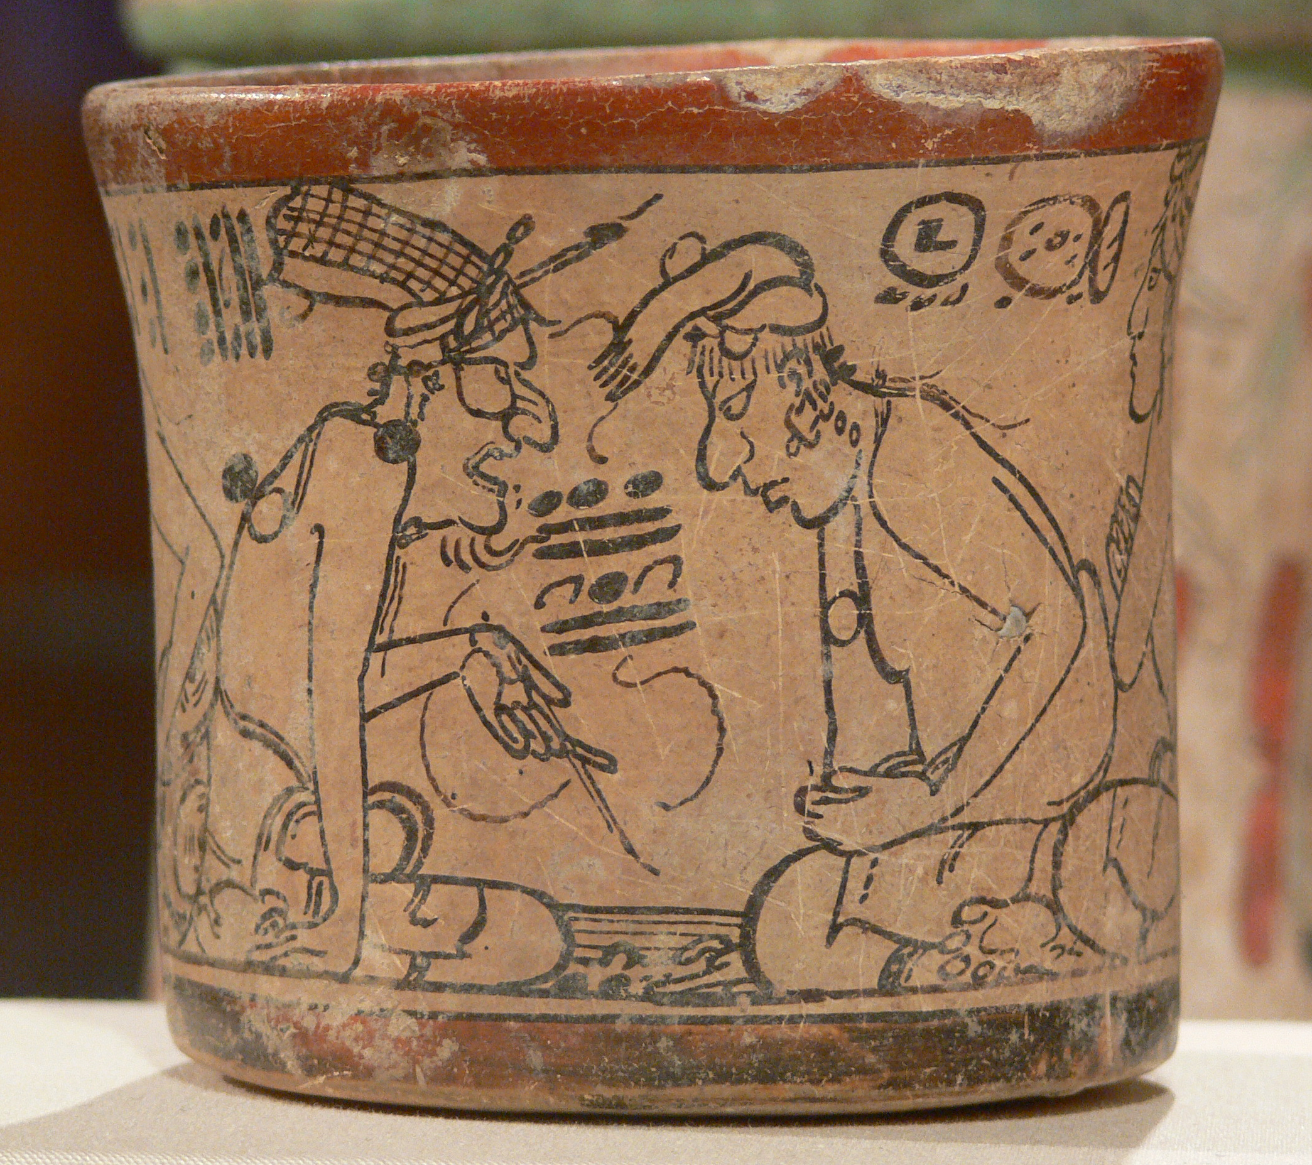
Maya Decentralization
By the time the Spaniards arrived (post 1511 CE), six centuries after the collapse of the cities in Peten (Guatemala), Mayan societies were thoroughly decentralized, parsed into a bewildering variety of townships and principalities, many without kings. The books of Chilam Balam, prophetic annals written down in the late sixteenth century, dwell endlessly on the disasters and miseries that befall oppressive rulers. [DE, p. 378]. They compile knowledge on history, prophecy, religion, ritual, literature, the calendar, astronomy, and medicine. Written in the Yucatec Maya language and using the Latin alphabet, the manuscripts are attributed to a legendary author called Chilam Balam, a chilam being a priest who gives prophecies and balam a common surname meaning ʼjaguarʼ.
Picture, Wikipedia: Illustration of a Maya scribe on a Classic period(250-950 CE) vessel. Kimbell Art Museum, Fort Worth.

Slide 7
The Importance of so-called “interim periods”
When examining the “collapse” of the Egyptian Old Kingdom, the only thing that really seems to have declined precipitously is he power of Egypt’s elites ruling from the northern city of Memphis. Even in the Maya case, to describe the entire period between 900 and 1520 as “Post-Classic” is to suggest that the only real significant thing about it is the degree to which it can be seen as the waning of a Golden Age. In a similar way, terms like “Post-palatial Crete”, “Predynastic Egypt” or “Formative Peru” convey a sense of impatience, as if Minoans, Egyptians or Andean peoples spent centuries doing little but laying the groundwork for such a Golden Age… We’ve seen how this played out in Uruk (Mesopotamia), where centuries of collective self-rule (also termed “Prediynastic”)comes to be written off as a mere prelude to the real history of Mesopotamia—which is then presented as a history of conquerors, dynasts, lawgivers and kings. Some periods are dismissed as prefaces, others as postfaces, still others become intermediary.
The most striking example is Egypt with the traditional historical division of ancient Egypt into Old, Middle and New Kingdoms. Each is separated by an “intermediate” period, often described as epochs of “chaos and cultural degeneration”. In fact, these were simply periods when there was no single ruler of Egypt. Authority devolved to local factions, or, changed its nature altogether. Taken together, these intermediate periods span about a third of Egypt’s ancient history, down to the accession of a series of foreign or vassal kings (known simply as the Late period), and they saw some very significant political developments of their own. To take just one example, at Thebes between 754 and 525 BCE—spanning the Third Intermediate and Late periods—a series of five unmarried, childless princesses (of Libyan and Nubian descent) were elevated to the position of “god’s wife of Amun”, a title and role which acquired not st supreme religious, but also great economic and political weight at the time. In official representations, these women are given “throne names” framed by cartouches, just like kings, and appear leading royal festivals and making offerings to the gods.

Slide 8
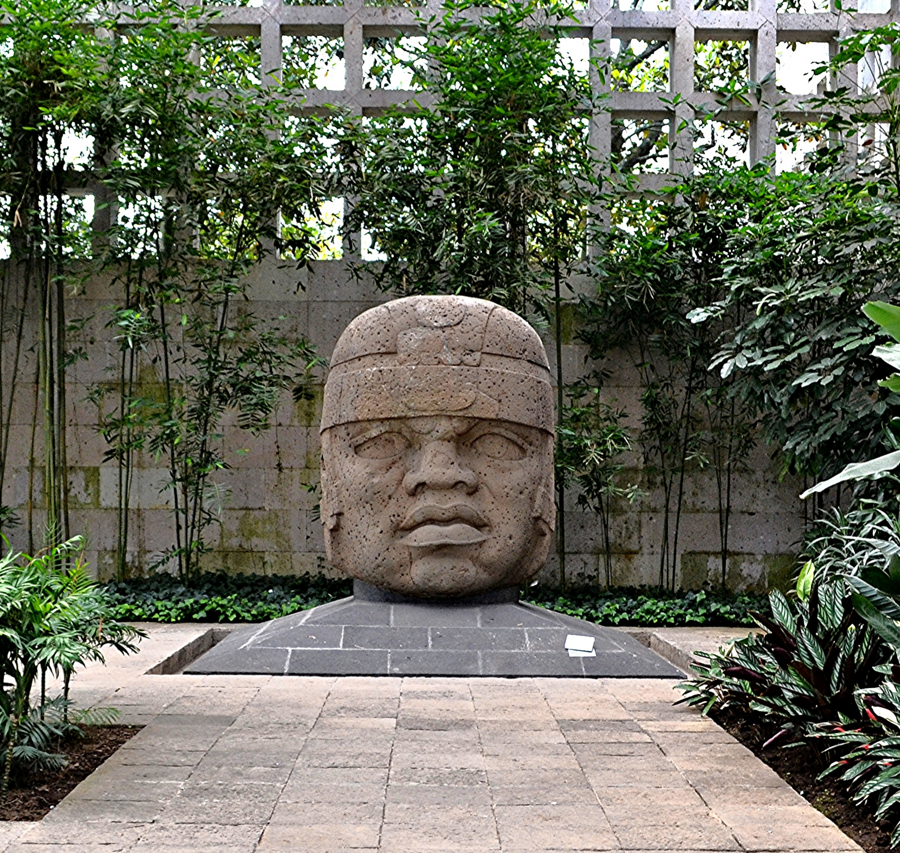
Olmec as a Theater State; the power of spectacle
The Olmecs are seen nowadays as cultural progenitors of later Mesoamerican kingdoms and empires in Guatemala, Honduras and southern Mexico, but there is little evidence that the Olmec themselves ever created an infrastructure for dominating a large population. So far as anyone knows, their rulers did not command a stable military or administrative apparatus that might have allowed them to extend their power throughout a winder hinterland. Instead, they presided over a remarkable spread of cultural influence radiating from ceremonial centers, which may only have been densely occupied on specific occasions (such as ritual ball games) scheduled in concert with the demands of the agricultural calendar, and largely empty at other times of the year. In other words, if these were “states” in any sense at all, then they are probably best defined as seasonal versions of what Clifford Geertz [progenitor of symbolic anthropology, 1926-2006] once called “theater states”, where organized power was realized only periodically, in grand but fleeting spectacles. {DE, pp. 383, 385-386].
Picture, Wikipedia: Olmec Head No.1, 1200–900 BCE. Little is directly known about the societal or political structure of Olmec society. Although it is assumed by most researchers that the colossal heads and several other sculptures represent rulers, nothing has been found like the Maya stelae which name specific rulers and provide the dates of their rule. The Olmec are strong candidates for originating the Mesoamerican ballgame so prevalent among later cultures of the region and used for recreational and religious purposes. A dozen rubber balls dating to 1600 BCE or earlier have been found in El Manatí, a bog 10 km (6 mi) east of San Lorenzo Tenochtitlan. These balls predate the earliest ballcourt yet discovered at Paso de la Amada, c. 1400 BCE, although there is no certainty that they were used in the ballgame.

Slide 9
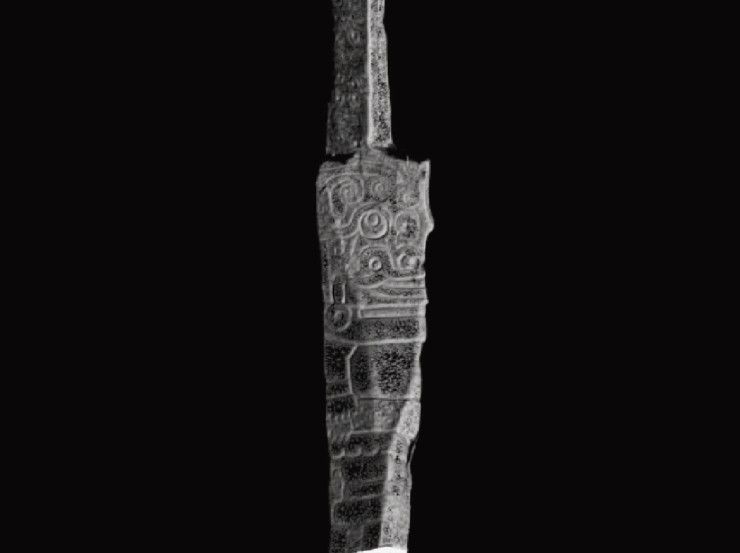
Chauvin de Huantar, and Empire built on esoteric knowledge
The Temples at Chauvin contain stone labyrinths and hanging staircases which seem designed not for communal acts of worship but for individual trials, initiations and vision quests. Theyi imply torturous journeys ending at narrow corridors, large enough only for a single person, beyond which lies a tiny sanctum containing a monolith, carved with dense tangles of images. The most famous such monument, a stela called “El Lanzon” (the lance) is a shaft of granite over thirteen feet tall, around which the Old Temple at Chauvin was constructured. A well-lit replica of the stela, often assumed to represent a god who is also the axis mundi, or a central pillar connecting the polar ends of a shamanic unverse, has pride of place in Peru’s Museo de la Nacion; but the 3,000 year old original still resides at the heart of a darkened maze, illuminated by thin slats, where no single viewer could ever grasp the totality of its form or meaning. [DE, pp. 389-390]
Picture, Wikipedia: the Lanzon Stele at Chauvin de Hunatar. Chavín de Huántar is an archaeological site in Peru, containing ruins and artifacts constructed as early as 1200 BC, and occupied until around 400–500 BC by the Chavín, a major pre-Inca culture. The site is located in the Ancash Region, 434 kilometers (270 mi) north of Lima, at an elevation of 3,180 meters (10,430 ft), east of the Cordillera Blanca at the start of the Conchucos Valley.

Slide 10
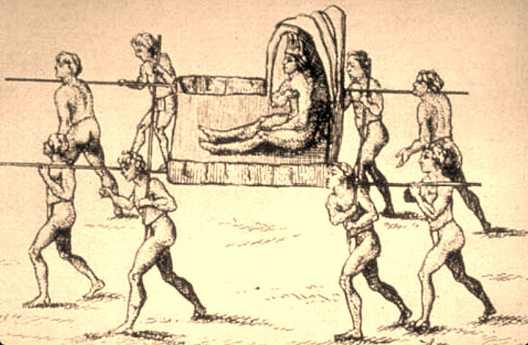
The Natchez of southern Louisiana in the 18th c., now near Natchez, MS: an example of sovereignty without either the apparatus for controlling knowledge nor an sort of competitive political field
By general consent, the Natchez (who called themselves Theoloel, or People of the Sun) represent the only undisputed case of divine kingship north of the Rio Grande. Anyone who came into the royal presence was expected to bow and wail, and to retreat backwards, No one, not even the king’s wives, was allowed to share a meal with him…However, away from the Great Village where the king resided, the ordinary Natchez lived very different lives, often showing blissful disregard fo he wishs of their ostensible ruler. Thus the king’s sovereignty extends about as far as the king himself can walk, reach, see or be carried. Within that circle it is absolute. Outside, it attenuates rapidly. Thus claims to labor, tribute or obedience could, if considered odious, be simply ignored. [DE, pp. 391-394]
Picture, Wikipedia: "The Great Sun, Paramount Chief of the Natchez People" in a 1758 drawing by Antoine-Simon Le Page du Pratz. The Natchez are noted for being the only Mississippian culture with complex chiefdom characteristics to have survived long into the period of European colonization.

