Slide 1
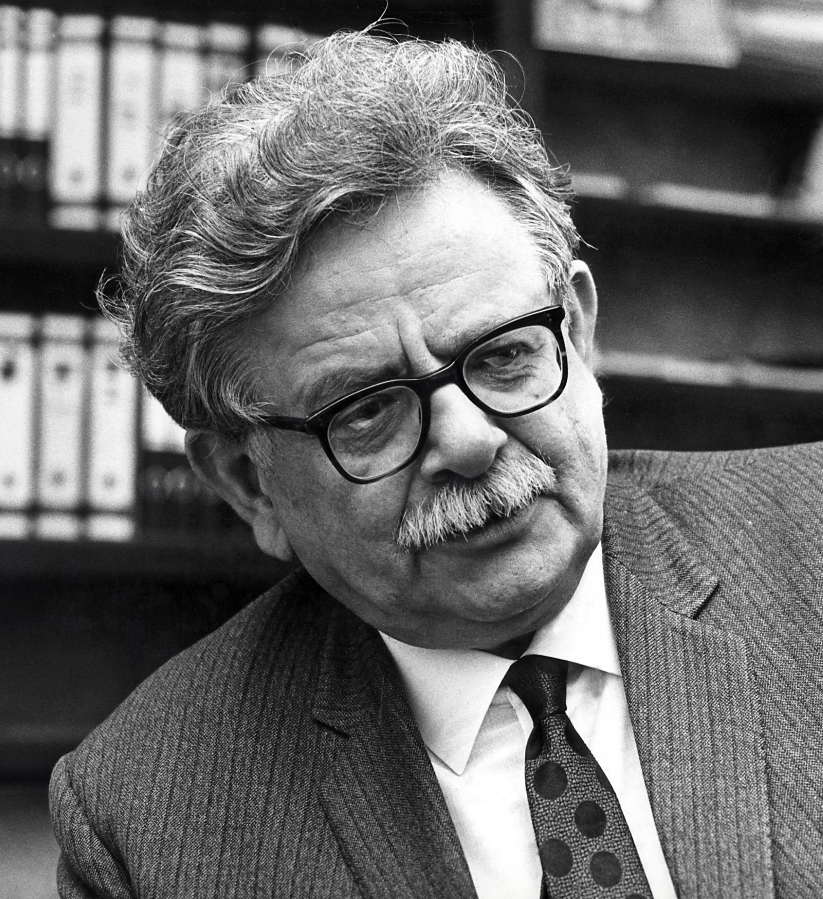
Elias Canetti (1905-1994) Bulgarian/English/Sephardic Jewish Nobel Prize winning writer
Cities begin in the mind, proposed Elias Canetti, a novelist and social philosopher. Canetti speculated that Palaeolithic hunter-gatherers living in small communities must, inevitably, have spent some time wondering what larger ones would be like. Proof, he felt, was on the walls of caves, where the faithfully depicted herd animals that moved together in uncountable masses. How could they not have wondered what human herds might be like? No doubt they also considered the dead, outnumbering the living by orders of magnitude. What if everyone who’d ever died were all in one place? What would that be like? These “invisible crowds “, Canetti proposed, were in a sense the first human cities, even if they existed only in the imagination.
Graeber and Wengrow support this speculation by pointing out that current advances in the study of human cognition suggest that very large social units are always, in a sense, imaginary. There is always a fundamental distinction between the way one relates to friends, family, neighborhood, people and places that we actually known directly, and the way one relates to emlpires, nations, metropolises, phenomena that exist largely, or at least most of the time, in our heads. Much of social theory can be seen as an attempt to square these two dimensions of our experience. [DE, p. 276].
Photo, Wikipedia: Elias Canetti

Slide 2
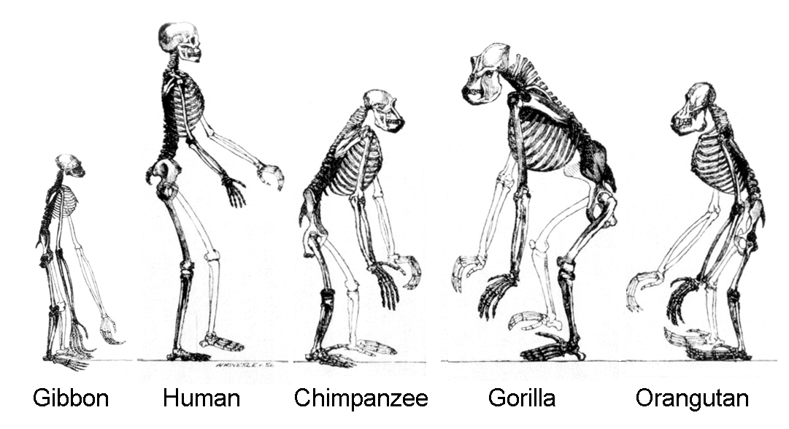
We are Distinguished from Other Primates by our ability to Shift Scales
The way the Turtle or Bear clans once existed across North America, or moiety systems across Australia, it made it a relatively simply matter for anyone disenchanted with their immediate biological kin to trael very long distances and still find a welcome. It is as though modern forager societies exist simultaneously at two radically different scales: one small and intimate, the other spanning vast territories, even continents. It is precisely this capacity to shift between scales that most obviously separates human social cognition from that of other primates. Apes may vie for affection or dominance, but any victory is temporary and open to being renegotiated. Humans tend to live simultaneously with the 150-odd people they know personally, and inside imaginary structures shared by perhaps millions or even billions of other humans. In this, at least, modern foragers are no different from modern city dwellers or ancient hunter-gatherers. We all have the capacity to feel bound to people we will probably never meet. Canetti had it right. Mass society exists in the mind before it becomes physical reality. And crucially, it also exists in the mind after it becomes physical reality. [DE, pp. 280-281].
Picture, Wikipedia: Skeletons of members of the ape superfamily, Hominoidea. There are two extant families: Hominidae, the "great apes"; and Hylobatidae, the gibbons, or "lesser apes".

Slide 3

How settlements affect humanity
As urban sociologist Claude Fischer (b. 1948), author of “America Calling”, put it: “Most cit dwellers lead sensible, circumscribed lives, rarely go downtown, hardly know areas of the city they neither live nor work in, and see (in any sociologically meaningful way) only a tiny fraction of the city’s population…Urbanites live in small social worlds that touch but do not interpenetrate.” [1977, “American Journal of Sociology”]. Cities were part of the process of contraction, from the vast expanses of Paleolithic culture areas, to those of Mesolithic and Neolithic, since urbanites could, and many did, spend almost their entire lives within a few miles’ radius. If one imagines a vast regional system being squeezed into a single urban space, then the formation of the earliest cities did pose insuperable cognitive challenges. Living in unbounded, largely imaginary groups is effectively what humans had been doing all along. It is apparent that from the beginning, because of their extreme variability, that settlements inhabited by tens of thousands of people, which make their first appearance in human history around 6000 years ago, along with bureaucracies and social classes, that there was conscious experimentation in urban form.
America Calling (1994)

Slide 4
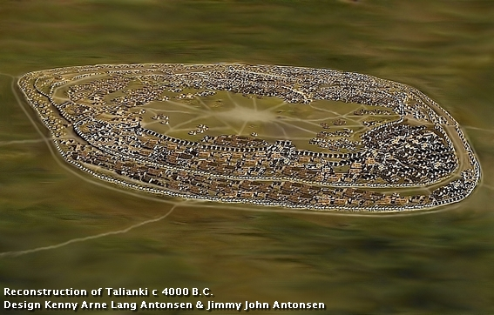
Cities are not simple; they don’t come out of thin air
Ursula Le Guin has a famous short story, “The Ones Whoi Walk Away from Omelas”, about an imaginary city which made do without kings, wars, slaves or secret police. We hae a tendency, Le Guin notes, to write off such a community as simple but in fact these citizens of Omelas were “not simple folk, not dulcet shepherds, noble savages, bland utopians. They were not less complex than us”. Why do we assume that people who have figured out a way for a large population to govern and support itself without temples, palaces and military fortificdations are shomehow less complex than those who have not? The mega-sites of Ukraine and adjoining regions were inhabited from roughly 4100-3300 BCE, which is considerably longer than most subsequent urban traditions. By 4500 chernozem (Russian for black earth settlements), legendary for their fertility, were widely distributed between the Carpathian and Ural Mountains. Taljanky, the biggest currently known, extends over 300 hectares, outspanning the earliest phases of the city of Uruk in southern Mesopotamia. It presents no evidence of central administration or communal storage facilities. Nor have any government buildings, fortifications or monumental architecture been found. The mega-sites appear to have consciously managed their ecosystems to avoid large-scale deforestation. This is consistent with archeological studies of their economy, which suggest a pattern of small-scale gardening, often taking place within the bounds of the settlement, combined with the keeping of livestock, cultivation of orchards, and a wide spectrum of hunting and foraging activities. Over eight centuries we find little evidence for warfare or the rise of social elites. The true complexity of the mega-sites lies in the strategies to prevent such things. Careful analysis by archeologists shows how the apparent uniformity of the Ukrainian mega-sites arose from the bottom up, through processes of local decision-making. {DE, pp. 290-295].
Reproduction, Wikipedia: Reconstruction of Talianki, a Trypillian mega-site. Talianki or Talianky is an archaeological site near the Talianky (village of the same name) Ukraine. It was the location of a large Cucuteni-Trypillian settlement dating to around 3850–3700 BC, currently the largest known settlement in Neolithic Europe

Slide 5
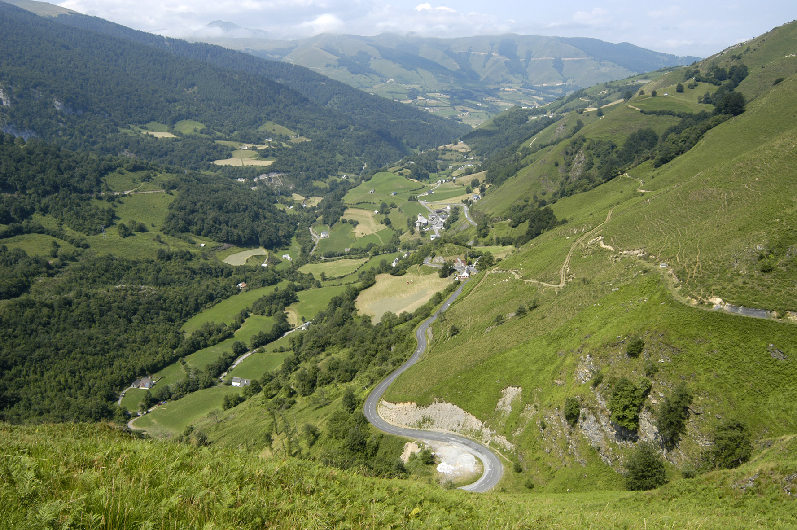
How ethno-mathematics can explain how a shared conceptual framework, based on the image of a circle and its properties or transformation, leads to shared decisions
Modern Basque societies imagine their communities in circular form, just as they imagine themselves as being surrounded by a circle of mountains. They do so as a way of emphasizing he ideal equality of households and family units. Everyone has neighbors to the left and to the right. No one is first, and no one is last. In the commune of Sainte-Engrace the circular template of the village is also a dynamic model used as a counting device, to ensure the seasonal rotation of essential tasks and duties. If any one household is for any reason unable to fulfil its obligations when it is time to do so, a careful system of substitution comes into play. The same system of first neighbors and substitution, the same serial model of reciprocity, is used to call up anything that requires more hands than a single family can provide: from planting and harvesting to cheese-making and slaughtering pigs. Basque villagers in this region are self-conscious egalitarians, in the sense that they insist each household is ultimately the same and has the same responsibilities as any others. {DE, pp. 295-296].
Picture, Wikipedia, Southern France, in the highlands of the Pyrenees-Atlantiques: View of Sainte-Engrâce in the Uhaitxa Valley

Slide 6
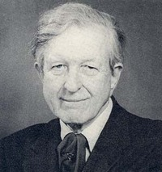
Mesopotamian “primitive democracy” according to Thorkild Jacobsen, Danish historian and Assyriologist
The earliest Mesopotamian cities—those of the fourth and early third millenia BCE—present no clear evidence for monarchy at all. We know what evidence for monarchy in such cities would be like, because half a millennium later (from around 2800 BCE onwards) monarchy appears in the Early Dynastic Period form of palaces, aristocratic burials, royal inscriptions, defensive city walls and the organized militia to guard them. He idea that Mesopotamia ossessed a primitive democracy was first advanced by Thorkild Jacobsen in the 1940s. District councils and assemblies of elders—representing the interests of urban publics—appeared both in earliest Mesopotamian cities and in all later periods of Mesopotamian history right down to the time of the Assyrian, Babylonian and Persian Empires, later scholars discovered. Popular councils and citizen assemblies (Sumerian: ukkin; Akkadian puhrum) were stable features of government, not just in Mesopotamian cities, but also in their colonial offshoots and in the urban societies of neighboring peoples such as the Hittites, Phoenicians, Philistines and Israelites. Participatory government in ancient Mesopotamian cities was organized at multiple levels, from wards—sometimes defined on ethnic lines or in terms of professional affiliations—up to larger urban disricts, and ultimately the city as a whole. [DE, pp. 298-303].
Academic Picture, Wikipedia: Thorkild Peter Rudolph Jacobsen (1904-1993) was a renowned Danish historian (at Harvard U.) specializing in Assyriology and Sumerian literature. He was one of the foremost scholars on the ancient Near East.

Slide 7
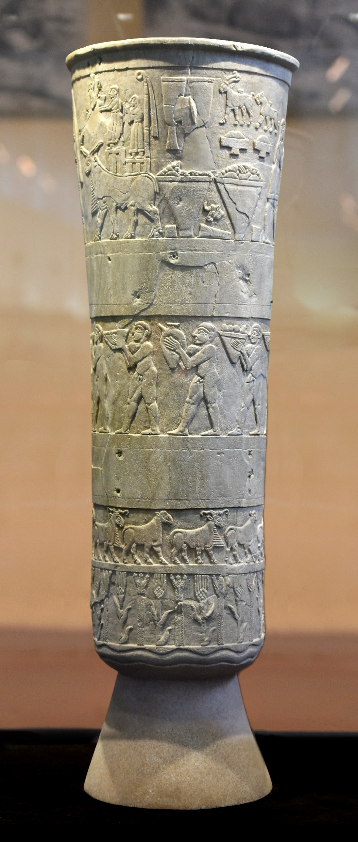
Uruk, 3300 BCE
Uruk, 3300 BCE, 200 hectares, dwarfing her neighbors on the southern Mesopotamian floodplain, population 20,000-50,000, where cuneiform script may well have been invented around 3300 BCE. Bookkeeping in the city’s temples was writing’s main function. Later it encompassed the world’s first literature and law codes. It had a high acropolis, including a raised public district called Eanna, House of Heaven, dedicated to the Goddess Inanna. Most of the public buildings seem to have been great communal assembly halls, open temples accompanied by a congenial space for public meetings, exactly what one might expect were Uruk to have been governed by a popular assembly; and as Thorkild Jacobsen emphasized, the Gilgamesh epic, which begins in Predynastic Uruk, does speak of such assemblies, including one reserved for the young men of the city. [DE, pp. 304-306].
Picture, Wikipedia: Devotional scene to Inanna, Warka Vase, c. 3200–3000 BC, Uruk. This is one of the earliest surviving works of narrative relief sculpture. For Sumerians, the ultimate purpose of all the factories and workshops was to provide the gods and goddesses of the city with an illustrious residence where they would receive offerings of food, fine clothing and care, which also meant servicing their cult and organizing their festivals. The latrer were probably depicted on the Uruk vase, one of the few surviving examples of narrative art from this early period, whos carved decoration shows a number of identical nude males parading behind one larger male figure to the temple precinct of the Goddess Inanna with their hield of field, orchard and flock. While in the much later story of Gilgamesh, a leader of the youth assembly did become lugal or king, there is no reason to think that monarchy played any significant role in the earliest cities of Mesopotamia. [DE, pp. 308-309]

Slide 8
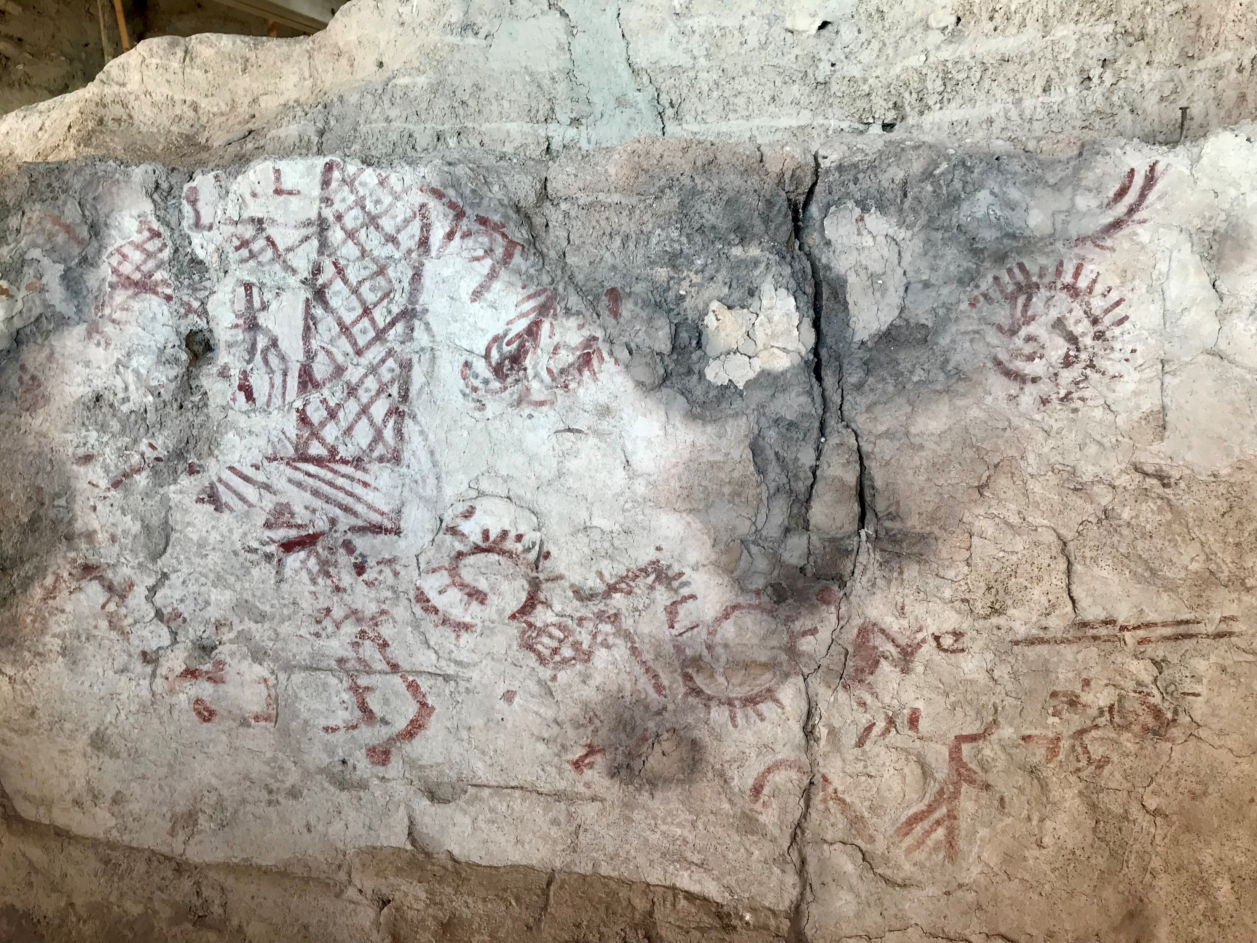
Arslantepe (Hill of the Lion, 3350-3000 BCE
A massive private structure that replaced a previous temple includes an armory with an assemblage of swords and spearheads finally crafted of arsenic rich copper, signaling a celebration of the means to enact violence, and a new aesthetic of personal combat and killing not found in the lowlands around Uruk. This is exactly the kind of physical infrastructure [forts, strehouses] we might expect from a society dominated by some sort of warrior aristocracy. The excavators have labelled this building the world’s “earliest known palace.” From 3100 BCE across the hlly country of what is now eastern Turkey, and then in other places on the edge of urban civilization, we see evidence of the rise of a warrior aristocracy, heavily armed with metal spears and swords, living in what appear to be hill forts or small palaces. For the first time we find tombs of men who, in life, were clearly considered heroic individuals of some sort, accompanied to the afterlife by prodigious quantities of metl weaponry, treasures, elaborate textiles and drinking gear. {DE, pp. 310-311]
Picture, Wikipedia: Mural paintings in the ruins of Arslantepe in the Malatya plain, Turkey. They are from 3350-3000 BCE, and were found in a complex that must have been a palace. Melid, also known as Arslantepe, was an ancient city, 3,300 ft. above sea level, on the Tohma River, a tributary of the upper Euphrates rising in the Taurus Mountains. It has been identified with the modern archaeological site of Arslantepe near Malatya, Turkey. By the late Uruk period development had grown to include a large temple/palace complex. Culturally, Melid was part of the "Northern regions of Greater Mesopotamia" functioning as a trade colony along the Euphrates River bringing raw mahe first swords known in the Early Bronze Age (c. 33rd to 31st centuries) are based on finds at Arslantepe by Marcella Frangipane of Rome University.terials to Sumer (Lower Mesopotamia).

Slide 9
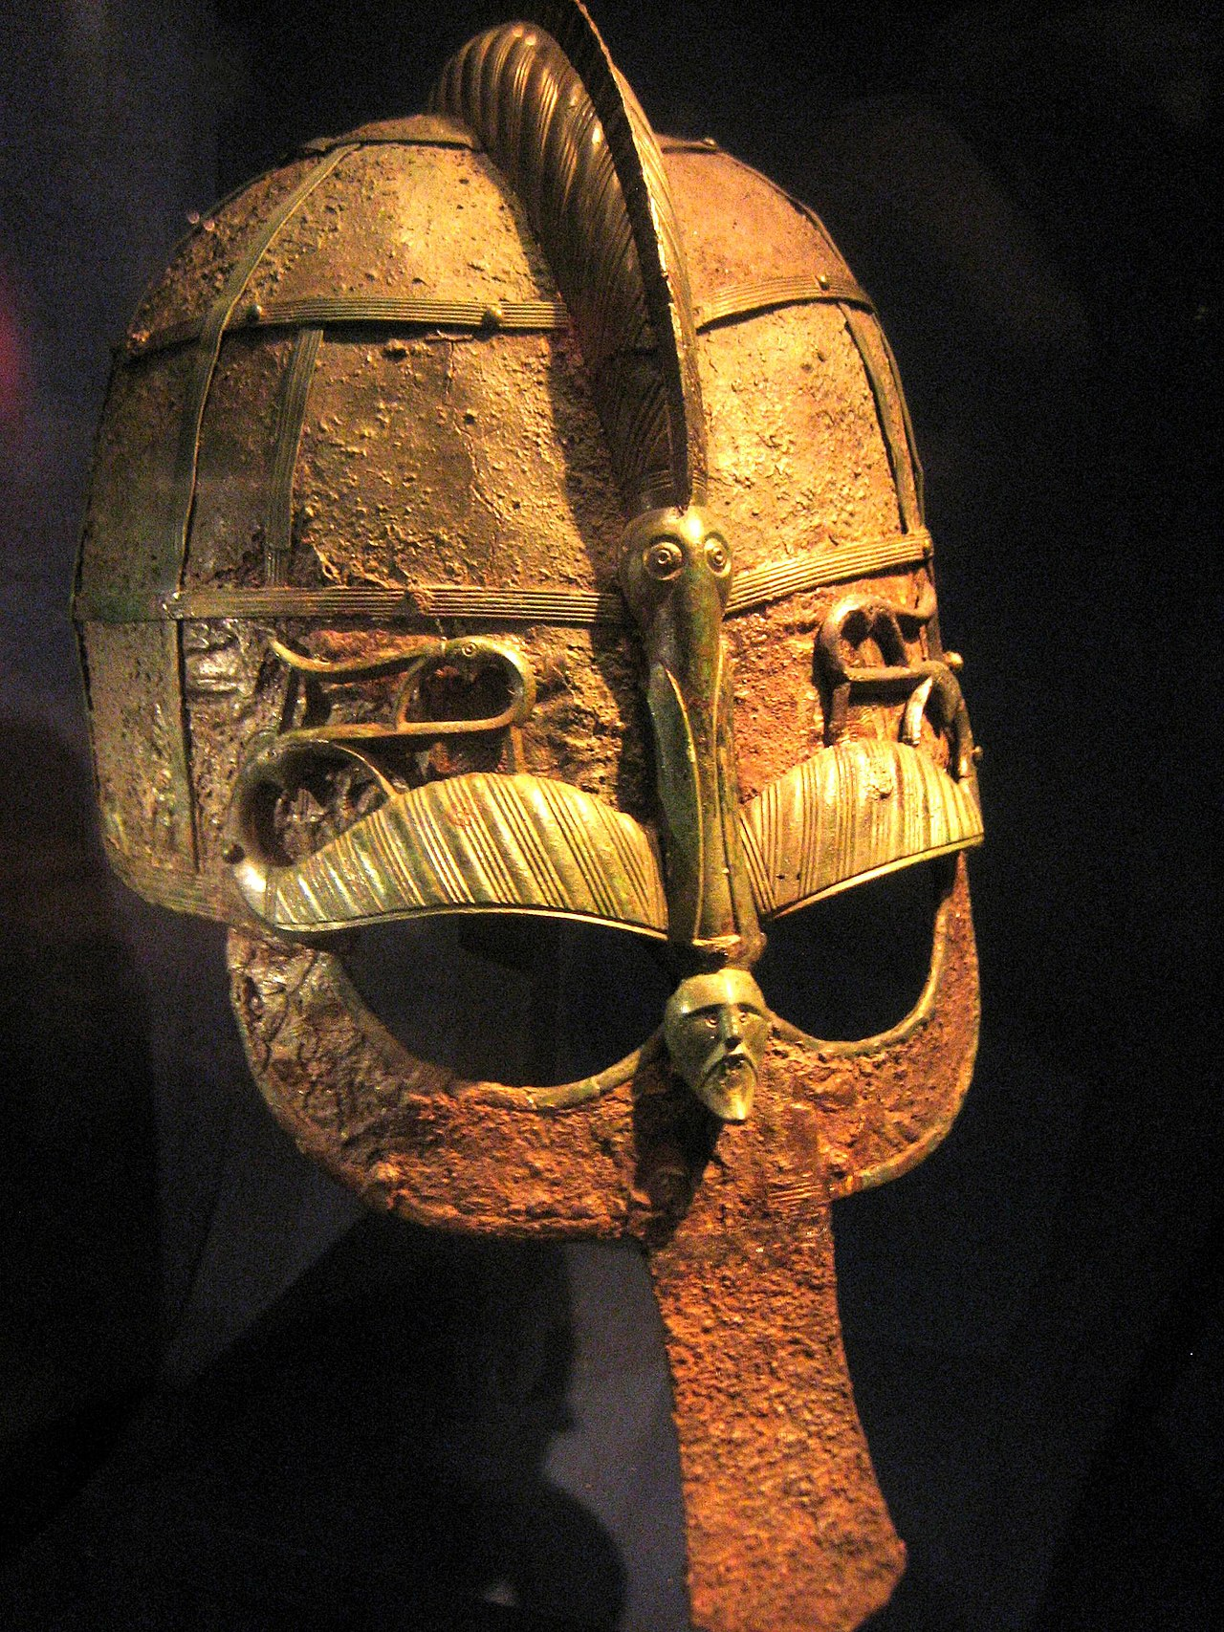
Hector Munro Chadwick’s (1870-1947)“Heroic Societies”
Graeber and Wengrow identify Arslantepe as the first example of English philologist Chadwick’s designation of heroic societies, first labeled by him in the 1920s, writing at much the same time as J. R. R. Tolkien [re “The Hobbit”, etc.] held the same post at Oxford--Prof. of Anglo-Saxon--as Chadwick did at Cambridge. Chadwick was initially concerned with why great traditions of epic poetry (Nordic sagas, the works of Homer, the Ramayana) always seemed to emerge among people in contact with and often employed by the urban civilizations of their day, but who ultimately rejected the values of the same civilizations. Archeologists have recently discovered a very real pattern of heroic burials indicating an emerging cultural emphasis on feasting, drinking, and the beauty and fame of the individual male warrior. The first written traditions of heroic poetry are much later in date than the heroic burials themselves, but shed light on earlier customs. All these cultures (including the potlatch societies of the Northwest Coast of North America and the Maori of New Zealand) were aristocracies without any centralized authority or principle of sovereignty (or, maybe, some largely symbolic, formal one). Instead of a single center, we find numerous heroic figures competing fiercely with one another for retainers and sales. There was a focus on game-like contests as the primary business of ritual, indeed, political life. Often, massive amounts of loot or wealth were squandered, sacrificed or given away in such theatrical performances. [DE, pp. 311-312].
In The Heroic Age (1912), a pioneering work of comparative literature, Chadwick conducted an examination of parallels between the epic poetry of the Greek Heroic Age and the Germanic Heroic Age. Celtic, Roman and Slavic epic poetry was also considered, which testifies to the wide and diverse knowledge possessed by Chadwick at this time. During such Heroic Ages, warrior aristocrats figure prominently, and courage and martial prowess is valued above all else. For Chadwick, such an Heroic Age was not one of primitiveness, but rather one of youthfulness, vigour and rebellion. According to him, Heroic Ages typically emerged when tribal societies came into close contact with more advanced civilizations, such as when the Germanic peoples encountered ancient Rome. He located the Germanic Heroic Age in the Vendel Period (Vendel helmet shown; in Swedish prehistory, the Vendel Period (Swedish: Vendeltiden; c. 540–790 AD) appears between the Migration Period and the Viking Age. The name is taken from the rich boat inhumation cemetery at Vendel parish church, Uppland), analogous to the Greek Heroic Age.
Picture, Wikipedia: Vendel Helmet.

Slide 10
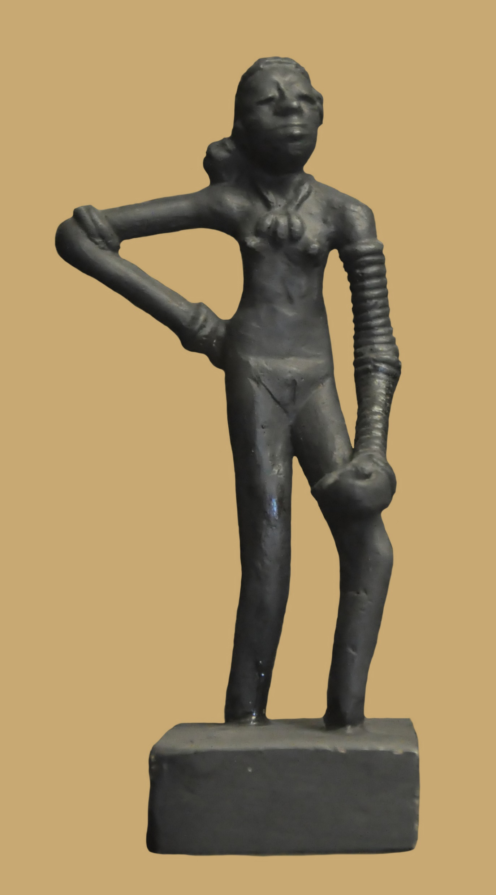
Mohenjo-Daro
.
.
.
Mohenjo-daro, meaning 'Mound of the Dead Men’, is an archaeological site in the province of Sindh, Pakistan. Built around 2500 BCE, it was the largest settlement of the ancient Indus Valley Civilisation, and one of the world's earliest major cities, contemporaneous with the civilizations of ancient Egypt, Mesopotamia, Minoan Crete, and Norte Chico. With an estimated population of at least 40,000 people, Mohenjo-daro prospered until around 1700 BCE.
The city is considered the greatest expression of a new form of society that flourished in the valley of the Indus at the time; aform of society which archeologists have come to know simply as the Indus or Harappan civilization. It was South Asia’s first urban culture. Here we find further evidence that Bronze Age cities—the world’s first large-scale, planned human settlements—could emerge in the absence of ruling classes and managed elites. Most of the city consists of the brick-built houses of the Lower Town, with its rid-like arrangement of streets, long boulevards and sophisticated drainage and sanitation systems (terracotta sewage pipes, pribate and public toilets and bathrooms were ubiquitous. Above the Lower Town looms the Upper Citadel, a raised ciic center, also known as the Mound of the Great Bath. {DE, pp. 313-314]
Picture, Wikipedia: Dancing Girl is a prehistoric bronze sculpture made in lost-wax casting about c. 2300–1750 BC in the Indus Valley civilisation city of Mohenjo-daro (in modern-day Pakistan), which was one of the earliest cities. The statue is 10.5 centimetres (4.1 in) tall, and depicts a nude young woman or girl with stylized ornaments, standing in a confident, naturalistic pose. Dancing Girl is highly regarded as a work of art. The statue was excavated by British archaeologist Ernest Mackay in Mohenjo-daro in 1926, It is now in the National Museum, New Delhi; having been allocated to India at the Partition of India in 1947. he girl is nude, wears a number of bangles and a necklace and is shown in a natural standing position with one hand on her hip. She wears 24 to 25 bangles on her left arm and 4 bangles on her right arm, and some object was held in her left hand, which is resting on her thigh; both arms are unusually long.^{[4]} Her necklace has three big pendants. She has her long hair styled in a big bun that is resting on her shoulder.
In 1973 British archeologist Mortimer Wheeler described the item as his favorite statuette: “She's about fifteen years old I should think, not more, but she stands there with bangles all the way up her arm and nothing else on. A girl perfectly confident of herself and the world. There is nothing like her, I think, in the world.” The statue led to two important discoveries about the civilization: first that they knew metal blending, casting and other sophisticated methods, and secondly that entertainment, especially dance, was part of the culture.

Slide 11
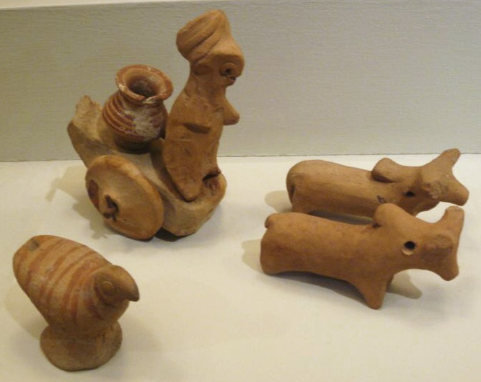
Harappa
The one rival to Mohenjo-Daro in the Indus civilization (whose outposts extended all the way to Oxus River in northern Afghanistan) was Harappa, 370 miles upstream on the Ribai River, a tributary of the Indus. [DE, p. 314] a comparison of the layouts of Mohenjo-Daro and Harappa shows that they are in fact, arranged in a quite dissimilar fashion. What is clear is that Harappan society was not entirely peaceful, with the human skeletal remains demonstrating some of the highest rates of injury (15.5%) found in South Asian prehistory. Examinations of Harappan skeletons have often found wounds that are likely to have been inflicted in battle. Yet there is no evidence of the aggrandizing behavior associated with the kshatriya class of warring nobles that we find in later epic tales such as the Mahabharata or the Ramayana—no evidence of spectacular feasts or sacrifices, no pictorial narratives of military prowess or celebrations of famous deeds, no sign of tournaments, no aristocratic burials. Indus civilization wasn’t some kind of commercial or spiritual arcadia, not was it an entirely peaceful society. But neither does it conain any evidence for charismatic authority figures: war leaders, lawgivers and the like. [DE, p. 318]
Picture, Wikipedia: Miniature Votive Images or Toy Models from Harappa, ca. 2500. Hand-modeled terra-cotta figurines with polychromy.

Slide 12
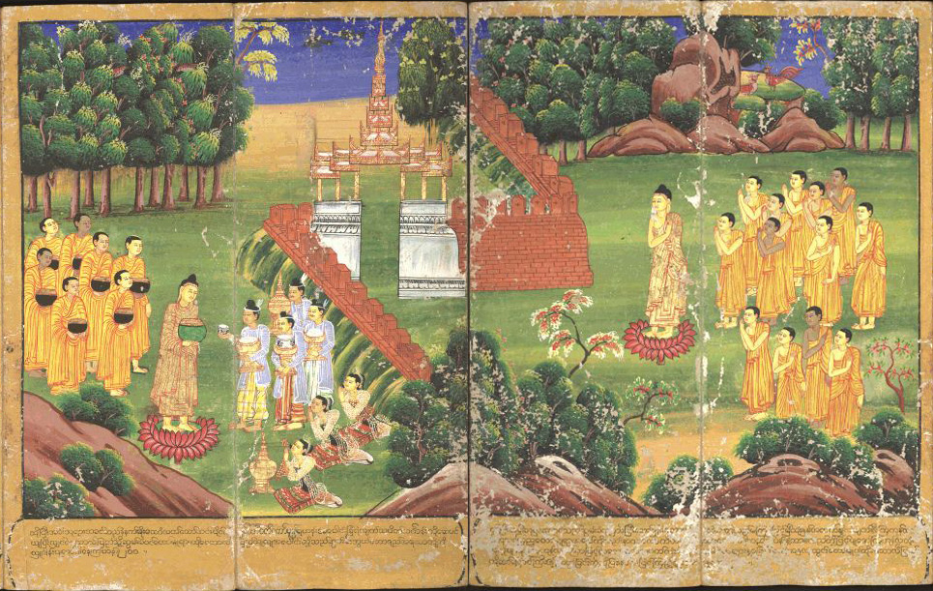
Sangha
The word sangha was first used for he popular assemblies that governed many South Asian cities in the Buddha’s lifetime (5th c. BCE). Buddha, inspired by these republics, led his followers who formed sangha or monasteries to require all monks to gather together in order to reach unanimous decisions, or sometimes majority vote, on matters of general concern. This remains true of Sangha to this day, despite the hierarchical structure of many Buddhist monasteries. [DE, pp. 319-320).
Picture, Wikipedia: Shakyamuni Buddha and his followers, holding begging bowls, receive offerings. An 18th-century Burmese watercolor.

Slide 13
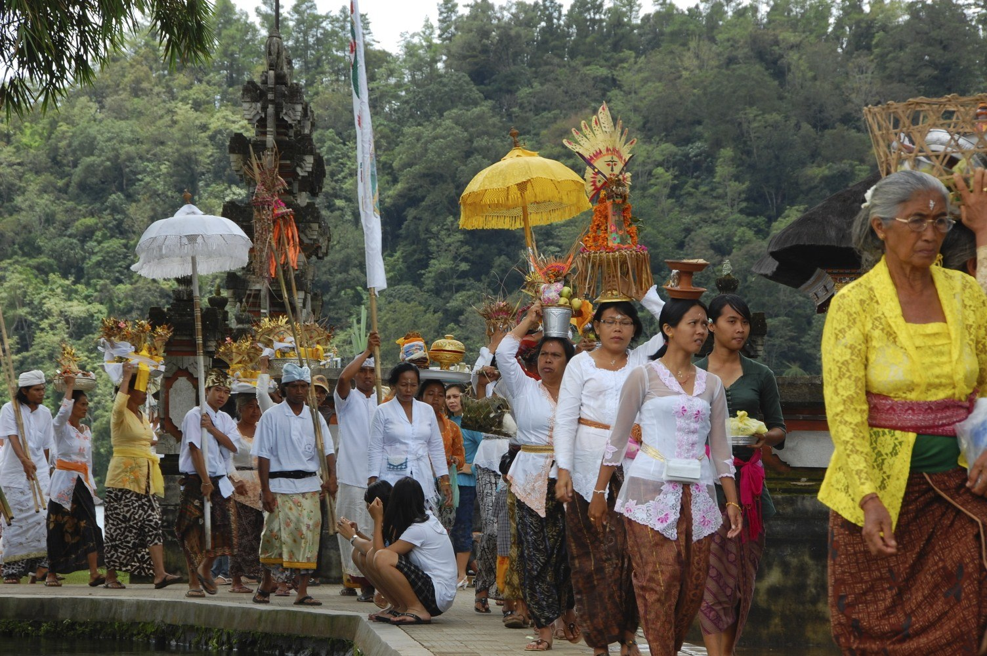
The Seka system in Bali, the only Indonesian, Hindu Island
While the Balinese are divided by the Hindu caste system, at the same time, the management of communities, temples and agricultural life are organized according to the seka system in which everyone is expected to participate on equal terms and come to decisions by consensus. If a neighborhood association meets, and some choose not to attend on the basis of caste superiority, they are obliged to pay fines for non-attendance, which help in repairing public buildings. Graeber and Wengrow use this example to show that there is no necessary correspondence between overarching concepts of social hierarchy and practical mechanics of local governance. Even with a caste hierarchy, where every individual should know his or her exact position in relation to everyone else, nonetheless practical governance takes place along egalitarian lines.
Also, while Bali was long divided into a a series of squabbling kingdoms, kings played no role in agriculture to feed the large Balinese population. Instead, the management of irrigation systems was governed by a system of water-temples, through which the distribution of water was managed by an even more complex system of consensual decision-making, according to egalitarian principles, by the farmers themselves. [DE, pp. 320-321].
Picture, Wikipedia: Procession with offerings entering a Hindu temple in Bali

Slide 14
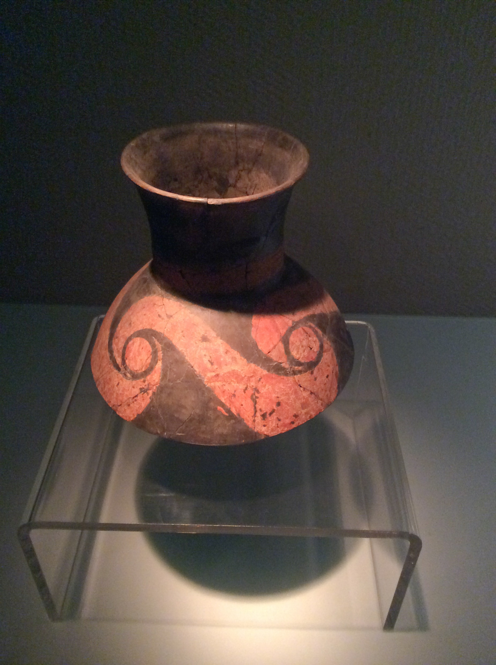
Taosi, the site of the world’s first documented social revolution in an urban setting
Taosi, located in the Jinnan basin presents evidence of social stratification—massive enclosure walls, road systems, and large, protected storage areas; rigid segregation between commoner and elite quarters, with craft workshops and a calendrical monument clustered around some sort of palace. Commoners tombs were modest; elite tombs were full of hundreds of lacquered vessels, ceremonial jade axes and remains of extravagant pork feasts. Then suddenly, around 2000 BCE, everything seemed to change. As the excavator describes it: “The city wall was razed flat, and… the original functional divisions destroyed. Commoners’ residential areas now covered almost the entire site…Stone tool workshops occupied what had been the lower-level elite residential area…” [Nu He, 2013]. Commoner graves burst in on the elite cemetery, and in the palace district a mass burial, with signs of torture and grotesque violations of he corpses, appears to be evidence for what the excavator descdribes as an “act of political retribution”. During the next 3 centuries the size of Taosi grew. Graeber and Wengrow hypothesize an age of widespread prosperity following the abolition of a rigid class system. While other interpretations are possible, Taosi invvites us to consider the world’s earliest cities as places of self-conscious social experimentation.
Picture, Wikipedia: A painted pottery jar Neolithic age (about 2500 year BCE, Taosi is an archaeological site in Xiangfen County, Shanxi Province, China. Taosi is considered to be part of the late phase of the Longshan culture in southern Shanxi, also known as the Taosi phase (2300- 1900 BCE). A painted stick discovered from a prehistoric dating from 2300 BCE excavated at the astronomical site of Taosi is the oldest gnomon known in China.^{[4]} The gnomon was widely used in ancient China from the second century BC onward in order determine the changes in seasons, orientation, and geographical latitude. The ancient Chinese used shadow measurements for creating calendars that are mentioned in several ancient texts. Taosi also contained an astronomical observatory, the oldest in East Asia. Several Chinese archaeologists postulate that Taosi was the site where the state of Youtang being conquered by Emperor Yao, (traditionally c. 2356–2255 BCE) who later instituted Taosi as the capital. In Chinese classic documents Yao Dian (Document of Yao) in Shang Shu (Book of Ancient Time), and Wudibenji (Records for the Five Kings) in Shiji (Historic Records), King Yao assigned astronomic officers to observe celestial phenomena, including time and position of sunrise, sunset, and stars in culmination, in order to systematically establish a solar calendar and a lunar calendar with 366 days a year with leap month. The observatory found at Taosi coincides with these records. It is theorized that the city collapsed with a rebellion against the ruling class. Graeber and Wengrow offer an alternative explanation above.

